Slide 1
Light inflaton model in a metastable Universe
By Abigail Keats

Slide 2
Outline
Introduction and motivations for inflation
Slow roll inflation
The model
EW vacuum stability
Model constraints in a metastable Universe
Results and conclusions

Slide 3
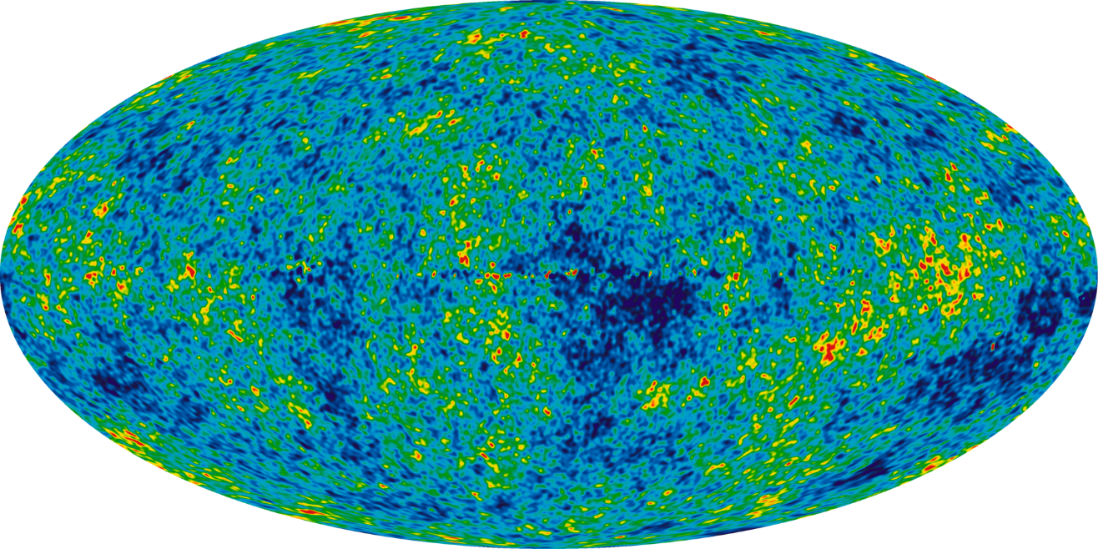
Problems with the Hot Big Bang Model
t
Past light cone
Horizon problem: In HBB model CMB has $\sim {10}^{3}$causally disconnected regions, yet we observe the Universe to be homogeneous and isotropic
Flatness problem: ${|Ω}_{curv,0}|<0.02$, requires fine-tuning ${|Ω}_{curv}\left(t_{Pl}\right)|≲{10}^{−60}$
Generation of primordial scalar perturbations
Mechanism for particle production/reheating
$$\overset{⃑}{x}$$
CMB
Inflationary epoch
$N_{min}\sim 60$ e-foldings
Scalar density perturbation, $\frac{δρ}{ρ}=5×{10}^{−5}$, from inflationary-enhanced quantum fluctuations of the inflaton field that exited the horizon at $\sim 60$ e-foldings prior to the end of inflation
Require a previous period of positively accelerating expansion for these regions to have been in causal contact, i.e. $aH$ increases with time.

Slide 4
Slow Roll Inflation: $\frac{β}{4}X^{4}$
+ $\frac{1}{2}ξRX^{2}$
Finite positively accelerating expansion period
Equation of state $ρ\sim −p$ satisfied with
slow roll conditions: $\frac{{\dot{X}}^{2}}{2V\left(X\right)}≪1 \& \left|\frac{\ddot{X}}{3H\dot{X}}\right|≪1$
$→a\left(t\right)=a_{0}e^{Ht}$
$$\dot{\text{X}}$$
Amplitude of scalar perturbations:
$$∆_{R}=\frac{3H^{3}}{2πV^{′}}=5×{10}^{−5}$$
$→β={10}^{−13}$
Tensor-to-scalar ratio:
$$r<0.1$$
However our model gives $r\sim 0.3$
Conformal transformation of the metric gives
$${10}^{−12}≤β≤{10}^{−9}$$
with $r<0.1.$
Here we assume no new scales below $M_{P}$,
$$ξ<O\left(1\right)$$
[F. Bezrukov, D. Gorbunov (2013)]

Slide 5
The Model
$V\left(φ,X\right)=$ $\frac{β}{4}X^{4}+\text{λ}(φ\text{†}φ+\frac{\text{α}}{\text{λ}}X^{2})^{2}\text{− }\frac{1}{2}{μ_{X}}^{2}X^{2}\text{− }\frac{1}{2}{μ_{φ}}^{2}φ\text{†}φ+\left(\frac{f_{I}}{2}\overline{{N_{I}}^{c}}N_{I}X\right)$
Symmetry breaking mass terms:
$$X→\left\langle X\right\rangle +χ$$
$$φ →\frac{v}{\sqrt{2}}+\frac{h}{\sqrt{2}}$$
Scalar inflaton field X with with quartic self-coupling:
$${10}^{−12}≤β≤{10}^{−9}$$
SM Higgs doublet, $φ$, with quartic self-coupling, $\text{λ}$
Scalar-Higgs portal coupling, $\text{α}$, providing a mechanism for reheating
Freeze-out WIMP dark matter production via: $χ→\overline{{N_{I}}^{c}}N_{I}$
with mass: $m_{N}=\left\langle X\right\rangle f_{I}$
[M. Shaposhnikov, I. Tkachev (2006); F. Bezrukov, A. Keats (2020)]

Slide 6
Previously analysed ${μ_{φ}}^{2}=0$
1) Heavy inflaton case: $m_{χ}>{2m}_{h} ,\left(8α<β\right)$
Reheat via $χ→hh$
In this case the inflaton are hidden: ${\left|θ_{m}\right|}^{2}≤O\left({10}^{−10}\right)$
[F. Bezrukov, A. Keats (2020)]
2) Light inflaton case: $m_{χ}<2m_{h} , (8α>β)$
Reheat via $χχ→hh$
$α/β$ parameter space: $(2.2×{10}^{−4})β^{\frac{3}{7}}≤α≤\sqrt{0.1β }$
$\text{[}\text{A}\text{.} \text{Anisimov}\text{, }\text{Y}\text{. }\text{Bartocci} \text{b}\text{ , }\text{F}\text{. }\text{Bezrukov}\text{ (2008}\text{)}$; F. Bezrukov, D. Gorbunov (2010)
F. Bezrukov, D. Gorbunov (2015)]
Efficient sphaleron conversion of lepton to baryon asymmetry requires $T_{reh}>T_{EW}$
Small radiative corrections to $\frac{\text{β}}{4}X^{4}$

Slide 7
Analysis of generic model
Now move from constrained model ${(μ_{φ}}^{2}=0)$ to generic model ${(μ_{φ}}^{2}≠0):$
In order to fully close the parameter space of the model with the additional parameter, $μ_{φ}$, we reconstrain the model assuming that the EW vacuum must be metastable
Additionally, we take into account cosmological constraints from inflation and reheating, and experimental constraints from measurements of the Higgs boson’s signal strength and decay width

Slide 8
Mass basis
Rotation of the mass basis with respect to the gauge basis:
$$\tilde{χ}=χ\cos{θ_{m}+h\sin{θ_{m}}}$$
$$\tilde{h}=h\cos{θ_{m}−χ\sin{θ_{m}}}$$
For $α>0 \& 2α>β$:
$${m_{χ}}^{2}=\frac{β}{α}\left({μ_{φ}}^{2}−v^{2}λ\right)−\frac{β^{2}}{8α^{2}}{\left({μ_{φ}}^{2}−v^{2}λ\right)}^{2}+O(α,β,α^{2})$$
$${m_{h}}^{2}={2v}^{2}λ+\frac{β^{2}}{8α^{2}}{\left({μ_{φ}}^{2}−v^{2}λ\right)}^{2}+O\left(α,β,α^{2}\right)={2v}^{2}λ_{SM}$$
$λ$ is not fixed by the Higgs Boson mass…

Slide 9
Stability of the EW vacuum
In the SM measurement of Higgs Boson mass fixes $λ$ at electroweak scale
$$m_{h}=\sqrt{2λ_{SM}}v=125 GeV$$
$$λ_{SM}\left(m_{h}\right)=0.129$$
Running of $λ$ to high energy scales is very sensitive to measurements of $m_{t}$and $α_{s}$
If $λ>0$ at all energy scales, the EW vacuum is stable
If $λ<0$ at some energy scale, the EW vacuum is either unstable or metastable
if its lifetime exceeds the age of the Universe
In our model $λ$ isn’t constrained by the Higgs Boson mass. We motivate the need of a metastable Universe on the basis of Dvali’s argument:
In order to evade the inevitable “quantum-break time” of a de Sitter Universe with positive vacuum energy we require a mechanism by which the Universe will end, as provided by a metastable vacuum state.
[G. Dvali, C. Gómez (2014); G. Dvali, C. Gómez, S. Zell (2017)]
$$0.10<λ\left(m_{t}\right)<0.135$$
[A. Bednyakov, B. Kniehl, A. Pikelner, O. Veretin (2015)]

Slide 10
Early Universe metastability constraints
$$φ=φ_{B}+\frac{h}{\sqrt{2}}<μ_{s}$$
Background field dynamics governed by inflationary attractor solution:
$$\sqrt{2}φ_{B}=\tan{θ_{inf}}X_{B}$$
$$\tan{θ_{inf}}\sim \left\{\begin{aligned}\sqrt{\frac{β−2α}{λ}}, α>0 \\ \sqrt{\frac{β+2α}{λ}}, α<0\end{aligned}\right.$$
Require $φ_{B}<μ_{s}$:
$→\text{choose} α>0 \& 2α>β, θ_{inf}=0$
$→$ other solutions $θ_{inf}≠0$ require fine-tuning $λ$
Require quantum fluctuations $h<μ_{s},$
for $α>0 \& 2α>β$, $α=O\left({10}^{−9}−{10}^{−5}\right)$ :
$m_{eff=}$ $O\left({10}^{14}−{10}^{16}\right) GeV>H$
$$h=O\left(\frac{H}{10}\right)=O\left({10}^{12}−{10}^{13}\right) GeV$$
$$μ_{s}=\sqrt{\frac{α}{|λ|}}X_{60}=O\left({10}^{15}−{10}^{17}\right) GeV$$

Slide 11
Summary of model constraints
Cosmological constraints
CMB constraints: ${10}^{−12}≤β≤{10}^{−9}$
for $ξ<O\left(1\right)$
Small radiative corrections: $α≤\sqrt{0.1β}$
Efficient reheating: $α≥2.2×{10}^{−4}β^{\frac{3}{7}}$
Universe overclosed with relic inflaton: $\left\langle X\right\rangle ≠0$
BBN constraints preferably requires ${Γ_{χ}}^{−1}<t_{BBN}$
$θ_{m}≳O\left({10}^{−5}\right)$
Metastability constraints
$0.10<λ\left(m_{t}\right)<0.135$
Inflation: $φ=φ_{B}+\frac{h}{\sqrt{2}}<μ_{s}$
$α>0 \& 2α>β$
Reheating: $h_{T}$
$λ\left(m_{t}\right)>0.120$
EW vacuum stable up to $T=O\left(M_{P}\right)$
SM Higgs Boson experimental constraints
Higgs’ signal strength, $μ=1.09±0.11$* gives upper bound on mixing angle
$θ_{m}≤0.14$
and lower bound
$λ\left(m_{t}\right)≥0.123$
Higgs invisible decay width bound: $Γ_{h→χχ}<{Γ_{h}}^{inv}$
* [M. Tanabashi et al. Particle Data Group (2018)]
$α>0 \& 2α>β$
$${ 10}^{−12}≤β≤{10}^{−9}$$
$2.2×{10}^{−4}β^{\frac{3}{7}}≤α≤\sqrt{0.1β}$
${O\left({10}^{−5}\right)≲|θ}_{m}|≤0.14$
$0.123≤λ\left(m_{t}\right)≤λ_{SM}$

Slide 12
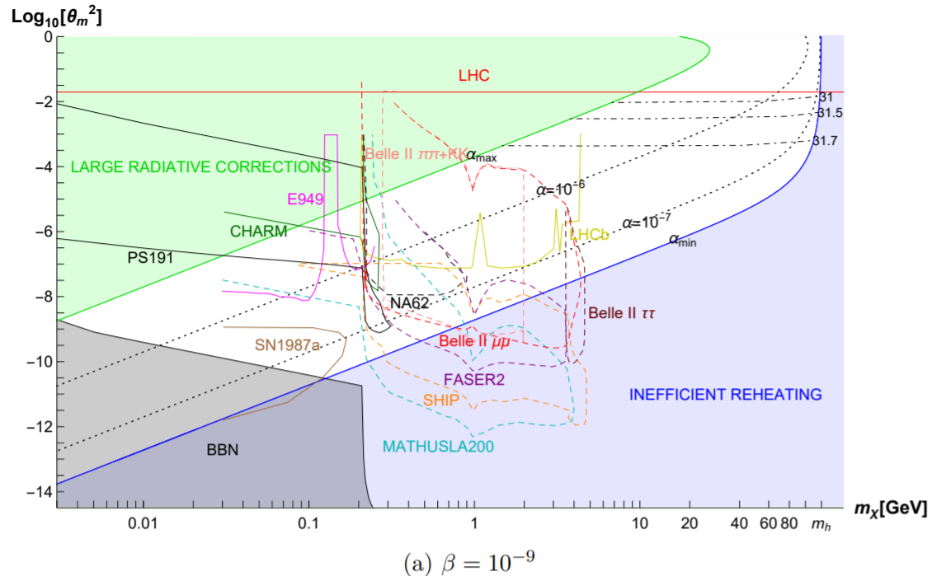
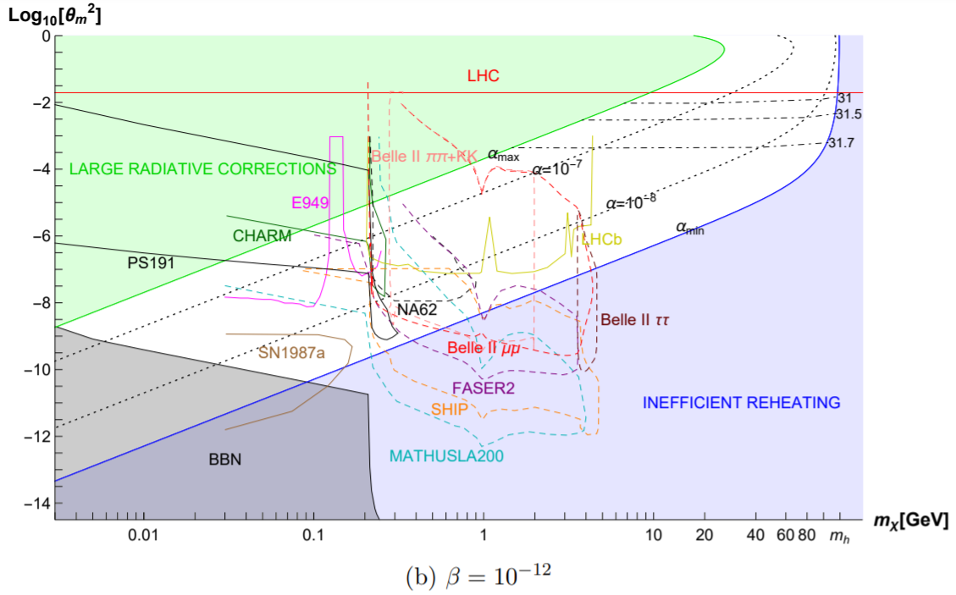
Results
Particle physics observables:
$$σ_{prod}=σ_{SM}\cos^{2}{θ_{m}}$$
$${|M}_{\tilde{h}→\tilde{χ}\tilde{χ}}|∝αv\cos^{3}{θ_{m}}$$
$${|M}_{{\tilde{h}}^{3}}|∝λv\cos^{3}{θ_{m}}$$
$${|M}_{{\tilde{h}}^{4}}|∝λ\cos^{4}{θ_{m}}$$
Cosmological observables:
Measurement of r!
$${|M}_{{\tilde{h}}^{3}}|$$
$$β={10}^{−9}$$
[F. Bezrukov, A. Keats (2021)]
$$β={10}^{−12}$$

Slide 13
Conclusion
The SM can be minimally extended by a single scalar inflaton field with a $ℤ_{2}$-symmetric potential to incorporate mechanisms for slow-roll inflation and reheating via an inflaton-Higgs portal.
We assume our Universe is in a metastable EW vacuum and consider the case where fine-tuning of $λ$ isn’t necessary, satisfied by $α>0 \& 2α>β$.
Our light inflaton model parameter space spans $m_{χ}=O\left({10}^{−2}−m_{h}\right)$GeV and ${θ_{m}}^{2}=O\left({10}^{−11}−{10}^{−2}\right)$, and evades all current experimental, cosmological and stability constraints required for a metastable vacuum.
Inflaton masses close to $m_{h}$ have larger mixing angles, here future precision measurements of linear and trilinear Higgs couplings may observe deviations from the SM expected values.
Accessibility to the parameter space of very weakly-coupled inflatons is dependent on the planned proposals of new experiments that target the hidden sector (namely MATHUSLA200, SHIP, and FASER2), which can probe mixing angles down to ${θ_{m}}^{2}=O\left({10}^{−11}\right)$ and inflatons with masses $m_{χ}\sim \left(0.03−5\right)$GeV.

