Slide 1
Ethics of data and their use
Data Science In-Reach Event
14 December 2021
Durham University

Slide 2
Research Questions/Introduction
How humans shape data and how data shape humans
How the practices of data production, analysis, and use must be understood as entangled in particular histories, institutions, relations, inequalities, and so on that must be navigated in order to help foster an ethical, accountable data science
How to engage ethically with data and their affiliate technologies – including how to ethically present findings to various publics

Slide 3
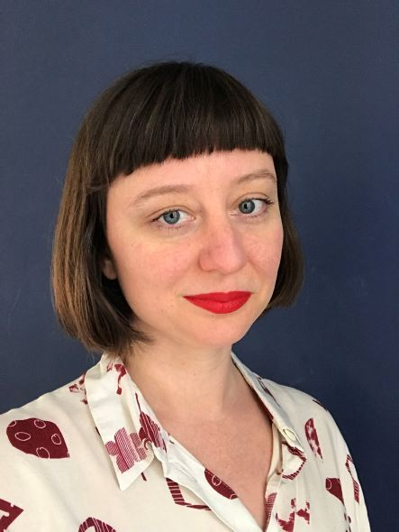
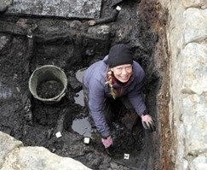
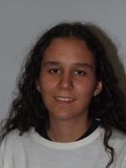
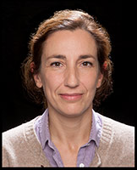
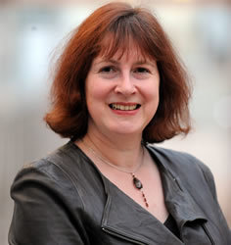
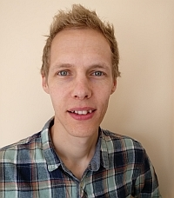
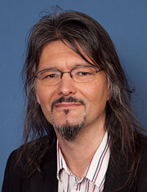
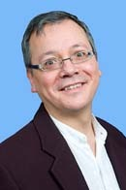
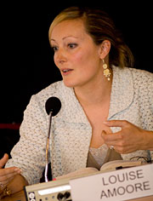
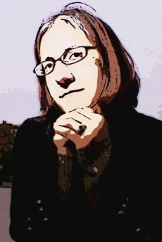
Prof Camila Caiado, Department of Mathematical Sciences
Dr Marta Diaz-Guardamino, Department of Archaeology
Dr Marlee Tichenor, Department of Anthropology
Professor Claire Warwick, Department of English Studies
Dr Trudi Buck, Department of Anthropology
Dr Alistair Brown, Department of English Studies
Prof John Wainwright, Department of Geography
Prof Robert Song, Department of Theology and Religion
Prof Louise Amoore, Department of Geography
Dr Sara L. Uckelman, Department of Philosophy

Slide 4
Prof Louise Amoore
Department of Geography louise.amoore@durham.ac.uk
Appointed to the UK independent body responsible for the ethics of biometric and data-driven technologies
Research interests: how contemporary forms of data and algorithmic analysis are changing the pursuit of state security and the idea of society
Relevant project: ESRC-funded ‘Data Wars: New Spaces of Governing in the European War on Terror’ (2008-2012)
Recent publication: Cloud Ethics: Algorithms and the Attributes of Ourselves and Others, Duke University Press, 2020

Slide 5
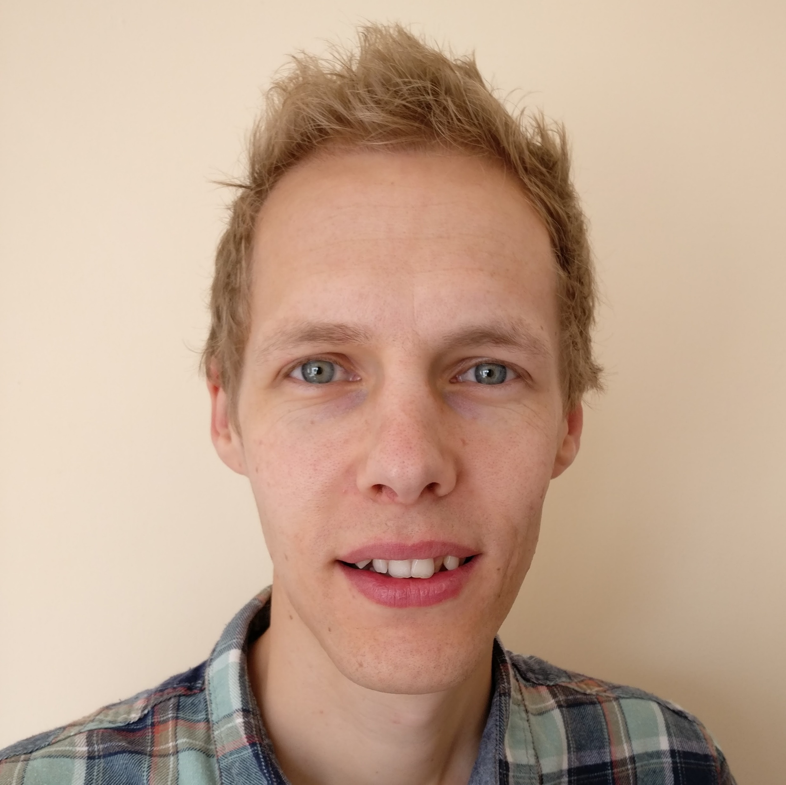
Dr Alistair Brown
Assistant Professor (Teaching) Digital Humanities and Modern Literature, Department of English Studies
Researcher development:
  Training for PhD researchers internally and externally on developing a social media profile, emphasising the ethics of online presence in a professional context (e.g. https://xot.futureteacher.eu/play.php?template_id=4#socialmedia)
Research dissemination:
  Edit READ: Research English At Durham and develop EDI guidelines on sharing and monitoring social media content; mediating the tension between brand and disciplinary responsibilities (https://readdurhamenglish.wordpress.com/)
Pedagogy and scholarship:
  Deliver workshops to Durham PGCAP and Open University on student use of social media, and best ethical practices when researching or monitoring student social media use for teaching and scholarship
Schools:
  Consultant for National Education Group on video games and online habits for young adults (https://nationalonlinesafety.com/experts/dr-alistair-brown)
Email: alistair.brown@durham.ac.uk
Twitter: @alibrown18
Profile: https://www.durham.ac.uk/staff/alistair-brown/

Slide 6
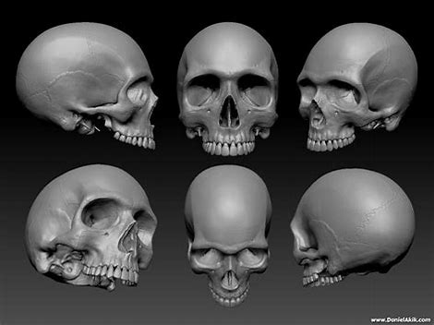
Ethics of Digital Data in Biological Anthropology
Dr Trudi Buck
Department of Anthropology t.j.buck@durham.ac.uk
Interests
Ethics of curation & teaching with human remains
Specific ethical challenges:
  Emotive nature of subject/colonial past
Understanding of ethical requirements of 3D data
  Defining how 3D data differ from physical human remains
Challenge - how best to develop & apply good practice
Projects/Grants
Decolonising an Anatomical Skeletal Teaching Collection
Vindolanda Archaeological Leather Project
Social Sciences & Humanities Research Council of Canada
https://www.vindolandaarchleather.com/

Slide 7
Camila Caiado
Professor in Statistics, Dept Mathematical Sciences
E-mail: c.c.d.s.caiado@durham.ac.uk
Director of Interdisciplinary PGT Programmes (inc. Masters of Data Science)
Institutes: IHRR, IDAS, Wolfson
Key interests
Data governance and trusted research environments
I have built and manage the Durham Trusted Research Environment that is used in HDR-UK and other smaller collaborations with local NHS Trusts.
Interest in designing Data Science programmes for everyone (with or without a quantitative background)
Relevant Grants and Consortiums (current and past)
Connected Health Cities, DHSC
Intensive Care Risk Identification, BHF
Healthy New Towns, Treasury
Health Data Research UK North (HDR-UK North)
NIHR Advanced Research Collaboration NENC

Slide 8
Prof Robert Song
Department of Theology and Religion robert.song@durham.ac.uk
Member of Durham CELLS (Centre for Ethics and Law in the Life Sciences)
Research interests: bioethics, ethics and the life sciences, and ethics in digital environments
Research projects: an ESRC-funded project on lay Christian, Muslim and Hindu ethical evaluations of new reproductive and genetic technologies
Monograph in production: Heavenly Bodies, on cosmetic surgery and the posthuman body

Slide 9
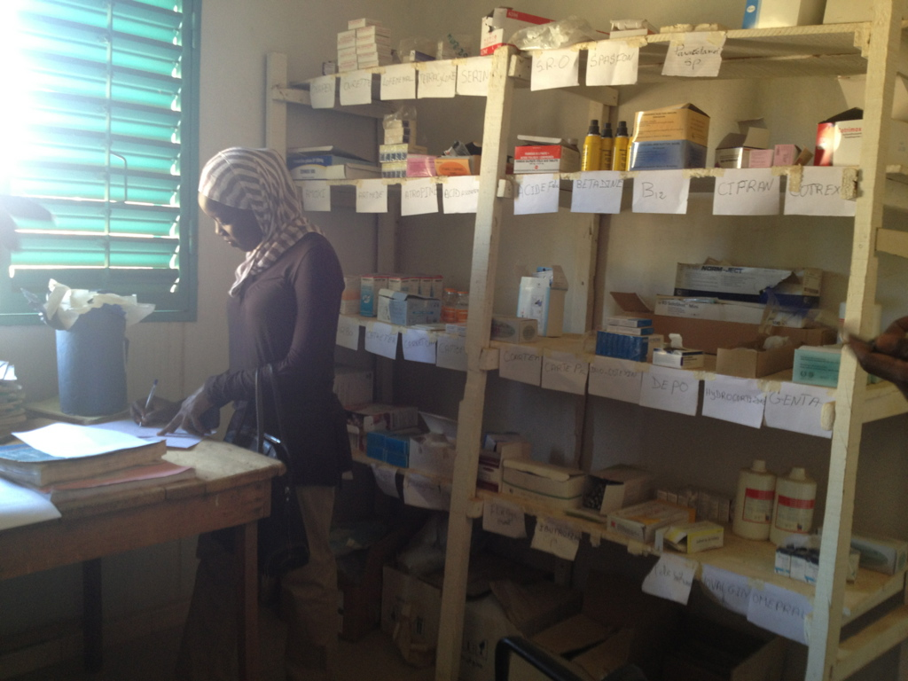
Dr Marlee Tichenor
Lecturer of Social/Health Anthropology marlee.tichenor@durham.ac.uk
Research interests: influenced by science and technology studies (STS), I research practices of data production and imputation for (global) health interventions, the role of quantification in new paradigms of global governance, and scientific cultures of data science and statistics
Teaching in prep: ‘Critical Perspectives on data and quantification’ (Data Science MSc) and ‘Anthropology of data and quantification’ (Anthro Y3)
Recent relevant publications: ‘Metrics’ (Cambridge Encyclopedia of Anthropology), ‘Metric Partnerships: global burden of disease estimates within the World Bank, the World Health Organisation and the Institute for Health Metrics and Evaluation’ (Wellcome Open)
Upcoming manuscript: Governing the Sustainable Goals: Quantification in Global Public Policy (Palgrave, with Sotiria Grek and Justyna Bandola-Gill)

Slide 10
Dr Sara L. Uckelman
Associate Professor of Logic, Department of Philosophy s.l.uckelman@durham.ac.uk
Philosophy representative on the Data Science MSc
Research interests: formal logic and foundations of AI, including questions of what data are, what is rationality, what is an algorithm, and the epistemic value of models/modelling
Relevant teaching: Ethics & Bias in Data Science
Recent publication: ‘Normative and descriptive rationality: from nature to artifice and back’, Journal of Experimental & Theoretical Artificial Intelligence, with T.R. Besold

Slide 11
Claire Warwick
English Studies and IDAS, c.l.h.warwick@durham.ac.uk
Interested in public perception, trust and understanding of AI especially in the context of cultural heritage and GLAM organisations.
Co-I of the AEOLIAN project (AHRC/NEH funded) https://www.aeolian-network.net/
Most recent publication: Warwick, Claire (2021). Negotiating the Digital Dystopia: The Role of Emotion, Atmosphere and Social Contact in Making Decisions about Information Use in Physical and Digital Contexts. New Review of Academic Librarianship 27(3): 259-279.
Historical background to these issues covered in forthcoming monograph: A World Elsewhere: Digital Humanities and the Cyberspace Decade, 1990-2001

