Slide 1
Computational Musicology
Cluster presented by
Eamonn Bell
<eamonn.bell@durham.ac.uk>
Departments contributing to cluster:
Anthropology
Computer Science
Music
IDAS In-Reach Event
December 14, 2021
Durham University

Slide 2
Computational Musicology

Slide 3
music information retrieval (MIR)
music informatics
music cognition
Computational Musicology
computational music theory
digital musicology
music technology

Slide 4
Research questions: Introduction
Musicology (≝ the study of music as a cultural and historical phenomenon) has always been data-intensive. Music supplies a soundtrack to everyday life and co-ordinates group action
Computation can help
identify patterns in existing datasets
derive new datasets
address bias in and improve transparency of historical research
Durham’s USPs
Music Department (consistently UK Top 5 in last 5 years) hosts combination of historical and computational expertise
DH-in-CS with two new computational musicologists on faculty
Special collections associated with Durham Cathedral and history of music technology

Slide 5
Research questions (examples)
How do we align two performances of the same musical work? [a classic problem, DTW helps (Müller and Appelt 2006)]
What is involved in search (and discovery) over 50M+ recordings?
How do we deal with new music data?
How do human beings synchronize to music and to each other when {playing, dancing to, listening to, consuming} music?
Is the global diffusion of musical events and styles a function of measurable properties of the (sub)populations that produce them?
Are existing statistical models satisfactory to capture the patterns latent in established musical traditions?

Slide 6
musicality

Slide 7
musicality
music

Slide 8
musicality
music
creativity

Slide 9
musicality
music
creativity

Slide 10
musicality
music
creativity

Slide 11
musicality
music
creativity
pitch, rhythm,
emotion...
space
time

Slide 12
musicality
music
creativity
pitch, rhythm,
emotion...
space
time

Slide 13
musicality
music
creativity
pitch, rhythm,
emotion...
space
time

Slide 14
musicality
music
creativity
pitch, rhythm,
emotion...
space
time

Slide 15
Opportunities and challenges for interdisciplinary/collaborative work
Well-formed research questions demand training and enculturation (= years of study), but/and....
...music data is multimodal: scores, audio, video, text — surveys, interviews — psychophysics, EEG, fMRI, motion-capture
So, we can't afford to be provincial/isolationist. Share methods (and data)!
Existing fora at Durham (Music and Science Lab) but scope for greater links (Psychology, Linguistics, Business...?)
Funding opps.: CES Templeton, DFG-AHRC; KTPs? (maturing industry players: Pandora, Spotify, ByteDance (TikTok); also, MS Research, Amazon)
The future at Durham: “Grand challenge”? (cross-cultural comp.mus.?)

Slide 16
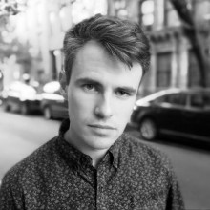
Eamonn Bell Department of Computer Science
<eamonn.bell@durham.ac.uk>
https://www.eamonnbell.com · ORCID: 0000-0002-9211-5192
Optical music recognition
Handwriting extraction for music domain (Bell 2019)
Gamification/crowdsourcing ground truth for image segmentation tasks
Natural language processing for music information retrieval (MIR)
New experiences for music listening and analysis from 1M+ timecoded YouTube comments (Bell 2020)

Slide 17
Martin Clayton martin.clayton@durham.ac.uk
Department of Music
Prof. of Ethnomusicology
Audio-based music analysis of diverse musical styles, inc. Indian music, especially rhythm and timing
Video-based analysis of bodily movement associated with music
Collaborative projects include:
Interpersonal Entrainment in Music Performance (AHRC, with T. Eerola, K. Jakubowski) – synchronisation analysis using computationally-derived onset time data, movement coordination analysis
EnTimeMent (EU FET, with ARC colleagues) – movement analysis using pose estimation, ML action recognition
Computational Musicology and the Study of Instruments for Indian Music (with IIT Bombay) – developing MIR tools for Indian music
Project on multimodal analysis developed with Durham Comp Sci. Dept
Project on MIR tools for Indian instrumental music developed with Meinard Müller, Audiolabs Erlangen

Slide 18
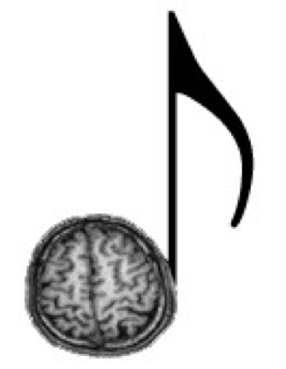
Nick Collins Department of Music
<nick.collins@durham.ac.uk>
https://composerprogrammer.com/ https://github.com/sicklincoln
MusAIc/MIRsic/"Corposition"
Machine listening and machine learning for interactive music, automatic composers and computational musicology
Audio corpus analysis projects tracing musical influence in synth pop, historical trends in electronic music 1950-1999, distinguishing Chicago House and Detroit Techno, content analysis over Radiohead's discography...
100+ computer music papers to date, lots of open source code including for SuperCollider, iPhone and Web Audio API
Recent collaborations: live hacking of deep neural networks (Grierson, Ruzicka), book chapter on Music AI in Clubs and Studio Production (Knotts), VR audiovisualiser (van 't Klooster)

Slide 19
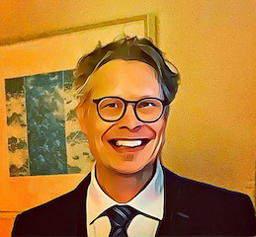
Tuomas Eerola Department of Music
<tuomas.eerola@durham.ac.uk>
http://github.com/tuomaseerola/opendata/
Prof. of Music Cognition
Music and emotions
Music perception
Computational models
Emotional expression in music from audio (2011 to 2021) and from semantic data (e.g., last.fm tags)
Perception of melody, consonance, and timing with open software (Midi toolbox in 2004 for Matlab, to consonance/dissonance models in 2021 in R)

Slide 20
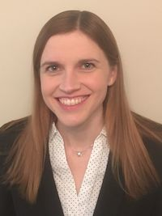
Kelly Jakubowski Department of Music
<kelly.jakubowski@durham.ac.uk>
https://musicscience.net/ · ORCID: 0000-0002-4954-7117
Music psychologist
Research interests: music & memory; musical imagery; timing & movement; cross-cultural music research
Data I work with: human behavioural, physiological, & movement data; textual data (e.g., song lyrics, Tweets, autobiographical memory descriptions), audio & symbolic representations of music
Methods I use: quantitative, qualitative, computational (data mining, natural language processing, etc.)

Slide 21
Hector Sequera <hector.sequera@durham.ac.uk>
Music Department
Specialist on Renaissance music (manuscripts, context, performance practice), and interested on computational musicology to:
Evaluate work on reconstructing/recomposing music that survives incomplete
Better understand stylistic features in different Renaissance genres (glossary creation)
I have so far worked on:
Corpus analysis to better understand stylistic features in Renaissance music
Comparing sets of two versions of the same piece within a corpus
Automatic extraction of 4-part polyphony from lute notation using machine learning

Slide 22
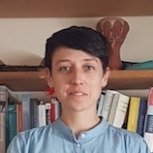
Sally Street Department of Anthropology
Assistant Professor in Evolutionary Anthropology
<sally.e.street@durham.ac.uk> https://www.durham.ac.uk/staff/sally-e-street/
https://orcid.org/0000-0001-8939-8016
About me:
Research: broad interests in evolution of cognition & culture
Teaching: specialise in research methods (statistics in R)
Research relevant to the theme:
Cultural evolution of traditional folk tunes in digital age
Using MIR techniques to measure complexity, novelty etc.

Slide 23
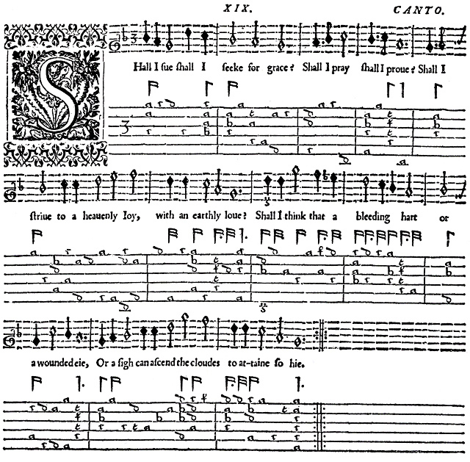
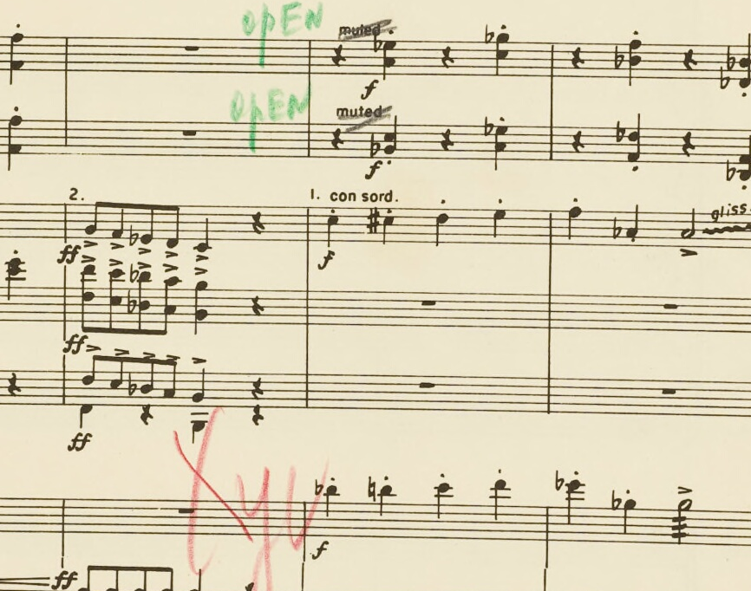
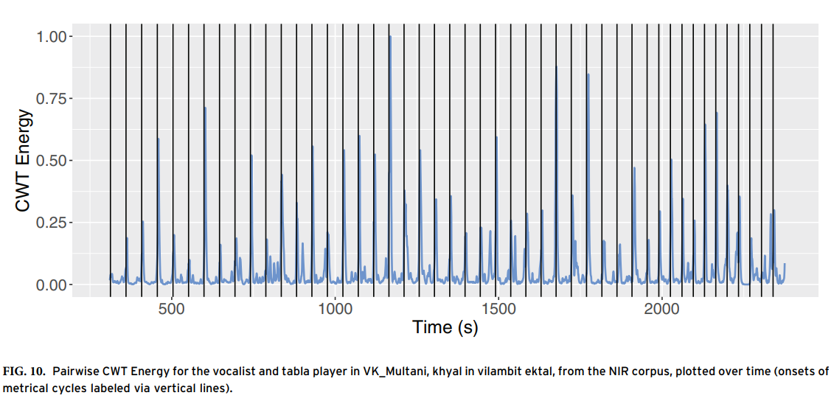
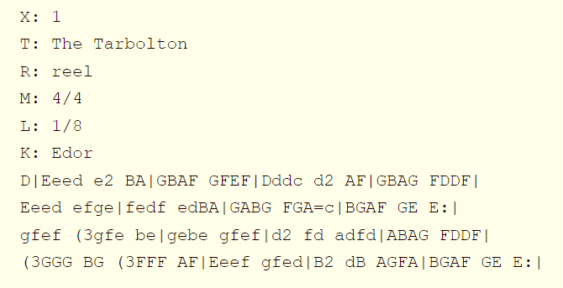
(Clayton et al. 2020)
Activity at time of memory (open response)
Please describe the memory associated with this music. Please give as much detail as possible (such as who you were with, where you were, and what you were doing in the remembered event) (open response)
(Jakubowski and Ghosh 2021)

Slide 24
computational musicology
What challenges to mainstream methods in “data science” are posed by the vagaries of music data?
What challenges to operational definitions of music used in data-driven research come from the humanities and the social sciences?
Does music fit the bill as a sandbox around which to organise a radically interdisciplinary research community?
EPB
Durham
Dec. 2021

