Slide 1
Data Science and the Business School – Sentiment Analysis
Dr Chrysostomos (Tommy) Apostolidis
chrysostomos.apostolidis@durham.ac.uk

Slide 2
Online platforms (such as blogs, websites, online communities and social media) are a rich source of user data.
The volume and the quality of the data, the structured and unstructured elements within the data and the type of content uploaded (e.g. text, images, videos) provide significant challenges in the compilation of data into information and insights
Machine learning can be used to ascertain consumer perceptions, attitudes and opinions through user generated content

Slide 3
In our work we used Sentiment analysis as part of our investigation using an Artificial Intelligence (AI) approach more commonly known as Natural Language Processing (NLP)
Sentiment analysis is a classification technique to ascertain perceptions and attitudes as a positive of negative construct
We use a corpus-based WordNet tool within Python to help analyse the data
Sentiment analysis works well with AI in producing models and algorithms which can ascertain intent within opinions in real time

Slide 4
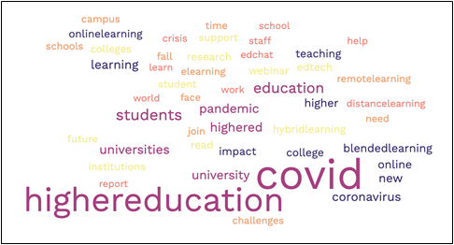
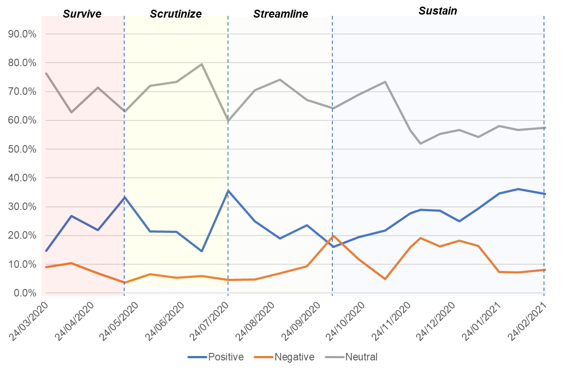
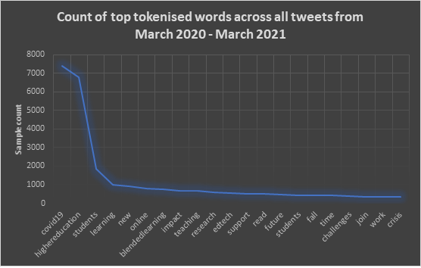
For example…

