Slide 1
Introduction to Durham Biostatistics Unit
IDAS In-Reach Day
Notes:
Good morning/afternoon
Thanks for the chance to talk
Talk serves as
- intro to DBU,
- who we are,
- the kind of problems we work on,
- and how to get in touch if you are interested in working with us or looking for biostatistical advice.

Slide 2


Durham Biostatistics Unit
Founded in 2021 to
- Support allied health research
- Develop new research methodology
- Assist in clinical trials and evaluation of health interventions
in the North-East of England
DBU
Department of Mathematical Sciences
Durham Research Methods Centre
Notes:
Recent initiative to support health research in the North-East of England
We work under the NIHR research design service North-East. This is one of twelve(?) RDSs throughout the UK, formed with the general philosophy of providing an easy-to-use service for clinicans and biomedical scientists to plan out research.
In particular, we advise on research in which new medical interventions or actions are definitively assessed – that is, clinical trials and similar setups. It is particularly important that such studies have precise and well-justified statistical analyses, which should generally be planned in advance.
We also develop new methodology when necessary. Modern medical and biomedical science has been in a stage of rapid development for much of the past twenty years, particularly in the development and analysis of digital medical data repositories. This development drives a constant need for development of new methods and analyses, many of which are bespoke.
Functionally, we operate between Durham and Newcastle universities, and work closely with researchers throughout County Durham, Tyne and Wear, and Northumberland.

Slide 3
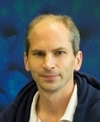
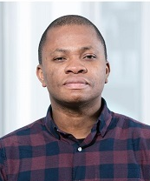
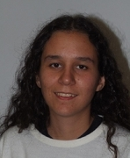
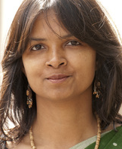
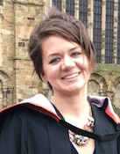
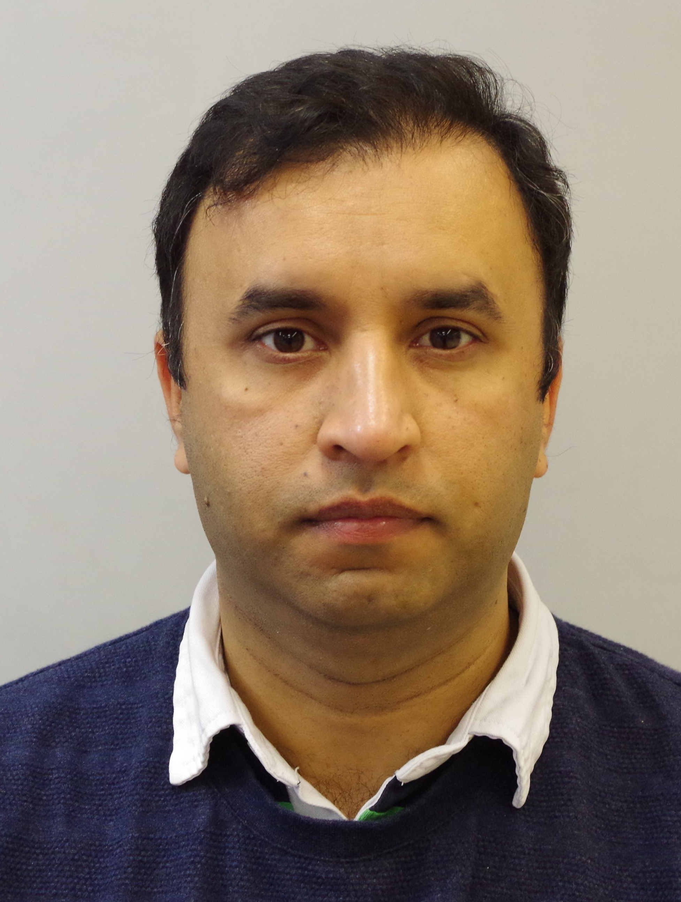

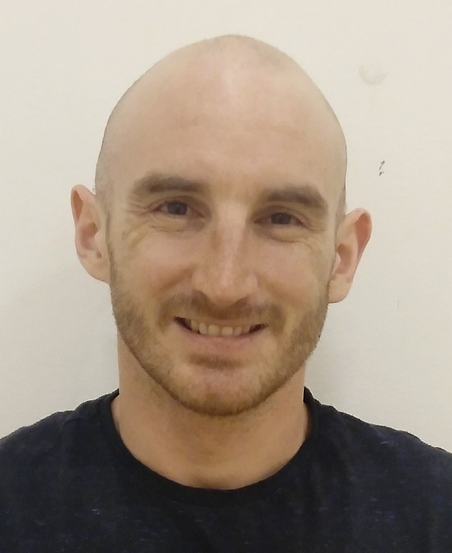
Who we are
Jochen Einbeck (Math.)
Statistician
Louis Aslett (Math.)
Statistician
Emmanuel Ogundimu (Math.)
Biostatistician
Camila Caiado (Math.)
Statistician
Nasima Akhter (Anth.)
Quant. researcher
Janelle Wagnild (Anth.)
Quant. researcher
Bilal Ashraf (Anth.)
DRMC Statistician
Ehsan Kharati (Anth.)
Biostatistician
James Liley (Math.)
Clinical, Biostatistician
Notes:
Within Durham, our core team is split between the MCS and the Durham Research Methods Centre.
Some of us will be familiar to those of you in the Mathematics department. We have a range of backgrounds and areas of expertise, which I will detail in a minute.

Slide 4
What we do
Where we can help
Grant applications: advice on research feasibility
Fellowship applications: long-term statistical planning
General research planning
Sample size estimation
Range of research types
Healthcare, anthropology, education, biology
Randomised trials, cohort studies, case-control, others
Interventional or observational
Notes:
Our work covers both planning and analysis stages of research. Ideally, we generally aim to help with both stages on research projects in which we are involved.
Practically, we often work on grant and fellowship applications, ensuring that research plans are feasible and that practical statistical analysis plans are in place. This requires effective and efficient communication of often complex analytical ideas. A critical part of this is often estimation of requisite sample sizes and research costs, which in turn require effective modelling and simulation.
Although we typically work in healthcare, we cover a range of research types, including anthropology and education. We also advise on research design for more fundamental biological research: cell biology, biochemistry and so on.
We work on a range of study designs covering both interventional studies, in which a new treatment or test is evaluated, and observational studies, where we attempt to make inferences about a population in an un-intervened state.

Slide 5
Research expertise – by application
Application | Sub-specialities
Anthropology | Resource distribution
Medicine/surgery | Electronic Health Records Disease-specific expertise Health inequalities
Public Health | Epidemiology Nutrition
Biophysics | Radiation dosimetry Accelerometry
Biology | Genomics Sequencing Neurology
Notes:
Our core team has a wide range of expertise in various scientific areas and applications. This tends to be important; increasingly, modern applied statistics is becoming specialized by application as much as by abstract methods.
In particular, we have extensive expertise in medical and surgical applications, including management of private and sensitive data, and use of modern health record types. Members of our team have worked in global health and epidemiology, in particular nutrition and distribution of healthcare resources.
We also have experience in bioinformatic-type analyses relating to genomics and sequencing, and in biophysical analysis.

Slide 6
Research expertise – by specialty
Application | Sub-specialities
Machine learning | Theory Practice High-performance computing
High dimensional statistics | Empirical Bayes Multiple testing
Bayesian methods | Markov chain Monte Carlo Variational Bayes
Other | Privacy/security Non-parametric models Simulation General statistical theory
Notes:
We also have expertise across a range of theoretical and computational areas.
The line between statistics and machine-learning is ever-blurry, but our team have expertise in both theory and practice. This is increasingly important in biostatistics, as researchers seek to use more complex statistical methods in response to increases in the volume of available data. A major consideration of practical machine learning is effective leverage of computational resources, with an added challenge in medicine that related data must often be processed in restrictive secure environments.
We have expertise in high-dimensional statistics and Bayesian methods, as well as a range of specific statistical fields.

Slide 7
Research expertise– by analysis
Application | Sub-specialities
Randomised controlled trials | Design Analysis Practicalities
Prediction | Machine learning Performative prediction Personalised medicine
Other trial designs | Case control studies Cohort studies
Other | Sampling Reaching at-risk populations Global health
Notes:
The bread-and-butter of our work is clinical studies, which tend to fall into several major categories.
Randomised controlled trials are the gold standard of evidence for interventions, and observational cohort studies for epidemiological inference.
Case control studies are the workhorse of medicine and a common initial study design, and are routine in genomics and other high-dimensional analyses.
Incentivised by increasing digitization of healthcare records and development of high-profile machine learning methods, there is increasing interest in predictive analysis in many medical fields, particularly prompted by development of high-profile machine learning methods.
We also have expertise in practicalities around sampling and reaching at-risk populations, which are important practical considerations in research design.

Slide 8
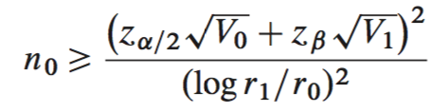
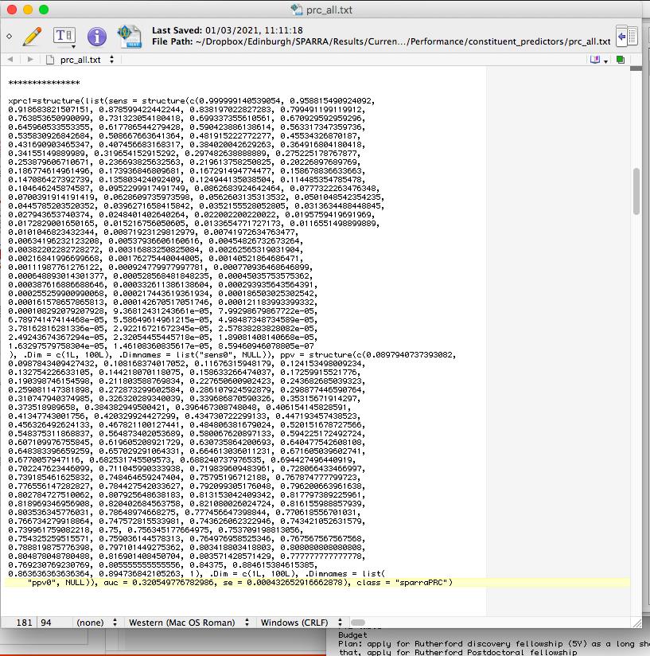
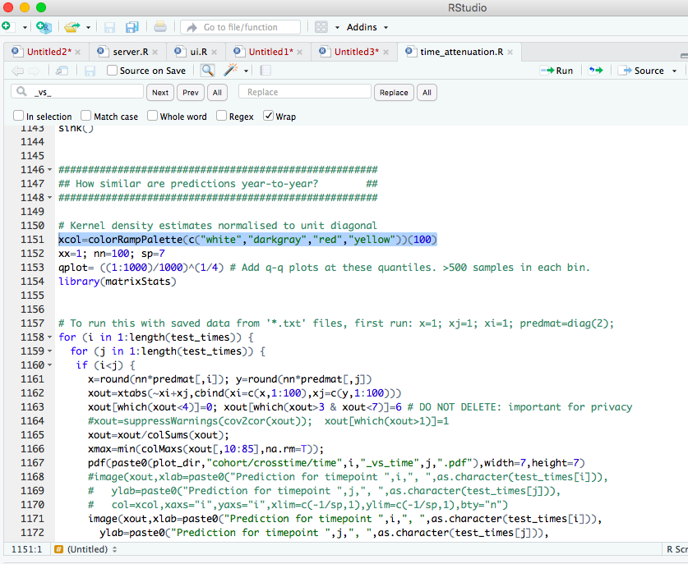
Day-to-day examples
Ethos
Rigorous, valid, ethical and reliable research design
Efficiency and economy
Focus analysis on the desired questions
Help researchers to understand, not just apply
Examples of day-to-day work
Power calculation
Effectiveness of intervention
Study design
Improve study efficiency
Systematic review and meta-analysis
+
+
Notes:
Our day-to-day work typically includes determination of appropriate sample sizes and statistical power. We frequently look at analysis of whether an intervention is effective, and in what ways.
When designing studies, we generally look for ways in which the same data can be used more efficiently to answer the questions at hand.
At times, we also help with systematic reviews and meta-analysis, looking at how best to interpret a range of evidence on a topic.
Our general ethos is to provide statistical advice and study plans which are theoretically rigorous and valid – so correct, ethical, and reliable, in that they can actually be implemented.
We have a continual focus on efficiency, which ties in with ethics – it is important to not spend more money or recruit more patients than necessary to answer a question.
As previously mentioned, an important part of our work is effective communication. It is essential that researchers are able to understand what they are doing and why, rather than blindly following instructions.

Slide 9


Example 1. Diagnosis of Crohn’s disease.
Design
3 center non-randomised study.
All patients undergo all investigations (MRI, endoscopy, capsule)
Research question
Are all visualisations equivalent in the assessment of known Crohn’s patients?
Planning
Primary outcome: positive yield rate by the three methods.
Intra-patient correlation of 40% (estimated from retrospective data).
113 patients to detect a minimum difference of 15% in diagnosis rate
10% attrition rate: 125 patients will be recruited for the trial.
Analysis
Generalised estimating equation: compare the odds of diagnosis in single model
Notes:
In the next couple of slides I’ll give a couple of examples of recent projects, and the kind of things we do.
Crohn’s disease (CD) is a chronic inflammatory condition of the gastrointestinal tract. It usually affects the small bowel and colon with variety of symptoms including diarrhoea, abdominal pain, weight loss and fatigue. About 100,000 people per year are diagnosed with CD.
To diagnose Crohn’s disese, the entire gastrointestinal tract must be visualised. This can be done externally, with an MRI, using a traditional endoscope, or using a ‘capsule endoscope’, which is a small camera the size of a pill which is swallowed. Capsule endoscopy is a has revolutionised GI endoscopy as it opens up the possibility of examining the GI tract in a non-invasive manner.
We were asked to help designing a trial to assess whether these three methods were equivalent in the diagnosis of Crohns
Possibly the most important question in planning this study was determining how many patients we would need to find a clinically meaningful effect. This requires estimation of several parameters around the expected outcomes, and forward simulation of anticipated data. We determined that 125 patients would be required to find a clinically meaningful effect.
We planned to use a method called ‘generalised estimating equations’ to analyse this. DOUBLE CHECK DETAILS OF WHAT WAS DONE HERE

Slide 10

Example 2. UK Mini Mitral study
Design
10 center randomised controlled trial
70 month duration
Research Question
Does minimally invasive (keyhole) mitral valve surgery improve physical functioning compared to conventional (open) surgery?
Sample size estimation
To detect a minimal clinically important difference: 316 patients required
Analysis
Mixed effect models (intra-patient and intra-site correlations)
Repeated measure/longitudinal analysis,
Survival analysis
Interrupted time series analysis to allow Covid-19 impact
Notes:
In another example, we were asked to help in the design and analysis of a randomised controlled trial to assess options for mitral valve surgery.
The mitral valve is a valve in the heart, which can be damaged by various diseases or gradually with age. With damage, it stops working as well, and needs to be surgically repaired. Traditionally, this involves invasive open-heart surgery, with a large chest incision.
A second option is ‘minimally invasive’ surgery, sometimes called ‘keyhole’ surgery, which uses much smaller incisions.
The aim of this trial was to assess whether patients physical function was better or worse after keyhole as opposed to open surgery. We found that around 316 patients were required.
This analysis requires a range of analytical methods, including an allowance for the impact of the COVID-19 pandemic.

Slide 11
Work with us!
In order to complement the expertise of the core team, we are looking for Affiliates with
- experience in quantitative analysis/statistics
- domain-specific expertise (anthropology, biology, etc)
- discipline-specific expertise (high-dimensional data, ML/AI, etc)
Please get in touch with us if you are interested!
See: https://www.durham.ac.uk/research/institutes-and-centres/research-methods/research/the-durham-biostatistics-unit/
Notes:
A chance to make a big difference to health research and bring your expertise to the people who need it. There’s a perennial problem in theoretical and methodological statistics of our methods doing the rounds of statistical journals, and if we’re lucky making it to obscure R and python scripts, but we’re lucky if any become widely used.
Working directly with the people doing this research – and especially the range of people we see – is certainly helpful in this regard. In the other direction, it’s always good to find new applications and problems.
A great aspect of the work we do is the range of areas and applications. In any given week, we could be looking at a study on physiotherapy for Parkinsons, a trial on heart valve replacements, a study on mouse genetics, and an assessment of care provision in primary education
We may draw on affiliates in our day-to-day work to review grant applications etc

Slide 12

How to contact us for advice
RDS - NENC
See https://rds-nenc.nihr.ac.uk/
General research design and methods
Durham
https://www.durham.ac.uk/research/institutes-and-centres/research-methods/research/the-durham-biostatistics-unit/
Notes:
To contact us for advice directly, it is easiest to go through the RDS-NENC, based in Newcastle. As well as statistical advice, the RDS provides extensive services on general research design: grant writing, recruitment planning, and public and patient involvement in research.
We have a growing website in Durham, and are generally happy to be approached.
Thank you very much everyone for listening. Happy to take questions.

