Slide 1
Politics & Data Science
Dr. Patrick M Kuhn (SGIA/CIPB)
p.m.kuhn@durham.ac.uk
Contributing departments:
SGIA/CIPB, Geography, Computer Science

Slide 2
Politics & Data Science
Potential Outcome Framework
Field/Lab/Survey Experiments
Natural Experiments
Data Science
Machine Learning / NLP
“Big Data”
Bayesian Statistics
Politics
Power / Conflict
Institutions (formal/informal)
Beliefs / Behaviour

Slide 3
Research Areas
Measurement
  Sensitive and missing data
  Complex and multidimensional concepts
  Extracting information from unstructured text, speech, and images
Digitisation’s political impact
  Impact of changing informational environment on politics

Slide 4
Opportunities and challenges for interdisciplinary/collaborative work
How to extract meaningful information and create new knowledge from exponentially increasing unstructured text, speech, and image data?
How does digitisation and digital communication affect the use of political power and democracy more generally?

Slide 5
CIPB as DU Politics & Data Science Hub
Centre for Institutions and Political Behaviour (CIPB)
  14 quantitative and computational political scientists covering a large variety of substantive topics – one of the largest group outside the Loxbridge golden triangle
  Development and application of cutting-edge quantitative and computational methods focusing on measurement, description, and causal inference within political science
  Links within DU (e.g., DRMC, BENC) and leading international universities and centres (e.g., IQSS, ESOC, V-Dem, WZB)
  Track record of UKRI (ESRC/AHRC) and Leverhulme funding
  Active consultancy work for Meta/Facebook and various survey and polling firms

Slide 6
Research Spotlights

Slide 7
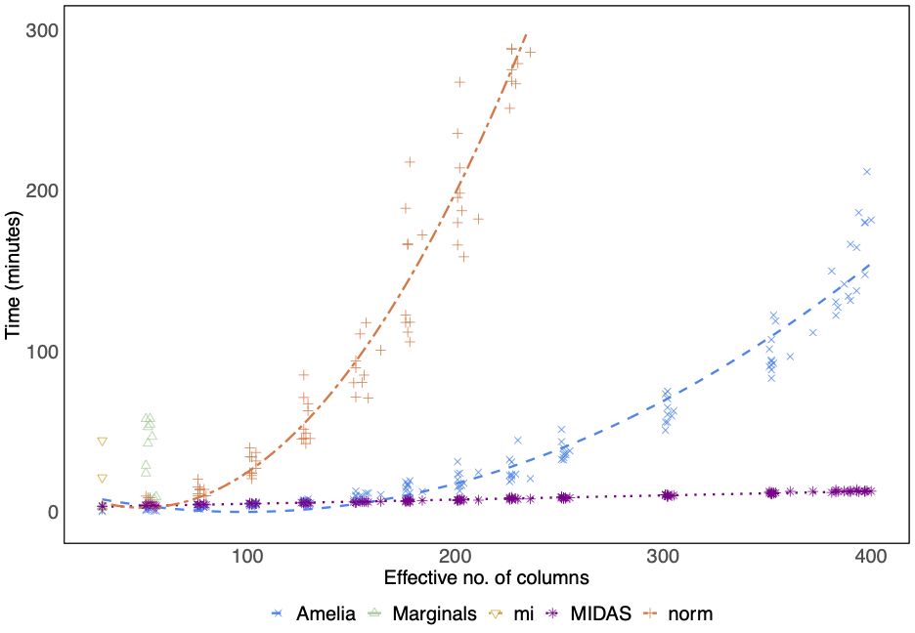
Measurement I: Missing Data
Problem: Non-randomly missing data in complex datasets
Current limits: Poor at capturing non-parametric or non-linear relationships, computational bottlenecks
Solution: Multiple imputations using denoising autoencoders (MIDAS)
Result: Better modelling and prediction of complex data, more scalable than existing approaches
Lall & Robinson (2021) The MIDAS Touch: Accurate and Scalable Missing-Data Imputation with Deep Learning. Political Analysis

Slide 8
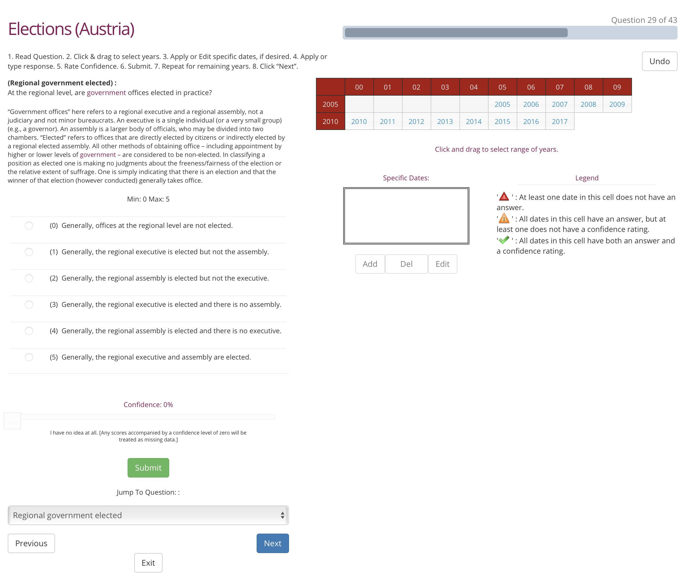
Measurement II: Complex Concepts
Problem: Measurement of complex concepts consistently across time and space
Existing Approaches: Blackbox ordinal indices
Solution: Surveys with anchoring vignettes and item response models to aggregate expert rating
Result: Varieties of Democracy (V-Dem) largest and most resolved dataset on democracy and related topics, covering ~ 200 polities (some over two centuries) and several hundred indices per observation
Medzihorsky et al. (2021) The V-Dem Measurement Model: Latent Variable Analysis for Cross-National and Cross-Temporal Expert-Coded Data. V-Dem Working Paper

Slide 9
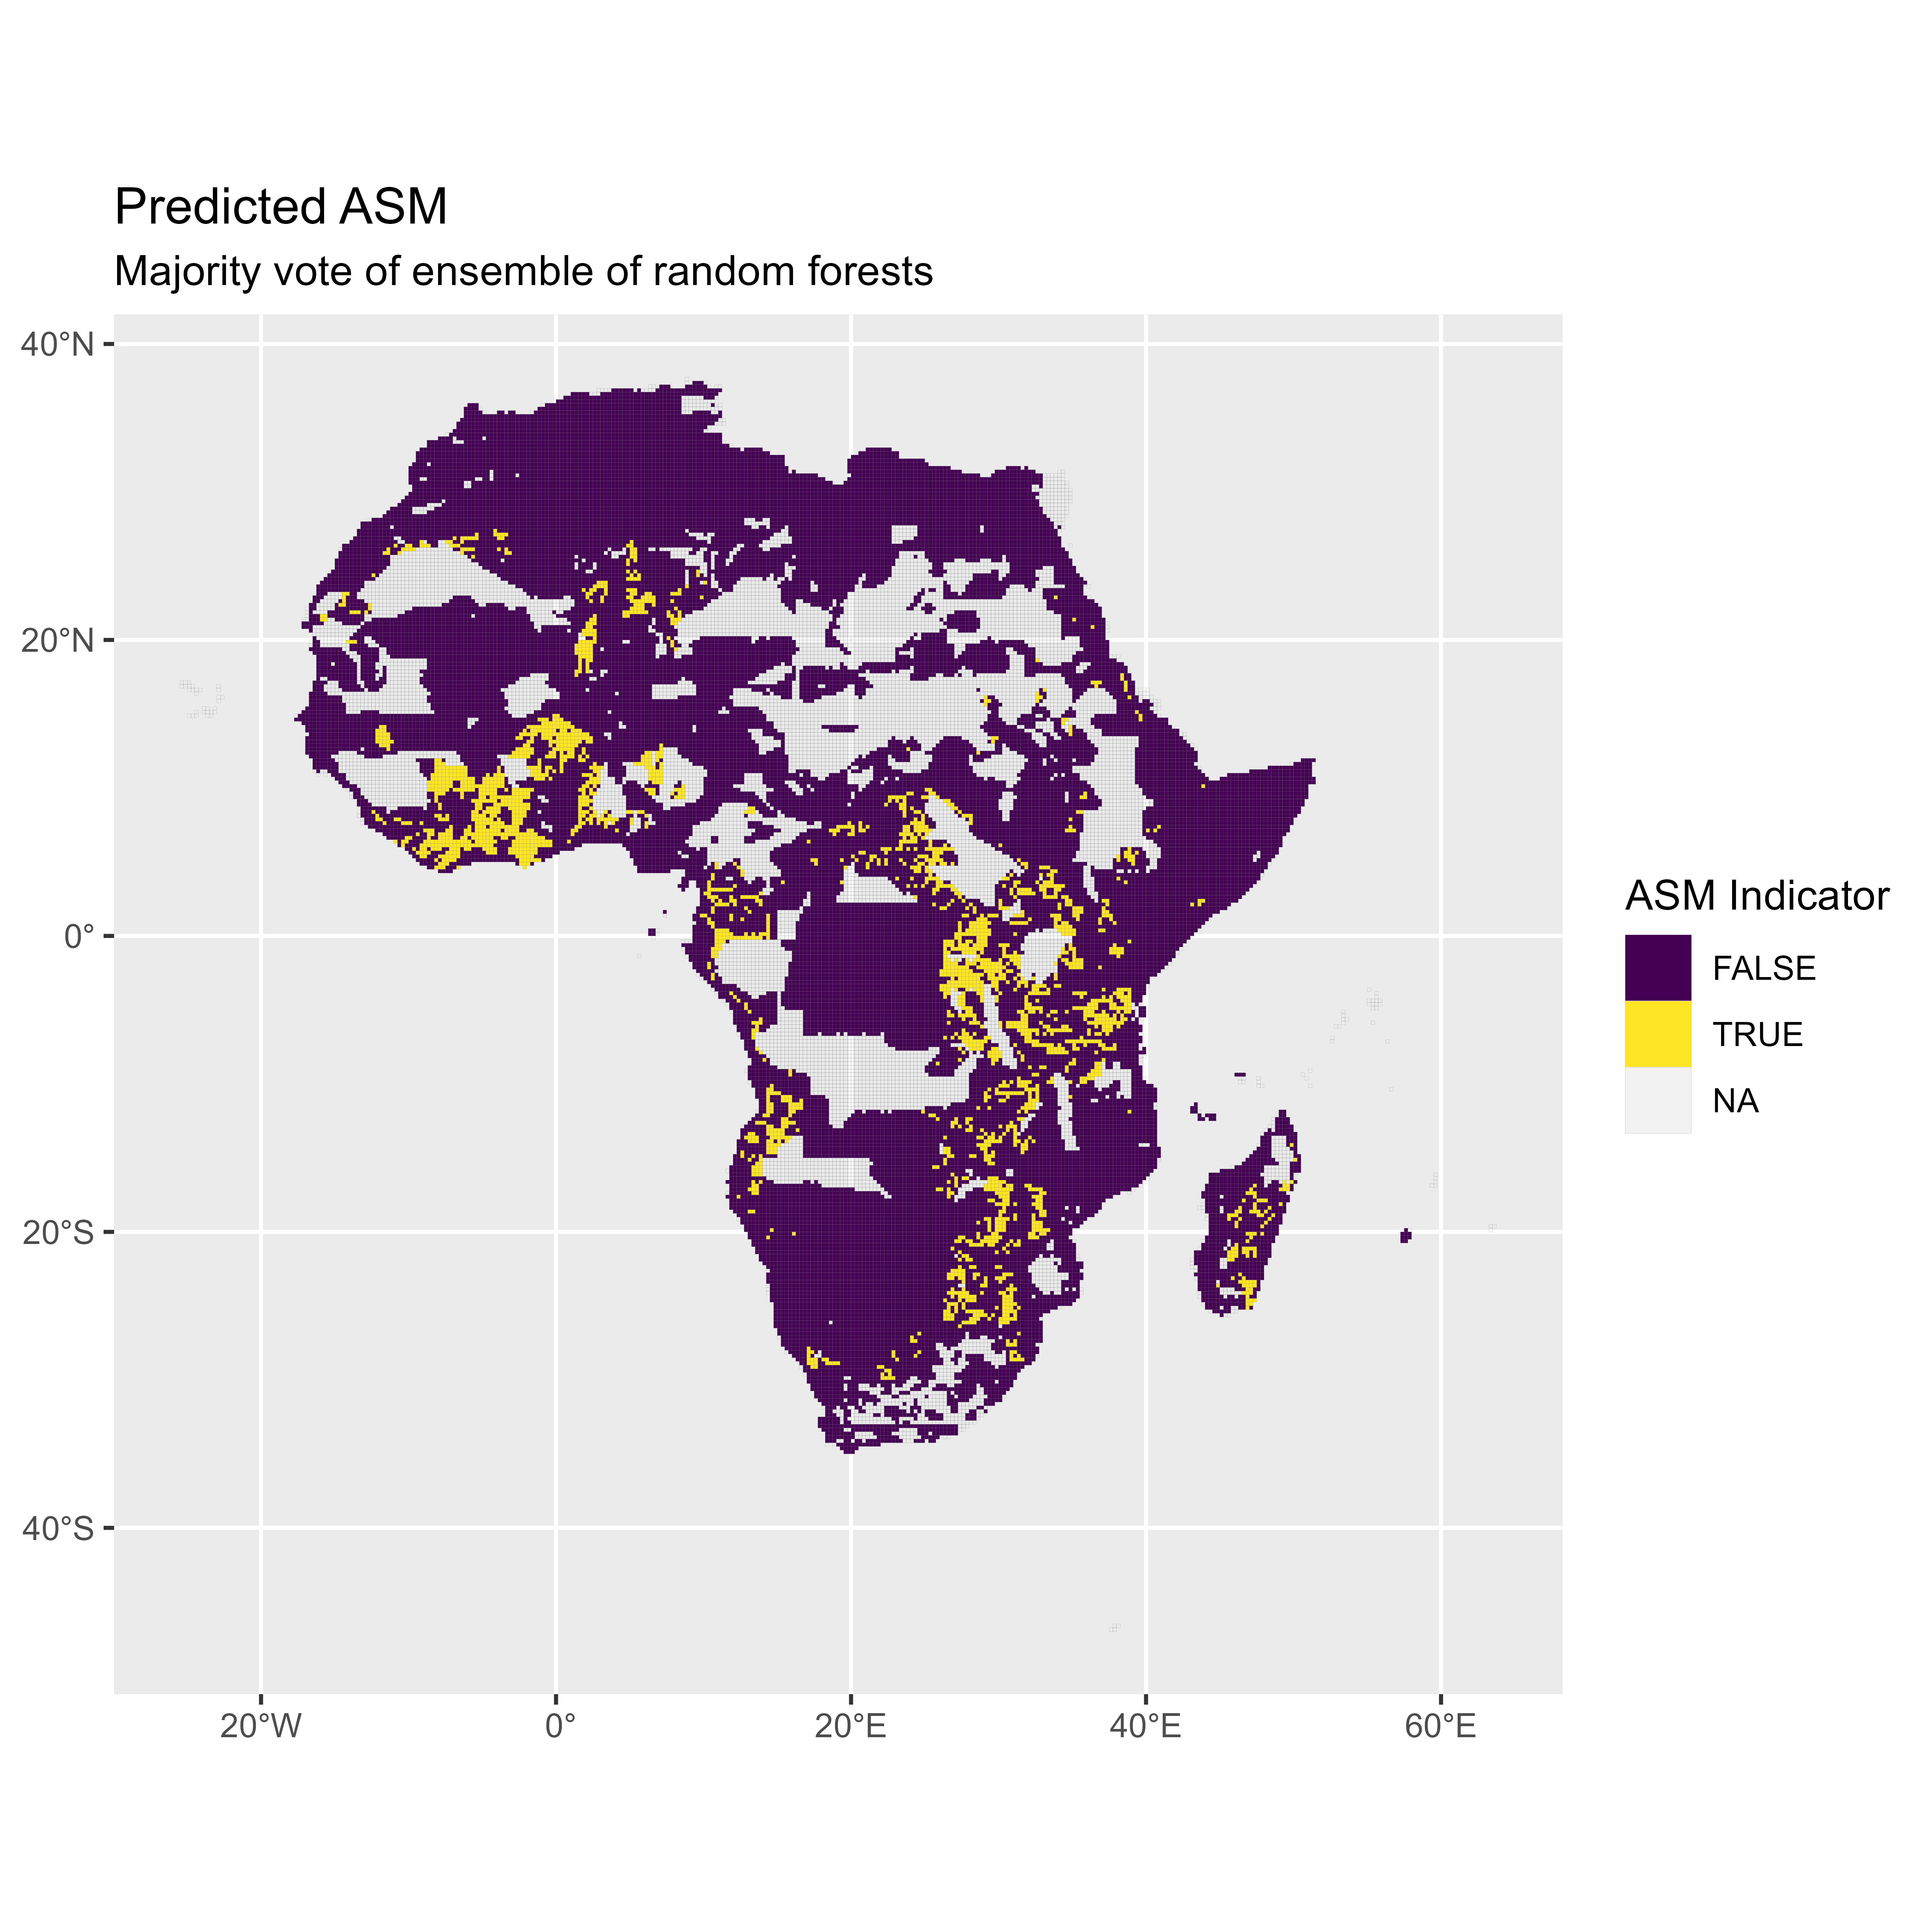
Measurement III: Hard to Measure
Problem: Predicting artisanal and small-scale mining in sub-Saharan Africa
Solution: Random forest classifier using fine-grained geological maps
Result: Predicts small scale mining in 20x20km cells with 90% accuracy
Rigterink et al (2021) . Economics of Conflict Extractives Project. ESOC and The Crisis Group

Slide 10
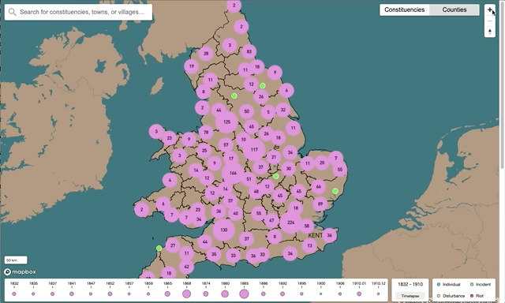
Measurement IV: Extracting Events
Problem: Systematic scalable search strategy for remotely stored text archives with download restrictions
Existing approach: Expert keyword search
Solution: Download-restricted efficient search strategy (DRESS)
Result: Performs at least as well as expert human on small scale task, but scales, transparent, and replicable – applied to identifying 19th-century election violence events
Cohen, Kuhn & Vivyan (2021) Causes and Consequences of Election Violence: Evidence from 19th-century England & Wales. ESRC/AHRC funded Grant (2017-2021)

Slide 11
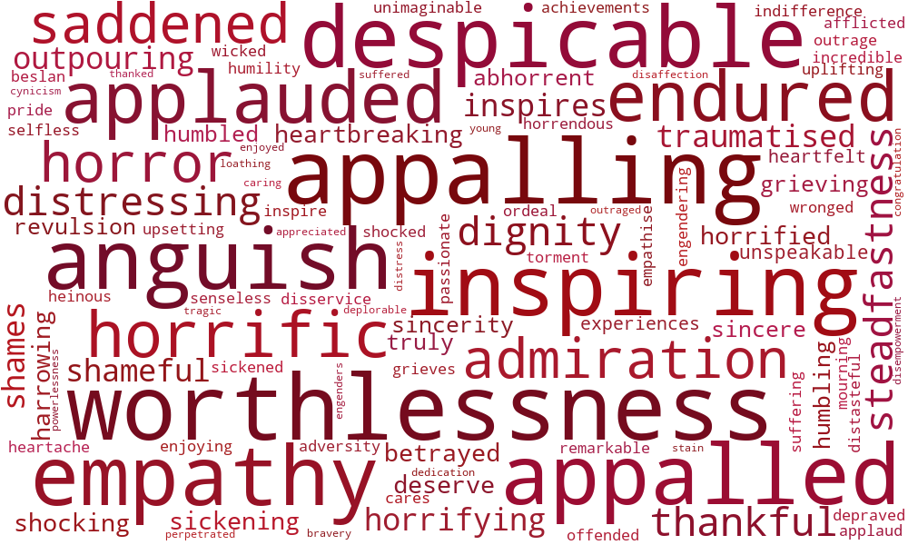
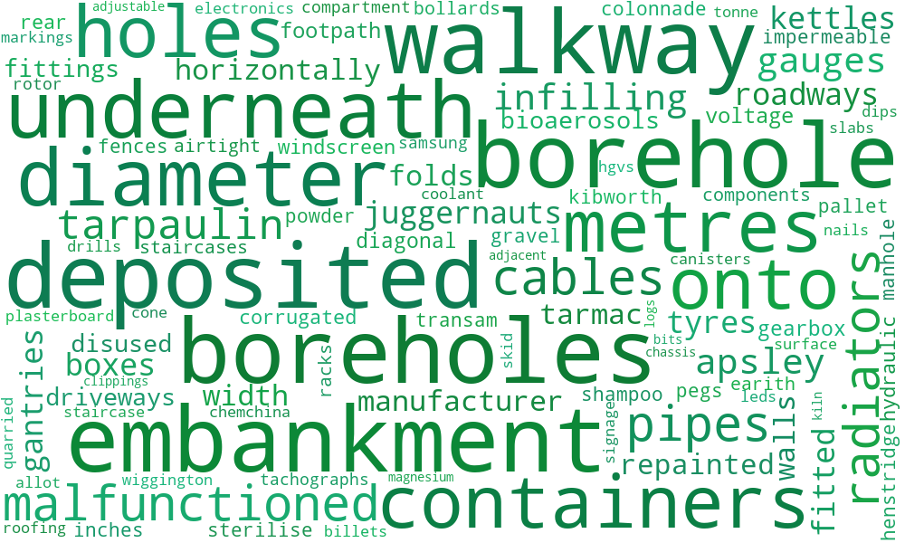
Digitisation: Emotive Political Speech
Question: When and why do politicians use emotive rhetoric?
Traditional approach: Qualitative content or discourse analysis
Solution: Combine Affective Norms of English Words (ANEW) dictionary with word embedding techniques to create domain-specific dictionary
Result: Applied to 2 million parliamentary speeches in UK and Irish parliament – emotive rhetoric used to appeal to larger electoral audiences
Osnabrügge, Hobolt & Rodon (2021). Playing to the Gallery: Emotive Rhetoric in Parliament. American Political Science Review 115(3): 885-899.

Slide 12
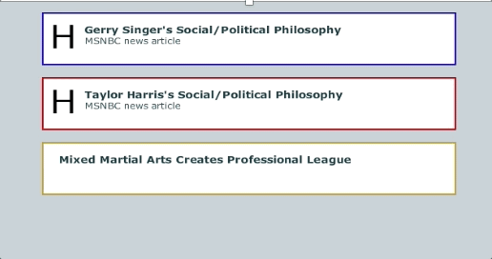
Digitization: Informational Consumption and Consequences
Problem: Political communication involves dynamic information flow
Traditional approach: Observational and static experimental data
Solution: Dynamic Process Tracing Environment (DPTE) – now defunct (currently seeking funding for V2.0)
Insights:
  Attention focused on high-level races
  Voters use partisan cues and heuristics, including gender
  Richness of the informational environment matters
Various publications by David Andersen and Tessa Ditonto in leading political science and methods journals
Andersen & Ditonto (2018) Information and its Presentation: Treatment Effects in low- and high-information environments. Political Analysis 26(4): 379-398.

Slide 13
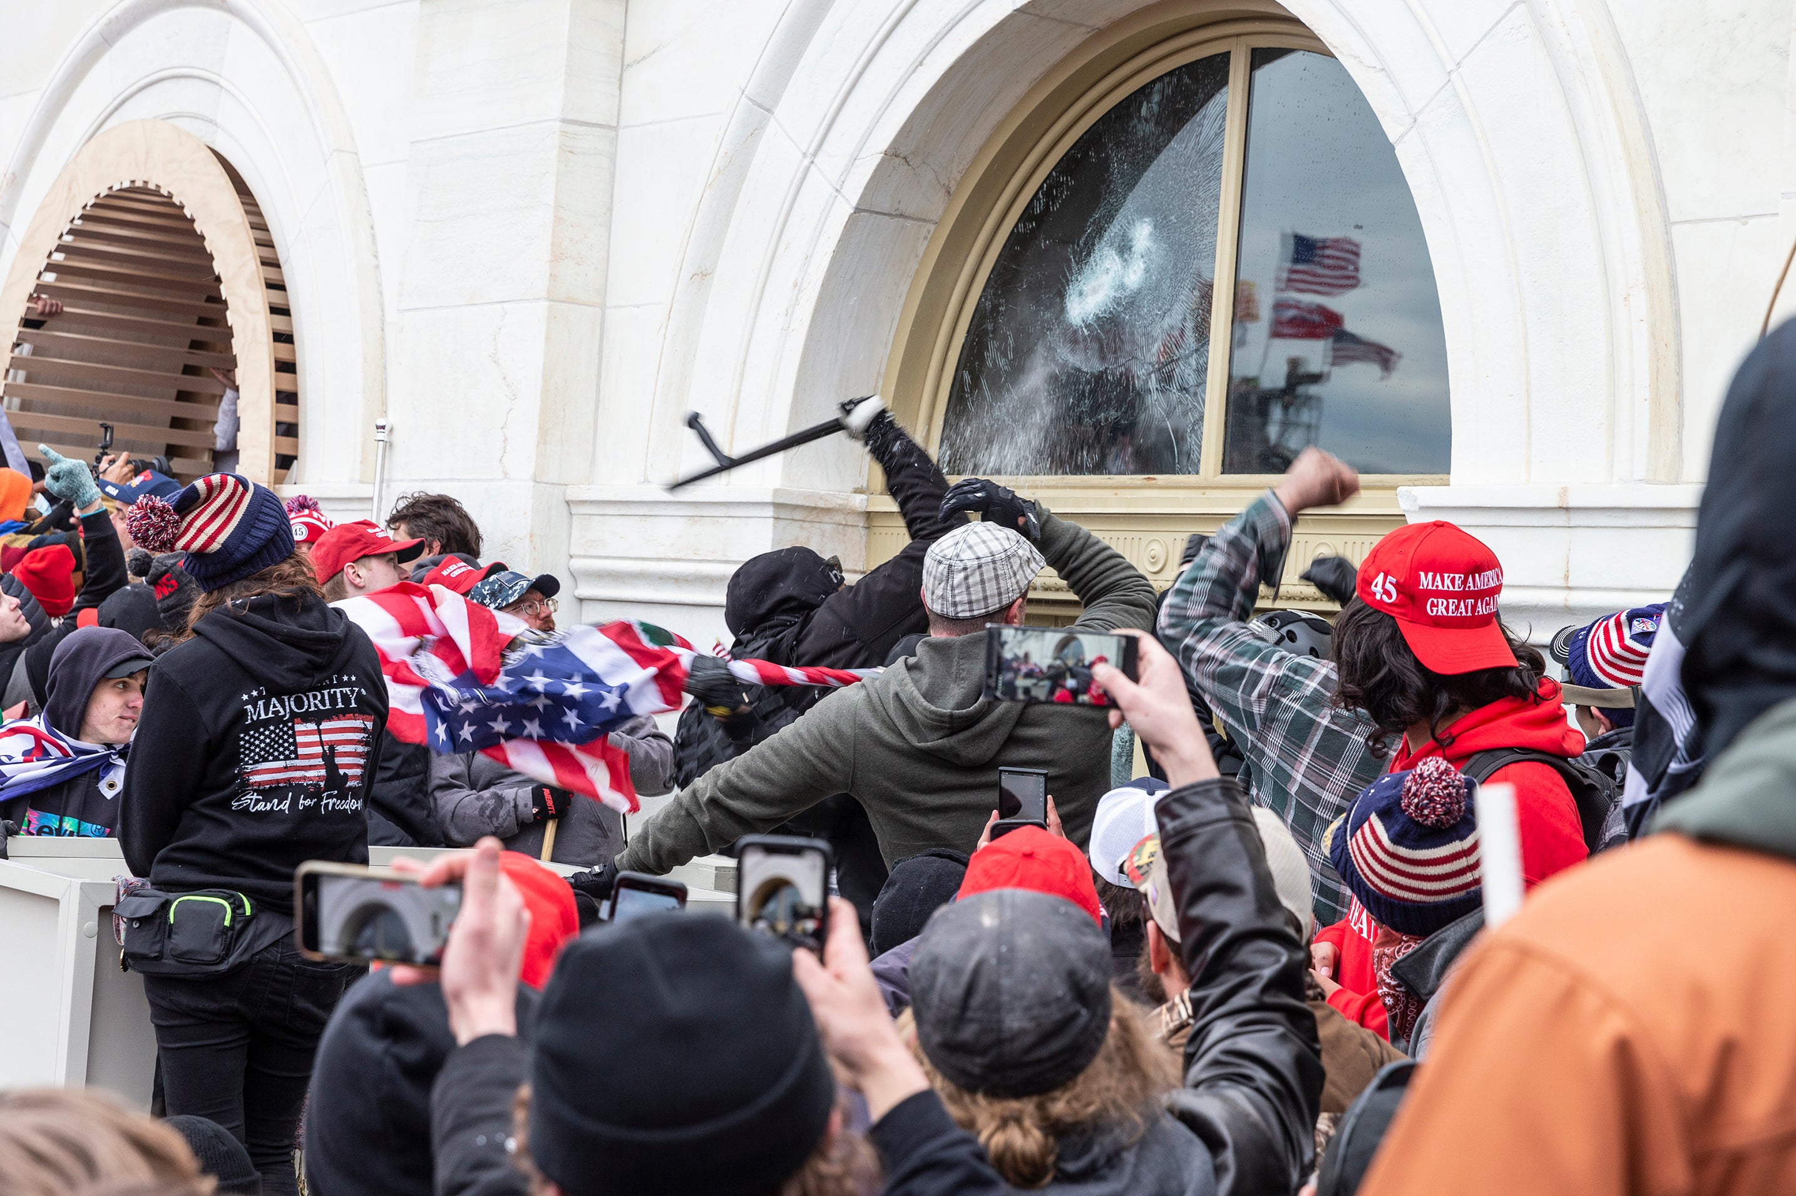
Digitisation: Social Media & Democracy
Questions: Impact of social media on democracy
Approaches: Large-scale observational data analysis, social media experiments
Insights:
  Misinformation in the realm of politics more concentrated and asymmetric the commonly assumed (at least in US context)
  Social media may have a differential impact on affective and ideological polarization
  Social media may contribute to violence/conflict (e.g., Myanmar, US Capital Riot)
Members in the cluster currently working in this area:
Kyriaki Nanou, Moritz Osnabrügge, and Monica Stephens

Slide 14
Academics in Cluster

Slide 15
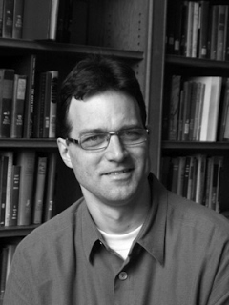
Patrick M Kuhn
SGIA, CIPB, DRMC Fellow
Director of the Centre for Institutions and Political Behaviour (CIPB)
Political Economy of Development and Conflict:
  PI of ESRC/AHRC funded grant on “Election Violence in England and Wales (1832-1914)”: 1 PDRA (2017-2021)
  Co-I on follow-up grant involving the collection, digitisation, and topic coding of over 15,000 candidate election addresses (1832-1914)
Survey Methodology/Experiments:
  Evaluation of indirect question designs to capture sensitive information supported by BA/Leverhulme Small Grant and published in Political Analysis
p.m.kuhn@durham.ac.uk

Slide 16
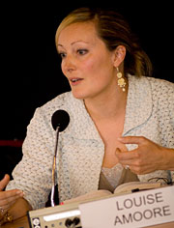
Louise Amoore
Geography
Cluster Convener of Politics-State-Space:
  Research cluster of geography, focusing on understanding the geographical dimensions of violence, justice, and power
Geopolitics, Technology and Security:
  PI on ERC Advanced Grant “Algorithmic Societies: Ethical Life in a Machine Learning Age”
  Recent book “Cloud Ethics: Algorithms and the Attributes of Ourselves and Others”
louise.amoore@durham.ac.uk

Slide 17
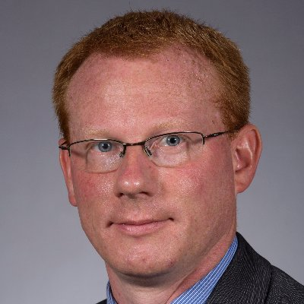
David Andersen
SGIA, CIPB
Researcher on Dynamic Process Tracing Environment (DPTE):
  (Defunct) platform to dynamically simulate and experimentally control informational content in a political campaign context
Political Psychology and US Government:
  Exploring how people learn about politics, how what they learn affects their beliefs, and how they act politically
  PI on BA/Leverhulme Small Grant “Dynamic Experiment Exploring Susceptibility to Social Media Misinformation Campaigns”
david.j.andersen@durham.ac.uk

Slide 18
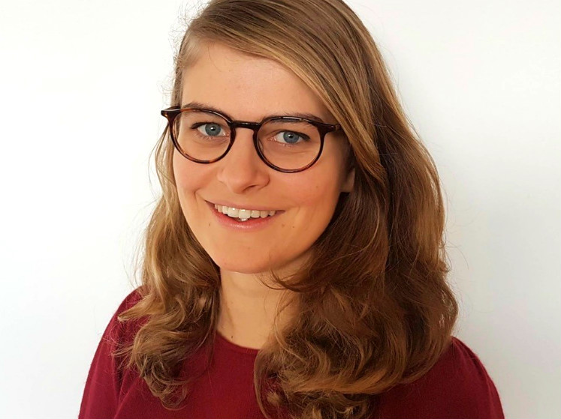
Diane Bolet
SGIA, CIPB
Starting August 2022 at SGIA/CIPB:
  Currently a Postdoctoral Researcher at the IPZ at the University of Zurich
Comparative Political Behaviour / far-right voting:
  use of fine-grained spatial and local economic data to link local pub closures in Britain to UKIP support
diane.bolet@durham.ac.uk

Slide 19

Gidon Cohen
SGIA, CIPB
Head of the School of Government and International Affairs
  Founding member and Director of the CIPB
History and Politics:
  Machine-learning and natural language processing of historical text
  Adaption of capture-recapture methods to estimate historical party membership
  Co-I of ESRC/AHRC funded grant on “19th-Century Election Violence in England and Wales”: 1 PDRA (2017-2021)
  Co-I on follow-up grant involving the collection, digitisation, and topic coding of over 15,000 19th-century candidate election addresses
gidon.cohen@durham.ac.uk

Slide 20

Juraj Medzihorsky
SGIA, CIPB, Fellow DRMC
DRMC Programme Lead for the MDS (Social Analytics)
Computational and Statistical Methods:
  Project Manager for Statistical Computing at V-Dem
  Text analysis and latent class analysis
juraj.medzihorsky@durham.ac.uk

Slide 21
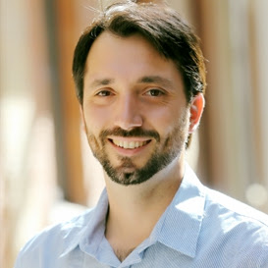
Vittorio Merola
SGIA, CIPB
Starting January 2022 at SGIA/CIPB:
  Previously Assistant Professor at Stony Brook University (NY, USA)
Political Economy and Political Psychology:
  Exploring how people from opinions, how they adjust their views in light of new information, and how these dynamics affect political behaviour across contexts
  Large-scale survey experiments on motivated reasoning and misinformation within and outside social media
vittorio.merola@stonybrook.edu

Slide 22
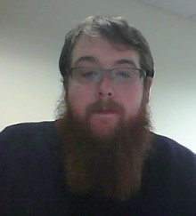
Adrian Millican
SGIA, CIPB, DRMC Fellow
Teaching Quantitative Methods
  PSA Video Series on Teaching Quantitative Methods
  Co-Convenor of the DRMC Research on “Teaching Quantitative Methods”
Political Behaviour:
  PI on BA/Leverhulme Small Grant “Dynamic Experiment Exploring Susceptibility to Social Media Misinformation Campaigns
adrian.millican@durham.ac.uk

Slide 23
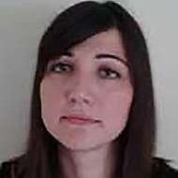
Kyriaki Nanou
SGIA, CIPB
SGIA Co-Director of the Global Politics Institute
European and EU Politics:
  PI of Leverhulme/BA Small Grant “Seeking the Personal Vote: How Legislators Exploit the Party Line”
  Hate speech project using over 6 million Brexit-related tweets
kyriaki.nanou@durham.ac.uk

Slide 24
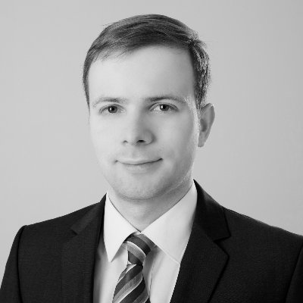
Moritz Osnabrügge
SGIA, CIPB
Quantitative Text Analysis:
  Combining affective norms of English Words (ANEW) dictionary with word embedding techniques to create domain-specific dictionaries.
    Hate speech project using over 6 million Brexit-related tweets
    The strategic use of emotive rhetoric in the UK parliament
  Cross-domain topic classification in political texts
moritz.osnabruegge@durham.ac.uk

Slide 25
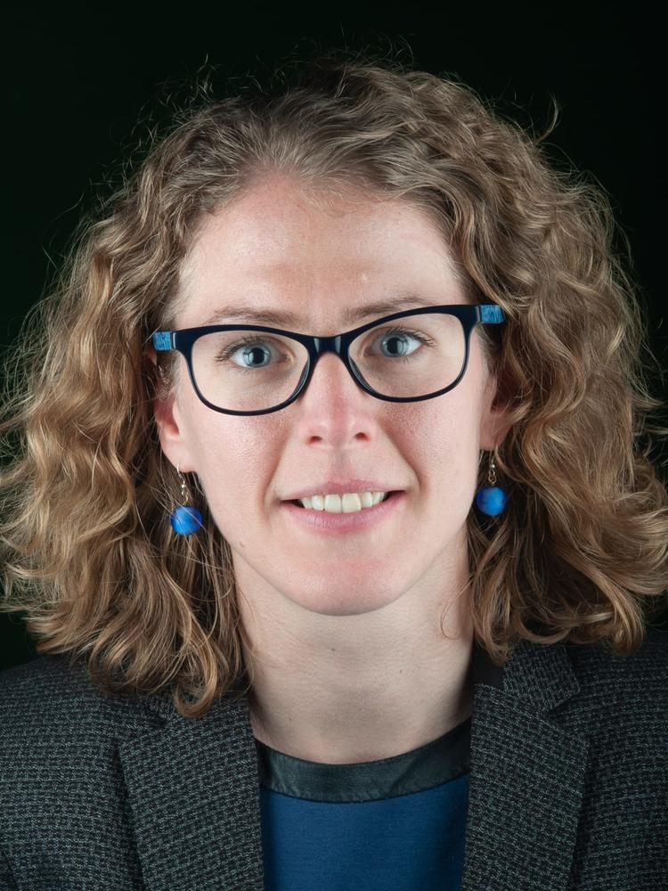
Anouk Rigterink
SGIA, CIPB
Economics and Conflict Fellow at Princeton University and the Crisis Group (2019/20)
  Explore conflict management between artisanal and industrial mining using spatial machine learning classifier on fine-grained geological data to identify artisanal mining sites.
Political Economy of Development and Conflict:
  Co-I on EGAP Metaketa III Project “Natural Resource Governance”, involving RCTs and lab-in-the-field experiments
anouk.rigterink@durham.ac.uk
Notes:
Spatial

Slide 26
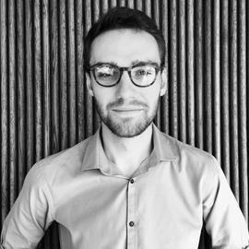
Thomas S Robinson
SGIA, CIPB
Research collaborator with Meta/Facebook
  Member of the statistics and privacy team
Computational Methods:
  Multiple imputation using denoising autoencoders
  PI of BA/Leverhulme Small Grant “Synthetic data and deep learning”
  Co-I on large Education Endowment Funded grant “Evaluation, synthesis and translation of education intervention evidence”
thomas.robinson@durham.ac.uk
Notes:
Spatial

Slide 27
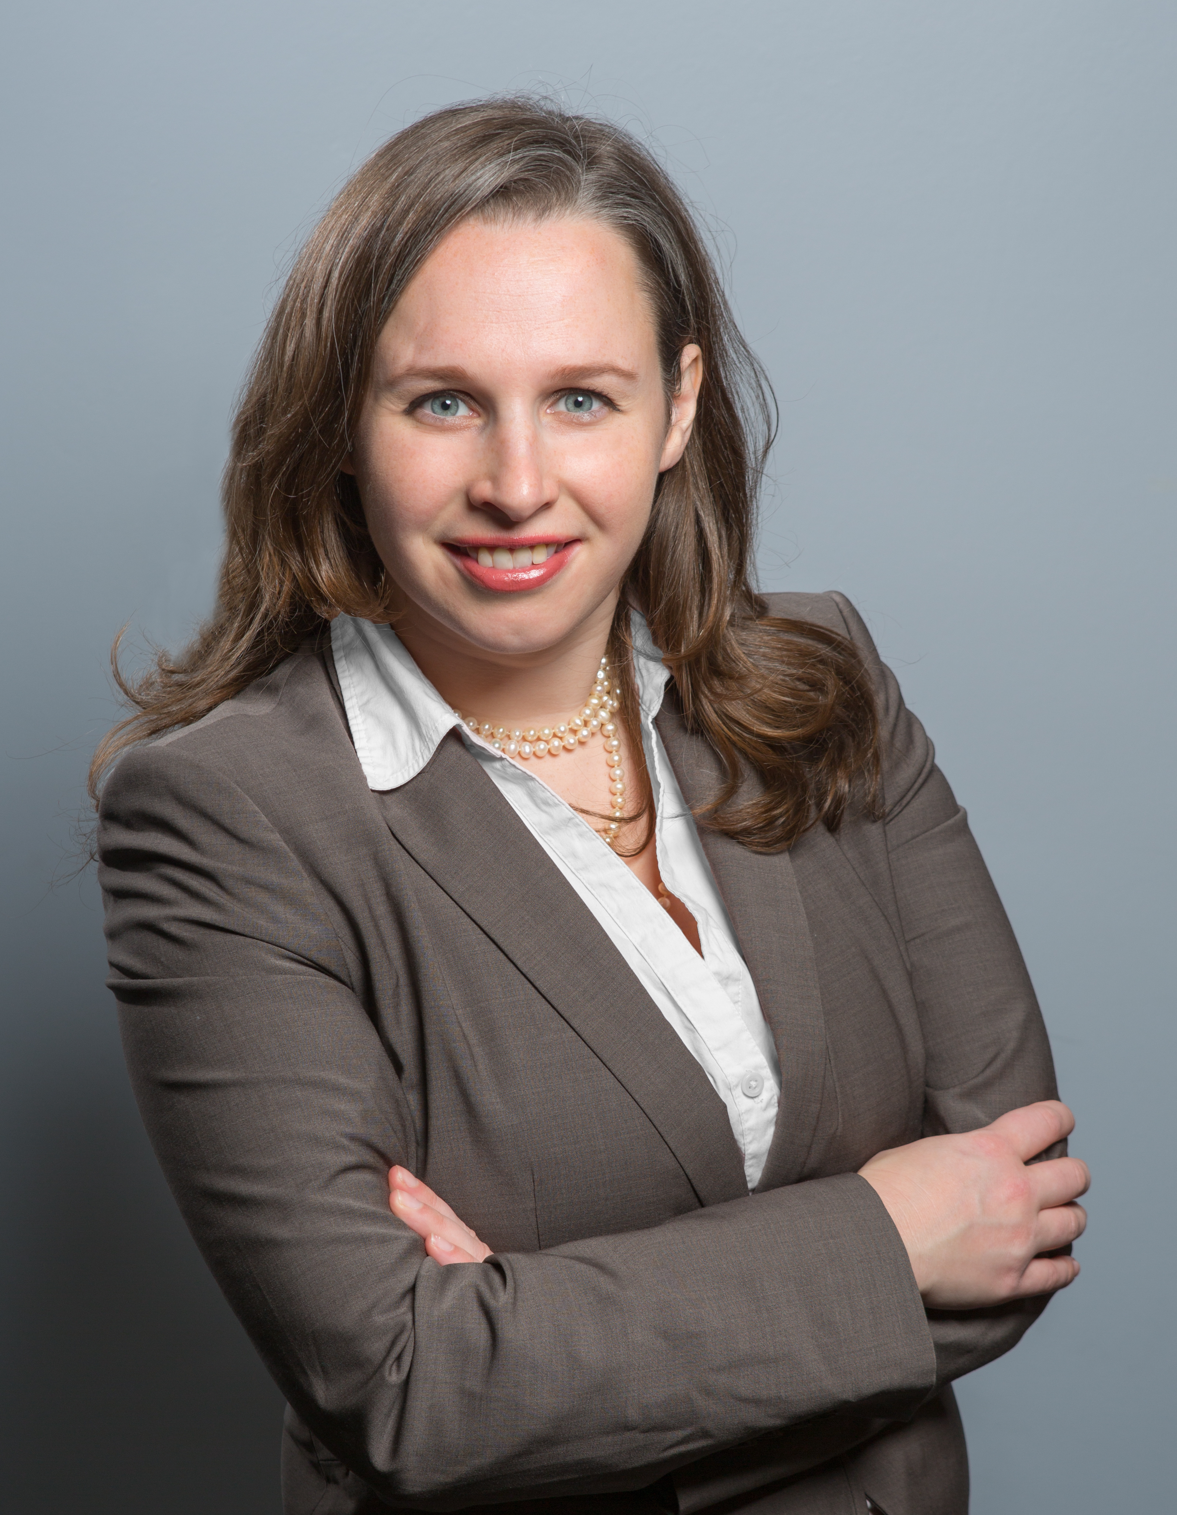
Monica Stephens, Geography
Monica.Stephens@durham.ac.uk
https://geog.space/
A Geospatial Infodemic: Mapping Twitter conspiracy theories of COVID-19 (2020, Dialogues in Human Geography, 10(2))
Misinformation in the digital age: an American infodemic (Elgar, 2022 – book under review with Elgar for 2022)
“Peddling Post-Truth: The Role of Twitter in State-Level Childhood Vaccine Policy” (resubmission pending to American Journal of Public Health)
Current projects
Methods & expertise
Geographic Information Systems (GIS), social network analysis (SNA), data mining-Twitter, geocoding/geolocating online content, R
Global media communications/public public outreach (2021: NPR, ABC, Associated Press, Reuters, etc..)
Datasets to share--Geocoded Tweets: USA- 2020-2021 election to insurrection; Parler (USA)
I use digital traces to understand issues of inequality exclusion and marginalization augmented by social media and online communities
How do proprietary mapping platforms (Apple/Google) reproduce colonial extraction practices and expose communities to misinformation in sub-Saharan Africa?
Research

Slide 28
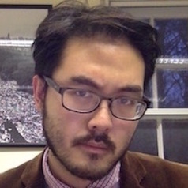
Neil Visalvanich
SGIA, CIPB
Race and Ethnic Politics:
  Explored influence of racial and ethnic diversity on political institutions, mass political behaviour, and public opinion
  Using statistical analysis and large-scale survey experiments
  Co-I in BA/Leverhulme Small Grant “Seeking the Personal Vote: How Legislators Exploit the Party Line”
neil.visalvanich@durham.ac.uk

Slide 29
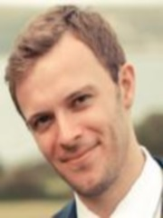
Nick Vivyan
SGIA, CIPB, Fellow DRMC
Founding member of the CIPB
British Political History:
  Co-I of ESRC/AHRC funded grant on “Election Violence in England and Wales (1832-1914)”: 1 PDRA (2017-2021)
  PI on follow-up grant involving the collection, digitisation, and topic coding of over 15,000 candidate election addresses (1832-1914)
Estimation of Political Opinion and Ideology:
  PI of ESRC funded grant ”Estimating Constituency Opinion in Britain”
  Currently Leverhulme Research Fellowship on “The Idiosyncratic Voter: Issue Opinion and Democratic Politics in Britain”
nick.vivyan@durham.ac.uk
Notes:
Spatial

Slide 30
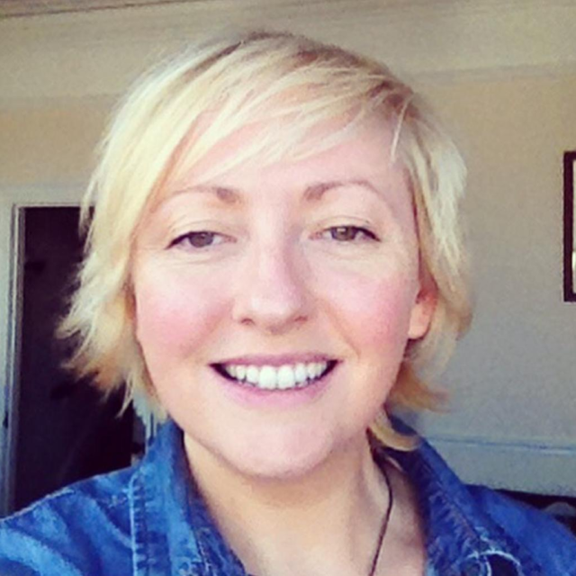
Sarah Wyer
Computer Science Department
About me: PhD Student working with Prof Sue Black:
  Founding member: Bias in AI UK Network
  Large Scale Language Models (e.g. GPT-3)
  Natural Language Generation (NLG), identifying, and mitigating intersectional bias (e.g. Gender, race)
  NLP
  Misinformation
  Social & political issues stemming from NLP and NLG
  Diversity and Inclusion
sarah.wyer@durham.ac.uk

Slide 31
Other Academics Listed
Andrew Dwyer (Geography)
Nicholas Syrotiuk (Library, DRMC)

