Slide 1
PROBING NEW PHYSICS WITH ULTRA-HIGH-ENERGY COSMIC RAYS
Robert Heighton
(working with Lucien Heurtier)
IPPP Internal Seminar, 24th June 2022

Slide 2
Overview
UHECR and cosmogenic neutrinos
Adding a right-handed Majorana neutrino
Simulating detector results
Conclusions

Slide 3
UHE COSMIC RAYS
Cosmic rays: e.g. protons, nuclei
UHE = ultra-high energy (> PeV)
LHC max
UHECR
GeV TeV PeV EeV
10⁹ 10¹² 10¹⁵ 10¹⁸
E [eV]

Slide 4
THE GZK LIMIT
E_{GZK} ≈ 50 EeV
Protons interact with CMB
p + γ → ∆⁺ → n + π⁺
Nuclei undergo photodisintegration
Cutoff of UHECR flux

Slide 5
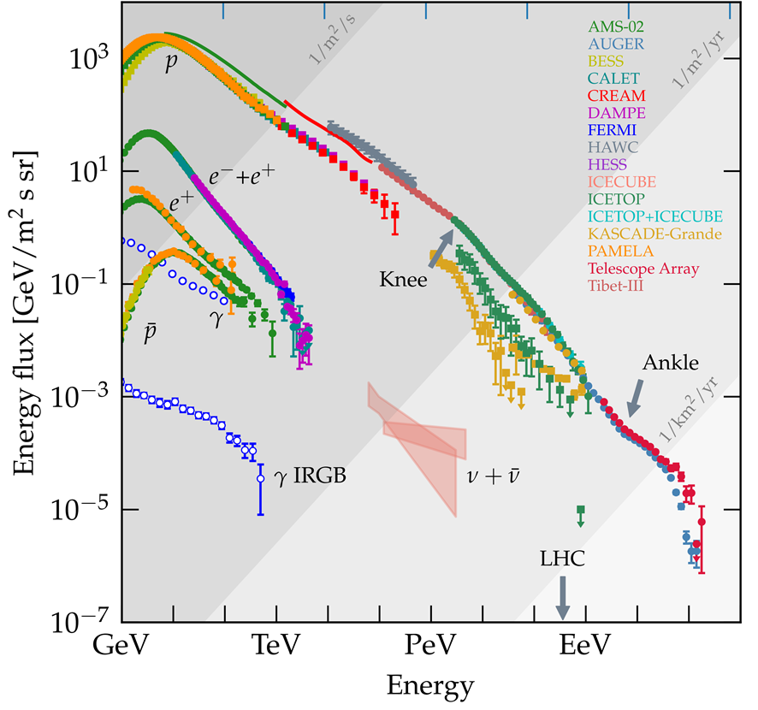
The GZK Limit
p + γ → ∆⁺ → n + π⁺
Pions decay
⇒ Cosmogenic Neutrinos
Evoli, Carmelo (2018) The Cosmic-Ray Energy Spectrum. Zenodo https://doi.org/10.5281/zenodo.4309926

Slide 6
The cosmic Accelerator
Cosmogenic neutrino flux at ~EeV scales
Neutrino-proton interactions with CoM energy ~45 TeV
A probe of higher energies

Slide 7
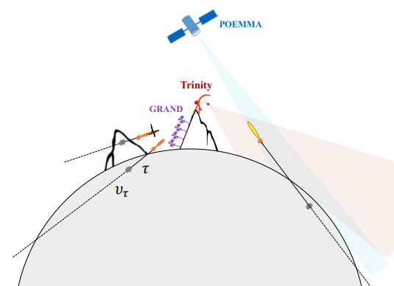
Detection
IceCube, ANITA, Auger
in future: GRAND, POEMMA, Trinity
Huang et al., “Probing New Physics at Future Tau Neutrino Telescopes” (2021)

Slide 8
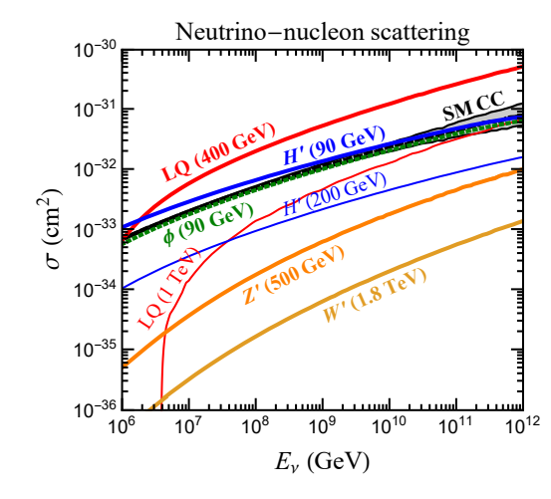
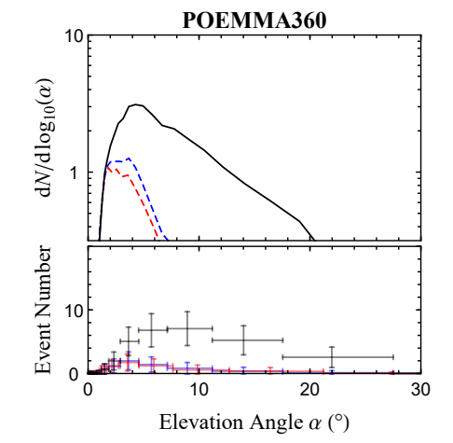
New Physics?
Huang et al., “Probing New Physics at Future Tau Neutrino Telescopes” (2021)

Slide 9
New Physics?
Flux
SM
modified σ
long-lived particle
Emergence angle

Slide 10
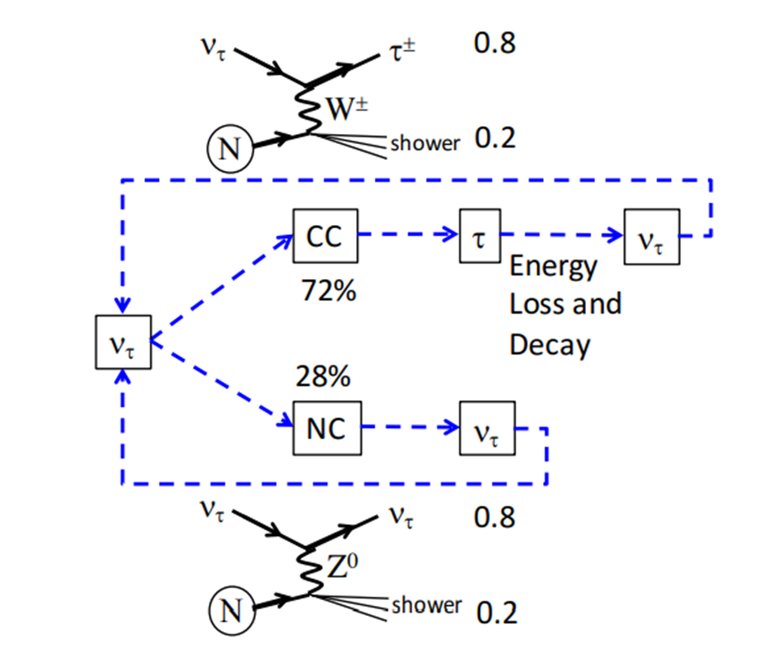
Tau Neutrinos in the Earth
NC and CC interactions
Tau decay
Tau regeneration
ν_{τ}
Alvarez-Muñiz et al., “A Comprehensive Approach to Tau-Lepton Production by High-Energy Tau Neutrinos Propagating Through Earth” (2018)
τ
decay
ν_{τ}
CC

Slide 11
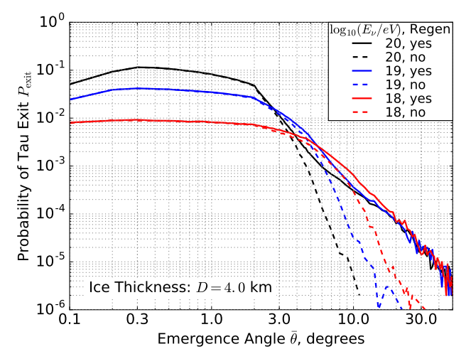
Alvarez-Muñiz et al., “A Comprehensive Approach to Tau-Lepton Production by High-Energy Tau Neutrinos Propagating Through Earth” (2018)

Slide 12
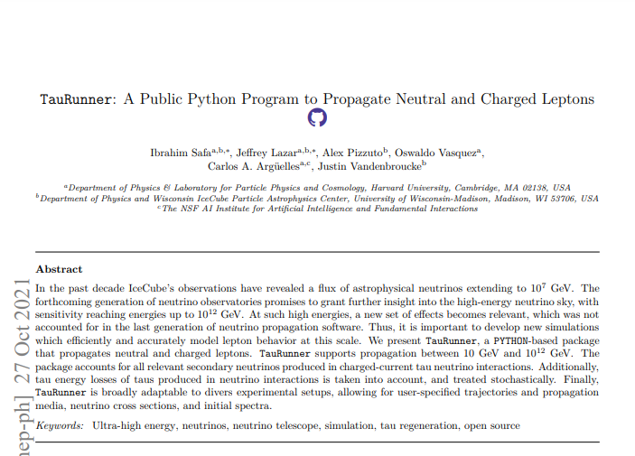
Taurunner
Monte-Carlo approach to propagation of neutrinos and charged leptons
Accounts for energy loss of tau
Simulates neutrinos traversing chord of the Earth’s interior (all within SM)

Slide 13
Adding the RHN
Neutrinos in the standard model have left-handed chirality
Possible BSM physics: right-handed neutrino
Majorana neutrino coupled via seesaw mechanism

Slide 14
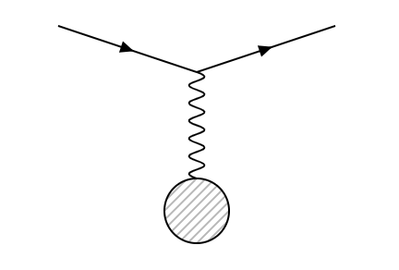
RHN Interactions
CC and NC (with mixing)
$$−ℒ⊃ \left(\frac{g}{\sqrt{2}}\right)\sin\left(θ_{mix}\right)W_{μ}^{+}{\overline{N}}^{c}γ^{μ}P_{L}τ + \left(\frac{g}{2\cos{θ_{w}}}\right)\sin\left(θ_{mix}\right)Z_{μ}{\overline{N}}^{c}γ^{μ}P_{L}ν_{τ} +h.c.$$
N
τ
ν
N
N
ν
W⁺
Z⁰
Z⁰

Slide 15
RHN Decay
Various decay modes (lighter charged leptons, neutrinos, hadrons)
Strongly mass-dependent
Regeneration
Additional detectable air showers (analogous to taus)
ν_{τ}
RHN
decay
ν_{τ}
NCm
decay

Slide 16
Results
Using mass 5 GeV
Varying mixing angle
Incoming energy 10 EeV
Define P(exit) as number of RHNs exiting with energy > 30 PeV per incoming neutrino
Compare to analytical result for one interaction (dotted line)

Slide 17
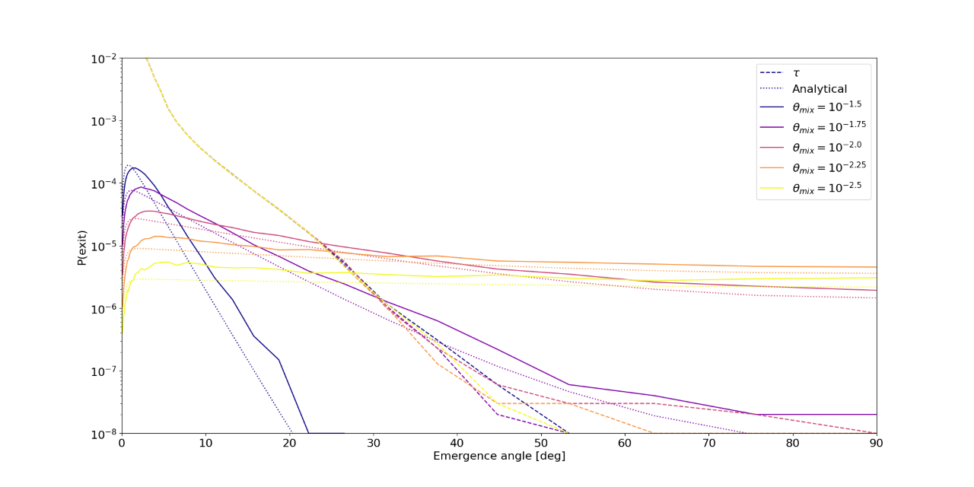

Slide 18
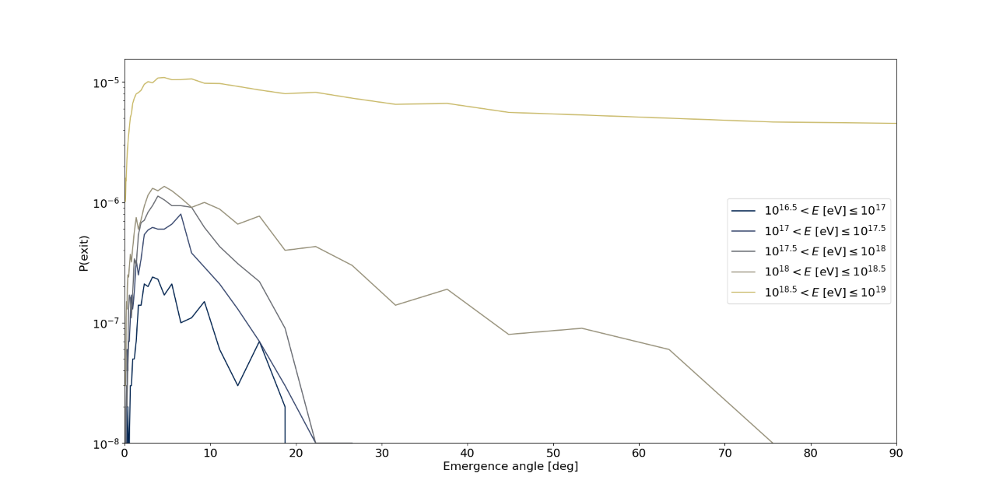

Slide 19
Detector simulations
POEMMA
(satellite)
GRAND
array
Earth

Slide 20
Preliminary Detector Predictions
Simplified simulation of POEMMA
(similar code for GRAND in progress)
Modelling with optimistic cosmogenic neutrino flux within IceCube and Auger constraints
Event number (of RHNs and taus) over 5-year run

Slide 21
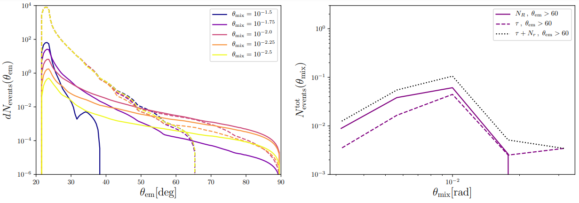

Slide 22
Varying Initial Energy
Used 10 EeV
Expected cosmogenic neutrino flux spread over EeV scales
Simulate with lower energy

Slide 23
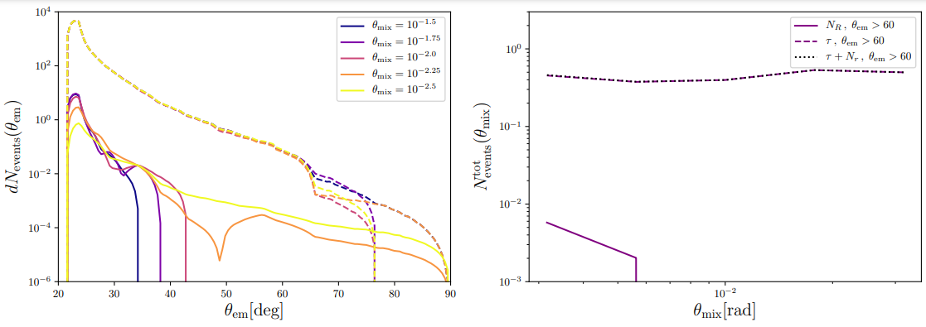

Slide 24
Discussion
Necessity for high energies motivates methodology
Observable effects
Can be used to constrain parameters

Slide 25
Further Study
Improve statistics
Test other masses
Predict constraints
Play with further BSM models (e.g. Majoron?)

Slide 26
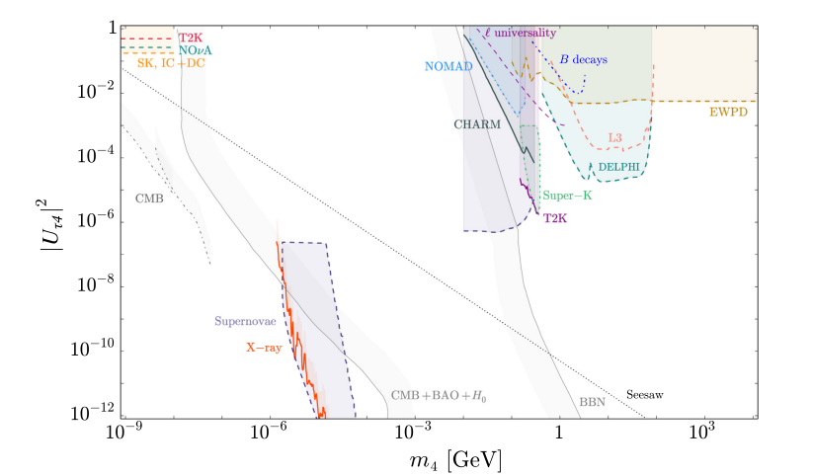
Dasgupta and Kopp, “Sterile neutrinos” (2021)

Slide 27
Conclusions
BSM physics, such as a right-handed Majorana neutrino model, would affect the phenomenology of Earth-traversing UHE neutrinos, modifying results at observatories such as POEMMA.
Future experimental results may allow us to constrain model parameters.
The necessity of vast energies, even for exploring physics at smaller scales, motivates UHECRs as an avenue for testing BSM physics.

Slide 28
Questions?

