Slide 1
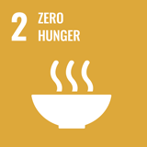
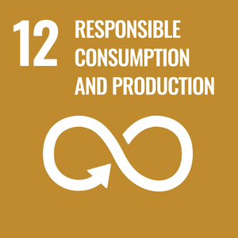
Soil Fertility and Nitrogen Management in Tropical Rice Fields
Water Management using Smart Radiation Sensors
COSMIC-SWAMP Workshop Day 2
19th July 2022
Remote
Mellissa Soller/Alexandre Heinemannr

Slide 2
Summary:
Our expectation with COSMIC-SWAMP sensor;
Soil fertility management;
Rice (Upland and Flooded);
Fertilizer recomendation (Nitrogen)

Slide 3
Our expectation with COSMIC-SWAMP sensor
We expecte that with the COSMIC-SWAMP sensor the accuracy in measuring soil humidite during crop growth and development will be improved to help us better understand the nitrogen dynamics.

Slide 4
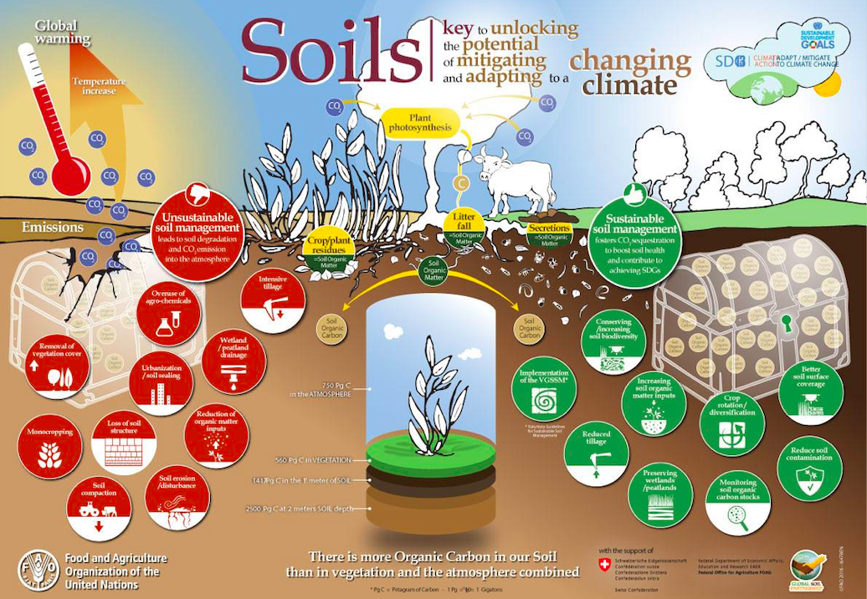
Notes:
United Nations Organization (ONU) through FAO secretariat is been supporting actions to improve agriculture sustainability (2030 Agenda and Sustainable Development Goals - SDG), enhancing carbon storage in soil (Right side of the figure above).

Slide 5
Soil Fertility Management: diversifying agricultural systems
Crop rotation(no-tillage, integrated crop-livestock, crop-livestock-forest, ...), together with cover crops (reducing synthetic fertilizer inputs)
Adoption of beneficial microorganisms (as Azospirillum brasiliense, for rice)
Increase Soil Carbon Stocks
Sustainable intensification
Notes:
Tha best practices to improve soil Fertility reducing synthetic Nitrogen in the systems.

Slide 6
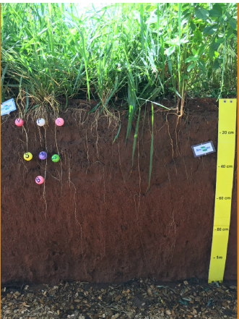
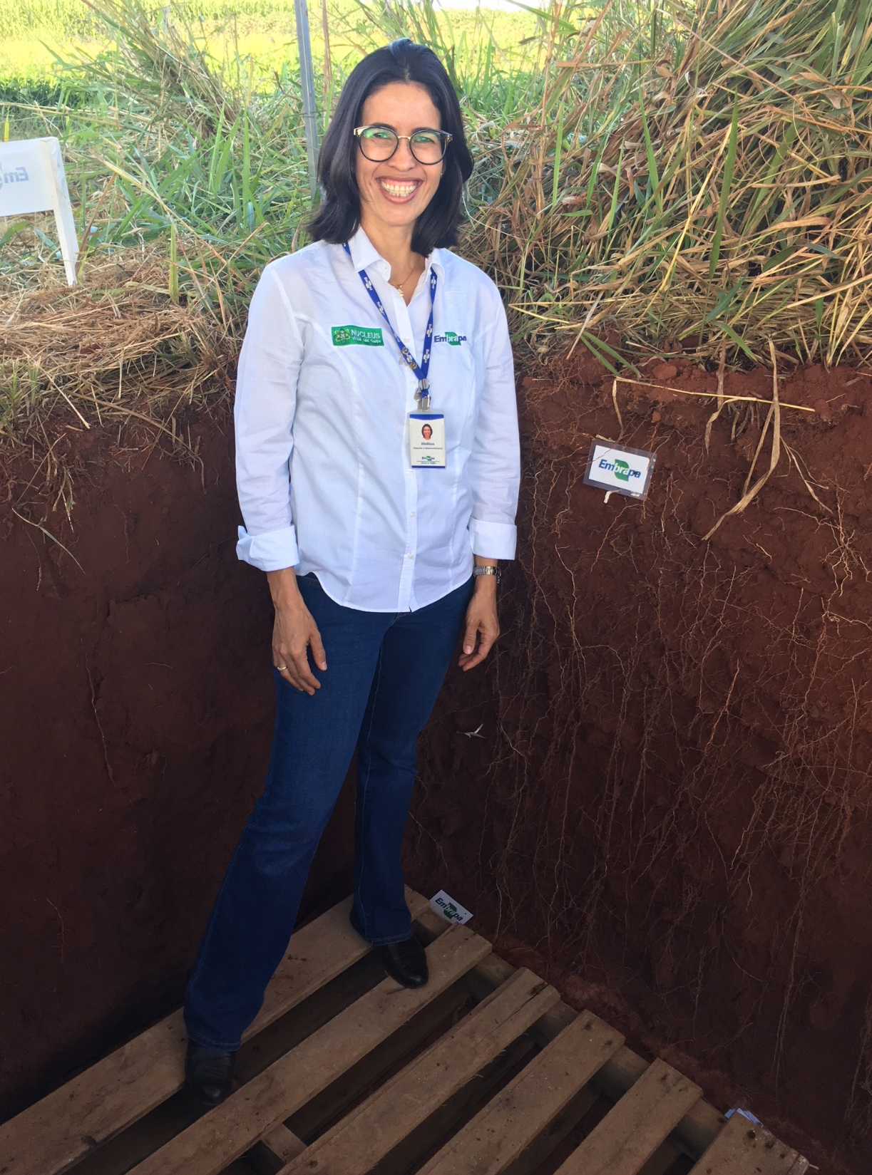
Soil Carbon Storage!
Notes:
Very importante to have cover crops for roots improvement in the systems, increasing carbon storage and decreasing synthetic N.

Slide 7
Rice: world population staple food
Cultivated in a wide range of climate and soil
More than 90% of world production= paddy systems
Rice fields offer services: jobs, market development, cultural aspects...

Slide 8
Challenges for soil Fertility management and fertilizer recomendation for rice

Slide 9
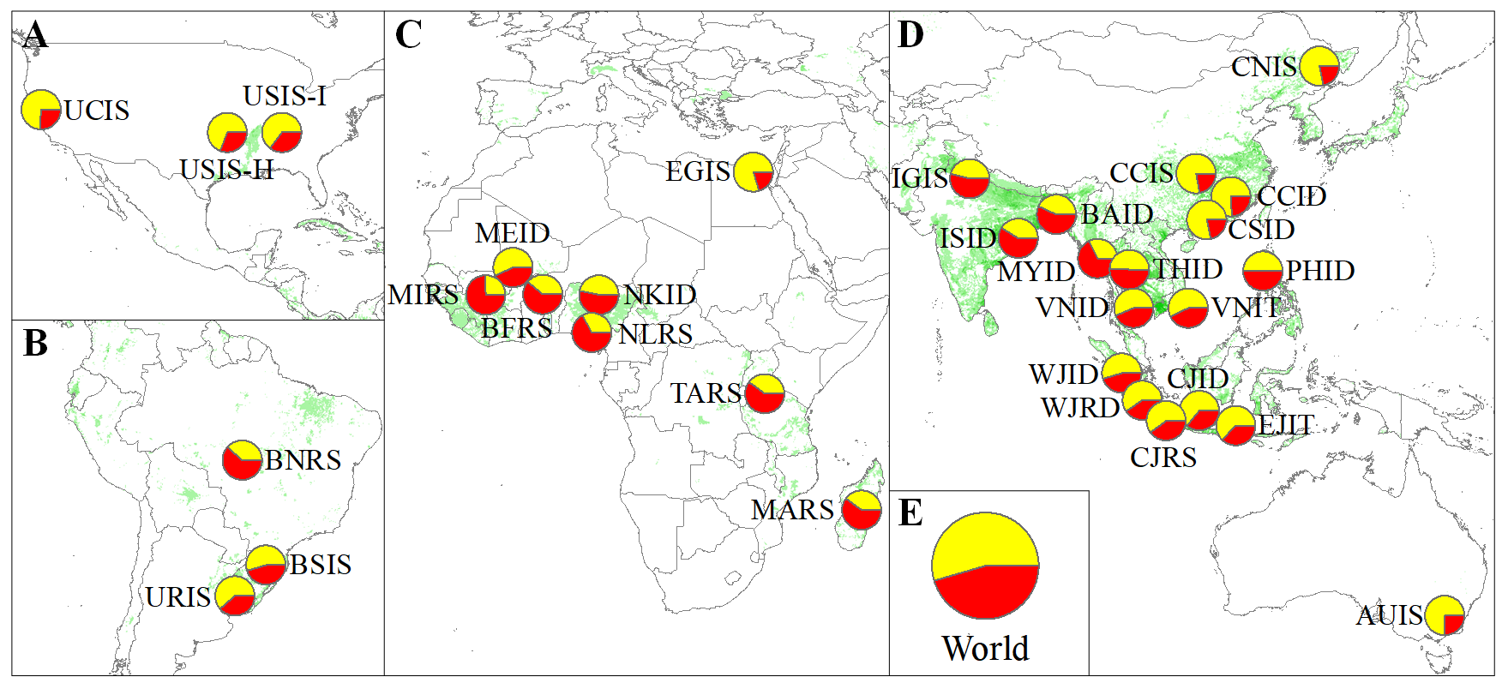
Rice systems associated yield gap (red portions of pie charts) and actual yield (yellow portions of pie charts) expressed as percentage of the yield potential
Yuan, S. et al. Sustainable intensification for a larger global rice bowl. Nat Commun 12, 7163 (2021)

Slide 10
Yield and global warming potential on both area and yield-scaled basis across 32 rice cropping systems
Average Yield (% of Potential)
Potencial de aquecimento global (Mg CO2-eq)
Global warning potential (Mg CO2-eq)
Yuan, S. et al. Sustainable intensification for a larger global rice bowl. Nat Commun 12, 7163 (2021)

Slide 11
Water supply on both area and yield-scaled basis across 32 rice cropping systems
Produtividade média (% em relação a produtividade potencial)
Average Yield (% of Potential)
Lâmina requerida (mm)
Water Supply (mm)
Yuan, S. et al. Sustainable intensification for a larger global rice bowl. Nat Commun 12, 7163 (2021)

Slide 12
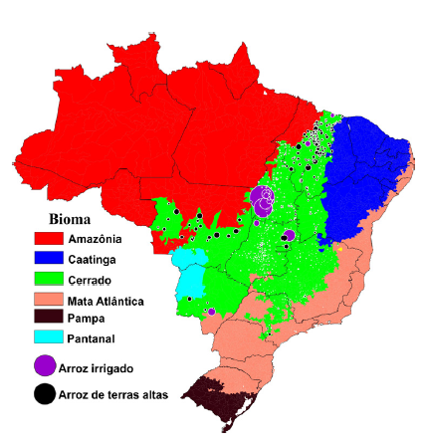
RICE PRODUCTION IN BRAZILIAN CERRADO
Paddy Rice
Upland Rice
Produção proporcional da produção de arroz em casca nos municípios com vegetação de cerrado. Fonte: Adaptada Soler-Silva et al., 2020, de IBGE (2018)

Slide 13
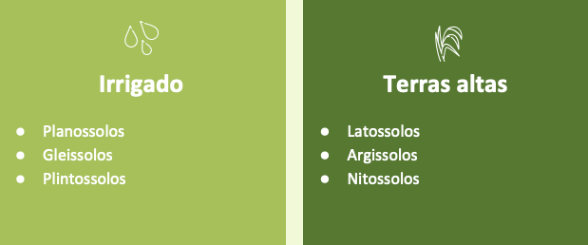
AND WHAT WE ARE FINDING IN THE RICE FIELDS OUT THERE...
Different Soil Classes can be found under rice cultivation
Paddy Rice
Upland Rice
Planosols
Gleysols
Plinthosols
Ferralsols
Acrisols
Nitisols

Slide 14
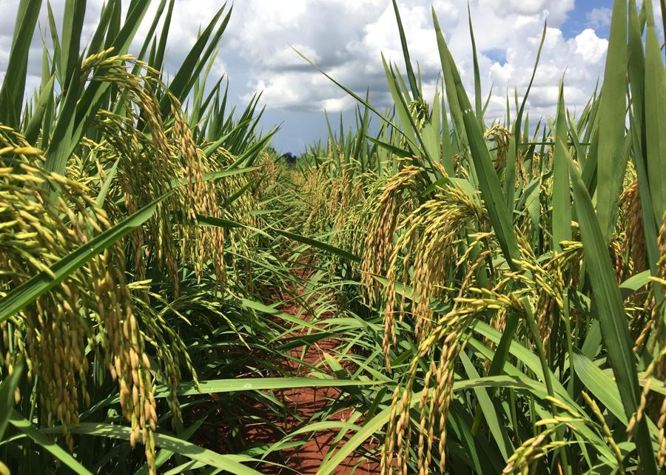
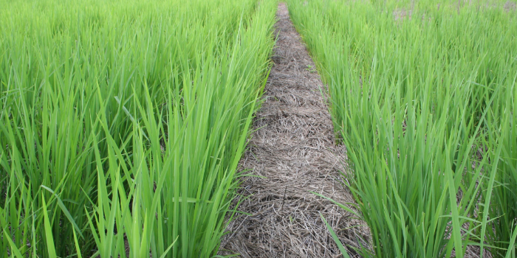
UPLAND RICE: SOIL CHARACTERISTICS
Upland: oxic soils, rainfed, high P adsorption, deep profile, usually high water drainage, low carbon, high aluminum, very acidic.
NO-TILLAGE
CONVENTIONAL TILLAGE

Slide 15
Challenge 2: Modern cultivars
Cultivars changes throught the years:
Present
Grain yield
High yield and grain quality
Less grain yield and/or low quality
Nutrients
More demanding
Less demanding
Past

Slide 16
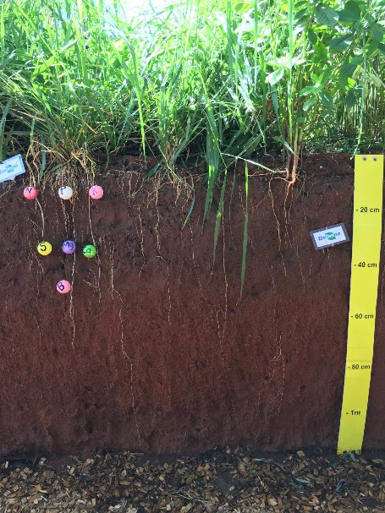
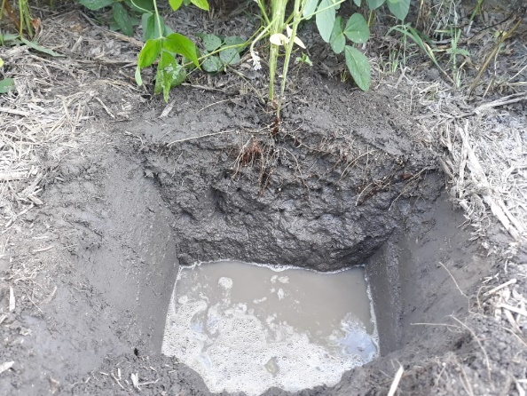
Challenge 3: plant nutrition by soil
Closed system
Open system
Notes:
In a closed system (as human bodies), all nutrientes can be absorved. In an open systems, nutrientes can be lost by volatilization, leaching, gases emissions, especially Nitrogen.

Slide 17
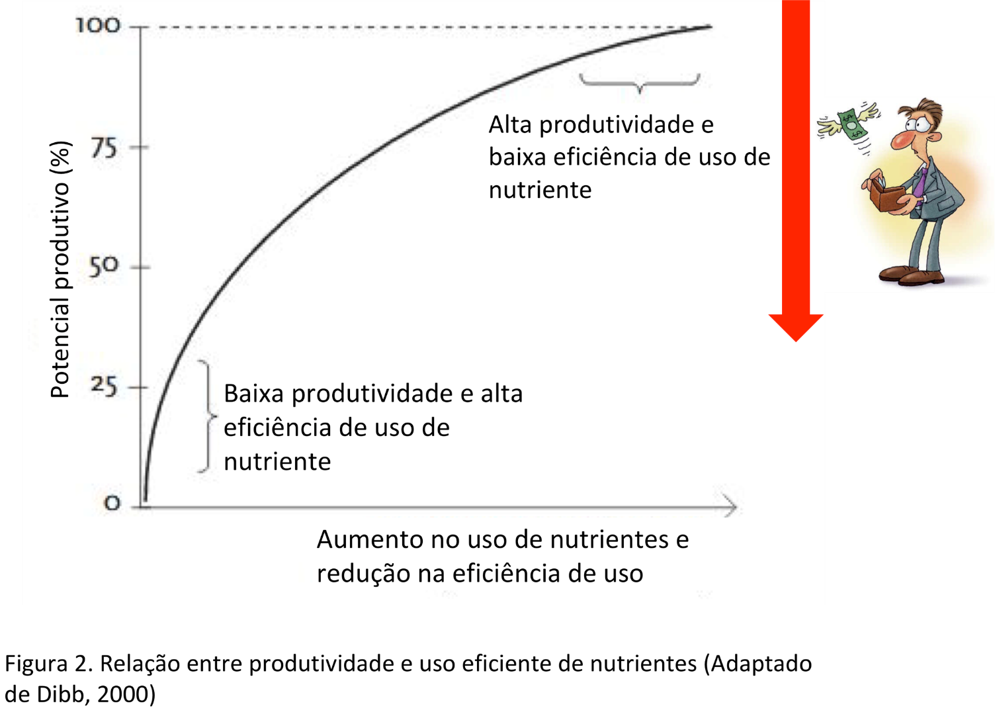
Challenge 4: farmers profitability
High yield and low nitrogen use efficiency
Potential yield (%)
Low yield and high nitrogen use efficiency
Increase in Nitrogen use and reducing in use efficiency

Slide 18
How was fertilizer recommendation?
30 Years ago...
Based on visual deficiency symptons;
Limitation: When visual symptons occurs, is too late to help;
Lack of synchronism (supply/demand);
Soil analysis was not routine practice;
Micronutrients and S contents were not evaluated;

Slide 19
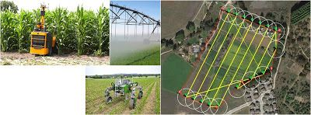
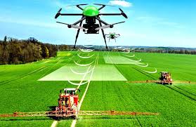
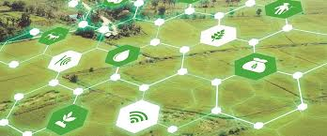
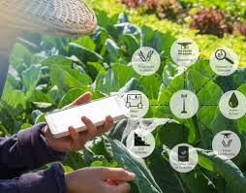
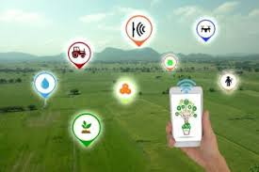
30 Years later...What has changed?
Notes:
Now we have moisture sensors, chlorophilmeters, drones, IoT

Slide 20
Nitrogen evaluation with time
Losses measurements
(N2O, NH3)
Calibration curves
1988
2022
N recommendation based on visual symptoms: no soil analysis
Based on plant demand(SPAD)
Spad+Drones+
sensors

Slide 21
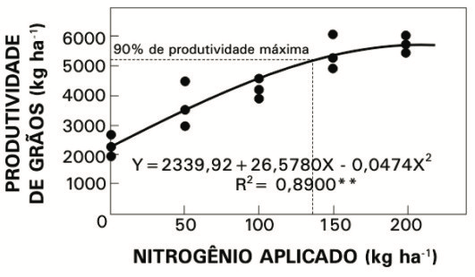
Calibration curves
Parsimony
90% of maximum yield
Grain yield (kg/ha)
Nitrogen (kg/ha)

Slide 22
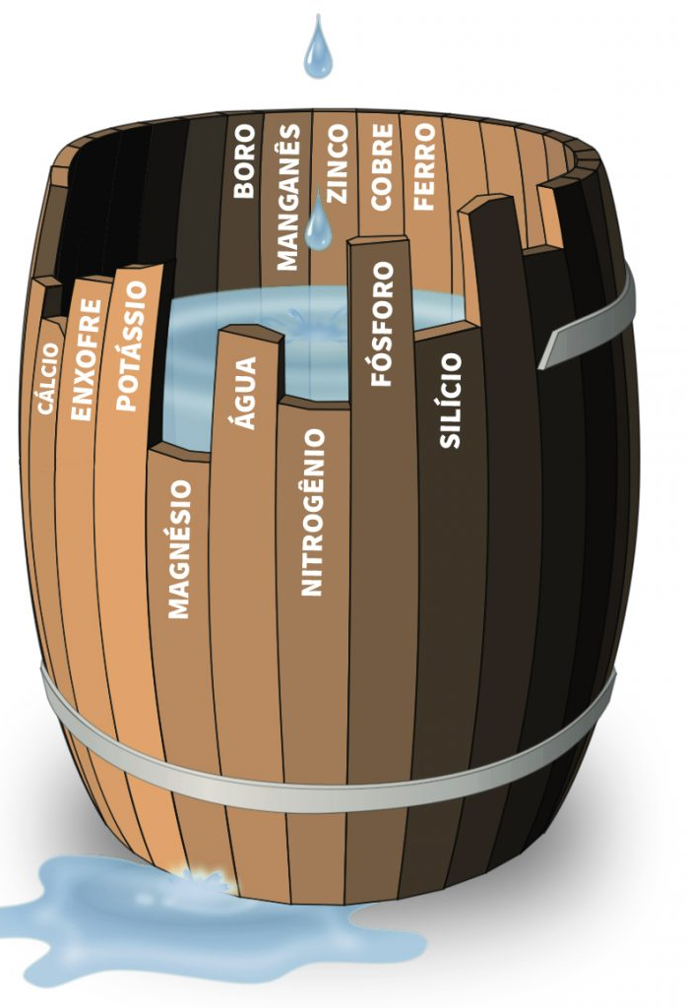
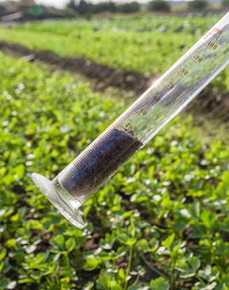
But all begins with soil fertility analysis…

Slide 23
Recomendation based on Soil Organic Matter (SOM)
Expected response to fertilization N
SOM (%) | Medium Yield | High Yield
 | N (kg ha⁻¹)
<=2.5 | 90 | 120
2.6 - 5.0 | 80 | 110
>=5.0 | <=70 | <=100
Notes:
Recomendation based on soil organic mater levels still is the most used in the world, and its use, according plant development has the best performance. The plant sensors has increasing its performance and accurary (besides low price), and is waited it will replace recomendation based on soil lab analysis.

Slide 24
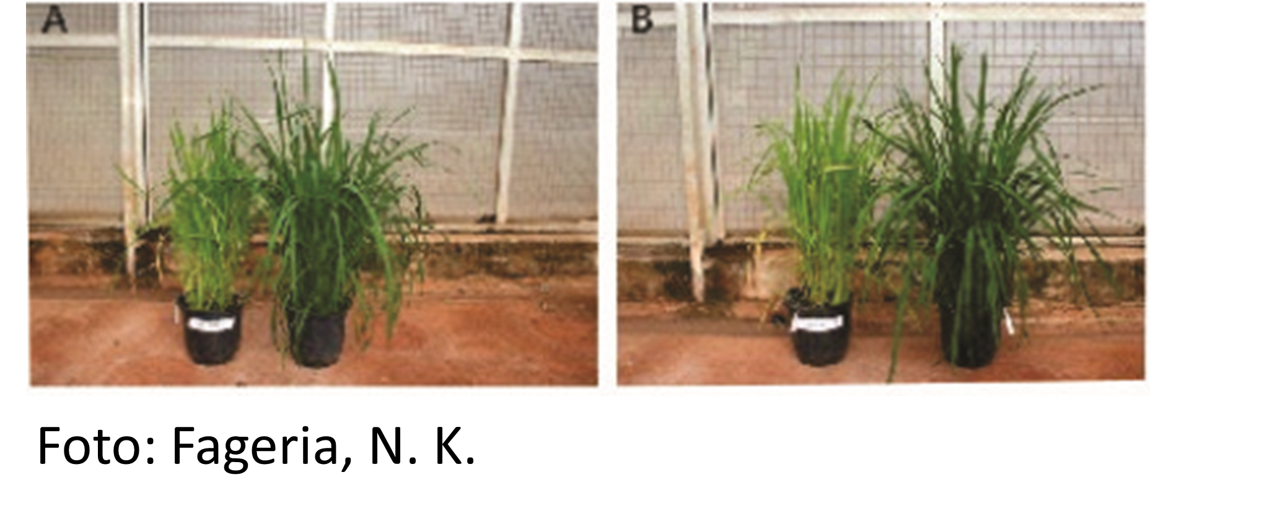
“Nutrient in the right dose, right time, right source and in the right location!”
SOWING TILLERING FLOWERING HARVEST
Most important action!
Notes:
Por outro lado ha variacao na necessidade de N de acordo com o estadio fenologico da cultura, e, baixa eficiência agronômica do nitrogênio (N) vem sendo observada ao longo dos anos em diversas culturas, principalmente devido à adubação nitrogenada ser baseada na análise visual ou em uma recomendação tradicional. O uso inadequado desse nutriente pelos agricultores, muitas vezes em excesso, na tentativa de não reduzir a produtividade e, consequentemente, seus lucros, fez com que se aumentassem os riscos de contaminação ambiental, e aumentassem os custos de produção. (Inserir custo de produção MAGRI)
Os produtores enfrentam um dilema quanto à aplicação de N em cobertura. O fertilizante nitrogenado está cada dia mais caro, porém a deficiência de N nas culturas pode resultar em reduções significativas de produtividade e consequente perda de lucros. Dessa forma, os produtores têm aplicado fertilizante nitrogenado para minimizar o risco de deficiência, às vezes em excesso, resultando em custo adicional desnecessário e subsequente contaminação das águas superficiais e subterrâneas com nitrato.

Slide 25
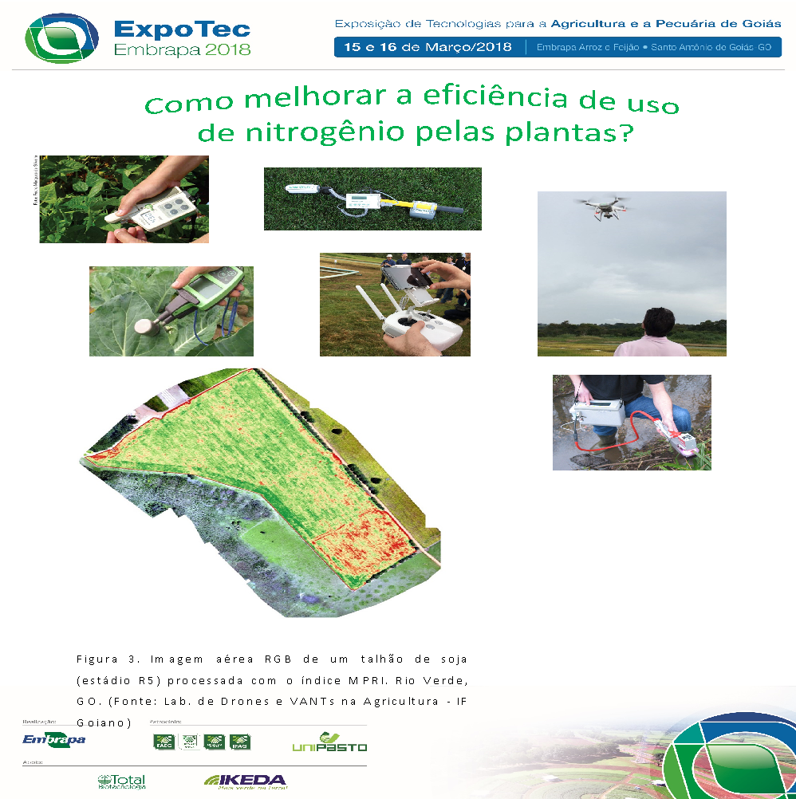
Sensors (Drone)
Notes:
Next Generation technology to be used by farmers soon.

Slide 26
Thank you!

