Slide 1
High Precision: Experiment wishes
Sinéad M. Farrington (University of Edinburgh)
On behalf of the ATLAS and CMS Experiments

Slide 2
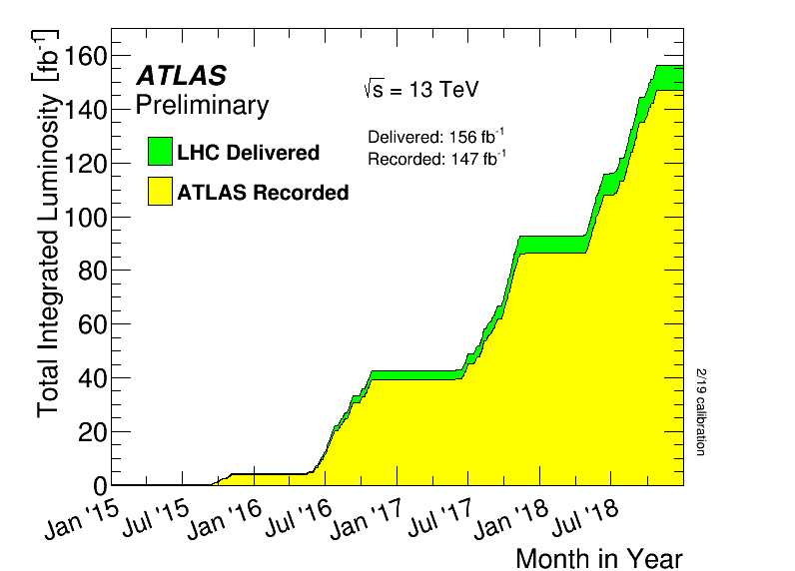
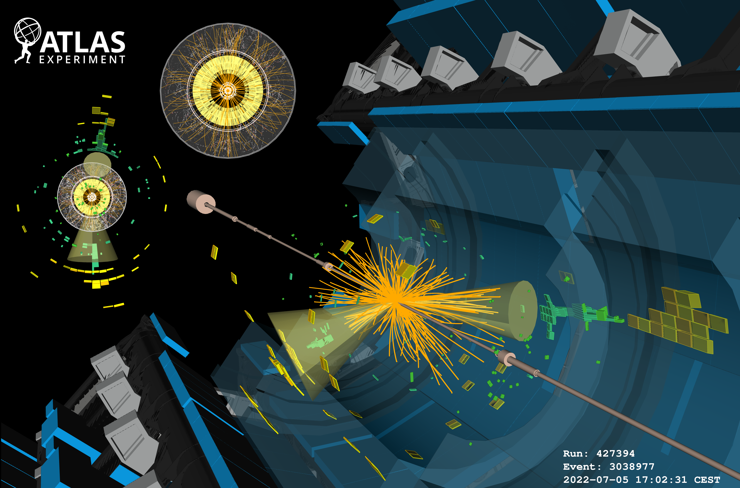
LHC Status
Data taken in Run 2
And now in Run 3!

Slide 3
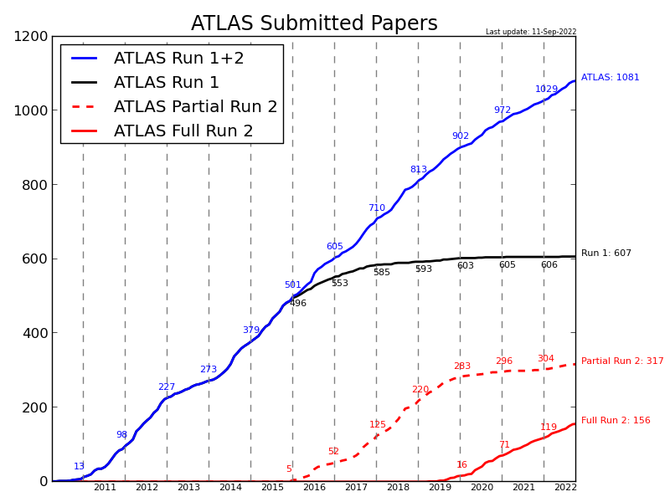
LHC Publication status
Happily reached the milestone of 3000 papers across the LHC
1000 each from ATLAS and CMS milestone!
Timeline: https://atlas.cern/updates/news/1000-collision-papers
http://cms-results.web.cern.ch/cms-results/public-results/publications-vs-time/
More still to come, now also looking forward to early Run 3 papers

Slide 4
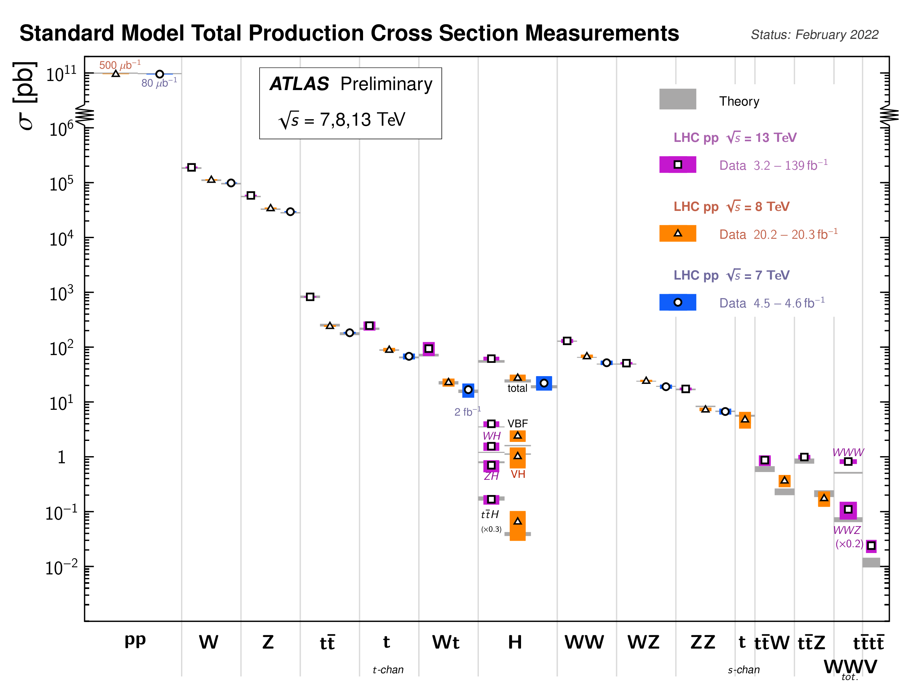
LHC so far
Nobel prize-winning research and much besides

Slide 5
LHC so far
Modelling uncertainties play a significant role in analyses and their strategies
Some increasing efforts to sidestep theoretical uncertainties but care is needed with such approaches
Recognised that there is a lag in porting the state-of-the-art from theory into experiment, often because of implementation issues

Slide 6
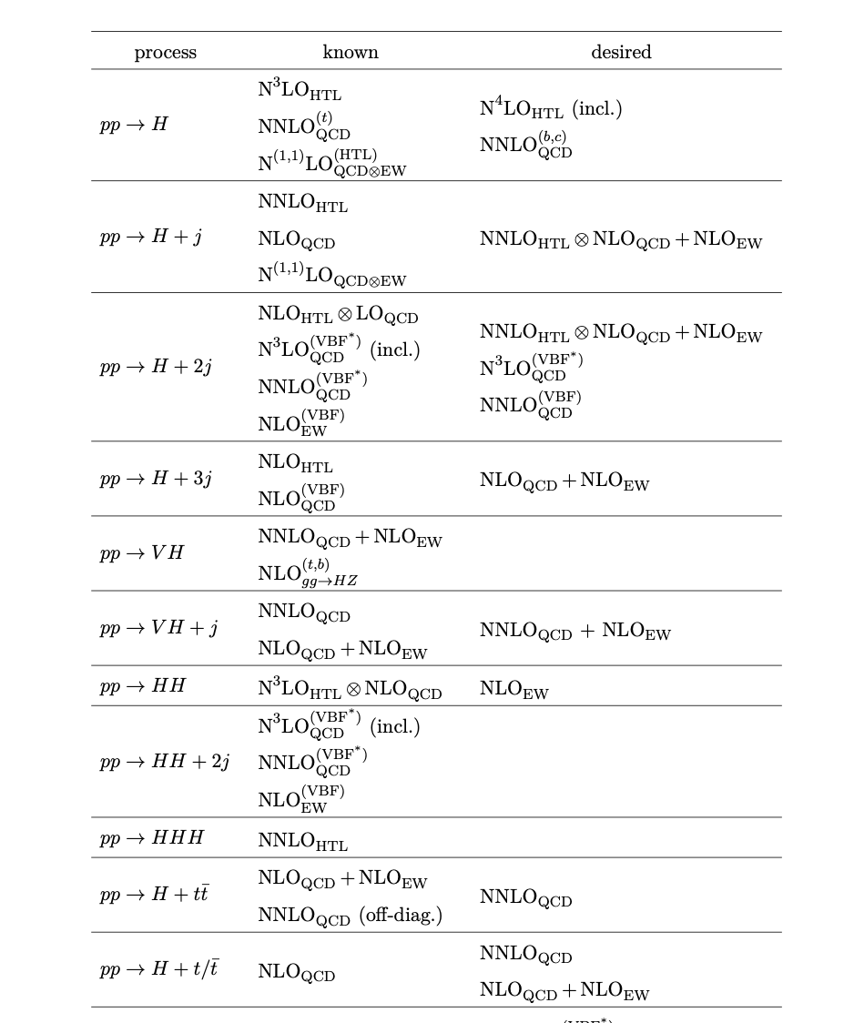
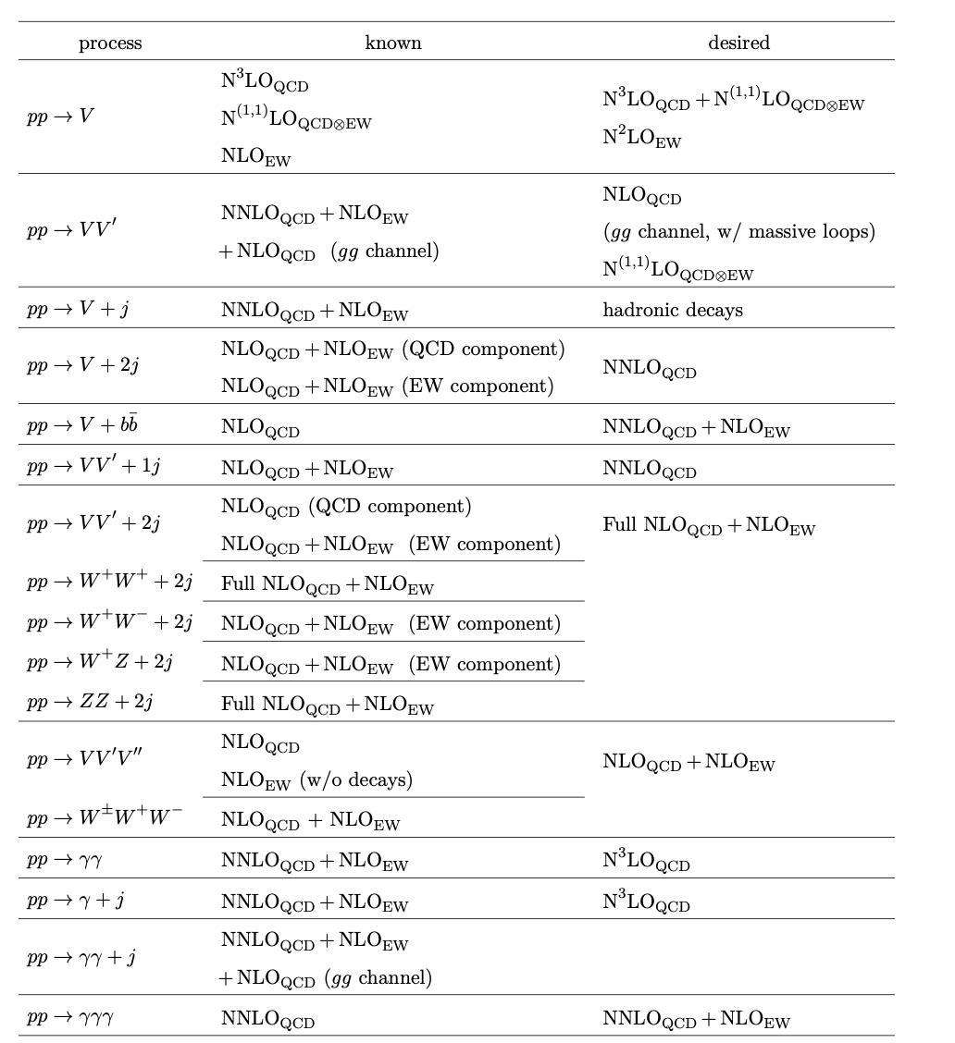
Experiment Wishlist
arXiv:2207.02122v1
Les Houches: subset of authors updated the wishlist despite the workshop not taking place during the pandemic
Include table here***
I will be necessarily selective!

Slide 7
Usability
Predictions are most valuable when they are predictions of what we can measure
i.e. particle-level final states in fiducial kinematic regions, with uncertainties which requires
Continued progress in turning full final state MC into precision calculation tools
Quantifying uncertainties from NP QCD effects, parton shower, Scales, EW corrections and PDFs
A lot of progress on this, but worth underlining that this is the most valuable type of prediction

Slide 8
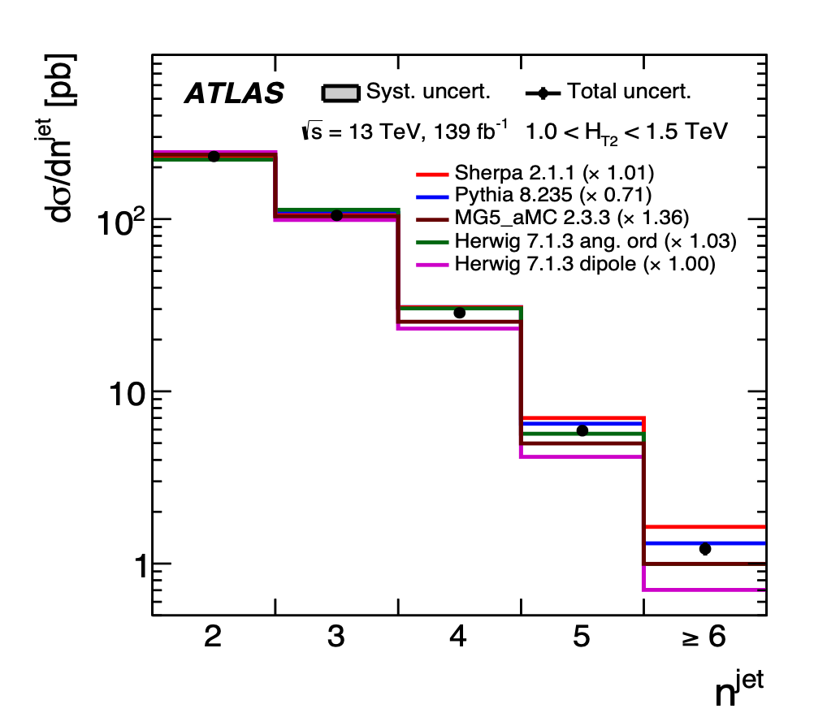
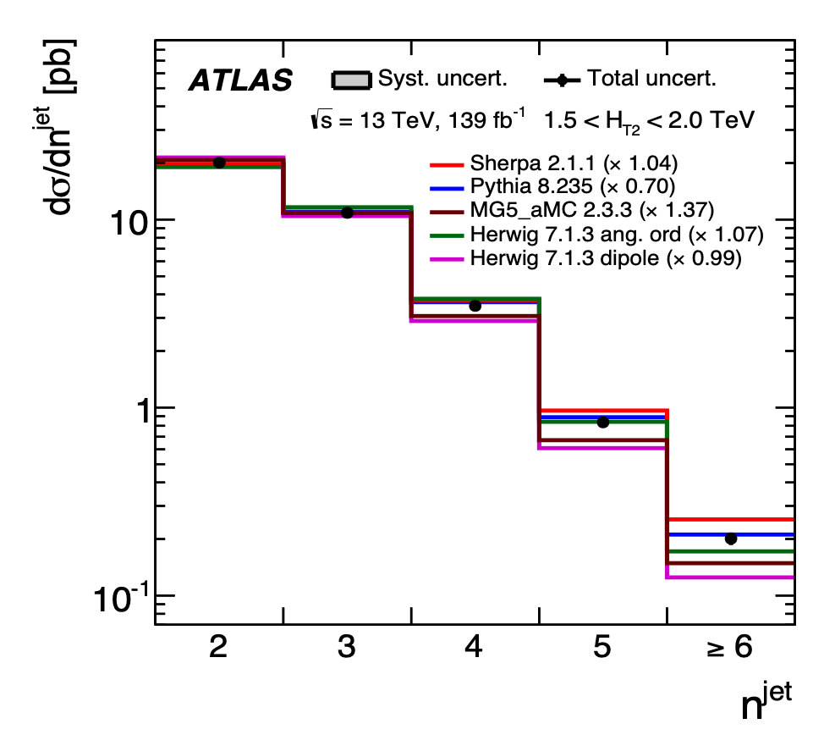
Parton Showers and Hadronisation
JHEP 01 (2021) 188
Jet measurements
Event shapes describe the dynamics of energy flow in multijet final states
Infrared and collinear safe
Hard wide-angle radiation is tested by looking at the event-shape tails
Sensitive to higher order calculations
Discrepancies njet>4
High stats to differentiate energies
Notes:
In particular, the Pythia prediction overestimates the inclusive dijet production cross section in the studied phase-space region by 30%, which can be attributed to the large value of 𝛼S included in the Pythia tune (see Table 1), whereas the MG5_aMC prediction underestimates it by 35%. The Sherpa prediction gives an adequate description of the measured integrated cross sections. In addition, an excellent description of the inclusive dijet production cross section is found for the Herwig 7 prediction based on dipole showers, whereas Herwig 7 prediction based on angle-ordered showers underestimates it, at most by 9%. The Pythia prediction provides a good description of the shape of the differential
jet
cross section as a function of 𝑛 description of the fiducial cross sections as a function of 𝑛 . Sherpa tends to overestimate the cross sections for 𝑛jet > 4. The Herwig 7 based on dipole showers and MG5_aMC predictions, while giving a
good description of the cross section at low 𝑛
jet
, underestimate the measurements at high 𝑛
jet

Slide 9
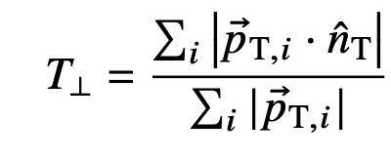
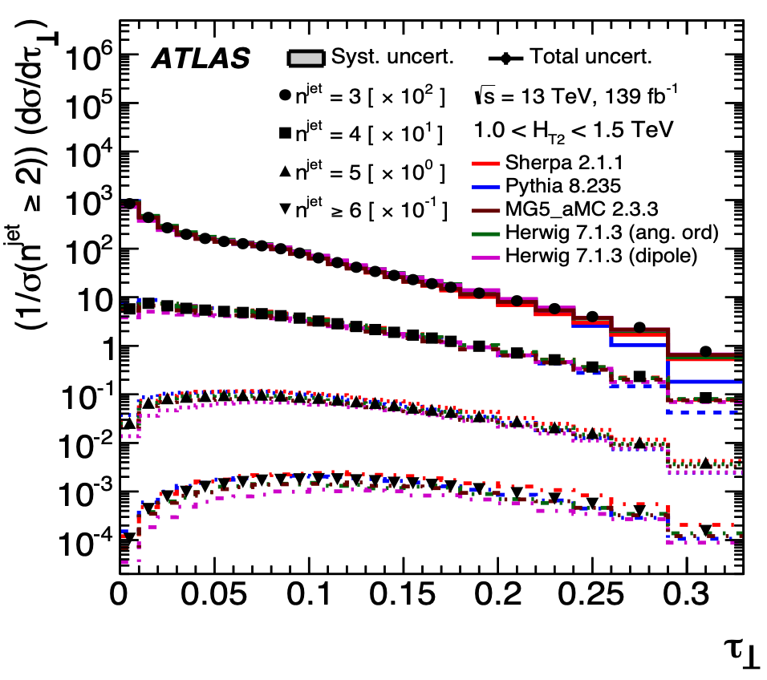
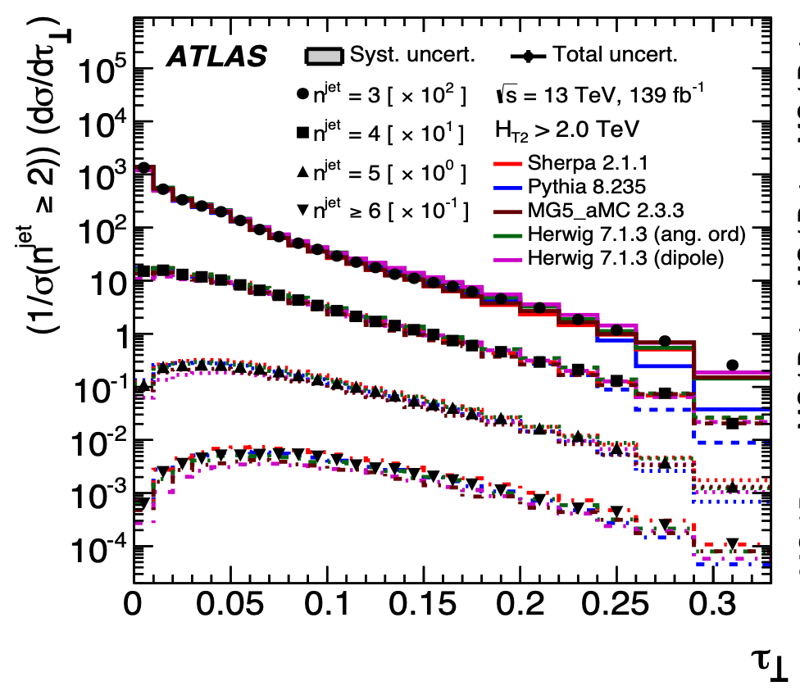
Parton Showers and Hadronisation
Jet measurements
Underestimated at high τ,
isotropic events
There are more isotropic
events at low energies
Notes:
shows the normalised cross section as a function of 𝜏⊥. For low 𝑛jet, the MC simulations
tend to underestimate the measurement in the intermediate region of 𝜏⊥, with the exception of the
Herwig 7 predictions. At high values of 𝜏⊥, where the population of isotropic events is expected to
be larger, all MC predictions underestimate the measurements. In particular, the largest deviation is
found for the Pythia prediction where the high-𝑝T third jet is less likely to be produced isotropically.
jet
The shape of the distributions tends to agree with data for larger 𝑛 measurements at low values of 𝜏⊥, whereas the Herwig 7 prediction based on dipole showers highly underestimates the measurements in such region. The behaviour of 𝜏⊥ as a function of 𝐻T2 indicates more isotropic events at low energies, with increasing alignment of jets with the thrust axis for higher energy scales.

Slide 10
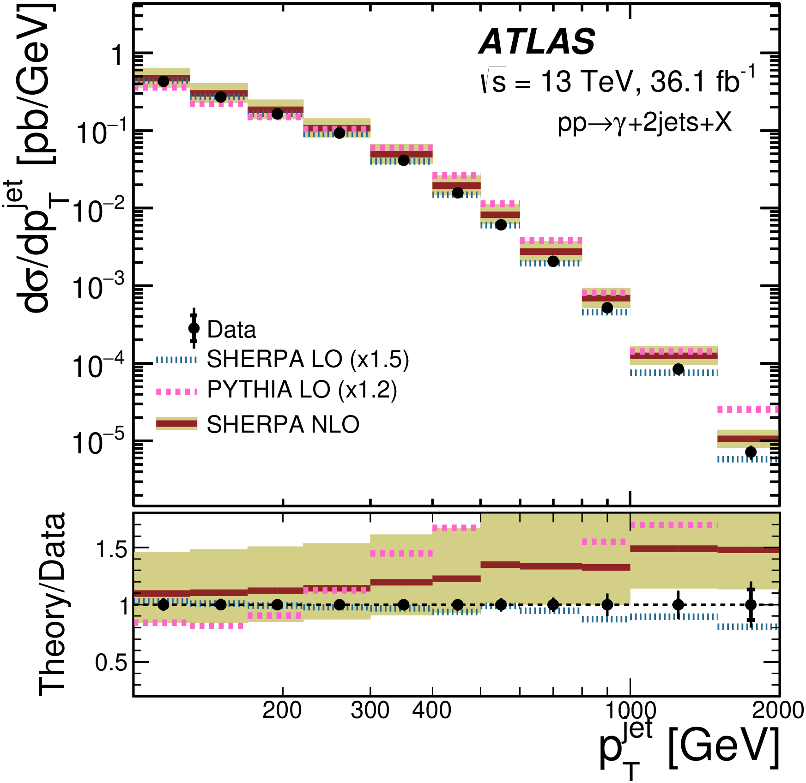
Parton Showers and Hadronisation
JHEP 03 (2020) 179
Photon+dijet measurements
Adequate agreement, but
central values show trend
Notes:
The cross section decreases by approximately five orders of magnitude in the 150–2000 GeV range.

Slide 11
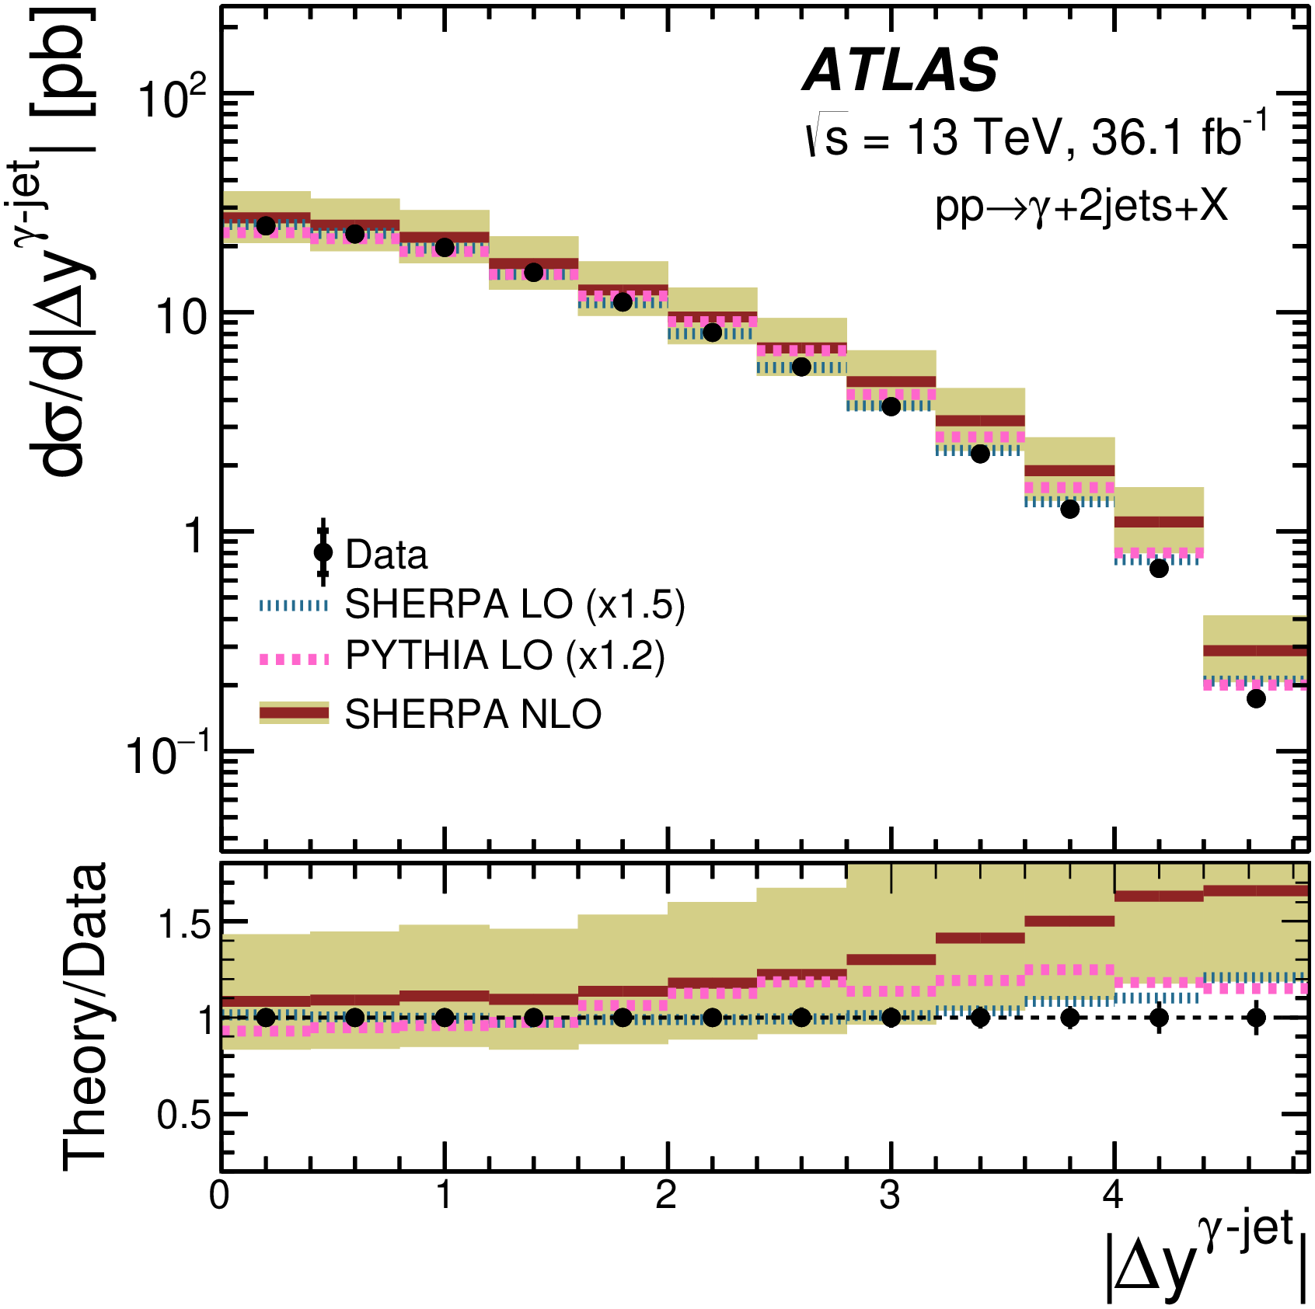
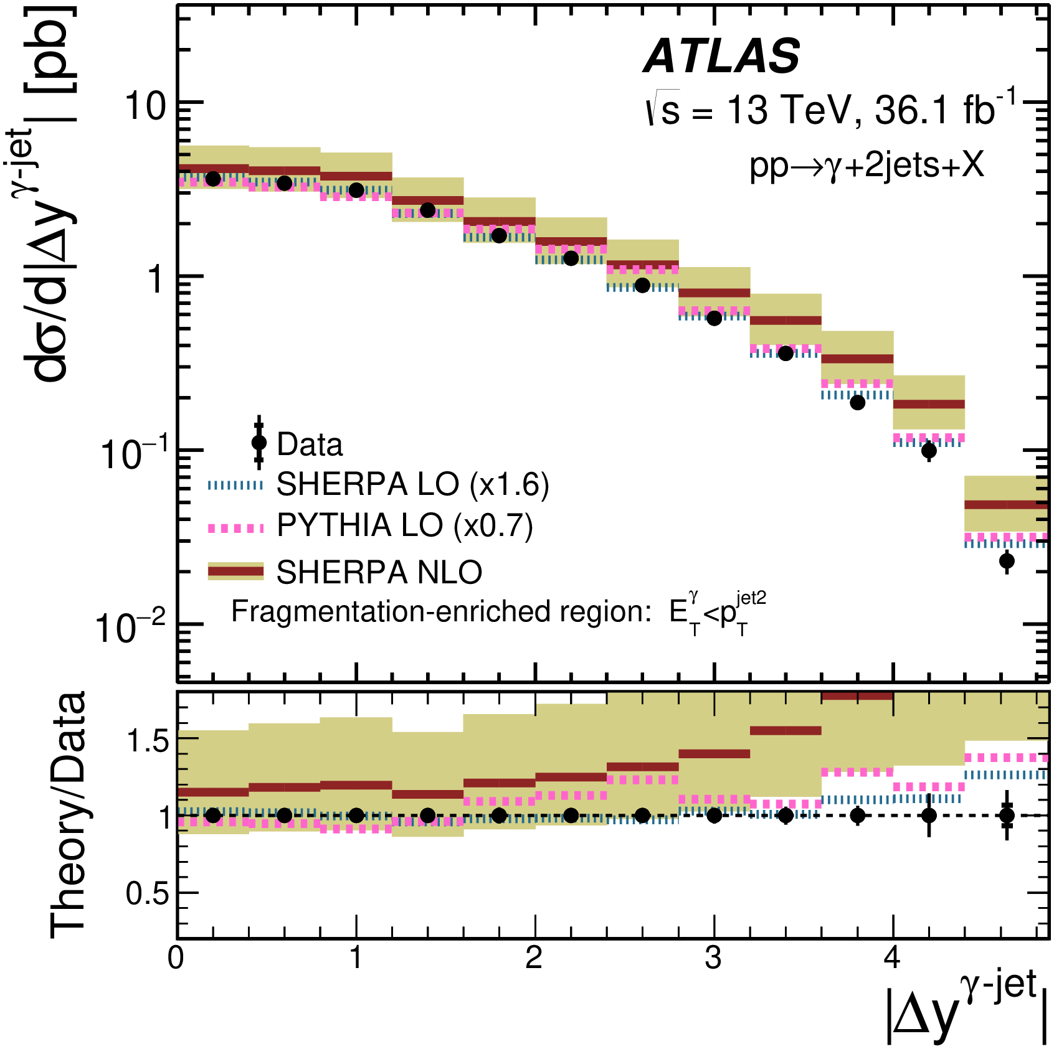
Parton Showers and Hadronisation
Photon+dijet measurements
Data undershoots all models
Notes:
On the right is fragmentation enriched region
The measured cross sections decrease as |∆yγ–jet| increases in all three phase-space regions.

Slide 12
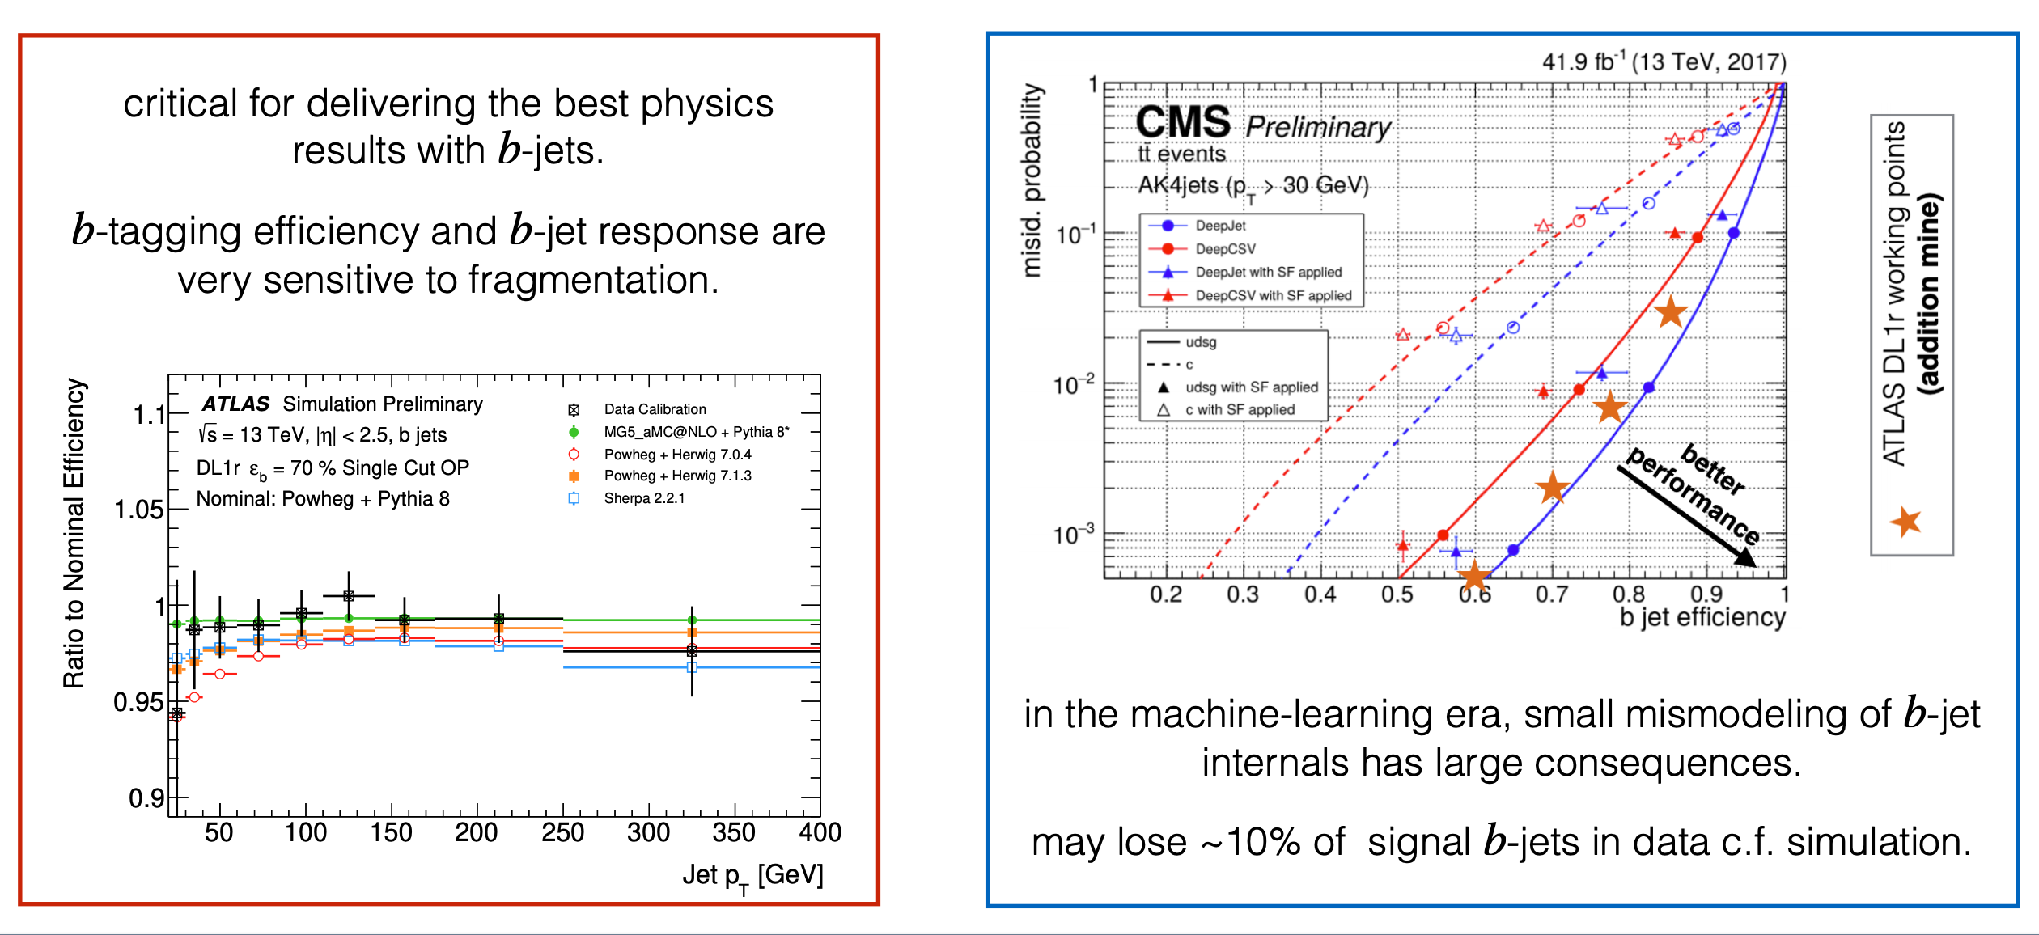
Parton Showers and Hadronisation
b in top events
Heavy flavour jet measurements
C. Pollard

Slide 13
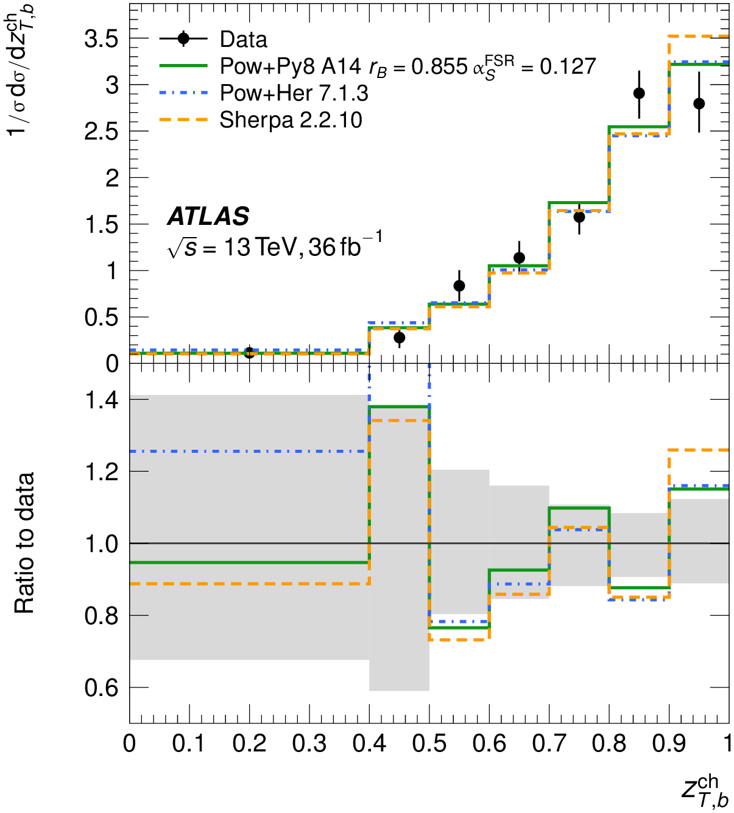
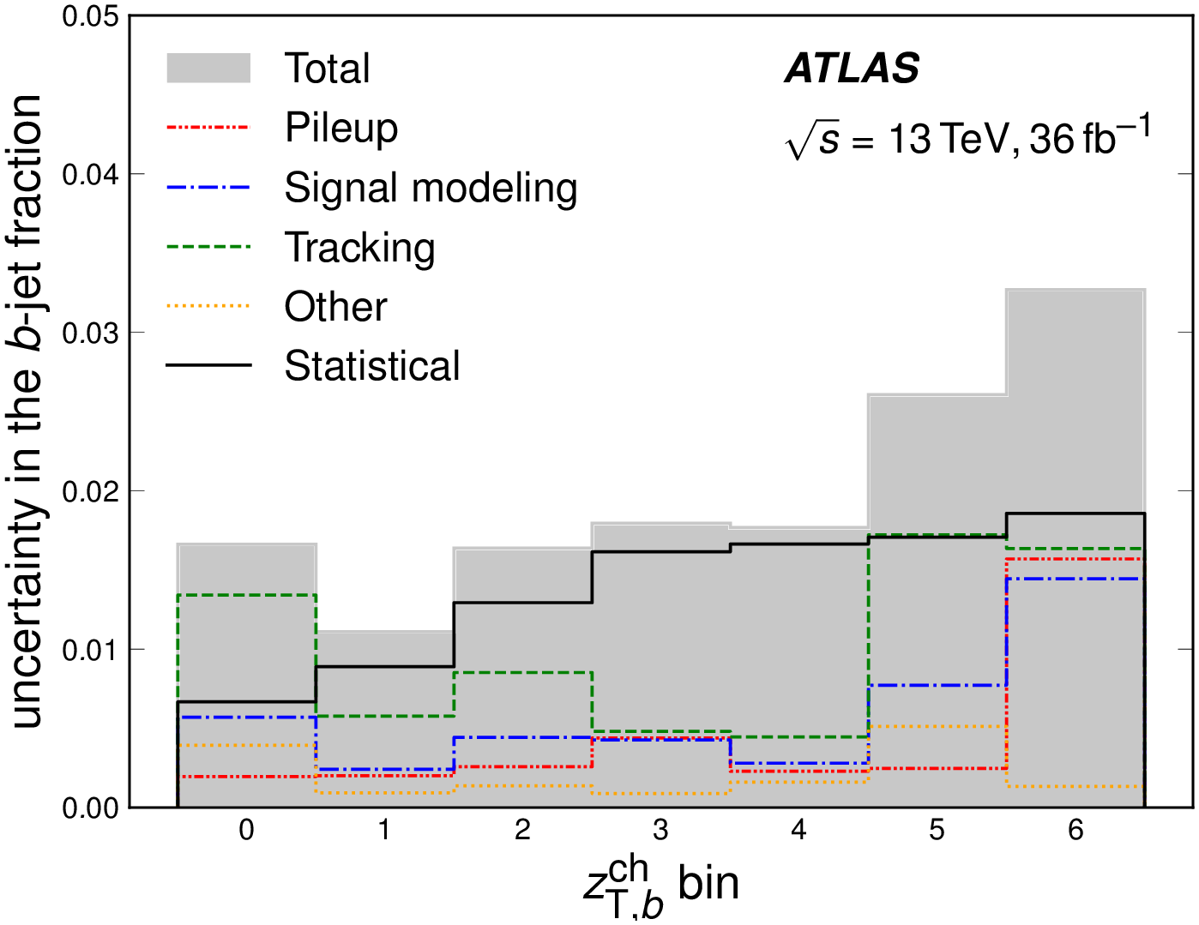
Parton Showers and Hadronisation
PRD 106, 032008 (2022)
Ratio of b hadron and jet charged momenta transverse to incoming beams
Uncertainties in some
bins dominated by
modelling uncertainties
Renormalisation/scale

Slide 14
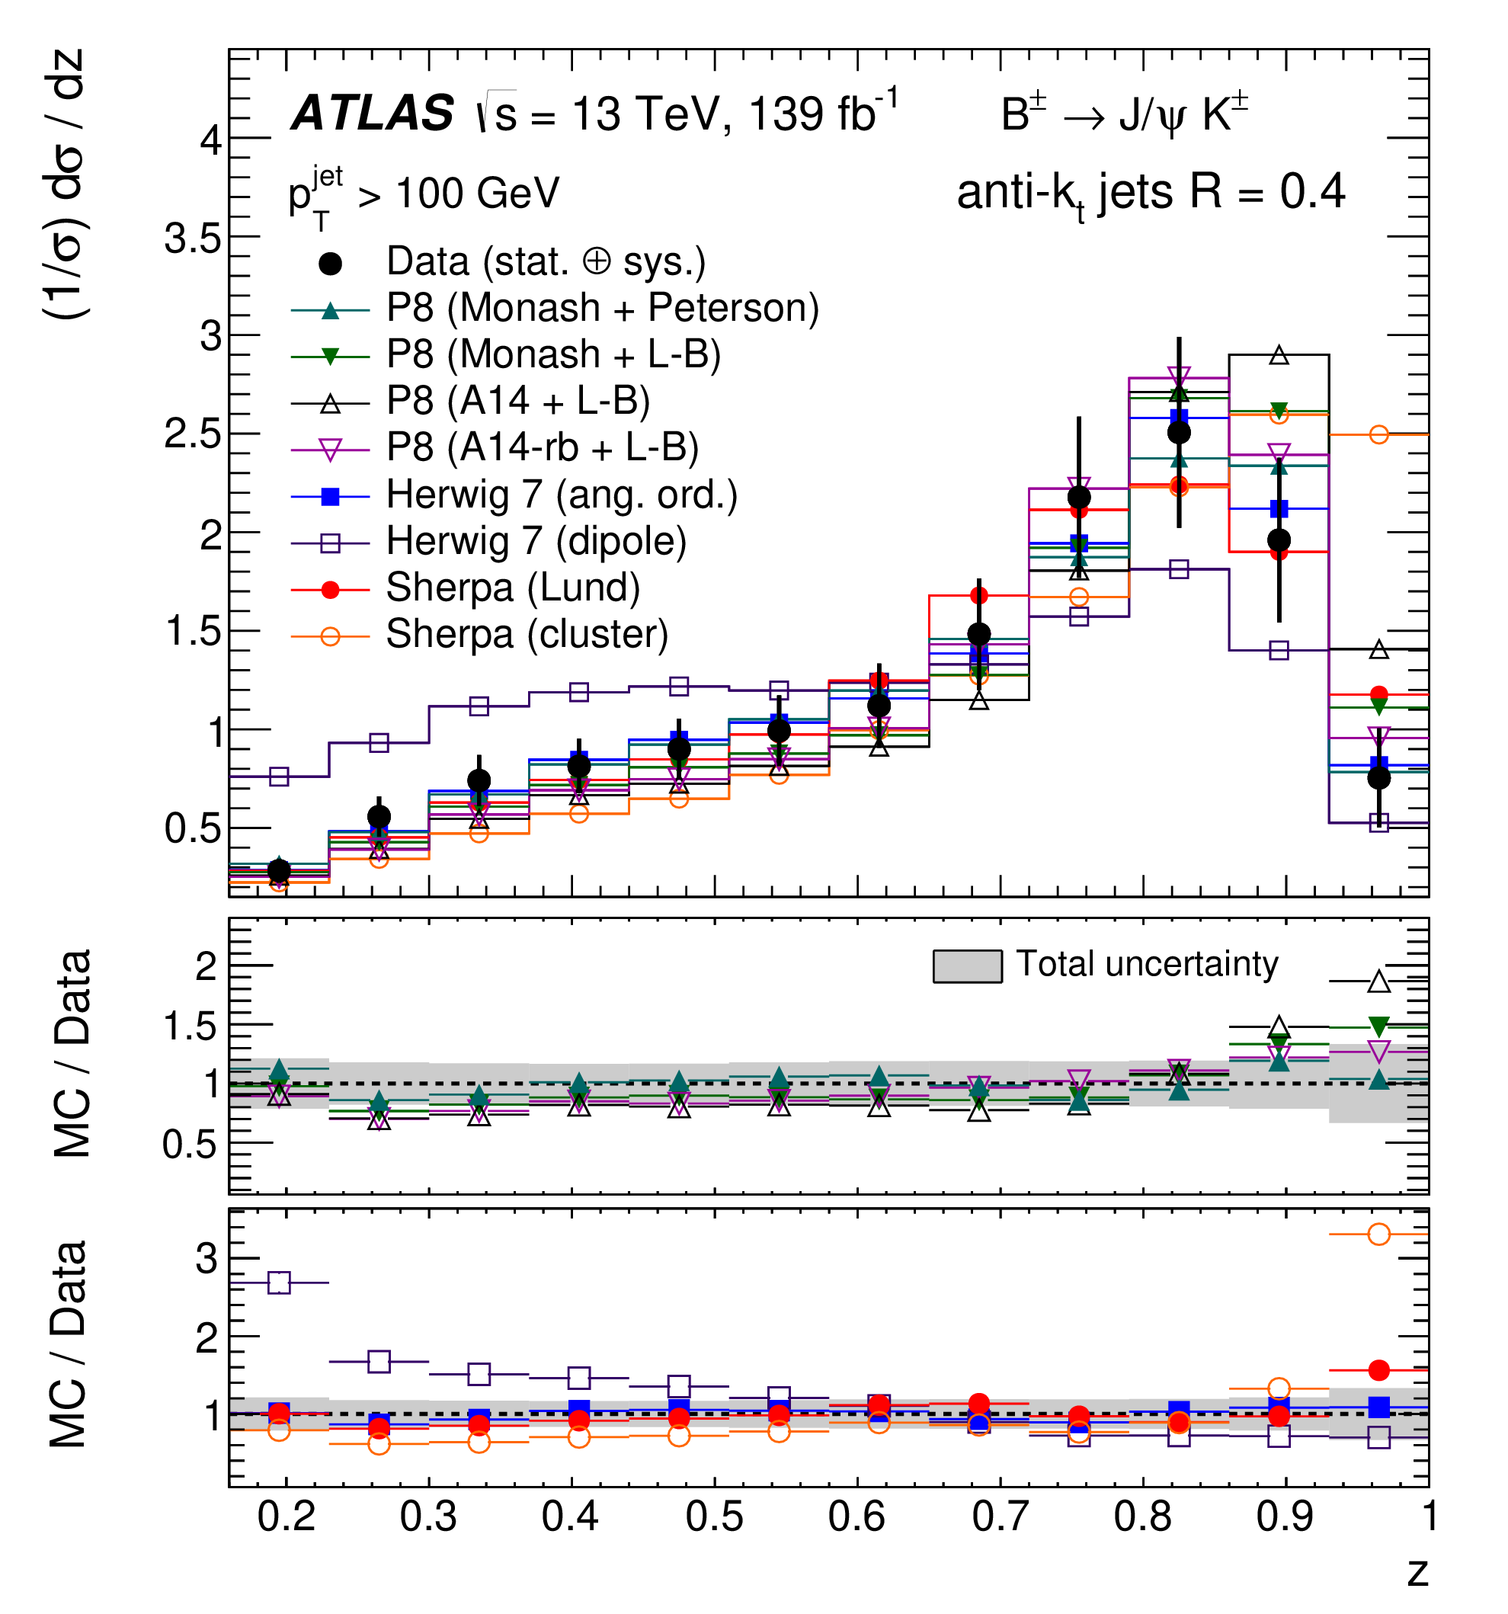
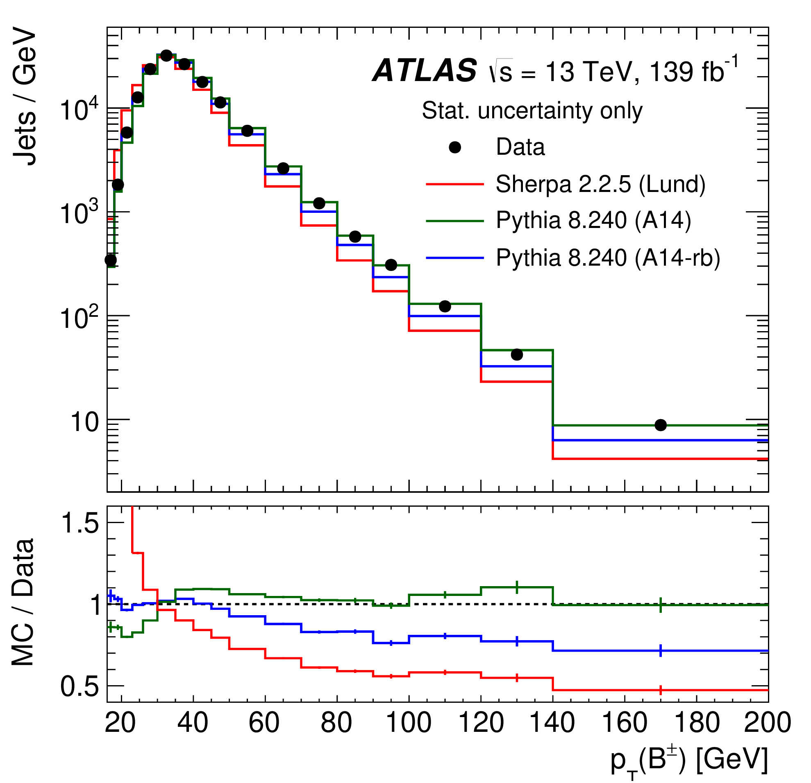
Parton Showers and Hadronisation
JHEP 12 (2021) 131
Exclusive B’s
Longitudinal momentum

Slide 15
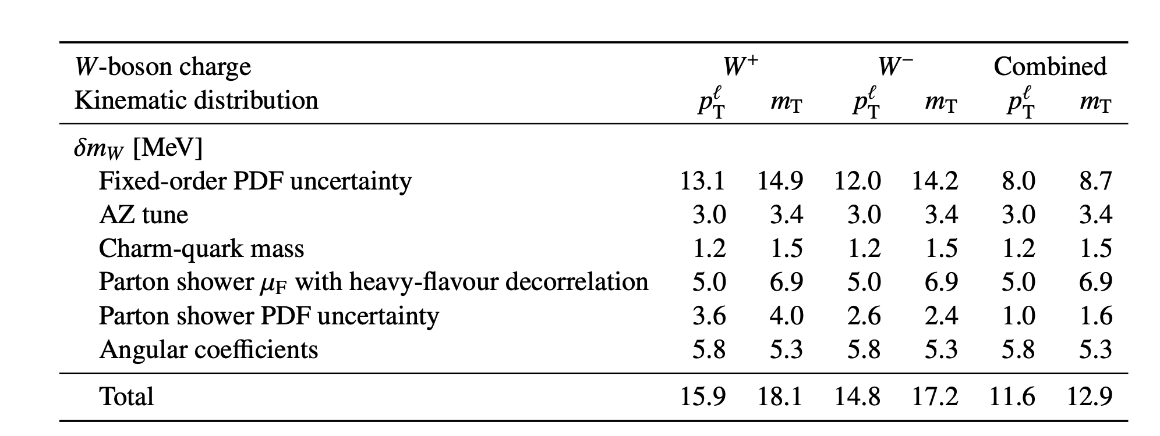
W mass
Eur. Phys. J. C 78 (2018) 110
Modelling of parton showers and hadronization, PDFs affects the ATLAS W mass measurement

Slide 16
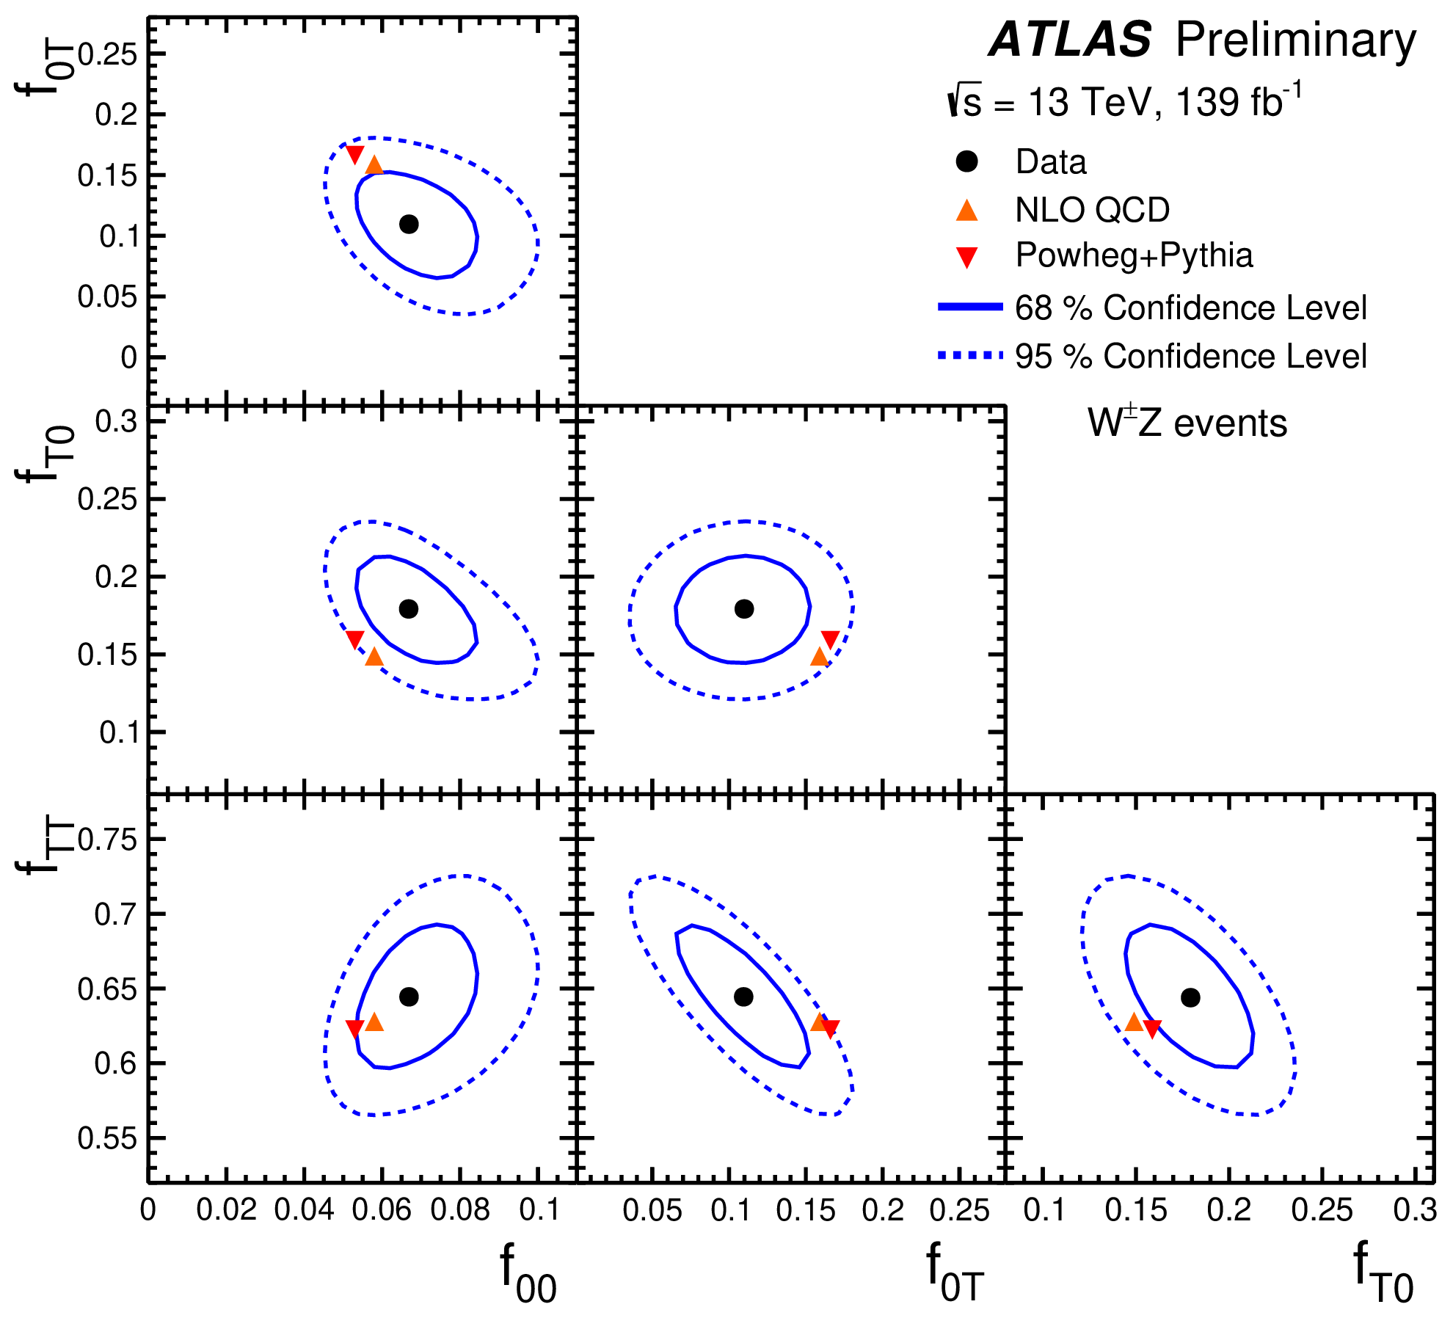
Boson Polarisation
ATLAS-CONF-2022-053
Measurements of polarization in diboson production test gauge symmetry structure
ATLAS recently measured simultaneous pair-production of longitudinally polarized bosons
MC predictions relied on several reweightings, with resultant systematic uncertainties

Slide 17
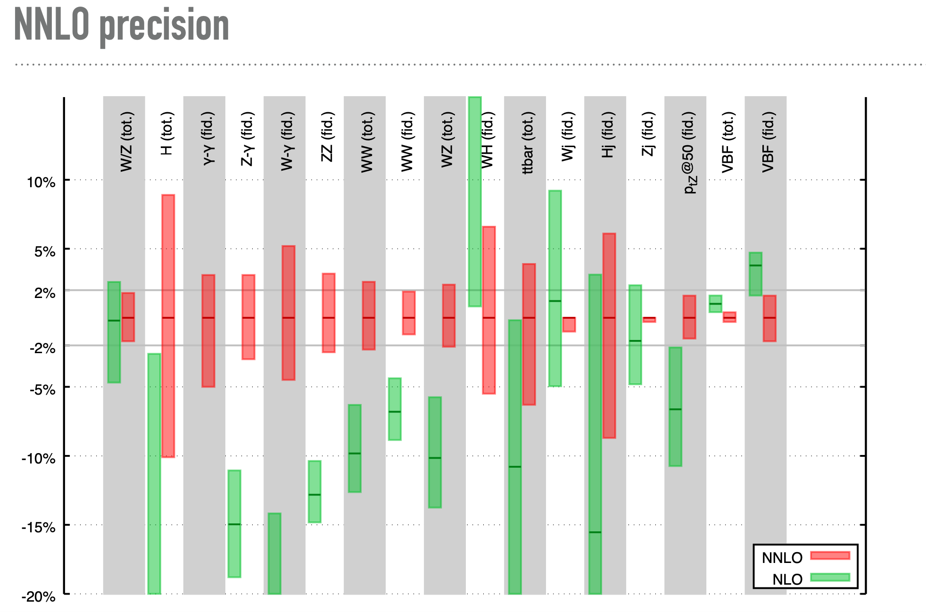
NLO/NNLO Convergence
How to deal with a lack of perturbative convergence in key variables
Simple scale variation may yield too low an uncertainty
G. Salam

Slide 18
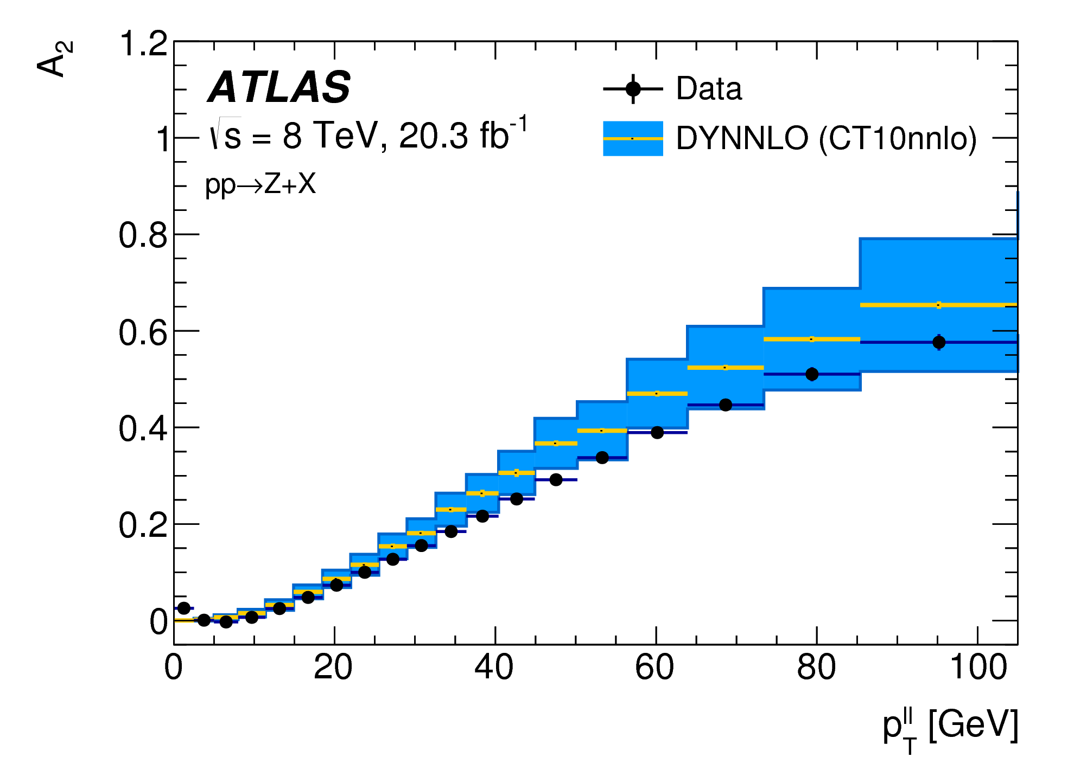
W mass
Angular structure of vector boson decay
How much momentum the leptons carry, function of high order corrections
The angular distribution of the W- and Z-boson decay leptons is determined by the relative fractions of helicity cross-sections for the vector-boson production
NNLO prediction for inclusive production
NLO accuracy for the angular variables
Significant impact on LHCb W mass
when evaluating renormalisation and
factorisation scale uncertainties

Slide 19
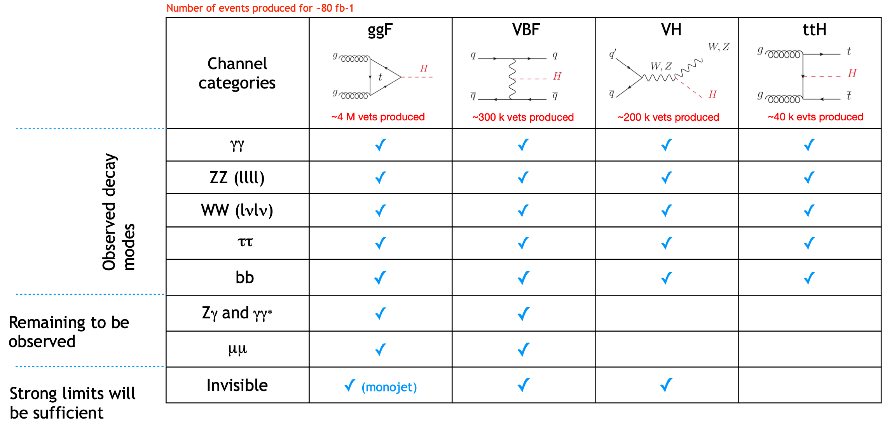
Higgs Status
Not observed
Evidence
Adapted from M. Kado

Slide 20
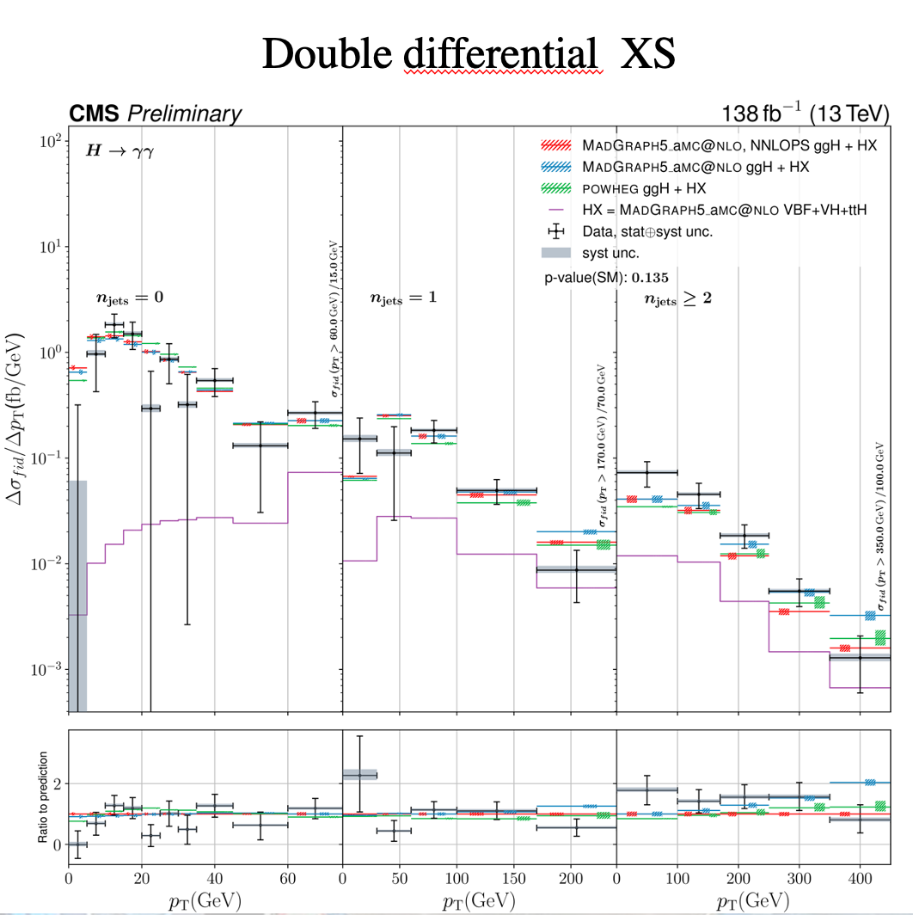
Higgs pt
In addition to many observations and cross section measurements, a hallmark of Run 2 has been the shift to the precision era even in double differential cross-sections
Requires calculation at high pt

Slide 21
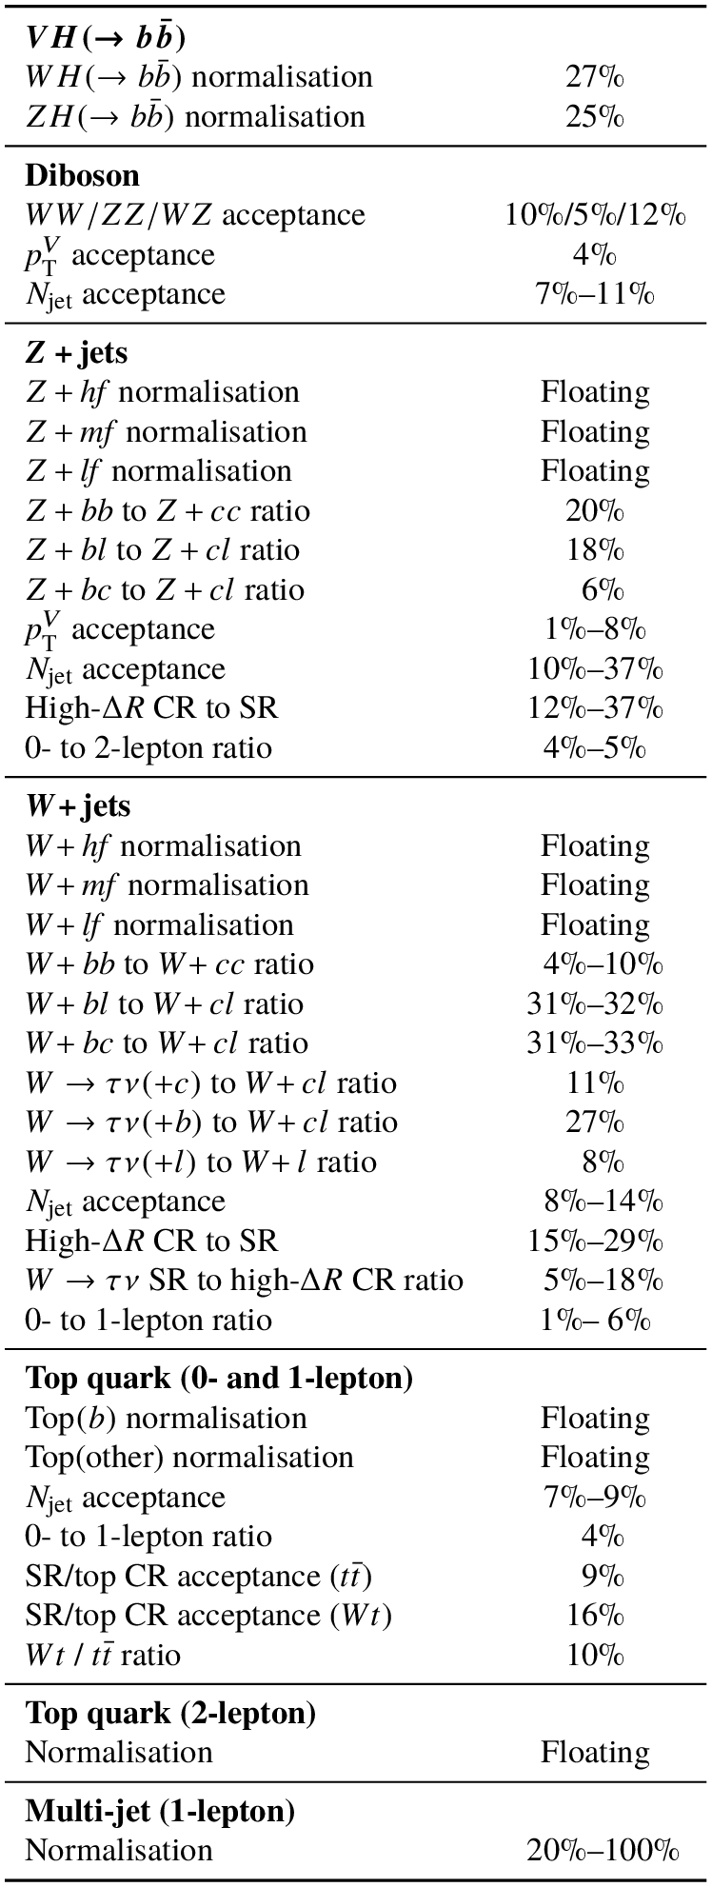
Higgs to cc
-
Eur. Phys. J. C 82 (2022) 717
-
W/ZH, H to cc limit of 26 (31) observed (expected) times SM cross section
Also at 95% CL which is less than the ratio of c to b mass, thus can say with a 95% CL that the Higgs-charm coupling is smaller than the Higgs-b coupling
One to watch for the future
Table shows background modelling systematics
note the dominant systematics

Slide 22
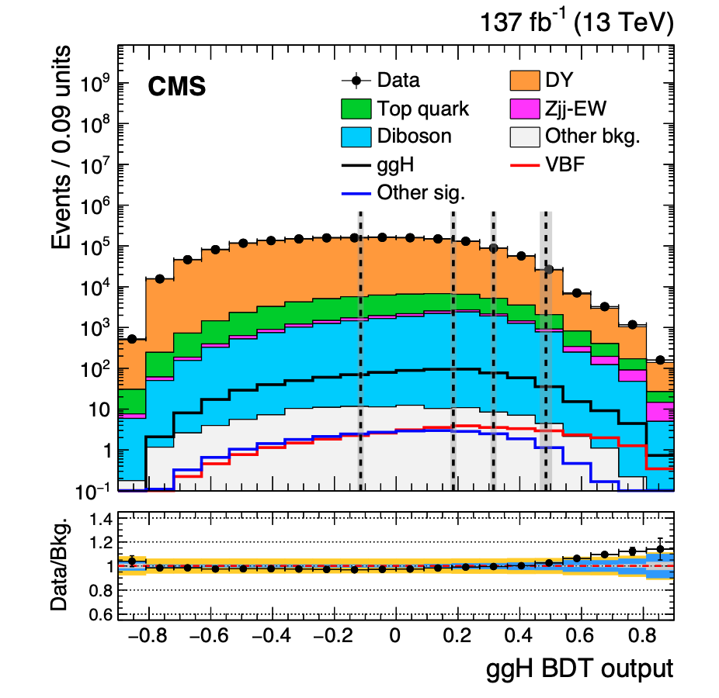
Higgs to muons
JHEP01(2021)148
Evidence!
CMS: signal strength
Statistically dominated now
But that will change over time and is an example of places to look for legacy impact
Orange band is theory
uncertainty combined with
experimental in blue
e.g. Contamination of ggF in
VBF region causes ~15-25%
systematic uncertainty
Notes:
Renormalisation, pdf, factorization scales, uncertainties on number of jets cause uncertainty on contamination of VBF in ggF region

Slide 23
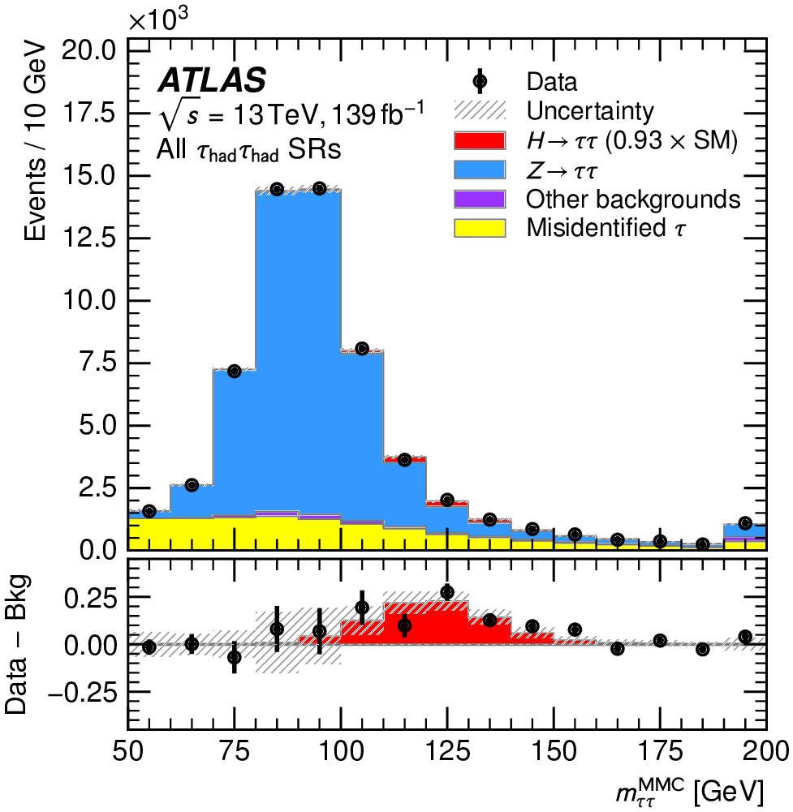
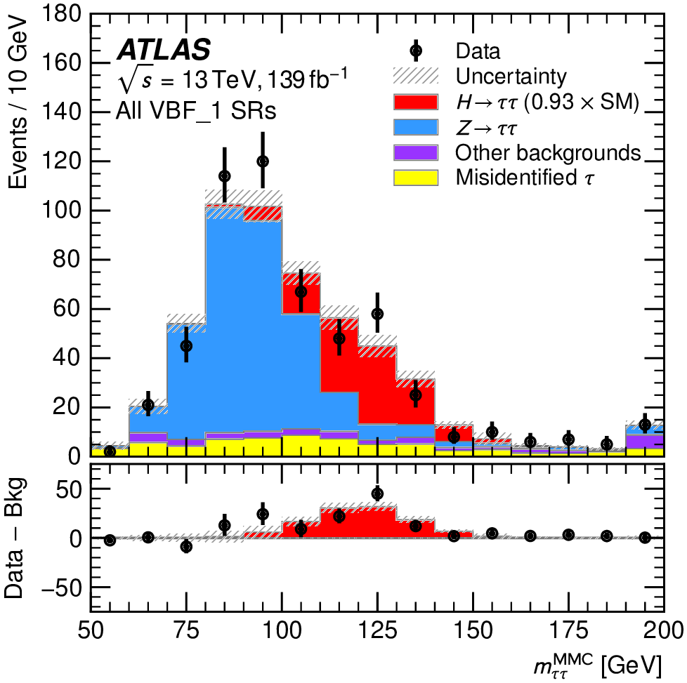
Higgs tau tau
JHEP 08 (2022) 175
Strong observation in this channel, inclusive cross-section:
This result is a single-channel observation of VBF at 5.3 sigma

Slide 24
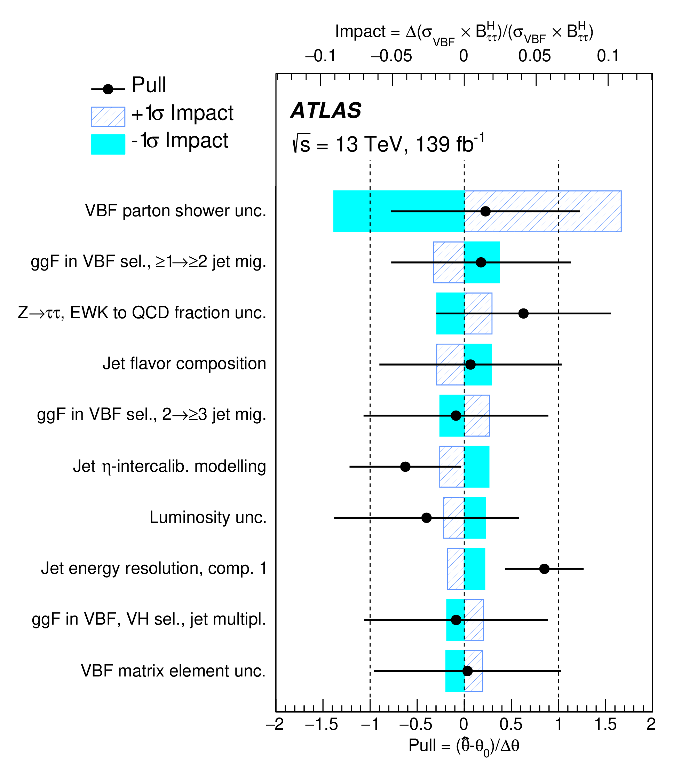
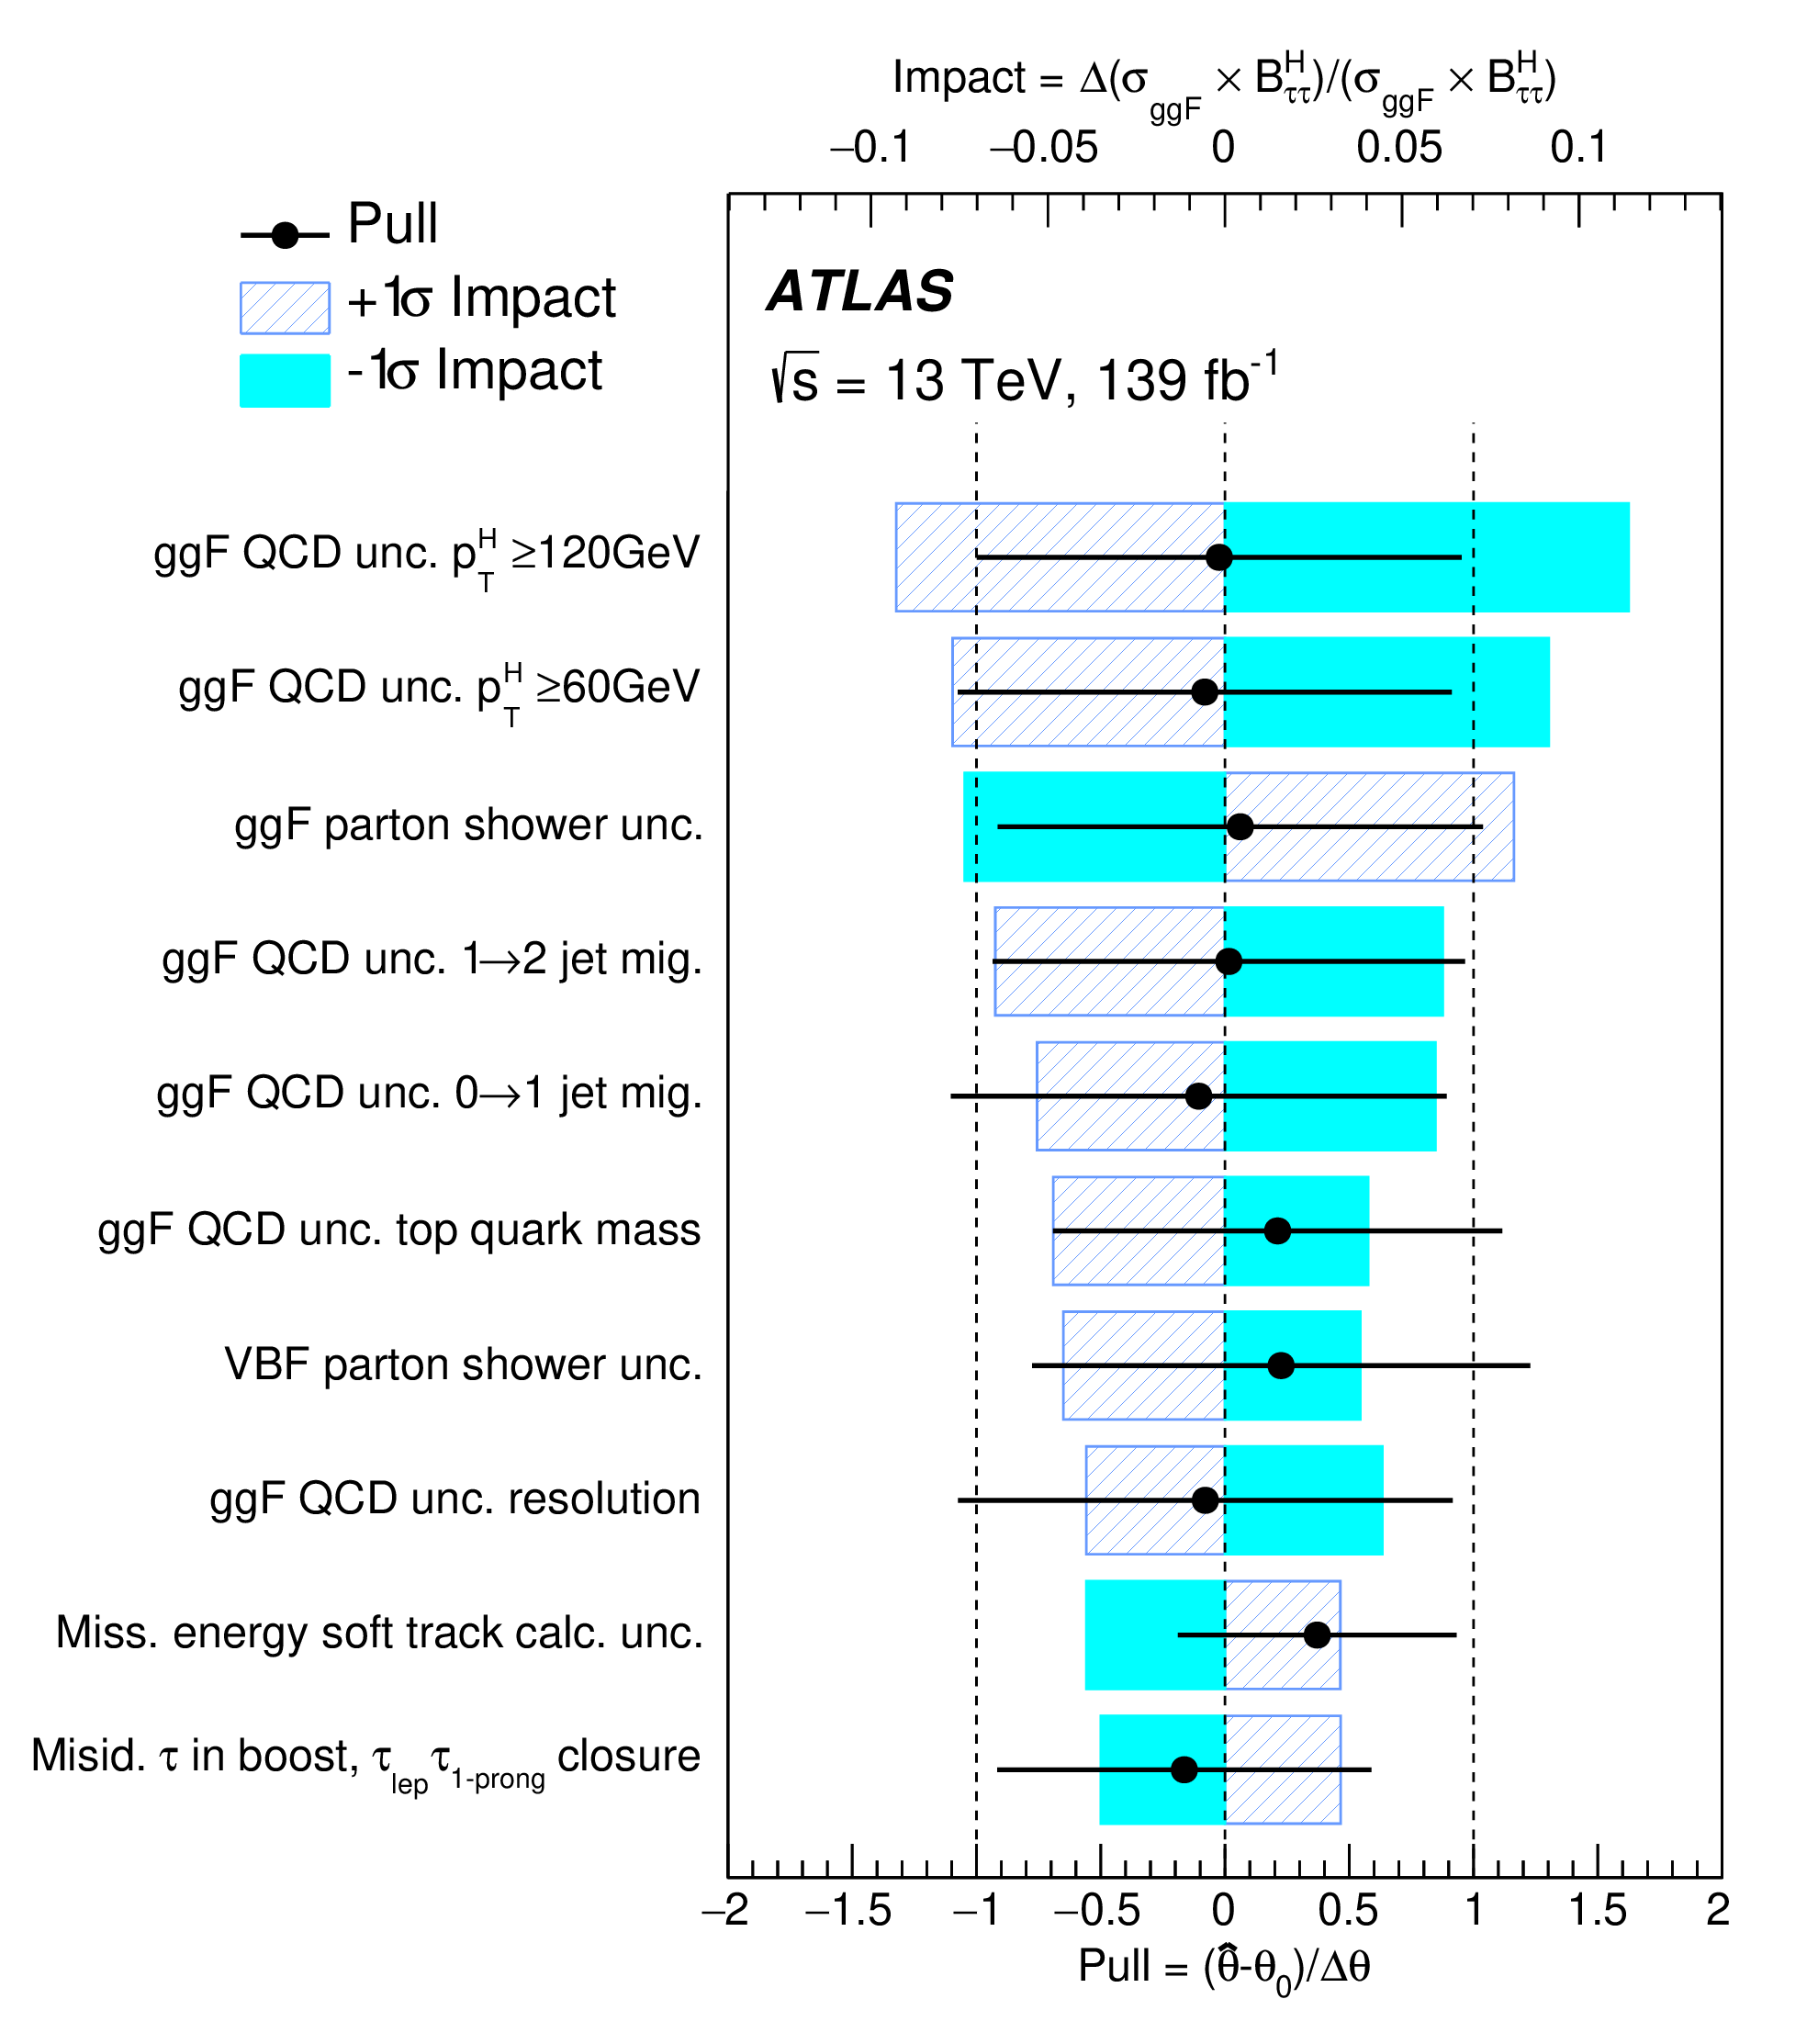
Higgs tau tau
An example of nuisance parameter ranking plots, used throughout Higgs studies
Float known uncertainties within their ranges
Now seeing this approach in some other types of analysis

Slide 25
Higgs tau tau
Background modelling is well-controlled with data regions
Results are now systematics dominated, and these are dominated by theoretical uncertainties, in particular parton shower and ggF QCD uncertainty

Slide 26
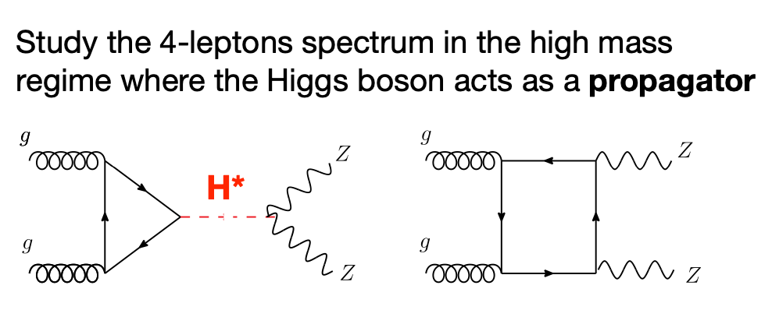
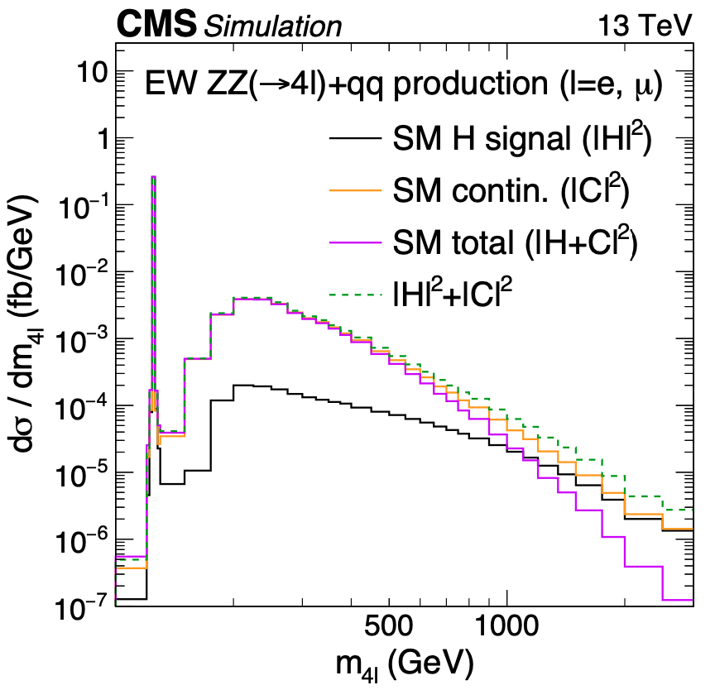
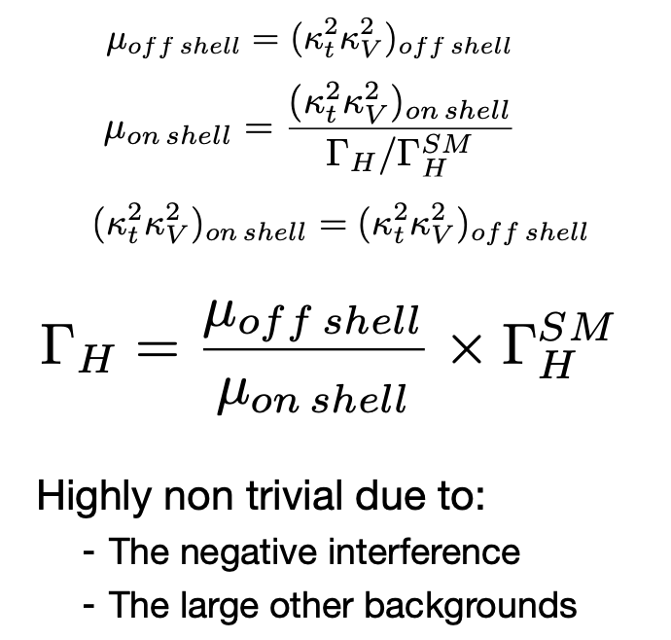
Higgs Width
CERN-EP-2021-272
Approximately 10% of Higgs at LHC gives on-shell VV
Assume

Slide 27
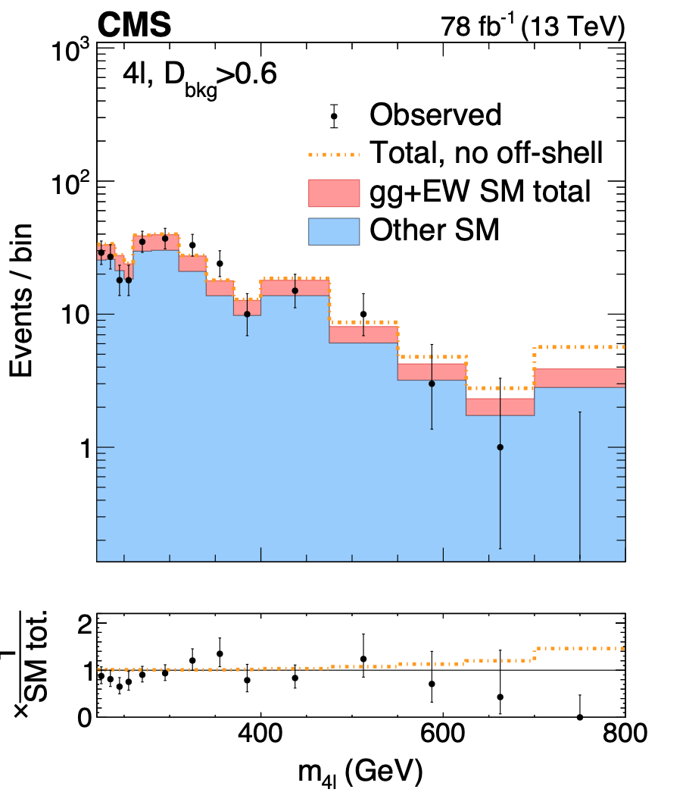
Higgs Width
CERN-EP-2021-272
Scenario with no off-shell contribution is excluded at 3.6 sigma
68% CL 95% CL

Slide 28
Higgs Width
ATL-PHYS-PUB-2015-024
Theoretical uncertainties:
simulation of extra jets up to 20% depending on Njets
Scale variations (up to 30%)
PDF uncertainties (up to 20%)
Also EW corrections to qq ZZ/WZ (up to 20% at masses of 1 TeV)
Ultimately HL-LHC studies indicate 95% C.L. results with 3 ab-1:

Slide 29
Di-Higgs
Total production cross section is very small ~30fb
Currently set limits on HH production (inclusive of both diagrams)

Slide 30
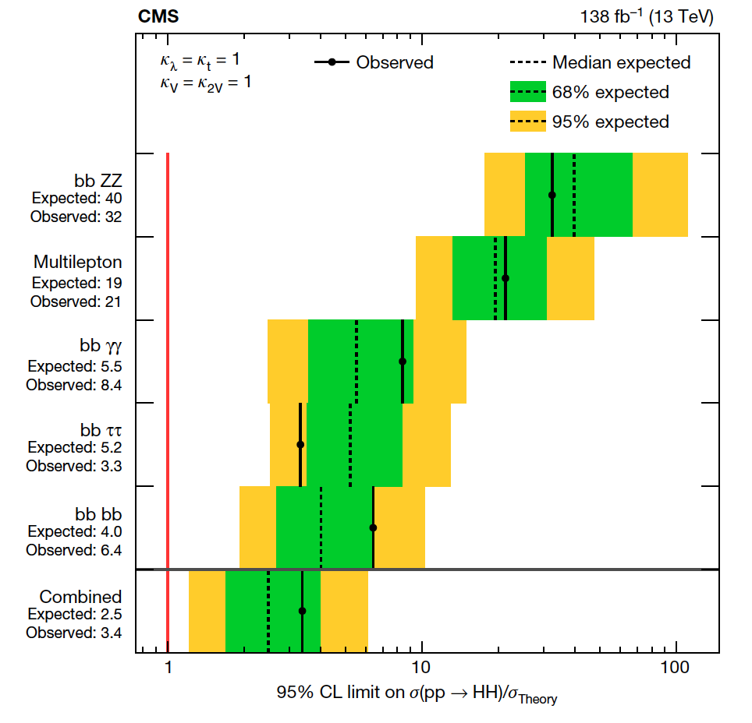
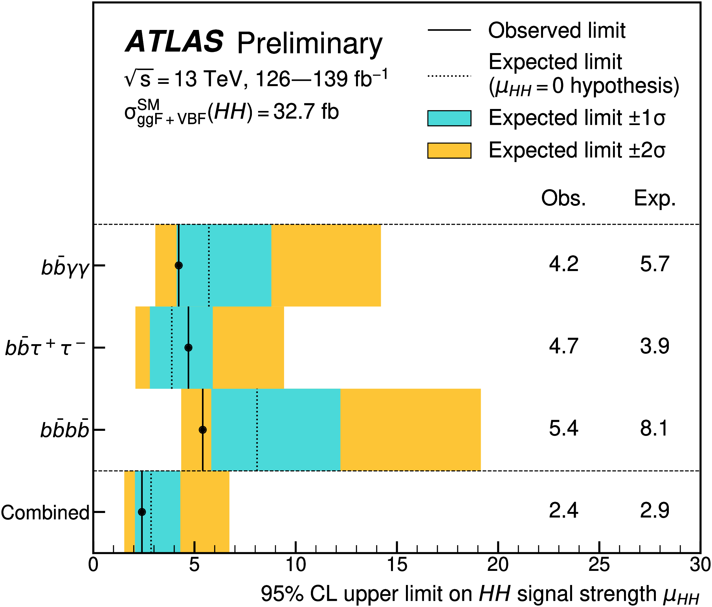
Di-Higgs
Nature 607 (2022) 60-68
Getting close to SM: both experiments set limits on cross-section at ~2.5 x SM cross-section
Theory systematics: parton shower up to 13%; PDF up to 12%; scale variations up to 8%
Notes:
Scale variations 2-8% systematic
PDF 1-12%
Parton shower 6-13%

Slide 31
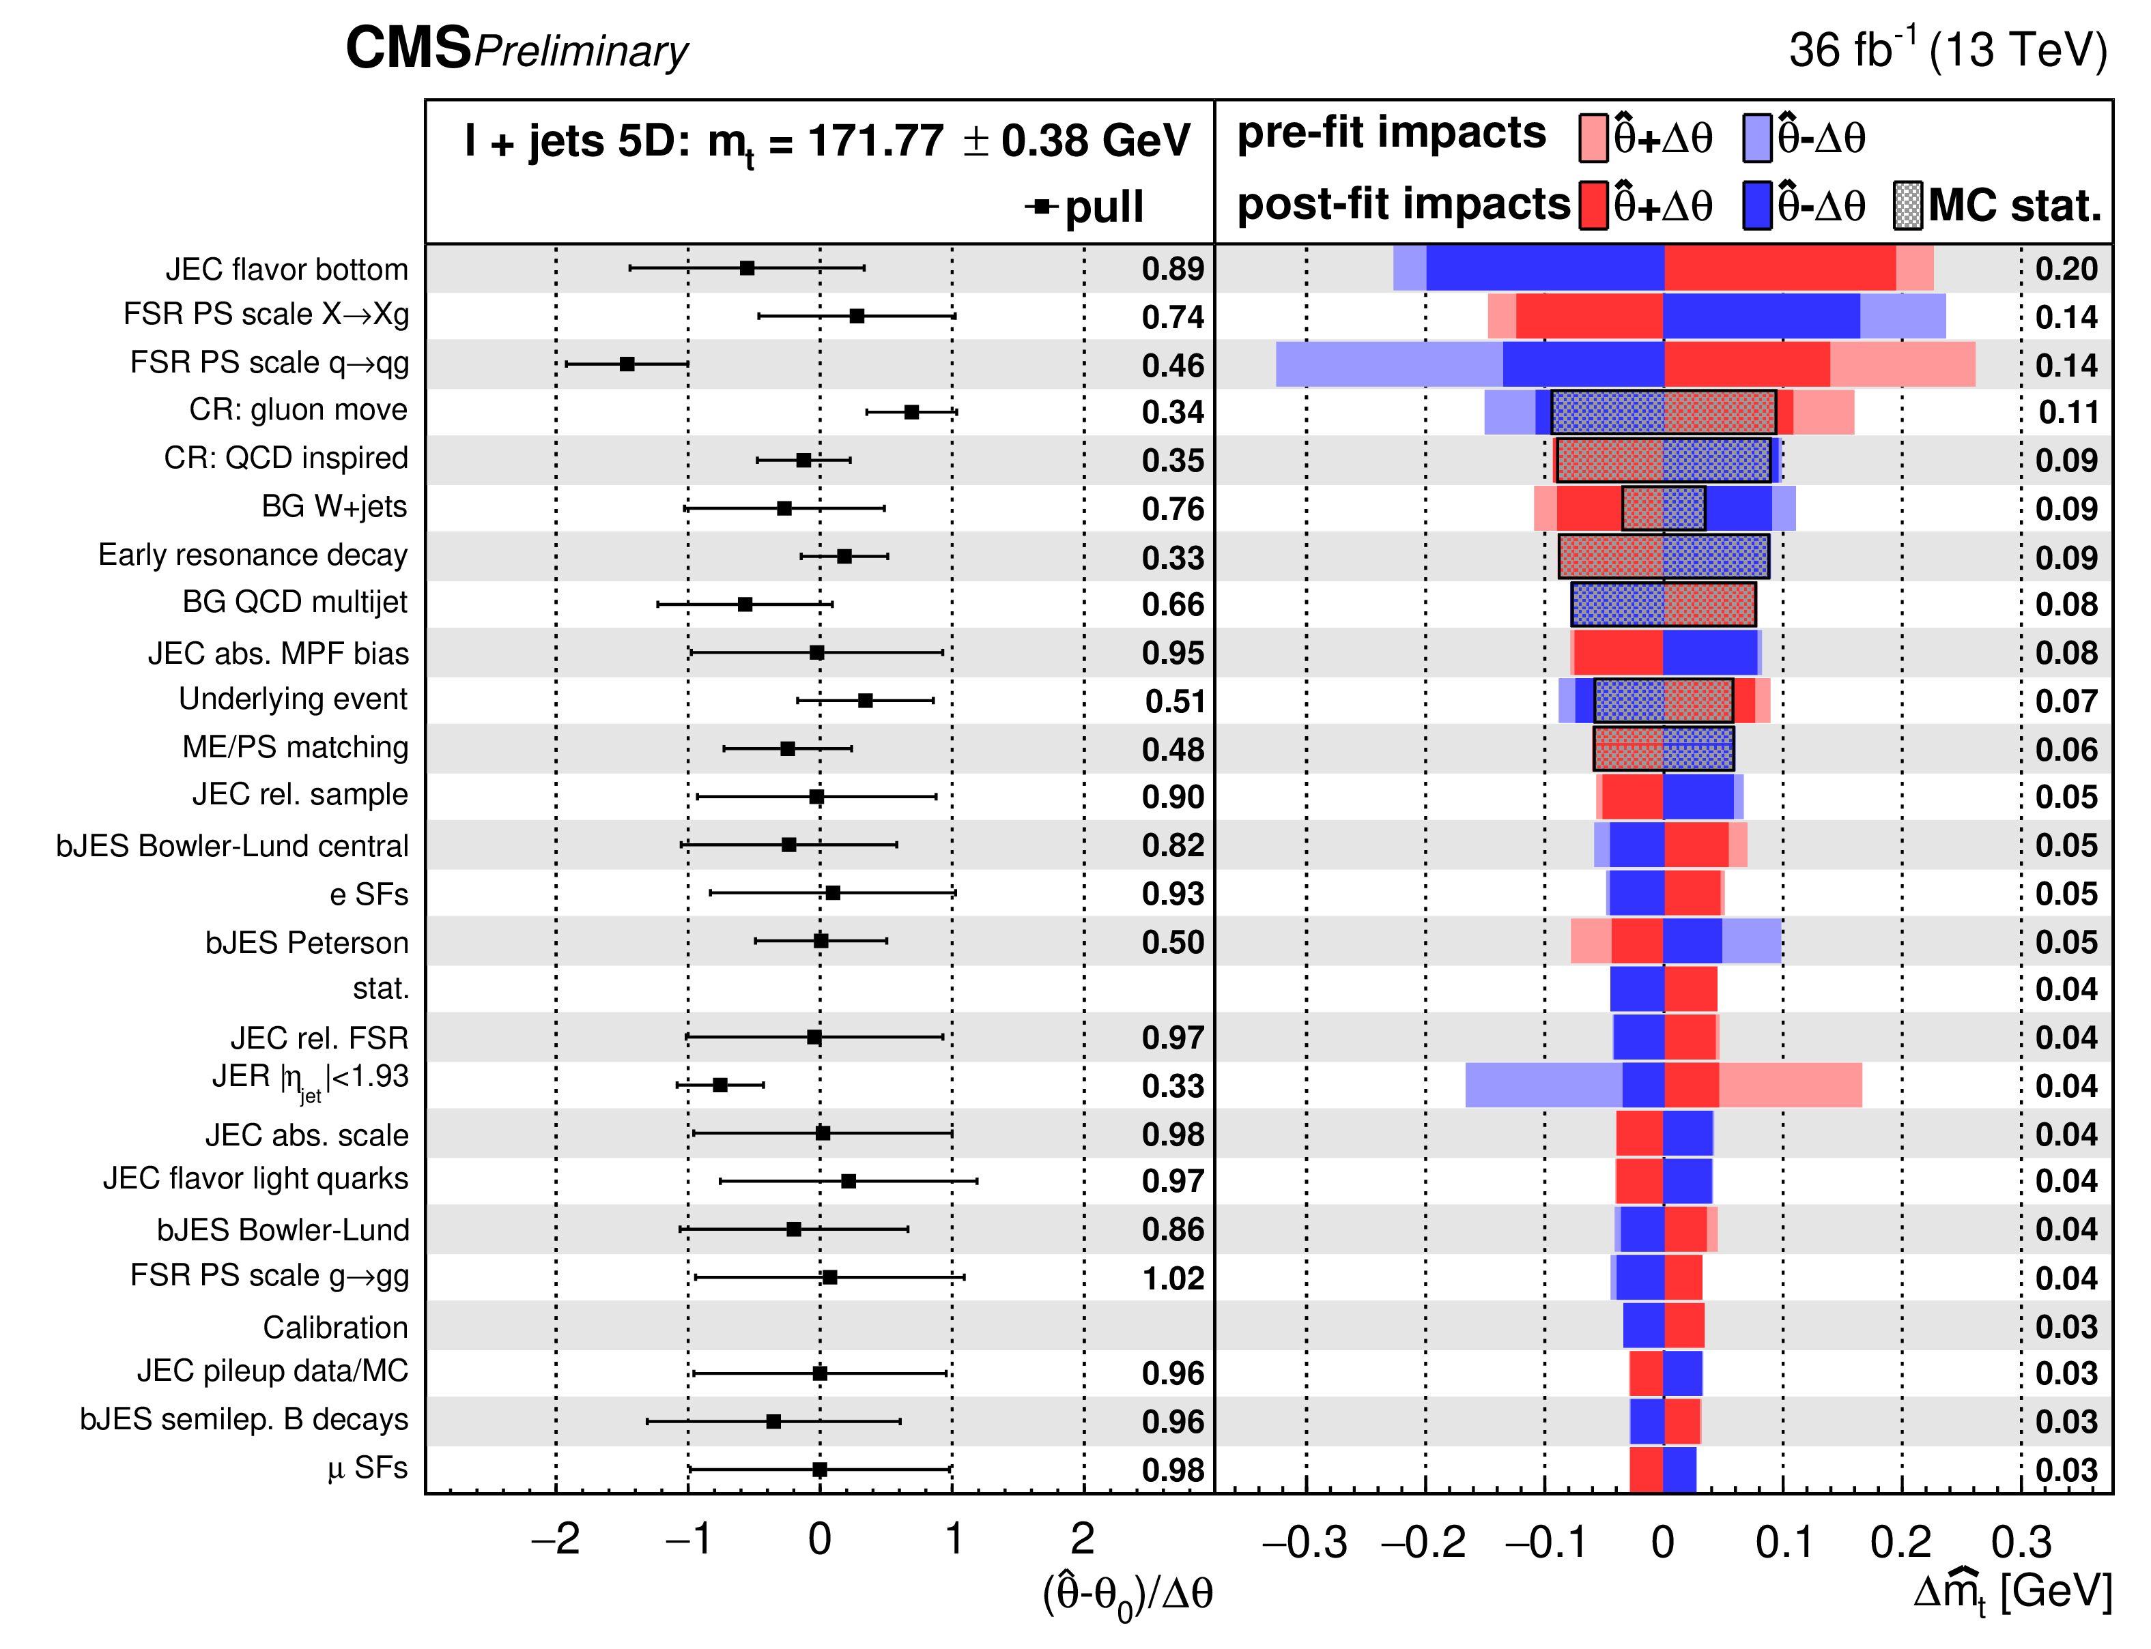
Top
CMS-PAS-TOP-20-008
Profile likelihoods, floating uncertainties, are becoming more common in top physics
Requires scrutiny from theorists and experimentalists, as in Higgs analyses
What is the meaning of a variation that is e.g. comparing two parton showers?
Notes:
JER 1/5; bJES halved

Slide 32
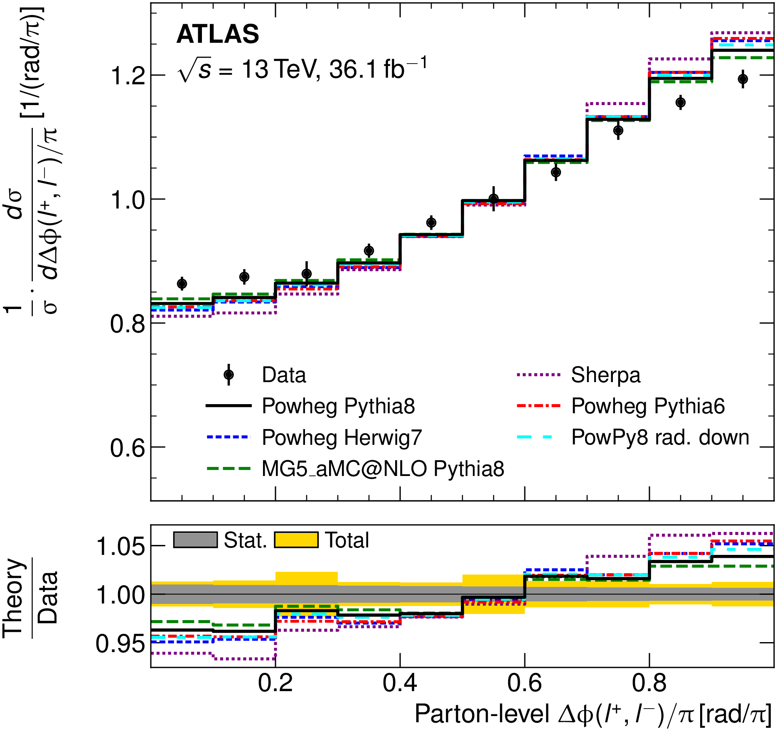
Top Quark Spin Correlations
Eur. Phys. J. C 80 (2020) 754
At the LHC top quarks in pair production are not polarised
A spin correlation between the tops is expected and has been observed.
A stronger spin correlation is measured in tension at the 3.2 standard deviations level with the NLO prediction.
Notes:
Nominal model from POWHEG-PY8, very large number of checks were carried out with different PS and generators (MG5_aMC@NLO AND SHERPA).

Slide 33
Conclusions
Fruitful collaboration between theorists and experimentalists has been a backbone of the success of the research programs of the LHC
Whether that’s precision or searches
The collaborations support these interactions through the formal groups e.g. LHCHXSWG, through associateship programs with the experiments – if as a theorist you have an idea to pursue please ask for details on these schemes
Run 3 sees us go deeper into the precision regime of the LHC
Run 3 also sees us explore novel phase space with the use of new triggers, new experiments (e.g. FASER) demanding to open up precision in new regimes
This talk is necessarily selective, let’s talk at the workshop if you have a question and we can dig into the details!

