Slide 1
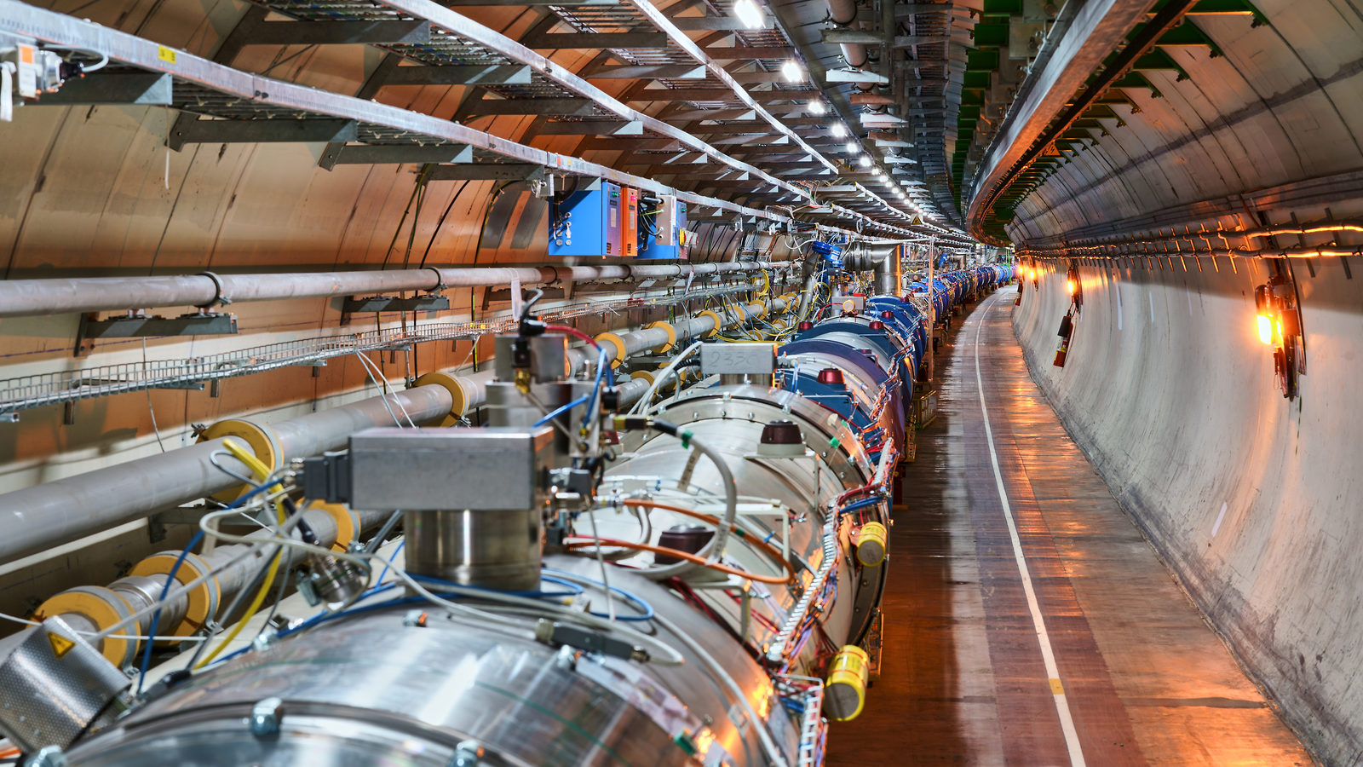
Building and operating the collider!

Slide 2
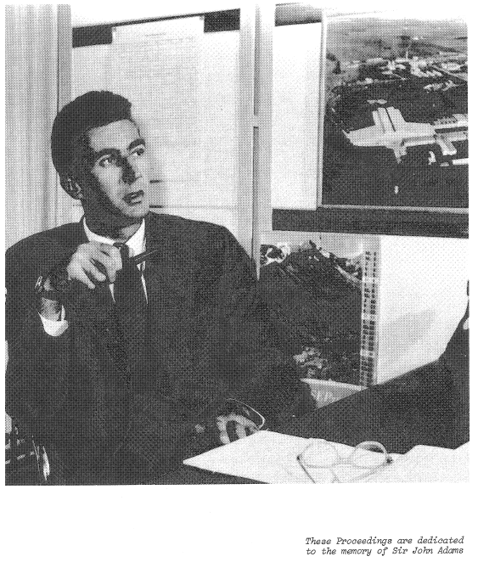
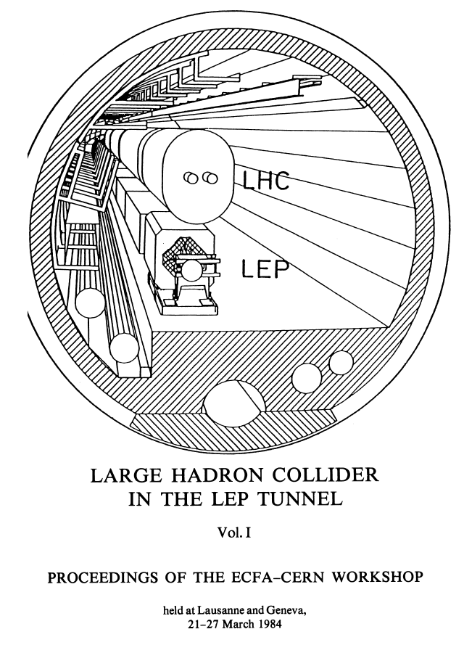
Even before the drawing-board stage, the farsighted John Adams noted in 1977 that the tunnel for a future large electron–positron (LEP) collider should also be big enough to accommodate another ring of magnets.

Slide 3
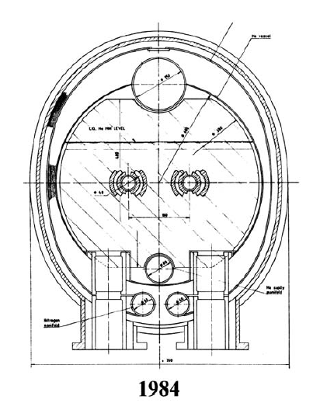
Challenges Accepted
(After some debate!)
High magnetic field
2-in-1 magnet design
Superfluid helium
LEP isn’t even installed yet but we’re going to start work on an accelerator which needs:
a magnet design we’re not sure works;
fields we can’t yet produce;
to be cooled by superfluid helium in 27 km tunnel deep underground

Slide 4
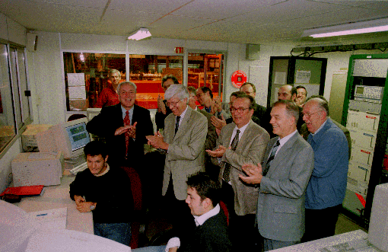
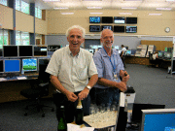
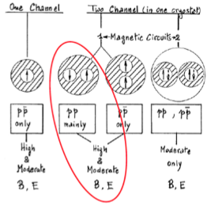
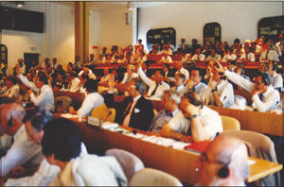
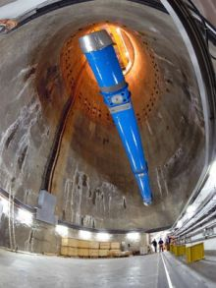
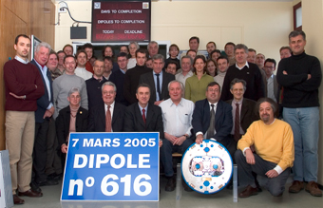
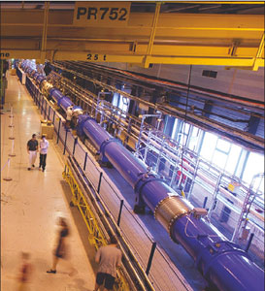
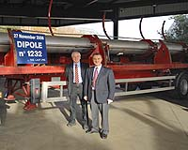
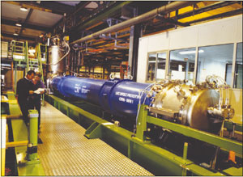
June 1994
first full scale prototype dipole
June 2007 First sector cold
ECFA-CERN workshop
April 2008
Last dipole down
1994 project approved by council (1-in-2)
Main contracts signed
1984
90
91
92
93
94
95
96
97
98
99
00
01
02
03
04
05
06
07
08
09
10
2002 String 2
November 2006
1232 delivered
First set of twin 1 m prototypes
Over 9 T

Slide 5
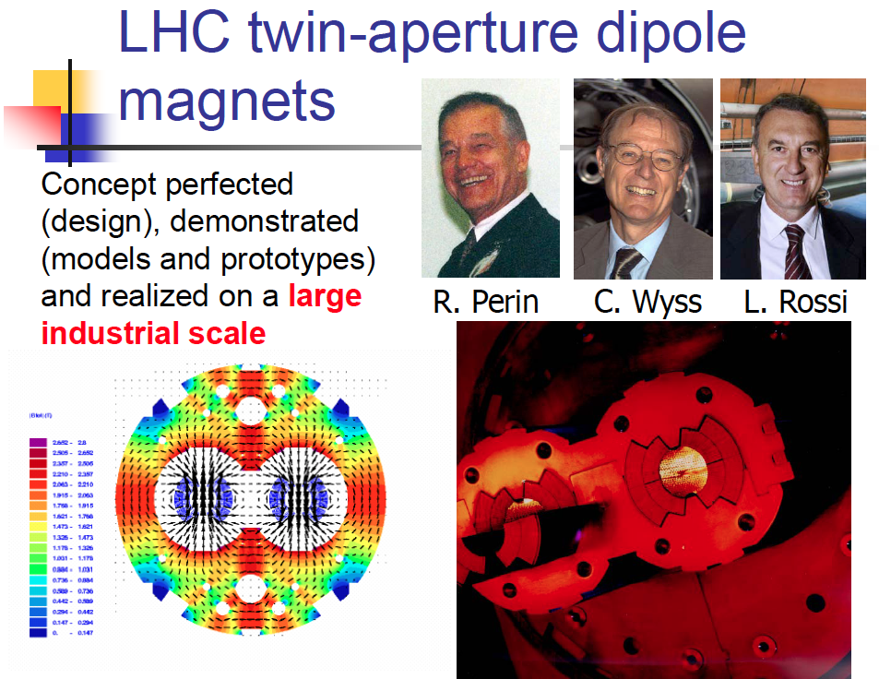

Slide 6
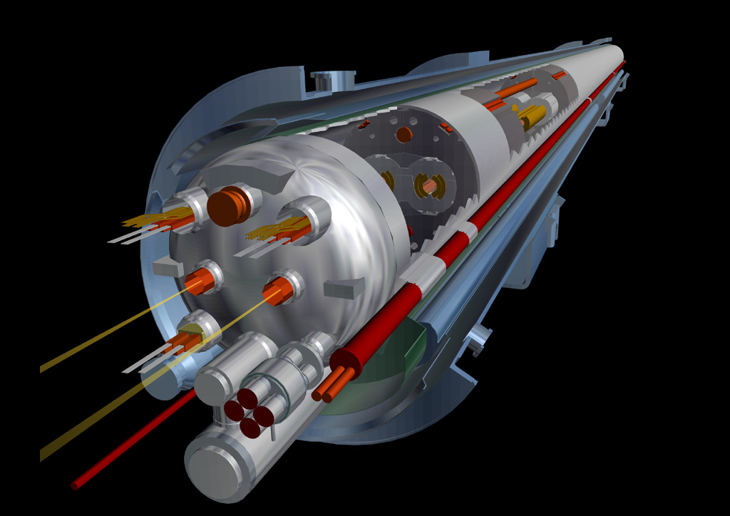
Technology: beautiful, when well done!
Vacuum
Cryogenics
Power Converters

Slide 7
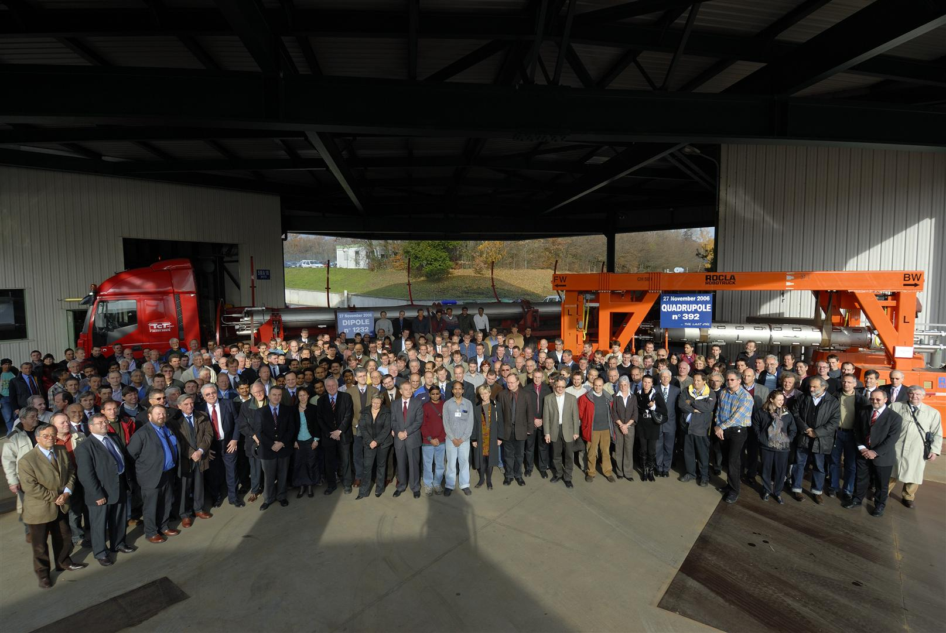
2006

Slide 8
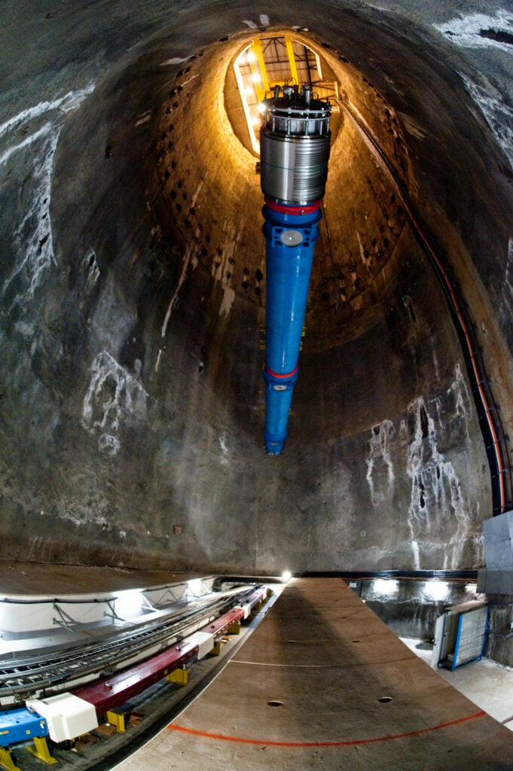

Slide 9
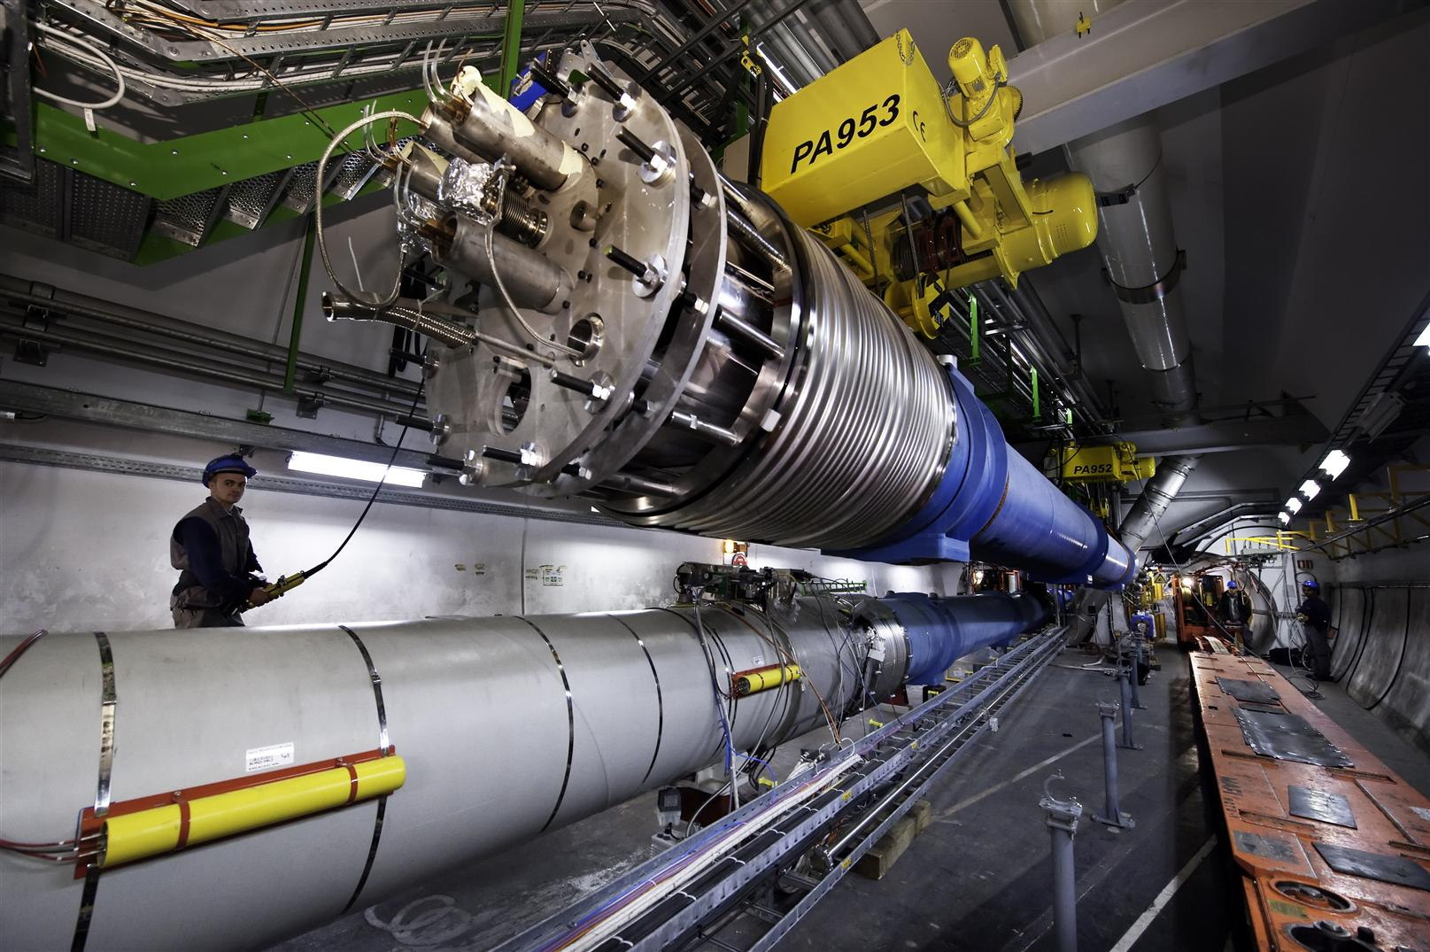

Slide 10
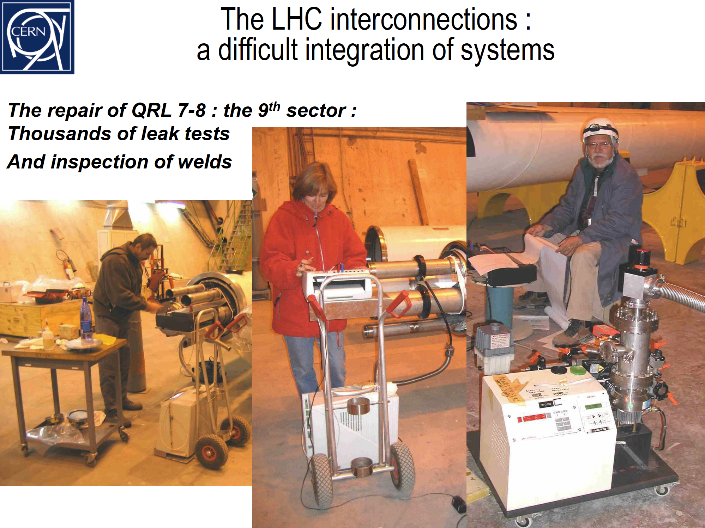

Slide 11
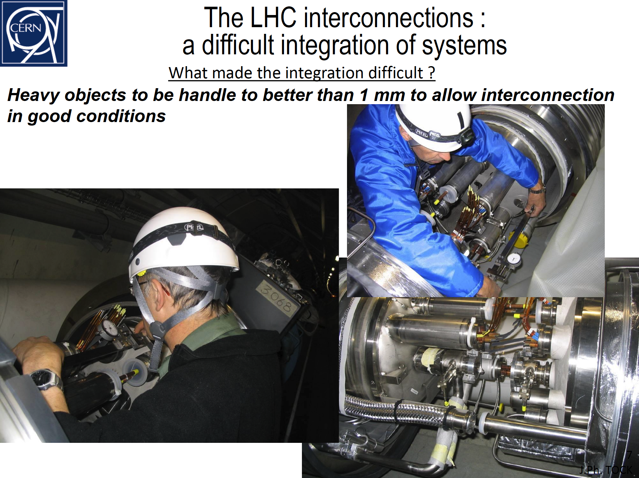

Slide 12
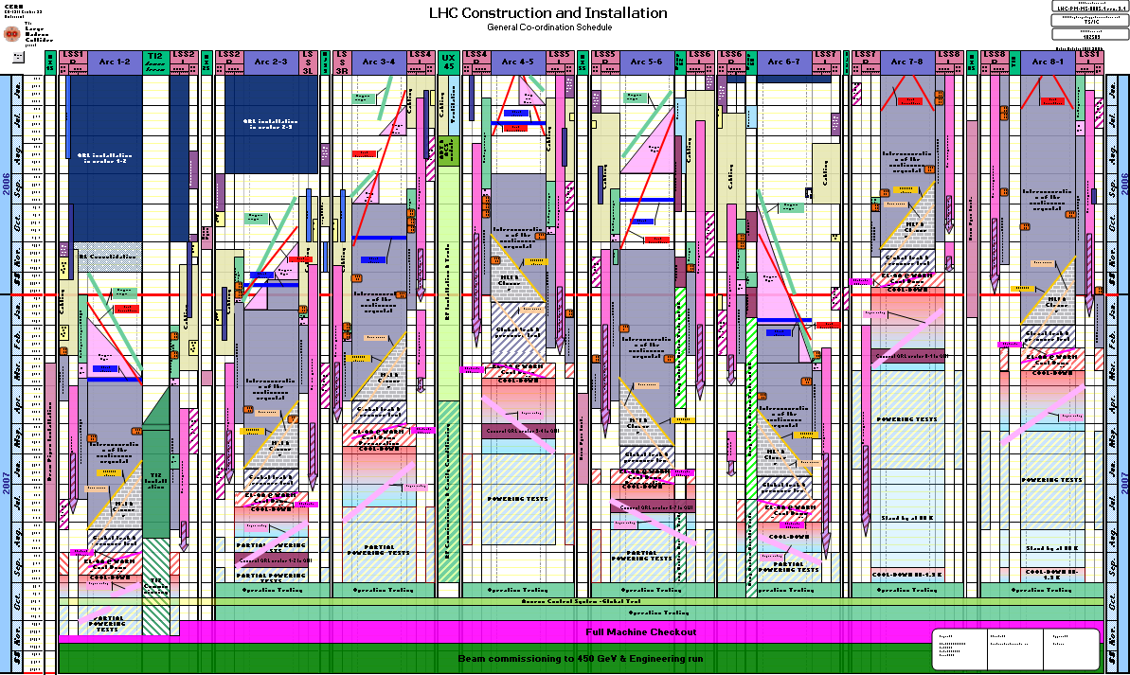
And then a miracle occurred
QRL
INTERCONNECTION
COOL
DOWN
POWERING
TESTS

Slide 13
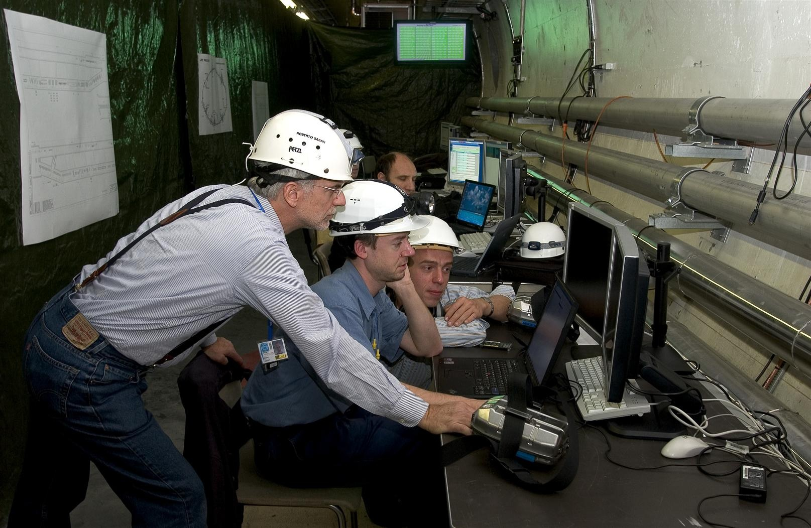
Magnet circuits: underground control room

Slide 14
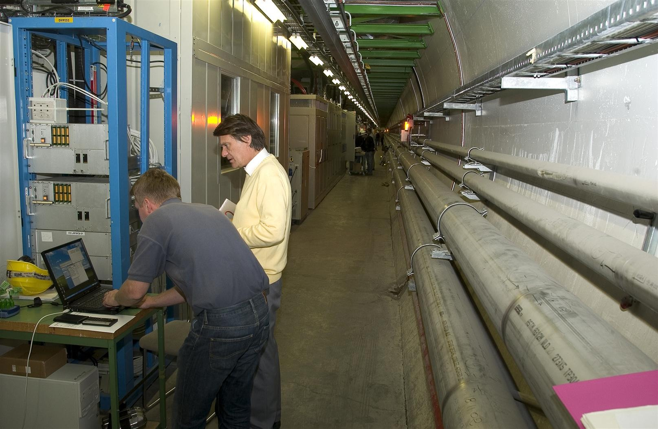
Quench protection system: “make it so they have to give us access to do a reset.”

Slide 15
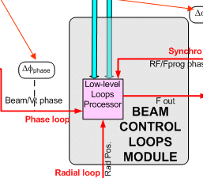
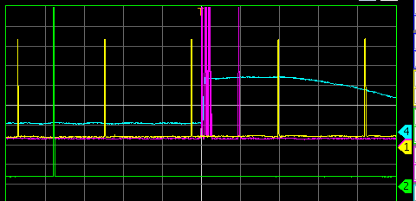
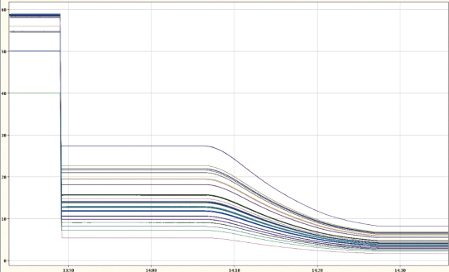
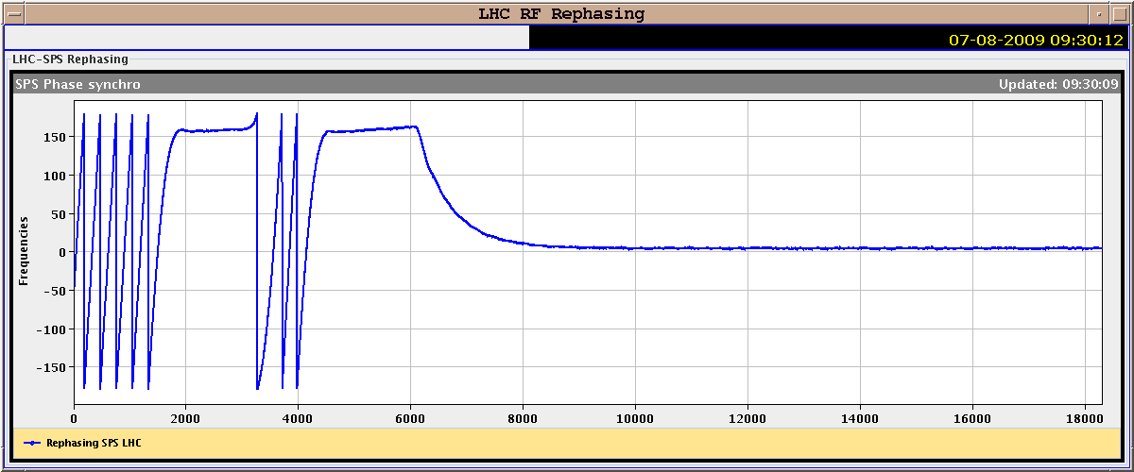
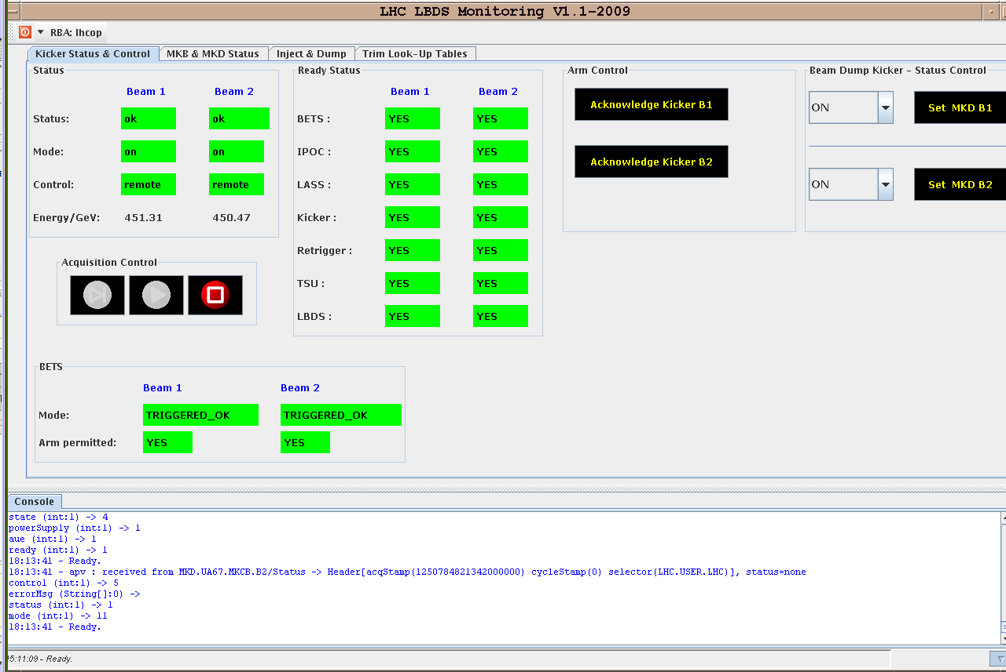
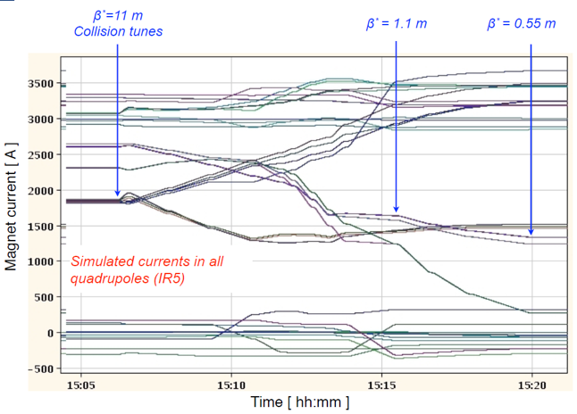

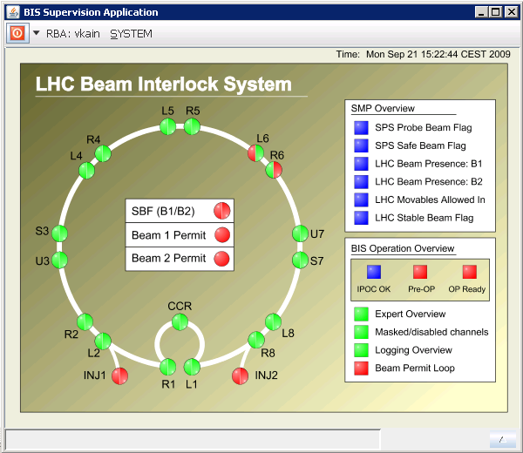
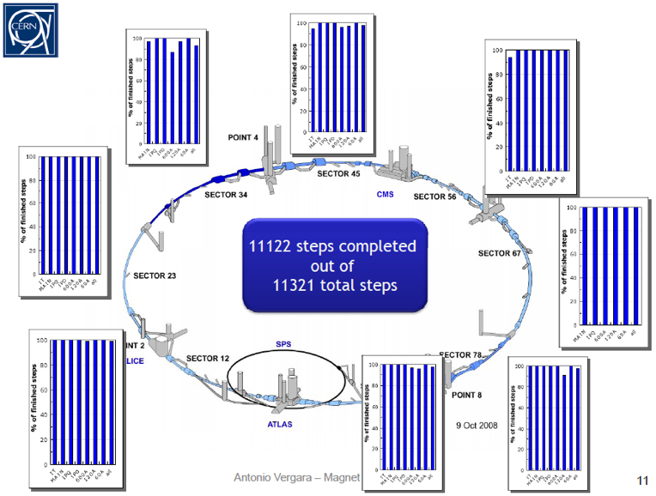
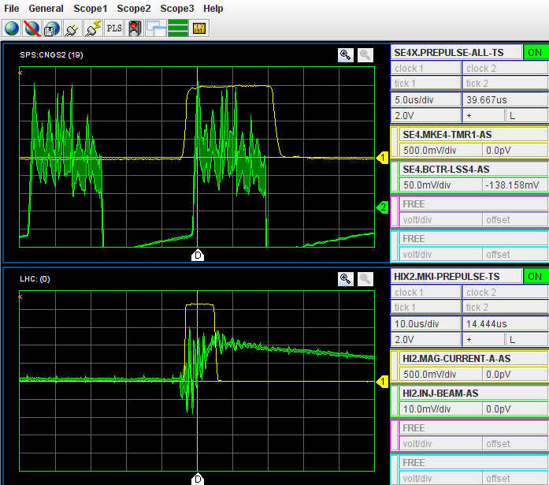
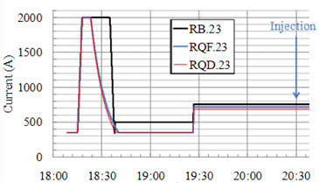
Preparation: hardware commissioning and machine checkout
MAGNET CIRCUIT TESTS++
Transfer lines
Injection, Extraction
RF, injection sequence
Timing System
Beam Interlock System
Collimators
Vacuum
Interlocks system
BLMs, BPMs
BTV, BCT
Beam dump
Powering Groups of Circuits
Magnet model
Sequencer, alarms
Controls, logging, DBs
LSA, optics model, YASP
Re-phasing in the SPS:

Slide 16
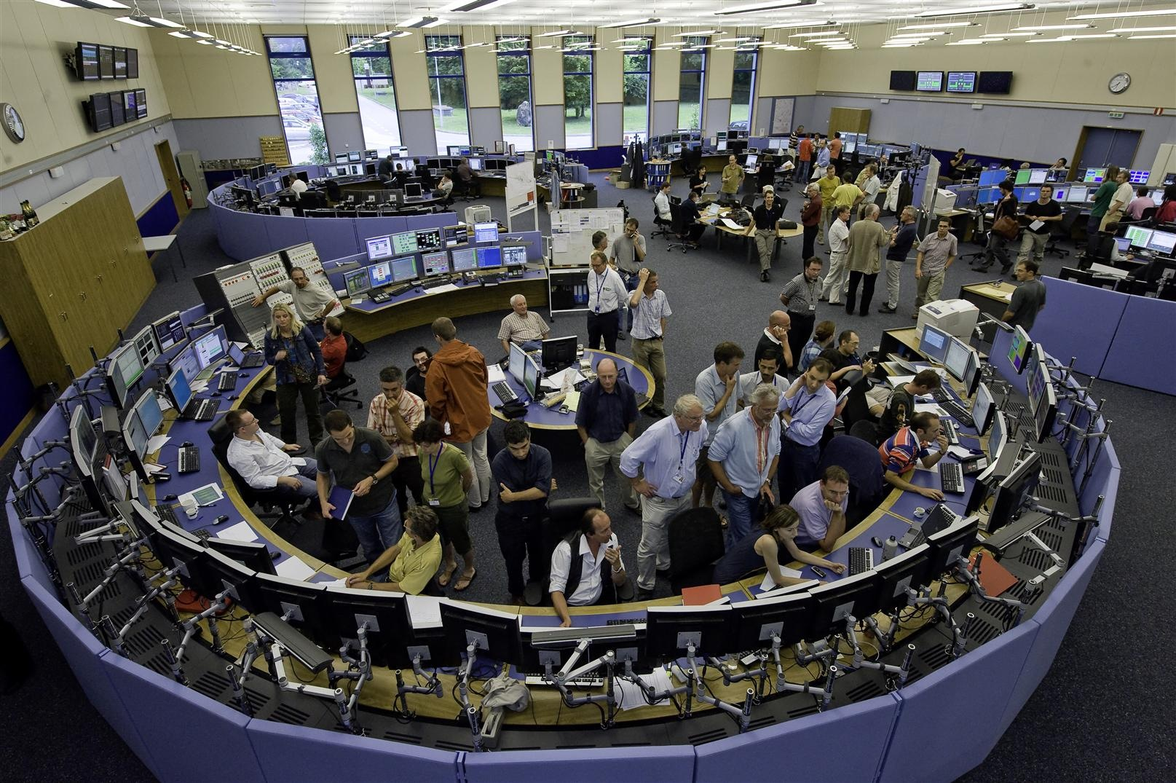
Sector test with beam - 2008

Slide 17
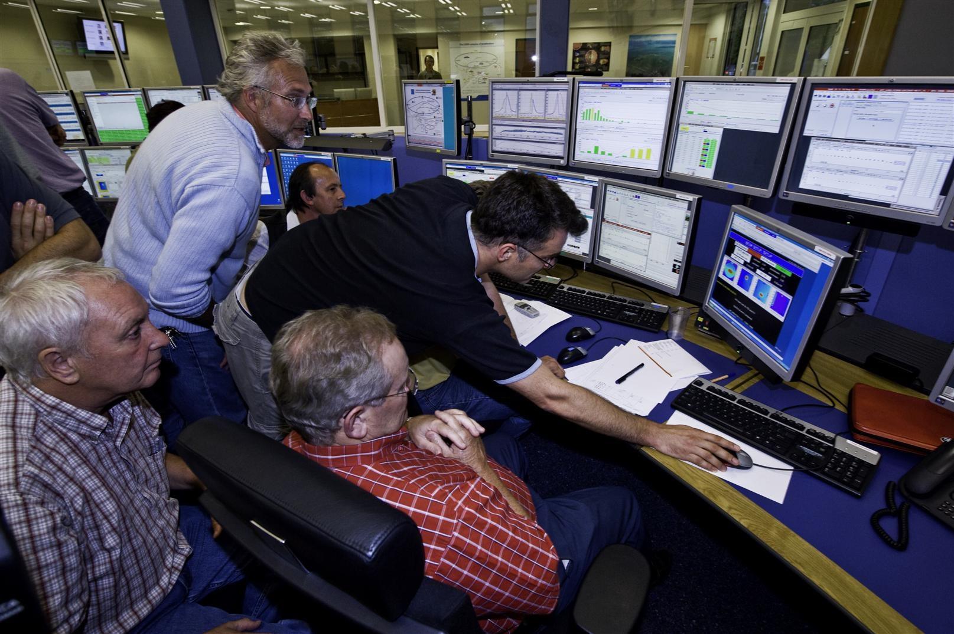
Management getting in the way

Slide 18

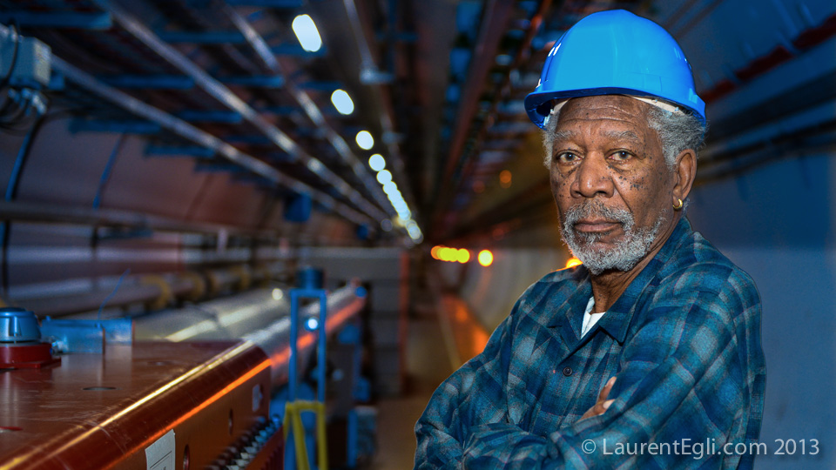

Slide 19
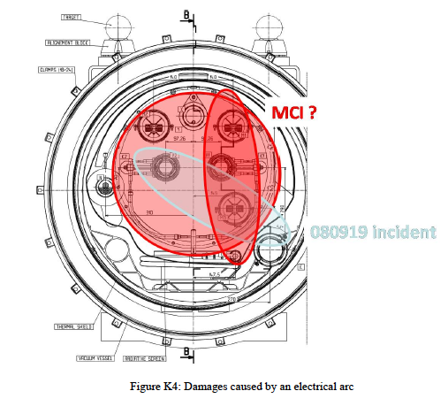
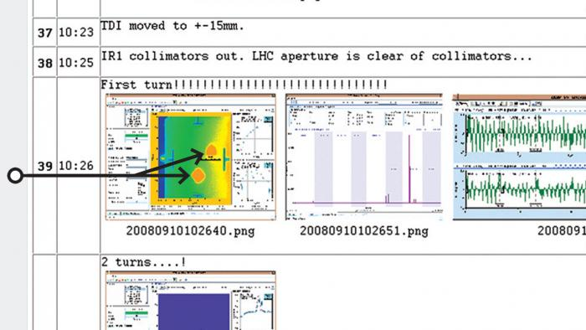
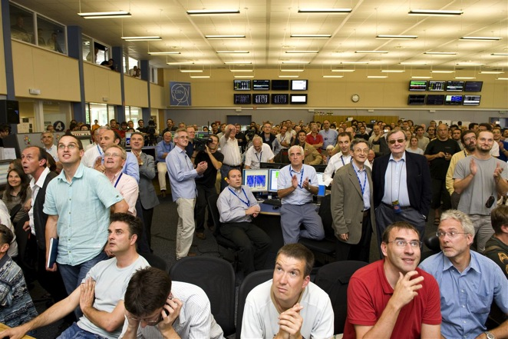
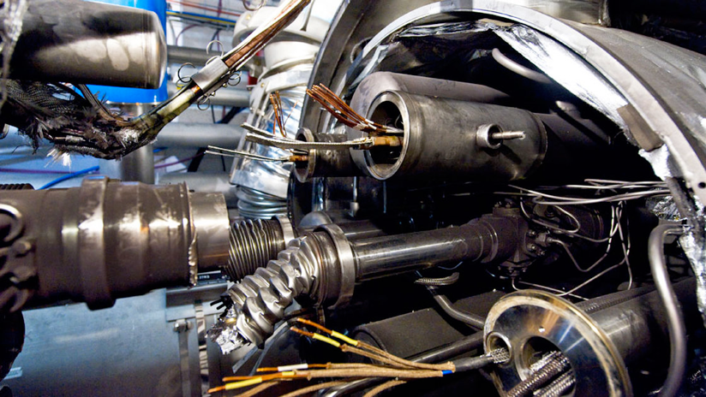
Conception
Initiation
Birth – overdue
Withdrawal from community for mediation and preparation
LHC approved by the Elders
Rival stumbles
SSC cancelled
1984
90
91
92
93
94
95
96
97
98
99
00
01
02
03
04
05
06
07
08
09
10
Hubris (?) September 10, 2008
Nemesis September 19, 2008

Slide 20
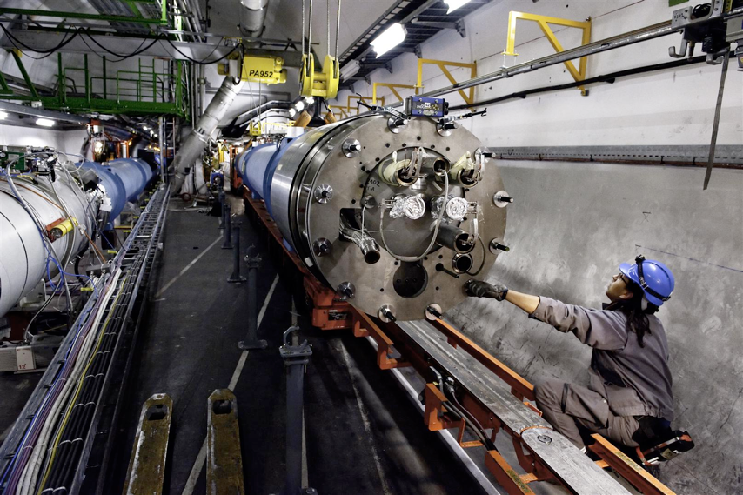
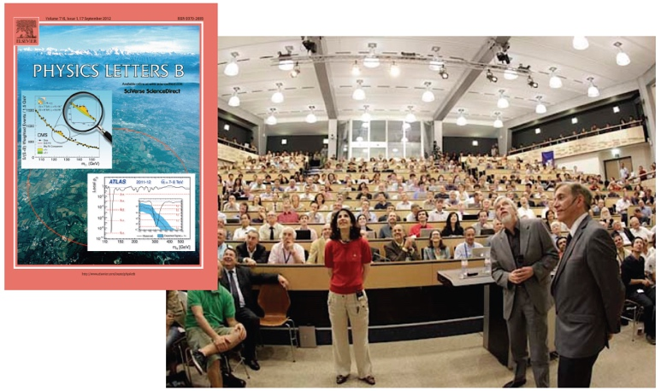
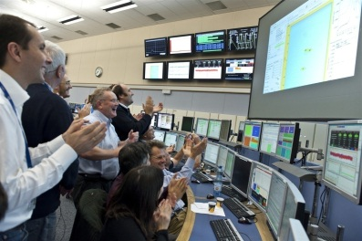
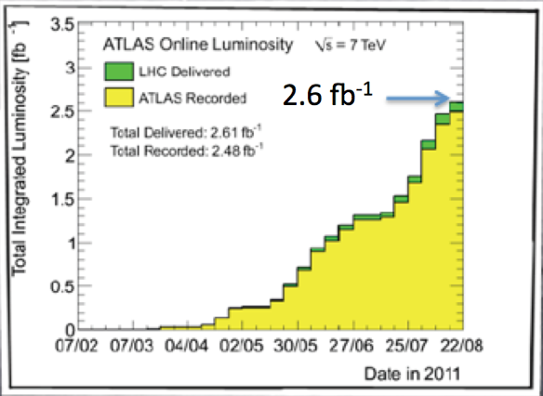

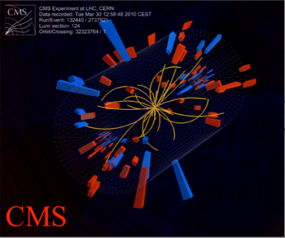
Apotheosis and atonement
Trial/descent in the underworld
4 July, 2012
November 29, 2009
Resurrection and rebirth
2009
2010
2011
2012
2013
Ascension
Heroic subplot
March 30, 2010
First collisions at 3.5 TeV

Slide 21
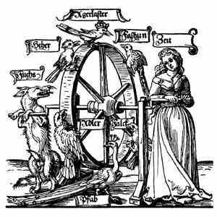
And let us not forget Fortuna
Late
Over budget
Blew it up after 9 days
Costly, lengthy repair
Rival coming up fast on the outside
Had to run at half energy
And yet…

Slide 22
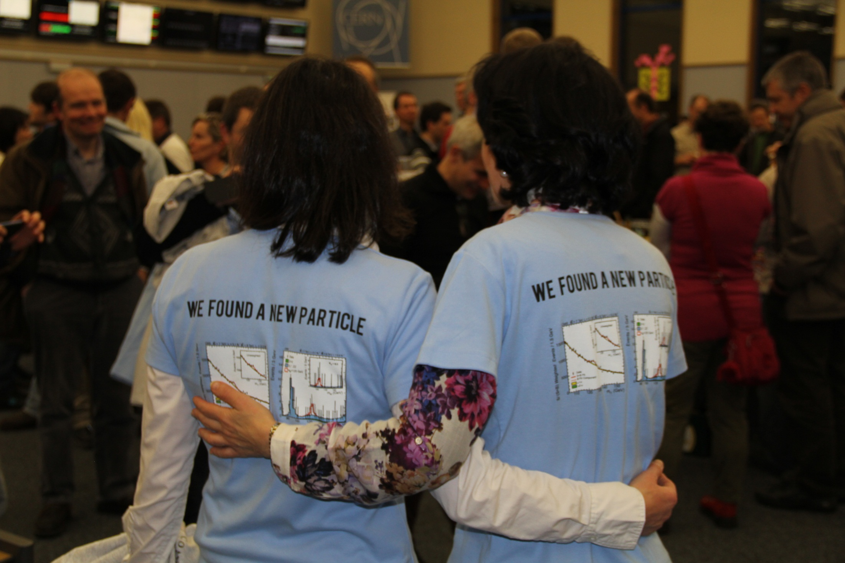

Slide 23
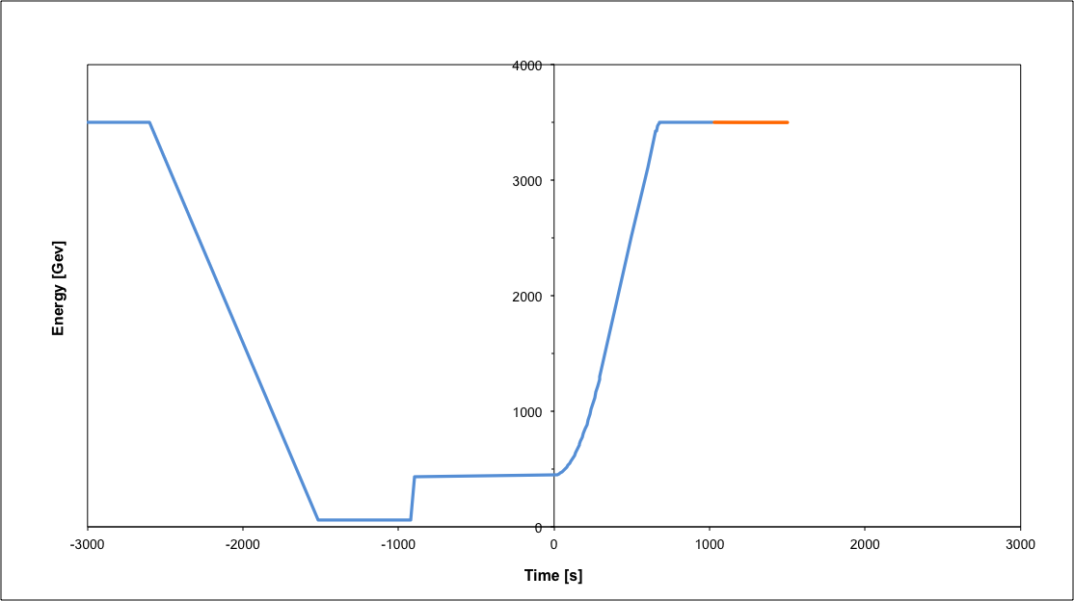
LHC Nominal Operational cycle
Beam dump
Squeeze
Stable beams
Collide
Ramp
Ramp down/precycle
Ramp down | 45 mins
Injection | ~30 mins
Ramp | 15 mins
Squeeze | 10 mins
Collide | 5 mins
Stable beams | 0 – 30 hours
Injection
Turn around from stable beams to stable beams - 2 to 3 hours on a good day

Slide 24
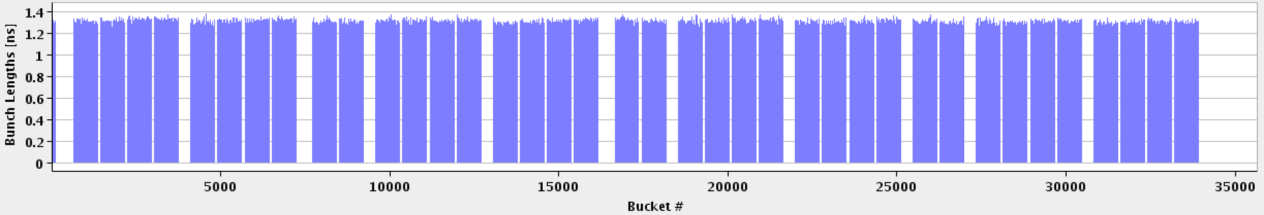
(Nominal) LHC bunch structure
25 ns bunch spacing
Nominal bunch population ~1.2 x 10¹¹ protons per bunch
(In 2023 1.8 x 10¹¹ protons per bunch)
1 PS batch
(72 bunches)
1 SPS batch
(288 bunches)
Abort gap
26.7 km 2800 bunches

Slide 25
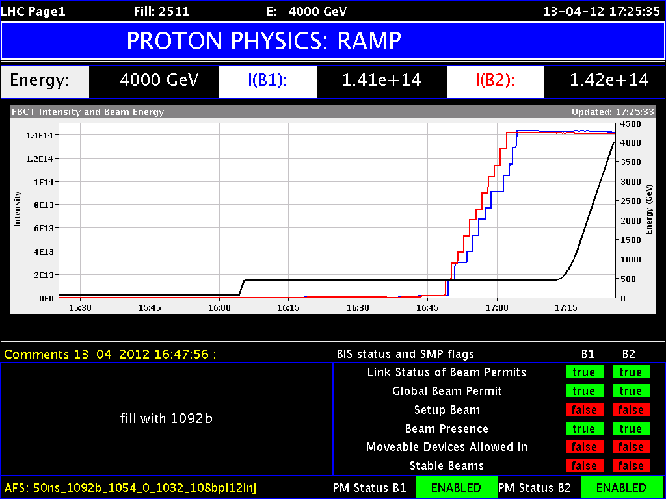
Ramp
Load power converters (1700+)
Load collimators
Load RF settings
Load transverse feedback
Get orbit and tune feedback on
Send timing event
Get a cup of coffee
BLM thresholds, beam dump - tracking energy
There’s a lot going on in the background…

Slide 26

Squeeze
Small beam size at interaction point implies larger beams in the triplet magnets
Larger beams implies a larger crossing angle
Aperture concerns dictate caution
Beam size - triplets (4 sigma) | Beam size IP (4 sigma)
~6 mm | ~40 microns

Slide 27


Collimation
1.2 m
beam
Total = 108 collimators
About 500 degrees of freedom

Slide 28

Collimation at the energy frontier
Superconducting coil @ 1.9 K
quench limit ~ 50-100 mJ/cm³
Factor ~ 10¹⁰
Aperture: r ~ 20 mm
Proton beam: ~350 MJ

Slide 29

Luminosity
N | Number of particles per bunch
k_{b} | Number of bunches
f | Revolution frequency
σ* | Beam size at interaction point
F | Reduction factor due to crossing angle
High brightness beam from the injectors [and keeping it bright]
Squeezing well beyond design

Slide 30

Plus stunning availability…
2018 data

Slide 31

ATLAS and CMS

Slide 32


