Slide 1
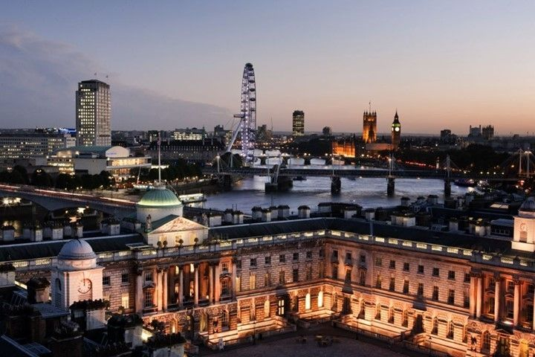
Coupling Metric-Affine Gravity to a Higgs-Like Scalar Field
Durham
Claire Rigouzzo
■
Claire Rigouzzo
15/12/2022

Slide 2
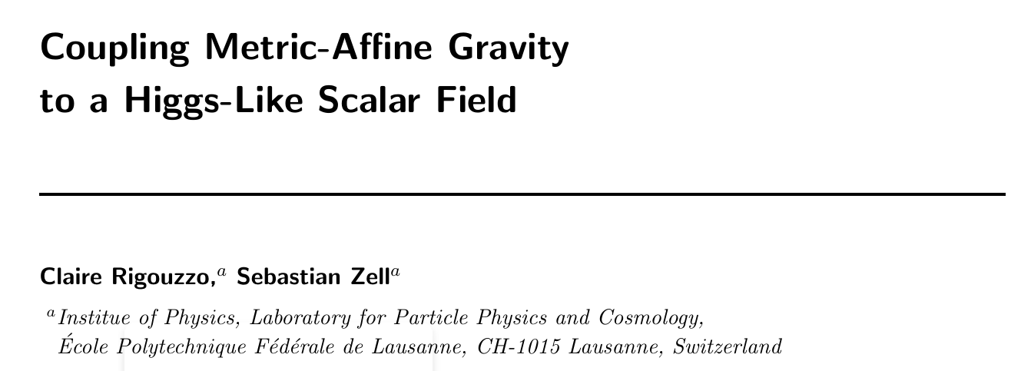
Plan:
3. Interactions
1. Gravity Sector
2. Matter Sector
[1] C.Rigouzzo and S.Zell, 2204.03003

Slide 3
1. Gravity sector
In Differential Geometry, there are a priori two different quantities defined on a manifold:
The metric $g_{μν}$ which defines distances.
The affine connection $Γ_{ μν}^{α}$ which provides a way to parallel transport vectors.
Leads to two different formalisms:
 | Metric formalism | Metric Affine formalism
Degrees of freedom | $$\{g_{μν}\}$$ | $$\{g_{μν},Γ_{ μν}^{α}\}$$

Slide 4
1. Gravity sector
Deviations from Riemannian geometry
$${\dot{R}}_{αβγδ}$$
$$\boxed{T_{αβγ}=Γ_{\begin{aligned}αβγ \\ \end{aligned}}−Γ_{αγβ}}$$
$$\boxed{Q_{αβγ}=∇_{α}g_{βγ}}$$
$$T_{αβγ}$$
$$Q_{αβγ}$$
a) Curvature
b) Torsion
c) Non-metricity

Slide 5
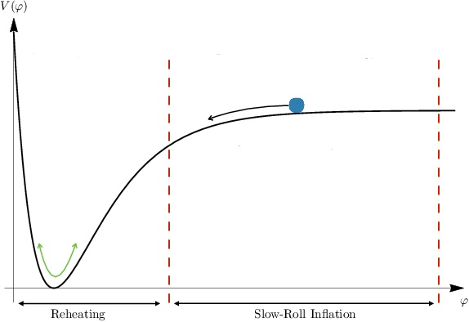
2. Matter sector
For simplicity: scalar field [New paper on the way…]
Outlook at Higgs inflation

Slide 6
3. Interactions
Ingredients:
Curvature
Torsion
Non-metricity
Scalar field
Rules:
Matter sector < mass dim 4
Interactions between the gravity and matter sector < mass dim 4

Slide 7
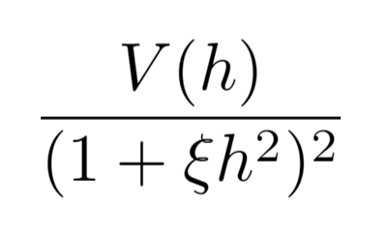
3. Interactions
Procedure:
Solve for torsion and non-metricity
Plug back solutions in the action ~ “effective action”
Perform a conformal field transformation of the metric to ‘remove’ non-minimal coupling

Slide 8
Appendix
Split into irreducible components is the most efficient way to perform computations.
$$Q^{α}=g_{μν}Q^{αμν}$$
$$T^{α}=g_{μν}T^{μαν}$$
$$Q^{αβγ}$$
$${\hat{Q}}^{α}=g_{μν}Q^{μαν}$$
$$T^{αβγ}$$
$${\hat{T}}^{α}=ε^{αβγδ}T_{βγδ}$$
$$t^{αβγ}$$
$$q^{αβγ}$$

Slide 9
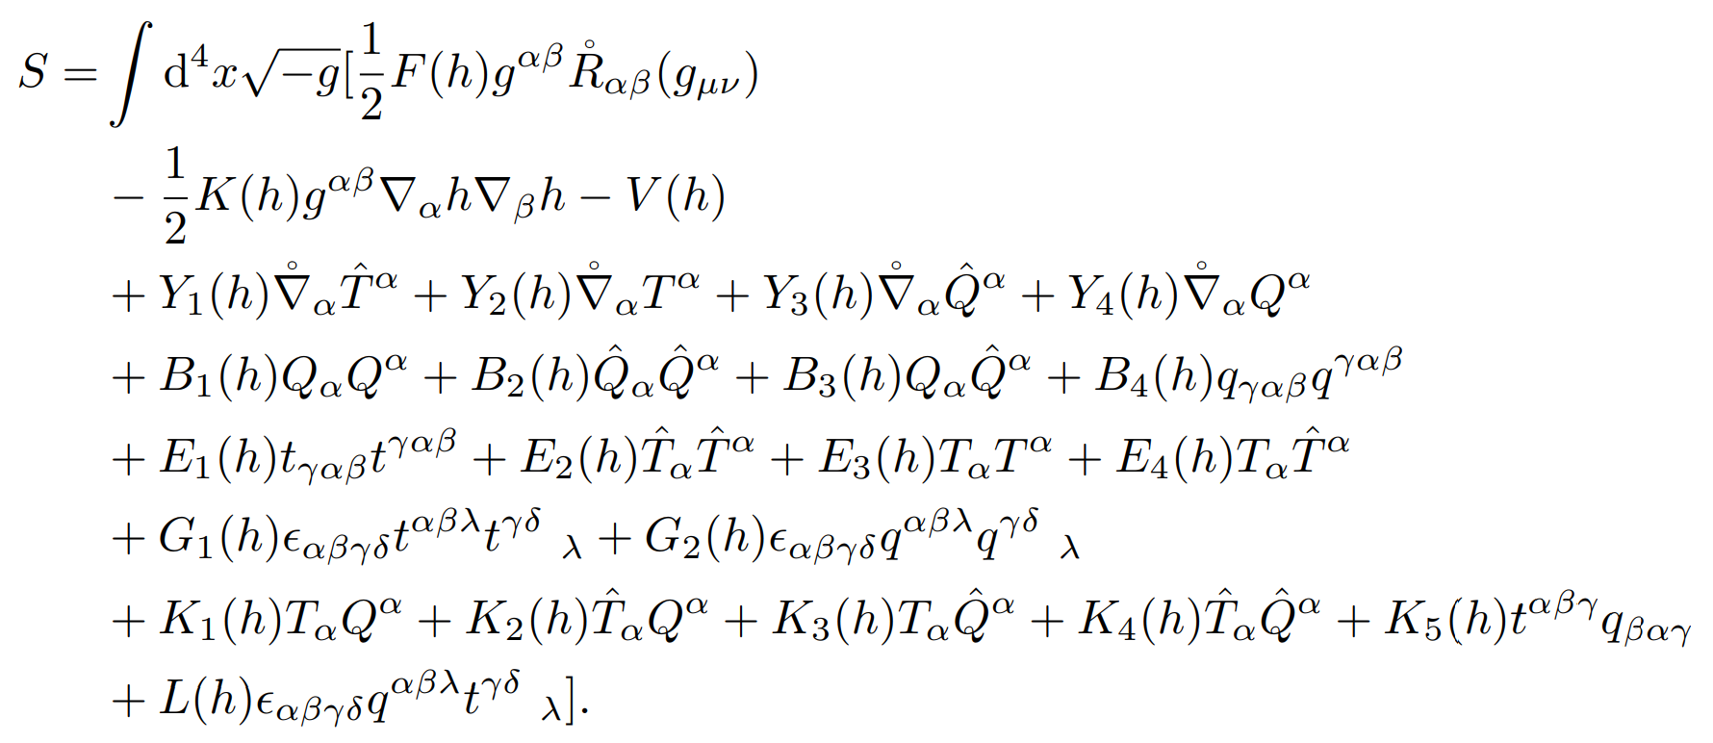
Appendix
Ricci scalar
Scalar sector
Source terms
Non-metricity squared
Torsion squared
Gravity sector
Levi-civita terms
Interactions

Slide 10
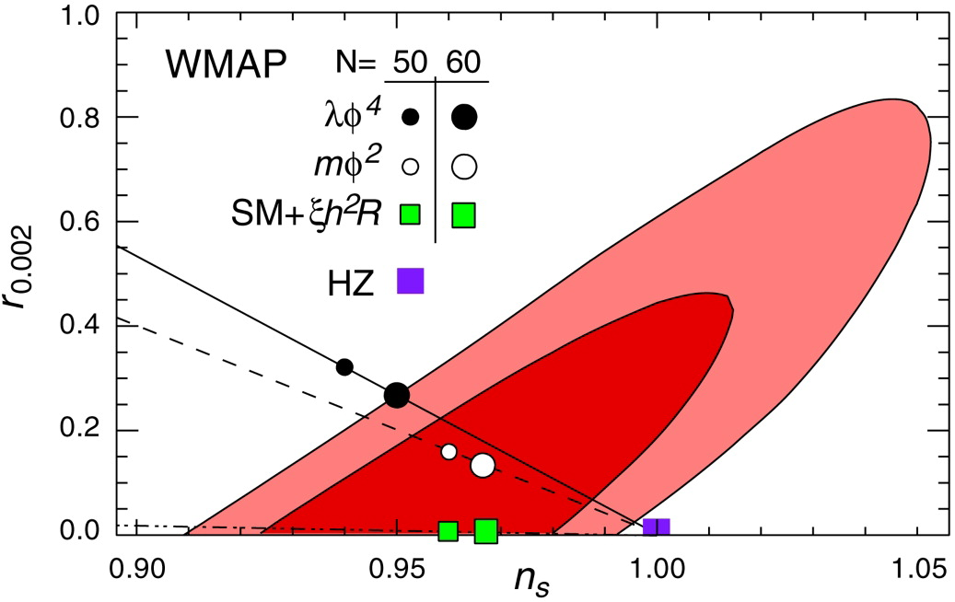
Appendix
Can confront theoretical prediction with CMB observations from PLANCK.
It happens that Higgs inflation in metric formalism lie within observations [5]
[5] F. Bezrukov, M. Shaposhnikov, The Standard Model Higgs boson as the inflaton, 0710.3755

Slide 11
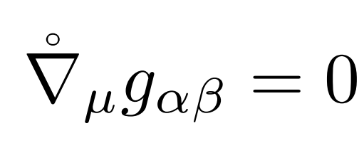
Appendix
Notations:

