Slide 1
Regge pole description of scattering by dirty black holes
Shiqian Hu
Theoretical Particle Physics and Cosmology
King’s College London
YTF 2022, Durham, Dec 15, 2022
arXiv: 2211.17147
with Theo Torres, Mohamed Ould El Hadj and Ruth Gregory
Notes:
RPs and the associated complex angular momentum (CAM) technique are the counterparts to QNMs. While QNMs have a real angular momentum and a complex frequency, the RPs have a real frequency and a complex angular momentum.

Slide 2
Outline
Dirty black hole and Geodesic motion
Critical effects
Deflection angle
Resonances
Regge poles
Wave scattering by a dirty black hole spacetime
Scattering cross section
Conclusions
Notes:
We show the definition of dirty black hole and the metric to describe. DBH spacetime may exhibit various critical effects for geometrical optics.
We then find the resonances by computing the Regge pole spectrum for different configurations.
We look at scattering by compute the differential scattering cross section for various configurations.
In conclusion, we highlight the role of critical effects.

Slide 3
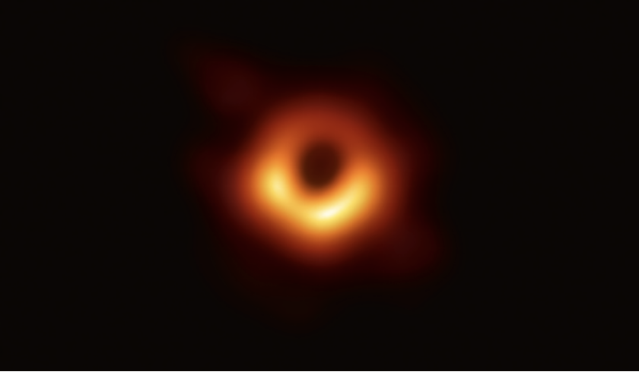
What is a dirty black hole?
Black holes
Spacetime ripples: Gravitational waves, Advanced Laser Interferometer Gravitational Wave Observatory, 2016
Black hole images: First picture of a black hole, Event Horizon Telescope, 2019
Dirty black holes ¹
Black hole with surroundings:
The presence of matter and fields around black holes
¹ M. Visser, Phys. Rev. D 46, 2445-2451 (1992)
Notes:
The detection of gravitational waves, reveal the first evidence of black hole.
EHT reports taking the first picture of a black hole.
The most recent two major breakthroughs have taken black holes into the field of experimental astronomy. It is now necessary to study black holes not only as isolated objects but also within their environment. DBH is that kind of black hole, it describes bh with their environment.

Slide 4
Dirty black hole
The spacetime is given by two distinct Schwarzschild geometries:
$$R_{s}$$
$$∞$$
$$M_{−}$$
$$M_{+}$$
Applying Israel junction conditions
$$ΔK_{ab}−ΔKh_{ab}=8πS_{ab}=Eu_{a}u_{b}−P(h_{ab}−u_{a}u_{b})$$
Time dependent trajectory
$$(t_{±}\left(τ\right),R_{s}(τ))$$
$$\dot{R_{s}}=\ddot{R_{s}}=0$$
$$P=ω E$$
Notes:
First, we review the derivation of the DBH spacetime. Here is a conventional expression that two different spacetimes are glued together.
Inputting the form of the geometry into junction condition, we derive the two independent equations; S is the energy momentum of the shell. $ΔK_{ab}$ is the jump in extrinsic curvature across the shell. u is the outward pointing normal on each side of the shell.
Here we look at the static shell which requires, and assuming an equation of state for the shell.
We then have static configurations fully characterised by the mass of the shell and its equation of state;
Junction condition explaination

Slide 5
Locations of shell
The minimum value of $R_{s}$, ($M_{+}=M_{−}$)
$$R_{s,min}=\frac{1+4ω}{2ω}M_{±}$$
Different locations of the shell:
$R_{s}<3M_{−}, (ω>\frac{1}{2})$
The shell lies inside the inner light ring
$3M_{−}≤R_{s}≤3M_{+},(\frac{\sqrt{3}−1}{4}<ω≤1)$ Config. 1
The shell lies between the light-rings
$R_{s}>3M_{+}, (ω<\frac{1}{2})$ Config. 2
The shell lies out the outer light ring
Inner light ring $3M_{−}$
Outer light ring $3M_{+}$
Notes:
For a given equation of state, the minimum value of Rs is when the shell has vanishing energy, which means $M_{+}=M_{−}$
The important feature of a black hole spacetime of relevance to QNM’s and RP’s is the light ring.
We now see three different possibilities for the shell location depending on where it is situated with respect to the light-rings of the interior and exterior Schwarzschild masses.
As the local Schwarzschild mass is M+ outside the shell, this means that the 3M− light-ring no longer exists, and the spacetime will have only one light-ring at r = 3M+.
When the shell lies between the two light rings, it is possible for all equations of state in this range, and the spacetime have two light rings present.
If the shell lies outside, then again there is only one light-ring in the spacetime, although it is now inside the shell at 3M−.

Slide 6
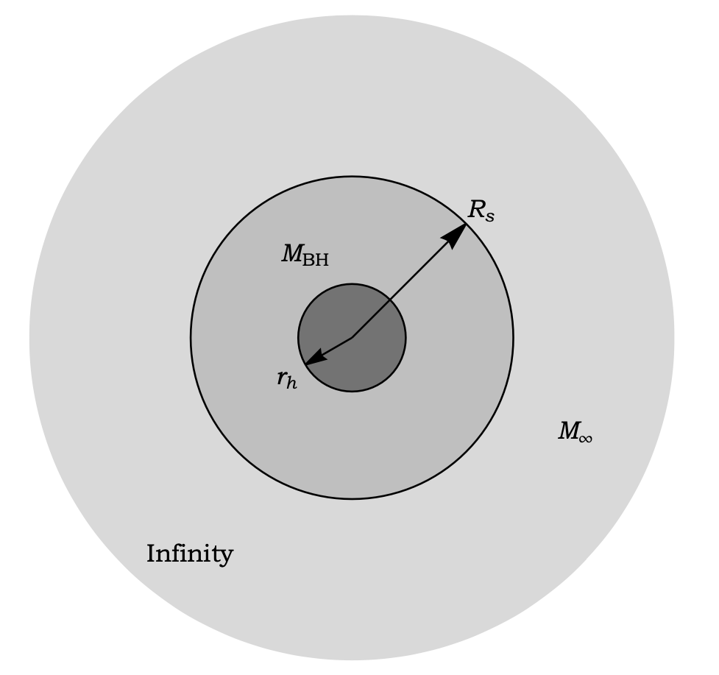
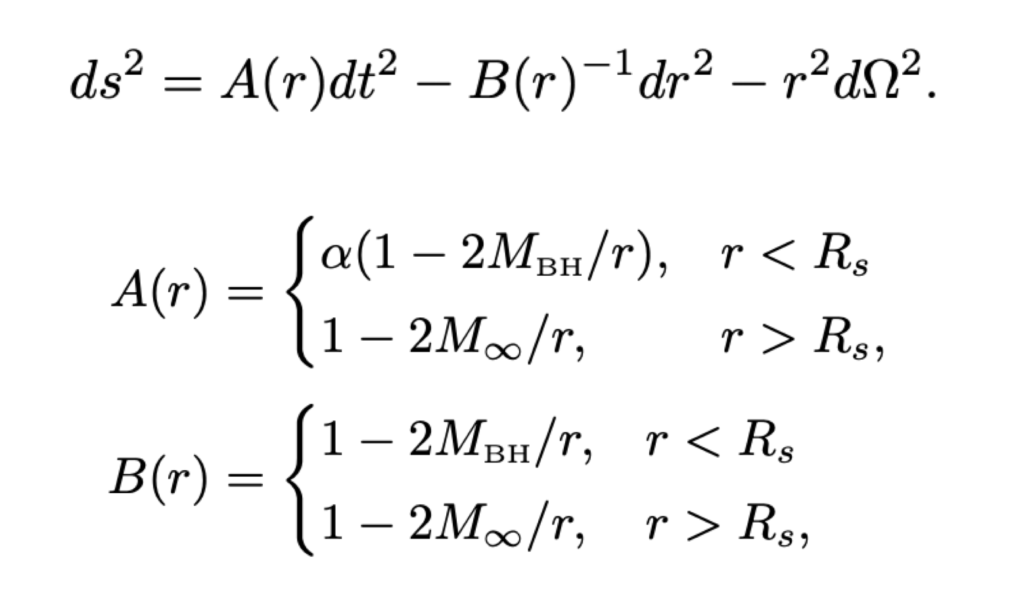
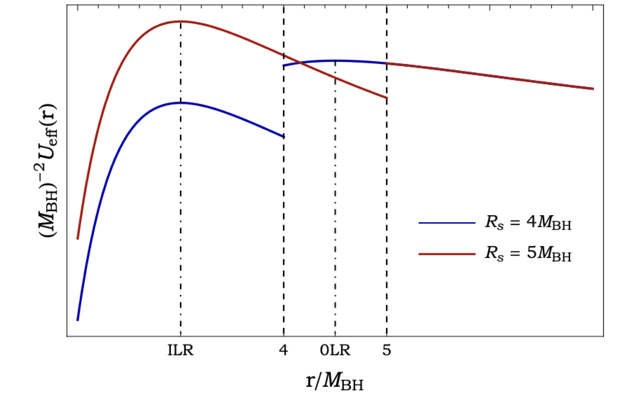
Change of notation
The metric is given by a global coordinate system $(t,r,θ,φ)$
$$α=\frac{R_{s}−2M_{∞}}{R_{s}−2M_{BH}}$$
The equation of motion of a null geodesic
$$M_{∞}=1.5M_{BH}$$
Notes:
Now we alter our notation into a global coordinate system by replacing $M_{−}$ with M_bh and $M_{+}$ with M_infinity.
$α$ is inserted to ensure the induced metric on the shell is well defined from each side.
The reason we didn’t start with this is because it is not possible to define a global time coordinate unless the shell is static and we want to derive all possible configurations with a physical equations of state.
Now we move our insights to the rich geodesics structure. U_eff is the effective geodesic potential.
The important notion emerging from the geodesic motion relevant to our study of resonances is the light-ring. It corresponds to a local maximum and an unstable equilibirum point of geodesic potential, which offers an intuitive link to QNMs.

Slide 7
Scattering effects
Classical scattering cross section and geodesic deflection angle
Notes:
$u=\frac{1}{r}$ and $u_{0}=\frac{1}{r_{0}}$, $r_{0}$ is a turning point, $Θ\left(b\right)+2nπ=±θ$ (scattering angle)
Before turning our attention to the spectrum of resonances of DBH, we present the effects in the scattering based on geodesics structure.
The link between between geodesic motion and scattering effect is best seen through the deflection angle. Here we give the deflection angle and
Geodesic deflection angle, which can be used for explaining various critical effects in a dirty black hole spacetime.
The black disc represents the inner black hole with mass MBH, the dashed green circle represents the location of the shell at r = R_S and the dashed black circle depicts the inner light-ring at r = 3MBH.
In the left, the plots depicts glory scattering where the geodesics are scattered in the backward direction.
The picture illustrates rainbow scattering. In this case, we can see a congruence of geodesics, (solid red curves). The rainbow ray (black solid curve) defines an extremal angle, called the rainbow angle.
The ray of minimum deviation (#7 in Fig. 2) is called the rainbow ray.

Slide 8
Scattering effects
Notes:
The picture depicts the orbiting phenomenon. Obviously, the geodesics orbit around the inner light ring. In this case, the deflection angle is divergent for a critical impact parameter, a particle orbits indefinitely at r = 3MBH around the light-ring.
d) The picture represents grazing rays. A congruence of rays centred around the grazing impact parameter b = b R_s is shown (solid red curves). The grazing ray (solid black curve) sets the boundary of the so-called edge region.

Slide 9
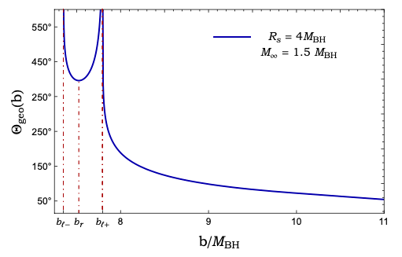
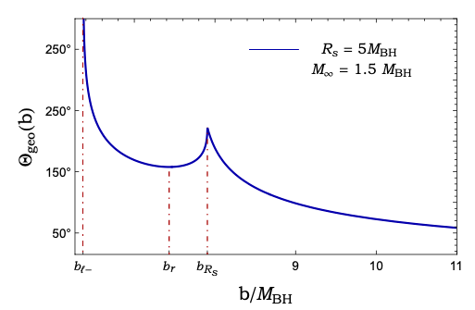
Critical effects in DBH spacetimes
$θ_{r}=157.8°$,rainbow angle
$θ_{r}=35.8°$,rainbow angle
$$b_{l_{−}}=\frac{3\sqrt{3}M_{BH}}{\sqrt{α}}$$
$b_{l_{+}}=$ $3\sqrt{3}M_{∞}$
$$b_{l_{−}}=\frac{3\sqrt{3}M_{BH}}{\sqrt{α}}$$
$b_{R_{s}}=\sqrt{\frac{R_{s}^{3}}{R_{s}−2M_{∞}}},$ grazing
Notes:
If the shell lies between the light-rings, then there is the possibility for geodesics to probe each light-ring separately. Each light-ring is associated with a divergence of the deflection angle, leading to orbiting.
In the case where both light-rings are accessible to geodesics, we expect two such divergences to be present, associated with orbiting around the inner and outer light-rings. The rainbow angle θr ≈ 35.8◦ and is associated with the impact parameter b_r.
If the shell lies outside 3M_\infinity, a single light-ring is present in the geometry, which is now located inside the shell. In this case, the orbiting effect is qualitatively the same as for an isolated black hole and is associated with the critical impact parameter $b_{l_{−}}=\frac{3\sqrt{3}M_{BH}}{\sqrt{α}}$
Contrary to the previous case, this maximum is not associated with the second light-ring but rather to the presence of the shell. Since this second local maximum is not an (unstable) equilibrium point, it will not be associated with a divergence of the deflection angle but rather with a singular point, It is important to note that the singular point occurring at b_rs, it’s a local maximum of the deflection angle, but does not satisfy the condition dΘgeo/db = 0,
which implies that it is not associated to rainbow scattering, Instead, this singular point will lead to grazing as discussed previously.

Slide 10
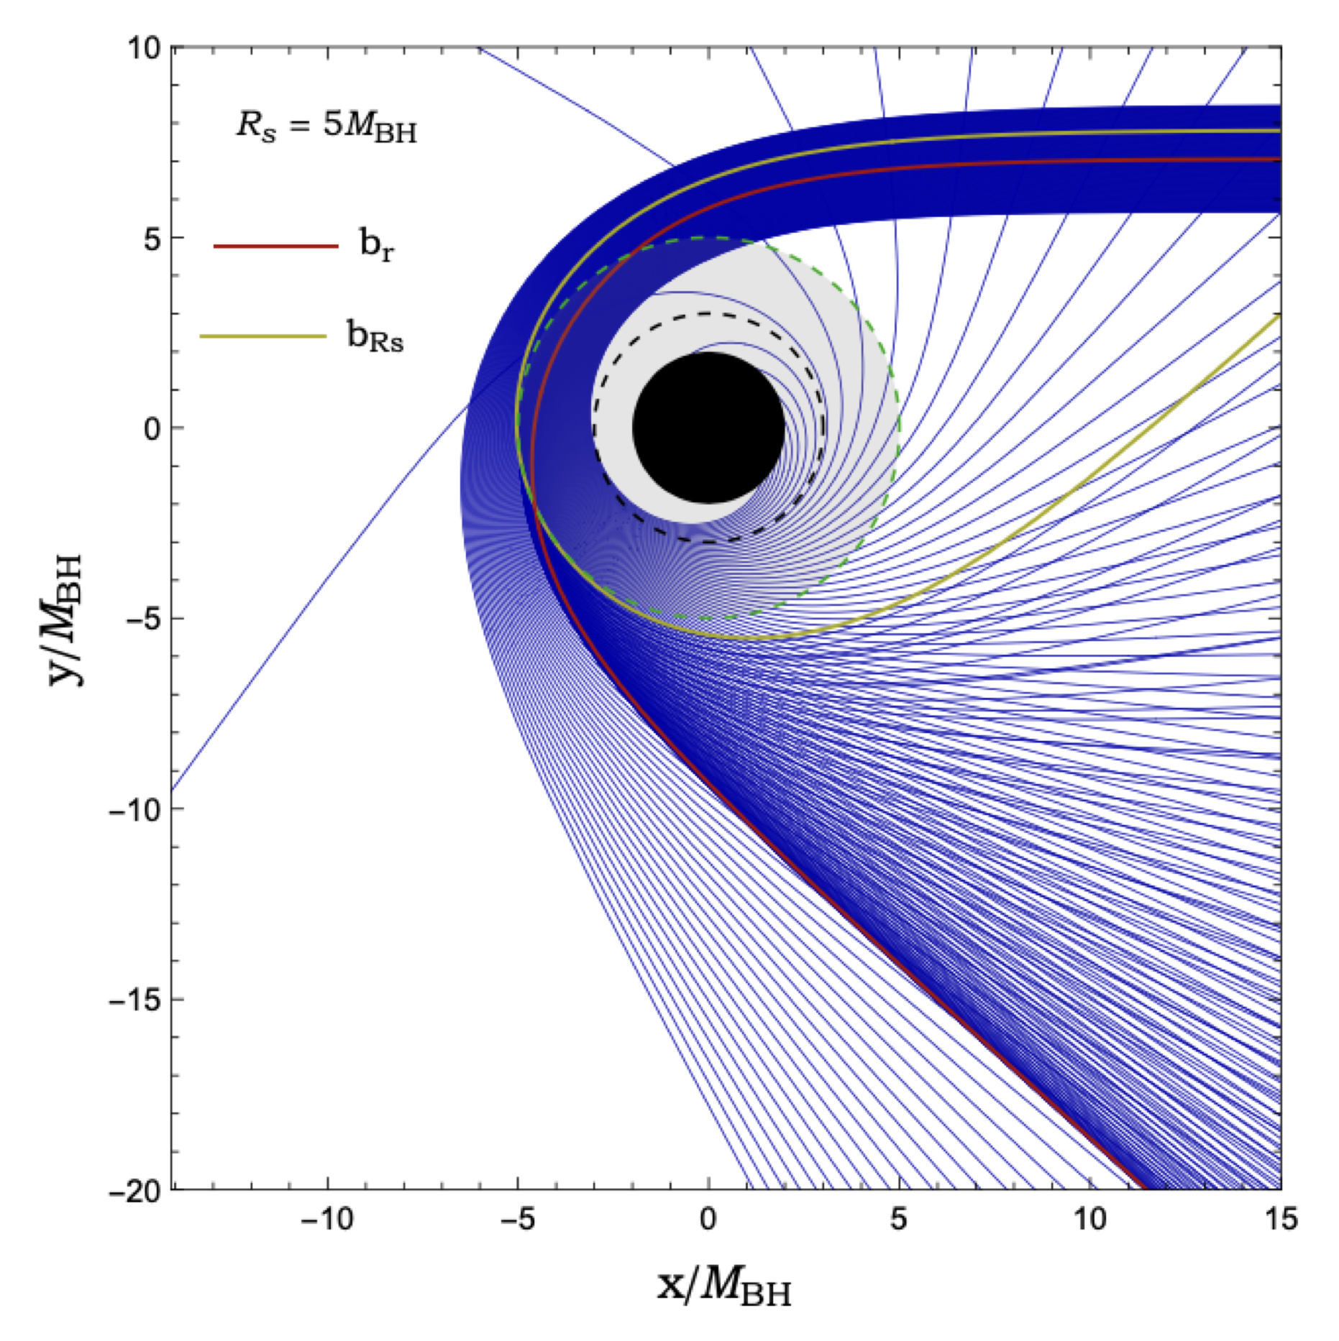
Critical effects in DBH spacetimes
Null geodesics scattered by a DBH
Impact parameter $b_{r}$ leads a divergence for $θ≠0 or π$
$b_{R_{s}}$ leads to a singular point where the scatter has a discontinuity
Notes:
This depicts a congruence of geodesics in this DBH set-up. The red and dark green rays represent the rainbow and grazing ray respectively and are both associated with an extremal angle.
Note the qualitative difference between the rainbow and grazing ray which resides in the concentration of geodesics around each critical trajectory.

Slide 11
Waves on a dirty black hole spacetime
We consider a scalar field, $φ(x)$, propagating on the DBH spacetime
Radial equation and effective potential
Tortoise coordinate
The solutions defined by their behavior at the horizon $r=2M_{BH}$, and at spatial infinity $r→+∞$
Boundary condition on the eigenfunctions $φ_{ωl}$ at the shell
Notes:
We consider a scalar field, Φ(x), propagating on the DBH spacetime, governed by the Klein-Gordon equation
Performing a standard separation of variables, leads to a radial equation of the form, where Vl(r) is the effective potential which is given by
we introduce the ingoing modes of waves, which are defined by…..
Boundaries conditions are taken at the discontinuous Rs.

Slide 12
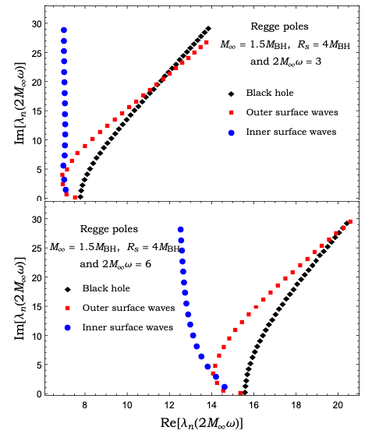
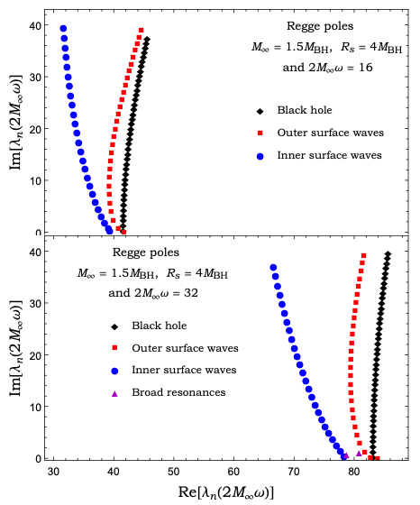
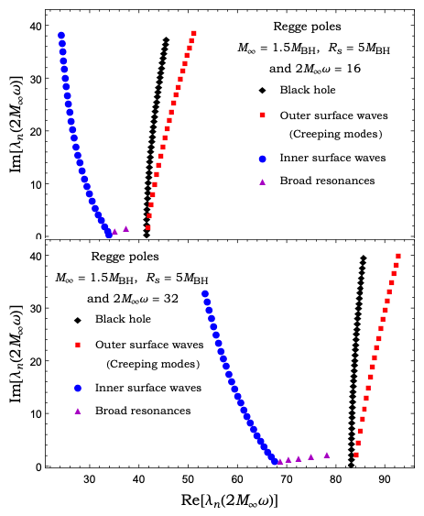
Resonances of the dirty black holes
Notes:
To compute the Regge pole spectrum of dirty black holes, we use a numerical method which is an extension of the original continued fraction method developed originally by Leaver.
The leftmost one shows the Regge pole spectrum for the first configuration with parameters M∞ = 1.5MBH and Rs = 4MBH for two different frequencies 2M∞ω = 3 and 6.
For both frequencies, the Regge Pole spectrum exhibits two branches, represented in blue and red. For low overtones, the two branches merge, with the distinction becoming clear at higher overtones. Note that the splitting occurs for smaller values of n as one increases the frequency. We can identify the origin of both branches as coming from the existence of two light-rings or from the inner-ring.
Middle one shows the spectrum of the Regge pole also for the first configuration with the same parameters but for two different high frequencies.
We can see that the structure of the spectrum remains the same, however for very high frequencies (lower panel), we can see the emergence of a new branch (purple triangles) between the two branches associated with the inner and outer light-rings.
The right shows the Regge pole spectrum for 2M∞ω = 16 and 32 and this for the second configuration, The structure remains the same for both frequencies but the number of poles in the middle branch has increased with frequency.

Slide 13
Wave scattering by a DBH
The differential scattering cross section
Construct the CAM representation of $f(θ)$ using a Sommerfeld-Watson transformation
[Antoine Folacci and Mohamed Ould El Hadj, Phys. Rev. D 99, 104079 (2019)]
The background integral contribution and the second term
Notes:
We compute the differential scattering cross sections. We use the partial wave expansion, and we compare with the results constructed by CAM representations of these cross sections.

Slide 14
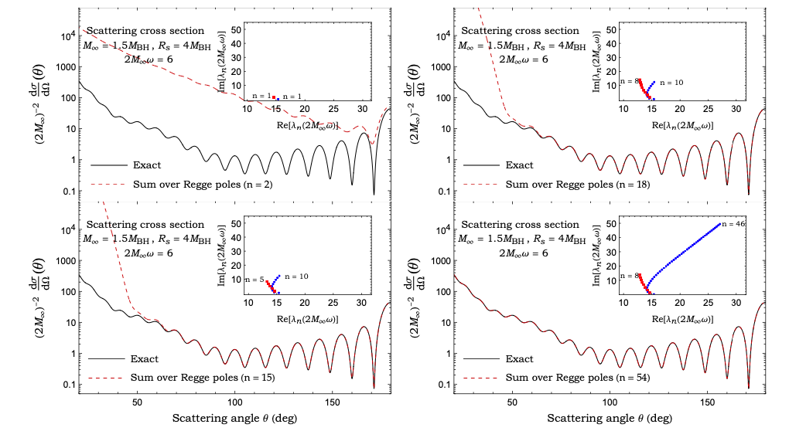
Scattering cross section
Notes:
This shows the scattering cross section constructed from the CAM approach at 2M∞ω = 6 for a shell configuration with M∞ = 1.5MBH and Rs = 4MBH,
We can see that it gets progressively closer to the scattering cross section constructed from partial wave expansion by including increasingly more Regge poles in the sum. Indeed, the sum over only the first two Regge poles in equation (60) does not reproduce the cross section, however, summing over 54 Regge poles, but without including the background integral, the agreement is perfect with that constructed from the partial wave expansion for θ >20◦ .

Slide 15
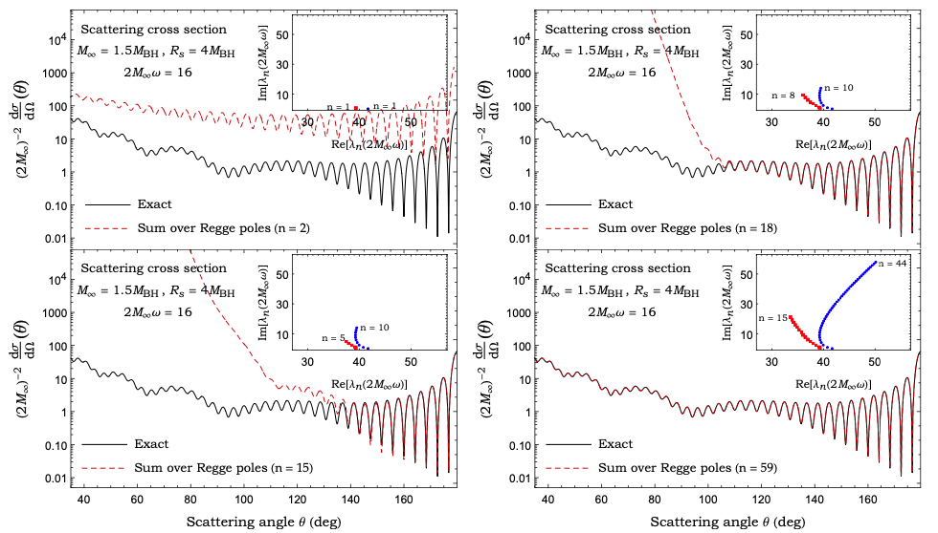
Scattering cross section
Notes:
For the same DBH configuration, the scattering cross section at high frequency 2M∞ω = 16. In this case, with just 18 Regge poles the glory and the orbiting oscillations are very well reproduced. With 59 Regge poles and without adding the background integral the result obtained from the CAM approach is again indistinguishable from partial wave expansion for θ 􏰰 30◦ on the plot.

Slide 16
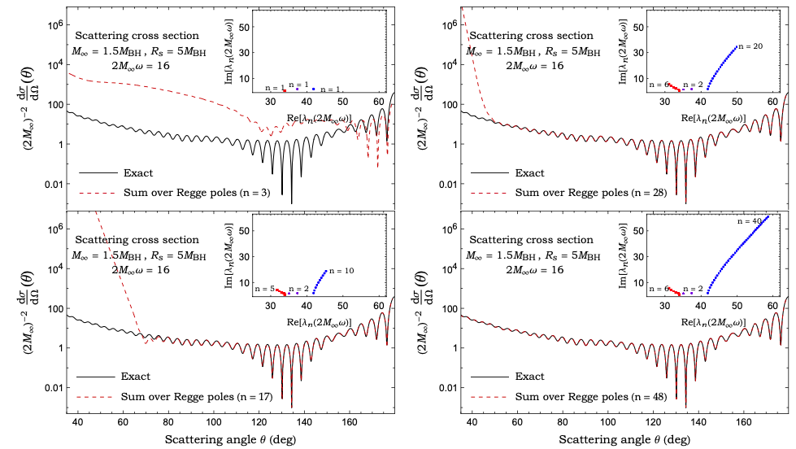
Scattering cross section
Notes:
This plot shows the scattering cross section for a DBH configuration with Rs > 3M∞ at 2M∞ω = 16. Here, we have the shell configuration with M∞ = 1.5MBH and Rs = 5MBH. In this case, to construct the result from CAM approach, we sum over three different branches and with 17 Regge poles the glory as well as the orbiting oscillations are captured. By including 48 Regge poles, but no background integral, the agreement is excellent with the partial wave expansion result for θ > 30◦.
We have shown that the scattering cross section can be described and understood in terms of the Regge Poles, i.e., in terms of various contributions from different types of resonances. we have identified different branches associated with the properties of the light-rings and the shell position and/or its matter content. To conclude our description of the differential scattering cross section, we return to the discussion of critical effects associated with geodesic motion described. We can indeed understand qualitatively the observed scattering cross sections from the various critical effect. As in the case of the isolated black hole, the orbiting effect and the glory (associated with a single light-ring) will result in oscillations in the scattering cross section as well as an increase for θ ∼ 180◦.

Slide 17
Scattering cross section
$R_{s}>R_{OLR}$: Scattering amplitude is enhanced at rainbow angles
$R_{ILR}<R_{s}<R_{OLR}$: Scattering cross sections exhibits noticeable modulation at all angles
Notes:
In DBH spacetimes, we have shown that we may expect modulations due to the rainbow effect and to grazing (creeping modes) or secondary orbiting. The rainbow effect will lead to a local amplification of the scattering cross section around the rainbow angle. Grazing, i.e., the edge rays (creeping modes) or second orbiting will lead to further oscillations and global modulations of the scattering cross section.
Note the qualitative difference that for configurations where the shell is outside the outer light-ring, the scattering cross is mainly modulated around the rainbow angle while for the case where the shell lies between the two light-rings the scattering cross sections exhibits noticeable modulation at all angles.

Slide 18
Conclusions
The scattering of planar waves incident on a dirty black hole spacetime
The spectrum of resonances of DBHs
The Regge pole spectrum of different DBH configurations
The existence of two branches associate with the inner light-ring and with either the outer light-ring or the shell depending on the DBH configuration.
The possible existence of a third branch with a nearly constant imaginary part.
The complex angular momentum representation of the scattering with the identification of RP spectrum
Notes:
Our study fits into the general goal of modelling and understanding black holes within their environments. we have investigated the scattering of planar waves impinging on a dirty black hole spacetime.
We focused on the spectrum of resonances of DBHs and calculated the Regge pole spectrum of different DBH configurations.
We identified two key properties of the RP spectrum of DBHs. The two branches emerge from the original isolated black hole spectrum. The separation from the original branch to the two distinct ones appears first for large overtone numbers, and the two branches may overlap for low overtone. The existence of the two branches results in modulation of the scattering cross section.
In addition to these two branches, we have identified a third branch corresponding to broad resonances trapped between the inner light-ring and the thin shell.
We have shown that the RP spectrum and their associated residues accurately describes the scattering cross section, including the modulations and deviations from the case of an isolated black hole.

Slide 19
Thanks for your attention.

