Slide 1
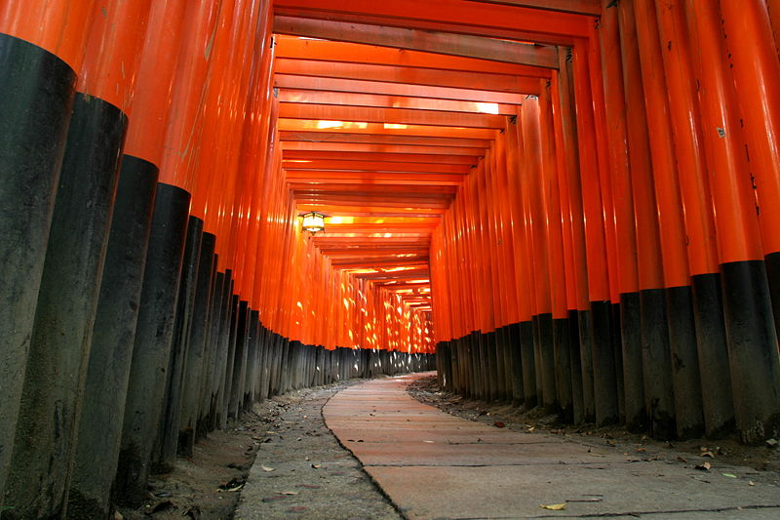
Neutrinos – The Big Answers (?)
UK HEP Forum
Apr. 27th, 2022
Dave Wark
Oxford University

Slide 2
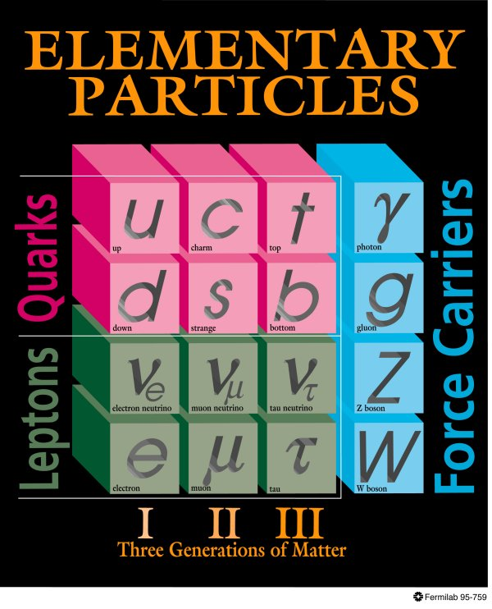
The Standard Model (~1980)
Neutrinos in the 1980 Standard Model:
  Three neutrinos with a conserved lepton flavour number.
  Massless.
  Strictly Left-handed.
?
??
?
??
???
H
Higgs

Slide 3
The Standard Model (~now)
Neutrinos in the 198 Standard Model:
  Three neutrinos with a conserved lepton flavour number.
  Massless.
  Strictly Left-handed.
?
??
?
??
???
H
Higgs

Slide 4
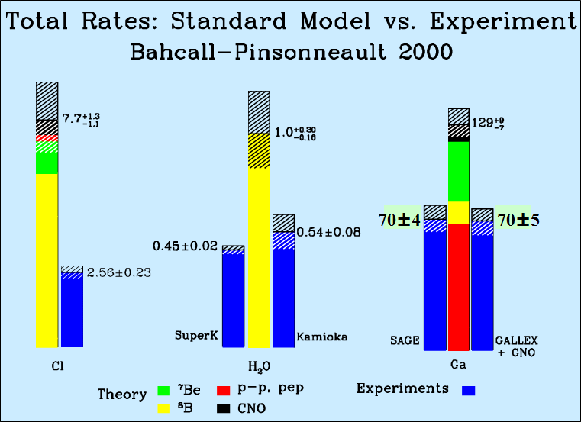
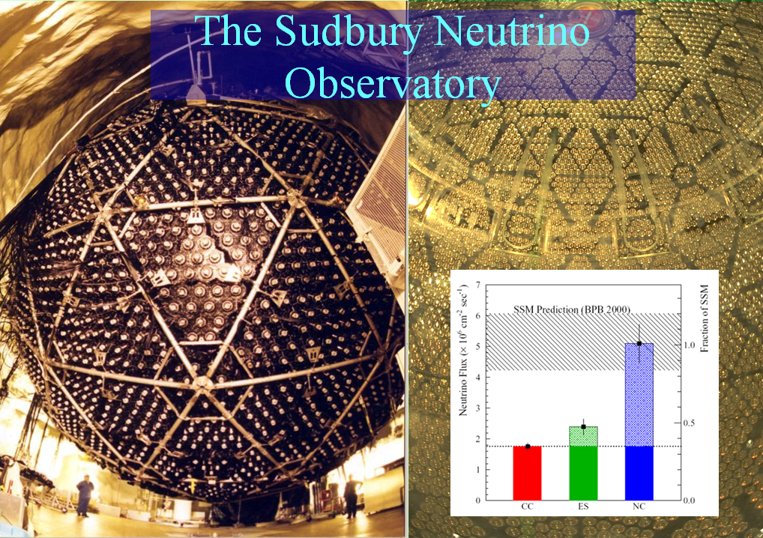
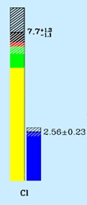



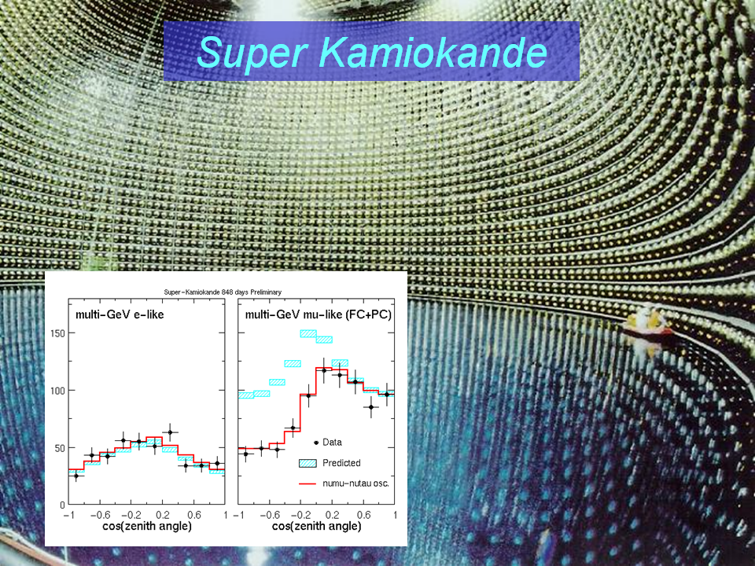
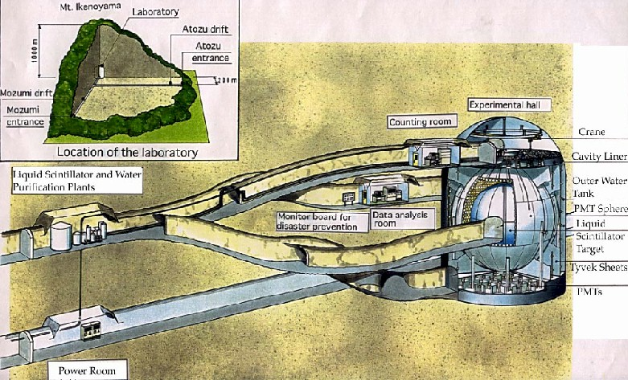

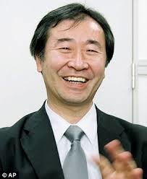

The combination proves that neutrinos oscillate,
and hence have mass – our first big answer!.
To which we now add results from Chooz, Palo Verde,
K2K, MINOS, MINOS+, T2K, NOvA, Daya Bay, RENO,
Double Chooz, BOREXINO, OPERA, ICARUS,
Icecube, ANTARES, and more. . .

Slide 5
More Big Answers.
We have measured the three angles in the neutrino mixing matrix with varying accuracy.
We have determined the mass-squared differences, and the sign of one of them.
We have “hints” of CP violation from T2K, but no sign of it in NOvA, so no clarity there.
We have “indications” of NO and “preferences” for the octant from global fits. However…

Slide 6
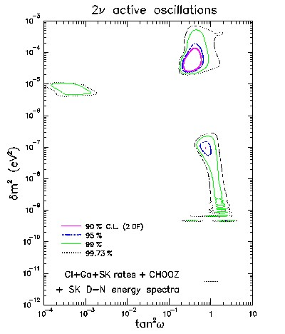
A warning from history.
After the results of the gallium experiments were known it was widely assumed that the solar neutrino problem was solved by neutrino oscillations (see Bahcall and Bethe, PRL 65, p 2233, 1990),
but there was no proof.

Slide 7
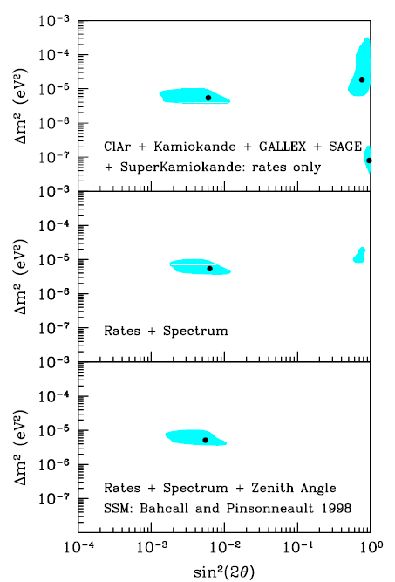
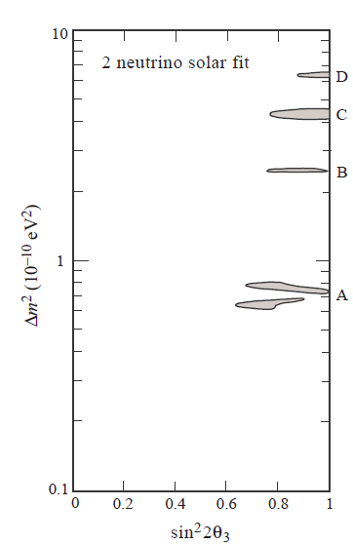
Using all data as of
Neutrinos ‘98.
These are 99% c.l. contours!
Note that these best fits would essentially rule out CP violation in terrestrial experiments.
Be careful of global fits of
systematics limited experiments!
Systematics do not have distributions, and they don’t follow the central limit theorem, and they aren’t Gaussian!

Slide 8
What is the Mass Hierarchy?
It “probably” looks
something like this
Log m²
m₃
Δm²₂₃ ~ 2.5 x 10⁻³ eV²
m₂
Δm²₁₂ ~ 7.5 x 10⁻⁵ eV²
m₁
ν_{e}
ν_{μ}
ν_{τ}

Slide 9
What is the Mass Hierarchy?
But it could look like this
Log m²
m₃
m₂
m₁
m₂
m₁
m₃
Normal Heirarchy
Inverted Heirarchy
ν_{e}
ν_{μ}
ν_{τ}

Slide 10
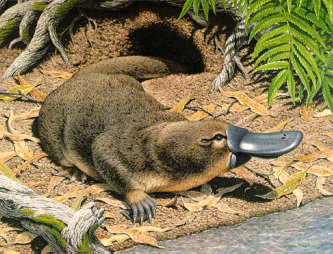
Does this look natural?

Slide 11
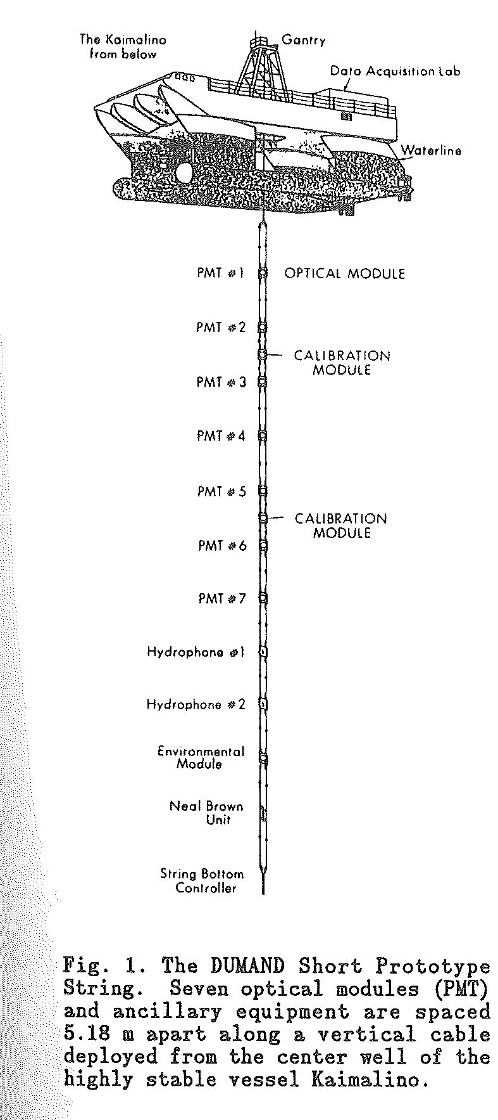
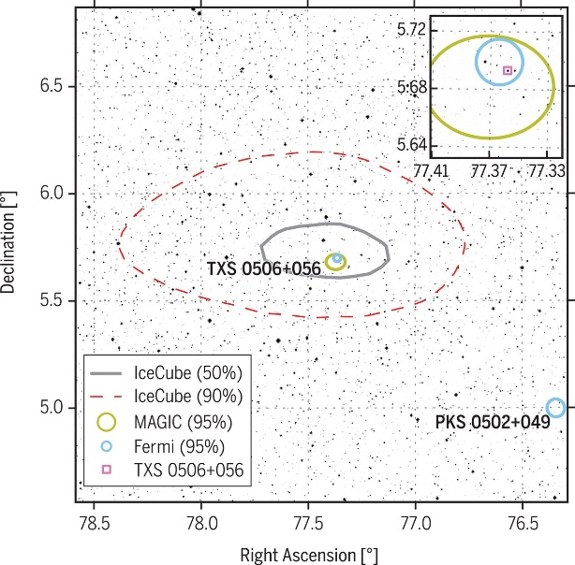
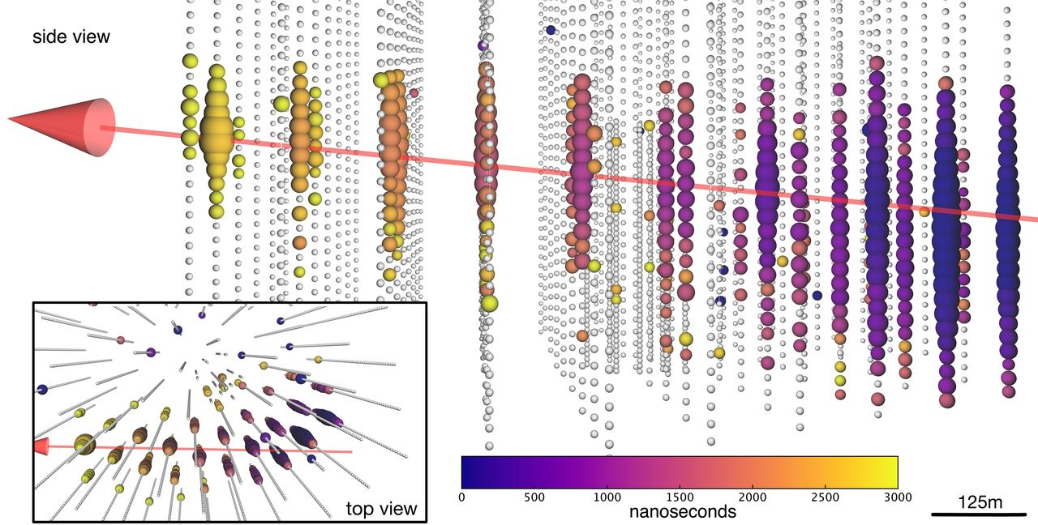
More Big Answers
Can we see neutrinos from high-energy processes in the deep universe?
YES!
This is now astronomy!

Slide 12
Big Answers to Come (I)
What is the Mass Hierarchy?
To do this in a single experiment we either look at the interference term in the three-flavour oscillation formula with JUNO, or use the matter effect in DUNE (beam neutrinos) or Hyper Kamiokande (atmospheric neutrinos).
Maybe enough other experiments will agree that a global fit will be convincing, but for myself, I trust results much better when there is more than one single-experiment measurement of sufficient significance.
Hopefully known by early 30’s.

Slide 13
Big Answers to Come (II)
Is CP violated in neutrino oscillations?

Slide 14
Big Answers to Come (II)
Is CP violated in neutrino oscillations?
Experiments are moving within their errors, but interpretation changes as they do.
Could be statistics or an error in one/both experiment(s).
A joint analysis is underway which may cast light on differences in approach.
In any case these two experiments lack the sensitivity to make a definitive statement on CP violation.
We await Hyper Kamiokande and DUNE for a clear measurement.

Slide 15
Big Answers to Come (II)
Is CP violated in neutrino oscillations?
In order for this to happen we must make significant progress on systematics, particularly on understanding neutrino interactions.

Slide 16
Big Answers to Come (II)
Is CP violated in neutrino oscillations?
To move beyond this we will need a new type of neutrino source, and we will need one sooner than we seem to be planning for.

Slide 17
Big Answers to Come (III)
What is the Octant?
This determination will also come from long-baseline experiments (perhaps aided by other atmospheric neutrino measurements).
It is harder to say when it will happen, as the ability to distinguish the octant depends very strongly on what the actual value of θ₂₃ is (obviously there is no octant to determine if θ₂₃ is 45◦).
HK 10 yrs
DUNE 40 kT

Slide 18
Big Answers to Come (IV)
Are neutrinos their own anti-particles? If they are, it would be the discovery of an entirely new class of particles, something that happens very rarely!
What are the absolute masses of neutrinos?

Slide 19
Measuring absolute m_{ν}
Supernovae – Prodigious producers of neutrinos, and measuring time shifts can in principle measure neutrino masses, m_{ν} < ~30 eV.
Kinematic limits: If you believe the oscillation results, all Δm²≪1 eV, therefore only ν_{e} measurements have useful sensitivity → current best is Tritium Beta Decay, m_{ν} < 0.8 eV.
If neutrinos have Majorana masses, then zero-neutrino double-beta decay is allowed → observation of 0νββ decay would be direct evidence for neutrino mass, <m_{ν}> < ~1.3 eV.
Neutrinos are the second most numerous particle in the Universe → even a tiny neutrino mass could have astrophysical implications, Σm_{ν} < 0.28 eV(?)

Slide 22
SNO Systematic Flux Uncertainties
Before astrophysical limits can be
considered equivalent to laboratory
limits, we need proper quantification
of systematics and model dependencies.
  Error Source
  Energy scale
  Energy resolution
  Non-linearity
  Vertex shift
  Vertex resolution
  Angular resolution
  High Energy γ’s
  Low energy background
  Instrumental background
  Trigger efficiency
  Live time
  Cut acceptance
  Earth orbit eccentricity
  ¹⁷O, ¹⁸O
  Experimental uncertainty
  Cross-section
  Solar Model
  CC error (%)
  -5.2, +6.1
  ±0.5
  ±0.5
  ±3.1
  ±0.7
  ±0.5
  -0.8, +0.0
  -0.2, +0.0
  -0.2, +0.0
  0.0
  ±0.1
  -0.6, +0.7
  ±0.2
  0.0
  -6.2, +7.0
  3.0
  -16, +20
ES error (%)
-3.5, +5.4
  ±0.3
  ±0.4
  ±3.3
  ±0.4
  ±2.2
  -1.9, +0.0
  -0.2, +0.0
  -0.6, +0.0
  0.0
  ±0.1
  -0.6, +0.7
  ±0.2
  0.0
  -5.7, +6.8
  0.5
  -16, +20
In any case, using precious
cosmological data to
constrain m_{ν} would be like
using LEP as a tide gauge.
The sensitivity to m_{ν} reached
by astrophysics should act as
a spur to get laboratory sensitivities
to match them!
Return ↑

Slide 23
Big Answers to Come (V)
Do Sterile Neutrinos exist? That is not a falsifiable statement, so not a good one to ask.
Can the indications of an excess in the LSND experiment be explained by simple oscillations via a sterile neutrino?

Slide 24
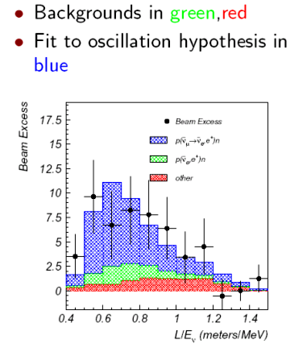
Sterile Neutrinos: LSND Starts it all...
Excess of electron anti-neutrinos in a “beam” from stopped pion decay…

Slide 25
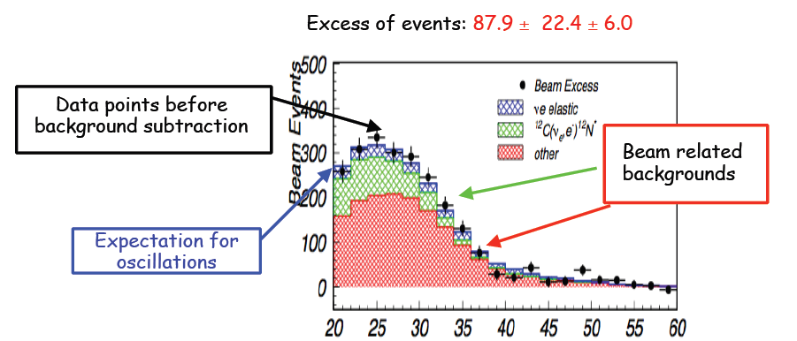

LSND Starts it all...
Excess not seen by
KARMEN experiment with similar sensitivity...

Slide 26
Big Answers to Come (V)
Do Sterile Neutrinos exist? That is not a falsifiable statement, so not a good one to ask.
Can the indications of an excess in the LSND experiment be explained by simple oscillations via a sterile neutrino?
NO. This hypothesis has been tested and rejected.
Are some of the other indications caused by sterile neutrinos? Which ones? A bunch of weak, inconsistent indications don’t make a strong one.
Sterile neutrinos may exist, but we have no significant experimental evidence that they do.
SBN will hopefully provide guidance.

Slide 27
Some final thoughts (I).
During my career we have made significant progress.
  Neutrino Oscillations are now routinely observed.
  Neutrino Astronomy now exists, and many new telescopes are being built.
We Boomers have not used up all the questions, however, and we have left many great ones for the end of our careers or for our successors.
  What is the MH?
  Is θ₂₃ maximal, if not what is the octant?
  Is CP violated in neutrino oscillations?
  Are neutrinos Majorana or Dirac or both?
  What is the absolute mass scale?
  Can we reproduce evidence for sterile neutrinos?
  Are there surprises?

Slide 28
Some final thoughts (II).
What programmes would I bet on continuing beyond the current round?
  Neutrinoless double beta-decay. No outcome of the current round of experiments would make you not need to build more. Ditto for the other neutrino mass measurements, especially the astrophysical probes.
  CP violation in oscillations. We will need a better beam, as we will be systematics limited! We will need many other measurements to constrain systematics.
  Neutrino astronomy, which will grow and grow.
  New methods and new experiments - We are limited by our technology, so we need to keep thinking (Project 8).
  And we will keep looking for supernovae, and DSN, as they should be a scientific gold mine!

Slide 29
