Slide 1
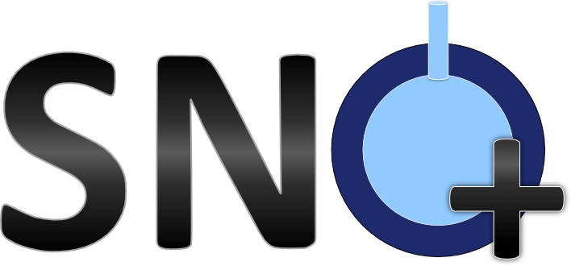
Measurement of Cosmogenic Neutron Multiplicity at SNO+
Katharine Dixon
King’s College London

Slide 2
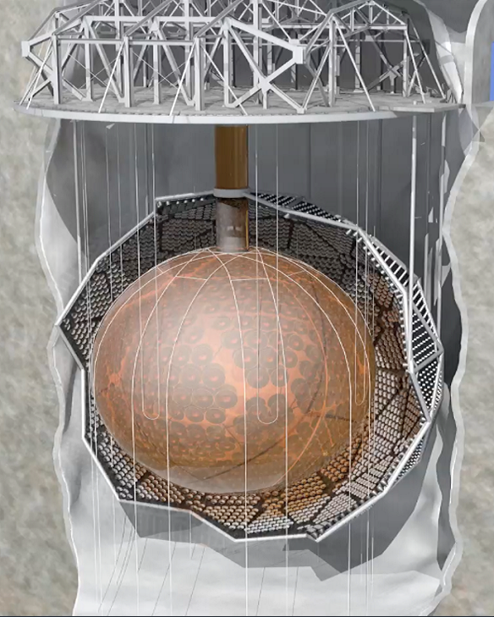
SNO+
$∼90$ outward looking PMTs (OWLs)
Acrylic vessel (AV), $12 m$ in diameter, contains the LAB
The SNO+ detector is located $2070m$ underground in SNOLAB, Canada
Three phases: water, scintillator, tellurium
Main goal is the search for neutrinoless double beta decay ($0νββ$)
Cavity filled with ultra-pure water (UPW)
$∼9300$ inward-facing PMTs mounted on a PMT support structure (PSUP)

Slide 3
Cosmogenic Neutrons
Due to the overburden, approximately three high energy cosmic muons pass through the detector per hour
The cosmic muons produce free neutrons which capture onto hydrogen atoms that will emit $2.2MeV$ gammas
Muon-induced neutrons pose as a background to many physics experiments which require very low backgrounds
$$γ$$
$$n$$
$$τ≈200μs$$
$$γ$$
$$n$$
(not to scale)

Slide 4
Neutron Multiplicity
The number of neutrons produced changes with energy
SNO has already made a measurement of the muon-induced neutron yield in heavy water
SNO+ can measure this yield, with the same muon flux, in water and scintillator
[1]
[1] Cosmogenic neutron production at the sudbury neutrino observatory, 2019

Slide 5
Measuring the Neutron Yield
Neutron multiplicity is determined through the measurement of the neutron yield:
Number of neutrons produced by a given muon - related to the number of neutron followers observed:
$$N_{obs}=εN_{n}+B$$
$B$ is the sum of the muon-induced and detector backgrounds.
$ε$ is the neutron detection efficiency…
Path length of the muon given by the distance between entry and exit points on the detector.
The reconstruction uncertainties in the position ($2.1°$) and direction ($2.2°$) will affect these.
$$Y_{n}^{μ}=\frac{N_{n}^{μ}}{L_{μ}ρ}$$
Density of the medium.

Slide 6
Neutron Detection Efficiency
$$ε=\frac{no. neutrons which pass selection cuts}{total number of neutrons generated along muon track}$$
This is position dependant so must be evaluated for each individual muon
The efficiency is low in water due only 9-25 PMT hits per neutron capture event
The misreconstruction of the muon track must also be taken into account
$$4.6m$$

Slide 7
Summary
The SNO+ detector allows for the measurement of neutron multiplicity in different media using the muon flux observed at SNOLAB
This will provide a greater understanding of the cosmogenic neutron background at SNOLAB depths
This analysis will be repeated during the scintillator phase of SNO+

