Slide 1
Using a Neural Network to Approximate the Negative Log Likelihood Function
Nathan Jamieson, Kevin Lannon, Shenghua Liu, Kelci Mohrman, Sirak Negash, Sergio Sanchez Cruz,
Yuyi Wan, Brent Yates
for the CMS Collaboration

Slide 2
Introduction
This study builds on a previous CMS analysis [1], in which 16 Wilson Coefficients (WCs) in the framework of standard model effective field theory (SMEFT) were used to parameterize different types of new physics that could affect top quark production.
Data → Event Selection → Histograms → Statistical Analysis → Extracting Results
Limitation: Published 1D and 2D scans lose information about the WCs, and the other popular way to communicate LFs—the covariance matrix at a measured point—assumes Gaussianity.
Binned observed yields
Full likelihood function (LF), which gives the delta negative log likelihood (ΔNLL) as a function of the 16 WCs and close to 100 nuisance parameters (NPs)
profile away NPs
Profiled ΔNLL, a function of the 16 WCs only
scan in 1D and 2D (frozen and profiled)
Published confidence intervals and contours
Binned simulated yields that depend on WCs
[1]: https://doi.org/10.1007/JHEP03(2021)095
Notes:
88 nuisances

Slide 3
Introduction
Data → Event Selection → Histograms → Statistical Analysis → Extracting Results
Goal of this study:
  Following the proposal of efficiently distributing LFs as deep neural networks (DNNs) [2],
  Train a DNN to learn the profiled ΔNLL
  To produce a fast, differentiable, and portable approximation of the profiled ΔNLL with the NPs already profiled away—16 inputs (WCs), one output (ΔNLL).
Use a DNN to approximate this step
To enhance this step
[2]: https://doi.org/10.1140/epjc/s10052-020-8230-1

Slide 4
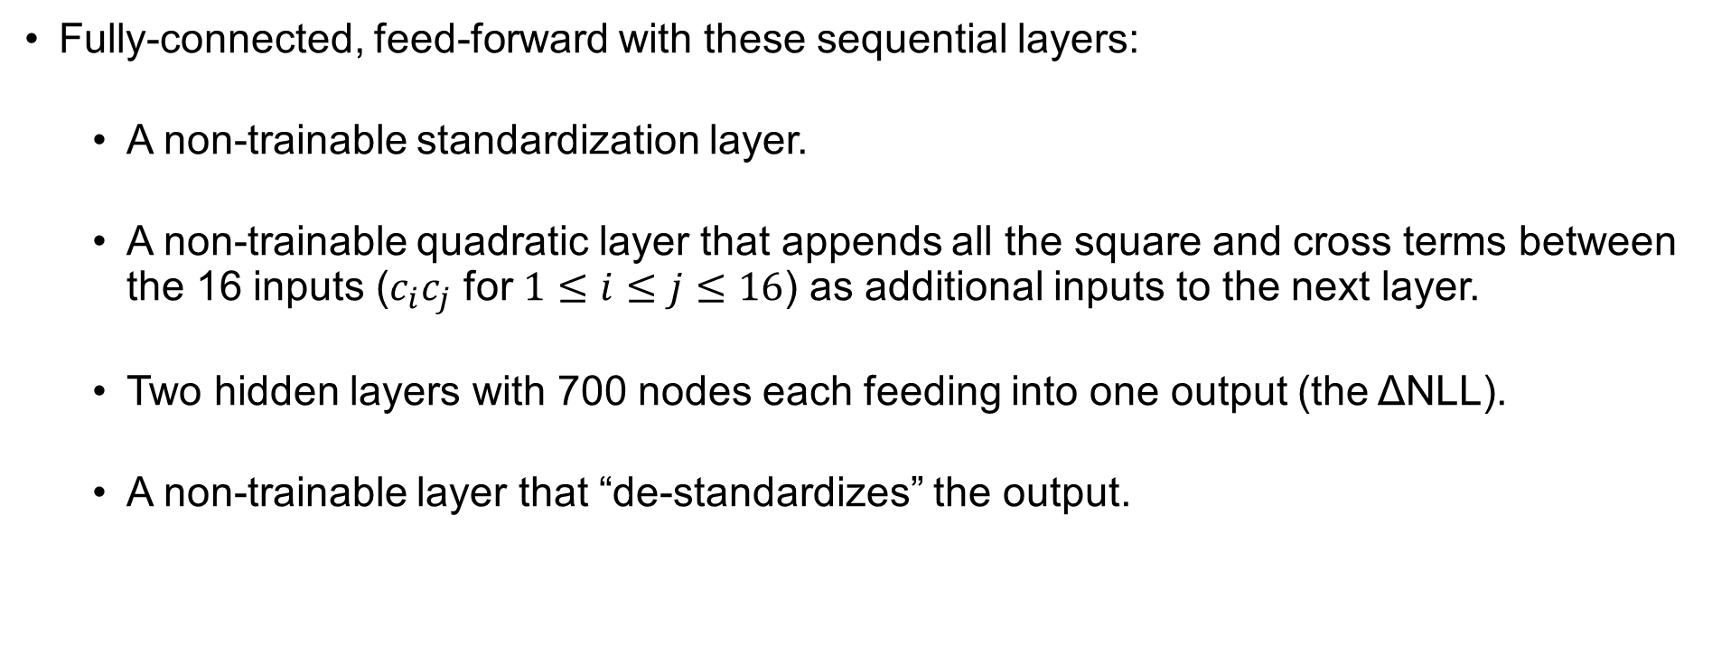
DNN Architecture
Fully-connected, feed-forward with these sequential layers:
  A non-trainable standardization layer.
  A non-trainable quadratic layer that appends all the square and cross terms between the 16 inputs ($c_{i}c_{j}$ for $1≤i≤j≤16$) as additional inputs to the next layer.
  Two hidden layers with 700 nodes each feeding into one output (the ΔNLL).
  A non-trainable layer that “de-standardizes” the output.
Notes:
This saves the DNN from having to learn the quadratic dependence of the likelihood on the WCs discussed on Slide 2.

Slide 5
DNN Training
Training set sampled from the full ΔNLL function that was extracted from experimental data of multilepton events selected from 2017 CMS data [1].
The sample has around 50 million points across the 16D space with the NPs profiled away in the process.
Training set output (ΔNLL) distribution. Regions in the WC space with low NLL (high likelihood) are sampled more heavily to improve DNN performance in these regions of interest.
[1]: https://doi.org/10.1007/JHEP03(2021)095

Slide 6
DNN Training
We use the MSE loss function.
Loss curve. Loss eventually approaches 10⁻⁴ without the training and testing curves separating significantly, indicating an excellent fit without overfitting.
Notes:
Testing, or validation, curve. Learning rate reduction.

Slide 7
DNN Training
Accuracy curve. A point is considered accurate if the predicted output is within 0.05 absolutely of or 1% relative to the target output.
Eventually, the DNN reaches over 99% accuracy, confirming an excellent fit.

Slide 8
DNN Training
Residual plot. Other than the very few outliers at the bottom of the plot near the output value of 130, the residuals show no obvious pattern and concentrate around 0, indicating a good fit across the range of outputs in the testing set.

Slide 9
DNN Validation
To further visualize the accuracy of the DNN, we show select 1D and 2D scans published in Ref. [1] compared to DNN predictions.
For statistical reasons, both the published and DNN-predicted curves (or surfaces in 2D scans) are shifted vertically so that their respective minimum is 0.
Example scans.
Reminder: All the NPs are already profiled away, so these are “slices” of the 16D WC space.
[1]: https://doi.org/10.1007/JHEP03(2021)095
Notes:
Description: You’ll see these plots later, these are just examples to explain what’s going on. Target (full statistical calculation, correct answer) vs predicted. Frozen vs profiled. 1D vs 2D (one of the 16 WCs, so there would be 16 of these plots). Shift down to 0 (that’s what the small delta means). Sigma intervals and contours.

Slide 10

DNN Validation
1D scans of $c_{tφ}$.
Good agreement in all scans.

Slide 11

DNN Validation
1D scans of $c_{bW}$.
Slight deviation in the bottom right plot (profiled, zoomed-in), due to different minimization algorithms settling in slightly different minima.
Good agreement for the rest.

Slide 12

DNN Validation
Confidence contours of 2D scans of $c_{φt}$ and $c_{tφ}$.
Good agreement in both scans.

Slide 13
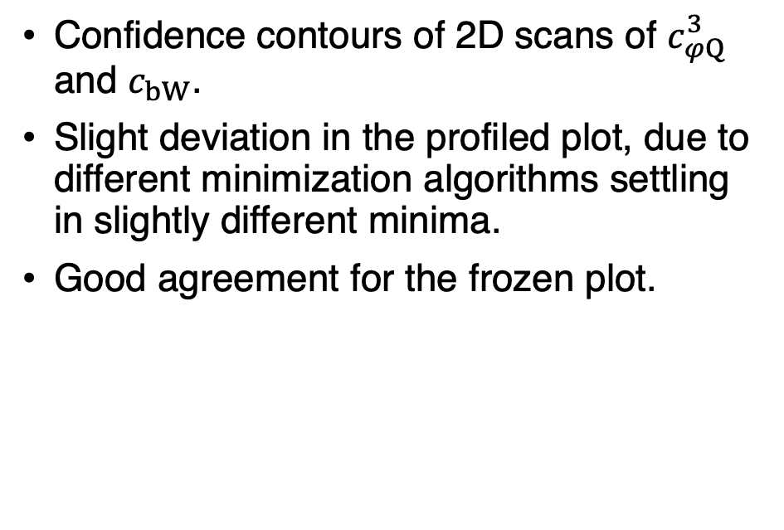
DNN Validation
Confidence contours of 2D scans of $c_{φQ}^{3}$ and $c_{bW}$.
Slight deviation in the profiled plot, due to different minimization algorithms settling in slightly different minima.
Good agreement for the frozen plot.

Slide 14
DNN Advantages and Limitations
Evaluation speed up
  5 orders of magnitude of speed up on the profiled ΔNLL, which can be really useful depending on the use case.
Portability
  The DNN is small (megabytes) and portable across software environments.
Limitations
  The DNN is an approximation.
  It does not retain information about the systematic uncertainties encoded by the NPs.
  Needs an initial investment of ~50 M ΔNLL evaluations with NPs profiled away and a few hours training on one GPU.

Slide 15


DNN Distribution
Currently in conceptualization stage of how to distribute.
PyPi: established ability to distribute model and analysis function.
  Only interfaces with Python and needs packages (PyTorch).
ONNX: Open format to store DNN models that allows them to be used across many frameworks.
  Haven’t tried yet, but could if there are interested users.
Distribute the PyTorch, ONNX, or other formatted model via HEPData.
  Is there interest in this approach?
Any other distribution requests/recommendations?

Slide 16
Conclusion
We have a trained DNN that approximates the profiled LF with high accuracy.
For use cases that do not require
  exact ΔNLL values,
  the systematic uncertainties encoded by the NPs,
an initial investment of sampling the profiled ΔNLL and training the DNN yields
  a differentiable, fast, and portable approximation of the profiled ΔNLL of our analysis
  to share with the community without losing information about any of the WCs.
  seeking input about most productive ways to facilitate sharing

Slide 17
Backup Slides

Slide 18
Hyperparameter Tuning
Hyperparameter | Considered | Best trial
Nodes | 500-2000 | 700
Layers | 2-4 | 2
Minibatch size | 512, 1024 | 512
Epochs | 500 | 500
Activation function | SELU, ReLU | ReLU
Loss function | Huber Loss, MSE | MSE
Optimizer | SGD, ADAM | ADAM
Initial learning rate | 10⁻³, 10⁻⁴, 10⁻⁵, 10⁻⁶ | 10⁻⁴
Learning rate reduction factor | 0.2 | 0.2
Learning rate reduction patience | 5-25 | 20
Learning rate reduction threshold | 10⁻⁶ | 10⁻⁶

Slide 19

DNN Validation
1D scans of $c_{φQ}^{3}$.
Slight deviation in the bottom right plot (profiled, zoomed-in).
Good agreement for the rest.
Notes:
Explain deviation.

Slide 20

DNN Validation
Confidence contours of 2D scans of $c_{tW}$ and $c_{tZ}$.
Slight deviation in the profiled plot.
Good agreement for the frozen plot.

Slide 21

DNN Validation
Confidence contours of 2D scans of $c_{φQ}^{−}$ and $c_{tG}$.
Slight deviation in the profiled plot.
Good agreement for the frozen plot.

Slide 22
Profiling in PyTorch [3]
Use the same optimization tools as DNN training, but instead on the inputs (WCs) of the DNN to minimize the output (NLL).
  Use torch.autograd on the trained NN.
Minimizes sum(ln(ΔNLL + constant)) to
  profile many points in the input space at once, taking advantage of GPU acceleration.
  give more weight to smaller NLLs.
[3]: https://doi.org/10.48550/arXiv.1912.01703

Slide 23
References
[1]: The CMS collaboration. Search for new physics in top quark production with additional leptons in proton-proton collisions at √s = 13 TeV using effective field theory. J. High Energ. Phys. 2021, 95 (2021). https://doi.org/10.1007/JHEP03(2021)095
[2]: Coccaro, A., Pierini, M., Silvestrini, L. et al. The DNNLikelihood: enhancing likelihood distribution with Deep Learning. Eur. Phys. J. C 80, 664 (2020). https://doi.org/10.1140/epjc/s10052-020-8230-1
[3]: A. Paszke et al. PyTorch: An Imperative Style, High-Performance Deep Learning Library. e-Print: 1912.01703. https://doi.org/10.48550/arXiv.1912.01703

