Slide 1

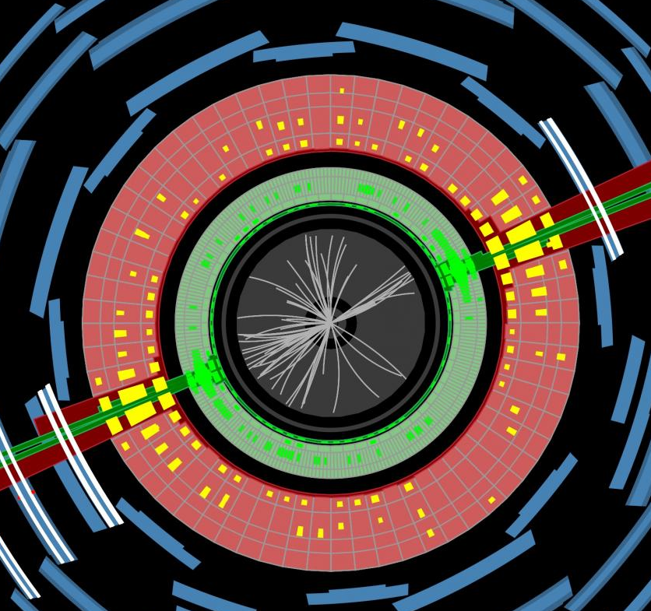
(Re)interpretation of the LHC results for new physics
Durham 29/8/2023
Jon Butterworth, UCL Physics & Astronomy
Testing the scalar triplet solution to CDF’s heavy W problem at the LHC
JMB, Julian Heeck, Sihyun Jeon, Olivier Mattelaer, Richard Ruiz
Phys.Rev.D 107 (2023) 7, 075020
2210.13496 [hep-ph]

Slide 2
Outline
Motivation
  The W mass: CDF and custodial symmetry
  The Type II Seesaw model
  Bringing them together
Method
  Rivet, Contur and, the LHC measurement library and SM predictions
Results and conclusions

Slide 3

Motivation

Slide 4
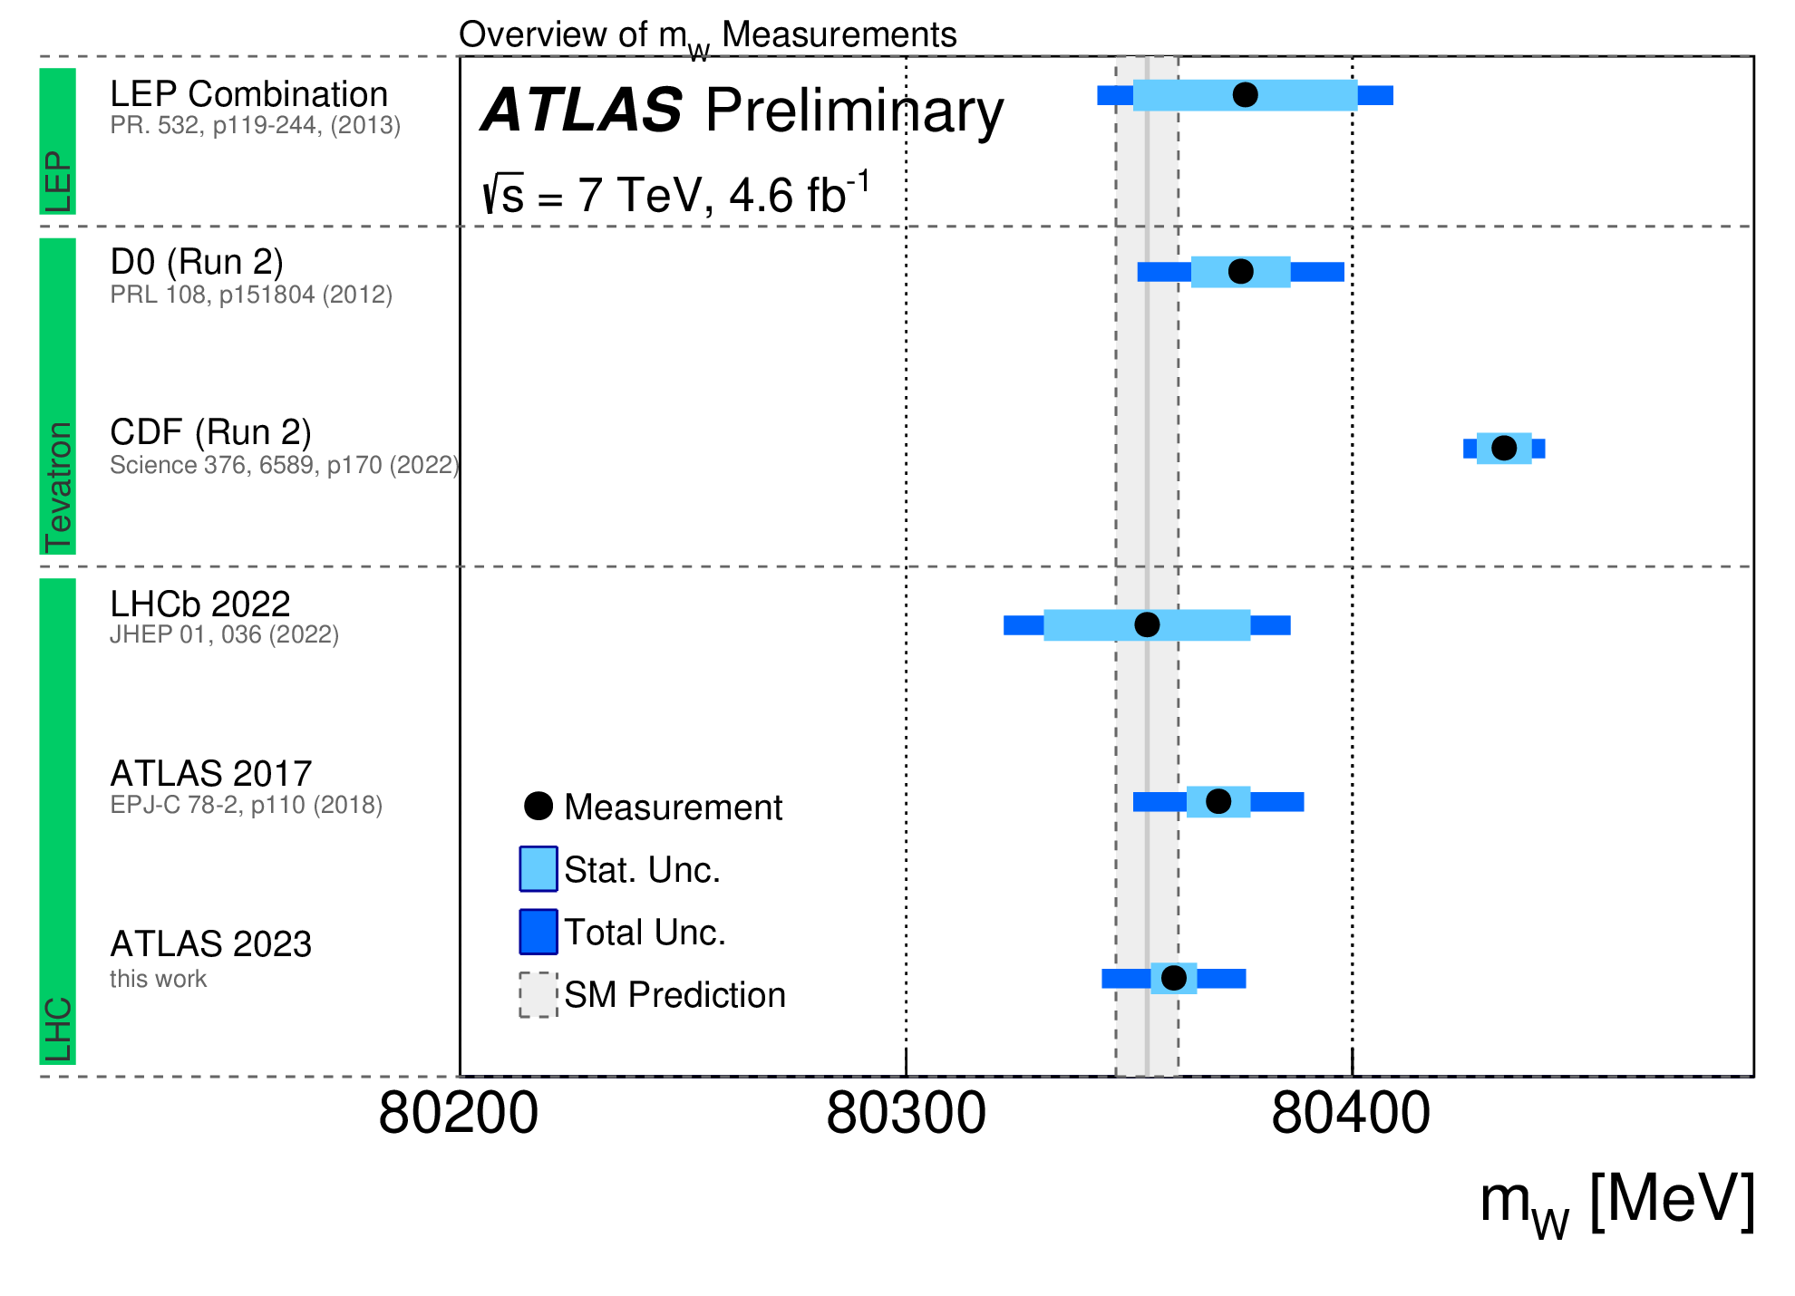

The W mass
ATLAS-CONF-2023-004

Slide 5
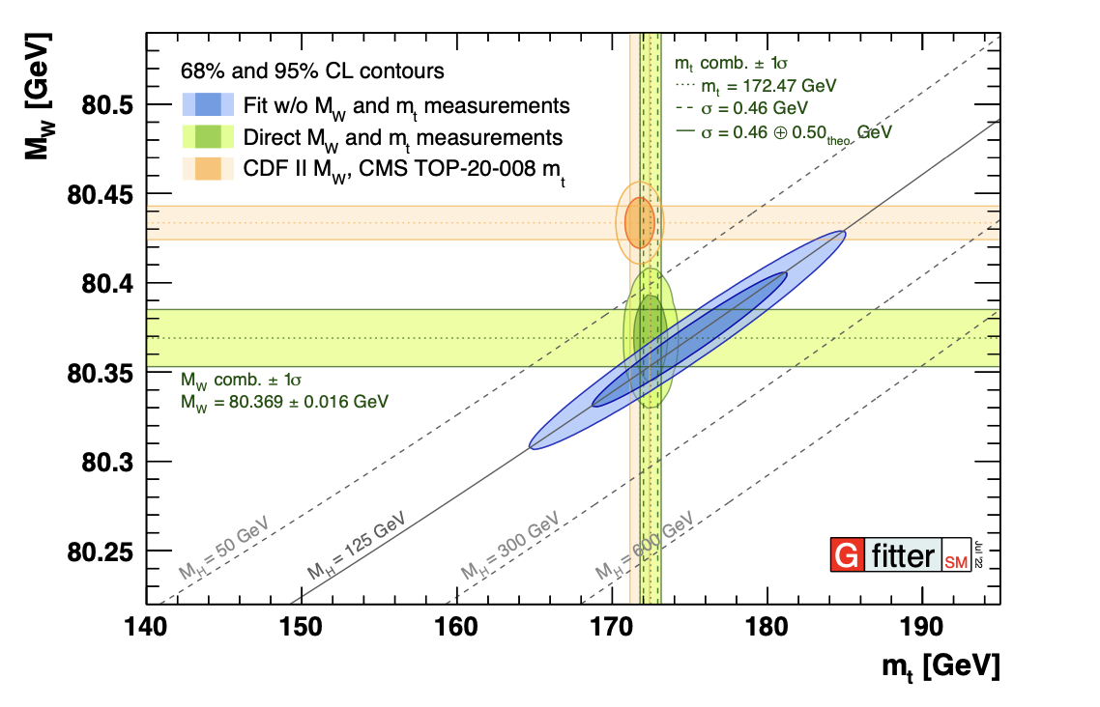
The W mass

Slide 6

Custodial Symmetry
Residual SU(2) symmetry after spontaneous symmetry breaking
  Invariance under rotations among (W¹, W², W³) i.e. M(W^{+/-}) = M(W³)
  After mixing with U(1):
  Obviously must be broken (but only slightly!) if CDF are even approximately right
  Many BSM models build in ρ₀ = 1
  But not all…

Slide 7
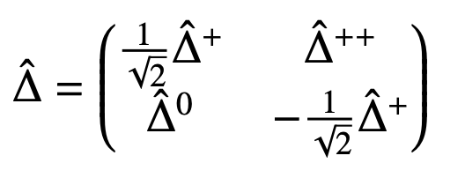
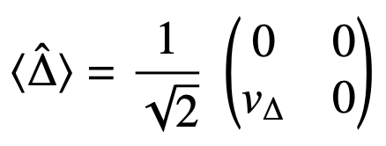
Type II Seesaw Model
Add a complex scalar triplet with a vev to the SM
Introduces Majorana mass terms for neutrinos
Direct connection between neutrino oscillation parameters and Yukawa couplings implies correlations between collider signatures (Δ decays to leptons) and neutrino sector
Breaks custodial symmetry at tree level… 🙂
… but reduces ρ₀ , and thus M_{W} 😞

Slide 8
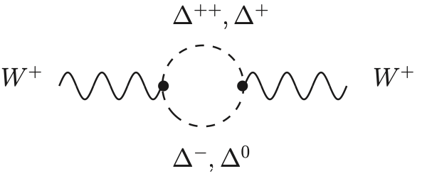
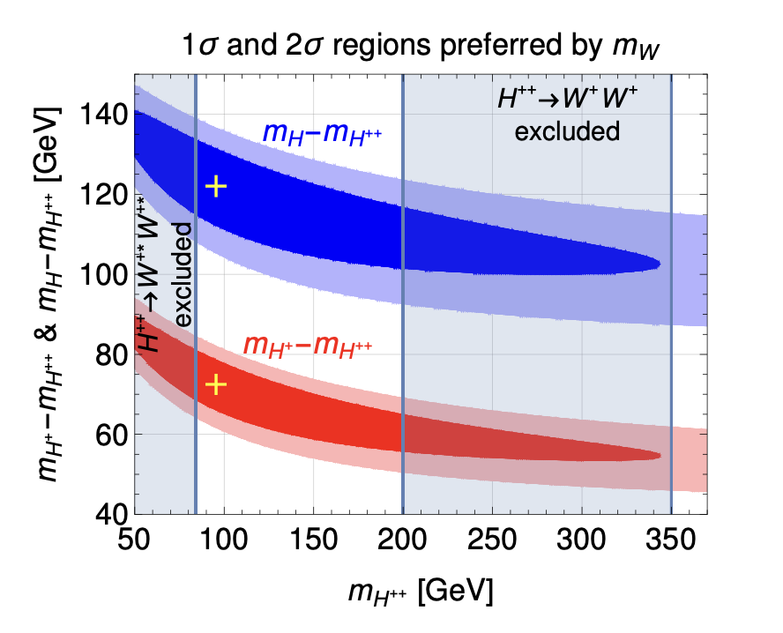
Two problems solved?
Low vev (≲ 1 GeV) means the tree-level effect is small
One-loop contributions can be large and opposite in sign
Low Yukawa couplings/vev evades many searches
  Y << 1, MeV < v∆ < GeV
A CDF-like shift in M_{W} implies upper bounds on mass states
J Heeck, Phys.Rev.D 106 (2022) 1, 015004 2204.10274

Slide 9

Method
The LHC measurement “library”

Slide 10
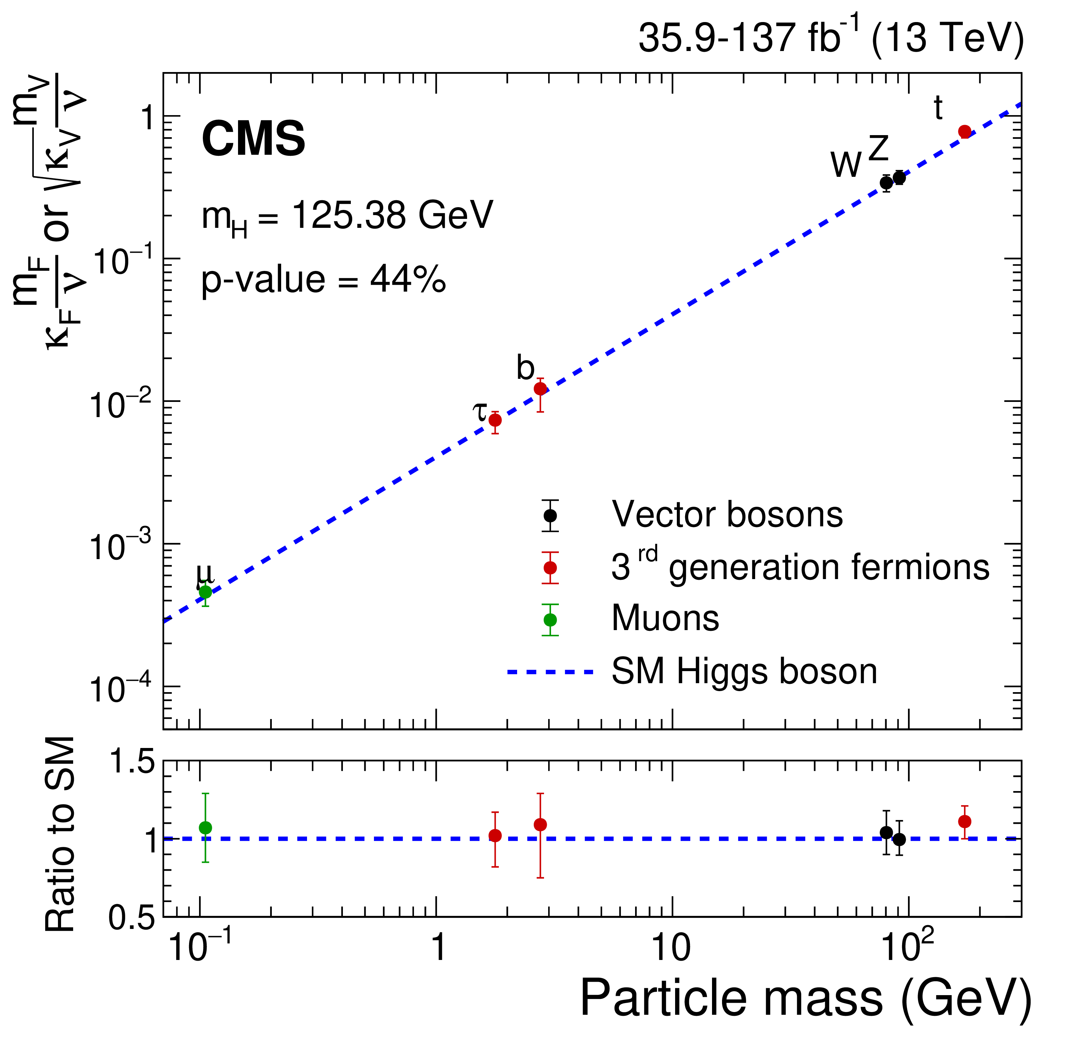
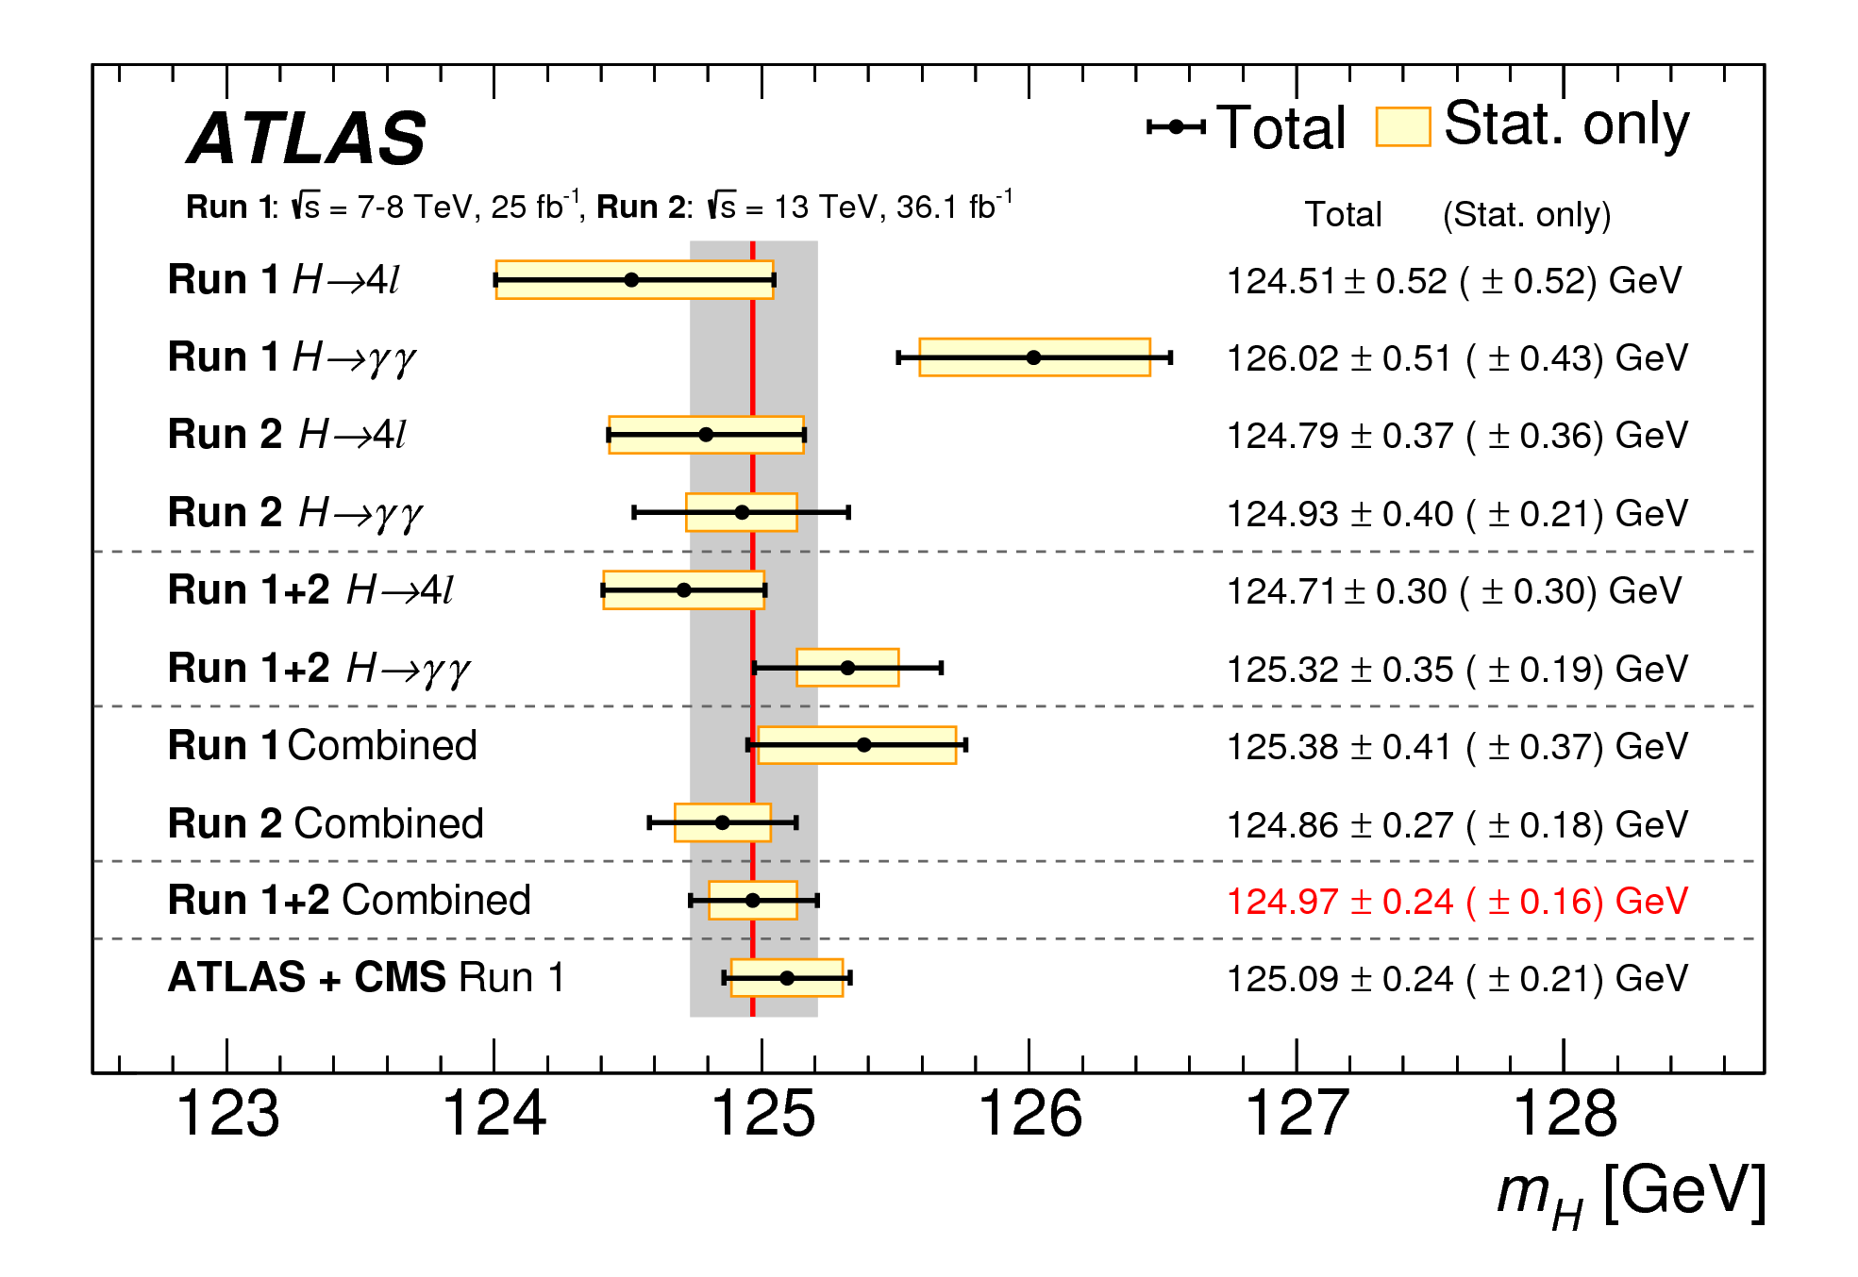

Slide 11
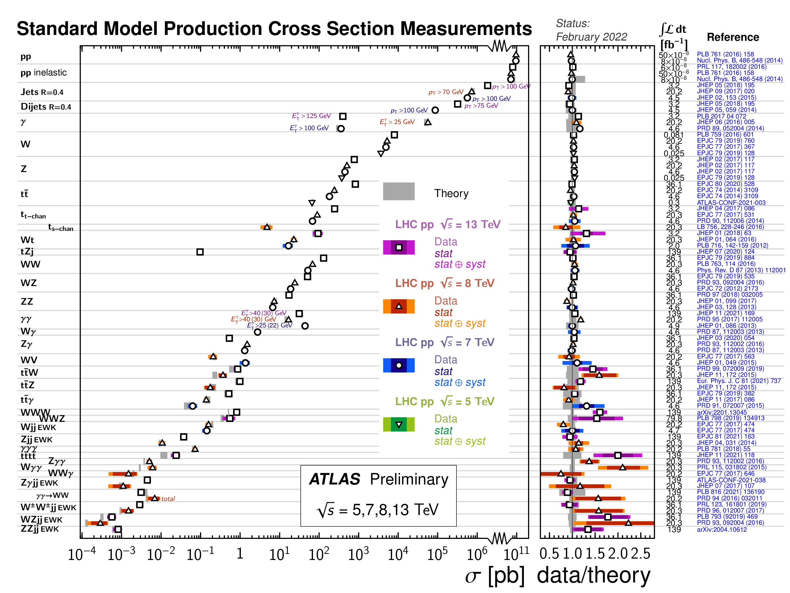

Slide 12
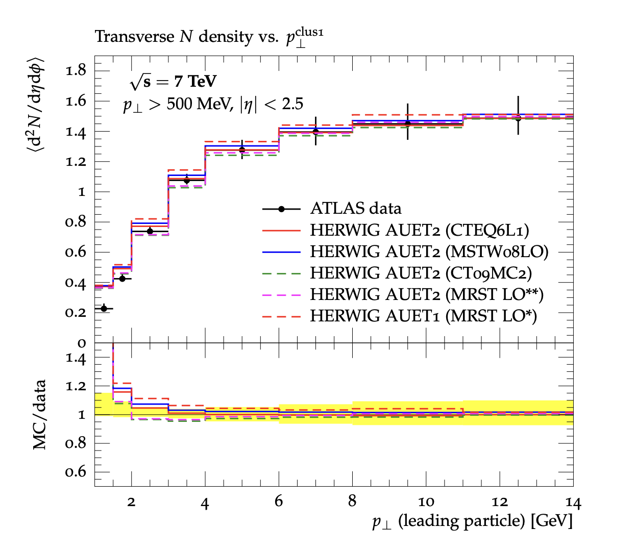
Introducing Rivet
Robust Independent Validation of Experiment and Theory arXiv:1003.0694, arXiv:1912.05451
Direct legacy from HERA (1990s, HZTOOL)
Developed by MCnet for tuning and validation of new MC event generators
  e.g. What does the underlying event look like in 7 TeV pp collisions?
Library of measurements of final state particles produced in collisions, and variables derived from them
Buckley et al, Bierlich et al
From ATL-PHYS-PUB-2011-008

Slide 13
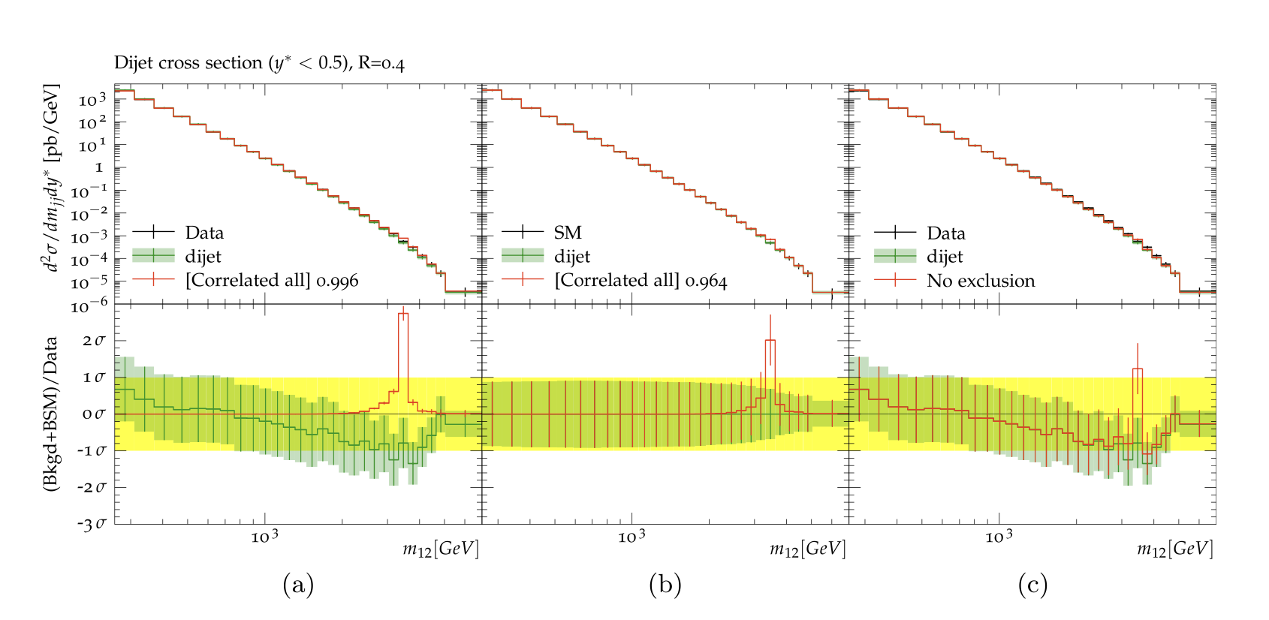
Introducing Contur
Constraints On New Theories Using Rivet arXiv:1605.05296, arXiv:2102.04377
Extend the power of Rivet beyond the Standard Model
Signal-injection of final-state particles from Beyond-the-SM physics events on to the measured cross sections in Rivet
From Altakach, JMB, Ježo, Klasen, Schienbein arXiv:2111.15406
Increasingly precise measurements and calculations together extend the reach
JMB, Grellscheid, Krämer, Sarrazin, Yallup; Buckley et al

Slide 14
Developments
New interface between Rivet+Contur and Madgraph
  Could already drive a MG scan using Contur machinery (as with Herwig)
  Can now access Rivet+Contur from within the MG UI and use MG scanning machinery
Wider selection of SM predictions, move to using these only
  no more assumption that the data ≡ SM.
Use of correlation matrices, more Rivet analyses, other minor improvements (Contur 2.4)
(See Yoran’s talk this afternoon for more.)

Slide 15
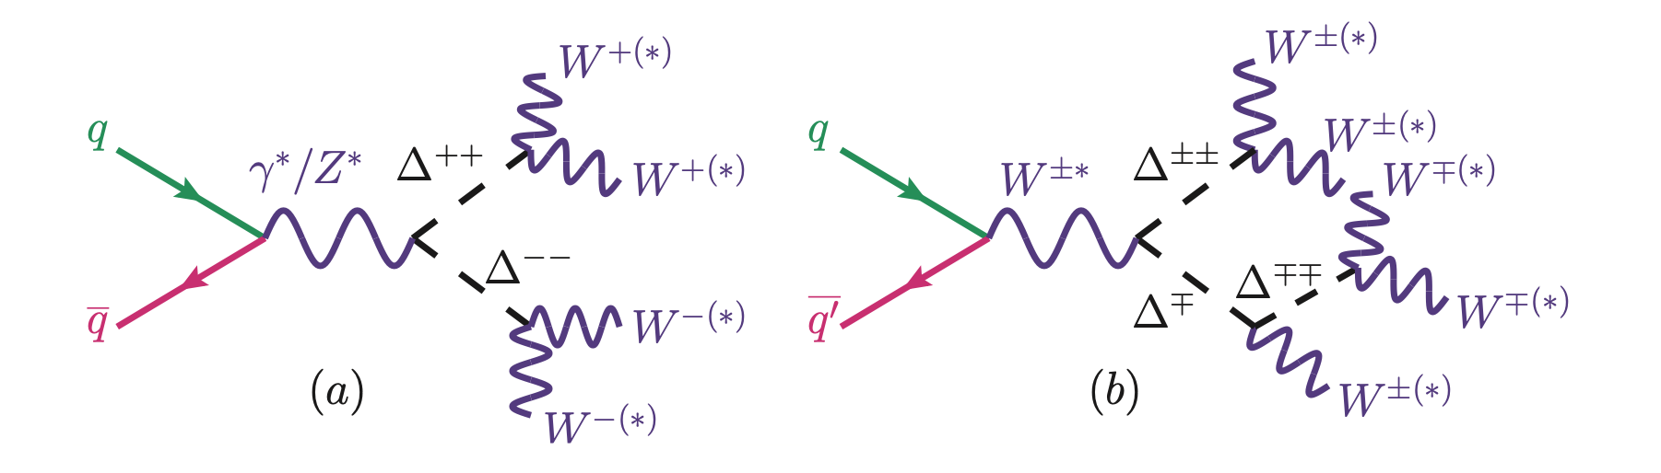
Analysis
Feynrules¹ → UFO → Madgraph → Pythia → Rivet → Contur (over 130 LHC measurement papers)
vev = 1 GeV
  High enough that Δ decays are prompt. At very low values (~0.1 MeV for M_{Δ++} = 200 GeV) may not be true
  Little effect on collider phenomenology otherwise
¹ Pich, Santamaria, Bernabeu, Phys. Lett. B 148 (1984) 229–233.

Slide 16
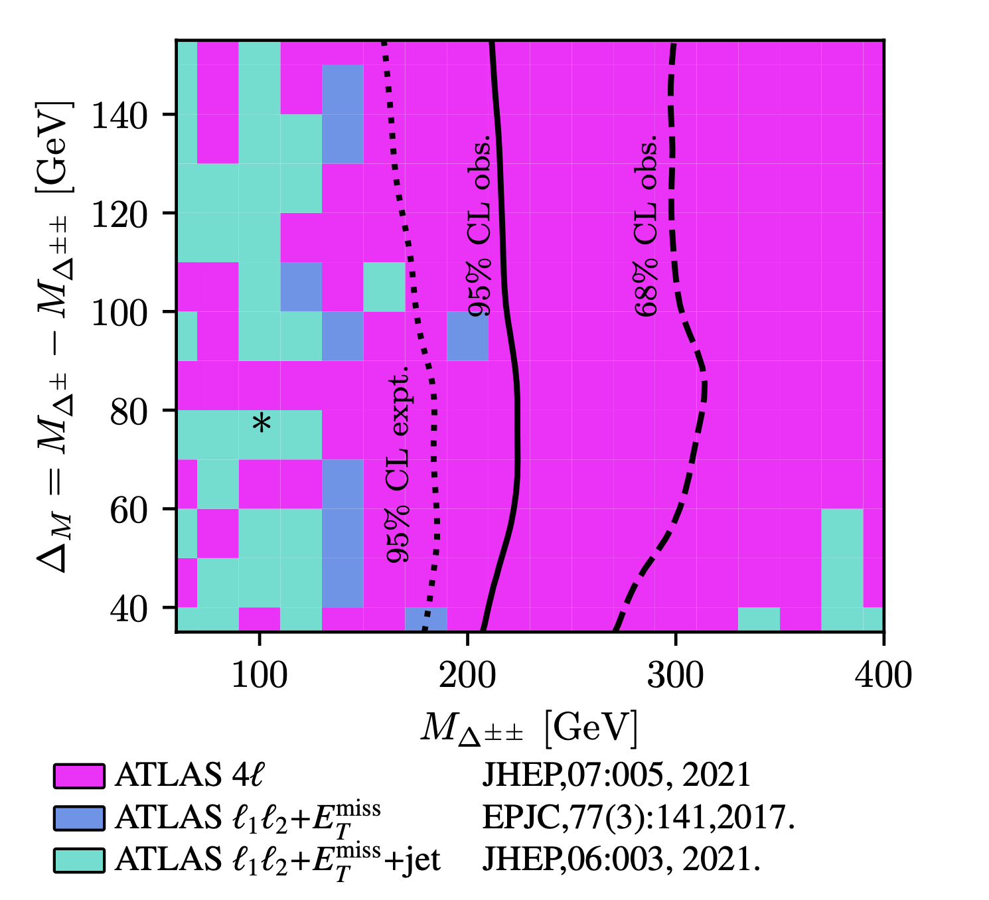
Analysis
The (M∆±±,∆M) parameter space overlaid with the 95% (solid) and 68% (long-dash) exclusion limits as obtained from MGaMC + Contur.
Values to the left of the lines are excluded.
Also shown is the 95% expected exclusion (dotted).
The colour-shading scheme indicates which SM measurement provides the dominant exclusion.
The black asterisk indicates the best fit value from Heeck (2022)
All possible final states were scanned

Slide 17
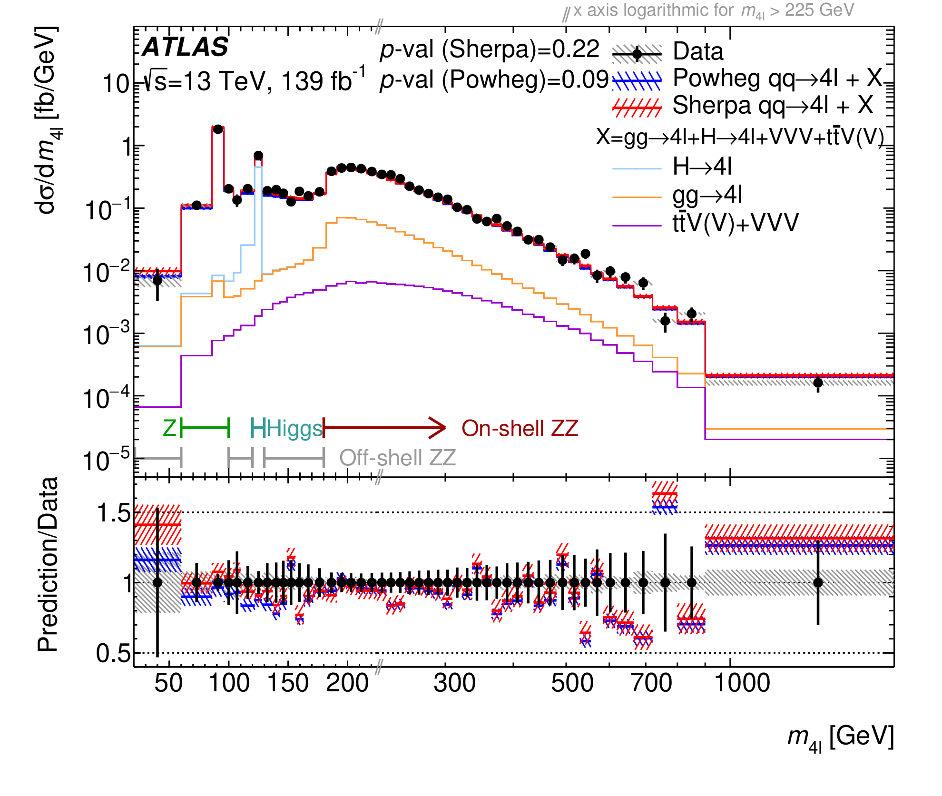
arXiv:2103.01918, JHEP 07 (2021) 005

Slide 18
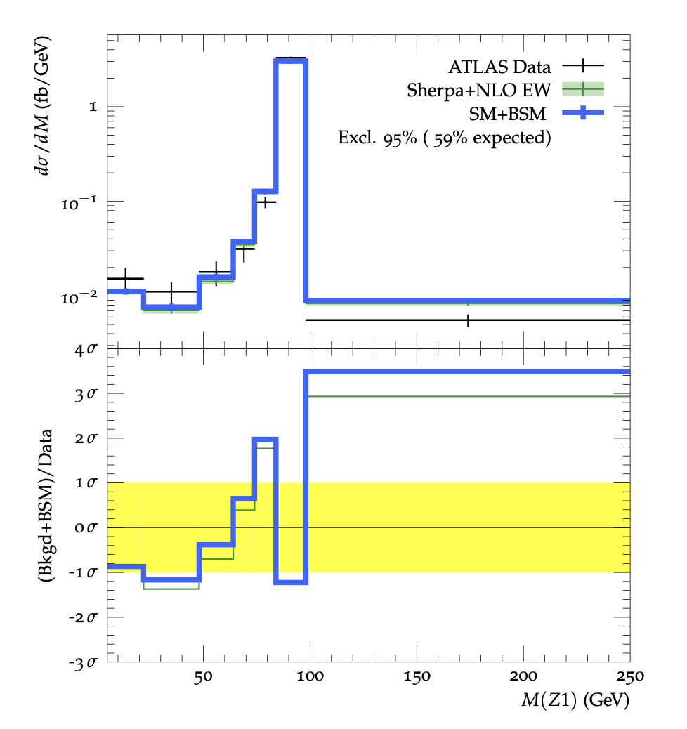
Example of Impact
Upper panel: Representative differential cross section as a function of the highest-mass dilepton pair in 4-lepton measurements used in this study showing:
ATLAS data (crosses) JHEP 07 (2021) 005
Predicted SM yields (green) Sherpa, SciPost Phys. 7 (3) (2019) 034
Predicted SM+BSM yields for (M∆±± , M∆± ) = (180 GeV, 255 GeV) (blue).
Lower panel: bin-by-bin significance of expected theory yields relative to data with combined data and theory uncertainties (band).

Slide 19

Conclusion
Previously “unconstrained” best fit point is actually already excluded by LHC measurements, for promptly-decaying Δ⁺⁺
Still a worth looking for in LLP searches, but not otherwise

