Slide 1
Bidirectional Linking in HEPData
HEPData.net
Jordan Byers
(Durham University)
Jordan.byers@durham.ac.uk
30th August 2023

Slide 2
Bidirectional Linking
Linking Records to Records, and Tables to Tables.
In this new update, you may now define basic relationships for bidirectional linking in the form of record-to-record, or table-to-table referencing.
Possible Applications:
Linking theoretical predictions to measurements.
Linking covariance matrices to measurements.
These relationships are displayed on the final records page.
NOTE: Only includes FINALISED records.

Slide 3
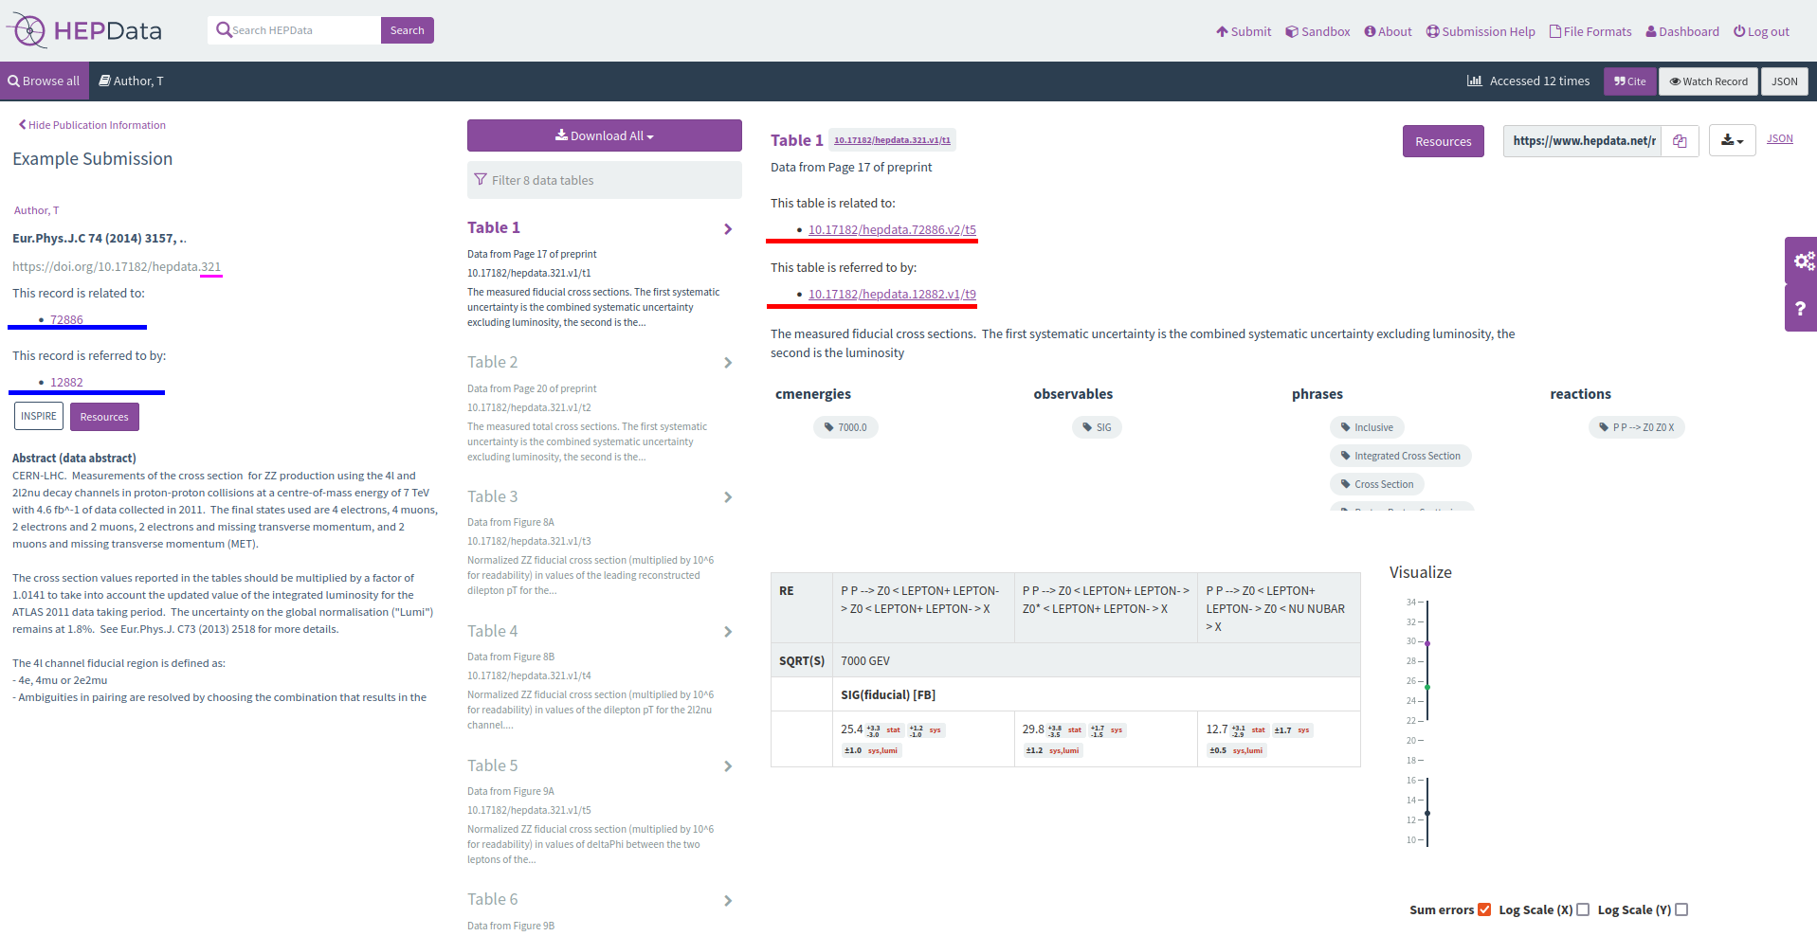
Example Record - #321
Example record displaying bidirectional relation data.

Slide 4
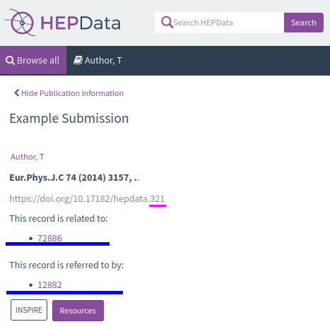
Record Linking
NOTE: The HEPData record ID is underlined in pink.
Relations
- A list of all records that this record has defined as related.
Referring to this
- A list of all FINALISED records that refer to this record.

Slide 5
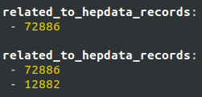
Record Linking
Submission.yaml
Comma separated values
Entries on new line, starting with a dash

Slide 6
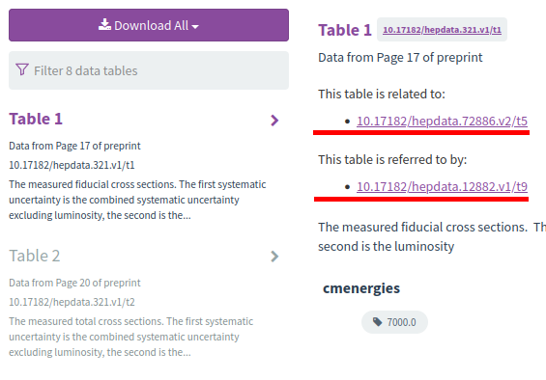
Table Linking
Relations
- A list of all records that this record has defined as related.
Referring to this
- A list of all FINALISED records that refer to this record.

Slide 7
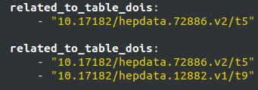
Table Linking
Submission.yaml
Format: “10.17182/hepdata.[Record ID].v[Version]/t[Table]”
Example: “10.17182/hepdata.72886.v2/t5” ]
Comma separated values
Entries on new line, starting with a dash.

Slide 8
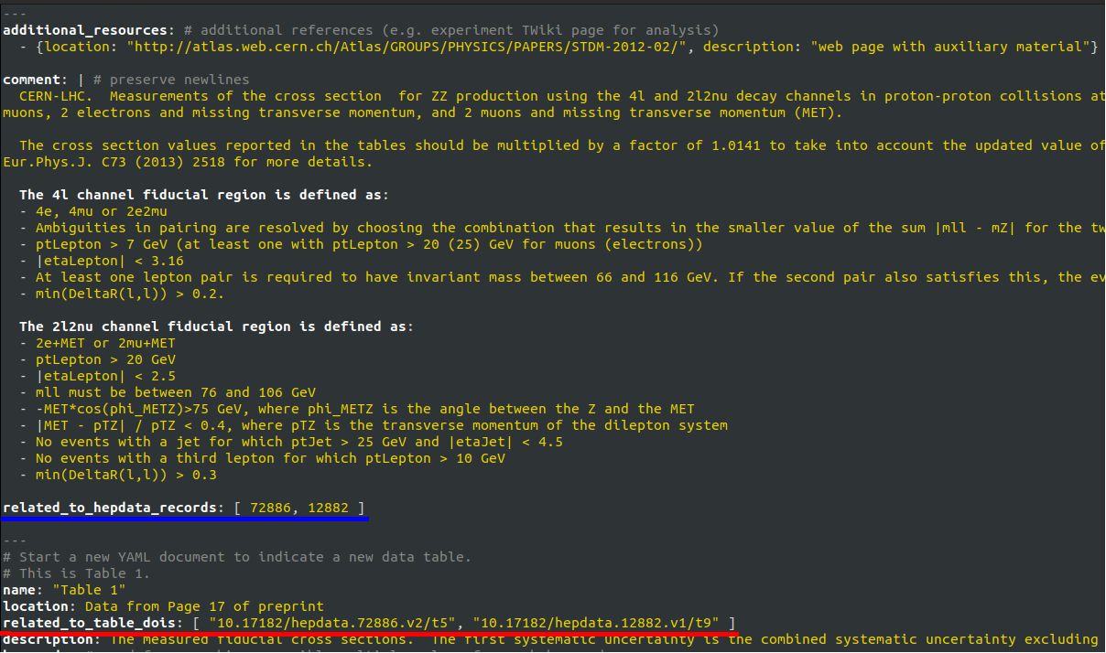
Submission.yaml
Example
This is an example snippet of a submission.yaml showing how one of the previous examples can be used.

Slide 9
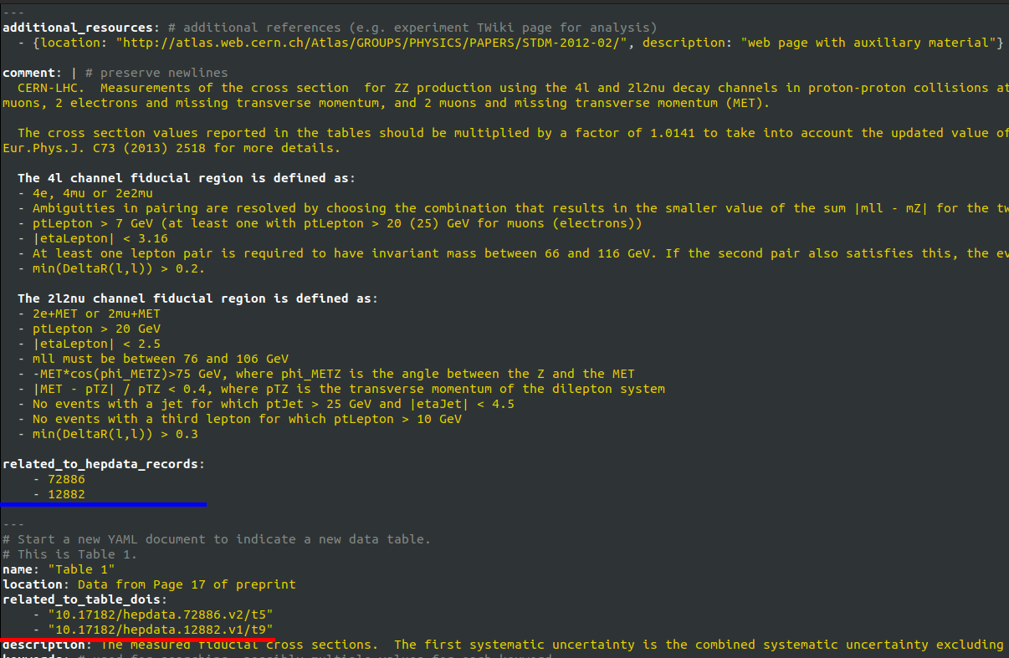
Submission.yaml
Example
This is an example snippet of a submission.yaml showing how one of the previous examples can be used.

Slide 10
Feedback Action
Records
- Record title display instead of only ID.
Tables
- Table name display instead of only DOI.
- Mouseover tooltips for related records!

Slide 11
End Notes
Thanks for your time.
Feedback & Further Work
Contact - info@hepdata.net
- Mouseover preview
- Replace DOI/Records with names
- ++?
Submission Assistance
(HEPData Submission)
https://hepdata-submission.readthedocs.io/en/latest/bidirectional.html

