Slide 1
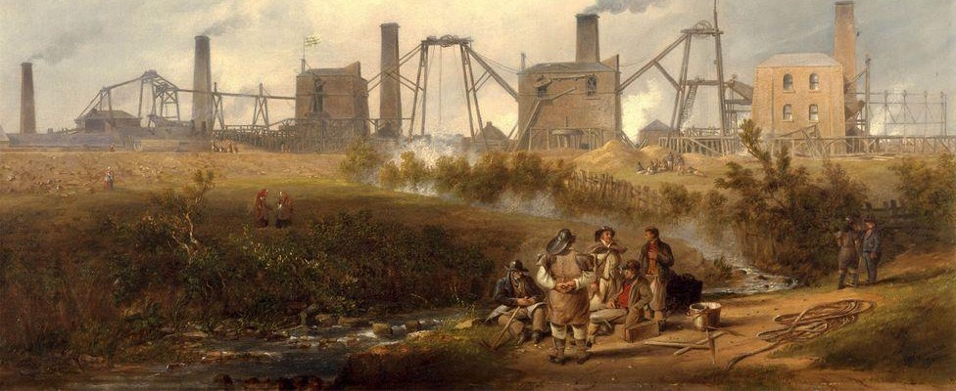
Geothermal heat extraction from abandoned mines
M
In this talk:
Introduction to mine water heating
Modelling mine water heating
Application: mine water heating in Durham
Challenges and limitations
Painting of Murton Colliery in 1843 by John Wilson Carmichael
Jeroen van Hunen, Julien Mouli Castillo, Michael MacKenzie, Alexandra Sweeney, Charlotte Adams & GEMS team
IAS and IDAS event on modelling, 2nd May, 2023

Slide 2
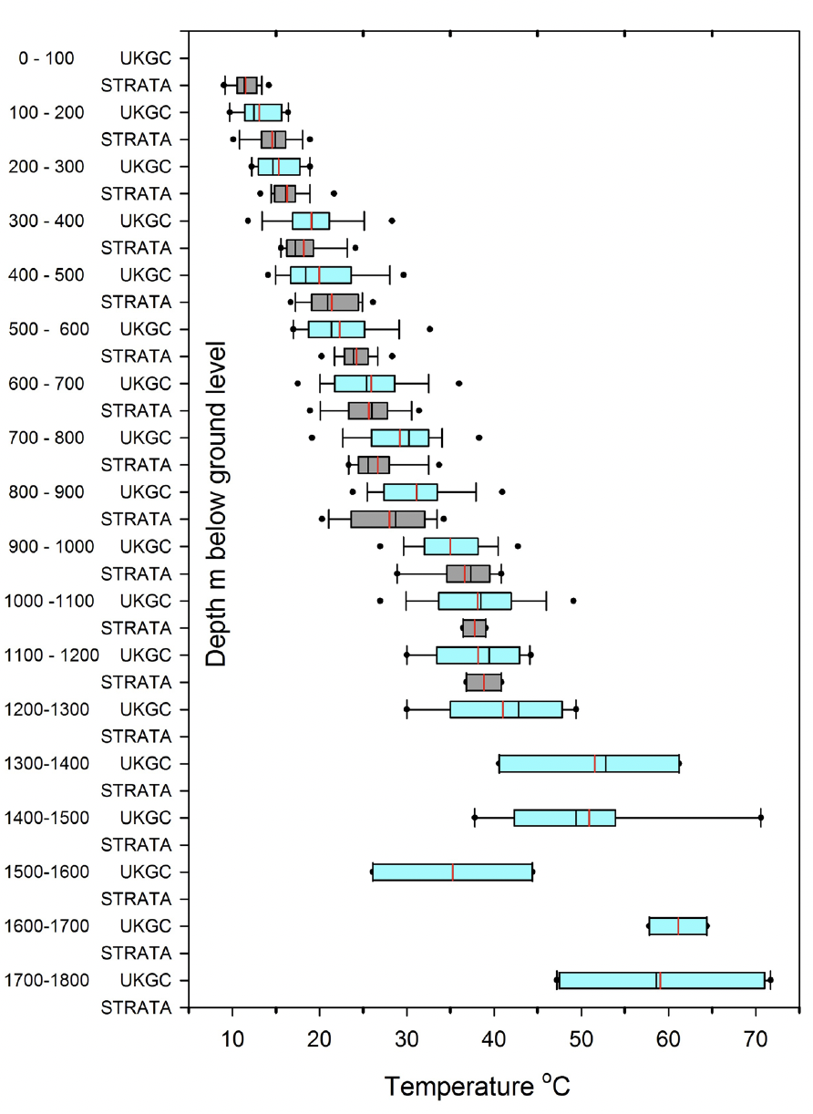
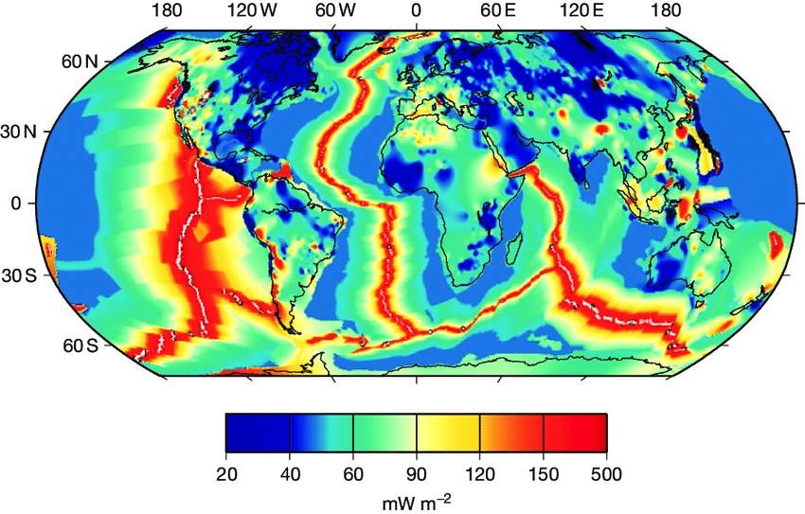
Geothermal potential of mines
World’s total energy consumption in 2020: ~17 TW
Heat released into space 44 TW (or 60 mW/m²)
Thermal gradient ~ 20-30º / km
Mine temperatures
Global surface heat flow
Farr et al., 2020
Marechal & Jaupart, 2011

Slide 3
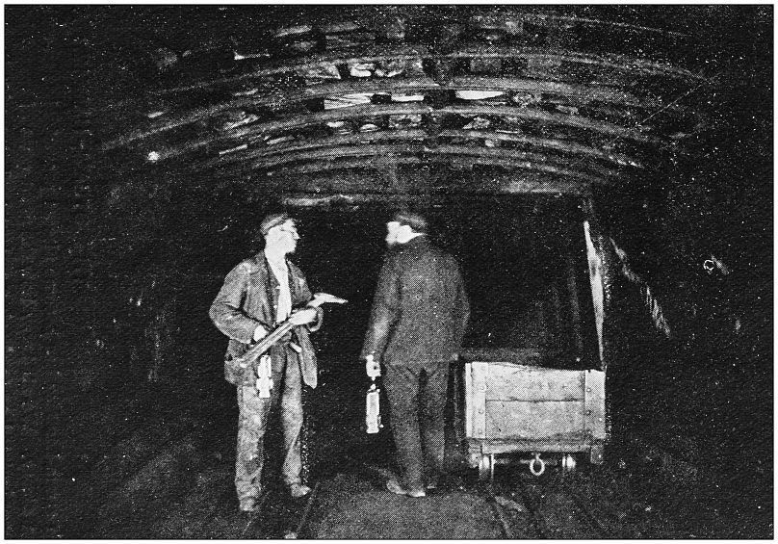
Mine water geothermal heating (MWGH)
>100,000 disused mines in Europe (UNECE), mostly flooded
~1 in 4 UK homes built on top of mines
Mine water temperature:
12-25ºC
Heat pump technology can increase this to 40-50ºC.
(Getty images)
Coal mine in British Midlands

Slide 4
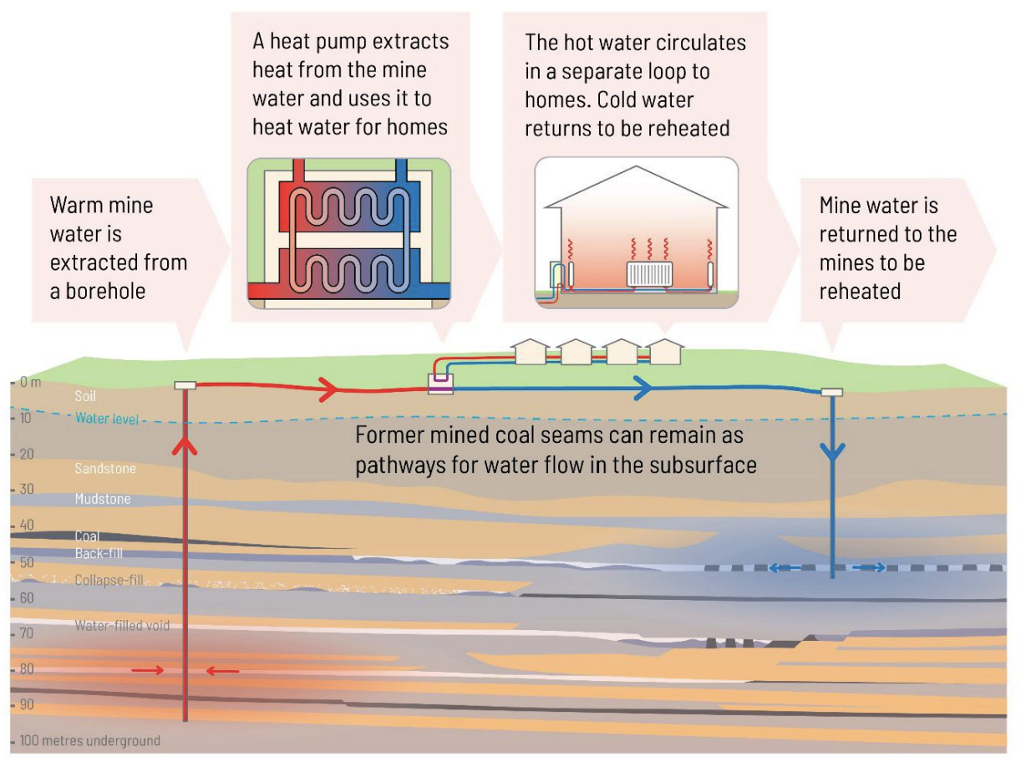
Image: Monaghan et al., 2021, https://doi.org/10.1144/qjegh2021-033

Slide 5
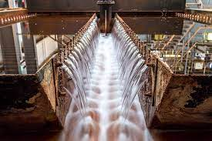
Mine water heating schemes in Europe
Norway: Folldal Cu-Zn-S mine; Kongsberg silver mine
Spain: Barredo-Figaredo coal mines, Asturia
Germany: Alsdorf, North Rhine Westphalia, many in Saxony
Poland: Szombierki Colliery, Bytom
Czechia: Jeremenko coal mine, Svornost Ag-Co-As-U mine
UK: Gateshead coal mines
France: Lorraine coal mines
Netherlands: Oranje Nassau coal collieries, Heerlen
Dawdon colliery pumping station, county Durham, UK

Slide 6
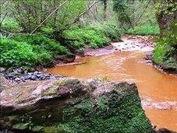
Optimizing mine water geothermal heat extraction
Re-injection of mine water essential
This risks ‘thermal breakthrough’
Modelling can provide quick and low-cost assessment
Main questions to answer:
Which mines are suitable for MWGH?
What are potential critical failure points?
What is the long-term capacity for heat extraction and storage?
Potential users:
Academics
Geo-engineering companies
Coal Authority
Monaghan et al., 2021

Slide 7
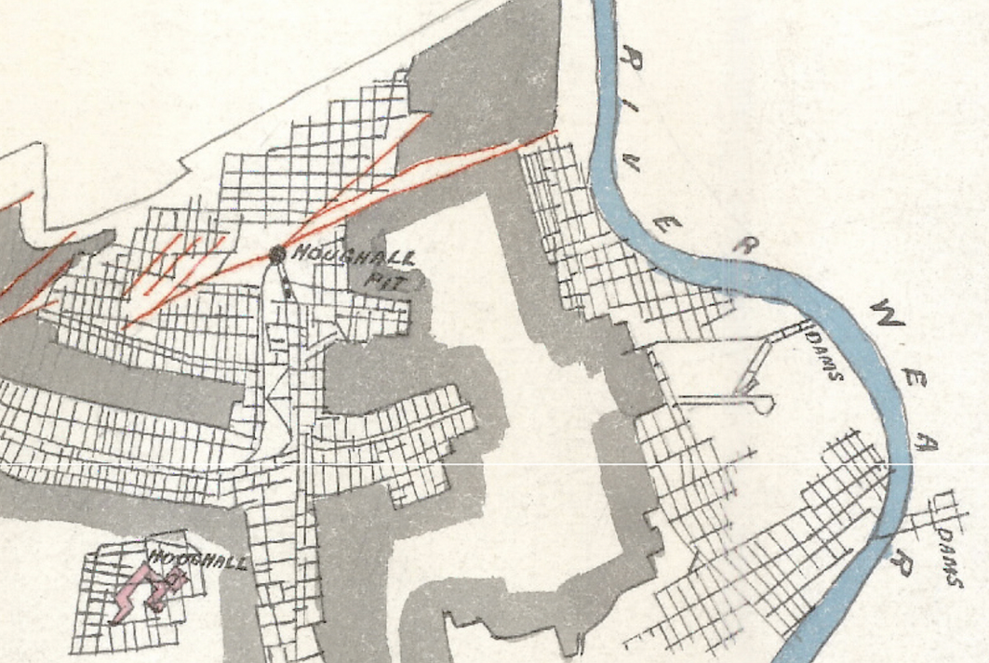
Mining and Modelling Methods
Re-injection
Pillar&Room and Longwall mining
ROOM & PILLAR
resulted in
galleries and ‘goaf’
GOAF
modelled with fluid flow and heat exchange in:
pipe network and FEM porous medium
Typical mine plan: Hutton coal seam below Durham

Slide 8
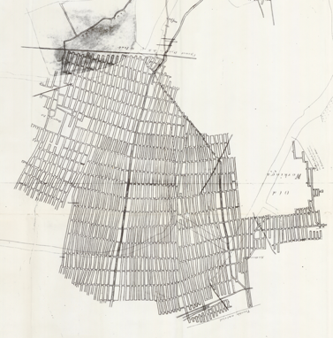
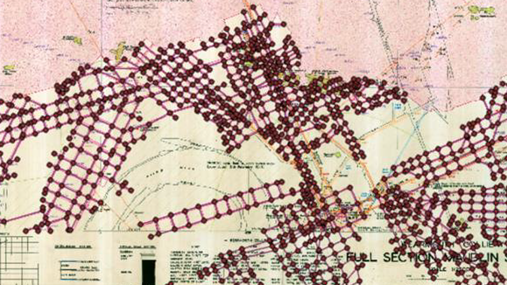
Workflow
1) Digitising mine plans
2) Flow though mine workings
3) Calculate heat exchange
between water and
rocks
H_{j}
rock
water
H_{i}
NODE i+1
PIPE j
Q_{ij}
r
NODE j
NODE i
water
r₀
PIPE j
NODE i

Slide 9
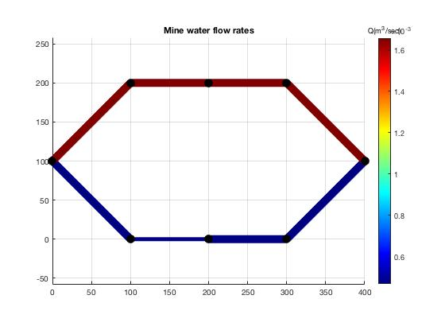
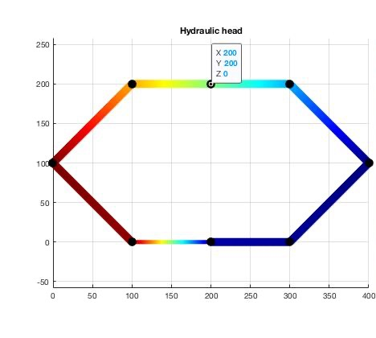
Simple example: two-gallery system
re-injection
point
abstraction
point

Slide 10
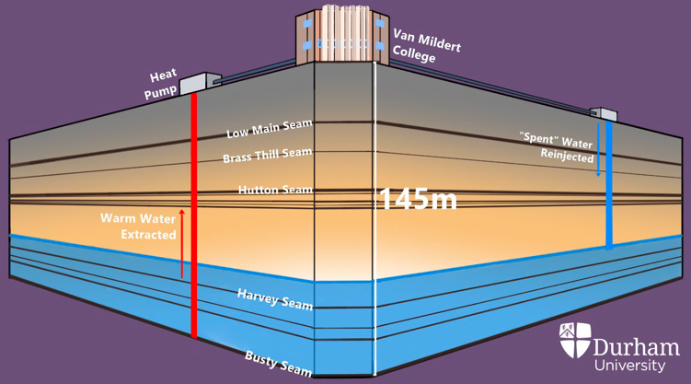
Case study: Mine water heating at Durham University
Feasibility study for several premises at the University site.
Utilizing the Hutton (upper) and Busty (lower) seams
Flow rate 6.5 litres/sec → 191 kW of heat → $≈$ heat for one building
Water inflow T: 8.5ºC
Rock T: 11ºC (Hutton) & 13.5ºC (Busty)
Planned operation time: ~30 years

Slide 11
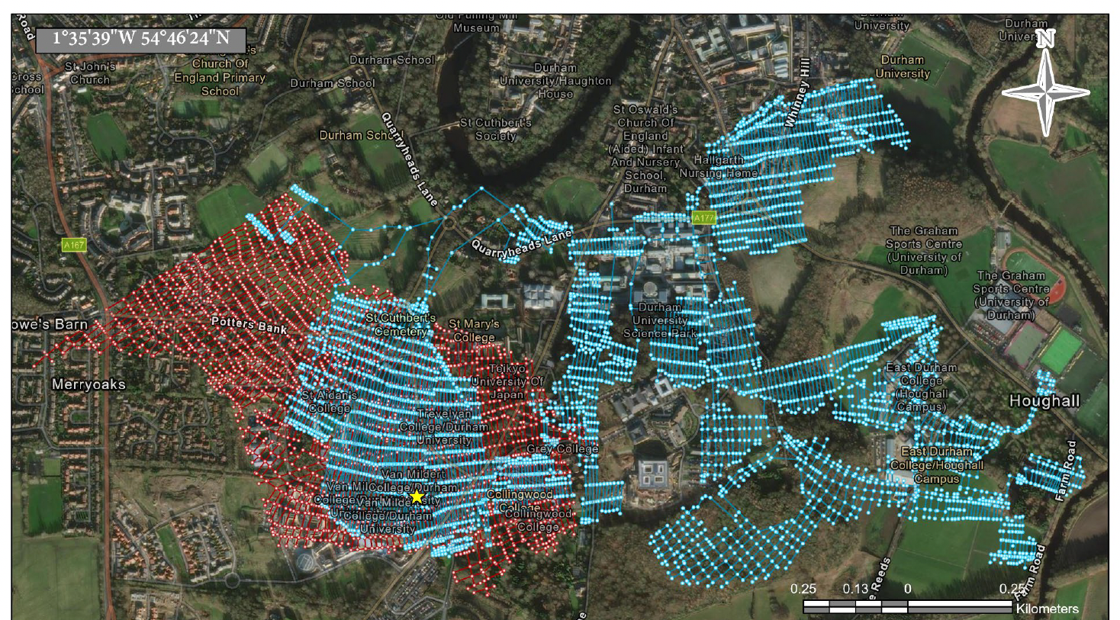
Hutton and Busty coal seams
Hutton seam:
1858-1908
62 m deep,
1.1 m thick
~35,000 m³ extracted coal
Busty seam:
1870-1935
145 m deep,
1.3-1.8 m thick
~800,000 m³ extracted coal
(MacKenzie, 2022)

Slide 12
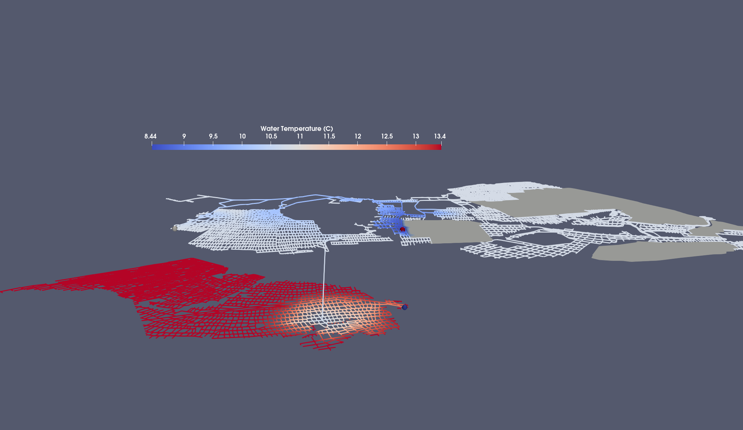
Default scenario:
1 user, 6.4 litres/sec, 1 shaft
T_{inflow} = 8.5 °C
T_{out} = 12.7 °C
T_{max} = 13.5 °C
Hutton Seam 62 m bgl
~11 °C
~13.5 °C
Busty Seam 145 m bgl
~ 4 km
Mouli-Castillo et al. in prep
Notes:
15 % Tout drop in 30 years

Slide 13
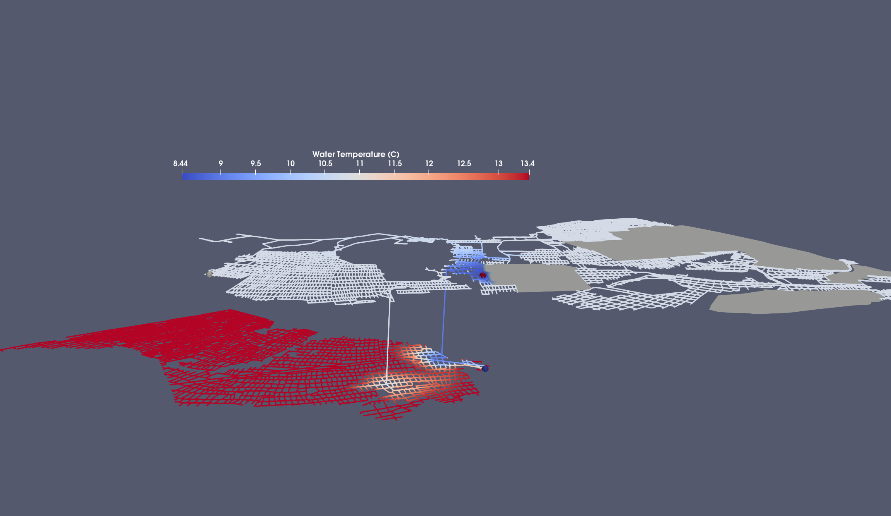
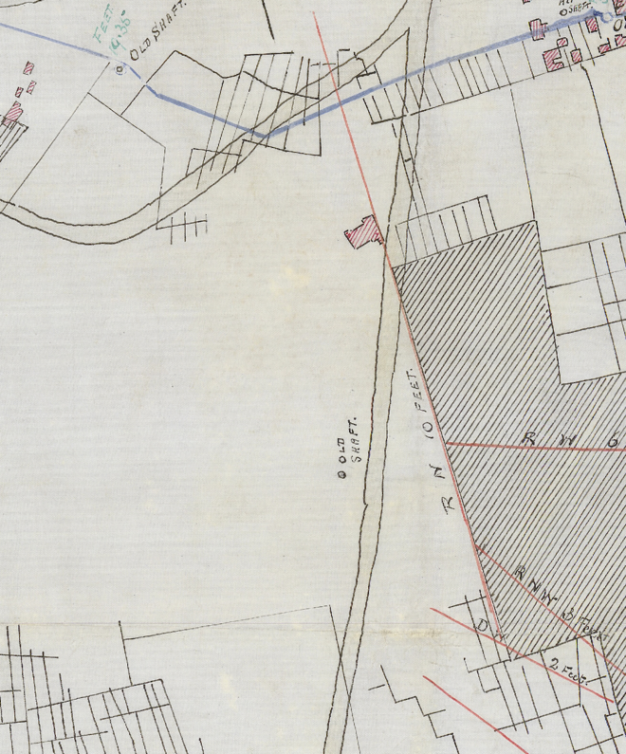
Effect of second, nearby shaft
T_{inflow} = 8.5 °C
T_{out} = 10.7 °C
T_{max} = 13.5 °C
~11 °C
~13.5 °C
~ 4 km
Mouli-Castillo et al. in prep
Notes:
15 % Tout drop in 30 years

Slide 14
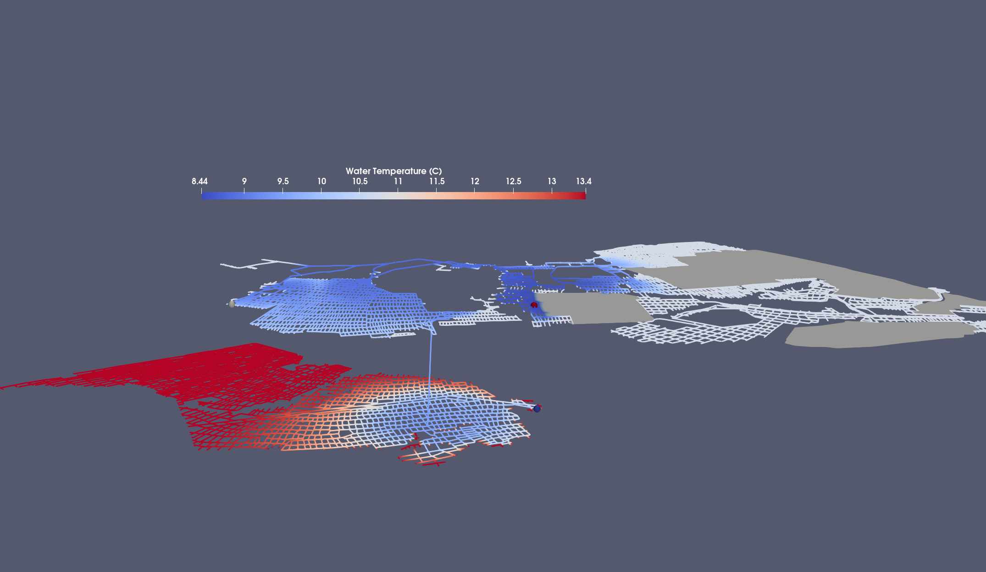
Effect of larger flow rate: 6.4 → 64 litres/sec
T_{inflow} = 8.5 °C
T_{out} = 10.3 °C
T_{max} = 13.5 °C
~11 °C
~13.5 °C
~ 4 km
Mouli-Castillo et al. in prep
Notes:
15 % Tout drop in 30 years

Slide 15
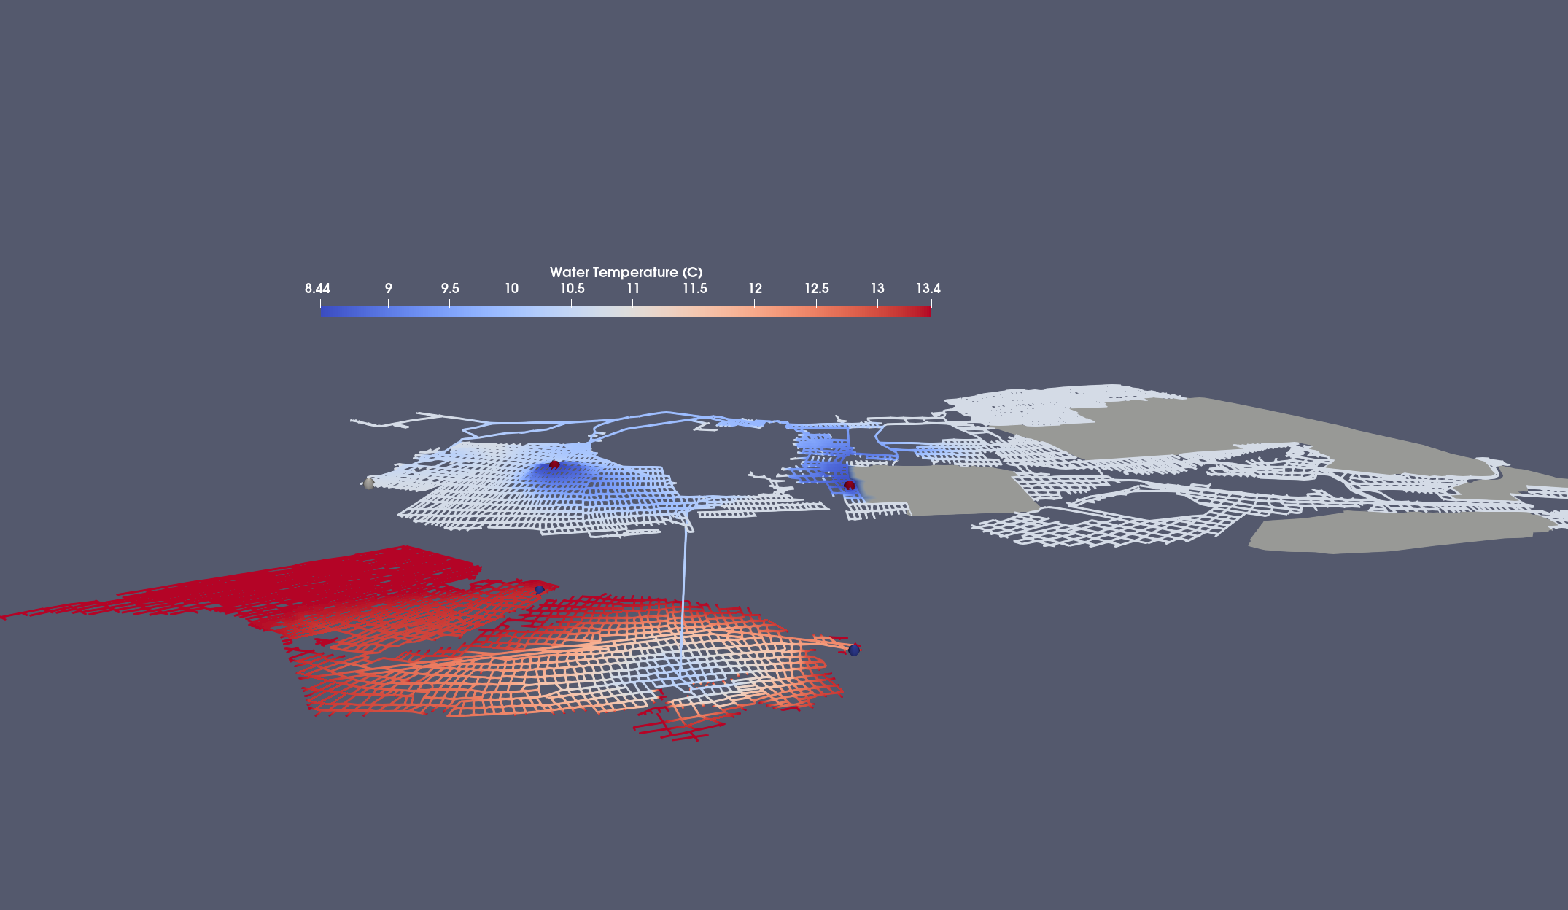
Effect of second user
☺ → ☺ ☺
T_{out} = 12.3 °C
T_{out} = 13.3 °C
T_{inflow} = 8.5 °C
T_{max} = 13.5 °C
~11 °C
~13.5 °C
~ 4 km
Mouli-Castillo et al. in prep
Notes:
15 % Tout drop in 30 years

Slide 16
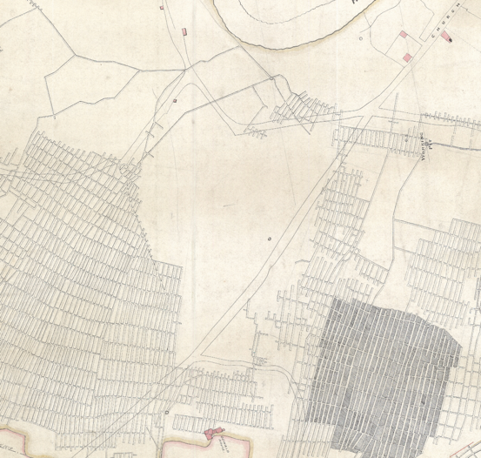
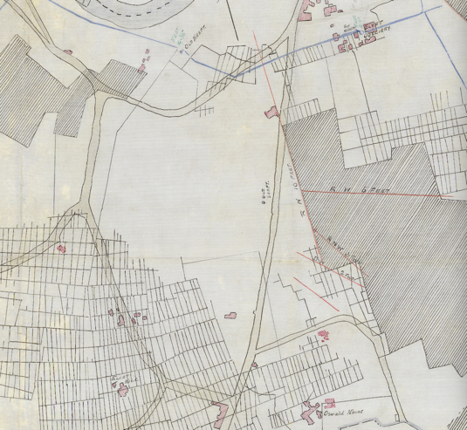
Challenges and limitations
Uncertainty in state of mines:
Backfilling of mines
Pillar robbing and map chronology
Mine abandonment
Mine collapse
Availability of data to calibrate models
MWGH relatively new
Limited potential for measurements
Successful projects provide limited data
Social/economical/regulatory challenges:
Social acceptance and retro-fitting
Investors and financial feasibility
Ownership and licenses
Mine plans of
the Hutton seam

Slide 17
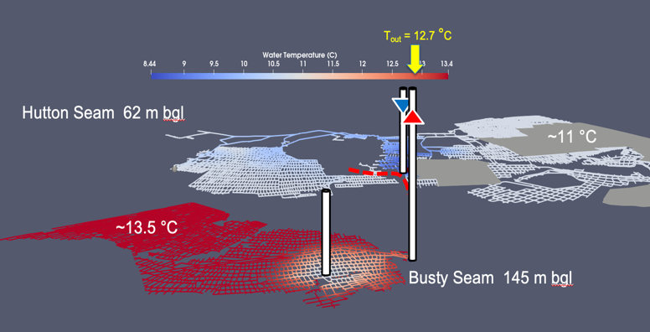
Conclusions
MWGH is large sustainable energy source if responsibly used
Modelling can provide low-cost pre-drilling technical feasibility estimates
Durham case study illustrates critical components:
Flow rates and pathway should allow enough time for water to re-heat
State of mines uncertain; shaft conditions are critical
Challenges:
Uncertainty in state of mine
Availability of data to calibrate models
Social/economical/regulatory challenges

Slide 19
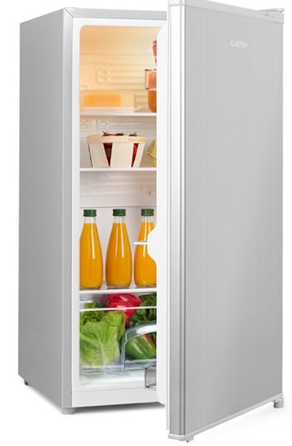
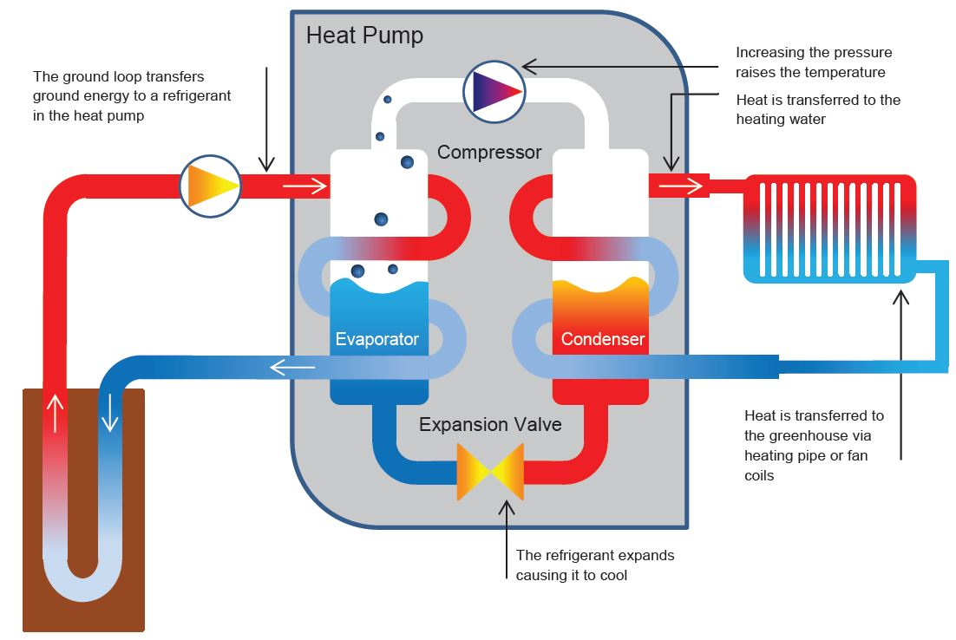
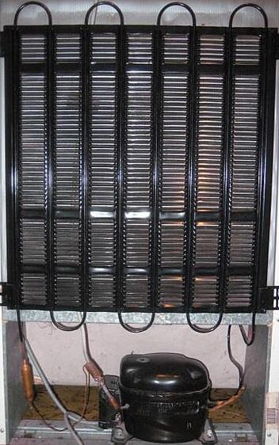
How does a heat pump work?
radiator
Coefficient of Performance (COP) ~4
(i.e. 1 kW electricity → ~4 kW heat)
compressor

Slide 20
Flow calculation
$$H_{i}−H_{j}=r Q_{ij}^{n}$$
(1)
r = resistance coefficient
n = flow exponent
H_{j}
$$\sum{Q_{ij} −q_{i}=0}$$
(2)
q_{i} = injection/abstraction at node i
H_{i}
Solve
$$AH=F$$
A = matrix for equation (1)
F = net flow balance equation (2)
Q_{ij}
NODE j
Update Q
water
PIPE j
Update A and F
Method by (Todini & Pilati, 1988)
NODE i

Slide 21
Heat transfer
Semi-analytical method
Energy balance: ΔE_{water} = -ΔΕ_{rock}
Heat transfer limited by:
Diffusive heat transfer in rock
Advective heat transfer in water
rock
water
NODE i+1
PIPE j
r
Dittus-Boelter
advective heat transfer
Heat
conduction
NODE i
r₀
Method by (Rodrigues and Diaz, 2009)

Slide 22
GEMS Research Project
Sept. 2021 – Aug. 2024, £1.7M EPSRC+NERC funding
Durham University:
Earth Sciences: Jeroen van Hunen (PI), Julien Mouli-Castillo,
Stefan Nielsen, Stuart Jones
Engineering: Zhiwei Ma, Susmita Koley, Tony Roskilly, Huashan Bao
Anthropology: Simone Abram, Chima Anyadike-Danes, Sandra Bell
Business School: Laura Marsiliani, Jingyuan Di
DEI / Heat Hub: Jacki Bell
British Geological Survey:
Alison Monaghan, Anna Hicks, Johanna Scheidegger, Andres Gonzalez Quiros
Project partners:
Mijnwater BV Heerlen
Lanchester Wines
Coal Authority
GeoEnergy Durham
Glacier Energy
Clyde Gateway
Durham County Council
NEIMME
Townrock Energy

Slide 23
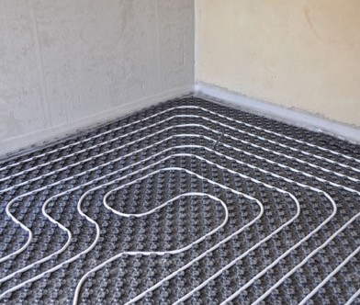
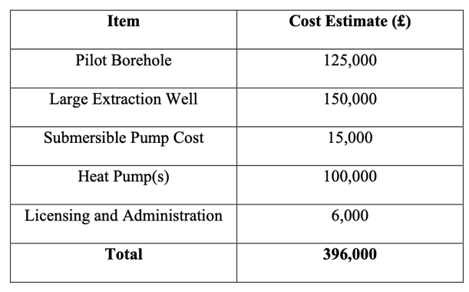
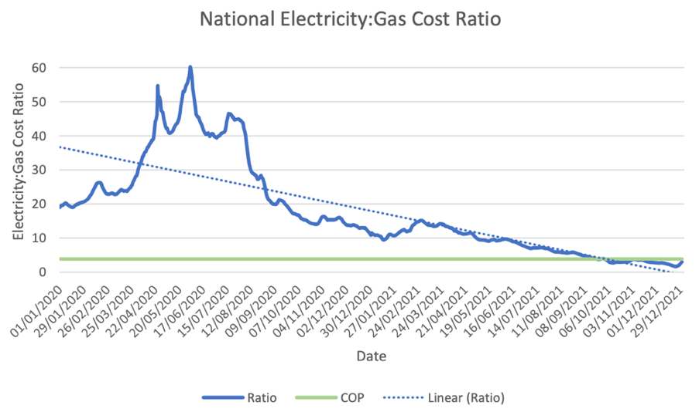
The end user
Disruption:
Gas boilers to be phased out
Lower temperature heat source and using our heat differently may require retro-fitting
Costs:
Capital costs (equipment + retrofitting)
Running costs (COP vs. electricity:gas price)
Environmental costs
→ Work on solutions with end users
$≈$4.5 (for 2021)
$COP≈$3.9
(MacKenzie, 2022)
Notes:
https://floorheating-direct.co.uk/
https://www.tricityappliance.com/blog/2018/october/the-pros-and-cons-of-a-gas-boiler/

Slide 24
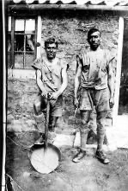
New regulations / policies / finance schemes
Recommendations on:
Regulations: Mine water geothermal heat is relatively new energy source in UK:
Requirement for new government regulations?
(e.g. Who owns heat underground?)
Financing: Risks associated with new mine water heating schemes and consequences for investors
Socio-economic impact: ensure a socially just energy transition
Images: Shutterstock; National business capital; Durham Record Office
Notes:
http://www.durhamrecordoffice.org.uk/article/10597/Coal-Mining

