Slide 1
Social networks: How much realism do we need?
Dr Jennifer Badham
Assistant Professor in Social Data Science
Department of Sociology
jennifer.badham@durham.ac.uk

Slide 2
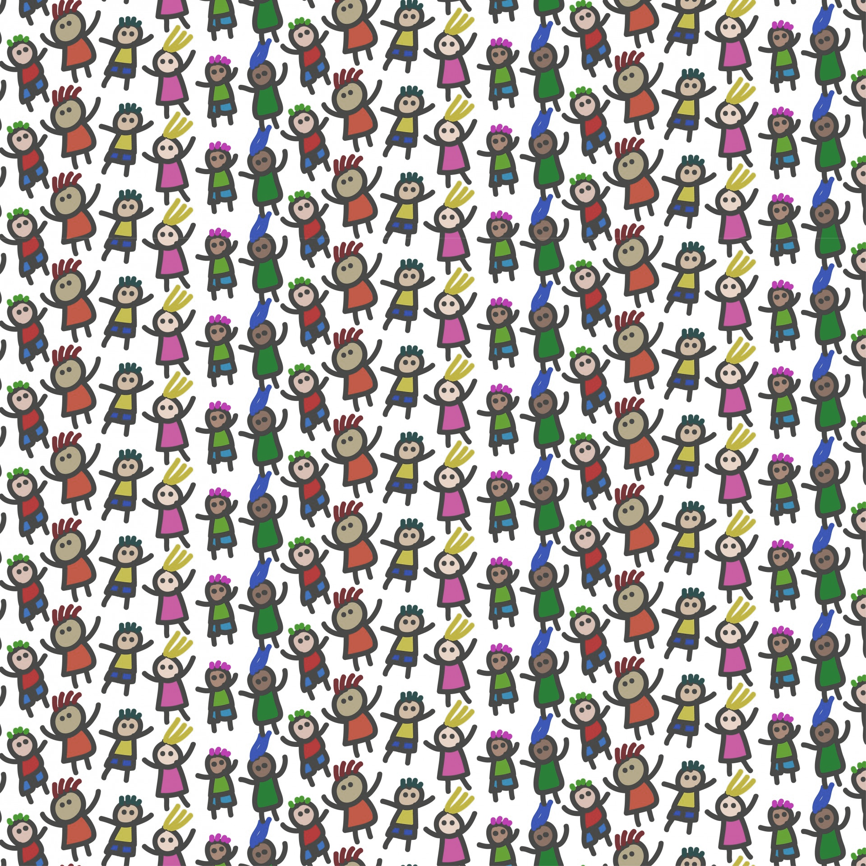
Motivation
200 children in a school year
Resources to work with 30 (15%) to encourage healthy behaviour
eat better, prevent smoking, be active….
Which 30 to choose?
Students with many friends?
Group who can provide mutual support?
Respected by other students?
Just one example from network diffusion

Slide 3
Idealised mechanisms for simulations of network diffusion
Simple
Complex
Probabilistic
Used for epidemics, rumours, information
Diffusion through chains of HIGH degree
Threshold
Used for behaviour change, innovation, peer pressure
Diffusion through chains of LOW degree
?
?
?
?
?
Centola, D., Macy, M. (2007), “Complex contagion and the weakness of long ties” in American Journal of Sociology 113(3), 702–734

Slide 4
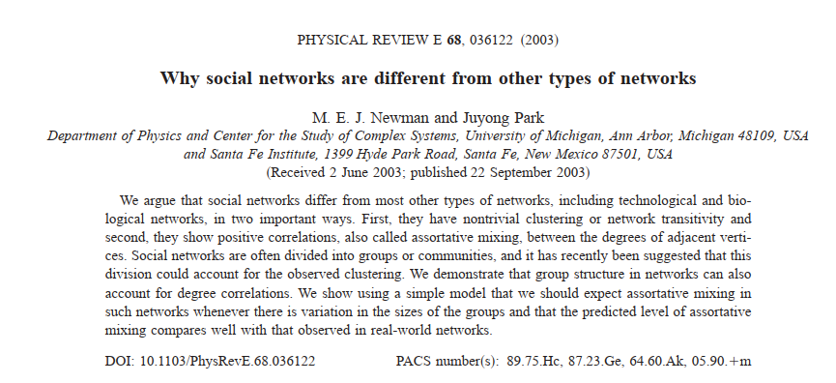
Networks for simulations more problematic
Property | Mean | Range
Nodes | 23.7 | 17 | 33
Edges | 101 | 61 | 157
Communities | 2.8 | 2 | 4
Density | 0.38 | 0.25 | 0.53
Degree: Mean | 8.4 | 6.1 | 10.7
Degree: Gini | 0.18 | 0.10 | 0.28
Degree: Assortativity | 0.16 | -0.15 | 0.47
Clustering Coefficient: Mean local | 0.69 | 0.52 | 0.91
Transitivity | 0.66 | 0.57 | 0.88
Geodesics: Mean | 1.8 | 1.4 | 2.7
Geodesics: Max | 4.1 | 2 | 6
Geodesics: Gini | 0.26 | 0.21 | 0.33
Betweenness: Gini | 0.60 | 0.43 | 0.83
Social networks have distinctive structural properties
Skewed, but not extreme, degree distribution
Positive degree assortativity
Positive substantial clustering coefficient
Example from Wellbeing in Schools study (2016)
15 friendship networks in school classes

Slide 5
Two traditions of network analysis: different questions
Borgatti et al 2009 – social scientists
Macro-analytical, theoretical: how do network properties relate to each other?
From a social scientist's point of view, network research in the physical sciences can seem alarmingly simplistic and coarse-grained. And, no doubt, from a physical scientist's point of view, network research in the social sciences must appear oddly mired in the minute and the particular, using tiny data sets and treating every context as different.
Mathematics /
Computer Science
Generalisability
Micro-analytical, empirical: how is influence exerted by individual nodes in the network of interest?
Social Science
Realism

Slide 6
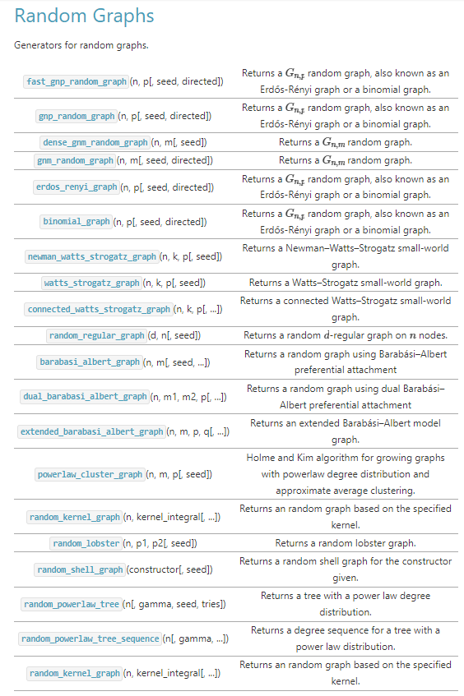
Available network generators cannot reproduce realistic properties
Random (Erdos-Renyi)
Degree distribution: normal, not skewed
Clustering: low
Assortativity: 0
Preferential attachment (Barabasi-Albert)
Degree distribution: extremely skewed
Clustering: no
Assortativity: negative
Small-world (Watts-Strogatz)
Degree distribution: delta up to normal, not skewed
Clustering: high
Assortativity: high

Slide 7
Network diffusion studies need convergence of traditions
Question: How do network properties affect social diffusion processes?
Must vary properties individually
Need the social environment for influence (realism)
Simulation as method (generalisability)
Our project: develop algorithms to generate more realistic social networks
Non-trivial to create networks that vary individual properties
Many properties beyond those identified
Properties interdependent
Early days, Feb 2023 to Jan 2026
Mathematics /
Computer Science
Generalisability
Social Science
Realism

Slide 8
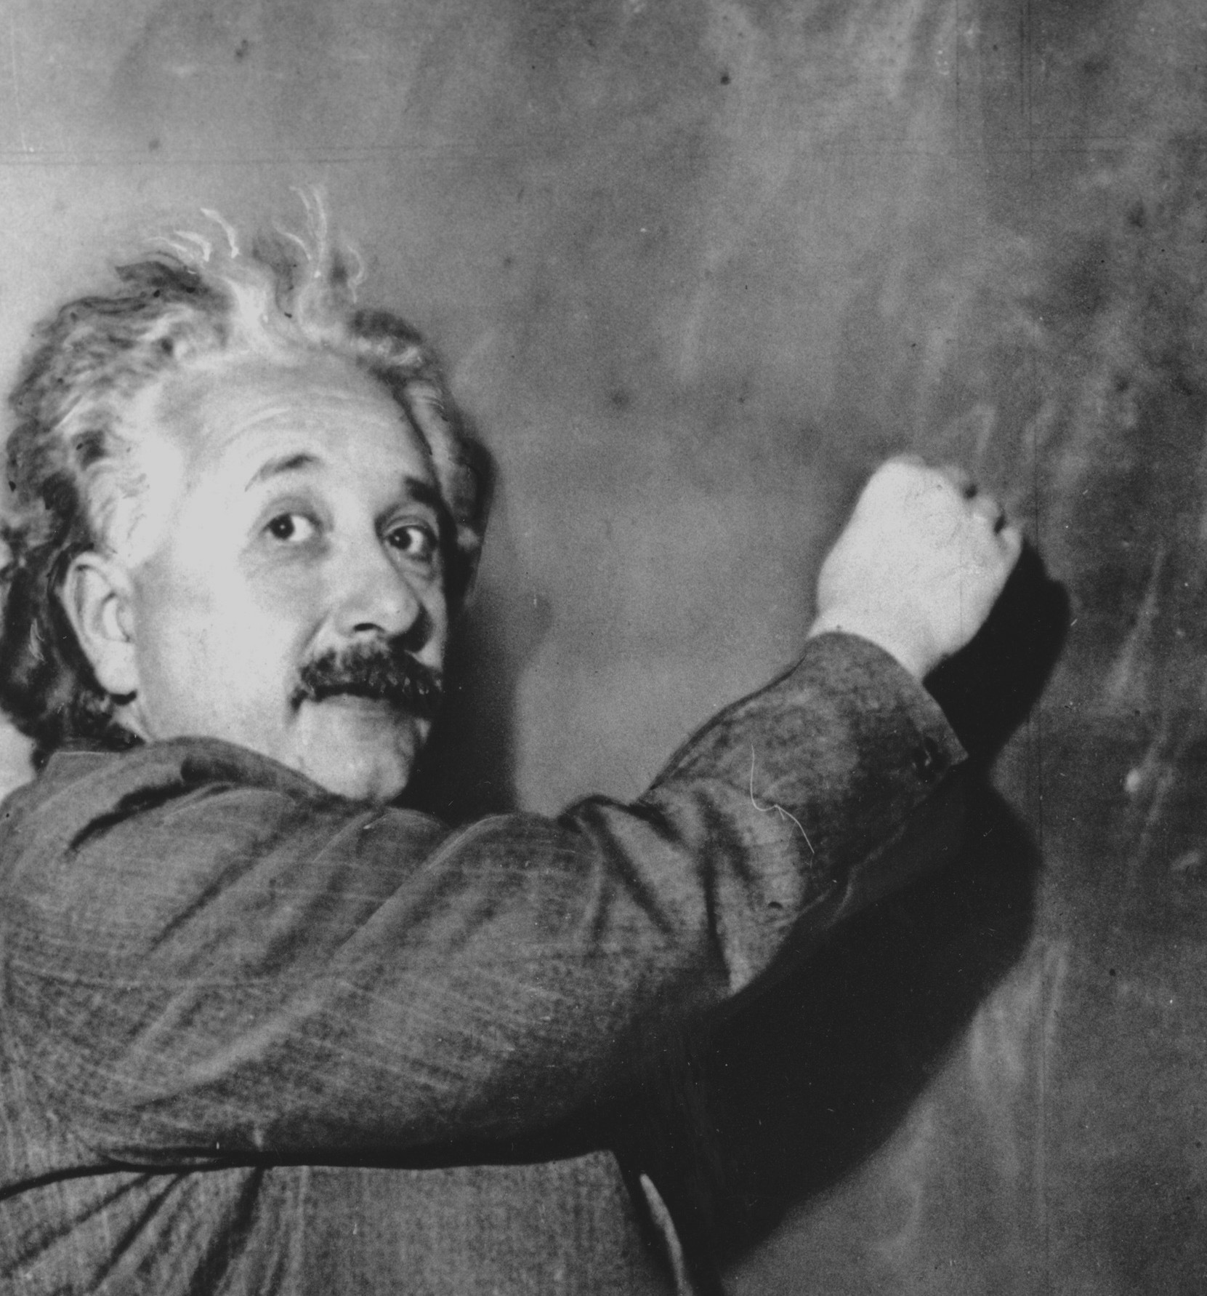
Raises broader questions about the art of modelling
Everything should be made as simple as possible, but not simpler
Part of project will assess the necessity of realism
What properties matter?
In what circumstances do they matter?
Value ranges, diffusion mechanism…
Mis-attribution of causality in simulation studies
Not measuring all relevant properties
Conflict between mechanism representation and the push to data driven models
Policy analysis is about hypothetical world
Machine learning summarises a dataset
Train/test say nothing about validity in any world not measured
Attributed to Einstein
https://quoteinvestigator.com/2011/05/13/einstein-simple/

