Slide 1


Durham
3rd May 2023
With apologies to Haruki Murakami
and thanks to James Millington (KCL) and Laura Turnbull-Lloyd (Durham)

Slide 2

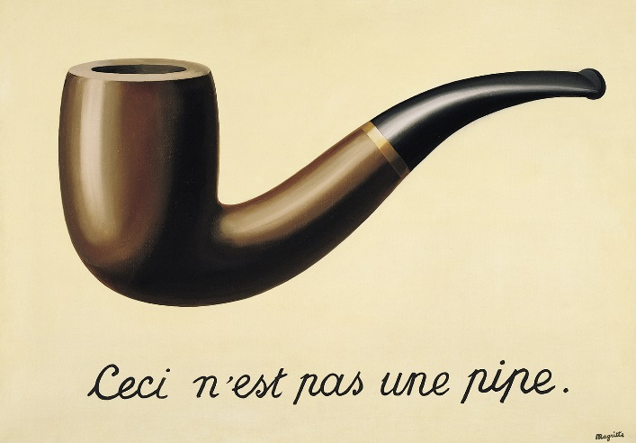
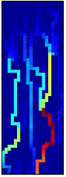


Outline
Introduction Modelling Connectivity What Modelling Tells Us Conclusions
Ceci n’est pas la connectivité
Introduction
what is connectivity?
Modelling connectivity
hydrology and sediment transport
vegetation and land degradation
people and landscape evolution
What modelling (connectivity) tells us
whither connectivity?
models and explanation
Conclusions
This project has received funding from the European Union’s Horizon 2020 research and innovation programme under the Marie Skłodowska-Curie grant agreement No 859937

Slide 3
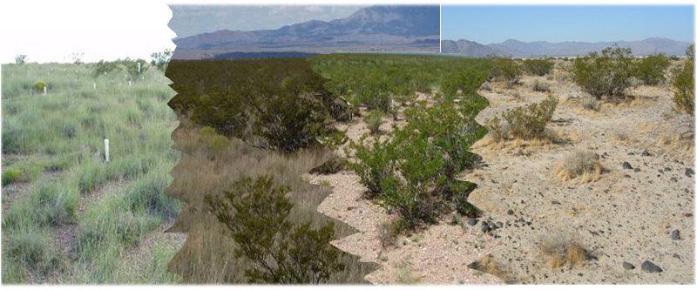
What is Connectivity?
Introduction Modelling Connectivity What Modelling Tells Us Conclusions
Composite image across grassland-shrubland ecotone, Sevilleta LTER, NM, USA

Slide 4
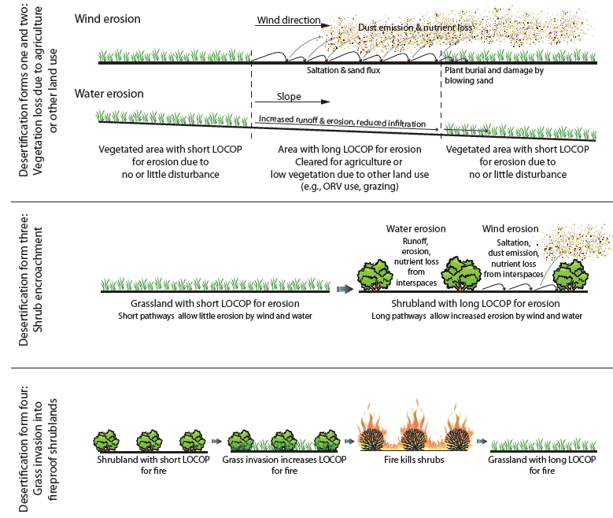
LOCOP
Introduction Modelling Connectivity What Modelling Tells Us Conclusions
Length
Of
COnnected
Pathways
(Okin et al. 2009, Bioscience)

Slide 5
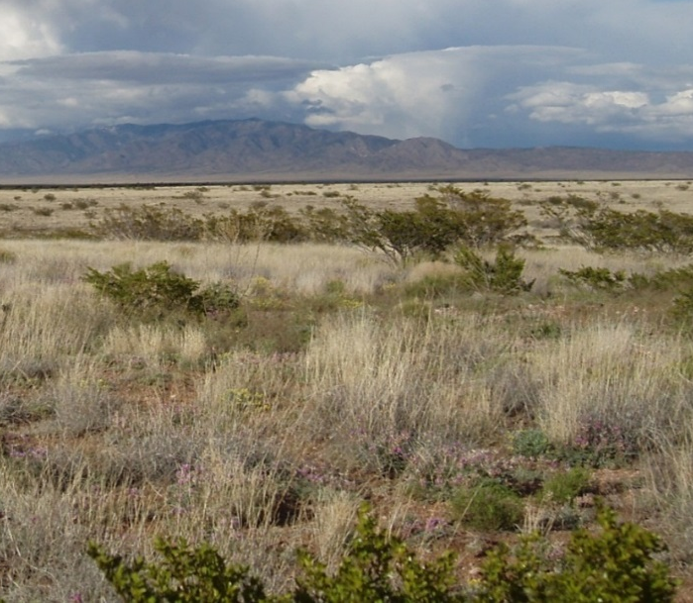

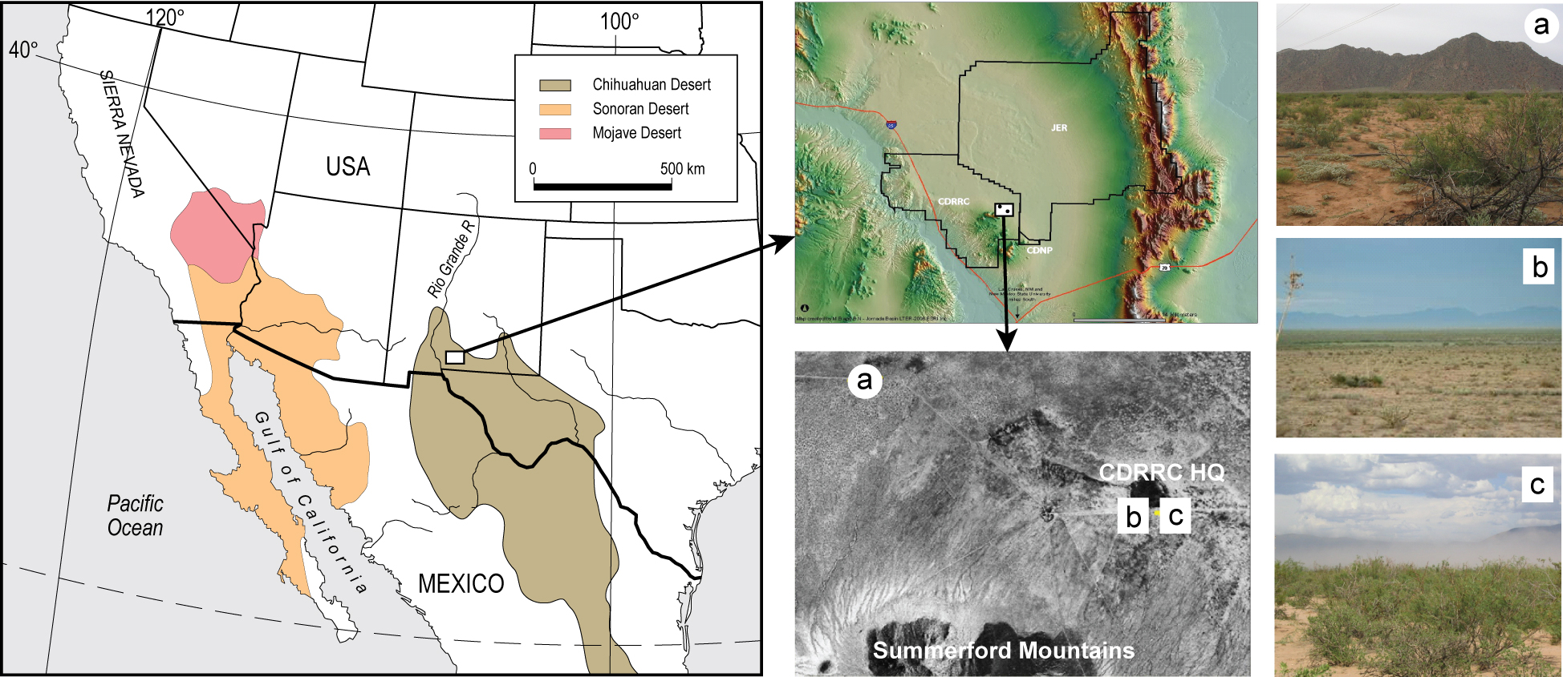
Modelling connectivity
Grassland, New Mexico, USA
Introduction Modelling Connectivity What Modelling Tells Us Conclusions
Three examples:
Runoff and sediment connectivity at Sevilleta
Integrated landscape modelling at Jornada
ABMs and the Mediterranean Neolithic
S
J
J – Jornada Experimental Range / LTER site
S – Sevilleta NWR / LTER site

Slide 6
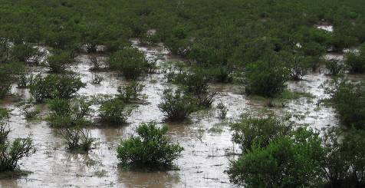

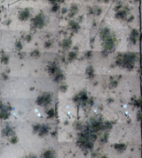
Connectivity on Dryland Hillslopes
Introduction Modelling Connectivity What Modelling Tells Us Conclusions
System Function
functional connectivity
runoff & erosion
vegetation
topography
System Structure
structural connectivity
Turnbull et al. (2008) Ecohydrology; Wainwright et al. (2011) Geomorphology

Slide 7
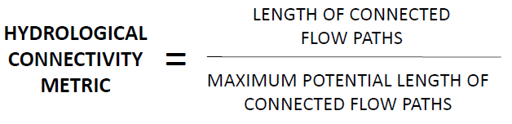
1. Runoff and sediment connectivity at Sevilleta
Introduction Modelling Connectivity What Modelling Tells Us Conclusions
FUNCTIONAL CONNECTIVITY
(dynamic at timescale of runoff/sediment transport events)
Hydrological connectivity:
Length of connected runoff flow paths
Sediment connectivity:
Length of connected sediment transport pathways
CONNECTIVITY METRIC
STRUCTURAL CONNECTIVITY
(static over short timescales, dynamic at timescale of structural-functional feedbacks)

Slide 8
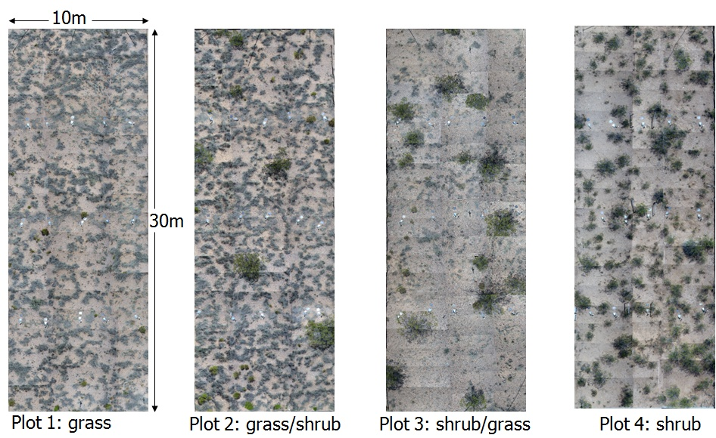
Estimating structural connectivity
Introduction Modelling Connectivity What Modelling Tells Us Conclusions
Notes:
So, defining sediment connectivity is a two-part process

Slide 9
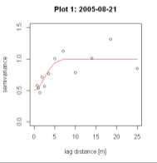
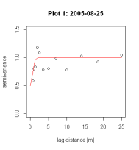
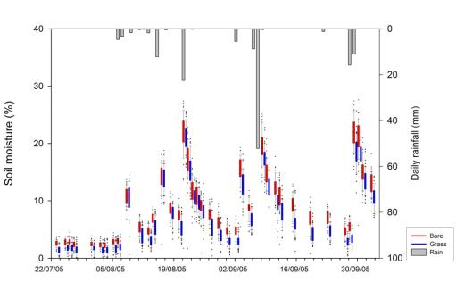
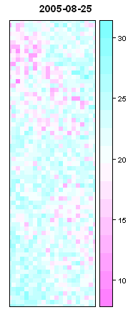
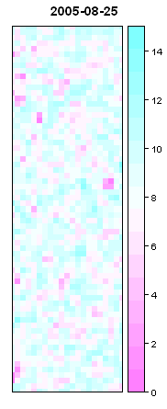
Initial soil moisture
Introduction Modelling Connectivity What Modelling Tells Us Conclusions
Measured surface soil-moisture dynamics
Kriged soil moisture
Kriged soil moisture
Soil moisture (%)
Soil moisture (%)
Turnbull et al. (2010) Hydrological Processes
Notes:
Process:
A semi-variogram was modelled for each sampling time period using a total of 90 points. The modelled semi-variograms showed distinct spatio-temporal variations in the spatial dependency of surface soil-moisture content over the course of one summer rainfall season.
The semi-variograms were then used to model the broader scale distribution of soil-mositure content, in consideration of observed spatial dependency in the structure of soil-moisture content. This process was repeated for all dates of soil-moisture measurements, and across the 4 sites over the grass-shrub transition.
Key findings:
Talk about soil moisture connectivity patterns

Slide 10
Estimating functional connectivity
Introduction Modelling Connectivity What Modelling Tells Us Conclusions
Quantification of length of connected flow path (runoff/sediment) to each point within study domain
Analysis of spatial model outputs of discharge and sediment transport
Requires selection of thresholds of discharge/sediment transport that constitute connected flow
Spatial model outputs of runoff/sediment transport
Notes:
Depending on the threhsold of runoff and sediment transport used to define what constitutes connectivity, lengths of connected flow paths may vary considerably. – i.e. what constitutes hydrologically significant connectivity, geomorphologically relevant sediment transport?

Slide 11
Evaluating functional connectivity
Introduction Modelling Connectivity What Modelling Tells Us Conclusions
Modelling scenarios:
Model testing:
Soil-moisture content
Low = 3.8 %
Med = 10.5 %
High = 21.1 %
Rainfall event size
33.8 mm
10.7 mm
4.1 mm
Measured Q
Observed Q
Thresholds of functionally connected pathways
Runoff = 0.2 l
Sediment transport = 0.2 kg
Runoff and erosion model (Mahleran) tested for multiple events under varied rainfall and antecedent soil-moisture content
(Turnbull et al., 2011, Journal of Hydrology)

Slide 12
Results: Spatial Connectivity Metrics
Introduction Modelling Connectivity What Modelling Tells Us Conclusions
HYDROLOGICAL CONNECTIVITY
SEDIMENT CONNECTIVITY
Soil-moisture content
Soil-moisture content
3.8 % 10.5 % 21.1 %
3.8 % 10.5 % 21.1 %
33.8
10.7
4.1
33.8
10.7
4.1
Event Rainfall (mm)
Event Rainfall (mm)
Notes:
Key think to note here is that the patterns of hydroligical connectivity and sediment connectivity are different.
Connectivity sensitive to thresholds used in calculating length of functionally connected pathways

Slide 13
Results: Mean hydrological connectivity metrics
Introduction Modelling Connectivity What Modelling Tells Us Conclusions
Higher hydrological connectivity associated with higher discharge
Different rainfall and antecedent soil-moisture content generating overall comparable discharge can exhibit greatly different hydrological connectivity

Slide 14
Results: Mean sediment connectivity metrics
Introduction Modelling Connectivity What Modelling Tells Us Conclusions
Higher sediment connectivity associated with higher total sediment export
Similar sediment connectivity metric for very different sediment export
  Pathways of connected sediment transport are yielding more sediment
  Lengths of pathways of connected sediment transport remain the same

Slide 15
Results: Mean connectivity metrics
Introduction Modelling Connectivity What Modelling Tells Us Conclusions
4.1 mm rain 10.7 mm rain 33.8 mm rain
Hydrological Connectivity
Sediment Connectivity
Thresholds of sediment connectivity are not directly related to thresholds of hydrological connectivity

Slide 16
How useful are connectivity metrics?
Introduction Modelling Connectivity What Modelling Tells Us Conclusions
Length of functional connectivity exceeds length of structural connectivity when connectivity metric > 1
General patterns of pronounced connectivity the same for hydrological and sediment connectivity BUT strength of connectivity varies
Locations on the hillslope where ecogeomorphic feedbacks will be particularly strong
Hydrological connectivity
Sediment connectivity
Mean hydrological connectivity = 2.8
Mean sediment connectivity = 9.4

Slide 17
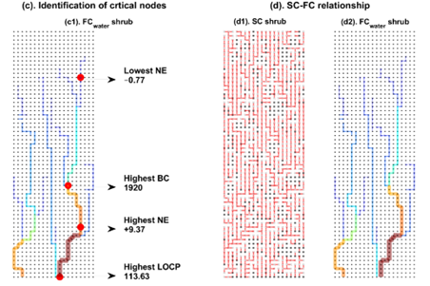
Introduction Modelling Connectivity What Modelling Tells Us Conclusions
Tiwari et al. (in prep.)

Slide 18
2. Integrated landscape modelling at Jornada
Introduction Modelling Connectivity What Modelling Tells Us Conclusions
Stewart et al. (2014) Ecological Monographs

Slide 19

Structure of cellular model
Introduction Modelling Connectivity What Modelling Tells Us Conclusions
Vegetation and topography control connexions, but they are not defined a priori
Stewart et al. (2014) Ecological Monographs

Slide 20
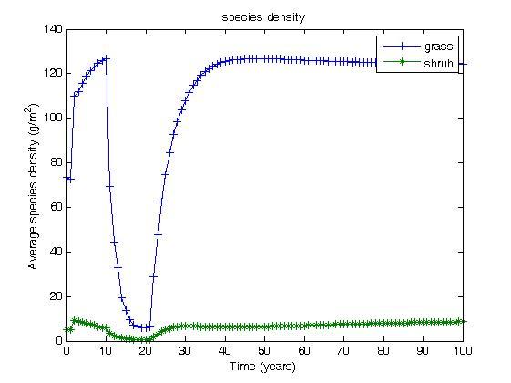
Two species response to drought
Introduction Modelling Connectivity What Modelling Tells Us Conclusions
Notes:
Both species initially increase their biomass in response to the input conditions which support a higher initial biomass. The timing of the drought was selected to coincide with this end of the initial increase of species. The average shrub biomass increases slightly, but cannot out compete the grass which continues to dominate the field. During the drought, the water added to the field is reduced from 100 to 5g/m2 as this represents the minimum water that could be applied without causing both species to die out completely. This results in a dramatic reduction in both species and it is interesting to note that the way by which the grass dies out and recovers very closely resembles the field data of [Peters 2006] which would suggest that our biomass model is adequate for the purposes of our work.

Slide 21
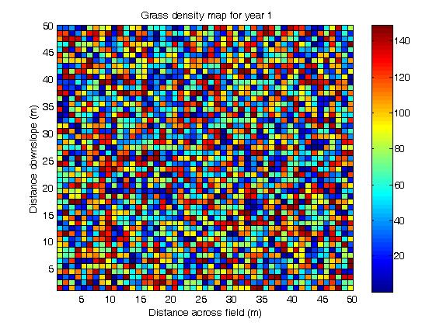
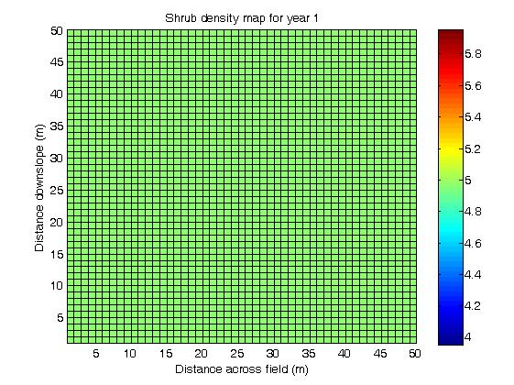
Initial species distribution
Introduction Modelling Connectivity What Modelling Tells Us Conclusions
Notes:
In all cases we start with an initially uniform distribution of grass and shrub, and following the method of [coutron 2004] we peturb the grass distribution with a low level of white noise, but shrub and resource distribution remain uniform. The result is that in approximately 1% of cells, the shrub biomass exceeds grass biomass. All three vectors operate within the field – the north edge of the field corresponds to row 0 here (imagine we’re stood on the top of the hill slope looking down). Wind and water operate north to south and the grazers operate south to north

Slide 22
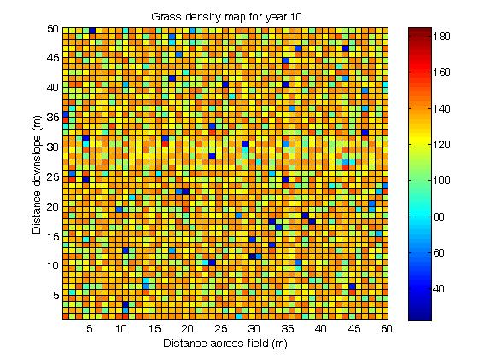
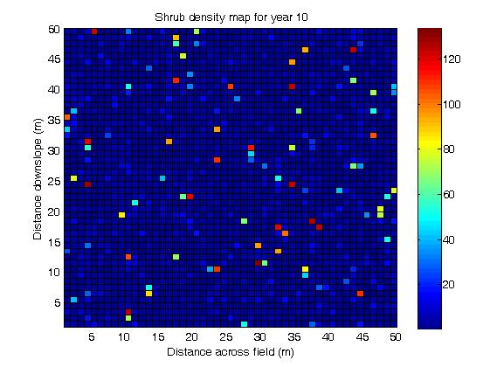
Year 10
Introduction Modelling Connectivity What Modelling Tells Us Conclusions
Notes:
No patterns form as the species increase in response to the initial biomass levels. The shrubs invade from the 1% of cells where the shrub concentration was initially higher, but no clear patterns are formed. Actually, the diffusive smoosh is distributing the resource more evenly through the field.

Slide 23
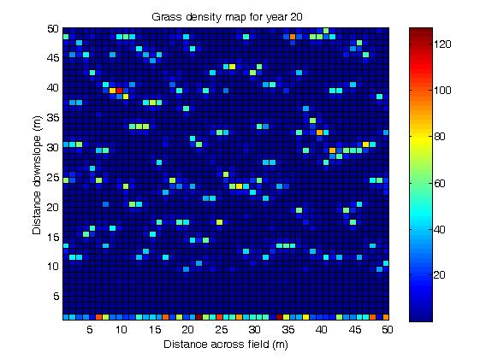
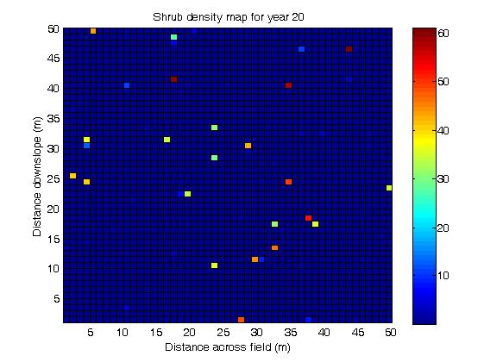
Year 20
Introduction Modelling Connectivity What Modelling Tells Us Conclusions
Notes:
At the end of the drought, biomass of both species has reduced dramatically leading to the seemingly random distribution of shrubs that persist through the drought. The grass has collapsed but formed slight bands in doing so – these bands locally concentrate resource allowing more of the species to persist for longer. The local concentrating of resource is so successful that the shrubs (who are better adapted to resource scarcity) survive on the edges of these bands, and the biomass in shrub cells is higher than the biomass in grass cells.
This slide also illustrates the problem with the cell wrapping method as applied to this model. When the vegetation in the field collapses, more of the resource moves down slope. When insufficient biomass remains to trap this resource, it is wrapped around and ‘dumped’ on the row zero. The relatively dense band of vegetation in row zero is therefore a modelling artefact, but we keep it in this simulation to see what the effect of a boundary condition is.

Slide 24
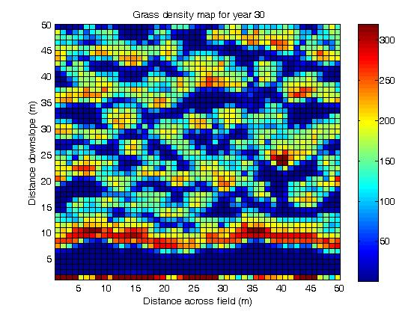
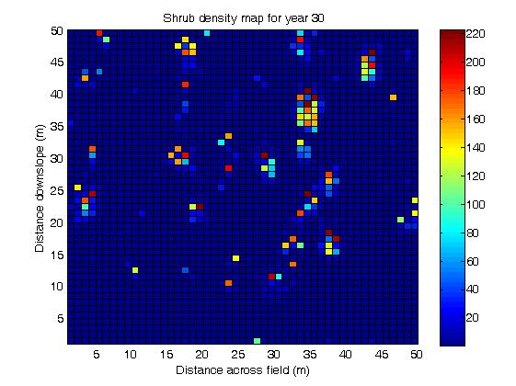
Year 30
Introduction Modelling Connectivity What Modelling Tells Us Conclusions
Notes:
After 30 years, the field species are recovering from the drought, and a marked banding pattern in the grass is noted. This forms from the bands that are developed in the resources during the drought. The banding pattern supports higher biomass for reduced resource than can be supported by a homogenous field distribution, and it can be noted that the biomass on the upflux edge of the band is significantly higher than at in a corresponding uniform field. The shrubs have recovered to form isolated islands which initiate on the down-flux edge of the grass band and the shrubs out-compete the grass within these islands.

Slide 25
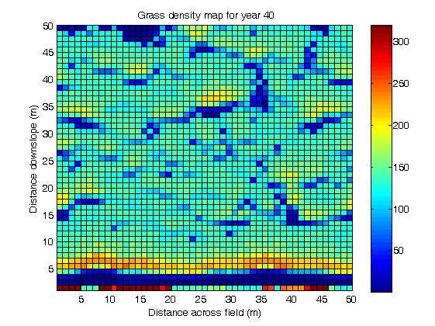
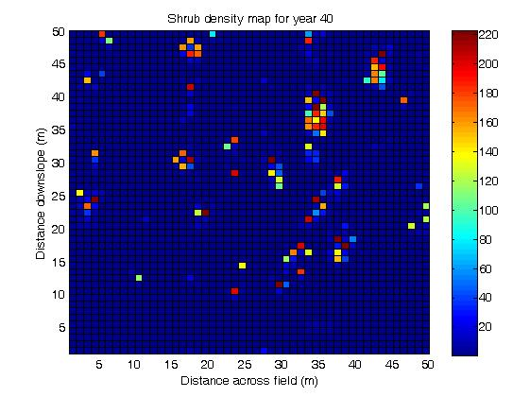
Year 40
Introduction Modelling Connectivity What Modelling Tells Us Conclusions
Notes:
The recovery of the field continues, and as with the no drought case, resource is redistributed from vegetated cells until the resource distribution becomes much more uniform and the banding patterns fade out. The island pattern associated with the shrub persists – this self organisation strategy allows the shrubs to remain within the field, where as previously they would have disappeared. This pattern also supports a higher shrub biomass than was noted in a no drought condition.

Slide 26
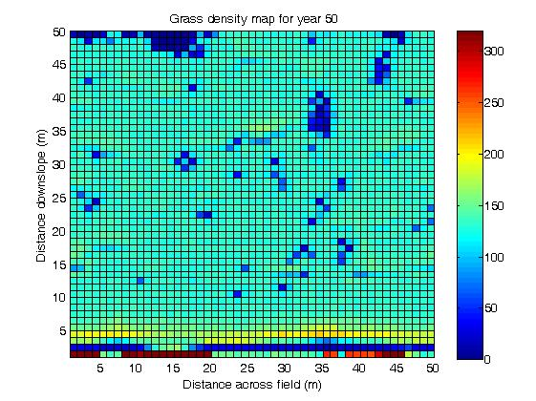
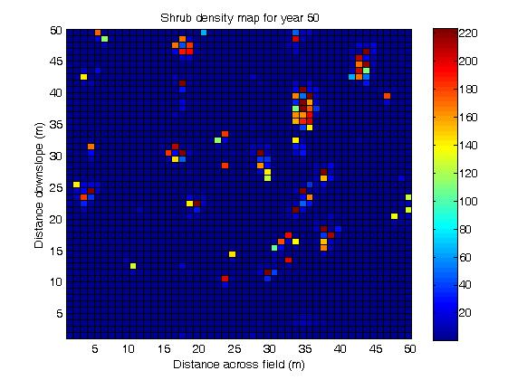
Year 50
Introduction Modelling Connectivity What Modelling Tells Us Conclusions
Notes:
The timing of droughts is also significant on the ultimate pattern produced in the vegetation. for an early drought (occurring when the deep layer resource is homogenous) the grass recovers quickly after the drought – this doesn’t necessarily happen in the field which could imply that another process inhibts grass recovery in the field. This quick recovery also inhibits the slower growing shrubs. Where two droughts are modelled, the field average grass density is slightly lower than either case involving a single drought, and the shrubs ultimately reach a much higher level. This would suggest that continued scarcity of resource favours the dominance of the shrubs, who are better able to capitalise on the resource accumulation on bands of grass. When two droughts occur, the number of connected cells is higher and grass recovers more slowly. This would cause increased overland runoff and erosion while the slow recovery favours the shrubs. However, these processes ARE NOT MODELLED HERE.
We observe that the artefact boundary condition does not affect cells beyond 5m into the field – therefore banding patterns can occur as a result of these local diffusive advection processes in the absence of any boundary or any other process.

Slide 27
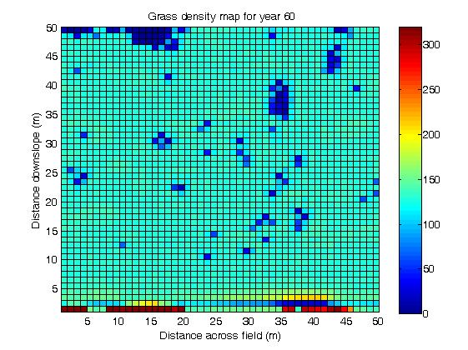

Year 60
Introduction Modelling Connectivity What Modelling Tells Us Conclusions

Slide 28
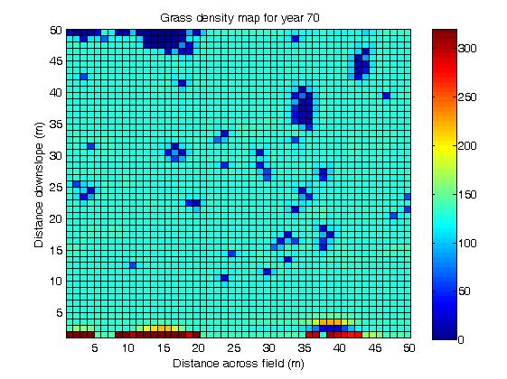
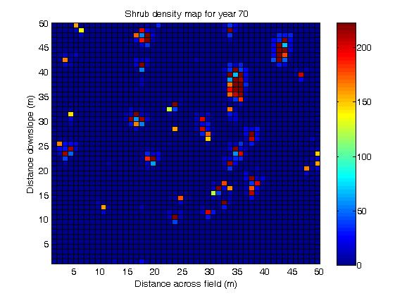
Year 70
Introduction Modelling Connectivity What Modelling Tells Us Conclusions

Slide 29
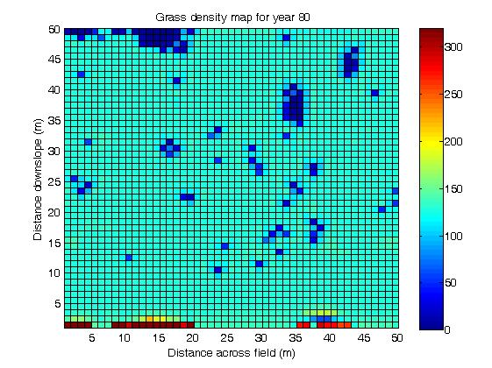

Year 80
Introduction Modelling Connectivity What Modelling Tells Us Conclusions

Slide 30
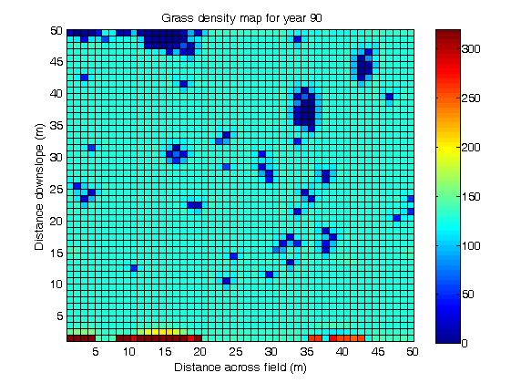

Year 90
Introduction Modelling Connectivity What Modelling Tells Us Conclusions

Slide 31


Year 100
Introduction Modelling Connectivity What Modelling Tells Us Conclusions
Notes:
The shrub islands become larger and contain higher biomass. Once established, the shrubs persist in the field. It appears that banding patterns form in the dominant field species, and island patterns form in the invading species.
In the absence of any other process, the grass will recover and the two species will co exist.

Slide 32
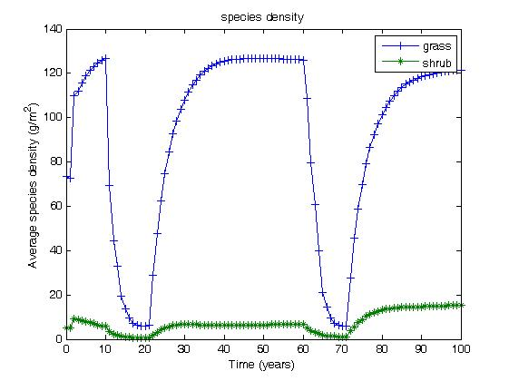
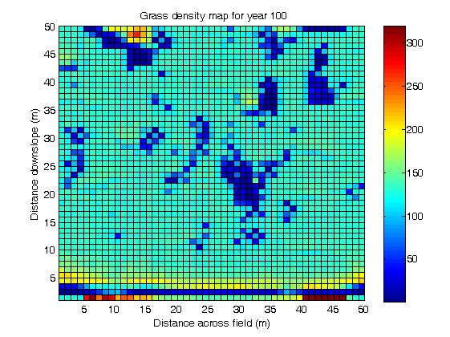
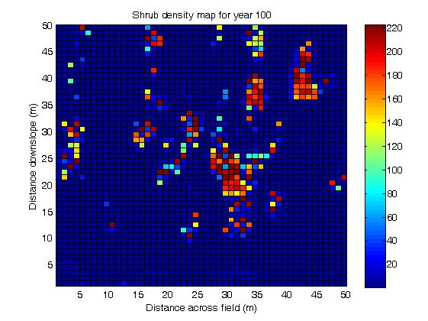
Introduction Modelling Connectivity What Modelling Tells Us Conclusions
Year 100 - 2 droughts

Slide 33
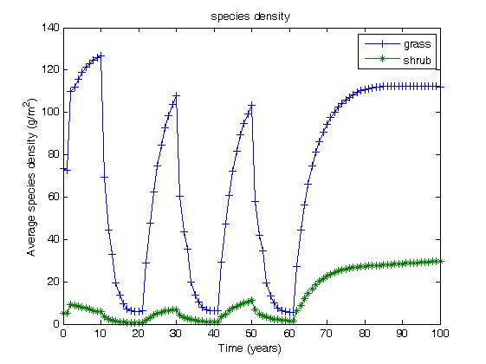
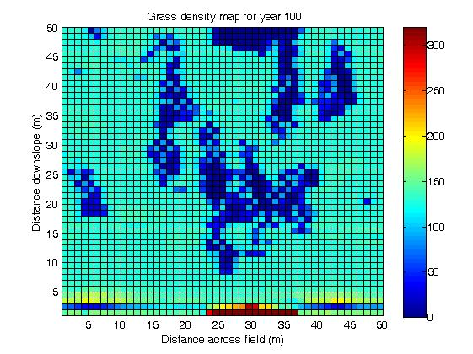
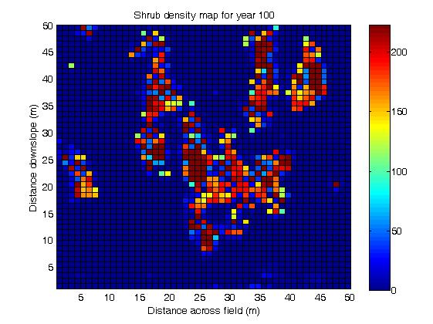
Introduction Modelling Connectivity What Modelling Tells Us Conclusions
Year 100 - 3 droughts

Slide 34
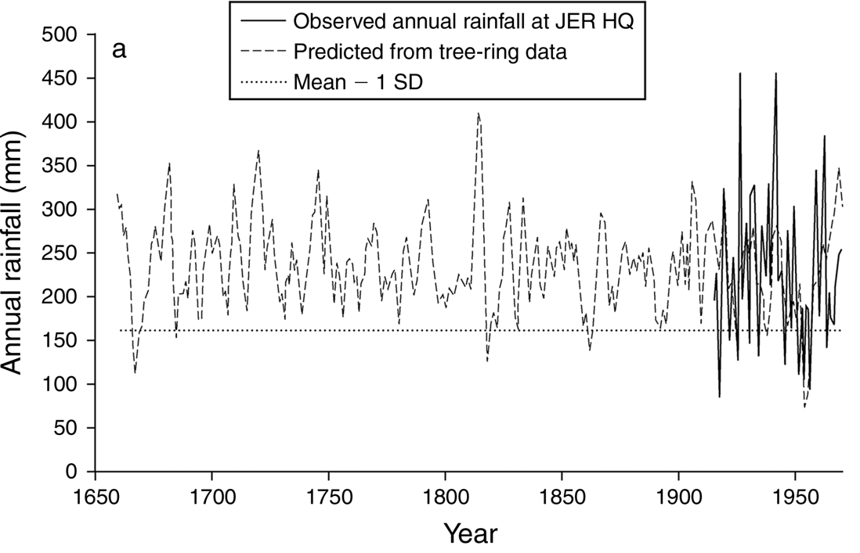
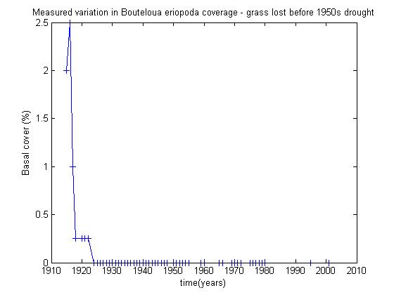
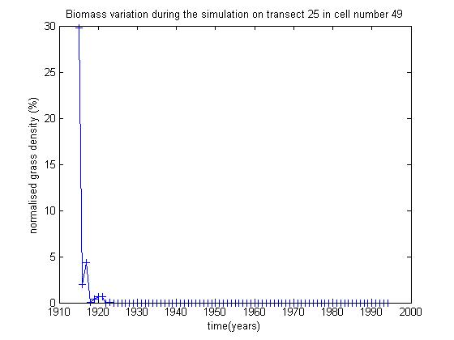
Model evaluation
Introduction Modelling Connectivity What Modelling Tells Us Conclusions
observed
simulated
Yao et al. (2006)
Stewart et al. (2014)
Grass lost before 1950s drought at Jornada LTER site

Slide 35
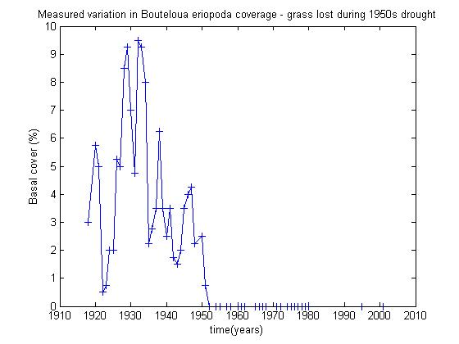
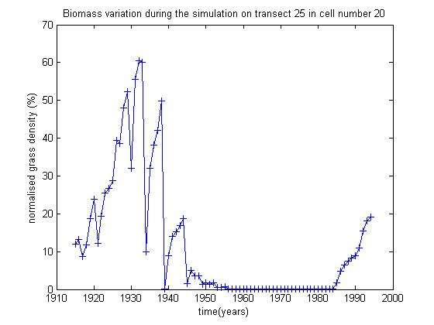
Model evaluation
Introduction Modelling Connectivity What Modelling Tells Us Conclusions
observed
simulated
Yao et al. (2006)
Stewart et al. (2014)
Grass lost during 1950s drought at Jornada LTER site

Slide 36
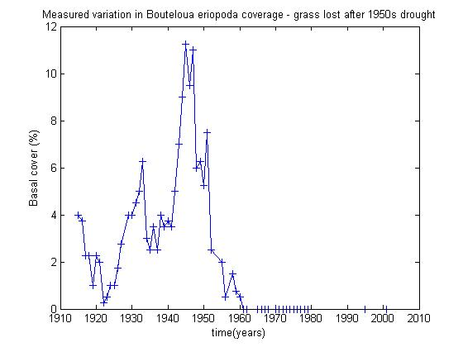
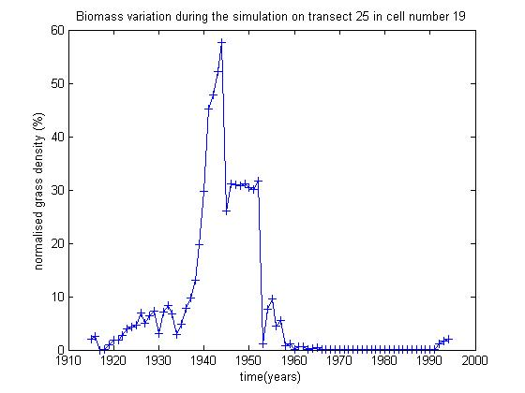
Model evaluation
Introduction Modelling Connectivity What Modelling Tells Us Conclusions
Grass lost after 1950s drought at Jornada LTER site
observed
simulated
Yao et al. (2006)
Stewart et al. (2014)

Slide 37
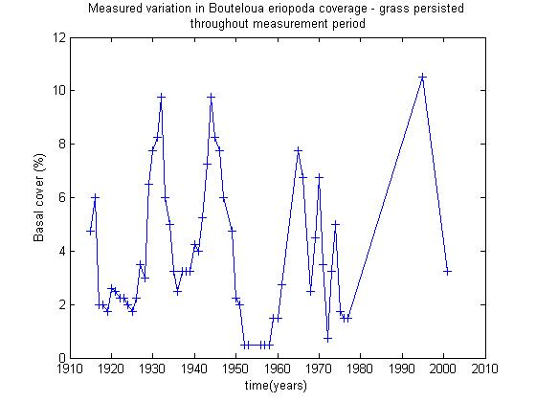
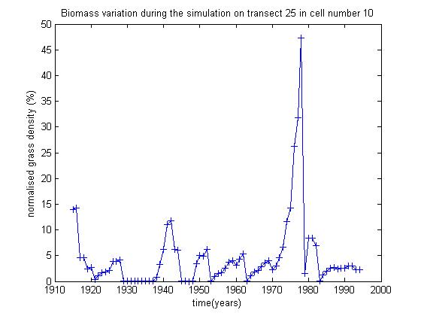
Model evaluation
Introduction Modelling Connectivity What Modelling Tells Us Conclusions
observed
simulated
Yao et al. (2006)
Stewart et al. (2014)
Grass persistence through observations at Jornada LTER site

Slide 38
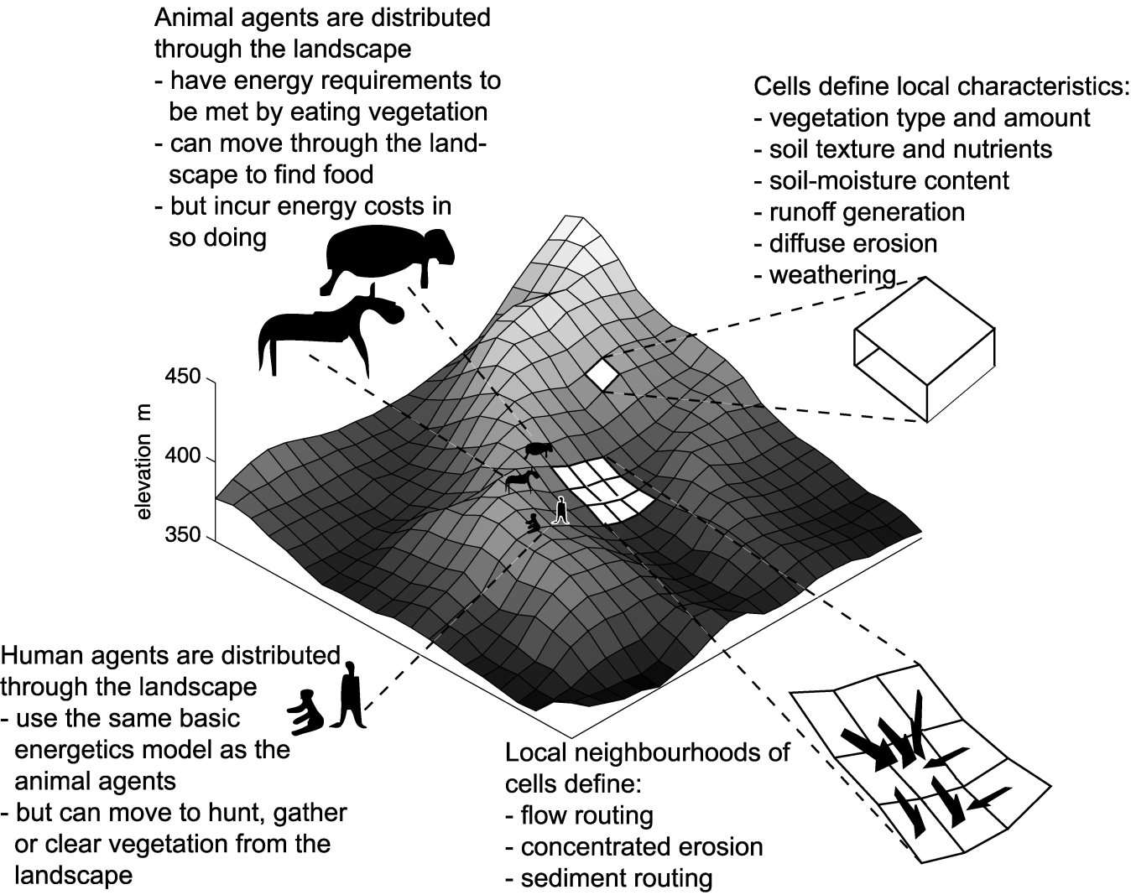

3. ABMs and the Mediterranean Neolithic
Introduction Modelling Connectivity What Modelling Tells Us Conclusions
CybErosion
Wainwright (2008) Geoforum

Slide 39


CybErosion^{eAg}
Introduction Modelling Connectivity What Modelling Tells Us Conclusions
Typical vegetation mosaic around agricultural settlement.
Blue patches are currently cultivated areas
Brown patches are bare (previously cultivated areas)
forest
Fire scar
grass
Erosion rates around slightly expanded view showing effects of settlement movement
shb
Wainwright (2015) in Dykes et al. (eds) Monitoring and Modelling Dynamic Environments.

Slide 40



CybErosion^{eAg}
Introduction Modelling Connectivity What Modelling Tells Us Conclusions
Net direction of
agriculturalist movement
Slow invasion rate, low population pressure, extensive production
Notes:
Run7 – broad band of erosion

Slide 41



CybErosion^{eAg}
Introduction Modelling Connectivity What Modelling Tells Us Conclusions
Net direction of
agriculturalist movement
Moderate invasion rate and population pressure, extensive production
Notes:
Run 4

Slide 42



CybErosion^{eAg}
Introduction Modelling Connectivity What Modelling Tells Us Conclusions
Net direction of
agriculturalist movement
Rapid invasion rate, high population pressure, intensive production
Notes:
run3

Slide 43






Introduction Modelling Connectivity What Modelling Tells Us Conclusions
Results from CybErosion^{eAg}
Scenario 1
Scenario 2
Scenario 3
vegetation
erosion
interaction

Slide 44

Introduction Modelling Connectivity What Modelling Tells Us Conclusions
Net direction of
agriculturalist movement
Erosion high when location of settlement intersects main flow pathways – structural ad functional connectivity?

Slide 45

Whither connectivity?
Introduction Modelling Connectivity What Modelling Tells Us Conclusions
What have we learned from these simulation studies about connectivity?
  Connectivity emerges from models without explicit representation of (whatever) it (is)
  It affects different processes in different ways and over different timescales
  Initial conditions are important
  Path dependency and contingency
  Heterogeneity: place as important as space
BUT …
  Subjectivity
  Hidden assumptions
  Can/should we generalize?

Slide 46
Models and explanation
Introduction Modelling Connectivity What Modelling Tells Us Conclusions
Confounding of the computer-simulation model with the “model of the phenomena” (after Winsberg)
Alternative styles of modelling, especially cellular, individual- and agent-based modelling:
  CM/IBM/ABM have the potential to represent various actions and reactions within environments that can have numerous spatial structures
  Can incorporate quantitative AND qualitative information
Learning through the process of modelling
Promotion of rigorous thought and conceptualization
A means of communicating, understanding and negotiating ideas and world-views
  (Millington and Wainwright, 2017, PIHG)

Slide 47
Conclusions
Introduction Modelling Connectivity What Modelling Tells Us Conclusions
A range of “bottom-up” modelling approaches are consistent with how we have interpreted connectivity in dryland environments without building “connectivity” into the models (we think)
Conceptualization of the system is critical in providing a real(ist) underpinning of our understanding of connectivity, e.g.:
  Importance of heterogeneity and spatial pattern (and by implication place)
  Appropriate representations of sediment-transport mechanisms (Mahleran approach to scaling sediment movement)
  Appropriate ecogemorphic feedbacks at the appropriate scale
But some model elements are problematic, e.g.:
  need to use subjective thresholds because continuum-based flow models are very poor at representing disconnexion
Modelling only tells us part of the story → but also what we need to look at next in the field

Slide 48

Thank you for your attention!
Introduction Modelling Connectivity What Modelling Tells Us Conclusions

Slide 49






















Only connect!
Ed Fredrickson
Jill Stewart
Tony Parsons
Greg Okin
Rich Brazier
Athol Abrahams
Laura Turnbull
Roger Simanton
Brandon Bestelmeyer
Eva Müller
Bill Schlesinger
Mel Neave

