Slide 1


IAS and IDAS discussion on modeling
Ulrik Beierholm
Psychology
3 May 2023

Slide 2
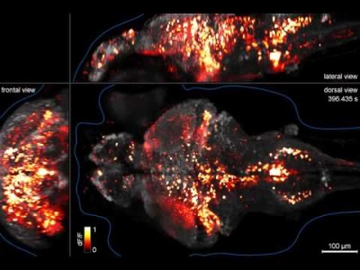
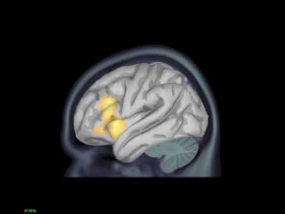
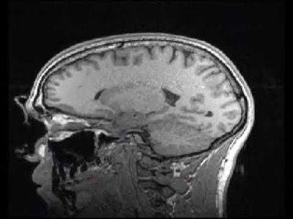
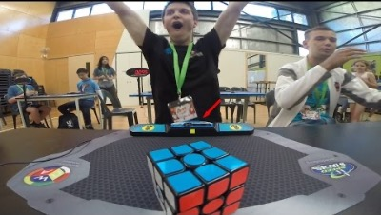
Time and space in neuroscience
Single cell
~1 ms
~ 1 um
Single cell modeling
Hudgkin-huxley
Integrate and fire etc
Spiking neural network
EEG/MEG
~100 ms
~ 1 cm
fMRI
~1 s
~ 1 mm
Large neural network
Convolutional NN
Cognitive models
Bayesian models
Reinforcement learning models
Behaviour
1 s +
1 cm +
Notes:
Calcium imaging recording from zebra fish
MEG recording
fMRI structural scan
Behaviour

Slide 3
Time and space in neuroscience
Single cell
~1 ms
~ 1 um
Single cell modeling
Hudgkin-huxley
Integrate and fire etc
Spiking neural network
EEG/MEG
~100 ms
~ 1 cm
fMRI
~1 s
~ 1 mm
Large neural network
Convolutional NN
Cognitive models
Bayesian models
Reinforcement learning models
Behaviour
1 s +
1 cm +
Notes:
Calcium imaging recording from zebra fish
MEG recording
fMRI structural scan
Behaviour

Slide 4
Time and space in neuroscience
Single cell
~1 ms
~ 1 um
Single cell modeling
Hudgkin-huxley
Integrate and fire etc
Spiking neural network
EEG/MEG
~100 ms
~ 1 cm
fMRI
~1 s
~ 1 mm
Large neural network
Convolutional NN
Cognitive models
Bayesian models
Reinforcement learning models
Behaviour
1 s +
1 cm +
Notes:
Calcium imaging recording from zebra fish
MEG recording
fMRI structural scan
Behaviour

Slide 5
Time and space in neuroscience
Single cell
~1 ms
~ 1 um
Single cell modeling
Hudgkin-huxley
Integrate and fire etc
Spiking neural network
EEG/MEG
~100 ms
~ 1 cm
fMRI
~1 s
~ 1 mm
Large neural network
Convolutional NN
Cognitive models
Bayesian models
Reinforcement learning models
Behaviour
1 s +
1 cm +
Notes:
Calcium imaging recording from zebra fish
MEG recording
fMRI structural scan
Behaviour

Slide 6
Time and space in neuroscience
Single cell
~1 ms
~ 1 um
Single cell modeling
Hudgkin-huxley
Integrate and fire etc
Spiking neural network
EEG/MEG
~100 ms
~ 1 cm
fMRI
~1 s
~ 1 mm
Large neural network
Convolutional NN
Cognitive models
Bayesian models
Reinforcement learning models
Behaviour
1 s +
1 cm +
Notes:
Calcium imaging recording from zebra fish
MEG recording
fMRI structural scan
Behaviour

Slide 7
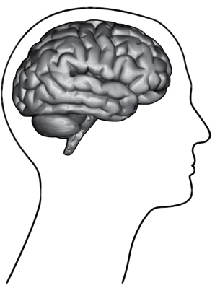
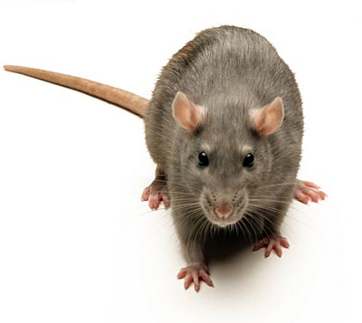
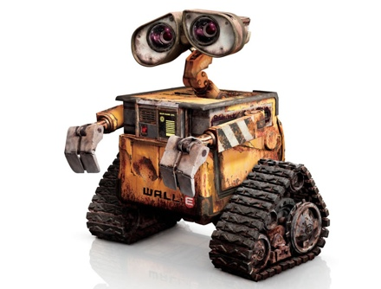
Computational Neuroscience &
Cognitive Psychology
Develop models of neurons, cognition, learning and behaviour
Models for machine learning can be tested on animals/humans
Models for animals/humans can inform machine learning

Slide 8
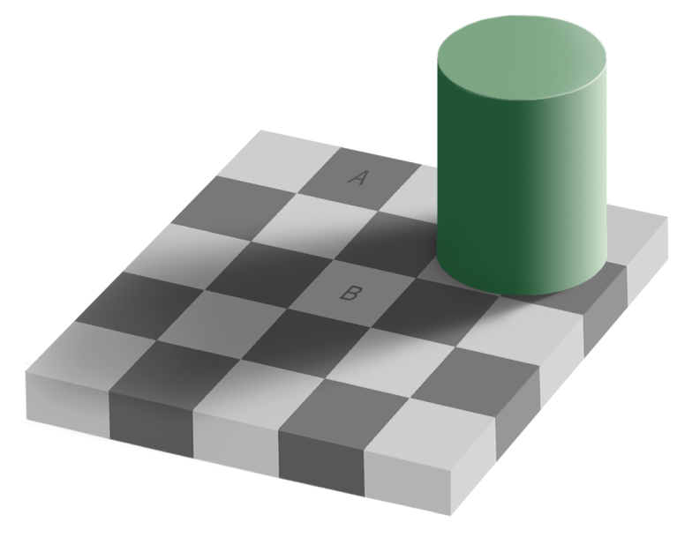
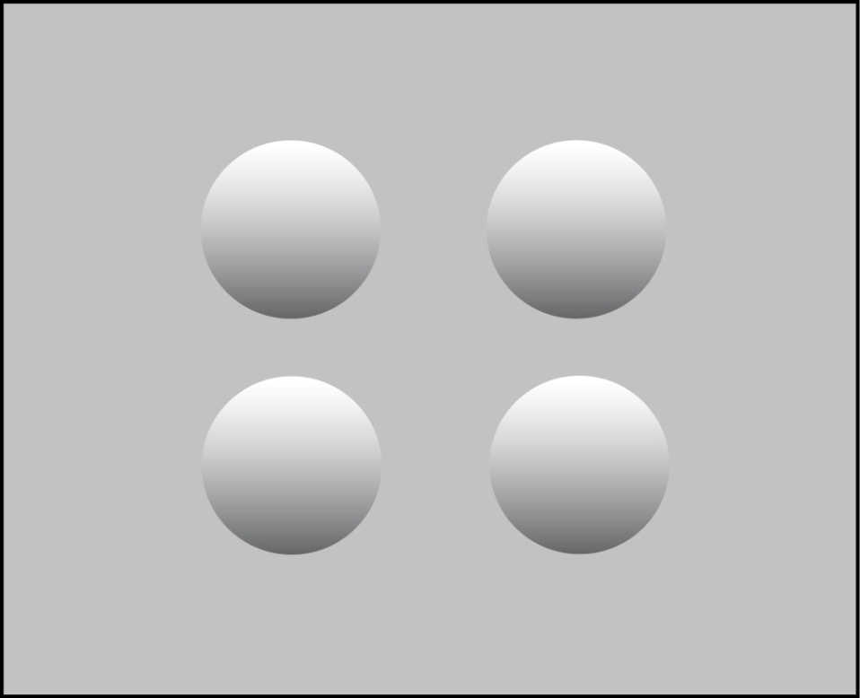
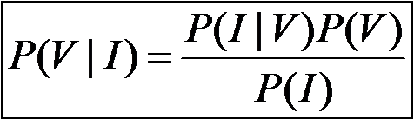
Bayesian inference in perception
Prior knowledge provides a way to disambiguate stimuli
Perceptual Bayesian inference:
  Ernst & Banks, 2002, Battaglia, Jacobs, Aslin, 2003, Knill, Saunders, 2002, Kording et al 2007 ….
“Bayesian Brain Hypothesis”
Notes:
Brain has to build statistical models

Slide 9
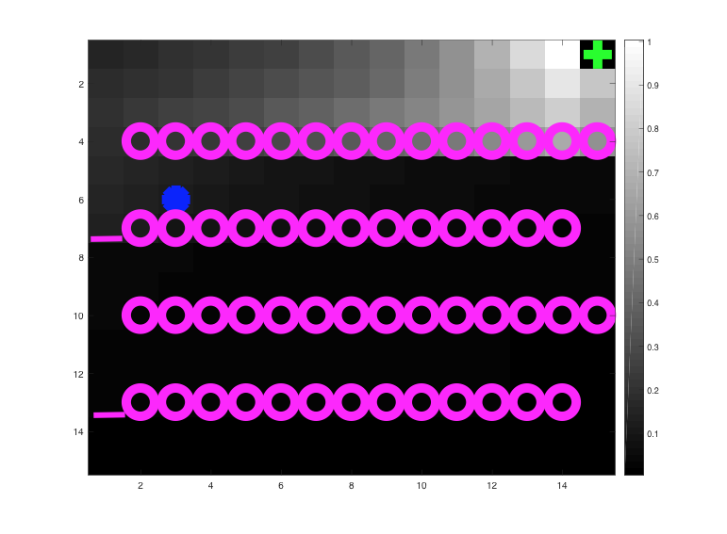
Reinforcement Learning - Dopamine
E.g. Temporal Difference (TD) learning
Encoded by dopamine neurons
  Located in mid-brain
Examined through decision making studies
Schultz, Montague & Dayan 97
Can use Q-learning or TD learning to model human and animal behaviours

Slide 10
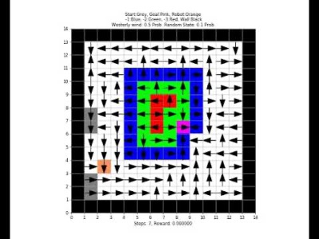

Slide 11
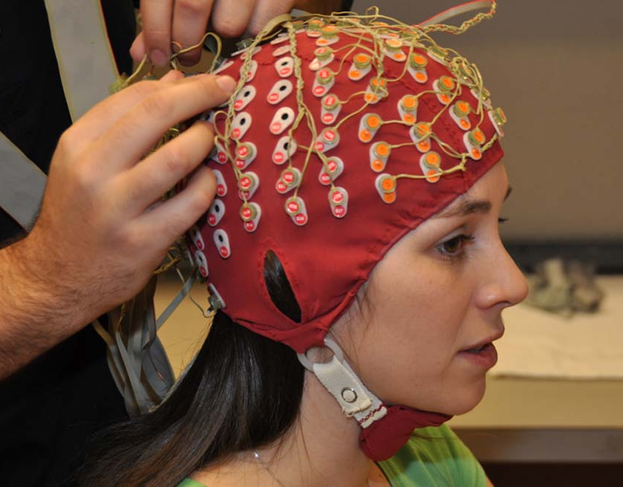
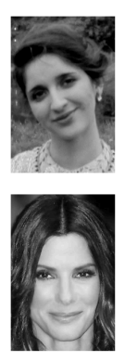
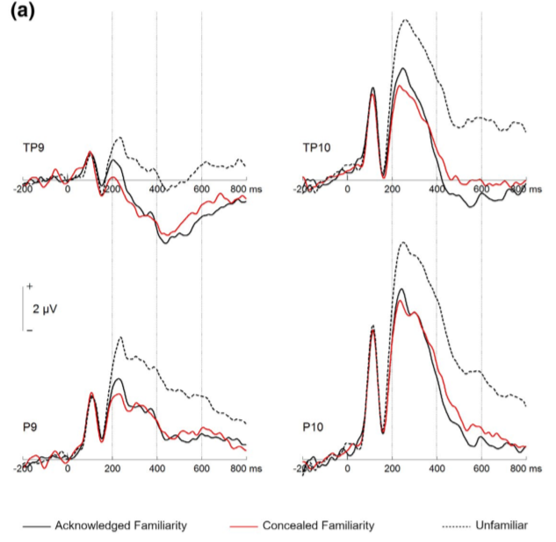
Decoding EEG
Decoding familiarity from visual
  Can we train an EEG classifier to tell if
    Face is familiar
    Face is unfamiliar
  with Holger Wiese
BCI decoding for communication
  Can we train an EEG classifier to tell
    what word/emoji a person is attending to
  with Toby Breckon
Decoding behaviour from single cell
  with Colin Lever
Notes:
Also have done work with Colin Lever on neural recordings

Slide 12
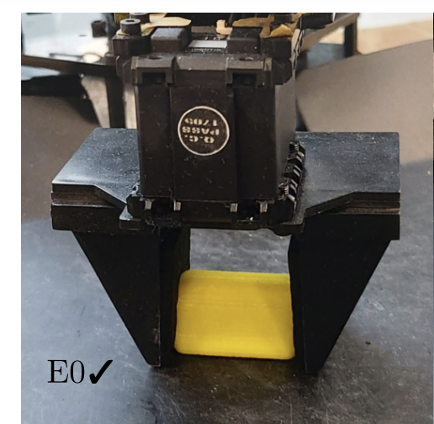
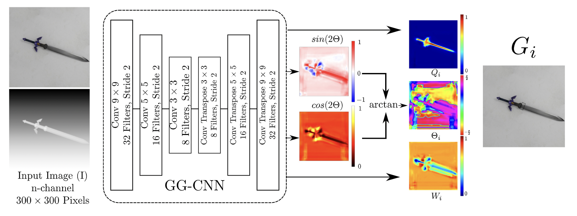
Neural networks – robot grasping
With Toby Breckon and Magnus Bordewich

Slide 13
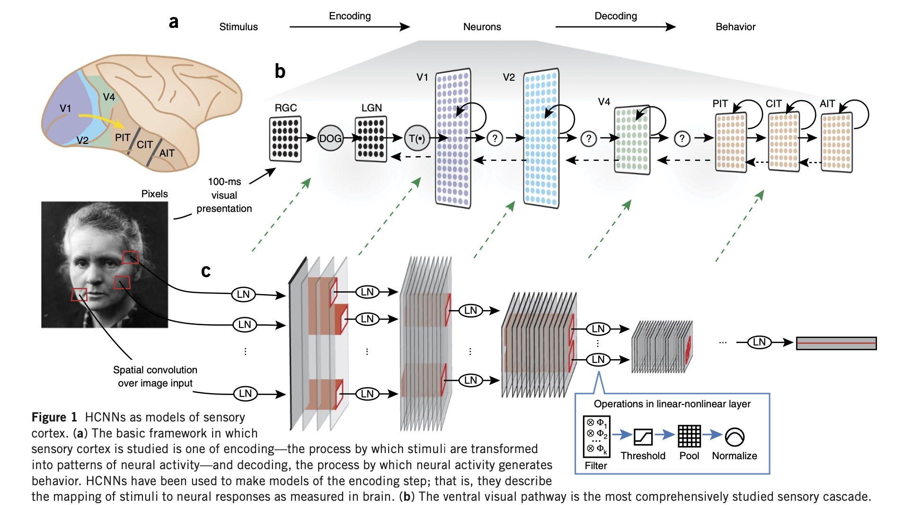
Neural network - Similarity
Yamins & DiCarlo 2016

Slide 14
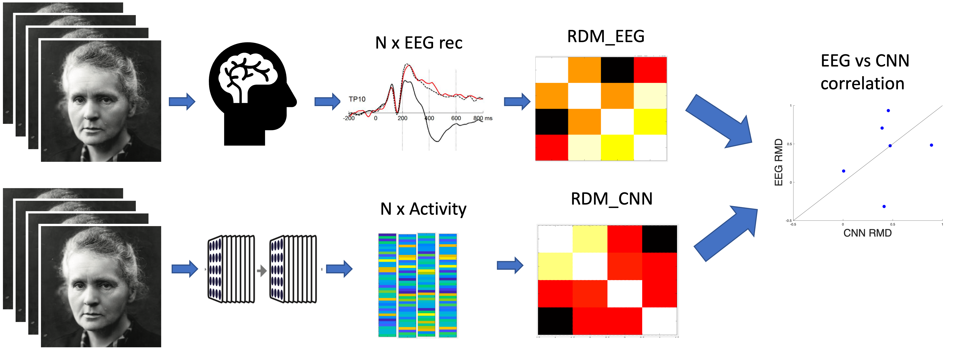
Neural networks as model of vision
Beierholm, in progress

Slide 15
Computational Neuroscience &
Cognitive Psychology
Given complexity of data now available, computational modeling is crucial
Neuroscientists often lack computational training
Collaborations across scientific boundaries are important

