Slide 1
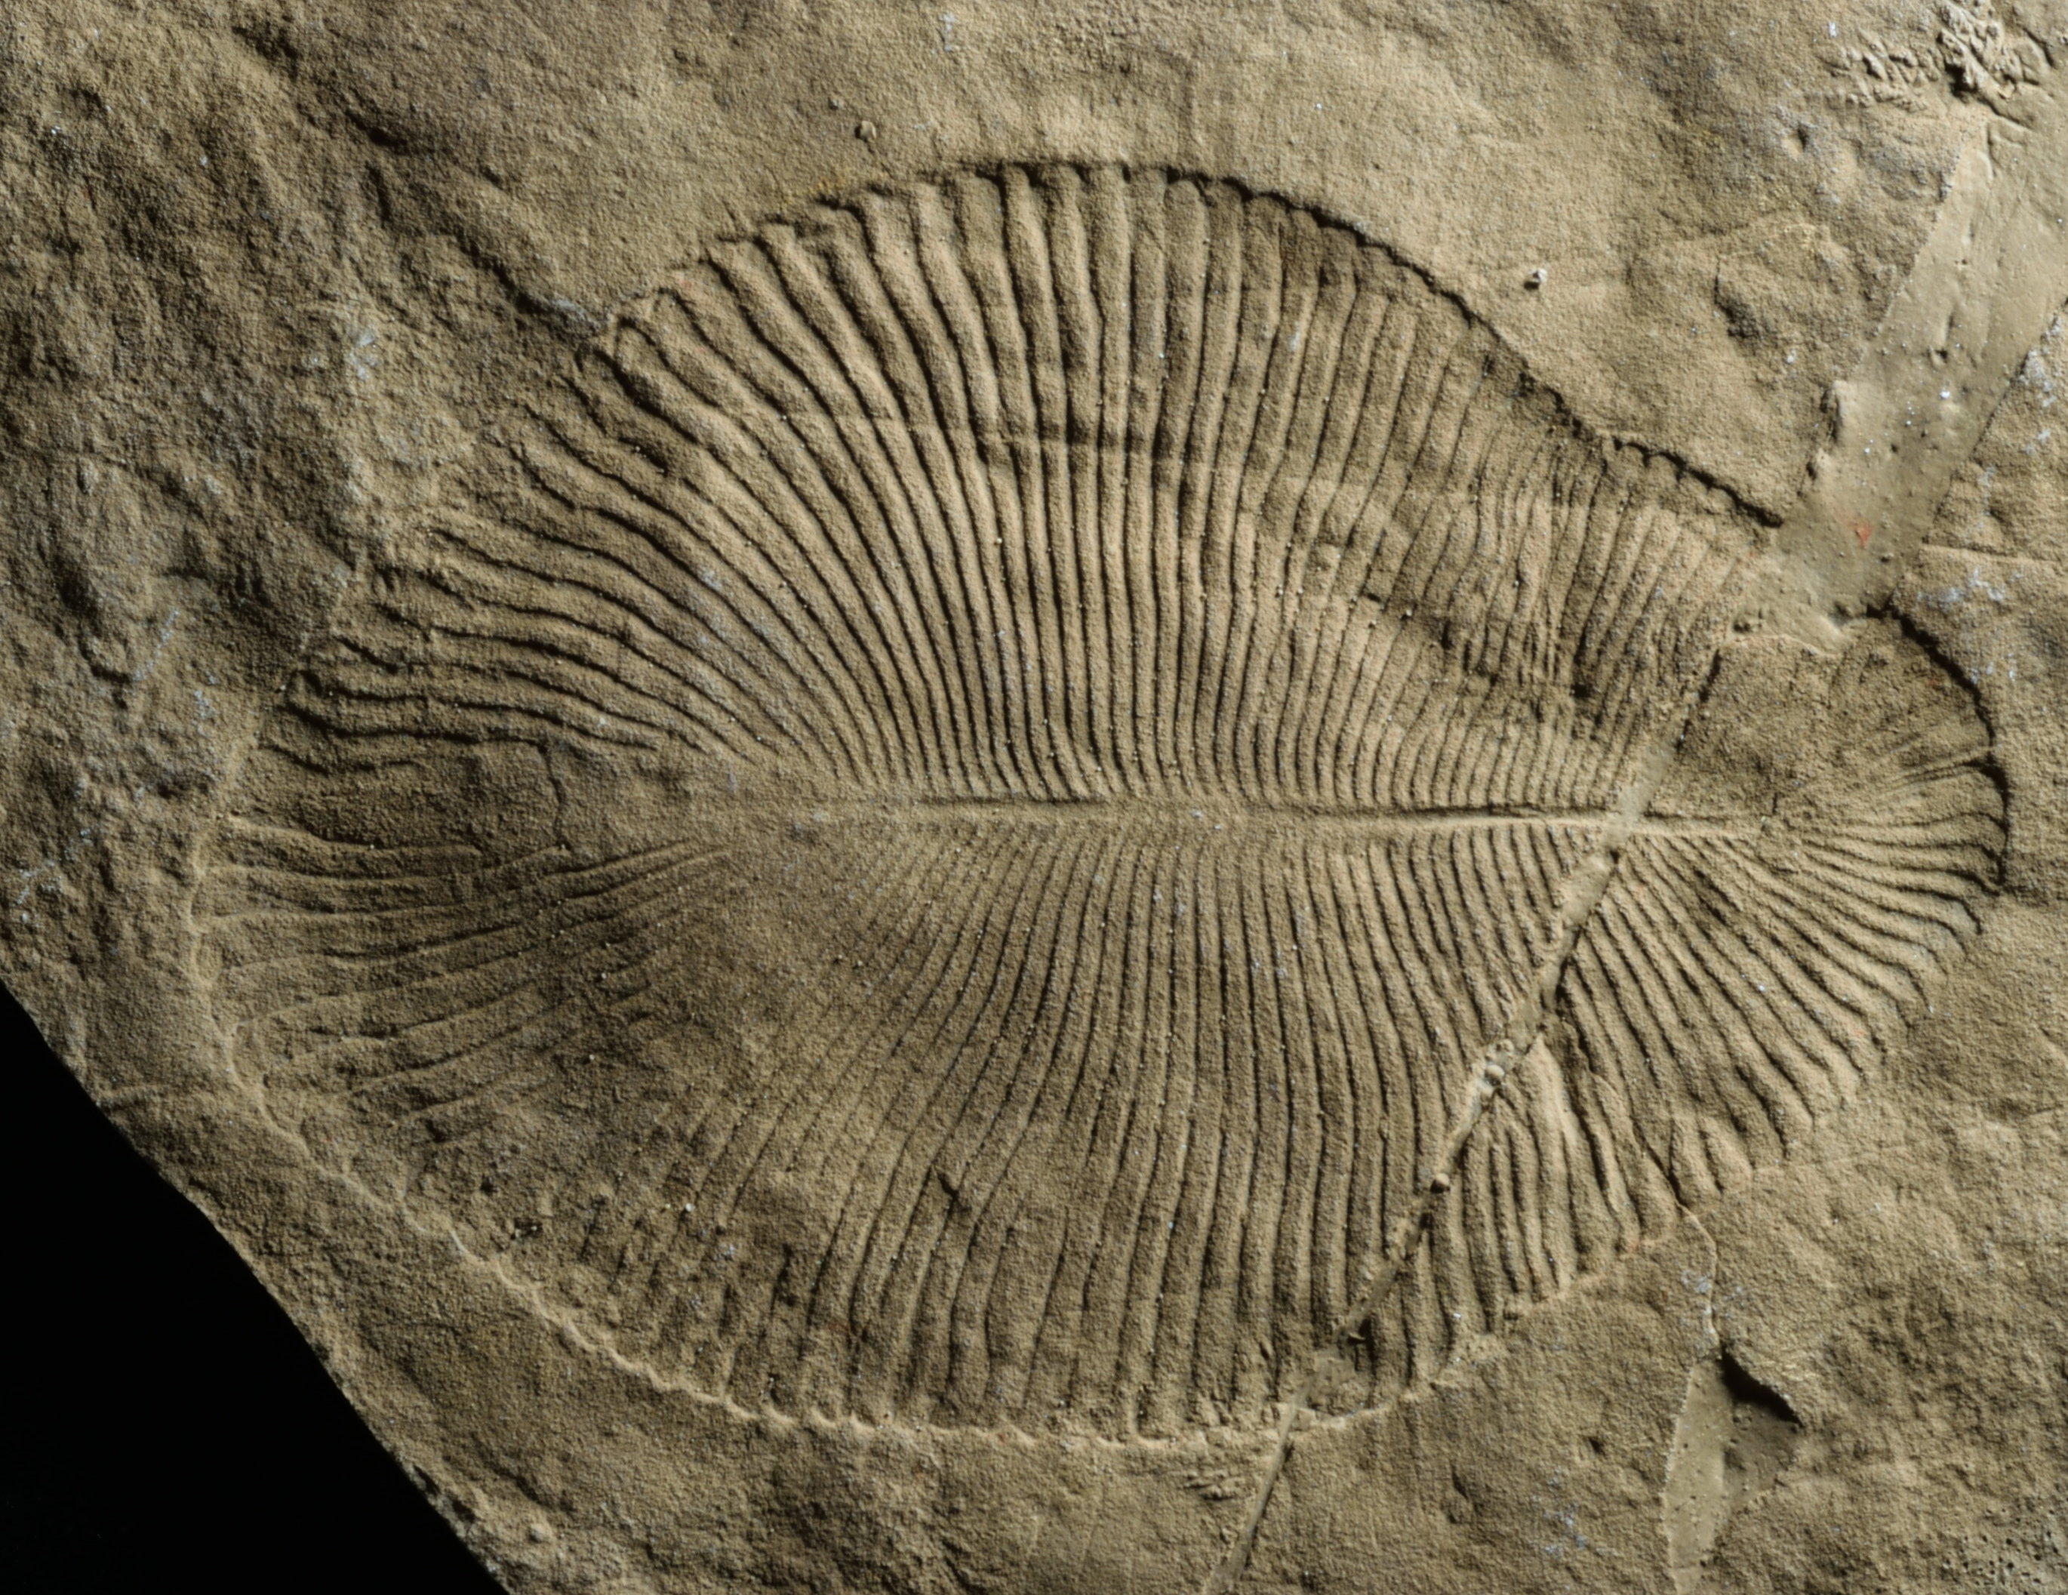
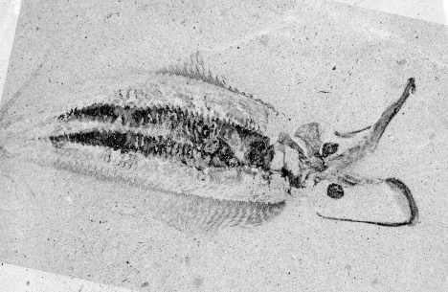
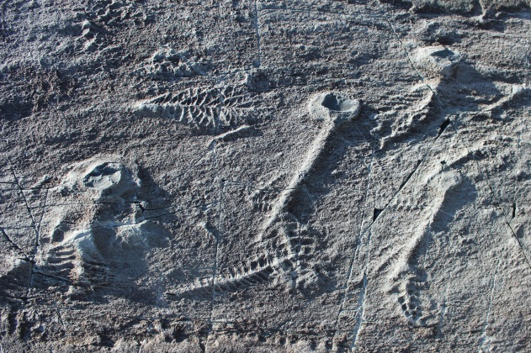
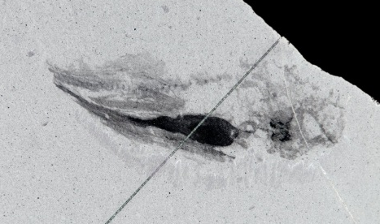
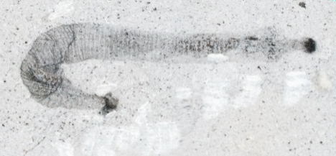
Modelling evolutionary history
A LIU
And the origins of animal body plans
Martin R. Smith
Department of Earth Sciences
3 May 2023
J-B CARON
Notes:
Martin R. Smith
Until 550 million years ago, the fossil record was devoid of any life more complicated than a seaweed
Then, in the geological blink of an eye, the planet changed forever.
In the Cambrian period, life left its mark on the planet as it never had before.
Zooplankton shuttled carbon to the previously barren sea floor; burrowing worms churned oxygen into the once stagnant sediment; reefs of biomineralizing organisms displaced microbial mats and played host to vibrant communities

Slide 2
Timing the explosion
10? years?
510 Ma
525 Ma
541 Ma
550 Ma
Kouchinsky et al. 2012

Slide 3
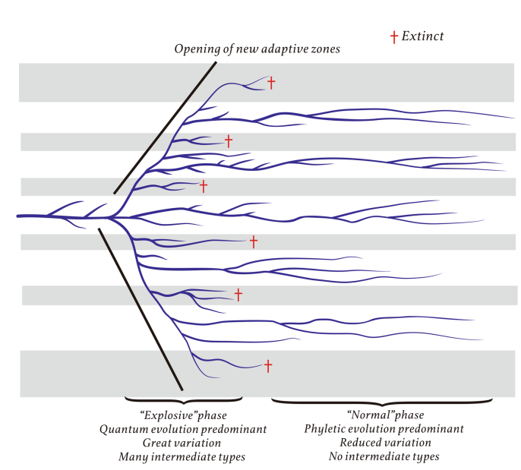
A unique explosive event?
Zhang & Shu 2021

Slide 4
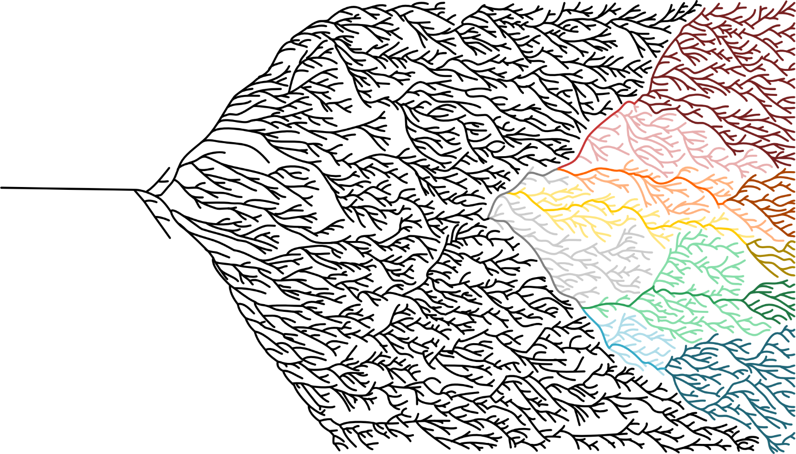
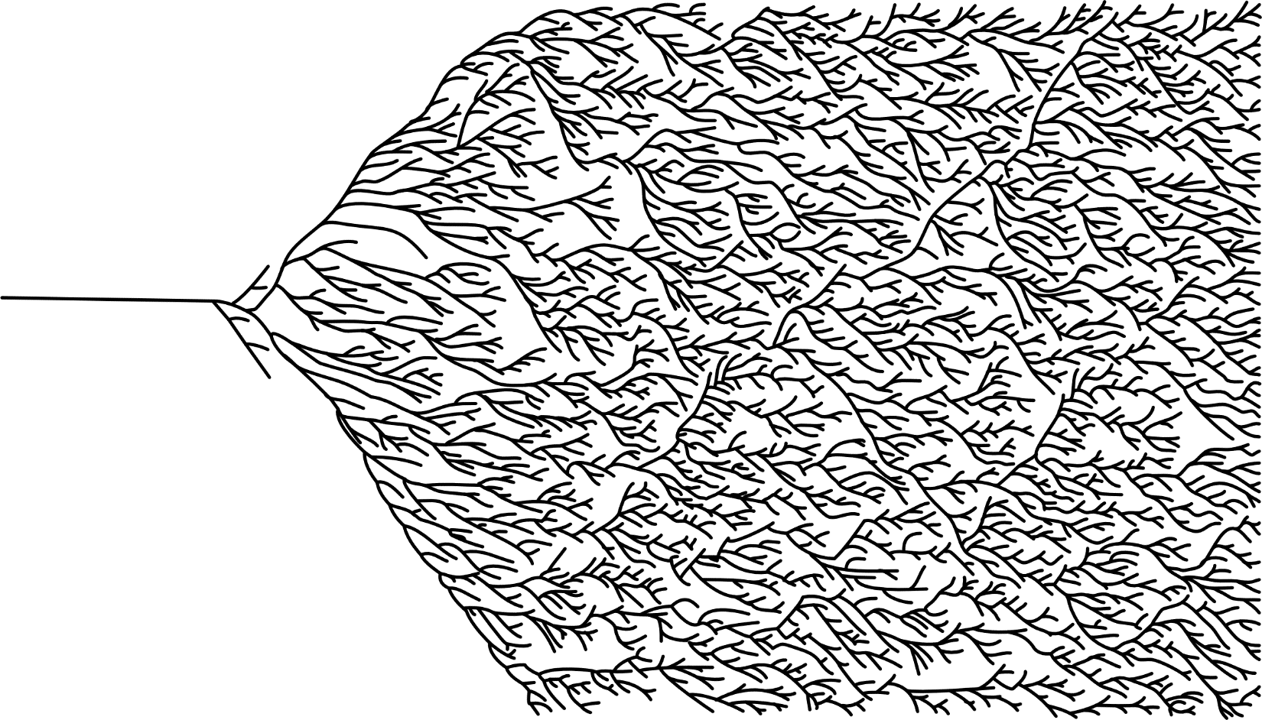
A unique explosive event?
After Zhaxybayeva & Gogarten 2004

Slide 5
Molecular clocks
1000 Ma
900 Ma
800 Ma
700 Ma
600 Ma
500 Ma
Sperling & Stockey 2017

Slide 6
Birth-death biases
Constant rates of speciation and extinction per group
Budd & Mann 2019
Notes:
A Starting with 1 species; B starting with 10 species.
Red lines are successful clades that manage to escape from the absorbing boundary of extinction; black ones, clades that go extinct.
In the case of initially small clades (A), most rapidly go extinct without reaching a substantial size. Initially larger clades (B) more often survive; note that those that go extinct tend to behave like the survivors until they rather rapidly collapse to extinction.

Slide 7
Fossil tests
Late Ediacaran
Early Cambrian
Sperling & Stockey 2017

Slide 8
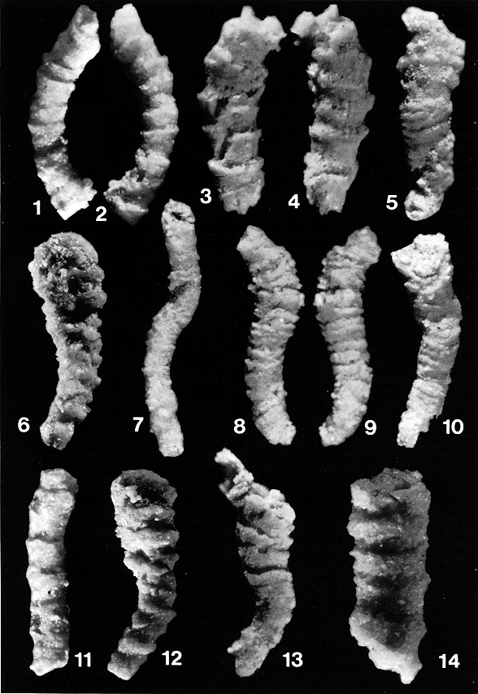
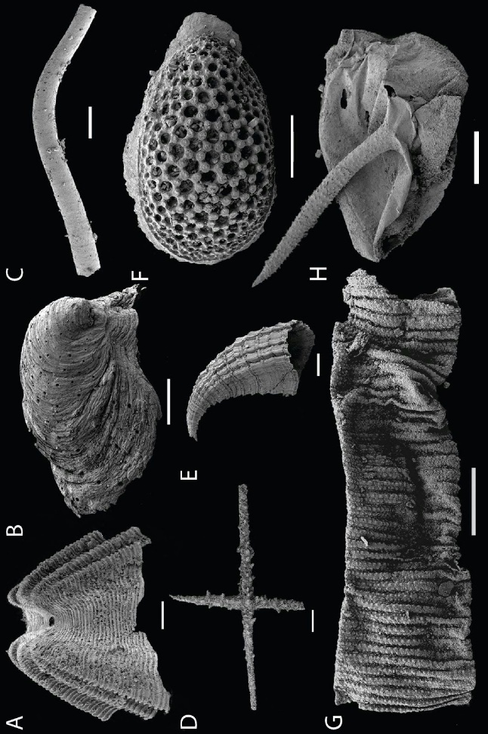
Fossil tests
Late Ediacaran
Early Cambrian
Shelly fossils
Butler 2015

Slide 9
Fossil tests
Late Ediacaran
Early Cambrian
Shelly fossils
Carbonaceous fossils
Slater et al. 2018 / Harvey et al. 2012

Slide 10
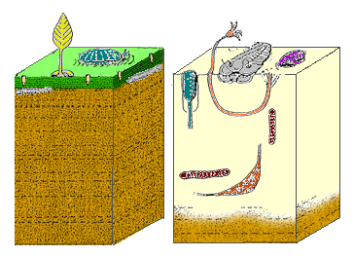
Fossil tests
Late Ediacaran
Early Cambrian
Shelly fossils
Carbonaceous fossils
Trace fossils

Slide 11
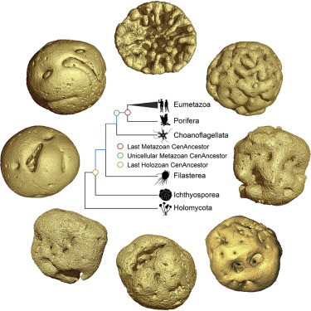
Fossil tests
Late Ediacaran
Early Cambrian
Shelly fossils
Carbonaceous fossils
Trace fossils
Phosphatized embryos
Yin et al. 2019 / Smith et al. in review

Slide 12
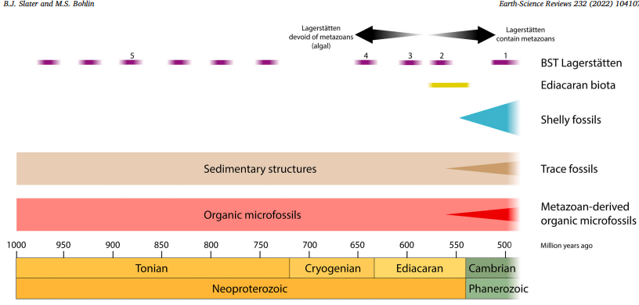
Fossil tests
Slater & Bohlin 2022
Notes:
This molecular clock picture is just WRONG. It’s missing something. The absence of fossils is not properly accommodated in the model.
If the fossil record is reliable: How fast did things diversify?

Slide 13
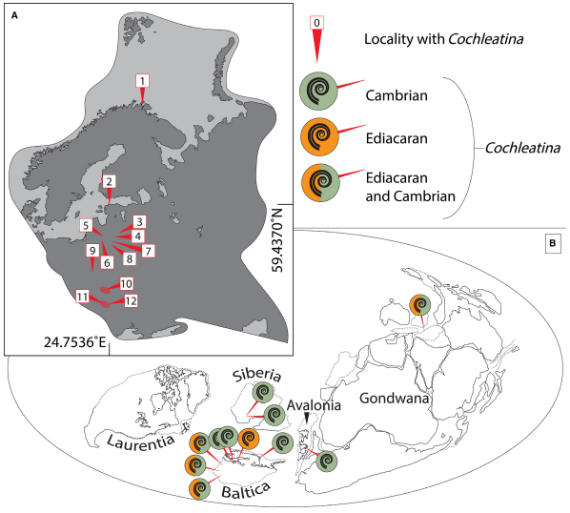
Fast or slow?
Accurate correlation between geographically disparate rocks
Slater et al. 2020

Slide 14
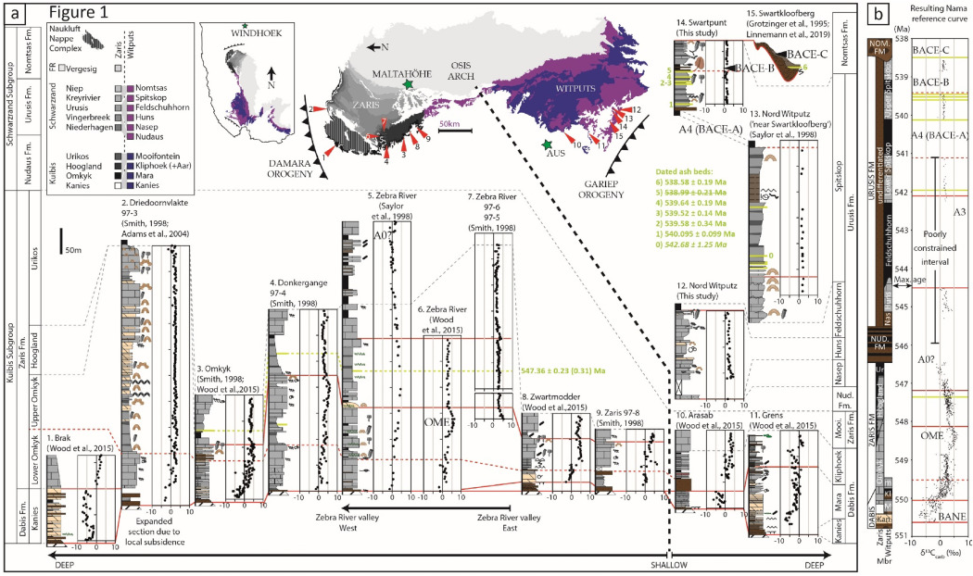
Bowyer et al. 2022

Slide 15
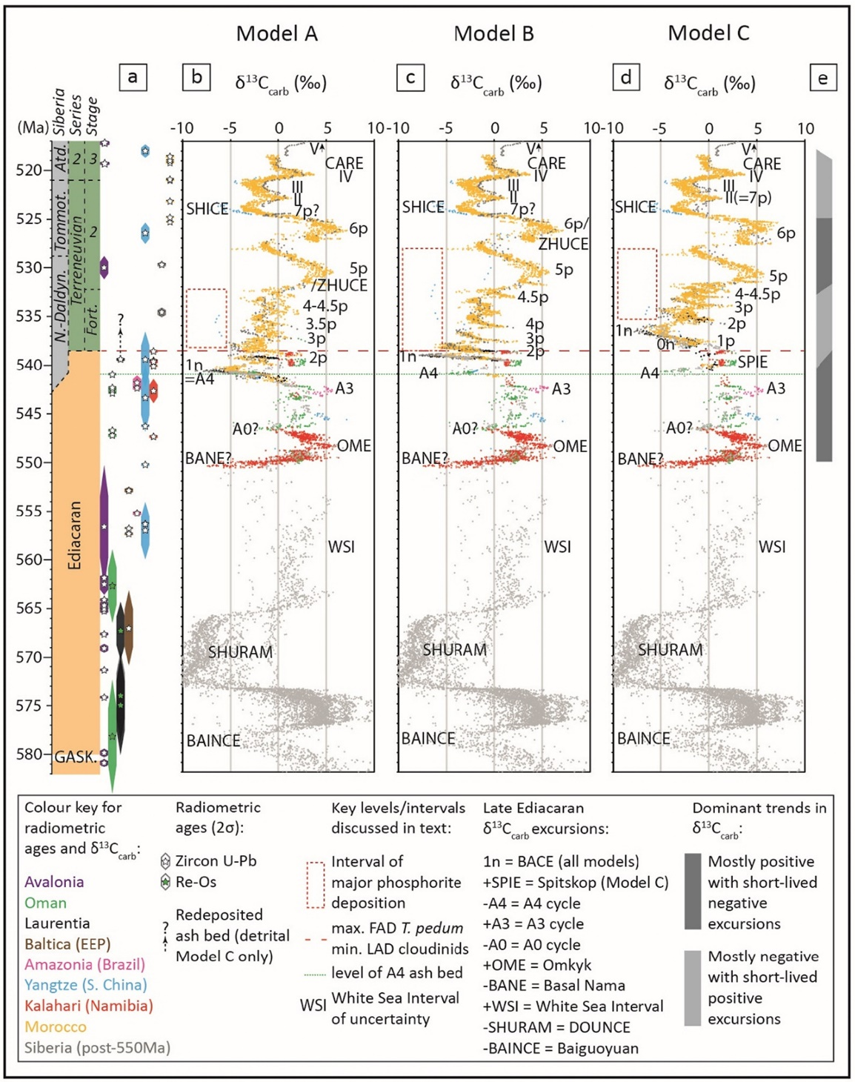
Bowyer et al. 2022

Slide 16
Linking rocks to taxa
Microfossils
Abundant
Widespread
Elements of larger organisms
Harvey et al. 2012
Notes:
Microfossils of a known age

Slide 17
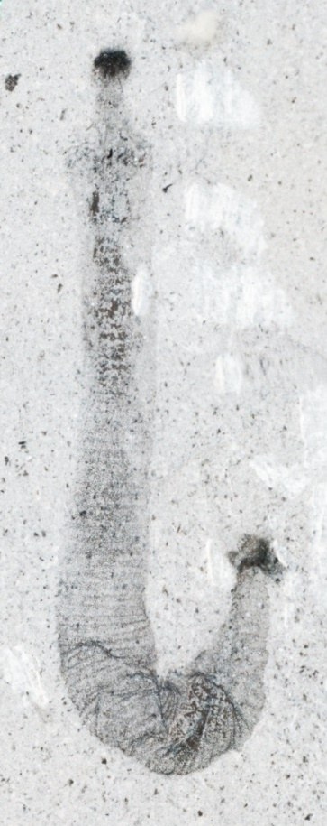
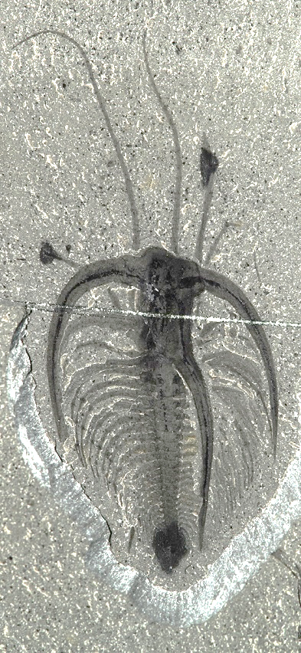
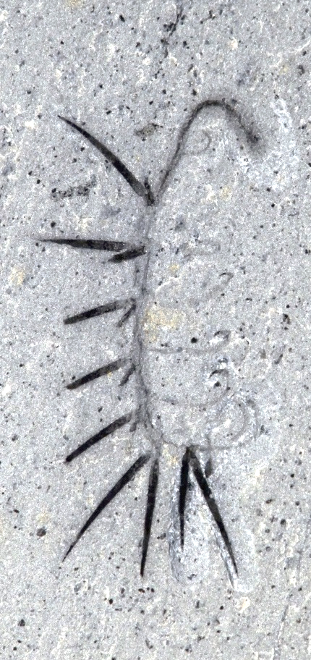
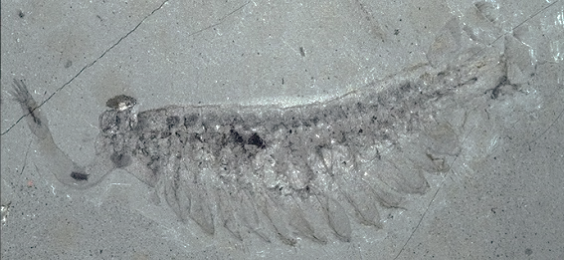
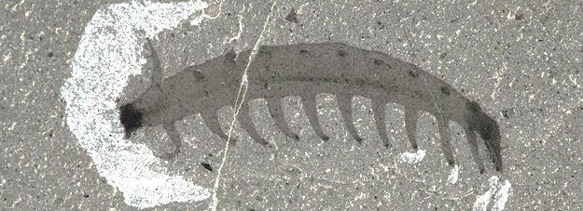
Complete organisms: Burgess Shale
Scathascolex
Aysheaia
Hallucigenia
Opabinia
Marrella
1 cm
Notes:
The modern body plans are very disparate; Cambrian fossils neatly fill in the gaps

Slide 18
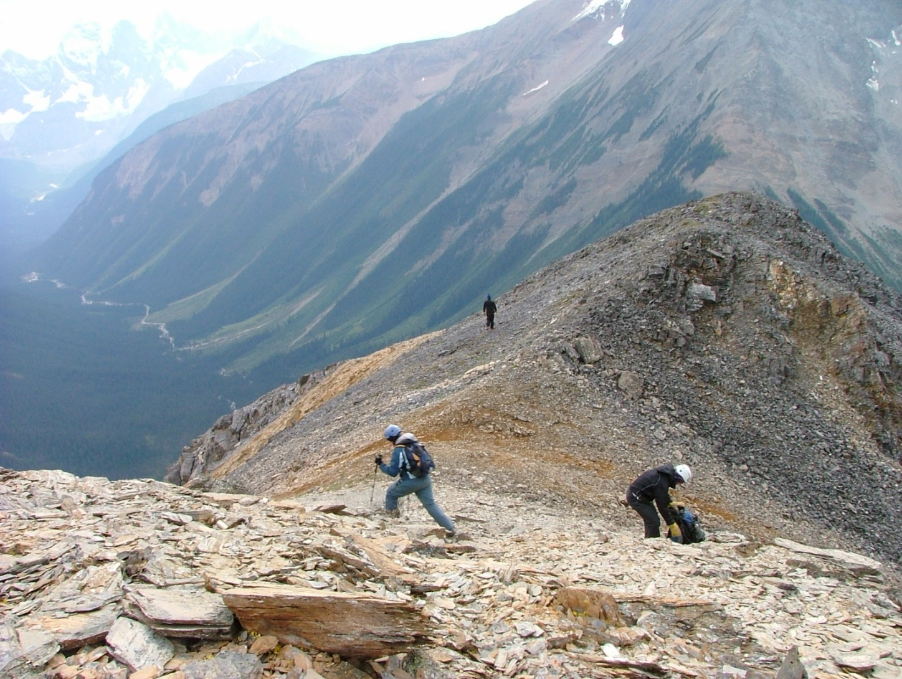
Burgess Shale

Slide 19
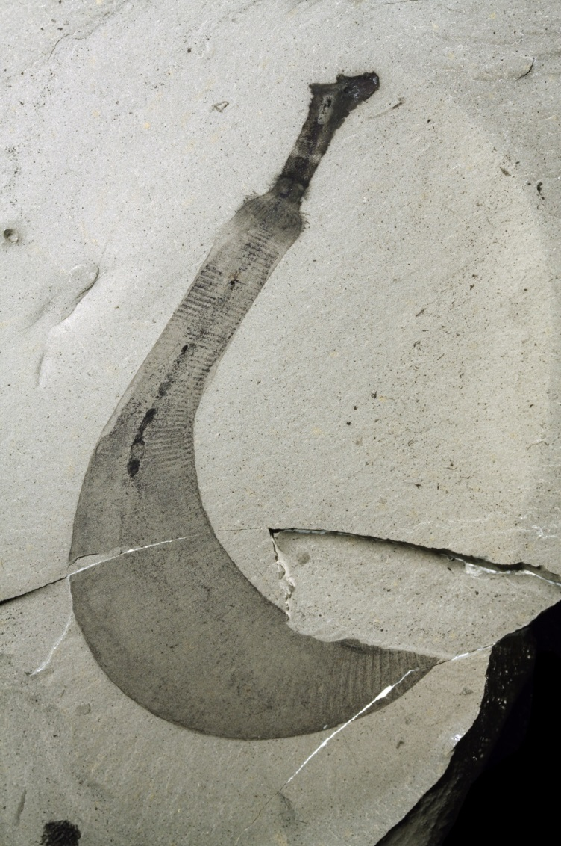
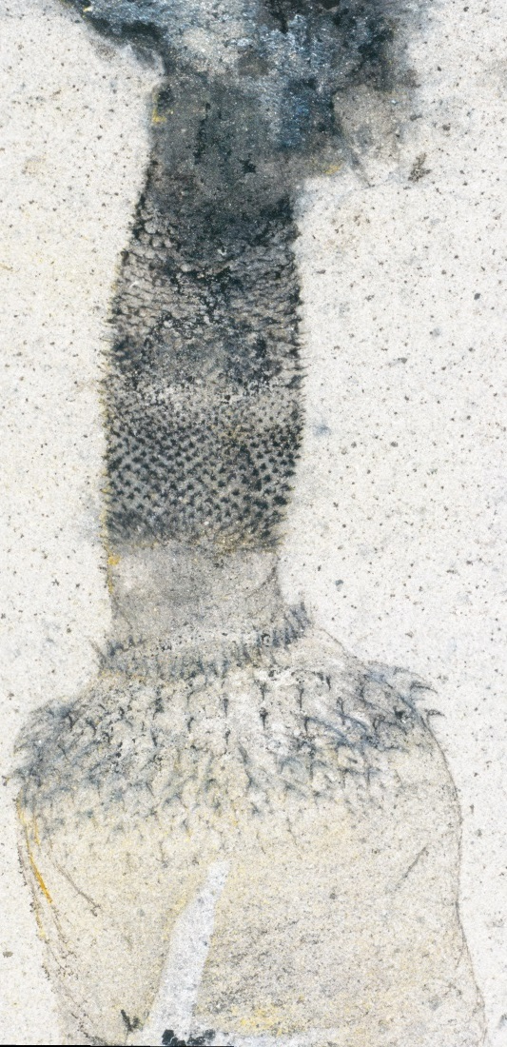
Burgess Shale preservation
Smith et al. 2015, Palaeontology
Notes:
And microscopic techniques are only now accessible enough to extract that extra detail from macrofossils

Slide 20
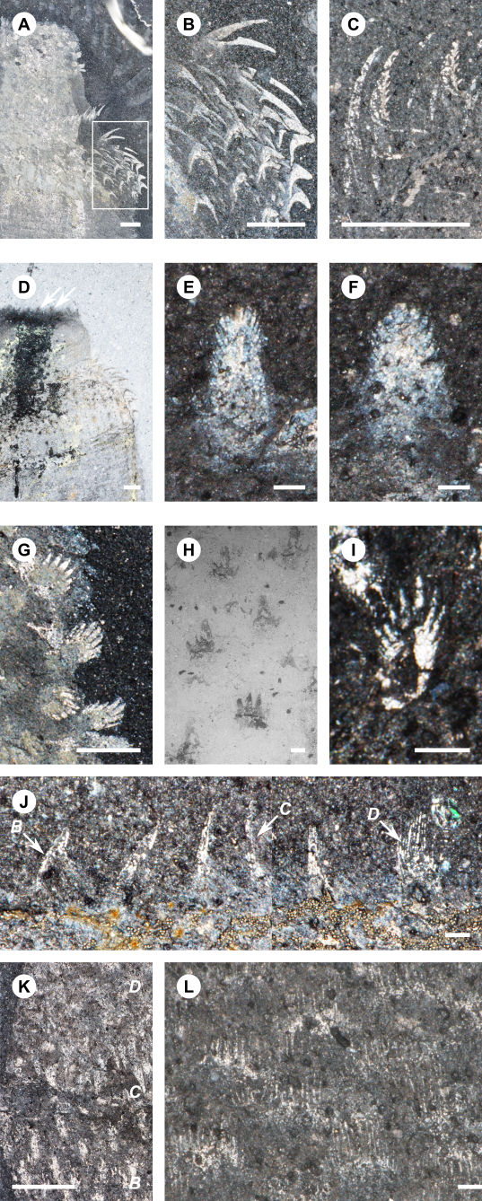
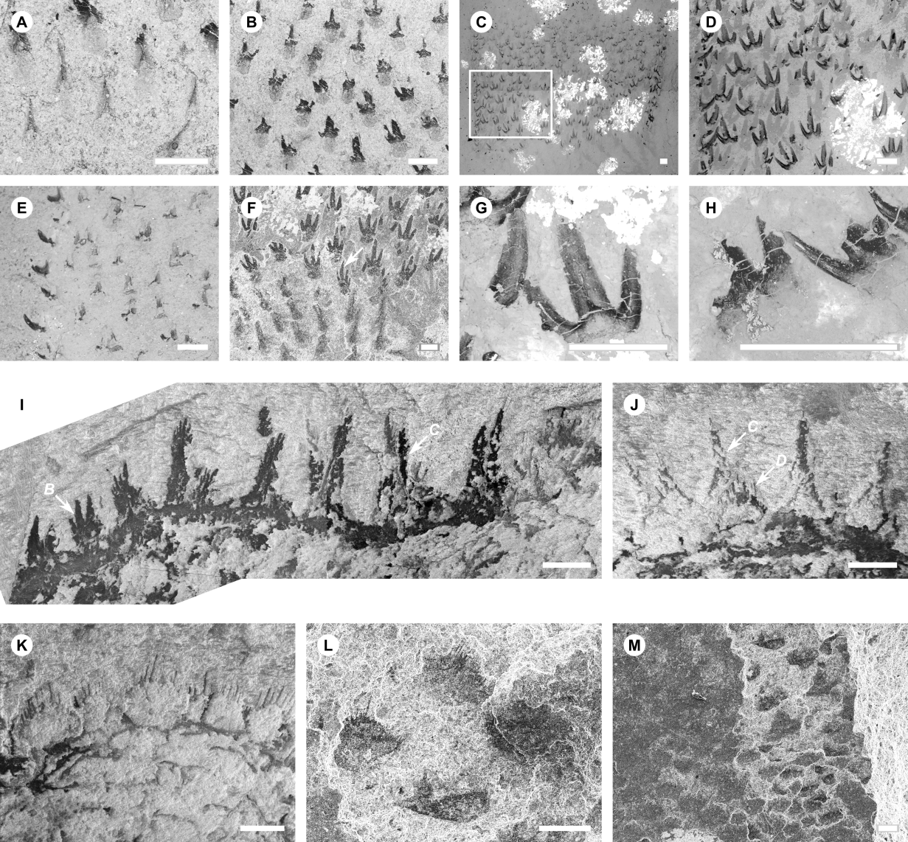
100 µm
Smith et al. 2015, Palaeontology
Notes:
Useful not only for new macro detail but also for SCF ID
… ,and I’ve managed to identify microfossils to a SPECIES of macrofossil, which is pretty impressive!

Slide 21
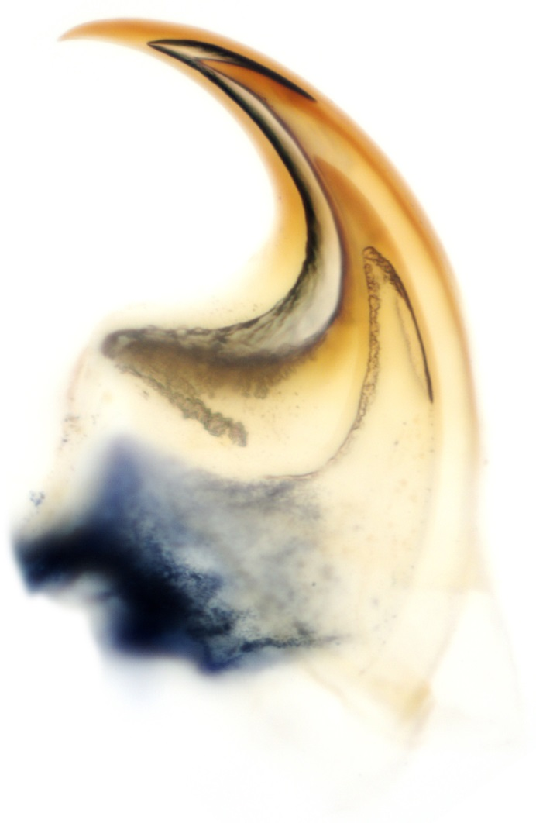
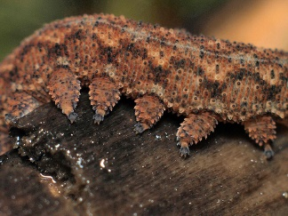
Detailed anatomy
Smith & Ortega-Hernández 2014
Notes:
In other cases, it’s examining living taxa that’s key to identification.
Indicates something profound about the mode of growth/moulting.

Slide 22
Hallucigenia
Smith & Ortega-Hernández 2014
Notes:
In other cases, it’s examining living taxa that’s key to identification.
Indicates something profound about the mode of growth/moulting.
More importantly, it’s the claws that expose a link with Hallucigenia.
Bingo – Lobopodians ARE onychophorans ?

Slide 23
Hallucigenia
Phlesch Bubble / J-B. Caron
Notes:
That, alongside a more detailed analysis, places Luci in stem velvet worms
Does that mean it’s not a lobopodian?

Slide 24
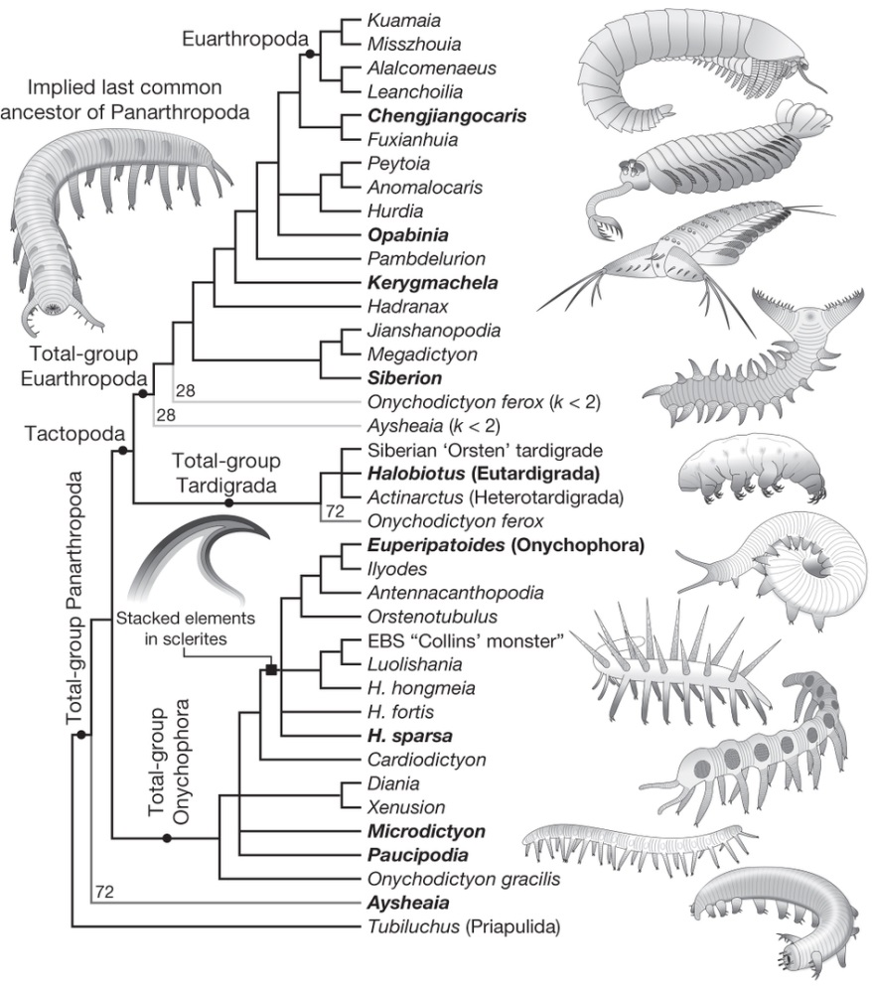
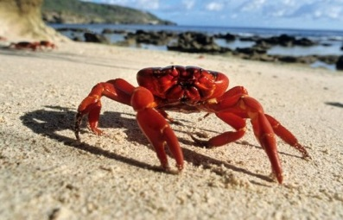
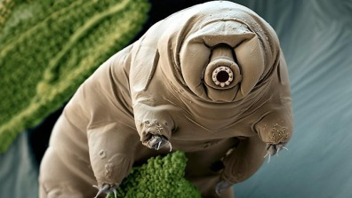
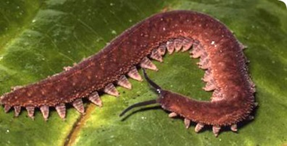
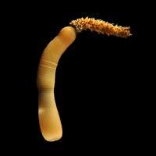
Phylogenetic implications
Smith & Ortega Hernández 2014
Notes:
A good dataset can go a long way to placing problematic fossils in their evolutionary context, and in resolving the relationships of modern groups.

Slide 25
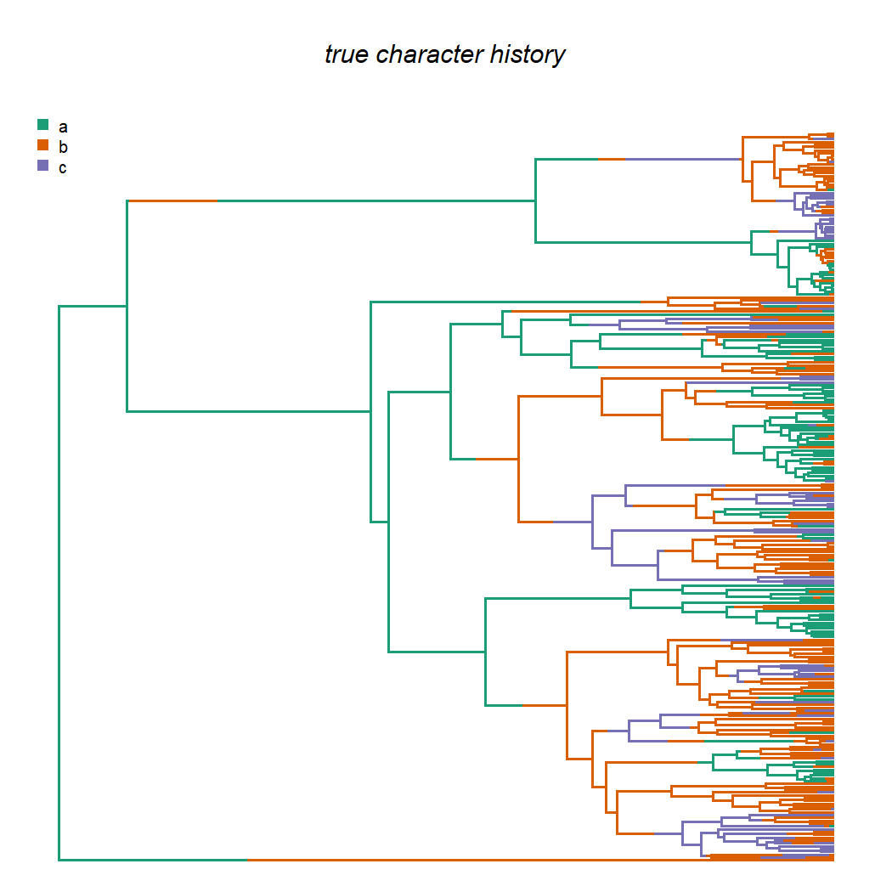
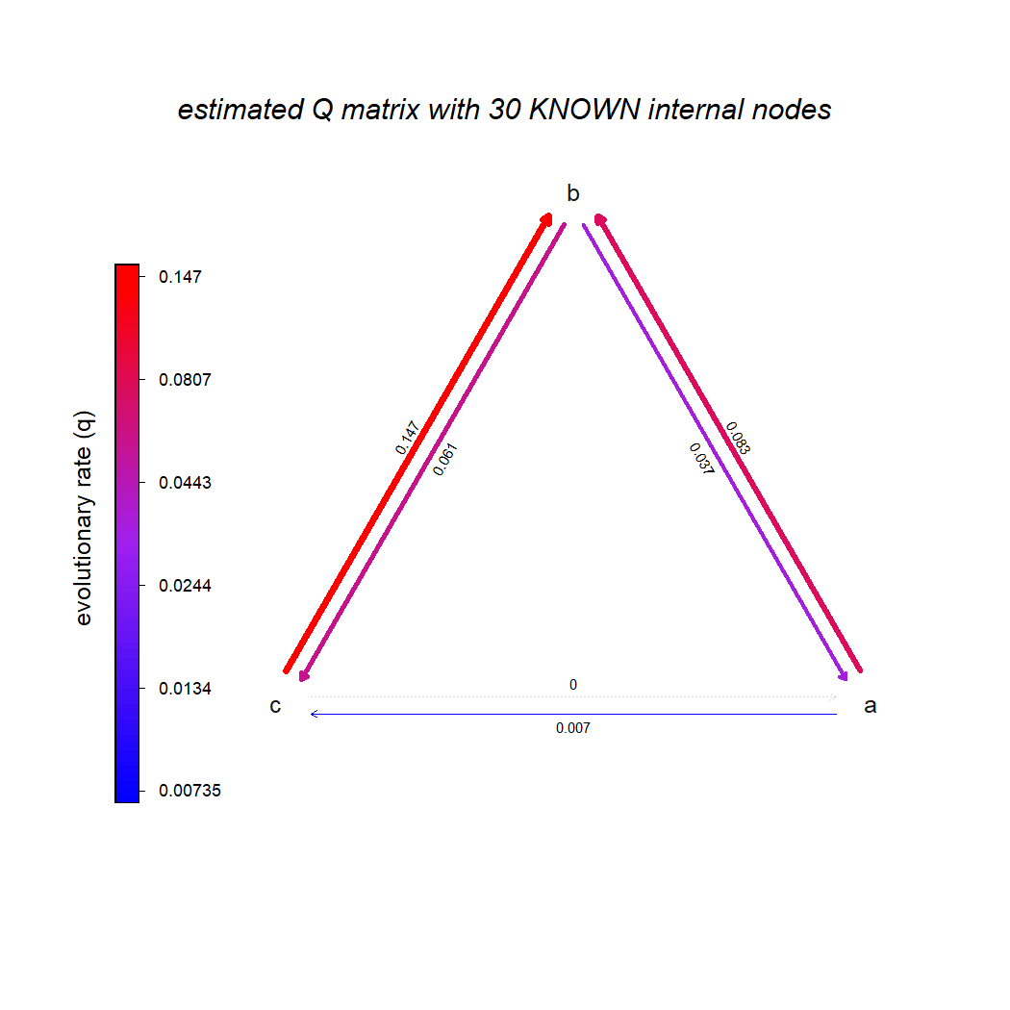
Liam Revell

Slide 26
Modelling morphological evolution
Absent (0) ↔ Present (1)
Single element (0) ↔ Stacked elements (1)
Logarithmic curvature (0) ↔ Archimedian spiral (1) ↔ Irregular curvature (2) ↔ (Unobserved states?)
Blue (0) ↔ Red (1) ↔ Brown (2) ↔ (Unobserved states?)

Slide 27
Fossils in phylogenies
Morphological data
Convergence?
Subjectivity?
Quantity?
Notes:
Morphology is subject to convergence – as is molecular data. And subjectivity – in alignment?
Typically less data than in a full DNA sequence, but strength of evidence is in cases stronger

Slide 28
Integration?
1000 Ma
900 Ma
800 Ma
700 Ma
600 Ma
500 Ma
Sperling & Stockey 2017
Notes:
The ideal – to integrate all this data: stratigraphy, molecules + morphology
And compare with more recent radiations to see whether the explosion was unique.

