Slide 1
Modelling accuracy during the pandemic – descriptive vs mechanistic models
Pieter Streicher – PhD Engineering
Research Associate at the University of Johannesburg – Department of Philosophy

Slide 2
The preference of ‘mechanistic’ modelling
Disease modelling moved away from ‘descriptive’ to ‘mechanistic’ modelling in the early 20th century.
Ronald Ross used ‘mechanistic’ modelling to show that malaria could be eradicated by reducing mosquito numbers.
At the time ‘descriptive’ modelling was used, starting with real data and working backwards to identify predictable patterns.
Mechanistic modelling helps with better understanding and can be used to run conditional scenarios which help in policy recommendations.

Slide 3
Better understanding vs accurate forecasts
Chris Witty, Chief Medical Officer for England,
“the best mathematical models are not necessarily the ones that try to make an accurate forecast about the future. What matters is having analysis that can reveal gaps in our understanding of a situation.”
However, during a pandemic, you also need accurate forecasts!
Antony Fauci,
“we need to know today what’s going on. We’ve got to know day by day: How many people are getting infected? Instead, we were blind.”

Slide 4
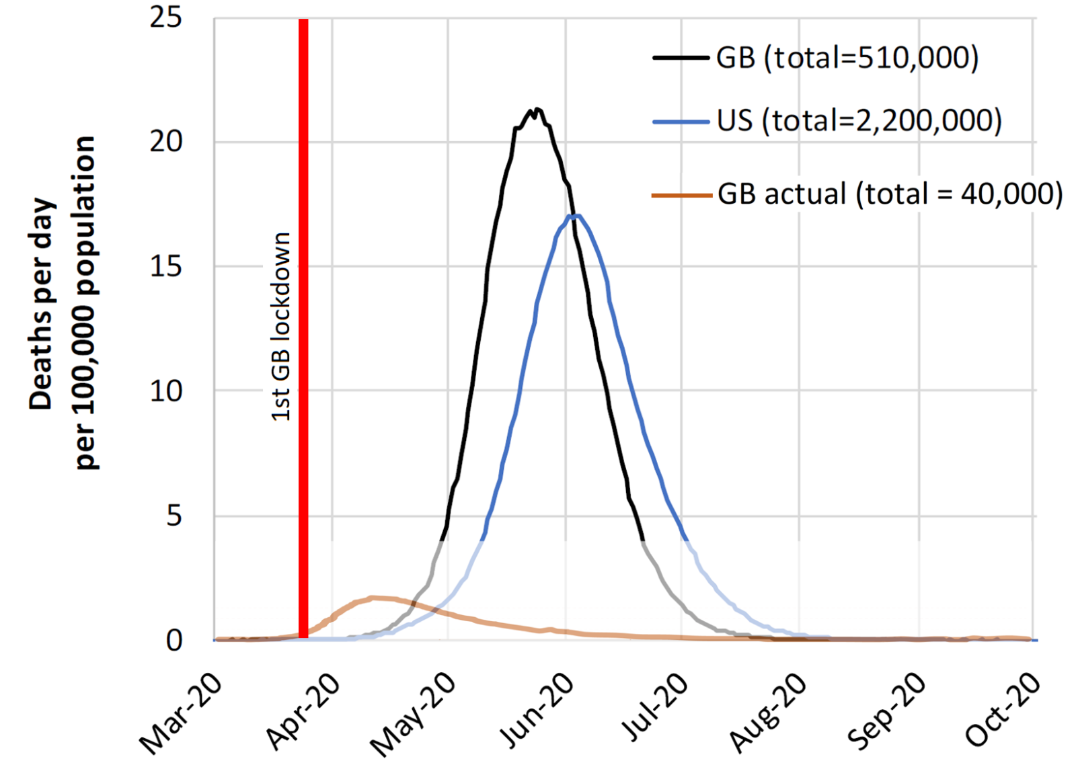
Modelling Accuracy
The lockdown saved 470,000 lives in the UK – BBC
510,000 – 40,000 = 470,000
(510,000 deaths corresponds to an attack rate of 81%)
However, countries that did not lock down had first wave attack rates of below 12%, some as low as 6%?

Slide 5
Questions?
How do we know whether the counterfactual unmitigated scenario for the first wave of 510,000 deaths was accurate?
What would the outcome have been with mitigation (without the lockdown) instead of the unmitigated scenario?
A significant portion (30%) of the lives claimed to be saved by 8 June 2020 were lost by January 2022, begging the question, to what extent did the lockdown postpone pandemic deaths as opposed to having saved lives?

Slide 6
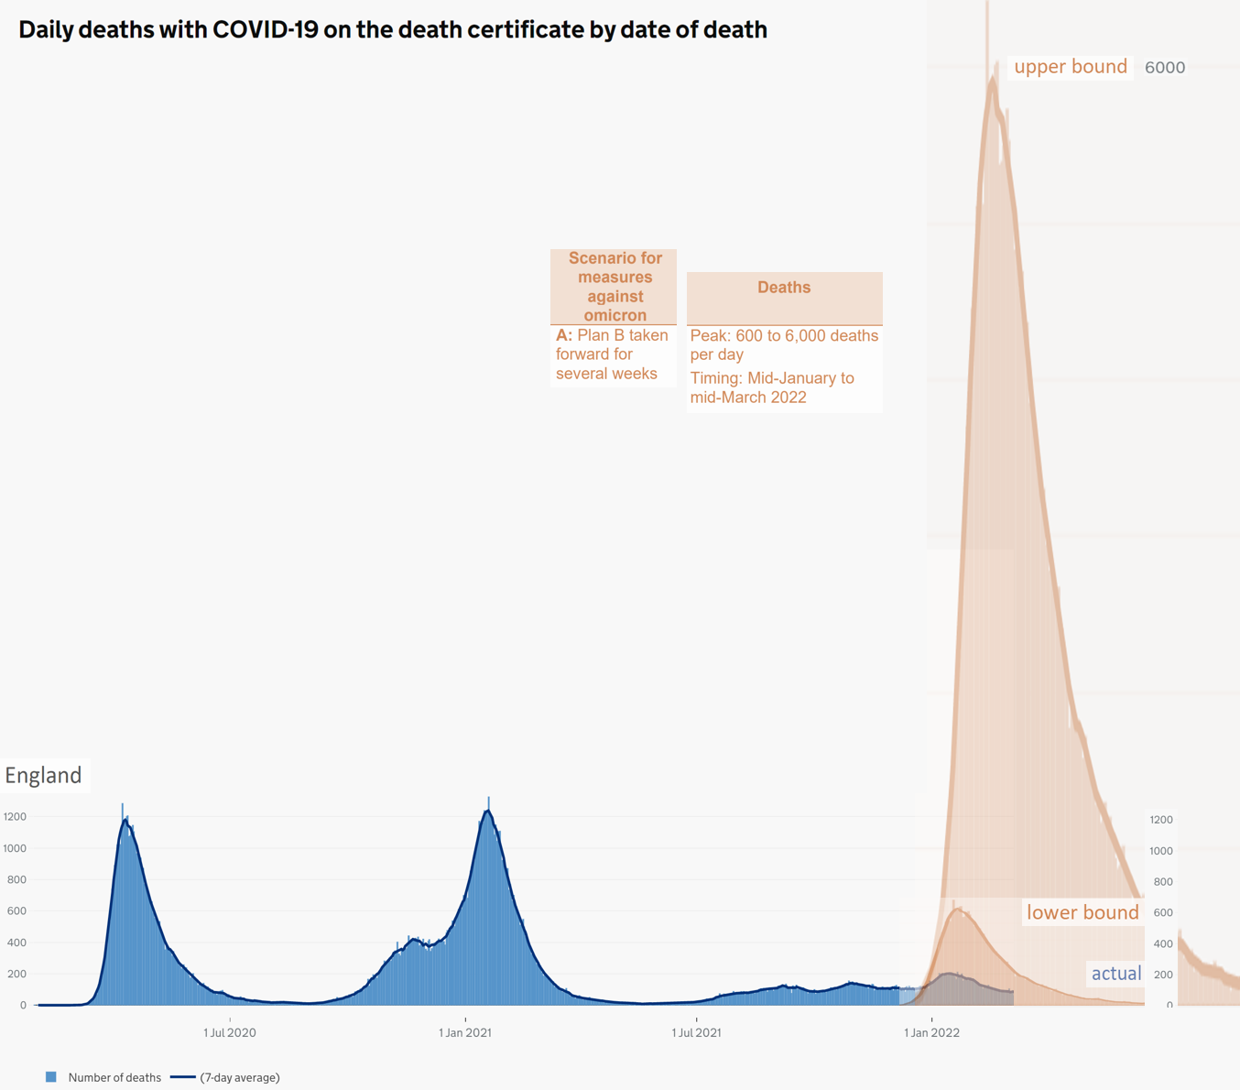
Modelling Accuracy
When the intended counterfactual scenario became the actual scenario – Omicron December 2021.

Slide 7
Do basic sanity checks!
SAGE Plan B modelled a 60% hospital fatality rate for Omicron!
In the first wave in England the ratio at the peak was 43%, in the second Alpha wave it was 32%, in the third Delta wave it was 16% and for the fourth Omicron BA.1 wave it was 10%.

Slide 8
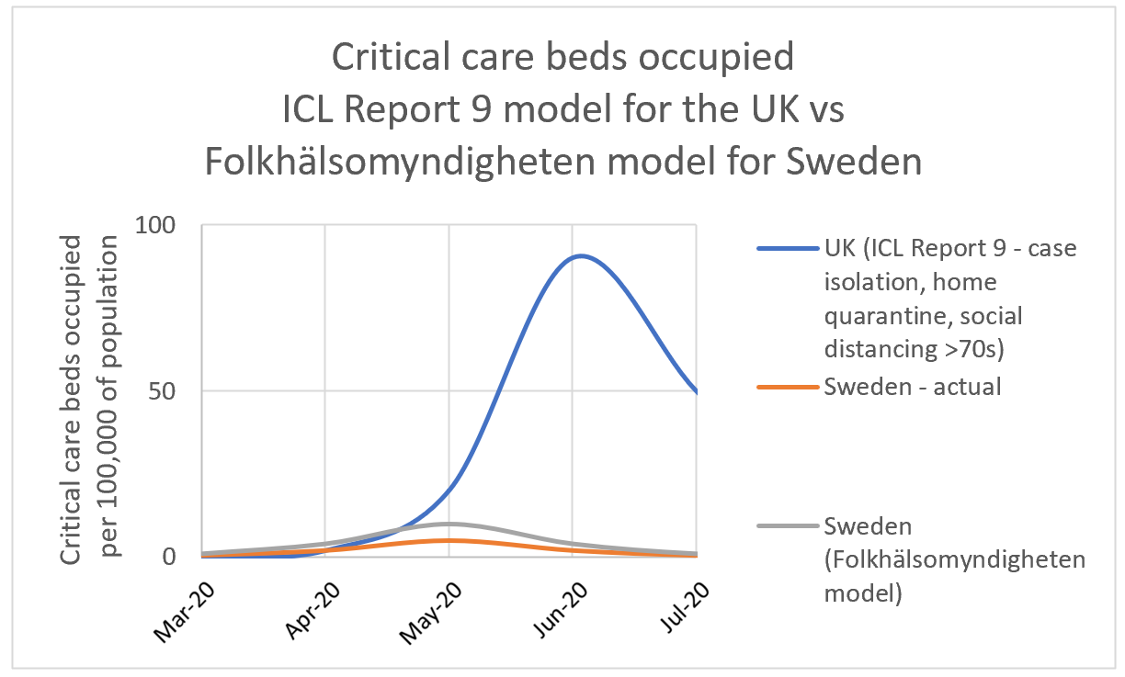
Comparing ICL Rep 9 to the modelling of the Swedish PHA

Slide 9
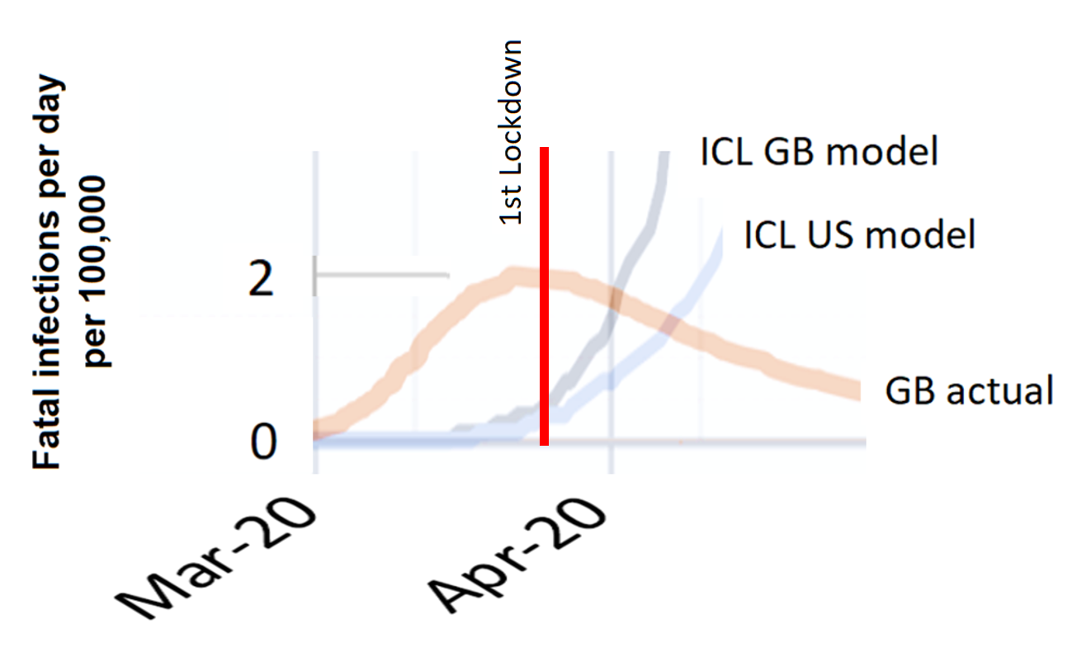
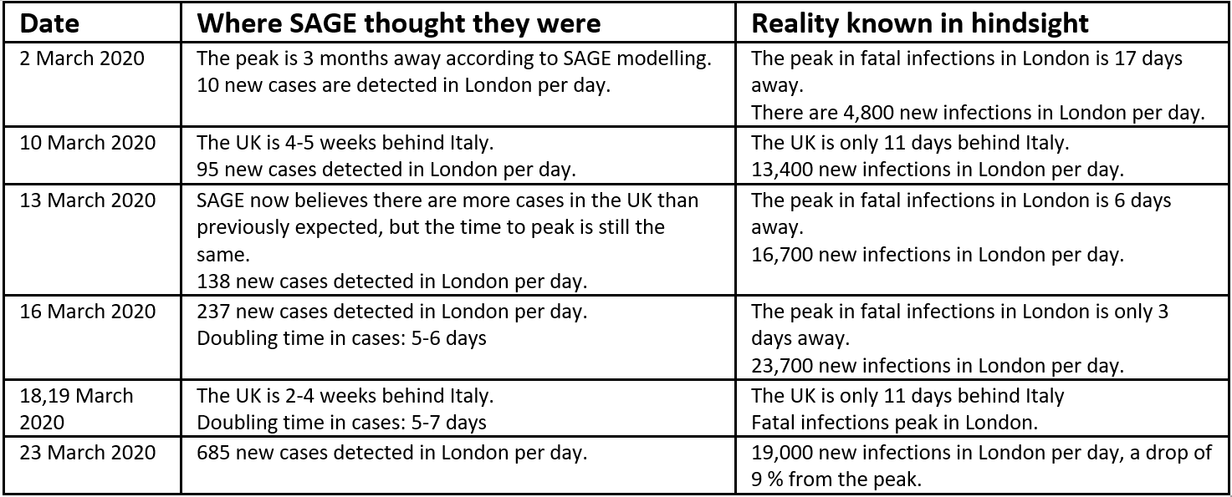
Temporal accuracy of models
Perception vs reality
Balancing loop problem – shower with delay between turning warm water tap and warm water arriving.

Slide 10
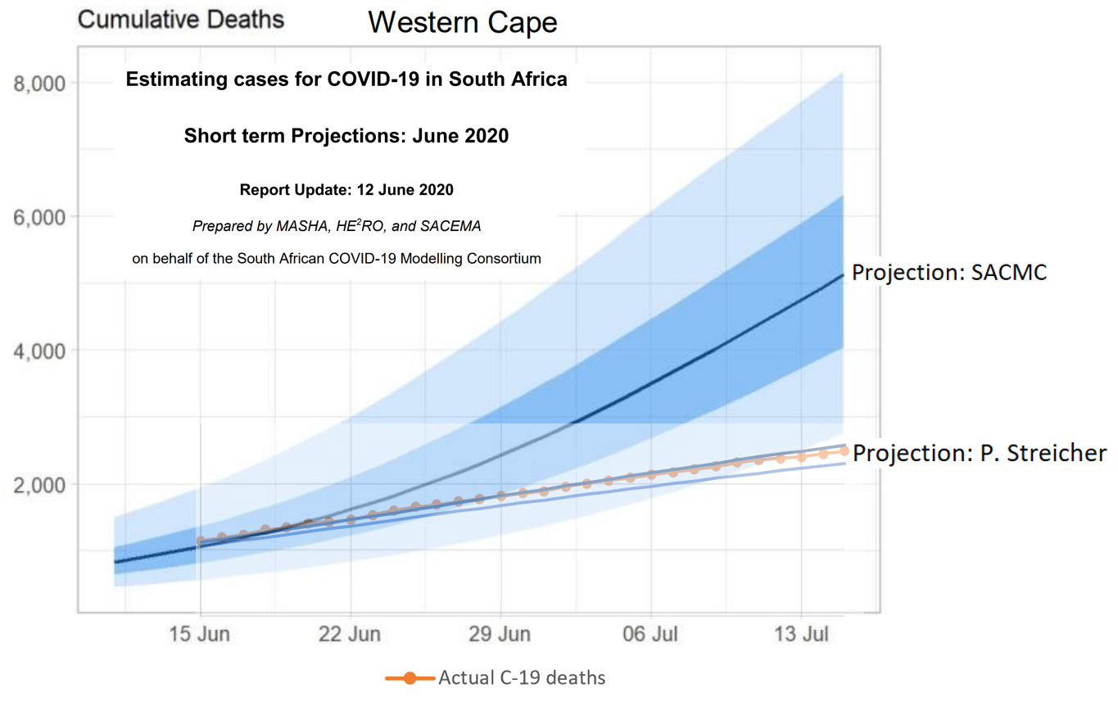
Descriptive modelling – curve fitting approaches

Slide 11
Ongoing evaluation and calibration
South African Covid-19 Modelling Consortium
“The model now incorporates behavioural heterogeneity as a mechanism to explain the lower- and earlier-than-expected peak in cases, deaths, and admissions in the Western and Eastern Cape in particular. This acknowledges the fact that some members of society experience different risks and exhibit different behavioural patterns, with highly connected individuals becoming infected earlier in the epidemic and infecting more contacts. It is modelled through altering the transmission function (force of infection) to decrease as immunity builds up in the most connected individuals early on.”
Several pandemic commentators have noted that new variant (and sub-variant) growth rates and epidemic sizes are always over-estimated. It is not sometimes high, or sometimes low. It is always an over-estimate, often statistically significant. This appears to be a systematic issue in disease modelling.
Professor Michael S Fuhrer explains why this might be the case:
“In a highly heterogeneous population, a new variant will find a niche to grow rapidly, and it is this rapid growth that will be observed. Any models that extrapolate from this early growth will systematically overestimate the epidemic size.”

Slide 12
Summary
Different models have different purposes.
During a pandemic, both accurate forecasting and conditional modelling is needed.
Complex problems can benefit from multiple approaches – a model provides but one perspective.
Accurate modelling requires ongoing evaluation and calibration.
Sanity checks should be used to assess if the answer provided by a complex mathematical model could possibly be true.

