Slide 1
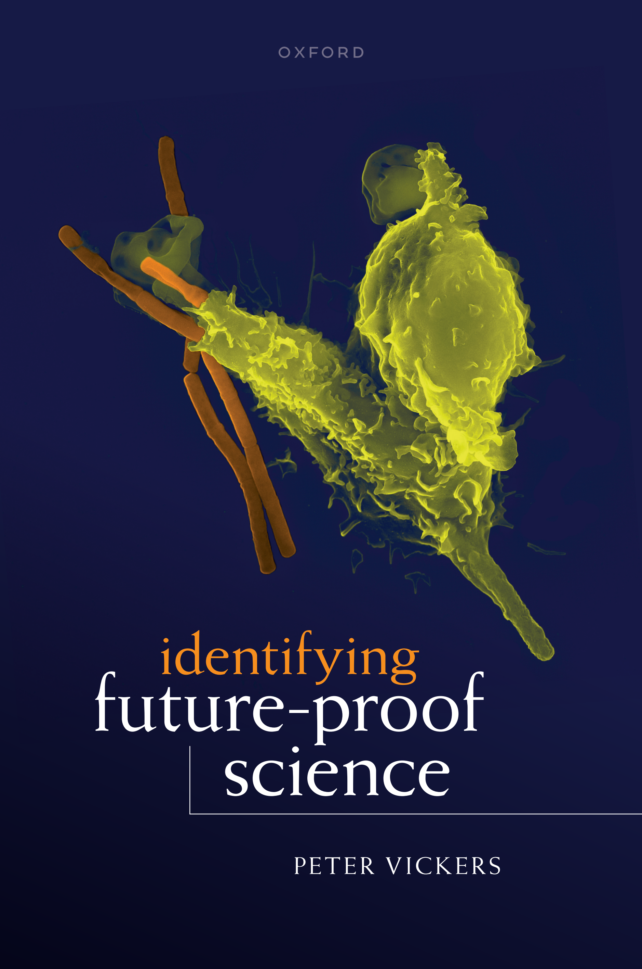
Identifying Future-Proof Science
(even in models)
Durham, IAS
4th May, 2023

Slide 2
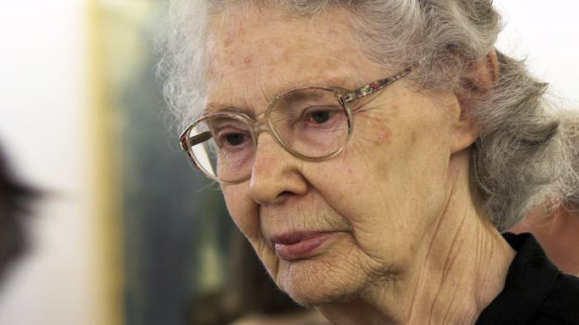

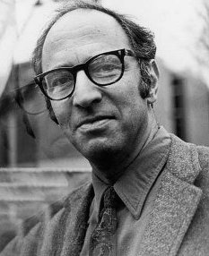


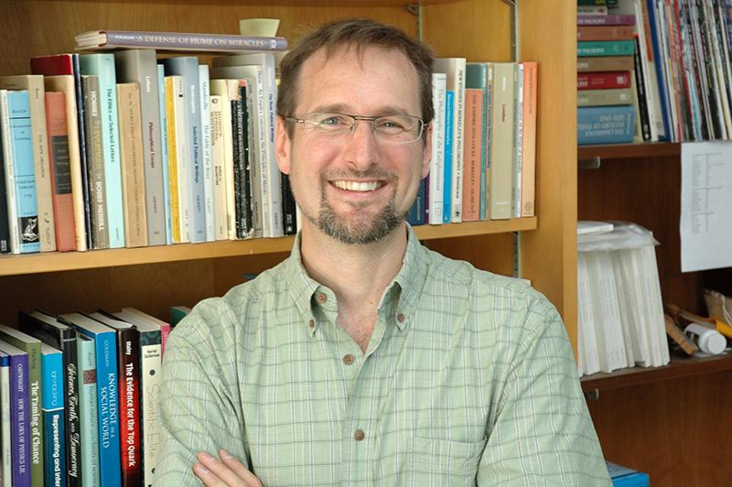









The “scientific realism debate”
antirealists
realists
?
?
?
?

Slide 3
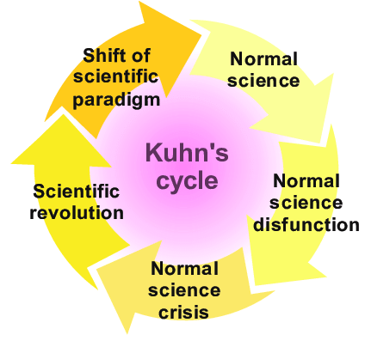
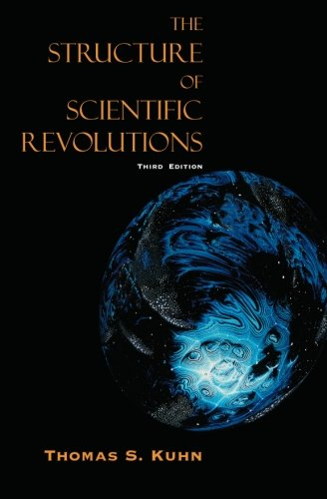

Slide 4
An alternative ‘science and truth’ debate

Slide 5
An alternative ‘science and truth’ debate

Slide 6
Notes:
1993 paper

Slide 7
The sun is a star.
The Milky Way is a spiral galaxy.
Smoking causes cancer.
The Earth is a slightly tilted, spinning, oblate spheroid.
The Moon causes the tides.
The water cycle.
DNA has a double helix structure.
Red blood cells carry oxygen around the body.
Normal person-to-person speech travels as a longitudinal compression wave through the particles in the air.
The outer core of the Earth is liquid metal.
S. America and Africa used to fit together like jigsaw pieces.
Fish living in the world’s oceans 100s of millions of years ago ultimately evolved into modern-day human beings.
Anthropogenic climate change.

Slide 8
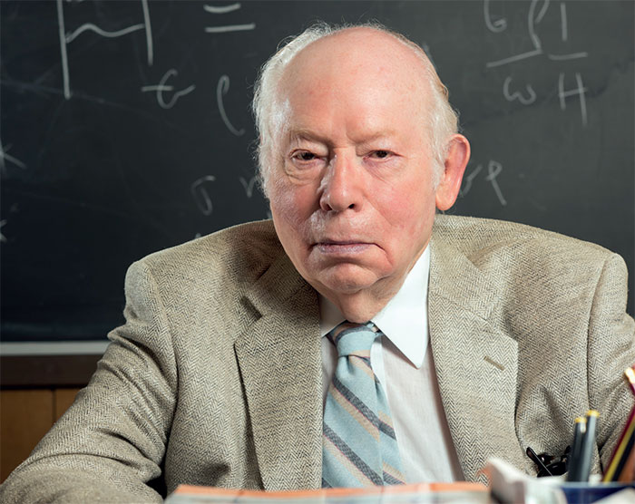

What are ‘scientific facts’?
“[T]here are truths out there to be discovered, truths that once discovered will form a permanent part of human knowledge.”

Slide 9
Established scientific fact
?
Hypothesis/theory
Ernst Mayr “often deplored that he was not aware that philosophers of science have investigated this transition from theory to fact” (Hoyningen-Huene, 2022)
“Where is the boundary between “established fact” and “very high confidence”?’
(IPCC report writer; quoted in Janzwood 2020).

Slide 10
Criteria for (future-proof) scientific facts:
  There exists a 95% consensus that X is an established scientific fact, in a scientific community that is large, international, and diverse.
Key point:
  In the entire history of science, there has never been a case where these criteria have been met, and then we’ve backtracked, despite enormous opportunity for that to happen (if it were ever going to happen).

Slide 11
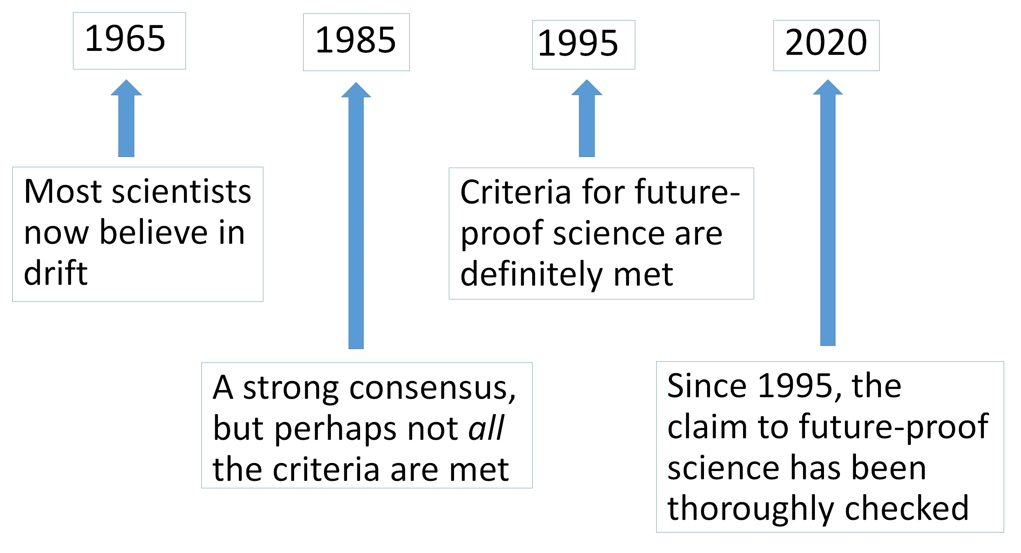

Slide 15
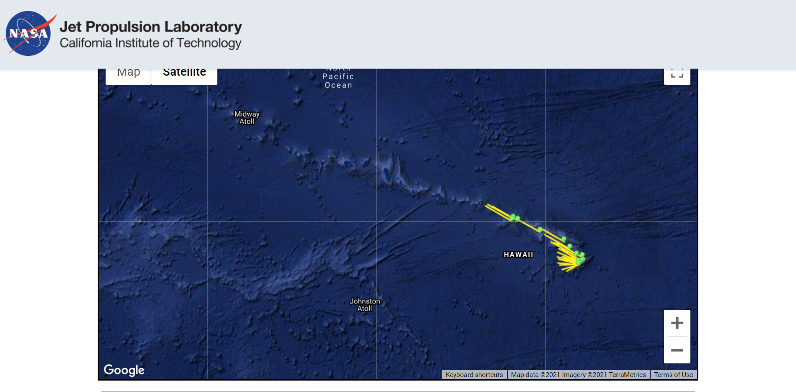
Proof by observation
https://sideshow.jpl.nasa.gov/post/series.html

Slide 16
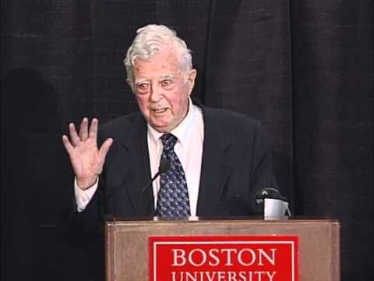
Ernan McMullin, 1984
“Here, as so often in science, theoretical entities previously unobserved, or in some cases even thought to be unobservable, are in fact observed and the expectations of theory are borne out, to no one's surprise.”
McMullin in 2010

Slide 17
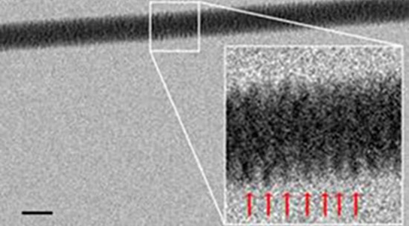
Gentile, F. et al. (2012): ‘Direct Imaging of DNA Fibers: The Visage of Double Helix’, Nano Letters 12(12): pp. 6453-8.

Slide 18
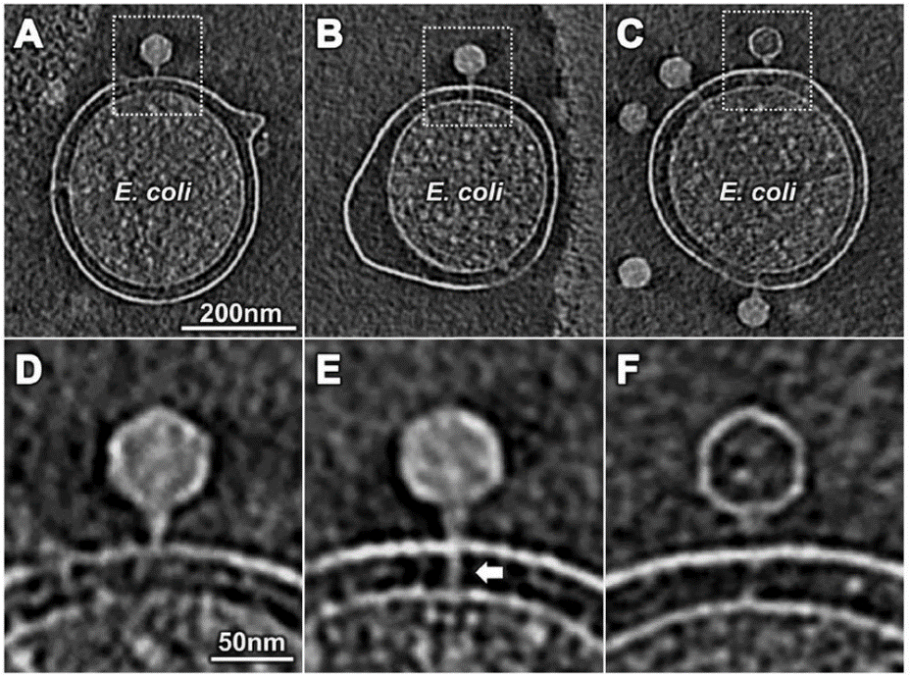
Hu, B. et al. (2013): ‘The Bacteriophage T7 Virion Undergoes Extensive Structural Remodeling During Infection’, Science 339(6119).

Slide 19
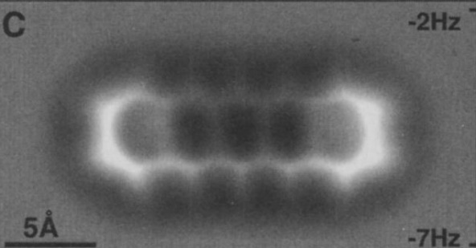
Gross et al. 2009

Slide 20
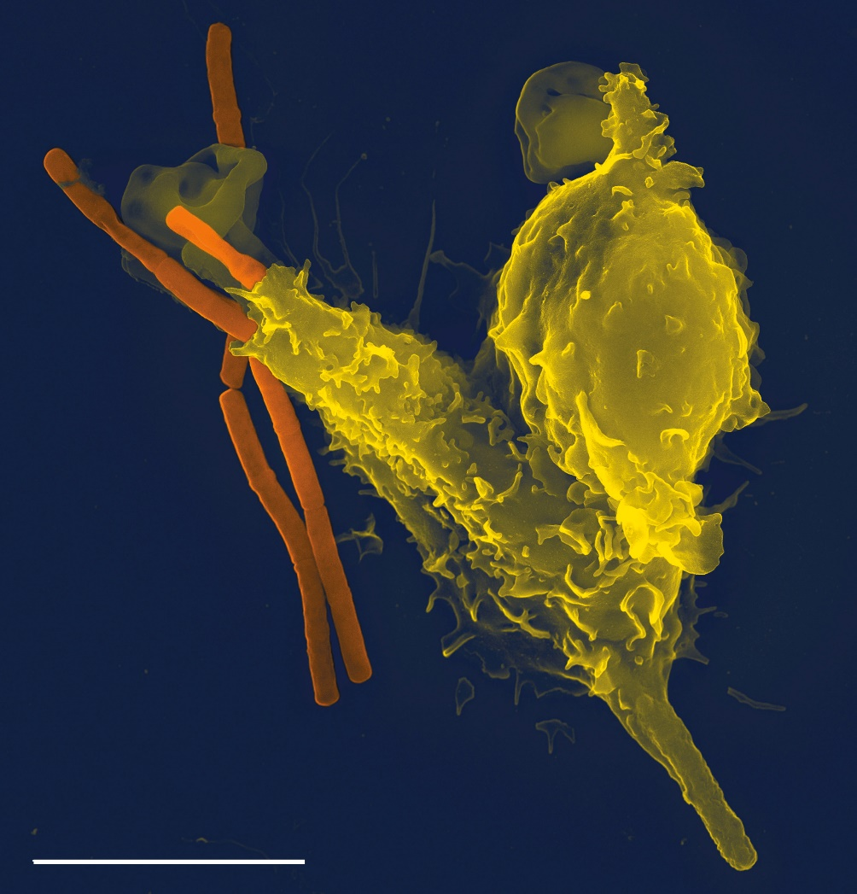
Notes:
A scanning electron microscope image of a single white blood cell (yellow/right) engulfing anthrax bacteria (orange/left). (2005)

Slide 21
It is highly non-trivial that there is any threshold that can be defined, where we have lots of examples, and no counterexamples.
It could have been the case that, in order to rule out all counterexamples from history, we would need to raise the bar so high that there are no examples.
This definitely did not happen. The stated criteria rule out all potential counterexamples from history, and leave us with hundreds of examples of ‘future-proof science’.

Slide 22
The sun is a star.
The Milky Way is a spiral galaxy.
Smoking causes cancer.
The Earth is a slightly tilted, spinning, oblate spheroid.
The Moon causes the tides.
The water cycle.
DNA has a double helix structure.
Red blood cells carry oxygen around the body.
Normal person-to-person speech travels as a longitudinal compression wave through the particles in the air.
The outer core of the Earth is liquid metal.
S. America and Africa used to fit together like jigsaw pieces.
Fish living in the world’s oceans 100s of millions of years ago ultimately evolved into modern-day human beings.
Anthropogenic climate change.

Slide 23
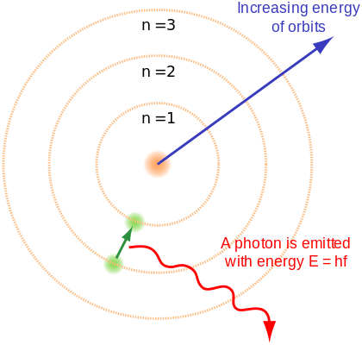
Bohr’s model of the atom

Slide 24
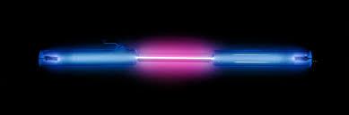
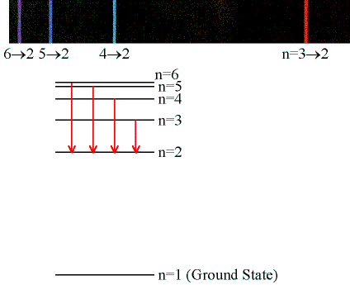

Slide 25
Bohr was right that:
hydrogen atoms consist of one proton and one electron
there is a Coulomb potential caused by the positive charge of the proton nucleus
the energies of the possible electron states are quantized
photon emission is caused by transitions between electron states

Slide 26
Successful Prediction
Hypotheses which fuel the success
Theory
(working posits)

Slide 27
BIG REVOLUTION!
Successful Prediction
Working posits are retained through theory change
Theory 1
Theory 2
(current theory)
(future theory)
Notes:
Approximately retained, anyway.

Slide 28
Bohr’s biggest predictive success
Frequencies of the spectral lines of ionised helium
Successful Prediction
The bits Bohr got right
Bohr’s theory
Current theory

Slide 29
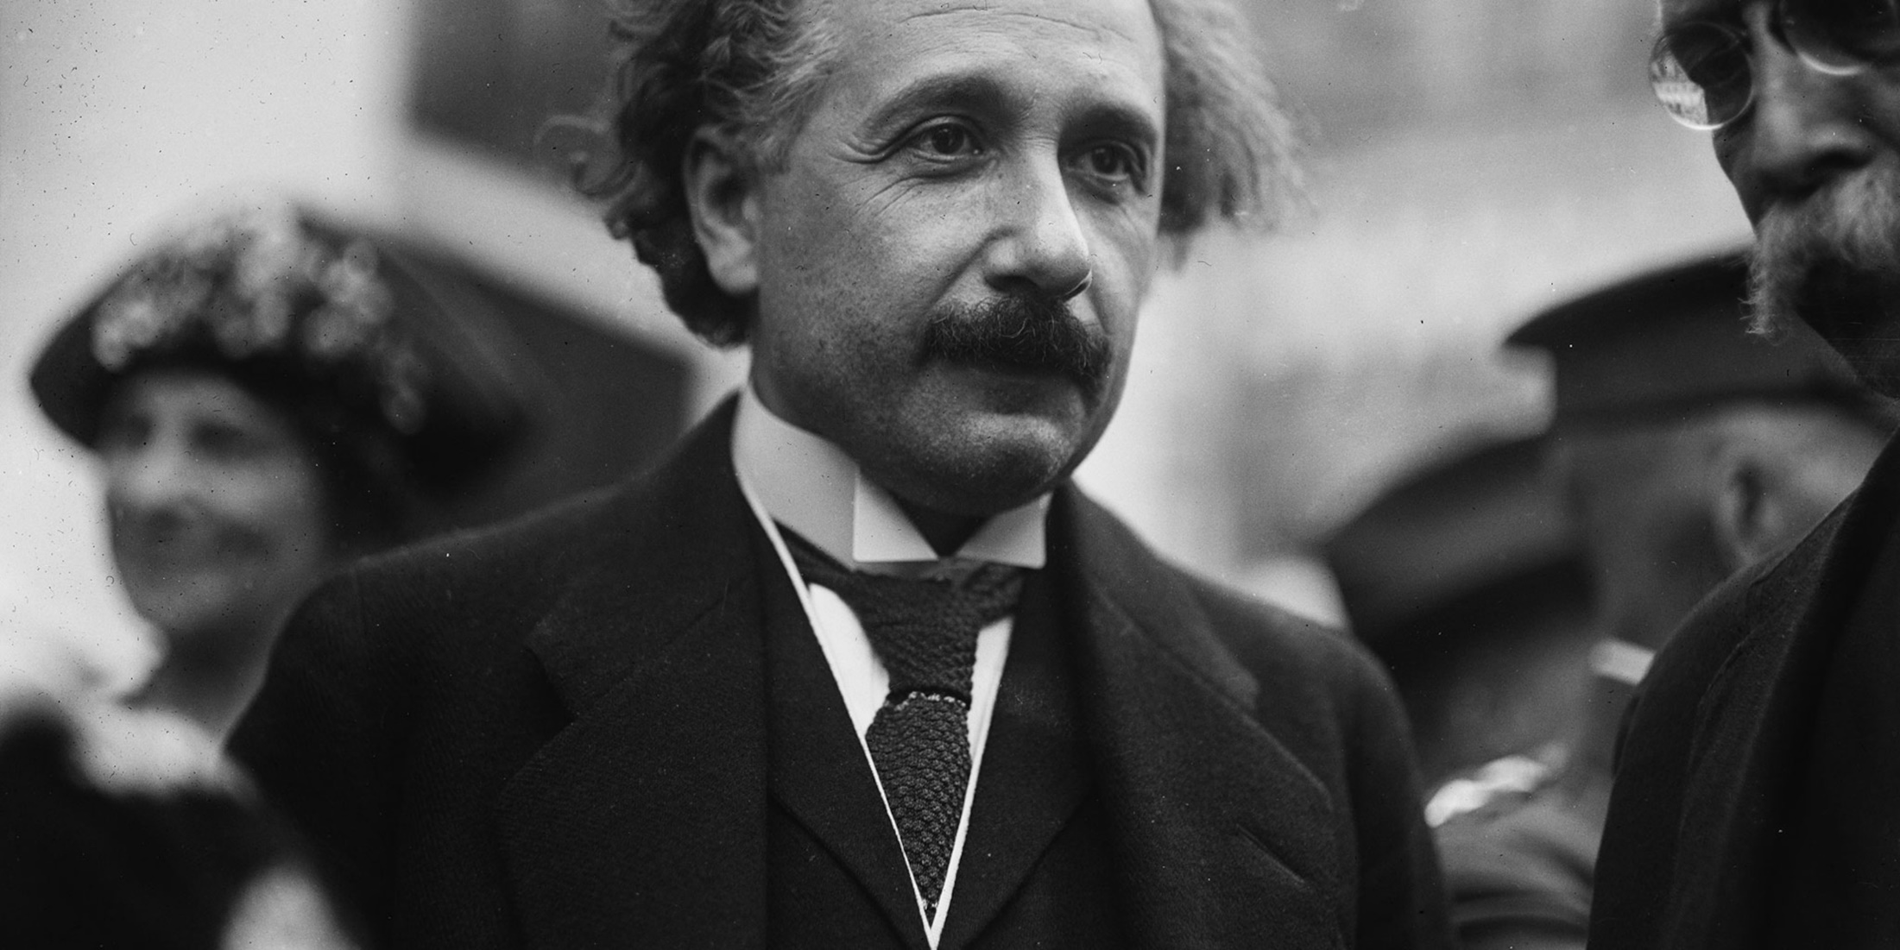
“Very remarkable! There must be something behind it. I do not believe that the derivation of the absolute value of the Rydberg constant is purely fortuitous.”

Slide 30
Abstract from details/specifics
To identify facts:
  Alice travelled to Durham.
  A bolide impact triggered the extinction of the non-avian dinosaurs.
  Planets in our solar system orbit in near-ellipses.
To find truth within models:
  Bohr said: “Electrons in a hydrogen atom jump between allowed orbits”
  Abstracting: “Electrons in a hydrogen atom transition between allowed energy states.”

