Slide 1
Designing New Materials
Stewart Clark
Department of Physics

Slide 2
A brief history of material science
8000-6000BC: Copper, Silk, Beer
5000-1000BC: Glass, Bronze, Iron
1000-1900AD: Magnetism, Metal conductivity, Gasses, Periodic Table, classical physics and chemistry
Now – modern physics meets chemistry...

Slide 3
What would we like to achieve?
Computers get cheaper and more powerful every year.
Experiments tend to get more expensive each year.
Computer simulation now offers acceptable accuracy, often it is now cheaper than experiment
Functional materials – designed for a specific function

Slide 4
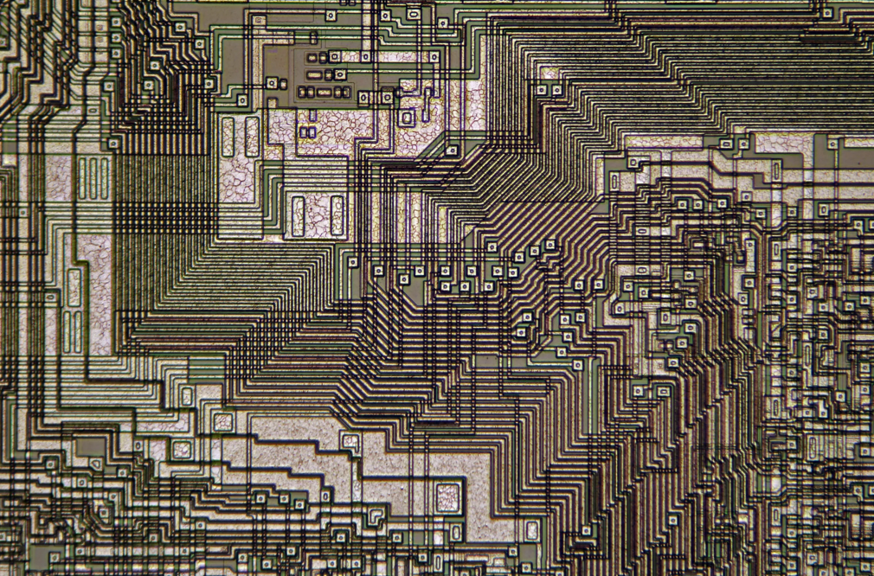
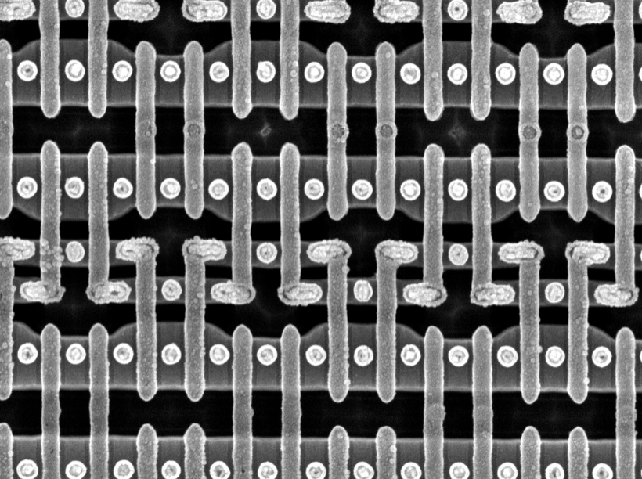
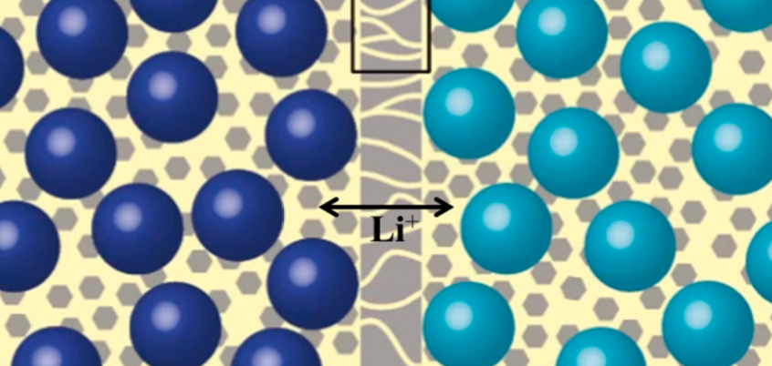
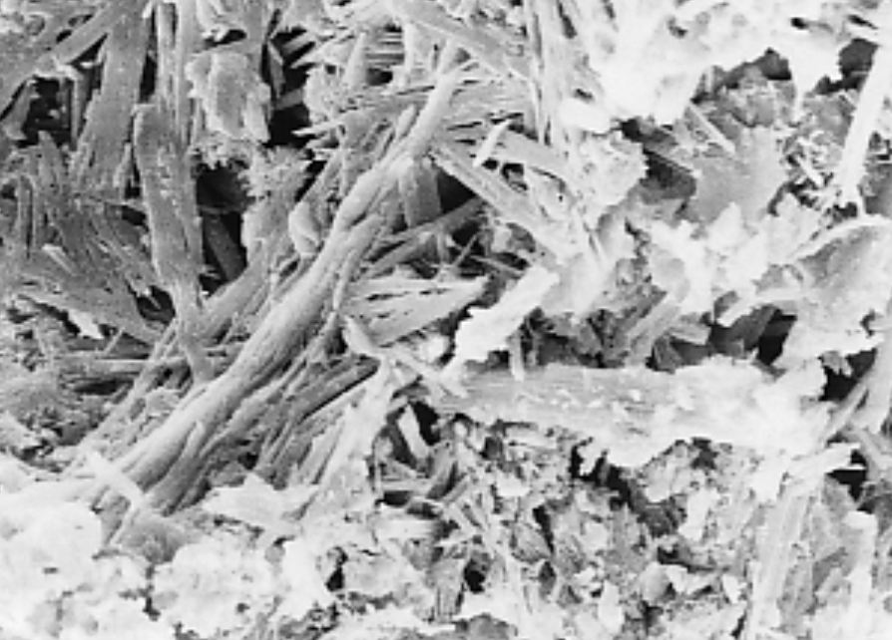
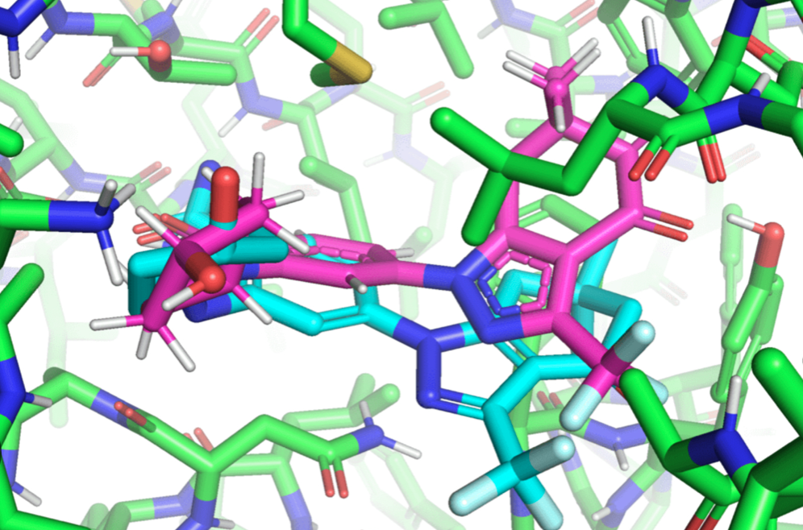
Functional materials

Slide 5
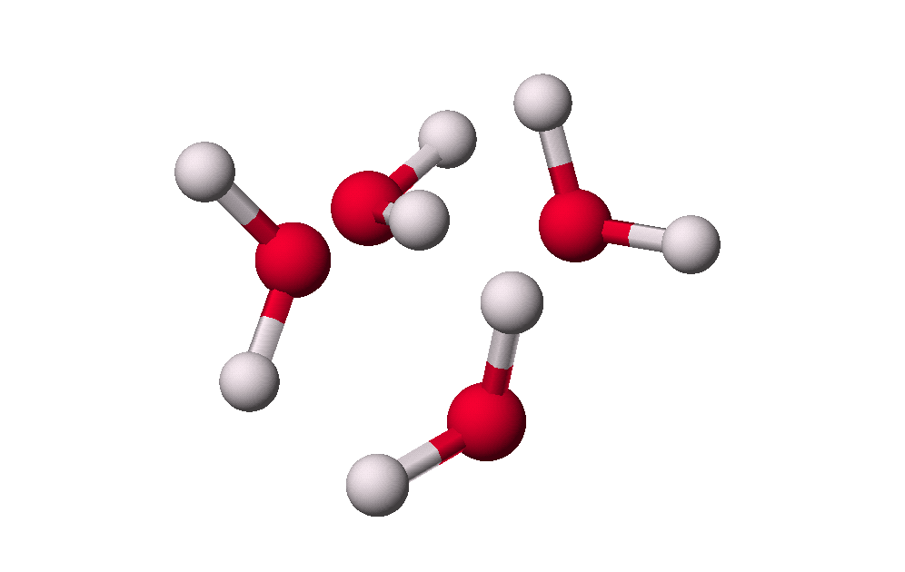
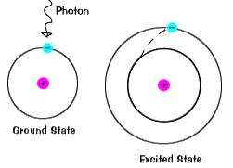
Length and time scales
Coarse-grained
Polymers
Molecular
alignment
>>10⁻⁷ s
Diffusion
Quantum mechanics
10⁻⁸ s
Intermolecular
motion
10⁻⁹ s
Bond motion
Electronic
transition
10⁻¹⁴ s
Atomistic
Modelling
10⁻¹⁵ s

Slide 6
Paul Dirac
“The underlying physical laws necessary for the mathematical theory of a large part of Physics and the whole of Chemistry are completely known and the difficulty is only the exact application of these laws which leads to equations too complicated to be soluble.”

Slide 7
My areas of research
Developing ab initio methods for computational solution of electronic structure of materials
Electronic structure leads to Material Properties
Implementation of methods: CASTEP electronic structure code (www.castep.org)
For use small to giant computers (many CPUs)
Applications to many areas of physics, chemistry and materials science

Slide 8
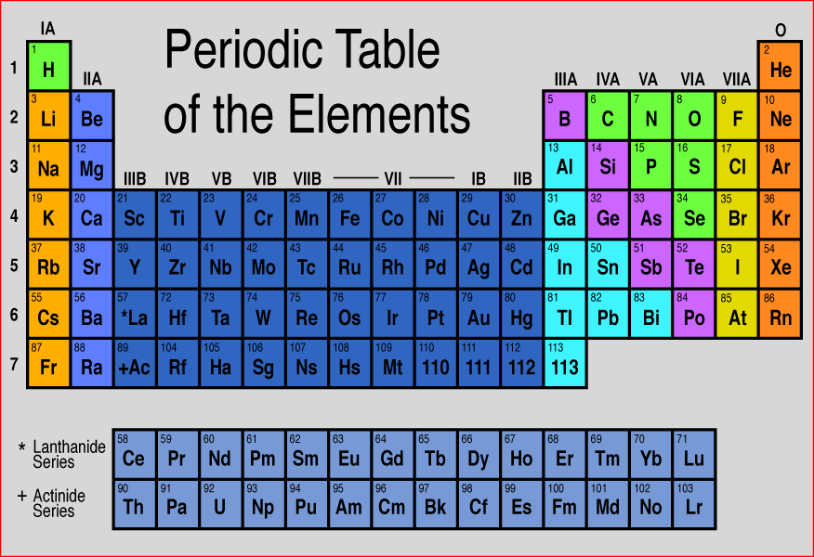
Aim of ab initio (parameter free) calculations
Atomic Numbers
Solve quantum mechanics
for the material
Predict physical and chemical
properties of systems

Slide 9
From first principles
The equipment
Application
Scientific problem- solving
“Base Theory” (DFT)
Implementation (the algorithms and program)
Setup model, run the code
Research output
“Analysis
Theory”

Slide 10
Summary
First principles electronic structure calculations:
Extremely powerful technique in condensed matter
Applicable to many different sciences
Condensed Matter Physics
Chemistry
Biology
Material Science
Surfaces
Geology
Simulate experiment (extreme conditions)
Computationally possible, but still requires good computer resources

