Slide 1
What can Covid Modeling Teach us about public Participation in Science?
Eric Winsberg
British Academy Global Professor, University of Cambridge

Slide 2
TWO KINDS OF RISK
Two Roles for Values
Harvard & Winsberg, 2021

Slide 3
Inductive Risk
The risk in deciding to declare something a fact:
We can never be 100% sure that a factual claim is true.
Whether the evidence is strong enough to warrant endorsing it depends on our appraisal of how serious it would be to make either a type 1 or type 2 error.
Consider the case of declaring a vaccine safe and effective.
It helps some, but not all the way, to moderate the claim to “The vaccine is at least *so much* effective.”
(Consider the claim that it is 80% effective at preventing hospitalization.)

Slide 4
Representational Risk
The risk in deciding how to build a representational tool
Choosing a methodology, adopting a data set, making a model.
Involves choosing what to represent, and how to represent it.
Why is this value laden?
Can influence what facts will be adopted downstream.
Can provide answers to irrelevant or harmful questions.
Consider: should schools be closed for a whole year in the Covid-19 pandemic?
Can obscure desired information.
Pfizer vaccine clinical trial—three possible endpoints
Serious disease
Infection
Household infection

Slide 5
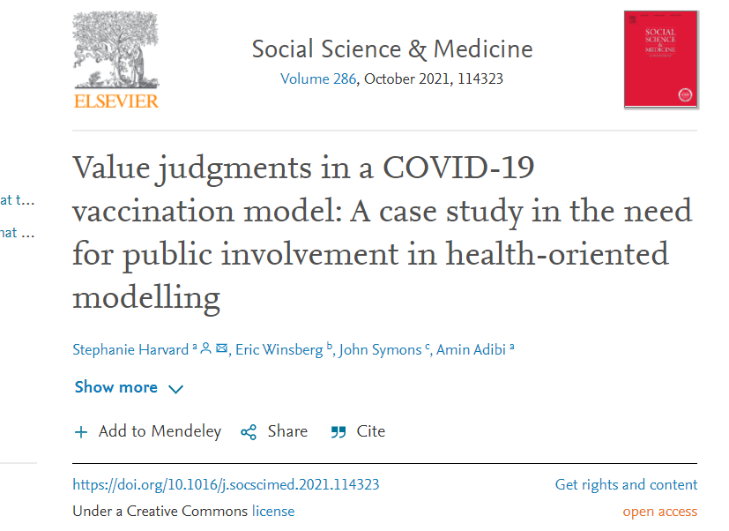
Causal inference in complex non-linear systems: a cautionary tale

Slide 6
Who cares about values?
We argue for taking greater care in managing value judgments in modelling:
Make value judgments explicit and interpretable by non-experts
Invite public involvement in making those value judgments.
Harvard, Winsberg, Symons, & Adibi 2021

Slide 7
Who cares about values?
We understand the goal of public involvement in modelling in terms of managing value judgments:
This gives us a clear reason for public involvement throughout the modelling process, not just in decision-making based on model results.
Also gives us a clear reason to involve patients and other members of the general public in modelling, not just clinicians and/or policymakers.
That is, if we agree that no one is better equipped to make social and ethical value judgments than anyone else.
Harvard, Winsberg, Symons, & Adibi 2021

Slide 8
Goal of Public Participation
If scientists and policy makers put forward a model, the public should be in a position to know the answer to this question:
Congruence Criterion: Ability to answer: If they had *my* values, is this the model they would have built? Or would they have built a very different one? Would policy choices have been different?

Slide 9
REPRESENTATIONAL DECISIONS
What to represent?
How to represent it?

Slide 10
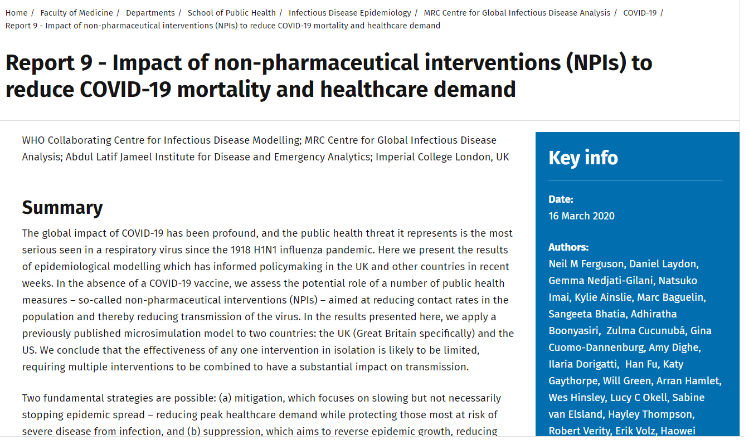
Imperial College London: RePort 9

Slide 11
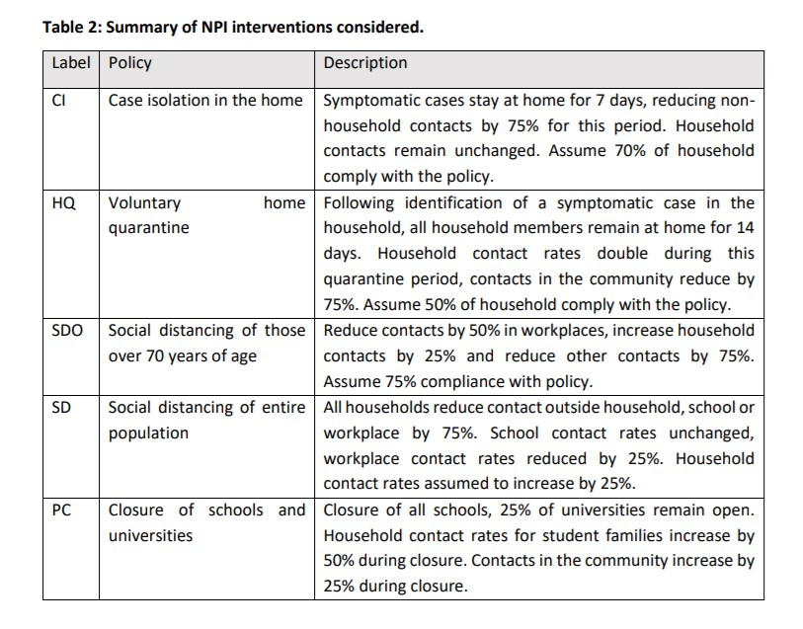
report 9 Purpose
Decide what level of infection mitigation is best? Projection under different policy choices

Slide 12
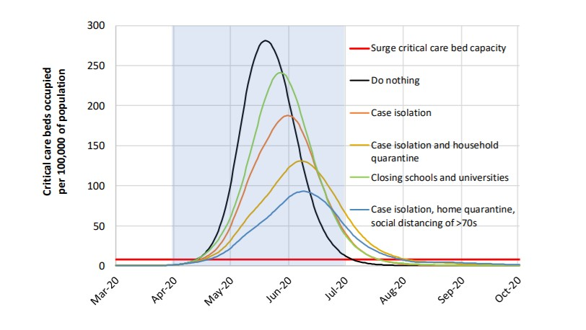
Different Policy Options

Slide 13
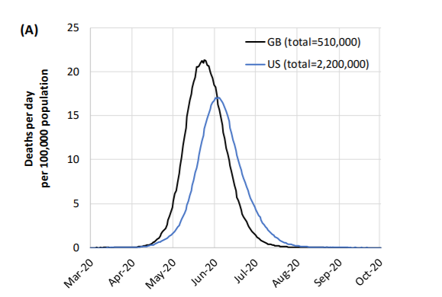
ICL Report 9

Slide 14
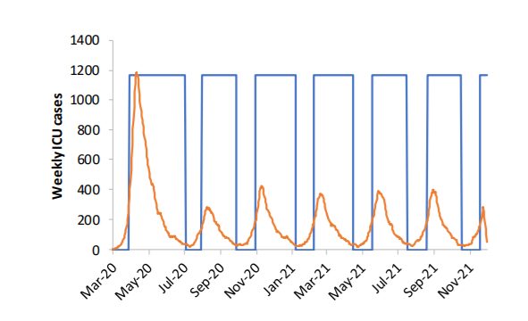
ICU demand in the UK

Slide 15
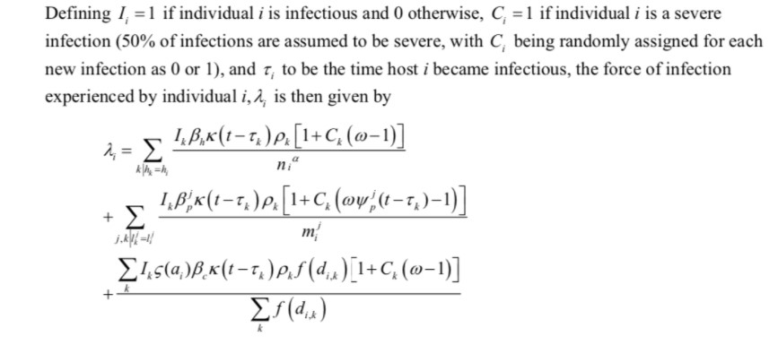
Representational Choices in Report 9 model
Basic model structure.
The choice to use an individual-based model rather than a network model with potential for heterogeneity.
The choice to not consider seasonality, animal reservoirs, etc.
(Where do waves come from? Why are they not in the model?)

Slide 16
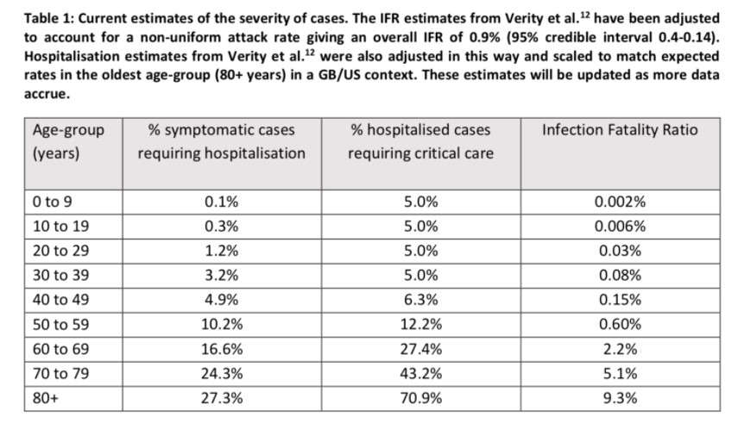
Crucial modeling choices
Verity et al
Other parameters
3 crucial ones: latency, time to self-quarantine, reduction in social contact rate.
900 others
Nothing about costs.

Slide 17
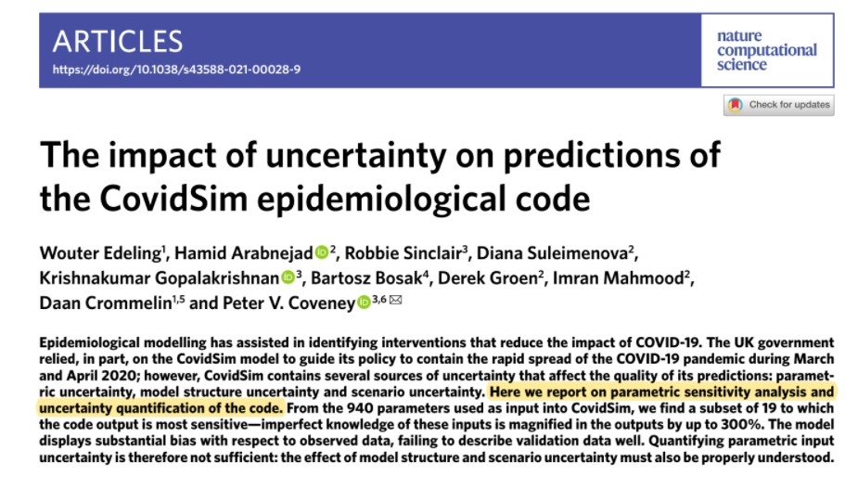
How should we Evaluate Report 9
In model development:
In ‘the (unlikely) absence of any control measures or spontaneous changes in individual behaviour’.
is this good for decision making?
Management of uncertainty (Edeling, 2020)
What's not included that is relevant to the decision:
learning loss, economic loss, mental health, loss of freedoms, loneliness and isolation at end of life, health effects of averted health care services.

Slide 18
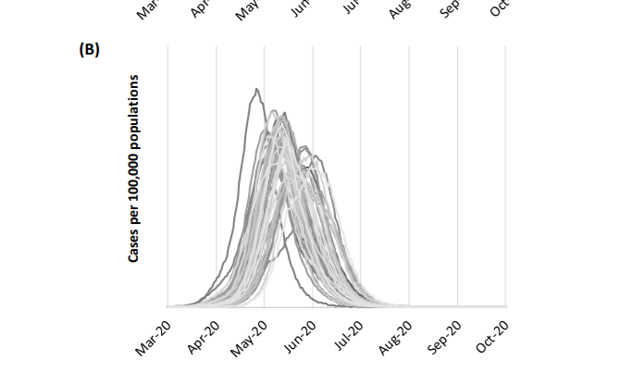
Evaluating Report 9: OUTcomes
Not correct to evaluate as a prediction model
Counterfactual claims are being made
Possibility of compensating errors.
Look at Sweden (report 12, Gardner, Flaxman), US states that remained open.
important to look at pace and tempo as well as final numbers.

Slide 19
WHAT TO REPRESENT
Consider three people whose views on NPIs differ:
All suppression mechanisms should be employed (on ethical grounds, given current evidence)
All suppression mechanisms should be terminated (on ethical grounds, given current evidence).
More information about each subset of mechanisms is required, and supports building a model for the purpose of reasoning about the effects of their continuation.
Same as above, but only with a model that adequately does X.

Slide 20
WHAT TO REPRESENT
A core value judgment in building the ICL model, then, is that it is an ethically-defensible project
E.g., more worthwhile than (for example) holding a public demonstration to protest the (dis)continuation of the lockdowns.
One question to ask members of the public is whether building the ICL model is a good and worthwhile thing to do, making explicit the model's intended purpose and the epistemic situation of the modelers.

Slide 21
What to represent
What outcomes to represent:
E.g., COVID-19 infections, hospitalizations, ICU beds and deaths.
Including these outcomes in the ICL model signifies an ethical judgment:
These are the important outcomes to consider when reasoning about lockdowns
More important than (indeed completely trumps) costs of lockdowns, which are not represented in the ICL model
or alternatively, in order to avoid signifying that: to clearly represent that the intended purpose of the model is to be used in synergy with tools that estimate costs.
“We do not consider the ethical or economic implications of either strategy here, except to note that there is no easy policy decision to be made.”
“We therefore conclude that epidemic suppression is the only viable strategy at the current time.”

Slide 22
What to represent
What variables to include
When variables are represented (or not) in a model, it means that understanding their influence on outcomes is part (or not) of the research question.
In this case: people's age
But not their race, income, postal code, occupation, or household size.
No mechanisms for generating waves in the absence of policy variations.
Nothing about what suppression mechanisms do to any other outcomes (i.e. costs)
This make the model inadequate for many possible purposes-does the public still want?

Slide 23
What to represent
Suppose there are no data on race. Does that eliminate the ethical implications of not including race?
No. Because you could include bad data, or decline to model without race data.
These are value judgments not scientific ones.
Do you represent uncertainty? if so how?
What counterfactual scenarios do you include?
Not hard to make the case that NF et al made their choices with an eye towards a certain kind of rhetorical force.

Slide 24
How to represent it
There is always a risk that a representational decision will be inadequate for the purpose to which it is put
When this happens, a number of social harms can result:
e.g., pernicious gaps in knowledge, damage to public trust, downstream endorsements of false claims.
This is representational risk (Harvard and Winsberg, 2022)

Slide 25
How to represent it
Hubei data vs. Diamond Princess data.
The choice to use an SIR model with an R rather than agent-based model
The choice to not consider seasonality.

Slide 26
REPRESENTATIONAL DECISIONS
'How to represent' and 'what to represent' overlap
All representational decisions affect what questions can be asked, and they reflect risk preferences.

Slide 27
Cost benefit vs. duty analysis
When good inference is not available, policy makers can revert to “duty analysis” rather than CBA
Should not use poor models as propaganda tools when doing duty analysis. And scientists should not abet this.
Smoking gun for this in Germany, but seems clear in other cases
Sometimes all choices will appear to violate one or another duty.
If so maybe reparations are in order. Bad inferences can obscure this.

Slide 28
WhAT's the PRobLEM with values?
Values vary by social position and most model builders come from the same social position.
education
race
class
occupation
(Gender identity?)
urban/rural
standpoint theory is relevant if you believe in it, but not necessary.

Slide 29
What to do? Transparency
Douglas, Elliot, Elliot and McKaughan
Can this satisfy our primary goal
Congruence criterion: to answer "if they had *my* values, is this the model they would have built? Or would they have built a very different one?"

Slide 30
Inarticulability
Suppose that the members of the ICL group had one and only one binary choice to make: use the DP data or the Hubei data. And suppose that they had in mind exact probability distributions that they assigned to each dataset overestimating and underestimating the effectiveness of each intervention to various degrees, say P(DP) and P(H). And suppose they had a complicated function of utilities over the space of each of those degrees of over and under-estimation. Even articulating just this amount of information would be overwhelming. But the situation is far worse than this: they have over 900 representational choices to make (just regarding the items they chose to represent, excluding those they chose to ignore!), and most of those choices are not in fact binary.

Slide 31
WHAT TO DO? Using the Right Values
what could this mean?
Who is an expert on this?

Slide 32
Public Participation
This will be hard!
Who should participate? (stakeholders? or everyone?)
What training should they receive and how should they receive it?
What goals are reasonable to strive for, given practical constraints?

Slide 33
Some (extremely optimistic) but *maybe* realistic…
goals in an alternative history of the ICL model
Maybe the public could have been able to weigh in on:
Do we have enough knowledge to made a model useful?
Are the projection scenarios reasonable?
Is the Hubei data set really better than the DP set or an average of the two?
Is it fair for the model to say nothing about how it will shift burden of disease from one class (or race, etc) of people to another.
"Sensitivity analysis will take too long!" Better to wait?
“The difference between locking down at 0.2 deaths per 100,000 population per week and doing so at 1.6 is the difference between 1,858,000 and 10,452,000 deaths globally over 250 days.”
Not include costs at all while not making this weakness much more clear.
(some lip service but nothing like: this model is not decision relevant without knowledge of costs.)
Does this look like science or rhetoric?

Slide 34
The ICL Example
Along with the goals of the last slide:
Seem like an excellent test case for thinking about how public participation should work.
What kind of process would lead to confidence that these minimal goals would be met?

Slide 36
Other Evaluations points? 'Performativity'
Biggs and Littlejohn: ‘Initial projections (of the ICL model) built in worst-case scenarios that would never happen as a means of spurring leadership into action’
Ioannidis et al: ‘In fact, erroneous predictions may have even been useful. A wrong, doomsday prediction may incentivise people towards better personal hygiene’
Van Basshuysen et al: ‘performativity may impair models’ ability to successfully predict the course of an epidemic; but it may provide an additional sense in which these models can be successful, namely by changing the course of an epidemic’
Changes in behavior away from what people would have done in the absence of the“doomsday predictions” typically have costs. And one of the most important functions of models for policy making is that we expect them to facilitate cost benefit analysis. Somewhat crudely, (but only somewhat) we need accurate and reliable models to determine which behaviors are in fact the best ones to carry out. If the very purpose of the model is constituted in part by a prior assumption of what the best course of action is, then things have become unacceptably circular, and the whole enterprise risks undermining both the credibility of science and the rights of the public to have policy choices that reflect their own values, rather than simply those of the model makers.

