Slide 1
PPAP Community Meeting: Where we are
M. Needham, A. Banfi, A, Buckley, A. Bevan, T. Berry, M. Gersabeck,
H. O’Keeffe, M. D’Onofrio, K. Palladino, J. Pastenak, A. Rajantie, R. Saakyan,
R. Seviour

Slide 2
Strategic Review
Several of the Strategic Review recommendations, directly touched on the role of PPAP
Review identified need for the development of a prioritized roadmap to feed into the next European Strategy update which will be completed ~2027. Suggested new committee to fulfill this role
Following the review STFC decided to split Science Board into PPAN and Facilities from later this year. Part of the Science Board (PPAN) remit roadmap prioritization

Slide 3
Strategic Review
No immediate change to PPAP role, but may evolve with establishment of Science Board (PPAN)
It’s part of the charge of Science Board (PPAN) to produce a prioritized roadmap
Review recommended completion of a prioritized roadmap by the end of 2023
That timescale seems ambitious and it's is up to Science Board to steer the process, but likely new roadmap process will happen on a short timescale
PPAP wants to start preparing the community for the development of a new roadmap: hence the structure of this meeting in looking towards the future

Slide 4
The role of PPAP
‘The purpose of the Advisory Panel is to provide a link between Science Board and the community, and represent the needs of the community to STFC.’
In helping Science Board to develop a prioritized roadmap, we can imagine two models for PPAPs role
PPAP collects information from the community and provides unprioritized roadmap to Science Board who prioritize/tension to produce the roadmap
PPAP collects information and already tries to prioritize, e.g. prioritizing within a field
Option B means the way that PPAP represents the community is changed
What does the community want ? We want to reflect on this in the discussions over the next days

Slide 5
Infrastructure call
The Wave 4 infrastructure call for preliminary activities is ongoing.
We received 5 new proposals + 4 resubmissions
We are asked to provide select up to 3 projects. Resubmitted projects do not count towards the 3 but we are asked to comment + rank if able
Projects looking to go in should provide PPAP with the call documentation by 10th July. We will rank the projects on the 17th July (timeline aligned with PAAP)

Slide 6
Infrastructure Call: Wave 4
New projects:
HALHF
Precision muons
Particle Beamline
XLZD
QUEST-DMC
Resubmissions
AION (selected by PAAP)
DATUM ​
SOLAIRE​
TRITON (selected by QTFP)
​

Slide 7
Infrastructure Call: Next rounds
Current infrastructure round has felt rushed. Can we be better prepared in the future? This my understanding
Caveat: future is uncertain (spending review, general election)
Expect another preliminary proposal infrastructure call in 2024 (Wave 5) for submission in Spring 2025
Next full project proposals round expected Spring 2025: Would require preparation in Spring/Summer 2024
New science board will play a role in future infrastructure calls
Projects can be proposed to Visions at any time. Visions is a useful route to identify projects ready for infrastructure call: XLZD went through Visions process.

Slide 8
The current program
Described in the last roadmap exercise completed in 2021
https://www.ukri.org/wp-content/uploads/2020/06/STFC-210322-PPAP-2021-Roadmap.pdf
Roadmap followed on from the 2020 European Strategy update and endorsed its recommendations
Described the current program and future opportunities
  Since then evolution in several areas of the program

Slide 9
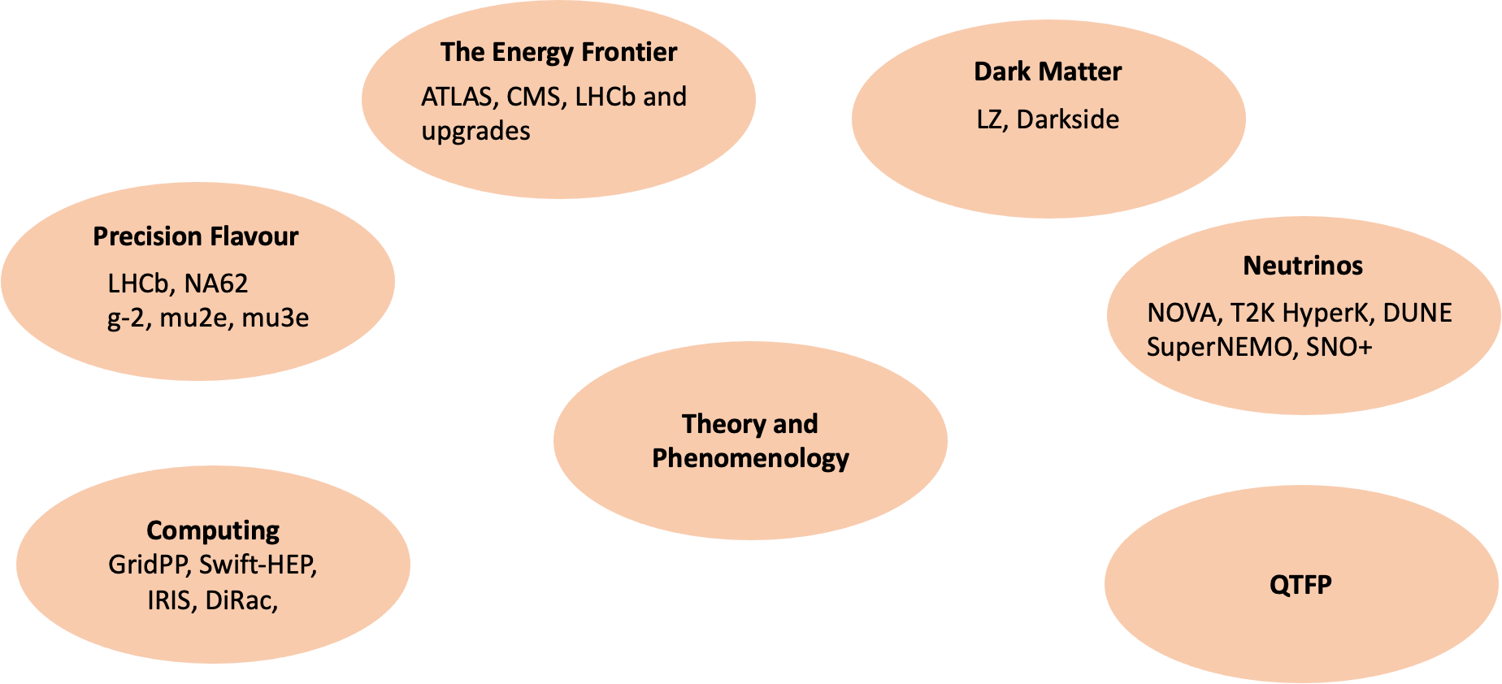
The current program
LEGEND

Slide 10
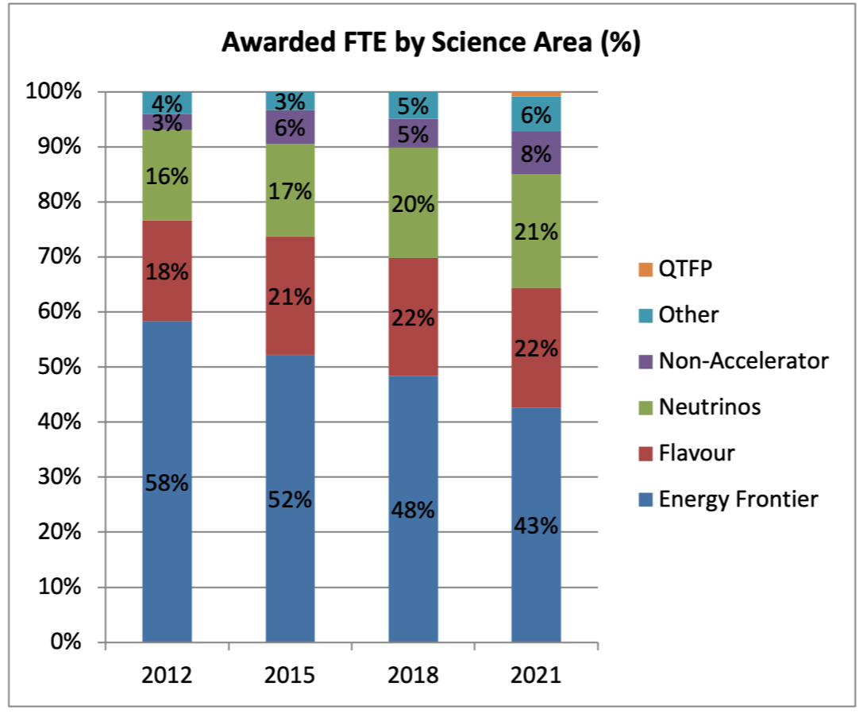
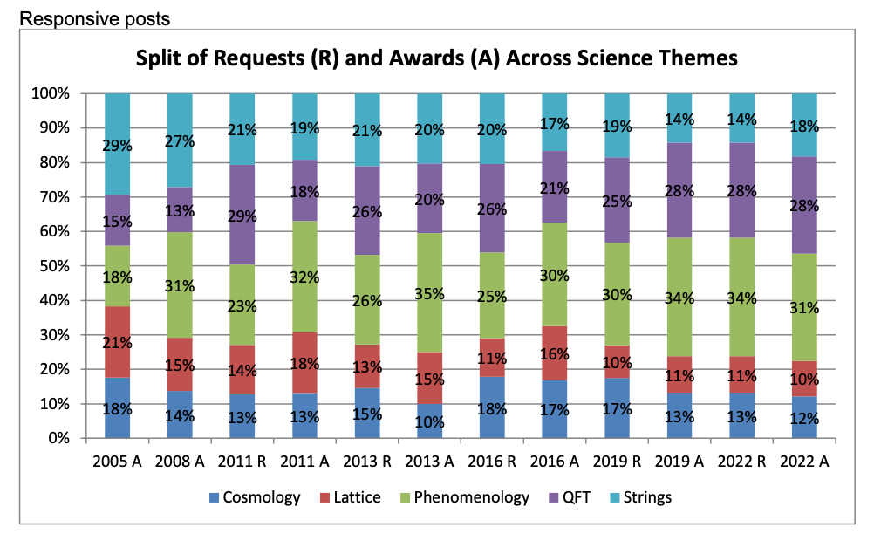
Current program
Evolution of the program judged from % FTE per area from the CG
Talk of Helen O'Keeffe IOP Town Meeting April 2022
https://tinyurl.com/ypv7vs64
Talk of Nick Evans PPAP meeting September 2023
https://tinyurl.com/yc3d8c28

Slide 11
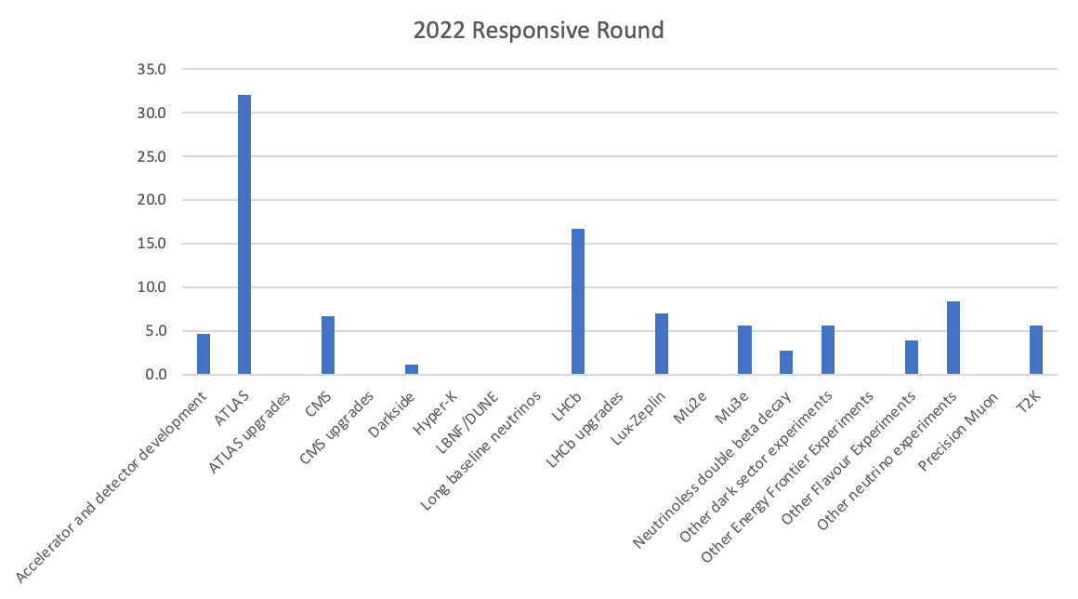
Current Program: 2022 Experimental Uplift

Slide 12
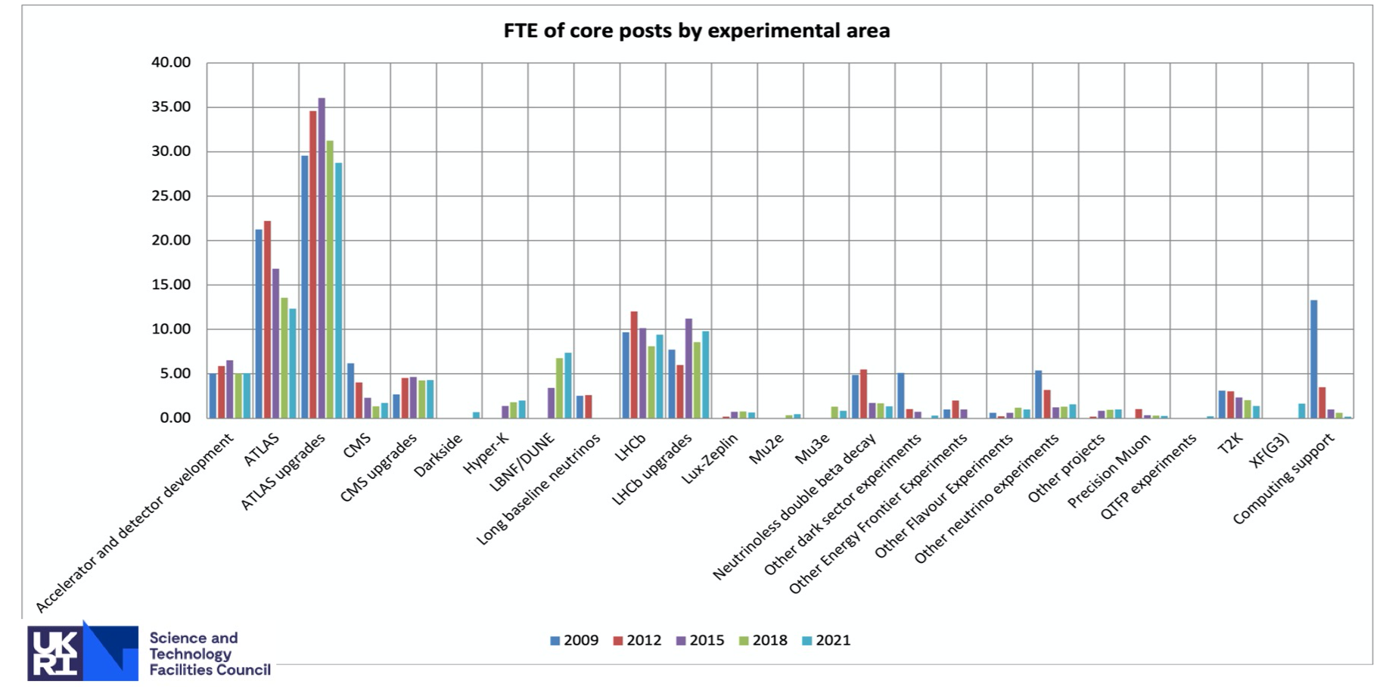
Current Program
Talk of Helen O'Keeffe IOP Town Meeting April 2022​
https://tinyurl.com/ypv7vs64​
​

Slide 13
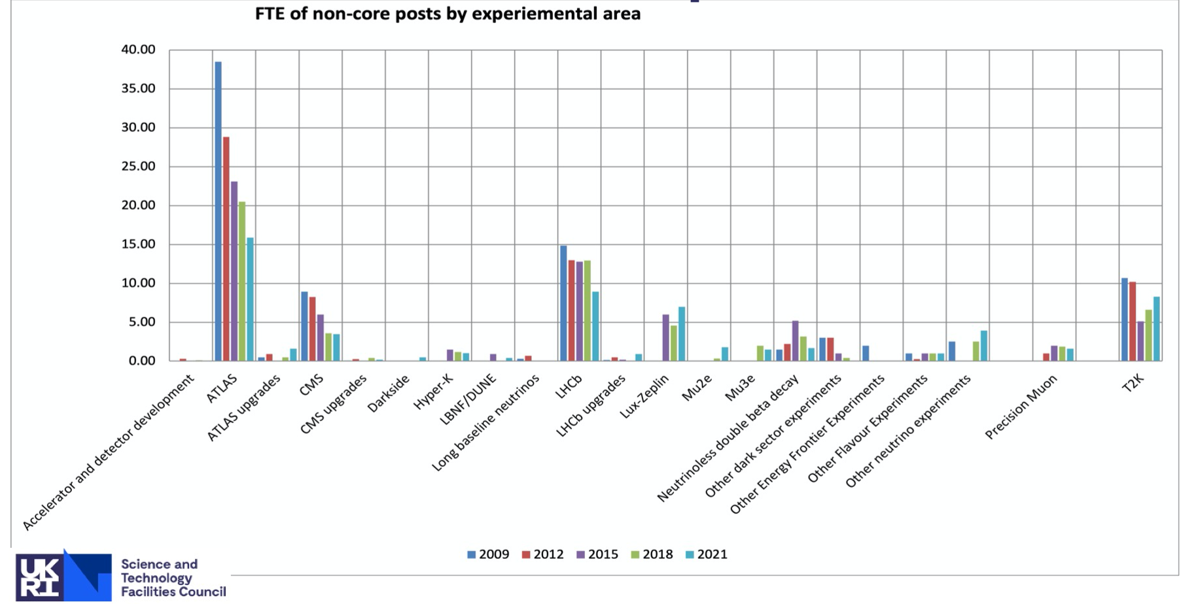
Current Program
Talk of Helen O'Keeffe IOP Town Meeting April 2022
https://tinyurl.com/ypv7vs64​​

Slide 14
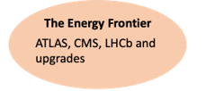
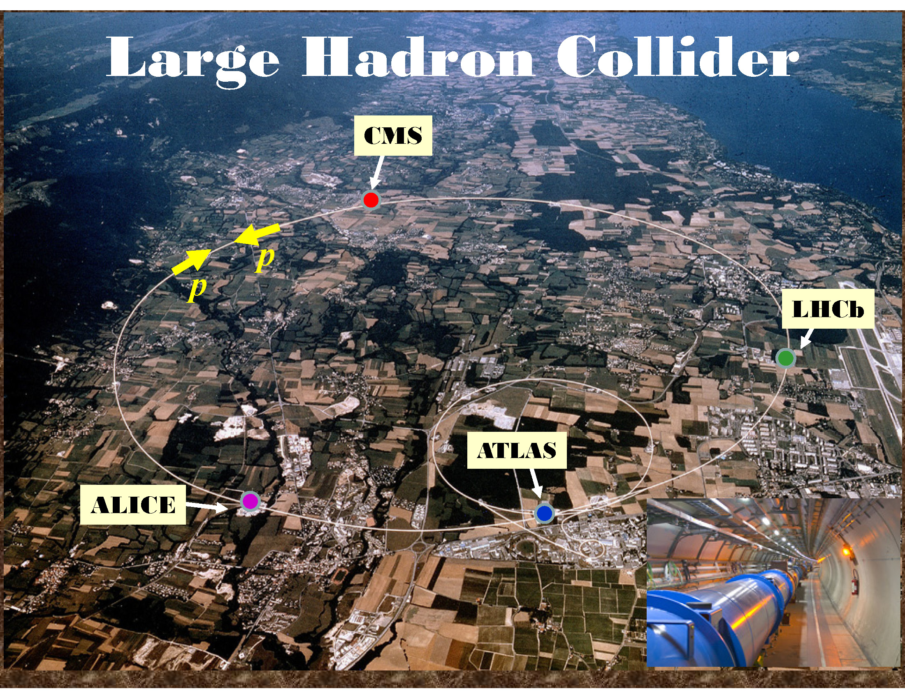
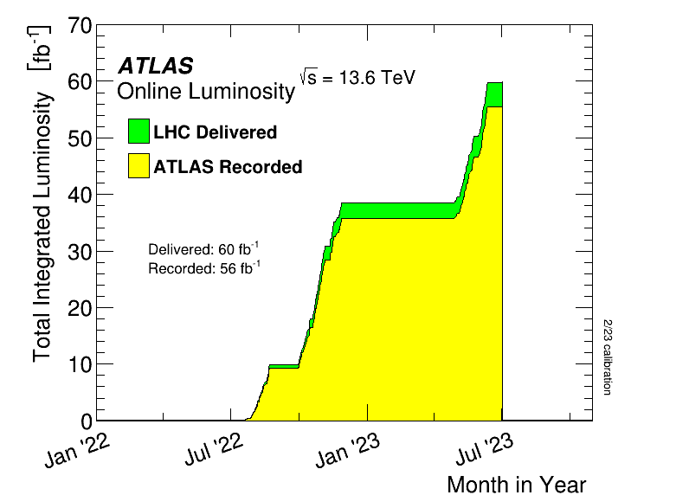
Energy frontier
LHC restarted in July 2022 for its Run 3 at a com energy of 13.6 TeV
~ 60/fb delivered so far (Run 2: ~140/fb)
Hit by cost of energy crisis in all EU..
But also FASER, SND@LHC, MOeDAL.

Slide 15
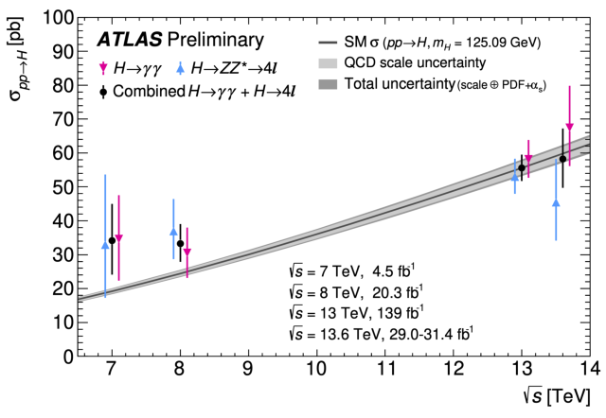
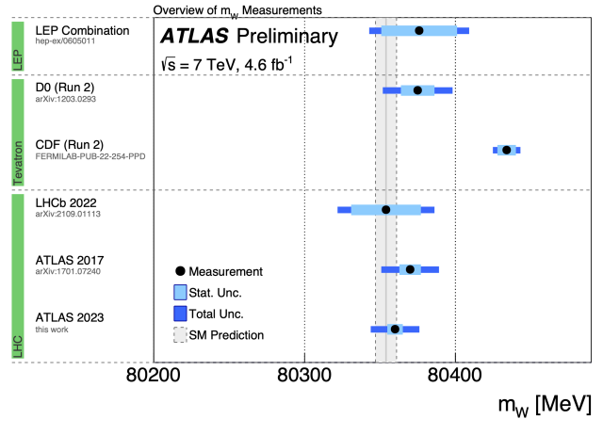
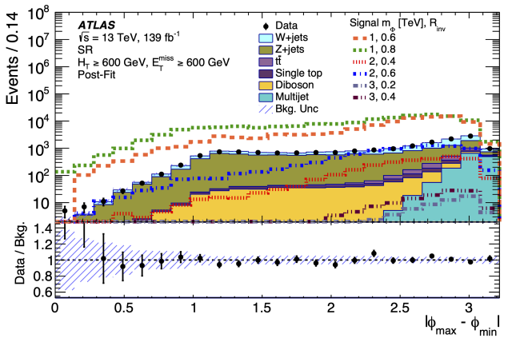
ATLAS
In UK: 15 Institutes, ~ 400 active members,
~ 150 students
Large involvement from UK community in key areas and leadership → continues to be integral part of the collaboration
Some recent highlights
Novel searches for new physics – e.g. signature sensitive to dark-matter possibly produced inside a normal SM jet: semi-visible jets
Dedicated precision studies to reduce further uncertainties on the W mass:
Fantastic results achieved using Run 3 data to measure the Higgs boson production cross section at 13.6 TeV
m_{W} = 80360 MeV+/-16 MeV

Slide 16
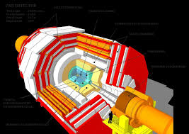

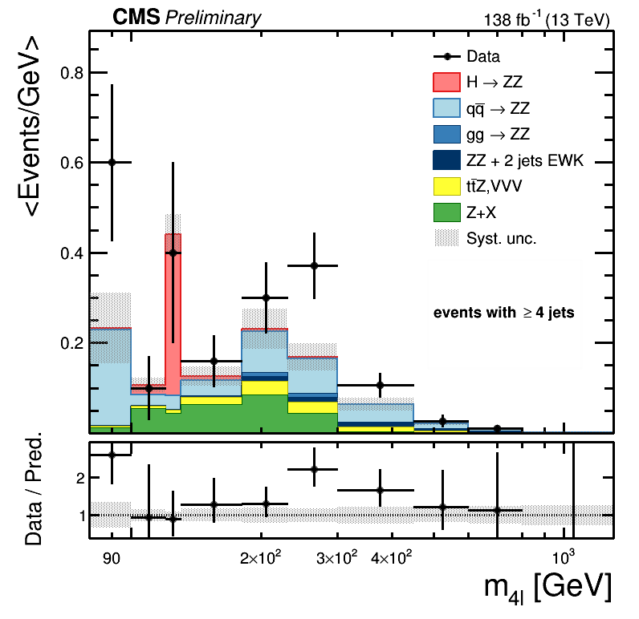
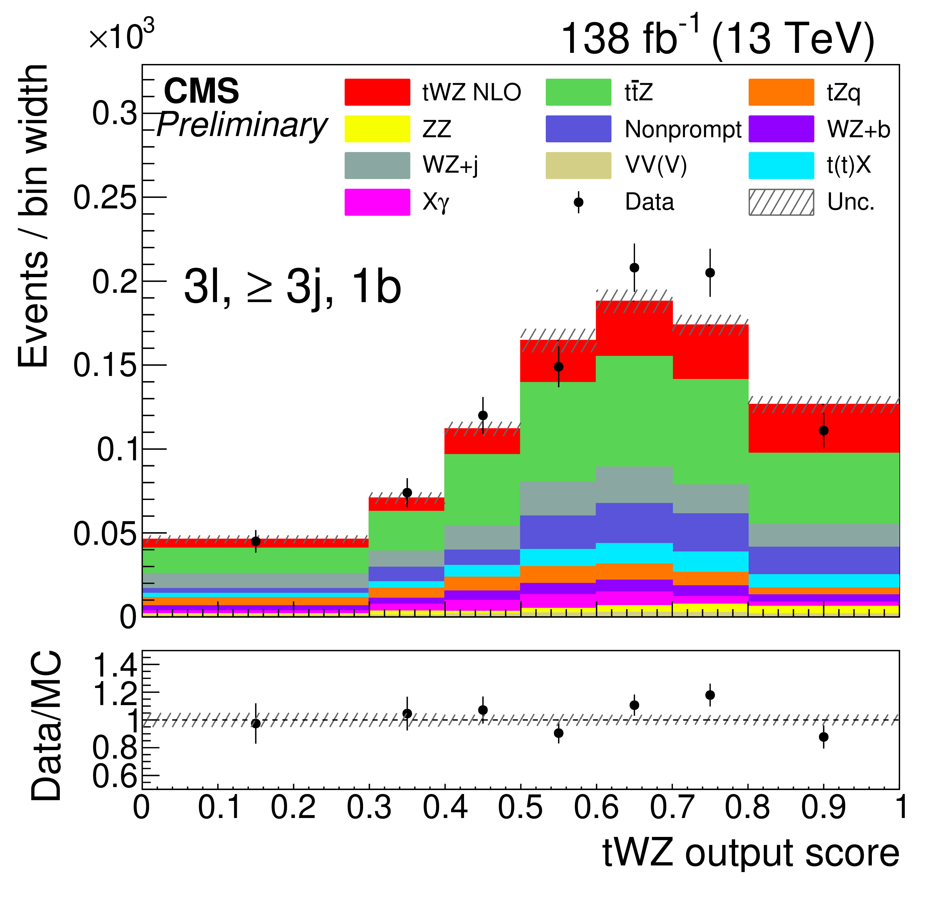
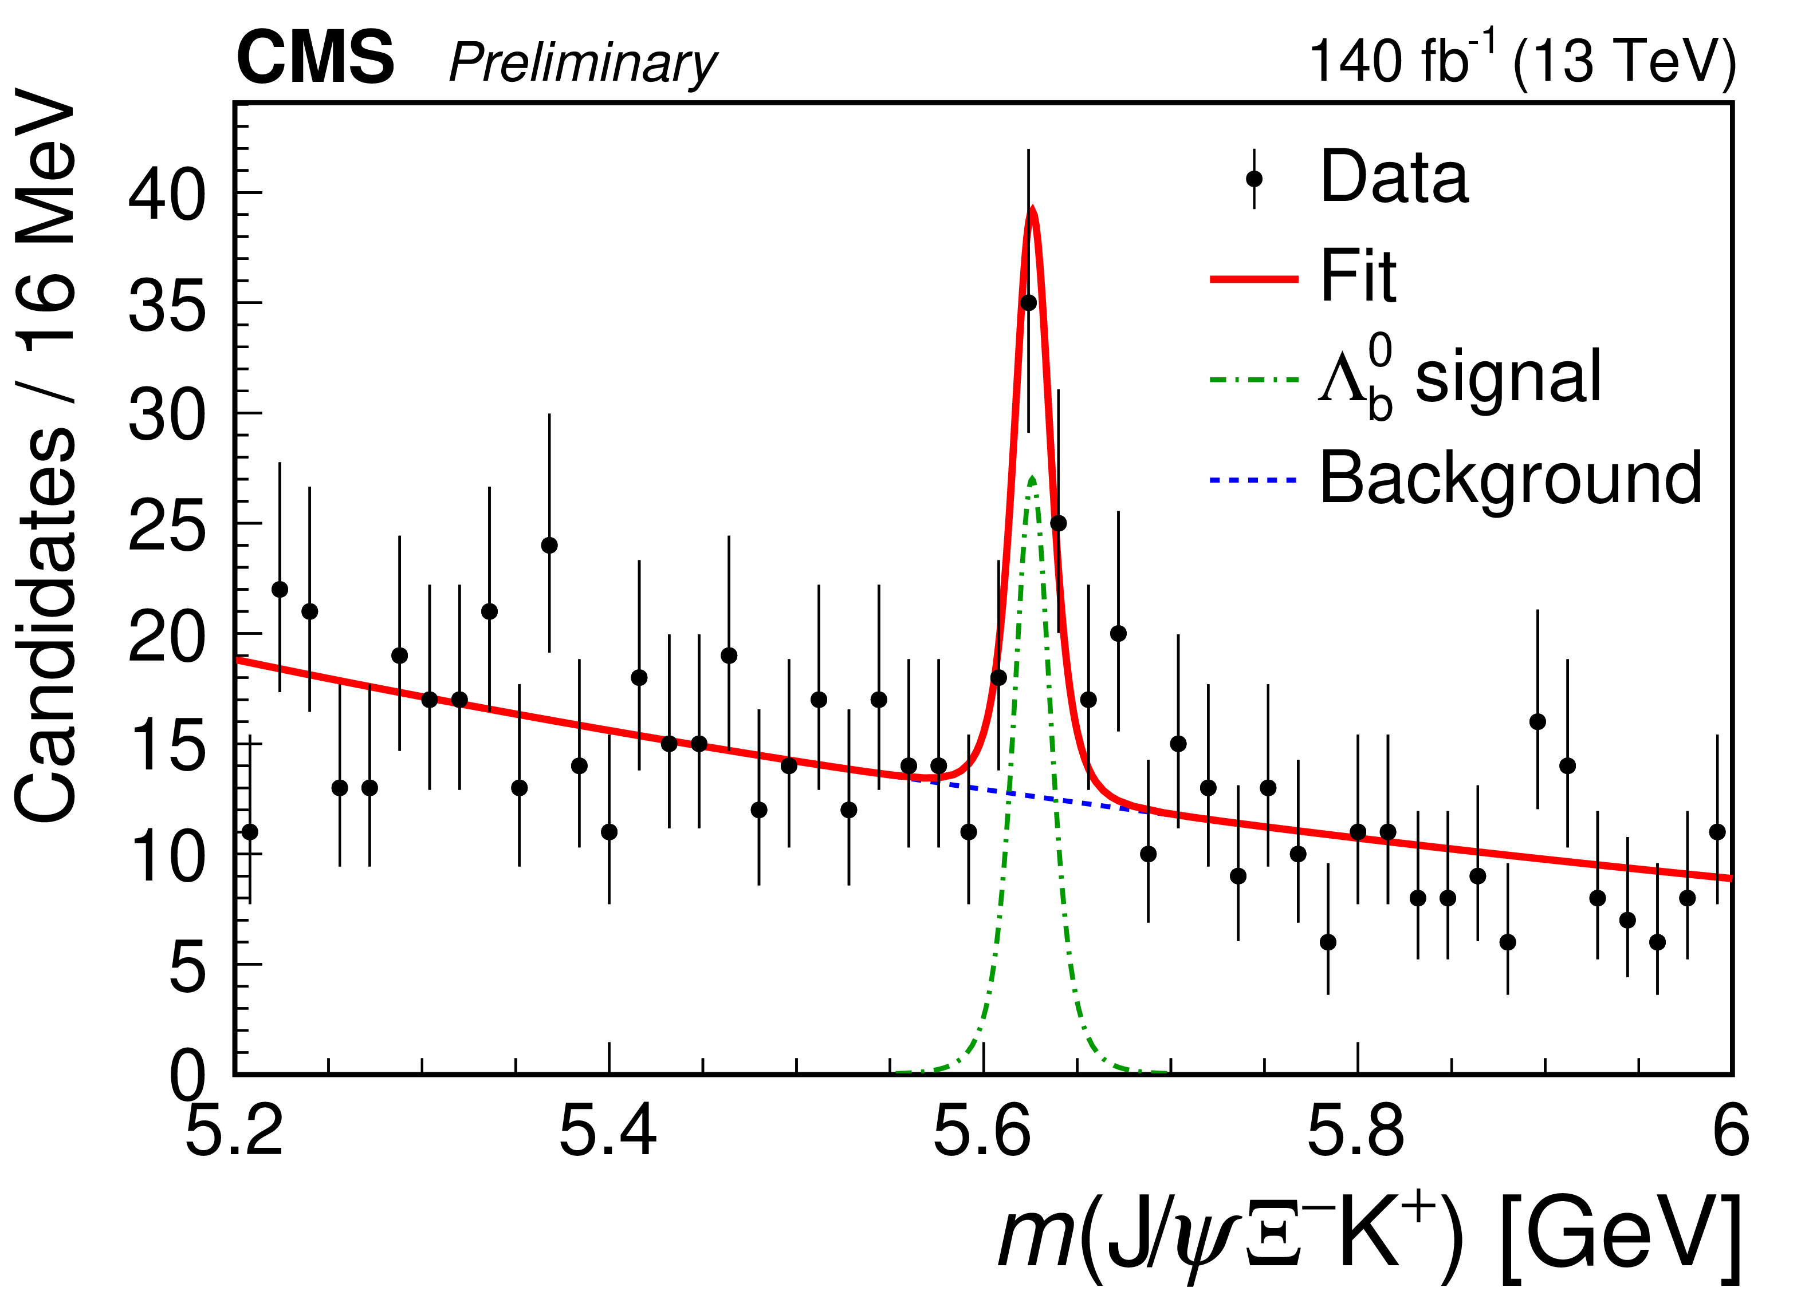
CMS
In UK:
Dedicated community working on data analysis and detector maintenance, with crucial expertise in key areas, e.g. ECAL:
4 Institutes, ~120 active members and ~25 students
https://cms.cern/news/problems-and-solutions-ecal-leak-story
Some recent highlights
UK experts able to patch up the problem and guarantee data taking in 2023
ZZ+jets production
Evidence of tWZ production
Observation of

Slide 17
Towards HL-LHC: ATLAS and CMS upgrades
See also Jon's talk CERN up to 2040
HL-LHC is a key part of both European and UK forward strategy
PPAP Roadmap:
Phase II upgrades of the ATLAS and CMS detectors for HL-LHC on-going at full steam - and LS3 is fast approaching (~ 2 years) as well as construction, commissioning and integration before 2029.

Slide 18
Towards HL-LHC: ATLAS and CMS upgrades
See also Jon's talk CERN up to 2040
ATLAS (major UK deliverables):
All new inner tracking detector ITK (strips and pixel)
Upgrades of Muon, LAr and Tile Calorimeters
Upgrade TDAQ System (DAQ, Event trigger & filter)
Computing (offline software, simulation, reconstruction)
High Granularity Timing Detector
ITK
TDAQ
CMS (major UK deliverables):
Tracking detector to be completely replaced (UK developed idea of L1 tracking, frontend ASIC and FPGA)
Upgrades of the Calorimeters (Barrel and Endcap)
L1-Trigger/HLT/DAQ
Muon system
MIP Detector System
Barrel ECAL
UK part of Serenity, used for L1 Trigger, HGC and tracker

Slide 19
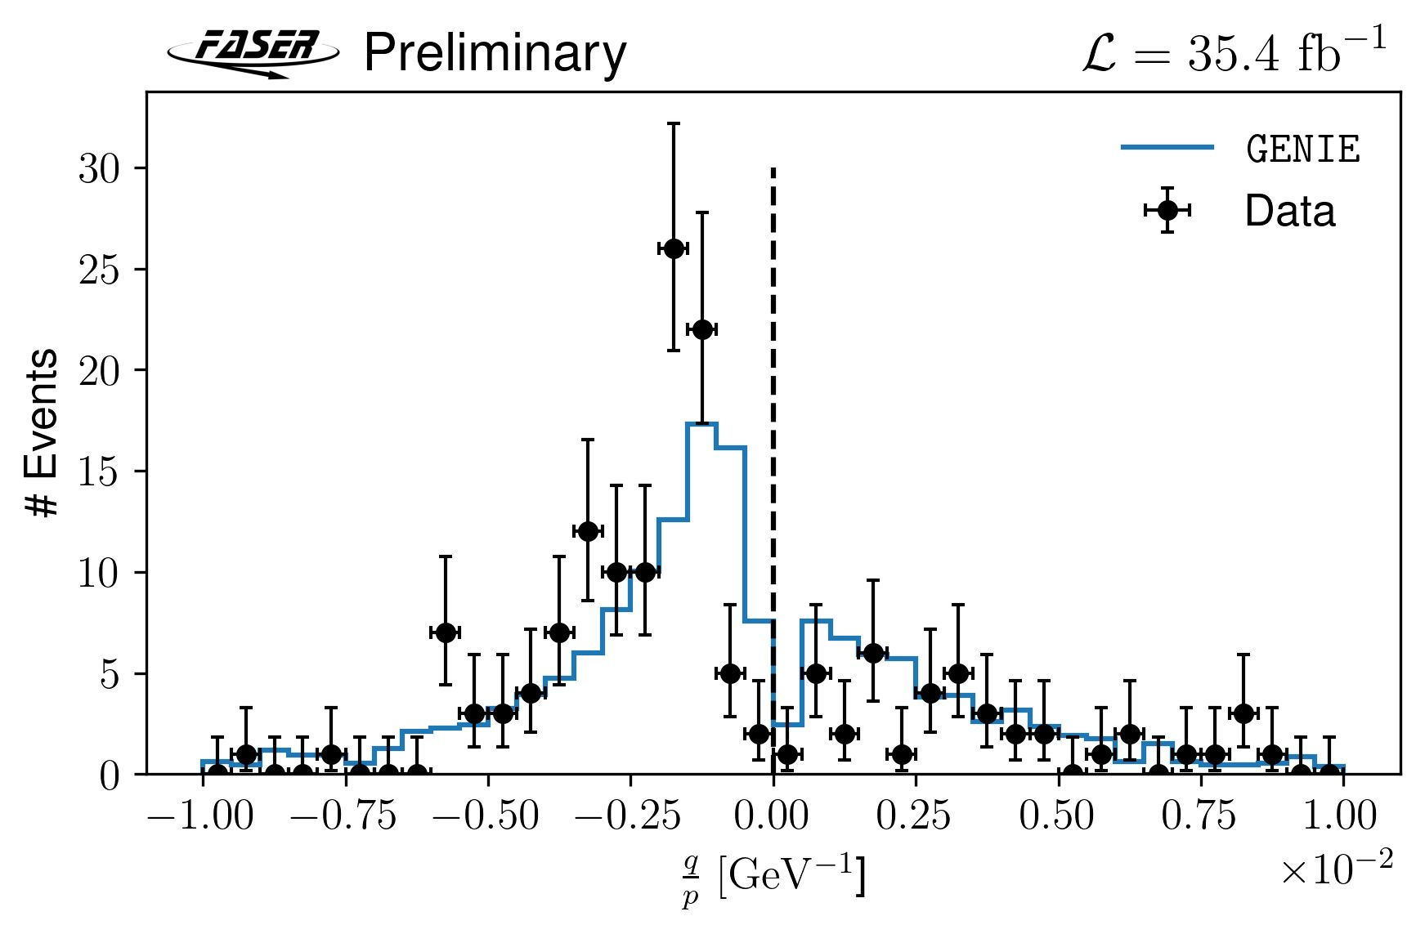
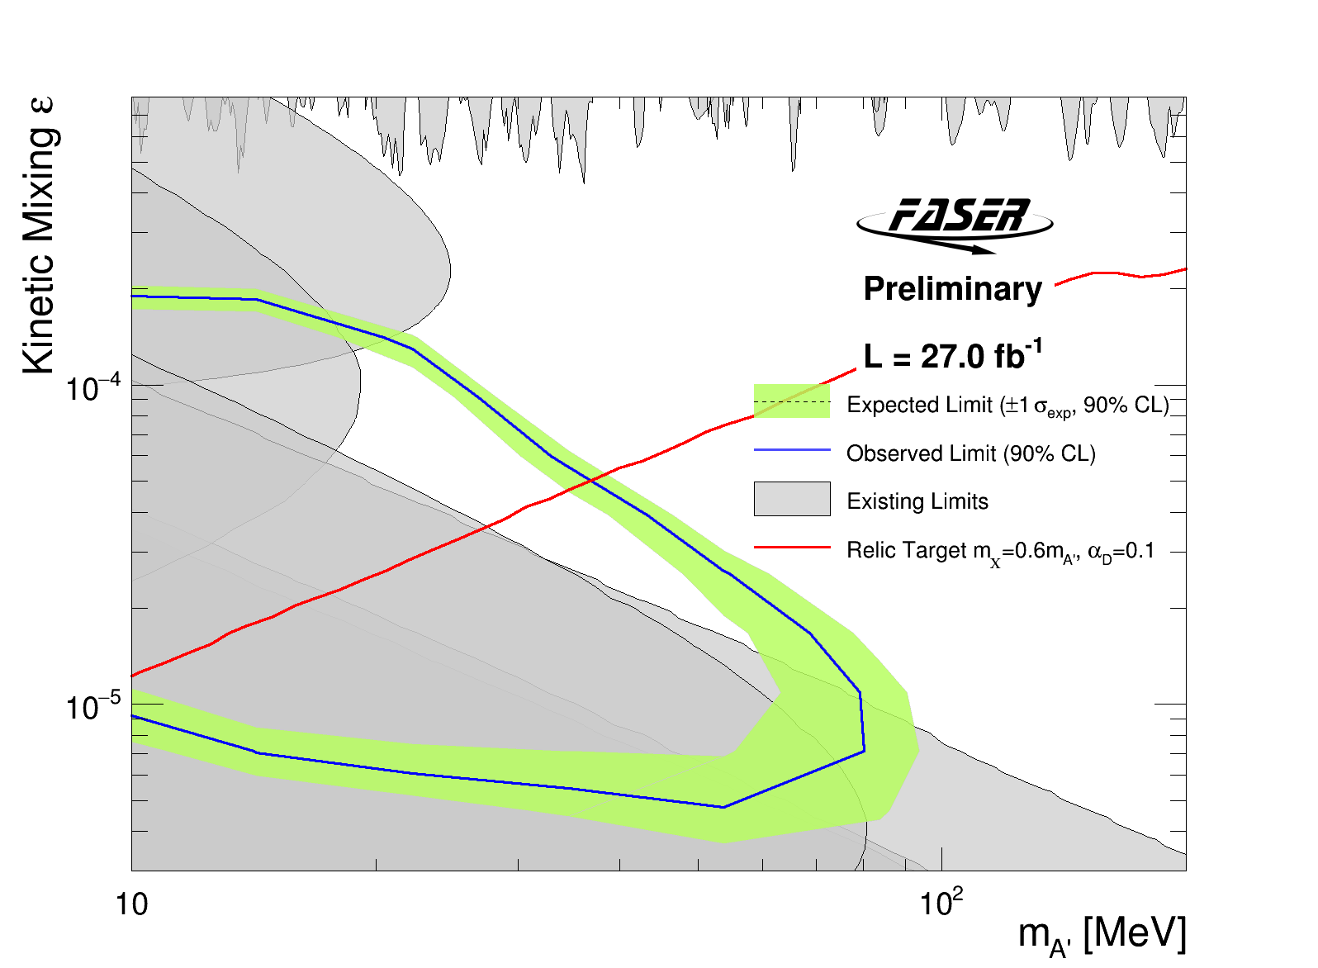
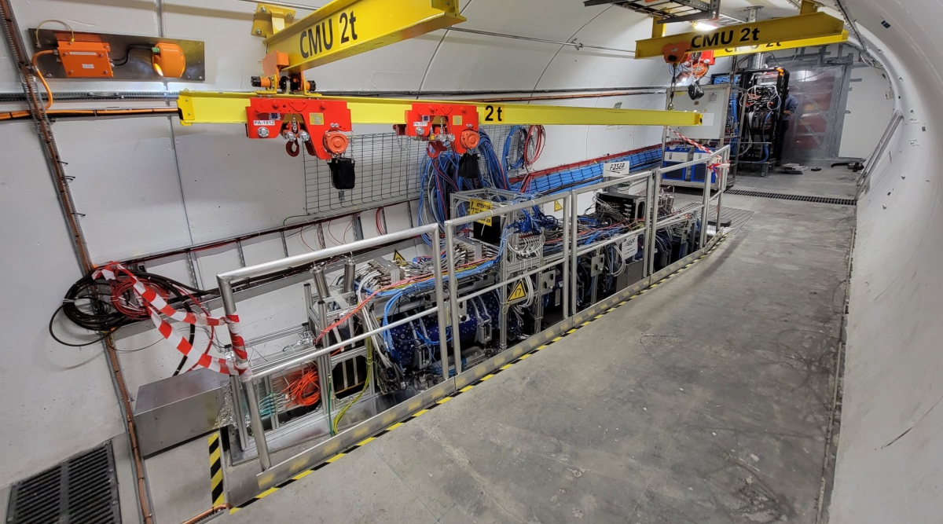
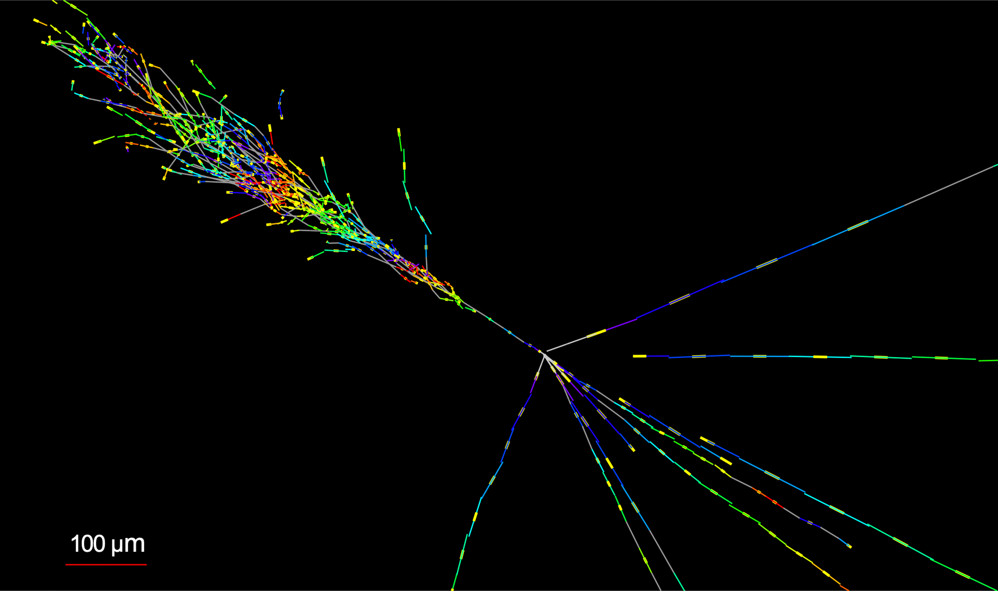
Beyond GPDs: FASER and SND@LHC
FASER + FASERν
Dark photon search
direct detection of collider neutrinos:
153 events → , ,16σ
arXiv:2303.14185
In UK: Liverpool, Sussex,
RHUL, Manchester
-ve muons
→ ν_{μ}
+ve muons
→ anti ν_{μ}
νe-like candidate CC event
Analysis of FASERν emulsion detector underway
CERN-FASER-CONF-2023-001
SND@LHC
In UK: UCL, Imperial
https://arxiv.org/abs/2305.09383
See also Jon's talk for MOedal, future Facility and more beyond GPDs

Slide 20
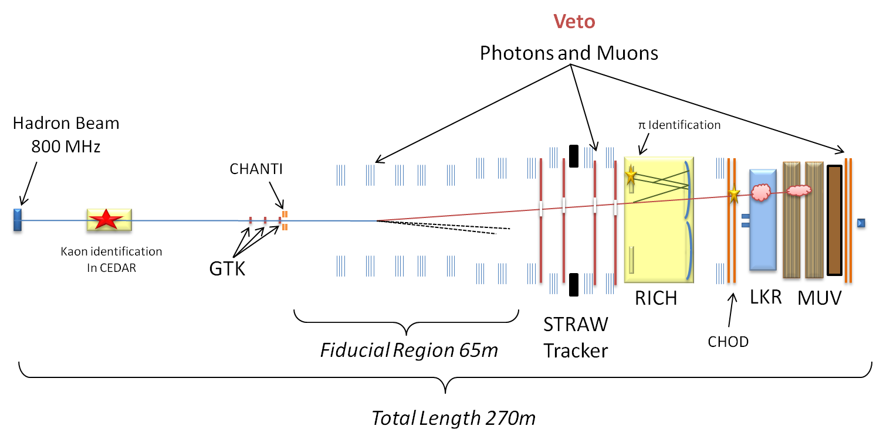
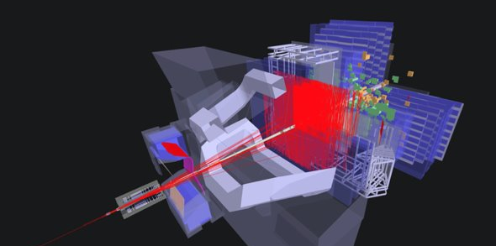
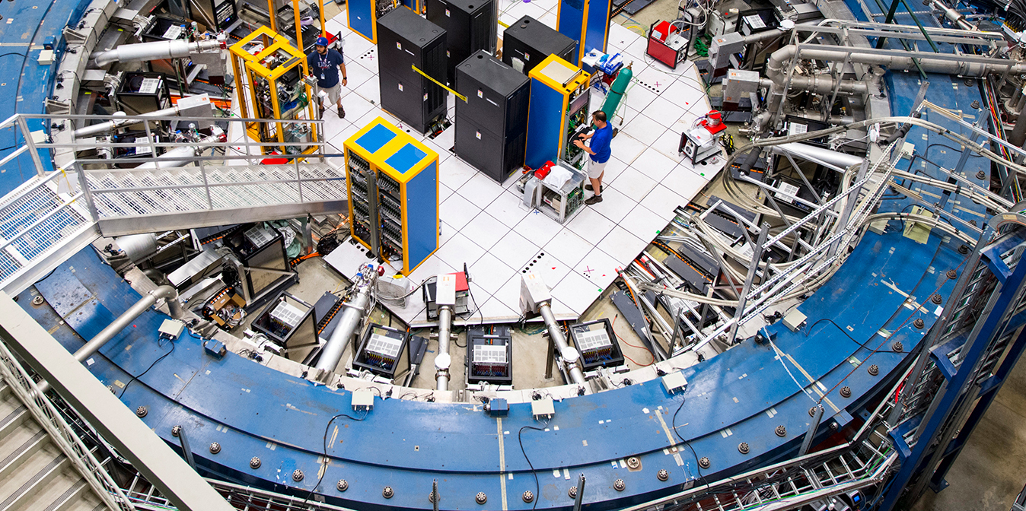
Flavour physics
UK involved in main quark and charged lepton flavour experiments
  Mostly funded through STFC PPGP/PPRP with significant additions from fellowships and other grants (esp. BESIII and NA62)
Recent top-level leadership in several experiments
  Muon g-2 Spokesperson 2018-20: Mark Lancaster
  NA62 Spokesperson 2019-22: Cristina Lazzeroni
  LHCb Spokesperson 2020-23: Chris Parkes

Slide 21
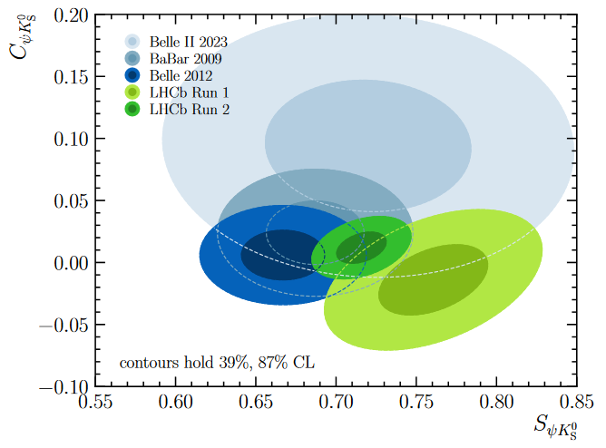
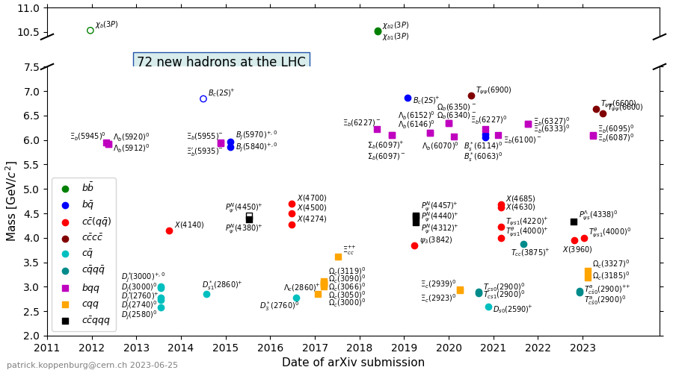
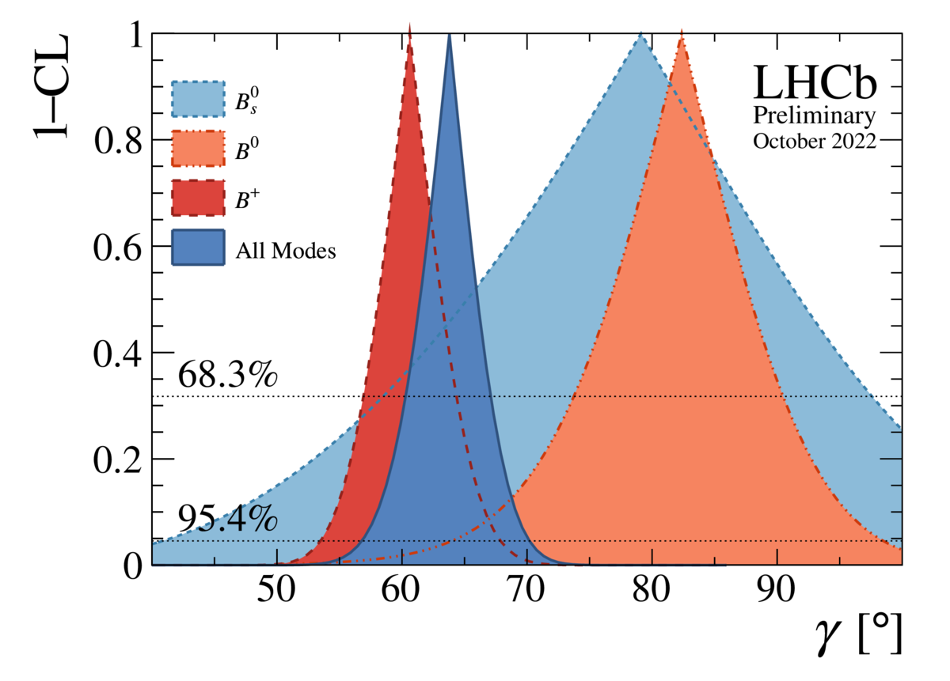
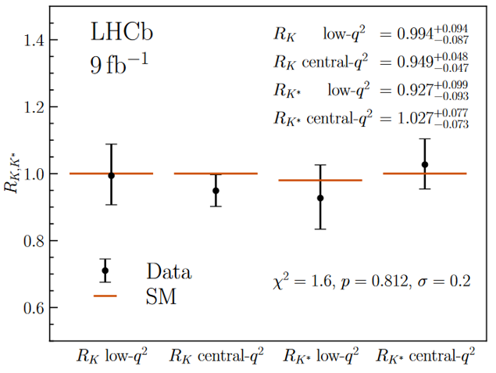
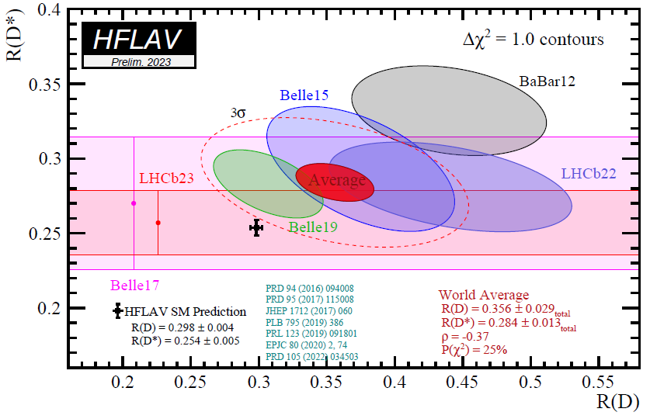
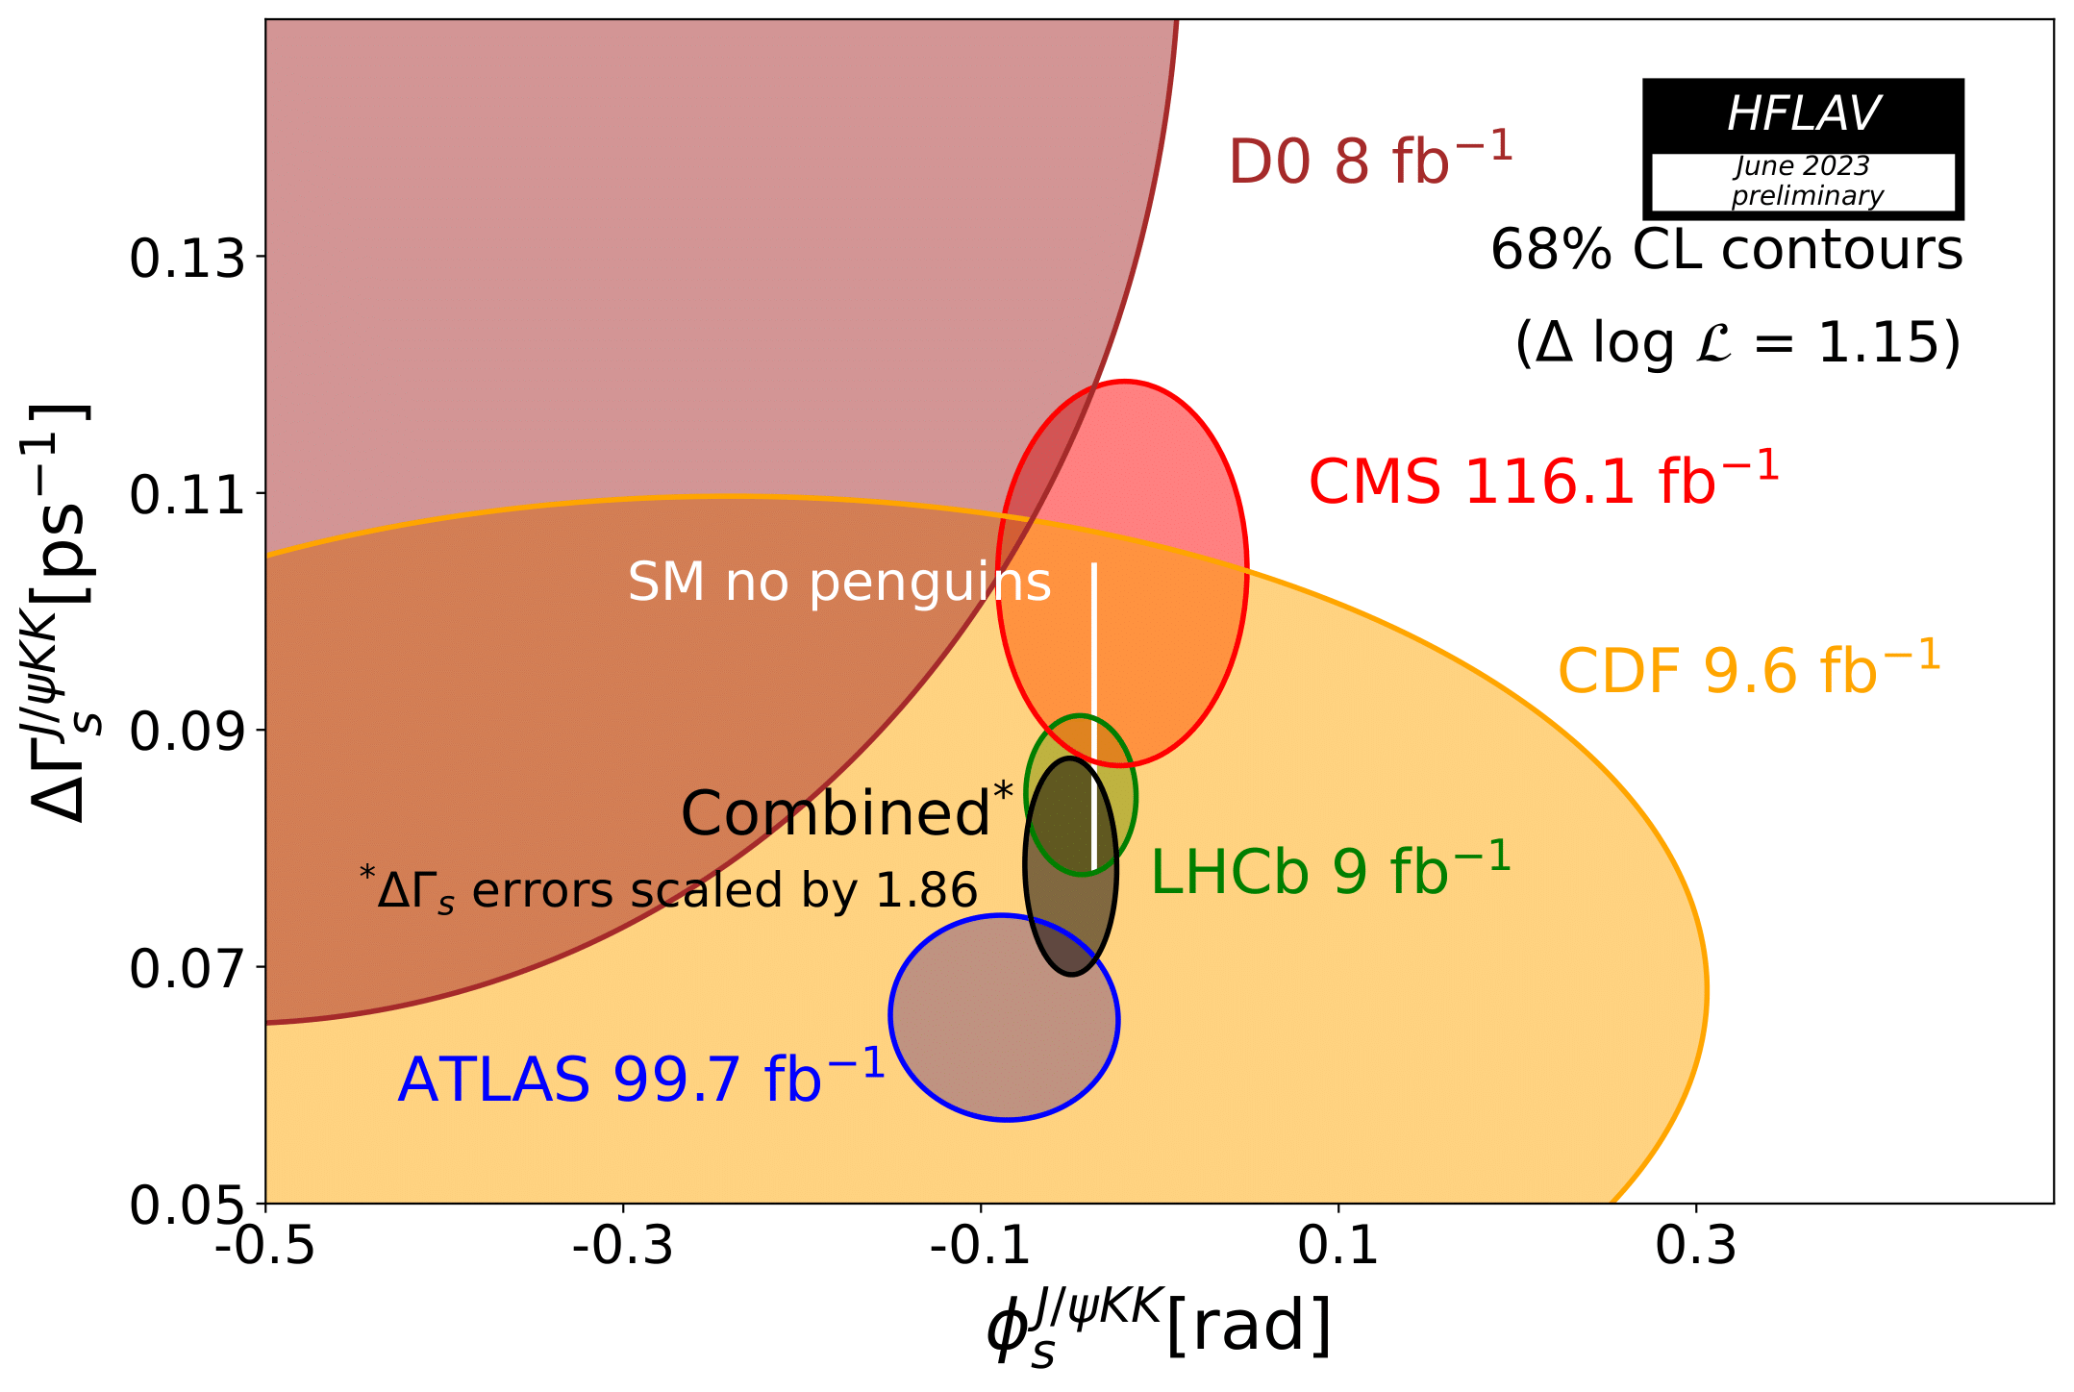
LHCb physics
CKM: sin(2β)
64 new hadrons by LHCb
11 institutes in UK
  +2 joining for Upgrade 2
Many LHCb analyses now on full dataset
CKM: γ
Lepton universality: loop level
Lepton universality: tree level
B_{s} time-dep. CP violation

Slide 22
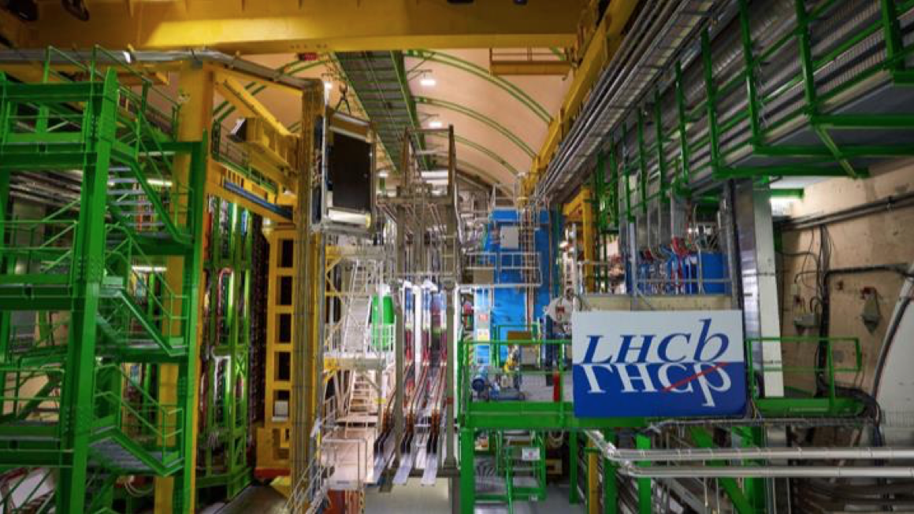
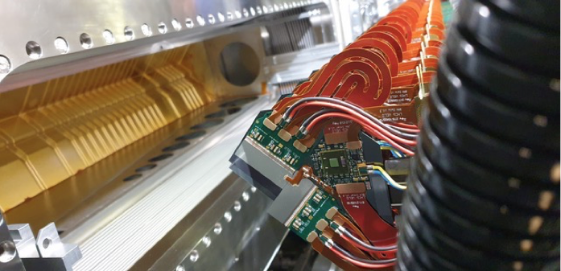
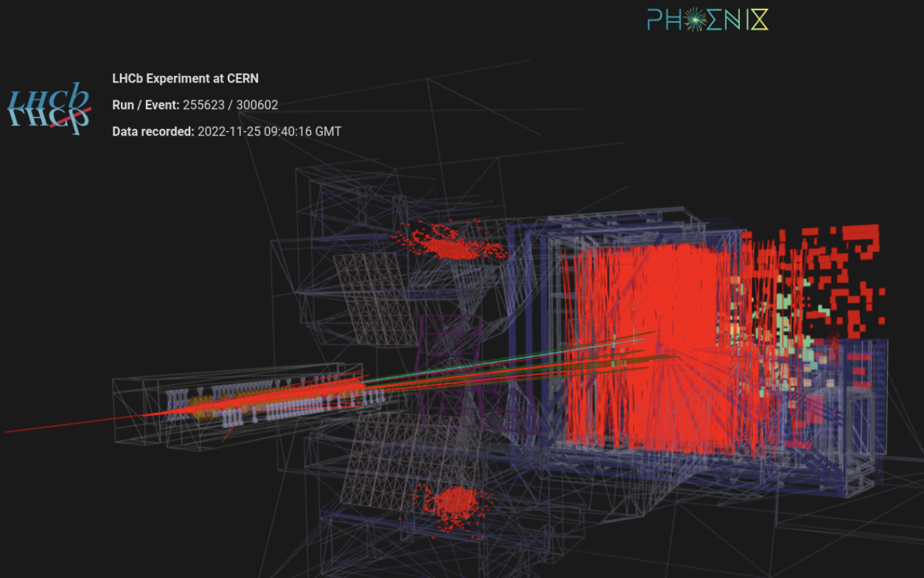
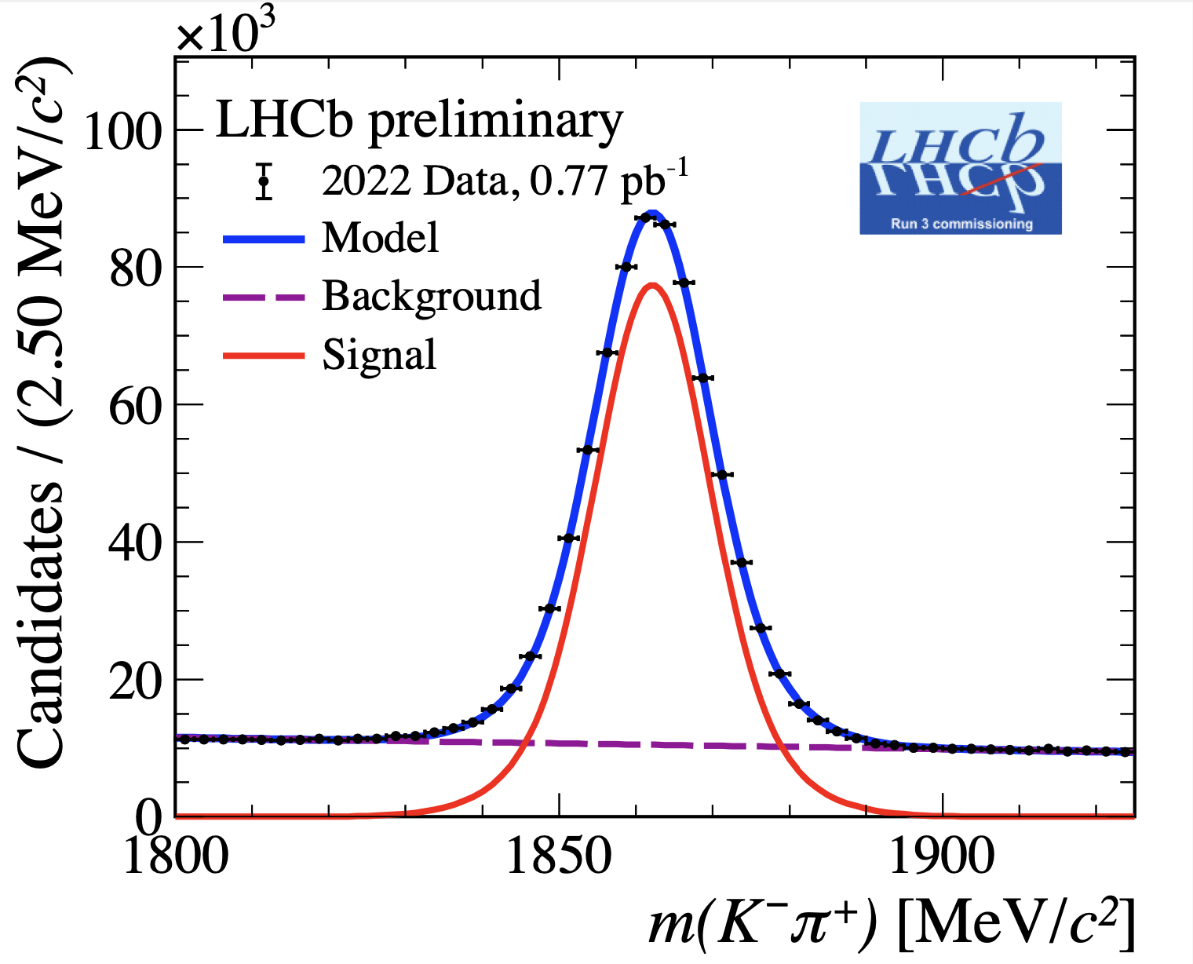
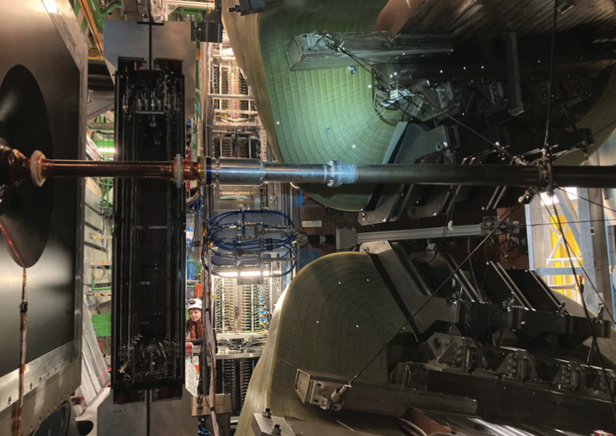
LHCb Upgrade 1
Upgrade affecting all subdetectors to read out at 40 MHz
Detector with higher granularity to maintain/improve performance with higher collision rate
  VELO and RICH with major UK construction contribution
Full software trigger on GPU/CPU
  Avoids inefficient hardware trigger
Installation complete and commissioning progressing well
VELO RF foil to be replaced in year-end technical stop
Complete Upgrade 1 detector
VELO installation
Proton-Ar collisions with SMOG2 injection
UT installation

Slide 23
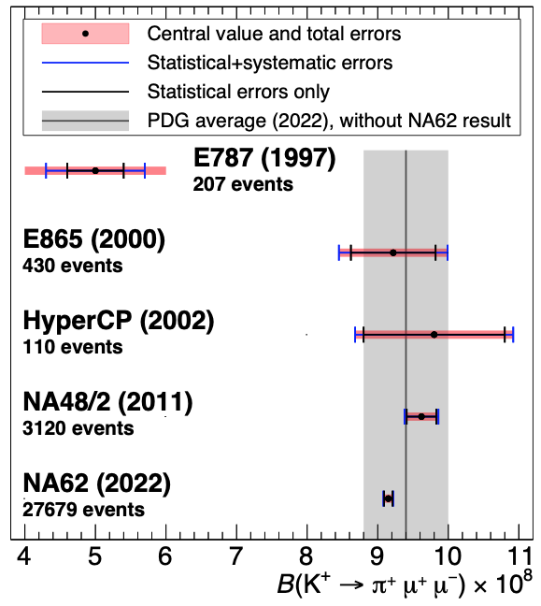
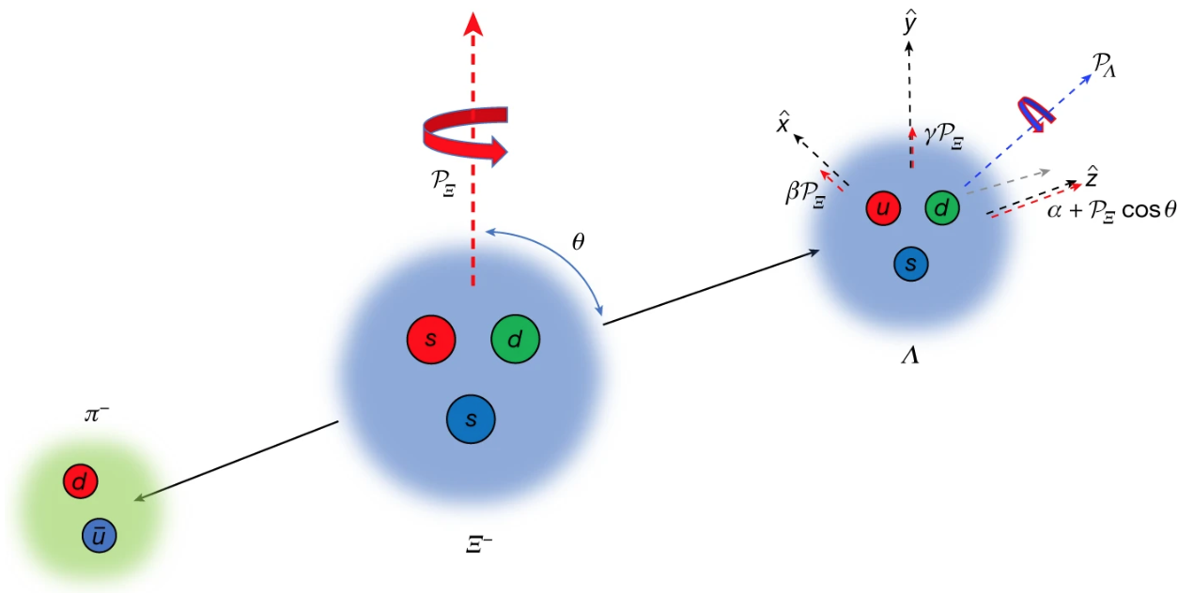
NA62 and BESIII
NA62: Fixed target ultra-rare kaon experiment at CERN SPS
Obtained evidence for K⁺→π⁺νν̅ with 2016-18 data
  Aim to collect 100 events assuming SM BF
Many other analyses of rare K⁺ decays
In UK: Birmingham, Bristol, Glasgow, Lancaster, Liverpool
JHEP 06 (2023) 040
BESIII: Charm threshold e⁺e⁻ collider experiment in Beijing
Unique access to quantum-entangled charm mesons
  Important input to LHCb analyses of charm mixing and CKM angle γ
Recent measurement probing CP violation in phase difference of baryon decay amplitudes
In UK: Manchester, Oxford
Nature 606 (2022) 64.

Slide 24
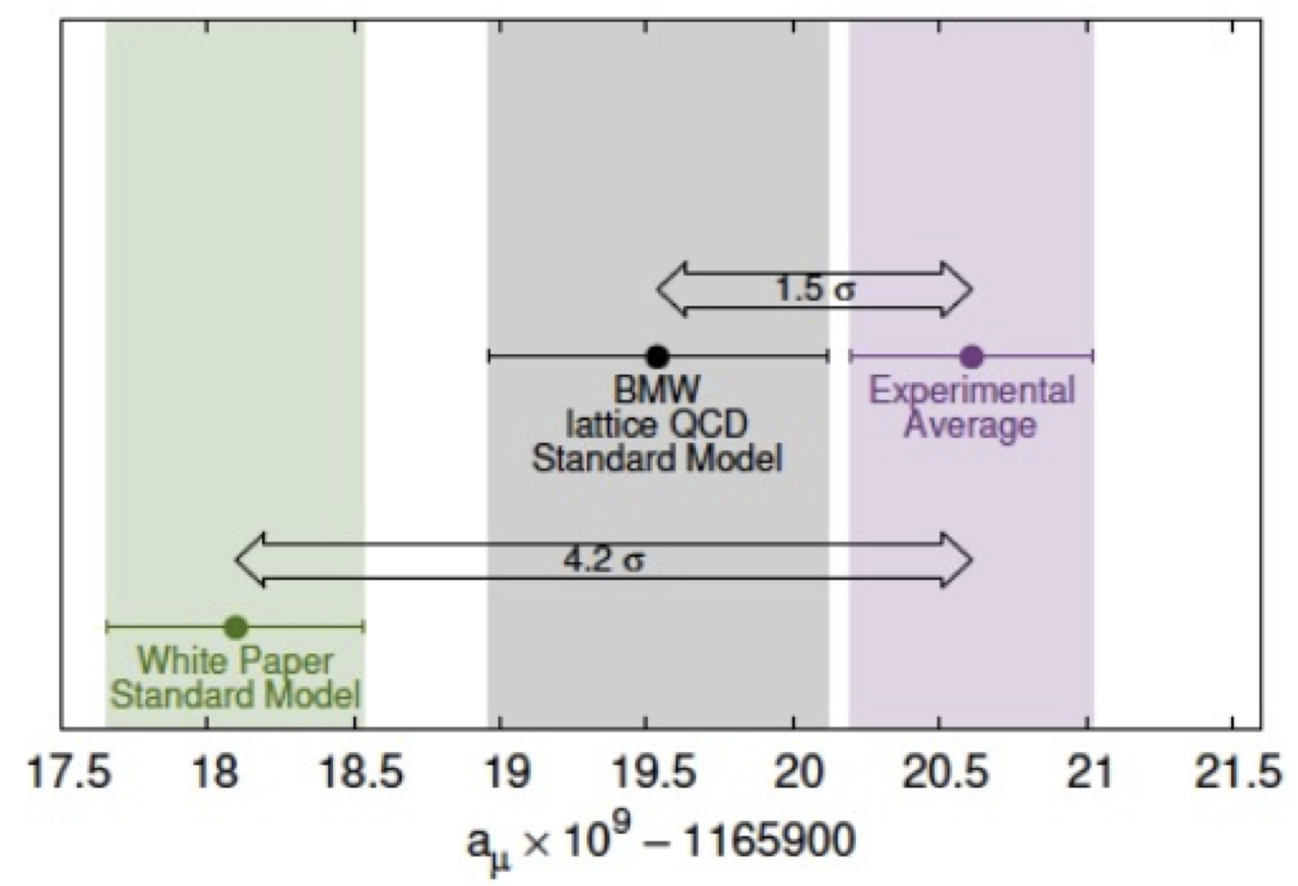
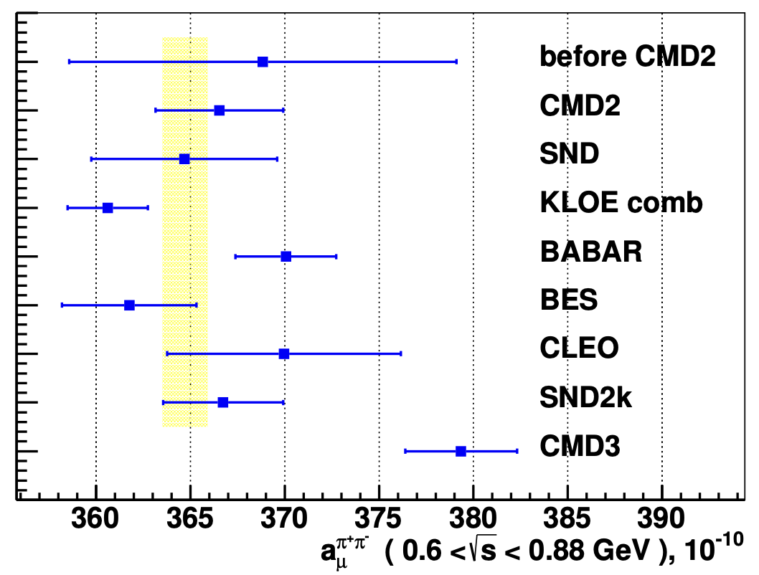
Muon physics
Lancaster, Liverpool, Manchester, UCL
Muon g-2 (FNAL): First result triggered major theory work and auxiliary measurements. Analysis of further runs ongoing with next release anticipated in late summer 2023.
COMET (J-PARC): First Phase-α data taking in March 2023. Phase-1 physics run to follow in JFY 2024.
Mu2e (FNAL): UK-led Stopping Target Monitor development and integration ongoing with aim of physics run starting in 2026.
Mu3e (PSI): Recent beam test of MuPix11 sensors. Detector installation beginning this year with aim of physics run starting in 2025.
Imperial, RAL
Liverpool, Manchester, UCL
Bristol, Liverpool, Oxford, UCL

Slide 25
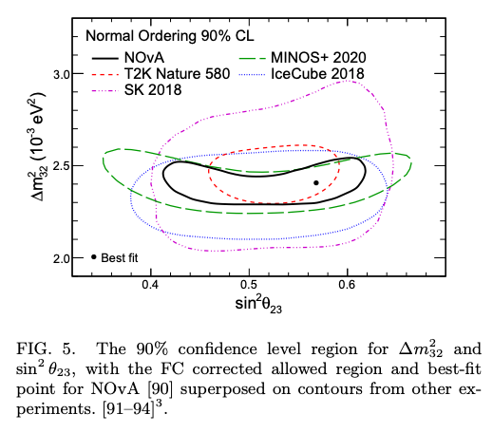
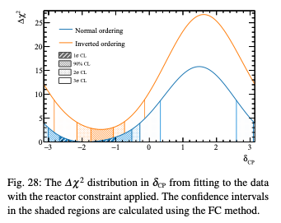


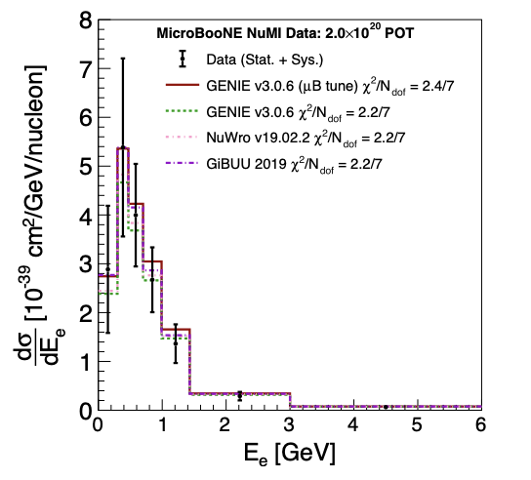

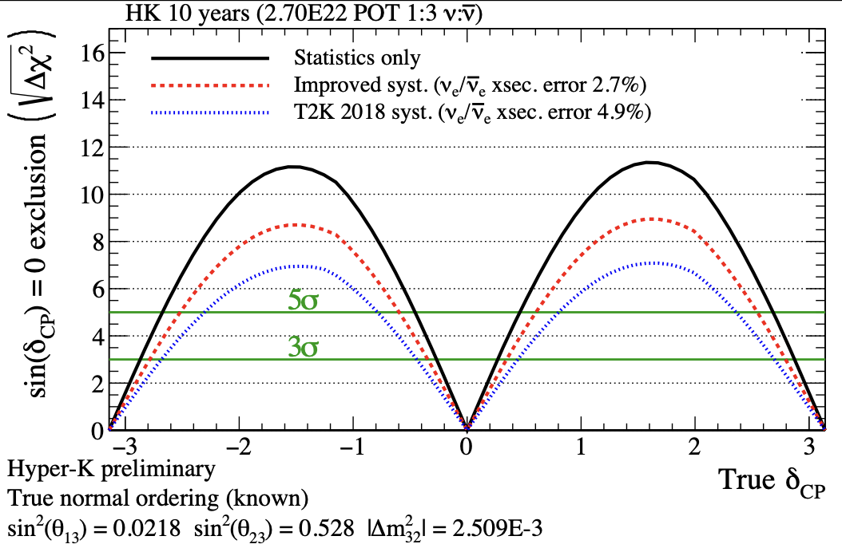

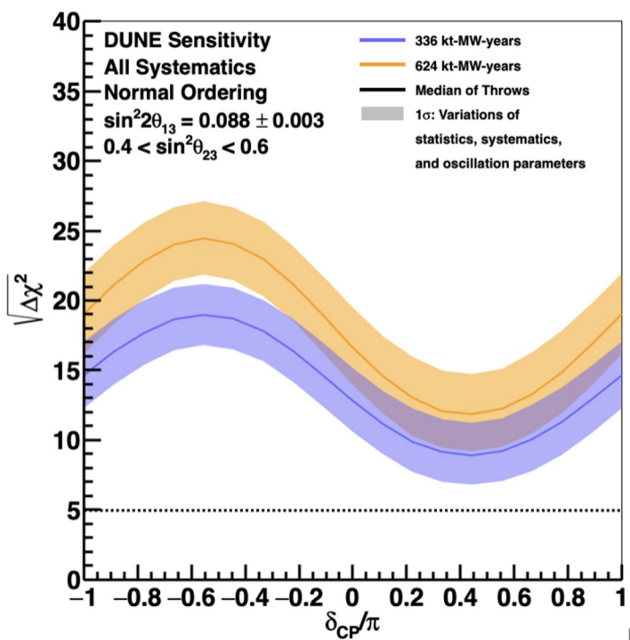

Long (and short)-Baseline Neutrino Experiments
Use neutrino and antineutrino beams to make measurements of
  PMNS matrix elements (including δ_{CP})
  interaction cross-sections
  mass ordering...
Searches for sterile neutrinos, other exotic phenomena.
Physics exploitation: T2K, NOvA, MicroBooNE (and soon SBND).
Construction of next-generation experiments is in progress: DUNE and Hyper-Kamiokande
UK members hold top-level (international) and numerous other leadership roles in these current and future experiments.
Phys. Rev. D 106, 032004 (2022)
arxiv:2303.03222 [hep-ex]
See talk by Jeanne Wilson 7th July
Phys. Rev. D 105, L051102 (2022)
Neutrino 2022 conference talk
Neutrino 2022 conference talk

Slide 26
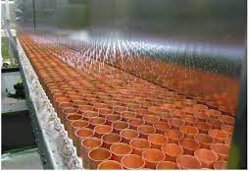
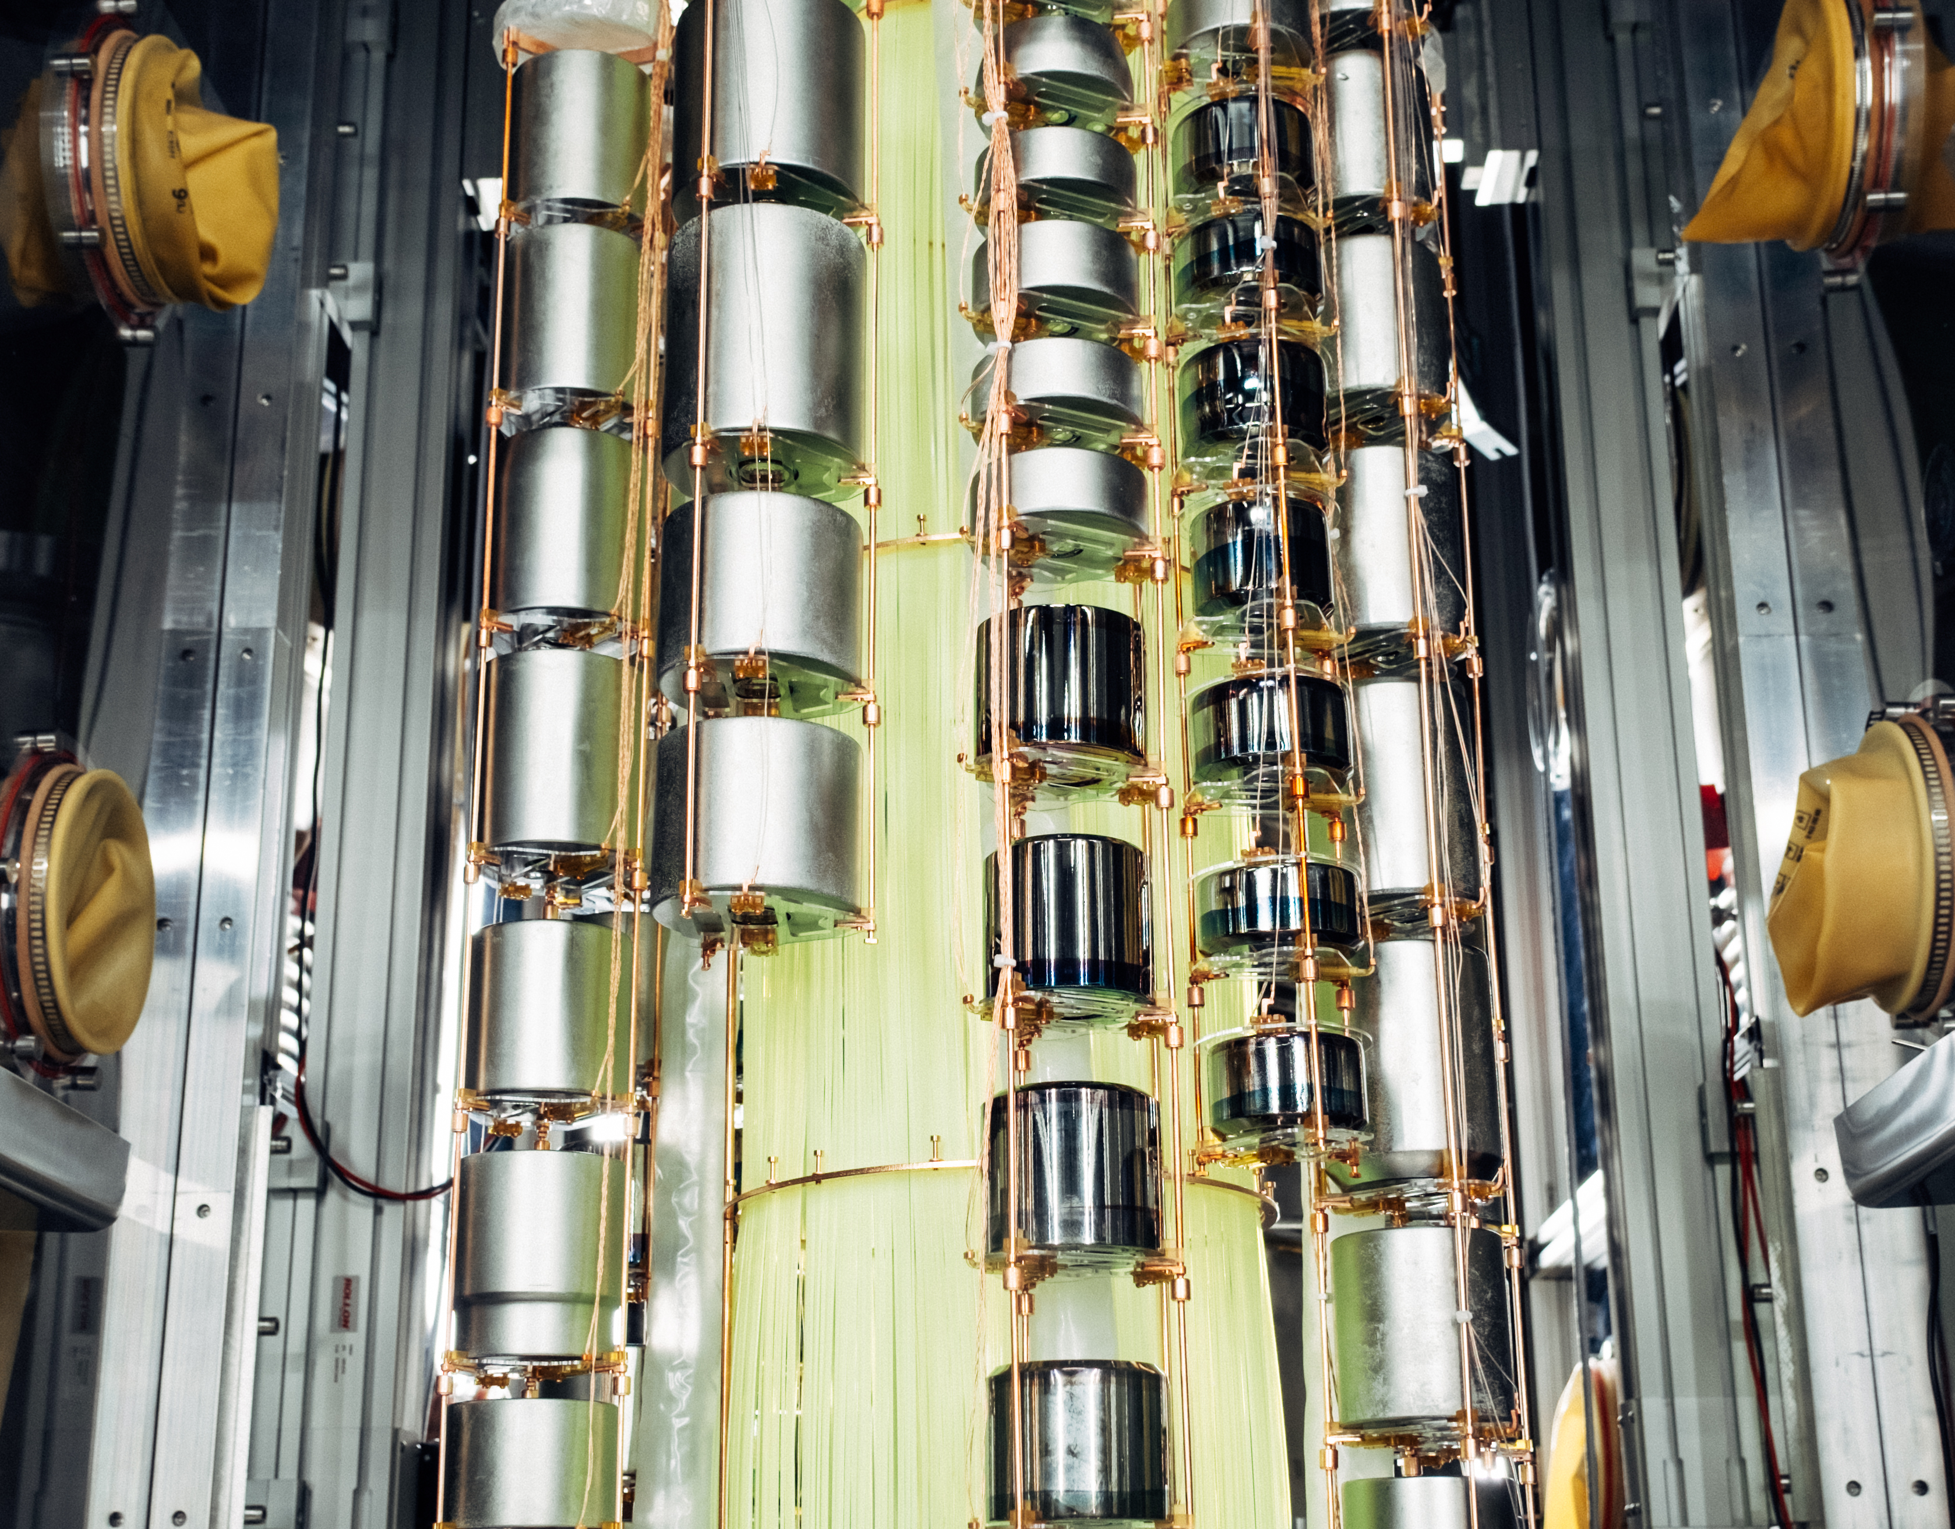

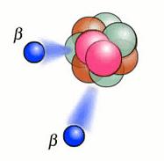
Neutrinoless Double Beta Decay, 0𝜈𝛽𝛽
Best probe for Lepton Number Violation
Sensitive to absolute neutrino mass
Physics exploitation of LEGEND-200, SNO+, SuperNEMO-D
UK community comes together to define strategy to probe Majorana neutrino masses in I.O and N.O parameter space
See Jeanne Wilson talk on 7 July

Slide 27
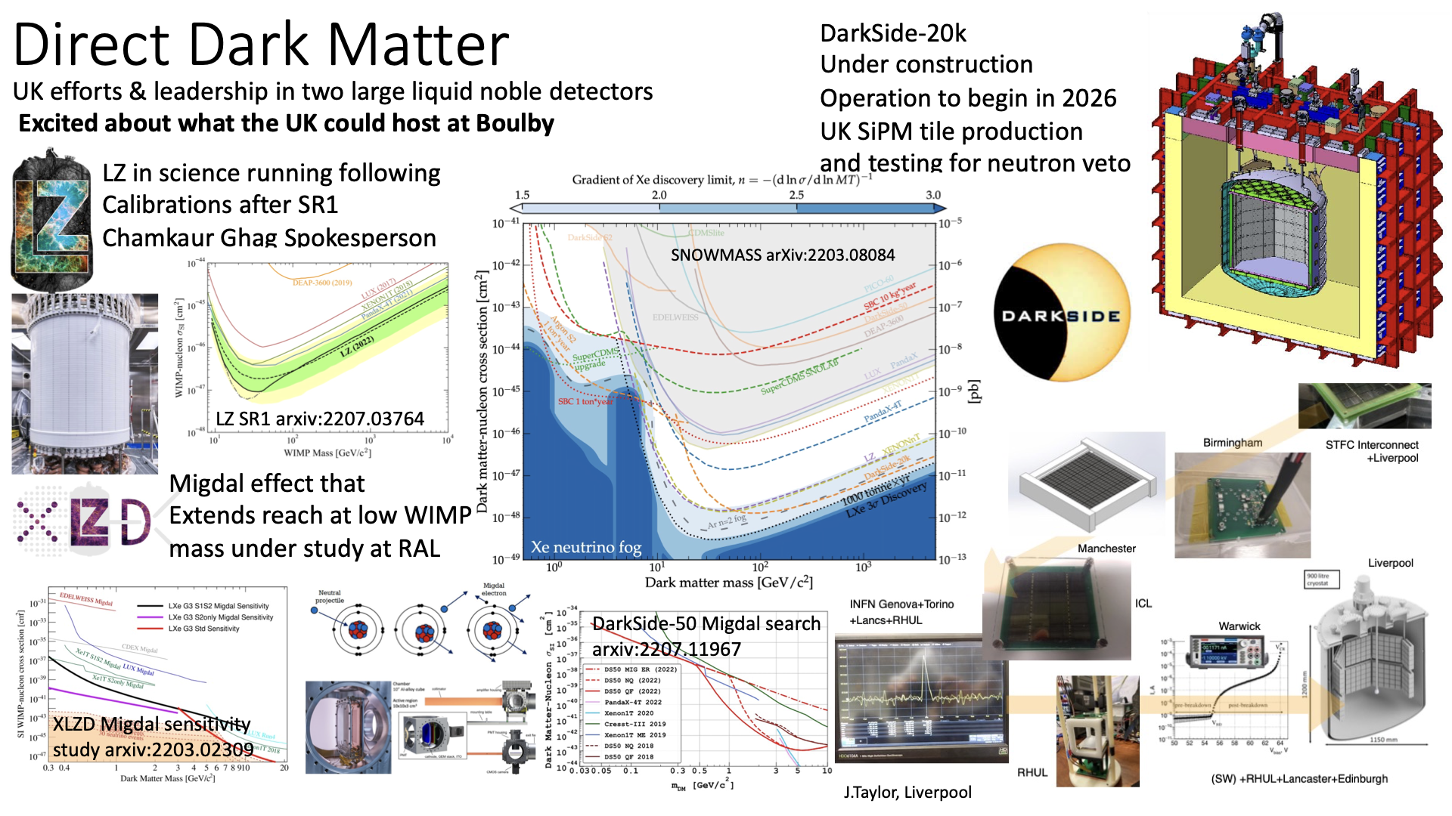

Slide 28
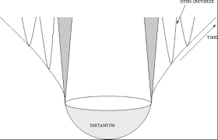
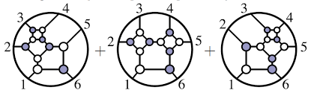
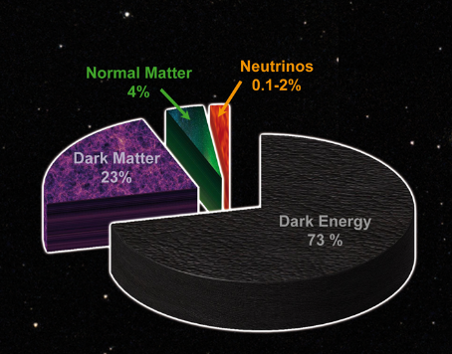


Experiment is still busy confirming the Standard Model…
CFT & QCD amplitude
SM
anomalies
QFT
Pheno
Cosmo Astroparticles
String Theory & Quantum Gravity
Lattice QCD
…
so what are
formal theorists
up to…?
Dark Matter/Dark Energy
Bootstrapping& Amplitude for Gravity
Gauge/gravity duality

Slide 29
Summary
This meeting has been designed to be forward looking – begin the process of preparing the roadmap and to look ahead to future opportunities
For each area we have asked speakers for short talks and then scheduled time for moderated discussion
We have a vibrant and varied current program and there a lot of excellent future opportunities available to the field. Strategic Review has highlighted that we need to prioritize as a community what we want to do for the next road map.

Slide 30
Backup

Slide 31


Combining ATLAS and CMS
Amazing results achieved combining Run 2 ATLAS and CMS searches – an example
Higgs boson decay into a Z boson and a photon
Independent searches from ATLAS and CMS have been combined to give first evidence of H → Zγ at 3.4 σ!

Slide 32


MOeDAL-MAPP
MoEDAL-MAPP detector employs unconventional methodologies tuned to the prospect of discovery physics.
MAPP will allow to explore new regions of the parameter space and search for LLP’s
Interesting new results from searches for monopoles. E.g.:
https://arxiv.org/pdf/2106.11933.pdf

