Slide 1



STFC Programmes Update
Karen Clifford
Head of Particle Physics Programme
PPAP Community Meeting
6-7 July 2023
Notes:
Good afternoon, thanks for having us. Apologies from Mark and Grahame

Slide 2

STFC Strategic Delivery Plan
Supporting the UK’s ambition to be a science superpower;
  An increase of £19M for STFC supported frontier research programmes in PPAN – uplift to CGs
  Enhancing UK scientific links globally including funding for LHCb 2030 (CERN), Hyper Kamiokande (Japan), US Simons Observatory (Chile) and EIC at BNL (USA)
  Supporting the development of a pipeline of skilled engineers and technicians - £2.5M in Phase I of STFC Skills Factory
  Investment in a pipeline of novel technologies – new early TRL R&D scheme
  Investing £7.5M in a new ‘AI for Science’ initiative within STFC’s Scientific Computing Department
Notes:
As a quick reminder, this is a snapshot of the STFC Strategic Delivery Plan for this spending review period. Mark had presented a number of slides outlining various priorities that touch upon the PPAN and particle physics areas.
Published on 02 September 2022:
Uplift to the CG! And enhancing UK research and innovation infrastructure!

Slide 3
Delivering our SDP: Pressures
Pressures (inflation/energy cost) being felt across our UK programmes and the portfolio of international research facilities we support
UK Challenges
Inflationary pressures on infrastructure costs
Supply chain challenges are slowing ability to spend
Current and future energy costs are hard to predict
International Challenges
Fluctuations in exchange rate
STFC’s budget assumed inflation at 2%
Notes:
Note the pressures that STFC is facing across its portfolio on the UK and international front. This is challenging but the outcomes of this SR have been extremely positive so its important that we maximise that as much as possible.

Slide 4
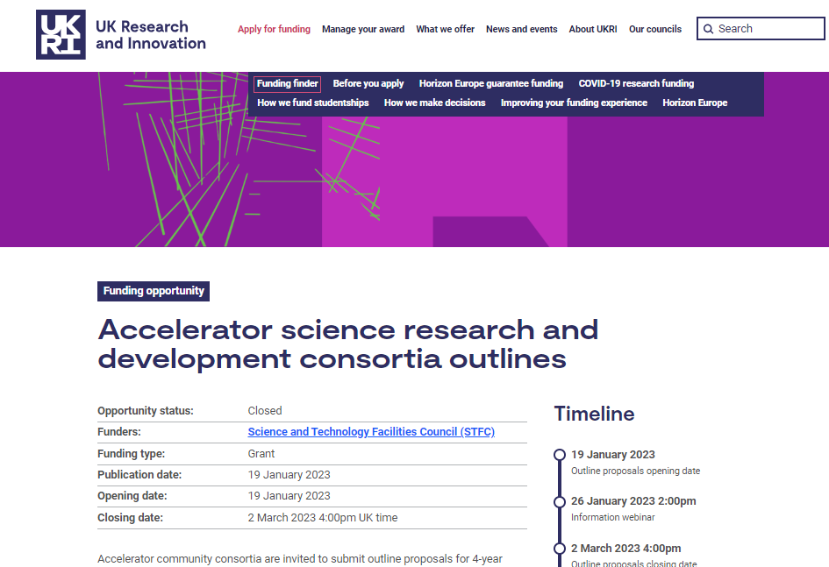
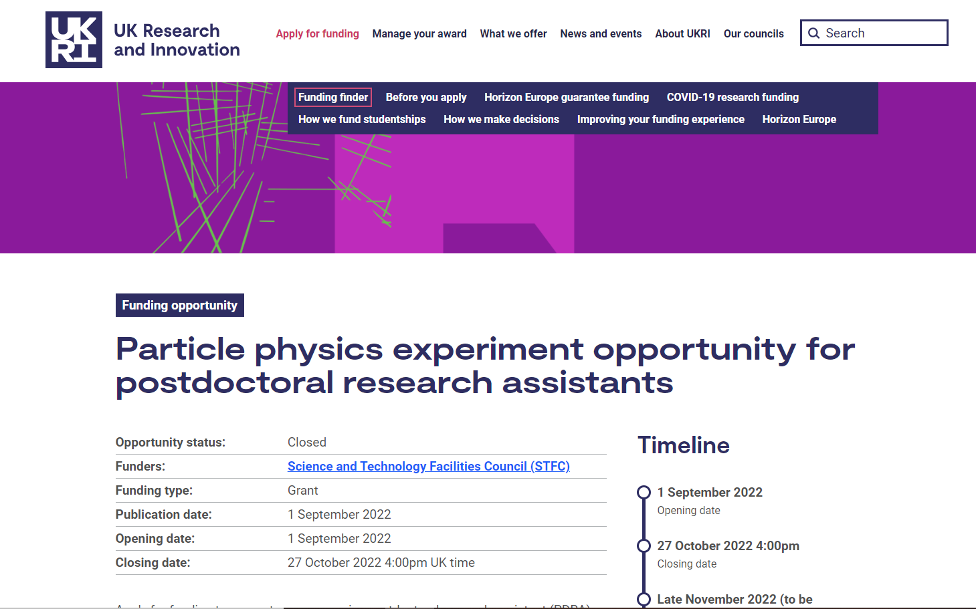
Strategic Review of Particle Physics
Report published January 2023:
A light-touch strategic review of particle physics to consider how to best ensure the long-term health of PP in the UK
Developments since the SRPP was published;
Accelerator R&D funding call
Detector R&D funding opportunity in discussions
UK Strategy for CERN developed with DSIT
Responsive PDRA round completed in 2022 to bolster the 2021 Experiment CG
Changes within STFC’s advisory structures (next slide)
Lessons learnt from analysis of funding large infrastructure projects
More emphasis on the importance of project management
Strategic Review of Particle Physics Panel – UKRI
Notes:
Really helpful review to consider how best to support PP in the UK.
Report recommendations which Mark presented in more detail in April but I thought it would be helpful mention the number of developments since publication that we have been doing.
Accelerator R&D call – call set up in November. Looking at R&D for LHC and upgrades, novel acceleration technologies and UK FEL capabilities. outline stage was peer reviewed by TAAB who were asked to undertake prioritisation activity of these outline proposal.
Detector R&D call in discussions
Jess Atkinson has been leading the development of the UK strategy with CERN with DSIT – more shortly

Slide 5
Changes to STFC’s advisory structures
Move to two parallel Science Boards each with a specific focus
Science Board
Provides strategic scientific overview and assessment of, and science advice on, all the programmes STFC supports. This includes both multidisciplinary Facilities and Particle Physics, Astronomy and Nuclear Physics (PPAN)
Technology and Accelerator Advisory Board
Provides strategic advice on STFC’s funding and support for underpinning technologies, such as detectors and instrumentation, specialist engineering, optics, e-infrastructure, accelerator science and technology, and the connection to innovation and industry
Existing
Science Board (PPAN)
Will provide advice on:
Long-term balance of the programme
Prioritised ‘roadmaps’ for different programme areas
Within the context of STFC’s 10-year financial plan
Science Board (Facilities and Laboratories)
Will provide advice on:
Overall scientific investment portfolio
Balance of capability and capacity across international and national large-scale multidisciplinary facilities
Within the context of STFC’s 10-year financial plan
New
Notes:
Review highlighted the need for improved strategic advice with a prioritised roadmap produced for particle physics. Recommendation was for a new small committee to be formed however STFC felt it would be more effective to revise the ToR of Science Board to be commissioned to develop this roadmap, but also help shape the UK community and National Labs.
A working group within STFC (PD, NL and SPC) established to operationalise the new PPAN Science Board. At the moment we are working on the induction programme and how they will work to deliver on their new ToR, and what information they require to do this.

Slide 6
New Science Boards - Membership
Science Board
(PPAN includes particle astrophysics, space science and related areas of accelerator science)
Science Board
(Facilities and Laboratories)
Board composition:
6 x Particle physics, including one theorist
6 x Astronomy/space science
2 x Particle astrophysics
2 x Nuclear physics
16 members plus a Chair
Members and the Chair must be based at UK institutions
Board composition:
To represent a broad cross section of STFC’s facility user and technology-focussed stakeholder communities including:
  Members of the UK academic and business/ industrial communities
  Members from national and international facilities and laboratories
16 members plus a Chair
Chair must be based at a UK institution/entity
Asking existing members of Science Board and TAAB to move to the relevant new Science Board
Call for new members closed in May, new Boards will form in the autumn, becoming operational in their new roles during 2024
Notes:
Individuals invited to the new SB will have an induction in September where we will begin to provide the landscape/ overview of the STFC PPAN programme.

Slide 7
Project Management
From the SRPP
An improvement in project management, e.g producing more realistic costings and timelines, should be effected by providing by more and better help and advice to the community at an early stage with timelines and forward planning. This would be part of a proper pathway to approval. …progress in this direction is already being made within the Project Office at RAL.
Lessons learnt
STFC has been analysing lessons learnt from funding large infrastructure/capital projects and going forward there will be more emphasis on;
Projects should work to further embed STFC PMF processes within their projects
Role and Responsibilities of PIs, PMs are clearly defined
PMP and Change Control
Risk register and issue logs
Notes:
The review also emphasised the importance on project management –
In addition, STFC looking across the board how it approaches funding large capital infrastructure projects
Some of the key points of the analysis were;
Project scope is manageable within cost and schedule
Full cost of project is understood, including I&C but funding to be released in stages aligned to outputs and deliverables.
Funding profile is realistic with controls to monitor and manage spend
PM effort is sufficient and PM works closely with the PI and is empowered to actively deliver the projects
Change control is robust and importance is understood.

Slide 8
STFC PP Project Office
Provision of professional Project Management and associated support to deliver PP/collaborative projects;
  All Project Managers are qualified to at least APM (Associated for Project Management) standard, all existing staff experienced in PP
  Backed up with comprehensive office support team and tools & processes developed specifically by us for collaborative/PP projects
  Use of the PO is strongly encouraged for STFC collaborative infrastructure projects in particle physics
Planning and execution expertise;
  Proposals (both creation and pre-submission review/optimisation), project plans, ...
  Standard processes for risk/issue management, finance admin, schedules, reports, ...
  Experience with PPRP, OsCs, JeS etc
Part of RAL PPD;
  Currently six staff and growing quickly, pool of staff so can provide fractions of FTE, and additional cover when needed
  Separate from STFC Programmes Directorate but we have an excellent working relationship
Effort towards proposals/planning is free* assuming the PO will be involved (and costed) in the subsequent project grant - only limited by staff availability/recruiting
  Provide the best help if involved in the experiment/project early as possible (i.e. pre-SoI): don't wait until proposal stage
  (Helps get the project set up as best as possible and plan it most appropriately and warning about staff recruitment needs)
Contact christopher.townsley@stfc.ac.uk in the first instance
Notes:
The project office in TD acts as a central coordination PM effort for accelerators and nuclear physics projects that is well established and working well for those projects. We also support project managers who may be based in universities that have the right credentials and experience to work closely with the PO.
Key point of this slide is to engage early with the Project Office at RAL early on for pp projects.

Slide 9
Particle Physics Programme Updates
Consolidated Grants
provide year-on-year increases in CG funding, starting from FY23/24:
  this will leverage more value from international subscriptions, primary target is to increase PDRAs in exploitation of our PPAN science programme
Experiment (Oct 2022 – Sept 2025)
Uplift deployed via the PDRA Responsive round in 2022.
Planning for the next CG round has begun – kick off meeting being scheduled for early October.
Theory (Oct 2023 – Sept 2027)
Uplift included in the 2022 round.

Slide 10
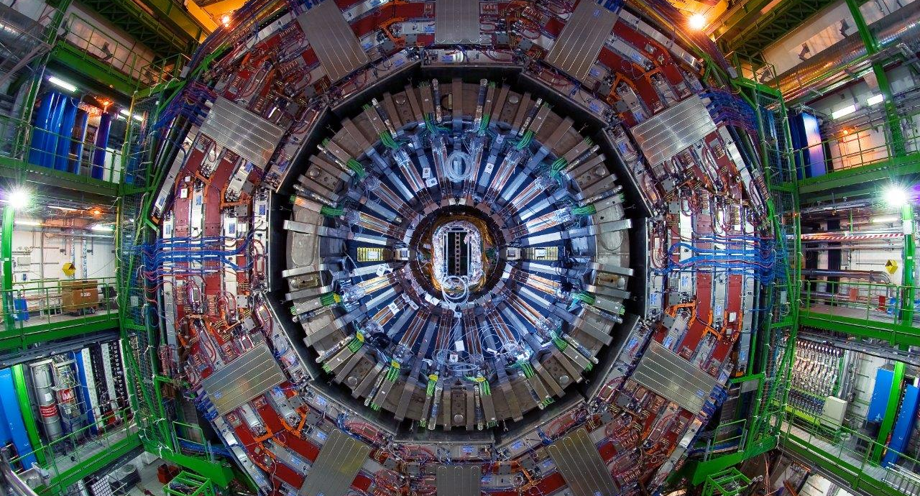
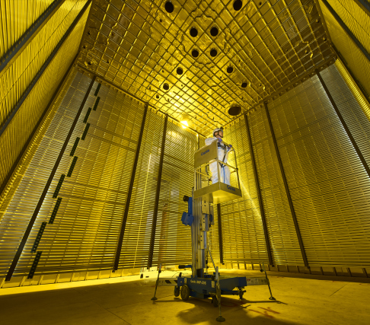
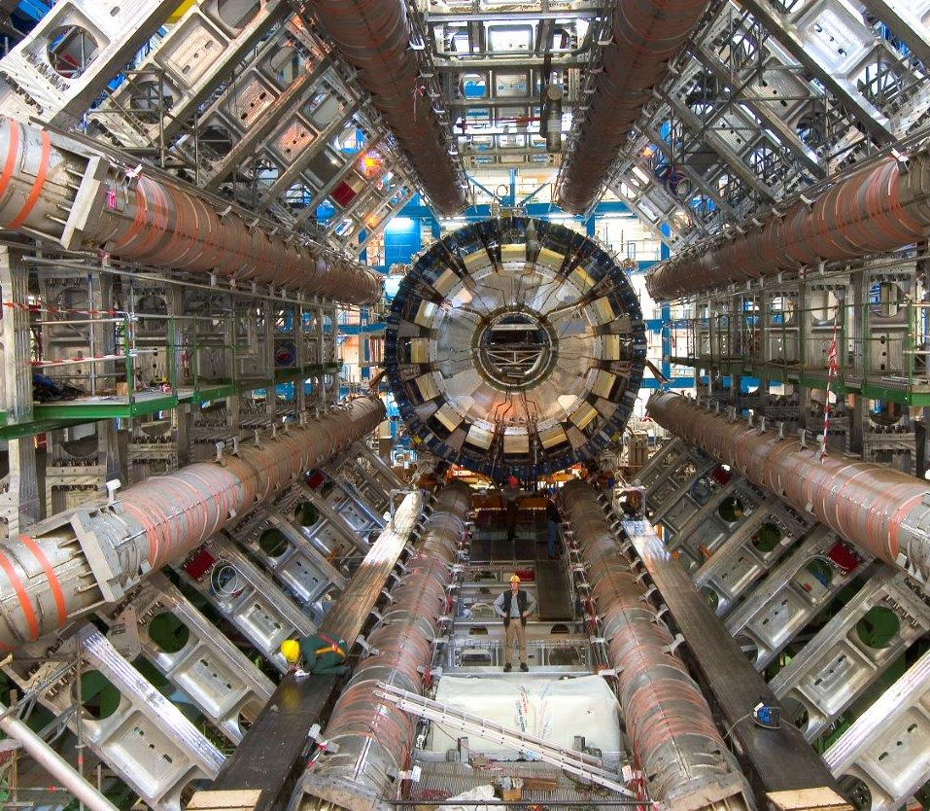

Particle Physics Updates
Energy Frontier
ATLAS Upgrade Phase II construction awarded in April 2023
CMS Upgrade Phase II construction will be extended and undergo peer review in 2024.
Flavour physics
LHCb Upgrade II R&D completing in the next year, pre-construction phase proposal going through peer review now (UKRI IF)
Mu3e nearing completion
Neutrino physics
DUNE construction (part of the LBNF/DUNE programme) mid-term review completed, peer review in autumn
Hyper-K construction (funding from the core programme + UKRI IF)
Dark sector
Projects funded primarily by the PA Programme
Theory
Cosmology, Lattice, Phenomenology, Quantum Field Theory, Strings
IPPP

Slide 11
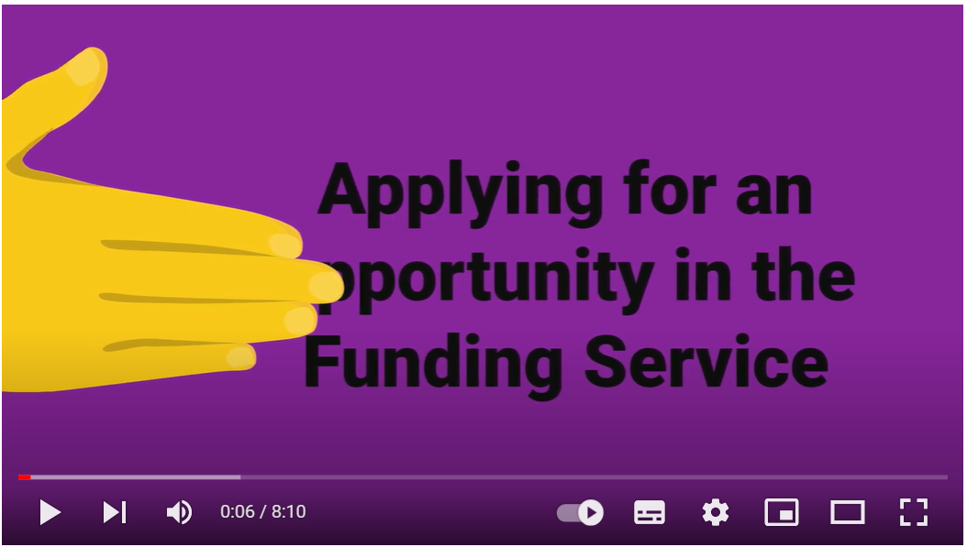
Applying for UKRI Funding is changing
UKRI’s “Simpler and Better Funding” (SBF) programme aims to create an easy-to-use funding service that supports all involved in research funding
• From (approximately) January 2024, all council funding opportunities will be launched and managed in The Funding Service (TFS)
• During 2023, we will still run some opportunities in Je-S while ramping up the schemes supported on TFS.
• The goal is that UKRI operates a single, consistent user-centred service that reduces the burden of finding, applying for and managing research funding (single “front door”)
STFC working to ensure the funding models we use (e.g CGs and project grants) are supported effectively in TFS
If you have experienced any issues, please let us know but also contact SBF@ukri.org
Series of videos on YouTube;
https://youtu.be/5NlWMVBr1jc - completing an application
https://youtu.be/i7f6TNz8mN8 - how to apply for an opportunity
https://youtu.be/w_JMIvw3KdU - how to find an opportunity
How applicants use the UKRI Funding Service – UKRI
Notes:
Back in April Mark highlighted that the way UKRI funding is managed is changing
Please prepare the same information you would for the CG but just be prepared that the format in which it is submitted will change. Please read the guidance when available and ensure you allow time for submission. Like any new system, there may be teething problems so please highlight these asap.
Please contact SBF if you are experiencing any issues or our Grants Team (Lindsay is here)!

Slide 12
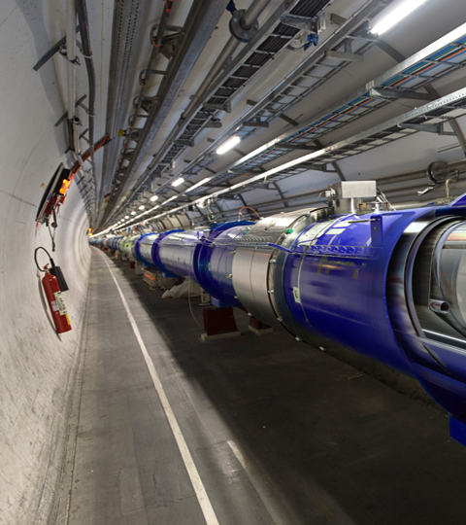
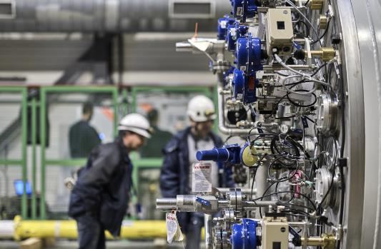

UK Strategy for Engagement with CERN
Aiming for publication in September 2023 hopefully with announcement by Science Minister
To be published on the gov.uk website with forewords from the Science Minister and Mark Thomson
Full implementation plan and monitoring and evaluation plan in place in early 2024
  Significant implementation already underway and making good progress e.g. industrial return activities
Implementation will be coordinated by STFC and it will involve stakeholders in STFC, DSIT, CERN, the UK research community and universities, other government departments and others to deliver the ambitions of the strategy
Photo from CERN
Department for Science, Innovation and Technology
Notes:
Purpose of the strategy
Maximise the mutual benefits and impact of UK investment in CERN for both CERN and the UK
Align and coordinate all UK CERN stakeholders behind one vision
Raise awareness of the opportunities afforded by CERN membership
In government now for review and approval.

Slide 13

STFC Visions Update
STFC Visions aims to identify ground-breaking, early-stage concepts that have the potential to be developed into ambitious initiatives and infrastructures, and might not have been captured through STFC's existing processes.
Key Aims:
  to build capacity to react quickly to emerging opportunities
  to better position STFC to influence new strategic and funding opportunities, outside of core funding (note: there is no direct funding attached to the scheme)
  to support STFC research communities to drive forward ambitious programmes of science and innovation
The Visions Panel focus on two assessment criteria:
    Is the concept going to deliver a step-change for the Research and Innovation community?
    Is the proposal timely within the current strategic landscape?
Project ideas can be submitted at any time throughout the year and will be used to support STFC's pipeline for future opportunities (e.g. Infrastructure Fund waves moving forward).
Notes:
From 2022 to 2025, UK Research and Innovation (UKRI) is investing a total of £481 million into a portfolio of research and innovation infrastructure investments to maintain the UK’s position as a research and innovation superpower.
The aim of visions to be able to tap into this funding and support research and innovation concepts that align to strategic priorities and initiatives.

Slide 14
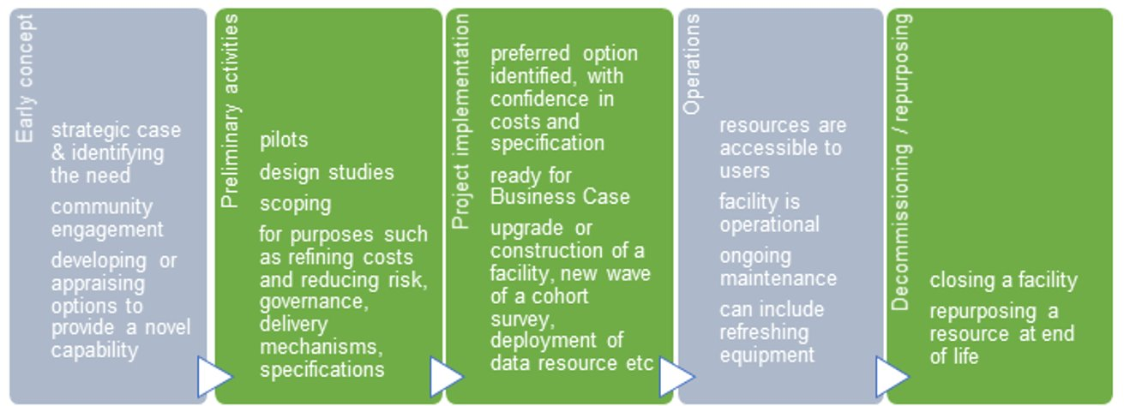
UKRI Infrastructure Fund Update
What is the UKRI Infrastructure Fund?
  Aimed at supporting significant investments that enable a step change in research and innovation infrastructure, where there is a key benefit that can be articulated to the research and innovation community. Focuses on an infrastructure providing an international- or national-level capability. Time bound funding. Infrastructure provides access, resources or related services to the wider, community outside the infrastructure institution itself (e.g. host institution and funding partners). Two Waves of funding complete, 2 in progress. Many STFC successes so far!
Recent Updates:
  Wave 3 in Progress
    Wave 3 Preliminary Activity outcomes just announced
    https://www.ukri.org/news/ukri-invests-72-million-
    upgrading-uk-research-infrastructure/
    Wave 3 Full Proposal process in progress
  Wave 4 Preliminary Activities recently launched (late May 2023)
Wave 4 Preliminary Activities:
Wave 4 Applications: Form follows structure of UKRI Infrastructure Fund proforma and guidance is provided per section where appropriate. External community submissions to STFC can only come through an Advisory Panel. Cross panel submissions encouraged!
Given the annual nature of the Infrastructure Fund for preliminary activities and the new role of STFC Visions, we encourage communities to only bring forward projects that are ready for consideration for funding in the current round and which are high quality and timely.
Notes:
Wave 3 outcomes for STFC – UK ELT, next generation GW
Wave 4 started late May with guidance going out to the Aps.

Slide 15
STFC Infrastructure Timeline
21 July
Mid-Sept
Oct/Nov
Dec 2023
Late May
infrastrategy@stfc.ac.uk
Notes:
Key message – AP is being asked to provide top 3 ranked proposals according to how they align to the IF
R&I science excellence and community support
Strategic drivers
High impact potential
Step change in capability
Feasibility and Deliverability
Accessibility
Environmental sustainability
Any questions please speak with PPAP in the first instance or you can contact the Infrastructure team directly.
The expectation is to run a PA round annually – the advice from the team is submit proposals through Visions throughout the year. A line will be drawn in the sand of what is in the pipeline May/June to then take forward through the process.

Slide 16


