Slide 1
DRD1

Slide 2
DRD 1: Highlights
DRD1 definition (from DRD1@CERN with 107 institutions ) : Devoted to gaseous detector technologies, such as MPGD, RPC, TPC, and large drift chambers, wire, and straw tube chambers. The addressed field of applications ranges from the future accelerator and non-accelerator-based particle physics experiments, nuclear and neutrino physics, Dark matter, and rare decays to medical, industrial, and civil security applications.
Breakdown into work packages
  WP1 Large area precision muon trackers
  WP2 Drift Chambers
  WP3 Straw tubes
  WP4,8 TPCs - large volume tracking and reaction/decay
  WP5 Calorimetry
  WP6 Photon detectors
  WP7 Timing detectors
  WP9 Beyond HEP applications

Slide 3
DRD 1: Highlights
DRD1 activities (so far) in the UK :
Development of low pressure optical TPC for Migdal effect searches to support Dark Matter (MIGDAL : RAL, Imperial, Birmingham, Oxford and KCL as leading UK institutions)
    Interest in WP4 (Optical-TPC with GEMs for rare event searches)
Development next generation high-sensitivity low-noise RPCs using novel materials and fC-level amplifiers for cheap large-area applications e.g. ANUBIS, neutrinos, etc (WP1) and ﻿﻿development of high-granularity demonstrators (WP5)
Development of Spherical Proportional Counters (Birmingham)
    Light Dark Matter Searches
    Neutron spectroscopy and other applications
Warwick TPC platform (WarTPC)
  Identify and develop novel gas mixtures for a HPgTPC for neutrino interactions. (WPs 4, 8)
  Develop an optical readout for single-point resolution at diffusion limit of gas mixture. (WP8)
  Readout structures and electronics for HPgTPCs and prototyping of a calibration system. (WP8)

Slide 4
DRD 1: How to join / Further reading
Contact: Pawel Majewski (RAL) and Oleg Brandt (Cambridge)
  Please let us know if interested in contributing to DRD1!
Links:
  Slides from DRD1 meeting at CERN (two weeks ago) (https://indico.cern.ch/event/1273991/timetable/?view=standard)
  DRD1 proposal (draft) https://indico.cern.ch/event/1273991/attachments/2668256/4630156/RD_EXTENDED-PROPOSAL__DRD1.pdf
Highlight mailing lists
  To be created after the meeting

Slide 5
DRD 1: UK Status / Activity
So far : email exchange and informal discussions between potential participants
No meetings so far
First meeting (preferably in person ) very soon
So far groups involved are:
Pawel Majewski; RAL/PPD
Oleg Brandt; Cambridge U.
Kostas Nikolopoulos; Birmingham U.
Xianguo Lu, Yorck Ramachers, Gary Baker; Warwick U.
Patrick Dunne, Imperial
Morgan Wasco, RAL/Oxford

Slide 6
DRD2

Slide 7

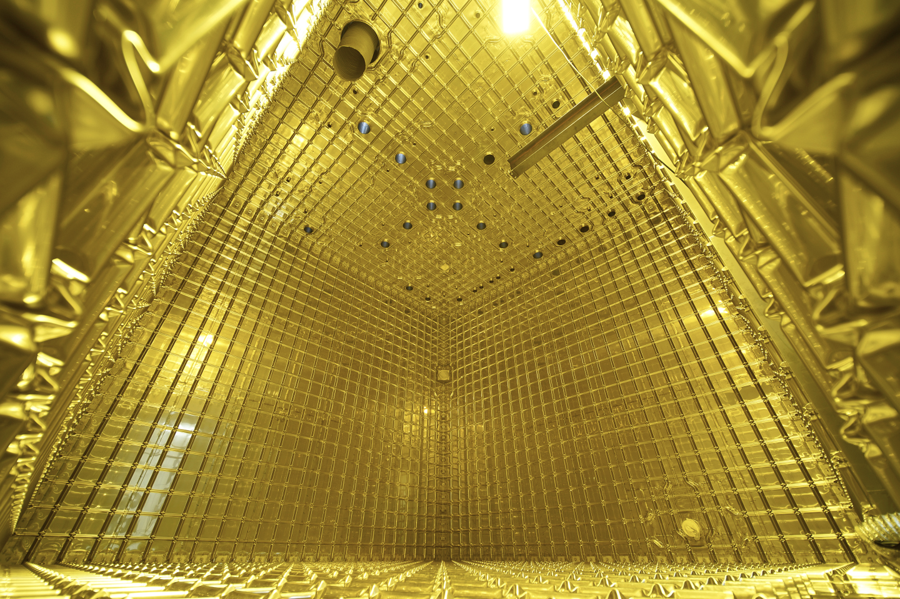
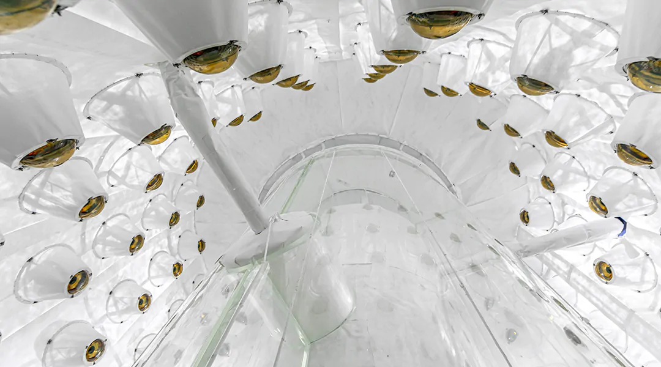
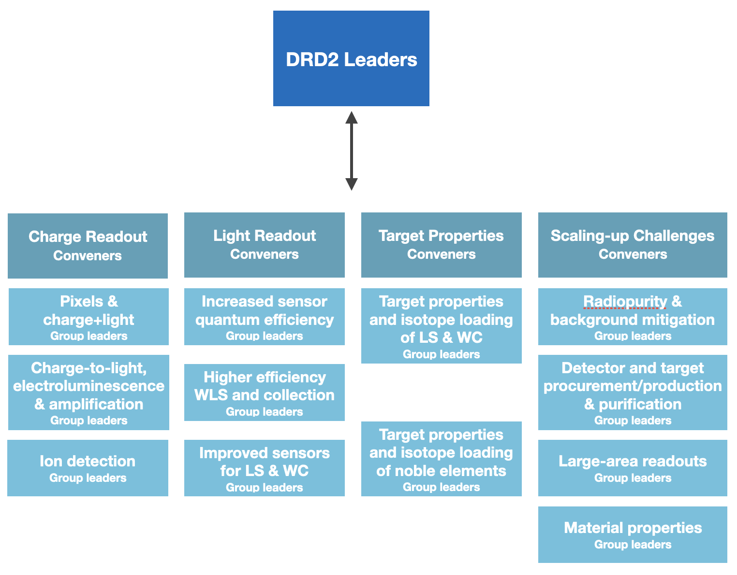
DRD 2: UK Status / Activity
SNO+
DUNE
LZ
Collaboration structure and proposal draft complete
Community Meeting 20 April (https://indico.cern.ch/event/1214404/)
Proposal will be uploaded to indico soon
Groups involved
Edinburgh
Liverpool
Manchester
King’s
Oxford
Royal Holloway
RAL
Sheffield
Sussex
UCL
York
UK Leadership

Slide 8
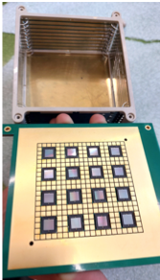
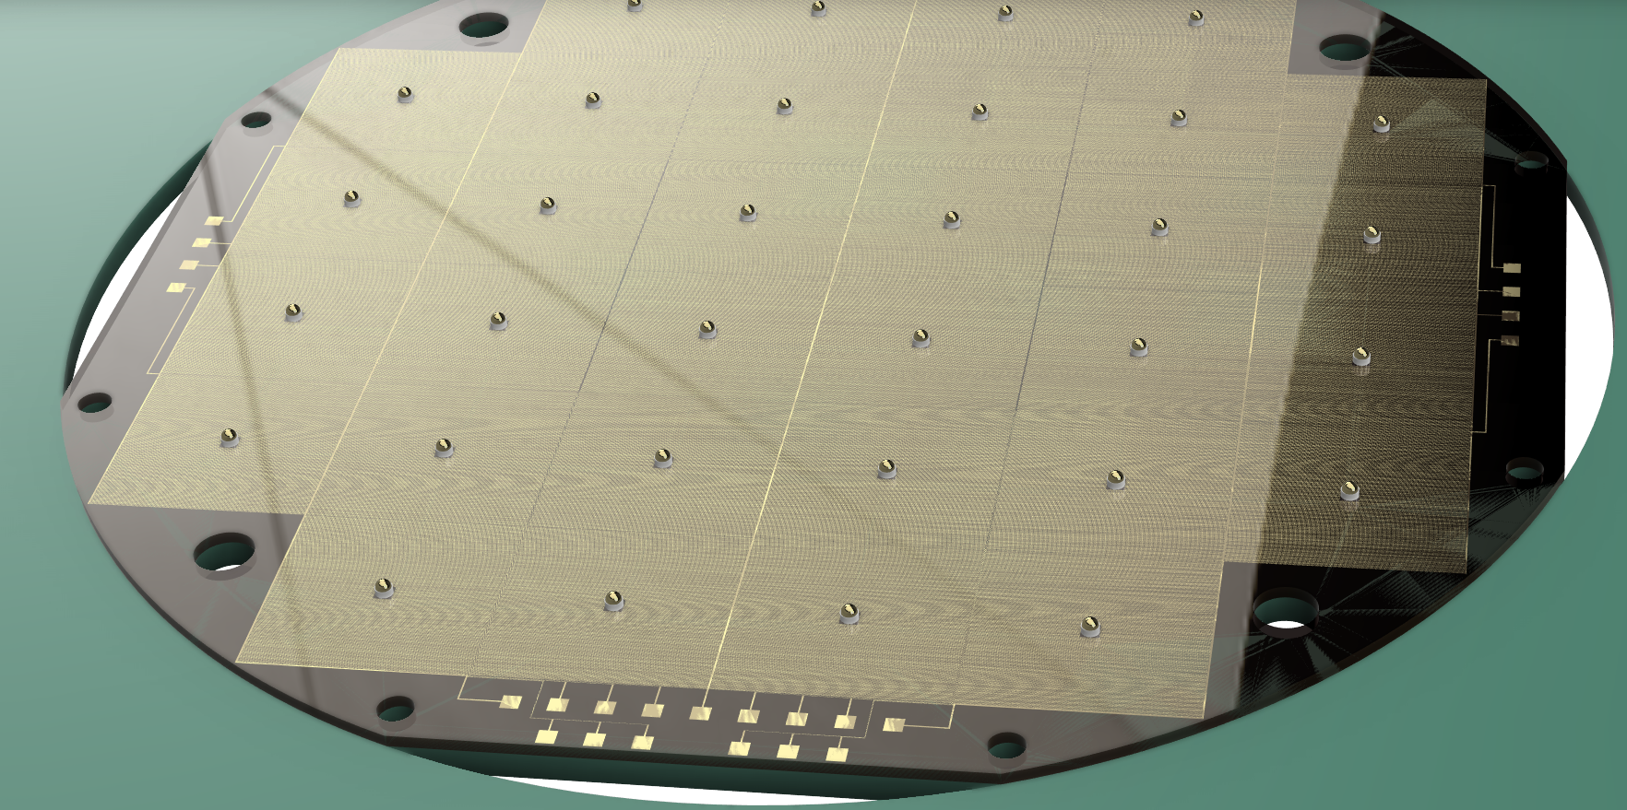
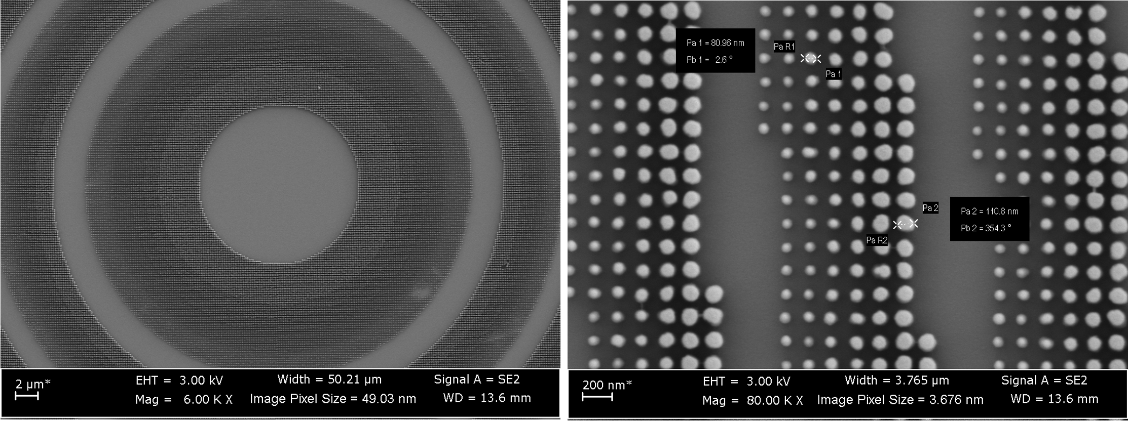
DRD 2: Highlights
Te loading for SNO+
Quantum dots for LS
Granular S2 readout for NEXT
Large area WLS
Radioactivity background control
And more! …
ARIADNE
Back-illuminated spad cell
SoLAr prototype
Metalenses
L+C prototype

Slide 9
DRD 2: How to join / Further reading
Contact persons: Roxanne Guenette (roxanne.guenette@manchester.ac.uk) & Jocelyn Monroe (Jocelyn.Monroe@rhul.ac.uk)
Link: https://indico.cern.ch/event/1214404/
Use registration to record your email for the mailing list!

Slide 10
DRD3

Slide 11
DRD 3: UK Status / Activity
TF3 meeting towards formation of DRD3 happened at CERN in March
UK Tracker Community (notice this spans a bit further than DRD3) has met a few times over the past year, triggered by FCC UK meetings
  09/22 in Birmingham gathering the tracking community to start talking about the future
  05/23 we had a brief catch-up towards another in-person meeting
  Last week we gathered in Liverpool to flesh out projects that we want to work on
Upcoming Meetings:
  We only just had one and are digesting the minutes of that, hopefully condensing down on projects that the community in the UK would want to follow up on, many of these being in the frame of DRD3
Groups currently active:
Birmingham, Bristol, Brunel, Cambridge, DL, Edinburgh, Glasgow, Lancaster, Liverpool, Manchester, QMUL, Open University, Oxford, RAL, Sheffield, UCL, Warwick
Notes:
Which group am I forgetting, check notes from Bmgh meeting

Slide 12
DRD 3: Highlights
UK test beam facility
Common interface ASIC (DRD7)
Monolithic CMOS sensors
Radiation tolerance
Irradiation
facility
CDT training
DAQ and demonstrator
(DRD7)
Extreme
fluence
Monolithic LGADS
TPA instrumentation
3D stacking
Mechanics and cooling
(DRD8)
Interconnect technologies
Diamond sensors

Slide 13
DRD 3: How to join / Further reading
Contact persons:
Laura Gonella (Birmingham), Eva Vilella (Liverpool), Daniel Hynds (Oxford), Jens Dopke (RAL)
Further reading:
  Meetings linked on the first slide!
Started setting up a CERN based mailing list (JISC options were just not right): uk-detector-rd@cern.ch
  We didn't want to call it DRD3 something and it is open to anyone - traffic is very limited as of now!

Slide 14
DRD4

Slide 15
DRD 4: UK Status / Activity
DRD 4 covers particle identification and photon detectors
+ transition radiation detectors + scintillating fiber trackers.
UK groups have a strong history of involvement with particle identification detectors (LHCb RICH and NA62 KTAG).
UK Groups involved: Birmingham, Bristol, Cambridge, Edinburgh, Imperial, Leicester, Oxford, QMUL, RAL, Sussex, Warwick.
UK industrial partners: Photek Ltd.

Slide 16
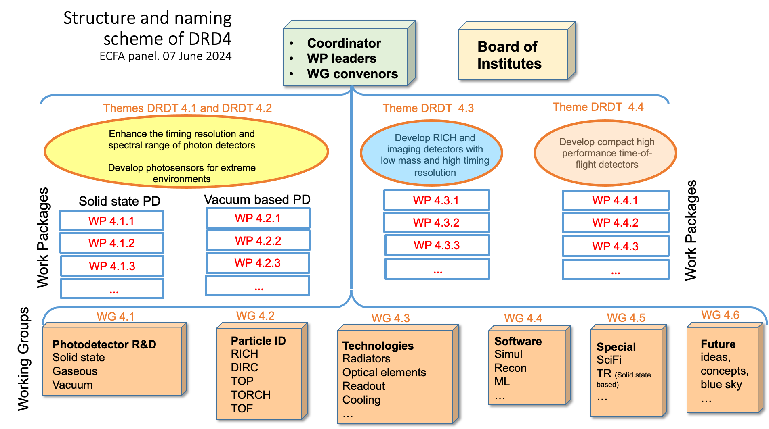
DRD 4: International structure
https://indico.cern.ch/event/1300527/contributions/5471845/
Expect UK involvement in most WGs.
WP involvement less clear until funding situation is known.

Slide 17
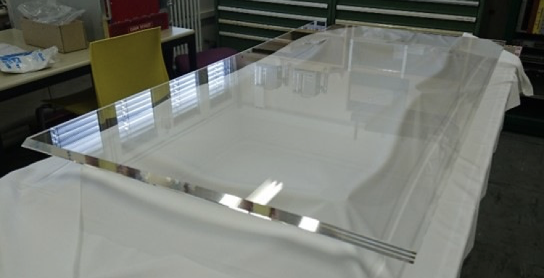
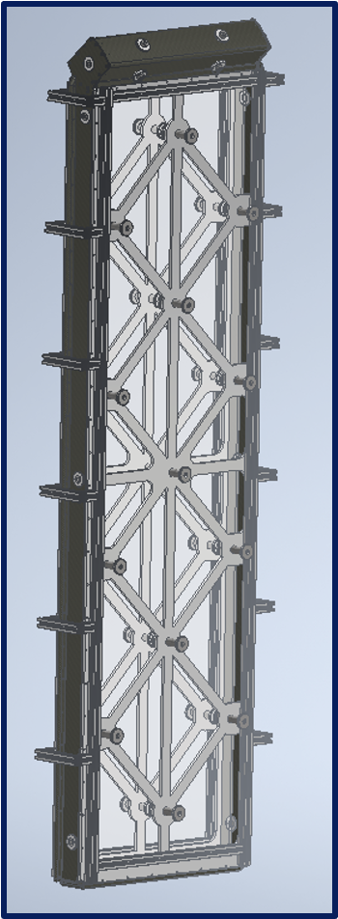
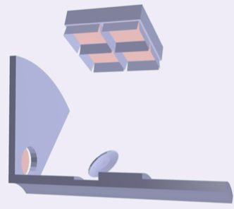
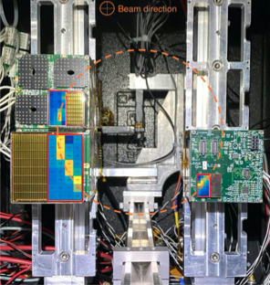
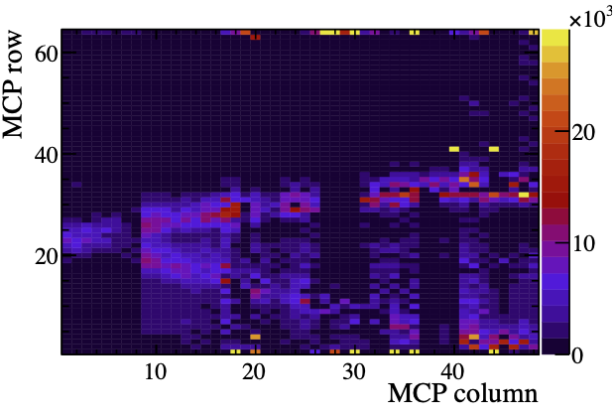

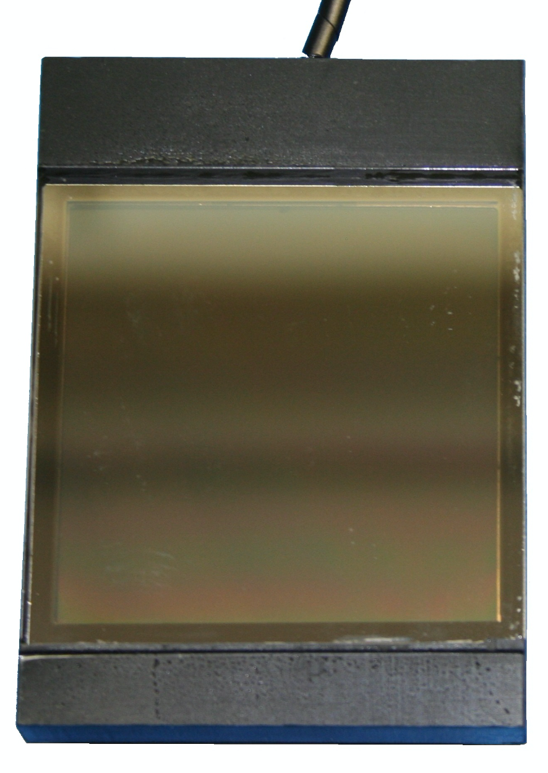
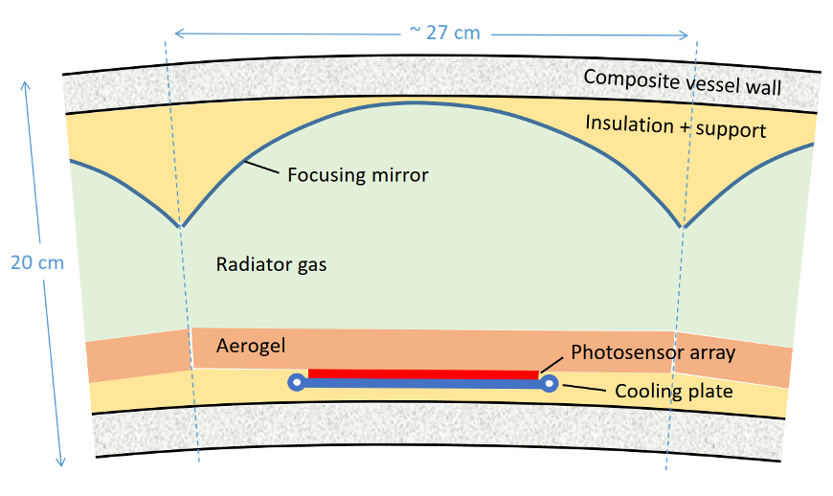
DRD 4: Highlights
Design of new KTAG
detector for HIKE.
Design of the LHCb TORCH time-of-flight detector for Run 5.
Conceptual ideas for PID at future experiments, e.g. ARC concept for compact dual RICH detector at the FCC-ee.
Addition of fast-timing information in LHCb RICH for Run 5.
Photon detector characterisation and development.

Slide 18
DRD 4: Highlights
Vibrant community in UK working on DRD 4 related activities.
Clear synergies between the needs for the next generation of experiments:
  Need for fast-timing photon-detectors (MCP-PMTs, SiPMs).
  Need for photon detectors with long lifetimes and high rate capabilities.
  Need to develop readout electronics based on new generation of ASICs (Fast-IC, picoTDC).
  Need to develop light-weight detector structures.
  Need for fast and accurate simulation with optical photons/of detector responses.

Slide 19
DRD 4: How to join
If you would like to get involved in UK DRD 4 efforts please contact Guy Wilkinson (guy.wilkinson@cern.ch)
Open call for nominations for UK DRD 4 conveners closed on the 3rd of July. Aim to conclude the nomination process by July 17th. Guy is acting as a point-of-contact for DRD 4 activities until the conveners are appointed.

Slide 20
DRD6

Slide 21
Calorimetry (former TF6 of Detector roadmap)
DRD kick-off meeting 12th January at CERN; UK meeting 6 March; DECAL talk, LCWS’23
Work split in 3 + 1 “tracks”:
  T1: Sandwich calorimeters/→ UK work on Calice, FOCAL/DECAL – CMS upgrade?)
  T2: Liquified Noble Gas calorimeters (not immediately relevant for UK).
  T3: Optical calorimeters (connects with UK activities on dual-readout/fibre based R&D)
  T4: Alternative or transversal proposals (no connection with UK)
Initial ‘proposals’ to coordinators 1/04; reviewed 29/06; consolidated by end July
Scope for potential coordinated UK effort in Calorimetry
DRD contacts: Nigel Watson / Iacopo Vivarelli

Slide 22
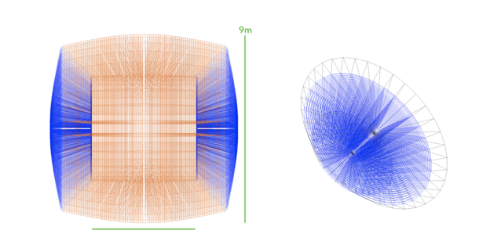
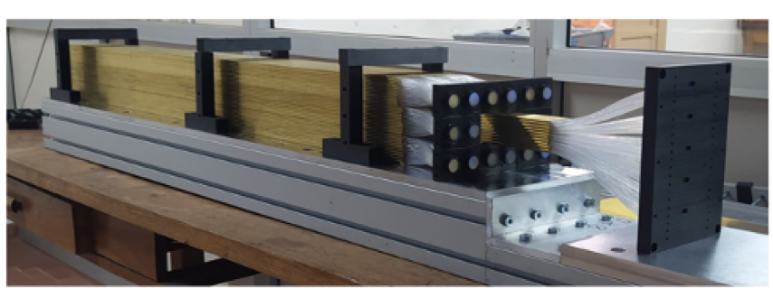
Optical (dual readout) calorimeters
International proto-collaboration for R&D on dual-readout for e⁺e⁻colliders.
R&D fully integrated in ECFA process since the beginning.
  DRD presentation about dual-readout
  Test beams performed in 2021, 2022, 2023 (EM-size prototypes).
  A few recent publications: arXiv:2203.04312, Instruments 2022 6(4), 59, arXiv:2202.01474.
Total funding for activities ~ 4M currency units to INFN/Korea/US for construction of hadronic-size fibre-based prototype + Crystal based dual readout.
Challenges:
  Tens of millions of SiPM readout to be read. Digital SiPM?
  Increase Cherenkov light collection efficiency. Blue/near UV fiber + SiPM?
  Timing to resolve energy deposits at different points in the fiber.
  Develop a calibration system.

Slide 23
UK contribution
University of Sussex funded via AIDAInnova, capital equipment and CG.
Current: simulation, performance, test beam analysis, monitoring ands DAQ, optical fibre characterisation, SiPM timing performance measurement.
Mid-term feasible contributions:
  Fibre characterisation for Had-size prototype, monitoring and DAQ.
  Fibre+SiPM calibration system for calorimeter.
  Transverse to multiple DRDs: Digital SiPM (connection with, e.g., noble liquid caloriemeters, tracking (SciFi) LiquidO, etc.)
Connections that could be explored: crystal work in the US.

Slide 24
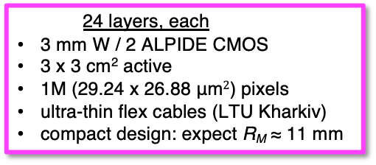
DECAL prototype reality: EPICAL-2
      24 layers, each
3 mm W / 2 ALPIDE CMOS
3 x 3 cm² active
1M (29.24 x 26.88 μm$2$) pixels
ultra-thin flex cables (LTU Kharkiv)
compact design: expect R_{M} ≈ 11 mm

Slide 25


Track 1 – Sandwich calorimeters
UK involved in CALICE R&D Collaboration since 2001, ~280 physicists/engineers
International project, develop complete PF calorimeter system, initial $e^{+}e^{−}$ focus
Reviewed regularly, e.g. by ECFA detector R&D panel
  https://twiki.cern.ch/twiki/pub/CALICE/WebHome/CALICEReport2018_final.pdf
Scope indicator:
  10 x Snowmass 2021LoI
Current UK interests
  DAQ/readout
  Simulation
  PFA algorithms (Pandora)
  MAPS ECAL (calo and sensor)

Slide 26
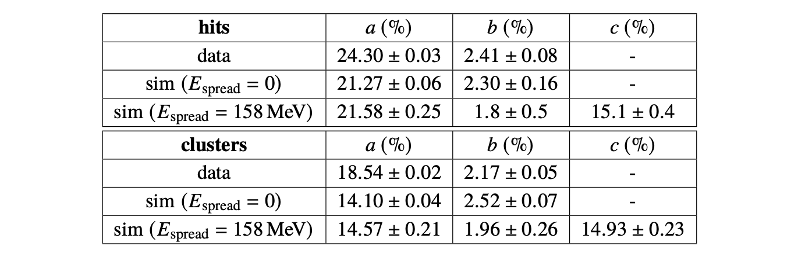
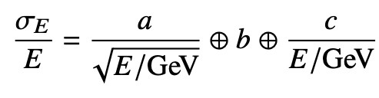
Calorimetric performance
  [JINST 18 (2023) 01, P01038]
Good standard performance
Better resolution from clusters
Uncertainties in beam energy spread

Slide 27


Future Opportunities for UK - SiW
Si-W calorimetry can give excellent PFA performance
  Potential to use same technology for outer tracker/preshower/ECAL
Affordable Si-W (Si-Pb) calorimeters, need sensor costs ~ CHF/cm² (active areas > 10⁷cm²)
  Potentially achievable with CMOS technologies, expanding market
Power needs study, CMOS estimates range ~50-100mW/cm² (no pulsing)
Prototype demonstrating concept of digital ECAL, in same CMOS line as CERN et al, can deliver radiation hardness to > 10¹⁵neq/cm²
Digital EM calorimetry, high potential esp. for future $e^{+}e^{−}$
  Ultra-high granularity can benefit physics as well as cost (boosted decays)
  Fast charge collection
  Currently, UK (Birmingham) working with ALICE FoCAL/pCT groups on EpiCAL-2
  Perfect time to expand/lead novel concept for future projects

Slide 28

Future Opportunities for DECAL
Si-W calorimetry can give excellent PFA performance
  Potential for reconfigurable technology: outer tracker/preshower/ECAL
    I.Kopsalis et al, NIM A1038 (2022) 166955
    P.P.Allport et al, Sensors 2022, 22(18) 6848
Affordable Si-W calorimeters, sensors ~ CHF/cm² (active areas > 10⁷cm²)
  Potentially achievable with CMOS MAPS
Power needs study, CMOS estimates range ~50-100mW/cm² (no pulsing)
Prototype demonstrating concept of digital ECAL, in same CMOS line as CERN et al, can deliver radiation hardness to > 10¹⁵neq/cm²
Digital EM calorimetry, high potential esp. for future $e^{+}e^{−}$
  Ultra-high granularity can benefit physics as well as cost (boosted decays)
  Calorimetric performance demonstrated
  Existing data with EPICAL-2 up to 80 GeV / SPS (analysis in progress)
  Enhance with optimised sensor development
  ECFA DRD proposal and interested in collaborate widely ☺
  Currently, UK (Birmingham) working with ALICE FoCAL/pCT groups on EpiCAL-2
  Perfect time to expand/lead novel concept for future projects

Slide 29
DRD7

Slide 30
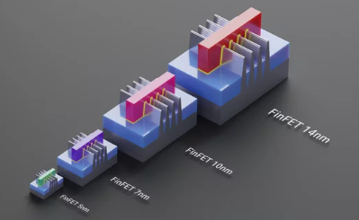
DRD7 – Purpose and activities
Purpose
  Advance the state-of-the-art in performance and deliverability of detector electronics and data processing
  Build expertise, improve and develop further common standards, methodologies,
  and IP for implementation of electronic and data processing systems
  Increase efficiency and decrease duplication of effort in detector electronics development
  Provide facilities and tools for R&D in the community, with long-term continuity.
Activities
  Oversee, drive and coordinate strategic R&D in electronics for particle physics
  Support and maintain an active and well connected R&D community
  Promote and maintain a connection between the developers and users of future electronic systems
  Coordinate cross-European access to technologies, tools, and knowledge
  Interface with other DRDs in areas of common interest, undertaking joint projects

Slide 31
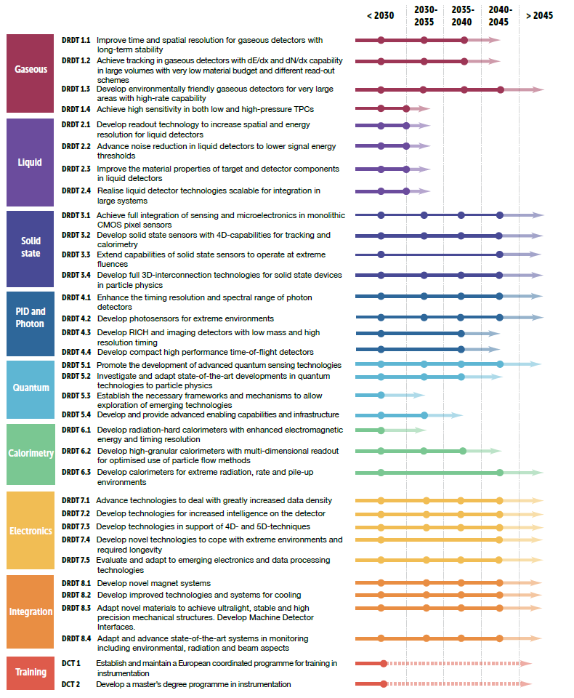
DRD7 – Wide engagement – Responsibility Sharing
WG 7.1: Data density and power efficiency
Szymon Kulis (CERN), Jeffrey Prinzie (KU Leuven), Jan Troska (CERN)
High data-rate ASICs and systems
New link technologies, including silicon photonics technology
Power conversion and efficiency optimisation
WG 7.2: Intelligence on the detector
Davide Ceresa (CERN), Francesco Crescioli (IN2P3-LPNHE), Frédéric Magniette (IN2P3-LLR)
Front-end programmability and modular design
Intelligent power management
Advanced data reduction techniques
WG 7.3: 4D and 5D techniques
Sophie Baron (CERN), Marek Idzik (AGH-Kracow), Adriano Lai (INFN-Cagliari)
High-performance sampling
High-precision timing distribution
Novel on-chip architectures
WG 7.4: Extreme environments
Giulio Borghello (CERN), Oscar Francisco (Uni-Manchester), Manuel Rolo (INFN-Torino)
Cryogenic technology and operation
Thermal management of ASICs
Radiation hardness
WG 7.5: Backend systems and COTS
Conor Fitzpatrick (Uni Manchester), Niko Neufeld (CERN), NN
Use and adaptation of advanced COTS technologies
Real-time software and firmware development
System-level control and readout
WG 7.6: Complex imaging ASICs and technologies
Marlon Barbero (IN2P3-CPPM), Michele Caselle (KIT), Iain Sedgwick (RAL), Walter Snoeys (CERN)
Common access framework to selected imaging technologies
Common IP for imaging ASICs
3D integration and interconnects
WG 7.7: Tools and technologies
Kostas Kloukinas (CERN), Xavi Llopart (CERN), Mark Willoughby (RAL)
Access and support to qualified technologies and tools
Investigation of emerging microelectronics technologies
Support and training for device and systems development and verification
Common IP and design reuse
DRD7:
A broad range of topics in
electronics

Slide 32
DRD7 – Key Dates
  Step 1a (Mar – Jun 2023): convenors
  Step 1b (Mar – Jul 2023): technical committee
  Step 2 (July – Aug 2023): Letter of Intent
  Step 3 (Sep – Oct 2023): second DRD7 workshop
  Step 4a (Sep – Nov 2023): initial set of projects
  Step 4b (Sep – Nov 2023): national communities
  Step 5 (Dec 2023): DRD7 Collaboration Proposal
  Step 6 (2024 on): Projects start in national communities
  seeks expressions of interest in specific projects
  defines few initial priority projects with relevant institutes and substantial community interest
  defines common plans & interfaces with other DRDs
  avoids duplication or omission of work
  set DRD7 work plan responding to other DRDs plans
  submit to the DRDC
  with scope of DRD7 + internal organisation + list of researchers and institutes
  to hear detailed proposals for the initial projects
  to discuss areas of common interest.
  open to both LoI signatories and other institutes seeking to join the effort
  take account of feedback from the DRDC
  planned and costed in detail
  discuss with national funding agencies
  define likely participation and resource envelope for the initial projects
  submit to the DRDC
  includes resource-loaded plans for the initial projects
  take into account feedback from the DRDC,
  make proposals to their funding agencies
  start projects as resources are allocated
=> from 2024 onwards: annual DRD7 workshops

Slide 33
DRD7: UK Status / Activity
Several EoIs submitted to DRD7, covering the following topics
  Common interface ASIC for detector readout, timing, and control [submitted by M. Prydderch]: specification, design, and (at a later stage) fabrication of a common interface ASIC for particle detectors. This device would couple a range of specialised front-end ASICs to a common industry-standard off-detector interface.
  Design of a Programmable Array Logic IP block for future front-end ASICs [submitted by A. Rose]: contribute to the ASIC-development effort through the design, development and testing of a Programmable Array Logic IP block which could be used as either a standalone entity or as a part of larger ASIC projects.
  Next-gen optical link evaluation [submitted by A. Rose]: initially focus on the evaluation of COTS components (e.g CWDM QSFP-28 100G, QSFP-DD 400G) and how best to adopt these parts to match the needs of HEP; later R&D will depend on the direction taken by the community
  Backend electronics in Ethernet-based environments [submitted by A. Rose]: investigating existing COTS solutions for particle physics applications, such as the applicability of FPGA-based “smart NICs” for customised processing, especially with regards to whether they can satisfactorily bridge between the detector environment and the COTS environment.
Interest (so far, more welcome) from multiple groups in the UK: Birmingham, Bristol, Imperial, Manchester, RAL, Royal Holloway, Warwick

Slide 34
DRD7: How to join / Further reading
UK Leads: Conor Fitzpatrick, Marcus French, Karolos Potamianos, Mark Prydderch, Andrew Rose
Mailing lists:
  General discussion: drd7-uk@cern.ch → don’t hesitate to subscribe and mention your interest in any of the DRD7 areas
  Contacting leads: drd7-uk-leads@cern.ch

Slide 35
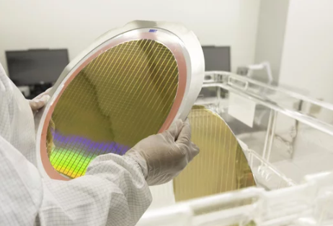

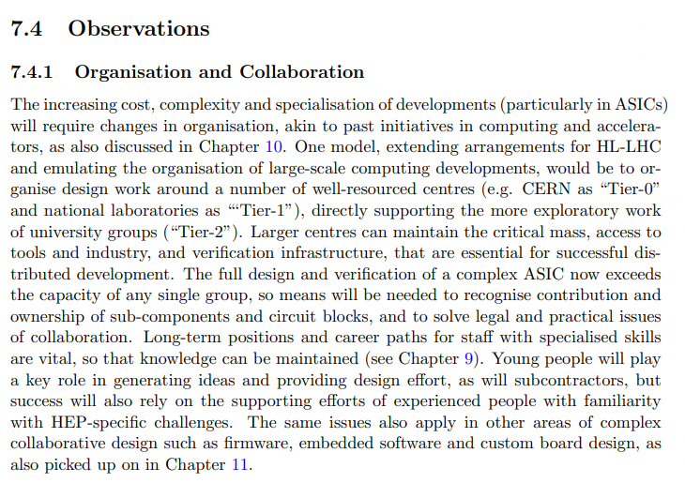
Enabling Technology Access – National strategy
Issues
  Wafer runs are now major investments in time and money
  Securing access to the technologies we need in an affordable way
  Many legal and practical issues with design sharing and team working
  Verification infrastructure, protocol testing, design reviewing, learning from mistakes
  Library management, distribution and maintenance
  Funding agency assurance
  ….
  We have to have to find ways to combine the strengths of all parties. The tiered structure proposed needs to be fleshed out
  – that process is ongoing, please input!

Slide 36
CDT

Slide 37
CDT Status / Activity
Funding for PhD students on instrumentation is clearly very limited at present
  Students on experiments often have some hardware as a part of their project, but rarely the project is purely on instrumentation R&D
  A UK instrumentation bid will need a large cohort of PhD students
  PhD training is key element of the general skills development plan
An initial discussion on setting up a CDT took place in June
  UKRI is moving in the direction of CDTs for student funding => 50% of EPSRC studentships now provided in this way
  Expectation that STFC will follow
  It is suspected that this allows access to other funding ring-fenced for training

Slide 38
CDT Status / Activity
The CDT would handle recruitment and support training of students within the instrumentation/DRD bid, ensuring consistency/quality control
  Projects would be steered by the individual DRD areas
  Discussions with the DRDs should start soon to estimate numbers, time profile, projects, etc.
The SOI to science board will likely contain three components:
  The main research bid (postdocs, staff, equipment)
  A CDT
  An industrial engagement strategy
Due to the main recruitment drive for students taking place in January, it is expected that a first cohort would not start before October 2025

