Slide 1

Progress in the ECFA implementation of the Detector R&D Roadmap
D. Bortoletto
*community feedback via RECFA delegates and National Contacts

Slide 2
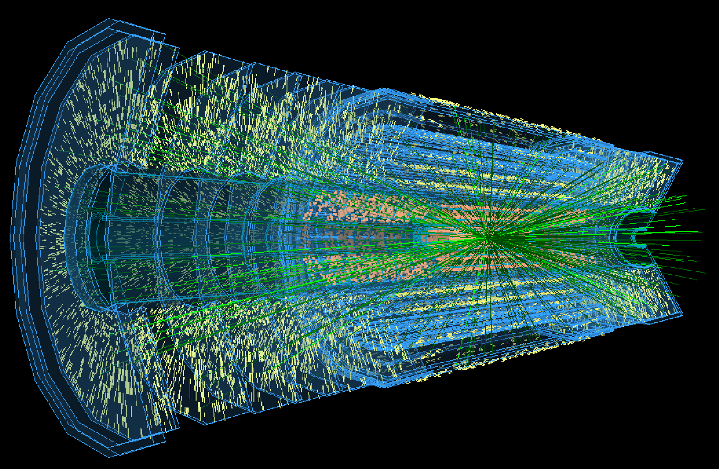
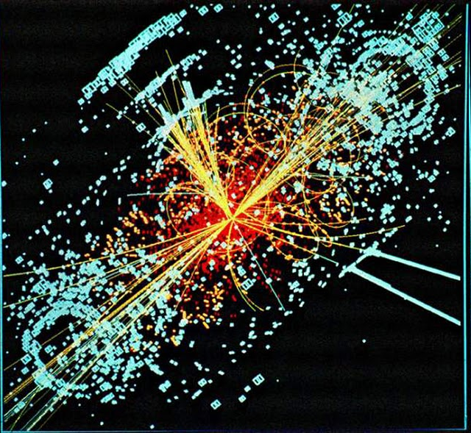
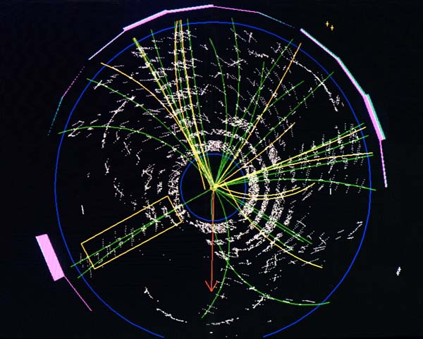

Detector R&D is critical
Building the silicon detectors for the LHC
RD2 formed 1990
RD48 –The ROSE Collaboration (1995-2000)
RD50 (2002-2013)
Oxygenated silicon detectors
p-type silicon
  All silicon detectors at the LHC will be n-p silicon detectors
Ultra radiation hard: 3D Detectors
Ultra fast silicon detectors: LGADS

Slide 3
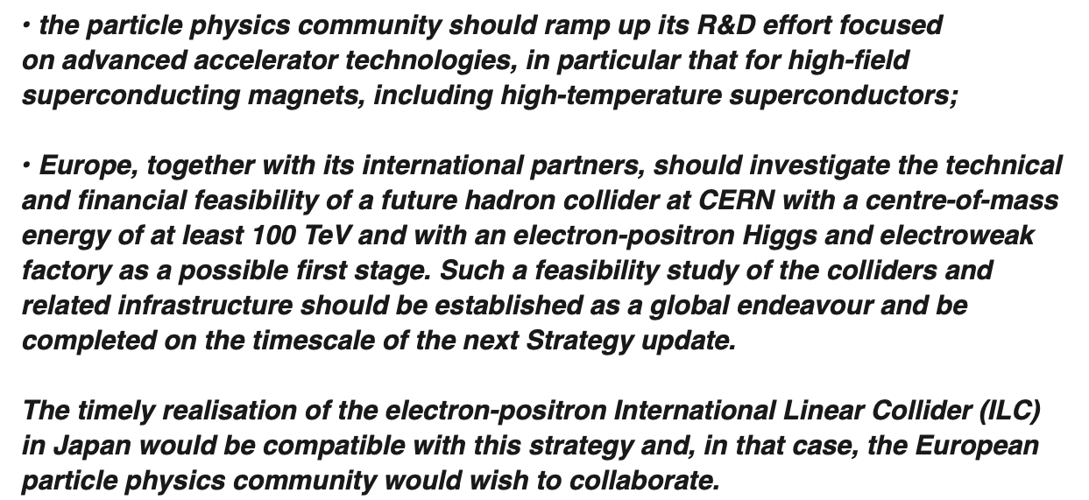
ESPPU
European Strategy update 2020 update

Slide 4
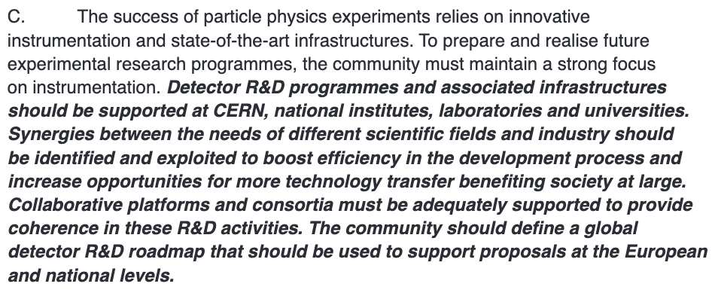
Detector R&D
Organised by ECFA, a roadmap should be developed by the community to balance the detector R&D efforts in Europe, taking into account progress with emerging technologies in adjacent fields. The roadmap should identify and describe a diversified detector R&D portfolio that has the largest potential to enhance the performance of the particle physics programme in the near and long term.

Slide 5
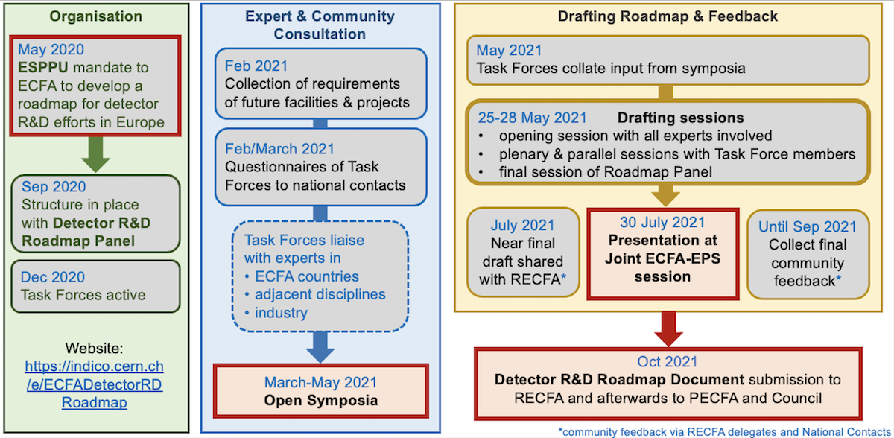
The ECFA ROADMAP

Slide 6

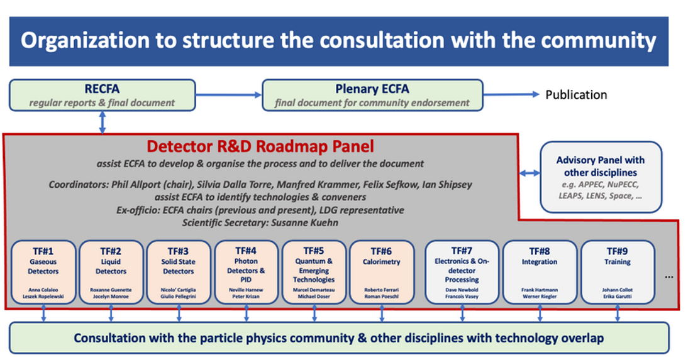
The ECFA Roadmap
Process organised by Panel and nine Task Forces
  67 authors; 12 expert Input Session speakers; ECFA National Contacts; Task Force Surveys; Advisory Panels of other disciplines; Symposia (121 Symposia presenters and 1359 Symposia attendees )
248 page report and 8 page synopsis document identifying the most urgent R&D topics.
Document finalized in 2021 and approved by CERN council
https://cds.cern.ch/record/2784893
https://indico.cern.ch/event/957057/

Slide 7
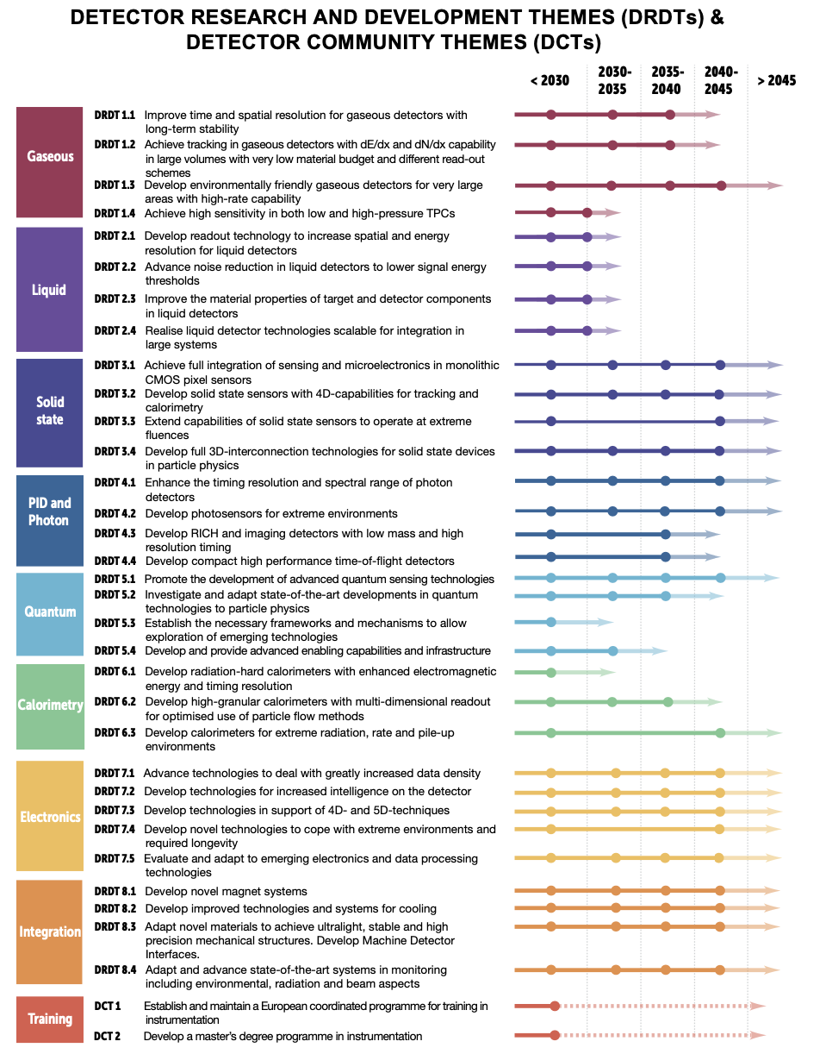
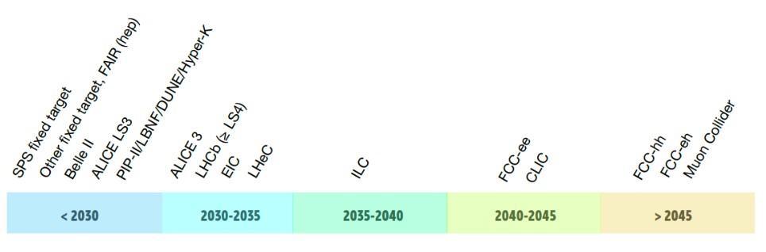
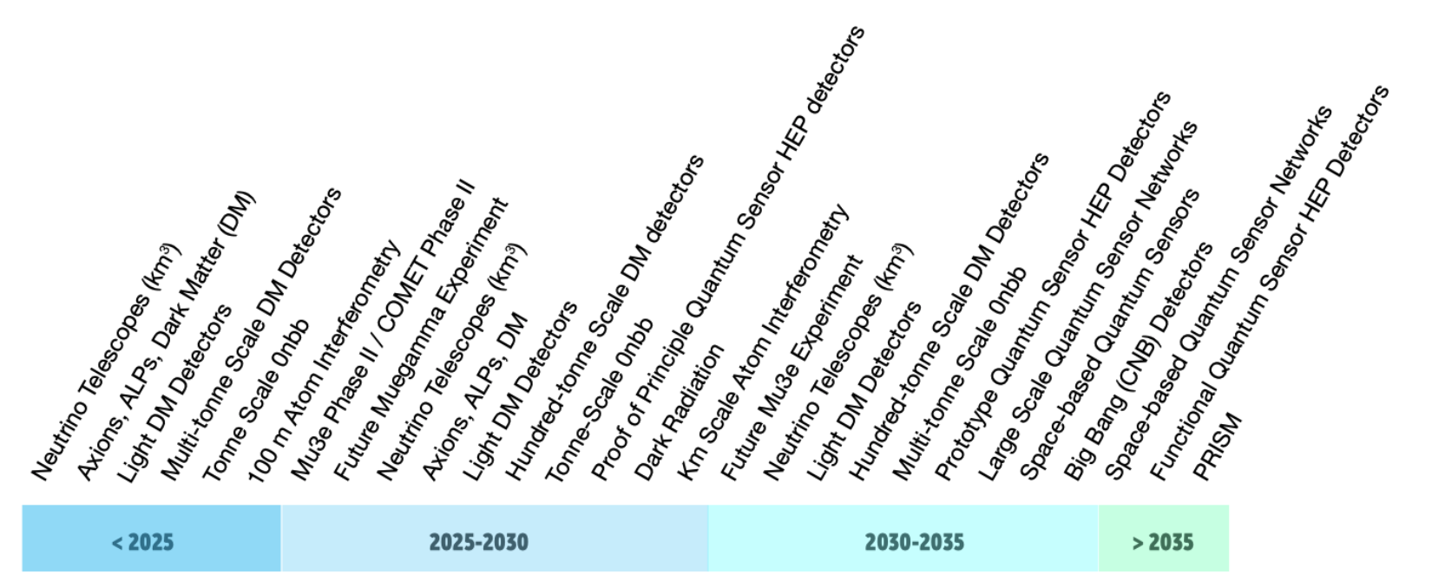
Detector RD Themes
Within each Task Force the aim is to propose a time ordered detector R&D programme by Detector Research and Development Themes (DRDT) in terms of capabilities not currently achievable
Accelerator dates
Non Accelerator dates

Slide 8
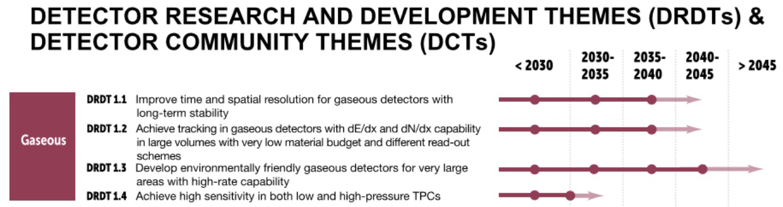
Detector RD Themes
Within each Task Force the aim is to propose a time ordered detector R&D programme by Detector Research and Development Themes (DRDT) in terms of capabilities not currently achievable
Accelerator dates
The faded region acknowledges the typical time needed between the completion of the R&D phase and the readiness of an experiment at a given facility.
Stepping stones are shown to represent the R&D needs of facilities intermediate in time.
Non Accelerator dates

Slide 9

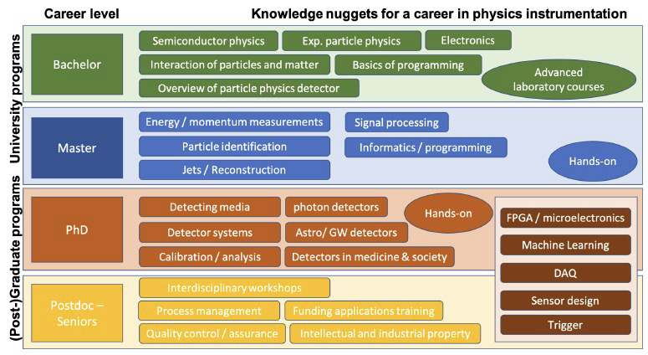
Detector RD Themes
Within each Task Force the aim is to propose a time ordered detector R&D programme by Detector Research and Development Themes (DRDT) in terms of capabilities not currently achievable
Accelerator dates
A structured training programme shall support the scientists in their career
Increase participation of young scientists, in particular graduate students, in leading edge instrumentation R&D, and to foster growth of future HEP instrumentation experts who can compete for permanent positions
arXiv:2107.05739
Non Accelerator dates

Slide 10
General Strategic Recommendations
GSR 1 - Supporting R&D facilities
GSR 2 - Engineering support for detector R&D
GSR 3 - Specific software for instrumentation
GSR 4 - International coordination and organisation of R&D activities
GSR 5 - Distributed R&D activities with centralised facilities
GSR 6 - Establish long-term strategic funding programmes
GSR 7 – “Blue-sky” R&D
GSR 8 - Attract, nurture, recognise and sustain the careers of R&D experts
GSR 9 - Industrial partnerships
GSR 10 – Open Science

Slide 11
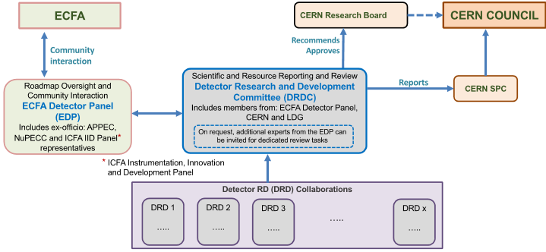
Implementation of the Roadmap
After the publication of the Detector R&D Roadmap, CERN Council requested ECFA to develop the plan for its implementation.
Three areas of Detector R&D:
  Strategic R&D: addressing the high priority items defined in the Roadmap via the DRDTs
  Experiment specific R&D funded outside DRD programme
  ”Bluesky” R&D

Slide 12
Implementation of the Roadmap
All CERN RD collaborations will cease at the end of 2023
In 2023, prepare and setup the DRD collaborations which will start January 2024
  DRD proposals are due July 2023 to be reviewed by the DRD committee (DRDC) in second half 2023
  Approval of DRDs by the CERN Research Board in Q4 2023
  Memoranda of Understanding (MoUs) to be signed end 2023/early 2024
DRDC committee is now finally almost in place and the chair has been selected
A template MOU will be provided based on experience with “small” experiments
DRD7 (electronics) will require member institutes to sign Memoranda of Agreement giving a range of agreed practices and possible issues around IP, NDAs etc that will need to be formally defined.
The term MoA will also be used to agreements between individual institutes and DRDs. This could be used to collect asmall annual membership levy per institute for “Blue Sky” R&D
All DRDs are making great progress. Most will submit the proposal by July 2023. DRD7 plans to submit its proposal by end 2023.
DRD5: progressing on a different time scale and a symposium is scheduled for October 2nd to October 4th and will be used for input to the proposal scheduled for end of 2024. More info at https://doser.web.cern.ch/).
DRD8: not sufficient interest in forming a dedicated DRD in the area of local cooling and low-mass mechanics

Slide 13
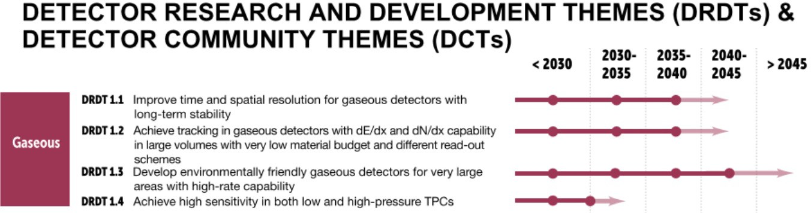
DRD1
DRD1 Gaseous Detectors (TF Convenors: Anna Colaleo (INFN Bari (IT)), Leszek Ropelewski (CERN))
Scientific organisation well defined with eight Technology/Activity Working Groups and work-packages of sub-groups of institutes towards common deliverables, workplans and sharing of resources.
Draft proposal release followed by community meeting to finalise proposal in mid-June with submission in July.
Community meeting: 1st-3rd March 2023 https://indico.cern.ch/event/1245751/
Organisation and workplan at https://indico.cern.ch/event/1214405/
(Also, for RD51 see https://rd51-public.web.cern.ch/)
Notes:
DRDT 1.1 - Improve time and spatial resolution for gaseous detectors with long-term stability
Future experiments require large areas to be instrumented with unprecedented timing capabilities both for time of fight particle identification and to aid track association to the correct event. Their physics programmes demand an improved momentum resolution and performance needs to be maintained over decades with minimal intervention.
DRDT 1.2 - Achieve tracking in gaseous detectors with dE/dx and dN/dx capability in large volumes with very low material Different readout methodologies are required for large volume tracking detectors including micro-pattern gas detector systems, optical readout and direct interfacing to ASICs. Low multiple scattering is essential as is enhanced particle identification through accurate determination of ionisation (either deposited energy or number of clusters) per unit length.
DRDT 1.3 - Develop environmentally friendly gaseous detectors for very large areas with high-rate capability
The largest area detector systems in an experiment are typically gaseous detectors, often as part of an outer muon spectrometer. Ease of maintenance, stable operation and, for some applications, the ability to cope with very large fluxes of charged particles are required. Key to future applications is the development of more ecologically friendly gas mixtures for gaseous detectors and mitigation procedures for use of greenhouse gases when this is unavoidable.
DRTD1.4: Achieve high sensitivity in both low and high-pressure TPCs
Large volume gaseous detectors provide a key technology for high efficiency searches for rare events with differing readout for optimizing the signal-to-noise ratio and reducing detector backgrounds

Slide 14
DRD1 WGs
Transverse activities enabling and facilitating the R&D activities:
DRDT
WG2 Applications
Tools and infrastructures
WG1 WG3 WG4 WG5 WG6 WG7 WG8
Inner and central tracking with PID capability
Technologies
Gas and material studies
Detector physics, simulations and software tools
Electronics for gaseous detectors
Detector production
Common test facilities
Training and dissemination
DRDT1.1
DRDT1.3
DRDT1.2
Photon detection (PID)
Timing detectors
Muon system
Calorimetry
TPC for rare event searches
DRDT1.4

Slide 15
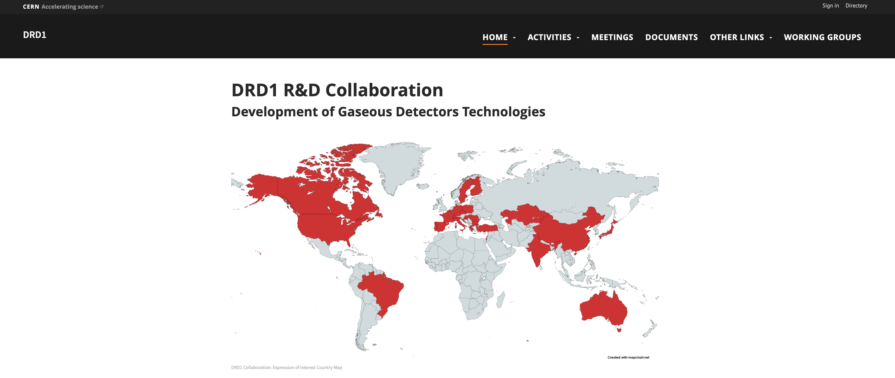
DRD1
March- 5 May: draft document preparation including a preliminary definition of Work Package
15 May: Start the community consultation. 1st Draft shared with Institute Contacts.
15 May - 1 June: Proposal Team works on the draft document within working groups, implementing the feedback from the community and preparation of the preliminary version of the Executive Summary with WP tables.
1 June: End of the community feedback about the first draft
16 June: Approval of the document for the community-wide discussion and release to the 2nd draft whole community.
22-23 June: DRD1 Community workshop - wide discussions during the community workshop
June- July: - Definition of the required resources for the outlined programme need ( split into personel effort (FTEs) and material plus services (non-FTE) costs. – institute’s inputs; executive summary
End-July: Submission of the proposal
22-23 June: DRD1 Community workshop
https://indico.cern.ch/event/1273991/timetable/?view=standard
Approximately 70 participants registered for the event (about half of them in person).
1.5 days of presentations and discussions about the proposal, Work packages, MoU
steps towards formation of the Collaboration
https://drd1.web.cern.ch/

Slide 16
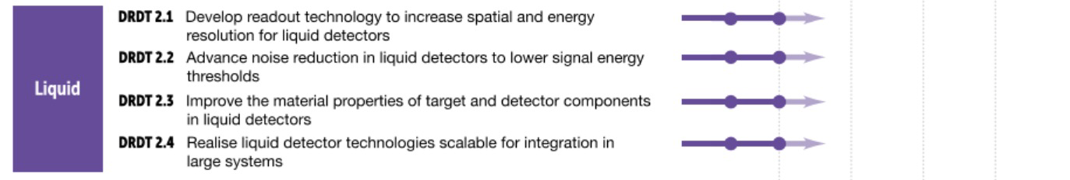
DRD2
DRD2 Liquid Detectors (TF Convenors: J. Monroe (RHUL (GB), R. Guenette (Manchester (GB))
Community meeting: 20th April 2023 https://indico.cern.ch/event/1214404/timetable/#20230420
Four main work-packages defined with sub-projects. Technical Areas (TAs) established and supported by the community
Representatives selected to iron out overlaps: RD1 (Gas detectors): Kostas Mavrokoridis, DRD4 (Photon detectors): Fabrice Retiere, DRD7 (Electronics): Elena Gramellini
Proposal first full draft completed. Deliverables tables for each TA completed. FTE/resources/facility (both available and needed) collected.
Organisation and workplan at https://indico.cern.ch/event/1214404/

Slide 17
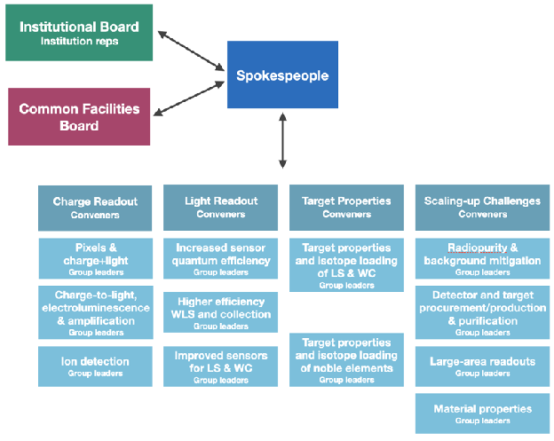
DRD2

Slide 18
DRD3

Slide 19
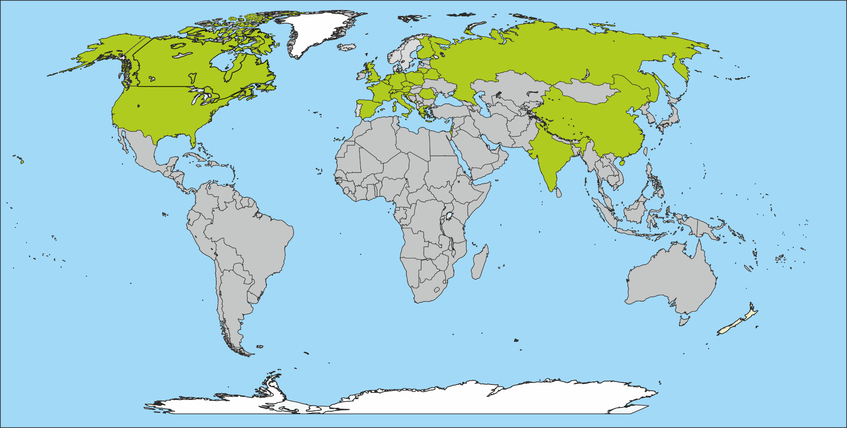
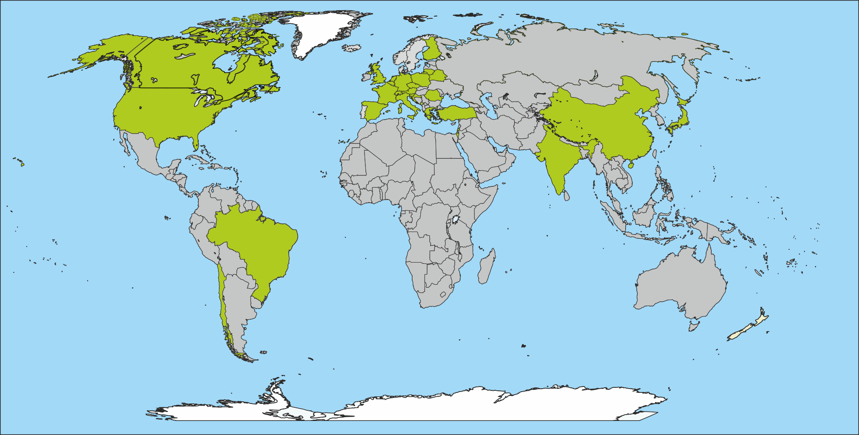
From RD50 to DRD3
DRD3
Status: 17.3.2023
RD50
s
(expression of interest)
92 institutes* (+27 institutes)
  68 in Europe (+18)
  12 in North America (+4)
  9 in Asia (+2)
  3 in South America (+3)
s
57 RD50 institutes*
(88% of RD50)
65 institutes; 438 members
  50 in Europe
  8 in North America
  7 in Asia
+ 35 other institutes
In DRD3 ≈ 62%
will be former
RD50 members
[*] 4 institutes included that did not send a questionnaire yet

Slide 20
DRD3

Slide 21
DRD3
DRD3 Solid State Detectors (TF Convenors: Giulio Pellegrini (IMB-CNM-CSIC) (ES)), Nicolo Cartiglia (INFN Torino (IT))
Detector R&D Themes (DRDTs) define the work-packages with seven Working Groups to organise the proposal deliverables with WG milestones already defined.
First full draft completed, with further iterations on resources estimates with institutes before proposal preparation process aimed to conclude around beginning of July.
Online questionnaire on resources completed. It will be sent out by the end of next week requiring feedback by the end of August.
Community meeting: 22nd-23rd March 2023 https://indico.cern.ch/event/1214410/timetable/#20230322.detailed
Further organisation information at https://indico.cern.ch/event/1214410/
(Also, for RD50 see http://rd50.web.cern.ch/ and for RD42 see https://rd42.web.cern.ch/rd42/)

Slide 22
DRD4
DRD4 – Detector R&D Collaboration on
Photodetectors and Particle ID
+ SciFi tracking + Transition Radiation

Slide 23
DRD4
DRD4 Particle ID and Photon Detectors (TF Convenors: Christian Joram (CERN), Peter Krizan (JSI (SI))
Community meeting: 6th-17th May 2023 https://indico.cern.ch/event/1263731/ and further background at https://indico.cern.ch/event/1214407/
A questionnaire was sent out about interest of institutions to join WGs and R&D plans in this area
~55 groups, incl. ~10 groups interested in SciFi tracking and Transition Radiation, and ~5 industrials.
Most teams are small (3 FTE) and have limited resources (~30 kEUR annual budget)
Work on the proposal is under way, to be completed by the end of July 2023 :
  Preparation team: Sajan Easo, Massimiliano Fiorini, Roger Forty, Christian Joram, Peter Križan, Imad Laktineh, Rok Pestotnik, Alessandro Petrolini, Fulvio Tessarotto
  4 (online) surveys were used to collect information about activities, resources, infrastructure, intentions. Information is partly incomplete and needs clarification.
  Working on details of WGs and combining R&D efforts in the proposal.
  Meetings will take place this and next week to consolidate input, decide on milestones and deliverables.
Interaction with other DRDs
  Interest in DRD4 photodetector R&D by DRD6, participation in WG meetings expected
  Interaction with DRD7: DRD4 deals with low light levels (~single photon detection) with specific requirements on the read-out electronics, probably no overlap with DRD7 plans

Slide 24
DRD6
DRD6 Calorimetry (TF Convenors: Roberto Ferrari (INFN Pavia (IT), Roman Poeschl (Université Paris-Saclay (FR))
“DRD Calo indico page”: https://indico.cern.ch/category/12772/
  Information on important events and access to relevant documents
  233 people from four regions registered so far
1st Community Meeting 12/1/23: https://indico.cern.ch/event/1212696/
Proposal phase until 31st of July 2023
  Input-proposals collected until 1st of April 2023
  2nd Community Meeting 20th April https://indico.cern.ch/event/1246381/
    Presentation of summaries of input-proposals (w/o disclosing confidential information)
    Presentation of a WP Structure on DRD Calorimetry
Input-proposals are about to be condensed the DRD 6 Calorimetry proposal
  Further iteration with stakeholders, community and higher level bodies
  Meeting with input proposal submitters
Proposal with plans and general overview on resources (~20 pages)
  Short overview of projects/activities with very mild ranking on maturity level
  Resource table ( Milestones, Deliverables, FTE)

Slide 25
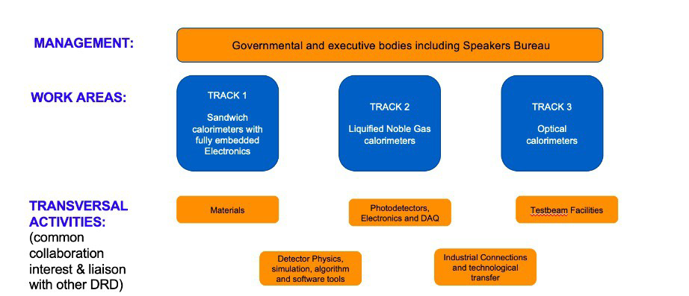
DRD 6
Transversal Activities are vital for the success of the collaboration
Transversal Activities will also ensure relations with other DRD

Slide 26
DRD6
31st July 2023 – Submission of DRD Calo proposal
Summer/Early Autumn
  Implementation of feedback from proposal review
  Detailed structure of work areas and transversal activities
  Consolidation of organisation
  Management structure
  Assigning names to the different boxes
  Understanding of which kind of documents we will need (MoU/MoA) and when
  Maybe a 3rd Community Meeting
  1st January 2024 – DRD on Calorimetry in place
  Kick-off Meeting Spring 2024

Slide 27
DRD7
DRD7 Electronics (TF Convenors: Dave Newbold (STFC (GB), Francois Vasey (CERN))
“Transversal” – Its scope depends on the content of other DRD proposals
7 Working Groups created, 21 conveners appointed
Each WG hosts projects to implement its objectives which then need to be aggregated into a coherent proposal to be submitted to DRDC.
Before reaching the proposal an LoI will be submitted in July 2023 which also contains ballpark resource estimates with full proposal before the end of the year.
Community meeting: 14th-15 March 2023 https://indico.cern.ch/event/1214423/timetable/#20230314.
Organisation and and interface to other DRD detailed in “Organisation of the DRD7 Collaboration. Version 6”

Slide 28
DRD7
Towards a DRD7 structure
Collaboration Board: participating institutes
Steering Committee: to be appointed
Technical Committee:WG7.x conveners
WG 7.1
Data Density &
Power efficiency
WG 7.2
Intelligence
On-Detector
WG 7.3
4D & 5D Techniques
WG 7.4
Extreme Environments
WG 7.5
Backend systems & COTS
WG 7.6
Complex
imaging ASICs & technologies
Conveners 1
Conveners 2
Conveners 3
Conveners 4
Conveners 5
Conveners 6
Projects
Projects
Projects
Projects
Projects
Projects
Transverse WG 7.7 Tools and Technologies
Projects
Conveners 7
05.07.23
28

Slide 29
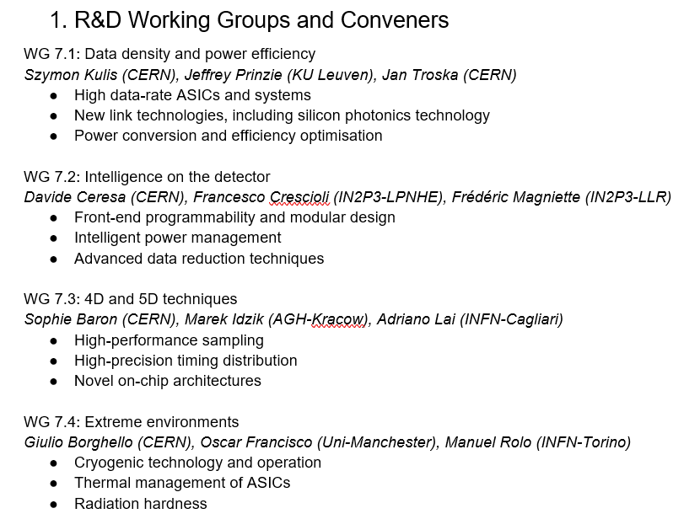
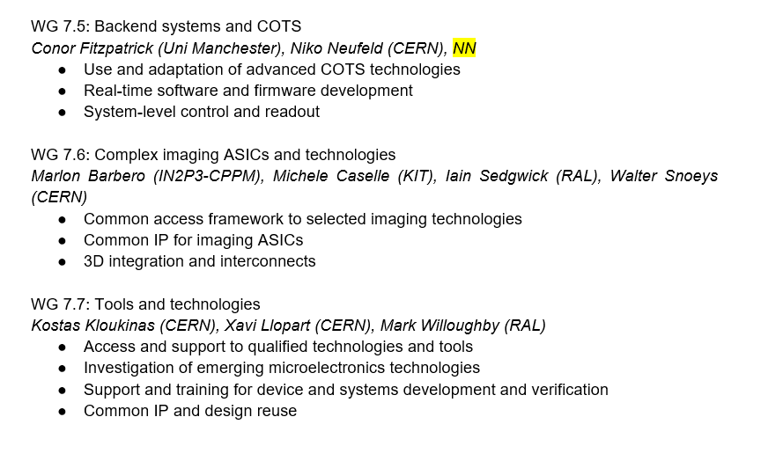
DRD7

Slide 30
DRD7
Call for projects sent out on 27.05.2023 with deadline on 30.06.2023
Criteria for strategic R&D projects defined
  Address novel, ambitious, and transformative topics with an appropriate risk appetite
  Have clearly presented objectives, scope, deliverables, and work plan
  Be pursued by a well-defined set of participating institutes, with clear responsibility assignments and an appropriate leadership and management structure
  Possess adequate resources and skills to conduct the proposed development over the entire project timeline
  Agree to report as required to allow an overview of progress to be maintained
Desirable characteristics
  Addressing multiple R&D themes in one development
  Involving multiple institutes, preferably supported by more than one funding agency
  Tackling system-level issues
DRD7 aggregates the WG projects into a coherent portfolio addressing the strategic priorities defined in the roadmap
Projects in DRD7 will target common generic developments, or exploration of cutting-edge technologies requiring negotiated access to frameworks and complex design flows. They may involve high costs, expert coordination or unique expertise, and can possibly only be effectively delivered as a common community effort.
DRD7 interacts and aligns with other DRDs to prevent duplicated or parallel developments, and to identify risky engagements which would benefit from support across the field

Slide 31
DRD7
Jul-23:
  expressions of interest processed by WGs
  Project proposals drafted by WGs and reviewed by steering committee
  LoI drafted and submitted to DRDC
  Alignment of electronics content with other DRDs
Aug-Sep-23:
  Elaboration of full project proposals
25-26 Sep-23:
  2nd DRD7 workshop at CERN, to shape the collaboration and discuss the project portfolio
Q3/4-23
  Administrative, technical and budgetary discussions
Q4-23
  DRD7 collaboration proposal submitted to DRDC

Slide 32
Conclusions
An amazing amount of work done extremely rapidly
CERN EP R&D Programme links at: Homepage | ep-rnd.web.cern.ch.
AIDAinnova web pages: https://aidainnova.web.cern.ch/
EURO-LABS information at https://web.infn.it/EURO-LABS/
Task force membership at: https://indico.cern.ch/event/957057/page/20875-panel-members-and-task-forces.

Slide 33

DRD1
Q4-2022/Q1-2023
Q2-2023
Q3-2023
Q4-2023
2024
Formation of the DRD1 proposal team
Collection of interest from the institutes (survey)
1st Workshop and shaping the direction of RD.
DRDC mandate reviewed and agreed with CERN management and EDP
Writing the proposal (scientific and organization) that includes conclusion and feedback from the workshop and survey
Collect feedback by institutes in contact with their funding agencies about the best funding schema
2nd Community Workshop
Mechanisms agreed with funding agencies for country specific DRD funding request.
End July –submission of the proposal, including resource information:
Establishing continuation of existing RD51 projects and carrying resources
.
Follow the review revisions and upon green light from DRDC, CERN
research board approves the formation of the collaboration
New structures operational and new R&D programmes underway from beginning 2024.
Through 2024, collection of MoU signatures with defined contribution areas per institute.
Ramp up of new strategic funding and R&D activities 2024-2026
resources needed
resources already available
Interest of institutes/FA to contribute to specific tasks
DRDC review (scientific, milestones, feasibility, financials)

Slide 34
DRD Collaboration Progress Overview
International Detector R&D (DRD) Collaboration Progress
DRD1 Gaseous Detectors (TF Convenors: Anna Colaleo (INFN Bari (IT)), Leszek Ropelewski (CERN))
Scientific organisation well defined with eight Technology/Activity Working Groups and work-packages of sub-groups of institutes towards common deliverables, workplans and sharing of resources.
Draft proposal release followed by community meeting to finalise proposal in mid-June with submission in July.
Community meeting: 1st-3rd March 2023 https://indico.cern.ch/event/1245751/
Organisation and workplan at https://indico.cern.ch/event/1214405/
(Also, for RD51 see https://rd51-public.web.cern.ch/)
DRD2 Liquid Detectors (TF Convenors: Jocelyn Monroe (RHUL (GB)), Roxanne Guenette (Manchester (GB)))
Four main work-packages defined with sub-projects.
Technical Areas (TAs) clearly established and supported by community feedback.
Deliverables tables for each TA being finalized. Most FTE/resources/facility (both available and needed) have been collected. Proposal writing underway with goal to have full draft early June.
Community meeting: 20th April 2023 https://indico.cern.ch/event/1214404/timetable/#20230420
Organisation and workplan at https://indico.cern.ch/event/1214404/
*community feedback via RECFA delegates and National Contacts

Slide 35
DRD Collaboration Progress Overview
DRD3 Solid State Detectors (TF Convenors: Giulio Pellegrini (IMB-CNM-CSIC) (ES)), Nicolo Cartiglia (INFN Torino (IT)))
Detector R&D Themes (DRDTs) define the work-packages with seven Working Groups to organise the proposal deliverables with WG milestones already defined.
First full draft of proposal targeted for end of May, with further iterations on resources estimates with institutes before proposal preparation process aimed to conclude around the end of June.
Community meeting: 22nd-23rd March 2023 https://indico.cern.ch/event/1214410/timetable/#20230322.detailed
Further organisation information at https://indico.cern.ch/event/1214410/
(Also, for RD50 see http://rd50.web.cern.ch/ and for RD42 see https://rd42.web.cern.ch/rd42/)
DRD4 Particle ID and Photon Detectors (TF Convenors: Christian Joram (CERN), Peter Krizan (JSI (SI)))
Community meeting discussed draft collaboration structure.
Work on the proposal and MoU underway for July 2023.
Community meeting: 6th-17th May 2023 https://indico.cern.ch/event/1263731/
Further background at https://indico.cern.ch/event/1214407/
DRD5 Quantum and Emerging Technologies (TF Convenors: Marcel Demarteau (ORNL), Michael Doser (CERN))
Very different and diverse community with many interfaces to other programmes and science areas.
“White paper” document prepared and in circulation for comments until mid-June with LoI targeted for July 2023 with full proposal before the end the year, given specific issues of overlaps etc with funded initiatives outside PP.
Draft of web pages explaining six quantum sensing families at https://doser.web.cern.ch/.
*community feedback via RECFA delegates and National Contacts

Slide 36
DRD Collaboration Progress Overview
DRD6 Calorimetry (TF Convenors: Roberto Ferrari (INFN Pavia (IT)), Roman Poeschl (Université Paris-Saclay (FR)))
Scientific organisation well advanced with four separate tracks defined and required resources identified including significant test-beam availability after 2025.
Draft proposal ready by start of June, second draft mid-June, target proposal readiness in mid July.
Community meetings: 12th January 2023 https://indico.cern.ch/event/1212696/ and 20th April 2023 https://indico.cern.ch/event/1246381/ .
Organisation, workplan and proposal status at https://indico.cern.ch/event/1213733/
(Also for CALICE see https://twiki.cern.ch/twiki/bin/view/CALICE/WebHome, for Crystal Clear see https://crystalclearcollaboration.web.cern.ch/ and for RD52 see http://www.phys.ttu.edu/~dream/index.html.)
DRD7 Electronics (TF Convenors: Dave Newbold (STFC (GB)), Francois Vasey (CERN))
With TF8, TF9 and “Transversal” topic area with seven Working Groups whose scope depends on the content of other DRD proposals.
Each WG hosts projects to implement its objectives which then need to be aggregated into a coherent proposal to be submitted to DRDC.
Before reaching the proposal an LoI will be submitted in July 2023 which also contains ballpark resource estimates with full proposal before the end of the year.
Community meeting: 14th-15 March 2023 https://indico.cern.ch/event/1214423/timetable/#20230314.
Organisation and planning are also detailed in the draft “Organisation of the DRD7 Collaboration. Version 5”
*community feedback via RECFA delegates and National Contacts

Slide 37
DRD Collaboration Progress Overview
TF8 Integration (TF Convenors: Frank Hartmann (KIT (DE)), Werner Riegler (CERN))
Survey launched to gauge community appetite for DRD in the areas on 23rd March 2023 to all those who registered interest. Results are returned and have been analysed.
Forum on Tracking Detector Mechanics 2023 31st May to 2nd June seen as opportunity for the mechanics and local colling community to discuss possible interest in forming a DRD for their specific area.
Other TF8 topics seen as equally important to the future of the field and funding mechanisms for these are needed, but they are not thought to be appropriate subjects for a DRD collaboration.
TF9 Training (TF Convenors: Erika Garutti (Hamburg University (DE)), Johann Collot (university Grenoble Alpes (FR)))
Now the topic of the dedicated new ECFA Training Panel
Kick-off meeting on 7th March 2023 with agenda at https://indico.desy.de/event/38365/.
Web pages etc are being constructed at https://indico.cern.ch/event/1270365/.
CERN EP R&D Programme links at: Homepage | ep-rnd.web.cern.ch.
AIDAinnova web pages: https://aidainnova.web.cern.ch/
EURO-LABS information at https://web.infn.it/EURO-LABS/
Task force membership at: https://indico.cern.ch/event/957057/page/20875-panel-members-and-task-forces.
*community feedback via RECFA delegates and National Contacts
7 July 2023
ECFA Detector R&D Roadmap – PPAP Meeting
37

Slide 38

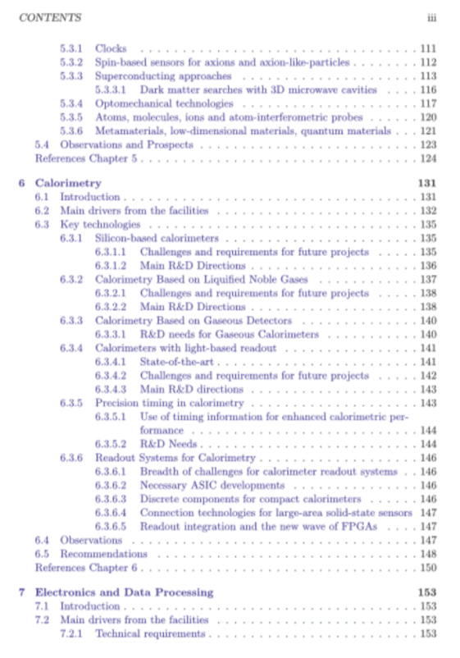
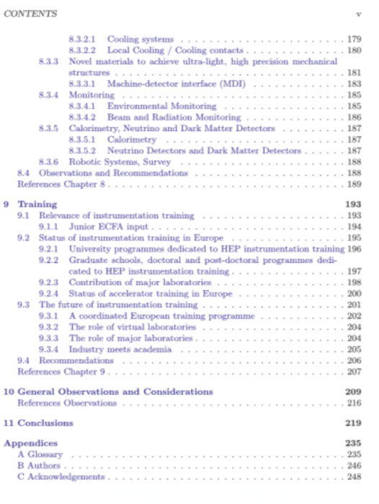
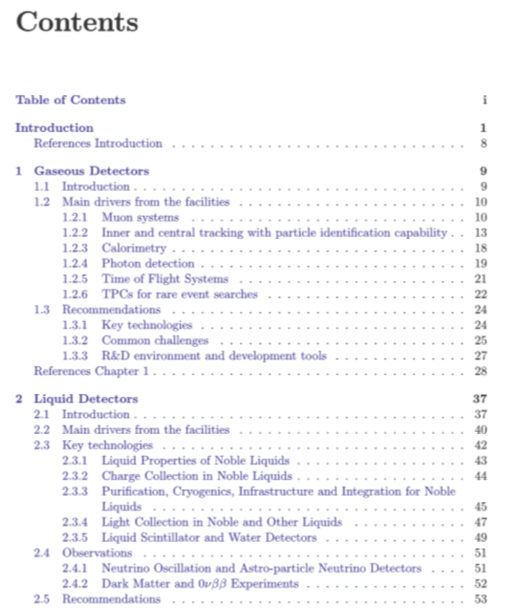
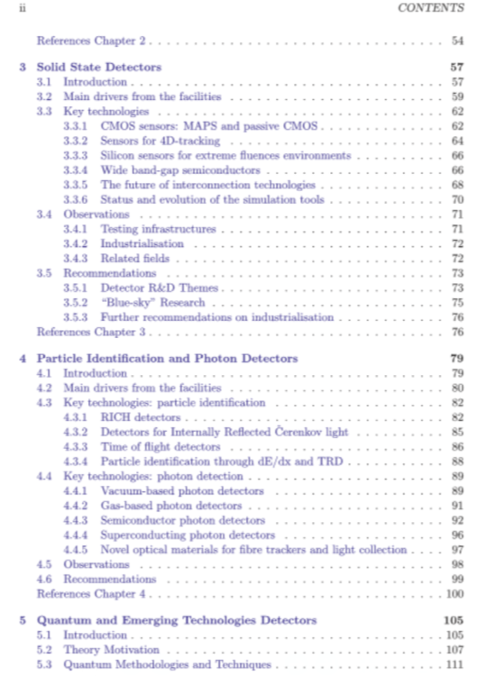

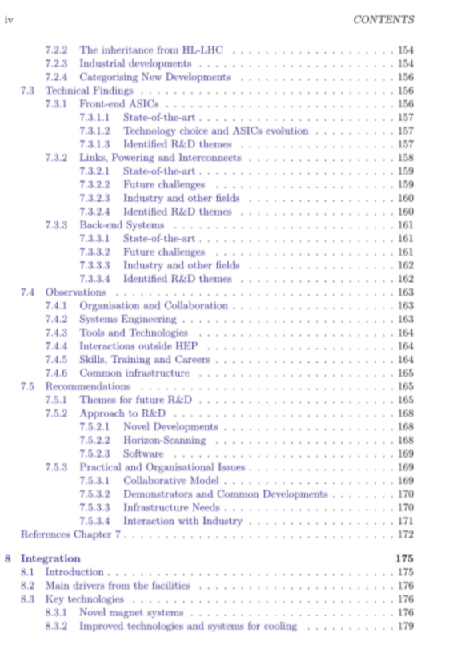
DOI: 10.17181/CERN.XDPL.W2EX
ISBN: 978-92-9083-614-8
Published 21.10.2021
(https://cds.cern.ch/record/2784893)
Also 8 page synopsis document:
https://cds.cern.ch/record/2784893/files/Synopsis%20of%20the%20ECFA%20Detector%20R&D%20Roadmap.pdf
CERN-ESU-017
ECFA/RC/21/510

Slide 39
DRD1 scientific structure
Applications
Tools and infrastructures
ECFA DRDT
Employing gaseous detectors at future facilities
Transverse activities enabling and facilitating the R&D activities: simulation/characterization tools, beam test facilities, industrial partnership, dissemination & networking
Inner and central tracking with PID capability
Technologies
Gas and material studies
Detector physics, simulations and software tools
Electronics for gaseous detectors
Detector production
Common test facilities
Training and dissemination
DRDT1.1
DRDT1.3
DRDT1.2
Photon detection (PID)
Timing detectors
Muon system
Calorimetry
TPC for rare event searches
DRDT1.4

Slide 40
DRD Proposal Organisation
The organisation of DRDs is expected to be largely up to the relevant communities
A document “Suggested Guidelines for DRD Proposal Preparation” has been prepared by the chairs of the ECFA Detector Panel recommending some commonality of language and information, to avoid confusing both reviewers and Funding Agencies.
CERN/SPC/1190 refers to Memoranda of Understanding (MoUs) in the context of agreements of Funding Agencies to support Strategic R&D through commitments to provide funding through their institutes towards the achievement of the DRD work-package milestones and deliverables.
DRD7 (electronics) will require member institutes to sign Memoranda of Agreement giving a range of agreed practices and possible issues around IP, NDAs etc that will need to be formally defined.
The term MoA will also be used to agreements between individual institutes and DRDs. This could be used to collect asmall annual membership levy per institute for “Blue Sky” R&D
The preparation of MoUs will require a common format to be developed by CERN as these will be agreements ultimately signed between the Funding Agencies and the host laboratory which also provides the formal programme oversight.
*community feedback via RECFA delegates and National Contacts

