Slide 1
Neutrinos Overview
PPAP – July 7th 2023
Jeanne Wilson
Notes:
25 + 5 minutes
In this talk I will give a brief explanation of the process of neutrino-less double beta decay and motivate why we need to search for it. I'll discuss the pros and cons of different experimental strategies and review the existing limits of neutrino less double beta decay rates and hence neutrino mass. I’ll discuss the achievements of current experiments and the R&D for future experiments with a strong focus on experiments with UK involvement and the UK strategy in this field.

Slide 2
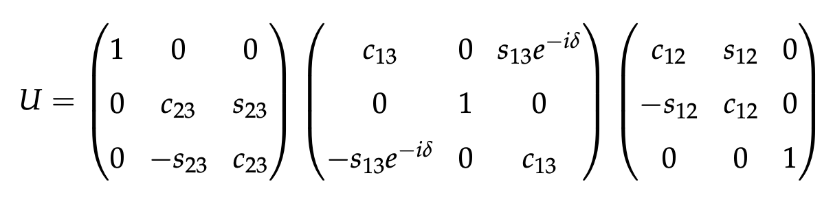

What do we know?
Neutrinos oscillate $\left(\begin{aligned}ν_{e} \\ ν_{μ} \\ ν_{τ}\end{aligned}\right)= U \left(\begin{aligned}ν_{1} \\ ν_{2} \\ ν_{3}\end{aligned}\right)$ $P_{ab}= \sin^{2}\left(2θ\right)\sin^{2}\left(\frac{1.27Δm^{2}L}{E}\right)$
Atmospheric
Long Baseline disappearance
Super-K, Hyper-K, IceCUBE- upgrade, T2K, Nova, DUNE
Close Reactor
Long Baseline appearance
T2K, Nova, Hyper-K, DUNE, JUNO
Solar
Far Reactor
SNO+, Super-K, Hyper-K, JUNO
Notes:
OK – First I’ll go the theory very briefly
We know that neutrinos oscillation – neutrino flavour changes sinusoidally dependent on L/E, three mixing angles and two mass differences and one phase parameter - the neutrino flavour states we observe are mixtures of mass states as given by the 3*3 PMNS matrix – which is commonly factorized like this, with – to first order - different areas measured by different neutrino sources.
And here I’ve included experiments that contribute to each area – not exhaustive but I’ve focused on current experiments with strong UK involvement.
+ KM3NET + ORCA involvement via Hull astronomy group

Slide 3
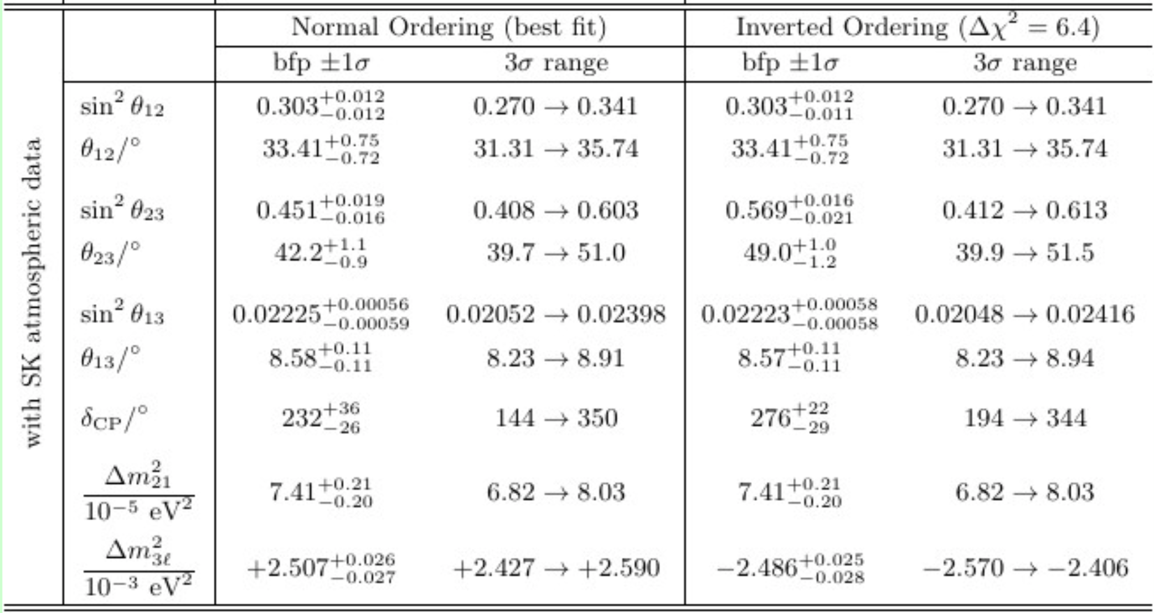
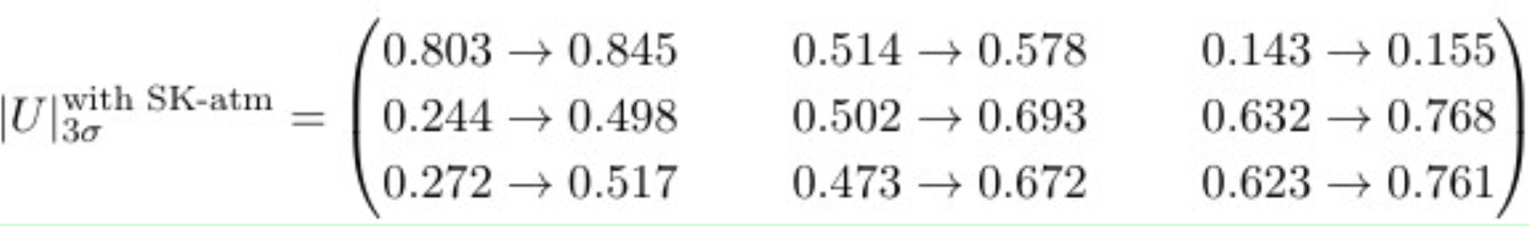
What do we know?
Precision measurements of oscillation parameters
http://www.nu-fit.org
Notes:
But as our measurements of the underlying mixing angles and mass differences get more precise, we can’t treat the effects in isolation and we move to global fits for precision oscillation parameter measurement
These are latest results from the NuFit collaboration, combining all oscillation data.
I’m not going to go through these in detail

Slide 4
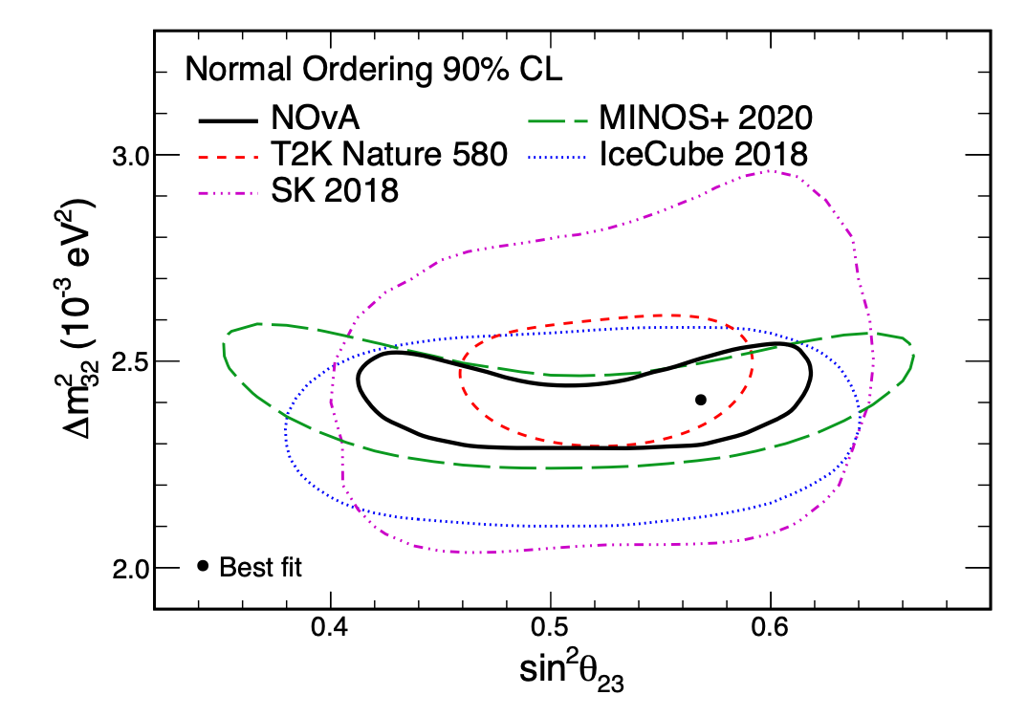
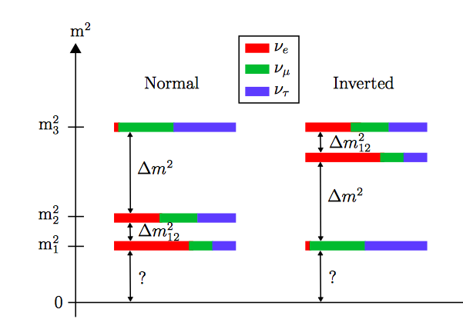

What don’t we know?
Is $θ_{23}$ maximal?
What is the sign of $Δm_{32}$?
  Normal or Inverted ordering?
Is $δ_{CP}$non zero?
  Motivated to explain matter-antimatter asymmetry
https://arxiv.org/pdf/2108.08219.pdf
Notes:
But we should examine the areas we are lacking in information,
We don’t know if $θ_{23}$ is maximal - 45 degrees or a little more or less. And more interestingly why – what is the significance if it is maximal?
– matter effects in the sun also allow us to determine that m2 is bigger than m1 but we don’t yet know the sign of dm32, which means we don’t know the mass ordering or hierarchy.
And of course there is much interest in the parameter delta-CP. If this is non-zero, differences would arise between neutrino and anti-neutrino oscillations, breaking CP-symmetry in the lepton sector, which is of course strongly motivated by the need to explain the matter-antimatter asymmetry of the universe.

Slide 5
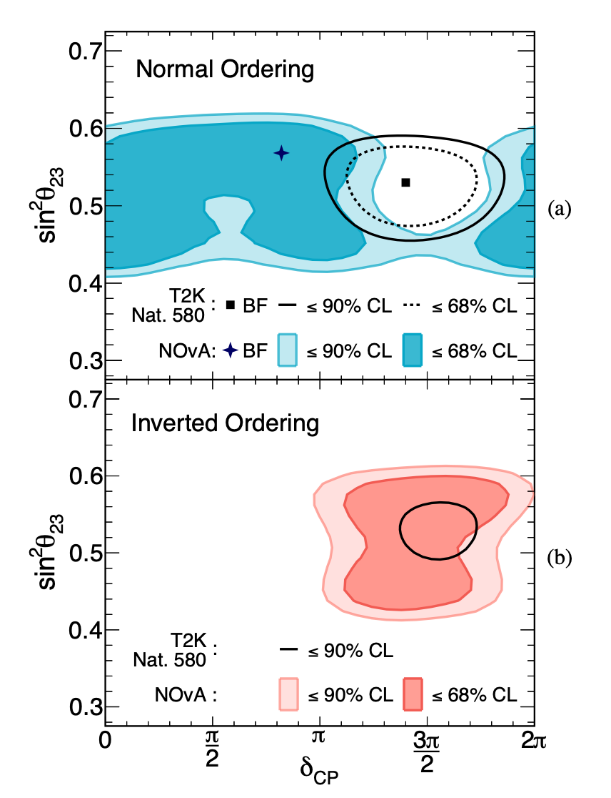

Tensions
Nova vs T2K
  T2K see asymmetry in $ν_{μ}\left(\overline{ν_{μ}}\right)→ ν_{e}(\overline{ν_{e}})$ oscillations giving 2$σ$ evidence for non-zero $δ_{CP}$ and excluding some values at 3$σ$
  NOvA data don’t show large asymmetry and prefer retained CP invariance, normal mass ordering and $θ_{23}>π/4$
Need for joint analysis (underway) and new experiments
Solar vs KamLAND
https://arxiv.org/pdf/2108.08219.pdf
Notes:
And whilst we are on tensions – there is some difference in the value of delta-m_12 coming from the combined solar measurements and from the KamLAND experiment are

Slide 6

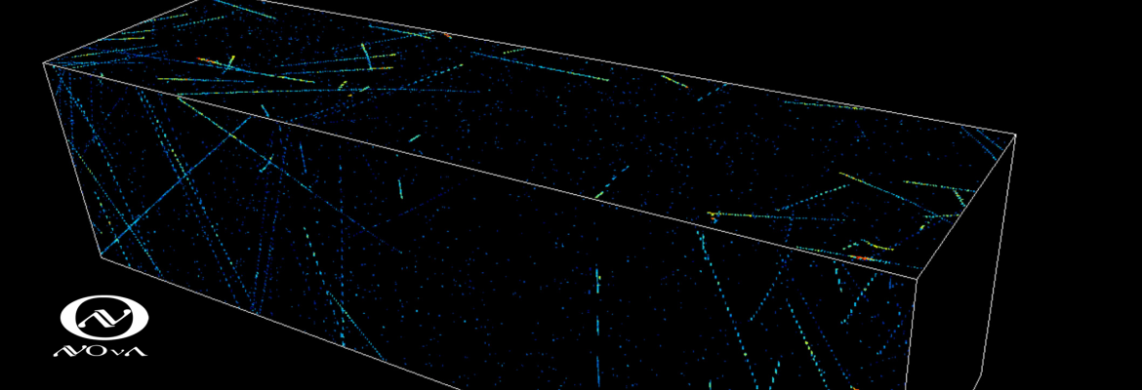
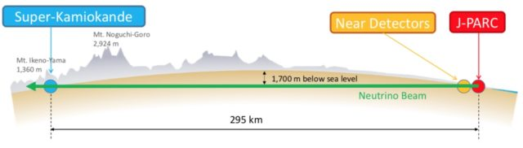

Current Oscillation Experiments
T2K
11 UK institutions
>80 UK members
Leadership in analysis, fitting, cross-sections, computing, ECAL
Will collect beam data up to HK start in 2027, including beam upgrades
NOvA
3 UK institutions
Leadership in analysis, IB, beam, recon
Data from NuMi beam until beam work for DUNE in FY27, >2.5$×$ more data to come
Different Baselines, Beam Energies and Detection Technologies
Joint NOvA-T2K analysis is currently under collaboration review with substantial UK involvement.
Notes:
T2K data plot

Slide 7
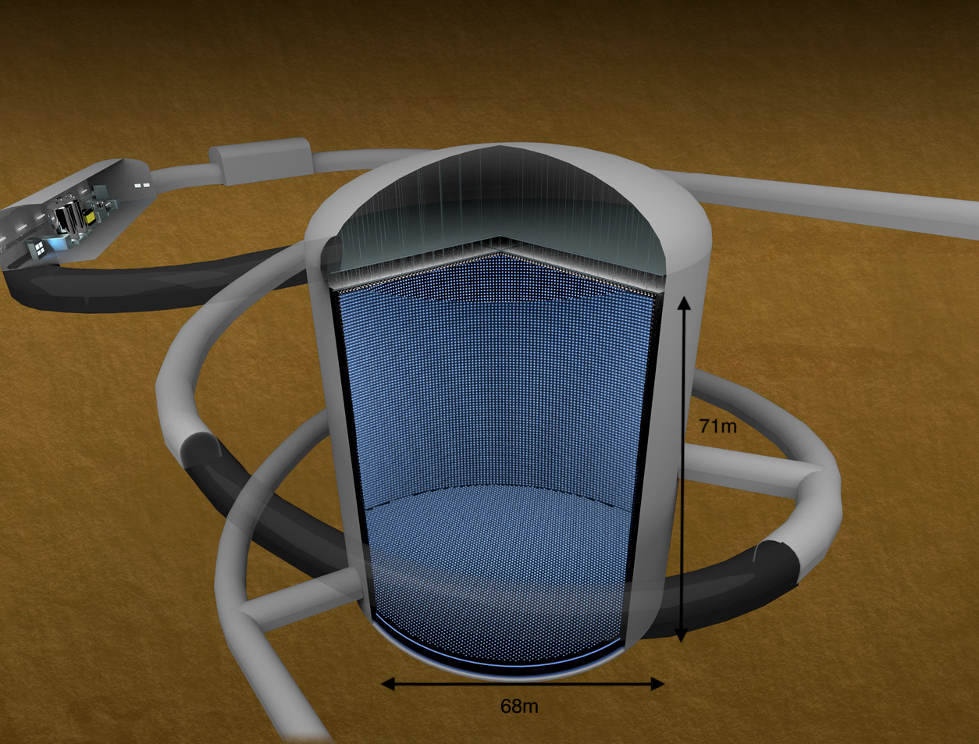
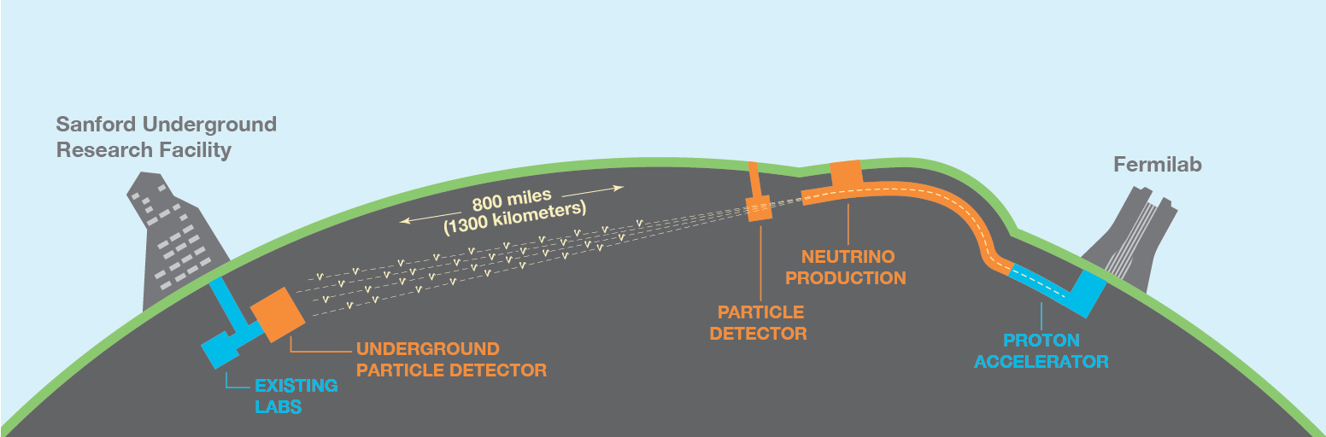

Future Oscillation Experiments
Hyper-K
Japan, baseline ~300km
Narrow beam energy 0.6GeV
Water Cherenkov far detector: 71m tall, 68m diameter, 260ktonnes H₂O
9 UK institutions
Leadership in DAQ, Calibration, Analysis, Computing, Outer Detector, Beam components, International Spokesperson
Construction underway, start of data taking 2027
DUNE
USA, baseline ~1300km
Broad energy beam– access to both $δ_{CP}$ and mass hierarchy
Liquid Argon Time-Projection Chambers far detector: 68ktonnes Lar
UK building majority of APAs for first 10kt LAr module, and DAQ for first two 10kt modules + proton target and RF cavities for LBNF 1.2 MW upgrade
Pandora reconstruction, Near Detector design, Physics
Notes:
Add JUNO – different slide

Slide 8
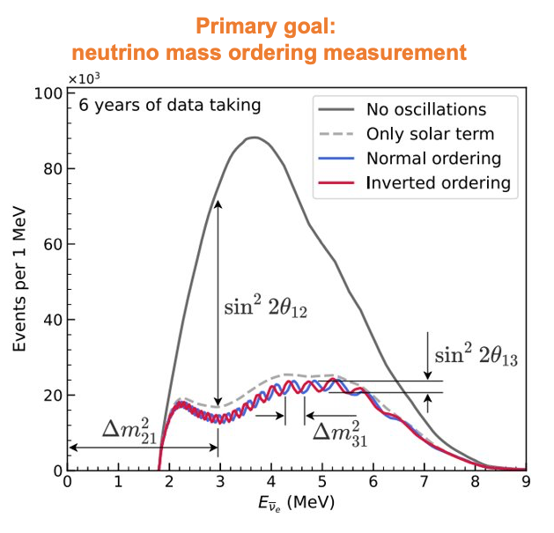

Near Future Oscillation Measurements
JUNO
  Detect sub-dominant oscillations in neutrinos from Chinese nuclear power plant
  3$σ$ sensitivity in 6 years with reactor only data
  + combine with atmospherics
  + other physics sensitivity (solar, SNO, geo-$ν$ etc)
  Construction advanced
  Data taking 2024
  2 UK institutes
Notes:
Warwick and Liverpool – funded through ERF/UKRI, university funding and CSC
Working on atmospheric oscillation analyses, event generation for GeV physics
Leadership of Nu-interactions WG in 2022

Slide 9

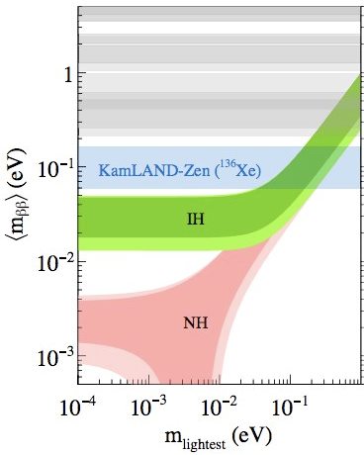
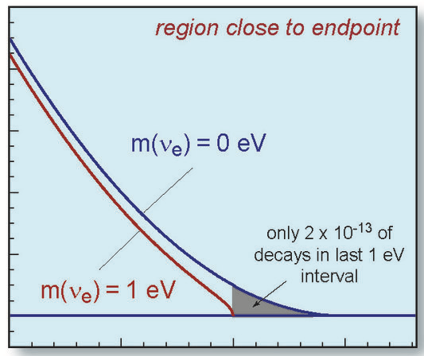





Neutrino masses
Adapted plot C Patrick
$0νββ$ NULL measurements
$$\left\langle m_{ββ}^{}\right\rangle =\left|\sum_{i}{U_{ei}^{2}m_{i}}\right|$$
Cosmology
pdglive.lbl.gov
∑m_{ν}<0.12eV
PRL 130, 051801
Allowed bands
$$Δm_{21}, \left|Δm_{32}\right|$$
$$m_{ν}^{2}=\sum_{i}{{\left|U_{ei}\right|}^{2}m_{i}^{2}}$$
Katrin${ m}_{ν}<0.9 eV$
Nat. Phys. 18, 160–166 (2022)
Notes:
Or to be a bit more precise this plot summarises our understanding of neutrino mass so far

Slide 10
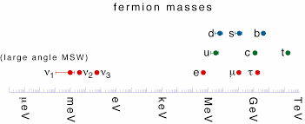


What don’t we know?
Absolute neutrino mass
Why are neutrino masses at least 6 orders of magnitude smaller than the other fermions
How do neutrinos get their mass
  Dirac or Majorana ?
  Observation of $0νββ$ = Majorana particles
Notes:
But we don’t know the absolute neutrino mass, and we can’t explain why those masses are so tiny.
As the only chargeless particles, neutrinos could be majorana particles - that can act as their own anti-particle, which might allow you to generate these very small masses through a see-saw mechanism.

Slide 11








UK expertise – Neutrino Mass
LEGEND-200 = 200kg 76Ge enriched HpGe detectors + LAr veto. Taking data now!
5 UK groups
LEGEND-1000 = 1000kg HPGe – discovery machine for all IO space
11 UK groups signed SoI (36 academics). Analysis leadership, steering committee
Moving to CD1 this autumn (DOE supported), first data 2028
Te-loaded liquid scintillator
Cost effective, scalable technology
- 5 UK groups, leadership in analysis, software, calibration, astro, Te-dev
Currently running with pure LS
Te Loading to start … -> 0.5% by mass
loading beyond 3% Te with acceptable light yield demonstrated
Isotope agnostic technique to distinguish individual particles, and probe $0νββ$ mechanisms and nuclear effects
5 UK groups, leadership in tracker, calibration, shielding and co-spokesperson
UK neutron shielding being installed
Next step double beta data taking!
Single, common multi-ton liquid Xe experiment for dark matter & $0νββ$
Potentially in Boulby
- 22 UK group on SOI (STFC Visions)
1 UK group. NEXT-100 -> -HD -> -BOLD
Enriched Xe HP gas TPC. Ba tagging for background free experiment
Notes:
Add liquid Xe community – NEXT and XLZD

Slide 12

UK $0νββ$ Strategy
1) Continued support for the exploitation of LEGEND-200, SNO+ and the SuperNEMO Demonstrator, recognising the unique near-term physics programmes of each experiment and building on substantial prior UK investment.
2) Support the development and construction of LEGEND-1000 in the near term as the highest priority project in the USA and Europe, ensuring the UK leadership in an experiment that will have >3σ discovery sensitivity for Majorana neutrinos in the inverted neutrino mass ordering range in the medium term.
3) Support the development of higher loading phases of SNO+, which will provide complementary sensitivity with a different isotope in the medium term and lay foundations for a technique that might be extended to the normal mass ordering in the longer term.
4) Build on cross-field scientific and technical opportunities from XLZD and other complementary efforts to further strengthen the main programme, and continue to support blue-skies R&D into new technologies able to reach sensitivities beyond the inverted mass ordering. These include new scintillator loading and detector developments, germanium high-purity semiconductor detectors, xenon time projection chambers (such as NEXT) and barium tagging techniques.

Slide 13
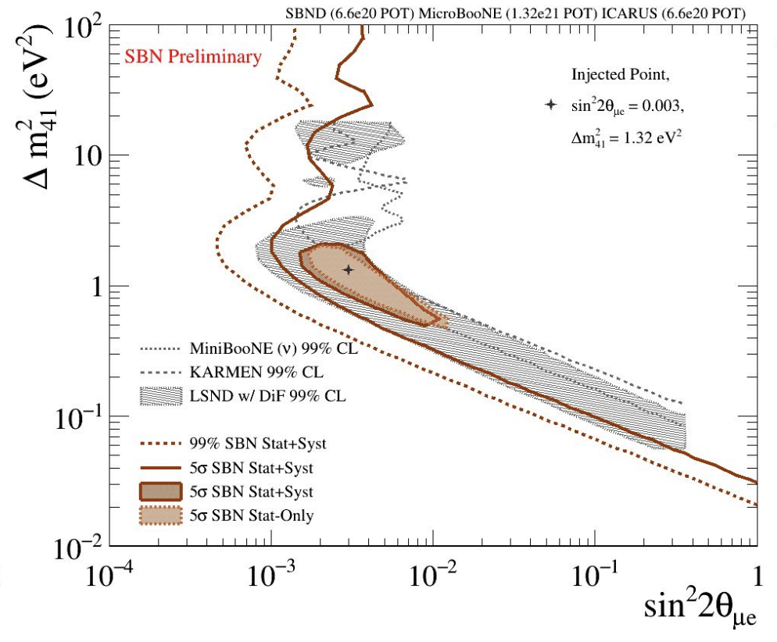
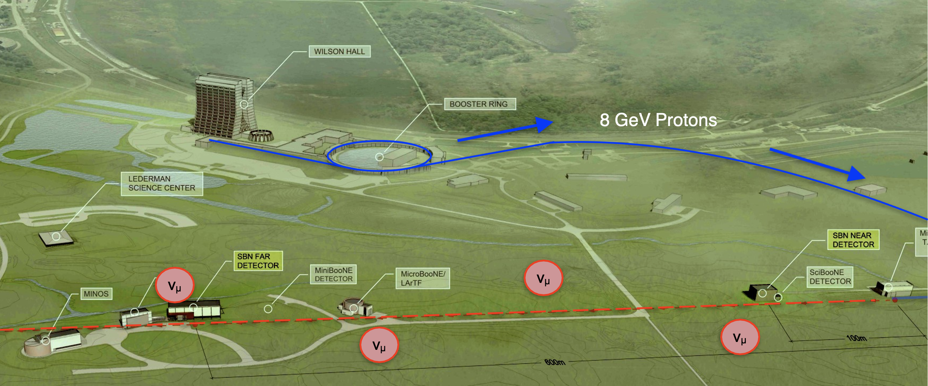
What don’t we know?
Is 3 flavour oscillations the complete picture?
Sterile neutrinos?
BSM?
BNB
MicroBooNE
ICARUS
SBND

Slide 14
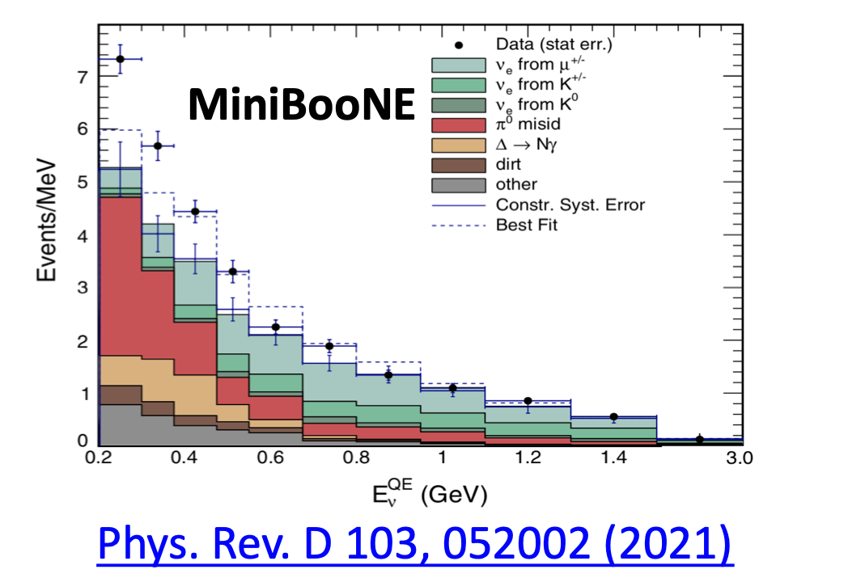


Anomalies
Series of anomalous results seen at short- baselines using a variety of neutrino sources (LSND, MiniBooNE, BGALLEX/SAGE, etc.), if caused by oscillations, are not consistent with a 3$ν$ picture
BNB
MicroBooNE
ICARUS
SBND
MicroBOONE:
Completed 5 year physics run in Fermilab BNB
– 7 UK groups, co-spokesperson and physics coordinator
– first results on tun 1-3 data, full analysis ongoing
  Photon excess? Disfavoured
  Electron excess? Disfavoured
  Light sterile $ν$ (3+1)? No evidence
  Other BSM models?
Notes:
Also the reactor antinu anomaly that I won’t mention here

Slide 15
What do we need?
Big detectors – international collaboration
Advanced detection techniques
Innovative analysis and computing solutions
Near Detectors and Dedicated beam experiments to measure Neutrino interactions
Neutrino sources
Proto-type detectors to develop and demonstrate technology
Fermilab SBN detectors
CERN Neutrino Platform
proto-DUNE
WCTE for Hyper-K (IWCD, mPMTs)

Slide 16
What do we need?
Big detectors – international collaboration
Advanced detection techniques
Innovative analysis and computing solutions
Near Detectors and Dedicated beam experiments to measure Neutrino interactions
Neutrino sources
Precision oscillation parameter measurements require reducing both statistical and systematic uncertainties to ~% level.

Slide 17
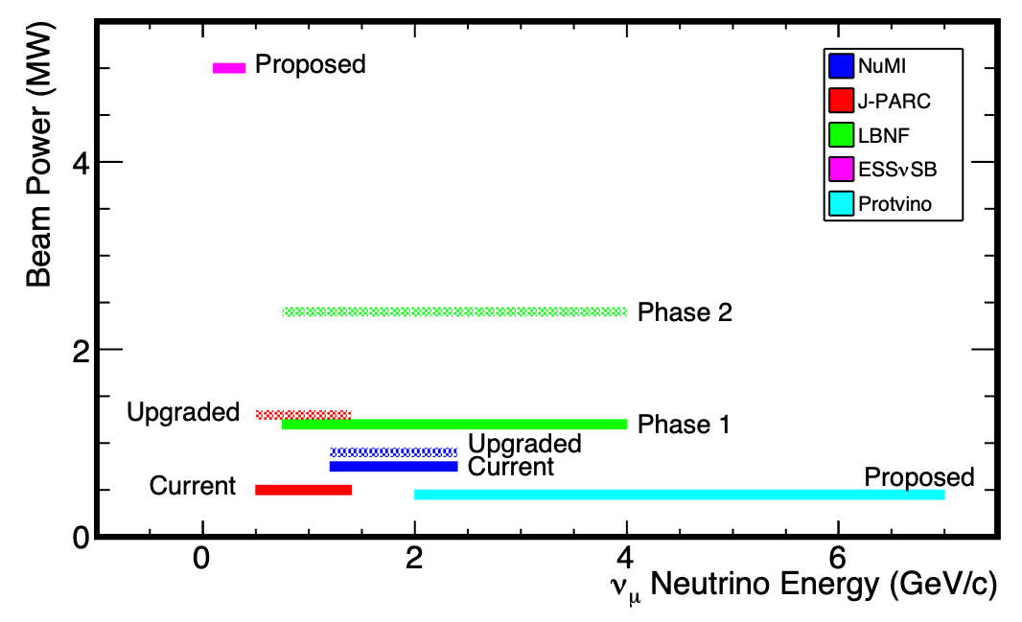




Neutrino Interactions
Understanding of cross-sections for neutrino interaction processes at:
Different energies
On different targets (Water, Argon…)
Producing different final states
$ν_{μ}, ν_{e}, \overline{ν_{μ}}, \overline{ν_{e}} (ν_{τ}, \overline{ν_{τ}})$
$\frac{dσ}{dθdE}$
And also for backgrounds that produce same final state topologies
Measurements of high flux, unoscillated (short baseline) beam
- Synergies with flux measurement (Near detectors)
- Synergies with sterile neutrino searches.
https://arxiv.org/pdf/2209.07480.pdf
$$l$$
Astro
$$θ$$
$$ν_{l}$$

Slide 18
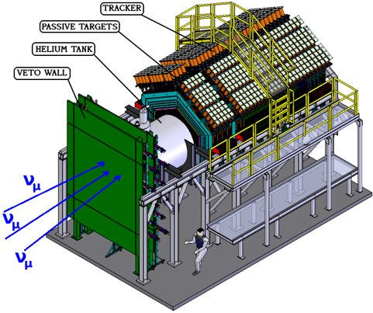
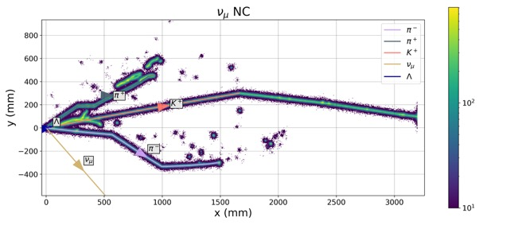
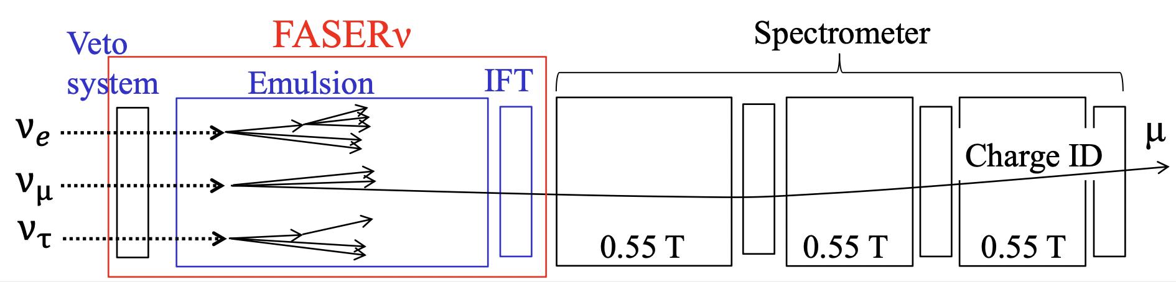

Neutrino interactions
MicroBOONE
Mentioned earlier but many interaction papers
SBND = 112 ton lAr TPC 110m from BNB source
~million $ν−Ar$interactions / year in GeV range
- 9 UK groups, leadership in physics coordination, commissioning, reconstruction
Physics running from 2024
MINERvA = high-precision measurements of neutrino interactions on various nuclei, in the 1-10GeV energy range
4 UK groups
Data taking 2010-2019, NuMI beam
LiquidO = opaque scintillator + lattice of optical fibres
High resolution imaging detector (PID) for GeV-neutrinos
- Growing UK activity
FASERnu = far forward emulsion detector at ATLAS IP
TeV energy cross-section measurements
UK involvement via Si Strip tracker interface

Slide 19
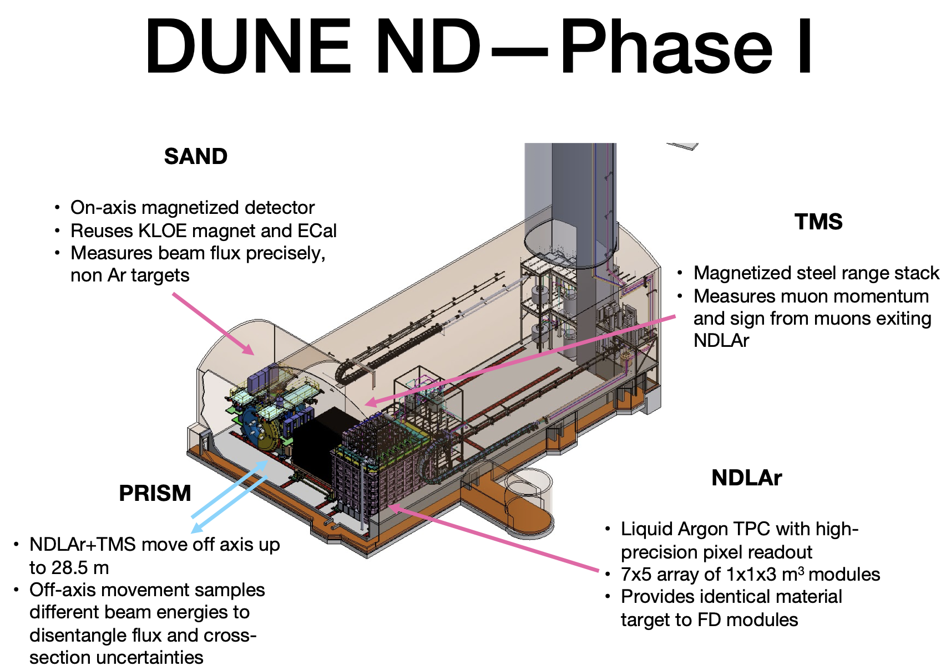
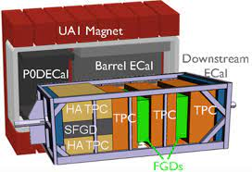
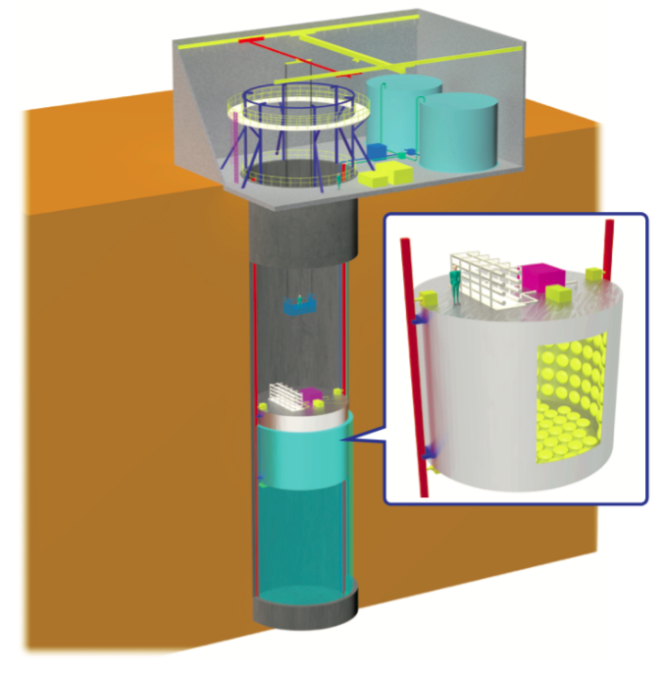
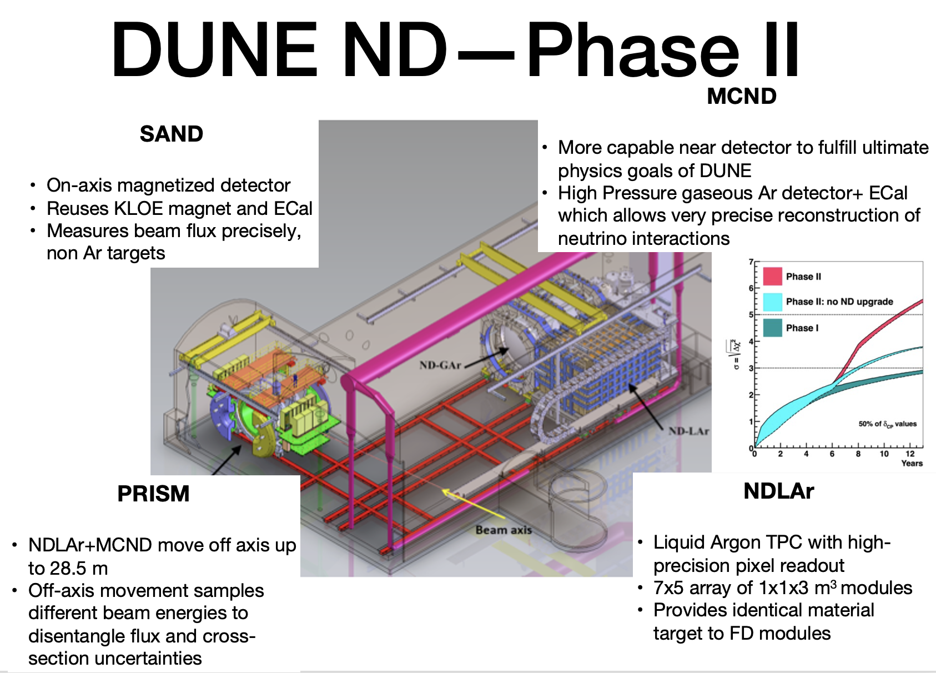
Neutrino Interactions
T2K -> Hyper-K
ND280 tracking detector
+ INGRID, WAGASCI, NINJA
– upgrade of ND280 with SuperFGD underway
- IWCD proposed for Hyper-K
PRISM concept
  peak energy of the neutrino flux falls with increasing perpendicular distance from the neutrino beam axis
  Span off-axis angles with moveable detector to sample different energies
  Linearly combine samples to create effective neutrino flux

Slide 20
What do we need?
Big detectors – international collaboration
Advanced detection techniques
Innovative analysis and computing solutions
Near Detectors and Dedicated beam experiments to measure Neutrino interactions
Neutrino sources
UK contributions to both J-PARC and LBNF Beam, Targets

Slide 21

New neutrino sources
NuSTORM = muon storage ring -> neutrino beam with well defined spectrum
Allows to measure cross-sections with %-level precision
UK Accelerator Design
15 UK groups

Slide 22
Why do we want to know?
Theoretical models, BSM ?
Most abundant particle – cosmological impact
Astroparticle observations
Non-proliferation

Slide 23
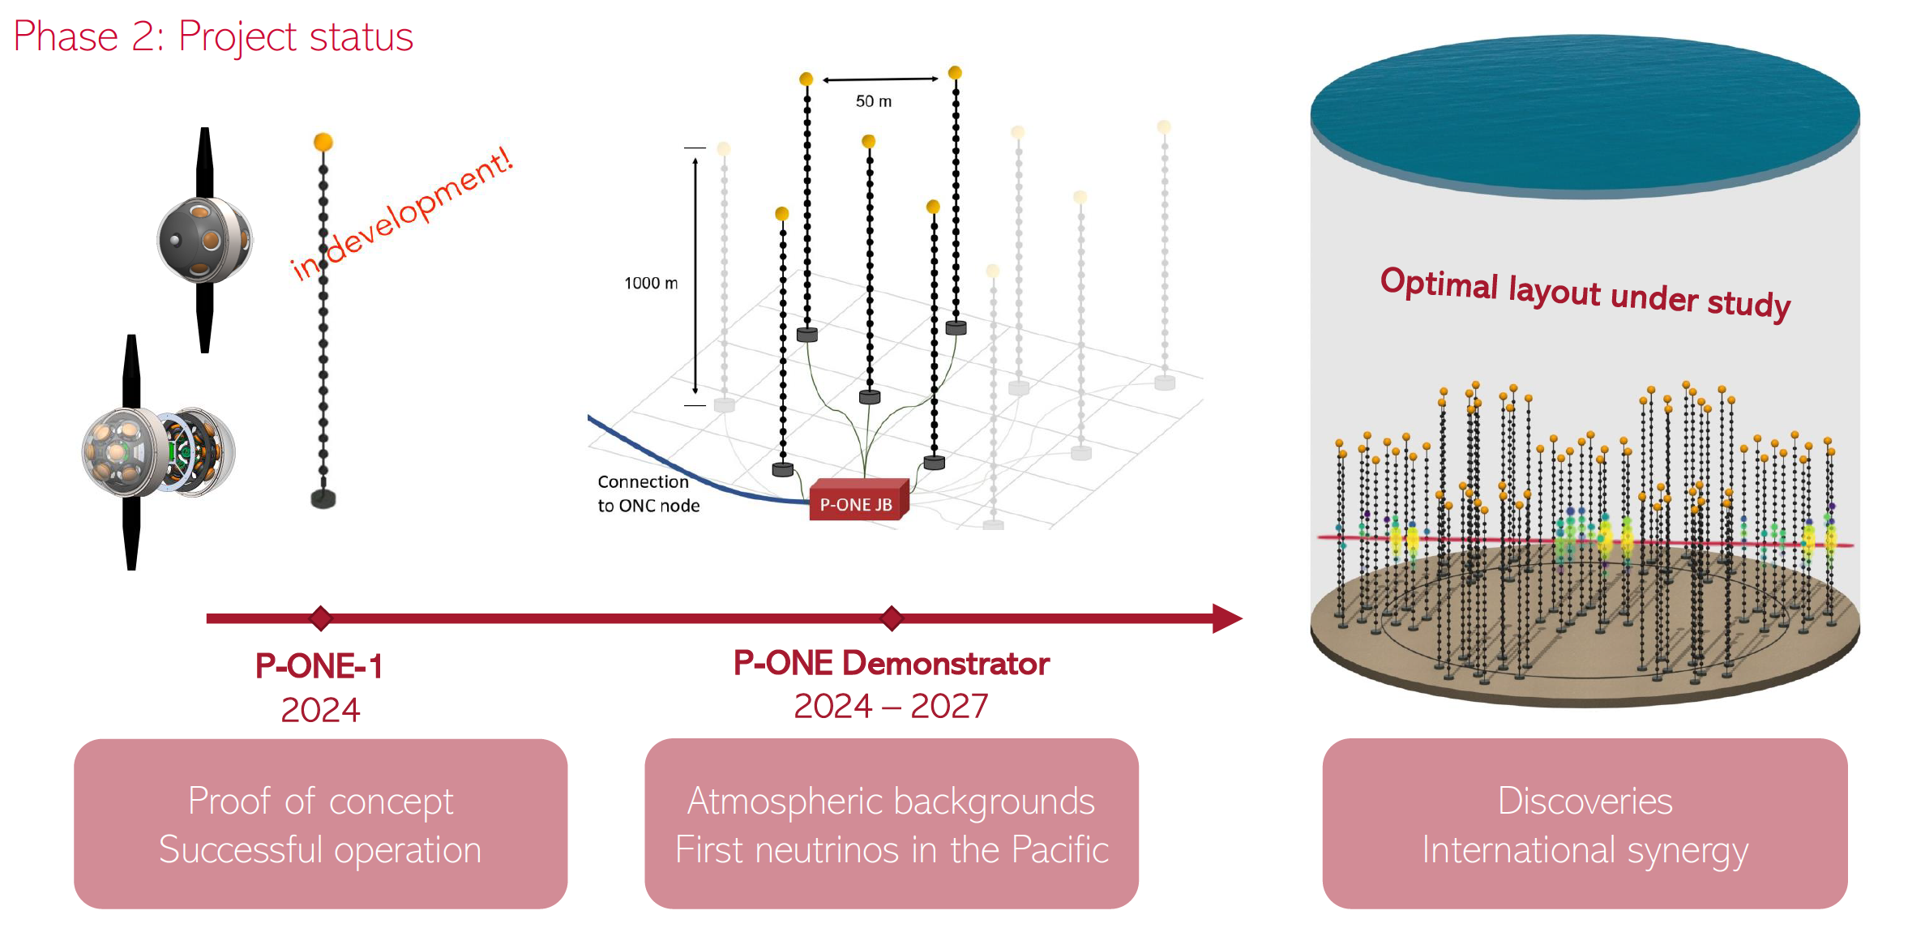
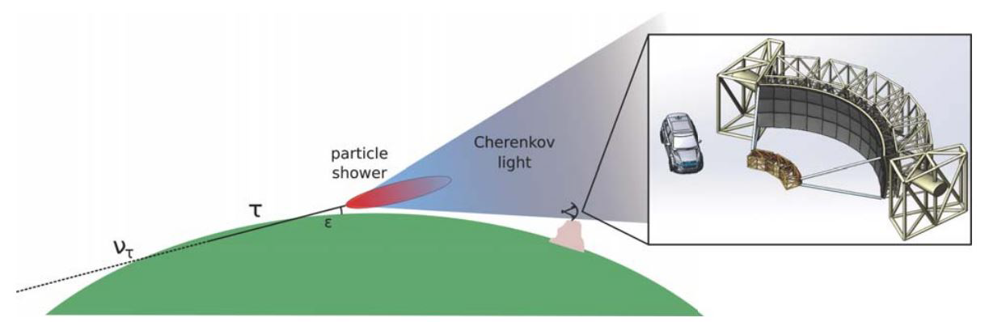
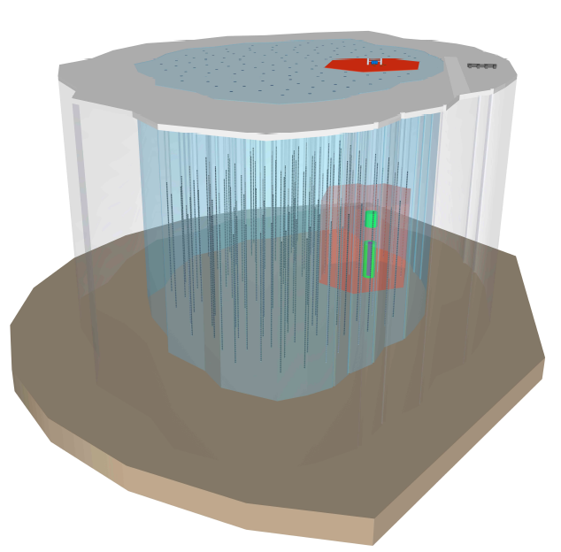
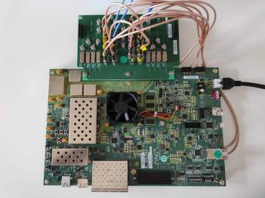
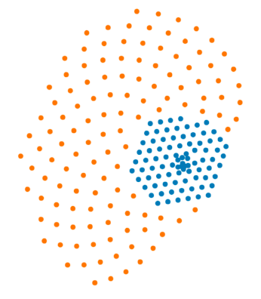
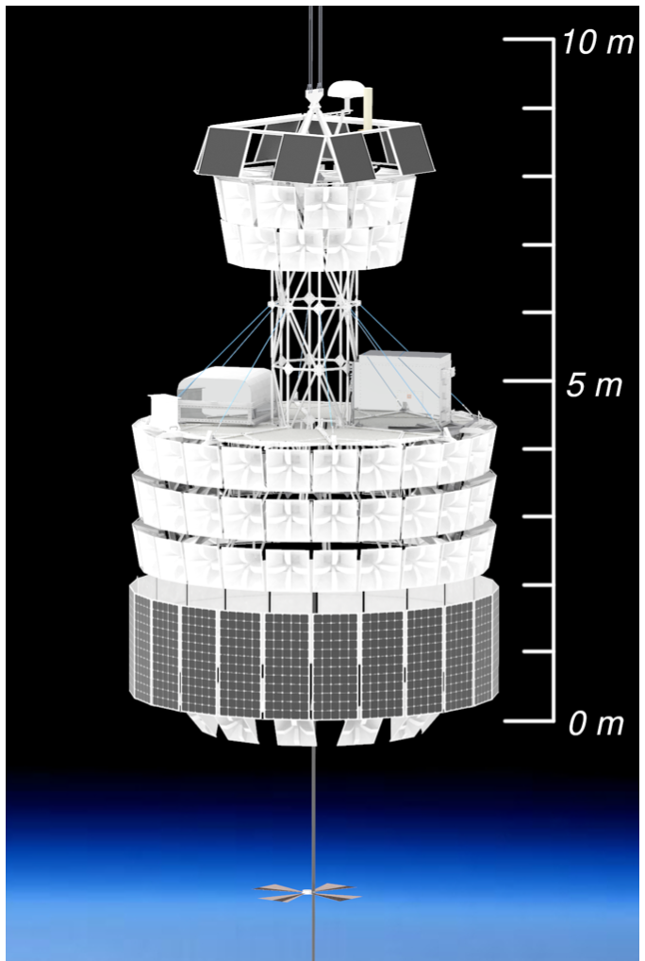
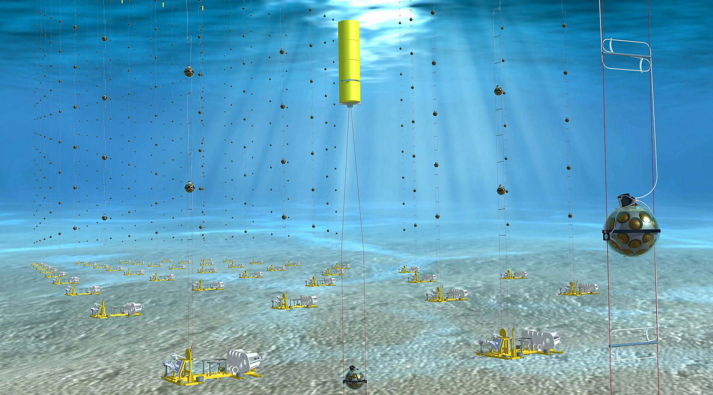
High-Energy Astrophysical Neutrino Consortium
UK HEAN consortium plans to coordinate efforts for future
- Community workshop is planned
P-ONE
- Different sky coverage from IceCube/KM3NeT/Baikal-GVD
- Superior angular resolution
Trinity
- Skimming tau experiment with IACT in USA
- Low threshold, plan to see PeV neutrino in Stage 1
UK-HEAN Consortium
Gen2 radio
Gen2 optical
IceCube
PUEO
- long-duration balloon experiment
- EeV neutrino discovery potential
IceCube-Upgrade
IceCube-Gen2
- Oscillation physics to astro (GeV to EeV)
- IceCube-Upgrade funded
KM3NeT
- New (Univ. Hull)

Slide 24
Why do we want to know?
Theoretical models, BSM ?
Most abundant particle – cosmological impact
Astroparticle observations
Non-proliferation

Slide 25
Reactor Monitoring Technologies
WATCHMAN AIT ->
BUTTON: Liverpool, Warwick, Edinburgh, Glasgow, Boulby, AWE in UK + U Penn and Lawrence Livermore and Pacific Northwest National Labs in US
BUTTON-30: construction of 30-ton detector to begin later this year
Goal: to develop innovative technology for remote reactor monitoring
Gd-WbLS with advanced photosensors (LAPPDs, WLS plates+SiPMs, 10” PMTs)
Funded -> 2025 (no-cost extension to WATCHMAN funding)
Future plan for BUTTON-500
At scale reactor monitoring demonstrator

Slide 26

Summary
Precision measurements of oscillation parameters
  $δ_{CP}, Δm_{23}$sign, is $θ_{23}$ maximal?
Is that it?
  Sterile neutrinos? BSM physics?
No one experiment fits all
Different baselines, energies, techniques to break correlations
Large statistics
  Powerful sources, large detectors
Low systematics
  Dedicated cross-section measurements
Neutrino mass?
  Absolute value
  Dirac or Majorana?
Near and Long-term strategy
  Different isotopes, techniques
Neutrino Observations
  Astroparticle, non-proliferation
Strong UK expertise
Multipurpose experiments and synergies
Innovation in technology and analysis

Slide 27
Acknowledgements
Thank you to:
  Xianguo Lu
  Justin Evans
  Jeff Hartnell
  Cheryl Patrick
  Matteo Agostini
  Ryan Martin
  Teppei Katori
  Roxanne Guenette
  Ruben Saakyan
  Liz Kneale
  Steve Biller
  Jim Dobson
  Jarek Nowak
Contributed slides with more details from various experiments follow in the backup
And probably many other people as well…

Slide 28
Backup

Slide 29
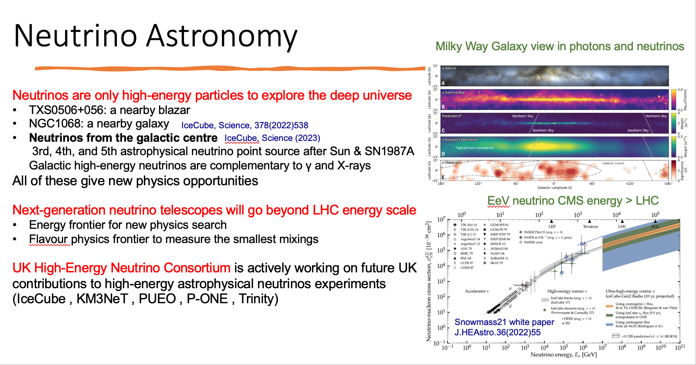
Neutrino Astronomy

Slide 30
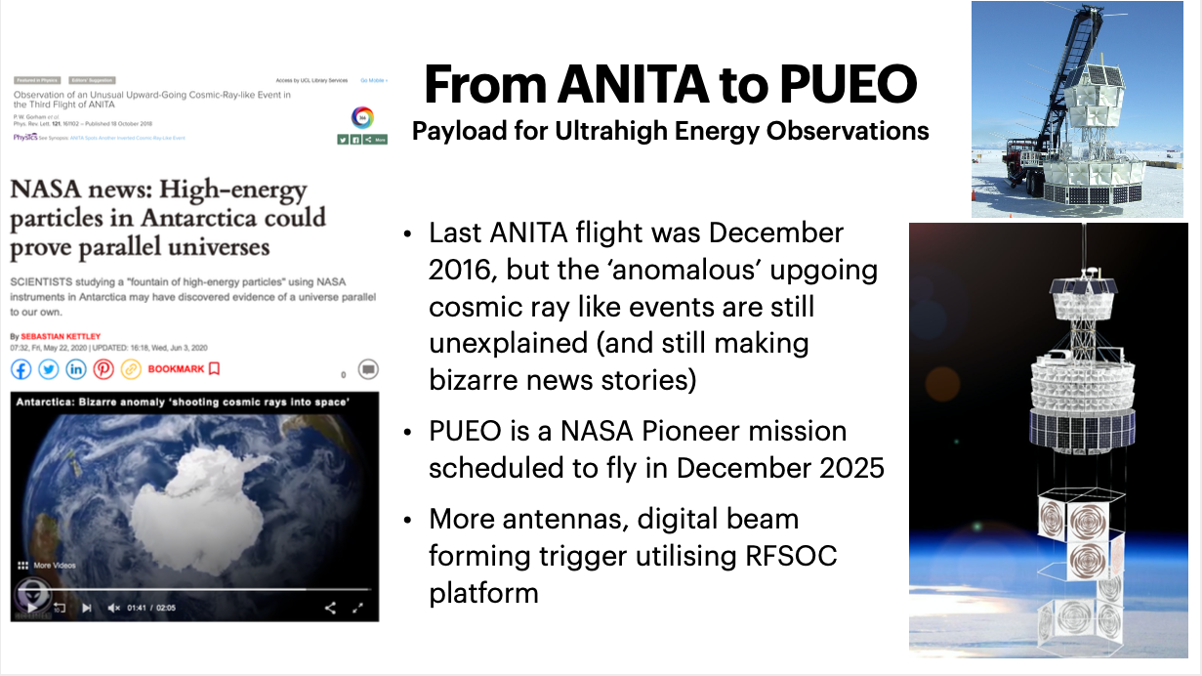
PUEO

Slide 31
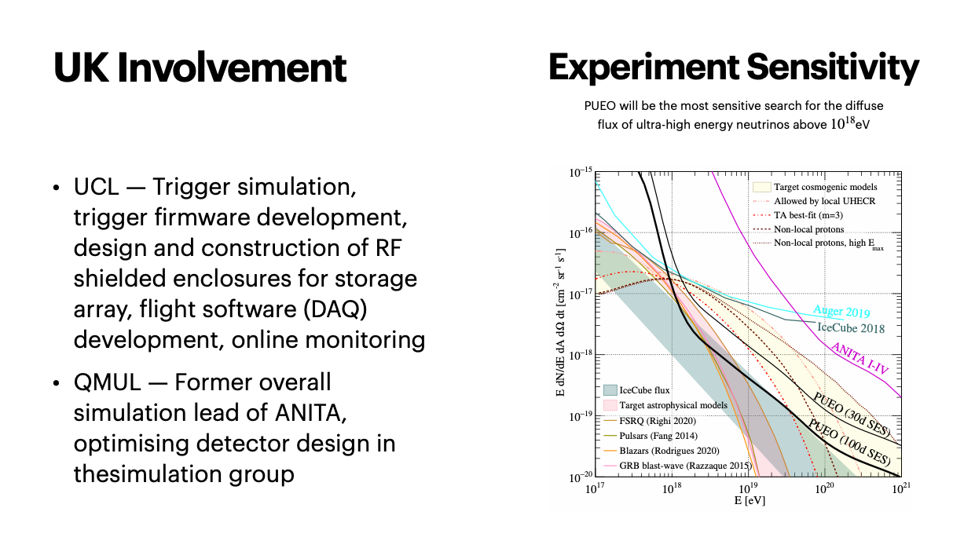
PUEO

Slide 32
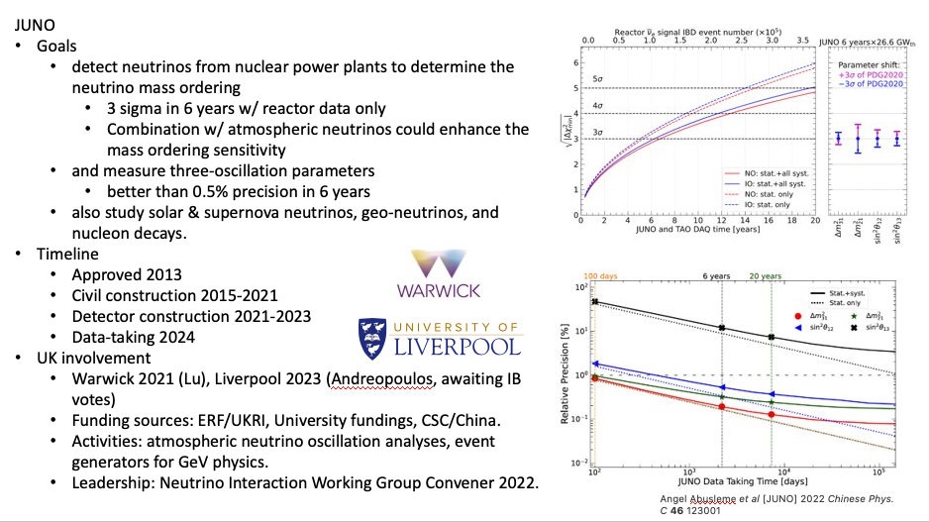
JUNO

Slide 33
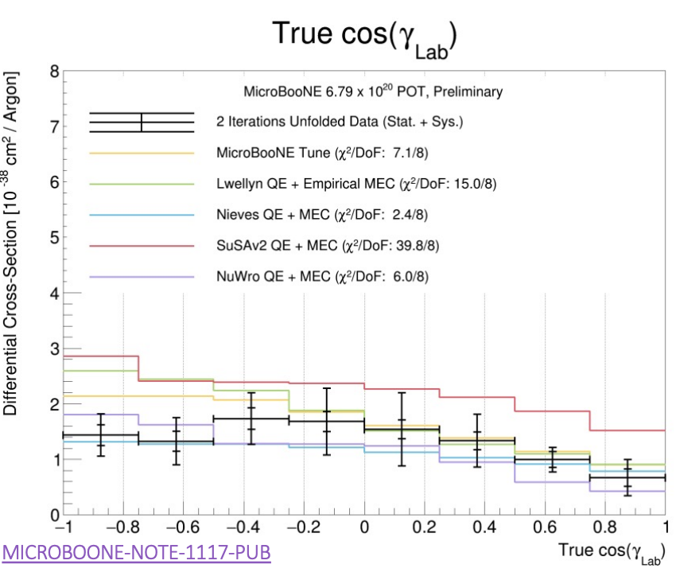
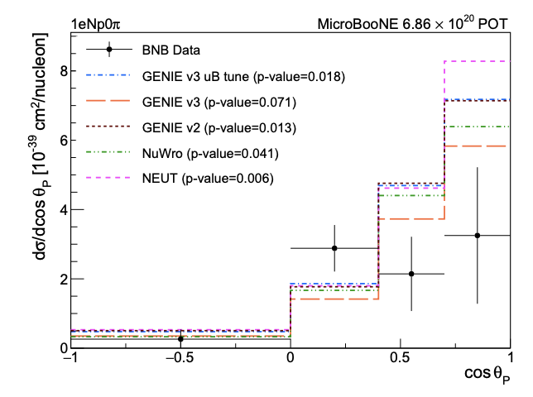
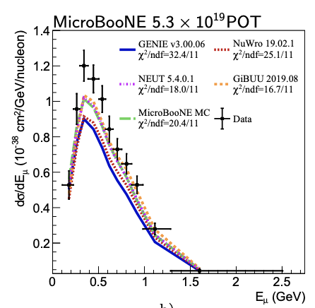
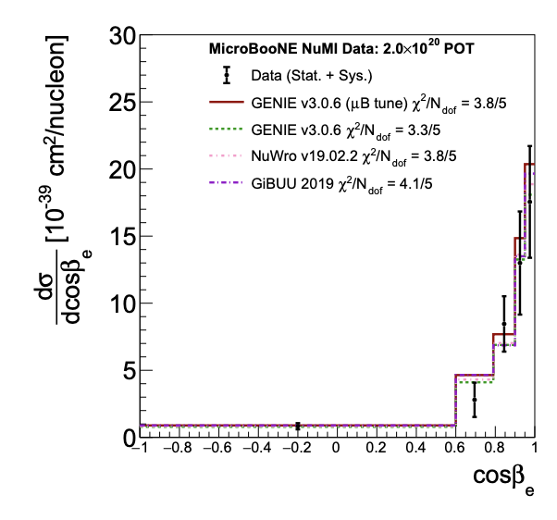
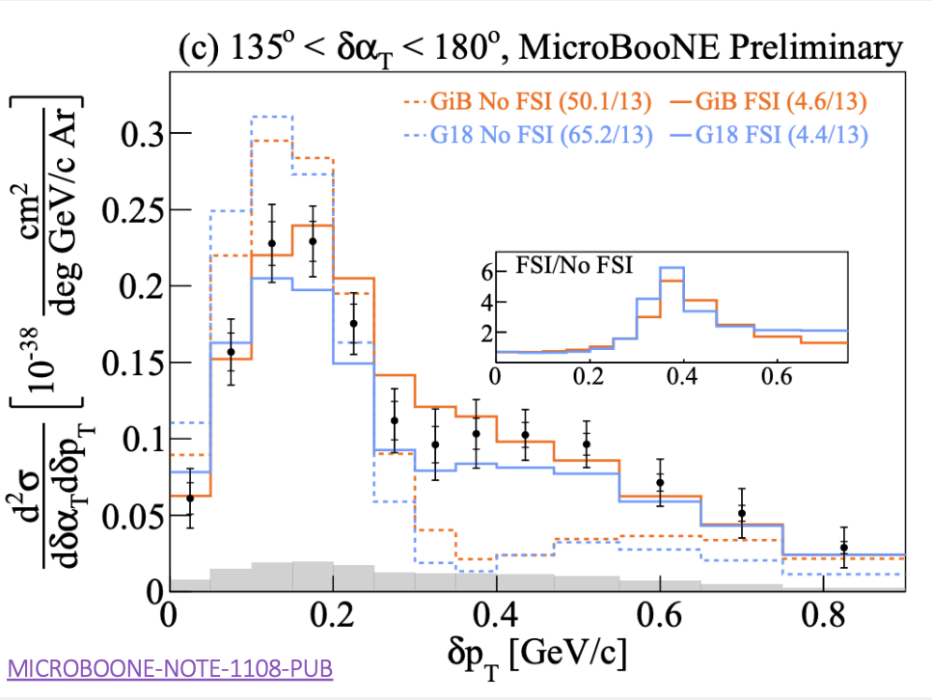
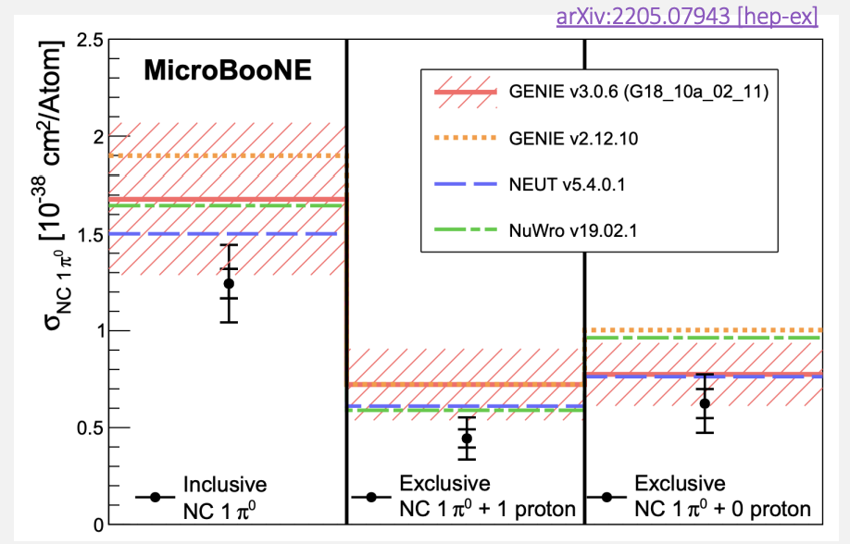
MicroBooNE - Neutrino interactions
First ever direct measurement of 2-proton cross section
First exclusive & differential ν_{e} xsec measurement
First energy-dependent inclusive ν_{μ} CC on argon
Phys.Rev.D 106 (2022) L051102
Phys.Rev.Lett. 128 (2022), 151801
Sensitivity to FSI
First inclusive differential ν_{e}+ν_{e} xsec on Ar
First NC π⁰ on argon at ~1 GeV
Phys.Rev.D 105 (2022), L051102

Slide 34
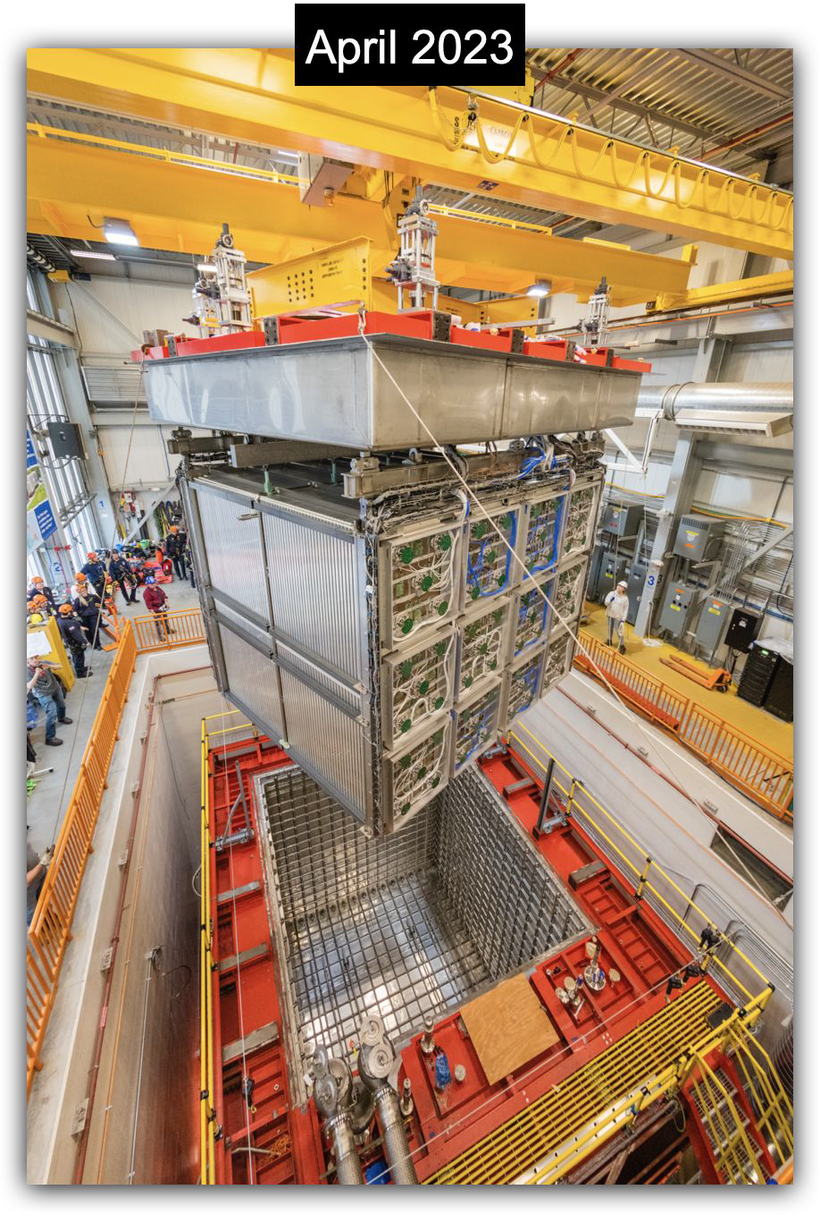
SBND
Short-Baseline Near Detector
Primary goals
  Definitive (>5σ) test of sterile neutrino hypothesis
  Precision measurements of neutrino interactions with argon
  BMS phenomena
  Testbed for LArTPC-related technologies
The SBND UK Collaboration (9 institutions):
  Edinburgh, Lancaster, Liverpool, Manchester, Oxford, RAL, Sheffield, Sussex, UCL.
  52 UK members, currently > 15 PhD students
UK Leadership roles:
  Two Physics Coordinators, TPC installation and Commissioning, Reconstruction software, Speakers Committee, …
SBND Timeline
  Ready for cryogenic commissioning – Q2 2023
  Start of physics commissioning – November 2023
  Start of physics run – Q1 2024
Detector rigging

Slide 35
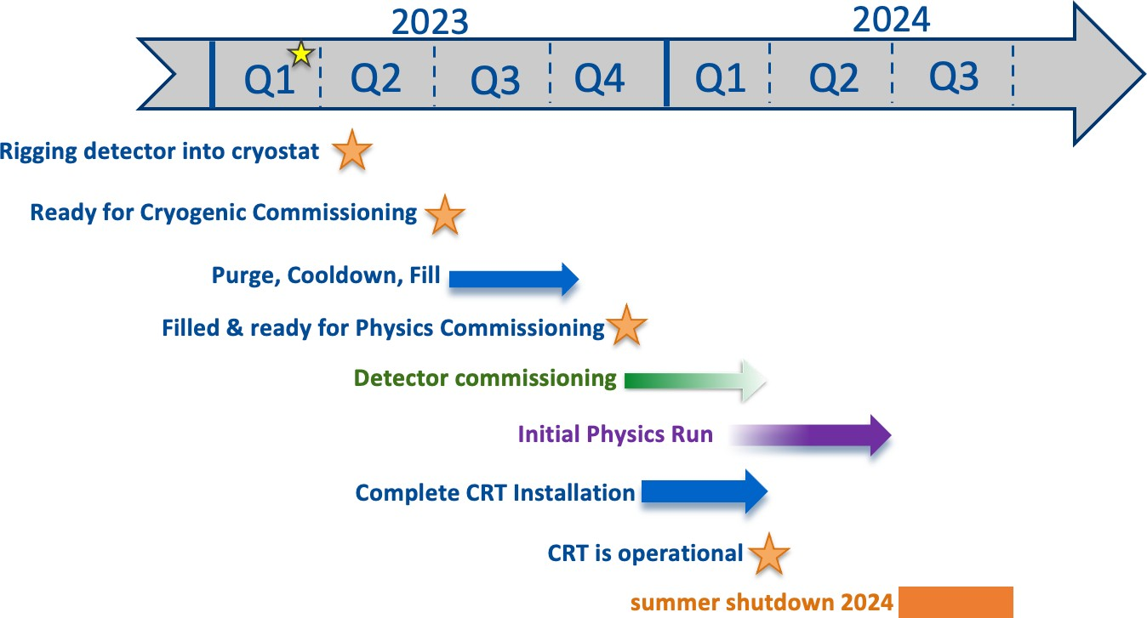
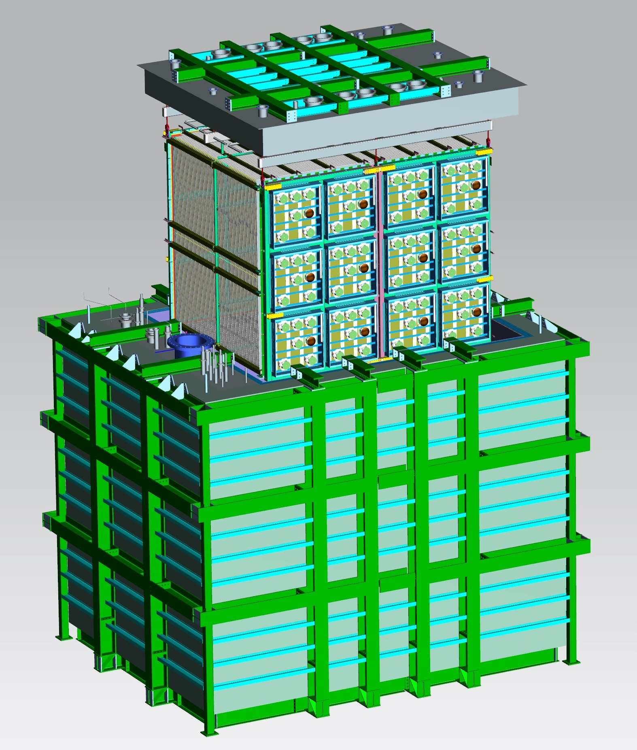

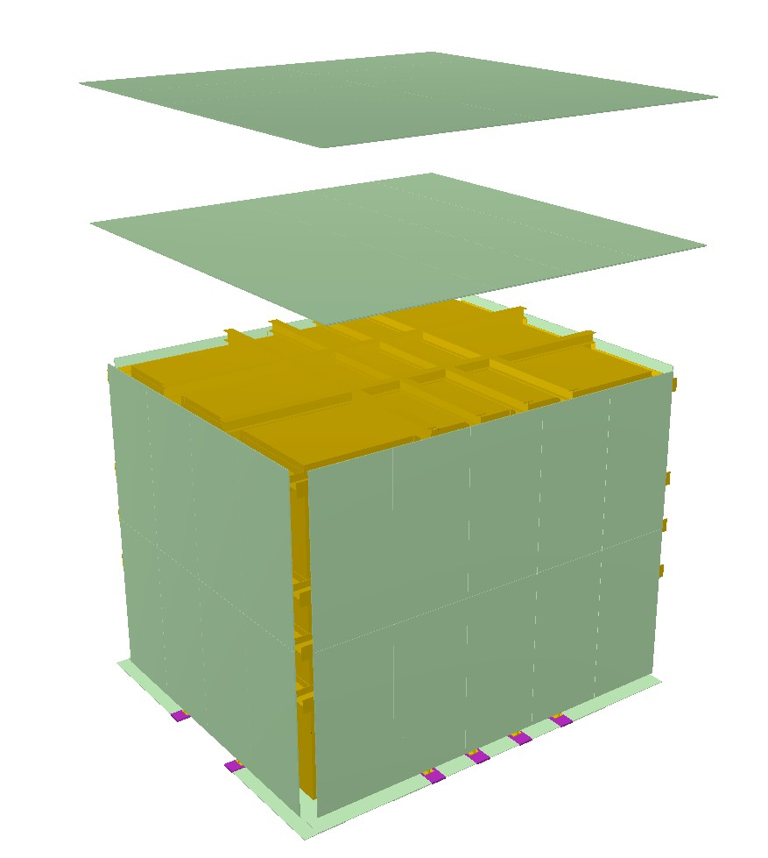
SBND - Timeline to Operations
Ap⁸²ril, 2023
November, 2023
Cryostat surrounded by a Cosmic Ray Tagger system.
Panels made of
scintillator strips
"#$%&&' )'&'*'#'

Slide 36
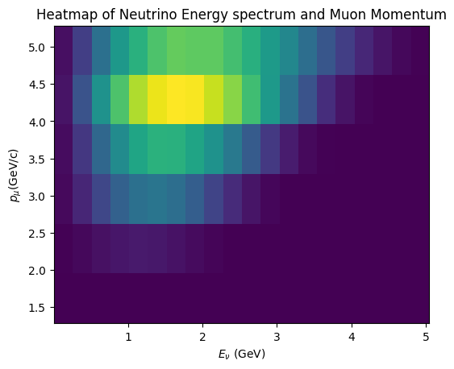
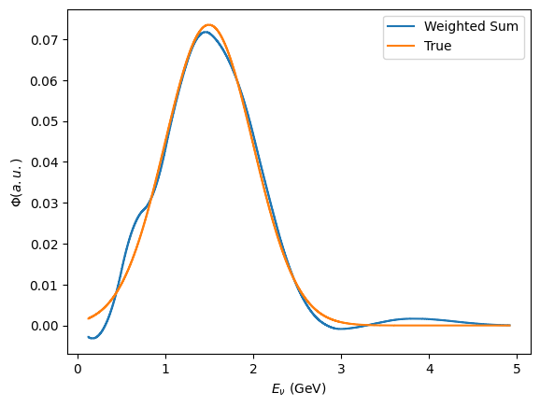
nuSTORM
Flux “set” by stored muon energy
Synthetic flux, combination of settings
  %-level ( ν_{e}N ) cross sections
    Multi differential / E_{ν} scan
  BSM searches
    E.g. steriles beyond FNAL SBN
  Muon collider demonstrator

Slide 37
nuSTORM: timeline and UK position
Timeline:
nuSTORM & International Muon Collider Collaboration (IMCC) initiatives launched following European Strategy for Particle Physics Update (ESPPU) 2020
Additional impetus from UK HEP Forum (LINK), Cosener's House, November 2023
  IoP Workshop: Exploring the Physics Opportunities of nuSTORM (LINK) April 2023
Present UK-led programme:
  In time for ESPPU 202x:
    Robust physics case:
      Cross section
      BSM (and “beyond steriles”)
      Nucleon/nuclear structure
    In collaboration with IMCC:
      Implementation options as part of IMCC demonstrator
  Short-term goal:
    2nd /major Edition of Physics@nuSTORM Workshop 2024
      Physics Programme Paper
UK position:
nuSTORM:
  Leadership of nuSTORM through CERN Physics Beyond Colliders (PBC) study to present
Particle/nuclear physics:
  Key contributions on cross sections, BSM, nuclear physics
Accelerator:
  UK-accelerator design
  World leading FFA experts
Detector:
  Clear UK strength; nuSTORM detector suite now under development
Groups involved: (nuSTORM at CERN: Feasibility Study, CERN-PBC-REPORT-2019-003, LINK)
Brunel, Cambridge, Durham/IPPP, Glasgow, Imperial, Kings, Lancaster, Liverpool, Manchester, Oxford, QMUL, Sheffield, STFC RAL, UCL, Warwick

Slide 38
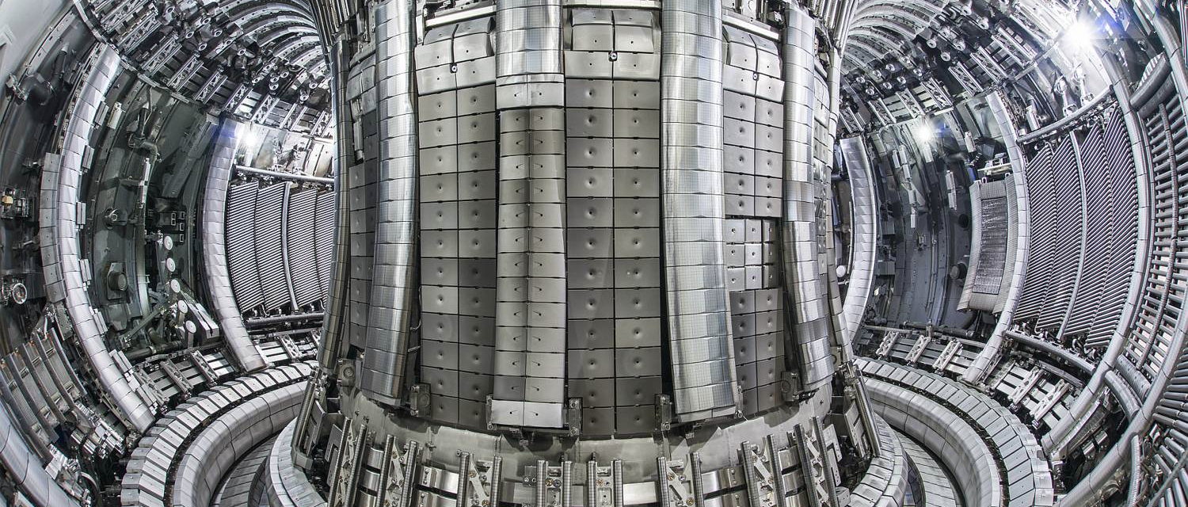


QTNM
Quantum Technologies
for Neutrino Mass
CRESDA
Goal
Neutrino mass measurement from ³H β-decay via Cyclotron Radiation Emission Spectroscopy using latest advances in quantum technologies.
Current project (QTFP Wave 1)
Technology Demonstration
Production and confinement of H-atoms, ≥ 10¹² cm⁻³
B-field mapping with ≲1 𝜇T precision, using H-atoms as quantum sensors (Rydberg magnetometry)
CRES detection of single electrons with quantum limited micro-wave electronics
Strategy: Phased Approach
CRESDA0 → CRESDA-Tritium → 100 meV → 50 meV → O(10 meV)
current
Culham Centre for Fusion Energy

Slide 39
Neutrino Physics
Is current UK Neutrino programme too broad/not broad enough?
  Breadth of areas (neutrino oscillations, 0𝜈𝛽𝛽, solar neutrinos, reactor neutrinos, absolute mass) vs breadth of projects in one area.
  If tensioning is needed, should it be between areas or between projects within area?
International Strategic Consideration – is UK well placed in all neutrino areas it pursues? How influential is it in international programme? What are the key upcoming opportunities; risks of missing them?
Is there the right balance between funding for science exploitation of existing experiments and construction/R&D for future projects?

