Slide 1

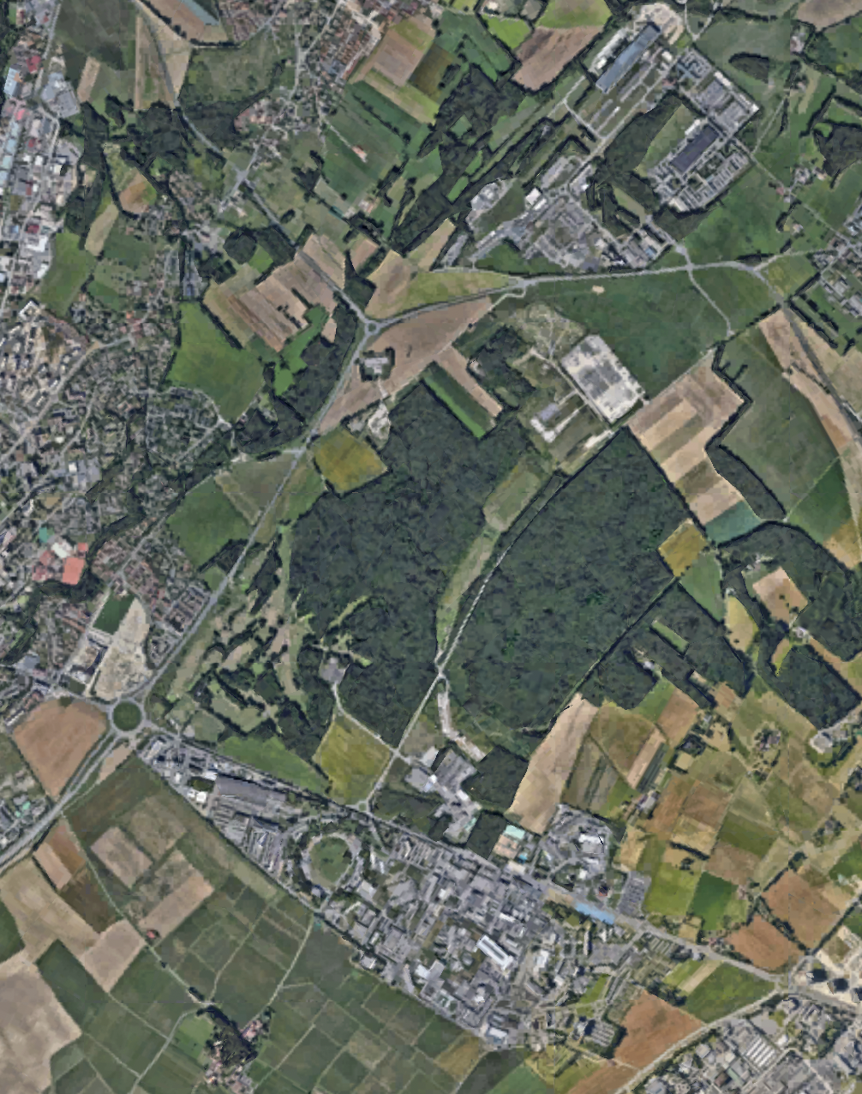

PPAP 6/7/2023
Jon Butterworth
CERN Programme to 2040

Slide 2
There’s a lot going on at CERN…
HL-LHC
  ATLAS, CMS, LHCb, forward physics, software and computing
North Area experiments
  COMPASS/AMBER
  NA61/SHINE, NA62,63,64,65
  ECN3 beam upgrade
Nuclear physics
  ALICE, n_TOF, ISOLDE …
Neutrino platform
Antimatter Factory program
Quantum Technology Initiative
Non-accelerator Axion searches
AWAKE
…

Slide 3
There’s a lot going on at CERN…
HL-LHC
  ATLAS, CMS, LHCb, forward physics, software and computing
North Area experiments
  COMPASS/AMBER
  NA61/SHINE, NA62,63,64,65
  ECN3 beam upgrade
Nuclear physics
  ALICE, n_TOF, ISOLDE …
Neutrino platform
Antimatter Factory program
Quantum Technology Initiative
Non-accelerator Axion searches
AWAKE
…
Will emphasise (particle physics) opportunities with current or potential UK interest
?

Slide 4
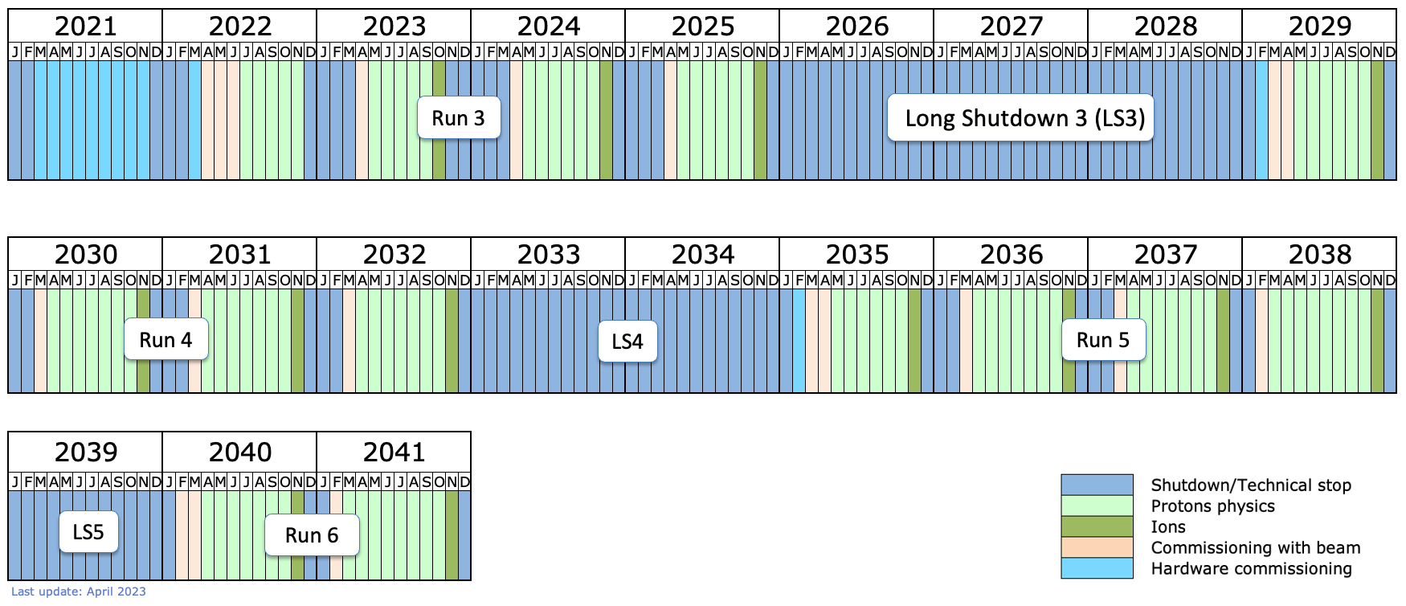
LHC+ long-term schedule
ALICE & LHCb
Phase IIb?
Now
ATLAS & CMS Phase 2
North Area Upgrade (ECN3)?
Forward Physics Facility running?

Slide 5
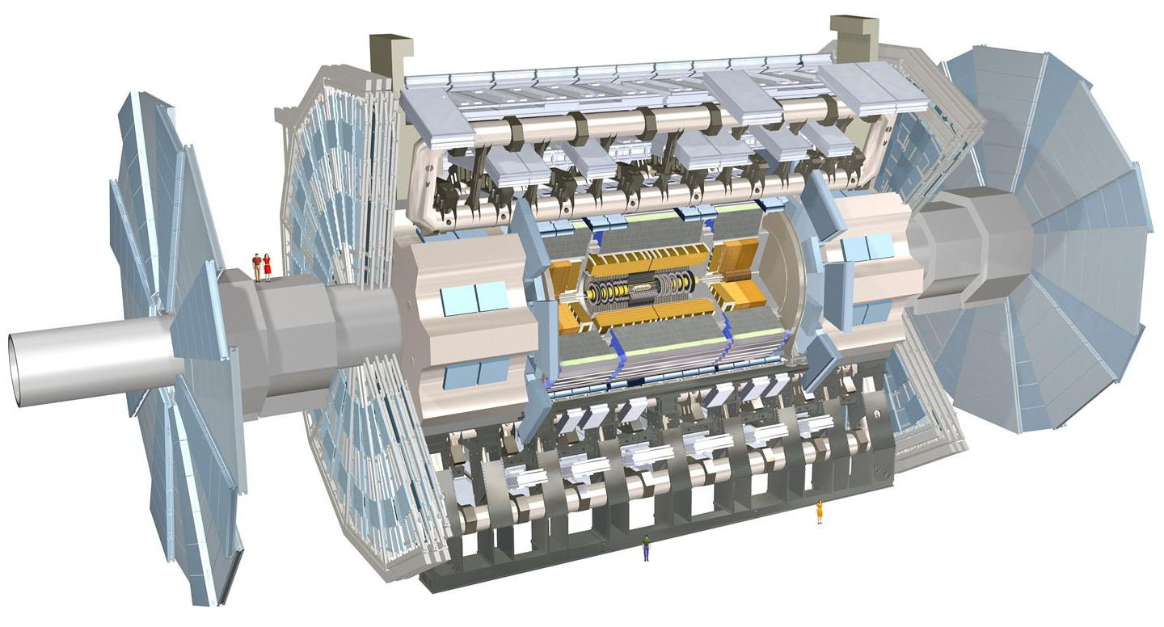
ATLAS Phase-2 Upgrade
Upgraded Trigger and Data Acquisition System
Single Level Trigger with 1 MHz output
Improved 10 kHZ Event Farm
Electronics Upgrades
On-detector/off-detector electronics upgrades of LAr Calorimeter, Tile Calorimeter & Muon Detectors
40 MHz continuous readout with finer segmentation to trigger
High Granularity Timing Detector (HGTD)
Precision time reconstruction (30 ps) with Low-Gain Avalanche Detectors (LGAD)
Improved pile-up separation and bunch-by-bunch luminosity
New Muon Chambers
Inner barrel region with new RPCs, sMDTs, and TGCs
Improved trigger efficiency/momentum resolution, reduced fake rate
Additional small upgrades
Luminosity detectors (1% precision)
HL-ZDC (Heavy Ion physics)
New Inner Tracking Detector (ITk)
All silicon with at least 9 layers up to |η| = 4
Less material, finer segmentation
Software & Computing
Optimisation
Capacity
New technologies

Slide 6
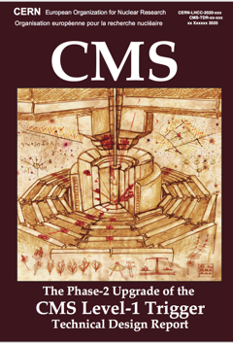
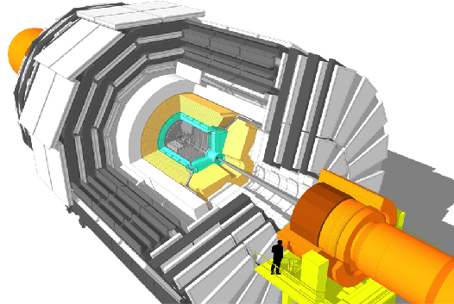
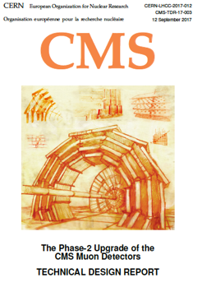
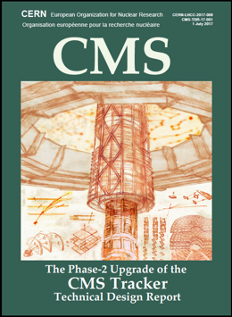
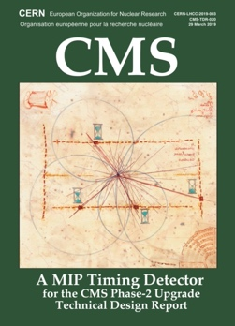
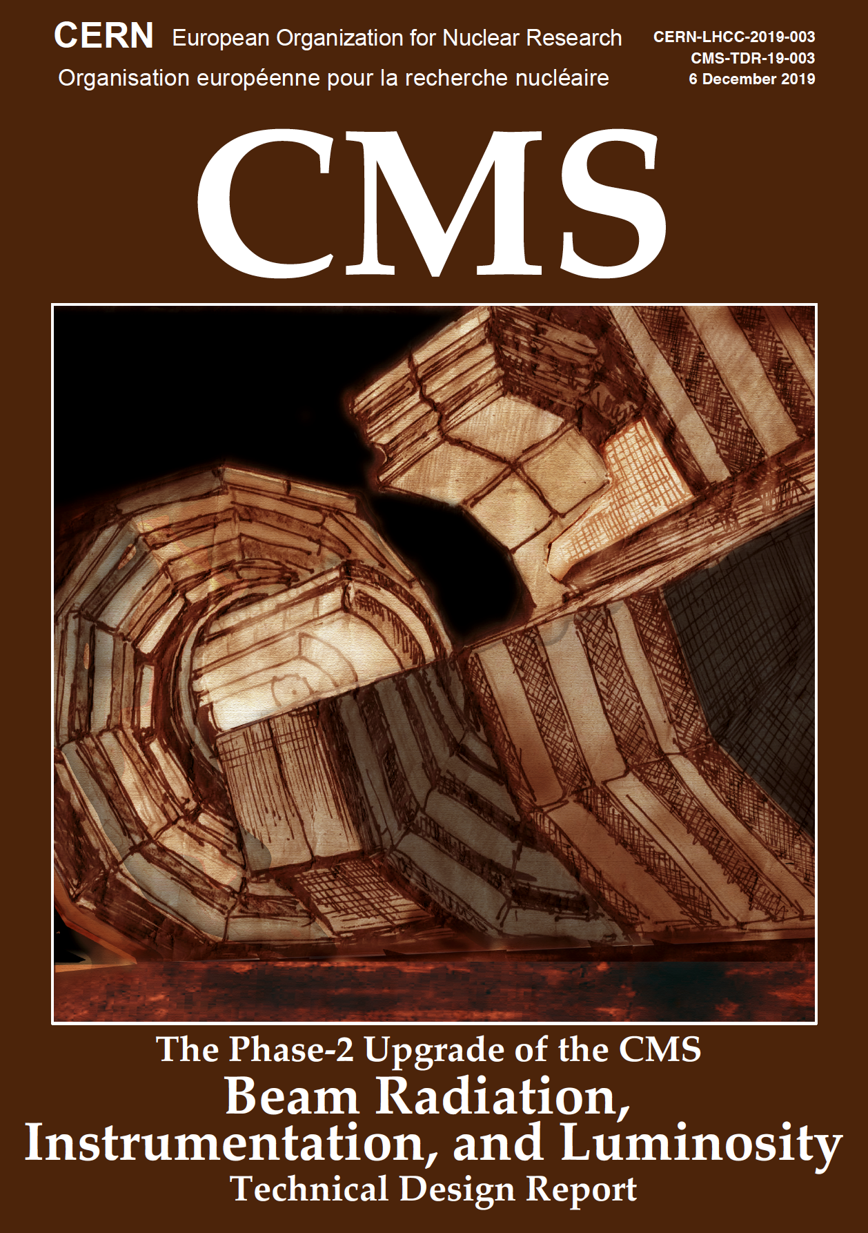
CMS Phase-2 Upgrade
L1-Trigger
https://cds.cern.ch/record/2714892
Tracks in L1-Trigger at 40 MHz
Particle Flow selection
750 kHz L1 output
40 MHz data scouting
DAQ & High-Level Trigger
https://cds.cern.ch/record/2759072
Full optical readout
Heterogenous architecture
60 TB/s event network
7.5 kHz HLT output
Barrel Calorimeters
https://cds.cern.ch/record/2283187
ECAL single crystal granularity at L1 trigger
with precise timing for e/γ at 30 GeV
ECAL and HCAL new Back-End boards
Muon systems
https://cds.cern.ch/record/2283189
DT & CSC new FE/BE readout
RPC back-end electronics
New GEM/RPC 1.6 < η < 2.4
Extended coverage to η ≃ 3
Calorimeter Endcap
https://cds.cern.ch/record/2293646
3D showers and precise timing
Si, Scint+SiPM in Pb/W-SS
Tracker
https://cds.cern.ch/record/2272264
Si-Strip and Pixels increased granularity
Design for tracking in L1-Trigger
Extended coverage to η ≃ 3.8
Beam Radiation Instr. and Luminosity
http://cds.cern.ch/record/2759074
Beam abort & timing
Beam-induced background
Bunch-by-bunch luminosity:
1% offline, 2% online
Neutron and mixed-field radiation
monitors
MIP Timing Detector
https://cds.cern.ch/record/2667167
Precision timing with:
Barrel layer: Crystals + SiPMs
Endcap layer:
Low Gain Avalanche Diodes

Slide 7
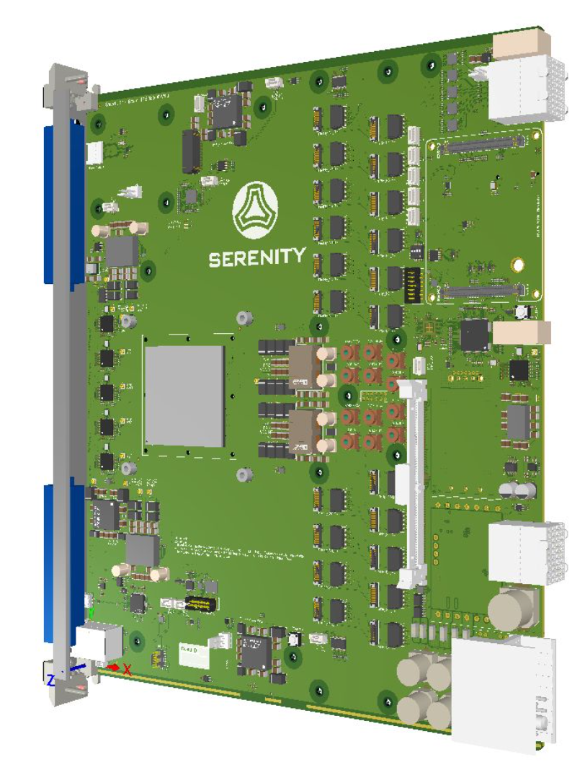
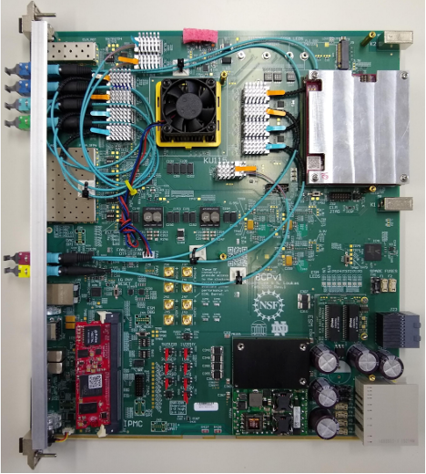
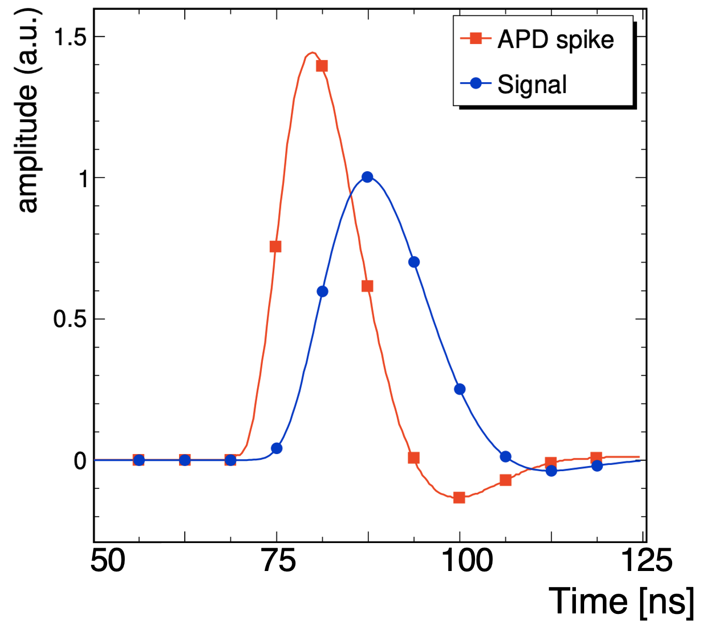

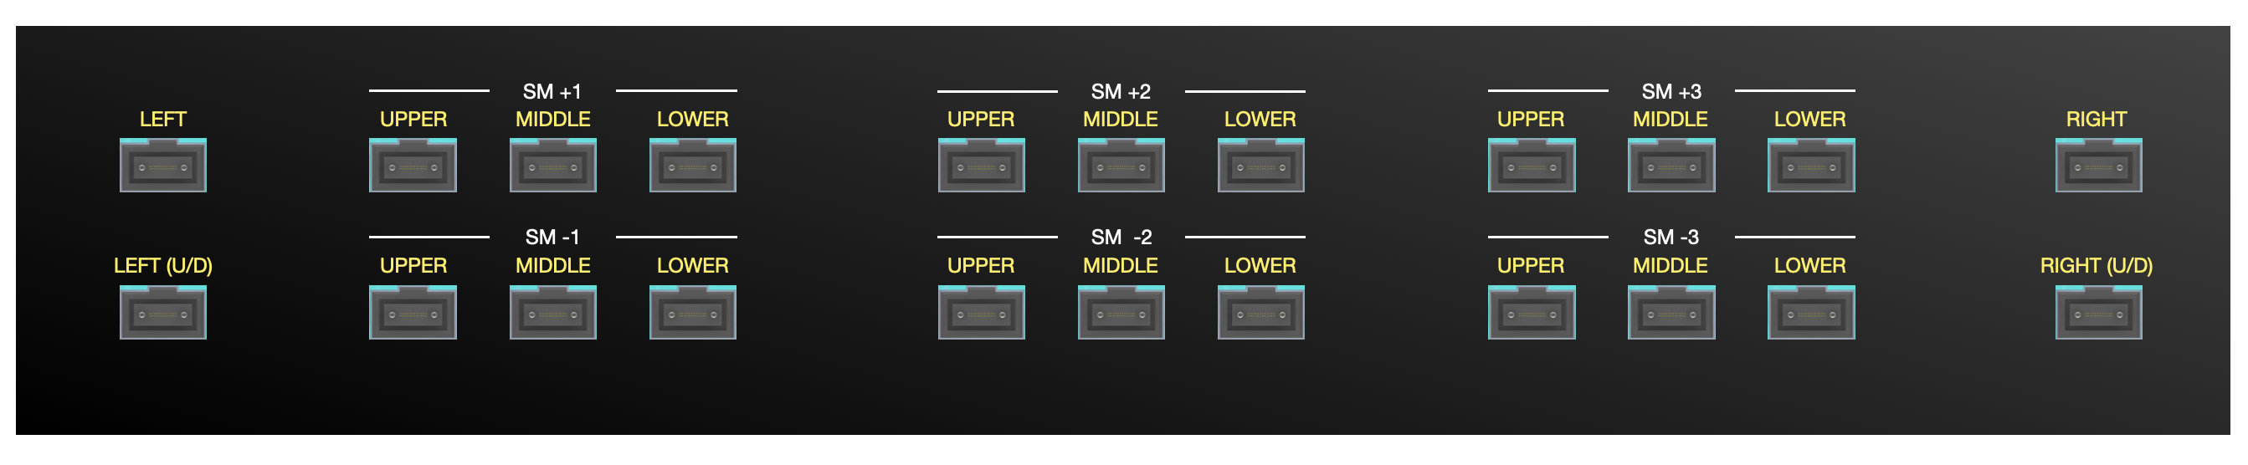
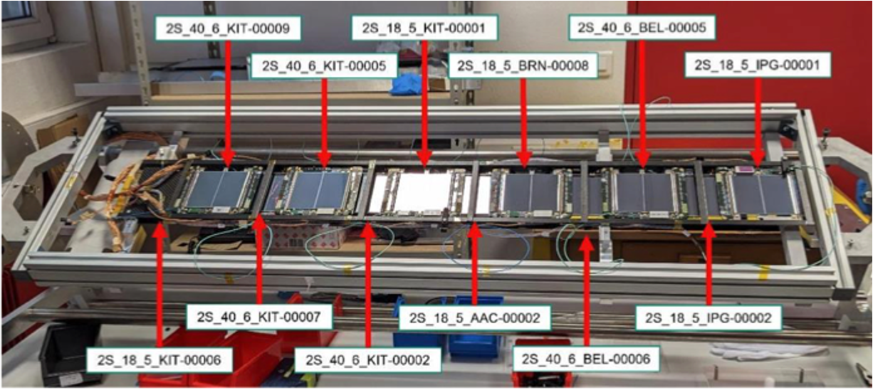
CMS Phase-2 Upgrade
L1-Trigger
https://cds.cern.ch/record/2714892
Tracks in L1-Trigger at 40 MHz
Particle Flow selection
750 kHz L1 output
40 MHz data scouting
DAQ & High-Level Trigger
https://cds.cern.ch/record/2759072
Full optical readout
Heterogenous architecture
60 TB/s event network
7.5 kHz HLT output
Barrel Calorimeters
https://cds.cern.ch/record/2283187
ECAL single crystal granularity at L1 trigger
with precise timing for e/γ at 30 GeV
ECAL and HCAL new Back-End boards
Muon systems
https://cds.cern.ch/record/2283189
DT & CSC new FE/BE readout
RPC back-end electronics
New GEM/RPC 1.6 < η < 2.4
Extended coverage to η ≃ 3
Calorimeter Endcap
https://cds.cern.ch/record/2293646
3D showers and precise timing
Si, Scint+SiPM in Pb/W-SS
Tracker
https://cds.cern.ch/record/2272264
Si-Strip and Pixels increased granularity
Design for tracking in L1-Trigger
Extended coverage to η ≃ 3.8
Beam Radiation Instr. and Luminosity
http://cds.cern.ch/record/2759074
Beam abort & timing
Beam-induced background
Bunch-by-bunch luminosity:
1% offline, 2% online
Neutron and mixed-field radiation
monitors
MIP Timing Detector
https://cds.cern.ch/record/2667167
Precision timing with:
Barrel layer: Crystals + SiPMs
Endcap layer:
Low Gain Avalanche Diodes

Slide 8
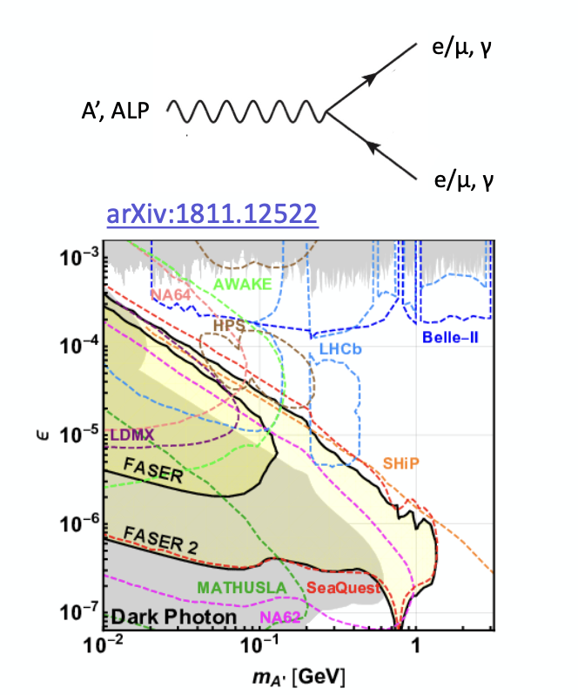
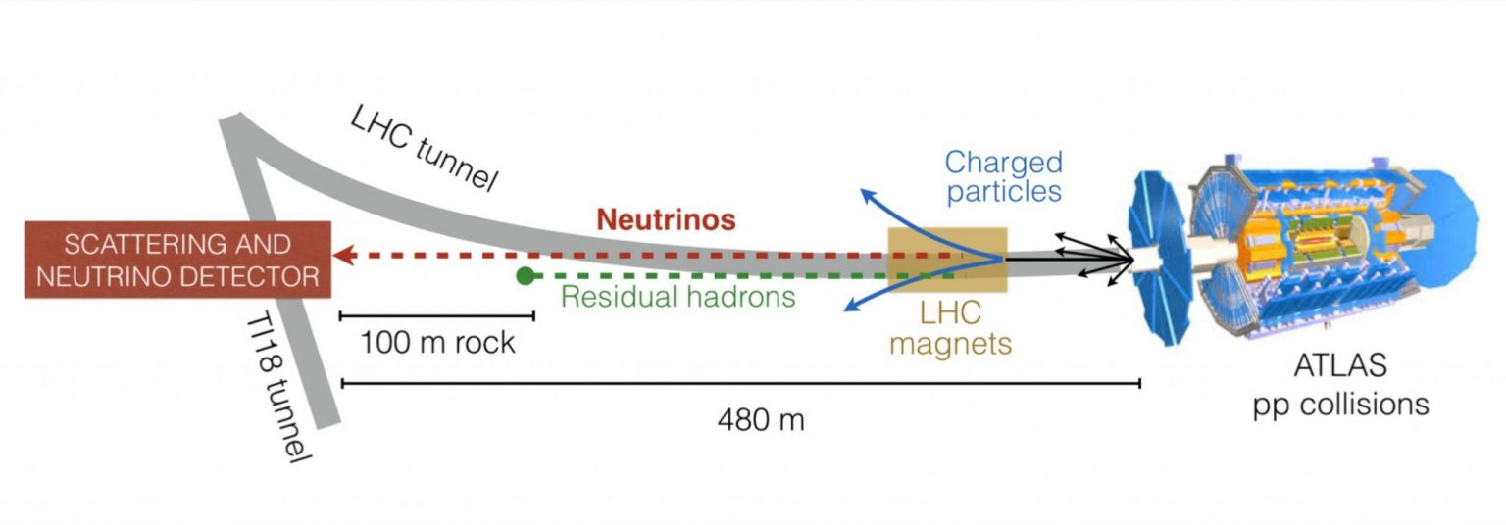
FASER
480m from ATLAS interaction point
Spectrometer, plus dedicated FASERν detector
Significant UK involvement
Future?
LLPs
FASER
Notes:
SND

Slide 9
SND@LHC
480m from ATLAS interaction point
Measures neutrinos from the LHC with emulsions & electronic tracker.
Aims at measuring pp→ νX and forward heavy flavour production, as well as search for dark photons
Small UK involvement, contributions to tracking in emulsions using graph neural networks
Future?
Notes:
SND

Slide 10
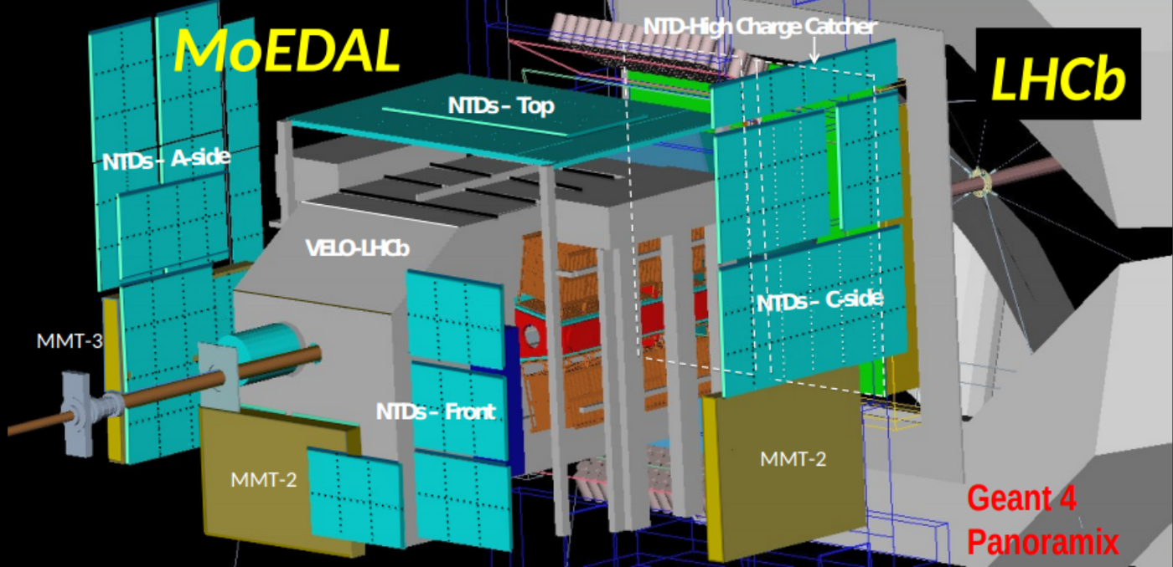
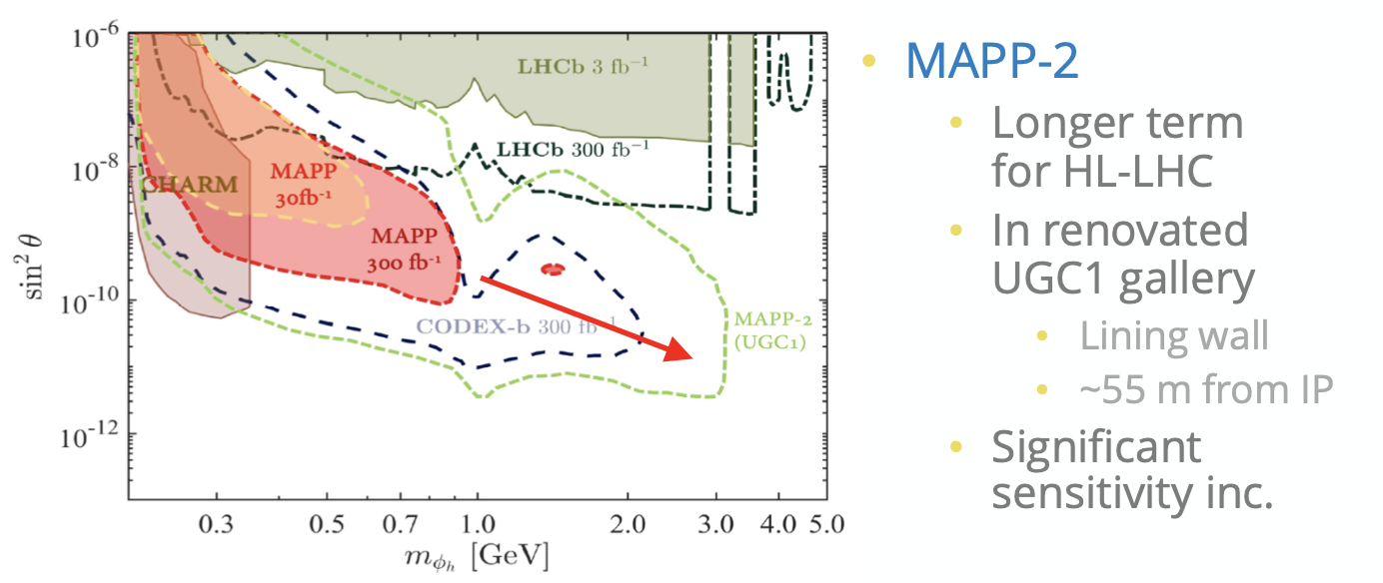
Long-lived Particles off-axis
Several current (MOeDAL-MAPP*, Milliquan) or proposed (ANUBIS, CODEX-b, Math) experiments at an an angle to the beam
Looking for a variety of long-lived particles (e.g. milli-charged particles, magnetic monopoles…)
MAPP-2 proposed for HL-LHC era
*Monopole and Exotics Detector at the LHC - Apparatus for Penetrating Particles

Slide 11
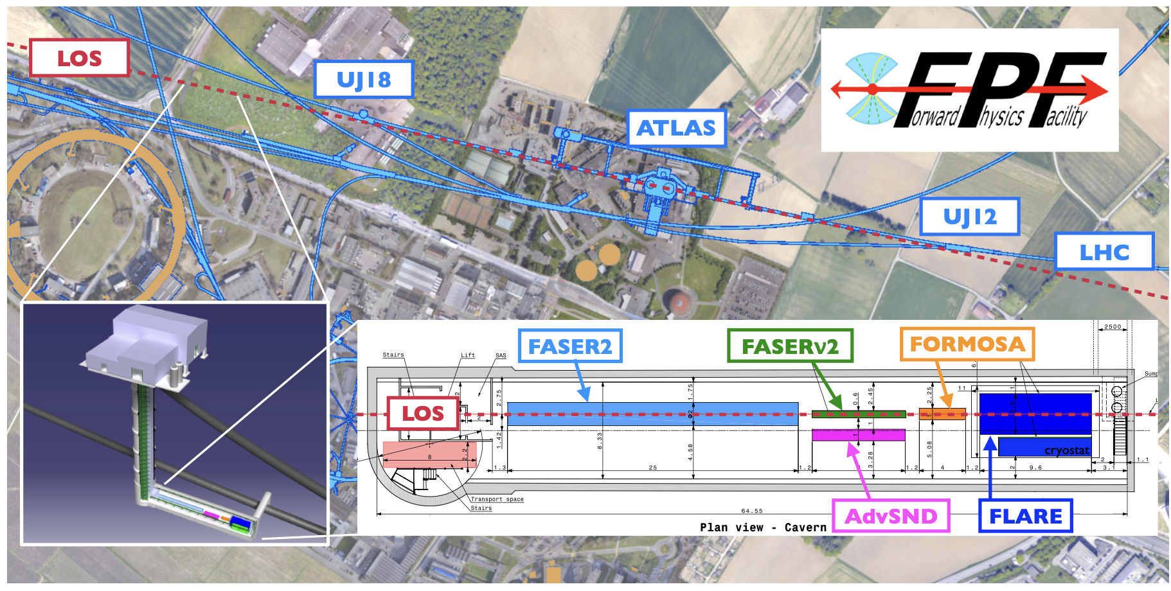
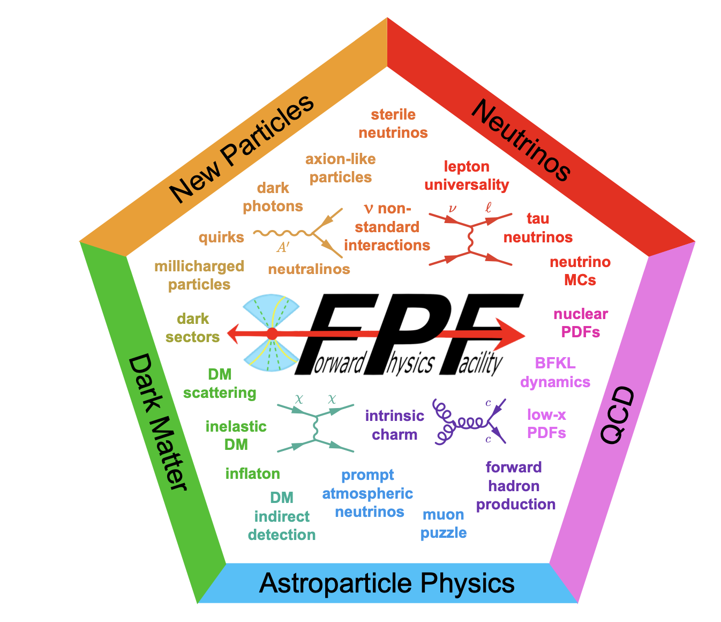
Forward Physics Facility
In line with beam (unlike MOeDAL-MAPP), but (unlike ALFA, TOTEM etc) shielded from IP
Several proposed new experiments with potential UK involvement.

Slide 12
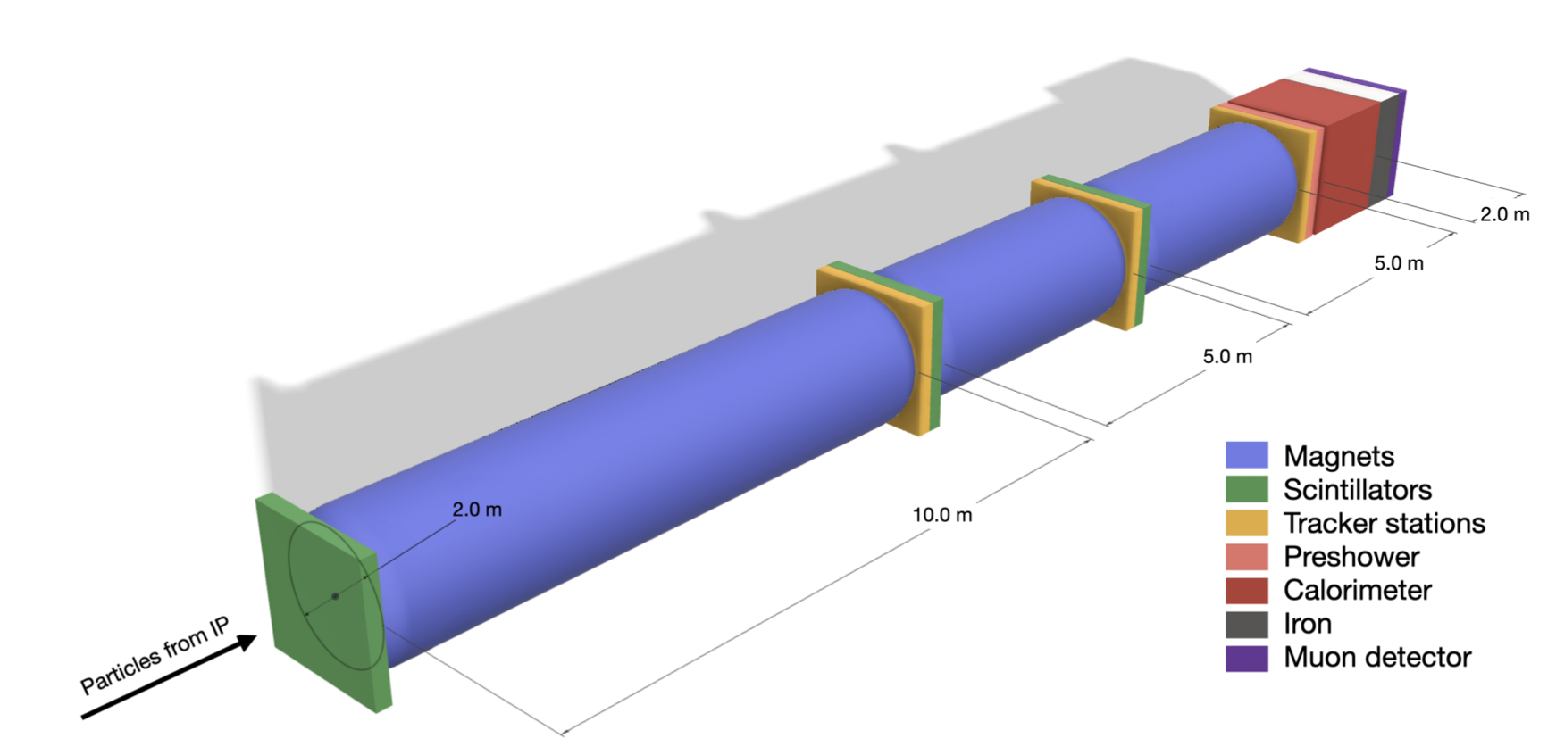
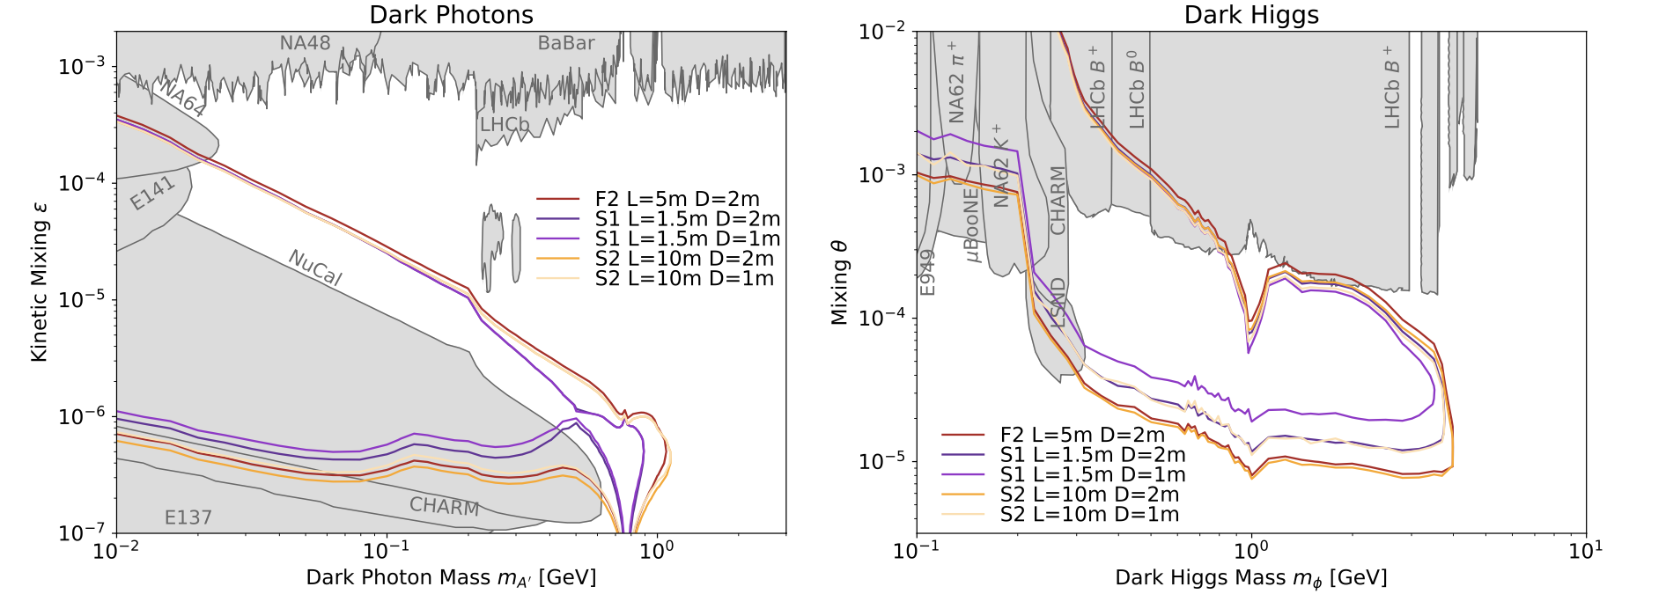
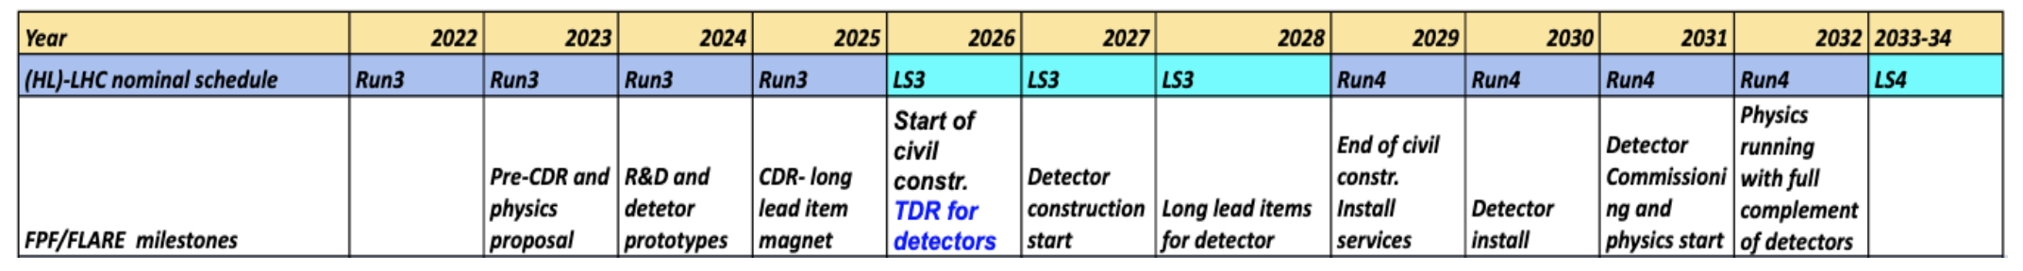
FASER2
FASER constrained by available space
FPF would allow a larger volume, increased reach (e.g. factor 15 in π⁰ acceptance)
Various detector configurations under discussion (Alcove, new cavern…)

Slide 13
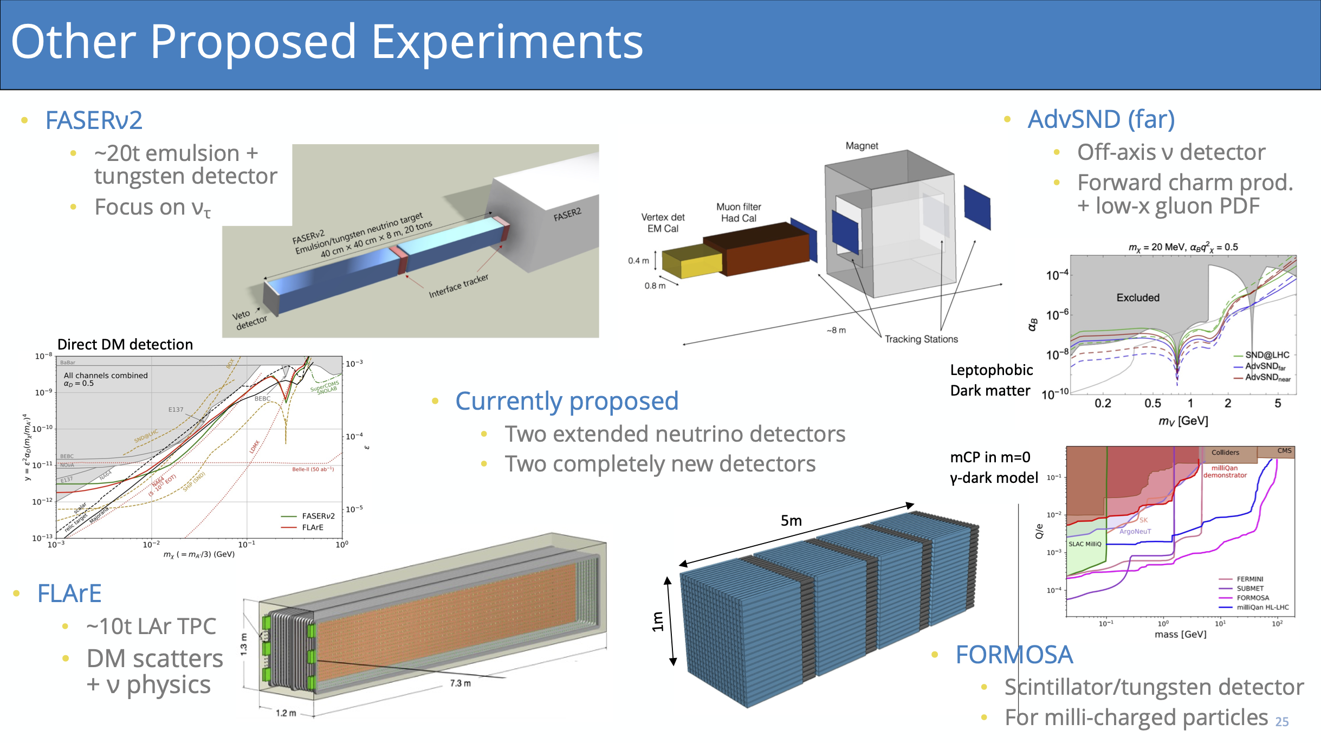
Forward Physics Facility
Slide from C. Gwilliam

Slide 14
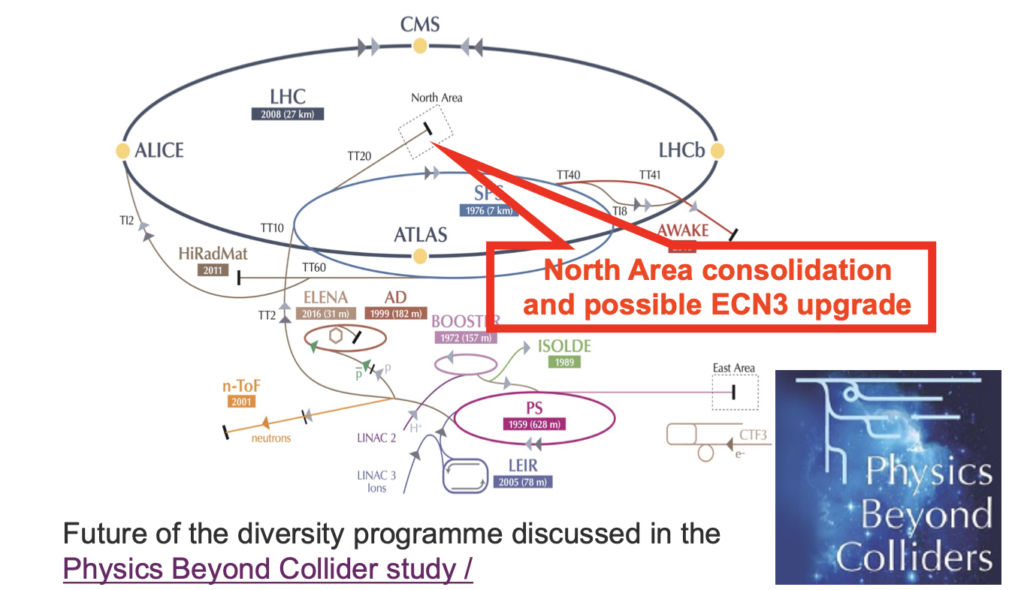
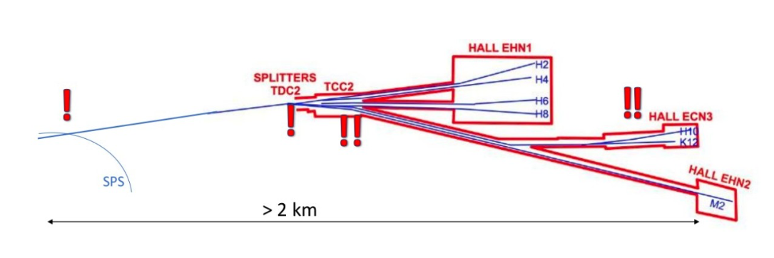
ECN3 intensity upgrade
Recommended by SPSC
  … presents unique opportunities for potential high-impact particle physics programs …. justifies in an experiment-agnostic way the intensity upgrade of ECN3.
Two feasible, competing scenarios discussed
  HIKE + SHADOWS
  Beam Dump Facility (BDF)/ SHiP
Open presentations at SPSC, 5 September. Review by end of year.

Slide 15
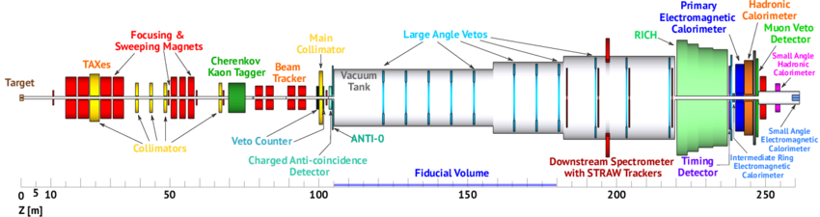
HIKE+SHADOWS
Hike: High Intensity Kaon Experiment, NA62 successor
  Phase 1 (8 years): Charged beams, aim for 5% precision on K⁺ → π⁺νν, & addressing wide variety of other channels relevant for lepton flavour violation & more (e.g. K⁺ → π⁺l⁺l– decays with x2 better precision). Includes running in beam-dump mode.
  Phase 2 (5 years): K_{L} beam and tracker similar to phase 1. Measure K_{L} → π⁰ee/π⁰μμ at 20% precision. Requires a new neutral beam line of 120 m length. (Background estimates in preparation.)
  Phase 3 (KLEVER): Aim at 20% precision on KL to π0νν. Requires a 270 m long KL beam line and probably 150m extension of ECN3 hall. (Not considered in the current review of the ECN3 future.)

Slide 16
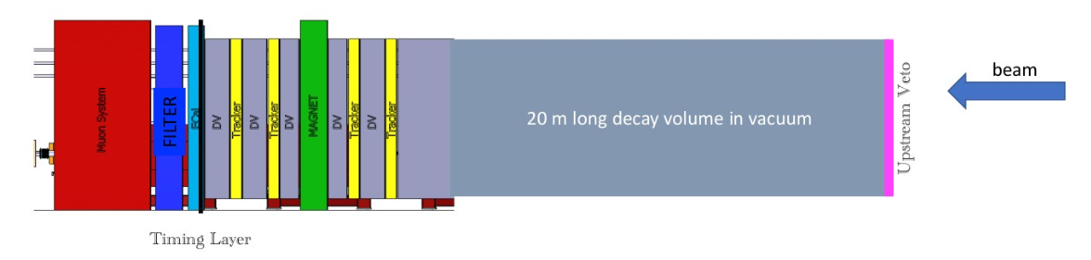
HIKE+SHADOWS
SHADOWS: Search for Hidden And Dark Objects With SPS
  off-axis beam-dump experiment running in parallel with HIKE in beam-dump mode. 4 year program.
  search for feebly-interacting particles (FIPs) emerging from charm and beauty decays.
  Program of searches for feebly interacting particles can be performed along with HIKE in on-axis in dump mode.
  Detector: 20m long, in vacuum decay volume, an Upstream Veto, a Tracking System with a (warm) dipole magnet, Timing layer, Electro-magnetic calorimeter, a filter and four Muon
  Stations. Transversal size: 2.5x2.5 m².
  Uses existing technologies: no intense R&D is needed, more than one option per detector is already available on the market

Slide 17
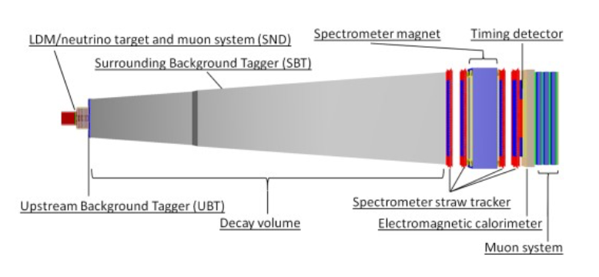
BDF/SHiP
Beam-dump Facility, Search for Hidden Particles, 13 year program
  Originally proposed for ECN4: widely reviewed. Considered positively by ESPP, but beyond budget due to the construction work needed for ECN4.
  Collaboration investigated other locations with view to cost reduction. Identified ECN3 as most cost-effective.
  Signal sensitivity and backgrounds are essentially the unchanged, after detailed re- optimisation. Also applies to the neutrino program, though can no longer use a magnetic spectrometer.
  Upstream system: Scattering & Neutrino Detector (SND). Search for light dark matter (LDM) scattering and perform neutrino physics.
  Downstream system: Hidden Sector Decay Search (HSDS) detector. Reconstruct decay vertices of FIPs, measure invariant mass and provide particle ID of decay products, in a nearly-zero background environment.

Slide 18
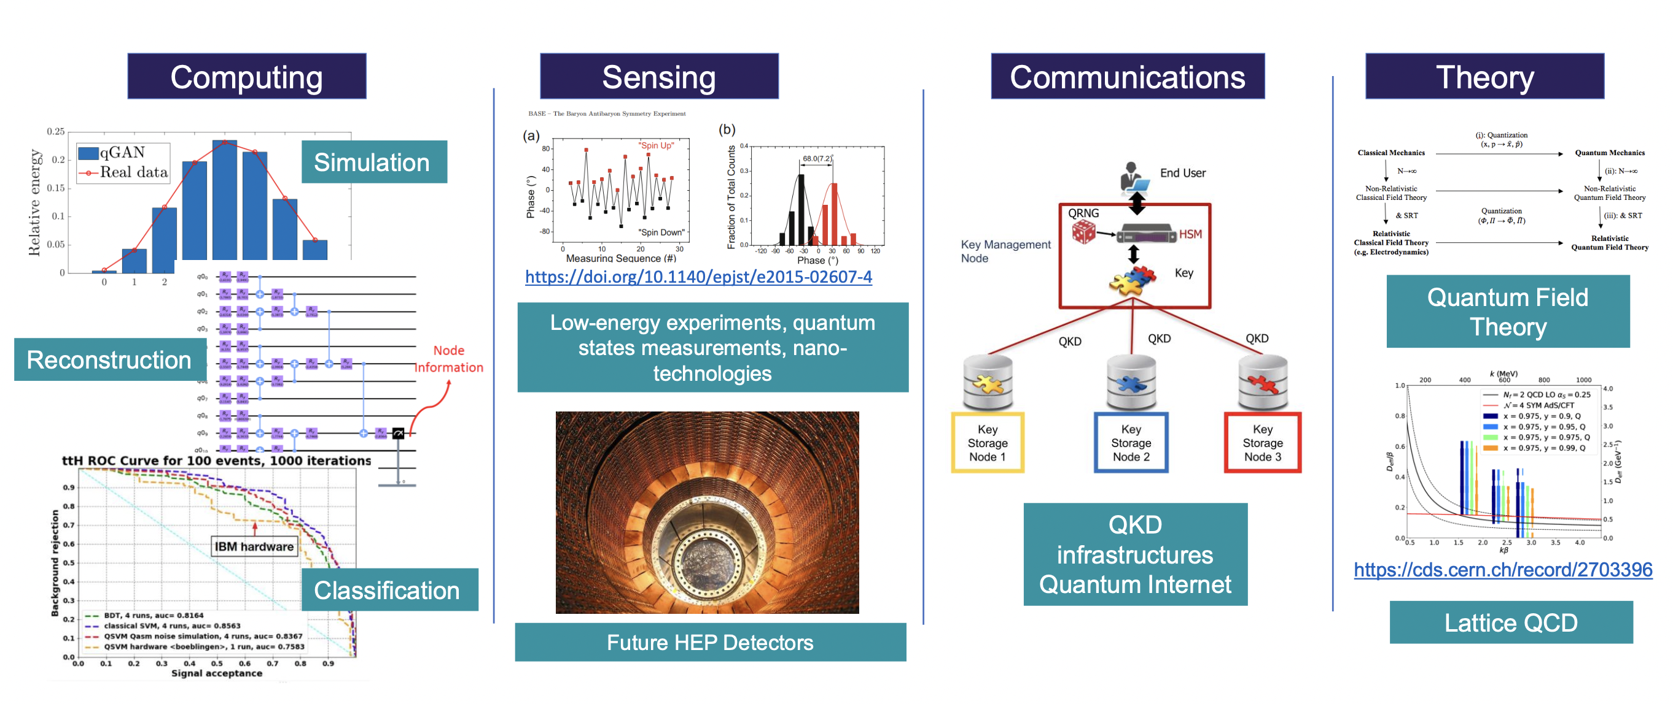
Quantum Technology Initiative
Phase 2 under discussion
(Slide from Alberto Di Meglio)

Slide 19
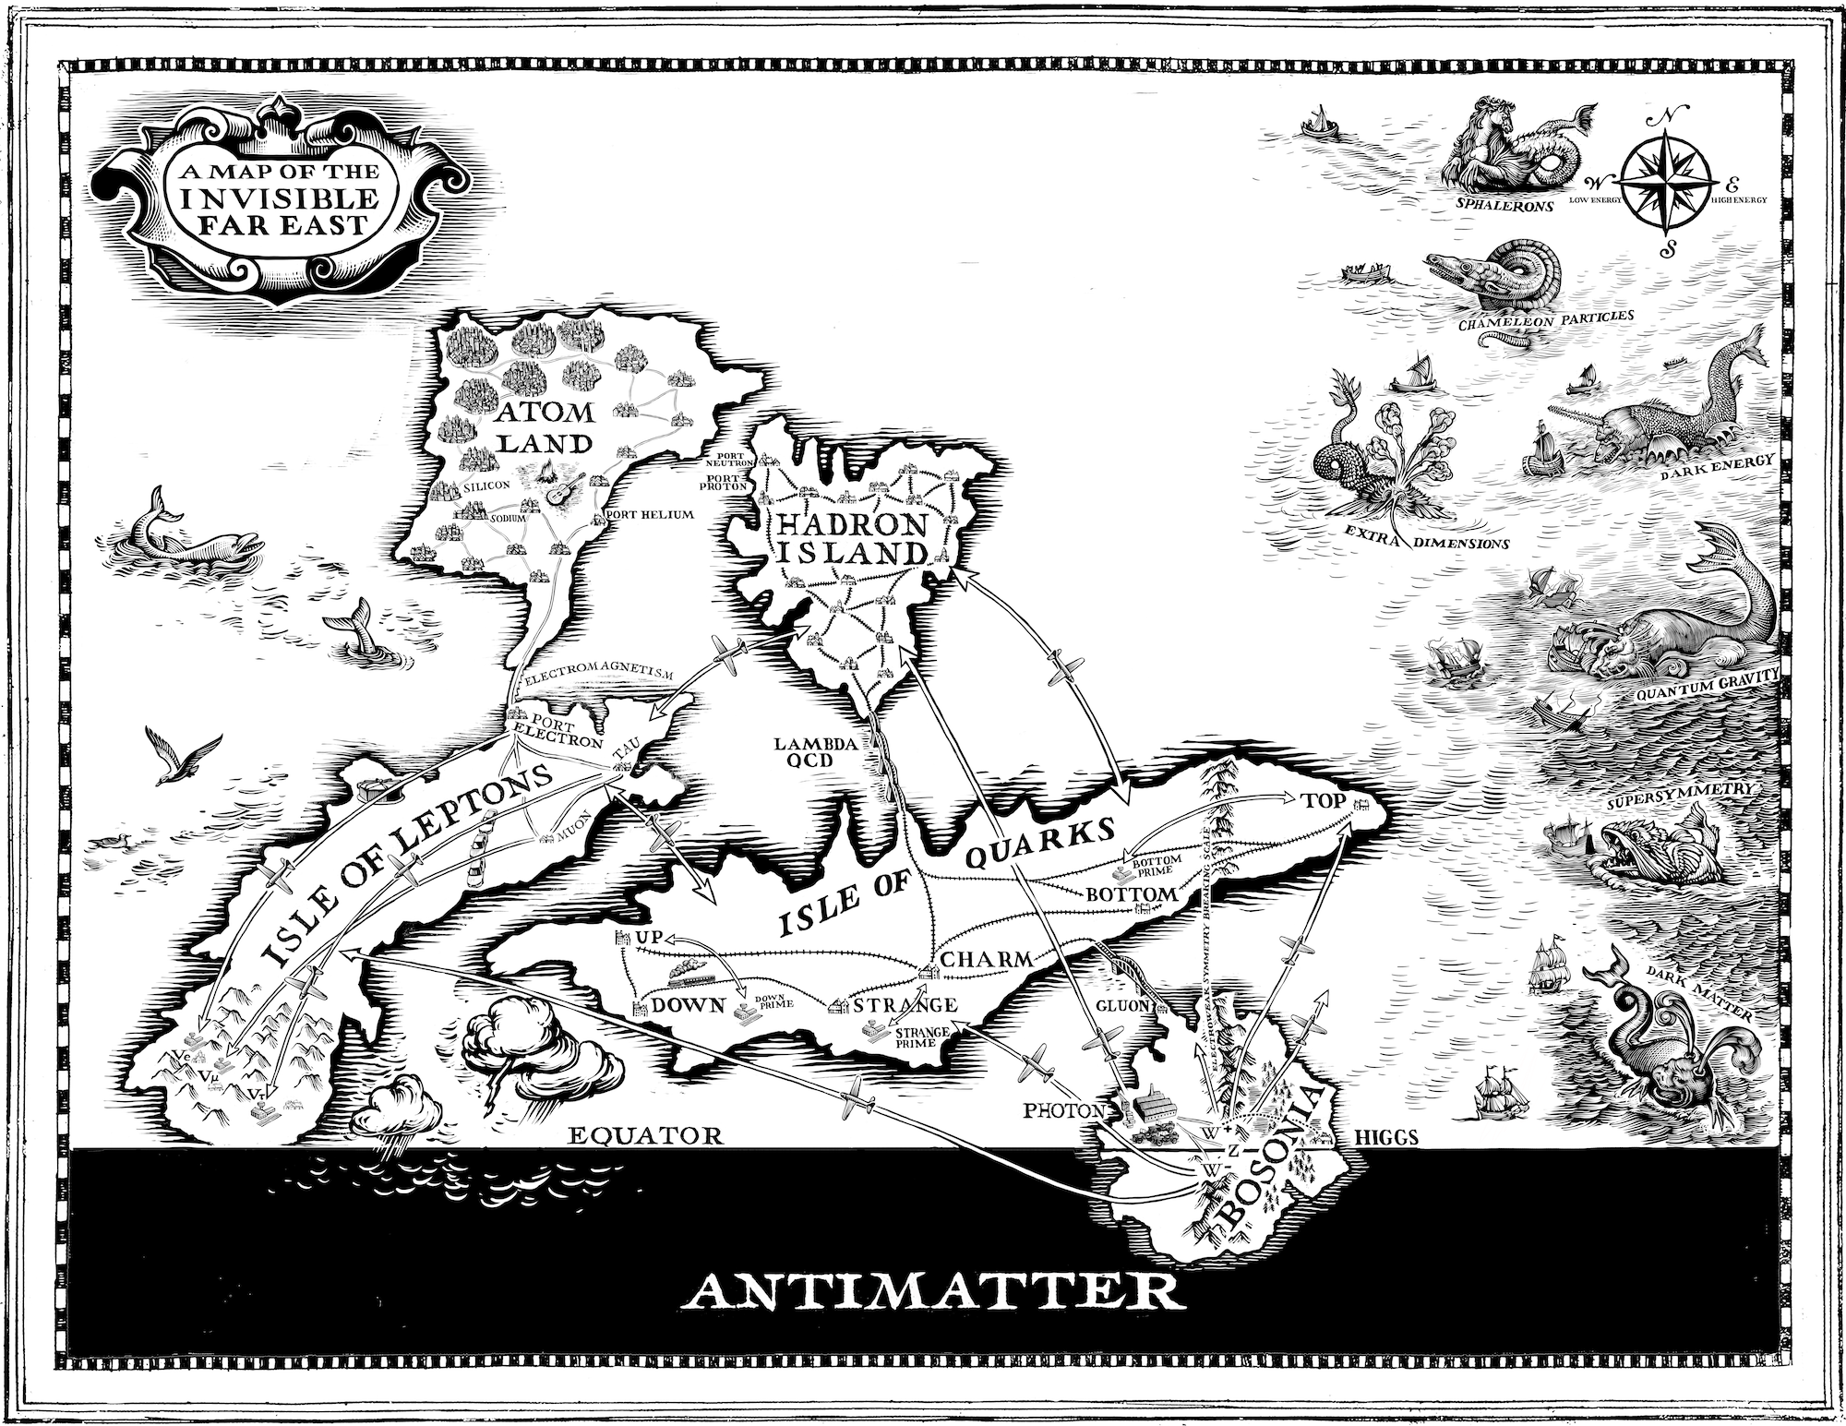
Discuss….
(and thanks to Tracey Berry, Marcella Bona, Mario Campanelli, Monica D’Onofrio, Carl Gwilliam, Cristina Lazeroni, Steve McMahon, Claire Shepherd-Themistocleous, Pedro Tiexera-Dias, and anyone I forgot, sorry…)
Notes:
This list came out of what I am doing personally on the LHC, but actually applies across the board.

Slide 20
Spares

Slide 21
