Slide 1
Boulby Underground Laboratory
Status and plans for growth for the UK’s Deep Underground Science Facility.
Sean Paling
Boulby Underground Laboratory
Science and Technology Facilities Council

Slide 2
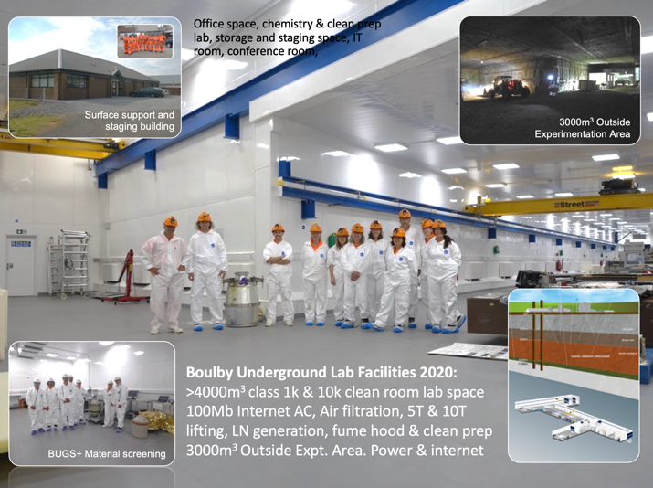
Boulby Underground Laboratory (UK)

Slide 3
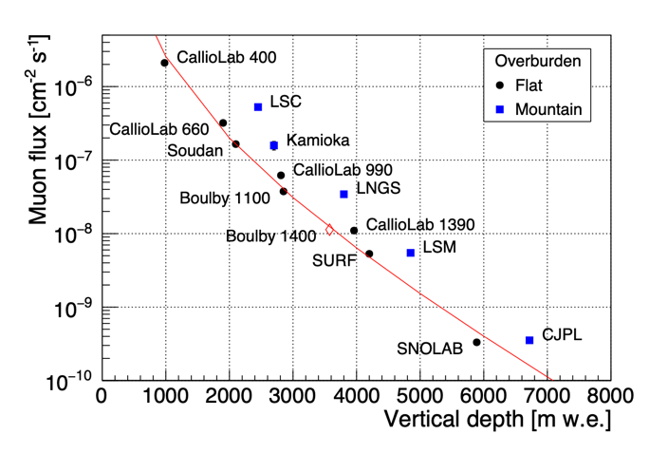
Boulby Underground Laboratory (UK)

Slide 4
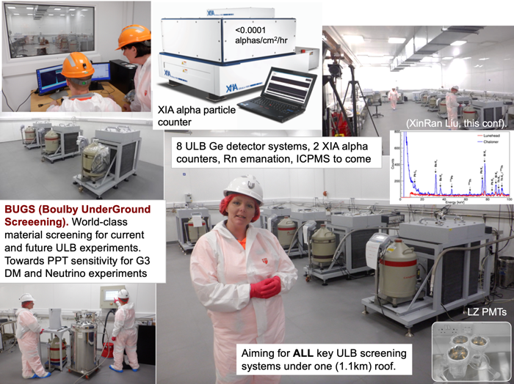
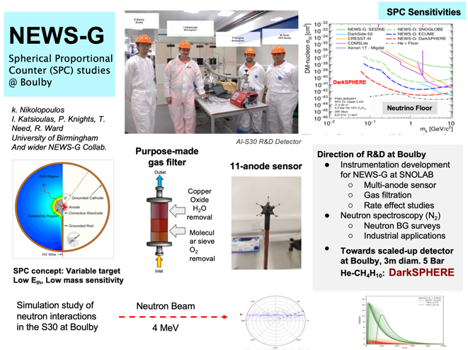
Boulby Science Now & Future
Particle physics and ultra-low background studies

Slide 5
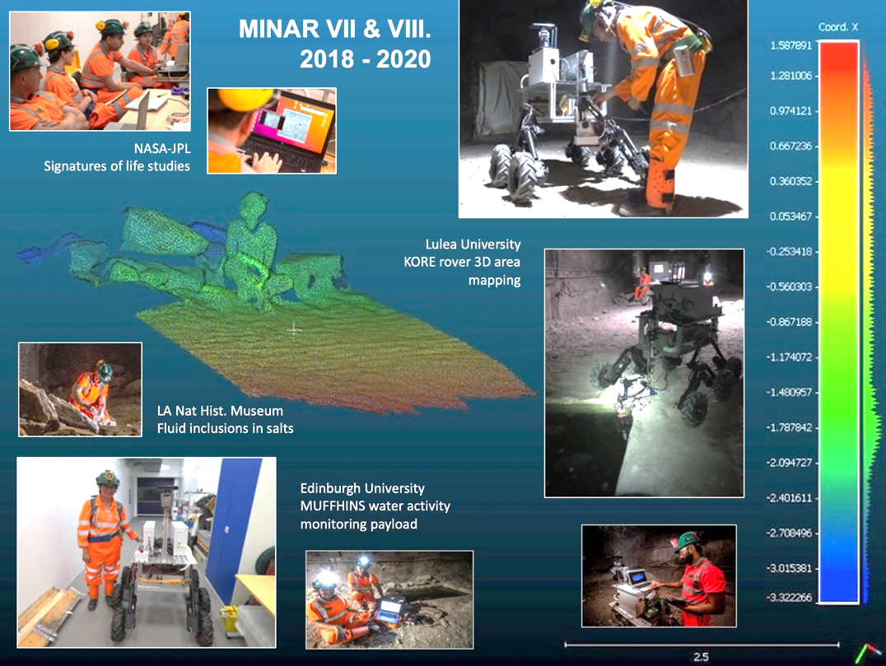
Multidisciplinary Science
Applied low background particle physics, Earth and Environmental science, Astrobiology & Planetary Exploration Technology Development.

Slide 6
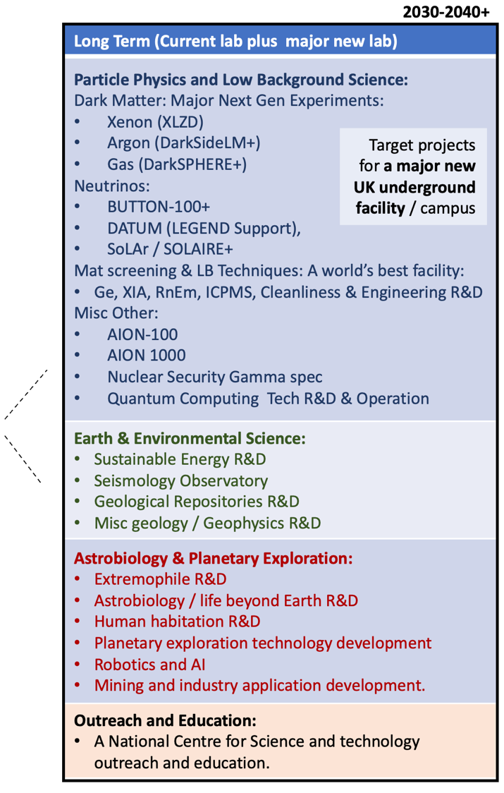
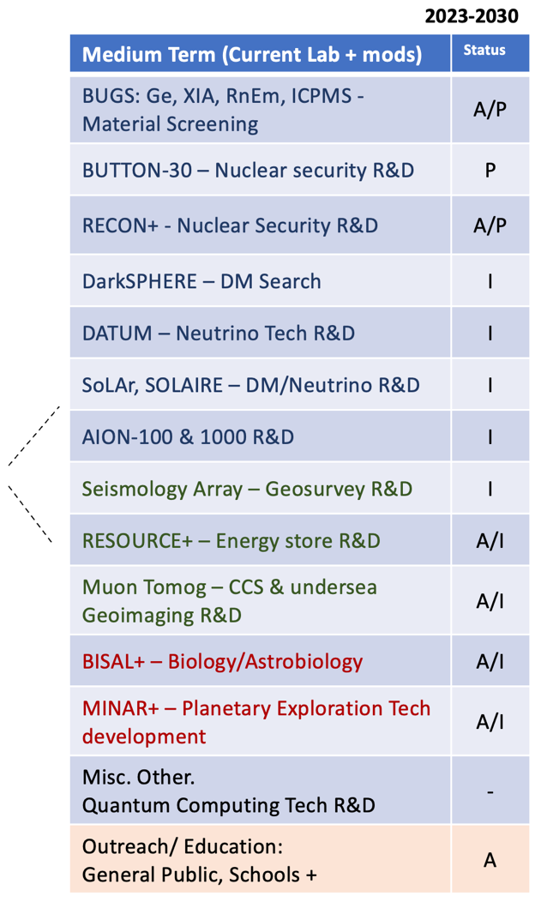
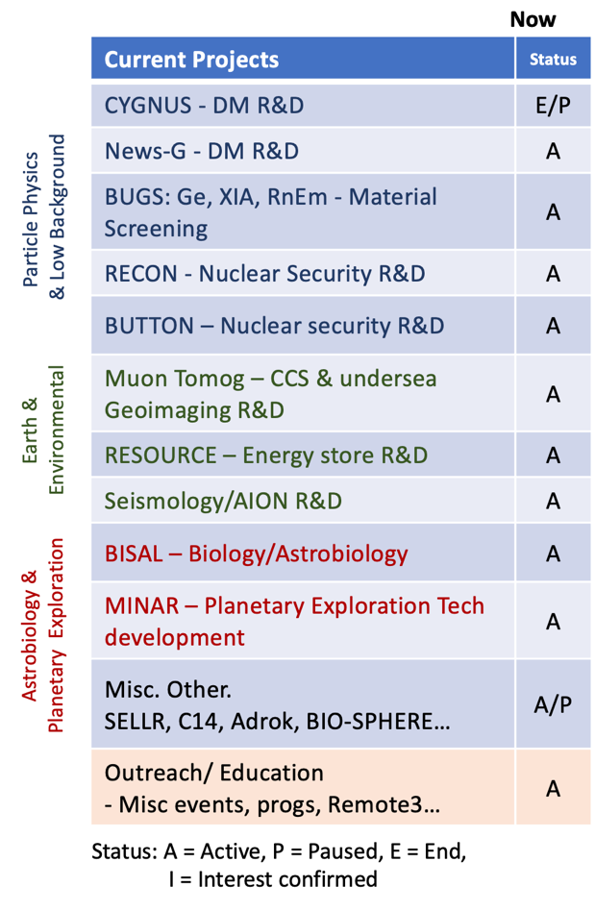
Boulby Activities Now and Potential Future

Slide 7
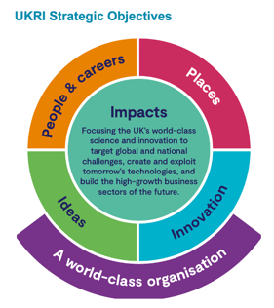
UK Underground Science Facilities. Now and the Future…
What Boulby Is:
An internationally-important centre for pure & applied multi-disciplinary science.
A local (North East) and national asset for science, technology and outreach/education.
A successful and proud example of science and industry partnership
A UKRI/UK facility with potential, opportunity and support for wide-ranging growth.
STFC/Boulby now looking to: continue to develop the UK underground science facilities to further enable truly internationally-important astro-particle physics and pure and applied multi-disciplinary science.
Short term: Maximally exploit the current Boulby facility to host world class Astro-particle Physics & Low Background Science, Earth & Environmental Science, Astrobiology & Planetary Exploration Studies
Medium-to long term: Prepare to build a major new deep underground science facility in the UK to host next-generation world-leading science projects coming 2030+
Boulby Development Project:
Plans & preparations for a major new multi-disciplinary Deep Underground Science Facility in the UK

Slide 8
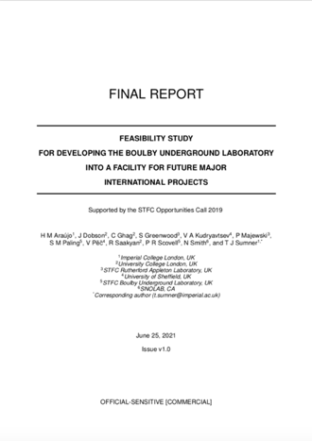
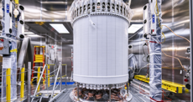
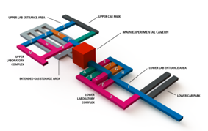
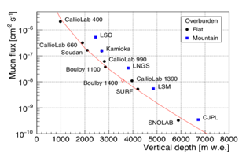
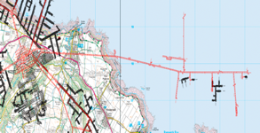
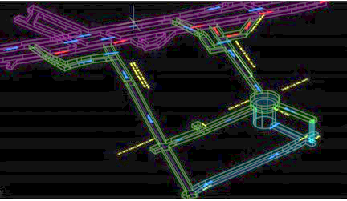
Boulby Feasibility Study (Boulby-FS)
Boulby-FS (2020-21) Overview:
Community-led study of motivation, context and practicalities of creating a major new deep underground science facility in UK
Infrastructure specifications for potential projects (Dark Matter, Neutrinos & more).
Conceptual designs for excavations and outfitting laboratories in 1.1km (Salt) and 1.4km (Polyhalite) layers
Staffing and surface facility needs.
Detailed costs and schedules.
LZ @ SURF.
Next generation in the UK?
Submitted to STFC June 2021
10 T Liquid Xenon
New lab specifications & designs
New lab in Salt?
New lab in Poly?
Government ‘fit’: Levelling Up, Strength in Places, Build Back Better, UK Science Superpower…
Results: It IS feasible, well motivated and timely.
Outfitted facility: £100-200m (Inc contingency, VAT)

Slide 9
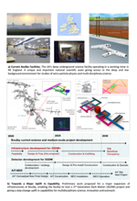
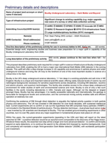
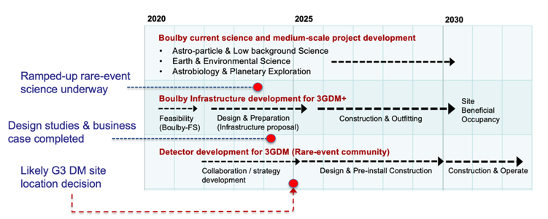
Next (Current) Steps: Boulby Development Project (BDP)
Next level planning and preparing for a…
“… greatly expanded underground science facility in the North East, with the potential to host a major international science infrastructure, such as a next generation dark matter experiment.” (STFC strategic delivery plan (2022-2025)
BDP Project Goal:
UKRI Preliminary Infrastructure Funding
£2.84M, 3 year project (2022/3-2024/5).
Tasks / Deliverables:
Facility design development (for sites at various depths and locations)
Science programme development
Business case(s), economic impact studies, risks → Submission to Gov.
Stakeholder engagement: Local, National & International:
Public & Partners
Government
Science communities & funders
Boulby Development Project Infrastructure Bid: 2022-2025
Boulby Development Timeline
XLZD Detector Build
XLZD Facility Occupy

Slide 10
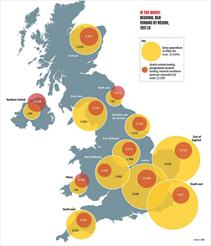
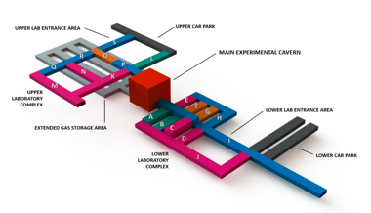
Summary: Boulby Development Project (BDP)…
Plans and preparations for a major new multi-disciplinary Deep Underground Science Facility in the UK.
Regional R&D Spending 2017-18
A world-leading UK deep underground science facility hosting next-generation science 2030+
Searches for Dark Matter
Neutrino studies
Quantum Sensors, Quantum Computing
Pure & applied low background particle physics
Earth and Environmental Sciences
Astrobiology & planetary exploration.
Outreach, Education and more…
Boulby
A LARGER and more ADVANCED lab is needed for major new science to be hosted in the UK
A new UK facility will bring:
HIGH-impact, world-leading science
LARGE multi-national collaborations
BIG fundamental science questions
MAJOR local & national investment, employment, impact and visibility
Government ‘fit’: Levelling Up, Strength in Places, Build Back Better, UK Science Superpower…
Boulby Development Project (BDP)
3-year Preliminary IF-funded study
~£3M from 2022-2025
Location & site design
Business case development
Stakeholder Liaison
Led by STFC/UKRI & UK science community

Slide 11
Boulby Underground Laboratory
Thank You
Sean Paling
Boulby Underground Laboratory
Science and Technology Facilities Council

