Slide 1
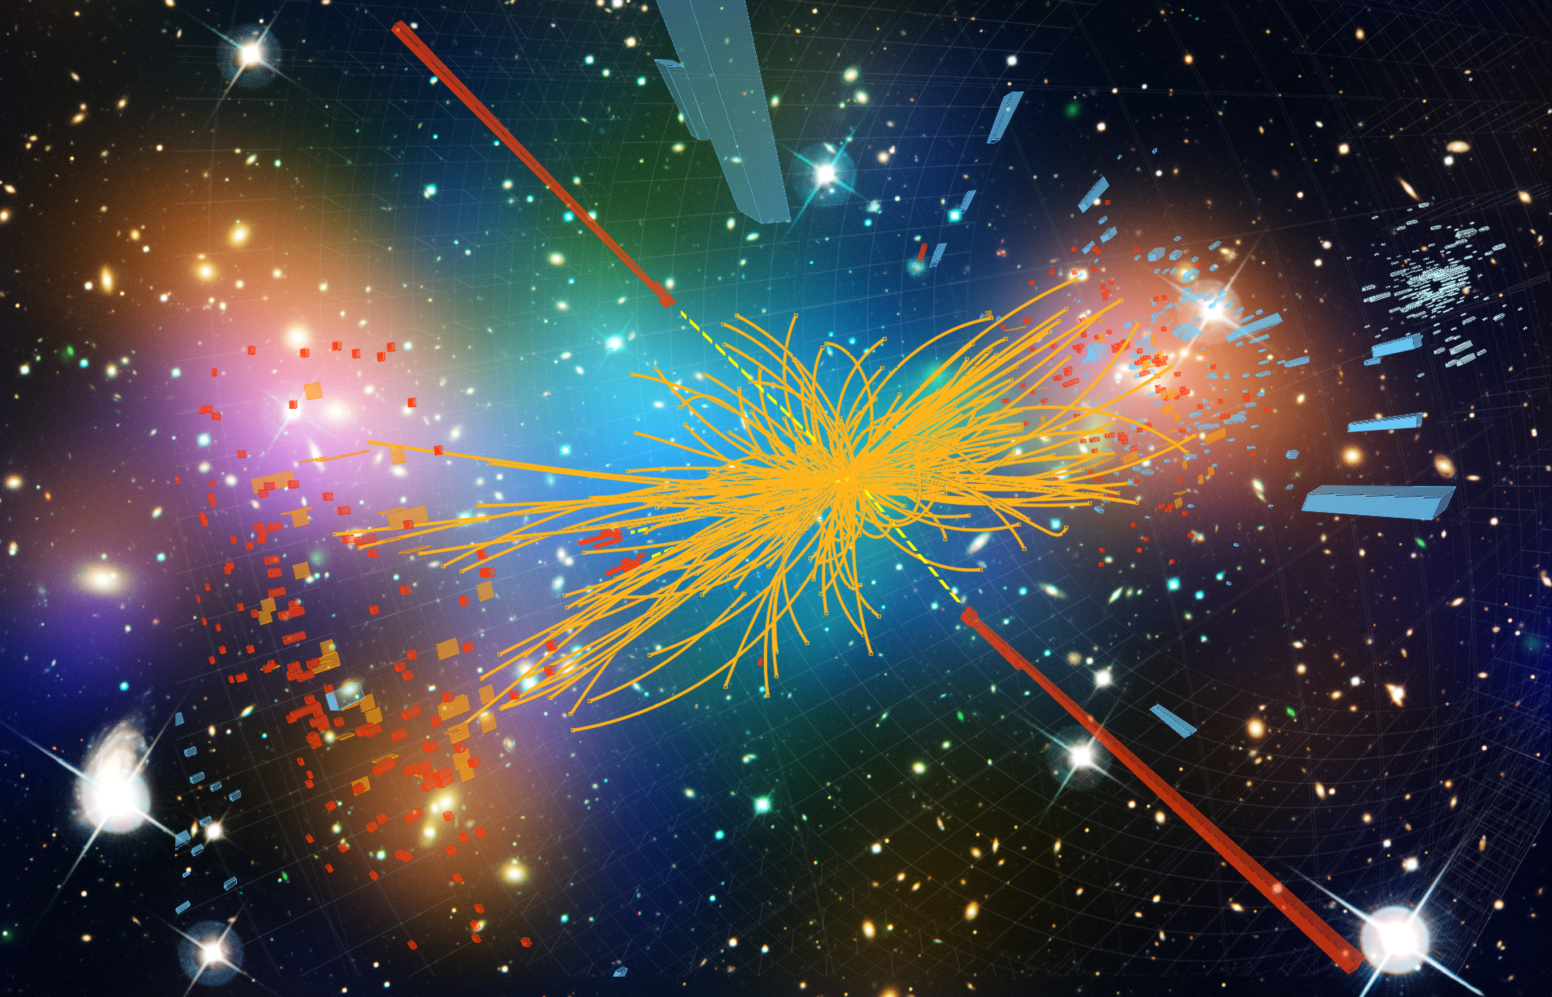

Higgs Cosmology
Arttu Rajantie
UK HEP Forum, 22 November 2023

Slide 2
Higgs Cosmology
The Standard Model has
19 parameters –
all have been measured
Can be extrapolated all
the way to Planck scale
We can meaningfully ask what
it says about the Early Universe
The Higgs field plays a particularly
important role
(Buttazzo et al 2013)

Slide 3
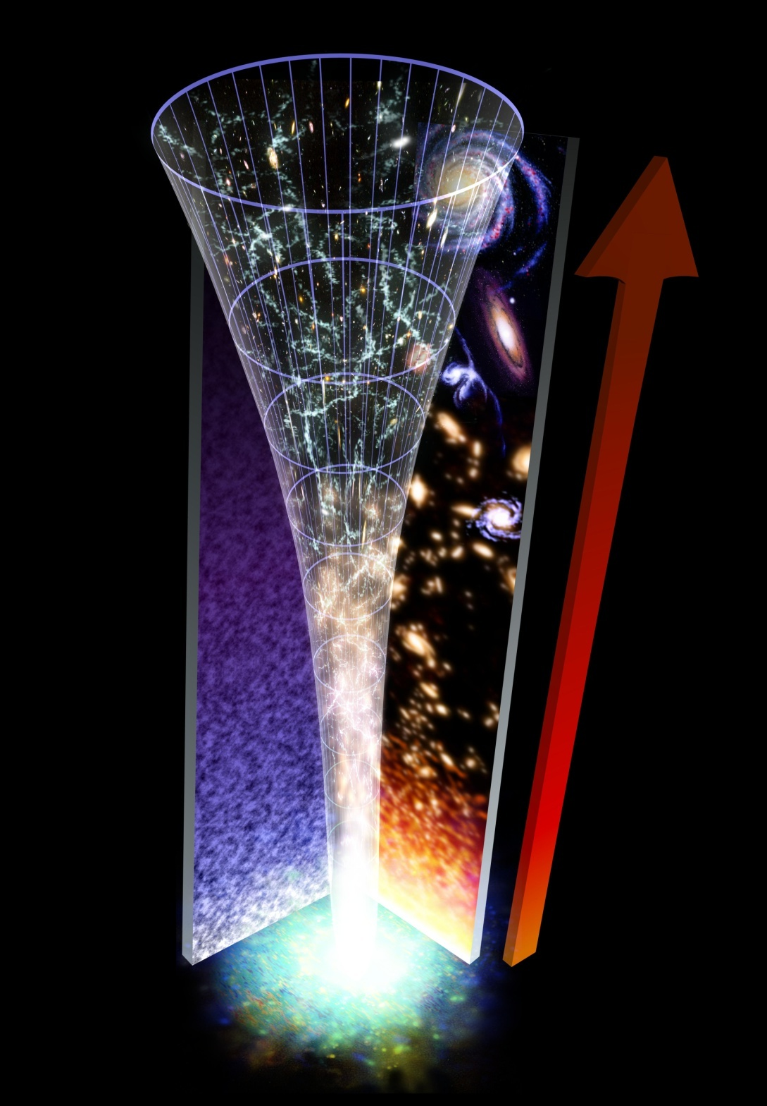
Higgs Cosmology
Baryogenesis
Gravitational waves
Dark matter
Inflation
Vacuum stability

Slide 4
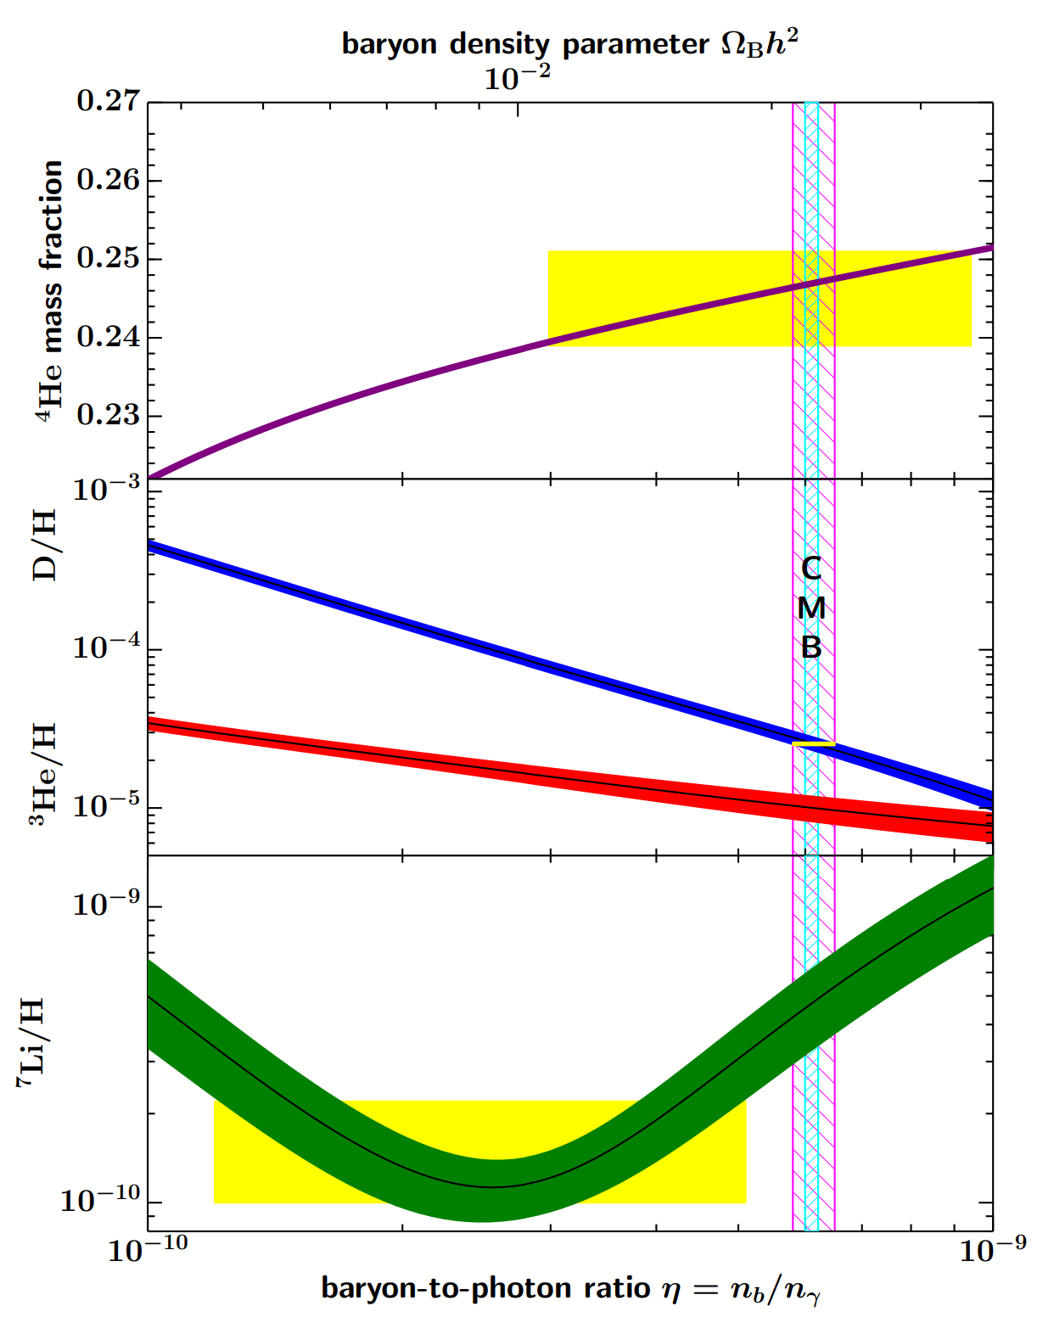

Baryon Asymmetry
Astrophysical observations:
Much less antimatter than matter $n_{\overline{B}}≪n_{B}$
Baryon asymmetry constrained by nucleosynthesis and cosmic microwave background (CMB)
$$η=\frac{n_{B}−n_{\overline{B}}}{n_{γ}}=\left(6.1±0.4\right)×{10}^{−10}$$
(Particle Data Group, 2020)

Slide 5
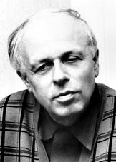
Sakharov Conditions (1967)
Baryon number violation
  Processes that produce different numbers of
  baryons and antibaryons
C and CP violation
  Particles and antiparticles must behave differently
  In the Standard Model: CKM matrix
Deviation from equilibrium
  In equilibrium numbers of particles and antiparticles are the same

Slide 6
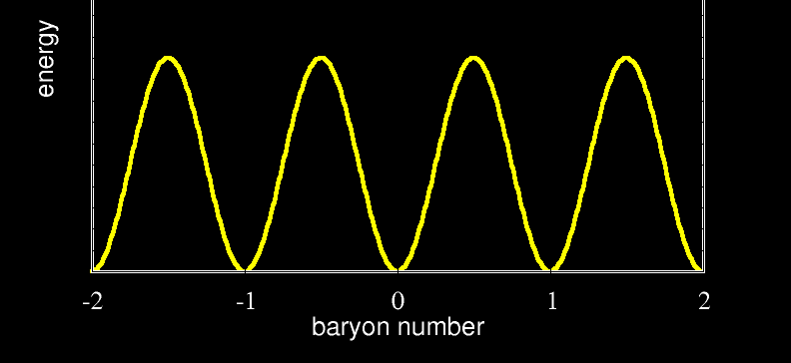

Baryon number violation
Perturbatively baryon number is conserved, $∂_{μ}j_{B}^{μ}=0$
Chiral anomaly
$$∂_{μ}j_{B}^{μ}=∂_{μ}j_{L}^{μ}=\frac{3}{32π^{2}}Tr {\tilde{F}}_{μν}F^{μν} ⇒ ΔB=3ΔN_{CS}$$
Zero temperature:
Quantum tunnelling
$Γ∼exp\left(−\frac{8π^{2}}{g^{2}}\right)∼{10}^{−170}$
Non-zero temperature:
$Γ∼\exp\left(−\frac{8πv}{gT}\right)$, where $v$ is the Higgs vev

Slide 7



Electroweak Baryogenesis
Kuzmin et al 1985:
First-order electroweak phase transition
  Growing bubbles of broken phase
  provides deviation from equilibrium
  Prevents baryon washout if $Δφ≳T$
In the Standard Model,
requires $m_{H}≲80 GeV$
(Kajantie et al 1996)
or BSM physics
With $m_{H}=125 GeV$, a smooth
crossover from symmetric to broken phase
$B$ conserved
CP
$B$ violated

Slide 8
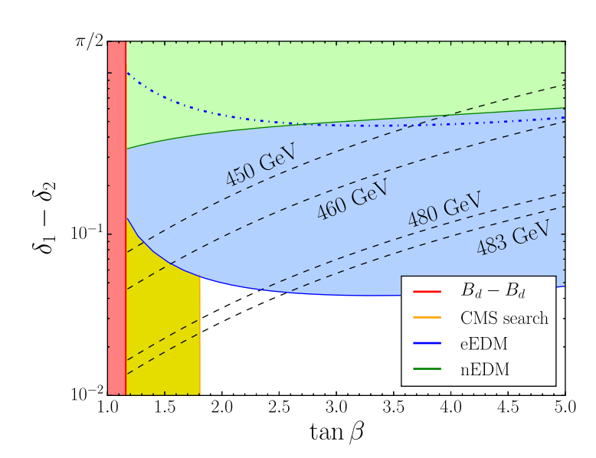

Beyond the Standard Model
MSSM: First order phase transition generally requires stop mass $m_{\tilde{t}}≲120 GeV$
(Carena et al. 2009)
  Ruled out by LHC data
NMSSM or two Higgs doublet model
  Requires extra CP violatation
  $⇒$ Largely ruled out by electron EDM
Some other models still possible,
e.g. composite Higgs or extra light singlet,
but heavily constrained by eEDM
(Bodeker and Buchmuller 2021)
(Dorsch et al 2017)

Slide 9
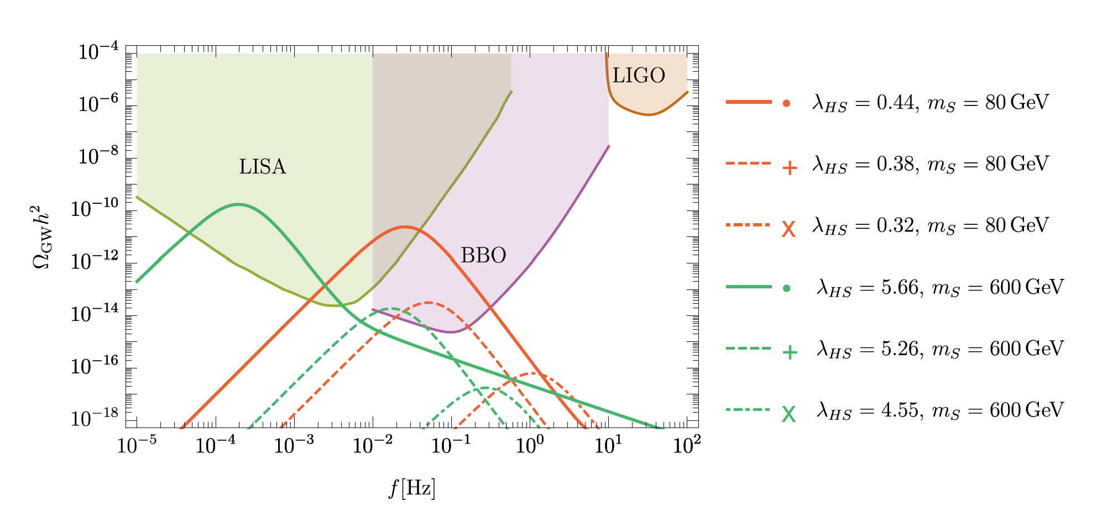

Gravitational Waves
First order phase transition:
Bubble collisions, sound waves,
turbulence
$⇒$ Gravitational waves
May be detectable with LISA
and future GW missions
See O. Gould’s talk!
(Beniwal et al 2017)

Slide 10
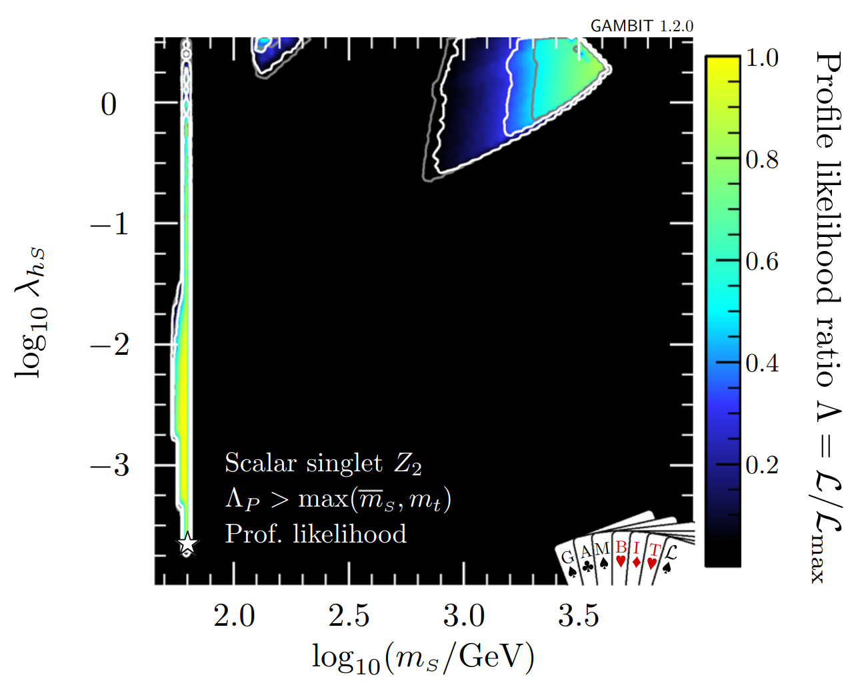

Higgs Portal Dark Matter
Unique renormalizable coupling between SM and dark sector:
$$Δℒ_{scal}=λ_{φh}H^{†}Hφ^{2} \\ Δℒ_{vec}=λ_{Vh}H^{†}HV_{μ}V^{μ} \\ Δℒ_{spin}=λ_{φχ}H^{†}H\overline{χ}χ$$
Constraints from global fits including invisible Higgs decays at LHC,
DM abundance and direct searches
(Athron et al 2018)

Slide 11
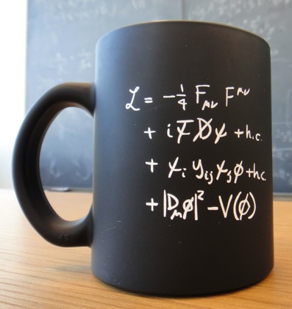


Non-Minimal Curvature Coupling
Early Universe: Higgs spacetime curvature $R∼H^{2}$
Standard Model symmetries allow
one more renormalisable term,
the Higgs-curvature coupling $ξ$:
$$ℒ=ℒ_{SM}+ξRφ^{†}φ$$
$\text{(}\text{Chernikov}\text{\&}\text{Tagirov}\text{ 1968)}$
Required for renormalisability,
runs with energy –
Cannot be set to zero!
Last unknown parameter
in the Standard Model
$$+ξRφ^{2}$$

Slide 12
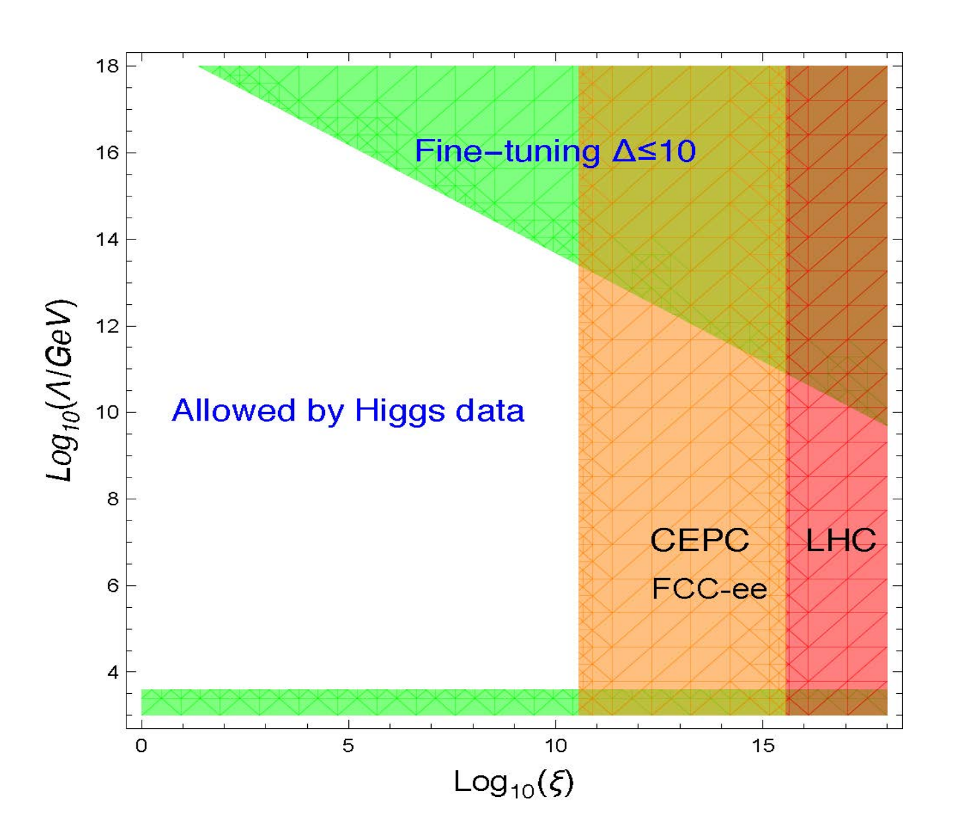


Measuring $ξ$
Curved spacetime:
$$ℒ=ℒ_{SM}+ξRφ^{†}φ$$
Ricci scalar $R$ very small today
⇒ Difficult to measure $ξ$
Colliders: Suppresses Higgs couplings
  LHC Bound $\left|ξ\right|≲2.6×{10}^{15}$ (Atkins&Calmet 2012)
  Future colliders: $\left|ξ\right|≲{10}^{11}$ (Wu et al. 2019)
(Wu et al. 2019)

Slide 13

Higgs Inflation
Bezrukov&Shaposhnikov 2007:
Conformal transformation to Einstein frame:
$${\tilde{g}}_{μν}=Ω^{2}g_{μν}, Ω^{2}=1+\frac{ξh^{2}}{M_{P}^{2}}, \frac{dχ}{dh}=\sqrt{\frac{Ω^{2}+6ξ^{2}h^{2}/M_{P}^{2}}{Ω^{4}}}$$
Asymptotically flat potential
$$U\left(χ\right)∼\frac{λM_{P}^{4}}{4ξ^{2}}{\left[1+\exp\left(−\frac{2χ}{\sqrt{6}ξ^{2}}\right)\right]}^{2}$$
Satisfies slow-roll conditions when $χ≫M_{P}$
$⇒$ Inflaton

Slide 14
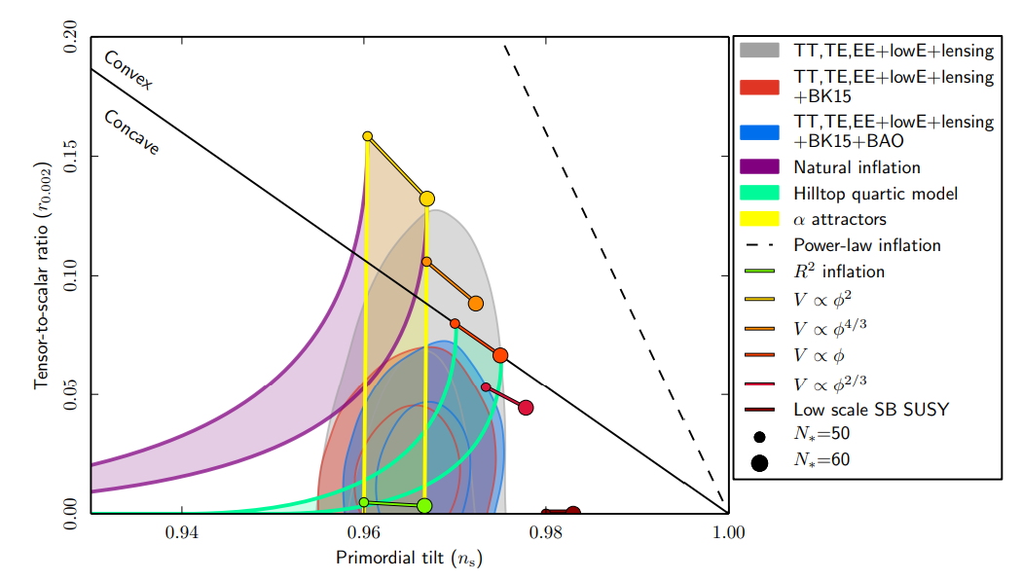

CMB Constraints
Amplitude of CMB anisotropies
$$⇒ξ≈47200\sqrt{λ}$$
Predictions
$n_{s}≈0.97, r≈0.003$
  Same as $R^{2}$ inflation
  Agree with observations
Theoretical problem:
  Violation of perturbative unitarity
  when $h≳M_{P}/ξ$
Many variants, e.g.,
  Palatini Higgs inflation (Bauer&Demir 2010)
  Higgs-dilaton inflation (Shaposhnikov&Zenhausers 2009)
(Planck collaboration, 2018)

Slide 15

Vacuum Metastability
For experimental
values $m_{H}=125.18 GeV$
and $m_{t}=173.1 GeV$
  $λ$ becomes negative
  at $μ_{Λ}≈9.9×{10}^{9} GeV$
  Minimum value $λ_{min}≈−0.015$
  at $μ_{min}≈2.8×{10}^{17} GeV$
(Buttazzo et al 2013)

Slide 16
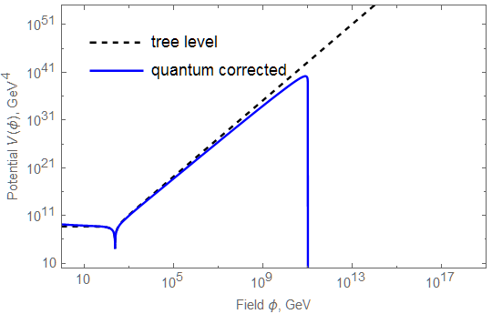

Vacuum Metastability
Renormalisation group improved Higgs effective potential
$V\left(φ\right)≈λ\left(gφ\right)φ^{4}$
Becomes negative
at $φ>φ_{c}≈{10}^{10}GeV$
True vacuum at
Planck scale?
Current vacuum
metastable against
quantum tunnelling
Barrier at
$φ_{bar}≈4.6×{10}^{10} GeV$,
height $V\left(φ_{bar}\right)≈{\left(4.3×{10}^{9} GeV\right)}^{4}$
(Based on a 3-loop calculation by Bednyakov et al. 2015)

Slide 17
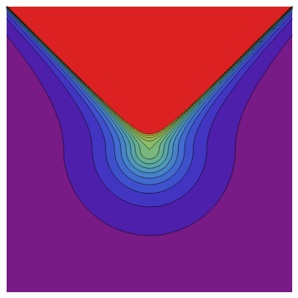

Bubble Nucleation
Bubble nucleation rate:
  $Γ∼e^{−B}$, where
  $B=$ “bounce” instanton action (Coleman 1977)
  Solution of Euclidean equation of motion
Spherical symmetric bounce
$⇒$ Lorentz invariant
Bubble expands at the speed of light
(see, however, De Luca, Kehagias & Riotto JCAP 2022)
Bubble interior:
Gravitational collapse in a microscopic time
(Unless trapped behind an event horizon)

Slide 18

Bubble Nucleation
Simple toy model: (Fubini 1976)
$V\left(φ\right)=\frac{1}{4}λφ^{4}$ with constant $λ<0$
Exact solution
$φ\left(r\right)=\sqrt{\frac{2}{|λ|}}\frac{2R}{r^{2}+R^{2}}$
Action $B=\frac{8π^{2}}{3\left|λ\right|}$
When $λ$ runs, $B≈\frac{8π^{2}}{3\left|λ_{min}\right|}≈1800$
(depending on Higgs and top masses)
$⇒$ extremely slow rate $Γ∼μ_{min}^{4}e^{−B}$
Can be enhanced by higher-dimensional operators, e.g., $φ^{6}$ (Branchina et al 2014)

Slide 19


Cosmological Setting
Assume: Bubbles grow at the speed of light and destroy everything they hit
⇒ There cannot have been any bubbles in our past light cone
today $η_{0}$
conformal time $η$
hot Big Bang
inflation
comoving distance

Slide 20
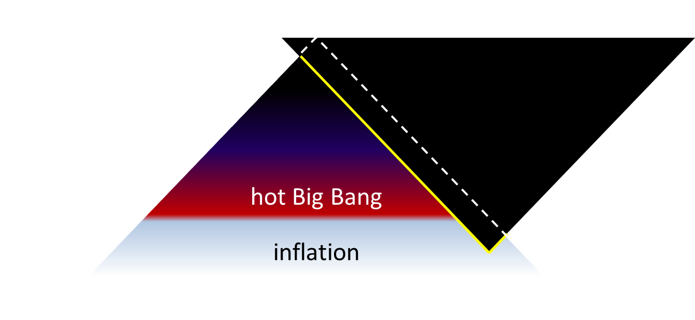

Past Light Cone
Probability of no bubble in the past light cone:
$$P\left(𝒩=0\right)=e^{−\left\langle 𝒩\right\rangle },$$
where $\left\langle 𝒩\right\rangle$ is the expected number of bubbles ($dη=dt/a$),
$$\left\langle 𝒩\right\rangle =\frac{4π}{3}\int^{η_{0}}{dη a{\left(η\right)}^{4}{\left(η_{0}−η\right)}^{3}Γ\left(η\right) }$$
Therefore, we must have $\left\langle 𝒩\right\rangle ≲1$
Integrate over the whole history of the Universe:
inflation, reheating, hot Big Bang, and late Universe
(For anthropists: $\frac{d\left\langle 𝒩\right\rangle }{dt}Δt≲1$)

Slide 21


Late Universe Stability Bounds
Number of bubbles in past lightcone: $〈𝒩〉≈0.125Γ/H_{0}^{4}$
Metastability: $0<〈𝒩〉≪1$, no contradiction with observations
$$m_{t}=172.69(30) GeV \\ m_{H}=125.25(17) GeV$$
(Buttazzo et al. 2013)

Slide 22
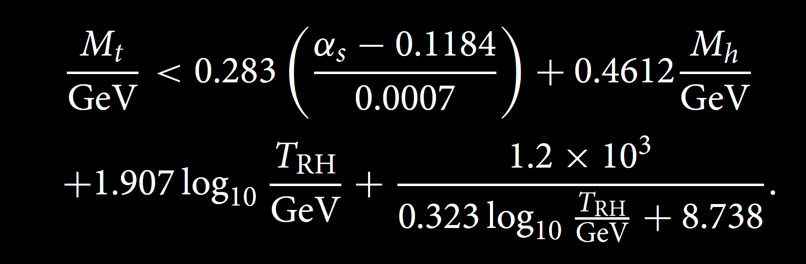

Hot Big Bang
High temperature:
Higher bubble nucleation rate
(Arnold&Vokos 1992; Espinosa et al 2008)
If reheat temperature $T_{RH}$
is high, this contribution
dominates
$⇒$ More unstable
Top mass bound: (Delle Rose et al 2016)
(Markkanen, AR, Stopyra, 2018)

Slide 23

Bubbles from Black Holes
Black holes can catalyse vacuum decay
(Hiscock 1987; Berezin et al 1991)
Burda et al 2016:
Planck-scale black holes catalyse
vacuum decay faster than they evaporate
$⇒$ Excludes primordial BHs with mass $M≲{10}^{12} kg$
Shkerin&Sibiryakov 2022:
Thermal effects due to Hawking radiation stabilise
(see also Strumia 2022)
$⇒$ No primordial black hole constraints from vacuum stability?
(Burda et al 2016)

Slide 24

Higgs Fluctuations from Inflation
Quantum fluctuations:
$$P\left(φ\right)∝exp\left[−\frac{8π^{2}}{3H^{4}}V\left(φ\right)\right]$$
Take the Higgs over the barrier
if the Hubble rate is high,
$H≳φ_{bar}≈{10}^{10}GeV$
(Espinosa et al. 2008;
Lebedev&Westphal 2013;
Kobakhidze&Spencer-Smith 2013;
Fairbairn&Hogan 2014;
Hook et al. 2014)
Does this imply an upper limit on
the scale of inflation
$H≲{10}^{10}GeV$ ?
Higgs fluctuations

Slide 25



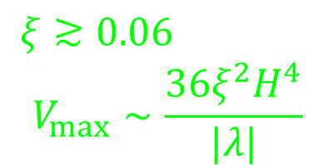

Higgs-Curvature Coupling
Positive non-minimal coupling $ξ$
$⇒$ effective mass contribution
$Δm^{2}=ξR$
Increases barrier height,
makes the vacuum more stable
(Herranen,Markkanen,Nurmi,AR 2014)
$$ξ≳0.06$$
$$V_{max}∼\frac{36ξ^{2}H^{4}}{|λ|}$$
$$V\left(φ\right)$$
Minkowski
$$φ$$
$$ξ≲0.02$$

Slide 26

(De)Stabilising the Potential
Minimal scenario:
Standard Model
+ $m^{2}χ^{2}$ chaotic inflation,
no direct coupling to inflaton
If $H≳μ_{inst}=6.6×{10}^{9}GeV$
and there is no new physics,
vacuum stability during inflation
requires $ξ≳0.06$
(Markkanen,Nurmi,AR,Stopyra 2018;
Mantziris,Markkanen,AR 2021,2022)
Stability at the end of inflation
requires $ξ≲$ 9
(Herranen,Markkanen,Nurmi,AR 2015; Figueroa,AR&Torrenti 2018)
(Markkanen, Nurmi, AR & Stopyra 2018)

Slide 27


Vacuum Stability Constraint on $ξ$
Stability both during and through the end of inflation requires
$$0.06≲ξ≲9$$
15 orders of magnitude stronger than the LHC bound
$\left|ξ\right|≲2.6×{10}^{15}$
Caveats:
  Assumes no direct coupling to inflaton (see, e.g., Ema et al. 2016, 2017)
  – Would still need $|ξ|≲O(1)$
  Assumes no new physics
  – Could stabilise potential altogether, or destabilise further
  Assumes high scale inflation $H≳{10}^{9} GeV$

Slide 28
Summary
The Higgs field plays a central role in aspects of cosmology:
  Baryogenesis
  Gravitational waves
  Dark matter
  Inflation
  Vacuum stability
Can place constraints on
  Cosmological scenarios
  BSM theories
  Non-minimal Higgs curvature coupling

