Slide 1
Quantum State-Channel Duality applied to Particle Physics* Clelia Altomonte** (she/her) IPPP Workshop: Quantum Computing for High-Energy Physics 19th-20nd September 2023 Durham
C
*C. Altomonte, and A.J. Barr, “Quantum State-Channel Duality applied to Particle Physics”(2022).
**MMathPhys dissertation project; King’s College London, TPPC probationary PhD student.

Slide 2
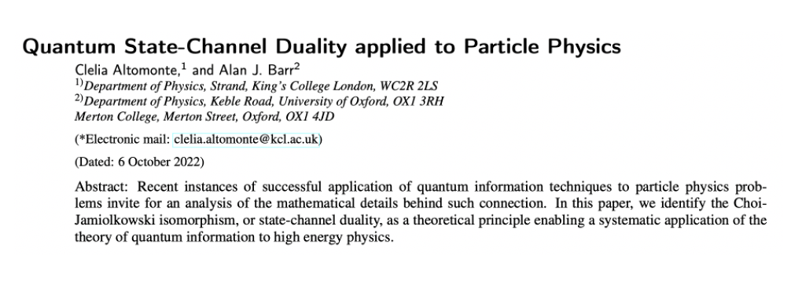
[C. Altomonte, A.J. Barr, 2022], Oxford MSc Mathematical and Theoretical Physics Dissertation

Slide 3
Motivation
«[…] you can describe it fully in several different ways without immediately knowing that you are describing the same thing. […]
I, therefore, think that a good theoretical physicist today might find it useful to have a wide range of physical viewpoints and mathematical expressions of the same theory. […]»
Richard Feynman

Slide 4
Outline
State-channel duality: SM scattering amplitudes as quantum channels,
suggest a dictionary
A toy model: e+e− → tt ̄ electroweak process with polarised beams
Extensions & applications: higher order corrections, foundational tests of quantum mechanics, new regimes for QI tests
Colliders as quantum computing implementations

Slide 5
Colliders as quantum computing implementations
Four conditions for quantum computing implementation [Nielsen and Chuang, 2010]:
Condition | How satisfied by Colliders
a. Robustly representing quantum information ✅ | PP observables (e.g. spin) and qudits Bloch vectors share group theoretic structure
b. Performing a universal family of unitary transformations. ⚠️ | State-Channel duality applied to PP (the topic of this talk)
c. Preparing a fiducial initial state. ✅ | Current colliders [Y. Afik and J. R. M. de Nova, 2021] Future colliders with polarised beams (e.g. CLIC) [H. Abramowicz et al., 2019]
d. Measuring the output result. ✅ | ATLAS

Slide 6
State-Channel duality
In quantum information theory, the initial and final states of a qudit are connected through operations called quantum channels. (One or more quantum operations (where B(H) is the bounded operator B on H )
Can we find quantum channels connecting the density matrices describing the initial and final states of particle physics processes?
YES, because of State-Channel duality (or Choi-Jamiolkowski isomorphism)

Slide 7
Quantum Channel | State (Choi-matrix)
A quantum channel = linear, completely positive, trace preserving map E : B(H) → B (H ′), connecting an input state space H of dimension d and an output state space H ′ of dimension d′ | a bipartite state of the tensor product of the input state space H and output state space H ′ (Choi-Matrix)
$$ℰ(\hat{ρ})=ℰ\left(\sum_{ij}{ }{\hat{ρ}}_{ij}|i⟩⟨j|\right)=\sum_{i}{ }{\hat{ρ}}_{ij}ℰ(|i⟩⟨j|)$$ | $$\tilde{ℰ}=\left[\begin{matrix}ℰ(|0⟩⟨0|) & ℰ(|0⟩⟨1|) & ℰ(|0⟩⟨2|) & ⋯ \\ ℰ(|1⟩⟨0|) & ℰ(|1⟩⟨1|) & ℰ(|1⟩⟨0|) & ⋯ \\ ℰ(|2⟩⟨0|) & ℰ(|2⟩⟨1|) & ℰ(|2⟩⟨2|) & ⋯ \\ ⋮ & ⋮ & ⋮ & ⋱\end{matrix}\right]$$
Properties: Completely positive iff it admits an operator-sum decomposition of the form: $ℰ(ρ)=\sum_{k}{ }E_{k}ρE_{k}^{†}$. Trace preserving: $\sum_{k}{ }E_{k}^{†}E_{k}=1$ caveat: operator-sum decomposition is not unique. | Related quantum channel is physically realisable iff Choi-matrix is a density matrix: $\tilde{ℰ}⩾0$ Which implies: $ℰ(ρ)⩾0 \text{whenever} ρ⩾0$ $trℰ(ρ)=trρ \text{for} \text{all} ρ$
is isomorphic to
[A. Ekert, 2022]

Slide 8
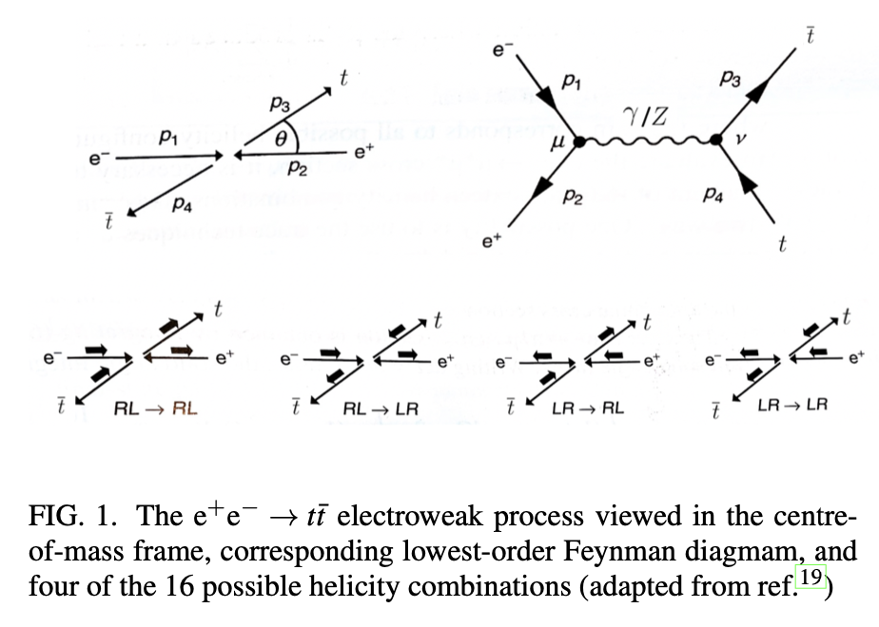
A toy model: $e^{+}e^{−}→t\overline{t}$electroweak process with polarised beams
[M. Thomson, 2021]

Slide 9
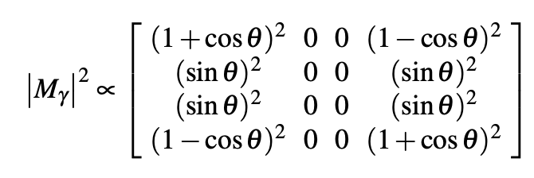
PP toy-model | Equations
Cross-section σ at l.o. in the electroweak coupling constants
Consider, e.g. $ℳ_{γ}$
Construct matrix with all 16 possible helicity combinations (suppose using polarised beams, so do not use trace techniques)
Fully electric interaction Fully weak interaction

Slide 10
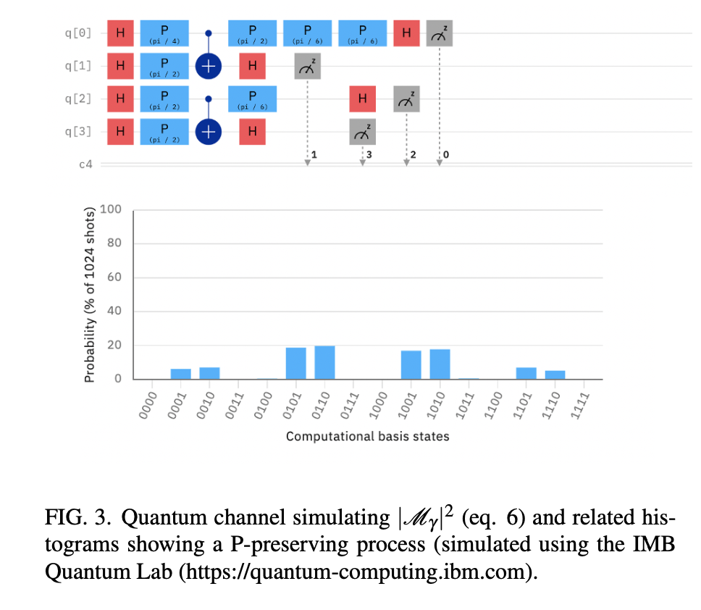
PP | State-channel duality | Quantum computing
PP density matrix |  | Identify as Choi-matrix
 |  | Analyse: it corresponds to a physically realisable quantum channel
 |  | Construct a quantum channel that outputs PP density matrix [IBM_quantum] with arbitrary precision (cf. Solovay-Kitaev theorem [M. Nielsen and I. Chuang, 2010]

Slide 11
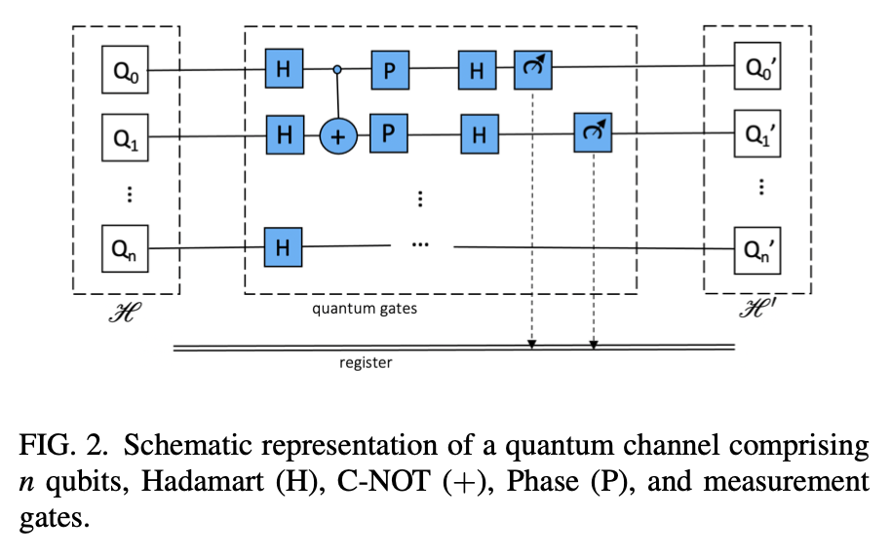
Constructing quantum channels
Translate obervables: (R, L) → Boolean computational basis (0,1)
Characterise each possible initial-final helicity state by a string of four digits.
Tunable precision: Solovay-Kitaev theorem [M. Nielsen and I. Chuang, 2010]

Slide 12
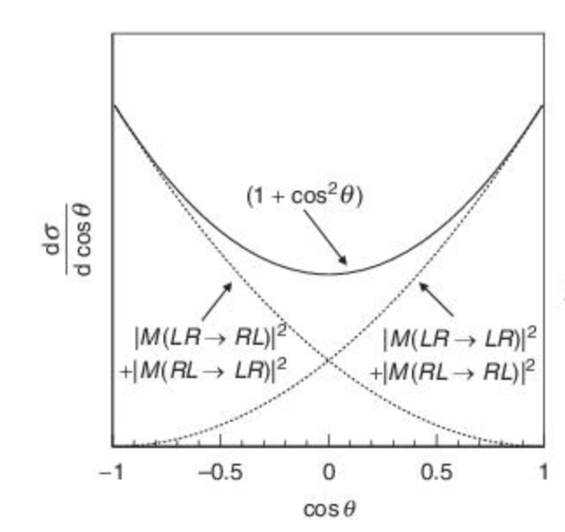
[M. Thomson, 2021]
[C. Altomonte and A.J. Barr, 2022]

Slide 13
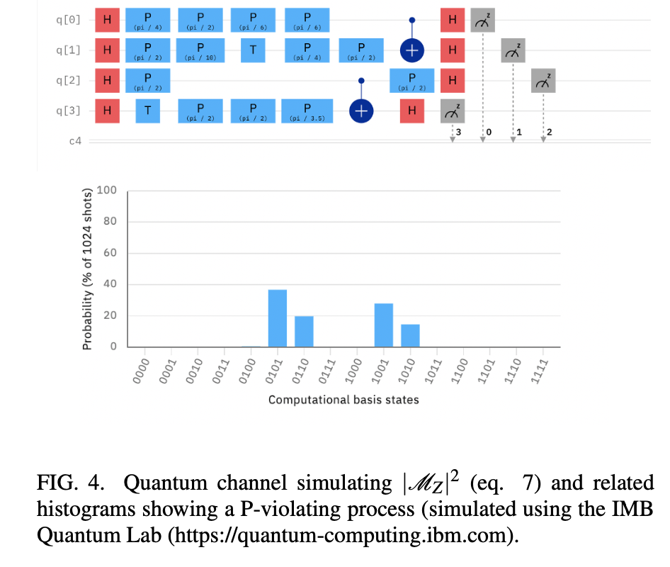
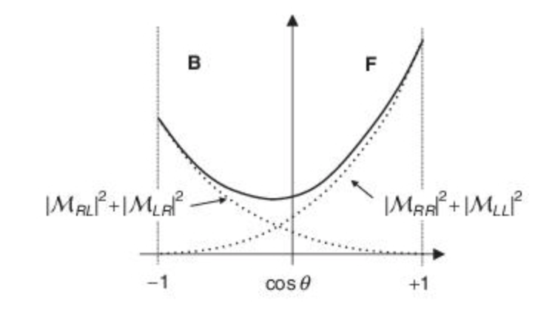
[M. Thomson, 2021]
[C. Altomonte and A.J. Barr, 2022]

Slide 14
Remarks and findings: constructing a dictionary translating between PP and QI
Derive
Identify
Identify
Derive

Slide 15
Serial Concatenation (QI)
It submits the quantum state to subsequent quantum channels [M. Wilde, 2017].
quantum channels $𝒩:ℬ\left(ℋ_{A}\right)→ℬ\left(ℋ_{B}\right) ℳ:ℬ\left(ℋ_{B}\right)→ℬ\left(ℋ_{C}\right)$ first channel’s output ${ 𝒩}_{A→B}\left(ρ_{A}\right)≡\sum_{k}{ }N_{k}ρ_{A}N_{k}^{†}$ second channel’s output $\left(ℳ_{B→C}∘𝒩_{A→B}\right)\left(ρ_{A}\right)=\sum_{k}{ }M_{k}𝒩_{A→B}(ρ)M_{k}^{†}=$ $=$ $\sum_{k,k^{′}}{ }M_{k}N_{k^{′}}ρ_{A}N_{k^{′}}^{†}M_{k}^{†}$
$$ℋ_{A}$$
$$𝒩$$
$$ℋ_{B}$$
$$ℳ$$
$$ℋ_{C}$$

Slide 16
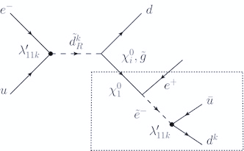
Serial Concatenation (PP)
PP interpretation: applicable to modelling sequential processes such as cascade decays and jets.
$$ℋ_{A}$$
$$𝒩$$
$$ℋ_{B}$$
$$ℳ$$
$$ℋ_{C}$$
Cf. classical algorithm (eq. 1) in [I. Knowles, 1990].
A more complex hybrid quantum-classical algorithm has been developed by
[G. Gustafson, S. Prestel, M. Spannowsky, and S. Williams, 2022]

Slide 17
Parallel Concatenation (QI)
Each subsystem A,B undergoes a different quantum channel [M. Wilde, 2017].
quantum channels $𝒩:ℬ\left(ℋ_{A}\right)→ℬ\left(ℋ_{C}\right) ℳ:ℬ\left(ℋ_{B}\right)→ℬ\left(ℋ_{D}\right)$ input density operator: $ρ_{AB}∈𝒟\left(ℋ_{A}⊗ℋ_{B}\right)$ parallel concatenation: $\left(𝒩_{A→C}⊗ℳ_{B→D}\right)\left(ρ_{AB}\right)=$ =$\sum_{k,k^{′}}{ }\left(N_{k}⊗M_{k^{′}}\right)\left(ρ_{AB}\right){\left(N_{k}⊗M_{k^{′}}\right)}^{†}$
$$ℋ_{A}$$
$$ℋ_{B}$$
$$𝒩$$
$$ℋ_{C}$$
$$ℋ_{D}$$
$$ℳ$$
$$ℋ_{A}⊗ℋ_{B}$$
$$ℋ_{C}⊗ℋ_{D}$$

Slide 18
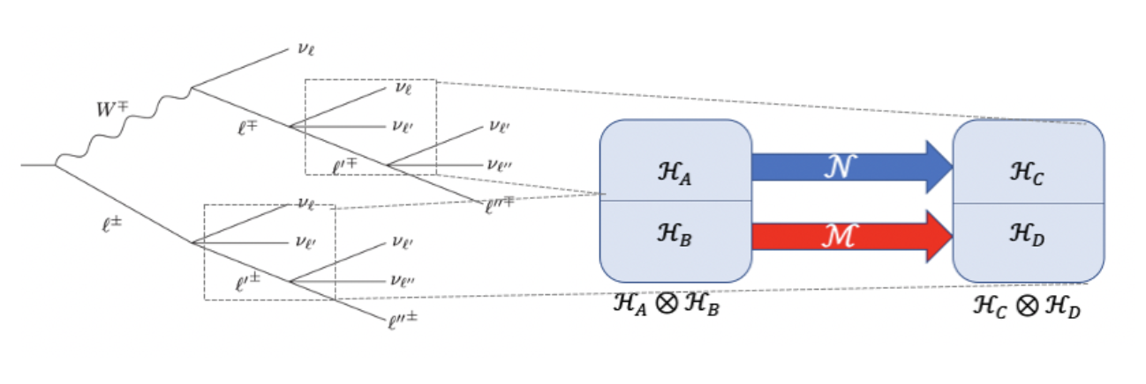
Parallel Concatenation (PP)
PP interpretation: applicable where subsystems are present and each subsystem undergoes such a process that can be regarded as independent of the state of the other subsystem, i.e. they constitute a product state that does not include entanglement.

Slide 19
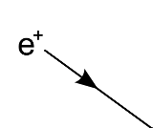
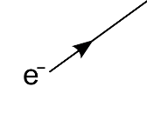
Preparation channel
It prepares a quantum system A in a given state $ρ_{A}∈𝒟\left(ℋ_{A}\right)$ [M. Wilde, 2017].
PP interpetation: draw an open incoming line in a Feynman diagram
$$ℋ_{A}$$
$$P$$
$$ρ_{A}$$
Appending channel
It is the parallel concatenation of the identity channel and a preparation channel [M. Wilde, 2017].
PP interpetation: add a parallel line in a Feynman diagram
$$ℋ_{A}$$
$$P$$
$$ρ_{A}$$
$$ℋ_{B}$$
$$1$$
$$ρ_{A}$$
$$ρ_{B}$$
$$P$$

Slide 20
Extensions & applications
Higher order corrections;
Foundational tests of QM; experimental tests of
QI; unitarity tests;

Slide 21
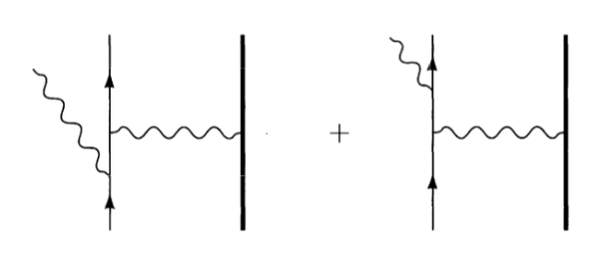
Higher order corrections
PP | Quantum Mechanics | Quantum computing
Feynman path Integral |  | Identify unitary operator
 |  | S matrix formalism
Feynman diagrams including quantum corrections |  | Channel for overall process (total probabilities) Channels for specific corrections (conditional probabilities)

Slide 22
Amplitude damping channel
Tree-level: $|0⟩_{A}⊗|0⟩_{E}↦|0⟩_{A}⊗|0⟩_{E}$ Tree-level + extra photon: $|1⟩_{A}⊗|0⟩_{E}↦\sqrt{1−p}|1⟩_{A}⊗|0⟩_{E}+\sqrt{p}|0⟩_{A}⊗|1⟩_{E}$
Higher order corrections
PP interpretation: Soft Bremsstrahlung
$$ℋ_{A}$$
$$P$$
$$ρ_{A}$$
$$ℋ_{B}$$
$${ρ′}_{AB}$$
$$D$$

Slide 23
Isometry: Stinespring’s dilation and Kraus’s ambiguity
Isometry: Operation that encodes a quantum state of one system into a quantum state of a larger system [A. Ekert, 2022] Let $ℋ$ and $ℋ$’ be Hilbert spaces such that dim $ℋ$ ⩽ dim $ℋ$’ . An isometry is a linear map $V$:$ℋ$→$ℋ$′ such that V†V = $1_{ℋ}$
Stinespring’s dilation: $ℰ$ arises from unitary evolution of dilated system, i.e: $$ρ⟼ρ^{′}={tr}_{𝒜}VρV^{†}$$ where suitably chosen ancilla $𝒜$ is traced out.
Kraus representation (operator-sum decomposition): operators $E_{i}$ must satisfy normalisation (completeness) condition $∑_{i} E_{i}^{†}E_{i}=1$, but depend on choice of basis for ancilla $𝒜$, i.e.: $$ρ⟼ρ^{′}=\sum_{i}{ }E_{i}ρE_{i}^{†}$$
[A. Ekert, 2022]

Slide 24
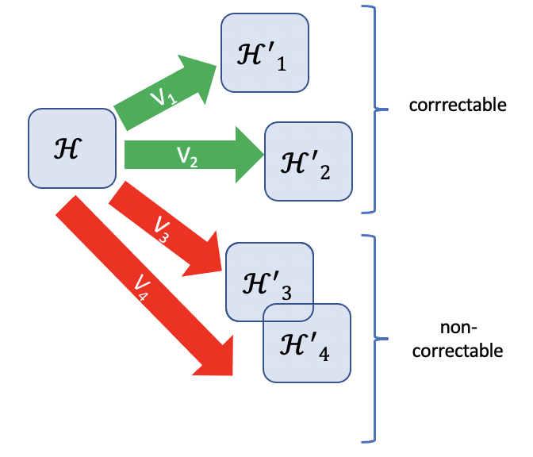
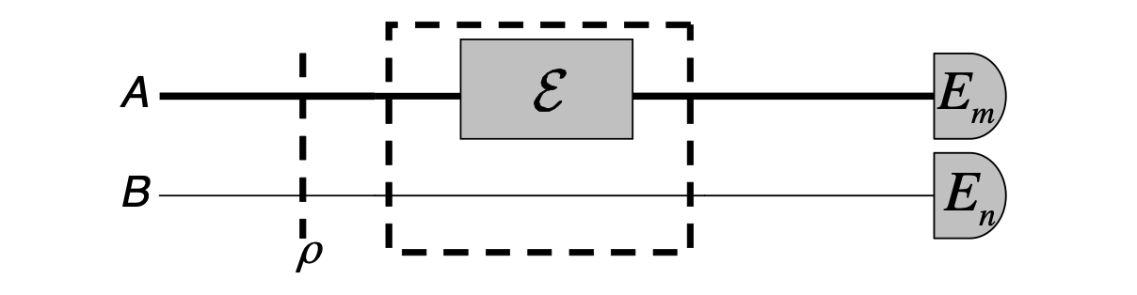
Stinespring Dilation and Quantum Error Correction (PP)
PP interpretation: applicable to current PP research to probe confined or otherwise hardly accessible degrees of freedom (c.f. flavour physics, dark matter searches, etc.)
"information on the underlying quantum process is mapped onto the state of some probe quantum system(s), and the process is reconstructed via quantum state tomography on the output states.” [M. Mohseni, A. T. Rezakhani, and D. A. Lidar, 2008] Unitarity tests;
[M. Mohseni, A. T. Rezakhani, and D. . Lidar, 2008]

Slide 25
testing the foundations of quantum mechanics in particle physics colliders by identifying the collider itself as a natural quantum-information processing machine provided that quantum mechanics holds.
performing tests of basic quantum predictions such as entanglement and quantum state and process tomography in high energy regimes
expanding theoretical modelling into regions where the Standard Model theory is difficult to calculate perturbatively, and where phenomenological models are currently employed, by having an alternative method for performing calculations
does not overlap with other quantum computing protocols currently applied to nuclear and particle physics, such as quantum Hamiltonian evolution simulations

Slide 26
References
H. Abramowicz et al., “Top-quark physics at the CLIC electron- positron linear collider,” Journal of High Energy Physics 2019 (2019), 10.1007/jhep11(2019)003.
Y. Afik and J. R. M. de Nova, “Entanglement and quantum tomography with top quarks at the LHC,” The European Physical Journal Plus 136 (2021), 10.1140/epjp/s13360-021-01902-1.
C. Altomonte, and A.J. Barr, “State-channel duality applied to Particle Physics”(2022) [and the references therein], https://ora.ox.ac.uk/objects/uuid:305b89aa-959c-4544-af43-8969fc4bdb31
R. Ashby-Pickering, A. J. Barr, and A. Wierzchucka, “Quantum state tomography, entanglement detection and Bell violation prospects in weak decays of massive particles,” (2022).
A. J. Barr, “Testing Bell inequalities in Higgs boson decays,” Physics Letters B 825, 136866 (2022).
A. J. Barr, P. Caban, and J. Rembielin ́ski, “Bell-type inequalities for sys- tems of relativistic vector bosons,” (2022), arXiv:2204.11063 [quant-ph].
A. Delgado and K. E. Hamilton, “Unsupervised quantum circuit learning in high energy physics,” (2022).
A. Ekert, “’Introduction to quantum information’ course page,” (2022) https://zhenyucai.com/post/intro_to_qi/. .
M. Fabbrichesi, R. Floreanini, and G. Panizzo, “Testing Bell Inequalities at the LHC with Top-Quark Pairs,” Physical Review Letters 127 (2021), 10.1103/physrevlett.127.161801.
M. Jiang, S. Luo, and S. Fu, “Channel-state duality,” Phys. Rev. A 87, 022310 (2013).
M. Mohseni, A. T. Rezakhani, and D. A. Lidar, “Quantum-process tomography: Resource analysis of different strategies,” Physical Review A 77 (2008), 10.1103/physreva.77.032322.
M. Nielsen and I. Chuang, Quantum computation and quantum information (Cambridge university press, 2010).
M. Thomson, Modern Particle Physics (Cambridge University Press, 2021).
M. Wilde, Quantum Information theory (Cambridge University Press, 2017).
S. L. Wu, et al, “Application of quantum machine learning using the quantum variational classifier method to high energy physics analysis at the LHC on IBM quantum computer simulator and hardware with 10 qubits,” Journal of Physics G: Nuclear and Particle Physics 48, 125003 (2021)
IBM Quantum https://quantum-computing.ibm.com/lab

