Slide 1




Growing Excesses of New Scalars at the Electroweak Scale at the LHC
Bruce Mellado
The Institute for Collider Particle Physics and iThemba LABS
The Institute for Particle Physics Phenomenology, Durham University, 06/07/23

Slide 2
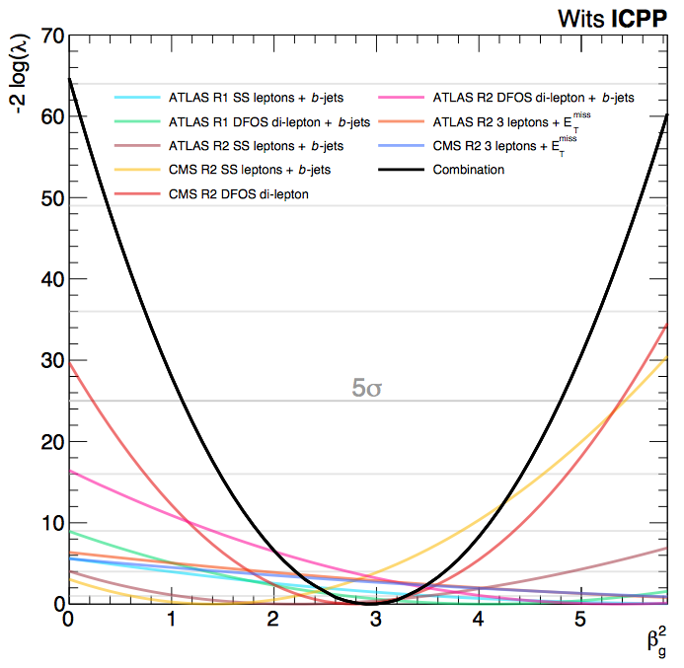
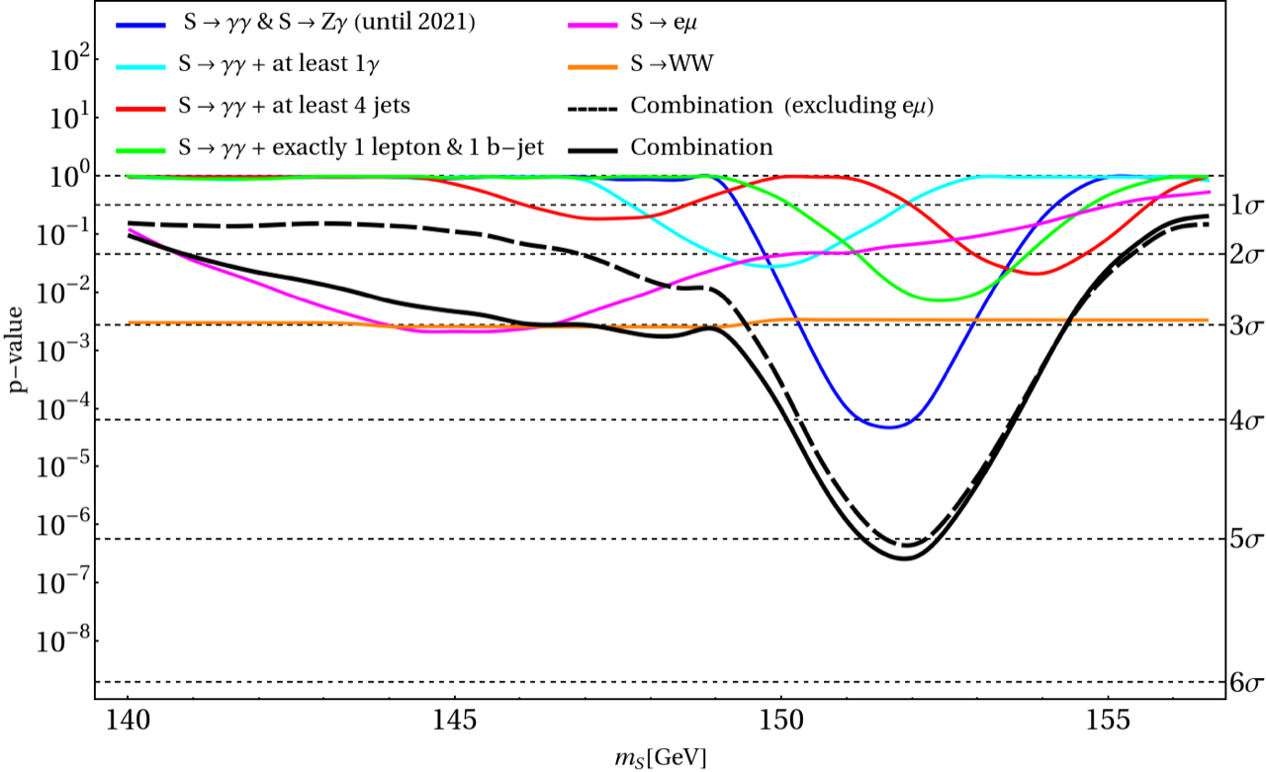
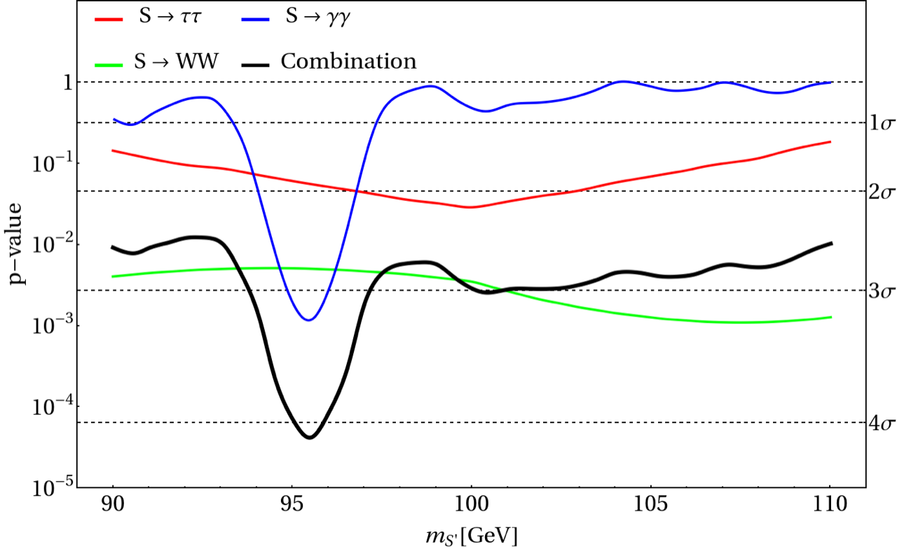
Outline
The simplified model
The multilepton anomalies
  Methodology
  The anatomy
The S(152) candidate
  First combination of 𝛾𝛾, Z𝛾
  New results
The S(95) candidate
Prospects for Run 3

Slide 3
The Simplified Model and 2HDM+S

Slide 4
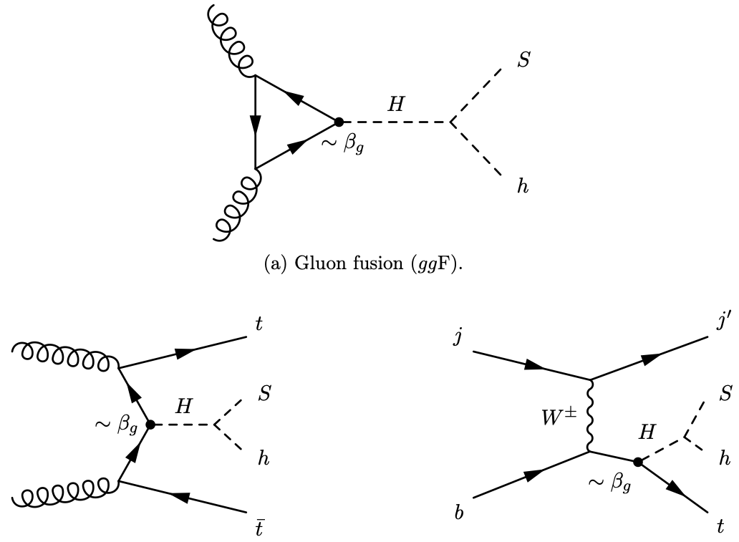
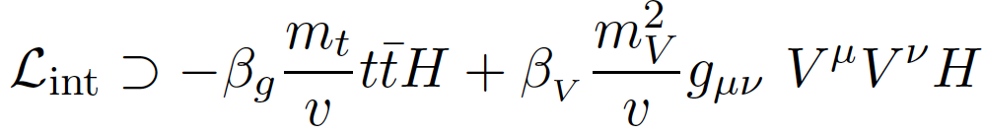
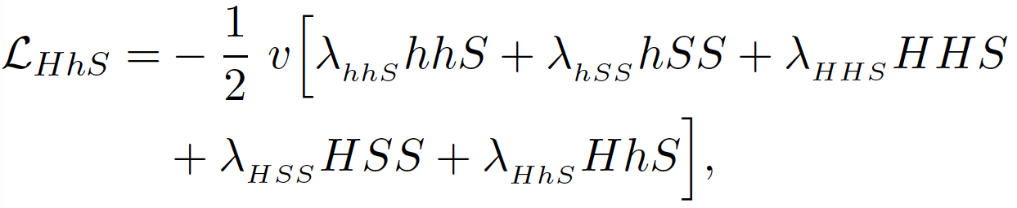
The simplified Model (from Run I)
Eur. Phys. J. C (2016) 76:580
The starting point of the hypothesis is the existence of a boson, H, that contains Higgs-like interactions, with a mass in the range 250-280 GeV
In order to avoid large quartic couplings, incorporate a mediator scalar, S, that interacts with the SM and Dark Matter.
Dominance of H→Sh,SS decay over other decays

Slide 5
The Decays of H
In the general case, H can have couplings as those displayed by a Higgs boson in addition to decays involving the intermediate scalar and Dark Matter
Dominant decays
Diboson decay

Slide 6
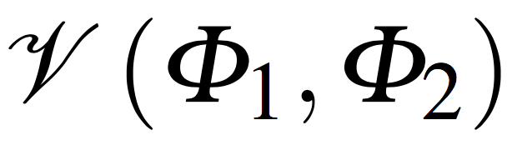
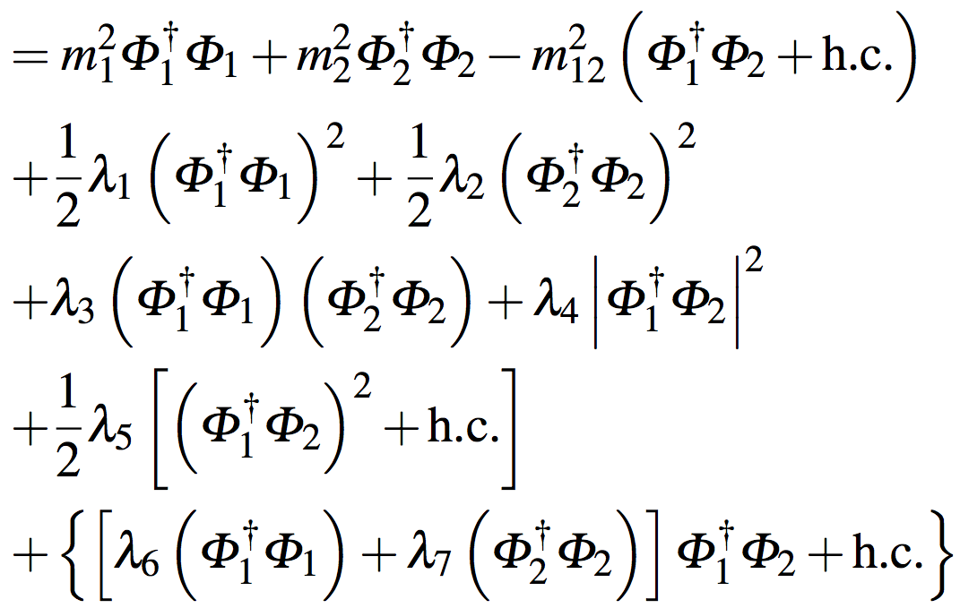
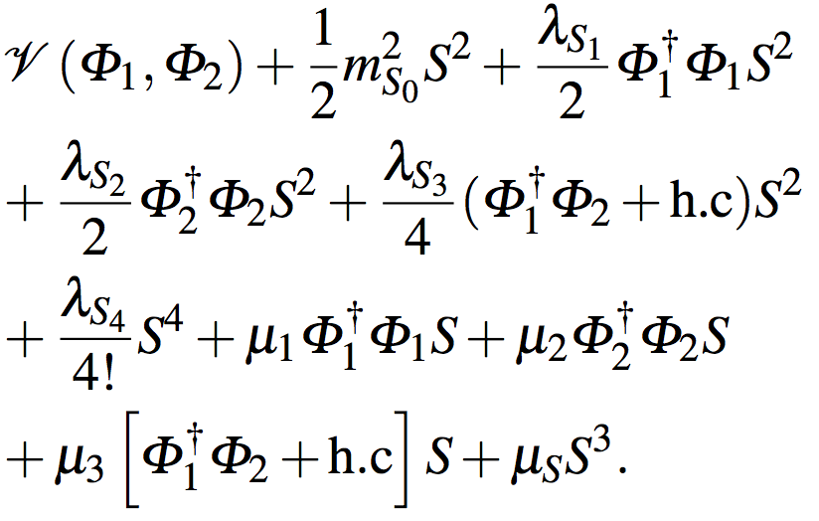
The 2HDM+S
Eur. Phys. J. C (2016) 76:580
Introduce singlet real scalar, S.
2HDM potential,
2HDM+S potential
Out of considerations of simplicity, assume S to be Higgs-like, which is not too far fetched.

Slide 7
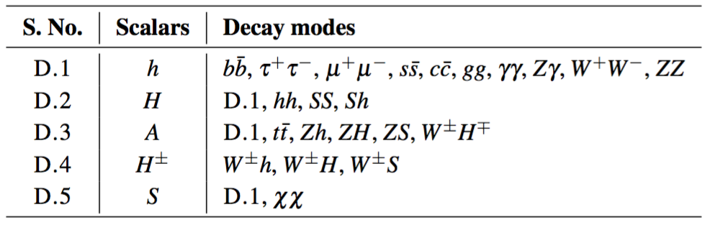
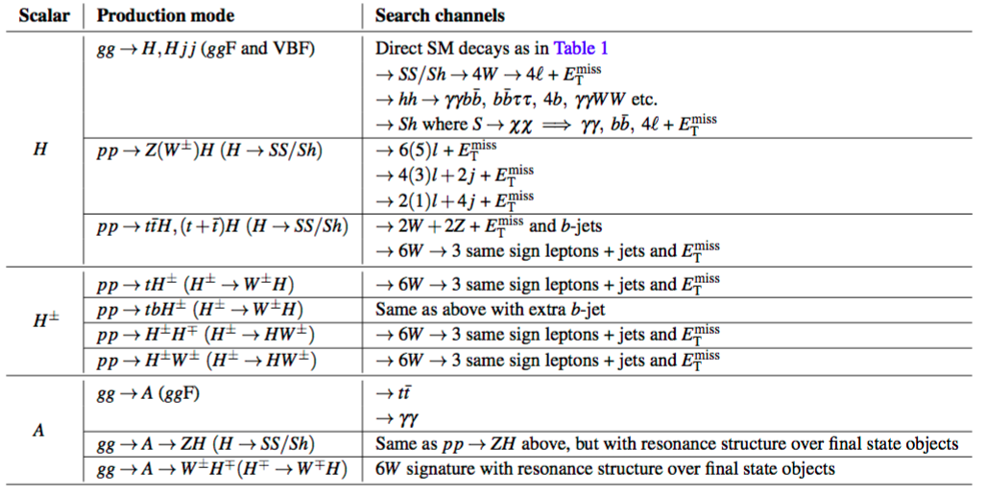
The model leads to rich phenomenology. Of particular interest are multilepton signatures
arXiv:1606.01674

Slide 8
Multi-lepton final states
It is paramount to remark that the excesses are seen in final states that were predicted 2015/2016 on the basis of a simplified model and not the result of scan of the available phase-space. Additionally, the parameters of the model where fixed then leaving only one degree of freedom: normalization
Thus, no look-elsewhere effects in parameter or phase-space

Slide 9
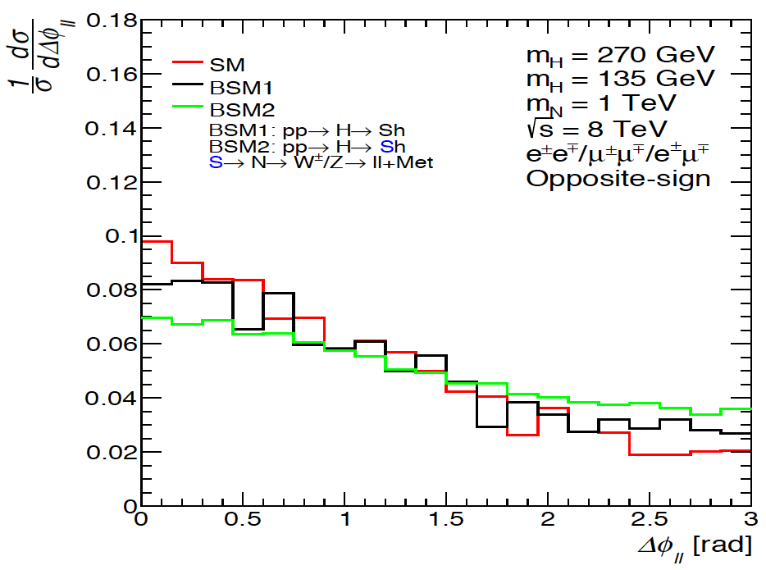
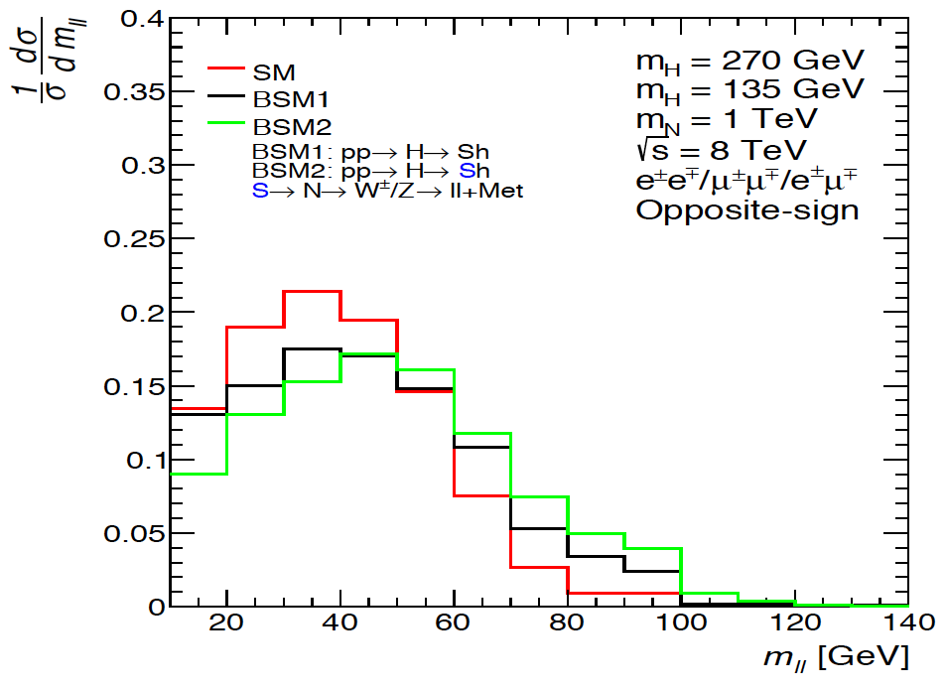
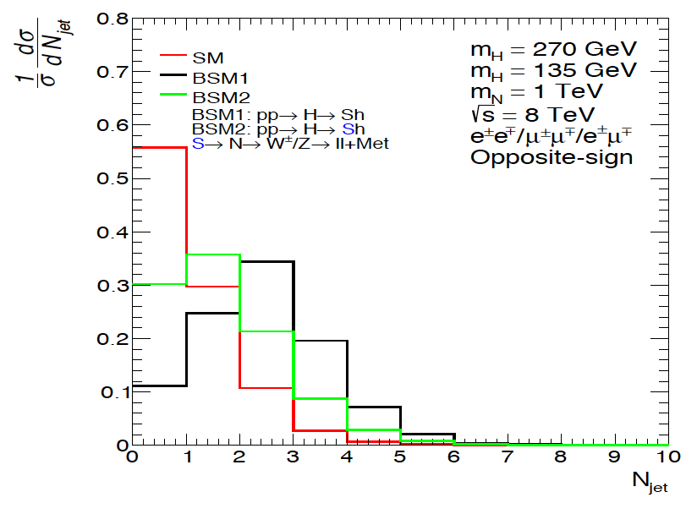
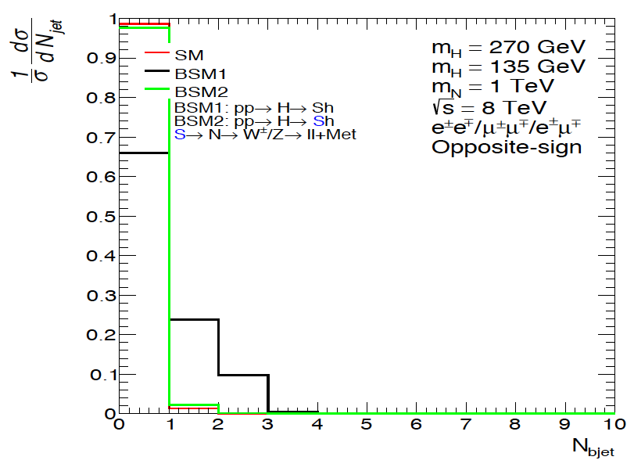
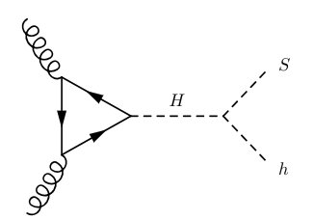
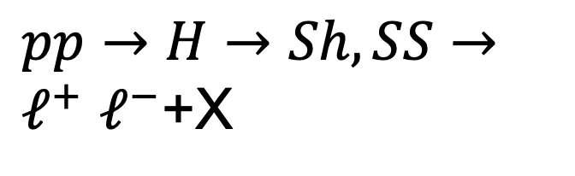
$pp→H→Sh,SS→ℓ^{+}$ $ℓ^{−}$+X
Sensitive to the mass of S
Expect di-leptons (m_{ll}<100 GeV, due to S→WW→ l𝞶l𝞶) with jets and b-jets with rates comparable to that of the SM Higgs boson
Relatively large jet multiplicity compared to the SM Higgs
Relatively large jet multiplicity compared to the SM Higgs

Slide 10
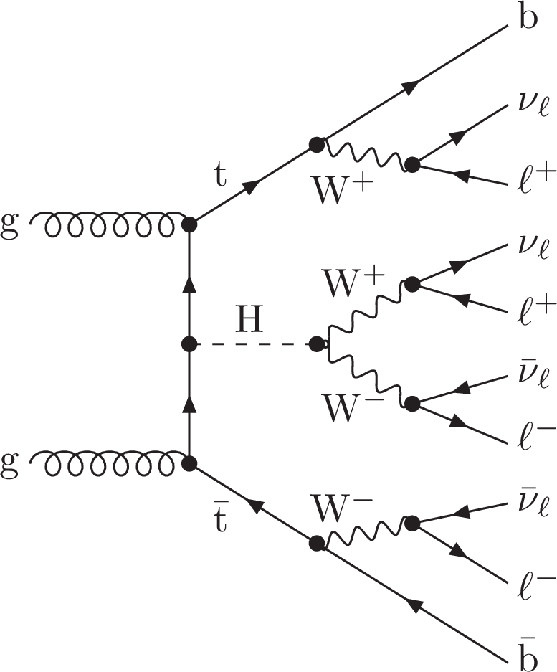
Top associated Higgs production
(Multi-lepton final states)
Reduced cross-section of ttH+tH is compensated by di-boson, (SS, Sh) decay and large Br(S→WW). Production of same sign leptons, three leptons is enhanced. Enhanced tH cross-section
Produces SS 2l, 3l with b-jets, including 3 b-jets
Explains anomalously large ttW+tth+4t cross-sections seen by ATLAS and CMS

Slide 11
Methodology
(to avoid biases and look-else-where effects)
Based Higgs p_{T}, hh, tth, VV in Run 1
Eur. Phys. J. C (2016) 76:580
Model defined and predictions made for multilepton excesses
Fixed final states and phase-space defined by fixed model parameters.
NO tuning, NO scanning
Update same final states with more data in Run 2
Study new final states where excesses predicted and data available in Run 1 and Run 2 (e.g., SS0b, 3l0b, ZW0b)
Multi-lepton excesses in Run 1 and few Run 2 results available in 2017
J.Phys.G 45 (2018) 11, 115003
J.Phys. G46 (2019) no.11, 115001
JHEP 1910 (2019) 157
Chin.Phys.C 44 (2020) 6, 063103
Physics Letters B 811 (2020) 135964
Eur.Phys.J.C 81 (2021) 365
Model parameters fixed in 2017 with m_{H}=270 GeV, m_{S}=150 GeV,
S treated as SM Higgs-like,
dominance of H→Sh,SS

Slide 12
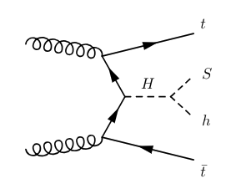
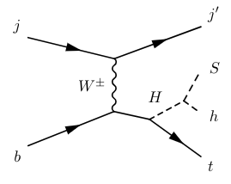
BSM inputs to the fit
The following assumptions are made:
  The masses of H and S are fixed to m_{H} = 270 GeV and m_{S} = 150 GeV
  The only significant production mechanisms of H come from the t-t-H Yukawa coupling:
    Gluon fusion
    Top associated production
  The Yukawa coupling is scaled away from the SM Higgs-like value by the free parameter β_{g}
  The BR of H ➝ Sh is fixed to 100%
  The BRs of S are Higgs-like
Therefore, the only free parameter in the fits is β_{g}²

Slide 13
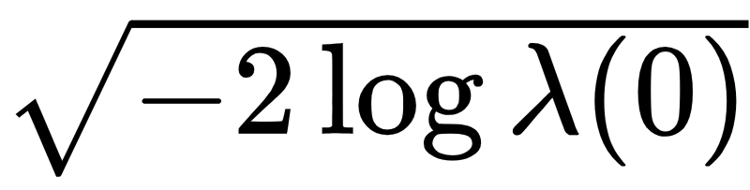
Combination of fit results (2019)
JHEP 1910 (2019) 157
Simultaneous fit for all measurements:
To the right: (-2 log) profile likelihood ratio for each individual result and the combination of them all
The significance for each fit is calculated as
Best-fit: β_{g}² = 2.92 ± 0.35
Corresponds to 8.04σ
Excesses have been growing since,
and new have emerged (Eur.Phys.J.C 81 (2021) 365)
Interpretation: Measure of the inability of current MC tools to describe multiple-lepton data and how a simplified model with H→Sh is able to capture the effect with one parameter

Slide 14
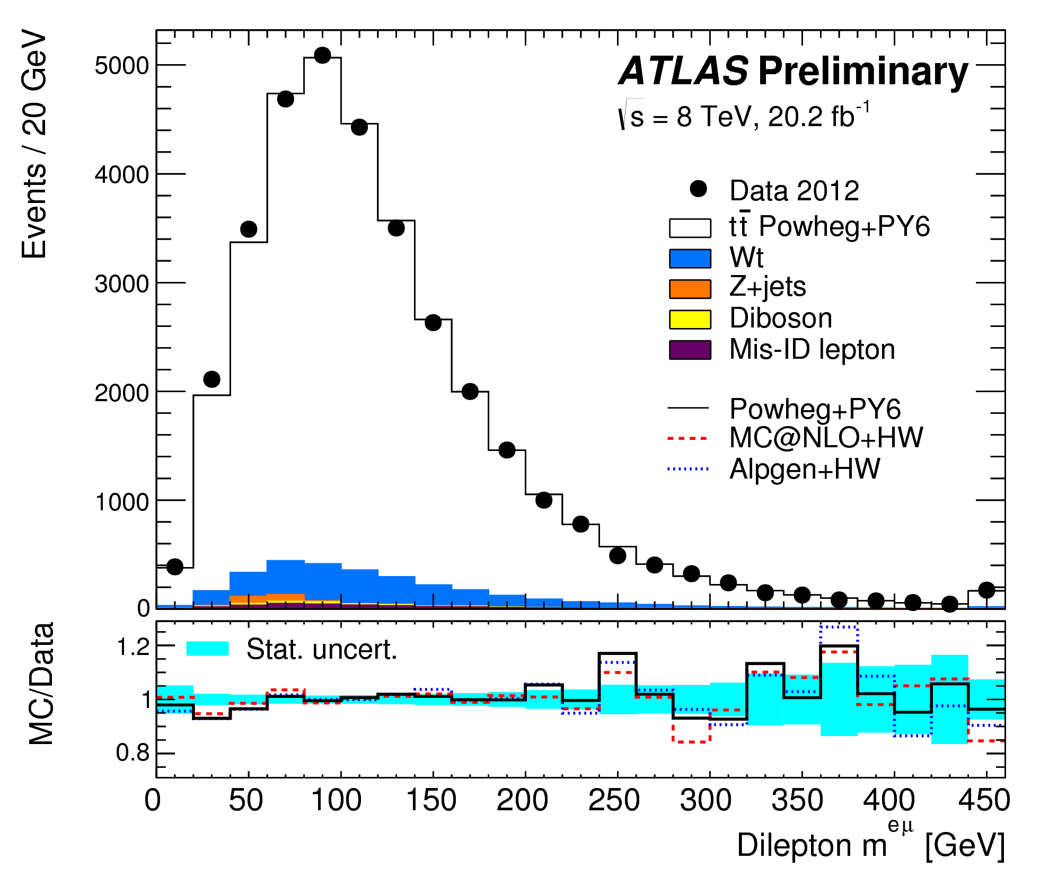
Eur. Phys. J. C 77 (2017) 804
Is the discrepancy due to ttbar events?
Discrepancy in ATLAS is localized at small values of m_{ll}

Slide 15
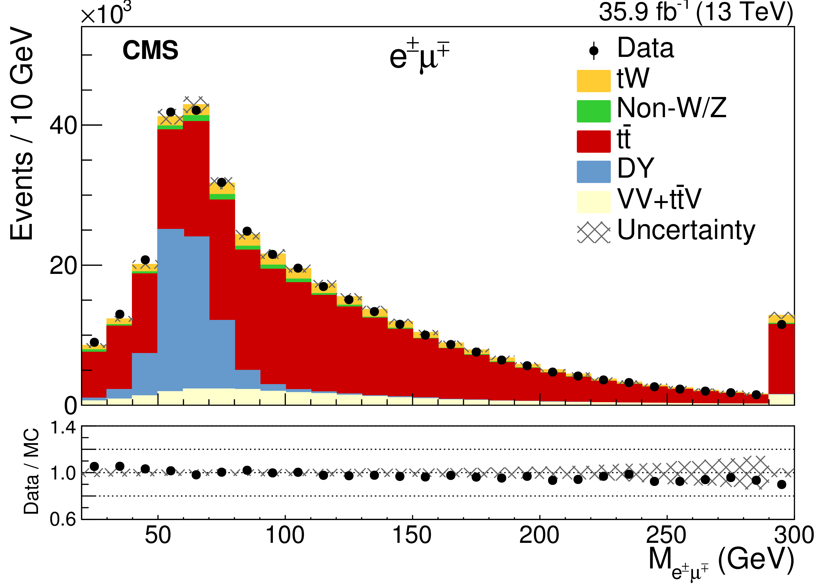
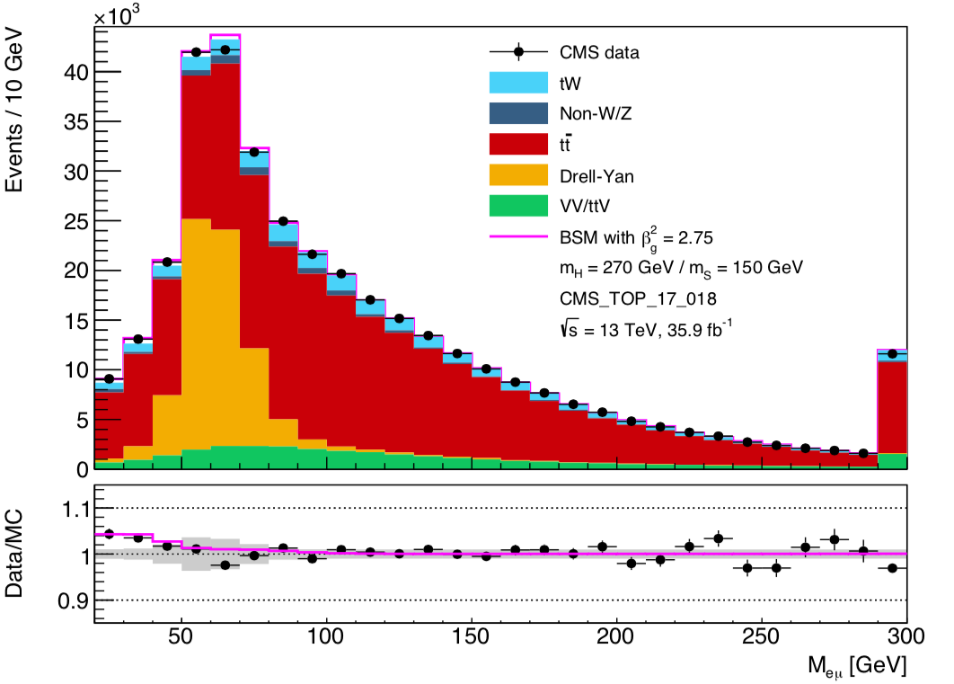
arXiv:1805.07399
CMS-TOP-17-018; CERN-EP-2018-074
Poor modeling of POWHEG + Pythia8 distribution is improved through reweighting
We fix the normalisation of the SM by scaling it to the data in the region
m_{ll} > 110 GeV
  A normalisation systematic of 3% is applied to all but DY
  DY systematic = 6.8%. 3% systematic on m_{ll} shape in top
  The fit is done to the region below 110 GeV
Fit results:
  β_{g}² = 2.79 ± 0.52
  Fit is extremely well constrained
Bulk of signal comes from Nb<2
Smal MC dependence, as m_{ll} shape comes from data
Tt+Wt is corrected (see above)
Take MC shape from 2b events
Used conservative assumption that l⁺l⁻+2b-jet final state is perfectly described by the SM. The discrepancy comes from events with N_{b}<2. Excess unlikely due to tt

Slide 16
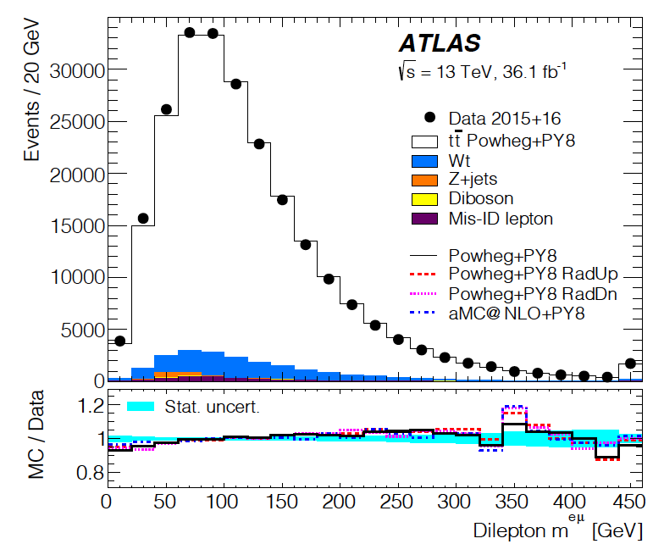
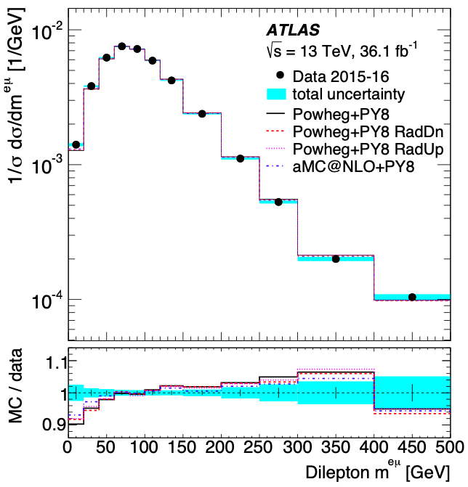
Results not included in the combination
Eur. Phys. J. C 80 (2020) 528
Sensitive to mass of S
Residual discrepancies at high m_{ll} will be fixed with missing NNLO QCD and NLO EW corrections
Excess at low mll remains prevalent, indicating that effects seen in Run 1 were not statistical fluctuations. NNLO QCD corrections do not fix the issue (see Mitov et al.)

Slide 17
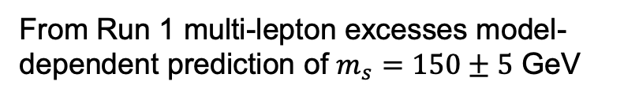
Excesses in di-leptons with full-jet veto not included above
Run 2
arXiv:1909.04370
Overall, MCs do a good job describing data except for m_{ll}<100 GeV
Run 1, J.Phys. G45 (2018) no.11, 115003
QCD NNLO to qq→WW, NLO QCD to gg→WW and NLO EW corrections applied

Slide 18
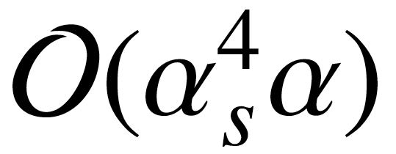
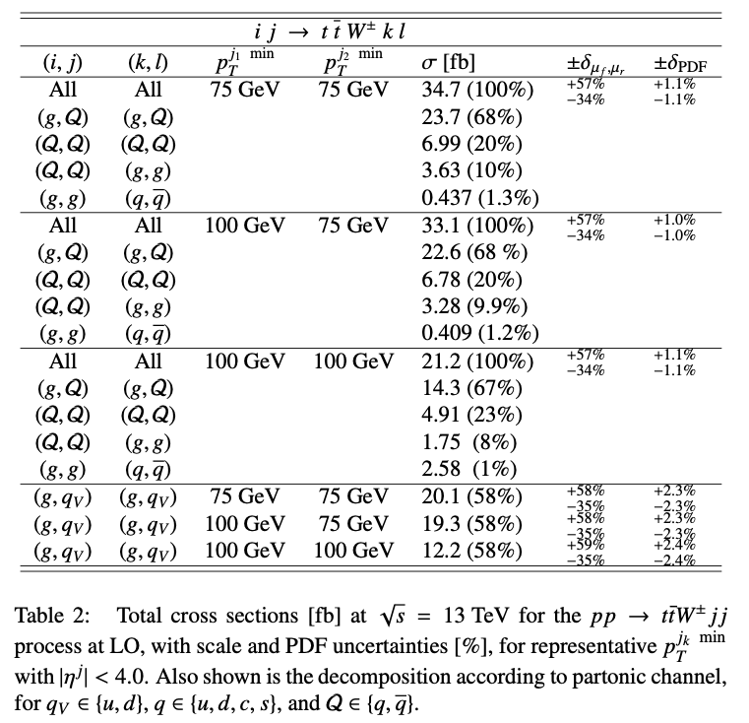
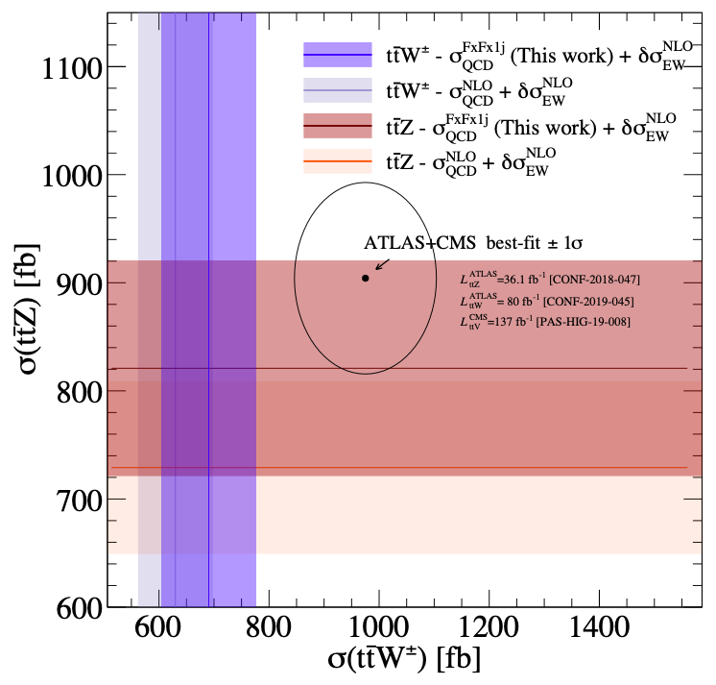
The anatomy of inclusive ttW at the LHC
S.Buddenbrock, R.Ruiz and B.M.
Physics Letters B 811
(2020) 135964
Using fixed order computations at and NLO multi-jet matching yielding similar (10%-14%) corrections to the inclusive rate
Detailed studies that include the decomposition in partonic channels and differential distributions
Tension between data and predictions does not wane.
For this process a complete NNLO computation is needed to reduce theory uncertainty

Slide 19
Anatomy of the multi-lepton anomalies (2023)
Final state | Characteristic | Dominant SM process | Significance
l⁺l⁻ + jets, b-jets | m_{ll}<100 GeV, dominated by 0b-jet and 1b-jet | tt+Wt | >5σ
l⁺l⁻ + full-jet veto | m_{ll}<100 GeV | WW | ~3σ
l±l± & l±l±l + b-jets | Moderate H_{T} | ttW, 4t | ~3σ
l±l± & l±l±l et al., no b-jets | In association with h | Wh, WWW | 4.2σ
Z(→l⁺l⁻)+l | p_{TZ}<100 GeV | ZW | >3σ
Anomalies cannot be explained by mismodelling of a particular process, e.g. ttbar production alone. Currently, every single type of excess has reached 3σ.

Slide 20
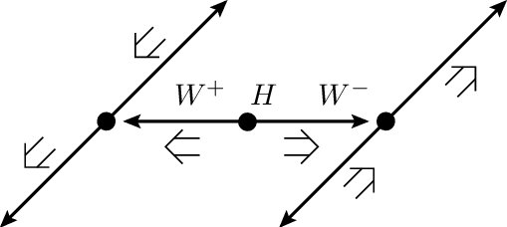
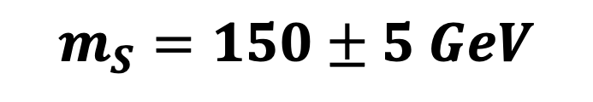
Prediction from the multi-lepton anomalies.
The di-lepton invariant mass is sensitive to the mass of S.
Assuming S→WW→llνν:
$$m_{S}=150±5 GeV$$
J.Phys. G45 (2018) no.11, 115003
The 151 GeV Candidate

Slide 21
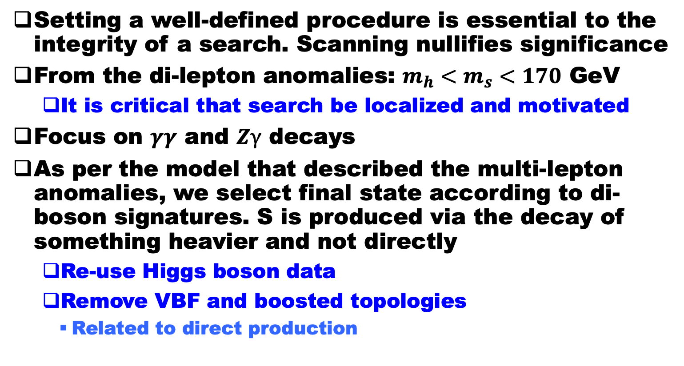
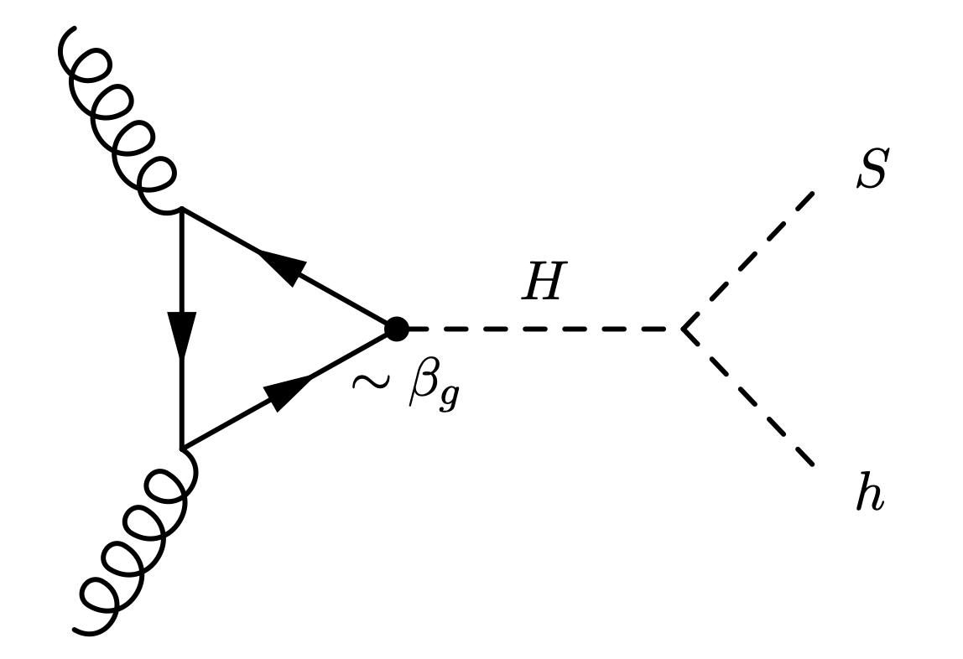


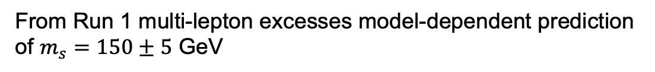
Procedure
(avoiding “cherry picking”)

Slide 22
A.Crivellin et al. https://arxiv.org/abs/2109.02650

Slide 23
Analysis of publicly available 𝛾𝛾, Z𝛾 spectra in associated production gives an excess at m_{S}=151.5 GeV.
Fiducial yields consistent with H→SS* hypothesis with m_{H}=270 GeV, which is used for the extraction of significance.
Excess not seen in S→ZZ→4l

Slide 24
Result is obtained with public results from the LHC experiments.
Using a simplified model and two degrees of freedom to include the decay of S→MET and residual LEE, global significance goes to 3.9𝜎 at 151.5 GeV.

Slide 25
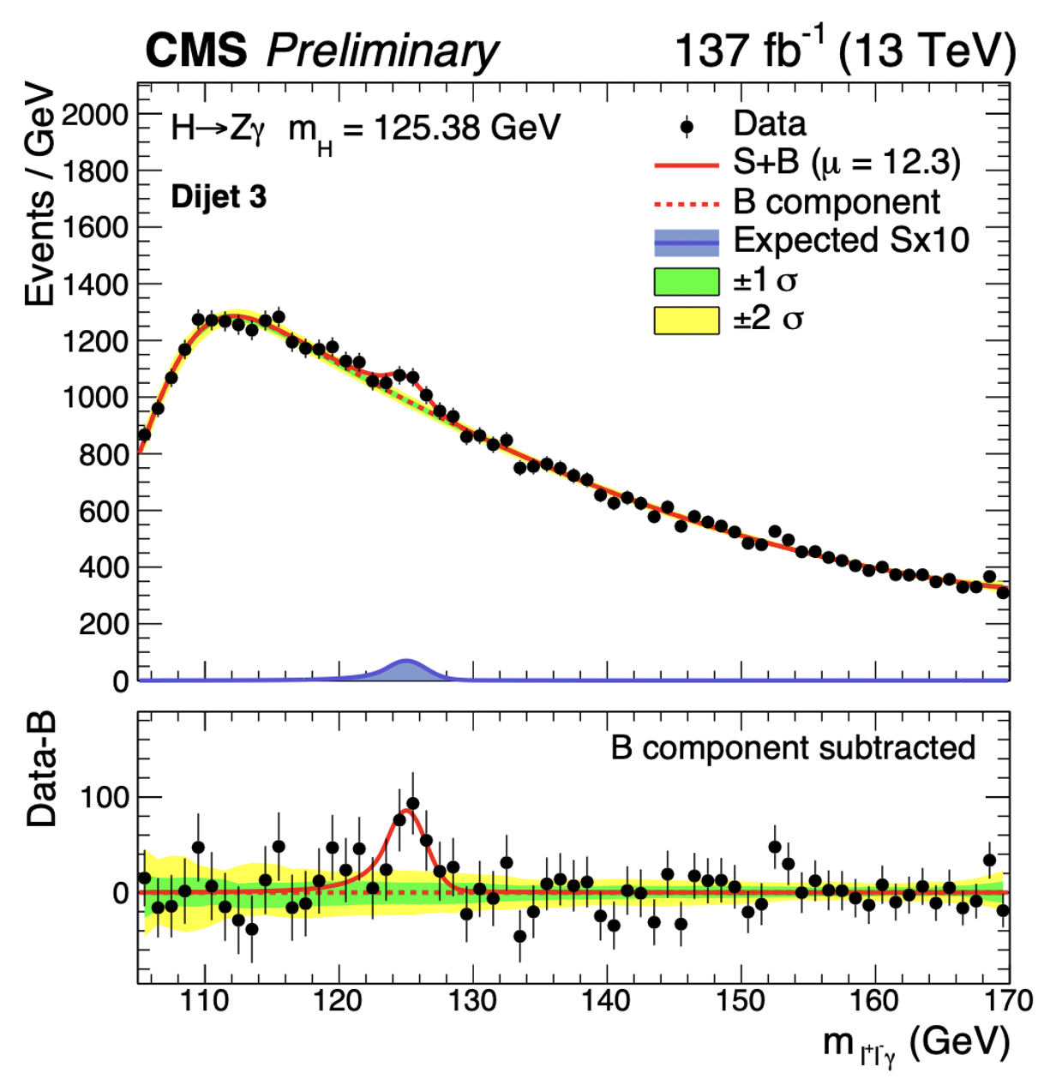



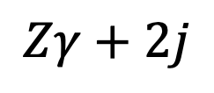
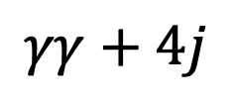
New excesses @151.5 GeV that appeared after the first combination (see above) in topologies consistent with associated production:
CMS-PAS-HIG-19-014
$$γγ+l+b$$
$$γγ+4j$$
$$Zγ+2j$$
$$γγ+γ$$
Excesses appear in corners of the phase-space predicted by the naive H→ SS* model with S being SM Higgs-like. In addition, seem to see S in association with MET and, possibly, with an extra photon
Bin for associated production VH, ttH, where excess is seen with di-photons.
ATLAS, arXiv:2301.10486

Slide 26
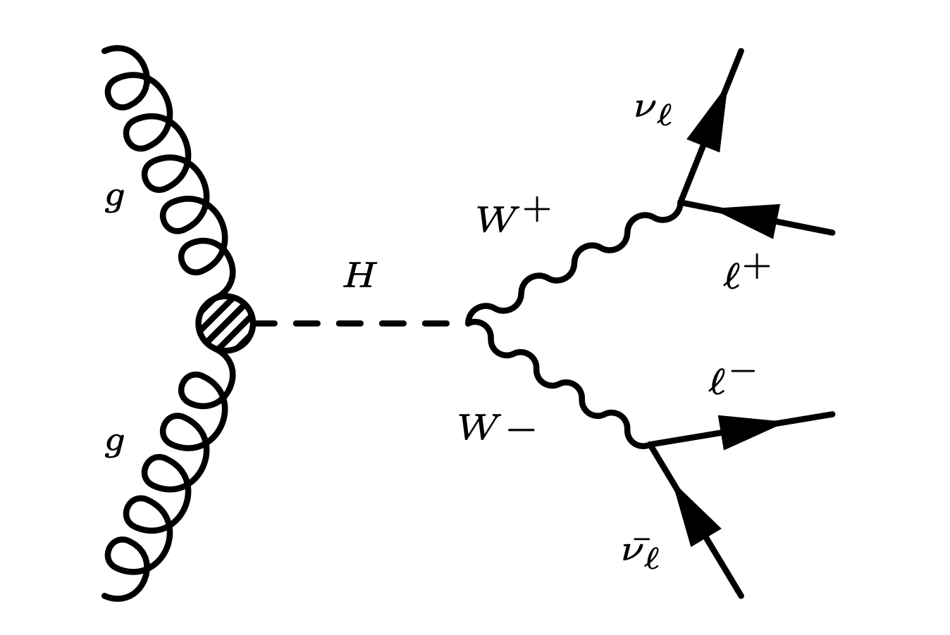

S.Bhattacharya, G.Coloretti, A.Crivellin, B.M.
arXiv:2302.07276
SM Higgs hypothesis alone. alone is having difficulty describing the ll+MET transverse mass spectra, giving room to other Higgs-like signals, including S(151).
ATLAS+CMS
$$H→WW→ℓνℓν$$
Currently, interpreting the broad excess in terms of H→S+MET, which appears to be the leading final state in excess described above

Slide 27
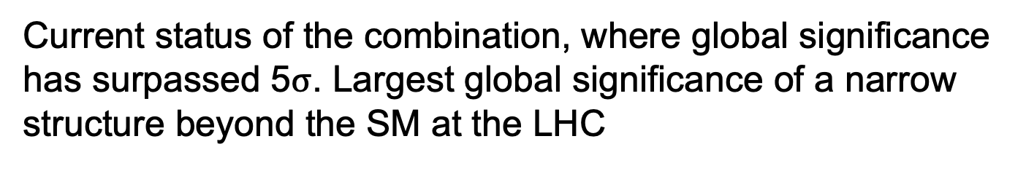
Current status of the combination, where global significance has surpassed 5$σ$. Largest global significance of a narrow structure beyond the SM at the LHC
S.Battacharya, et al. arXiv:2306.17209

Slide 28
The 95 GeV Candidate

Slide 29
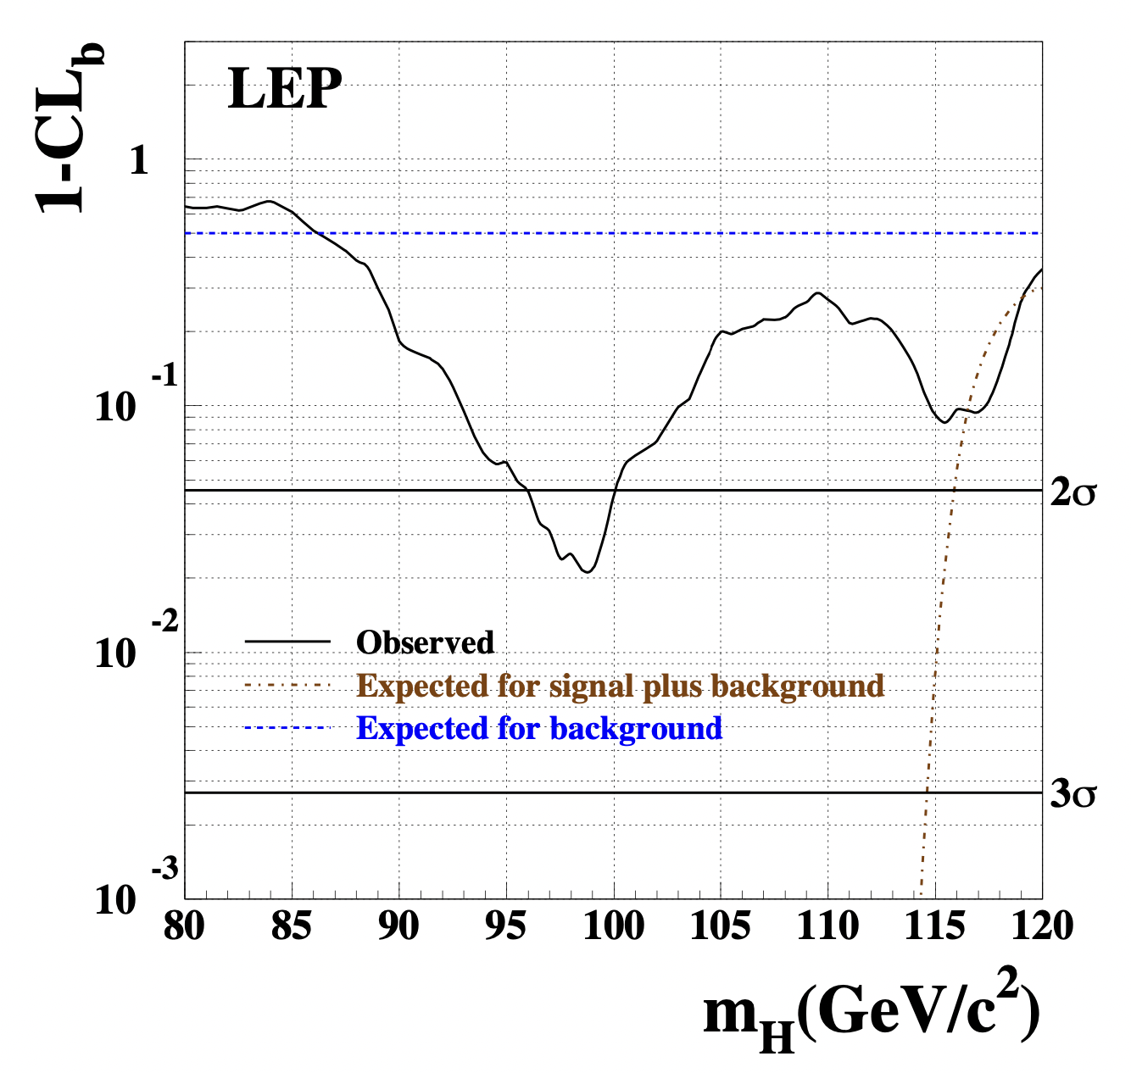
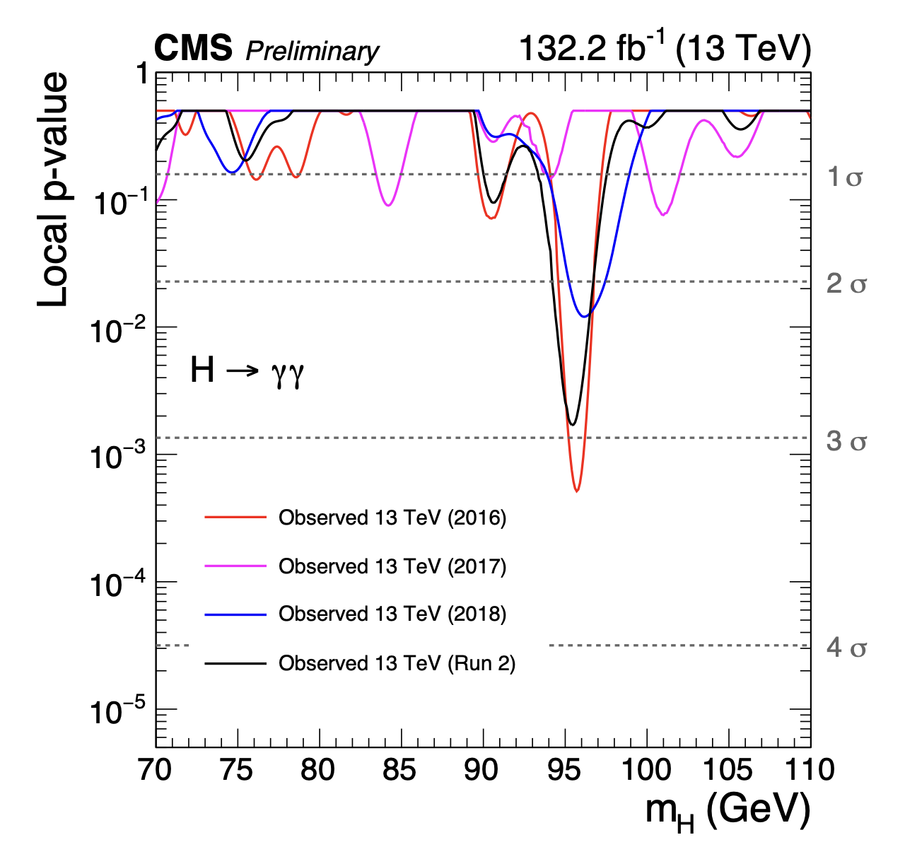
Some tantalizing results around 96 GeV from LEP and CMS, not contradicted by ATLAS. Interesting to see what the full Run 2 data set has to say. Further motivates asymmetric searches H→SS’…
LEP, Phys. Lett. B 565 (2003) 61–75
CMS PAS HIG-20-002

Slide 30
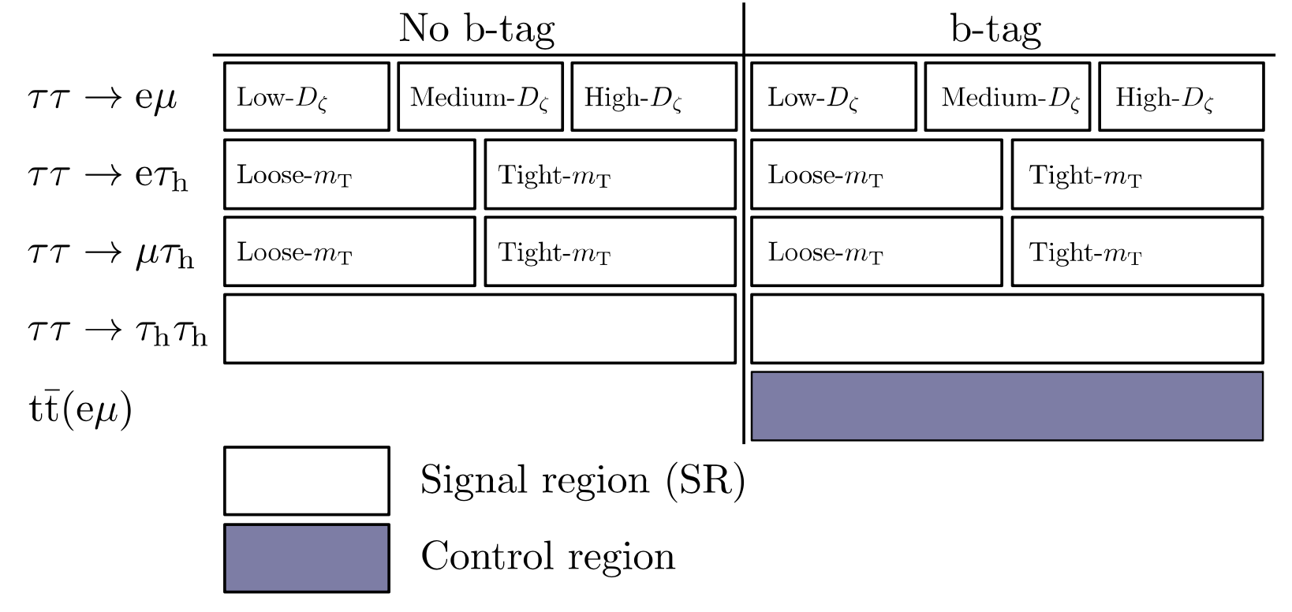
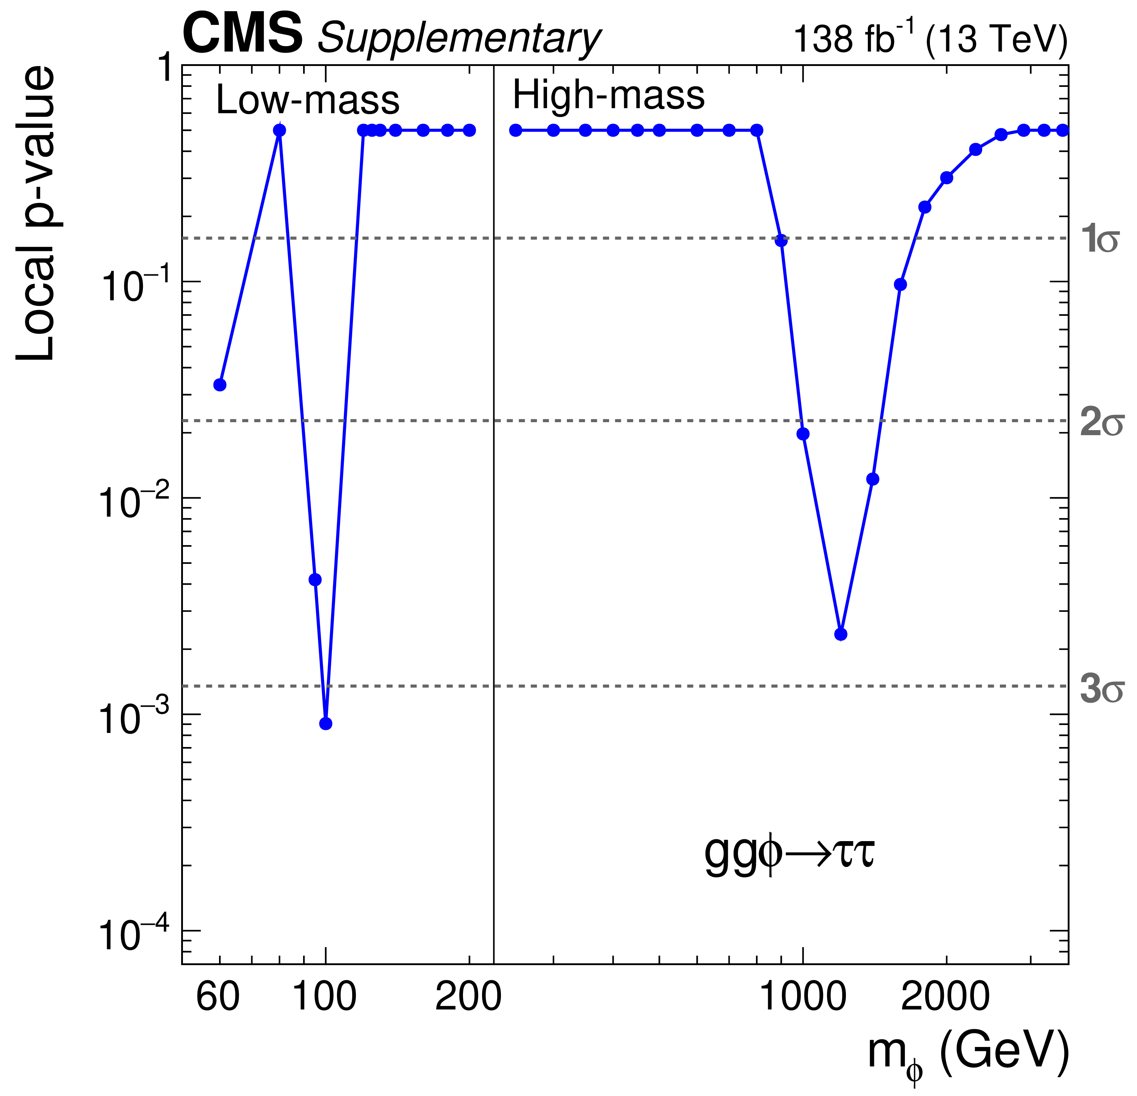
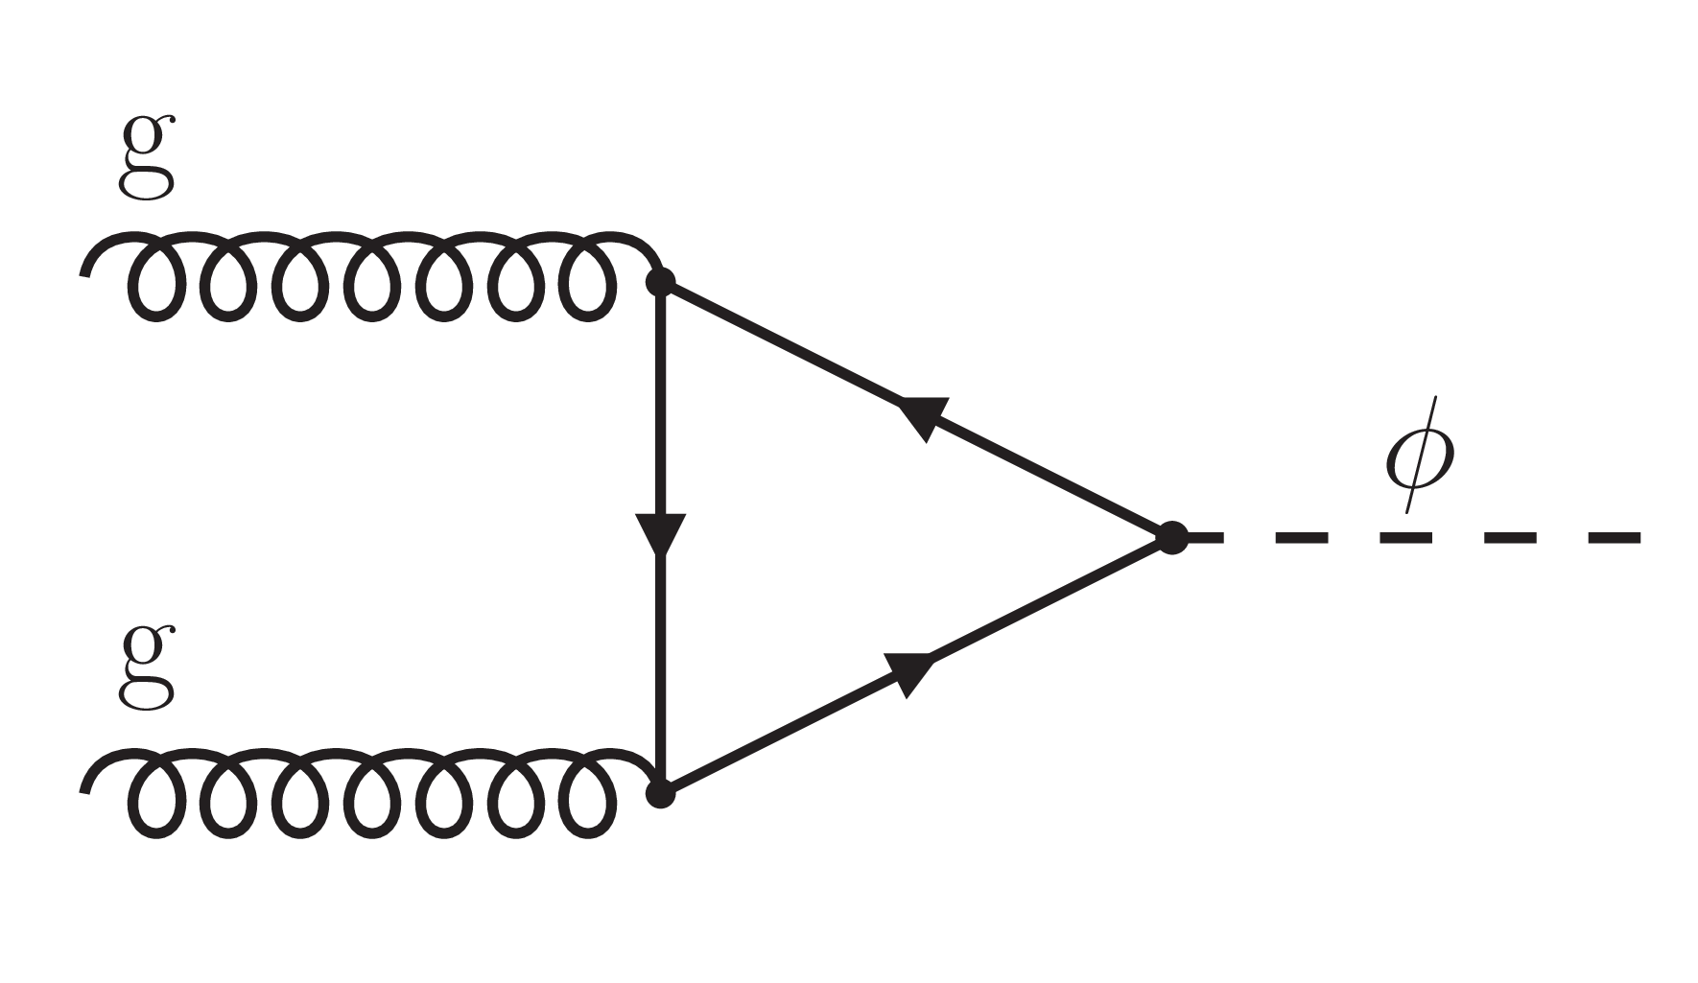
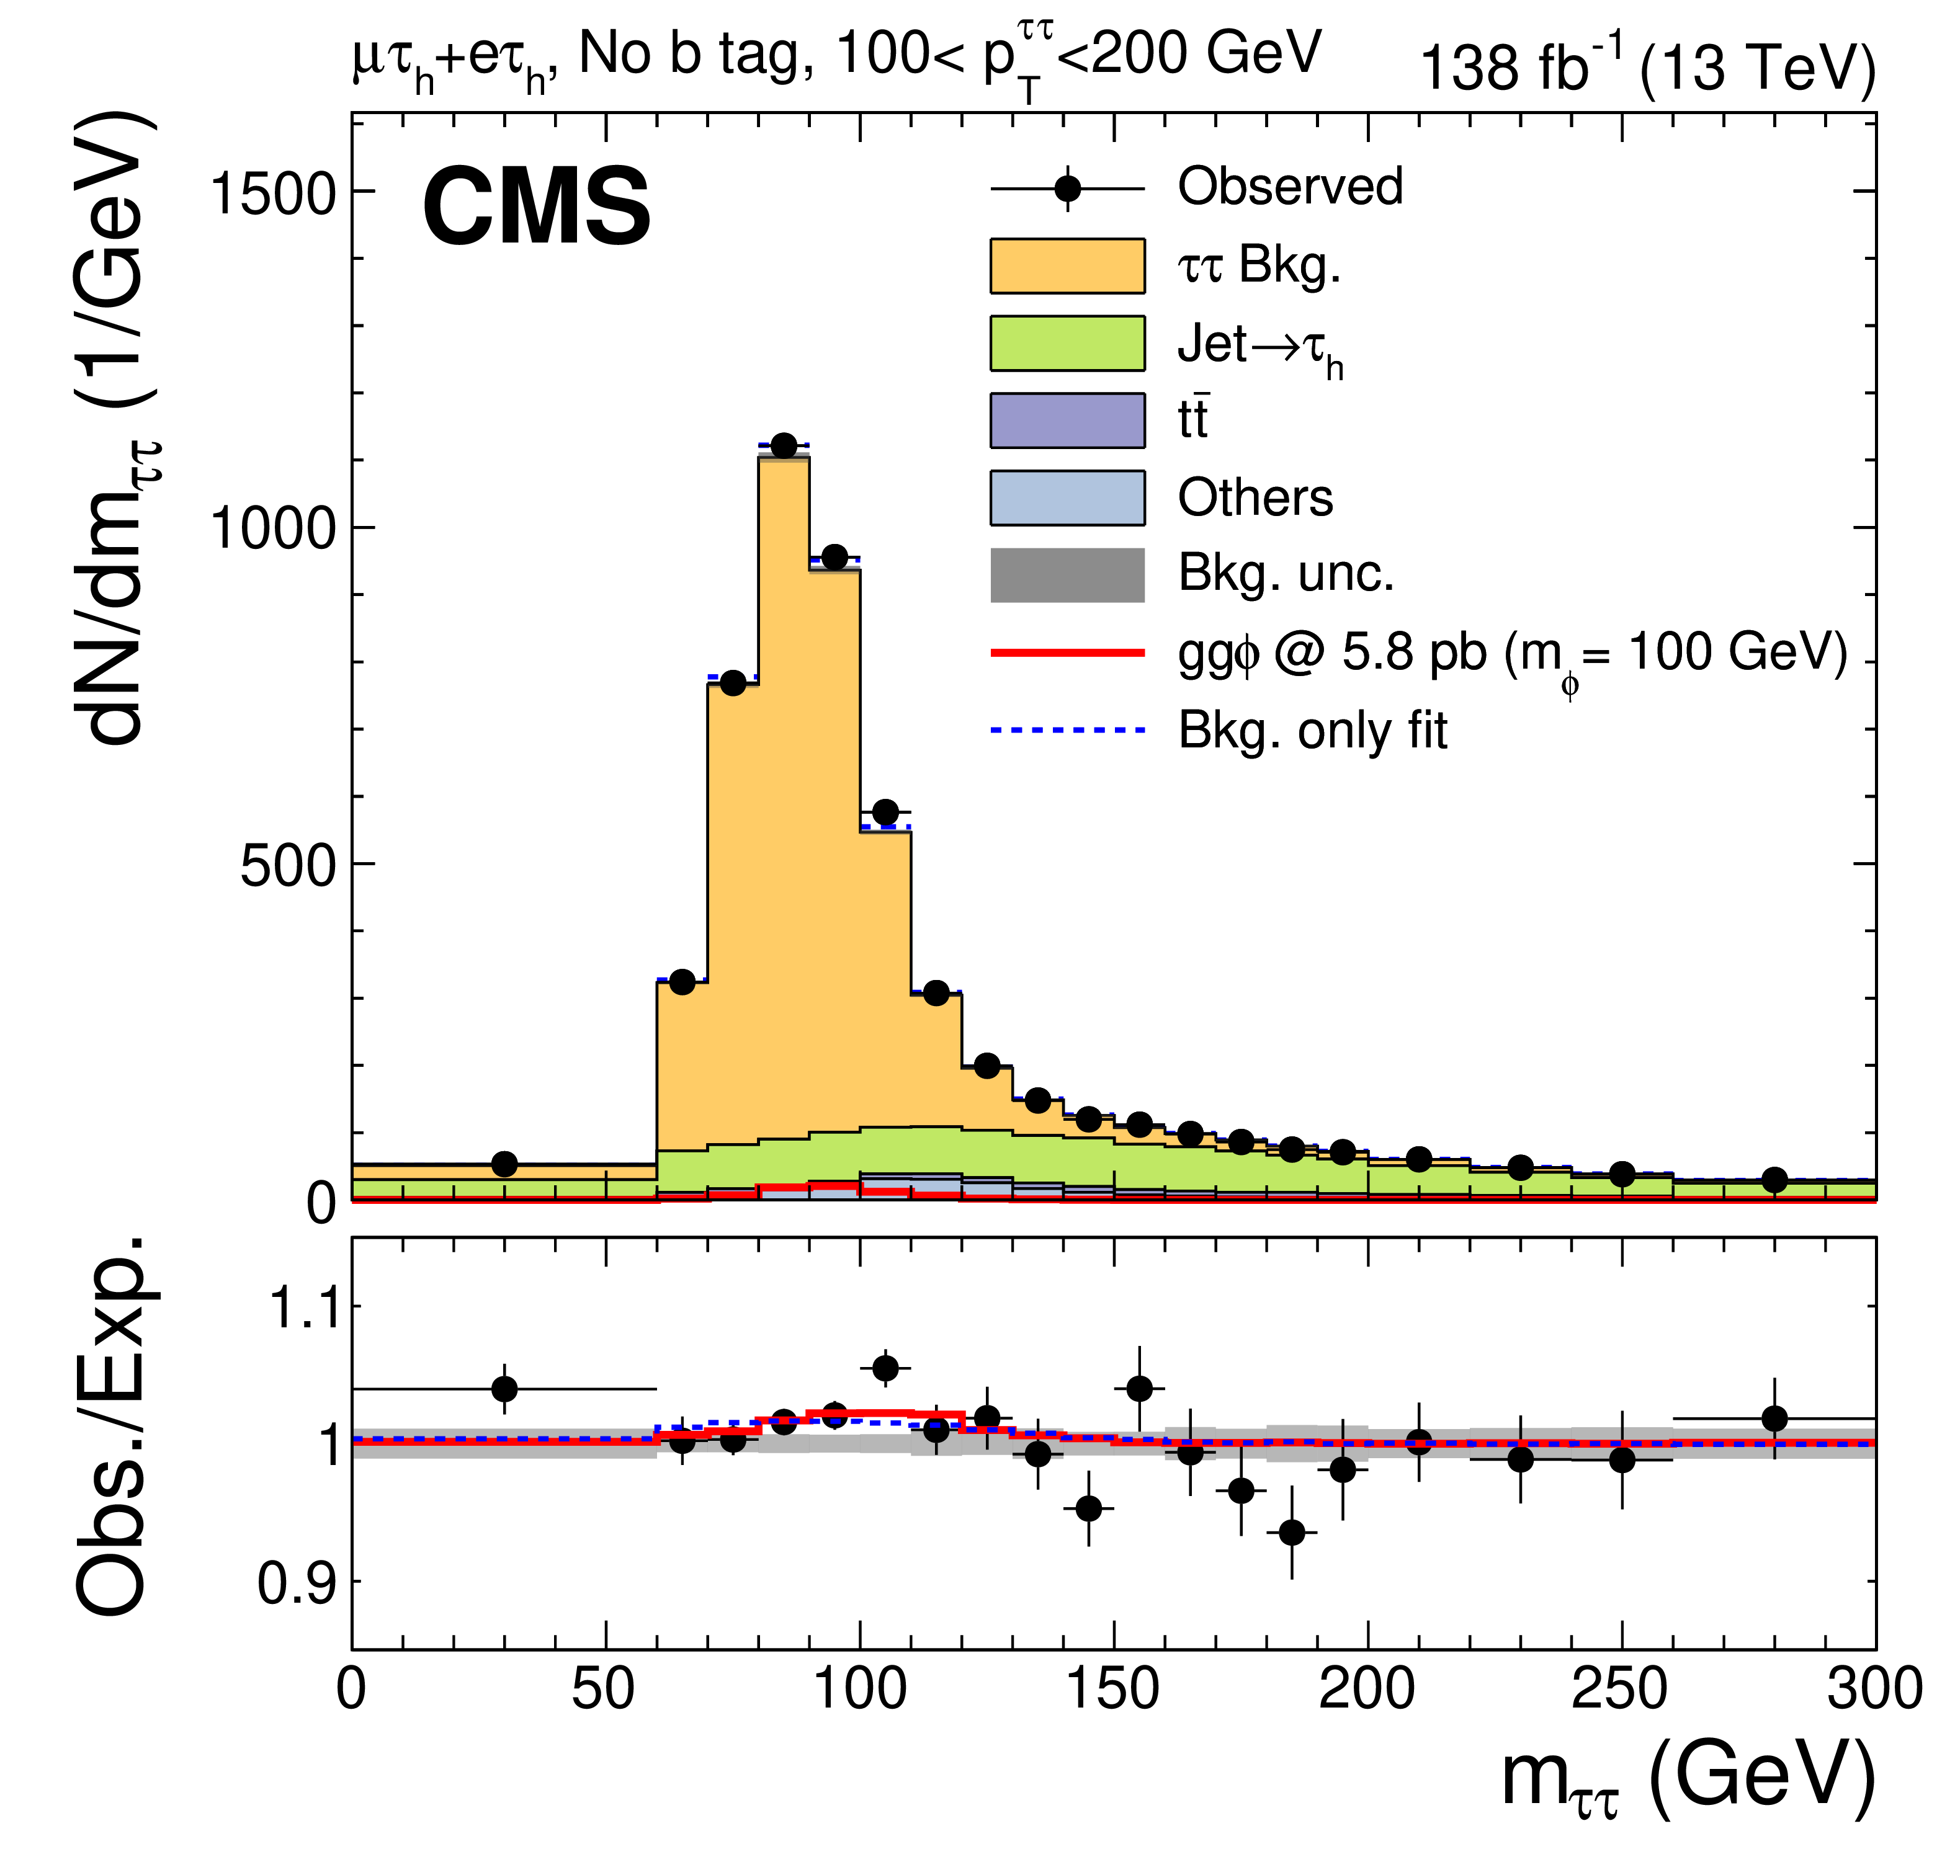
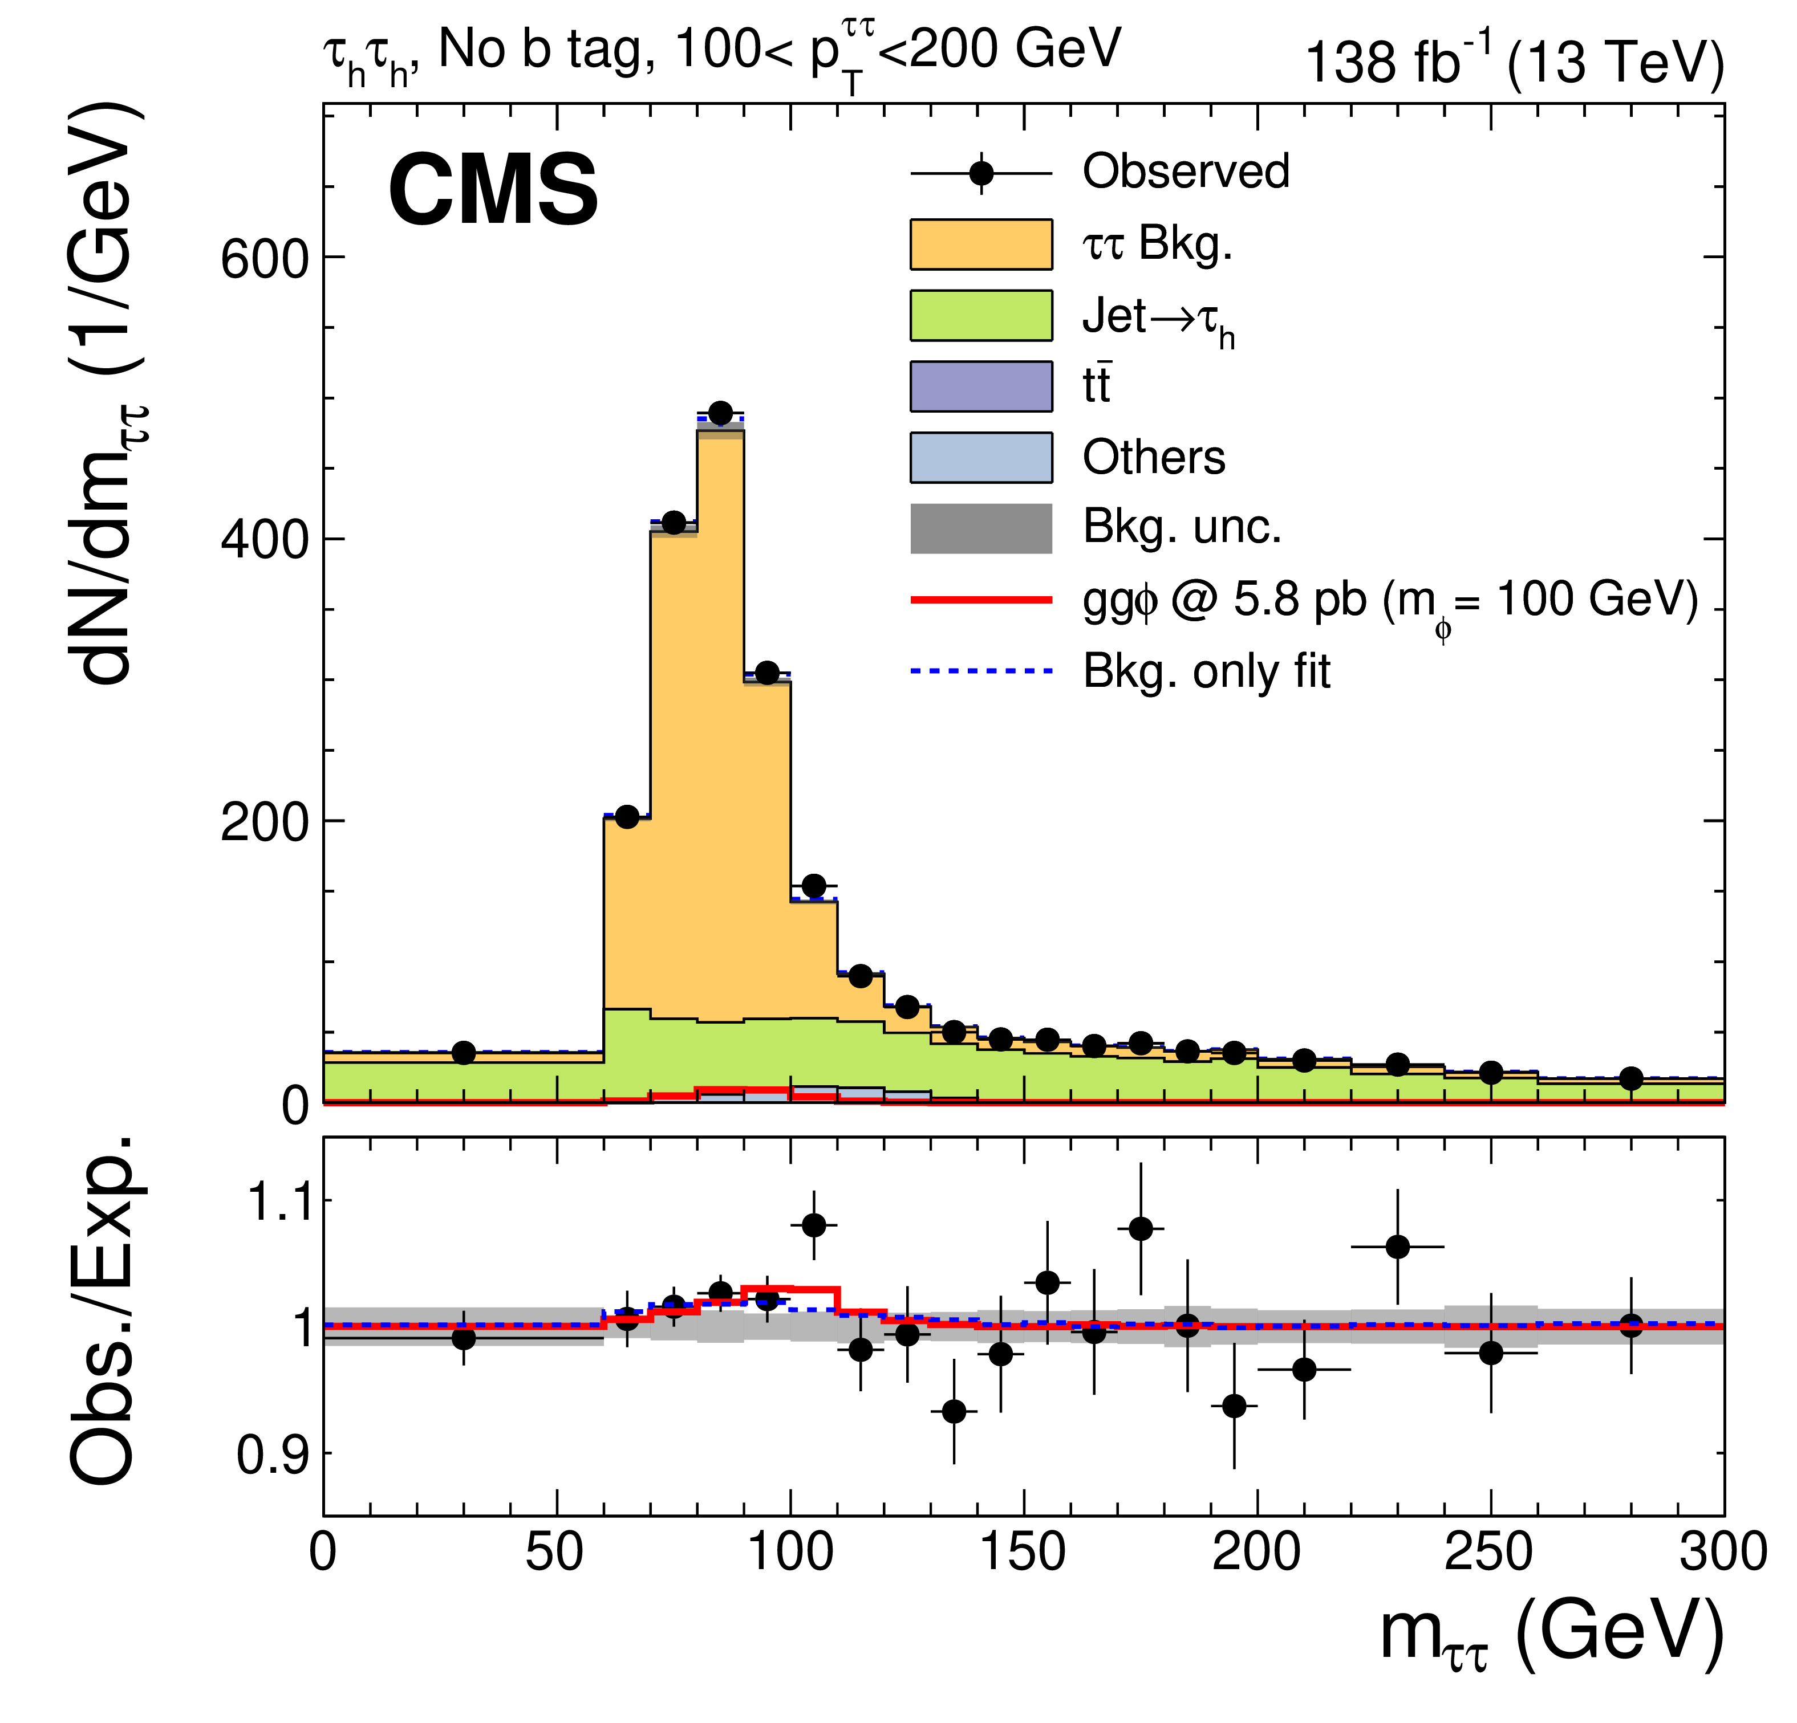

CMS, arXiv:2208.02717
Dedicated search for scalar decaying into tau pairs. CMS observes a local (global) excess of 3.1 (2.7)𝜎 at ~100 GeV.
$$H→ττ$$
Event classification scheme

Slide 31
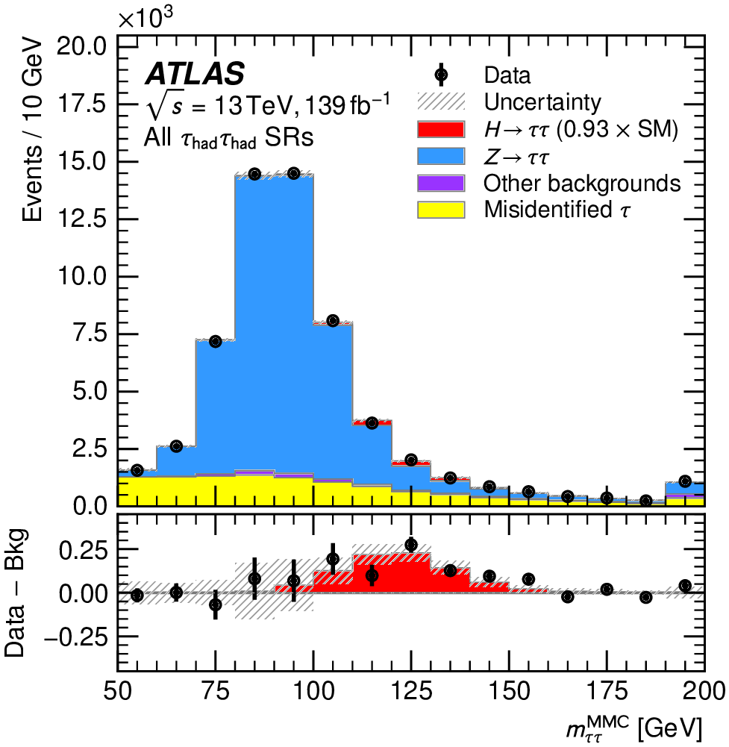
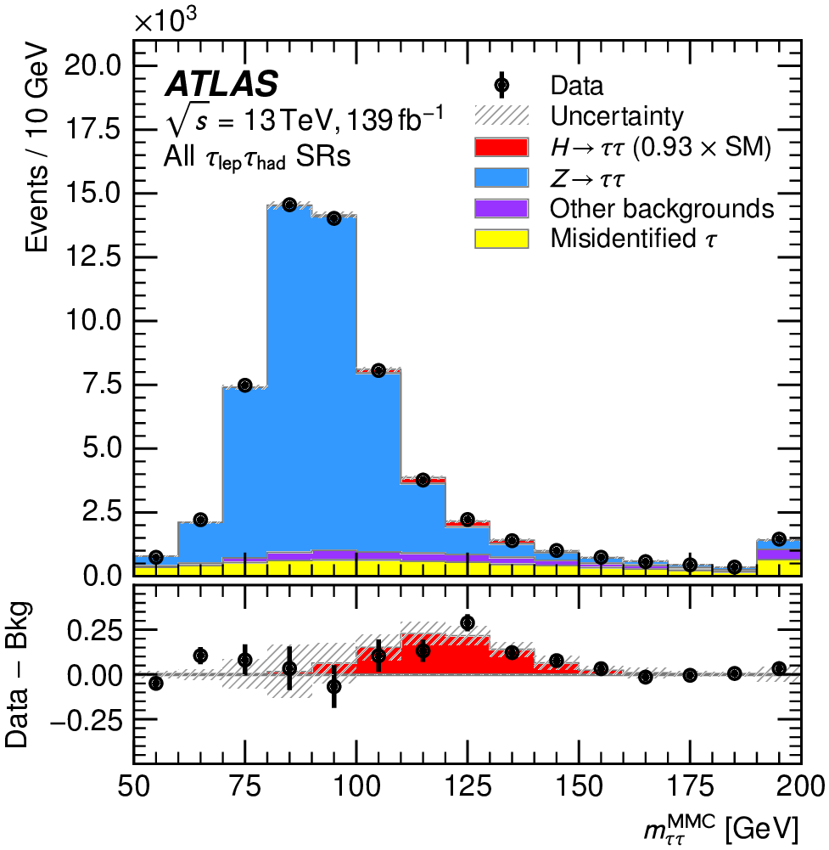
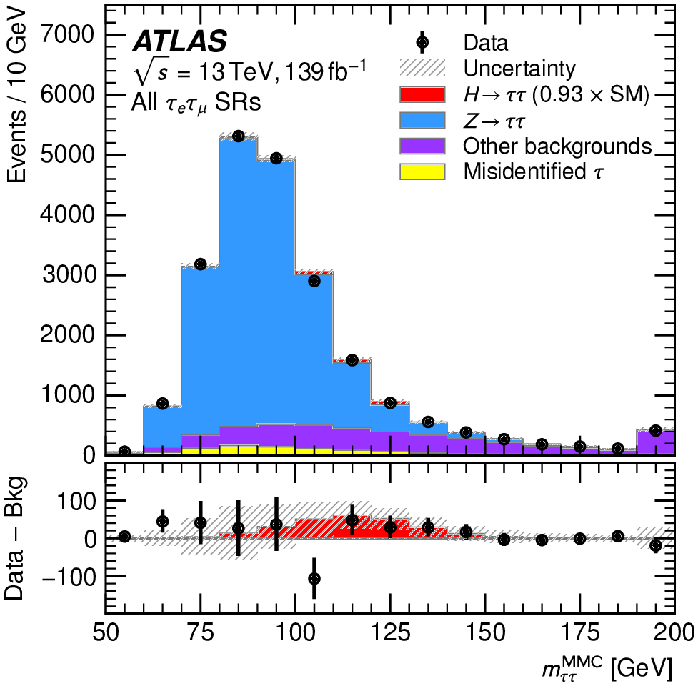

ATLAS, arXiv:2201.08269
$$H→ττ$$
ATLAS has not performed a dedicated search for low mass scalar. That said we do not seem to see a clear excess around 95 GeV in the sideband. Is the CMS excess an upward fluctuation?

Slide 32

S.Bhattacharya, G.Coloretti, A.Crivellin, B.M.
arXiv:2302.07276
ATLAS+CMS
$$H→WW→ℓνℓν$$
SM Higgs hypothesis alone. alone is having difficulty describing the ll+MET transverse mass spectra, giving room to other Higgs-like signals. Compatibility with other signals under study.

Slide 33

With recent results reported by the ATLAS experiment the significance of a narrow resonance at 95 GeV has reached 3.8$σ$ global significance.
S.Battacharya, et al. arXiv:2306.17209

Slide 34



Potential contributor to multi-lepton anomalies at the LHC
Source of leptons
$$S\left(152\right)→WW$$
$$S′\left(95\right)→bb$$
Source of b-jets

Slide 35

Eur.Phys.J.C 82 (2022) 8, 665

Slide 36



The importance of two and multi-body decays for the (HL)-LHC
Certain types of two-body decays are unexplored in important regions of the phase-space:
Other types of topologies are also unexplored
Machine Learning techniques, such as weak supervision, relevant to minimize model dependence, not used to its fullest potential
$$A→BC$$
$$A→BB^{∗}$$
$$A→BB^{(∗)}→C+X$$

Slide 37

Outlook and Conclusions
Discrepancies in multi-lepton final states at LHC w.r.t. current MCs are not statistical fluctuations
  They appear in corners of the phase-space dominated by different processes (Wt/tt/4t, VV, ttV, Vh, WWW)
    Hard to explain with MC mismodelling
With these anomalies one predicts a scalar, S, with a mass 150±5 GeV from the decay of a heavier, H.
Analysis of in associated production gives a large (~5$σ$) global excess around 152 GeV
Excesses at 95 GeV have grown, leading to 3.8$σ$ global significance
Searches for H→SS*,SS’, where asymmetric configurations play an important role at the LHC
  H→S(152)S(95)’, a candidate to explain anomalies

Slide 38
Additional Slides

Slide 39
J.Phys. G46 (2019) no.11, 115001
For simplicity we will assume that the S decays like the SM Higgs boson

Slide 40
J.Phys. G46 (2019) no.11, 115001

Slide 41

Masses in the 2HDM+S
Mass-matrix for the CP-even scalar sector will modified with respect to 2HDM
and that needs a 3 x3 matrix (three mixing angles). Couplings are modified.

Slide 42

Perform scans after fixing masses of physical bosons(m_{h1}=125 GeV, m_{h2}=140, m_{h3}=270 GeV, m_{A}=600 GeV, m_{H}±=600 GeV) in addition to the constraints described in arXiv:1711.07874, including the signal Yukawa coupling strength of β_{g}²=1.38±0.22 (translated into tan²β)

Slide 43






Correlation plots for the three mixing angles and tanβ.
Blue (red) points correspond to Br(h→SM) within 10% (20%) of the SM h values (J.Phys. G46 (2019) no.11, 115001 )

Slide 44






Results using N2HDECAY (arXiv:1612.01309) for one benchmark point

Slide 45
Impact of NNLO QCD in WW
The NNLO QCD corrections shift the m_{ll} spectrum towards larger values.
The discrepancy becomes larger in the region of interest with m_{ll}<100 GeV
Normalized to unity
NNLO corrections are small and go in the opposite direction w.r.t WW@NLO

Slide 46



A.Denner, M.Pellen,
arXiv:1607.05571
EW corrections are important at high p_{T} due to Sudakov logarithms.
Effect is less than 1% for m_{ll}<100 GeV, where discrepancies are seen.
Excess

Slide 47
The HistFactory method
K. Cranmer, G. Lewis, L. Moneta, A. Shibata, and W. Verkerke, HistFactory: A tool for creating statistical models for use with RooFit and RooStats, CERN-OPEN-2012-016.
Constructs a likelihood function from template histograms
Allows for a simple implementation of systematic uncertainties that affect normalisation and/or shape
The likelihood:
In our case, each “channel” is a different measurement.
The Poisson probability for the “expected” and “observed” number of events per bin.
Functional form of luminosity and its variations (not necessary for us).
Functional form of systematic variation with nuisance parameter αp.

Slide 48


3l with Z→ll (ZW cross-section)
CMS PAS SMP-18-002
Errors in the plot are dominated by the 15% uncertainty on normalization to account NLO/NNLO differences. The uncertainty of the shape is much smaller of order of few %
arXiv:1711.07874
Systematics that will directly affect the shape

Slide 49


With parameters presented here expect ~100 events.
Working on the model dependence of the mass reconstruction
arXiv:1711.07874
Sensitivity to mass in 3l state

Slide 50

JHEP 1910 (2019) 157

Slide 51



JHEP 1910 (2019) 157

Slide 52

The fitting procedure
The RooStats workspace is made by HistFactory
From the workspace, a profile likelihood ratio is calculated,
The best-fit value of β_{g}² is then calculated as the minimum of -2log(λ), with an error corresponding to a unit of deviation in this quantity from the best-fit point
The significance is calculated as √(-2 log λ(0)), since β_{g}² = 0 corresponds to the SM-only hypothesis
(here θ denotes the nuisance parameters)

Slide 53
Eur. Phys. J. C 77 (2017) 804
Is the discrepancy due to ttbar events?
Discrepancy in ATLAS is localized at small values of m_{ll}

Slide 54



CMS PAS TOP-17-014
Event selection with exactly two leptons (e,μ), m_{ll}>20 GeV and at least 2b-jets
Some MC describe m_{ll}, but fail the b-jet kinematics
Correct Powheg to describe m_{ll} distribution (see below)

Slide 55

b-jet multiplicity is robust theoretically

Slide 56
arXiv:1805.07399
CMS-TOP-17-018; CERN-EP-2018-074
Poor modeling of POWHEG + Pythia8 distribution is improved through reweighting
We fix the normalisation of the SM by scaling it to the data in the region
m_{ll} > 110 GeV
  A normalisation systematic of 3% is applied to all but DY
  DY systematic = 6.8%. 3% systematic on m_{ll} shape in top
  The fit is done to the region below 110 GeV
Fit results:
  β_{g}² = 2.79 ± 0.52
  Fit is extremely well constrained
Bulk of signal comes from Nb<2
Negligible MC dependence, as m_{ll} shape comes from data
Tt+Wt is corrected (see above)
Used conservative assumption that l⁺l⁻+2b-jet final state is perfectly described by the SM. The discrepancy comes from events with N_{b}<2. Excess unlikely due to tt

Slide 57

Eur. Phys. J. C (2019) 79:884
Top contribution too small to explain discrepancy. Toponium cannot explain it.

Slide 58

Chin.Phys.C 44 (2020) 6, 063103
The Muon g-2 and the 2HDM+S

Slide 59



2HDM+S potential with fixed parameters from multi-lepton anomalies at the LHC
Consider extra degrees of freedom in the form of SM singlet vector-like fermions
Allowed fermion masses with different choices of Yukawa couplings

Slide 60
G.Beck, E.Malwa, M.Kumar, R.Temo and B.M., 2102.10596
The multi-lepton anomalies and excesses in astrophysics

Slide 61

AMS02, PRL 122, 041102 (2019)
Leptophilic excesses, such as positron rise in PAMELA/AMS02

Slide 62




Dark matter annihilation.
Leptons, photons and protons from the decays of S.

Slide 63
Small size of bands for e+ and Fermi GC may be due to missing systematics due to incomplete background modelling.
Important implications on DM searches at the LHC (see below)
Data tend to prefer lighter DM

Slide 64
100 hours of running at the MeerKat appears to fall into the sensitive to the predictions of the model.

Slide 65


Slide 66


Slide 67
Impact on Higgs Physics
The presence of a BSM signal of the type H→Sh would lead to:
The presence of extra leptons in association with h. Affects the Wh measurement (Eur.Phys.J.C 81 (2021) 365)
Distortion of Higgs p_{T} and rapidity (under study)
No tuning of model parameters performed. Look at fixed corners of the phase-space fixed with parameters of 2017.

Slide 68


Nominal m_{H}=270 GeV and m_{S}=150 GeV.
Other points for illustration purposes

Slide 69


Survey of LHC results on Vh (V=W,Z) production (Eur.Phys.J.C 81 (2021) 365)
The BSM (H→Sh) signal appears at low p_{Th} and the SM signal is prevalent at larger p_{Th} (no tuning of parameters)
Include those results from ATLAS and CMS where no requirements on p_{Th} (or correlated observables) is not done or used in an MVA.
Those results where the final state is treated more “inclusively” display elevated signal strengths for Wh production:
This represents a 3.8σ deviation from the SM value of 1. BSM signal normalization less than expected from multilepton excesses assuming Br(H→Sh)=100%. Indicates that Br(H→SS) > Br(H→Sh)

Slide 70
CMS-PAS-HIG-19-017
New results from CMS in the measurement of Vh, h→WW add to the anomalies reported in Eur.Phys.J.C 81 (2021) 365
Deviation from the SM becomes stronger with p_{TV}<150 Gev

Slide 71



https://cds.cern.ch/record/2784454/files/HIG-19-014-pas.pdf

Slide 72



https://cds.cern.ch/record/2851512/files/HIG-22-002-pas.pdf

Slide 73


CMS, e𝞵
ATLAS, e𝞵

Slide 75
Abovementioned excess further motivates searches for bosons in asymmetric 𝛾𝛾bb configurations not performed before at the LHC
Expect more than 7𝜎 significance for one experiment with the Run 2 + Run 3 data sets.

