Slide 1

You don’t look like a theoretical physicist
Clare Burrage
University of Nottingham

Slide 2
What is dark energy and how do we find it?
Clare Burrage
University of Nottingham
Outline:
Accelerated expansion and the cosmological constant
Dark energy, scalar fields, and fifth forces
Non-linearities and screening

Slide 3
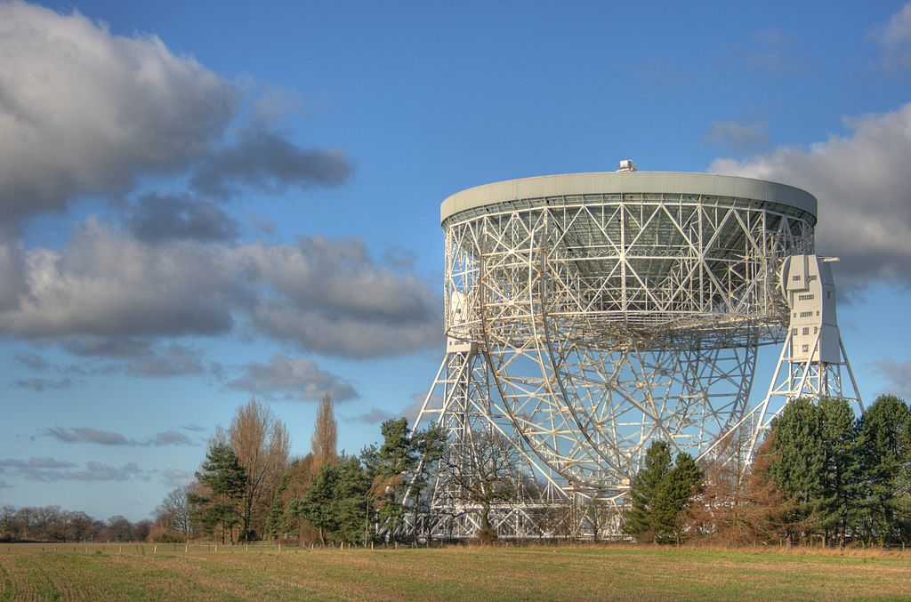
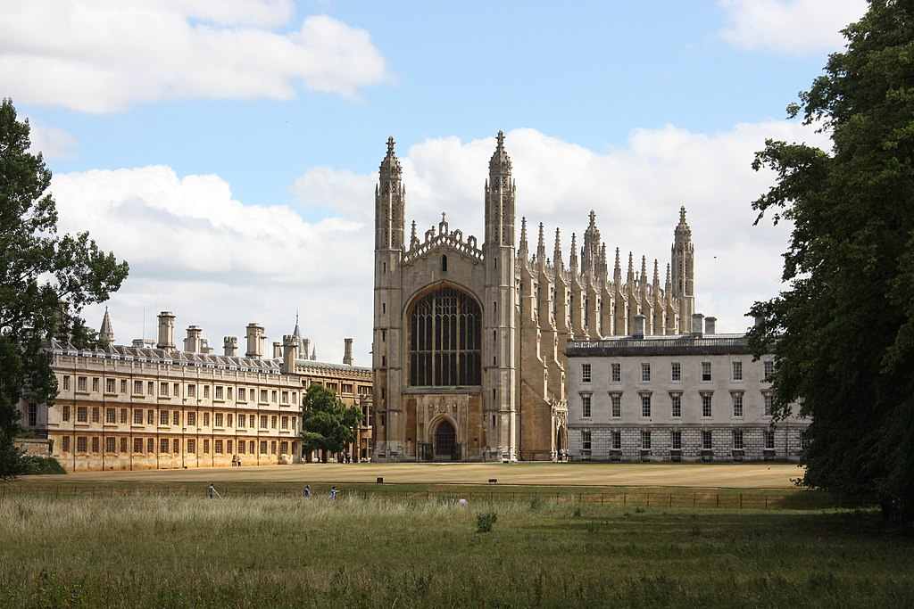
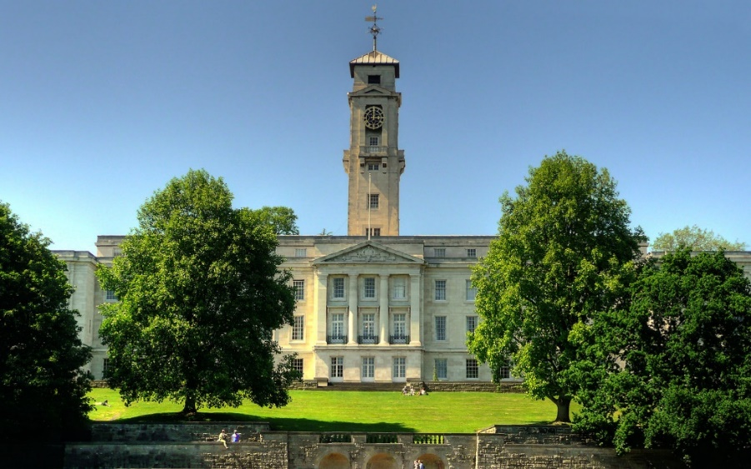

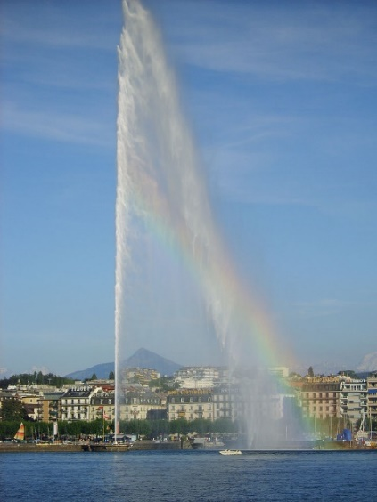
Who am I?
Cheshire
Cambridge
Nottingham
Hamburg
Geneva

Slide 4
The dark universe
Our Universe is well* described by a ΛCDM model with a cosmological constant
Λ ≈ 1.1 x 10⁻⁵² m⁻²
≈ (2.1 x 10⁻³³ eV)²
Corresponds to an energy density of
ρ_{Λ} ≈ 6.0 x 10⁻²⁷ kg/m³
~(2.3 x 10⁻³ eV)⁴
Planck 2018 results. VI. Cosmological parameters. A&A 641, A6 (2020)

Slide 5
The dark universe
Our Universe is well* described by a ΛCDM model with a cosmological constant
Λ ≈ 1.1 x 10⁻⁵² m⁻²
≈ (2.1 x 10⁻³³ eV)²
Corresponds to an energy density of
ρ_{Λ} ≈ 6.0 x 10⁻²⁷ kg/m³
~(2.3 x 10⁻³ eV)⁴
That’s weird!
Planck 2018 results. VI. Cosmological parameters. A&A 641, A6 (2020)

Slide 6
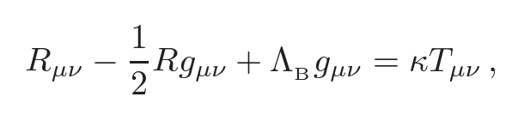

The Cosmological Constant
The Einstein equations contain a bare cosmological constant
Energy density associated to the vacuum gravitates in the same way
Classical contributions to the vacuum energy change at phase transitions

Slide 7
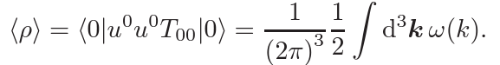
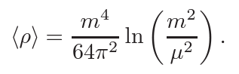
Vacuum Energy
Free scalar field with mass m (in flat space)
Similar result when considering bubble Feynman diagrams and curved space-time
Can we fine tune large contributions away?
  in a radiatively stable way?
  without knowledge of UV physics?
Many good reviews: e.g. Martin. Comptes Rendus Physique, 13, 2012, 566

Slide 8
Solving The CC Problem - An Incomplete List
Vacuum energy gravitates differently
(modified gravity)
We are computing the vacuum energy wrong
(modified quantum field theory, UV physics in the vacuum)
New symmetries set the Cosmological Constant to zero
(needs transitory new physics to produce acceleration)
Dynamical evolution in a higher dimensional or more UV complete theory
(possibly combined with anthropics)

Slide 9

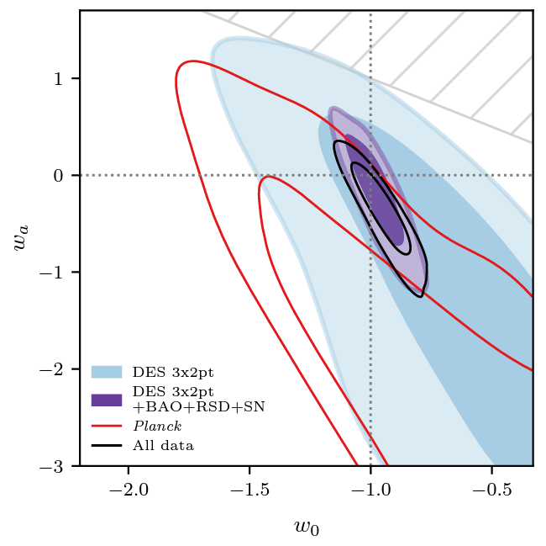
Is the Cosmological Constant Constant?
Time varying equation of state
Dark Energy Survey Year 3 Results, Phys. Rev. D 107 (2022) 083504

Slide 10
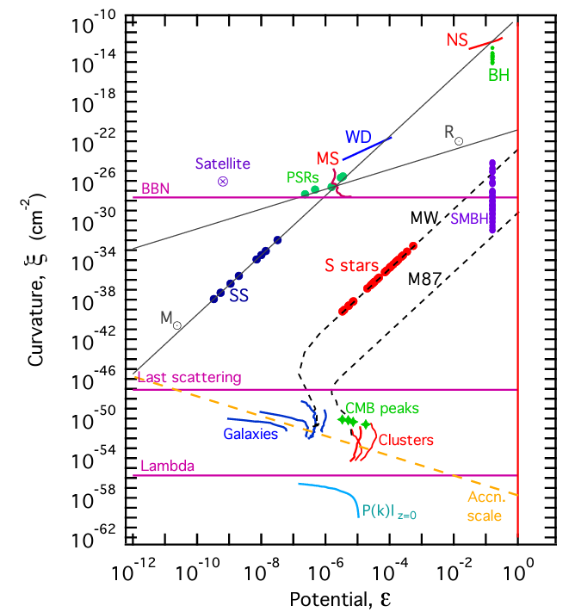
Testing Gravity
Baker, Psaltis, Skordis. ApJ 802 63, 2015

Slide 11
Dark Energy and Light Scalar Fields
A new type of matter
Quintessence directly introduces new fields to drive cosmological acceleration
New, light (fundamental or emergent) scalars
A modification of gravity
General Relativity is the unique interacting theory of a Lorentz invariant, massless, helicity-2 particle
Papapetrou (1948). Weinberg (1965).
New physics in the gravitational sector may introduce new degrees of freedom, often Lorentz scalars
Note: connections with light scalar dark matter models

Slide 12
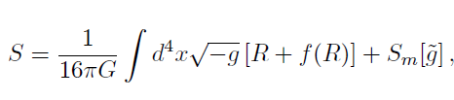
An Example: Conformally Coupled Scalars
Can start from an f(R) modification of gravity, which has an extra (hidden) scalar degree of freedom

Slide 13
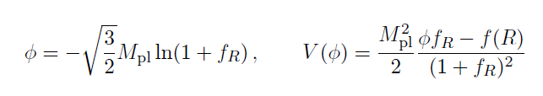

An Example: Conformally Coupled Scalars
Can start from an f(R) modification of gravity, which has an extra (hidden) scalar degree of freedom

Slide 14

An Example: Conformally Coupled Scalars
Can start from an f(R) modification of gravity, which has an extra (hidden) scalar degree of freedom

Slide 15
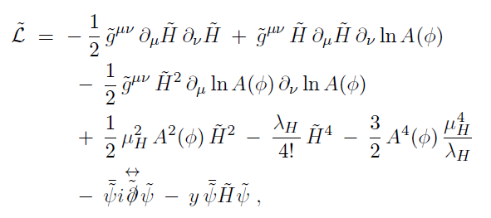
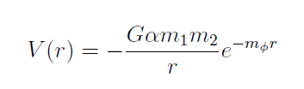
An Example: Conformally Coupled Scalars
At leading order this is a Higgs portal model
Leads to a fifth force
CB, Copeland, Millington, Spannowsky. JCAP 11 (2018) 036.

Slide 16
Can we forbid a coupling to matter?
Yes, through scale invariance! But then all mass scales must arise spontaneously
Soft breaking allowed, but constrained by observations
Suggestions for how to preserve this question at the loop level – but renormalisation then becomes challenging
Shaposhnikov, Zenhausern, 2009. Ghilencea, 2016. Ghilenceas, Lalak, Olszewski, 2016.
Ferreira, Hill, Ross, 2017.

Slide 17
Can we suppress a coupling to matter?
Locally weak coupling
  Symmetron and varying dilaton models
Pietroni (2005). Olive, Pospelov (2008). Hinterbichler, Khoury (2010). Brax et al. (2011).
Locally large mass
  Chameleon models
Khoury, Weltman (2004).
Locally large kinetic coefficient
  Vainshtein mechanism, Galileon and k-mouflage models
Vainshtein (1972). Nicolis, Rattazzi, Trincherini (2008).
Babichev, Deffayet, Ziour (2009).

Slide 18

Now and Then
Prof. Anne-Christine Davis
First woman to be appointed Professor in
the Faculty of Mathematics at the University
of Cambridge
First woman to hold a research position
in the Theory Division at CERN
https://plus.maths.org/content/women-mathematics-anne-christine-davis

Slide 19
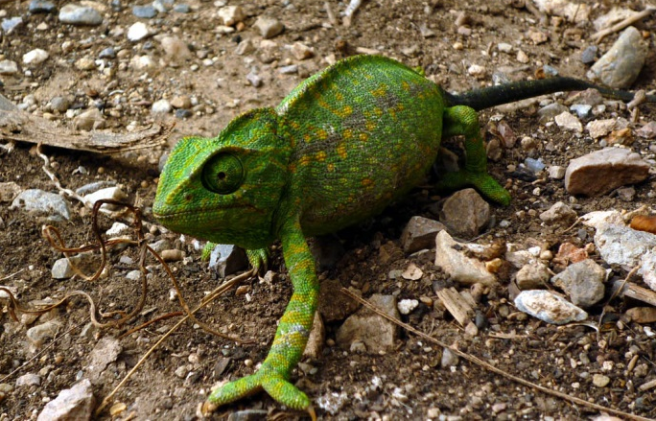
  The Chameleon
  A scalar field with canonical kinetic terms, non-linear potential, and direct coupling to matter
19
Khoury, Weltman. (2004). Image credit: Nanosanchez

Slide 20
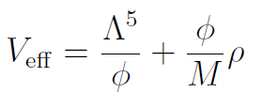
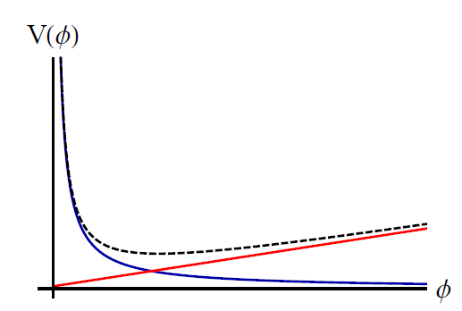
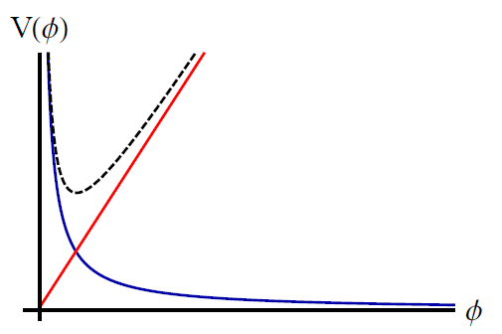
Varying Mass
  Dynamics governed by an effective potential
  Non-linearities in the potential mean that the mass of the field depends on the local energy density
  Low density High density
20

Slide 21
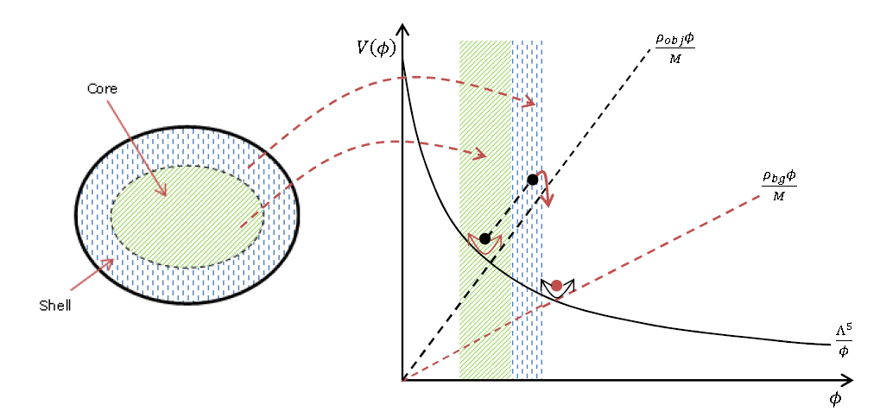
  Chameleon Screening
  The increased mass makes it hard for the chameleon field to adjust its value
  The chameleon potential well around ‘large’ objects is shallower than for canonical light scalar fields
CB, Copeland, Stevenson. (2015)

Slide 22
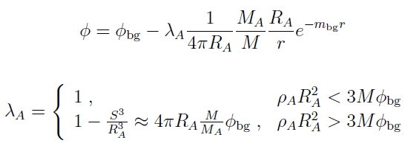
The Scalar Potential
Around a static, spherically symmetric source of constant density
This determines how ‘screened’ an object is from the chameleon field
Ideal experiments use unscreened test masses e.g. atomic nuclei, neutrons, microspheres, diffuse gas

Slide 23
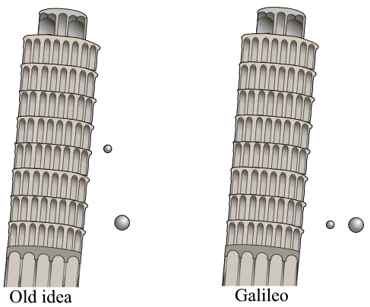
Testing the Equivalence Principle
Do large objects and small objects fall at the same rate?
Old idea Galileo Chameleons?
Image credit: Theresa Knott

Slide 24

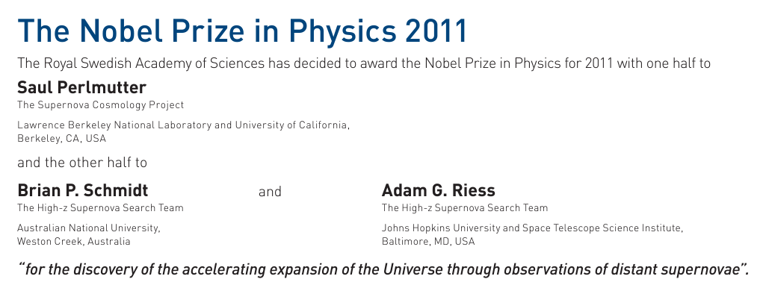
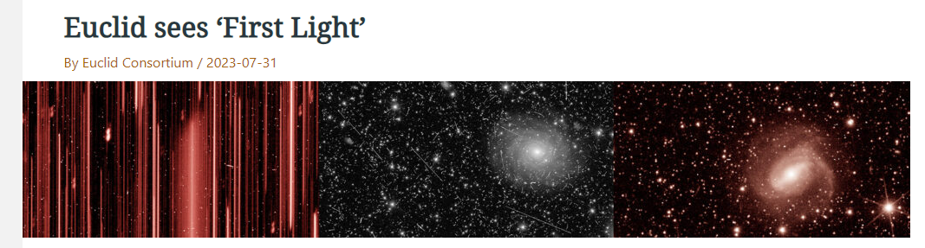
A turning point - 2011

Slide 25
Testing the Equivalence Principle
Do large objects and small objects fall at the same rate?
Old idea Galileo Chameleons?
Image credit: Theresa Knott

Slide 26
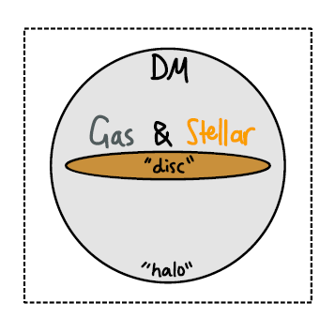
Tests on Galactic Scales
Different components of a dwarf galaxy may fall in a gravitational field at different rates
Stars are screened, gas and dark matter are not
Look for gas-star offsets & warping of galactic discs
Hui, Nicolis, Stubbs. Phys.Rev.D 80 (2009) 104002. Jain, VanderPlas. JCAP 10 (2011) 032 Desmond, Ferreira, Lavaux, Jasche. Phys.Rev.D 98 (2018) 6, 064015. Phys.Rev.D 98 (2018) 8, 083010. Desmond, Ferreira. Phys.Rev.D 102 (2020) 10, 104060. Image credit: Bradley March

Slide 27
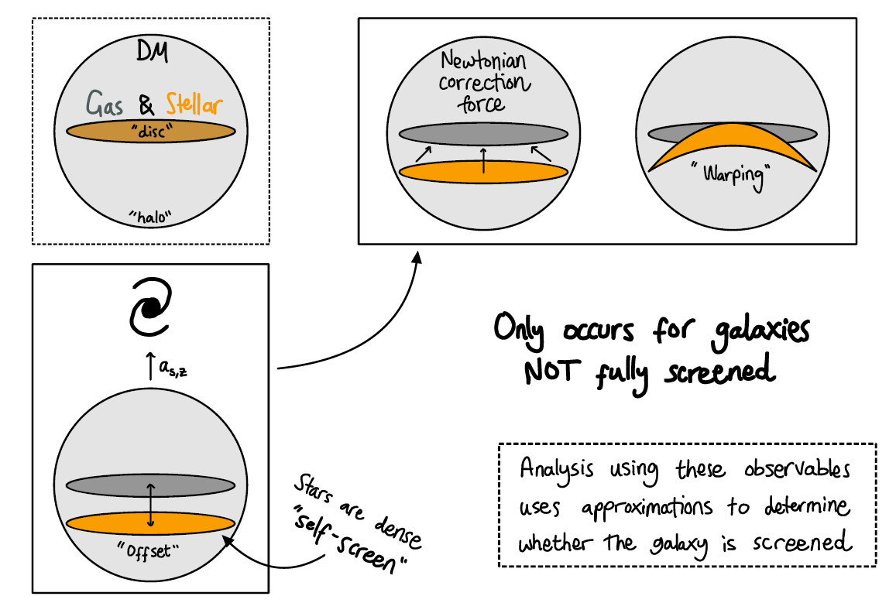
Tests on Galactic Scales
Image credit: Bradley March

Slide 28
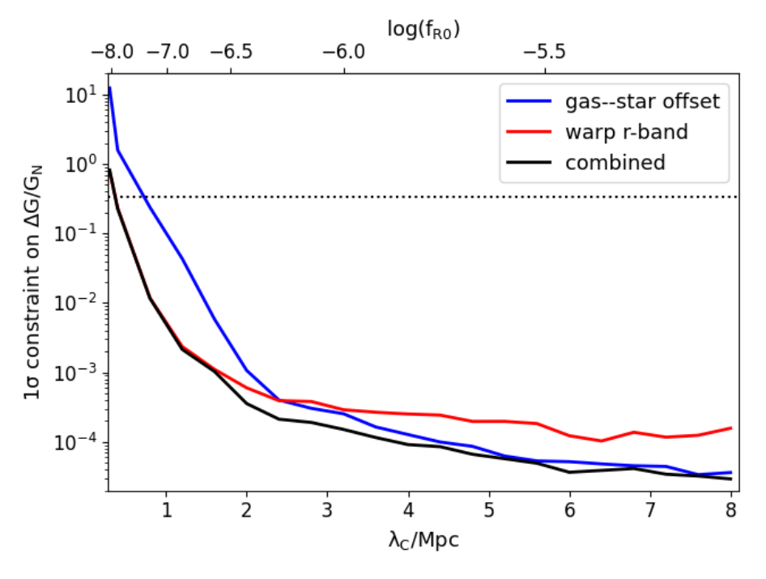
Tests on Galactic Scales
Gas star offsets determined by cross correlating ALFALFA (21cm survey) with NASA Sloan Atlas (NSA) (optical and near-IR), warps from NSA
Desmond, Ferreira. Phys.Rev.D 102 (2020) 10, 104060

Slide 29

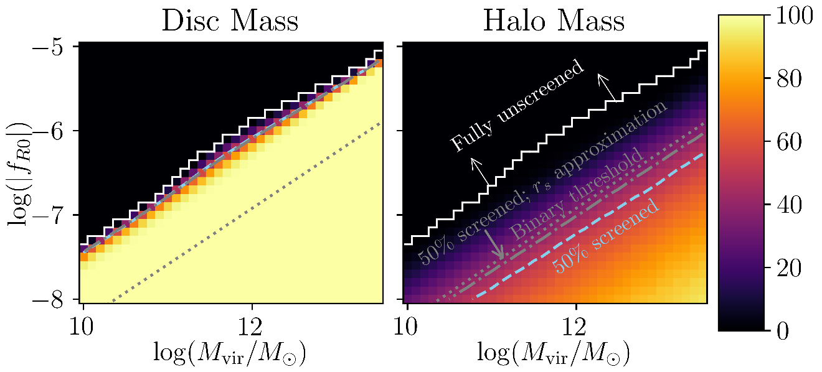
Tests on Galactic Scales
Common statement: fifth force is fully screened if object’s gravitational potential is deeper than
And fully unscreened if not
CB, March, Naik. arXiv:2310.19955

Slide 30
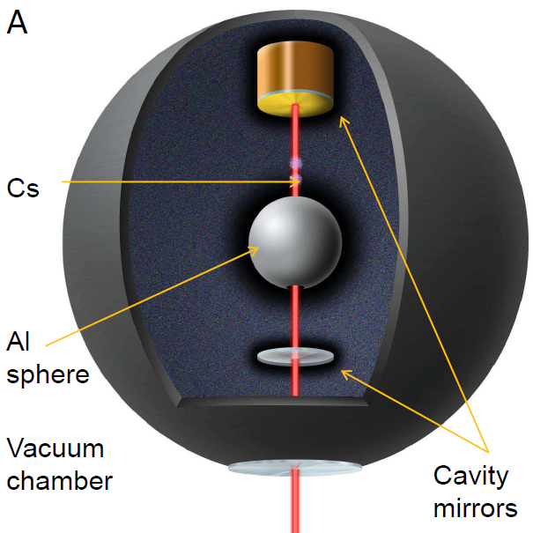
Laboratory Searches – EP violation
Jaffe, Haslinger, Xu, Hamilton, Upadhye, Elder, Khoury, Müller. (2017)
Rider, Moore, Blakemore, Louis, Lu, Gratta. (2016)
Ivanov, Hollwieser, Jenke, Wellenzohen, Abele (2013)
For a review see CB & Sakstein (2017). Brax, Casas, Desmond, Elder. (2022)

Slide 31
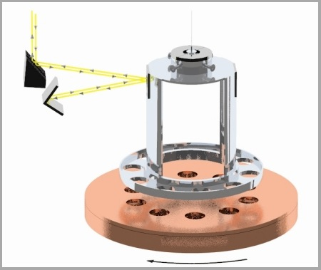
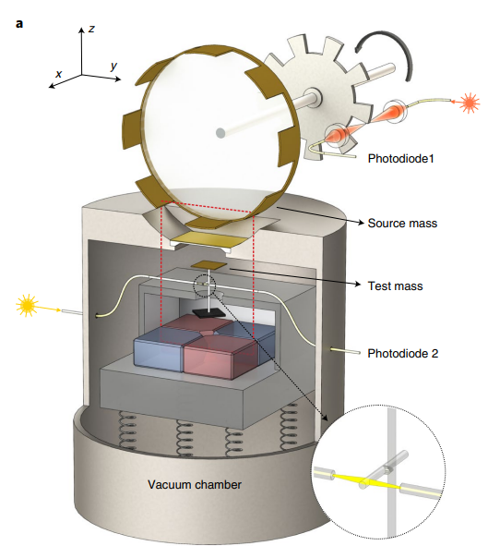
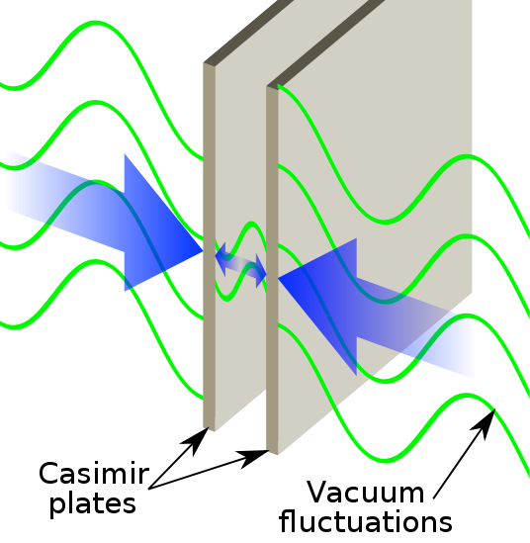
Laboratory Searches – Short Range Forces
Upadhye (2012). Kapner et al. (2006).Brax et al. (2007). Elder et al. (2019). Yin et al. (2022)
For a review see CB & Sakstein (2017). Brax, Casas, Desmond, Elder. (2022)

Slide 32
Atom Interferometry for Chameleons
Atoms are unscreened in much of the chameleon parameter space
Atom interferometry can measure accelerations experienced by atoms
A source mass in a vacuum chamber, produces chameleon potential felt by cloud of atoms
Sabulsky, Dutta, Hinds, Elder, CB, Copeland. arXiv:1812.08244

Slide 33
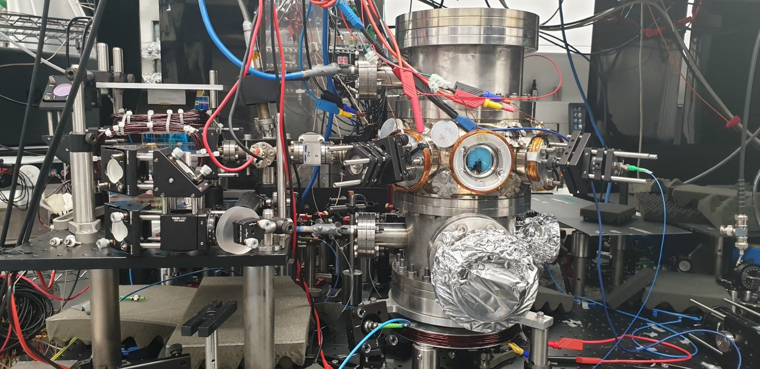
Imperial Experiment
Dedicated chameleon experiment, insensitive to the Earth’s gravitational field
Anomalous acceleration = -77 ± 201 nm s⁻²
Sabulsky, Dutta, Hinds, Elder, CB, Copeland. arXiv:1812.08244
See also: Jaffe et al. (2017). Image credit: E. Hinds

Slide 34
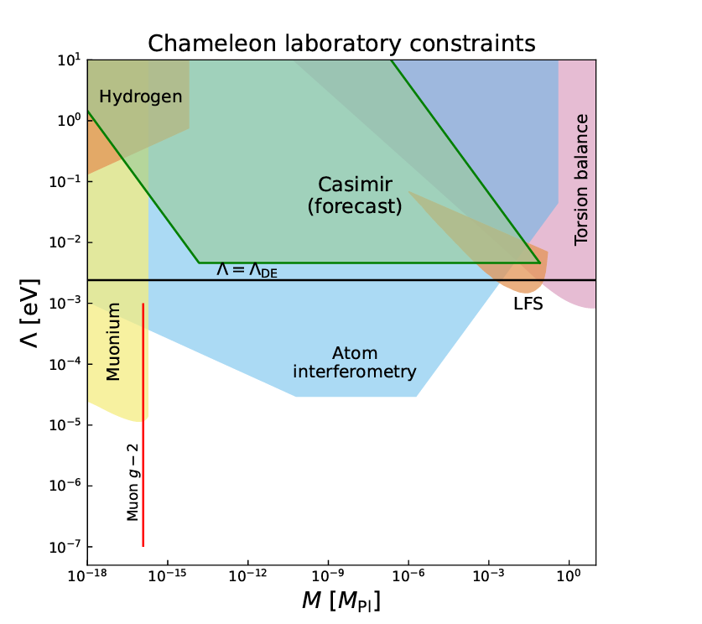
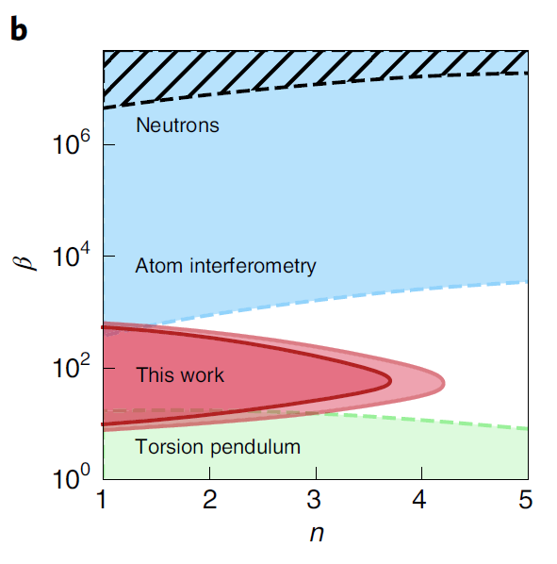
Chameleon: Combined Constraints
Bare potential: V(φ) = Λ^{n+4}/φ^{n}
Bare matter coupling: 1/M = β/M_{Pl}
Brax, Davis, Elder. Phys. Rev. D 107 (2023) 084025
Yin et al. Nature Physics 18 1181 (2022)

Slide 35
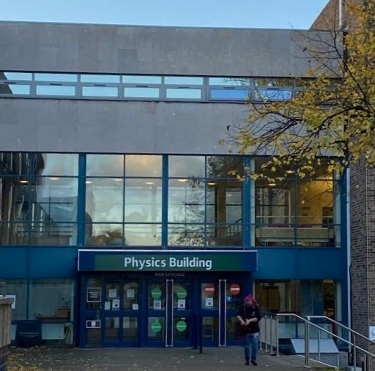
Now and Then
In 2021/22 our students were
31% Female, 69% Male
19% Black and Minority Ethnic (BME), 79% White
In 2022 our staff were
27% Female, 73% Male
14% Black and Minority Ethnic, 80% White
19% female professors compared to 14% on average in Physics departments in UK

Slide 36
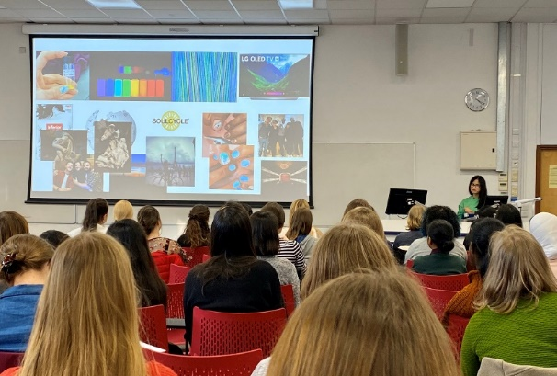
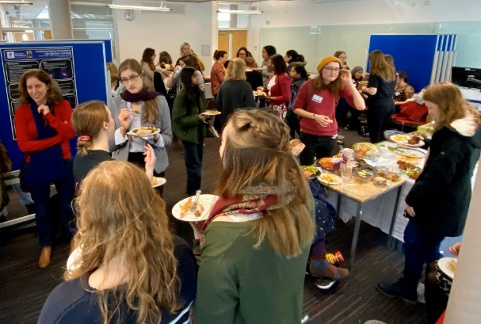

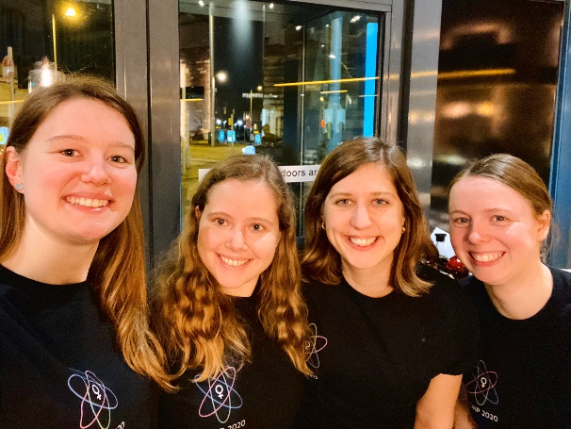
PGWiP March 2020
First national Post-Graduate Women in Physics Conference (PGWiP)
“[We] left the day feeling uplifted and more confident in ourselves”
“It … provided a safe space for women to talk about their experiences and struggles both inside and outside of academia.”
“It was excellent. Really grateful for the opportunity to meet such outstanding women, from the speakers and the audience.”
Organised by our students: Amy Whitney, Lizzie Elmer, Hannah Coleman, Emily Tyler

Slide 37
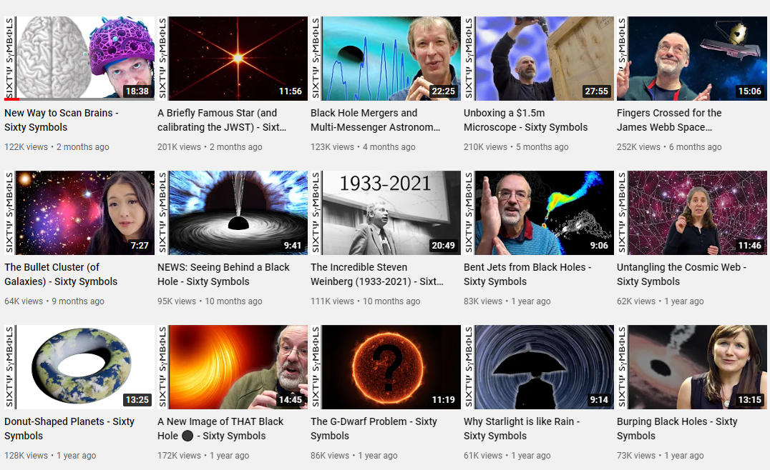
Sixty Symbols
Collaboration between the School of Physics and Astronomy and film maker Brady Haran
~855,000 subscribers. Most videos get over 100,000 views
https://www.youtube.com/user/sixtysymbols

Slide 38
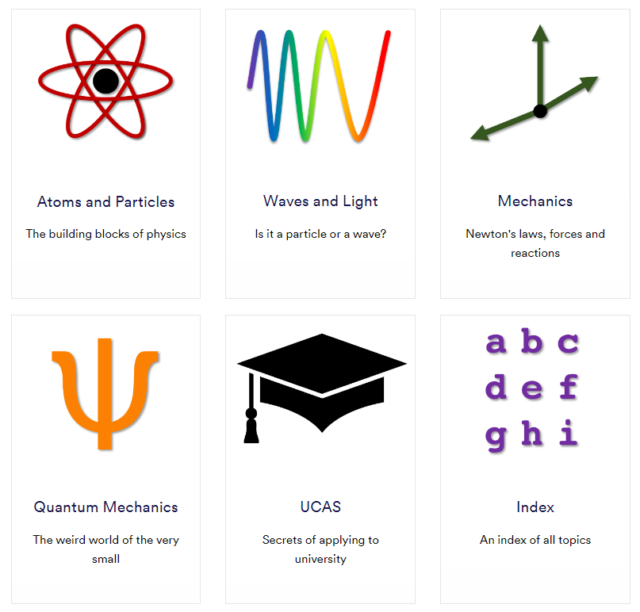
Sixty Ideas
Developed to add value by making Sixty Symbols easier to use for educational purposes
A curated set of videos matched to the A-level Physics curriculum
https://www.nottingham.ac.uk/physics/sixtyideas/

Slide 39

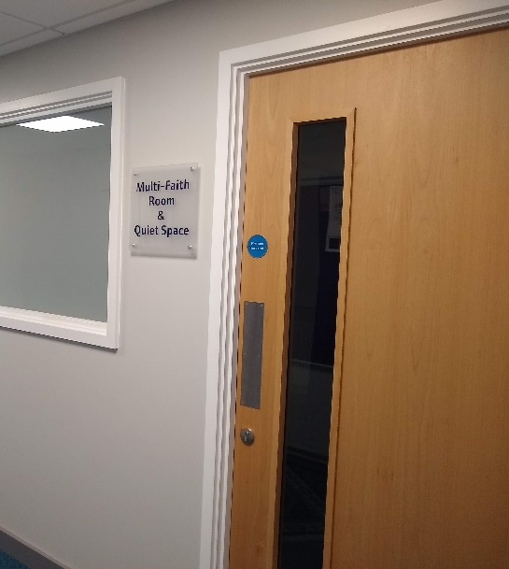

New Faith and Well-Being Space
In the basement of the physics building
Next to showers
Funding from faculty to transform space

Slide 40
Conclusions and Outlook
The expansion of our universe is accelerating, and we don’t understand why
Theories of dark energy motivate light scalars and fifth forces
Non-linearities lead to a rich phenomenology
New constraints arising from galaxy surveys and high precision laboratory tests

Slide 41
Conclusions and Outlook
The expansion of our universe is accelerating, and we don’t understand why
Theories of dark energy motivate light scalars and fifth forces
Non-linearities lead to a rich phenomenology
New constraints arising from galaxy surveys and high precision laboratory tests
A successful career (almost) always includes an element of luck
Don’t care too much about the opinions of others
Removing barriers to access helps everyone

Slide 43
Sixty Ideas – Support for Students and Teachers
Three major demographic factors correlated with a student choosing to study physics at school:
Gender: girls << likely than boys
Socioeconomic status: children from more disadvantaged families < likely
Ethnicity: people from certain ethnic backgrounds are > (eg Chinese and Indian) or < (eg white British and Afro-Caribbean) likely
https://www.iop.org/sites/default/files/2021-03/raising-aspirations-in-physics.pdf

Slide 44
Sixty Ideas – Support for Students and Teachers
Being taught by specialist teachers improves student motivation and performance
Schools in disadvantaged areas least likely to have specialist science teachers
Most state secondary schools have fewer physics specialists than other science subjects
Teachers need up-to-date examples and applications to make science appear more relevant to pupils
https://www.iop.org/sites/default/files/2021-03/raising-aspirations-in-physics.pdf

Slide 45
Awarding Gaps
Science Faculty: BAME students < likely to get a good degree (1st or 2:1)
University: students of faith < likely to get a good degree than those of no religion
Advance HE report in 2020:
50% of students have religion or belief
66% Christian, 18% Muslim
65% of Muslim students get good degree c.f. 76% overall
https://www.advance-he.ac.uk/knowledge-hub/research-insight-religion-and-belief-uk-higher-education

Slide 46
Awarding Gaps
Science Faculty: BAME students < likely to get a good degree (1st or 2:1)
University: students of faith < likely to get a good degree than those of no religion
Advance HE report in 2020:
50% of students have religion or belief
66% Christian, 18% Muslim
65% of Muslim students get good degree c.f. 76% overall
https://www.advance-he.ac.uk/knowledge-hub/research-insight-religion-and-belief-uk-higher-education

Slide 47
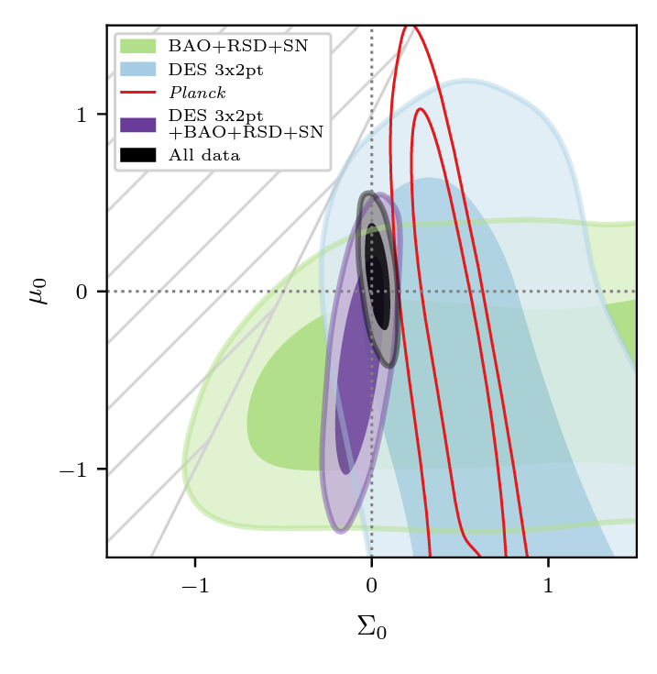
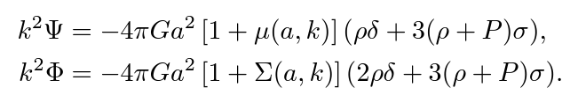
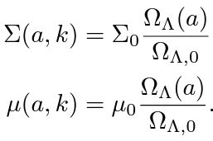
Testing Gravity on Cosmological Scales
For example: Parameterise modifications to the Poisson and lensing equations
Dark Energy Survey Year 3 Results, Phys. Rev. D 107 (2022) 083504

Slide 48
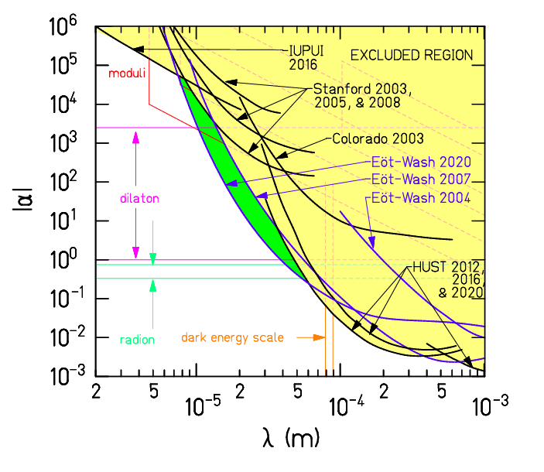
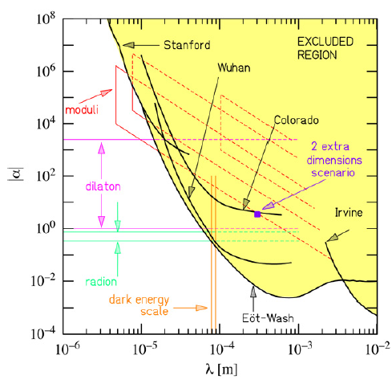
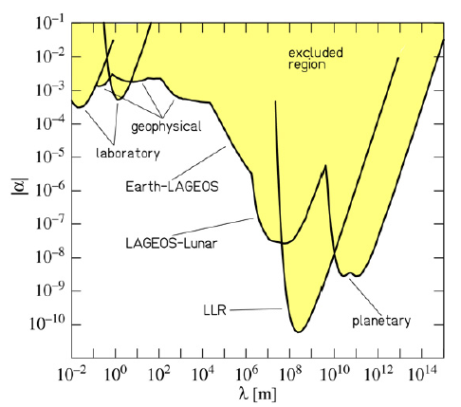
Yukawa Fifth Forces
A long-range Yukawa fifth force is excluded to a high degree of precision in the solar system
Adelberger et al. 2009. Lee et al. 2020.

Slide 49
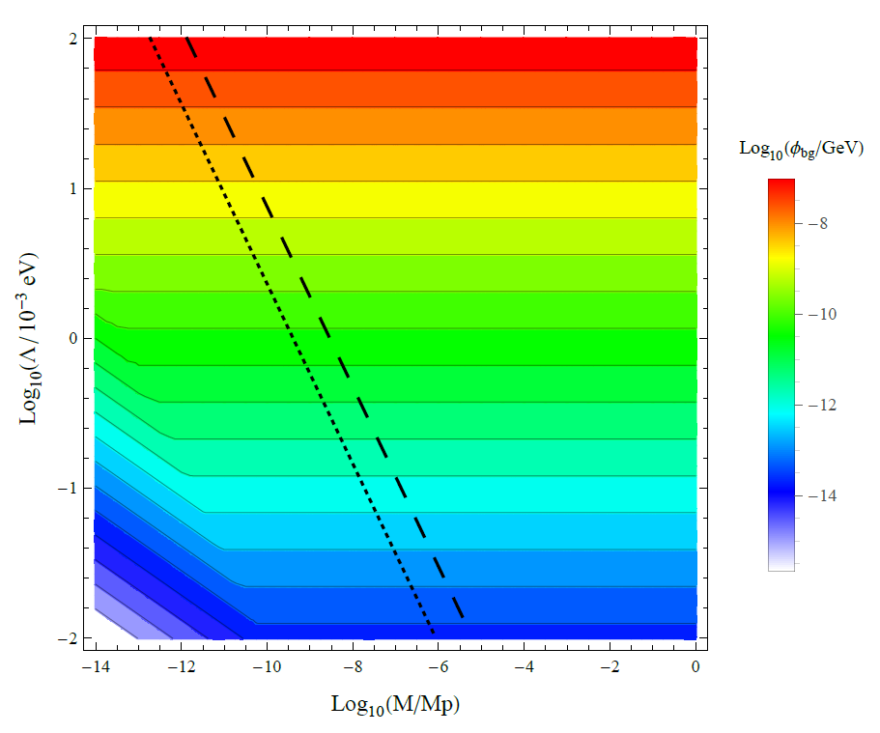
Why Atom Interferometry?
In a spherical vacuum chamber, radius 10 cm, pressure 10⁻¹⁰ Torr
Atoms are unscreened above black lines
(dashed = caesium, dotted = lithium)
CB, Copeland, Hinds. (2015)

Slide 50
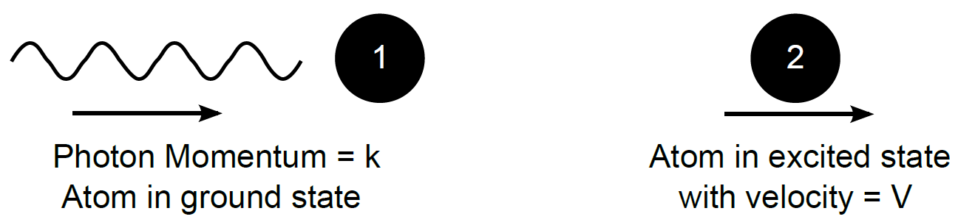
Atom Interferometry
An interferometer where the wave is made of atoms
Atoms can be moved around by absorption of laser photons

Slide 51
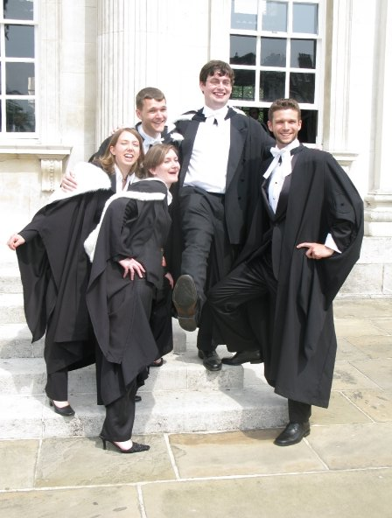
Now and Then
As an undergraduate ~ 25-30% female
mathematics undergraduates (fewer in
physics)
Very few female role models at PhD
and postdoc level
Often the only female voice to speak up
in meetings, or the only woman in the
room

