Slide 2
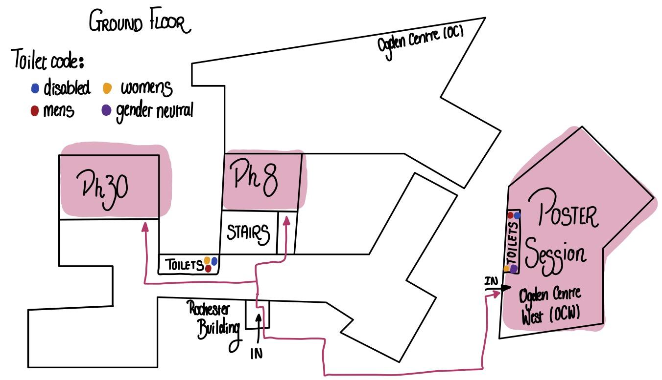

Slide 3
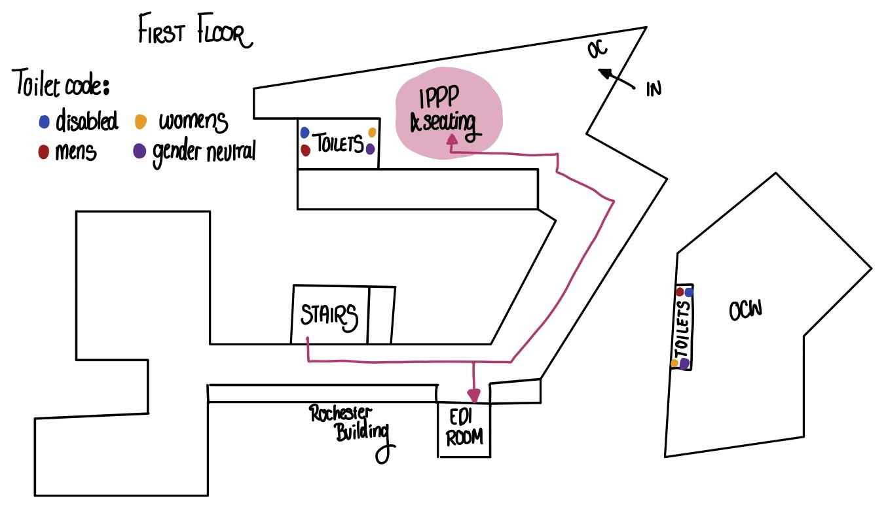

Slide 4
A reminder for anyone who hasn't uploaded their slides to add them to their contribution materials on the indico
A reminder for anyone who hasn’t uploaded their slides to the indico to do so in advance of their session.
If you are speaking in a session, introduce yourself to the session chair before the start of the session.
The doors to the physics department buildings are locked at 7pm. If anyone requires access after 7pm please ask on the WhatsApp group and someone will let you in.

Slide 5
PH8 Zoom Links:
Meeting ID: 1234567890
Password: password
PH30 Zoom Links:
Meeting ID: 1234567890
Password: password
Ken

Slide 6
Ken
Barbie outfits
Any actions that lead to an unsafe or uncomfortable environment will not be tolerated.
All participants are expected to behave professionally: be considerate, inclusive, respectful and collaborative.
Harassment and sexist, racist or exclusionary comments or jokes are not appropriate.
Harassment includes sustained disruption of talks or other events, sexual attention or innuendo, deliberate intimidation, stalking, and photography or recording of an individual without consent.
It also includes offensive or belittling comments related to age, gender, sexual orientation, ethnicity, nationality, disability, physical appearance or religion.
All communication should be appropriate for a professional audience including people of many different backgrounds. Sexual language and imagery is not appropriate.
Please try to be active bystanders! If you observe someone making anyone else feel unsafe, unwelcome or uncomfortable, please tell them so, and remind them of the Code of Conduct or report them to the YTF committee.
Outfit #1
Outfit #2
Outfit #3

Slide 7
EDI:
Mia West
mia.r.b.west@durham.ac.uk
Anyone in a Gorgeous YTF T-Shirt
General:
Tom Stone
thomas.w.stone@durham.ac.uk

Slide 9
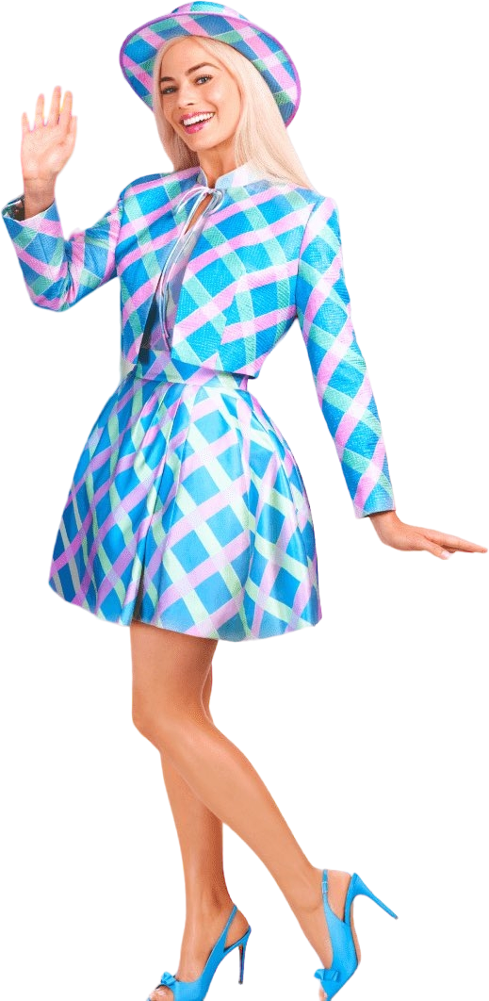
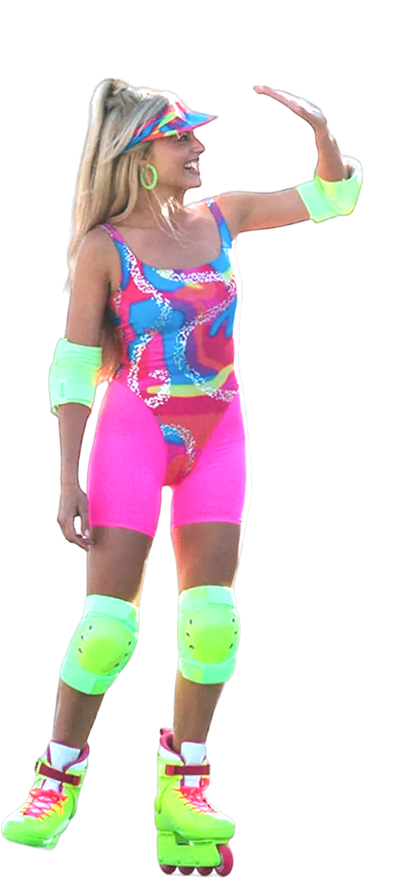
Barbie Bo
Outfit #1

