Slide 1
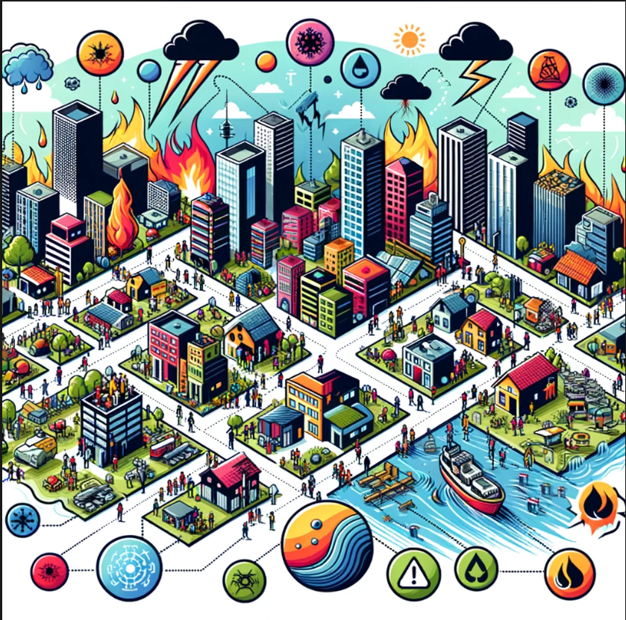
Virtual Reality (VR) in Hazard, Risk and Resilience Research and Practice 13 December 2023
www.durham.ac.uk/ihrr
(DAFNI–Durham Scoping Workshop)
Prof Bruce D. Malamud
Director & Wilson Chair of Hazard and Risk
Institute of Hazard, Risk and Resilience
Durham University, UK
E-mail: bruce.malamud@durham.ac.uk

Slide 2
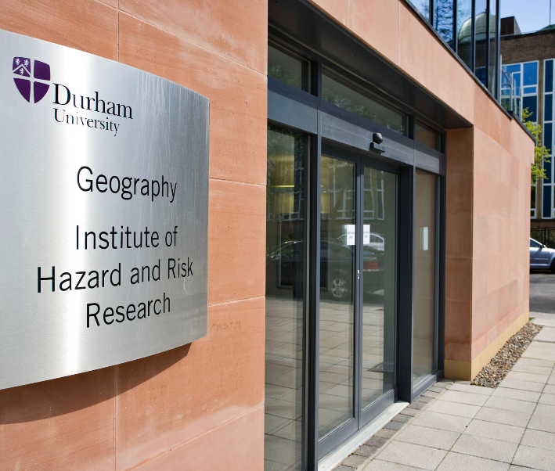
The Institute of Hazard, Risk and Resilience (IHRR) at Durham University (DU)
The IHRR is one of ten DU Research Institutes which cut across the 26 DU departments.
The IHRR (est. 2007) takes an interdisciplinary approach to understanding hazard, risk and resilience and actively translates research into practice.
Research encompasses the physical and social sciences, arts and humanities, while incorporating as wide a range of stakeholders as possible.

Slide 3
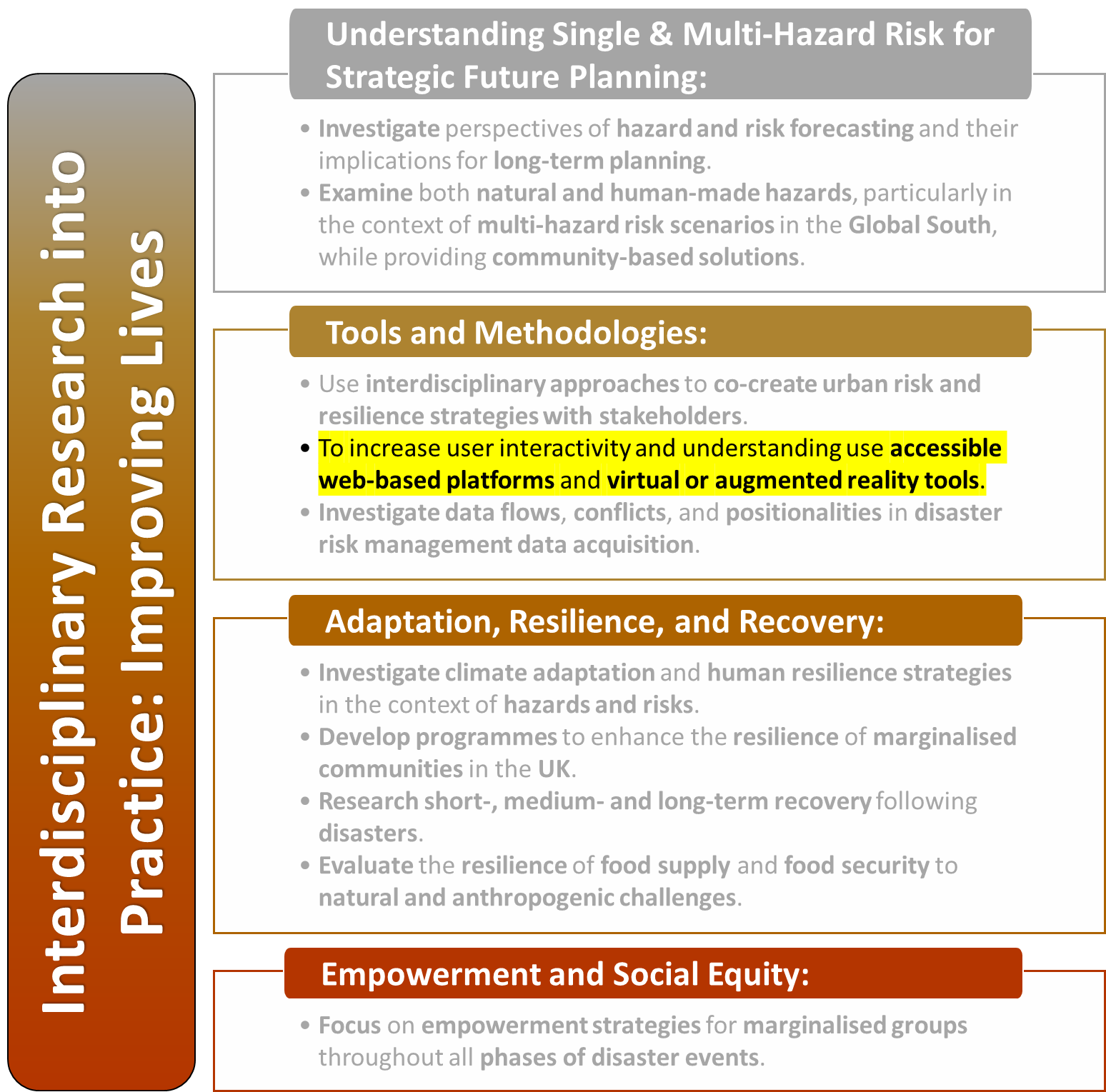
The Institute of Hazard, Risk and Resilience (IHRR) at Durham University (DU)
The IHRR is one of ten DU Research Institutes which cut across the 26 DU departments.
The IHRR (est. 2007) takes an interdisciplinary approach to understanding hazard, risk and resilience and actively translates research into practice.
Research encompasses the physical and social sciences, arts and humanities, while incorporating as wide a range of stakeholders as possible.

Slide 4
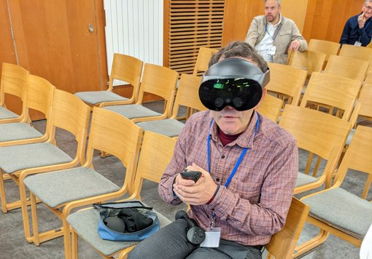
Virtual/Augmented Reality for hazard, risk and resilience
Ability to visualise data & info in 3D related to hazard, risk & resilience.
Modelling (e.g., landslides)
Visualisation of different aspects of risk in given locations:
Hazard types (what one can visually see, as many hazard ‘hidden’)
Exposure: human assets in a hazard-prone area (e.g., buildings, roads, energy lines)
Vulnerability: characteristics of people, communities or infrastructure which increase the susceptibility to the impacts of hazards.
Impacts of the hazards
Ability to create own 360-degree content for others to see
Photos of a place (uploaded to Google Street View)
Videos (uploaded to YouTube VR). Create virtual tours
Models (various hosting platforms, but more complex for user)
Wander app (VR, Nairobi)

Slide 5
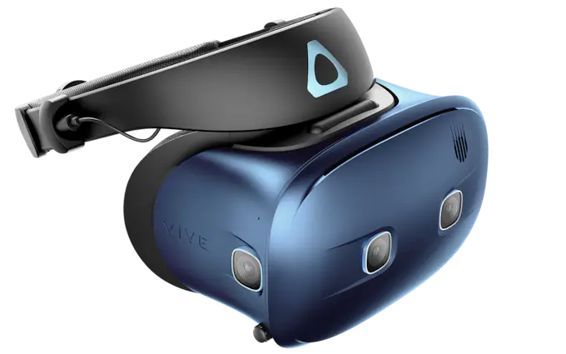
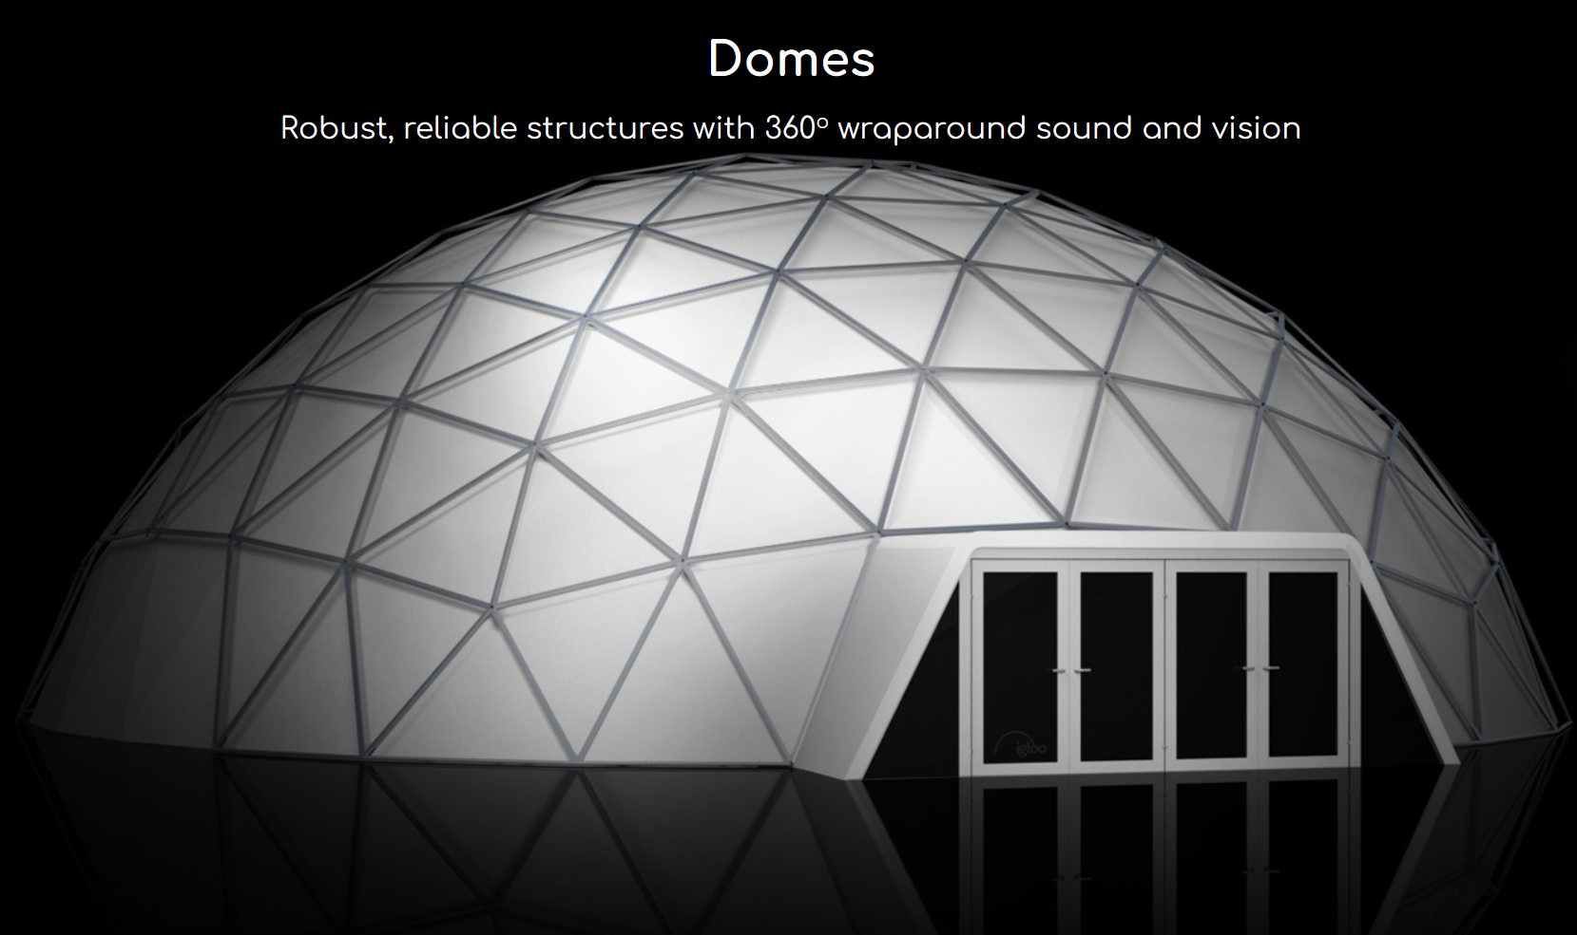
Virtual/Augmented Reality for hazard, risk and resilience
Ability to visualise data & info in 3D related to hazard, risk & resilience.
Modelling (e.g., landslides)
Visualisation of different aspects of risk in given locations:
Hazard types (what one can visually see, as many hazard ‘hidden’)
Exposure: human assets in a hazard-prone area (e.g., buildings, roads, energy lines)
Vulnerability: characteristics of people, communities or infrastructure which increase the susceptibility to the impacts of hazards.
Impacts of the hazards
Ability to create own 360-degree content for others to see
Photos of a place (uploaded to Google StreetView)
Videos (uploaded to YouTube VR). Create virtual tours
Models (various hosting platforms, but more complex for user)
Shared spaces and connections. Two or more people from different or same locations viewing and discussing assets together via headsets or ‘domes’. Shared visualisation between any combination of public, scientists, students, policy makers, of given hazard, disaster, model.
Creation of Apps.
Many of the above data intensive to create and/or host assets.

Slide 6
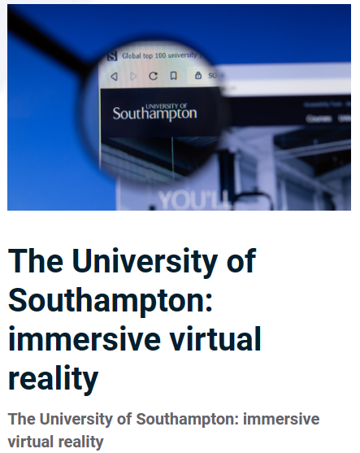
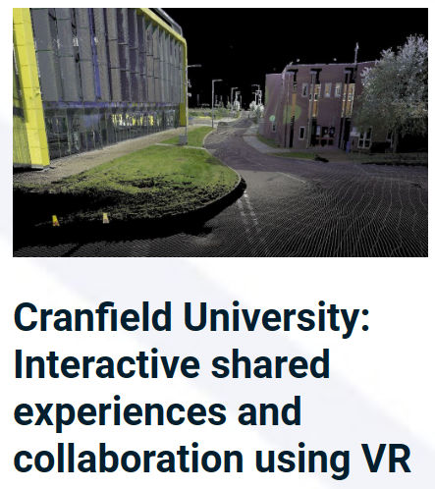
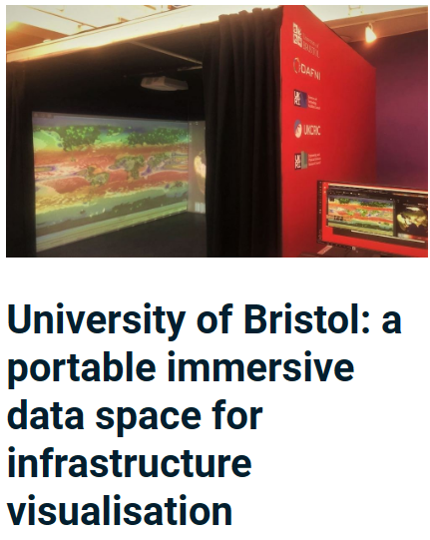
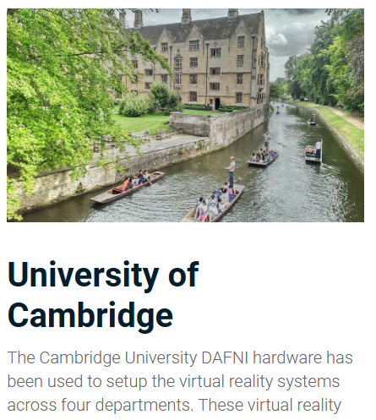
Virtual/Augmented Reality for hazard, risk and resilience
Ability to visualise data & info in 3D related to hazard, risk & resilience.
Modelling (e.g., landslides)
Visualisation of different aspects of risk in given locations:
Hazard types (what one can visually see, as many hazard ‘hidden’)
Exposure: human assets in a hazard-prone area (e.g., buildings, roads, energy lines)
Vulnerability: characteristics of people, communities or infrastructure which increase the susceptibility to the impacts of hazards.
Impacts of the hazards
Ability to create own 360-degree content for others to see
Photos of a place (uploaded to Google StreetView)
Videos (uploaded to YouTube VR). Create virtual tours
Models (various hosting platforms, but more complex for user)
Shared spaces and connections. Two or more people from different or same locations viewing and discussing assets together via headsets or ‘domes’. Shared visualisation between any combination of public, scientists, students, policy makers, of given hazard, disaster, model.
Creation of Apps.
Many of the above data intensive to create and/or host assets.
DAFNI funded hardware investment

