Slide 1
SCIMAP, flood modelling and the computational requirements
Sim M Reaney, Aaron J Neill and Ivo Pink
Department of Geography &
Institute of Hazard Risk and Resilience

Slide 2
Building Landscape Resilience for Water Quality and Flood Hazards
Notes:
Joint problems of flooding and degraded water quality.
Both problems affect large numbers of people and have significant economic impacts

Slide 3
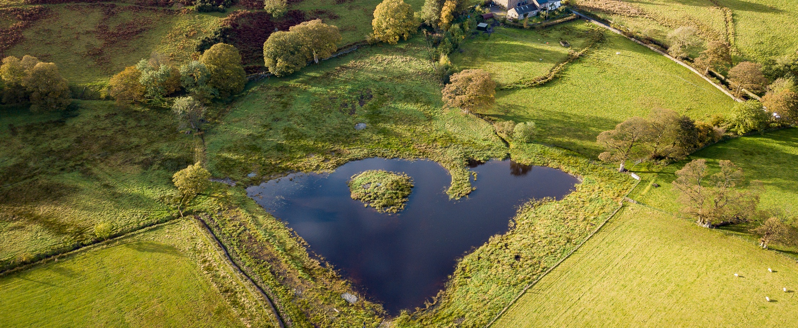
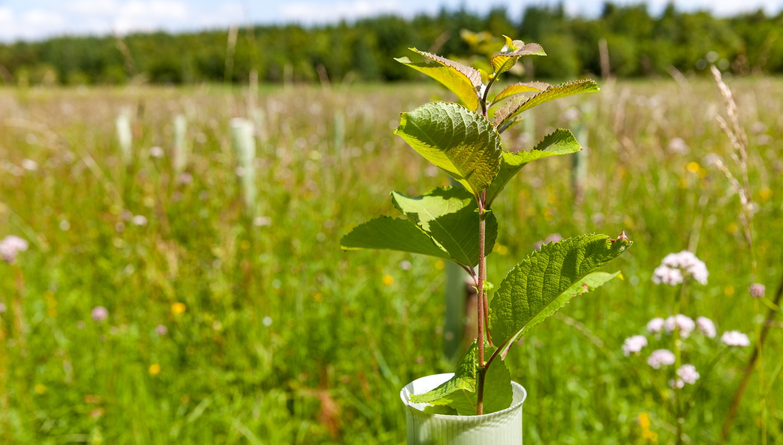
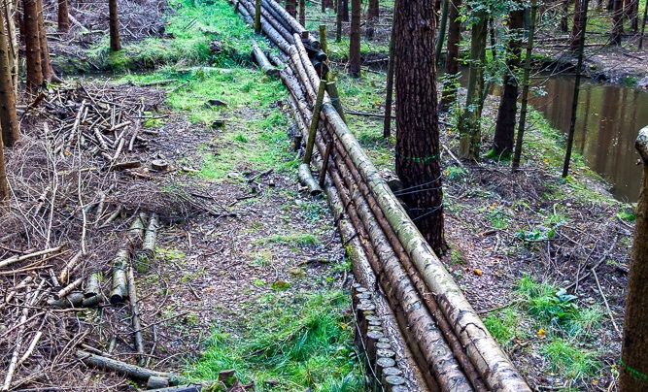
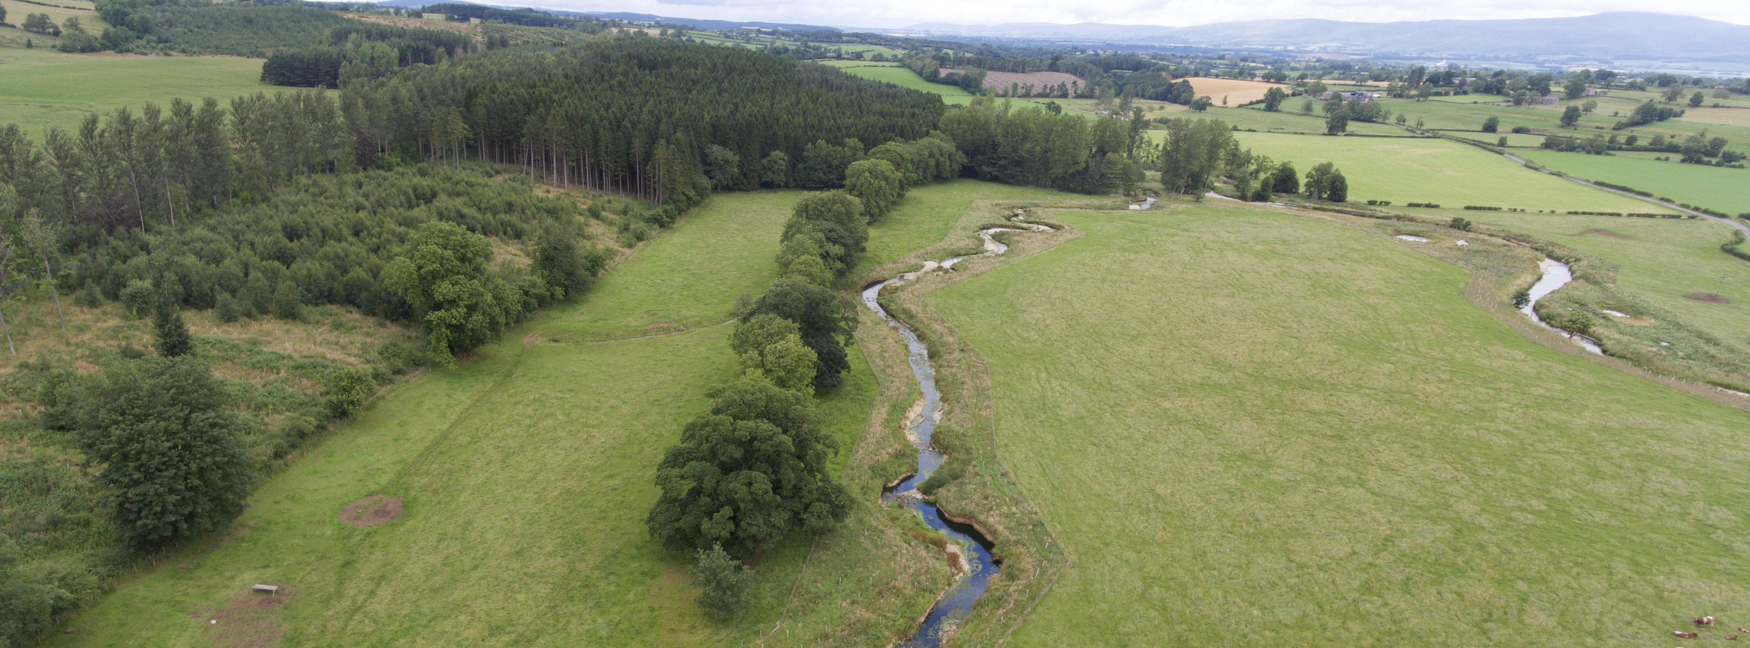
Key Nature Based Solution Questions Which solution do we choose? Where do we place them? How effective are they? Will they still be effective under future rainfall scenarios?
Notes:
Both problems can be addressed with nature based solutions in the catchment.
Briefly introduce the solutions of the slide
These NbS increase the resilience of the system to these hazards
However, there are open questions, regarding the choice of solutions, where we place them in the landscape and how effective they are under a range of conditions
Ho

Slide 4
Two Steps in the Approach: Extent and Then Detail
Step 1: SCIMAP
A rapid assessment tool
Identifies the top, most probable, sources of pollutants or flood waters to a river network.
Uses detailed geospatial information on the sources of pollutants and their pathways to the river channels.
Sediment, nutrients, FIOs and floods → identification of sites with multiple benefits
Widely Used
Step 2: Process Based Modelling
Detailed, process-based simulations
Real-world units of flow and water quality (N, P and sediment)
Able to simulate the response to land use, climate and management changes
Scenario developed by SCIMAP and tested with detailed models.
Within a predictive uncertainty framework
In-house models (CRUM3) and public models (HYPE, SPHY, Flood Modeller Pro)

Slide 5
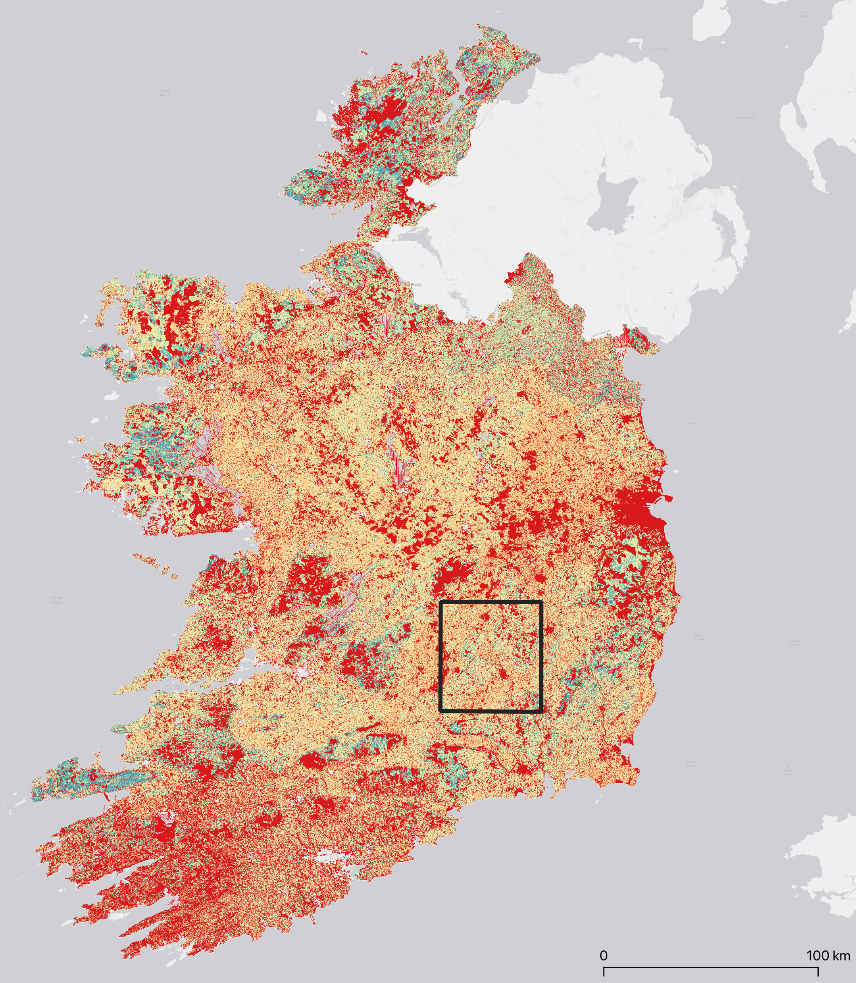
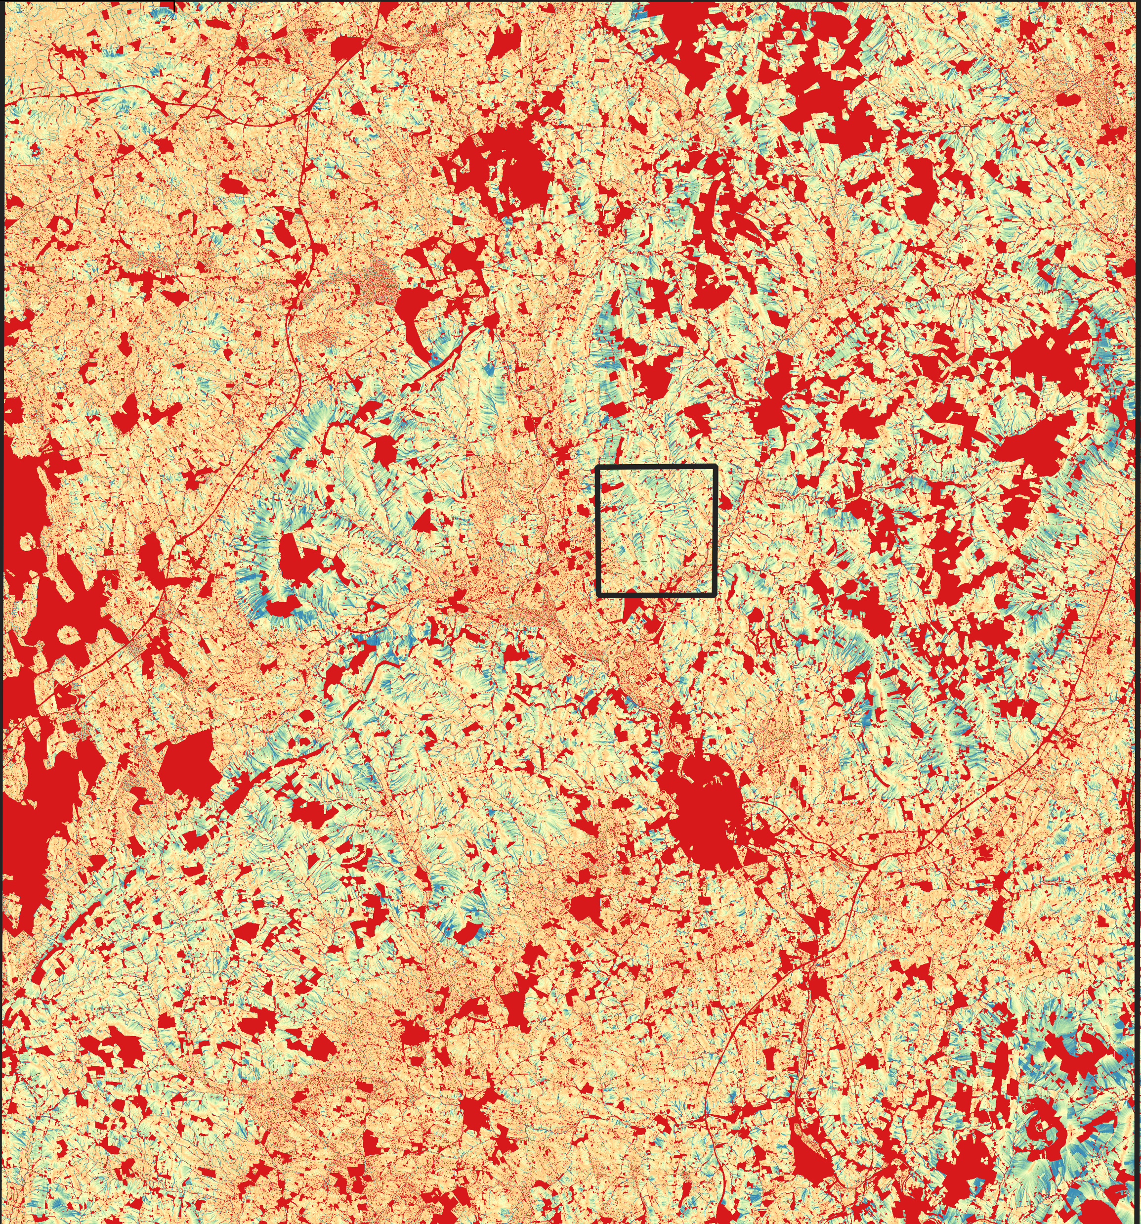
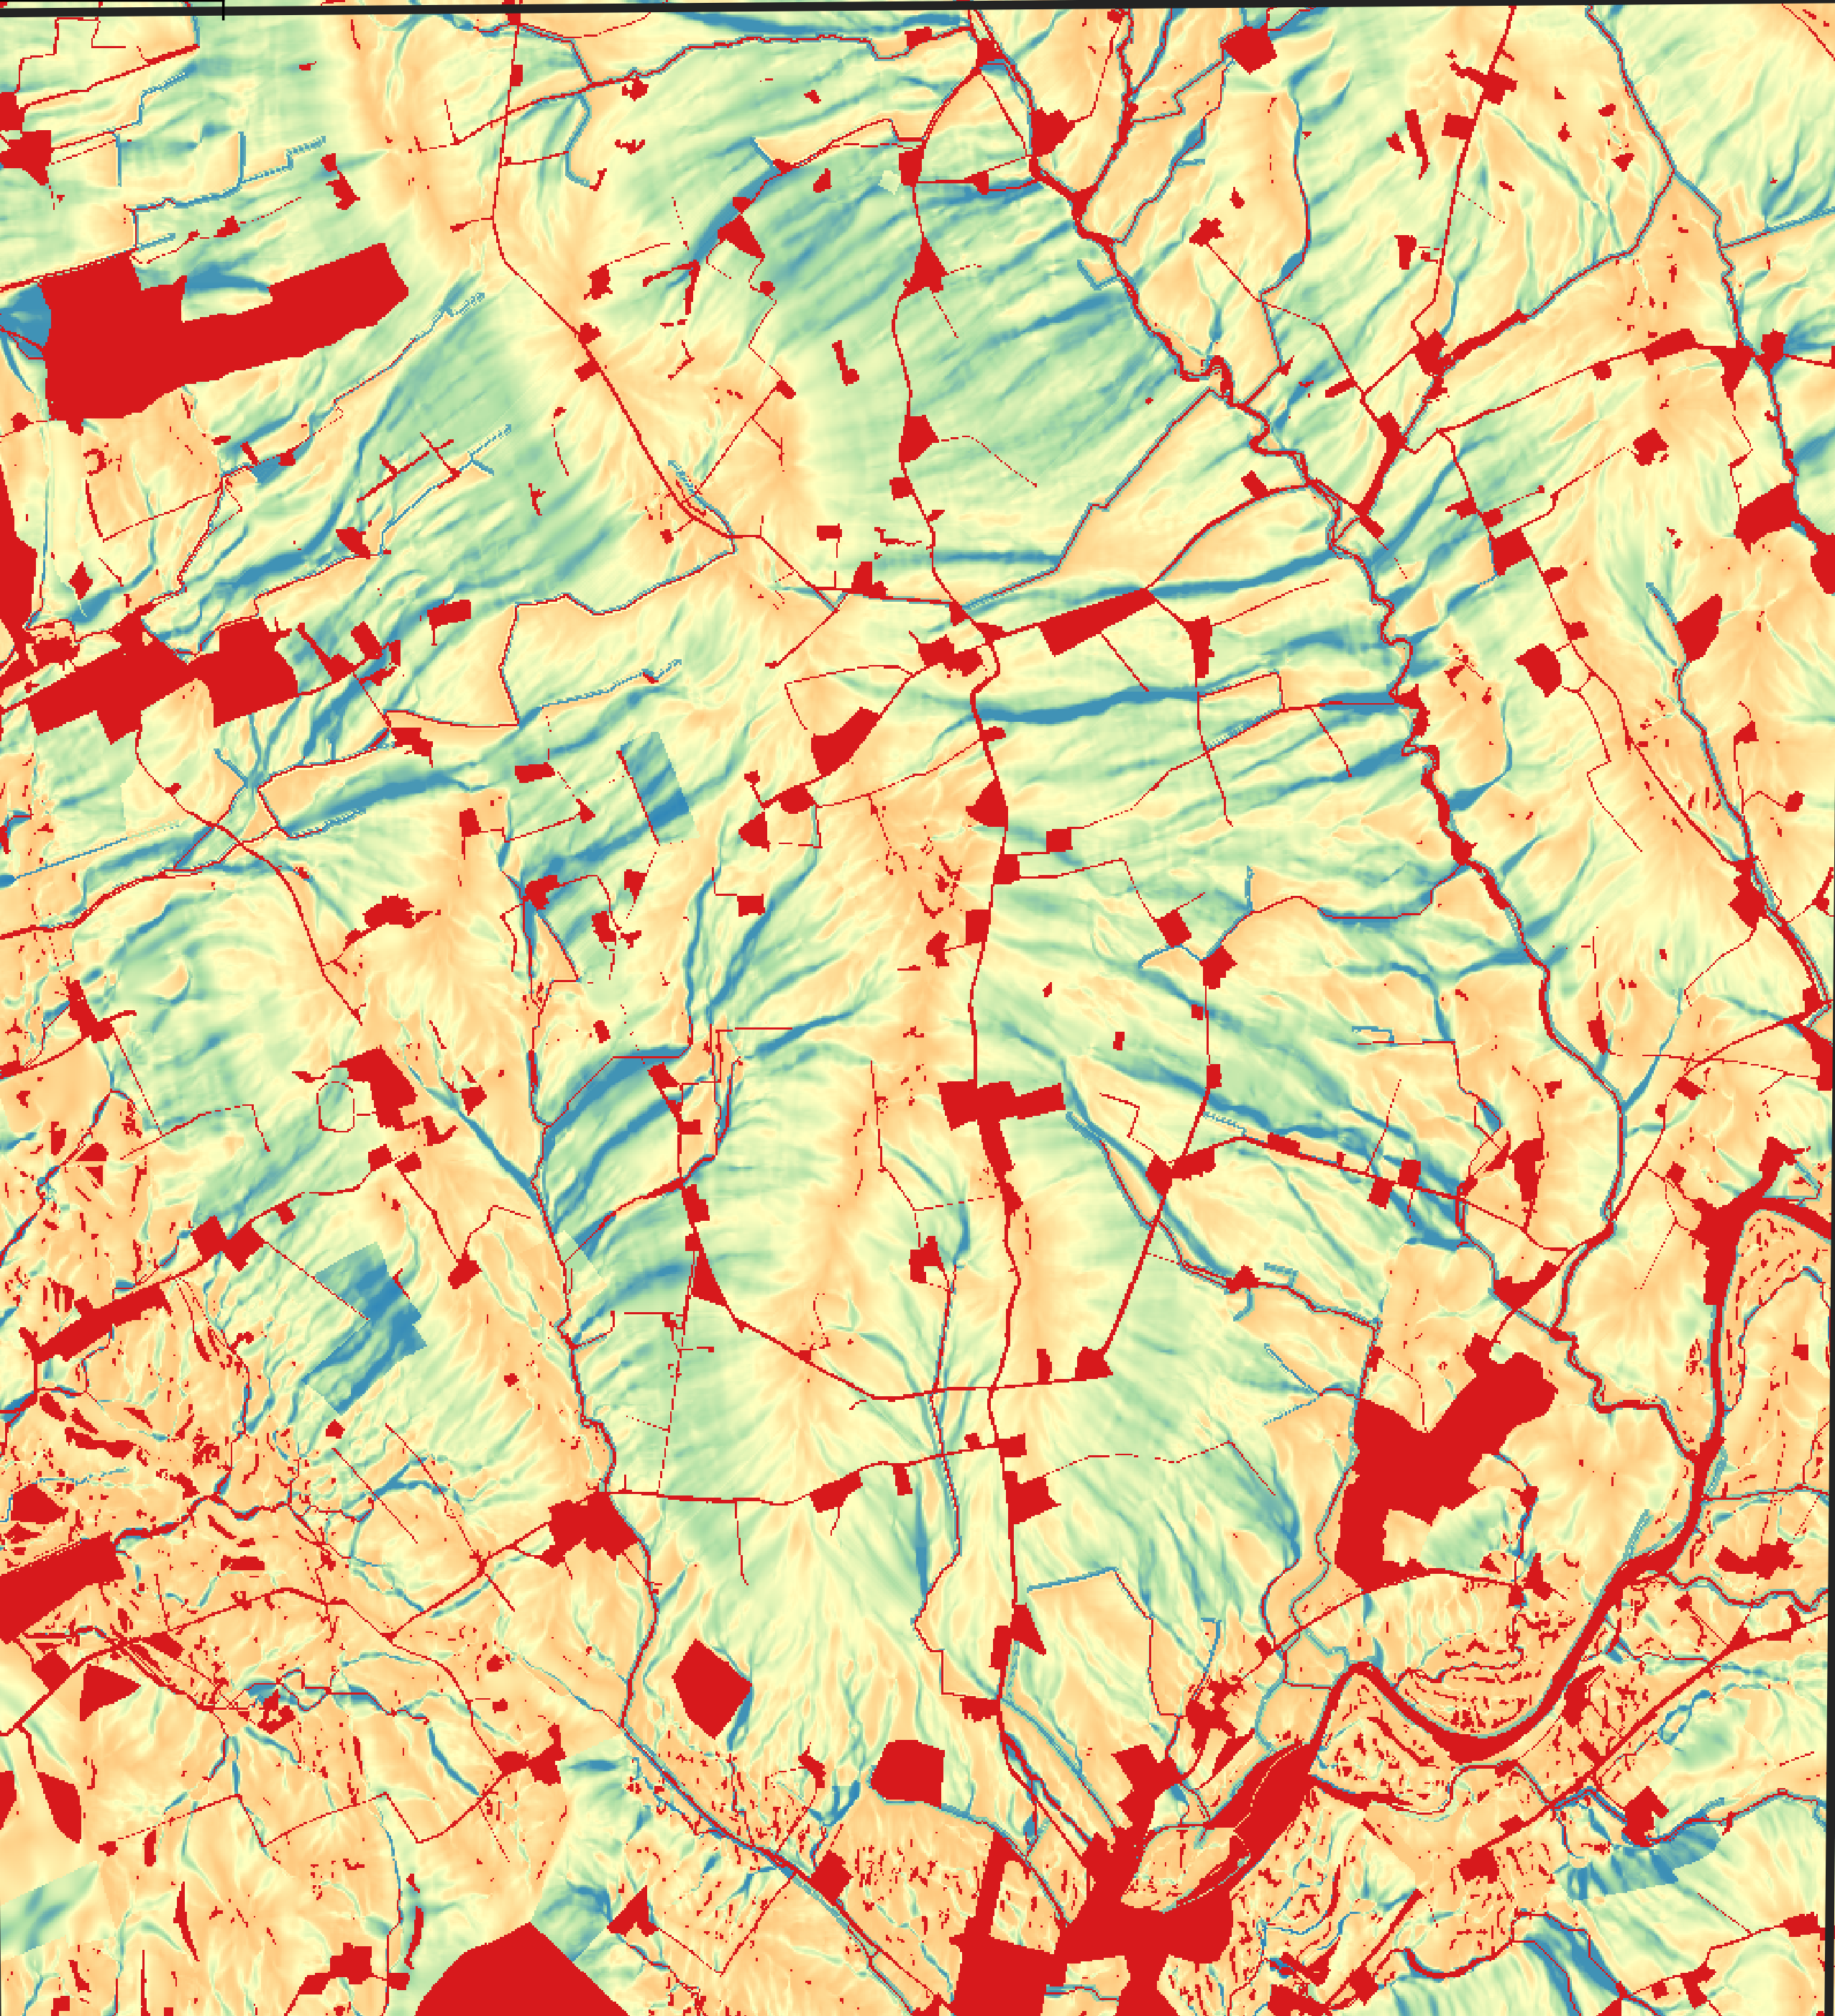
SCIMAP: Fine sediment erosion risk in Ireland
47 km
4.9 km

Slide 6
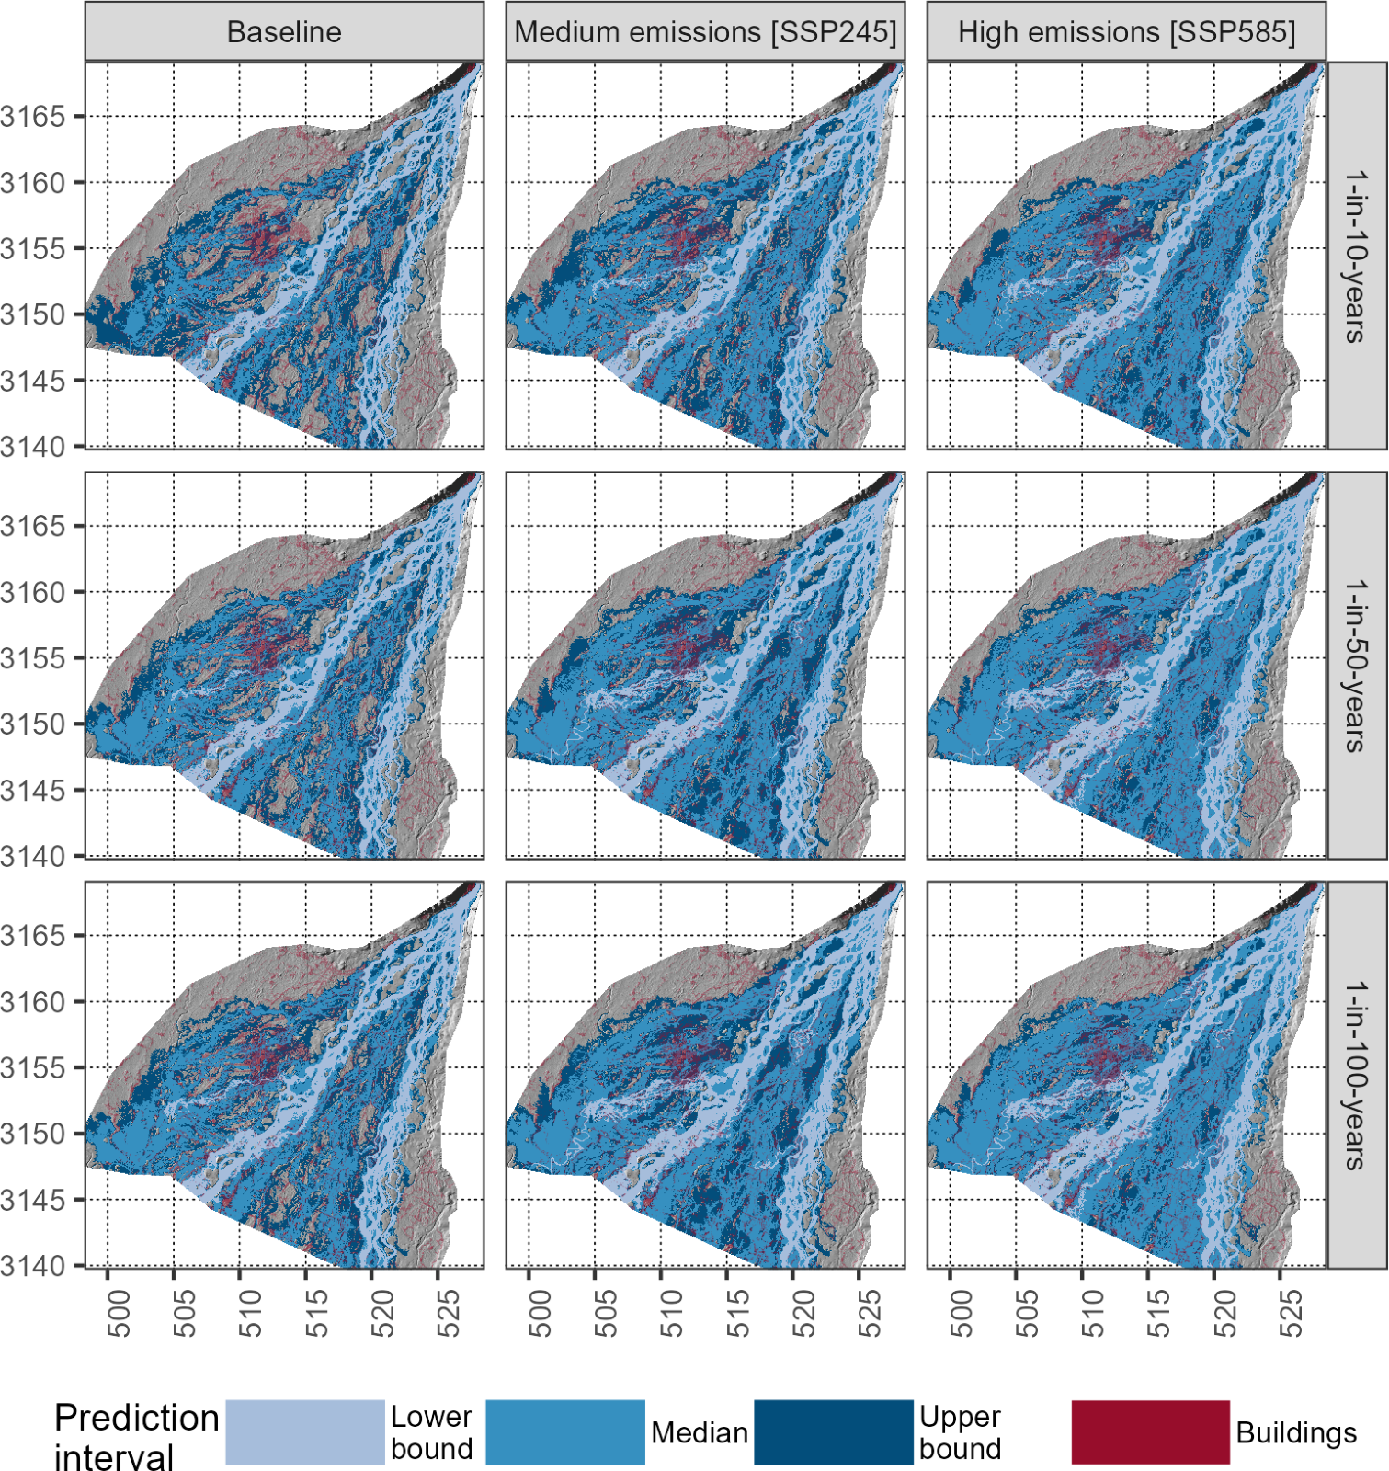
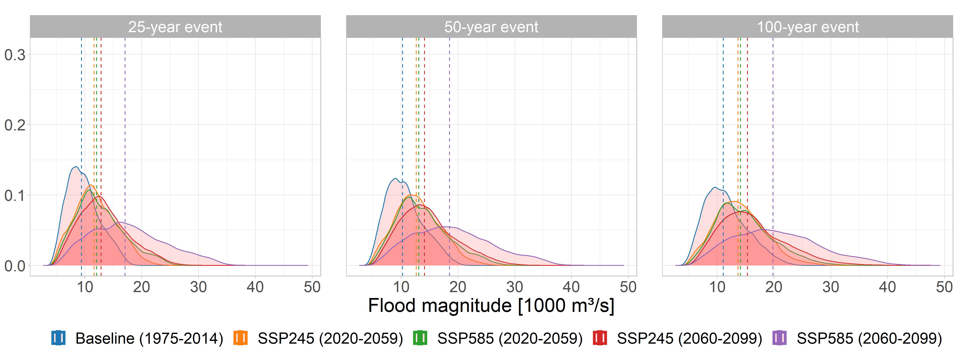
Process-based modelling: Flood risk in Nepal
Catchment rainfall-runoff modelling
Flood inundation modelling
Flood estimation
Karnali catchment (ca. 40,000 km²)
Ivo Pink
Notes:
This is an example of an intregrated atchment modelling and flood inundation analysis under projected cliate change.
Applied to the karnali catchment (ca. 40,000 km2) (twice the size of Wales) in Western Nepal
SPHY hydrological model
12 GCMs under multiple scenarios
Flood inundation modelling for 600 km2 on the alluvial fan
This example is based on Ivo Pink research.

Slide 7
Challenges and opportunities
Scale and Detail
Very-high resolution topographic datasets
Processing time & RAM requirements
Algorithms and land cover change assessment
Ability to explore the uncertainty in the results.
Effective visualisation and communication tools (XR?)
Scenarios
Exploring possible futures
Climate change under uncertainty requires multiple weather time series (ca. 12 GCMs)
Multiple land use change scenarios under different Shared Socioeconomic Pathways (SSPs)
All within a predictive uncertainty framework to also capture parameter uncertainty
Need for code optimisation and translations to HPC architectures
sim.reaney@durham.ac.uk | simreaney.github.io | www.scimap.org.uk

