Slide 1
AGS geotechnical data and AI tools for automating 3D ground model development
Professor David Toll
Sustainable Infrastructure, Department of Engineering
Co-Director, Institute of Hazard, Risk and Resilience

Slide 2
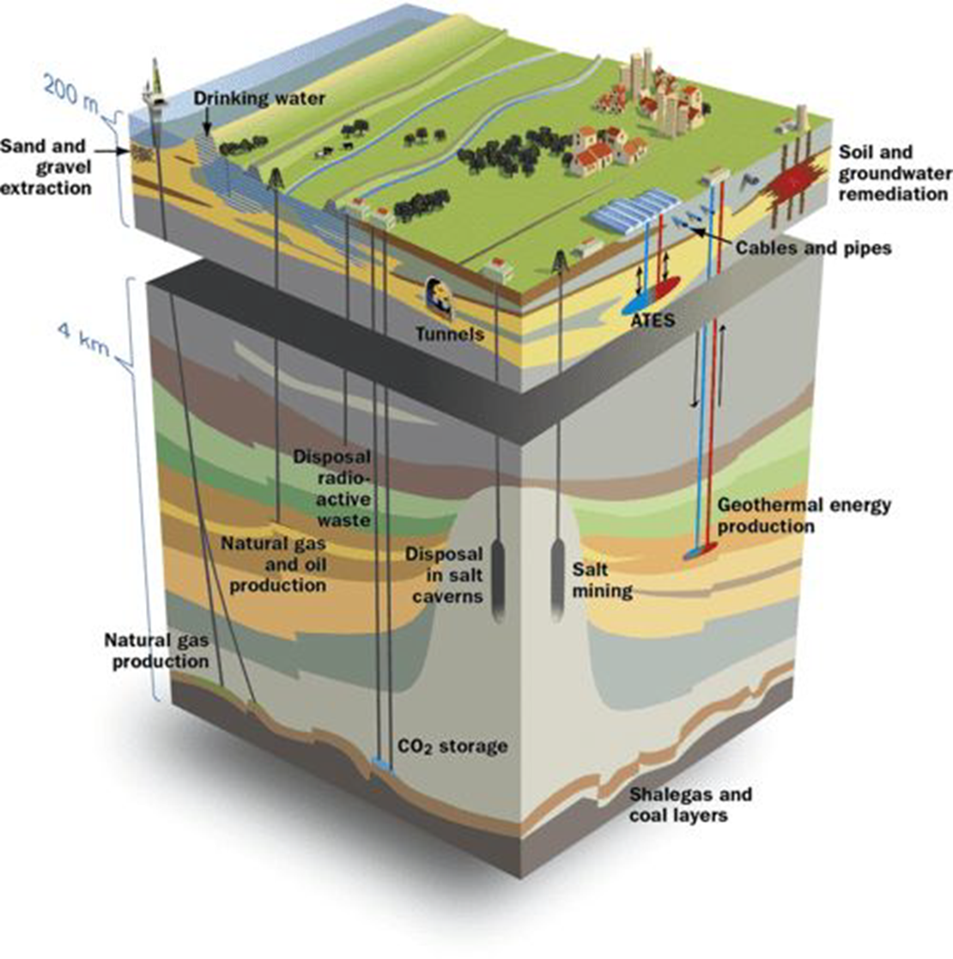
The sub-surface: key for infrastructure
The subsurface provides society with a wide range of essential services, including space for infrastructure, transportation, and resources such as minerals, water and energy.
All infrastructure is built on, or in, the ground
Geotechnical data is essential for design, construction and operation of infrastructure
BIM models focus on the superstructure and may include the structural foundation systems but rarely incorporate the sub-surface geotechnical data
There is an industry standard for geotechnical data – why aren’t we making better use of it?
Source: A technical investigation on tools and concepts for sustainable management of the subsurface in The Netherlands
Thanks to Holger Kessler, GO-Science

Slide 3
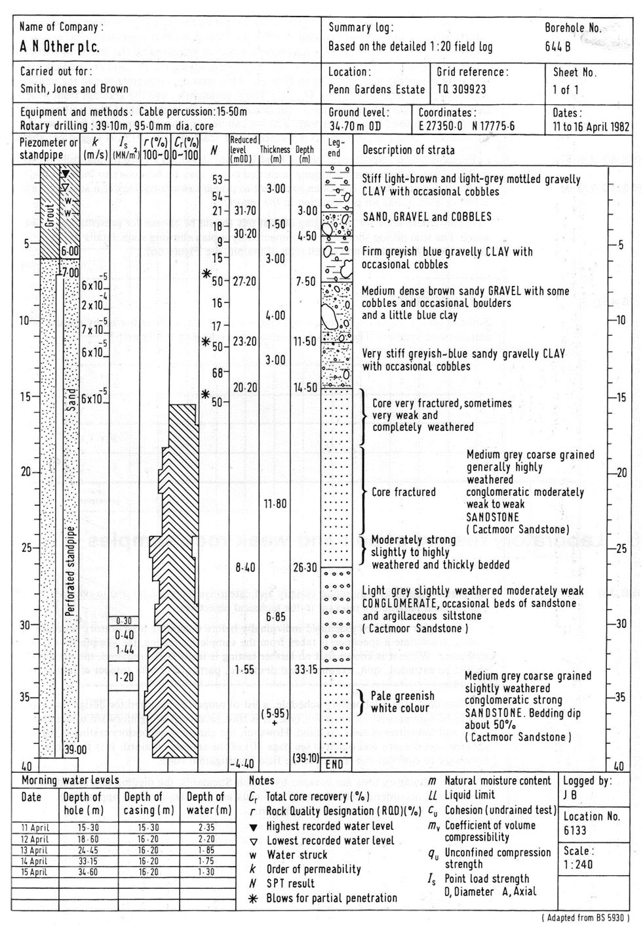
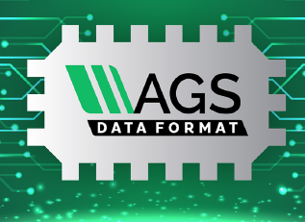
The AGS Data Format
A data format developed by industry for industry (from 1992)
Covers geotechnical and geoenvironmental data
Borehole information, lab tests, field tests, monitoring etc
The original data format only included factual information
New AGSi format includes interpreted ground models
All data from publicly funded projects should be lodged with BGS (NERC Geoscience data centre)
A wealth of data that could be used to create regional ground models (at the level of a city or a transportation network for example)
Bland, J., Walthall, S.X. and Toll, D.G. (2014) The Development and Governance of the AGS Format for Geotechnical Data, Proc. 2nd International Conference on Information Technology in Geo-Engineering, Durham. Amsterdam: IOS Press (Millpress), pp. 67-74.

Slide 4
Interpreted sub-surface models
Toll, D.G. (1995) The Rôle of a Knowledge-based System in Interpreting Geotechnical Information, Géotechnique, 45, 3, pp 525-531. https://doi.org/10.1680/geot.1995.45.3.525
Toll, D.G. and Shields, R. (2003) A Web-based Data Format for Ground Investigation Data, Electronic Journal of Geotechnical Engineering. www.ejge.net/2003/Ppr0321/Ppr0321.zip
Toll, D.G. (2007) Geo-Engineering Data: Representation and Standardisation, Electronic Journal of Geotechnical Engineering, JTC2 Special Issue,
http://www.ejge.net/2007/Ppr0699/Ppr0699.htm

