Slide 1
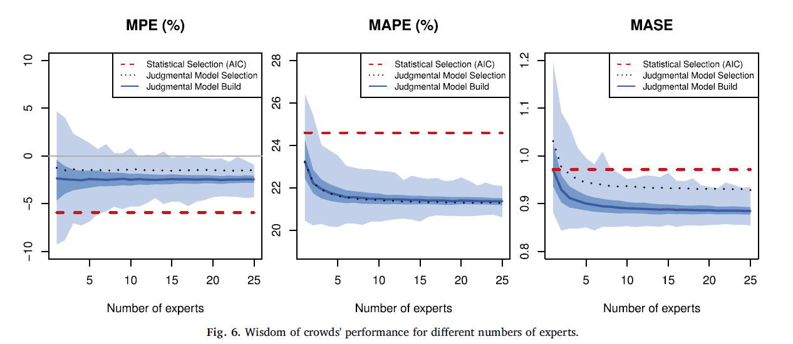
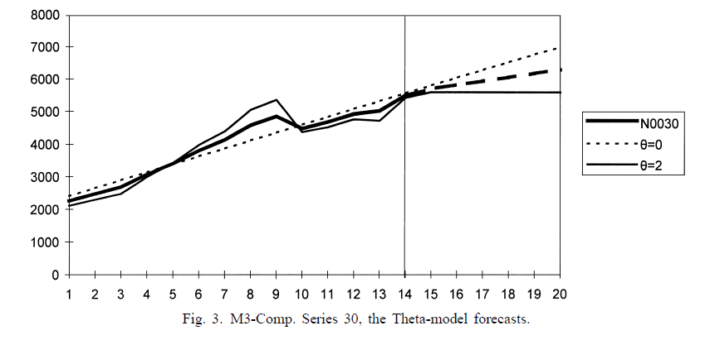
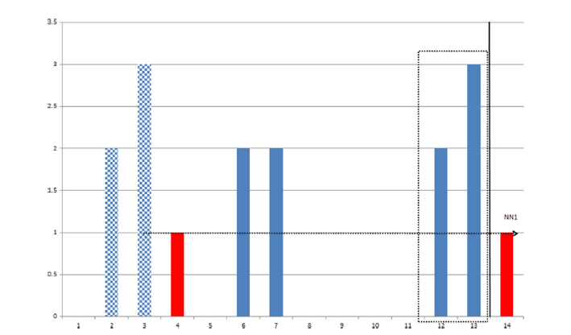





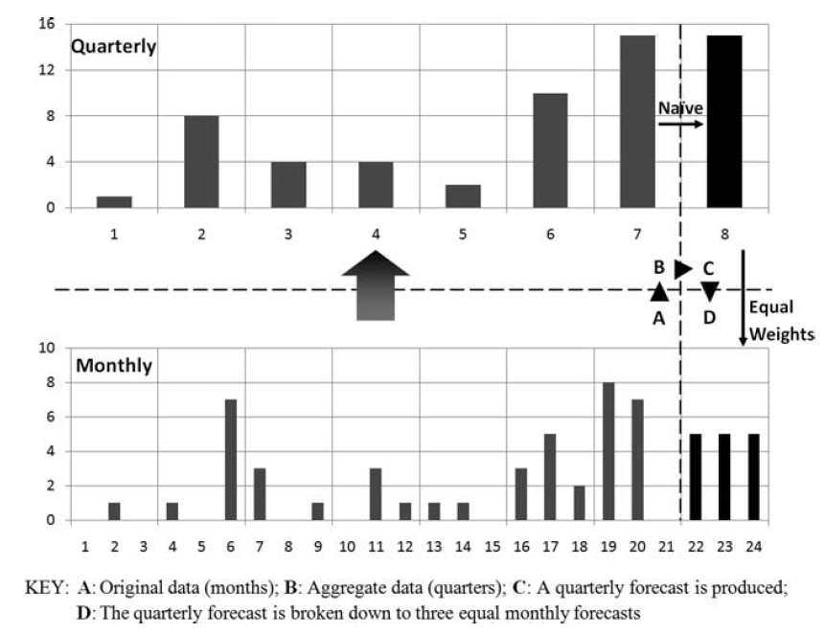






Professor Kostas Nikolopoulos, Dipl.Eng & D.Eng (NTUA ΕΜΠ), ITP(Northwestern)
Chair in Business Information Systems & Analytics
SCR Social Secretary, University College Durham (the Castle)
Durham University
Chair of COPIOR, www.copior.org
DAFNI
@ Durham

Slide 2



Slide 3

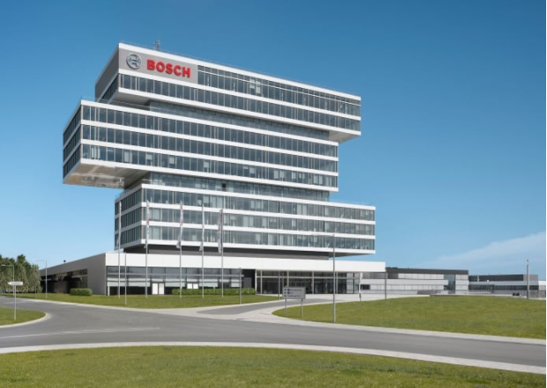




Slide 4
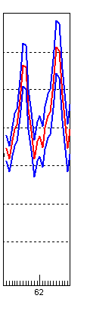
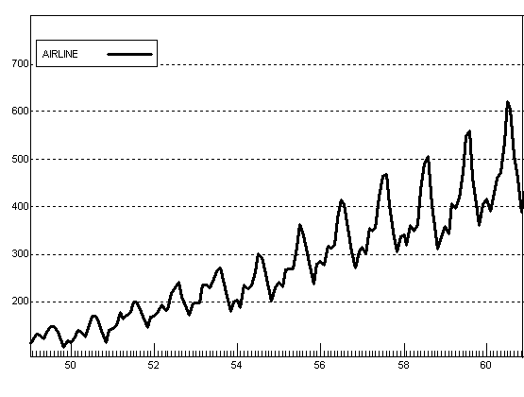
structure of this talk…
BUSINESS FORECASTING
QUANTITATIVE FORECASTING
JUDGMENTAL FORECASTING
Psychology
ForeSIGHT
+
Scenarios
IS/ICT
Stats
Time-Series or Causal

Slide 5
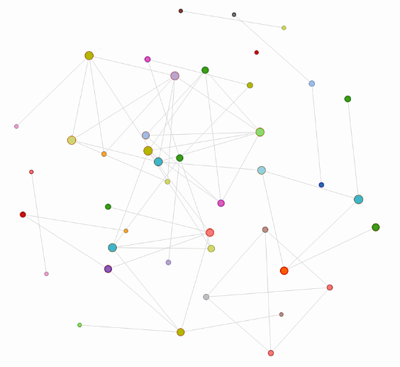
Real time forecasting in the nodes of a network through data from clever sensors and whatnot…

Slide 6
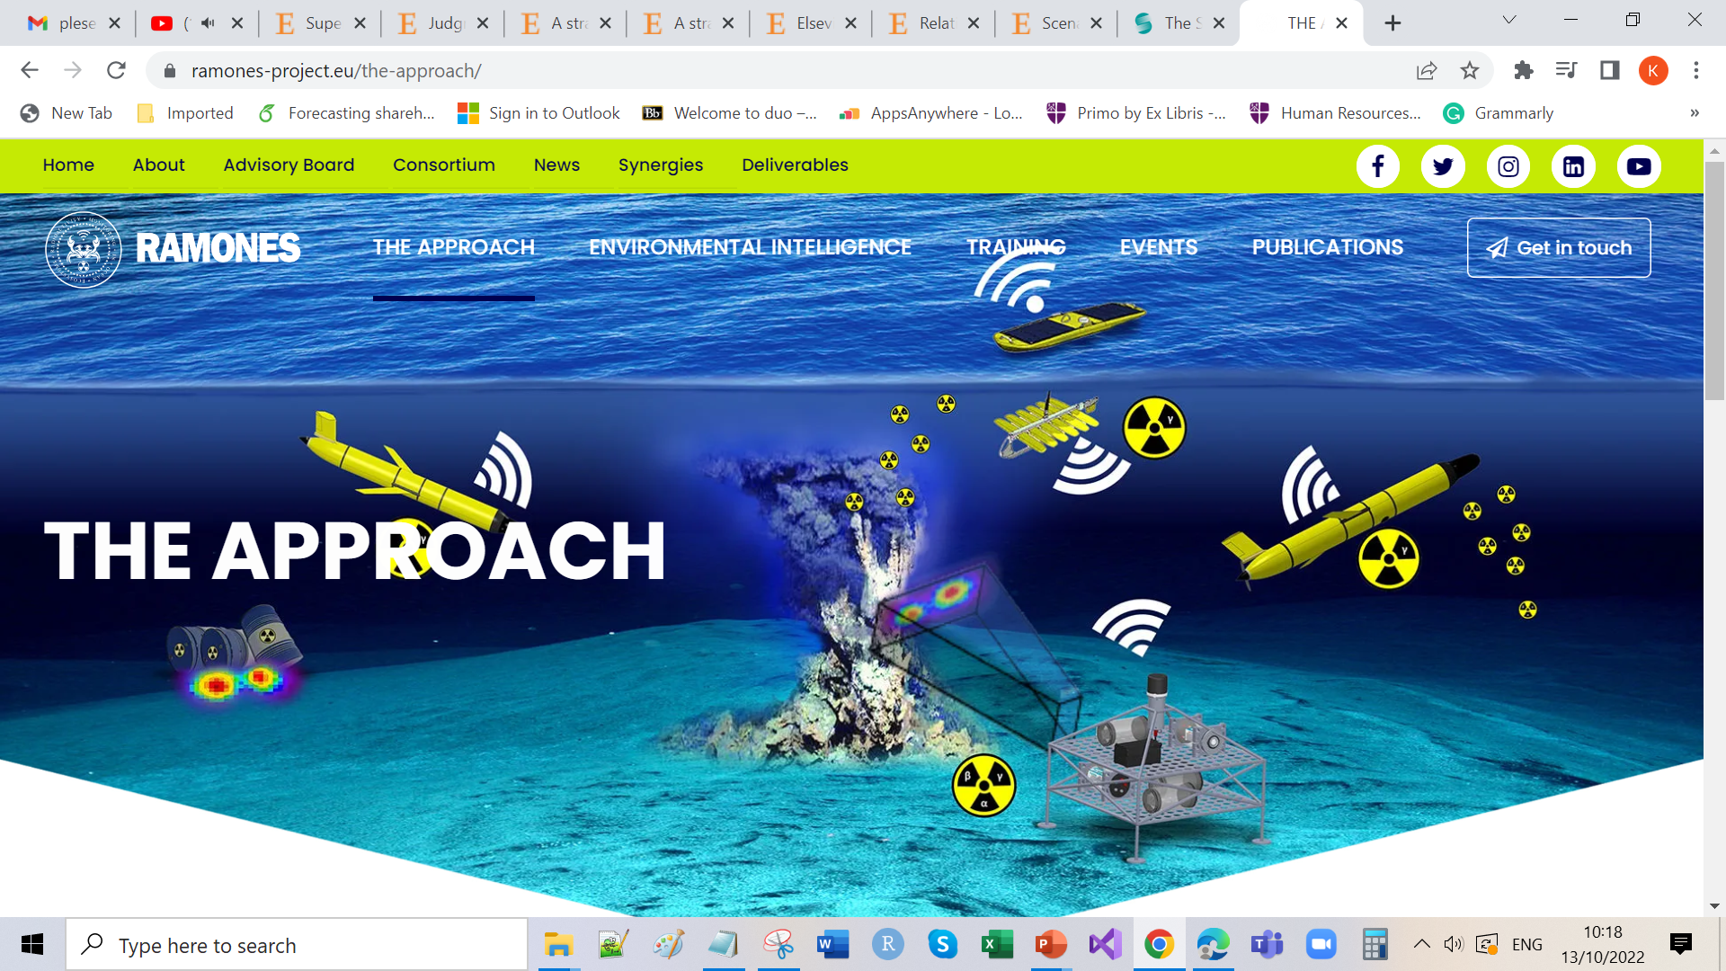

Slide 7

POIS²ON
RAMONES
PrOtotype Information System for SOcioecoNomic stakeholders
A true EI solution and initiative

Slide 8
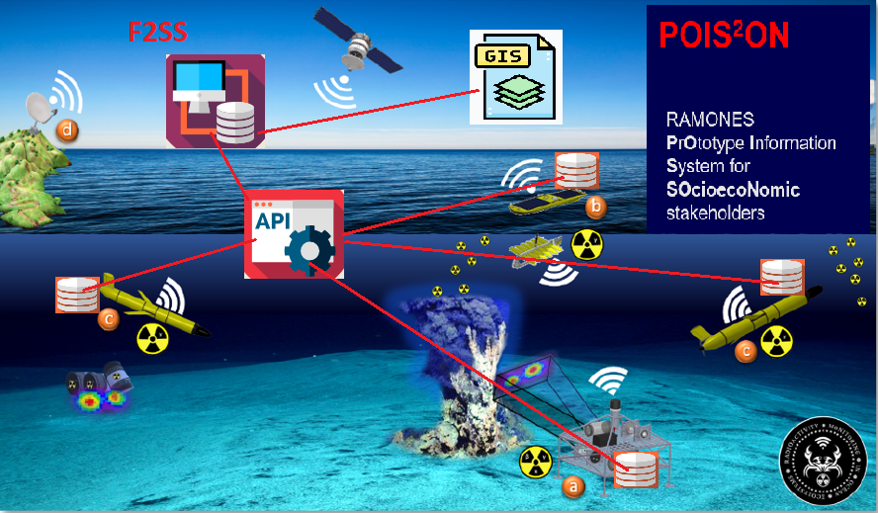

Slide 9
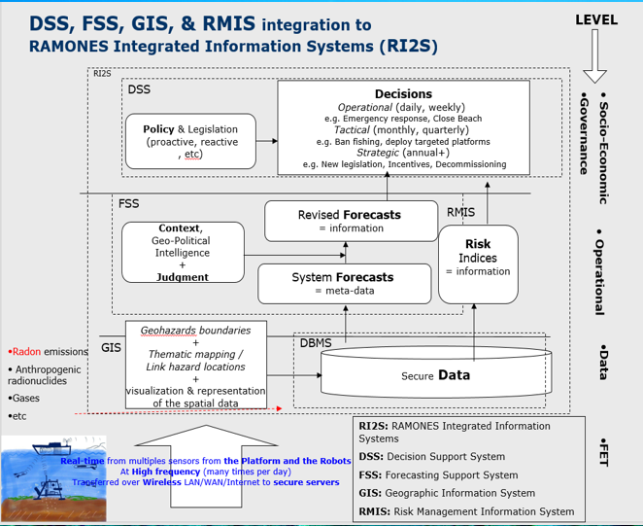

Slide 10
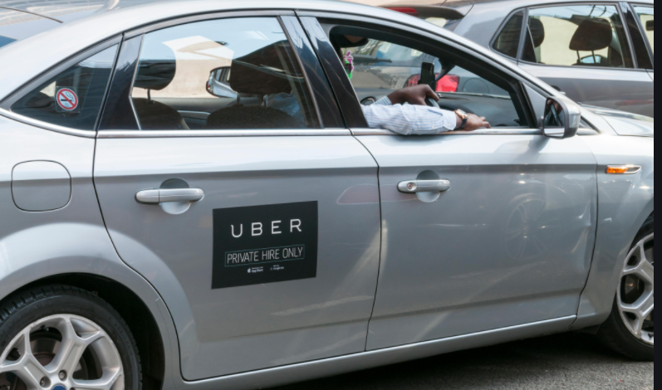
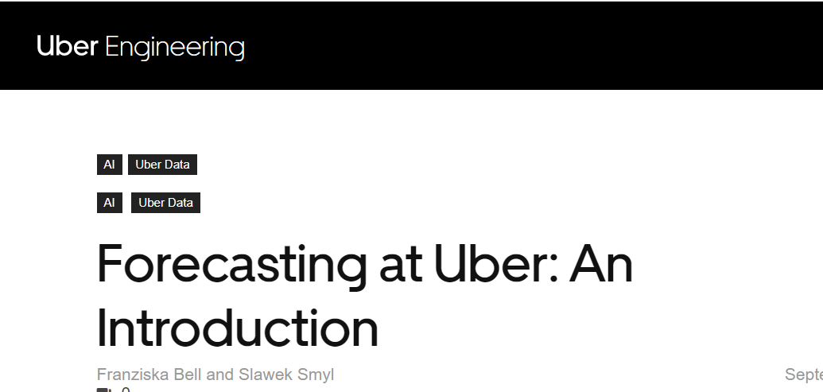
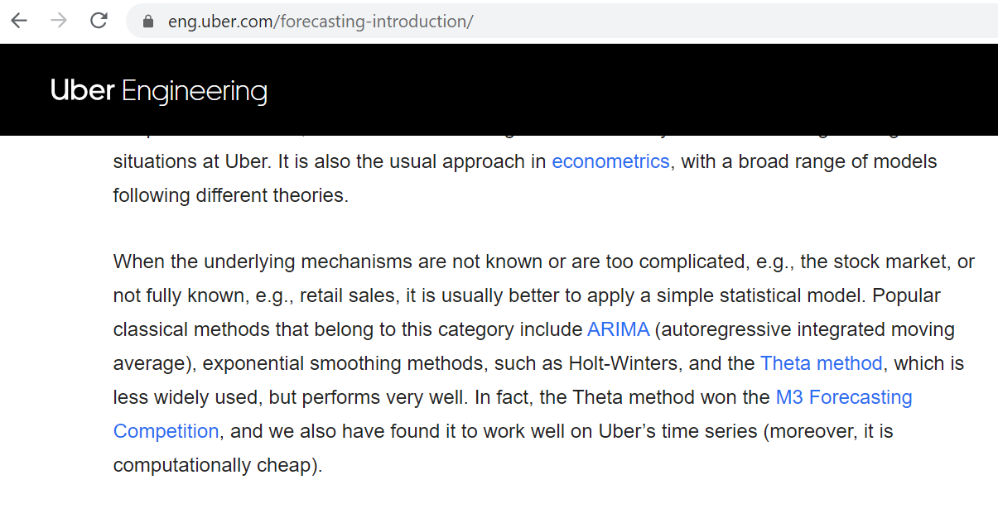
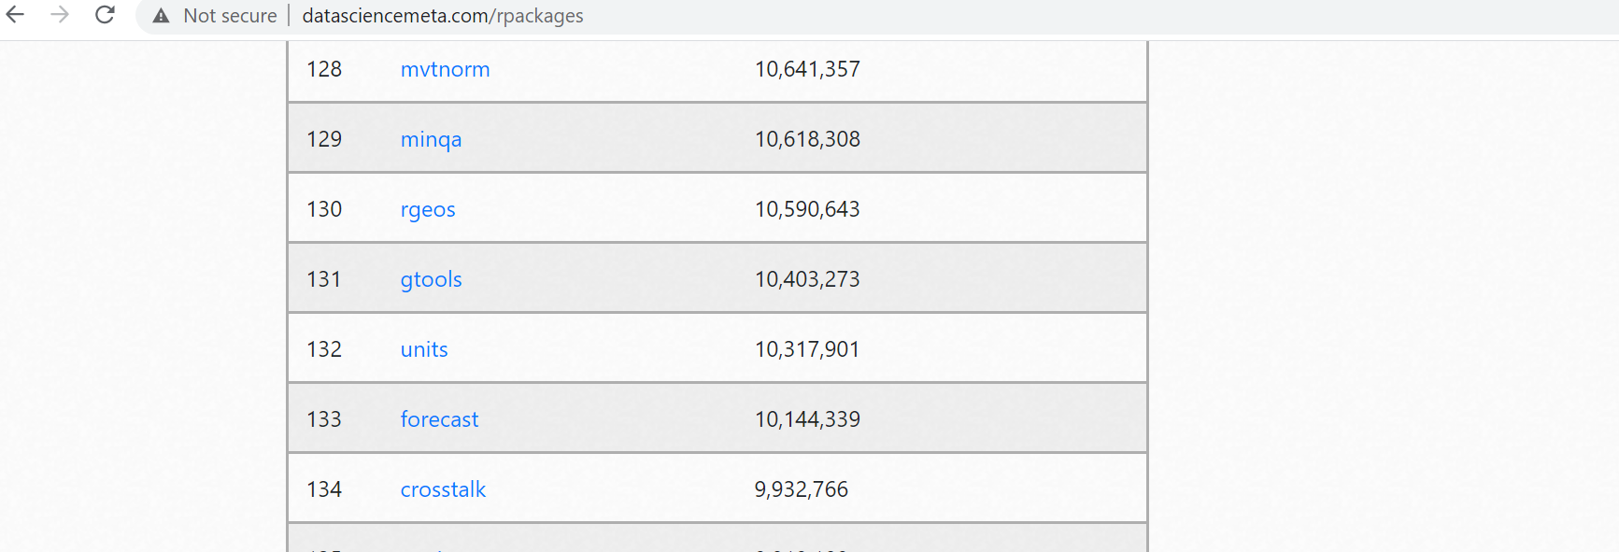
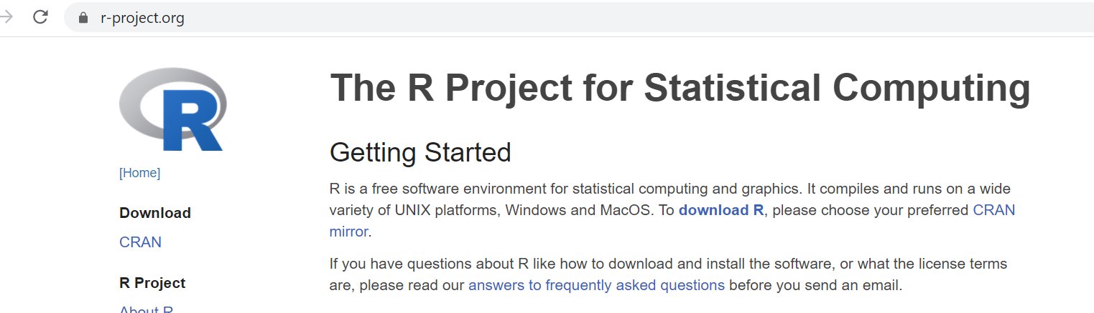






Slide 11
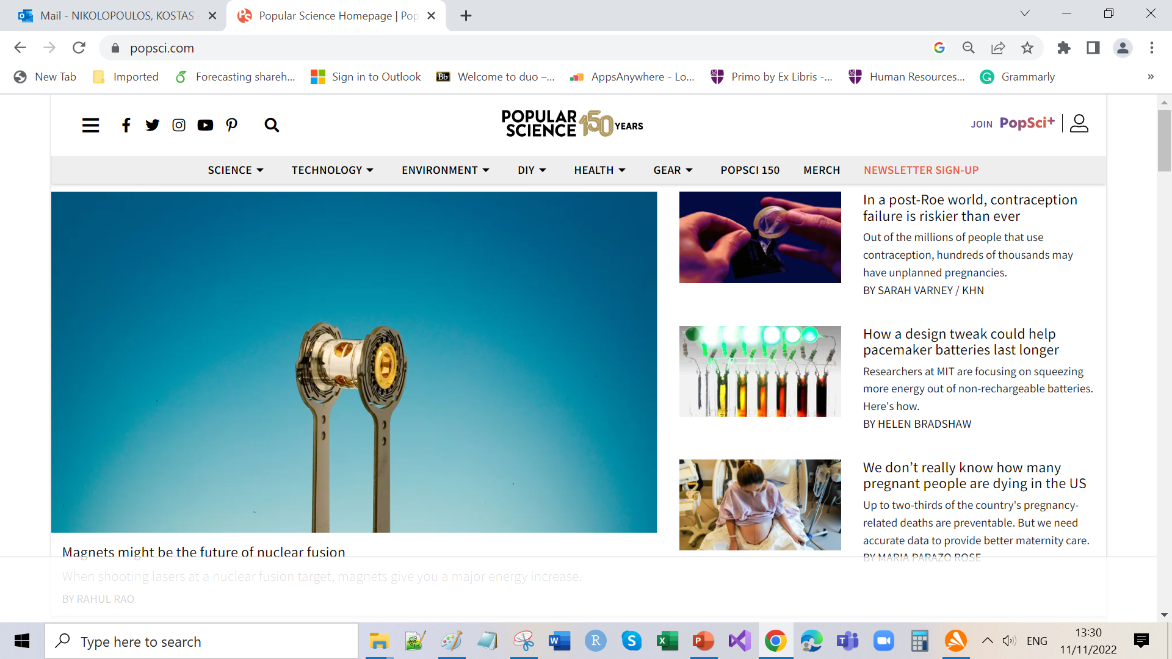
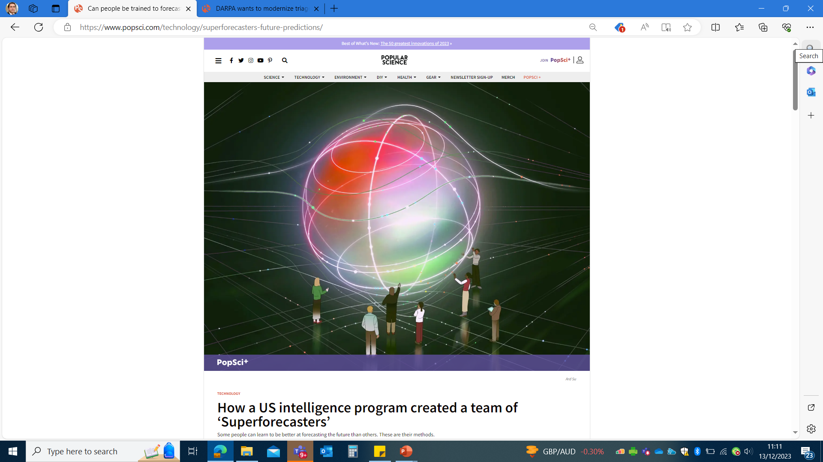
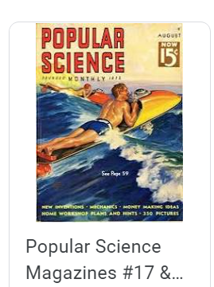

Slide 12
?

