Slide 1
Hazard, Risk and Infrastructure
Professor David Toll
Co-Director, IHRR
Research Challenge Director for Sustainable Infrastructure, Department of Engineering

Slide 2
Projects
ACHILLES. Assessment, costing and enhancement of long life, long linear assets (£4.9M) (EPSRC EP/R034575/1). David Toll and Paul Hughes (with Universities of Newcastle, Bath, Leeds, Loughborough, Southampton and the British Geological Survey).
CACTUS. Climate Adaptation Control Technologies for Urban Spaces (£1.8M) [EPSRC - EP/R005834/1]. David Toll, Paul Hughes, Karen Johnson, Ashraf Osman (with Universities of Cardiff, Queen’s Belfast, Dundee, Newcastle, Imperial College London)
TRANSPORT AFRICA. Sustainability and Resilience of Transportation Infrastructure in African Countries. (£1.1M) [GCRF - EPSRC EP/P029671/1]. David Toll, Paul Hughes & Karen Johnson (with KNUST, (Ghana), University of Pretoria (South Africa), Nyaoro & Associates (Tanzania)
CRAFT. Developing a novel Climate change Risk Assessment Framework for cultural heritage in Turkey (£127k) [AHRC: AH/V006320/1] Ashraf Osman, David Toll, Mike Crang. (with Middle East Technical University, Turkey).
Rize Landslides. Shallow Landslide Susceptibility Mapping in Rize, Turkey (£80k) [Royal Academy of Engineering] Ashraf Osman, Karen Johnson, Marti-Lloret-Cabot, David Toll (with Middle East Technical University, Turkey and Toker Drilling and Construction Company).
iModel Landslides. Integrated Modelling of Landslides due to Hydrometeorological Impacts in Langat Basin, Peninsular Malaysia (£380k) [NERC: NE/S003347/1] Ashraf Osman, Karen Johnson, David Toll (with Universiti Kebangsaan Malaysi).

Slide 3
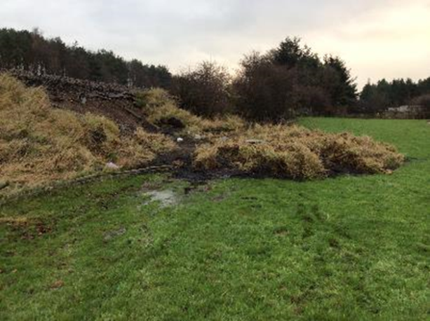
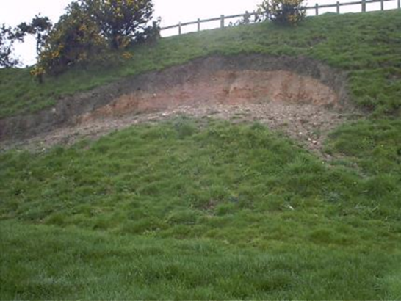
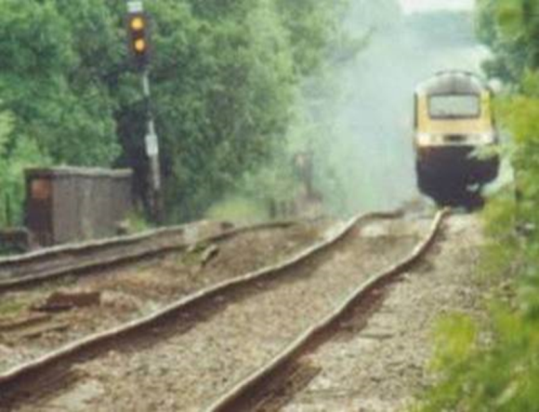
ACHILLES with Universities of Newcastle, Bath, Leeds, Loughborough, Southampton and the British Geological Survey
Investigating climate impacts on road/rail/flood embankments
Our national networks are ageing assets – rail network largely constructed more than 100 years ago and failures (landslides) are common
Field monitoring of responses to climate on 3 sites around UK (now have data sets >16 years)
Laboratory testing of water retention properties and strength in unsaturated conditions
Numerical modelling of soil-atmosphere interactions that can incorporate future climate scenarios
Findings explain long term deterioration of the geotechnical assets through environmental cycles
(photo courtesy of David Hutchinson, Network Rail)
(photo courtesy of David Patterson, Highways England)
(photo courtesy of Graham Birch, Network Rail)
ACHILLES. Assessment, costing and enhancement of long life, long linear assets (£4.9M) (EPSRC EP/R034575/1). David Toll and Paul Hughes (with Universities of Newcastle, Bath, Leeds, Loughborough, Southampton and the British Geological Survey).

Slide 4
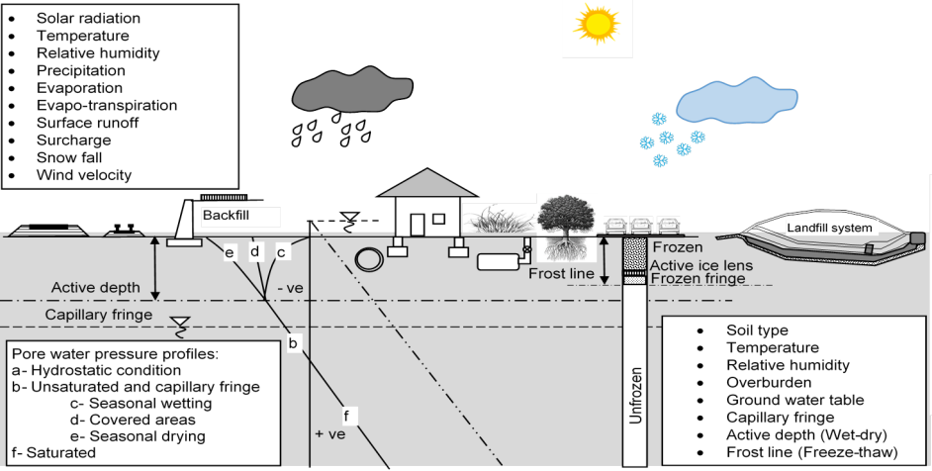
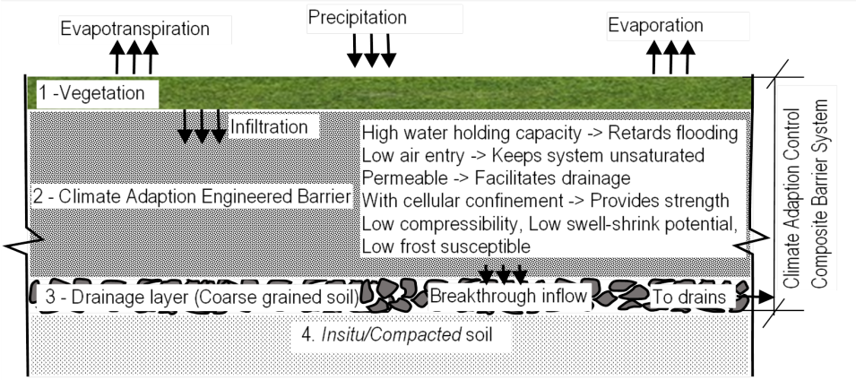
CACTUS with Universities of Cardiff, Queen’s Belfast, Dundee, Newcastle, Imperial College London
The research is developing climate adaptation composite barriers to protect our infrastructure in urban spaces (towns and cities), by combining water holding layers and a capillary barrier
Such barriers can provide resilient solutions to protect geo-infrastructure from more intense precipitation events and more extremes of wetting and drying that are expected to result from climate change
The technologies proposed are intended to protect geo-infrastructure such as shallow foundations, retaining walls and buried utilities from damage due to shrinkage/swelling of soil
CACTUS. Climate Adaptation Control Technologies for Urban Spaces (£1.8M) [EPSRC - EP/R005834/1]. David Toll, Paul Hughes, Karen Johnson, Ashraf Osman (with Universities of Cardiff, Queen’s Belfast, Dundee, Newcastle, Imperial College London)

Slide 5
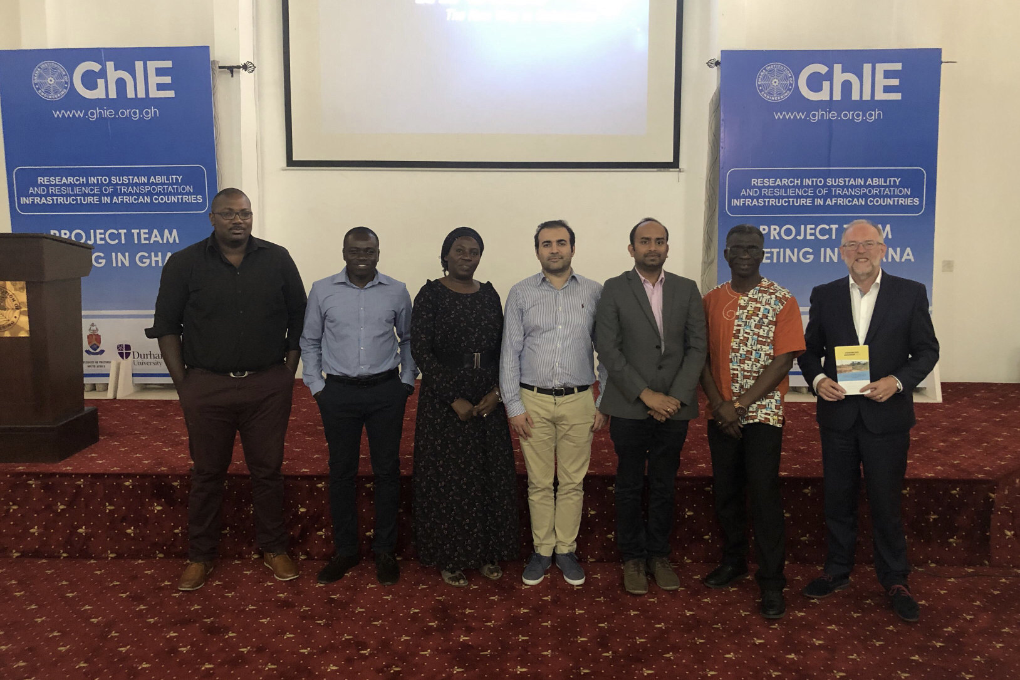
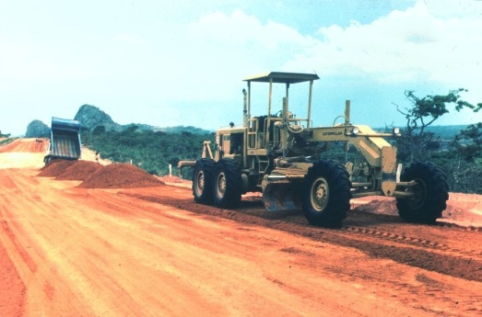
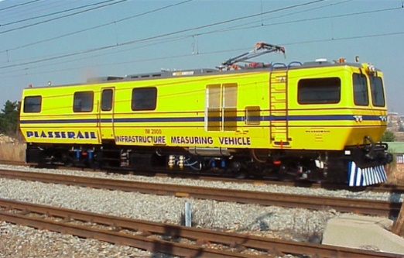
Transport Africa GCRF grant with Ghana, South Africa and Tanzania
Transport Africa has investigated
the use of naturally materials (lateritic gravels) as road construction materials in low volume rural roads (less than 300 vehicles per day)
the impacts of climate change on transportation infrastructure
Natural lateritic gravels are often classified as “sub-standard” as construction materials, but actually perform well when used in the right climatic conditions. Field studies have been carried out in Ghana and Tanzania
Climate effects have been studied on a railway embankment in South Africa on the coal export railway line. Embankments on the line were subjected to severe drought followed by extreme rainfall during 1995/6, which resulted in numerous embankment slope failures
TRANSPORT AFRICA. Sustainability and Resilience of Transportation Infrastructure in African Countries. (£1.1M) [GCRF - EPSRC EP/P029671/1]. David Toll, Paul Hughes & Karen Johnson (with KNUST, (Ghana), University of Pretoria (South Africa), Nyaoro & Associates (Tanzania)

Slide 6
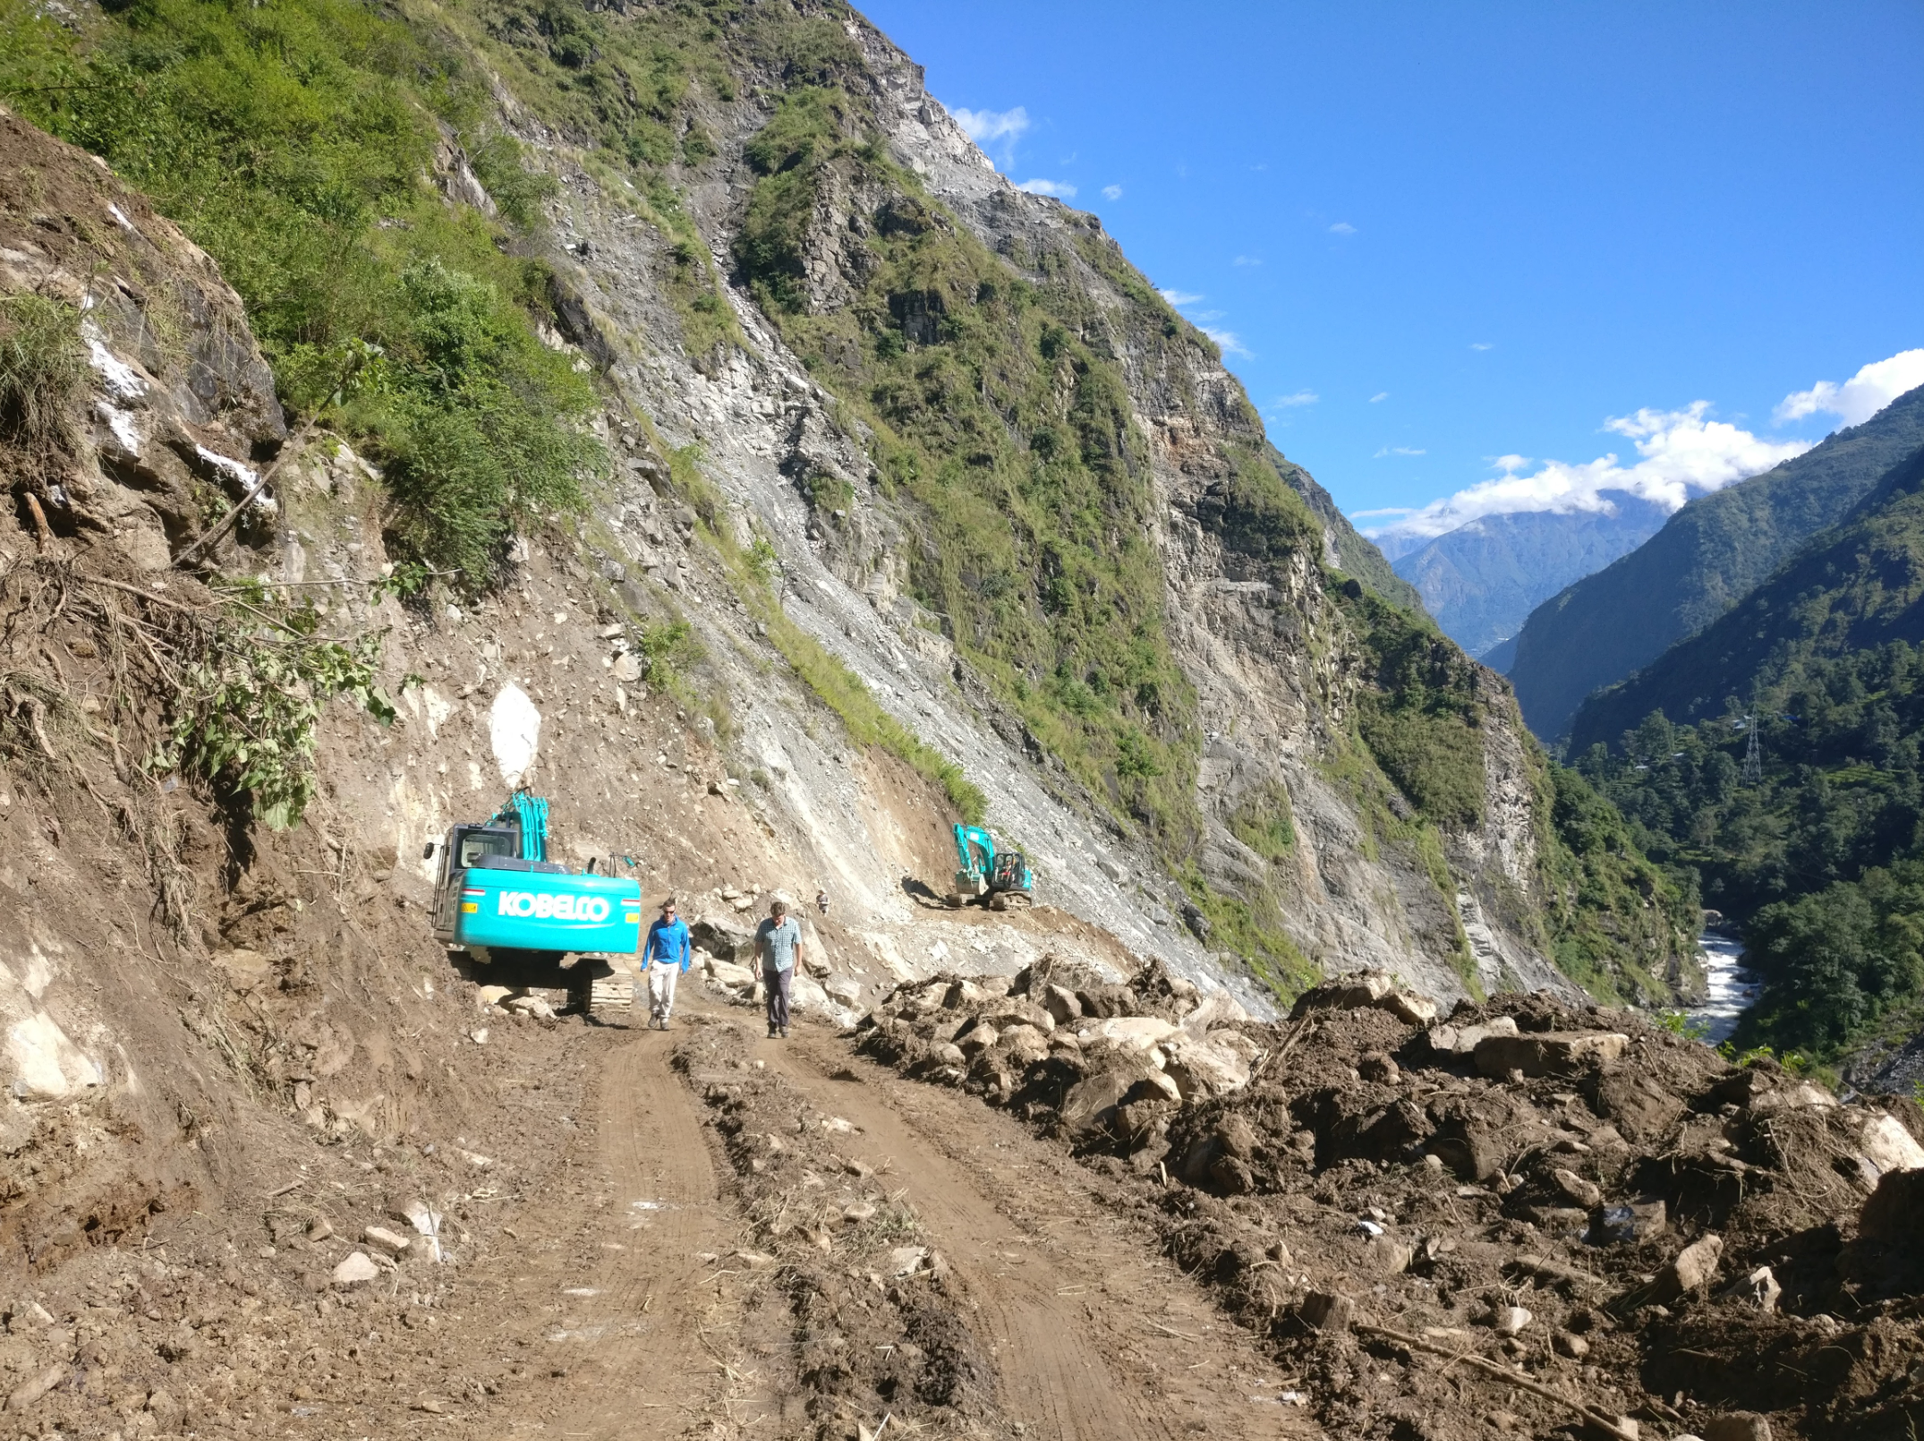
NEPAL: Impacts of Roads on Landsliding IHRR Action on Natural Disasters
A study was made of a newly widened 13.7 km long stretch of a district road in the mountainous area of Sindhupalchok district
During the monsoon in August 2018, 117 landslides (almost 9 landslides per kilometre) were recorded along the road, which was >600% increase compared to the slope failures in at the time of road widening
The road became unserviceable throughout the monsoon and the landslides along the road also caused major damage to agricultural lands
The damage from the landslides to the local communities negates the primary purpose of local road construction which is to enhance the socio-economic status of the rural communities in Nepal
Nepal Landslides. An investigation of the combined effect of rainfall and road cut on
landsliding in Nepal [IHRR Action on Natural Disasters] Samprada Pradhan, David Toll, Nick Rosser, Matt Brain

Slide 7
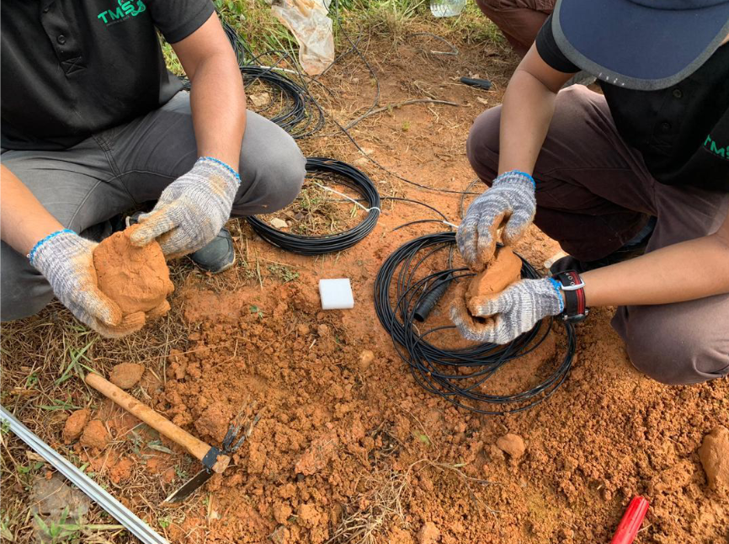
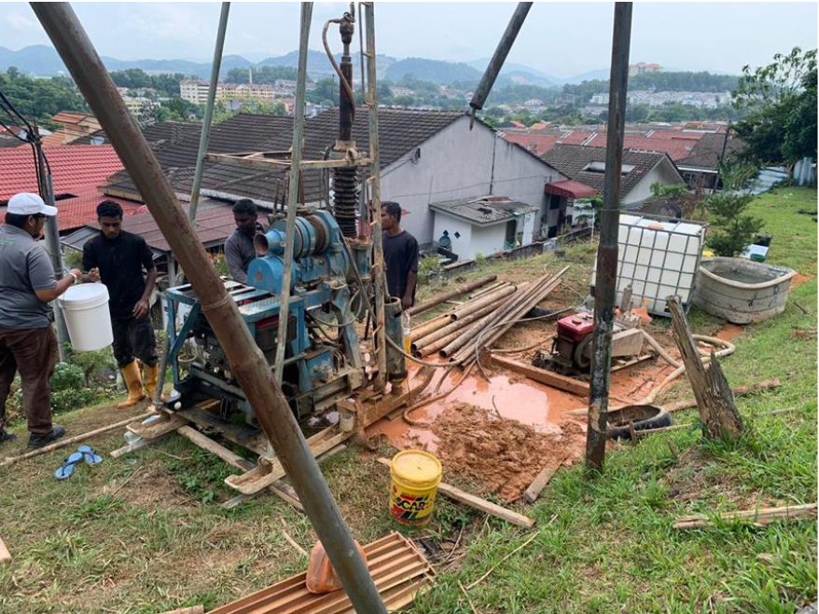
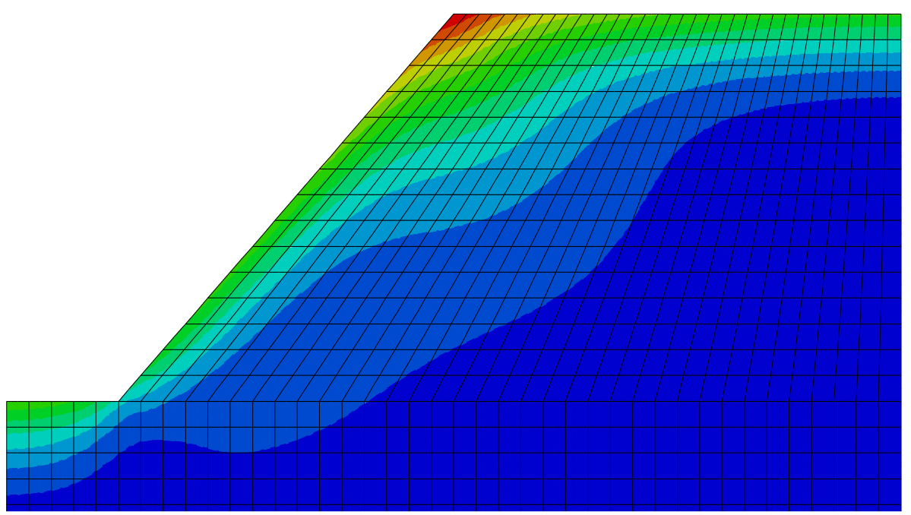
MALAYSIA: iModel Landslides
Field monitoring and numerical simulations of selected slopes at Langat River Basin in order to understand relationship between rainfall and landslides
Statistical Multivariate Analysis using ANN and GIS to produce a landslide susceptibility map
To produce an integrated disaster risk map using the landslide susceptibility map and the social vulnerability map
iModel Landslides. Integrated Modelling of Landslides due to Hydrometeorological Impacts in Langat Basin, Peninsular Malaysia (£380k) [NERC: NE/S003347/1] Ashraf Osman, Karen Johnson, David Toll (with Universiti Kebangsaan Malaysi).

Slide 8
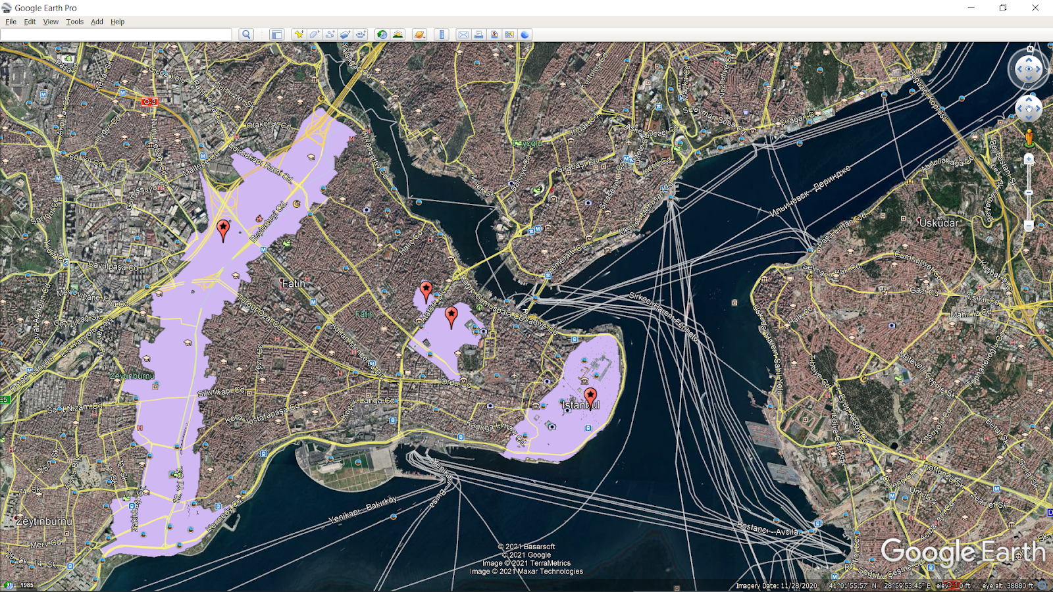
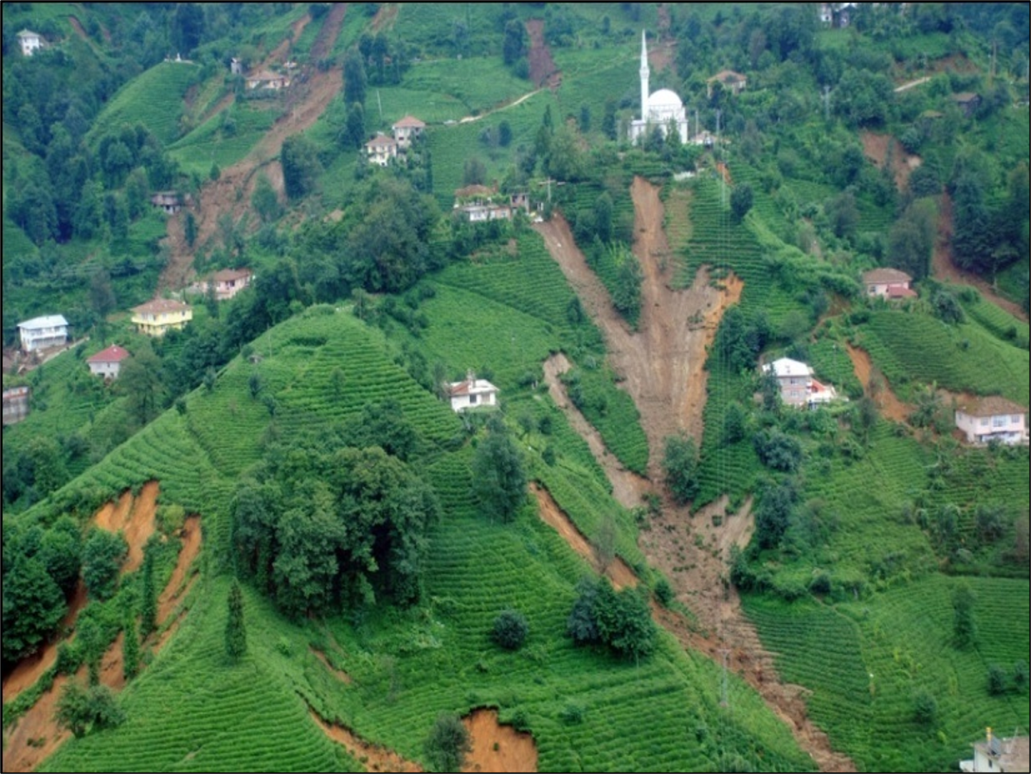
TURKEY: CRAFT/Rize landslides AHRC / Royal Academy of Engineering with Middle East Technical University
CRAFT
Assess future climate change scenarios for Turkey
Quantitative assessment of flood and landslide triggering due to climate impacts
Produce susceptibility maps for climate-change driven hazards
Undertake vulnerability assessment of historic monuments and sites that can be affected by hazards
Rize landslides
More than 95% of landslides are trigggered by rainfall​
Depth maximum 5 m “shallow landslide”
Steep slope angles. Usually associated with tea plantations
Commonly translational slides or flows
CRAFT. Developing a novel Climate change Risk Assessment Framework for cultural heritage in Turkey (£127k) [AHRC: AH/V006320/1] Ashraf Osman, David Toll, Mike Crang. (with Middle East Technical University).
Rize Landslides. Shallow Landslide Susceptibility Mapping in Rize, Turkey (£80k) [Royal Academy of Engineering] Ashraf Osman, Karen Johnson, Marti-Lloret-Cabot, David Toll (with Middle East Technical University).

