Slide 1
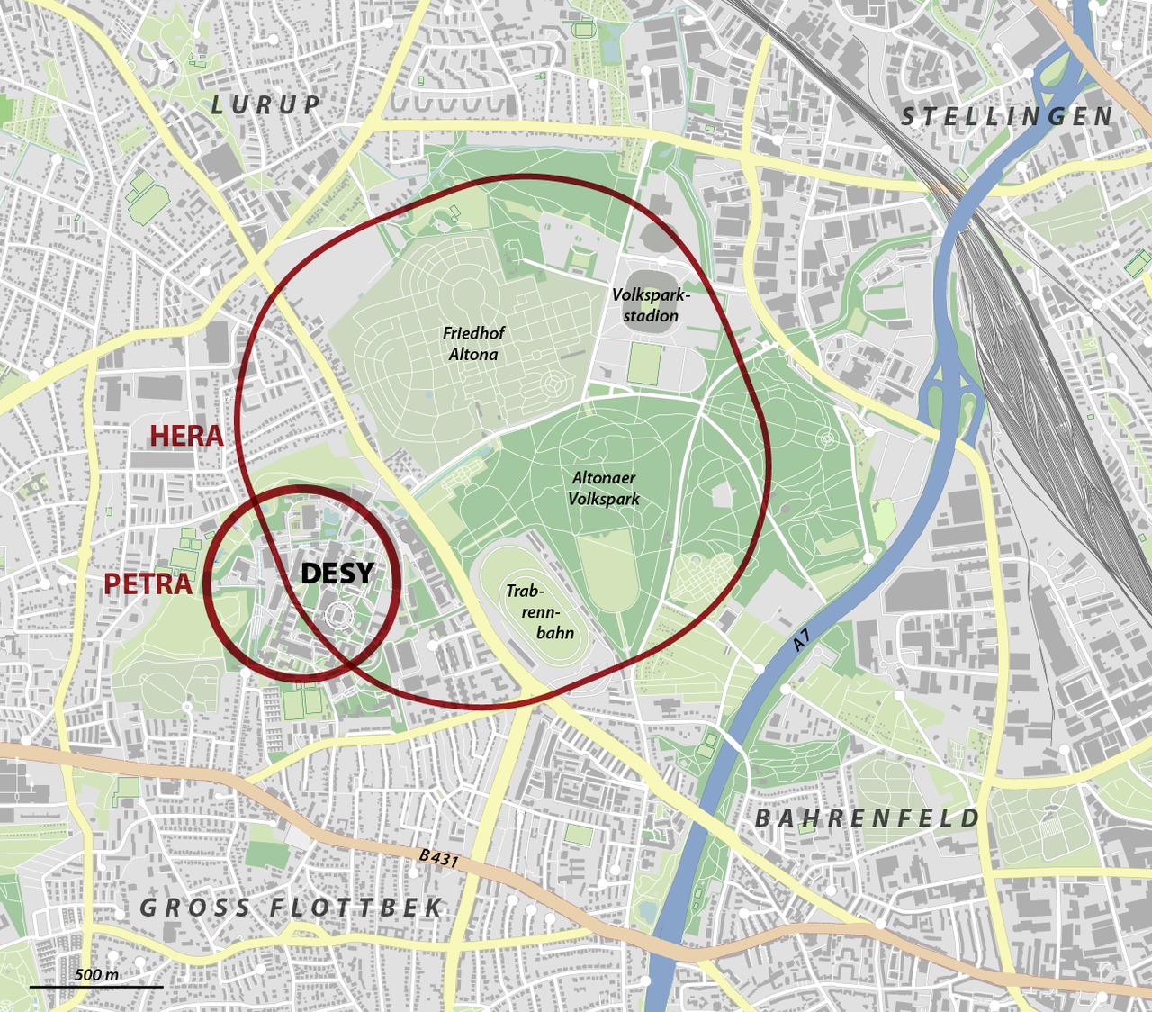
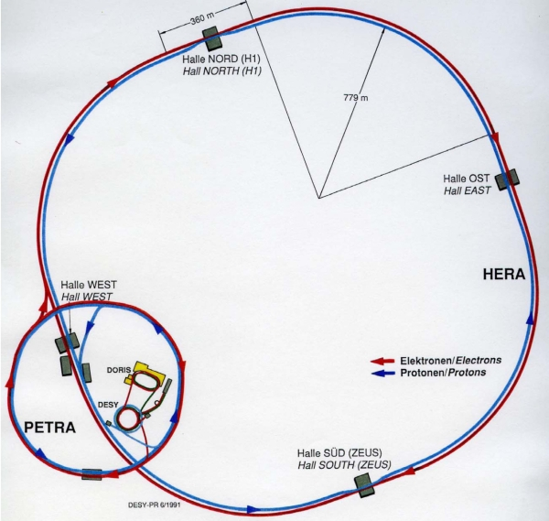
HERA as an EIC Bootcamp
Software and Physics
H1
ZEUS
Jon Butterworth University College London
MC4EIC Durham 5/6/2024
Notes:
Experiments.
Would we have found it anyway?
DIS
4l
Roman villa/cms. Traces of the SM will exist as long as there is a civilisation.

Slide 2
Complex Environment
Lots of physics going on, many interesting effects potentially at play
  (Polarized) Parton Densities
  Saturation/Recombination/Collective Effects
  Diffraction, low-x, peripheral collisions
  QCD radiation (initai, final…)
  (Resolved) Photons
  Collective effects
Difficult to calculate or model
May depend strongly on (obscure?) details of the observables and the kinematic selection
Need to have the software tools to draw robist physics conclusions → Reproducible comparisons, sometimes “between apples and oranges”

Slide 3
Physics Lessons
Experiment Neutrality
  Experiments need to compare with each other
  Theorists should be able to make their own comparisons
Generator neutrality
  If an observable only exists in a specific model, it is not an observable
  Code complications…
Fiducial Phase Space
  Say what you measure, minimize (model-dependent) extrapolation, at least in the first step

Slide 4
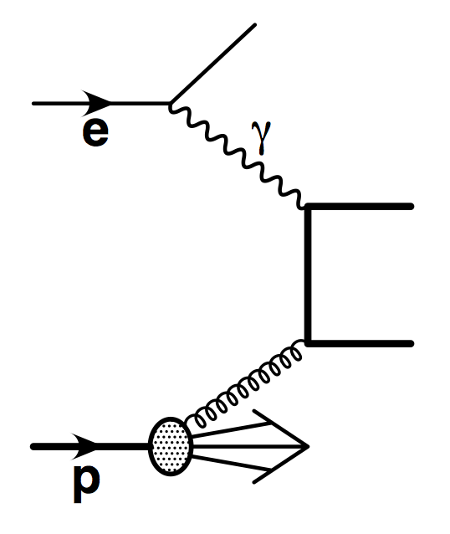
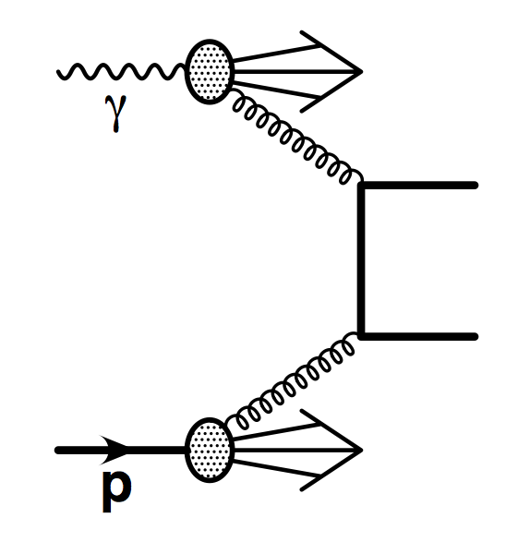
Real example: ZEUS charm photoproduction
Electron-proton collider, proton energy 820 GeV, electron energy 27 GeV
  Mean photon energy ~10 GeV.
  Photon proton CM energy ~100 to 300 GeV
  Kinematics highly boosted in the proton direction

Slide 5
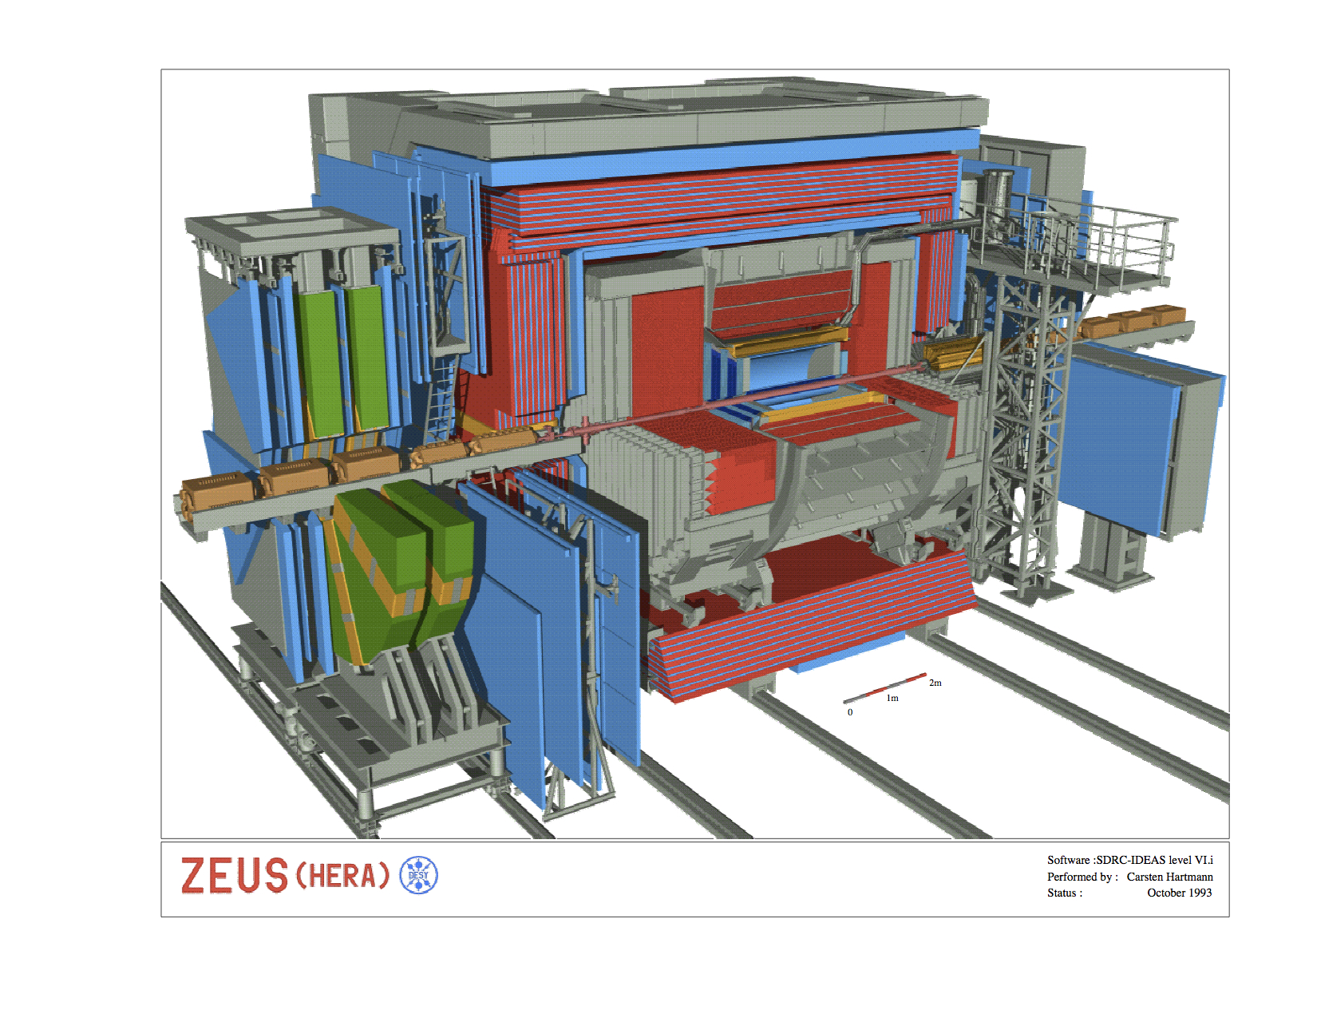
Real example: ZEUS charm photoproduction
Tagging of charm via D* decay
  →Highly dependent on track reconstruction, which has limited rapidity and p_{T} coverage.

Slide 6
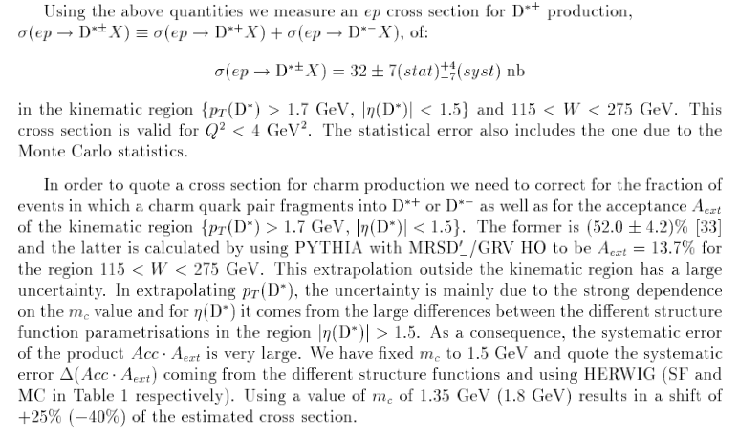

Slide 7
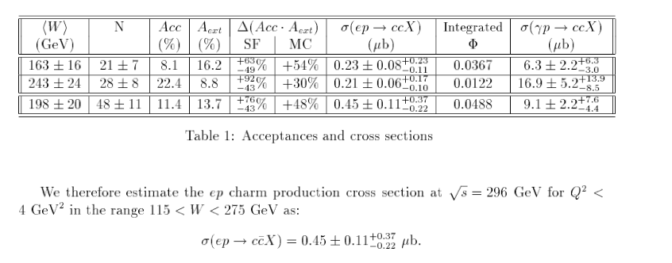
Real example: ZEUS charm photoproduction

Slide 8
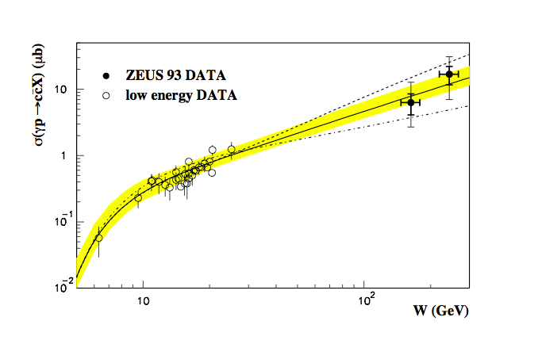
Real example: ZEUS charm photoproduction
Large energy extrapolation
Tiny acceptance → ~1.4% (and into tricky regions such as low p_{T} and high rapidity, hence high uncertainty)

Slide 9


HZTOOL
Fortran library of analysis routines
  Reproduce “what the experiment measured” on a given generated event sample
  Include jet finders, event-shape variables, other complex observables
  Experiment neutral
  Accessible to theorists
Difficult to maintain
  Lots of generator-conditional code CMZ/PATCHY/FORTRAN
  Not very scaleable (run same jet finder n times for n analyses)
J. Bromley et al in “Future Physics at HERA”
(Zhengzhou Hengzuan Machanical&Electrical Equipment Co.,Ltd)

Slide 10
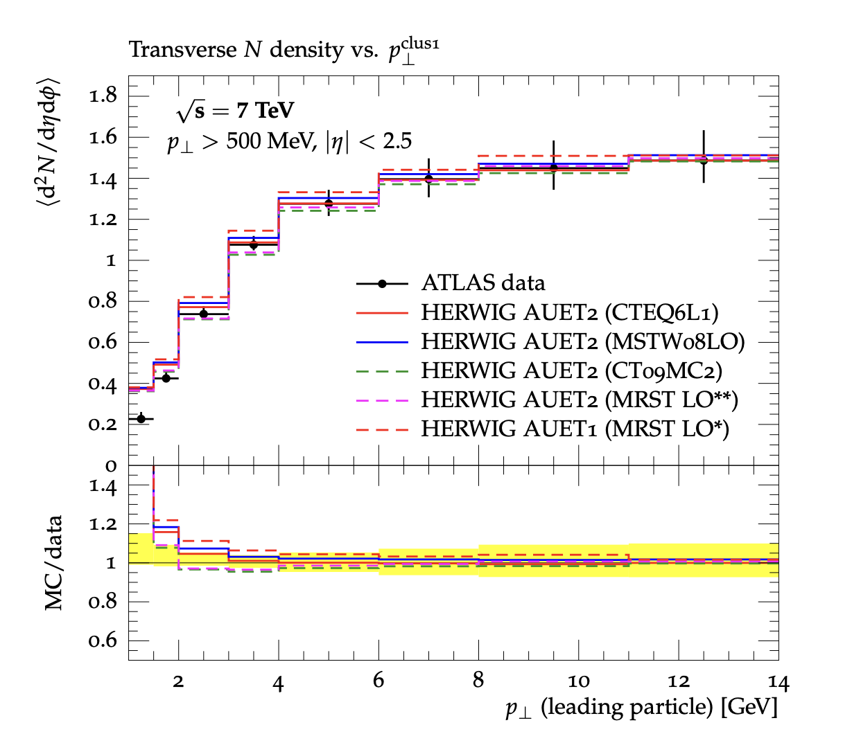
Rivet
Robust Independent Validation of Experiment and Theory
Direct legacy of HZTOOL
CEDAR eScience grant c2005 (JMB, Stirling, S Butterworth, Whalley → Buckley, Monk.)
Buckley et al, Bierlich et al arXiv:1003.0694 (CPC), arXiv:1912.05451 (SciPost), arXiv:2404.15984
Developed by MCnet for tuning and validation of new MC event generators
e.g. What does the underlying event look like in 7 TeV pp collisions?
Caching of results to improve scalability (“Projections”)
More dogmatic about using only final state particles
Which electron is your scattered electron?
What the **** is a Pomeron anyway?
From ATL-PHYS-PUB-2011-008
Paradoxically, HERA results are somewhat under-represented (timing, and use of HZTOOL)
Situation is improving. See e.g. Rivet, RivetHZTool and HERA - A validation effort for coding HERA measurements for Rivet, H. Jung et al

Slide 11
What’s Available: HERA
ZEUS_1995_I392386 Charged particle multiplicity and momentum spectra in Breit frame at ZEUS
ZEUS_1995_I395196 Neutral strange particle production in deep inelastic scattering at HERA (ZEUS)
ZEUS_1996_I420332 Measurement of the F2 structure function in deep inelastic e+ p scattering using 1994 data from ZEUS
ZEUS_1997_I450085 Dijet photoproduction analysis
ZEUS_1999_I470499 Forward jet production in deep inelastic scattering at HERA (ZEUS)
ZEUS_1999_I500267 Measurement of High-Q^2 Neutral-Current e^+p Deep Inelastic Scattering Cross-Sections at HERA
ZEUS_1999_I508906 Measurement of the E**2(T,jet) / Q**2 dependence of forward jet production at HERA
ZEUS_2000_I524911 Measurement of azimuthal asymmetries in deep inelastic scattering
ZEUS_2001_I568665 Dijet photoproduction analysis
ZEUS_2008_I763404 Diffractive photoproduction of dijets
ZEUS_2008_I780108 Multi-jet cross-sections in charged current e^\pm p scattering at HERA
ZEUS_2008_I810112 Measurement of D^\pm and D^0 production in deep inelastic scattering using a lifetime tag at HERA
ZEUS_2010_I875006 ZEUS dijet cross-sections in neutral-current DIS
ZEUS_2011_I945935 Scaled momentum distributions for K^0_S and \Lambda/\bar\Lambda in DIS at HERA
ZEUS_2012_I1116258 Inclusive-jet photoproduction at HERA and determination of the strong coupling
H1_1994_I372350 H1 energy flow and charged particle spectra in DIS
H1_1995_I394793 A Study of the Fragmentation of Quarks in ep Collisions at HERA
H1_1995_I396365 Transverse energy and forward jet production in the low-x regime at H1
H1_1996_I421105 Inclusive D0 and D*+- production in deep inelastic e p scattering at HERA
H1_1996_I422230 Charged particle multiplicities in deep inelastic scattering at HERA
H1_1996_I424463 Transverse momentum spectra of charged particles in DIS (H1 1996)
H1_1997_I445116 Evolution of e p fragmentation and multiplicity distributions in the Breit frame
H1_1998_I477556 Charged-particle photoproduction analysis
H1_1999_I481112 Measurement of D* cross-sections at HERA and determination of gluon density in the proton
H1_1999_I504022 Forward pi0 meson production at HERA
H1_2000_I503947 H1 energy flow in DIS
H1_2002_I561885 Measurement of D^*\pm meson production in deep inelastic scattering at HERA
H1_2005_I676166 Measurement of beauty production at HERA using events with muons and jets (H1)
H1_2006_I699835 Measurement of Event Shape Variables in Deep-Inelastic Scattering at HERA
H1_2006_I711847 Dijet photoproduction analysis
H1_2007_I736052 Inclusive production of D* mesons both with and without dijet production in DIS collisions (H1)
H1_2007_I746380 Diffractive production of dijets in deep-inelastic scattering and photoproduction at HERA
H1_2009_I810046 Strangeness Production at low Q^2 in Deep-Inelastic ep Scattering at HERA
H1_2013_I1217865 Charged particle production in deep-inelastic ep scattering at H1
H1_2015_I1343110 Diffractive dijets in DIS and photoproduction
HERA_2015_I1353667 Combined H1/ZEUS D^* production cross-sections in DIS
HERA_2015_I1377206 Measurement of sigma_red (F2) of H1 and ZEUS at different beam energies

Slide 12
Case Study: Underlying Event in Photon-Induced Processes
JMB, J. J. Castella, I. Helenius, S. Sanjrani, M. Wing
Cambridge, Jyväskylä, Bristol, UCL

Slide 13
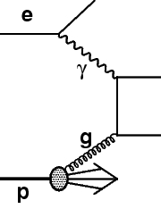
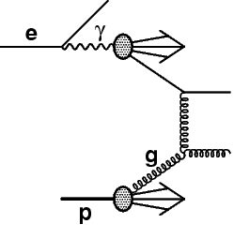
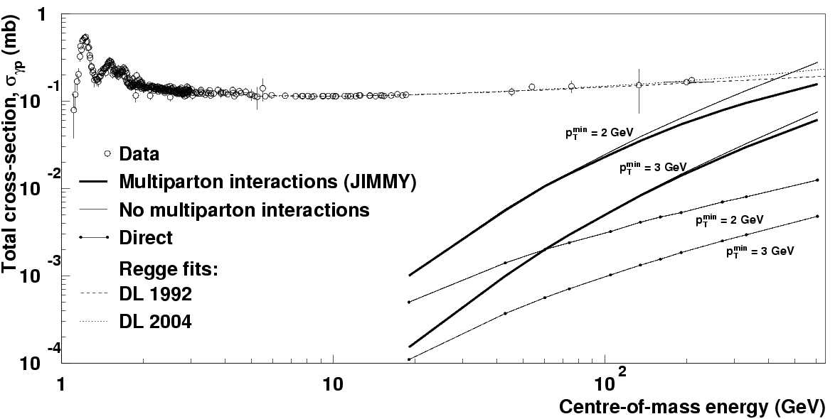
Motivation: Photons
Flux of almost-real photons is an unavoidable, and interesting, component of a beam of electrons
Rarer, but also interesting, in proton and heavy ion beams (actually, abundant but harder-to-see in HI)
Photon cross section is dominated by “hadronic component”
Contains soft and hard components
From JMB, M. Wing

Slide 14
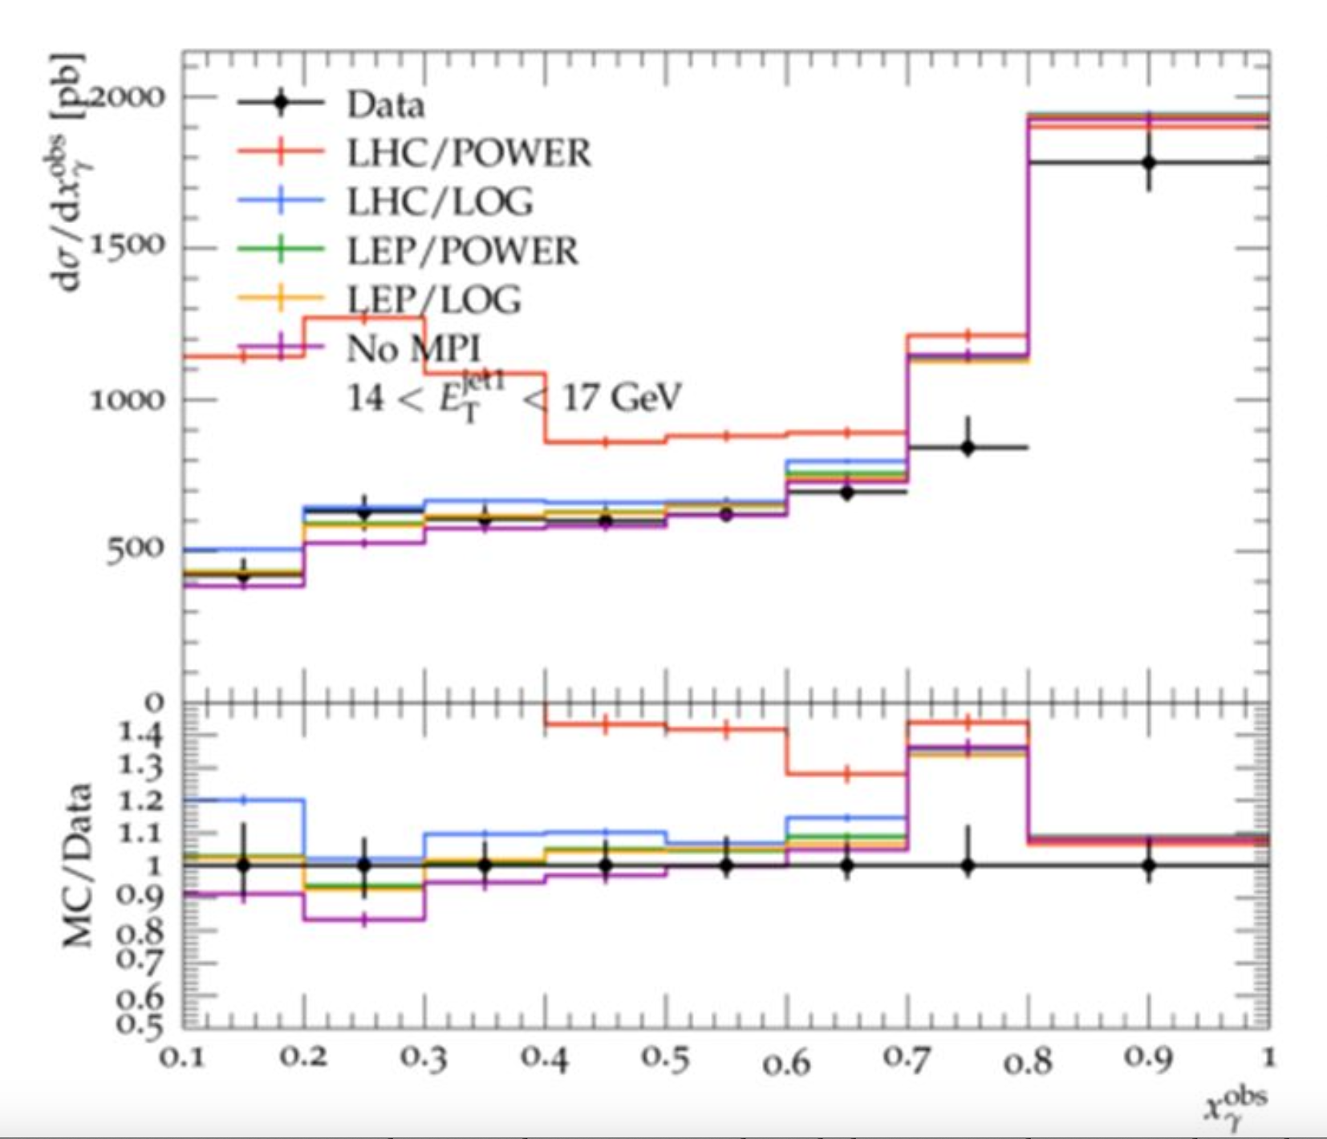
Motivation: Multiparton interactions
Photon cross section is dominated by “hadronic component”.
Total cross section exceeds the naïve parton-parton cross section
Implies more than one partonic interaction per hadronic collision
Has a significant impact on resolved component
Note: x_{γ}^{OBS} is a final-state observable, momentum fraction of the photon carried by the jets

Slide 15
ZEUS_1995_I392386 Charged particle multiplicity and momentum spectra in Breit frame at ZEUS
ZEUS_1995_I395196 Neutral strange particle production in deep inelastic scattering at HERA (ZEUS)
ZEUS_1996_I420332 Measurement of the F2 structure function in deep inelastic e+ p scattering using 1994 data from ZEUS
ZEUS_1997_I450085 Dijet photoproduction analysis
ZEUS_1999_I470499 Forward jet production in deep inelastic scattering at HERA (ZEUS)
ZEUS_1999_I500267 Measurement of High-Q^2 Neutral-Current e^+p Deep Inelastic Scattering Cross-Sections at HERA
ZEUS_1999_I508906 Measurement of the E**2(T,jet) / Q**2 dependence of forward jet production at HERA
ZEUS_2000_I524911 Measurement of azimuthal asymmetries in deep inelastic scattering
ZEUS_2001_I568665 Dijet photoproduction analysis
ZEUS_2008_I763404 Diffractive photoproduction of dijets
ZEUS_2008_I780108 Multi-jet cross-sections in charged current e^\pm p scattering at HERA
ZEUS_2008_I810112 Measurement of D^\pm and D^0 production in deep inelastic scattering using a lifetime tag at HERA
ZEUS_2010_I875006 ZEUS dijet cross-sections in neutral-current DIS
ZEUS_2011_I945935 Scaled momentum distributions for K^0_S and \Lambda/\bar\Lambda in DIS at HERA
ZEUS_2012_I1116258 Inclusive-jet photoproduction at HERA and determination of the strong coupling
H1_1994_I372350 H1 energy flow and charged particle spectra in DIS
H1_1995_I394793 A Study of the Fragmentation of Quarks in ep Collisions at HERA
H1_1995_I396365 Transverse energy and forward jet production in the low-x regime at H1
H1_1996_I421105 Inclusive D0 and D*+- production in deep inelastic e p scattering at HERA
H1_1996_I422230 Charged particle multiplicities in deep inelastic scattering at HERA
H1_1996_I424463 Transverse momentum spectra of charged particles in DIS (H1 1996)
H1_1997_I445116 Evolution of e p fragmentation and multiplicity distributions in the Breit frame
H1_1998_I477556 Charged-particle photoproduction analysis
H1_1999_I481112 Measurement of D* cross-sections at HERA and determination of gluon density in the proton
H1_1999_I504022 Forward pi0 meson production at HERA
H1_2000_I503947 H1 energy flow in DIS
H1_2002_I561885 Measurement of D^*\pm meson production in deep inelastic scattering at HERA
H1_2005_I676166 Measurement of beauty production at HERA using events with muons and jets (H1)
H1_2006_I699835 Measurement of Event Shape Variables in Deep-Inelastic Scattering at HERA
H1_2006_I711847 Dijet photoproduction analysis
H1_2007_I736052 Inclusive production of D* mesons both with and without dijet production in DIS collisions (H1)
H1_2007_I746380 Diffractive production of dijets in deep-inelastic scattering and photoproduction at HERA
H1_2009_I810046 Strangeness Production at low Q^2 in Deep-Inelastic ep Scattering at HERA
H1_2013_I1217865 Charged particle production in deep-inelastic ep scattering at H1
H1_2015_I1343110 Diffractive dijets in DIS and photoproduction
HERA_2015_I1353667 Combined H1/ZEUS D^* production cross-sections in DIS
HERA_2015_I1377206 Measurement of sigma_red (F2) of H1 and ZEUS at different beam energies

Slide 16
Also…
JADE_OPAL_2000_I513337 Jet rates in e^+e^- at JADE [35--44 GeV] and OPAL [91--189 GeV].
OPAL_1992_I321190 Hadronic Z decay charged multiplicity measurement
OPAL_1993_I342766 A Measurement of K^*\pm (892) production in hadronic Z0 decays
OPAL_1993_I343181 Measurement of photon production at LEP 1
OPAL_1994_I372772 Measurement of the production rates of charged hadrons in e^+e^- annihilation at the Z^0
OPAL_1995_I382219 Scaled energy distribution of D^* with flavour separation at LEP
OPAL_1995_I393503 K^0 Production in Hadronic Z^0 Decays
OPAL_1995_I398320 \Delta^++ Production in Hadronic Z^0 Decays
OPAL_1996_I402487 J/\psi and \psi^\prime Production in Hadronic Z^0 Decays
OPAL_1996_I428493 Production of B^* mesons at LEP1
OPAL_1997_I421977 \Sigma^\pm baryon production in Z hadronic decays at OPAL
OPAL_1997_I421978 Strange baryon production in Z hadronic decays at OPAL
OPAL_1997_I440103 Polarization of \phi, D^*+ and B^* mesons at LEP1
OPAL_1997_I440721 Event Shapes at 161 GeV
OPAL_1997_I447146 K^*0 meson production measured by OPAL at LEP 1.
OPAL_1997_I447188 Polarization of \Lambda^0 baryons at LEP 1
OPAL_1998_I467092 Production of f_0(980), f_2(1270) and \phi(1020) in hadronic Z^0 decay
OPAL_1998_I470419 Photon and Light Meson Production in Hadronic Z^0 Decays
OPAL_1998_I472637 Measurements of flavor dependent fragmentation functions in Z^0 -> q \barq events
OPAL_1998_I474012 Polarization of b-baryons at LEP1
OPAL_2000_I474010 Correlations for \Lambda^0 and \bar\Lambda^0 production at LEP1
OPAL_2000_I502750 Polarization of \rho^\pm and \omega^0 mesons at LEP1
OPAL_2000_I513476 Event Shapes at 172, 183 and 189 GeV
OPAL_2000_I529898 Multiplicities of \pi^0, \eta, K^0 and of charged particles in quark and gluon jets
OPAL_2001_I536266 Charged particle multiplicities for u, d, s events at the Z pole
OPAL_2001_I552446 Four-jet angles using Durham algorithm
OPAL_2001_I554583 \tau polarization at LEP1
OPAL_2002_I601225 Charged particle multiplicities in heavy and light-quark initiated events above the Z^0 peak
OPAL_2003_I595335 Charged particle momentum spectra in e^+e^- annihilation at \sqrts= 192 GeV to 209 GeV
OPAL_2003_I599181 Inclusive analysis of the b quark fragmentation function in Z decays
OPAL_2003_I611415 Dijet production in Photon-Photon collisions at E_CMS=198 GeV
OPAL_2004_I631361 Gluon jet charged multiplicities and fragmentation functions
OPAL_2004_I648738 Quark and gluon jet fragmentation functions
OPAL_2004_I669402 Event shape distributions and moments in e^+ e^- -> hadrons at 91--209 GeV
OPAL_2007_I734955 Inclusive charged hadrons in gm+gm
OPAL_2008_I754316 Jet production in Photon-Photon collisions at E_CMS=206 GeV

Slide 17
Also…
Partial routine for 2021 ZEUS charged particle analysis.
Many CDF and ATLAS routines used for tuning underlying event in proton-proton

Slide 18
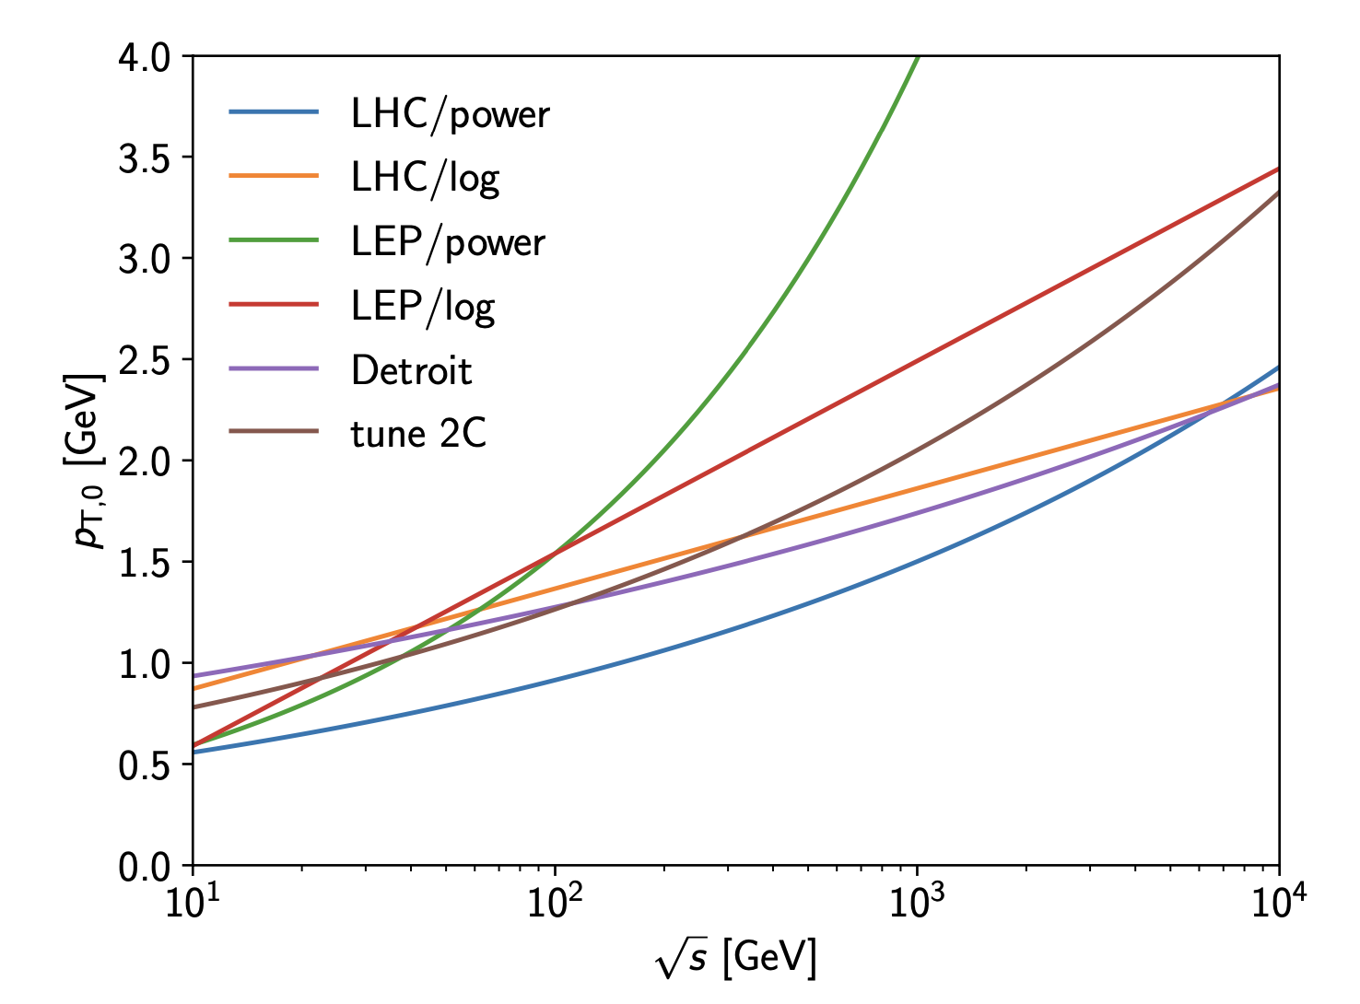
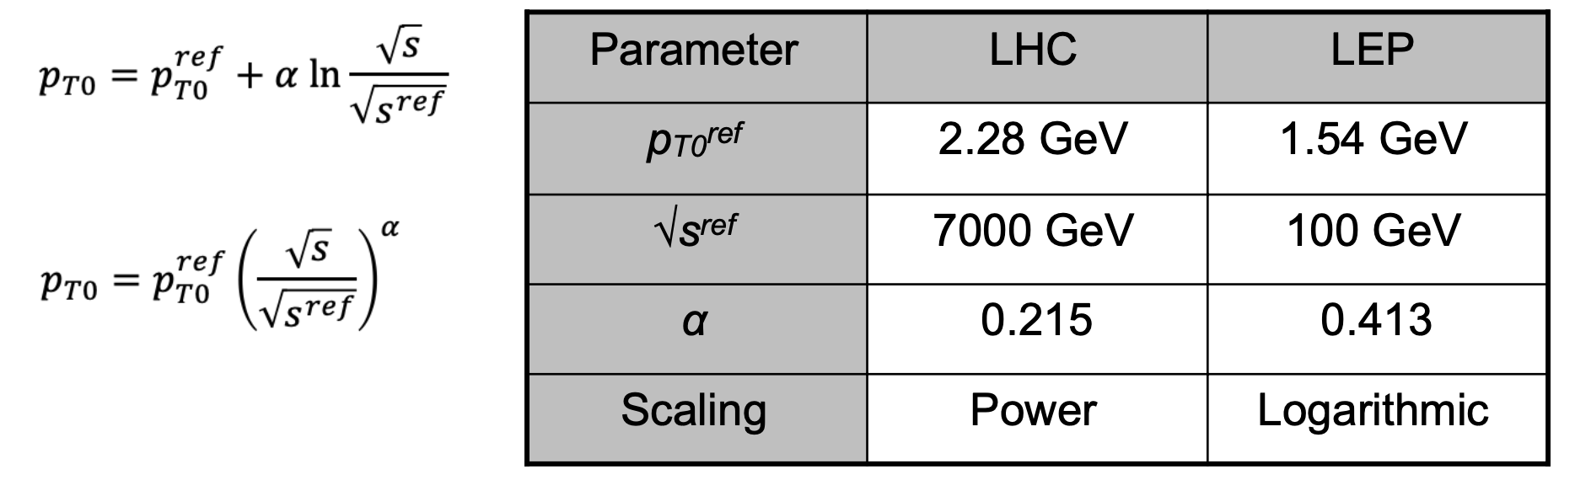
Parameters of the Model
Matter distribution inside hadron/photon (impact parameter dependence)
Photon and proton PDFs (defaults are CJKL, NNPDF 2.3)
Minimum p_{T} of partonic scatters, its energy-dependence, and matching to soft scatters,

Slide 19
ZEUS Data
Don’t use the default proton-proton tune for photon-proton

Slide 20
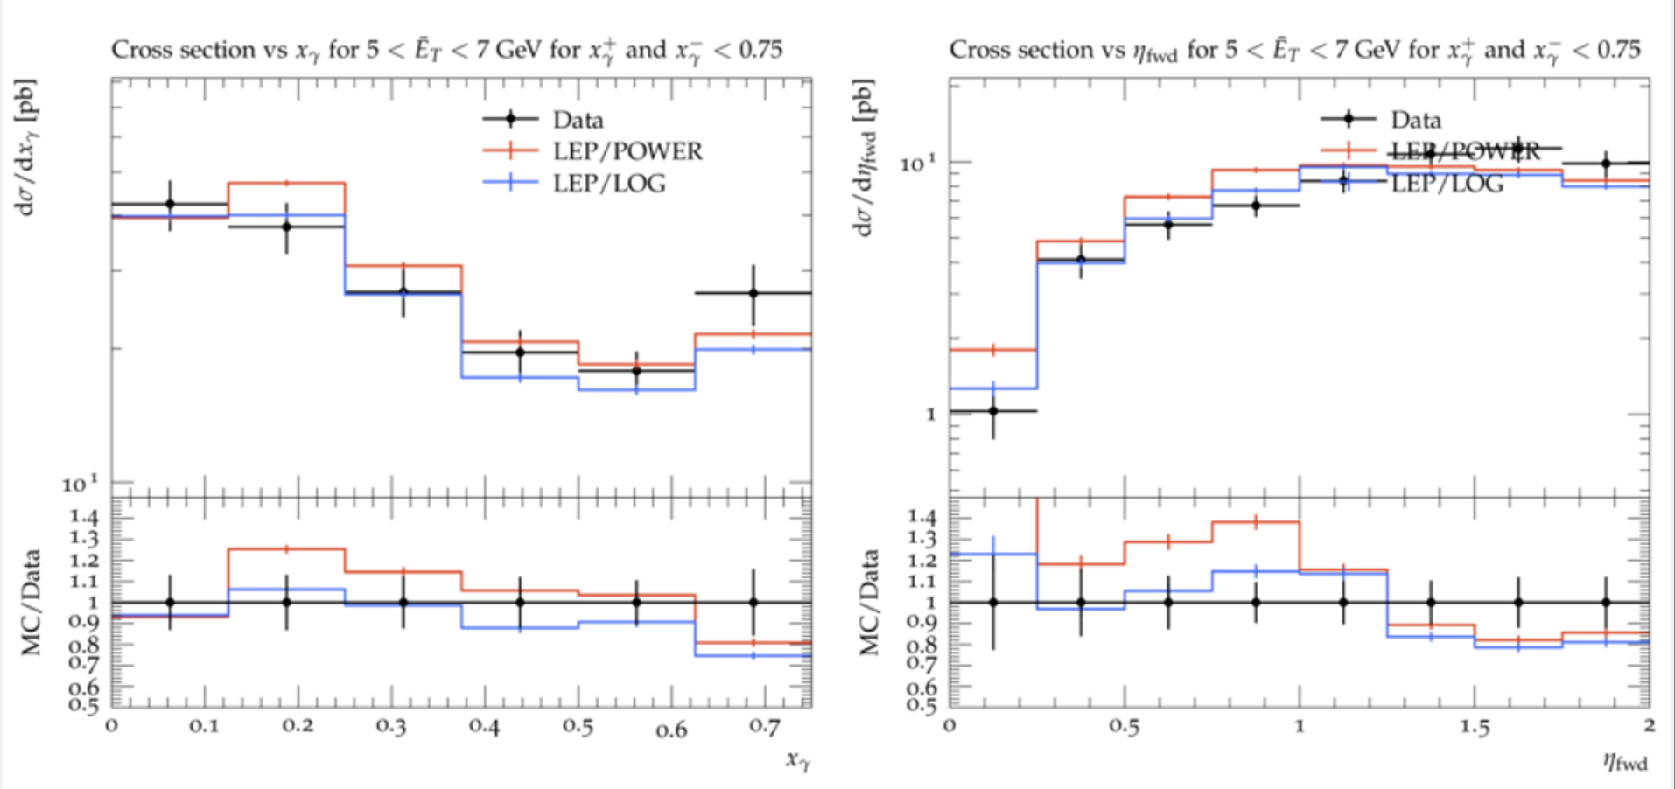
LEP Data
LEP tune with logarithmic scaling slightly better

Slide 21
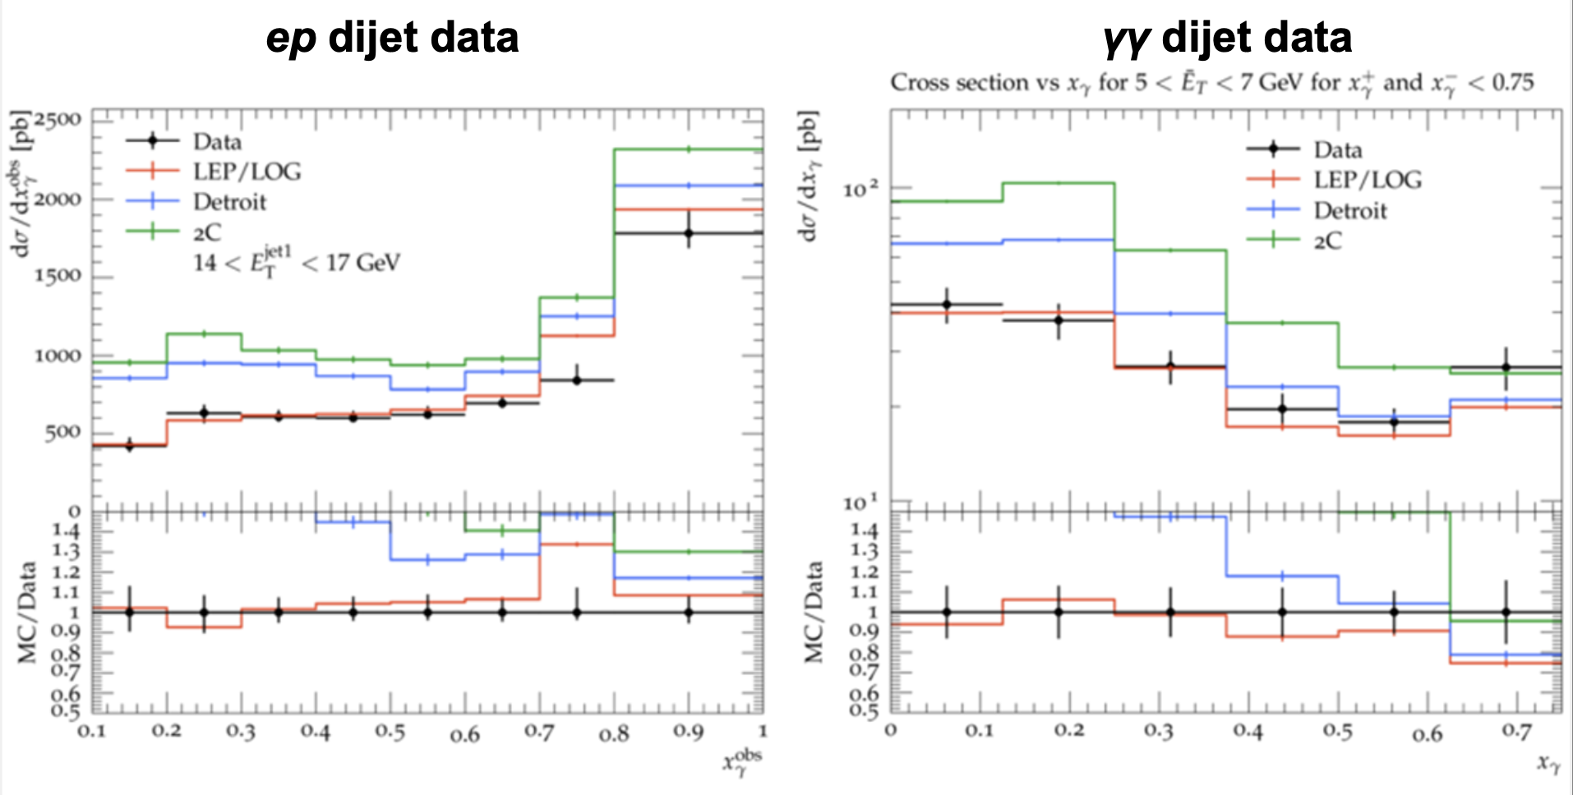
Tunes to CDF Data
Proton tunes not good for photons even when tuned at similar energy – this is about more than the energy dependence.

Slide 22
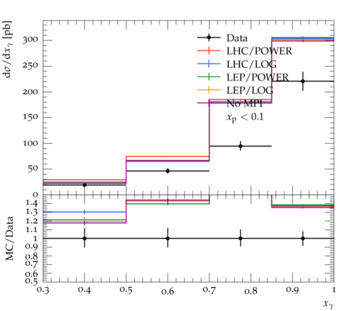
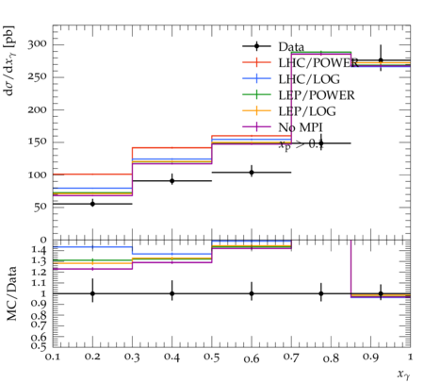
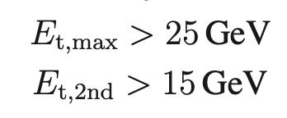
H1 Data
Level of agreement quite sensitive to kinematic cuts, jet p_{T}, and asymmetry of jet p_{T} cuts.

Slide 23
It’s not just MPI…
Parton shower and photon PDFs have significant influence on cross section (even at high x_{γ}^{OBS}).

Slide 24
Conclusions
Default proton-proton tunes do not describe HERA (or LEP) data, so probably not EIC data.
Can get simultaneous tune/description of HERA and LEP data.
  “Reasonable” description of HERA data with default LEP models, and better with “tuned” models
  No simultaneous description of HERA/LEP and pp data, even using settings tuned to pp data at the same centre-of-mass energy.
  Data favour fewer MPIs with photon-initiated processes than with protons.

Slide 25
Future Ideas
More data in Rivet
Systematic tune of soft parameters
Implement different impact parameter dependence for photons^{1,4}
Better treatment of the photon-quark splitting¹
Higher orders²
Refitting of photon PDFs would be great²
See also
1 Bähr, JMB, Forshaw, Seymour - JIMMY/Herwig)
2 Hoeche, Krauss, Meinzinger - Sherpa study
3 I. Helenius – Previous Pythia study
4 Previous talk, V.A.Narendran, A. Buckley

Slide 26
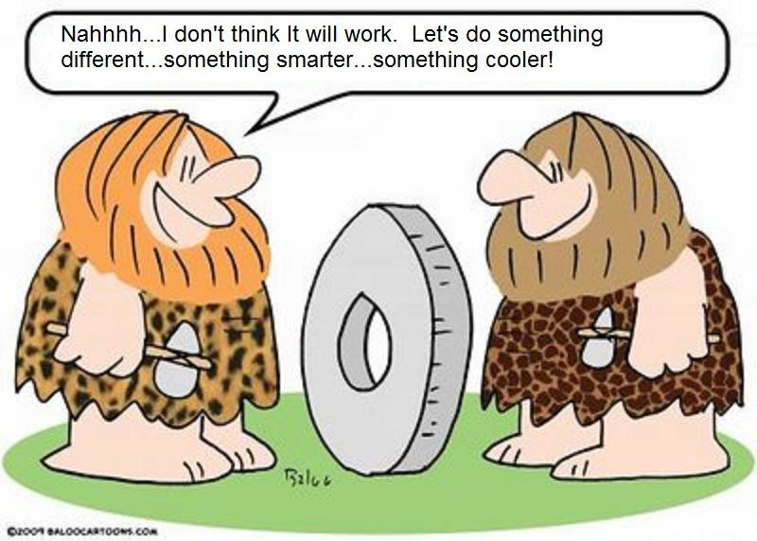
Summary

