Slide 1
Importance of polarisation observables in extraction of resonance properties
Mikhail Bashkanov

Slide 2
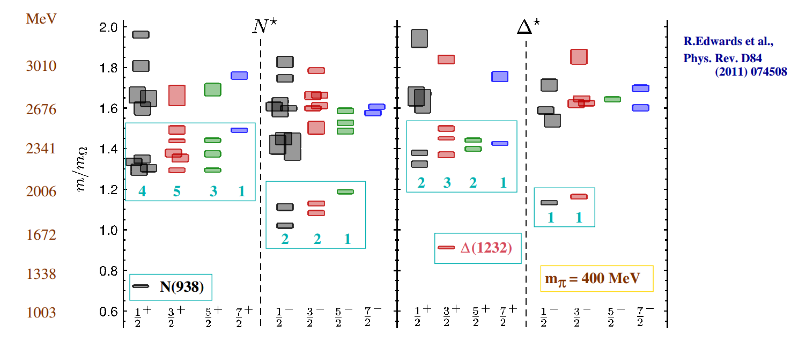
Lattice QCD
2

Slide 3
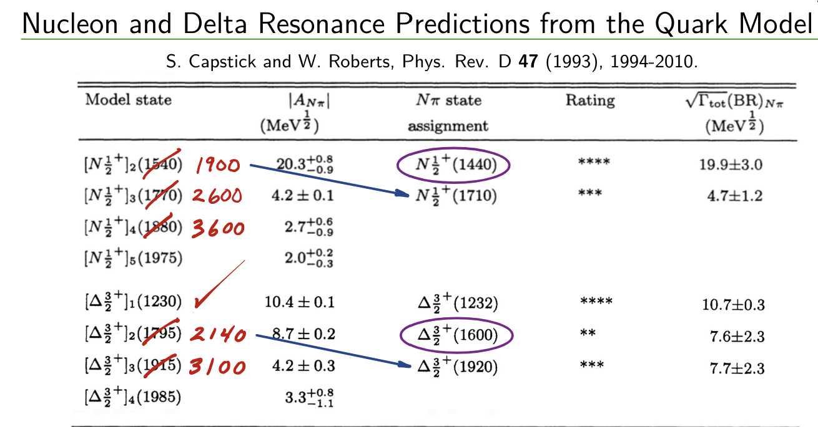
Lattice QCD
Derek Leinweber, Nstar 2024
3

Slide 4
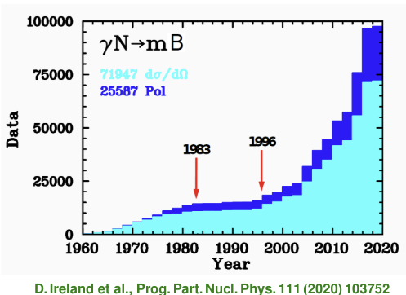
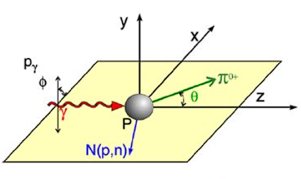
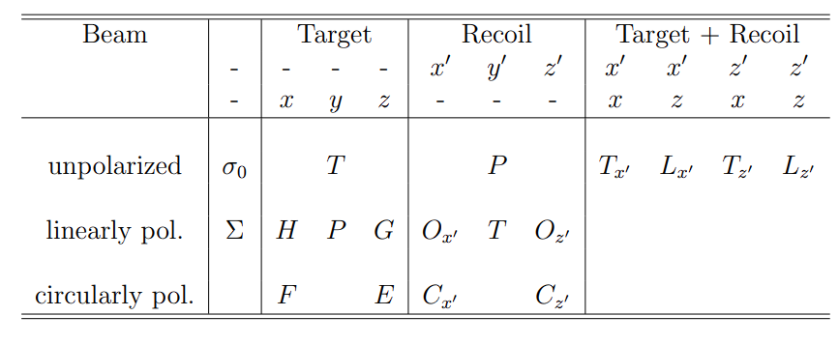

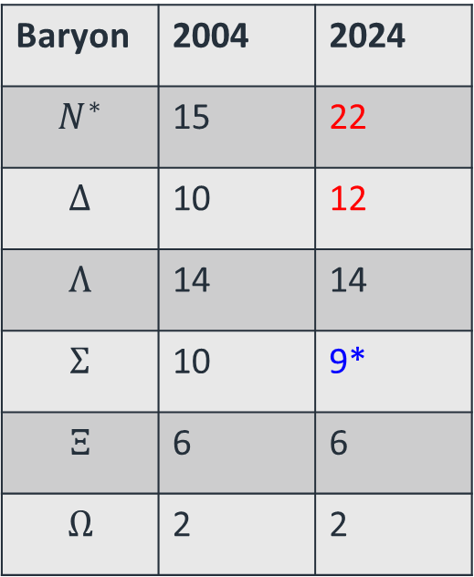
Baryon spectroscopy
Number of 3- and 4-star Resonances
Baryon | 2004 | 2024
$$N^{∗}$$ | 15 | 22
$$Δ$$ | 10 | 12
$$Λ$$ | 14 | 14
$$Σ$$ | 10 | 9*
$$Ξ$$ | 6 | 6
$$Ω$$ | 2 | 2
*$Σ\left(2250\right)$ was downgraded
MAMI, ELSA, JLAB
4

Slide 5
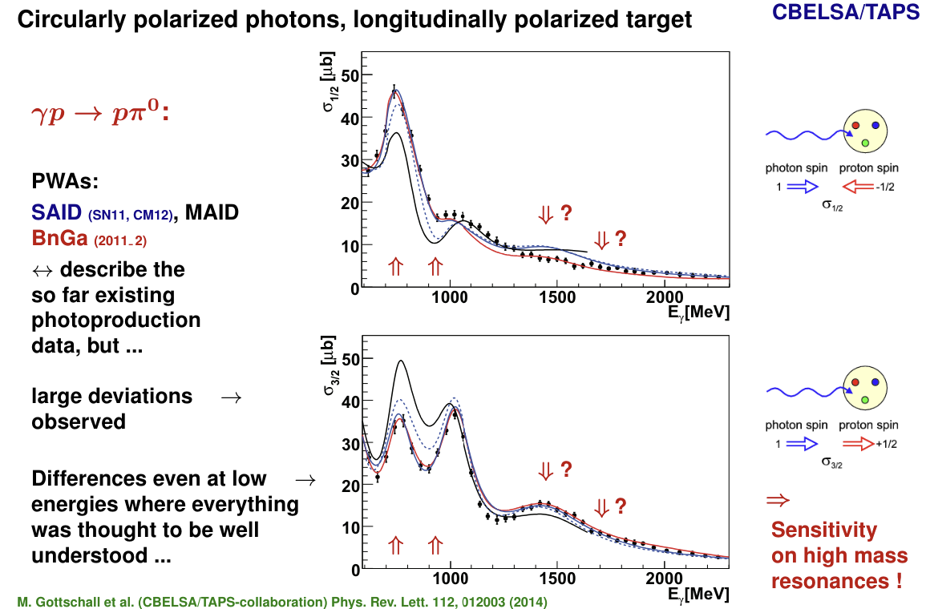
Polarisation is a key
Ulrike Thoma, Nstar 2024
5

Slide 6
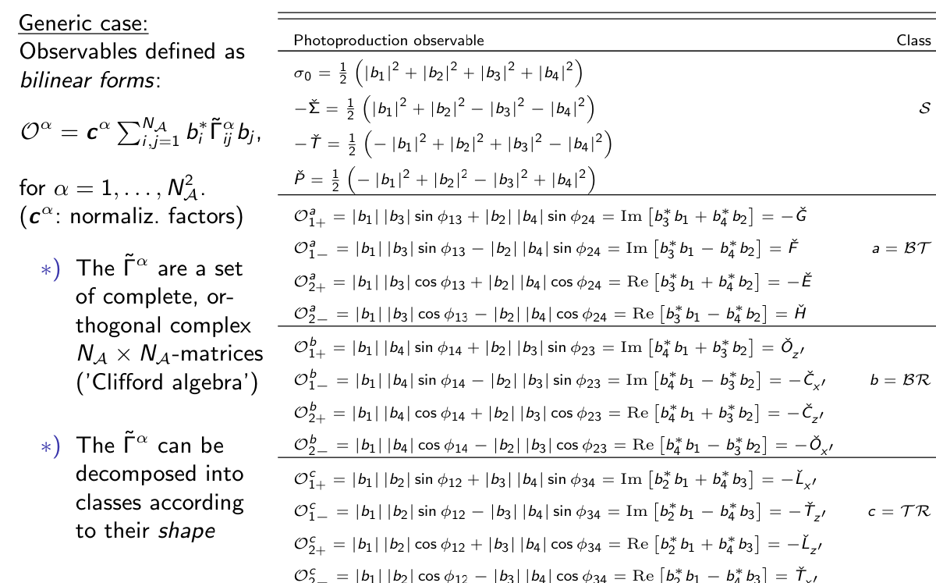
Polarisation observables
Yannick Wunderlich, NStar24
4 complex amplitudes -> 8 observables to define everything
May be even less (Y. Wunderlich, F. Afzal, A. Thiel, R. Beck, Eur. Phys. J. A 53, 5, 86, 2017)
6

Slide 7

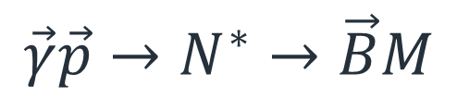
The full experiment
$$\vec{γ}\vec{p}→N^{∗}→\vec{B}M$$
7

Slide 8
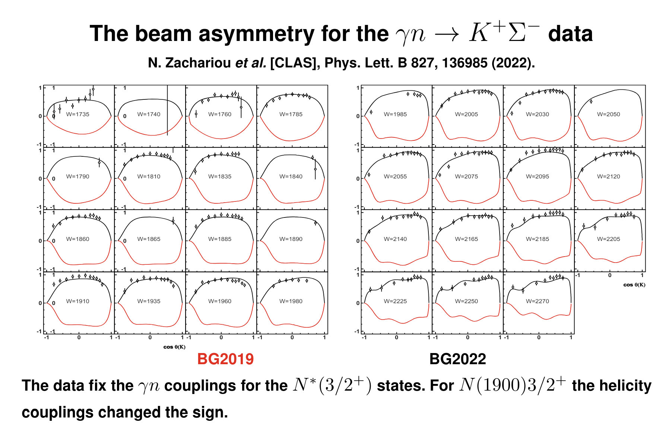
New observables
From A. Sarantsev, Nstar 2022
8

Slide 9
The full experiment
$$\vec{γ}\vec{p}→N^{∗}→\vec{B}M$$
9

Slide 10



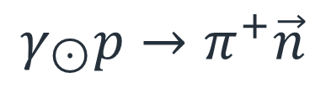


Cx observable
Analysing power
Polarisation
$$γ_{\begin{aligned}⊙ \\ \end{aligned}}p→π^{+}\vec{n}$$
$$γ$$
$$π^{+}$$
$$n$$
$$Θ,φ,E$$
p
Target
$$Θ^{′},φ′$$
Polarimeter
10

Slide 11
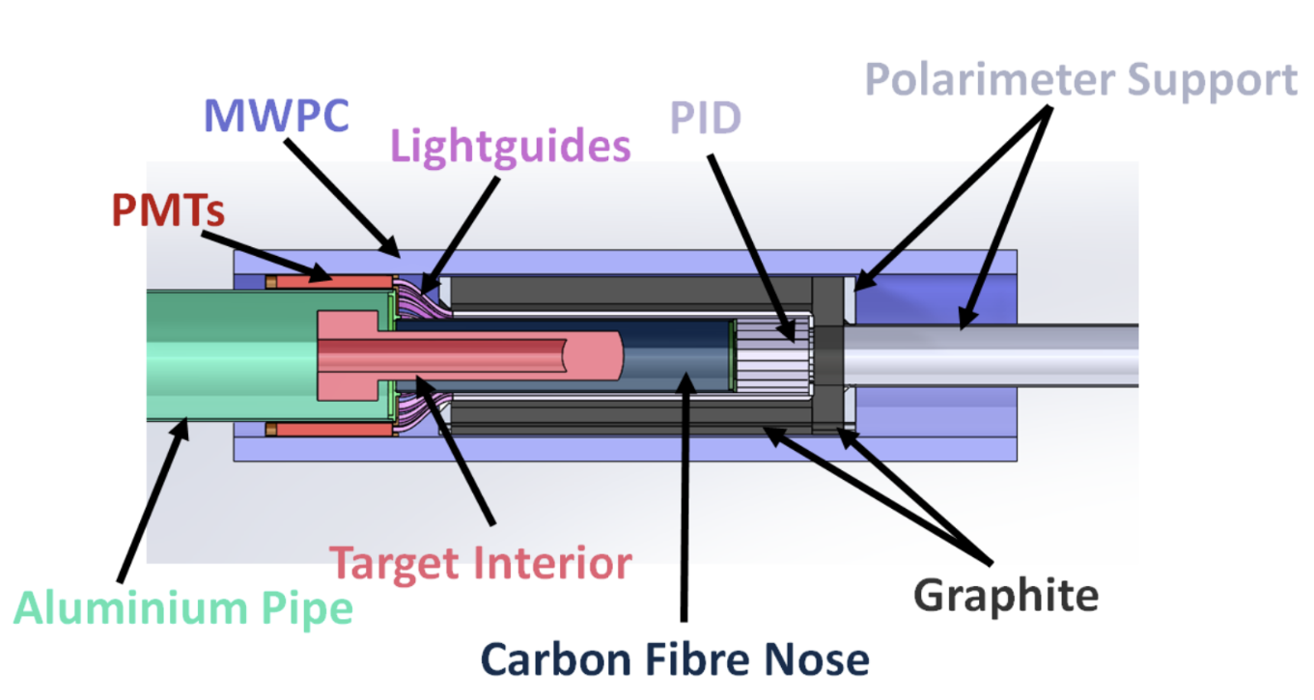
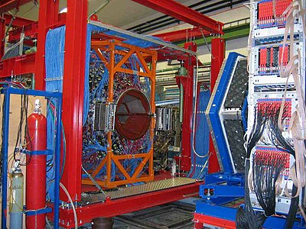
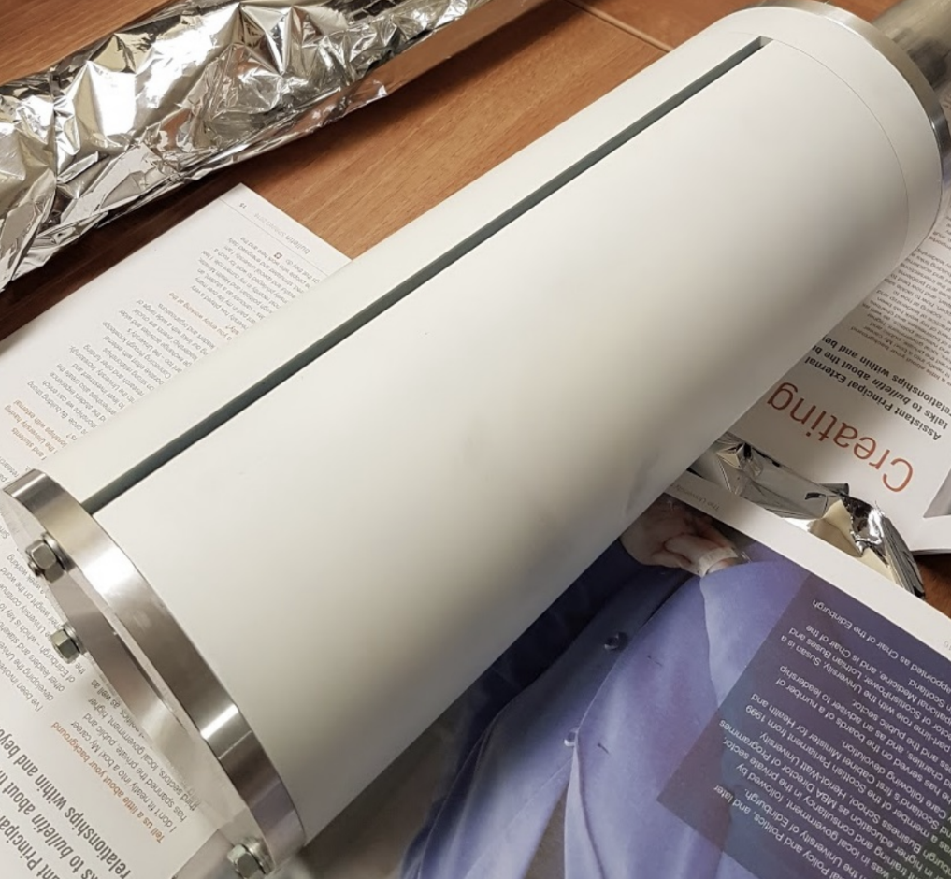
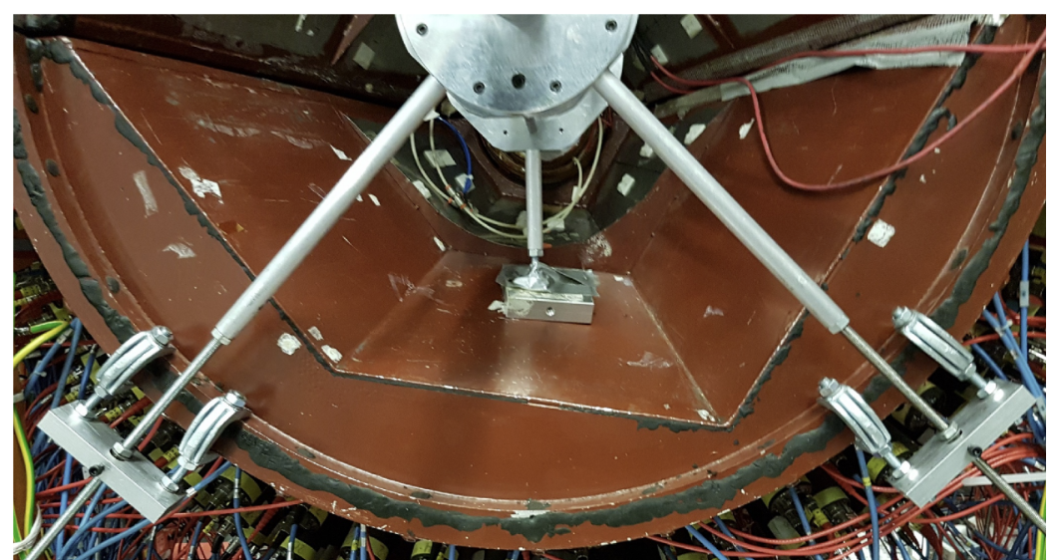
Setup
11

Slide 12
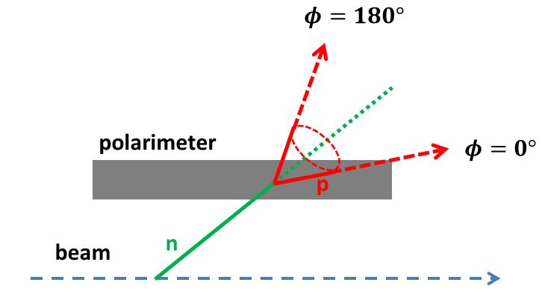
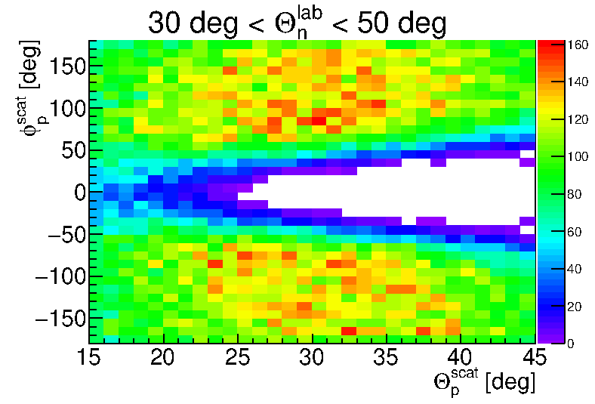
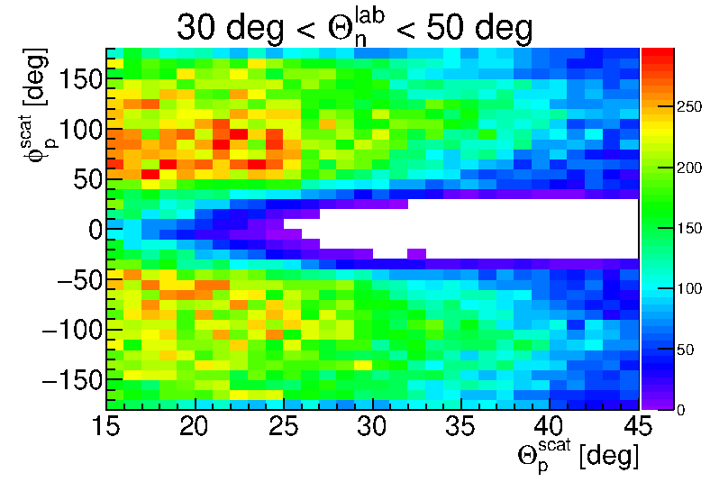


Geometrical Acceptance
$$Θ_{}^{n}−Θ_{scatt}^{p}>27°$$
MC
Data
12

Slide 13
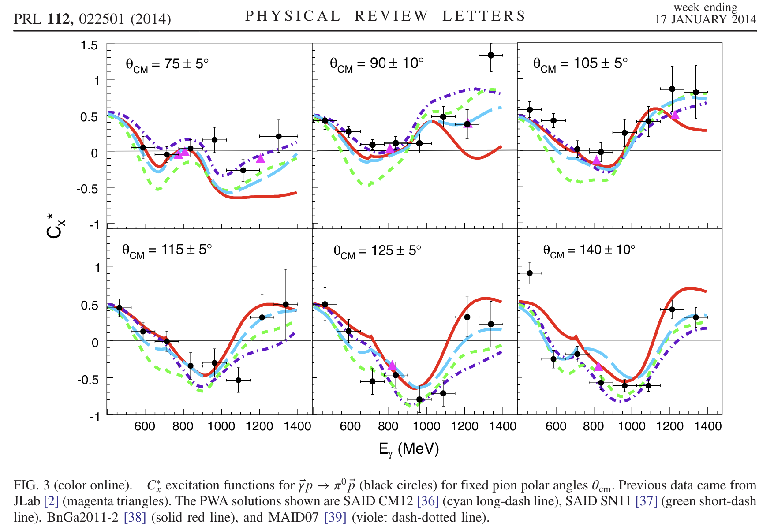
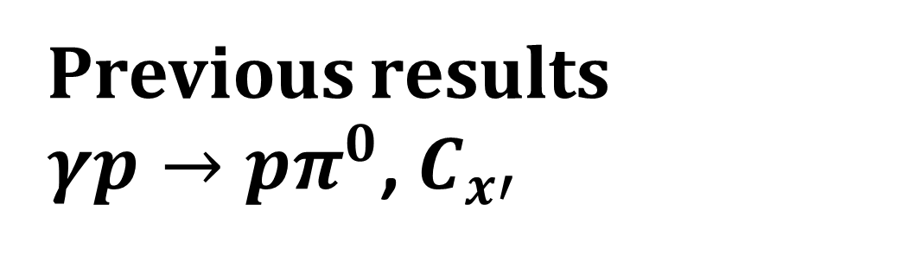
Previous results
$γp→pπ^{0}$, $C_{x′}$
13

Slide 14
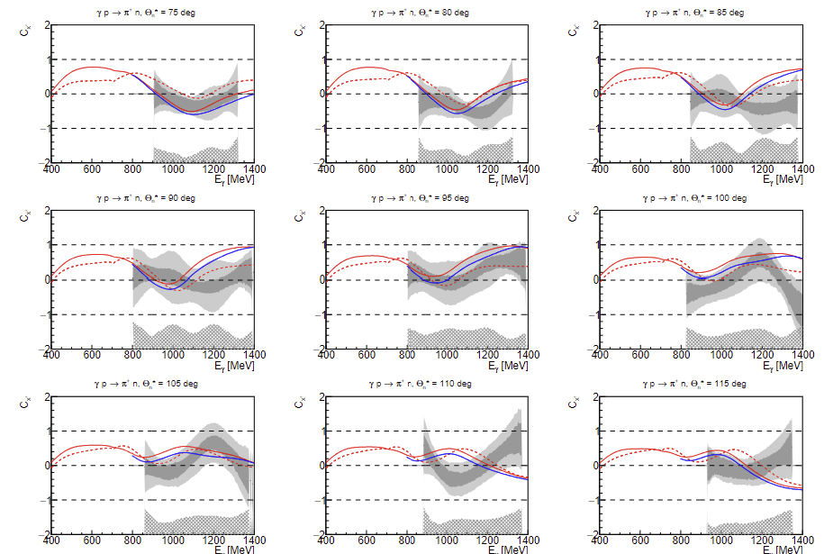
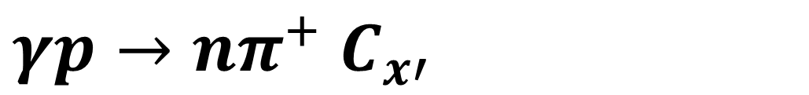
$γp→nπ^{+}$ $C_{x′}$
SAID22, SAID23, BnGa
14

Slide 15
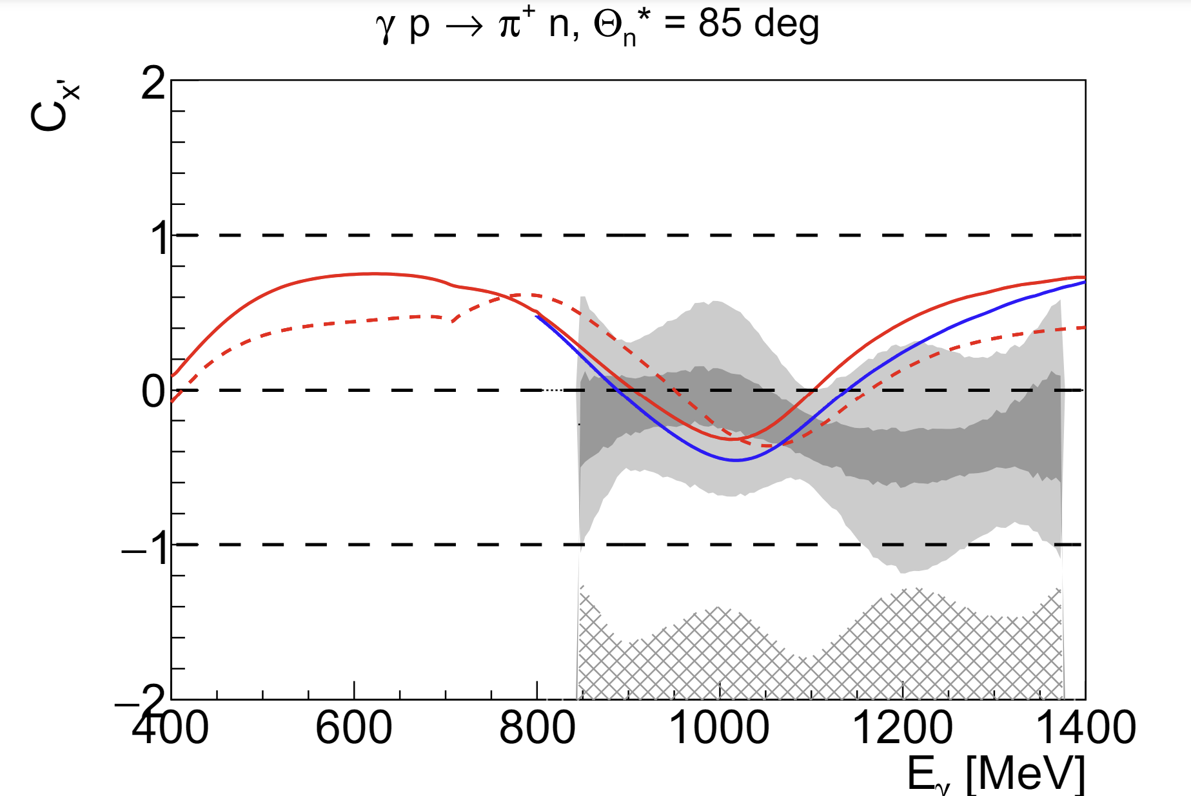
$γp→nπ^{+}$ $C_{x′}$
SAID22, SAID23, BnGa
15

Slide 16
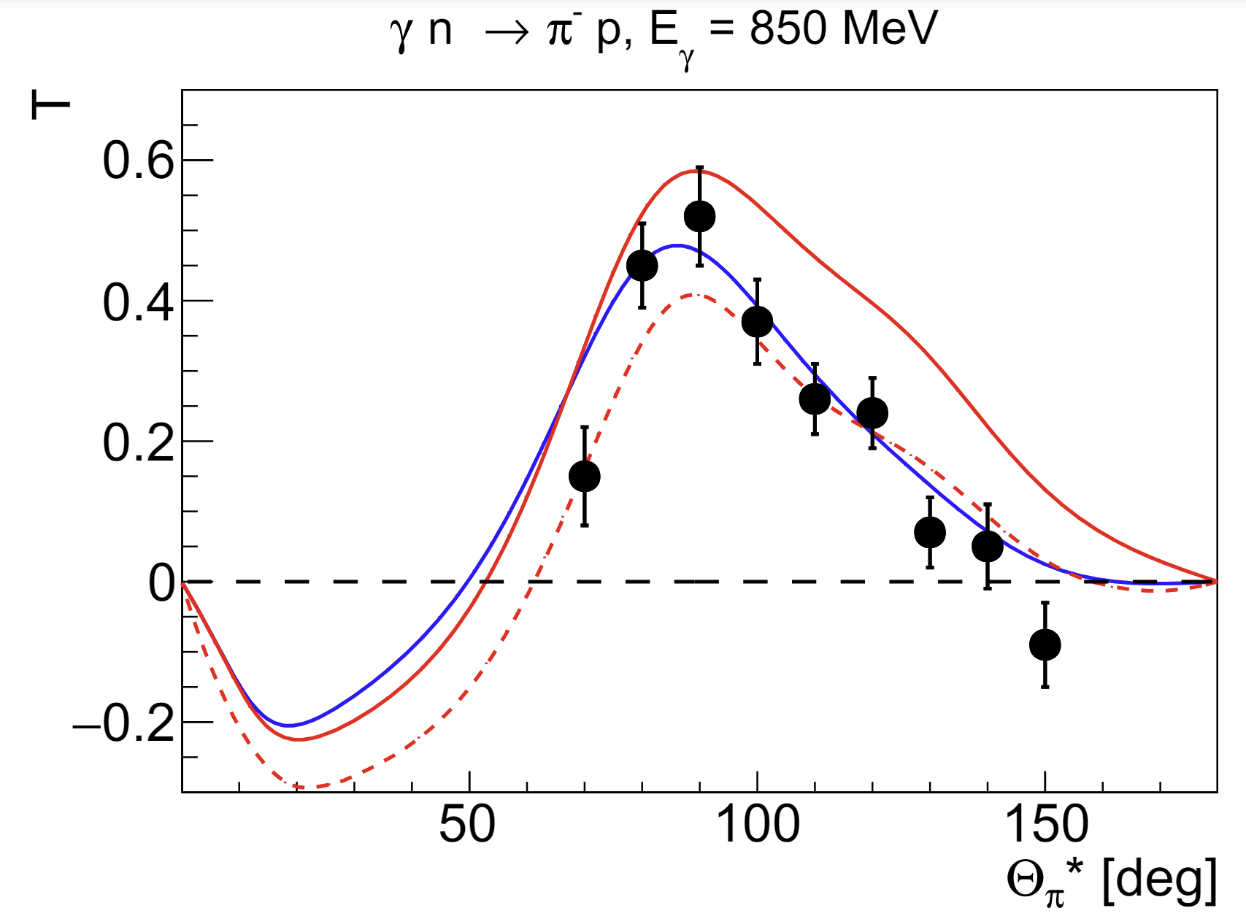
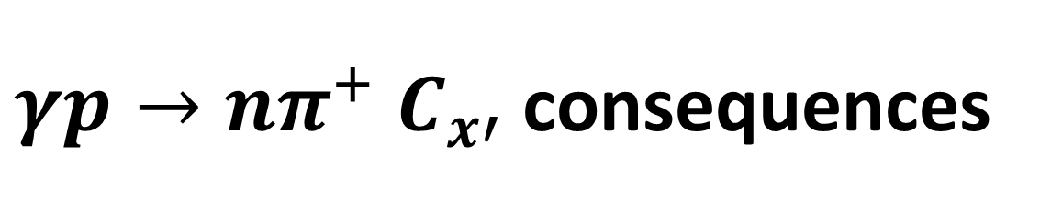
$γp→nπ^{+}$ $C_{x′}$ consequences
SAID22, SAID23, BnGa
16

Slide 17
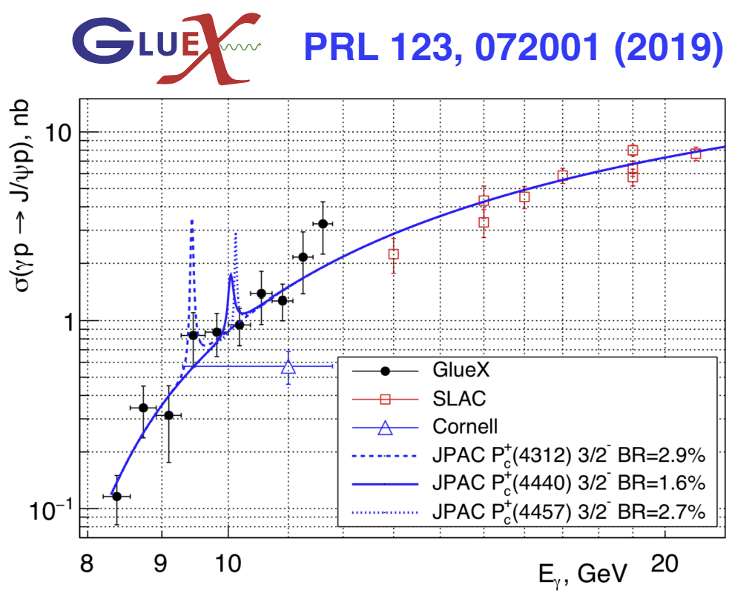
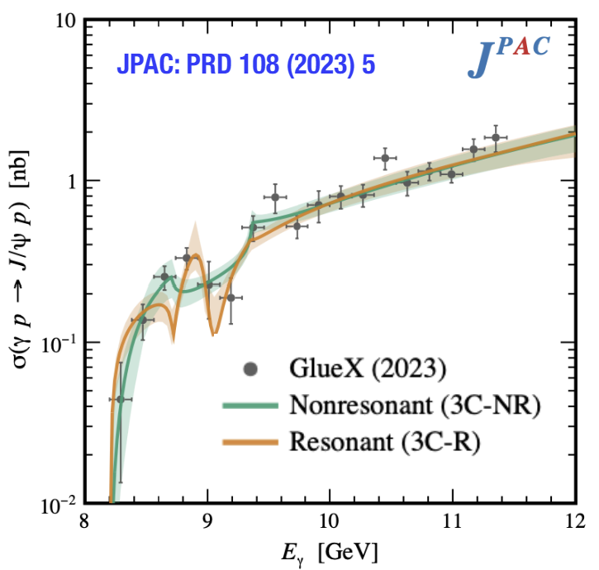
Polarisation observables at high energies?
Need Polarisation:
Beam?
Target?
Stats?
17

Slide 18
Conclusion
Double-polarisation measurements is a powerful tool
  Systematics
  Baryon spectroscopy
  Need other measurements besides Beam-Target
  High energies
18

Slide 19
Thank you

