Slide 1
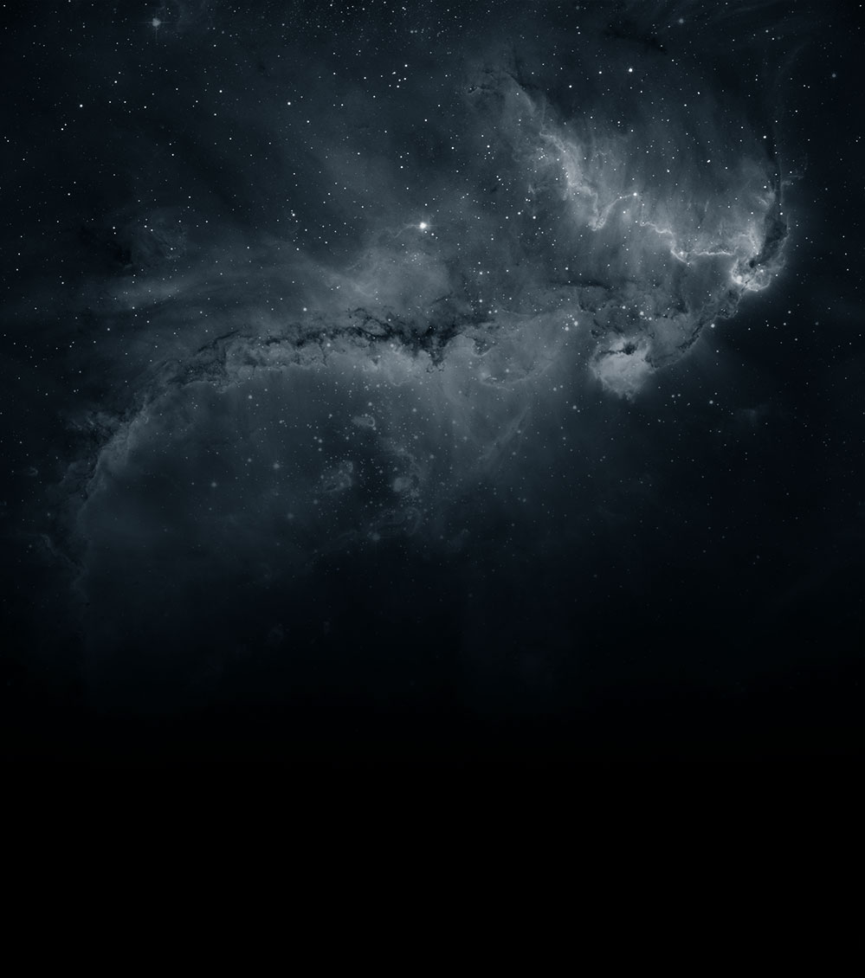


Gravity Effective Field Theories
Annual Theory Meeting
Durham
18 Dec 2024
Claudia de Rham

Slide 2
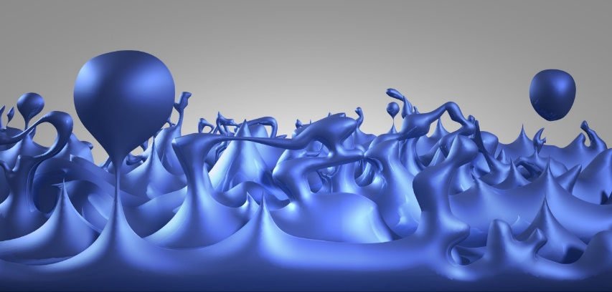
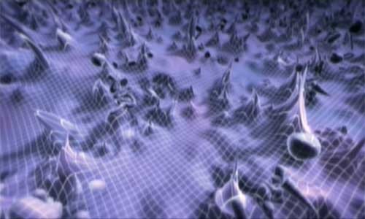

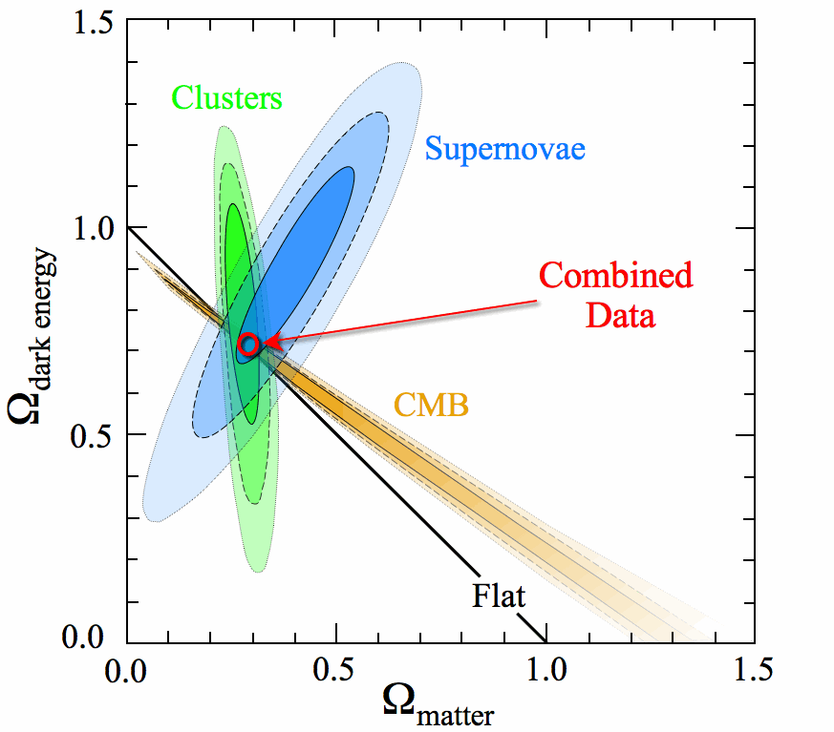
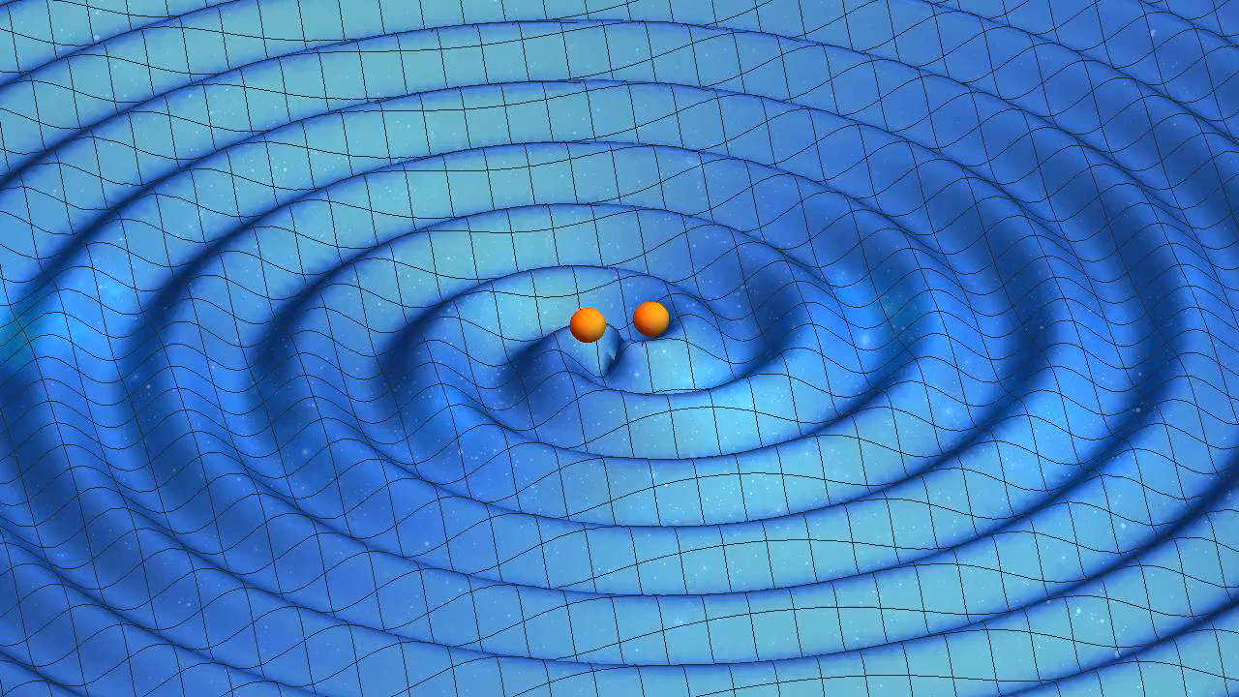
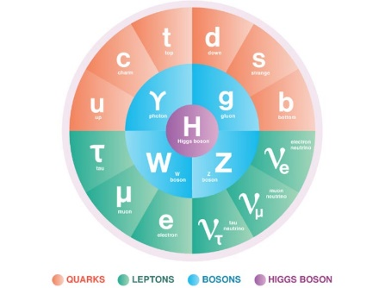
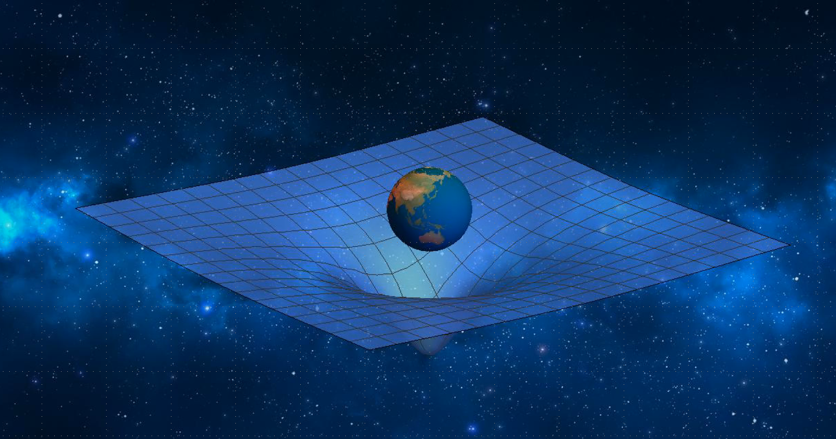
Energy
?
?

Slide 3



Effective Field Theory
Energy
UV completion of
Quantum Gravity
???
???
Low-energy EFT
Within low-energy gravitational EFTs,
what are the constraints from
“standard” UV completion
(in the Wilsonian sense)?
E.g.: GR + irrelevant operators
+ (B)SM fields
+ light degrees of freedom

Slide 4
Quintessence
SLED
Minimally coupled
to matter
DE is dynamical
(new dof)
Brans Dicke
eg. f(R)
Non-minimally
coupled to matter
Eternal
inflation
Graviton
is spin-2, massless
field
Unique Λ
DE is not dynamical
(no new dof)
Λ
Tunneling
dynamics
Landscape
of vacua
Anthropic
arguments
What is
Dark Energy?
Backreaction
Graviton has
mass (resonance)
Infinite extra
dimensions
DGP
Graviton
is not spin-2, massless
field
Consistent IR
modification of
gravity
Cascading
Gravity
Lorentz invariance
is broken
Self-
acceleration
Filtering /
degravitation
mechanism
Nonlocality
Ghost
condensate
de Rham, Tolley 2008

Slide 5
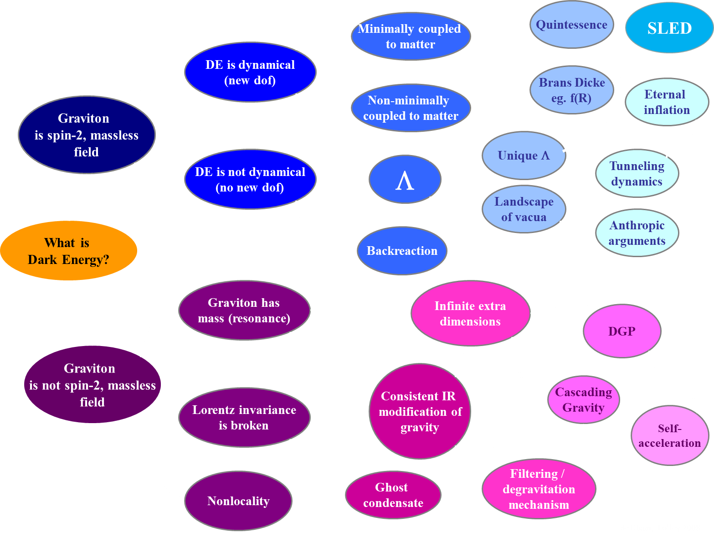
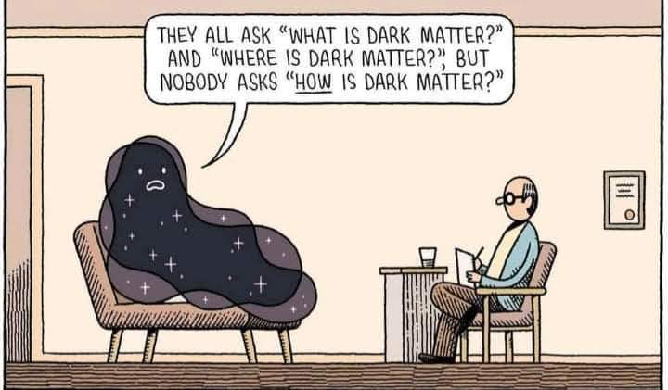
Beyond
Horndeski
Sym-metron
Horndeski
Galileons
EFT of Vector-Tensor
DHOST/
EST
Generalized Proca
Beyond
Generalized Proca
Proca-nuevo
biGravity/
Multi-
gravity
Warped MG
They all ask “What is Dark Energy”
and “Where is Dark Energy”, but
nobody asks “HOW is Dark Energy?
Mass-Varying
MG
Graviton has mass (local)
Quasi-dilaton
Partially Massless Gravity
Generalized Massive Gravity
Minimally Modified Gravity
Minimal Massive Gravity
Non-local massive gravity

Slide 6
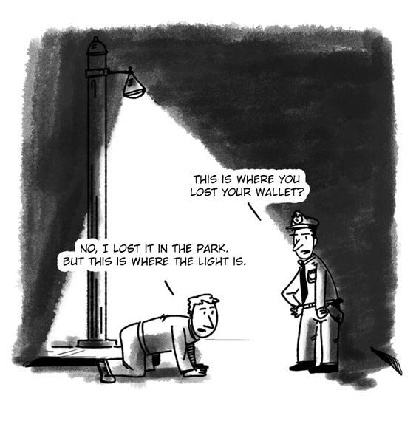
Guiding our searches for new discoveries

Slide 7
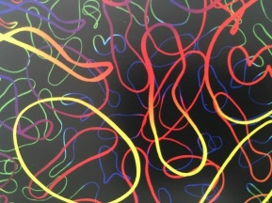

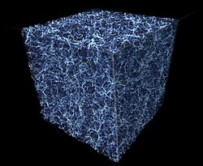
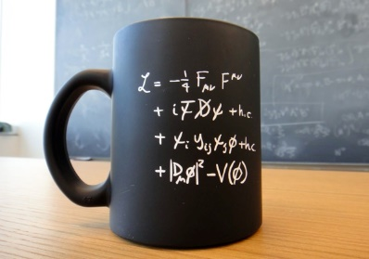
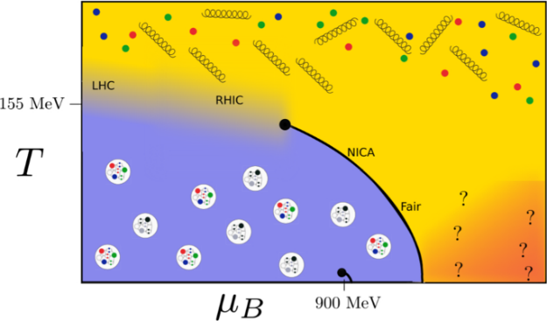
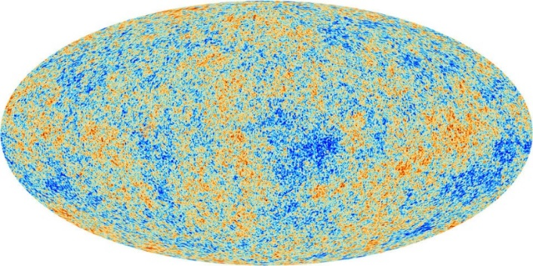
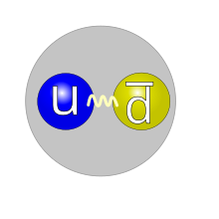
Energy
?
?
?
???

Slide 8

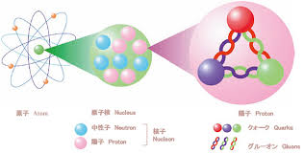

?
?
?
Causality
lamppost guiding searches for new science
in a neutral and agnostic way
S-matrix Bootstrap

Slide 9














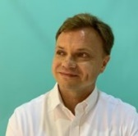

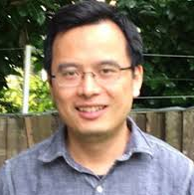
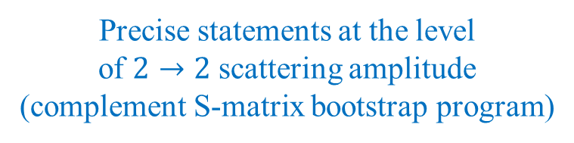
Constraints from UV Completion
Starting with the assumption of a healthy Wilsonian UV completion
(string theory or other)
Set up classes of IR constraints
Positivity Bounds
Causality Bounds
Precise statements at the level
of $2→2$ scattering amplitude
(complement S-matrix bootstrap program)
Unresolvable support outside
front velocity light cone
Alberte
Carrillo-
Gonzalez
Chen
Franckfort
Heisenberg
Jaitly
Jazayeri
Klapanek
Margalit
Melville
Momeni
Noller
Pozsgay
Rumbutis
Tokareva
Tolley
Zhang
Zhou

Slide 10

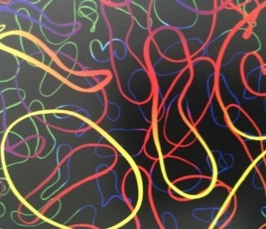
High-energy completion
Energy
?
?
Model may seem consistent at
low-energy

Slide 11
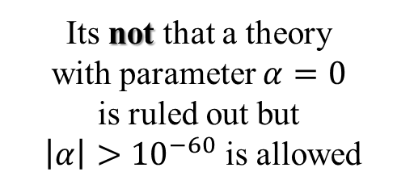
High-energy completion
Energy
?
?
Yet we know that some models
can never enjoy
a standard UV completion
60 orders
of magnitude
Its not that a theory
with parameter $α=0$
is ruled out but
$\left|α\right|>{10}^{−60}$ is allowed
Model may seem consistent at
low-energy

Slide 12
Assumptions on the UV Completion
1. Unitarity,
2. Locality,
3. Poincaré,
4. Causality
Weak-
coupling
translation
time-dependent
vacuum
S-matrix
bootstrap
Positivity
Bounds
Tree-level
weak-coupling
Specific
string theory
compactification
boosts
locality
Assumptions

Slide 13
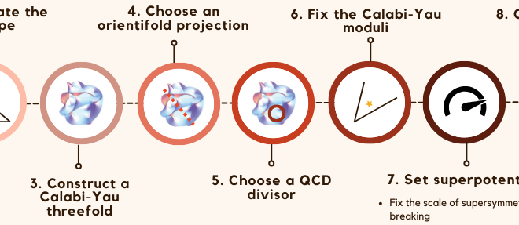

Assumptions on the UV Completion
1. Unitarity,
2. Locality,
3. Poincaré,
4. Causality
Complements approach
By David Marsh and co.
Weak-
coupling
translation
time-dependent
vacuum
S-matrix
bootstrap
Positivity
Bounds
Tree-level
weak-coupling
Specific
string theory
compactification
boosts
locality
Lotus in
Swamplandia
Assumptions

Slide 14
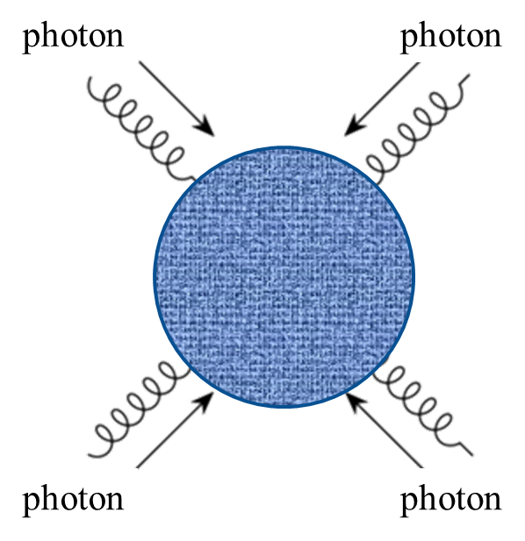
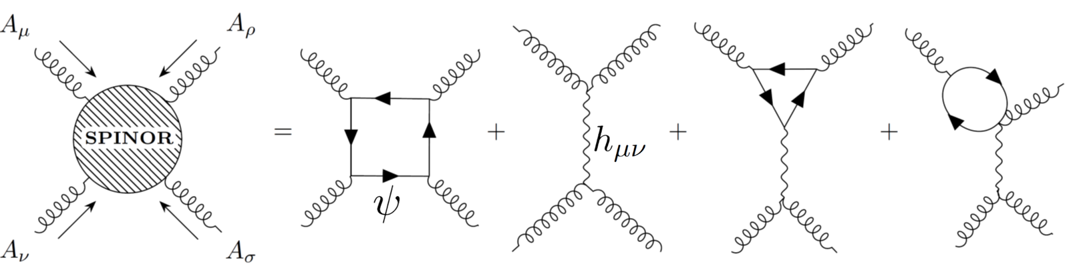
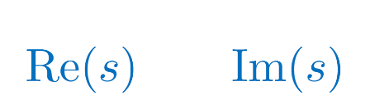
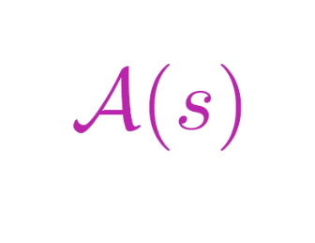
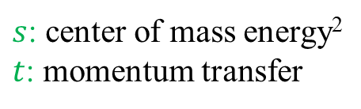

Low-energy Scattering
+…
: $2−2$ elastic scattering amplitude
$s$: center of mass energy²
$t$: momentum transfer

Slide 15
Low-energy Scattering
: $2−2$ elastic scattering amplitude
$s$: center of mass energy²
$t$: momentum transfer
Region where low-energy EFT is valid
UV completion

Slide 16

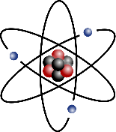
Analyticity - Causality
Causality
– encoded by requirement of analyticity –
is what connects UV to IR
UV completion
EFT

Slide 17
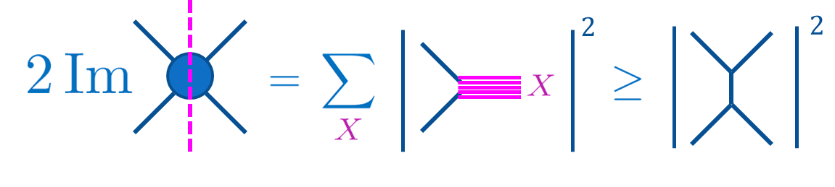
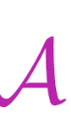
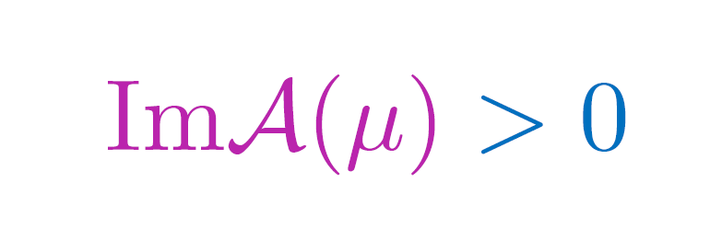
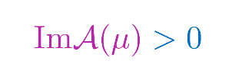
Non-Gravitational EFT
Unitary (optical theorem)
Lorentz invariant (crossing symmetry)
UV completion
: $2−2$ elastic scattering amplitude
$$m^{2}$$
$${3m}^{2}$$
$${4m}^{2}$$

Slide 18
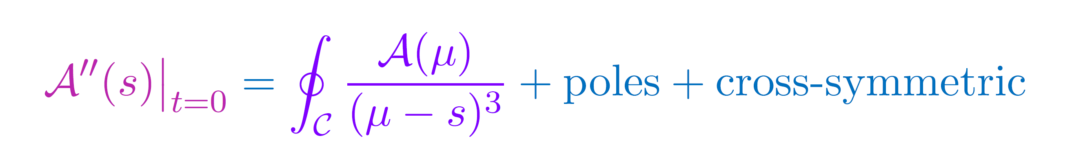

Non-Gravitational EFT
Unitary (optical theorem)
Lorentz invariant (crossing symmetry)
CAUSAL (analyticity)
UV completion

Slide 19
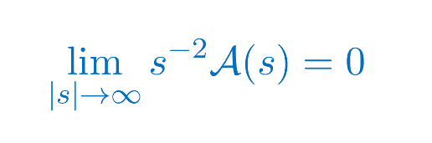

Non-Gravitational EFT
Unitary (optical theorem)
Lorentz invariant (crossing symmetry)
CAUSAL (analyticity)
Local (Froissart Bound)
UV completion
Pham and Truong 1985
Ananthanarayan, Toublan and Wanders, 1994
Adams et. al. 2006

Slide 20


Non-Gravitational EFT
CoM Energy
Unitary (optical theorem)
Lorentz invariant (crossing symmetry)
CAUSAL (analyticity)
Local (Froissart Bound)
positivity bounds
(applied to low-energy
scattering amplitude
or refractive index)
Low-energy
EFT
(sub)luminal sound speed

Slide 21
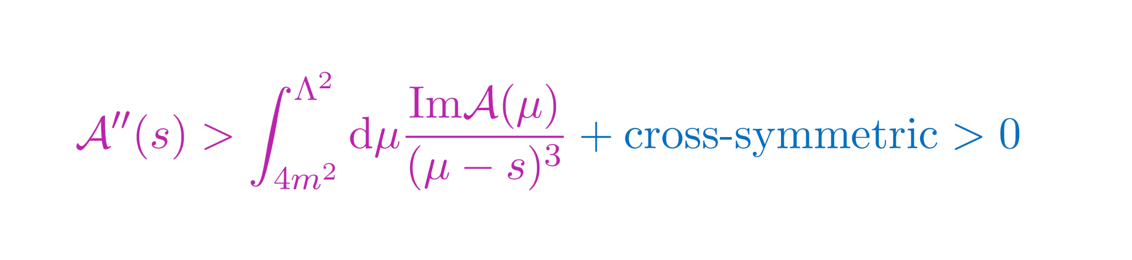
Ext 1. Improved Bounds
This part of the branchcut is calculable within the LEEFT and can be removed
LEEFT
valid
Subtracting our knowledge
CdR, Melville, Tolley, Zhou 1702.08577

Slide 22

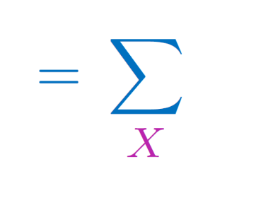


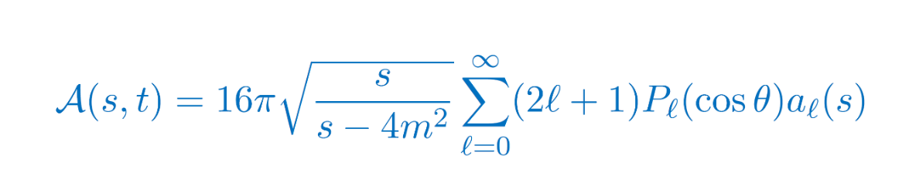
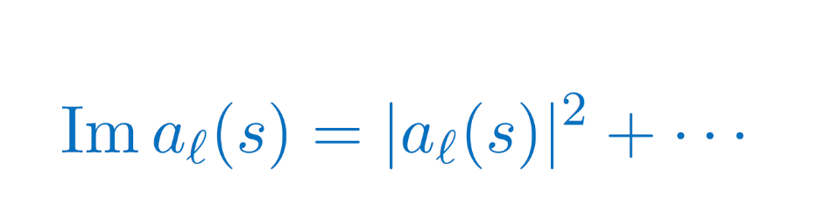
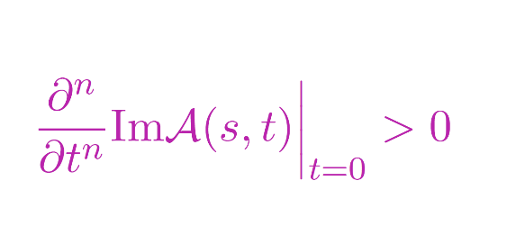
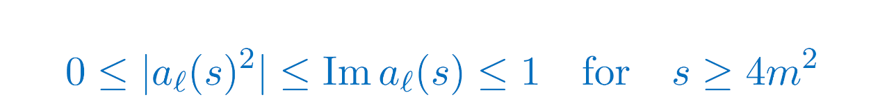
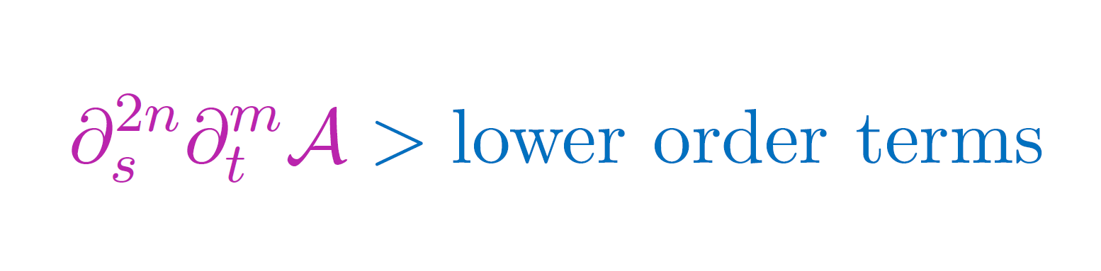
Ext 2. Beyond Forward Limit
$$2$$
$$2$$
The optical theorem carries an infinite more information than $σ>0$
CdR, Melville, Tolley & Zhou, 1702.06134
+ finite impact parameter bounds Caron-Huot, Rastelli, Simmons-Duffin, 2102.08951

Slide 23
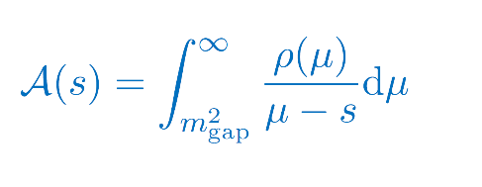
Ext 3. Non-linear bounds
Positive properties of Legendre/Gegenbauher polynomials imply further `EFT-Hedron’ bounds
Arkani-Hamed, Huang, Huang, 2012.15849
Chiang, Huang, Rodina, Weng, 2105.02862
For a dispersion relation
defining the Hankel matrices
Positivity of spectral representation implies positivity of each matrix
Moreover, full $s↔u↔t$crossing symmetry further implies a set of “null constraints”
which can further tighten these non-linear bounds
Tolley, Wang, Zhou, 2011.02400
Caron-Huot, Van Duong, 2011.02957
Sinha, Zahed, 2012.04877
Compact bounds on Det $H_{n}$

Slide 24
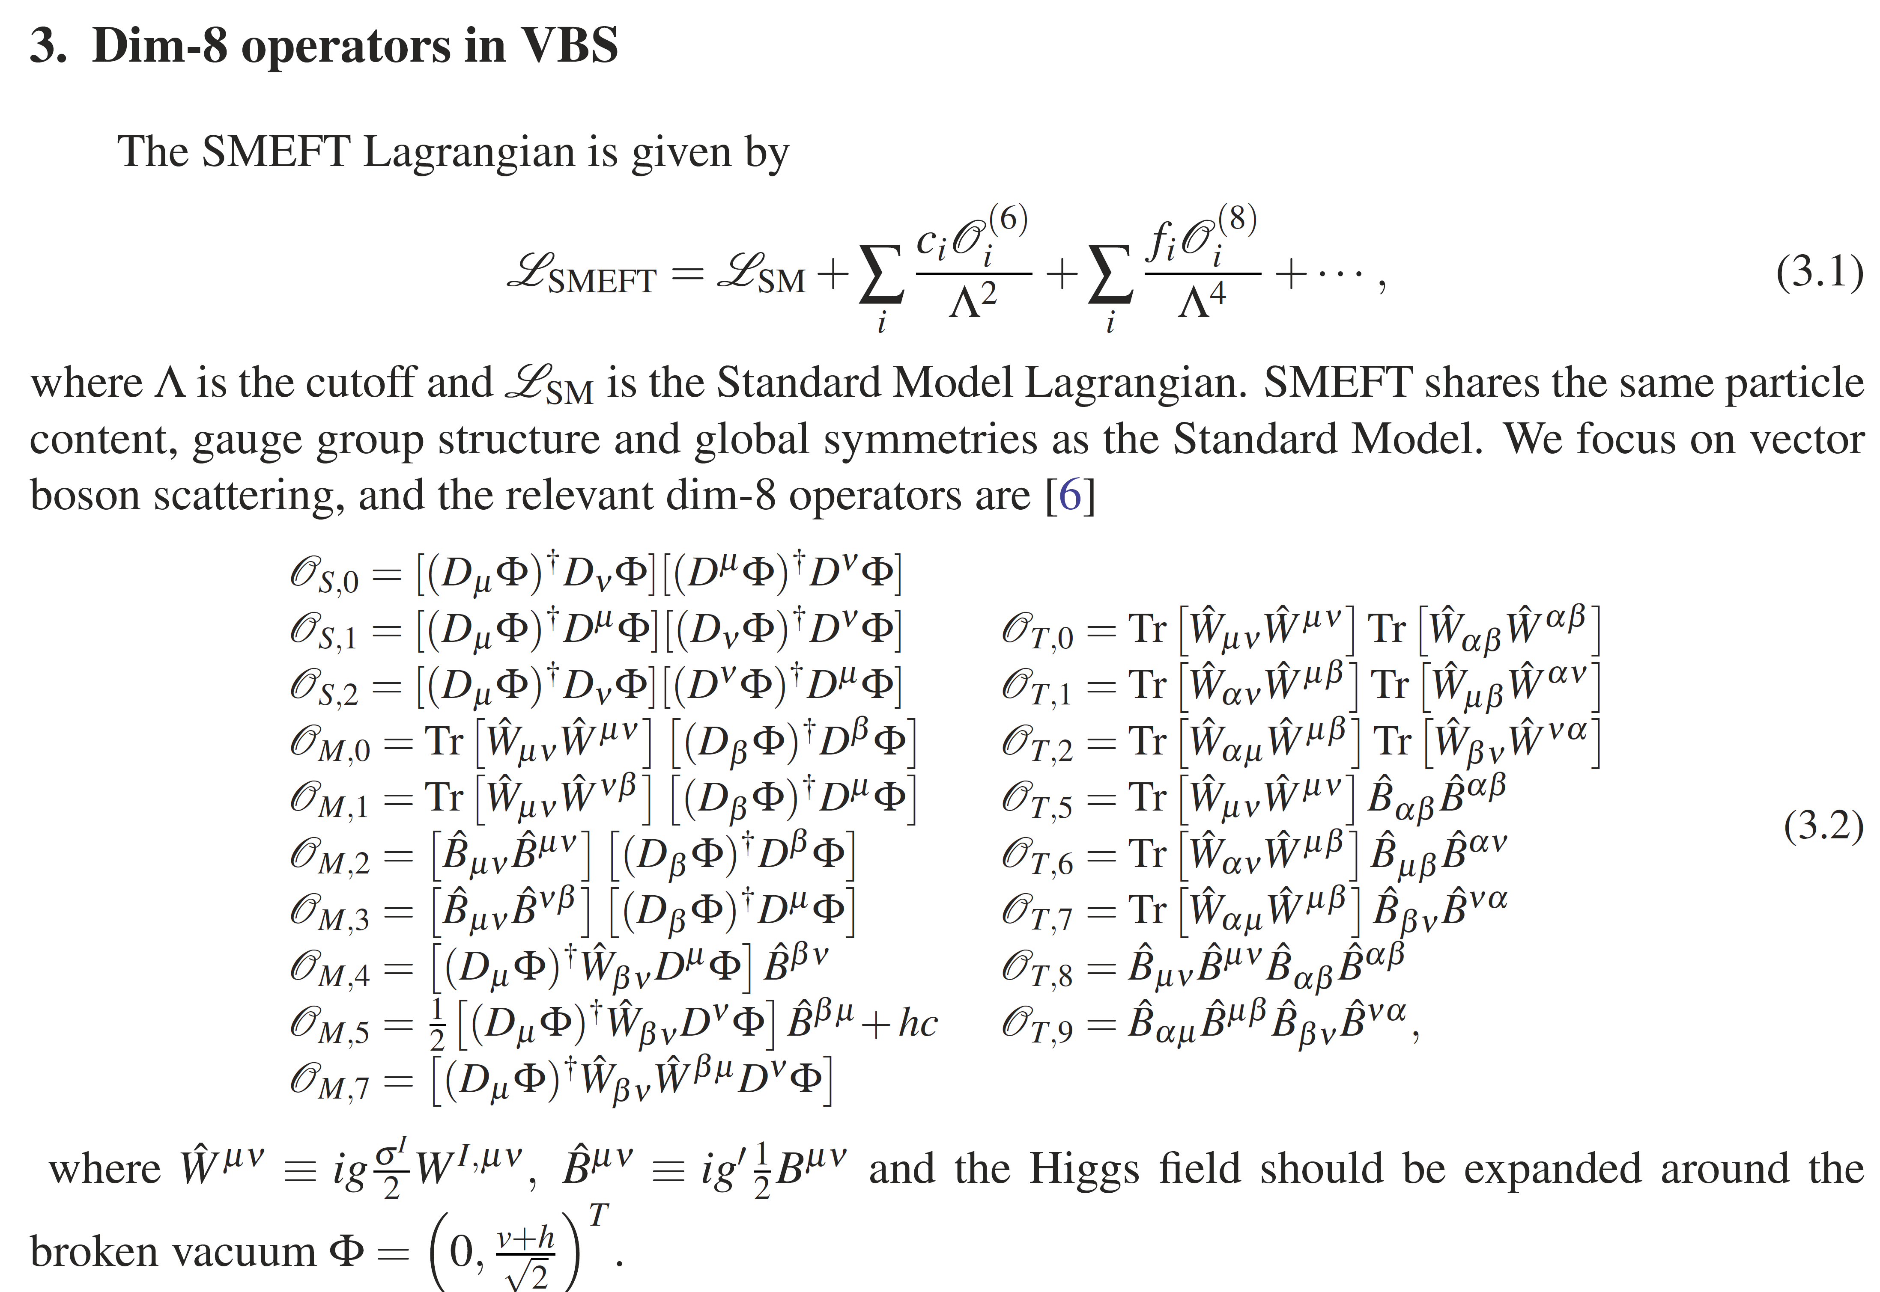
e.g.
Positivity bounds on
dim-8 SMEFT operators
C. Zhang and S.-Y. Zhou, 1808.00010
K. Yamashita, C. Zhang, and S.-Y. Zhou, 2009.04490
Regions compatible with data
Regions that can enjoy a standard high energy completion

Slide 25
Non-Gravitational EFT
CoM Energy
Unitary (optical theorem)
Lorentz invariant (crossing symmetry)
CAUSAL (analyticity)
Local (Froissart Bound)
positivity bounds
(applied to low-energy
scattering amplitude
or refractive index)
Low-energy
EFT
(sub)luminal sound speed

Slide 26






Gravitational EFT
CoM Energy
Unitary (optical theorem)
Lorentz invariant (crossing symmetry)
CAUSAL (analyticity)
Local (Froissart Bound)
$$φ$$
$$φ$$
positivity bounds
(applied to low-energy
scattering amplitude
or refractive index)
$$φ$$
$$φ$$
More subtle for gravitational EFTs
Low-energy EFT
(sub)luminal sound speed

Slide 27
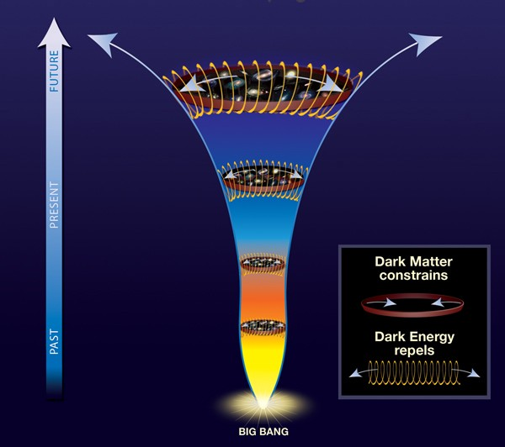

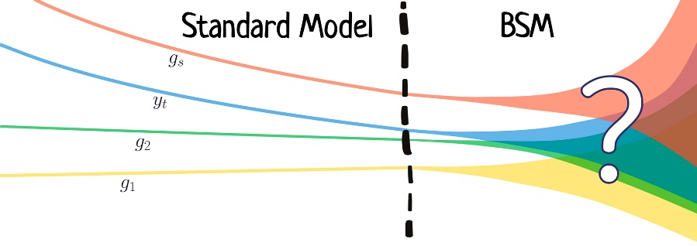
Positivity Constraints on…
Beyond Standard Model
dark energy
binary
gravitational systems
dark matter
Black Holes
Cosmological GWs
Inflation
Physics Beyond the Standard Model

Slide 28
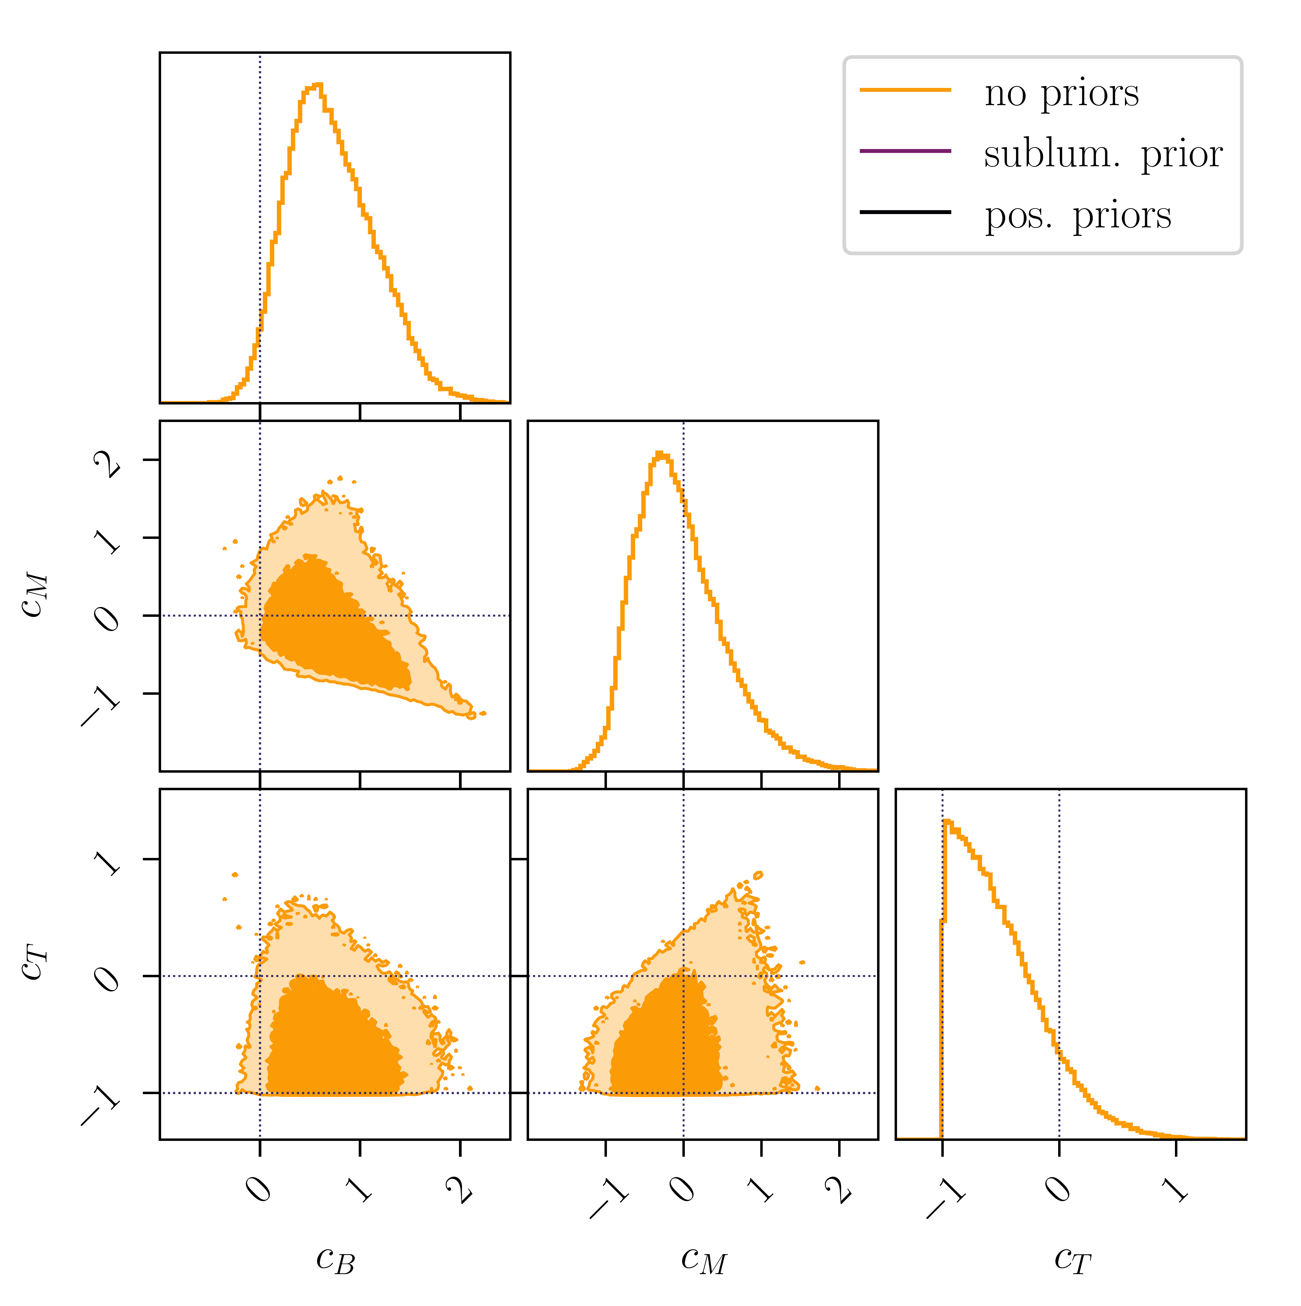
Constraints on Low-energy Models
Example of Cosmological model with parameters $c_{B,M,T}$
Constraints from observations
CMB, BAO, redshift space distortion,…
CdR, Melville and Noller 2103.06855

Slide 29
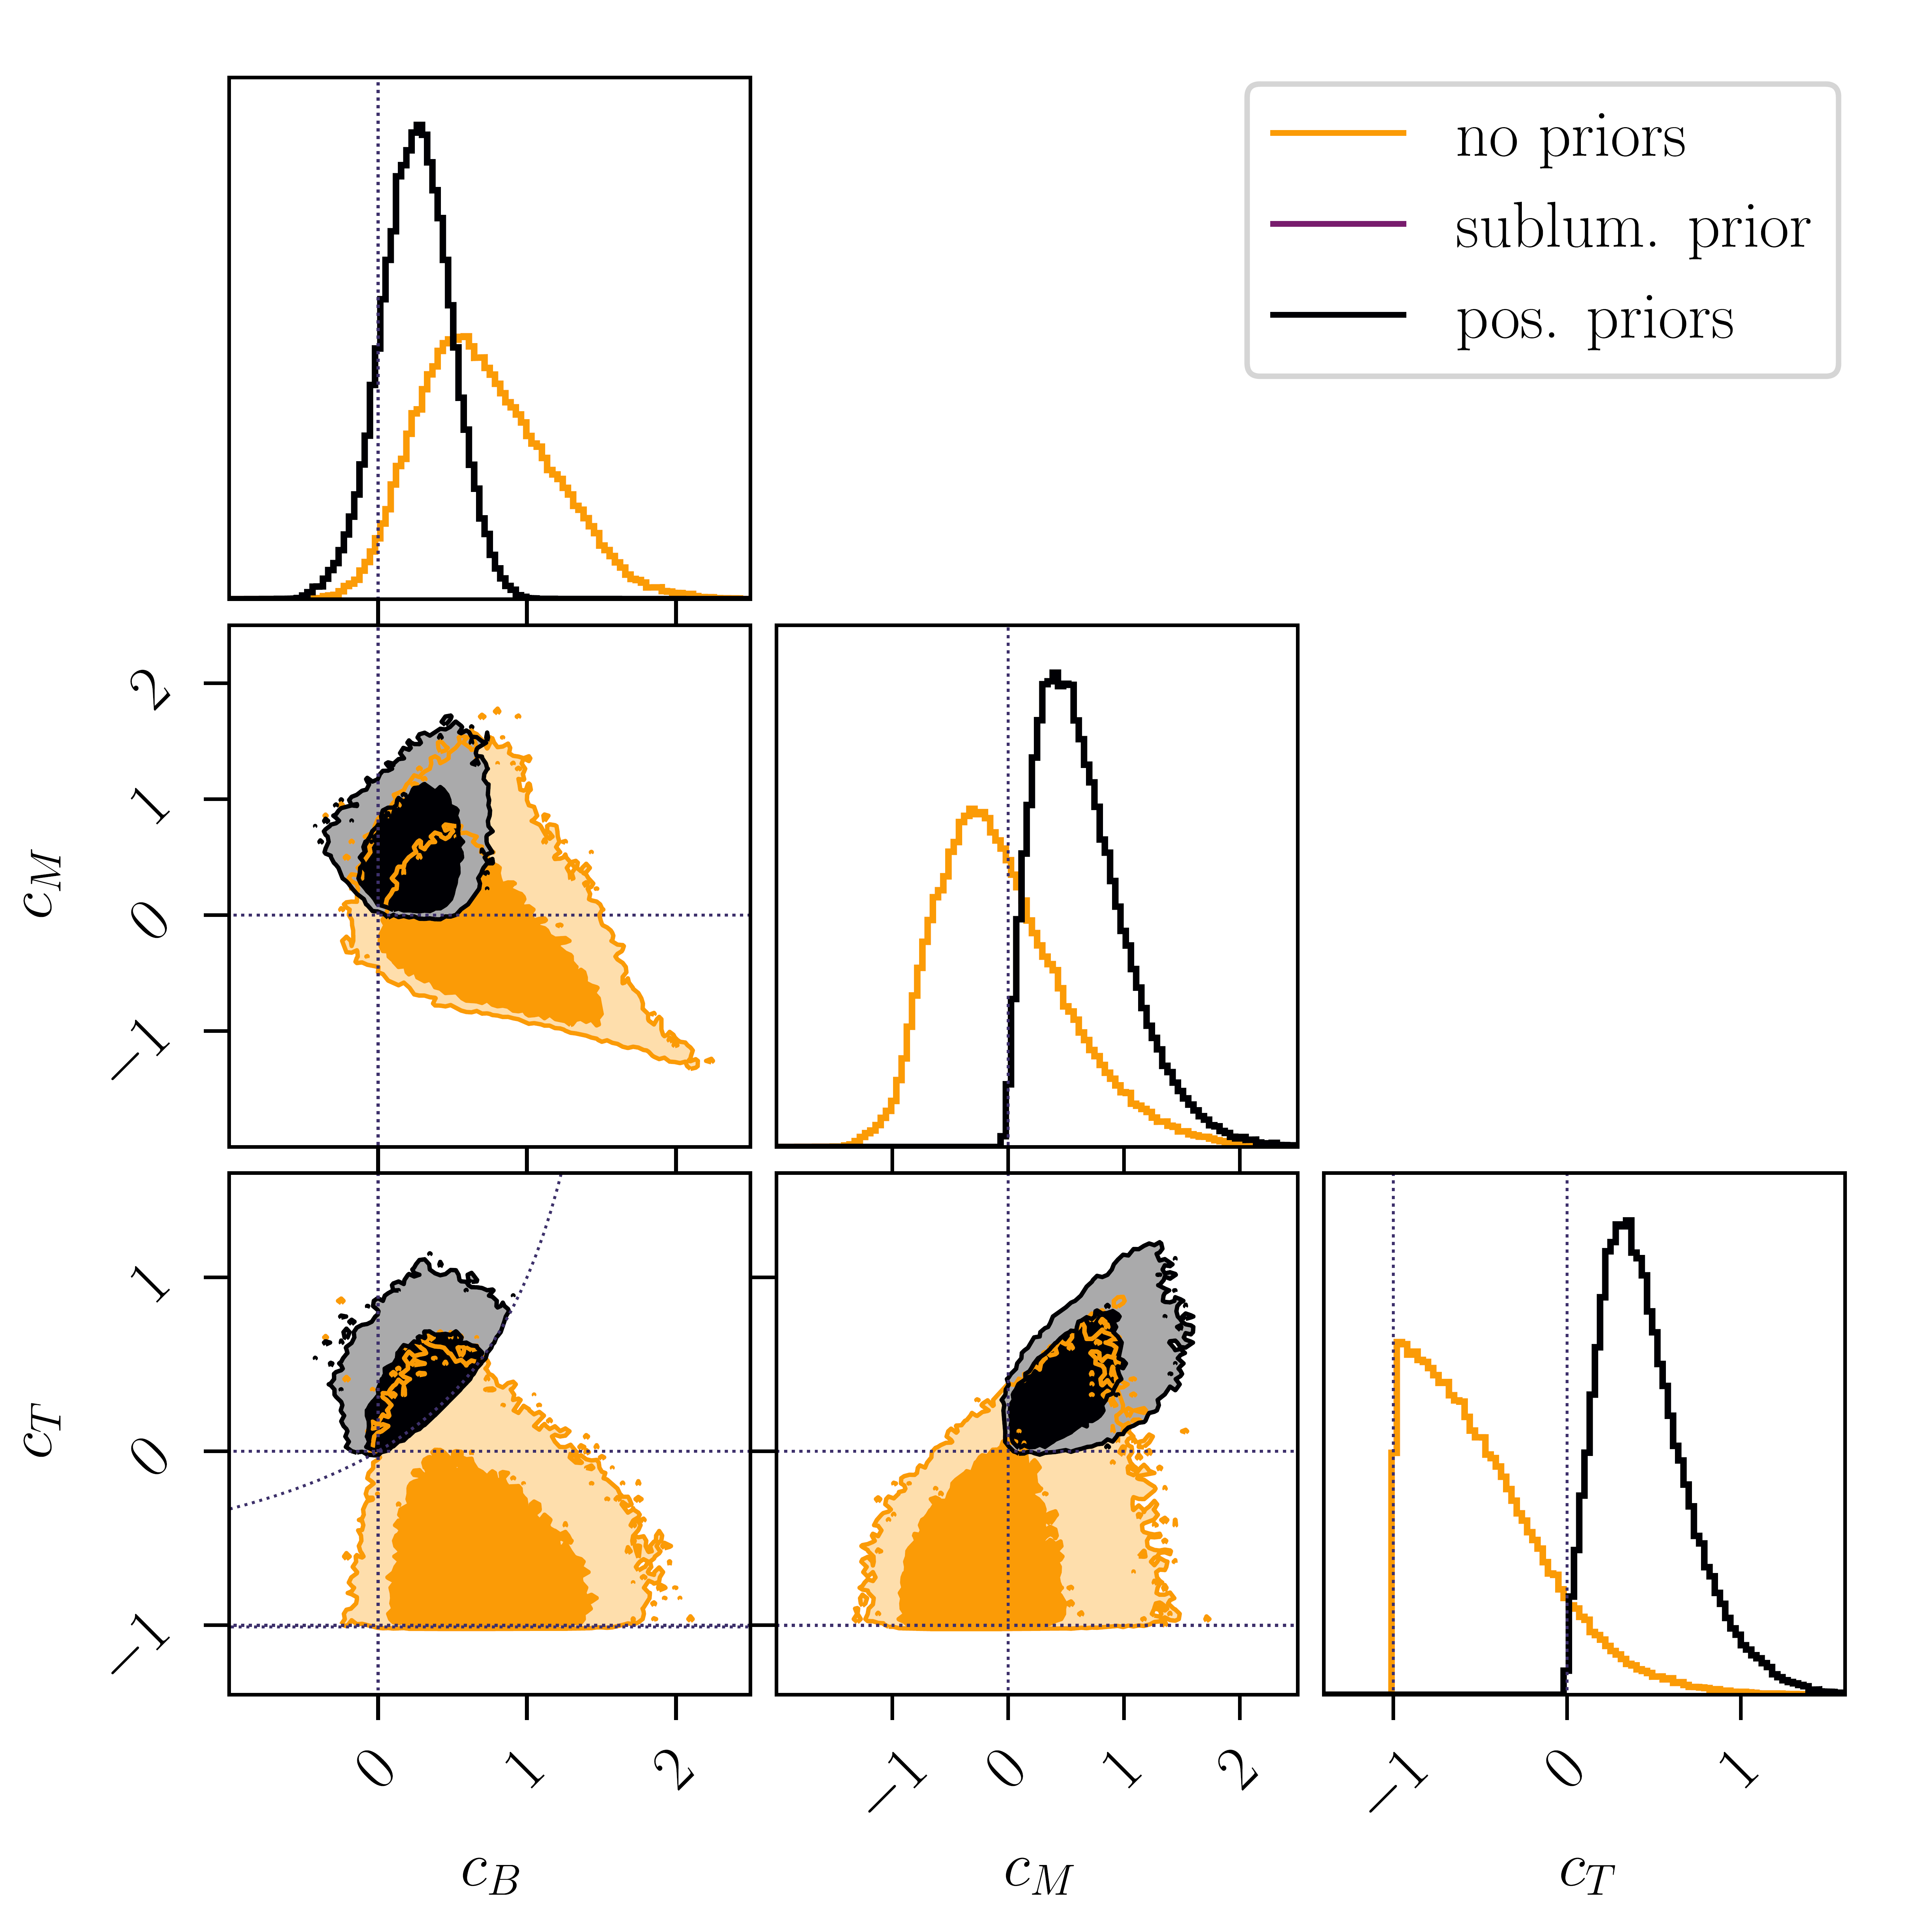
Constraints on Low-energy Models
Example of Cosmological model with parameters $c_{B,M,T}$
Constraints from observations
CMB, BAO, redshift space distortion,…
Constraints from causality and consistent high energy completion (Positivity Priors)
CdR, Melville and Noller 2103.06855

Slide 30

Applications to EFT of Cosmology
- absence of S-matrix
- lack of Lorentz invariance/crossing symmetry
- ambiguous connection with analyticity
- gravitational exchange pole
Direct application to cosmology is more subtle due to:
Directions in progress:
Cosmological bootstrap on correlators (only perturbative)
No constraints from UV completion (analyticity, non-perturbative UV unitarity still need to be formulated)
Arkani-Hamed, Baumann, Lee & Pimentel, 1811.00024
Baumann, Duaso Pueyo, Joyce, Lee & Pimentel, 1910.14051, 2005.04234
see Sleight & Taronna for Bootstrapping Inflationary Correlators in Mellin Space, 1907.01143, 2007.09993
Iacobacci, Sleight &Taronna, Correlators and Källén-Lehmann 2401.16591

Slide 31
Applications to EFT of Cosmology
- absence of S-matrix
- lack of Lorentz invariance/crossing symmetry
- ambiguous connection with analyticity
- gravitational exchange pole
Direct application to cosmology is more subtle due to:
Directions in progress:
Cosmological bootstrap on correlators (only perturbative)
Alternative approach is to focus on approximate S-matrix with broken boosts
Full formalism still under development
CdR & Melville 1703.00025
Grall & Melville 2102.05683
Melville & Pimentel 2309.07092, 2404.05712
See also work by Creminelli, Janssen & Senatore, 2207.14224
but assuming conformal invariance & 3d

Slide 32
Applications to EFT of Cosmology
- absence of S-matrix
- lack of Lorentz invariance/crossing symmetry
- ambiguous connection with analyticity
- gravitational exchange pole
Direct application to cosmology is more subtle due to:
Directions in progress:
Cosmological bootstrap on correlators (only perturbative)
Approximate S-matrix with broken boosts
Constrain Wilson coefficients defined around Minkowski vacuum and translate into constraints around cosmological backgrounds (requires adiabatic assumptions)
1904.05874, 1905.08816, 1906.11840, 1908.08644, 2103.06855, 2103.11195, …

Slide 33
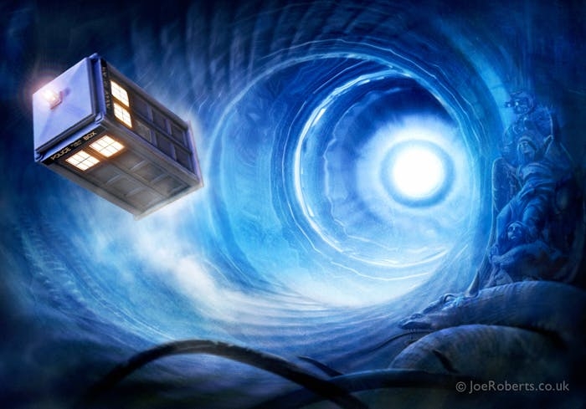
Applications to EFT of Cosmology
- absence of S-matrix
- lack of Lorentz invariance/crossing symmetry
- ambiguous connection with analyticity
- gravitational exchange pole
Direct application to cosmology is more subtle due to:
Directions in progress:
Cosmological bootstrap on correlators (only perturbative)
Approximate S-matrix with broken boosts
Constrain Wilson coefficients defined around Minkowski vacuum
Use Infrared causality as a proxy for positivity
Worked developed with Carrillo Gonzalez, Chen, Jaitly, Margalit, Pozsgay, Tokareva, Tolley & Zhang
Carrillo Gonzalez, Bounds on EFT’s in an expanding universe, 2312.07651

Slide 34
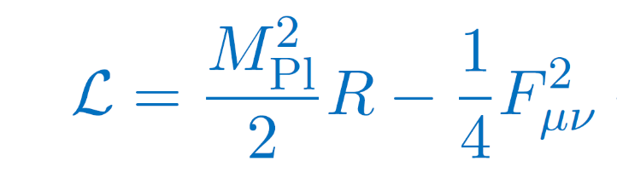





Motivation 2: Weak Gravity Conjecture
Consider a new BSM U(1)
Extremal Black Hole
evaporates
$$Q≤M$$
(to avoid naked singularity)
$$Q=M$$
(in units of $\sqrt{2}$Mpl)
For every $U(1)$, there must be a
massive charged particle with $Q≥M$
Arkani-Hamed, Motl, Nicolis, Cumrun, hep-th/0601001
Harlow, Heidenreich, Reece & Rudelius, 2201.08380

Slide 35



U(1) EFT
Weyl Curvature
Redresses BH mass and charge
New BH extremality condition is:

Slide 36



U(1) EFT
Weyl Curvature
Redresses BH mass and charge
New BH extremality condition is:
Kats, Motl & M. Padi, hep-th/0606100
Cheung & Remmen, 1407.7865
Hamada, Noumi & Shiu, 1810.03637
Extremal BHs can evaporate
without leading to naked singularity and
without postulating a massive charged particle with $Q≥M$
(other than BHs themselves).
If
Do positivity bounds impose $C>0$ ?

Slide 37








Unitarity + Causality with Gravity
Graviton exchange spoils analyticity
$$=$$
$$+ …$$
$$h_{μν}$$
???
t-channel pole from gravity exchange compromises positivity bound

Slide 38


Gravitational bounds
Gravity generically allows for some mild negativity
with Alberte, Jaitly and Tolley
2007.12667, 2012.05798
Confirmed using finite impact parameters bounds
Caron-Huot, Mazac, Rastelli & Simmons-Duffin, 2102.08951
Can be derived using “Infrared Causality”,
Chen, CdR Margalit & Tolley, 2112.05031, 2309.04534
arguments based on “Asymptotic Causality” (CEMZ 1407.5597) would fail

Slide 39





Flowing down to the IR
“Unknown” UV completion
New physics enters
Scale of
Quantum
Gravity
Electron
mass

Slide 40


Flowing down to the IR
Things may start
negatively….
Expect at worse:
Scale of
Quantum
Gravity
Positive contributions
to the amplitude
Contribute positively as
Electron
mass
But should end up
positively….

Slide 41
Flowing down to the IR
Scale of
Quantum
Gravity
hAhA
(graviton-photon scattering in SM)
Electron
mass

Slide 42

hAhA
(graviton-photon scattering in SM)

Slide 43






Flowing down
High-energy
Things may start
negatively….
We would have expected
at worse by very small amount
$$−$$
?
Scale of
Quantum
Gravity
$$≳−{10}^{−110}{eV}^{−4}$$
Positive contributions
to the amplitude
But should end up
positively….
We would have expected
to end up with a
positive amount
$$\sim \frac{1}{m^{4}}$$
$$\sim {10}^{−23}{eV}^{−4}$$
Electron mass

Slide 44


Flowing down
High-energy
Things may start
negatively….
We would have expected
at worse by very small amount
$$−$$
?
Scale of
Quantum
Gravity
$$≳−{10}^{−110}{eV}^{−4}$$
Positive contributions
to the amplitude
But should end up
positively….
We actually end up with
a large negative contribution
$$\sim \frac{−1}{m^{2}M_{Pl}^{2}}$$
$$\sim {−10}^{−67}{eV}^{−4}$$
Electron mass

Slide 45

Flowing down
High-energy
Things must start very negatively by an amount
that knows about mass of lightest particle….
by $at least\sim \frac{−1}{m^{2}M_{Pl}^{2}}$
?
Scale of
Quantum
Gravity
Positive contributions
to the amplitude
But should end up
positively….
We actually end up with
a large negative contribution
$$\sim \frac{−1}{m^{2}M_{Pl}^{2}}$$
$$\sim {−10}^{−67}{eV}^{−4}$$
Electron mass

Slide 46

Flowing back up
High-energy
?
The scale of the lightest massive particles has to be built in
within UV quantum gravity behaviour
Scale of
Quantum
Gravity
$$\sim \frac{−1}{m^{2}M_{Pl}^{2}}$$
with Jaitly and Tolley, 2023
Electron mass
consistent with Caron-Huot & Li, Aug 2024

Slide 47
Flowing back up
High-energy
?
The scale of the lightest massive particles has to be built in
within UV quantum gravity behaviour
Scale of
Quantum
Gravity
* New physics manifest itself through other
operators in the EFT
Not an Option
* New BSM physics lead to cancellations
Not an Option
* New physics affects Regge behaviour…
(e.g. higher-spin tower at low-scale ~ 10⁴ TeV)
$$\sim \frac{−1}{m^{2}M_{Pl}^{2}}$$
Electron mass

Slide 48







Graviton Scattering
$$h_{μν}$$
$$h_{αβ}$$
=
+…
Contribution to
Regge slope
$$h_{ab}$$
$$h_{cd}$$
Same observation occurs in other gravitational amplitudes
loops contributions to Regge residue ($s→∞$) are:
* not as small as naively expected
* and not small because of IR physics
The scale of the lightest massive particles has to be built in within
UV quantum gravity behaviour
with Jaitly and Tolley, 2023

Slide 49


Approximate Positivity to WGC
Requirements from unitarity, causality, locality and Lorentz invariance only demand
The WGC is not trivially satisfied for any EFT that enjoys unitarity, causality, locality and Lorentz invariance – there must be more to it
Low-energy gravitational EFTs do not need to be
strictly subluminal to be causal.

Slide 50

Gravitational EFTs
CoM Energy
Unitary (optical theorem)
Lorentz invariant (crossing symmetry)
CAUSAL (analyticity)
Local (Froissart Bound)
positivity bounds
Low-energy
EFT
(sub)luminal
sound speed

Slide 51
Small Superluminality – without gravity
As soon as a “substance” allows the tiniest superluminal speed,
nothing prevents us from stacking it so as to end up with a significant/observable “time advance”
time
Speed of
light
Speed of
light
$$Δt$$
Faster than light
space

Slide 52


No Gravity
With Gravity
As soon as a “substance” allows the tiniest SL,
nothing prevents us from stacking it so as to end up with a significant/observable “time advance”
Anything living on the spacetime inexorably curves the geometry.
There is a limit to “stacking”
Not always meaningful
violation of causality

Slide 53


Goldstone Boson without Gravity
$$φ$$
$$φ$$
Goldstone
boson
Higgs
$$φ$$
$$φ$$
Subluminality
Positivity
bounds
Asymptotic
Causality
Infrared
Causality

Slide 54


Goldstone Boson with Gravity
$$φ$$
$$φ$$
Goldstone
boson
Higgs
$$φ$$
$$φ$$
Subluminality
(in Einstein frame)
Positivity
bounds
Asymptotic
Causality
Infrared
Causality

Slide 55


Positivity vs Causality
Carrillo Gonzalez, CdR, Pozsgay, Tolley, 2207.03491

Slide 56



EFT of photons
+ many higher order operators
From integrating out heavy charged fields (electron,…)

Slide 57

Positivity vs Causality in EFT of photons
causality
Analytic
positivity
With Carrillo Gonzalez, Jaitly, Pozsgay, Tokareva, 2208.12631

Slide 58
Positivity vs Causality in EFT of photons
causality
Analytic
positivity
Take Home message:
Causality contradicts Positivity?
(NO!!!)
With Carrillo Gonzalez, Jaitly, Pozsgay, Tokareva, 2208.12631

Slide 59
Positivity vs Causality in EFT of photons
causality
Analytic
positivity
Note: some numerical bootstrap methods including additional tree-level weakly coupled assumption can be stronger
Take Home message:
Causality can probe uncharted territories,
not yet constrained by analytic positivity!
Combining both is powerful!
Take Home message:
Causality contradicts Positivity?
(NO!!!)
With Carrillo Gonzalez, Jaitly, Pozsgay, Tokareva, 2208.12631

Slide 60
Tools for EFT of Gravity
Positivity bounds applied on low-energy EFTs can probe unknown UV contributions. Connection between UV and IR is made thanks to analyticity demanded from causality & non-perturbative unitarity.
Application to SMEFT already proven powerful.
Generalization to bounds beyond 2-2 would be instrumental
Applications to gravitational EFTs & EFT of Cosmology is more subtle
Causality bounds applied directly at the level of the low-energy
EFT can provide powerful complementary bounds
Applicable to EFT of Gravity, Cosmology and generalizable beyond 2-2

Slide 61
IR lessons to UV physics
In gravitational EFTs, the presence of a t-channel pole spoils applicability of strict positivity bounds
Assuming the Froissart bound implies
UV Regge behaviour controlled by IR scale
The allowed amount of negativity, is precisely relevant to the WGC

Slide 62





Causality: Towards new Opportunities
While powerful, current positivity bounds have not yet reached their full potential
1. Positivity Limited to 2→2 scattering statements
2. Gravitational pole spoils full applicability
Current causality
can go beyond
3. Need of more precise dictionary with actual (gravitational) observables
real world, not empty & Minkowski as required by S-matrix bootstrap bounds

Slide 64





Scattering
Trajectory followed by EFT modes
Scattering angle: $θ_{ℓ}=∂_{ℓ}δ_{ℓ}$
Trajectory set by background metric
Eisenbud-Wigner scattering time-delay:

