Slide 1




Axion Phenomenology: from String Theory to the Lab
David J. E. Marsh

Slide 2
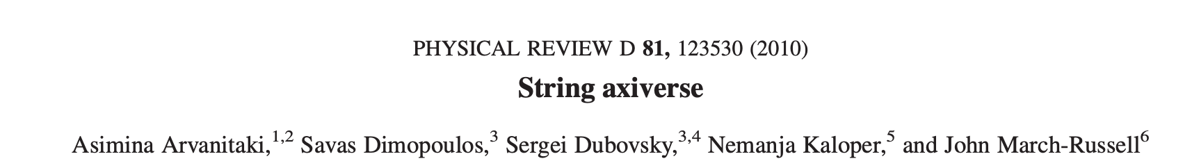

Slide 3
Axiverse in 2024
Finding the QCD axion
Linear & quasi-linear cosmology.
2 x 10⁻²
Advances in direct detection
No time for this ☹
”Fuzzy” DM
Constraints on cosmology
Hints?
All of the suggested probes have been explored and become precise, along with some (unexpected?) new developments in cosmology and direct detection.

Slide 4

String theory progress
Specifically, type IIB on CY3’s.
Demirtas, Rios-Tascon, McAllister

Slide 5
10D SUGRA has p-form fluxes. Consider IIB 4-form, C₄:
V from “triple intersections” = topological
SUSY → τ = Kähler modulus.
Eigenvalues of K give kinetic term → “decay constant”. Parametrically:
Decompose field into harmonic forms:
Basis of harmonic forms given by closed 4-cycles (divisors) in X:
Axion potential generated by ED3 instantons wrapping D:
# basis elements given by h11 Hodge number = topological
Q = instanton charge = topological
Compactify → massless fields in 4D:
→ massive “closed string” axions from gravity sector unavoidable.

Slide 6
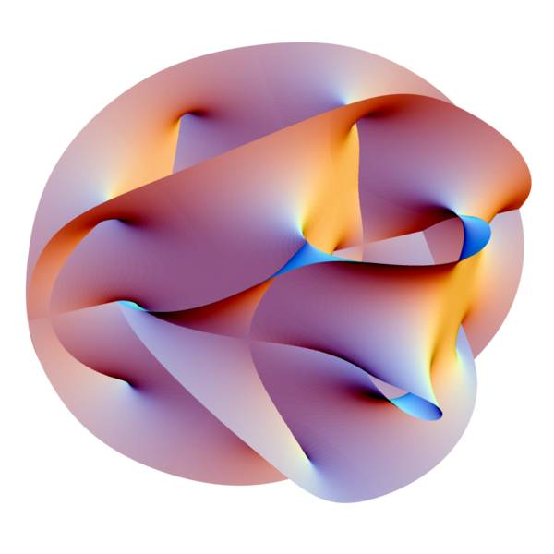
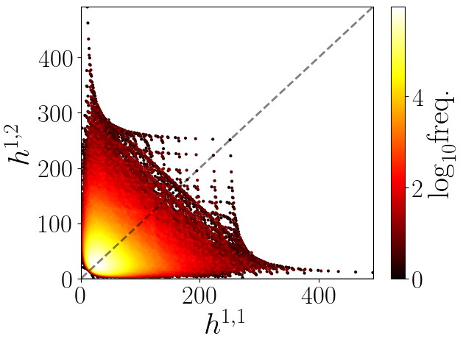
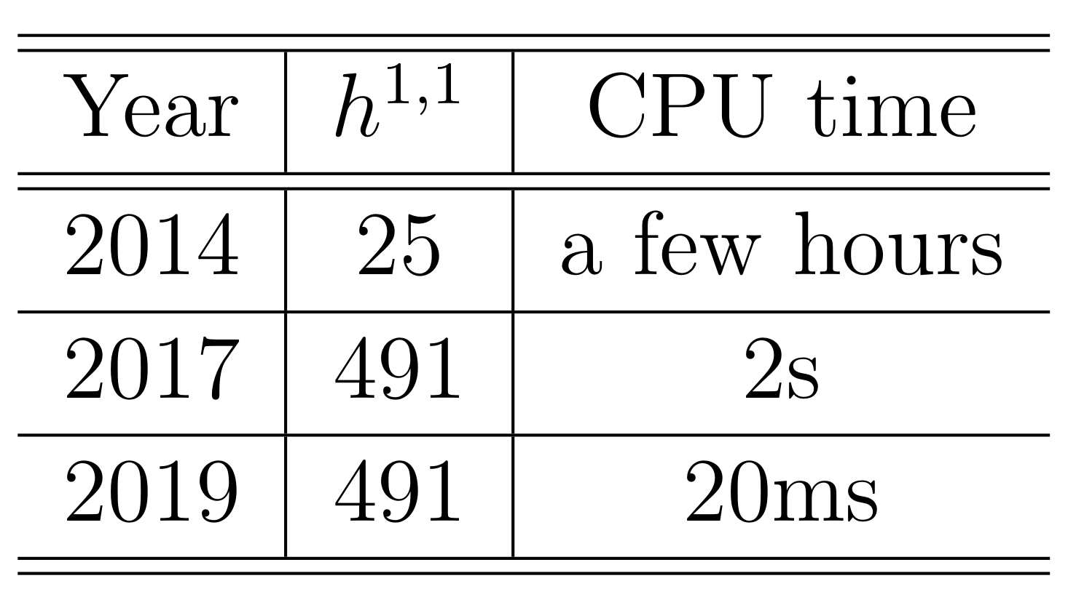
Calabi-Yau Manifolds
h11=27: most polytopes
h11=491: most CYs <10⁴²⁸
Fermat quintic. Section of polynomial in CP4.
→ A hypersurface in a “toric variety”.
Fast and automated with CYTools.
Batyrev: toric varieties from “polytopes”.
Kreuzer & Skarke: all 4x10⁸ polytopes.

Slide 7
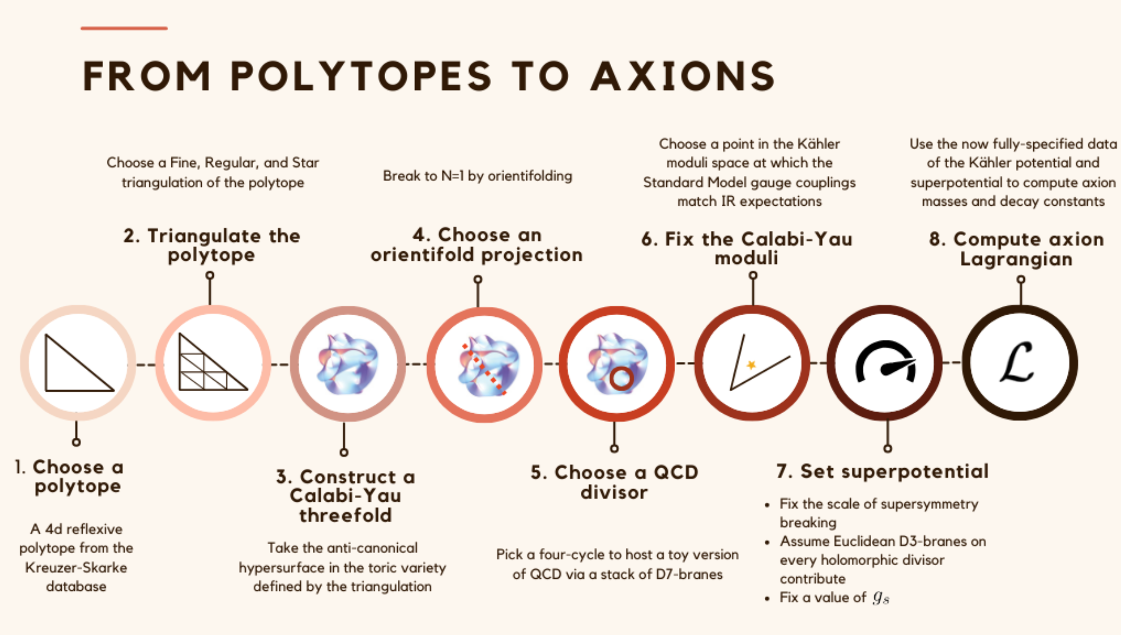
From Sheridan, DJEM et al (today!)

Slide 8
Axion Spectra from KS
Mehta, DJEM et al (2021)
superradiance bands
Not shown: ~70% of m<H₀ fields (!). Constant at large h^{1,1}.
Find vacua of V in fundamental domain. Expand to quartic order → masses +quartics (“fpert”).
Hodge Number h11
Mass spectrum “blue tilted”.
Decay constants log-normal, becoming smaller at large h11.

Slide 9
Axion-Photon Couplings
Recipe:
Consequences:
Choose a CY.
Choose a divisor to host QCD.
Dilate divisor to Vol=40 → QCD gauge coupling in UV.
Pick a divisor for QED. Same → GUT. Intersecting → non-GUT.
QED divisor → linear combination of axions coupling to EM.
Diagonalise matrices and compute couplings of eigenstates.
“Kinetic isolation”: K matrices are sparse → suppressed kinetic mixing of all axions into EM linear comb.
“Light threshold”: mass scale generated by ED3 branes on divisor → hierarchically suppressed coupling of axions lighter than this.
c.f. similar effect in GUTs found by Agrawal et al.
Not all axions couple with O(1) strength to photons, but some do.
Gendler, DJEM et al (2023)

Slide 10
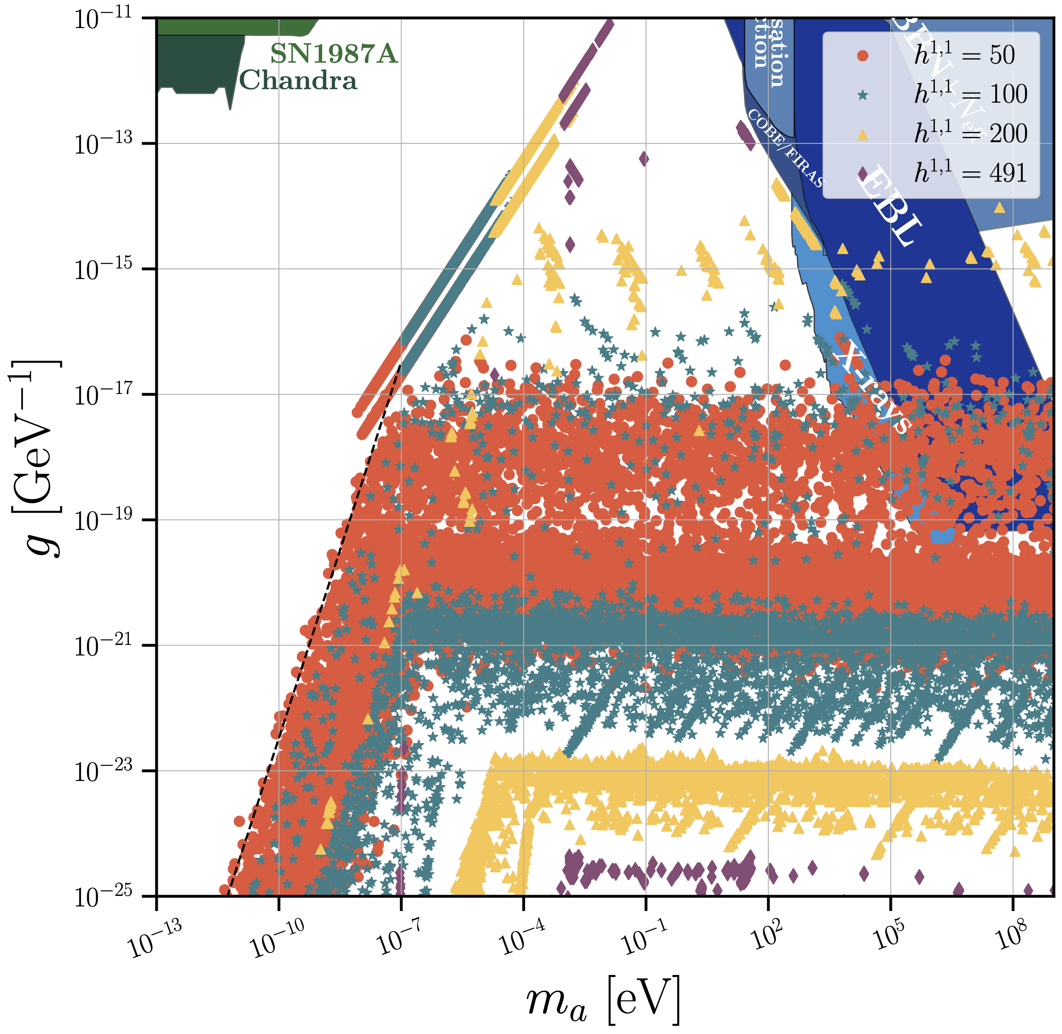
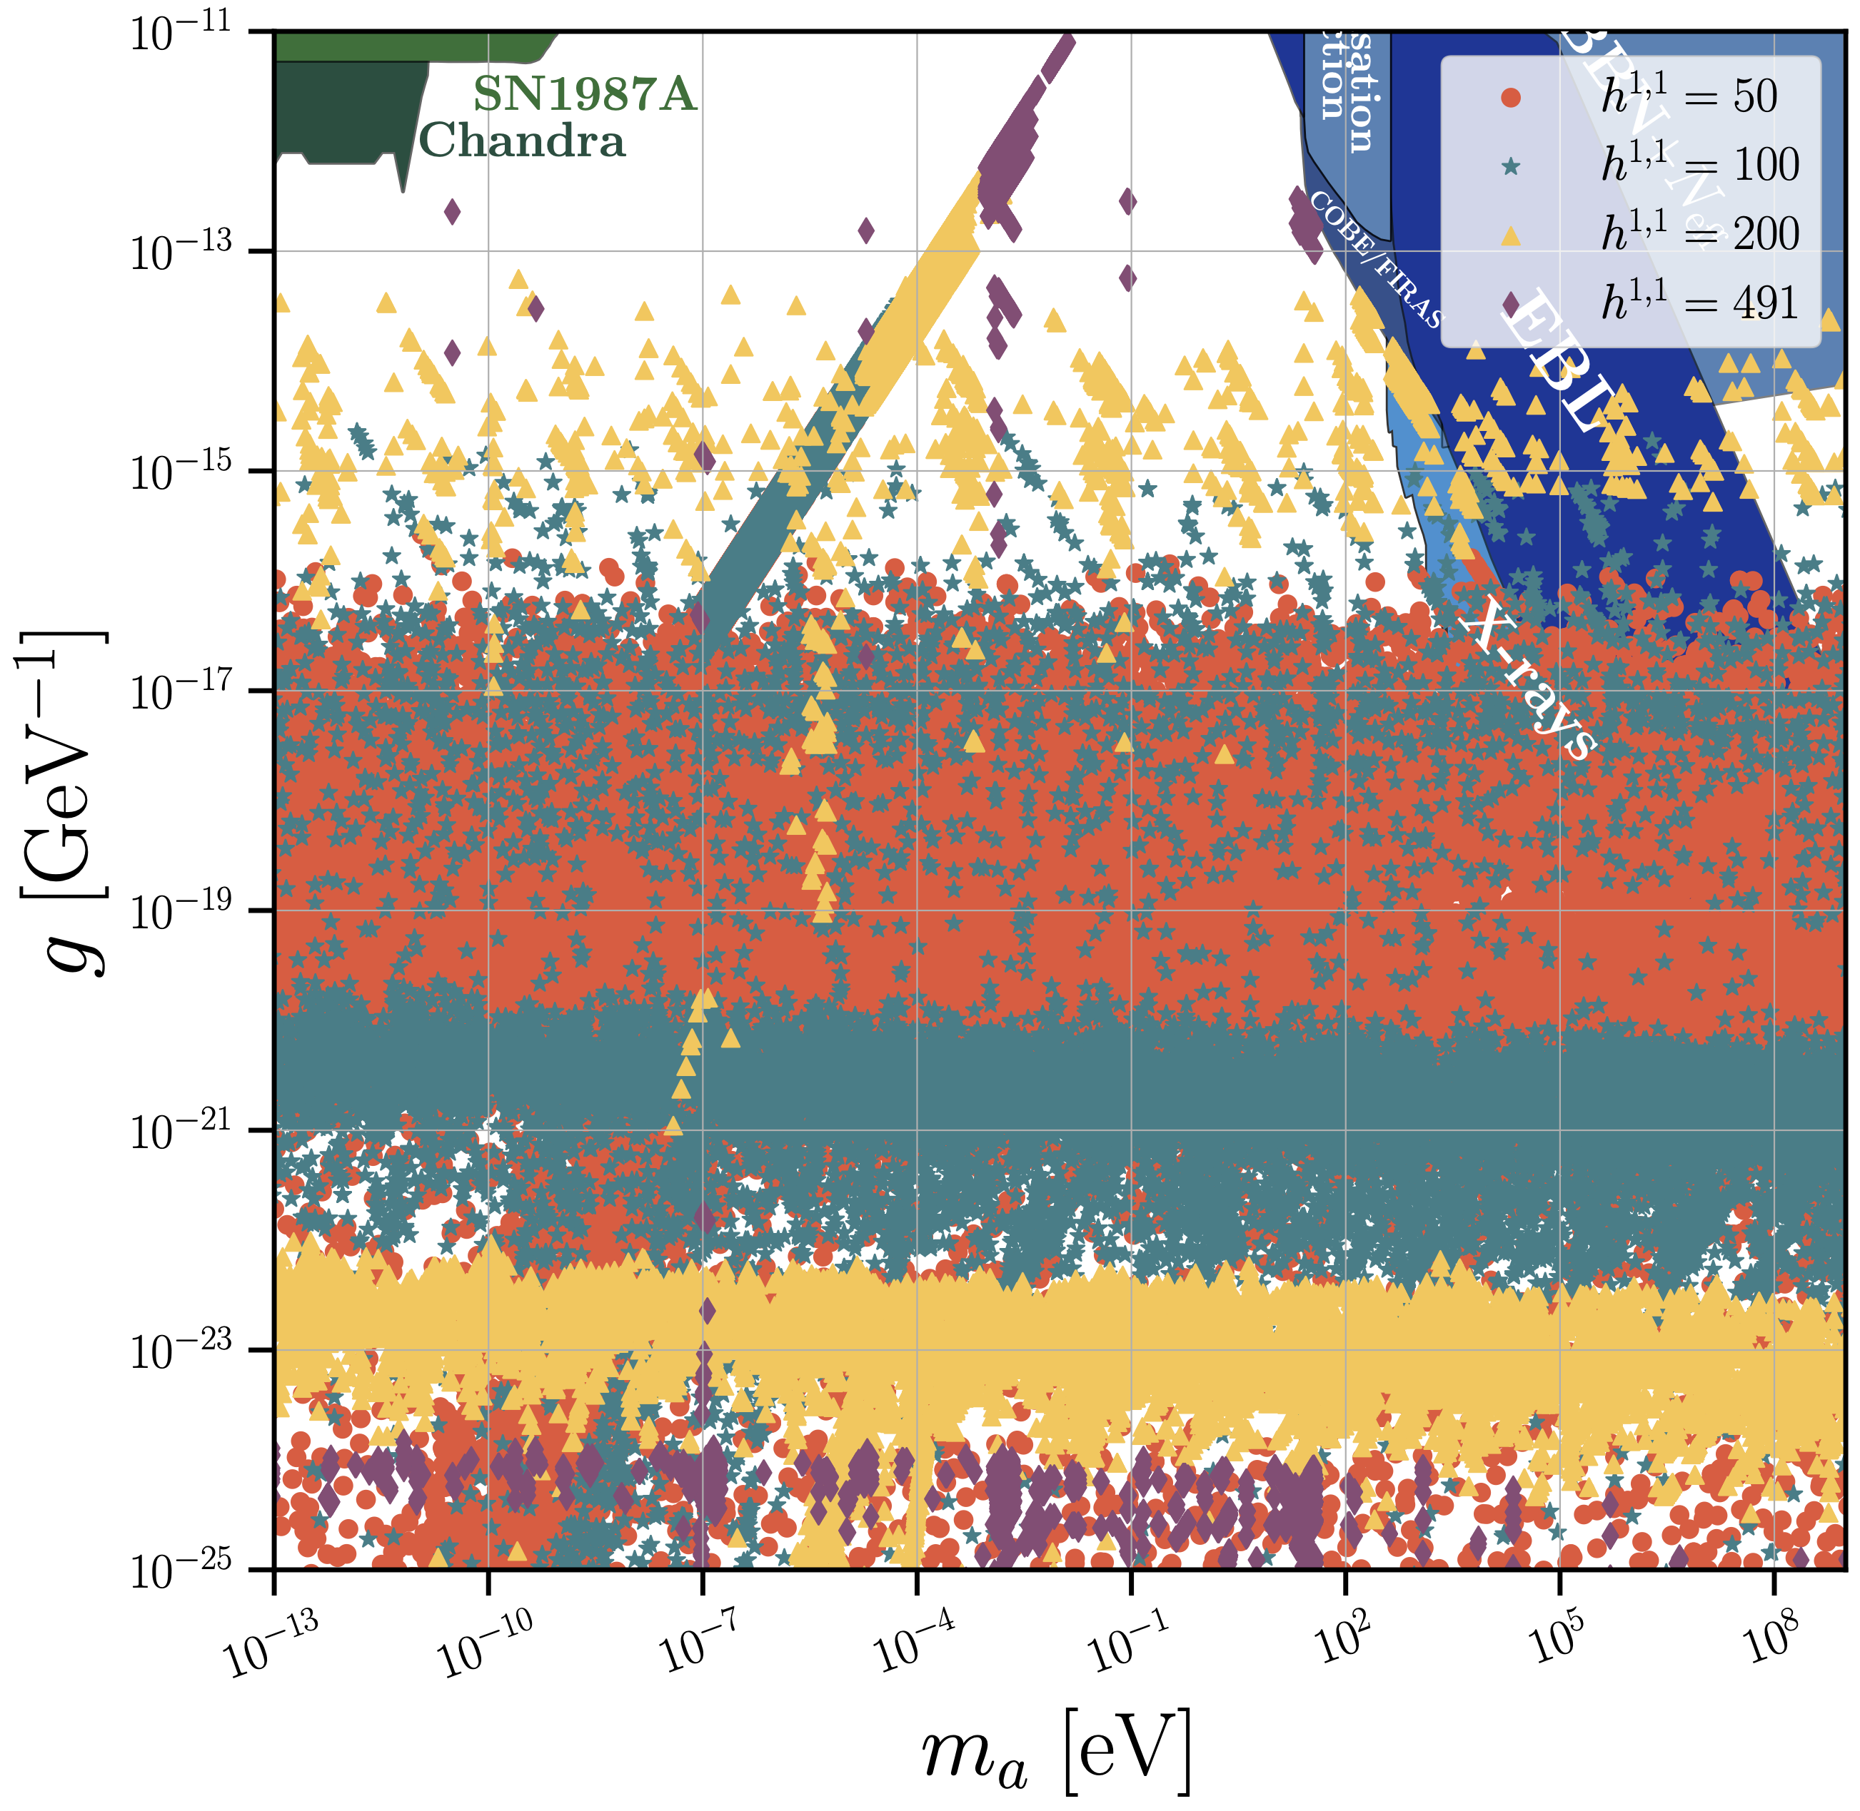
GUTs vs non-GUTs
Gendler, DJEM et al (2023)
GUT: QCD axion sets the light threshold. No axions above the QCD line.
Non-GUTs: (almost) anything goes.

Slide 11
In Development
Sampling the Weil-Petersson measure with Markov-Chain Monte Carlo in moduli space.
Laundry list:
Emulators for efficient physics computations.
Likelihoods not limits.
Check your lampposts: other CY constructions.
F-theory axiverse.
Consistent Standard Models from orientifold tadpoles.
Open string axions and the post-inflation model.

Slide 12
Ultralight axions

Slide 13
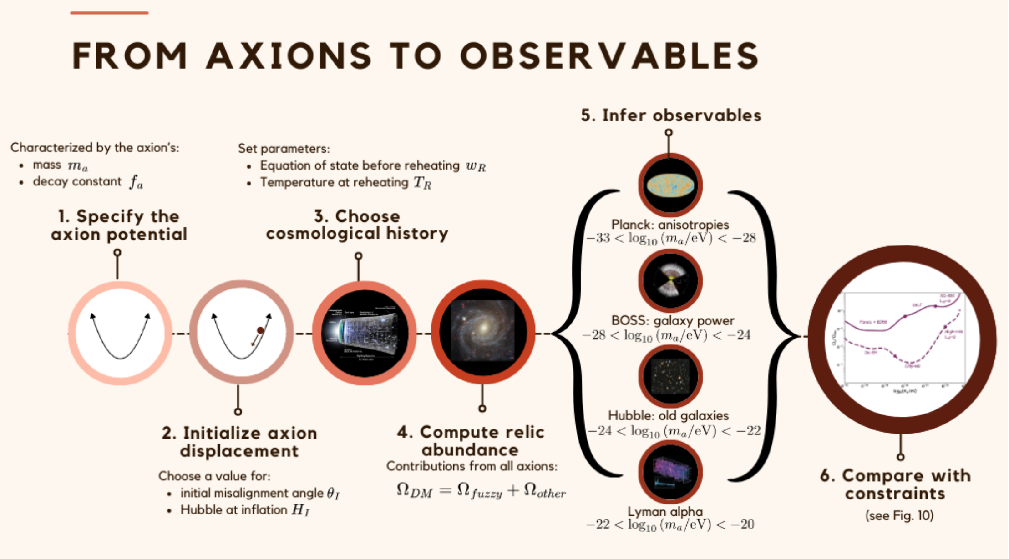
From Sheridan, DJEM et al

Slide 14
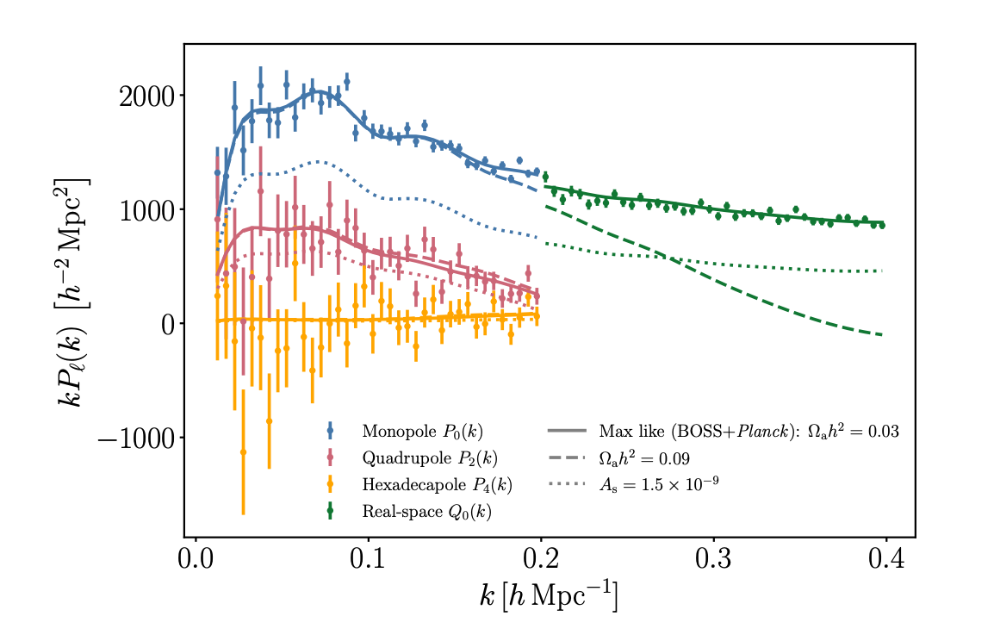
Recent advances in quasi-linear and non-linear modelling (halo models, EFTofLSS, emulators) allow precision limits from smaller scales → probe many axion masses.
Axiverse 2009: “step in P(k)”.
Axiverse 2024: EFTofLSS in the BOSS DR12 P(k) multipoles.
Lague DJEM et al (2021); Rogers, DJEM et al (2023).
Codes: axionCAMB, multinest, cosmosis, PeakPatch, CLASS-PT

Slide 15
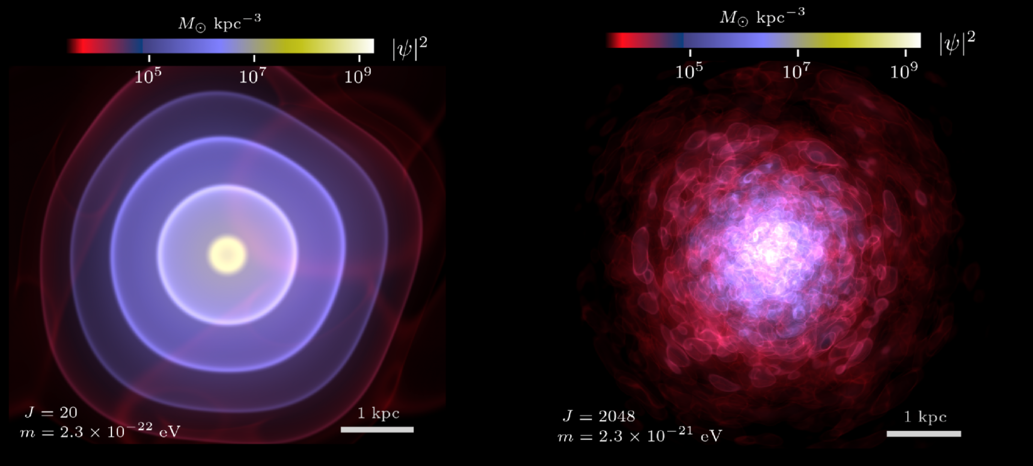
DM lower limit: 2.10⁻²¹ eV
Zimmermann, DJEM et al (2024)
Folk wisdom: de Broglie wavelength must be smaller than dwarf galaxy radius.
“Bosonic Tremaine-Gunn bound”. Extremely difficult to compute precisely.
Leo-II is cuspy. Waves give cores. Compare self-consistent wavefunction to model-independent reconstruction of density + rigorous stats → strong limit.

Slide 16
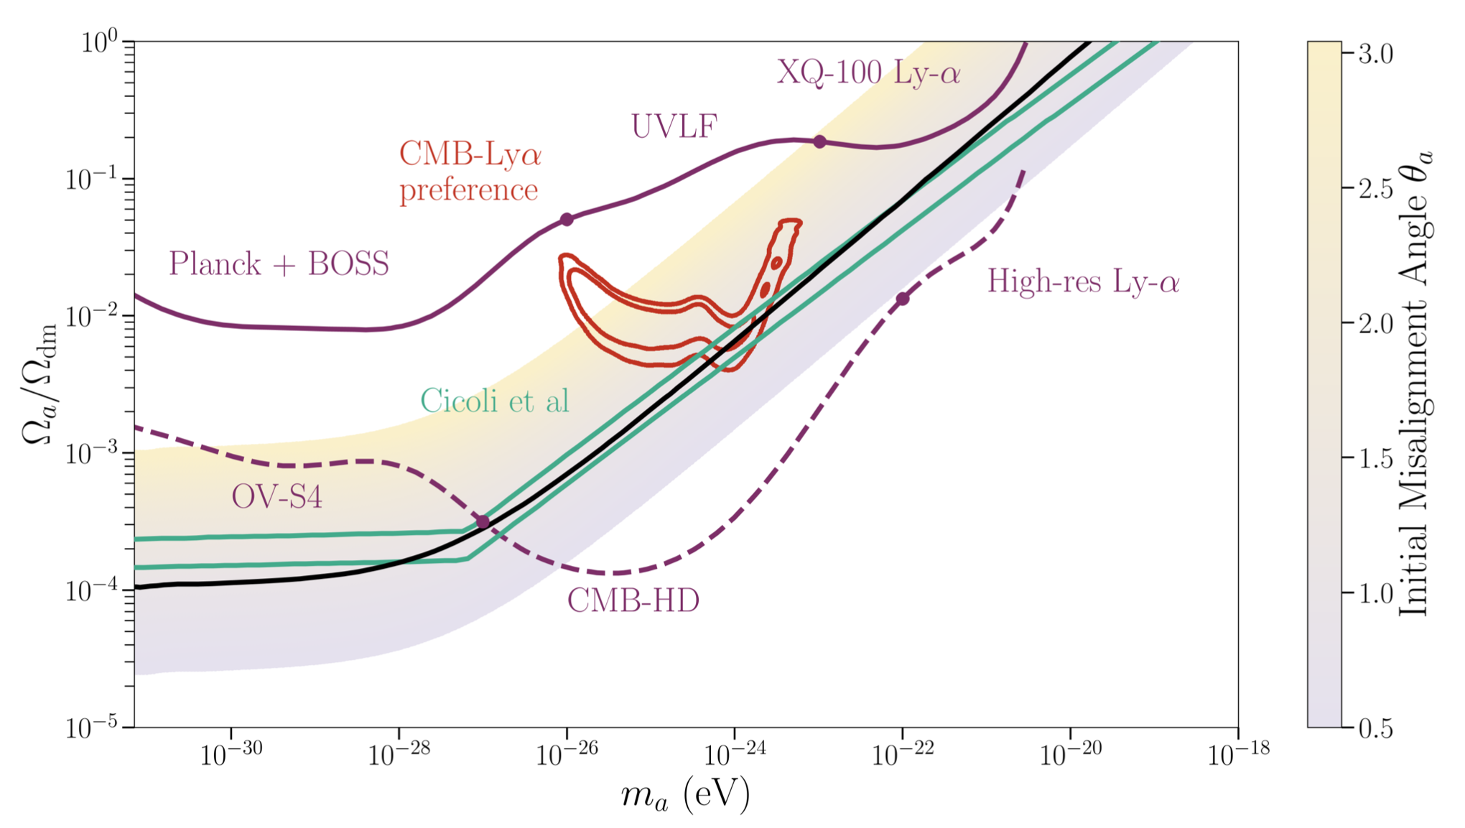
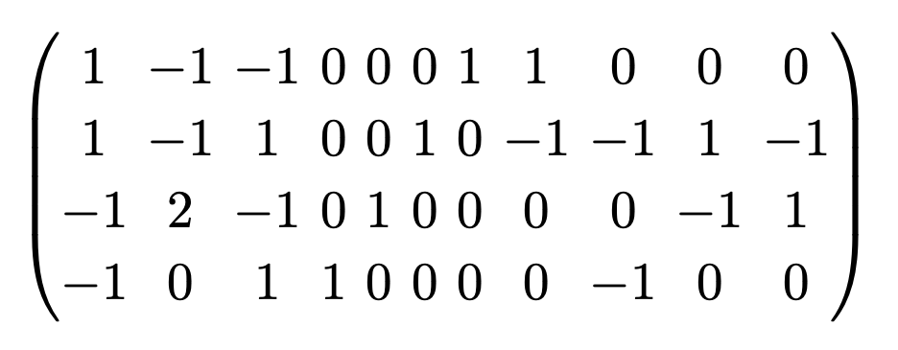
An explicit “fuzzy” axion
Sheridan, DJEM et al
Triangulate this polytope:
→ 7 axions in 10¹⁴ GeV to 10⁻²⁰ eV with f~10¹⁶ GeV.
Along a ray in moduli space → vary the mass.
Compute misalignment abundance with angle θi:

Slide 17
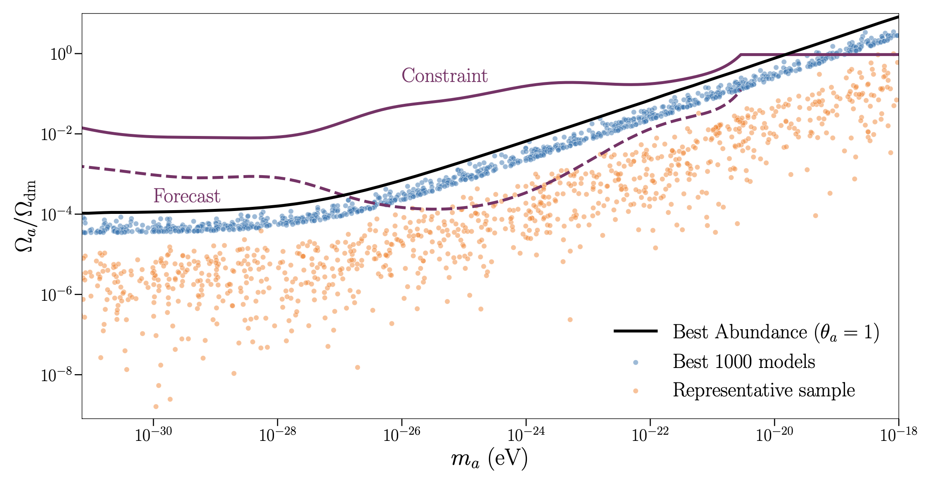
Population Statistics
Sheridan, DJEM et al
A topologically exhaustive construction for 1<h11<8. Points in moduli space chosen to get QCD gauge coupling + fuzzy axion → 1.8 million models.

Slide 18
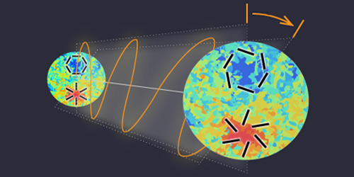
Birefringence
E→B rotation
β
E, B are CMB polarization states (Stokes)
Required mass range:
Minami & Komatsu (2020)
Planck collab. (2022)
H₀
H_{CMB}
Isotropic birefringence can be caused by an ultralight axion via:
Naturally get the measured value (!)

Slide 19
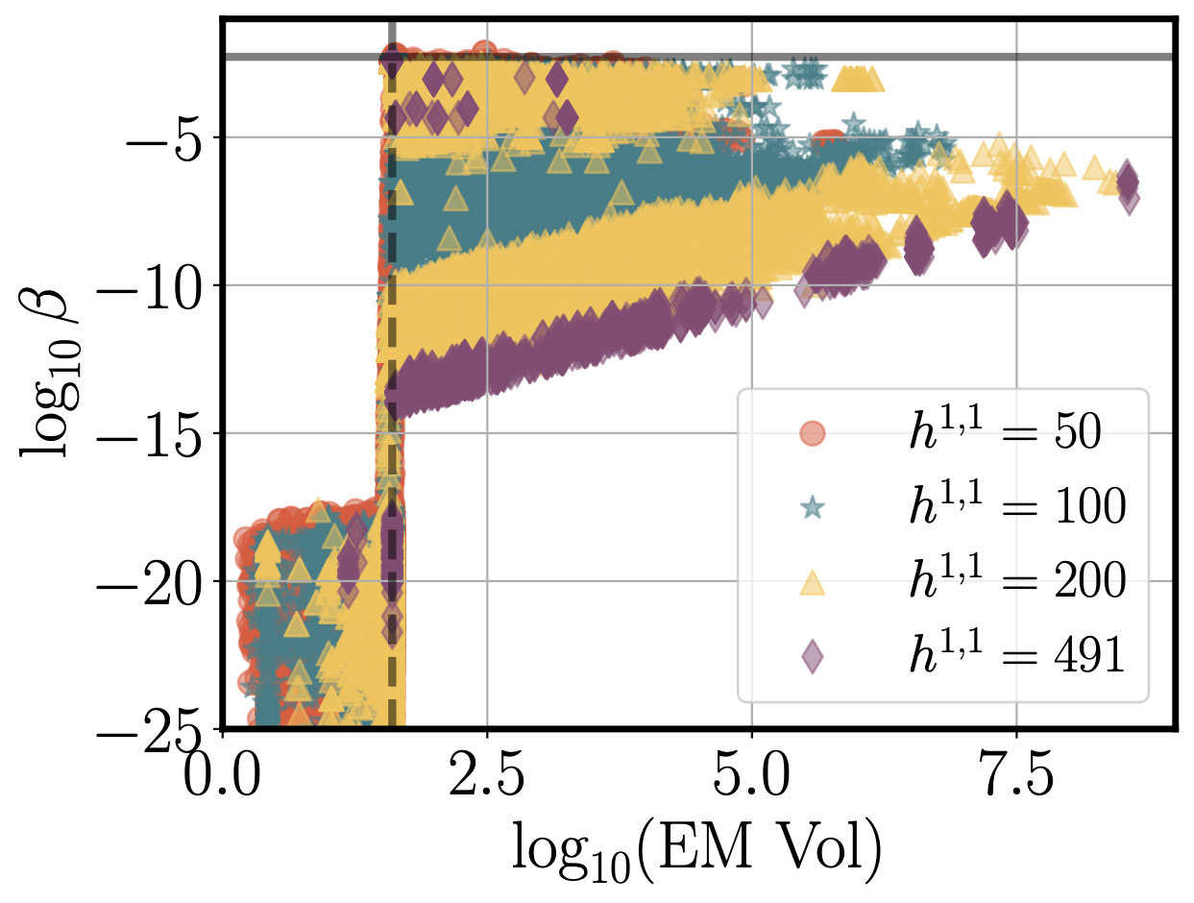
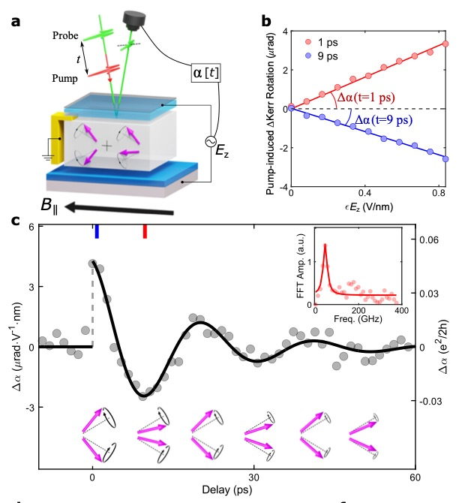
In string theory
… and in the lab
Discovery of the axion quasiparticle, Qiu, DJEM et al (submitted to Nature)
Measured and predicted angles ~α/2π. Happens if EW coupling at KK scale ~1/40.

Slide 20
Qcd axion direct detection

Slide 21
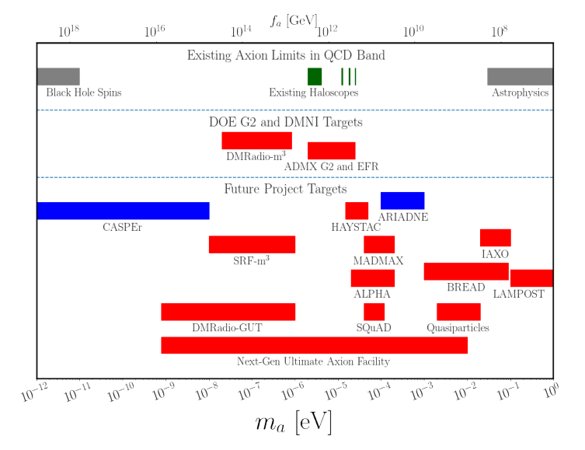
The QCD axion will be found
QCD axion mass:
kHz
THz
Bounded from above by SN1987A ν burst duration. Bounded from below by black hole superradiance.
Axion DM is an oscillating classical field in kHz to THz.
Snowmass “Axion Dark Matter” (inc DJEM)

Slide 22
Microwave ”Haloscope”
Sikivie (1983); ADMX collab.
Figs. “Dark Matter” (DJEM et al)
Axions interact with electromagnetism via:
→ axions source Maxwell’s equations:
B source → linearise for E wave equation:
→ resonance via boundary conditions.
Power 10⁻²² W in typical experiment

Slide 23
Haloscopes beyond GHz
Technology doesn’t scale well.
Many new ideas since ~2012.
Low frequency: DMRadio ABRA resonant circuits.
Mid: MADMAX dielectrics, ALPHA wire metamaterial.
High: BREAD dish antenna (or quasiparticles?).
Ciaran O’Hare AxionLimits Github

Slide 24
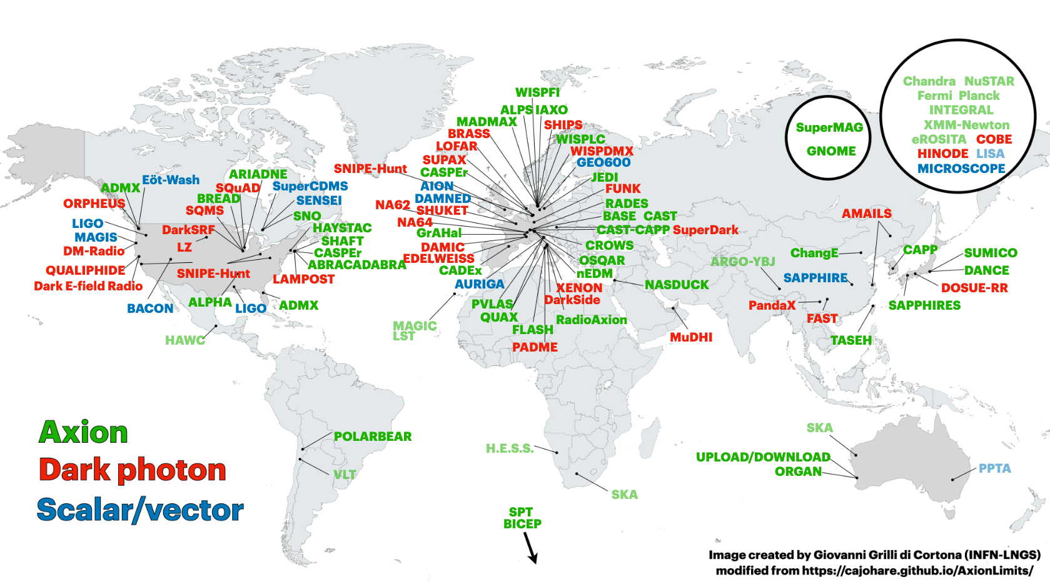
Haloscopes around the world
From COST Action COSMIC-WISPERs. WISP=weakly interacting slim particle.

Slide 25
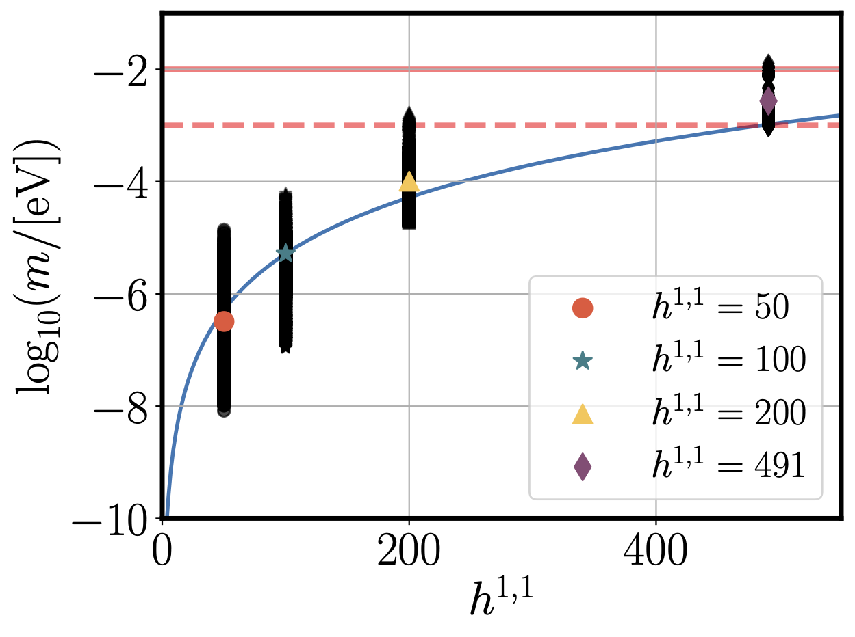
QCD Axion & string theory
All volumes >1 (control of EFT) → some volumes large.
Gendler, DJEM et al (2023)

Slide 26
Inferring topology
Gendler & DJEM (2024)

Slide 27
Heavy axions

Slide 28
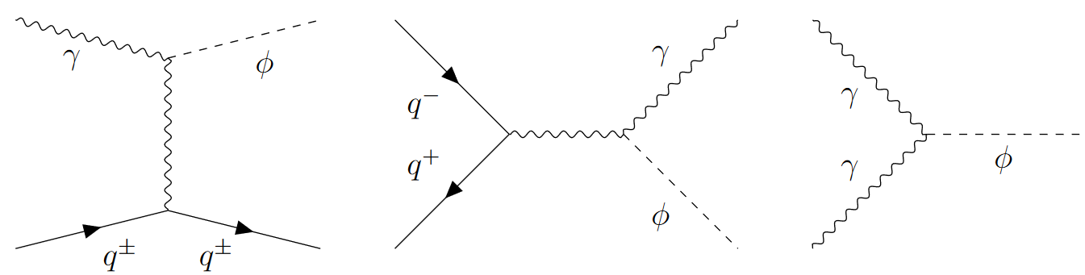
Heavy Axions Overproduce DM
Misalignment: anything much heavier than QCD axion → way too much DM. Free parameter → Fine tuning penalty?
Freeze-in: production from SM plasma. Same coupling → decaying DM.
Fractional Abundance

Slide 29
Constraining the Early Universe
Need to get rid of these problematic axions.
Use modified reheating epoch (w<0) and lower temperature T<<GUT.
Isocurvature constraints also favours low-scale inflation H<10¹⁰ GeV.
Recall the cosmological moduli problem:
Getting BBN correct → m_{SUSY} > 100 TeV.
If axions imply a maximum allowed T, does this give an upper limit on the SUSY scale?

Slide 30
Example: freeze-in + decay. h11=50 → f~10¹² GeV large axion-photon couplings.
Log₁₀ (Relative Abundance)
Fig: Gendler, DJEM et al (2023)
GAMBIT limits: Balazs, DJEM et al (2022)
Optical depth, X-rays: Langhoff et al (2022)

Slide 31
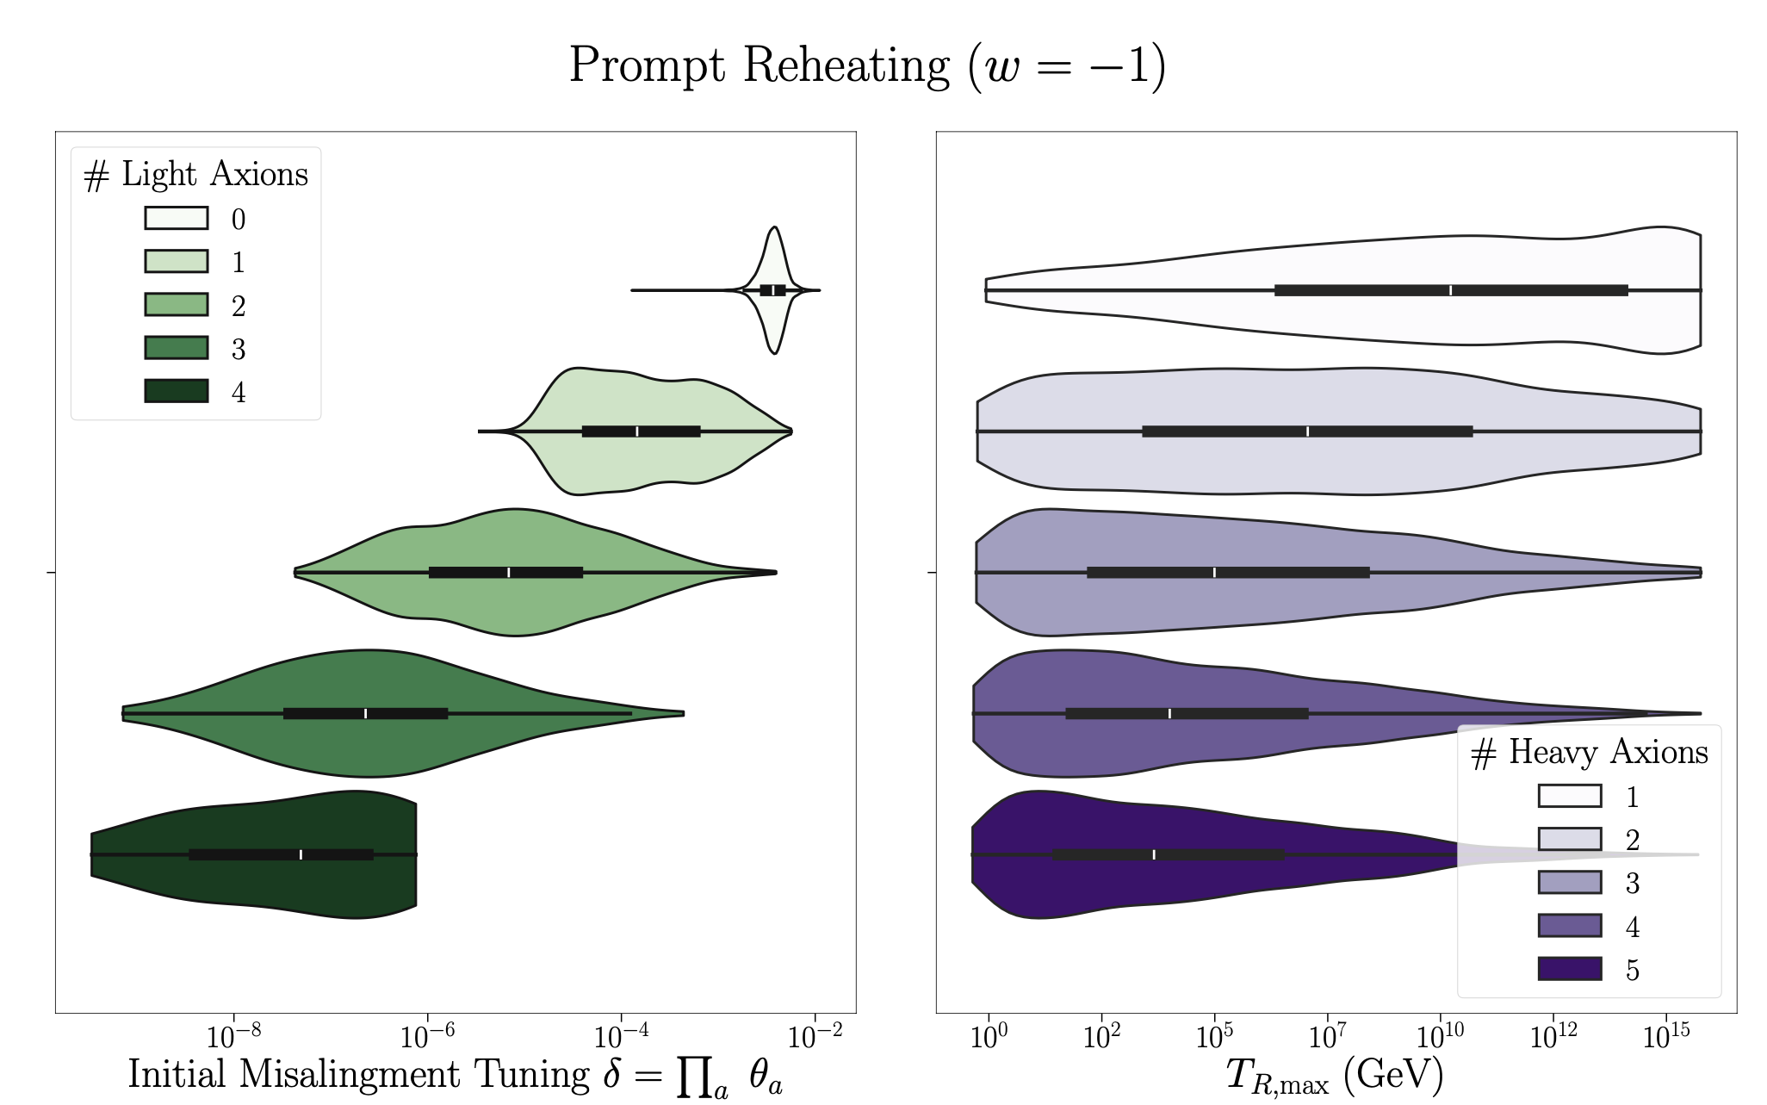
Example: misalignment abundance of complete ensemble at h11<8 → f~10¹⁶ GeV.
Sheridan, DJEM et al
“Light” axions roll after BBN → cannot be diluted → must be tuned.
“Heavy” axions removed with “prompt reheating”, i.e. low-scale inflation.

Slide 32
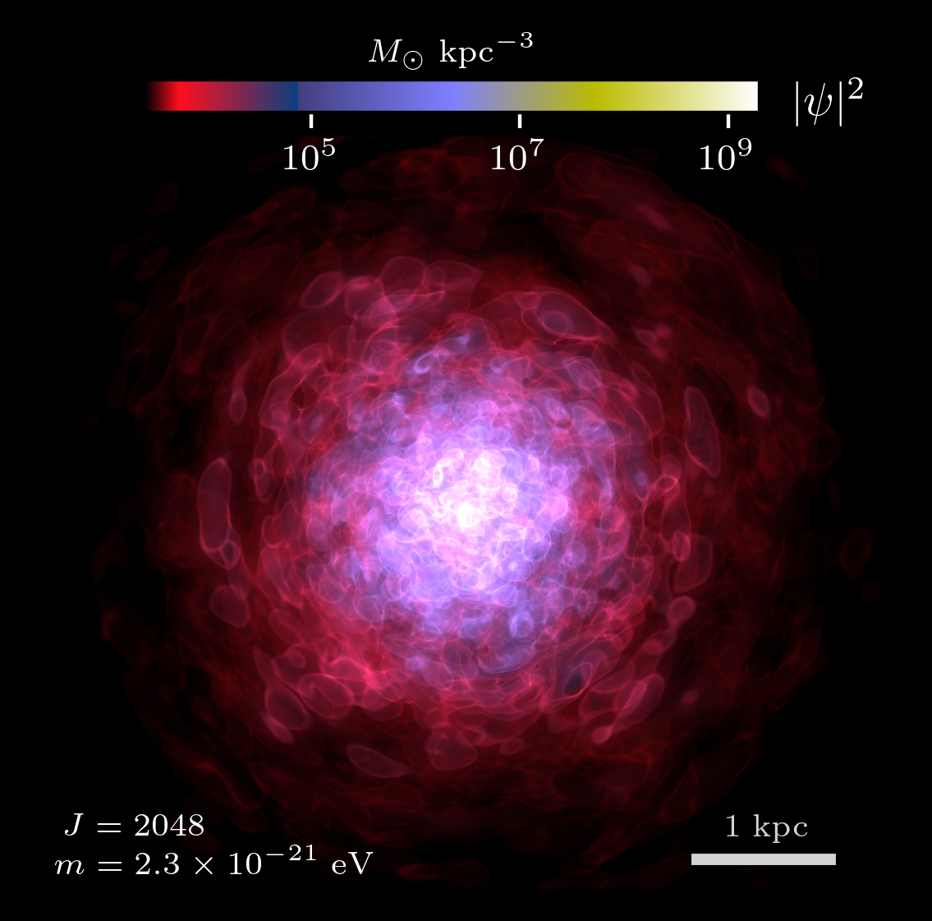

Slide 33
Backup slides

Slide 34
Superradiance!

Slide 35
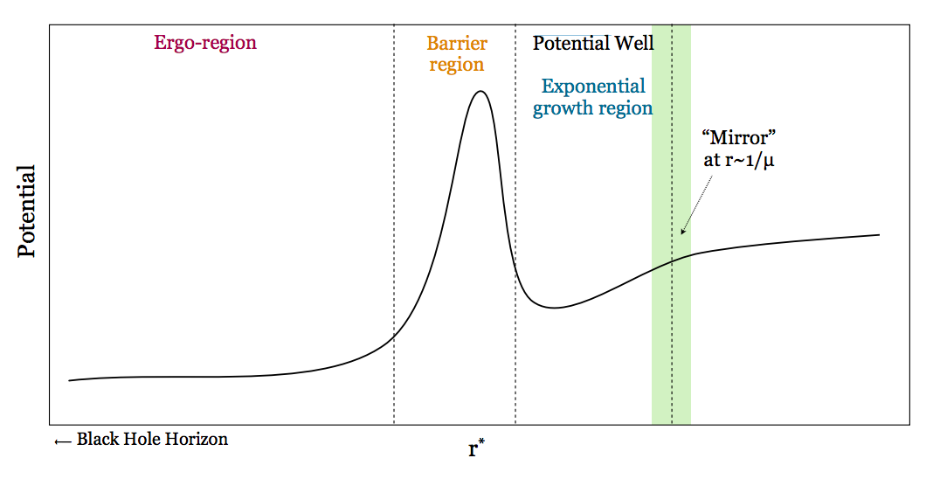
Black Hole Superradiance
Review: Brito et al (2015)
Solve for instabilities of KG equation on Kerr:
Physical picture: “Penrose process/ black hole bomb”
Non-relativistic limit in “tortoise coords”, find instability (ω²<0):
Fig: Arvanitaki & Dubovsky (2010)
Resonant bosons extract spin from astrophysical BHs, if Γ_{SR}>Γ_{others}

Slide 36
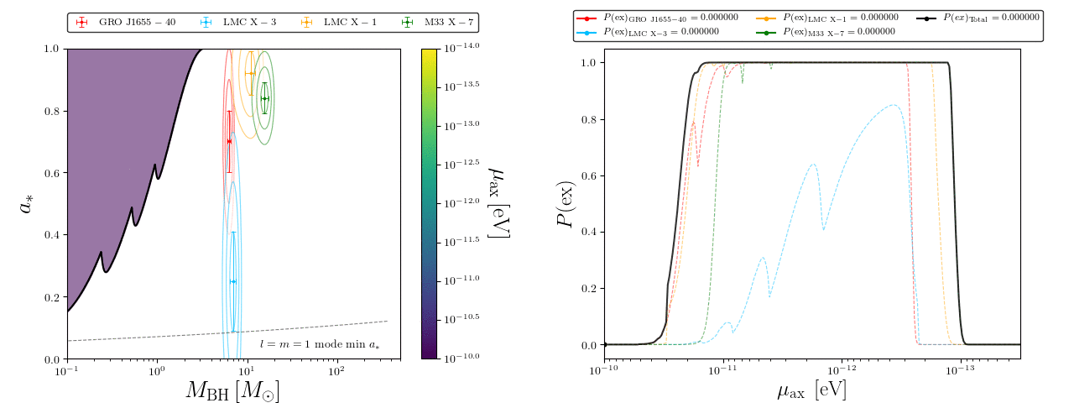
Exclude axion masses where known BHs exist in the superradiant forbidden region.
This sample: X-ray stellar BHs. Gaussian composite likelihood.
GIF by Matthew J. Stott
“Exclusion probability” is marginal likelihood. Statistically robust constraints.

Slide 37
Constraints on IIB CY Vacua
Ensemble of O(10⁵) CYs. All up to h11=5. 100 per h11 up to 176. Few per h11 to 491.
Above h11~ O(few) limit driven by stellar BHs with well measured spin.
First (?) application of “Cohomologies from Cosmology”
Trend easily understood from falling K eigs at large volume → Bosenova shut-off for stellar BH limits
(NB: this limit does NOT include LIGO BHs, which require different mass and spin model)
Mehta, DJEM et al (2021)

Slide 38
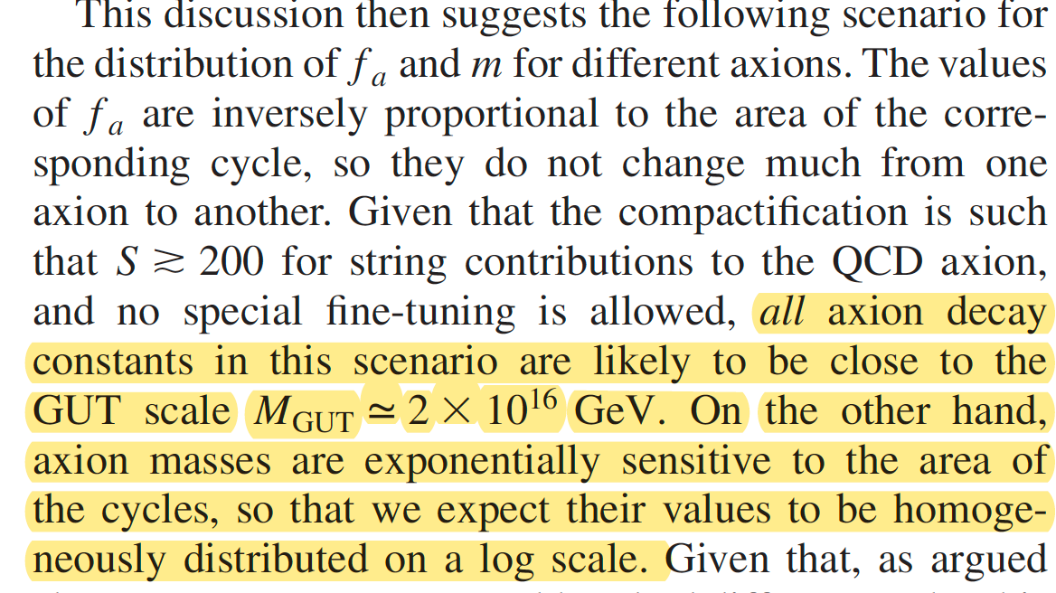
In explicit constructions, this turns out be true for the masses, while for decay constants it is true only for theories with N<O(10) axions.
We will meet the consequences in both settings of large and small f.

Slide 39
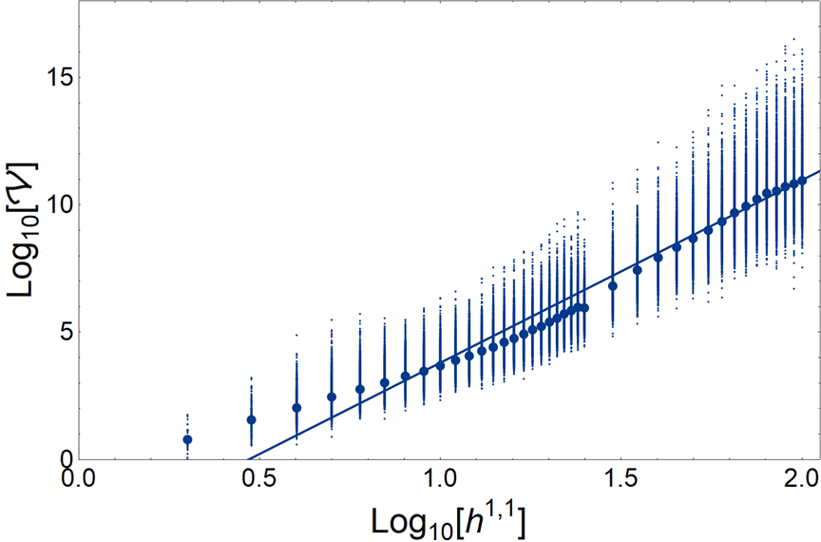
Volume Trend with h11 in KS
Volume computed at tip of SKC → location in moduli space with smallest volume still under control.

