Slide 1
Prospects for HL-LHC
Sinead Farrington
STFC PPD / U. of Edinburgh
16th December 2024

Slide 2
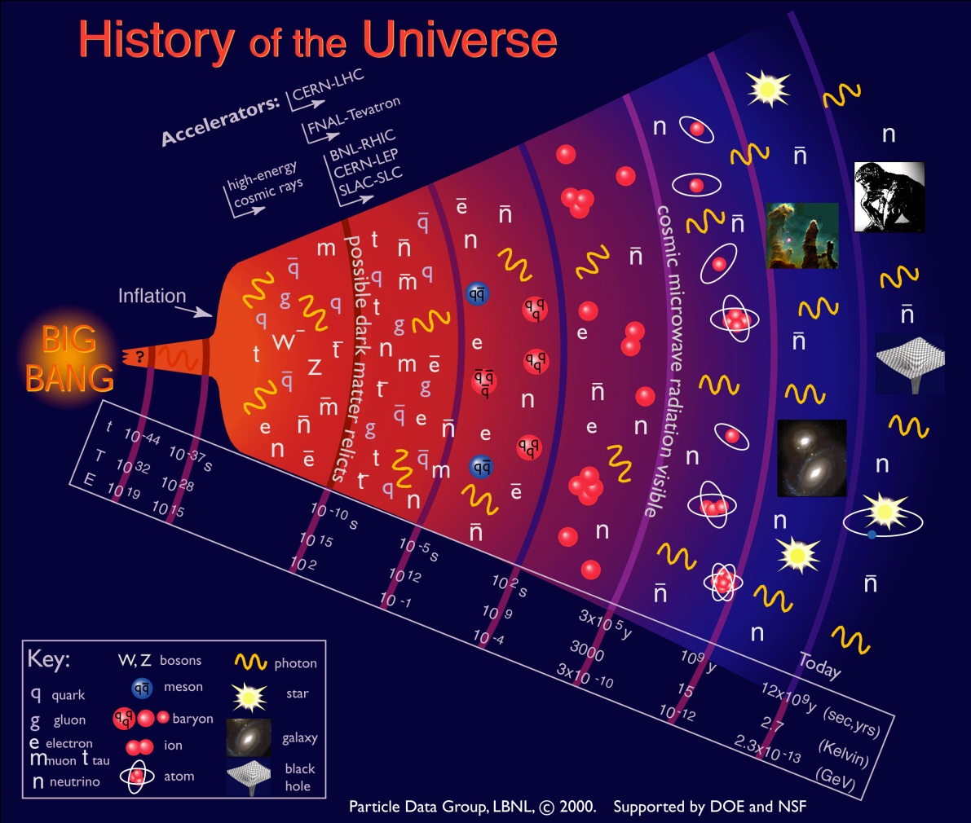
Understanding the Universe
Big Bang
now
Older ….. larger … colder ….less energetic

Slide 3
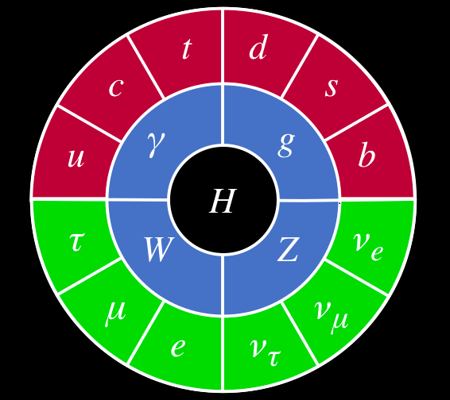
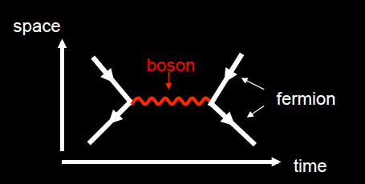
Standard Model of Particle Physics

Slide 4
Goals of Collider Particle Physics
Measuring Standard Model parameters precisely
It has 26 free parameters
Understanding the generation of mass (is the Higgs mechanism the right answer?)
Searching for new phenomena to rule in or out new theories
Standard Model has shortcomings
Joining up our understanding of the very large (galaxies) with the very small: what is dark matter?
CP violation
… E=mc²

Slide 5
Particle Collisions
Two particles collide at very high energy
New particles are produced which we detect and study
?

Slide 6
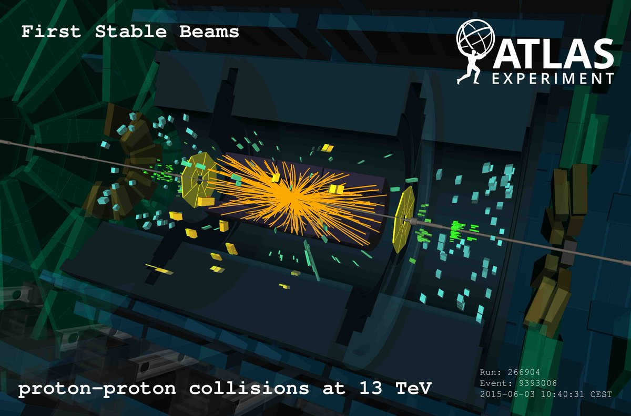
Proton Proton Collisions
LHC 13 TeV centre of mass energy
G. Salam
Underlying event

Slide 7
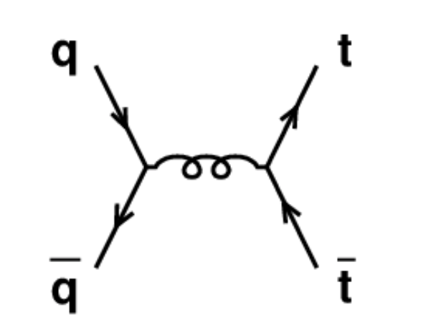
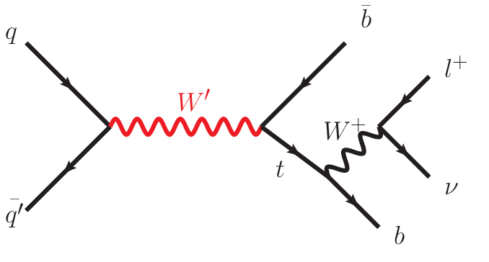
Proton Proton Collisions
Example production diagrams: top, exotic W’
Leads to multitude of signatures (leptons, jets…)
Motivates a General Purpose Detector with capabilities for all these particles (ATLAS and CMS)
b-physics detector: LHCb (C.Parkes 2023)
heavy-ion detector: ALICE

Slide 8
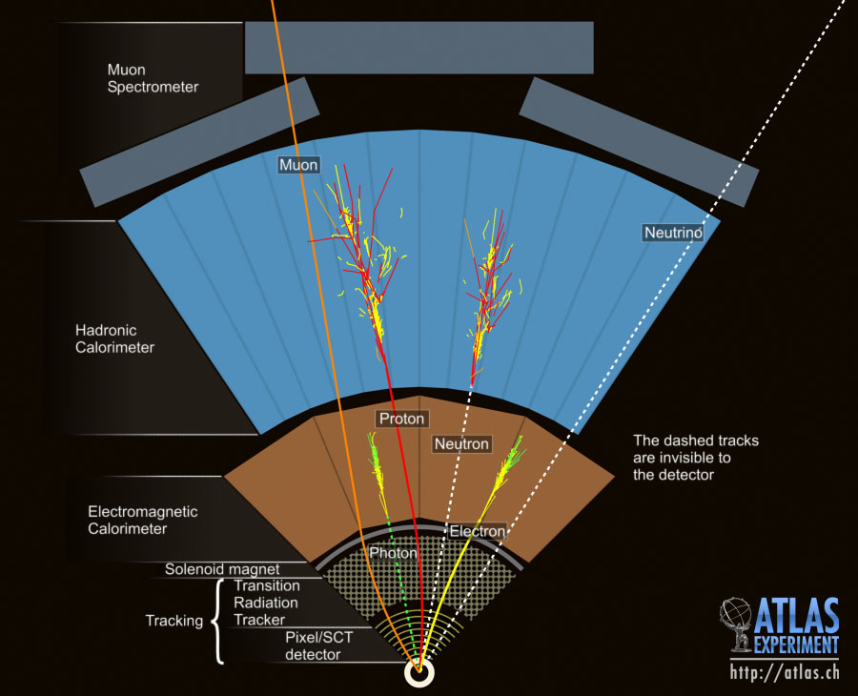
A Particle Detector
“Onion shell” structure enables reconstruction of particles
Use this capability to reconstruct particle interactions of
special interest

Slide 9
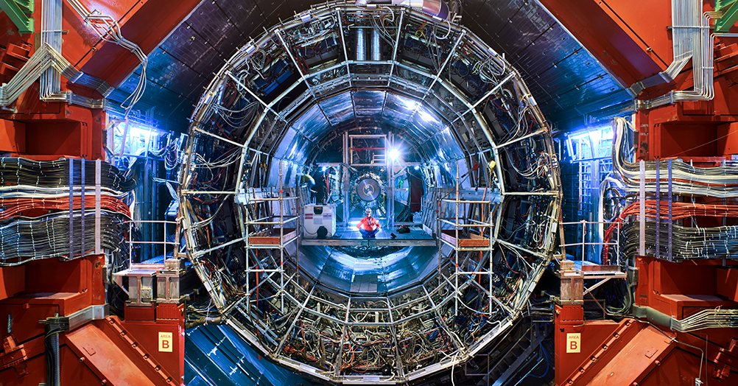
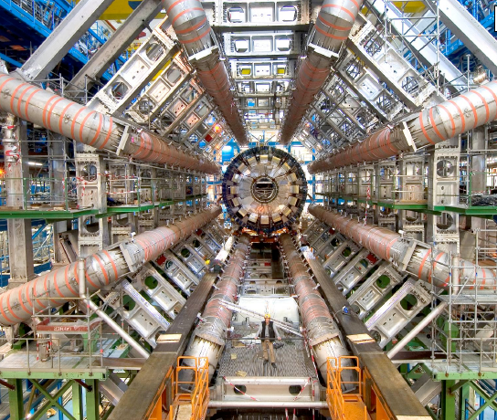
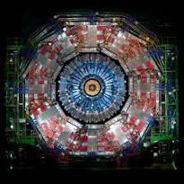
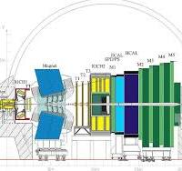
The LHC Detectors

Slide 10
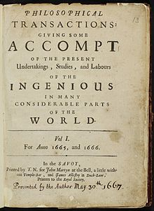
What is a scientific paper?
Original work
Peer-reviewed – adversarial process
Collaborations have strict internal review processes in addition
“Giving some Account of the present Undertakings, Studies, and Labours of the Ingenious in many considerable parts of the World” (Royal Society journal)
(savants)
1665

Slide 11
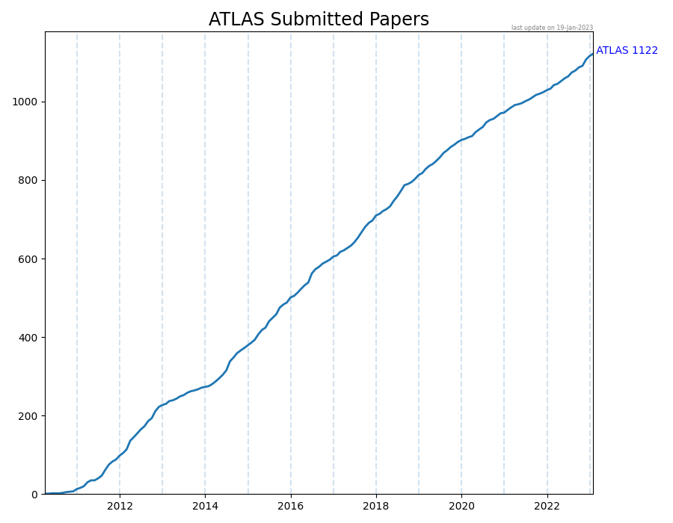
How far have we got
Each paper is the result of the collaboration’s work to
construct the detector
read data out
calibrate the data
process the data to reconstruct the objects
analyse the data…
Hence large authorship papers
1333 papers

Slide 12
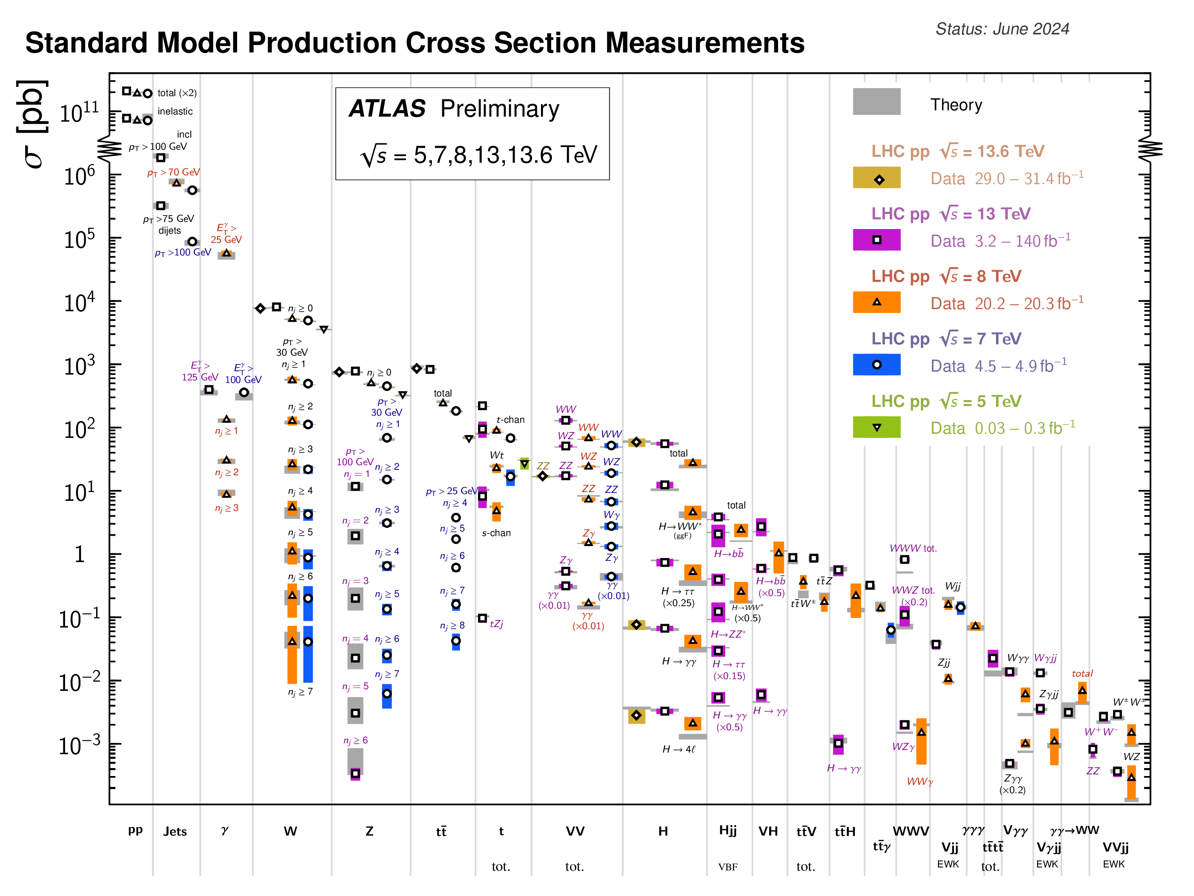
Which processes can we probe?
(HH)

Slide 13
LHC Collider Upgrades
Notes:
More powerful focusing magnets and optics
Crab cavities to tilt beams
Reinforced machine protection
New superconducting links
Upgraded accelerator

Slide 14
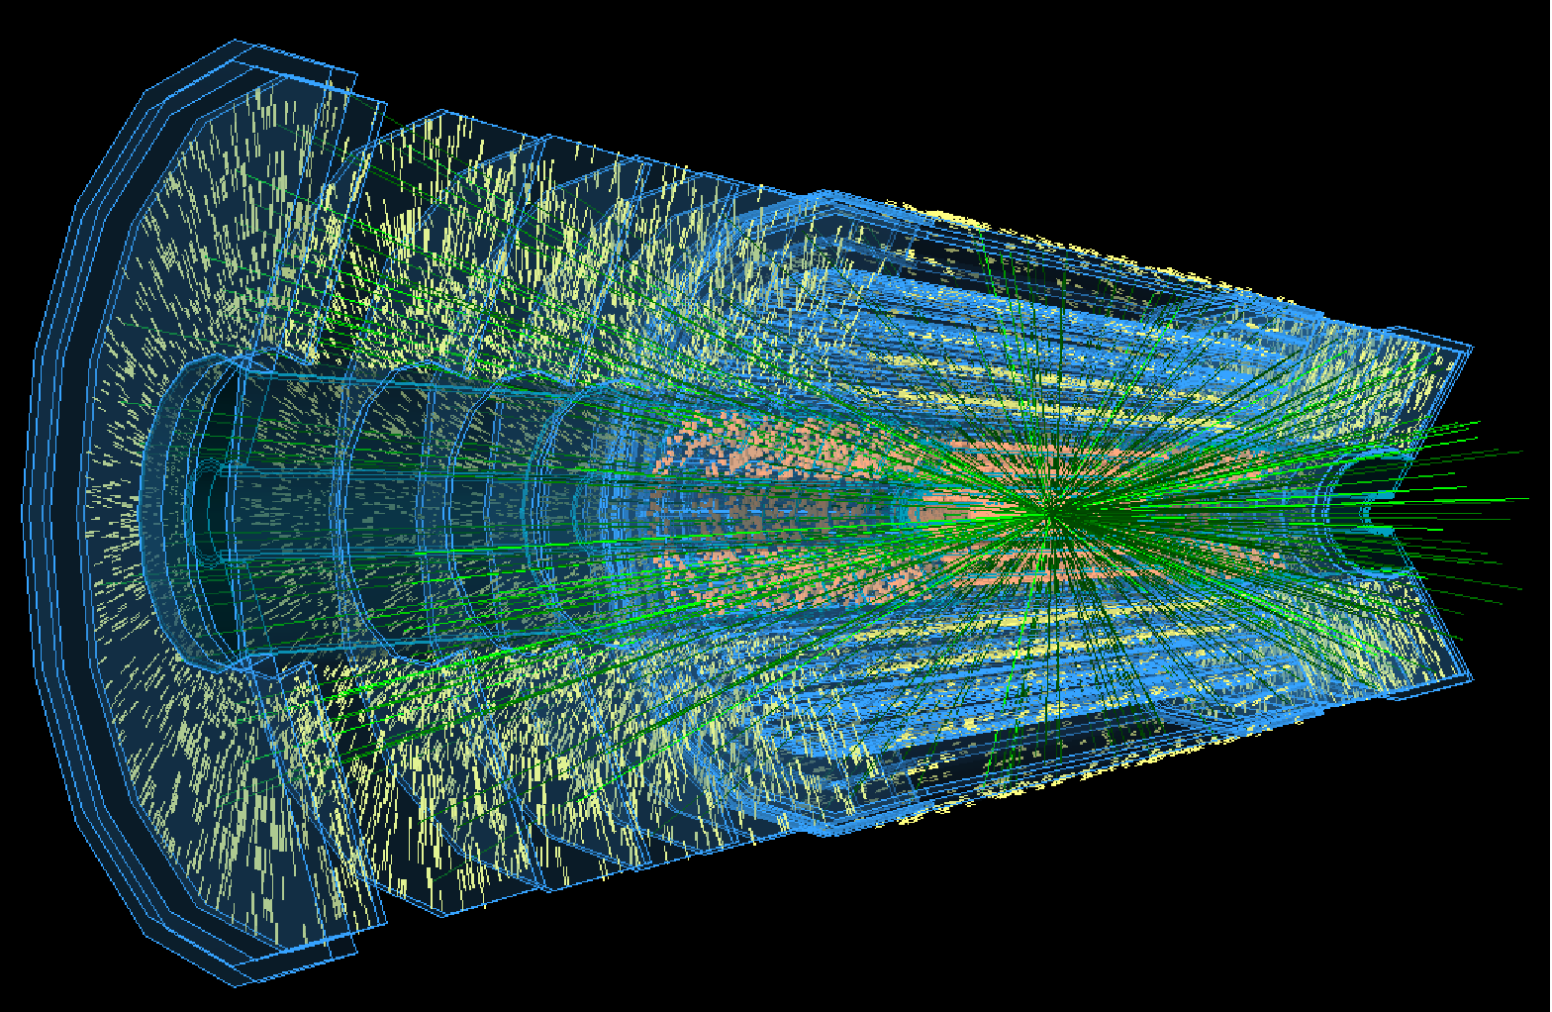
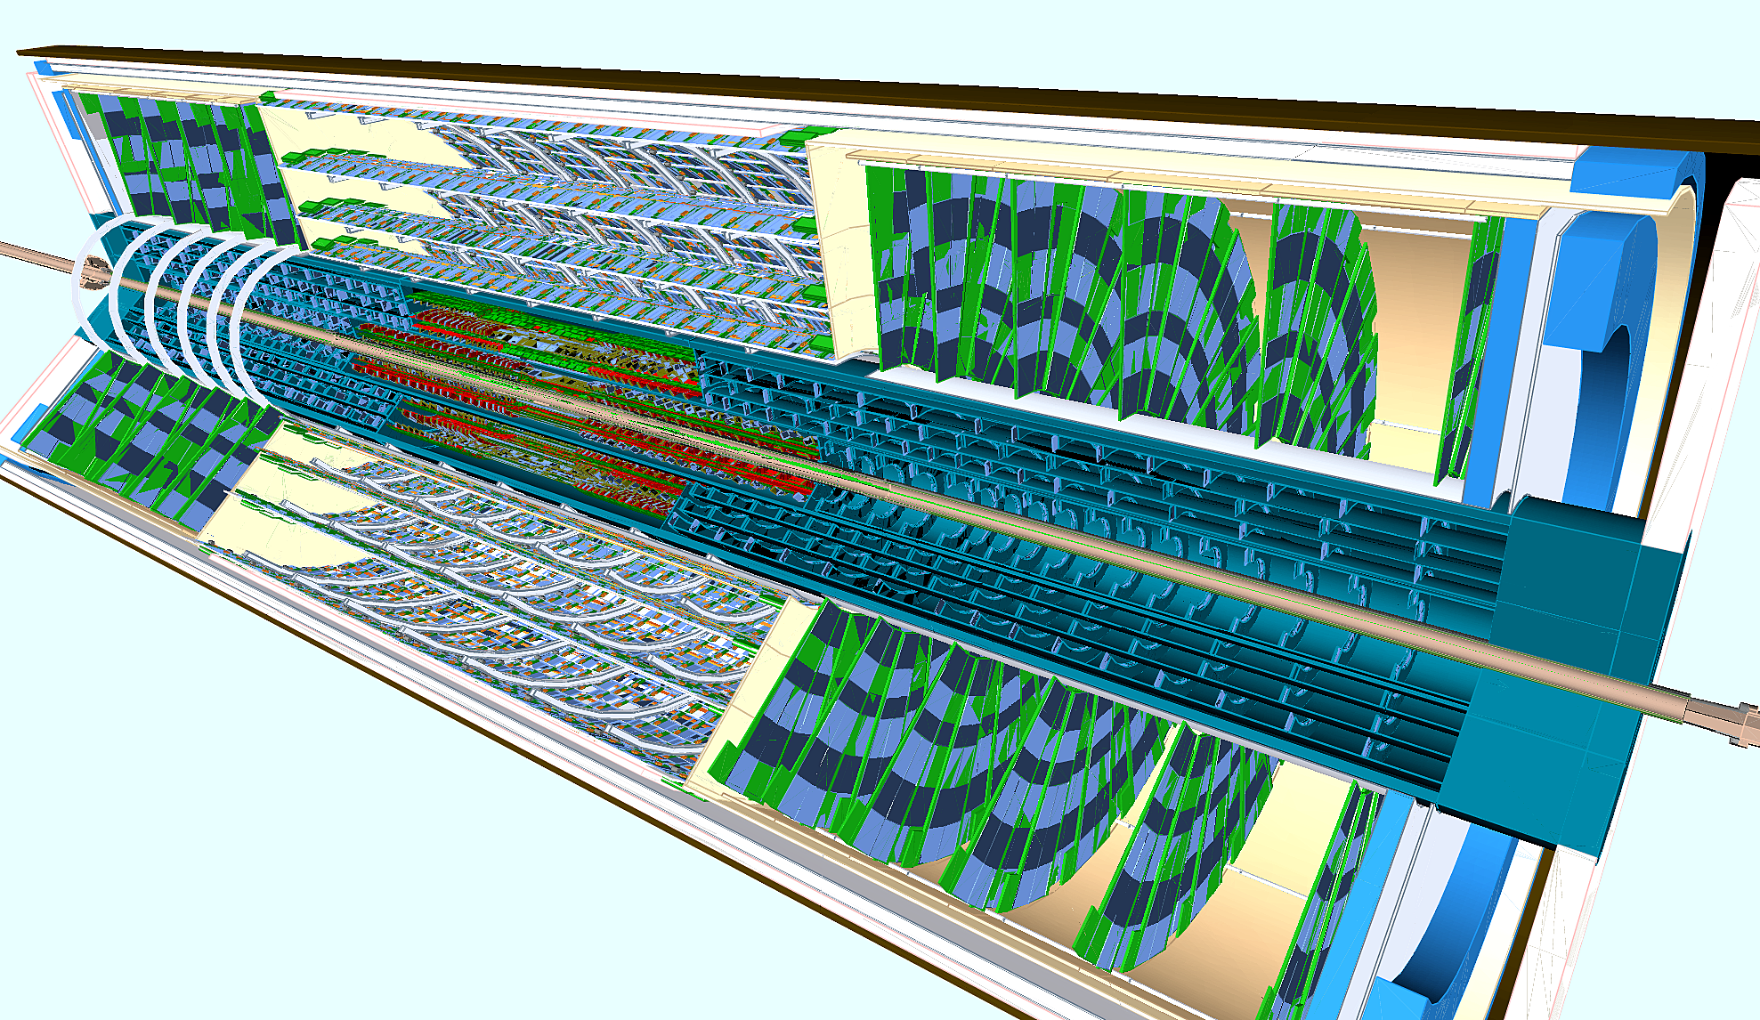
LHC Upgrades: data-taking 2030
~10x instantaneous luminosity
Pile-up of ~200 (c.f. 60 now) at ATLAS/CMS
High Luminosity-LHC detector occupancy would overwhelm existing detectors
Require finer-grained silicon detectors, new tracking detectors

Slide 15
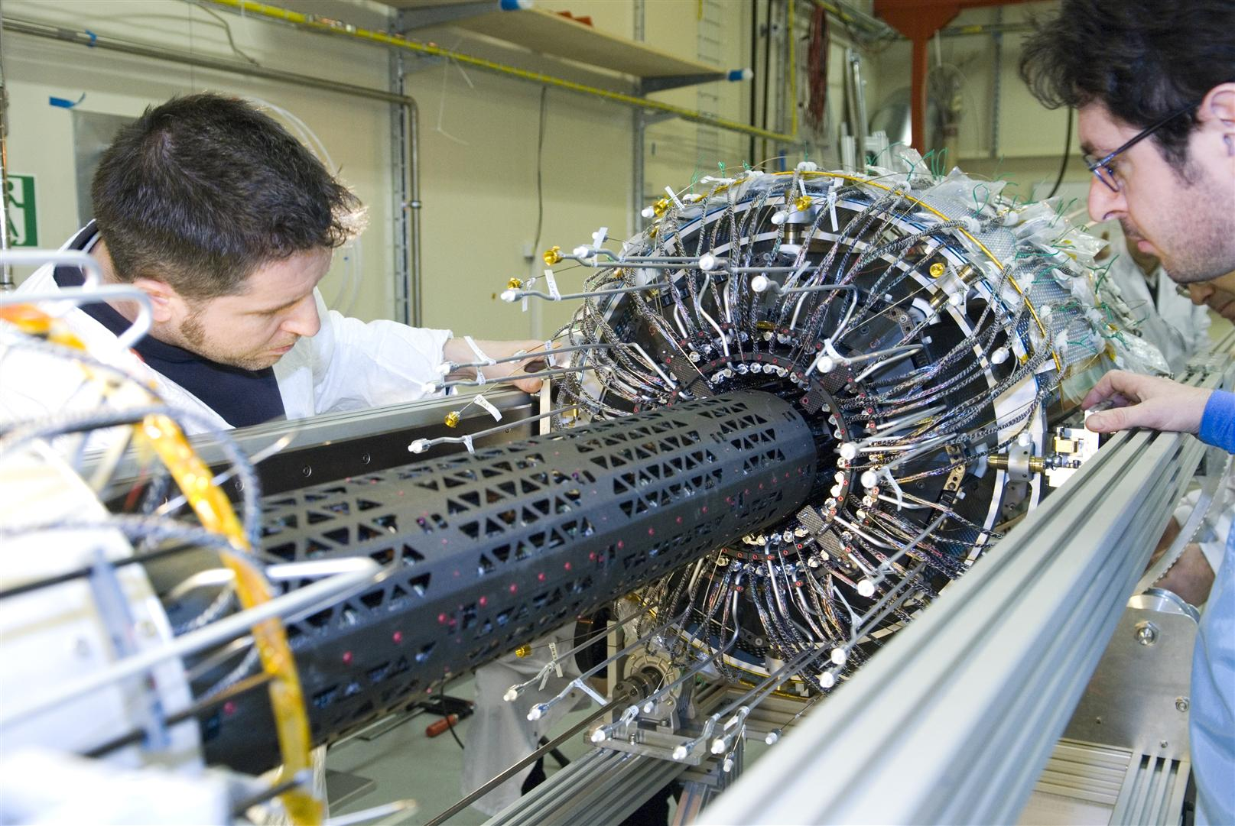
Precision silicon tracking

Slide 16
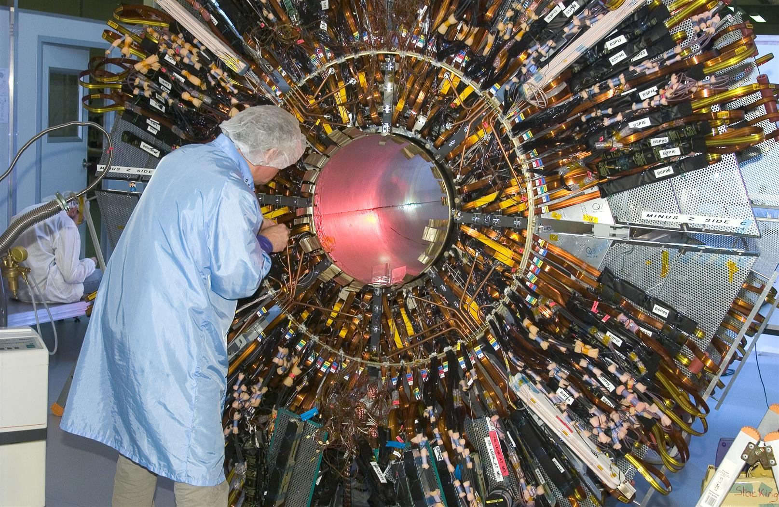
100’s millions readout channels

Slide 17
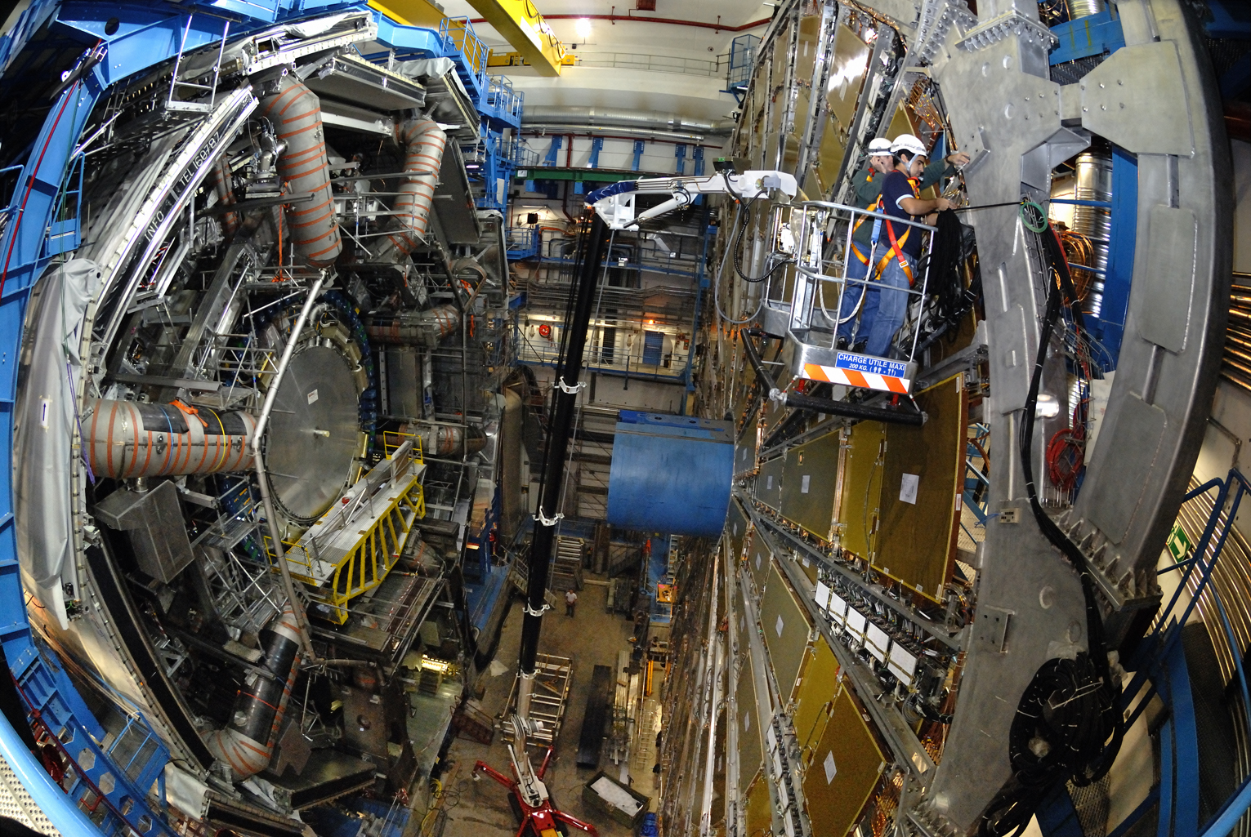
Large scale magnets and muon detection

Slide 18
Usability
Predictions are most valuable when they are predictions of what we can measure
i.e. particle-level final states in fiducial kinematic regions, with uncertainties which requires
Continued progress in turning full final state MC into precision calculation tools
Quantifying uncertainties from NP QCD effects, parton shower, Scales, EW corrections and PDFs
A lot of progress on this, but worth underlining that this is the most valuable type of prediction
Most valuable type of measurement: one that can be reinterpreted in light of new theory advances in decades to come

Slide 19
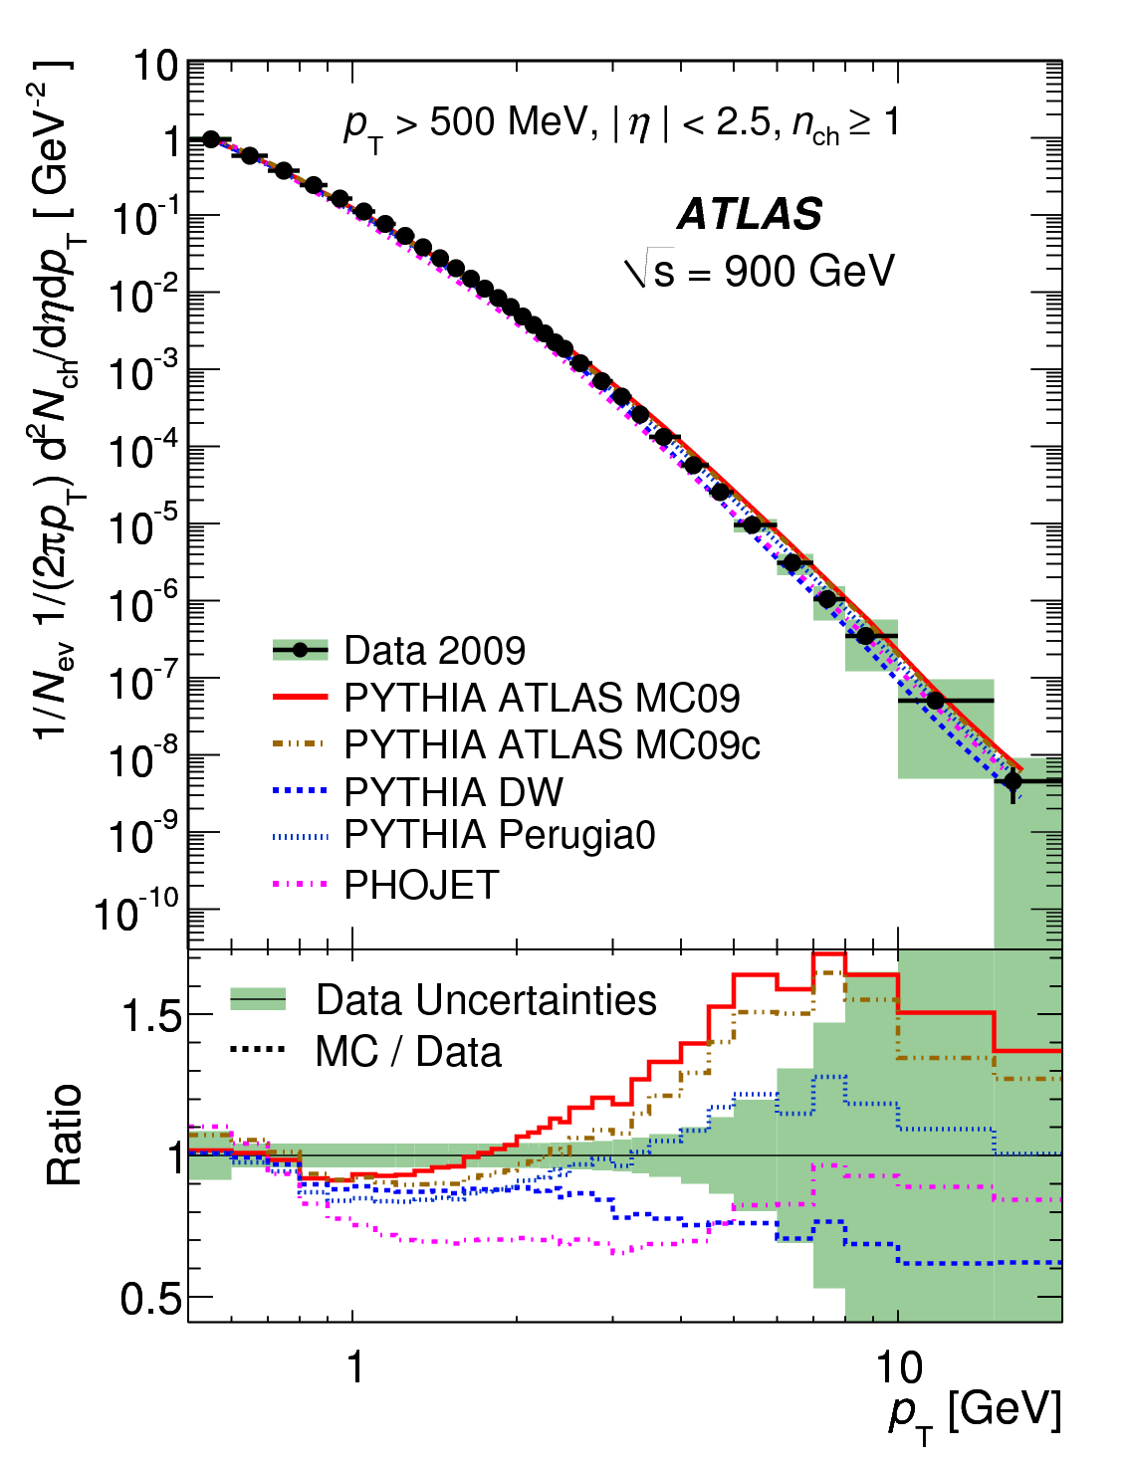
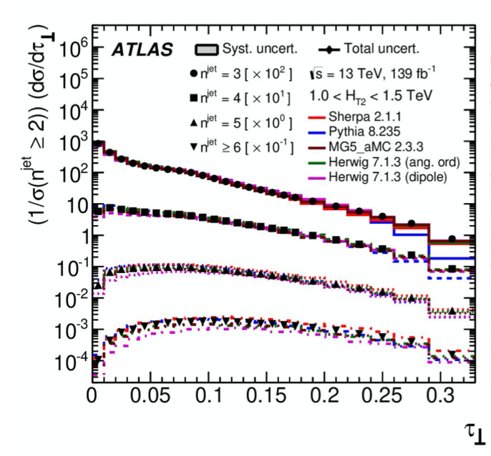
Which processes can we probe?: QCD
Not so statistics limited

Slide 20
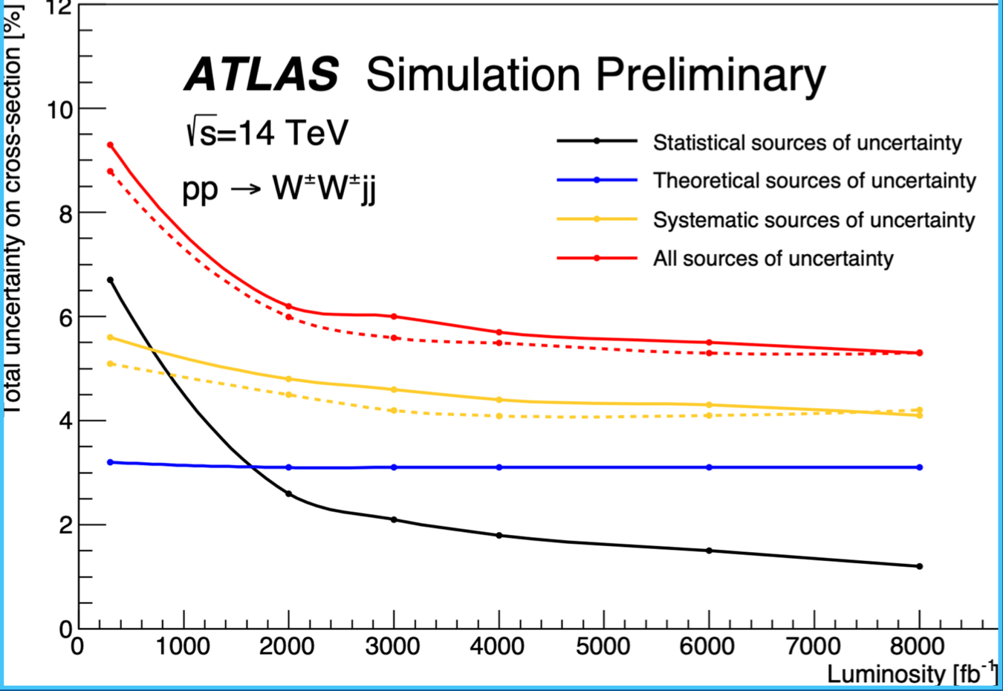
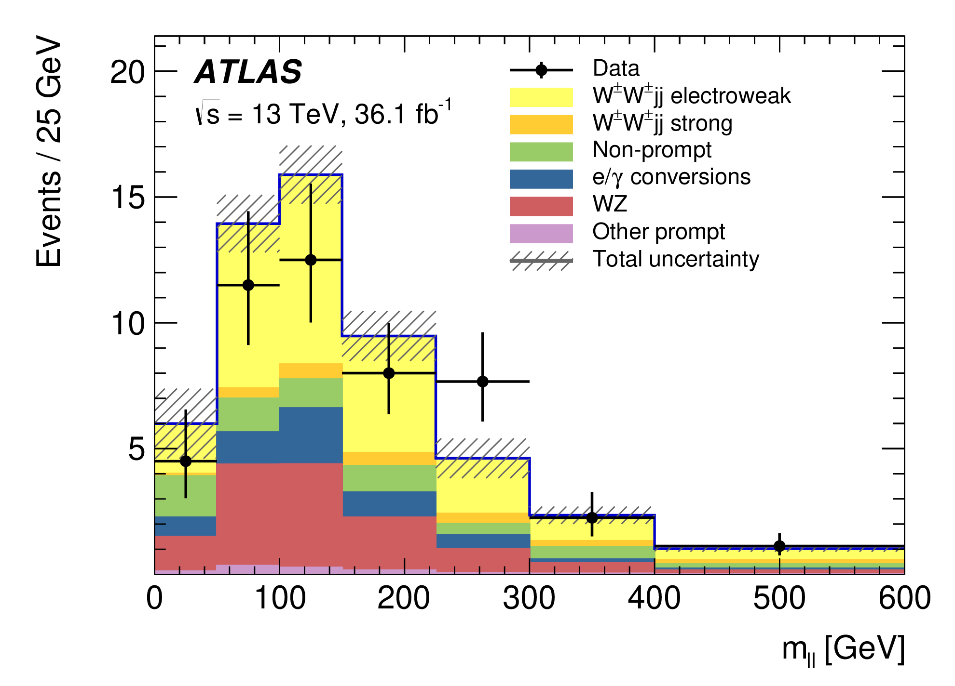
Prospects: Electroweak Interactions
Often statistics-limited
Many inter-related parameters
Example: WW scattering
Significant and delicate test of the Electroweak theory with the Higgs boson at the heart of it – deviation from exact SM Higgs predictions would alter WW cross-section potentially fatally for the SM, but it agrees with predictions so far.

Slide 21
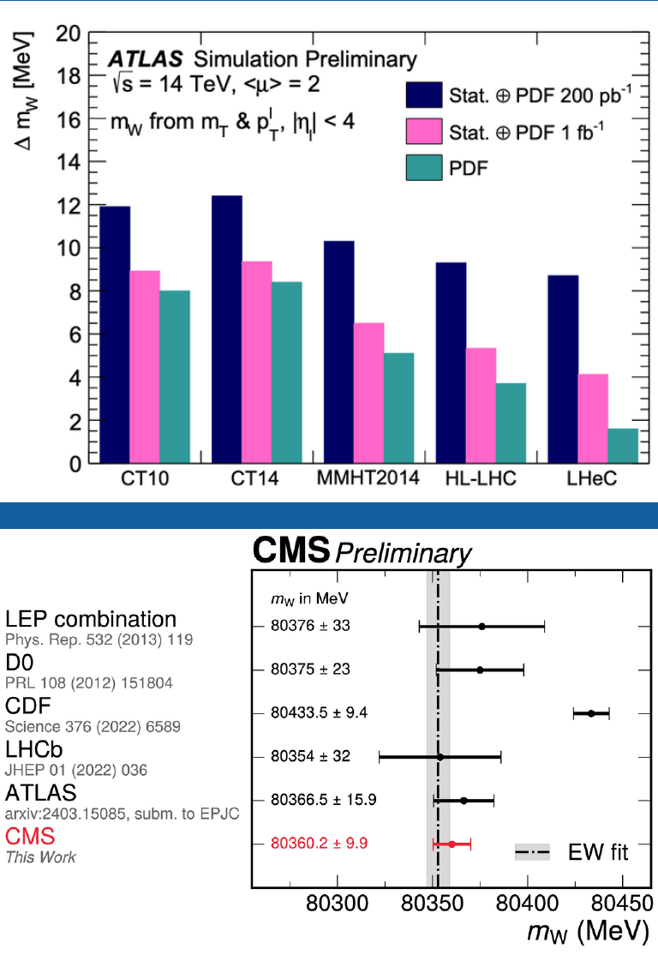
Prospects: W mass
W mass: precision at hadron collider

Slide 22
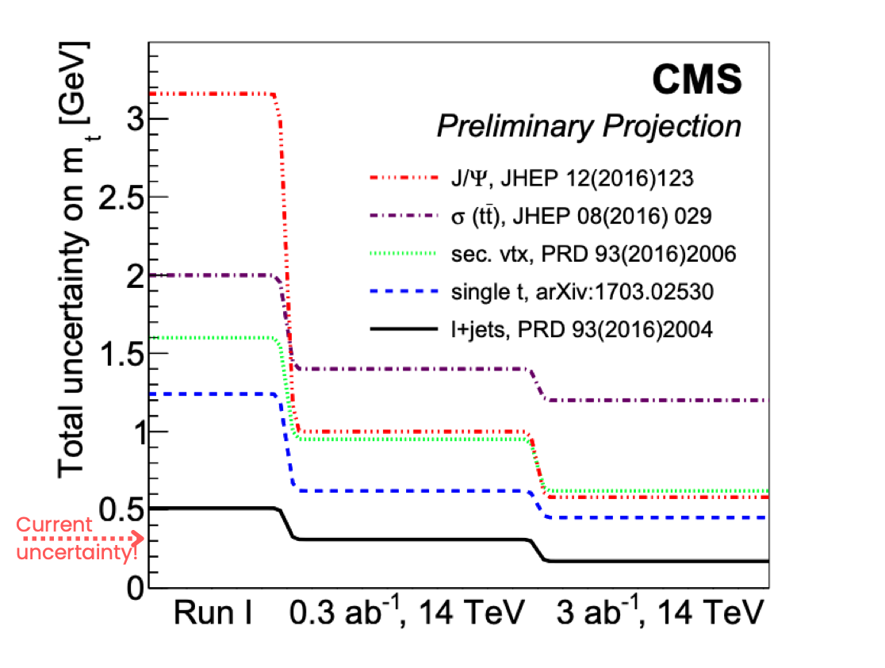
Prospects: Top mass

Slide 23
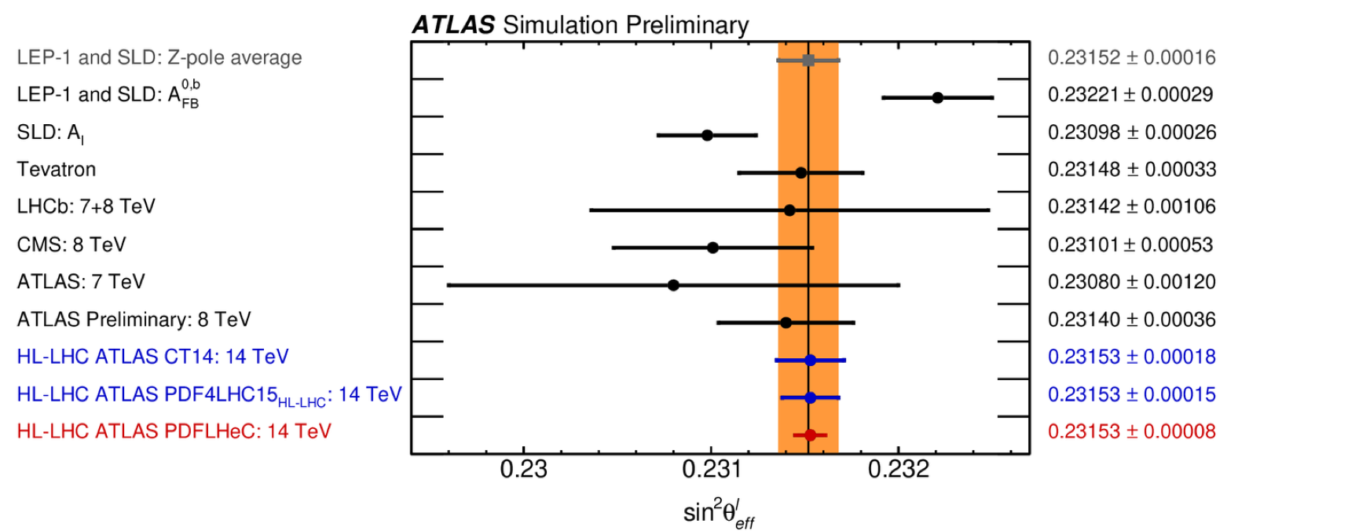
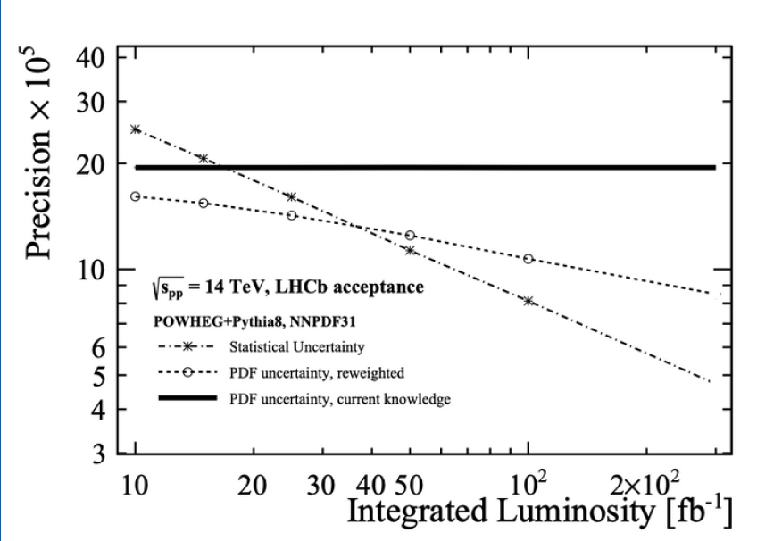
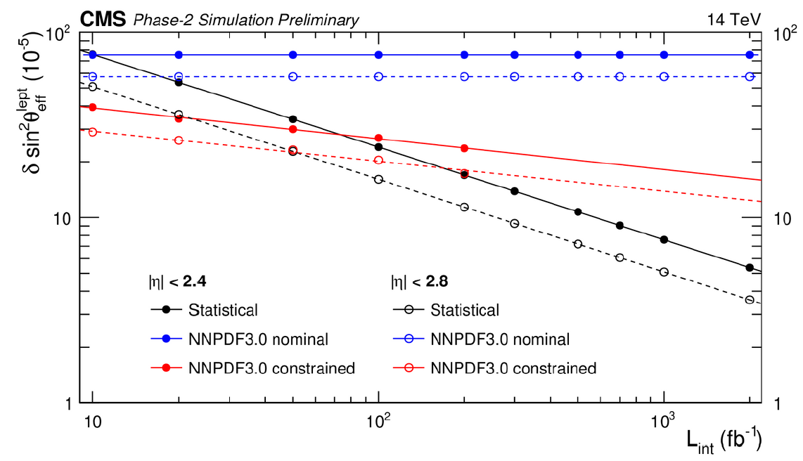
Prospects: Weak Mixing angle
LEP/SLD in 3 sigma tension
LHCb benefit from forward acceptance

Slide 24
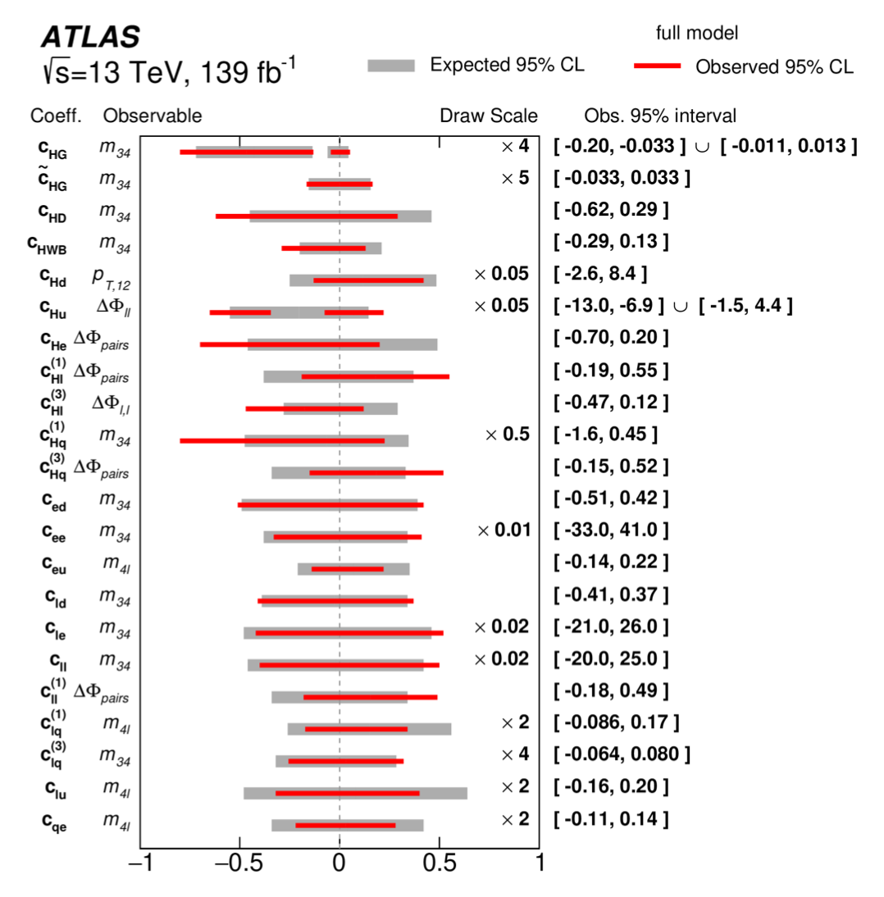
Joined-up picture: Effective Field Theory
Not a model as such, but an equation with terms additional to the SM, that modify it in specific ways

Slide 25
Prospects: Dark Matter
Standard Model has shortcomings, where’s the dark matter?
Collider approaches:
Look for specific theory predictions
Model-independent measurements
go and map out the phase space = what can we see (or not)?
organise by experimental signature
divide the parameter space up into “fiducial volumes” – well-defined regions, separated by cuts
Say what you saw or didn’t see in that region
This constrains the theories

Slide 26
Dark Matter / BSM in colliders?
#
Typically search for a mass resonance
Higher energy ➔ Access higher mass states
Higher luminosity ➔ Access rarer production processes
This has worked: ...J/ψ, ϒ, Z, Higgs, ...
But no evidence for resonances Beyond the Standard Model Ruled out phase-space: e.g. mass(Z’➔ τ⁺τ⁻) is > 2.4 TeV
O₁
Mass(O₁,O₂)
p
O₂
p

Slide 27
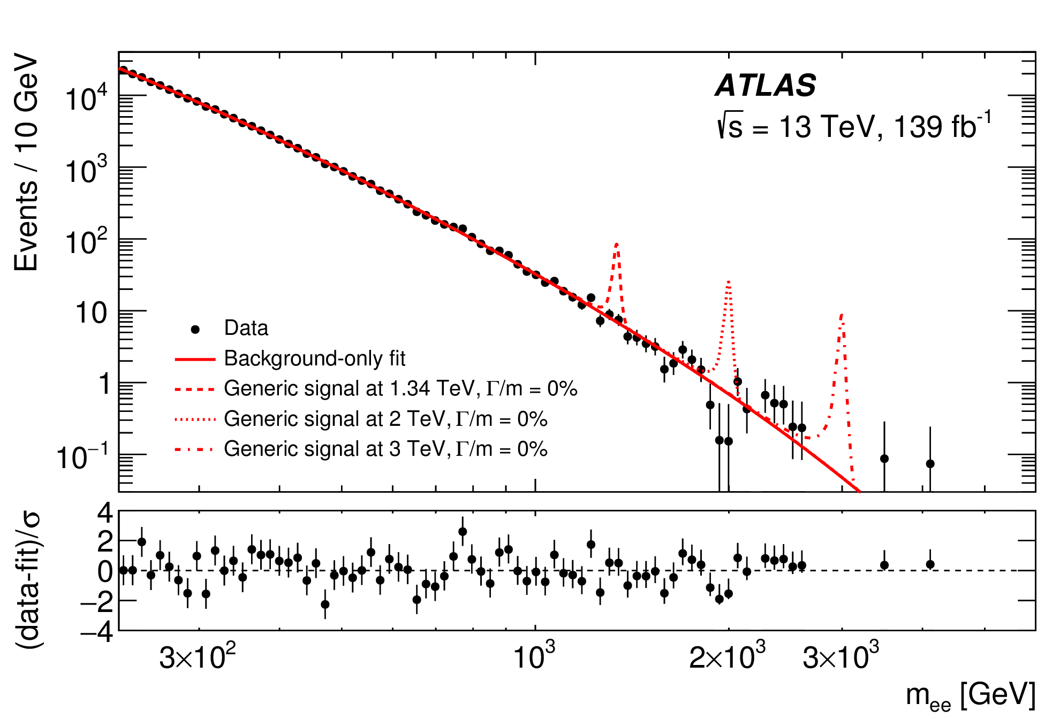
Which processes can we probe?: Searches
For example, rule out new particles decaying to two leptons up to around 4.5 TeV in mass

Slide 28
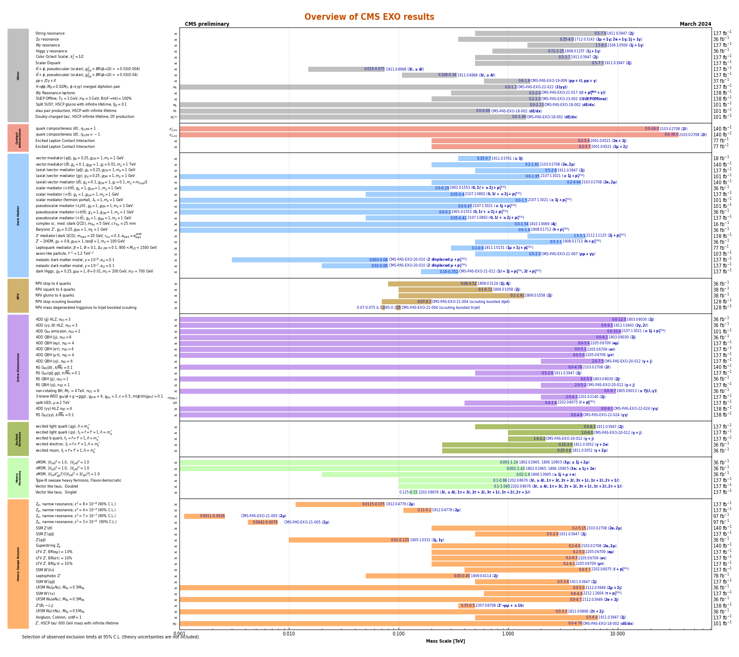
Searches (now)

Slide 29
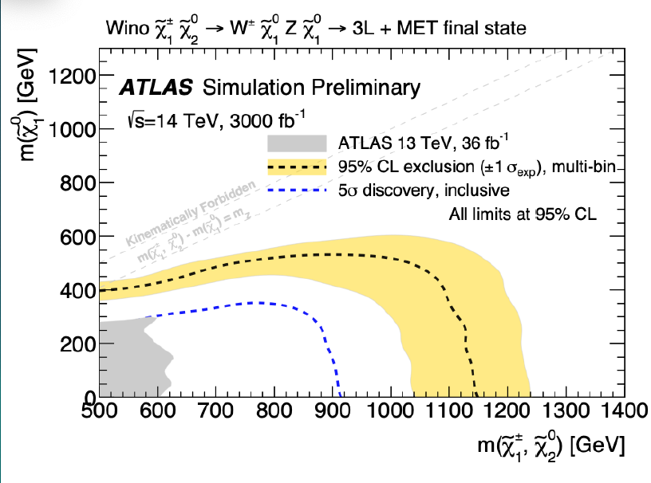
Prospects: Dark matter at HL-LHC
SUSY neutralino

Slide 30
Prospects: Z’

Slide 31
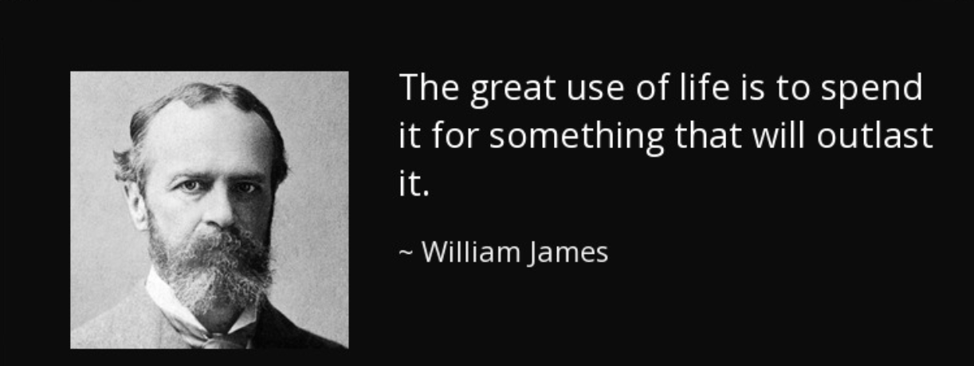
Legacy: Cross sections in fiducial regions

Slide 32
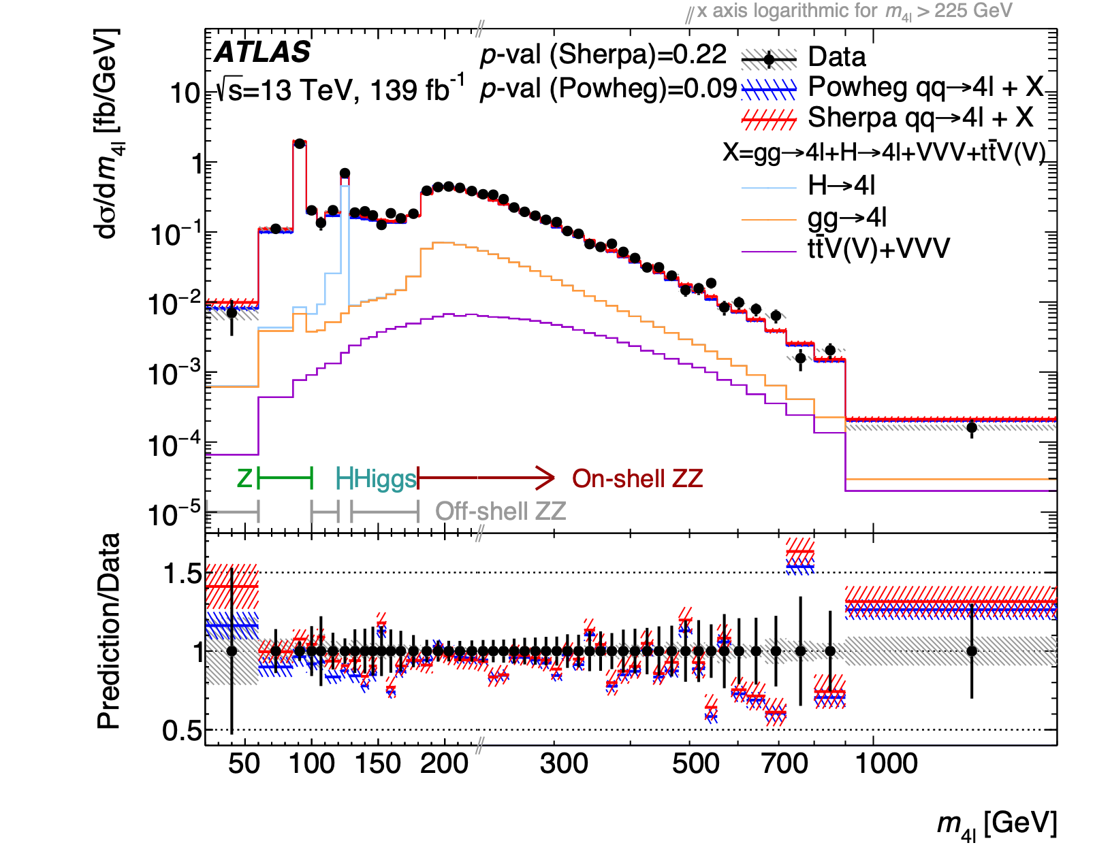
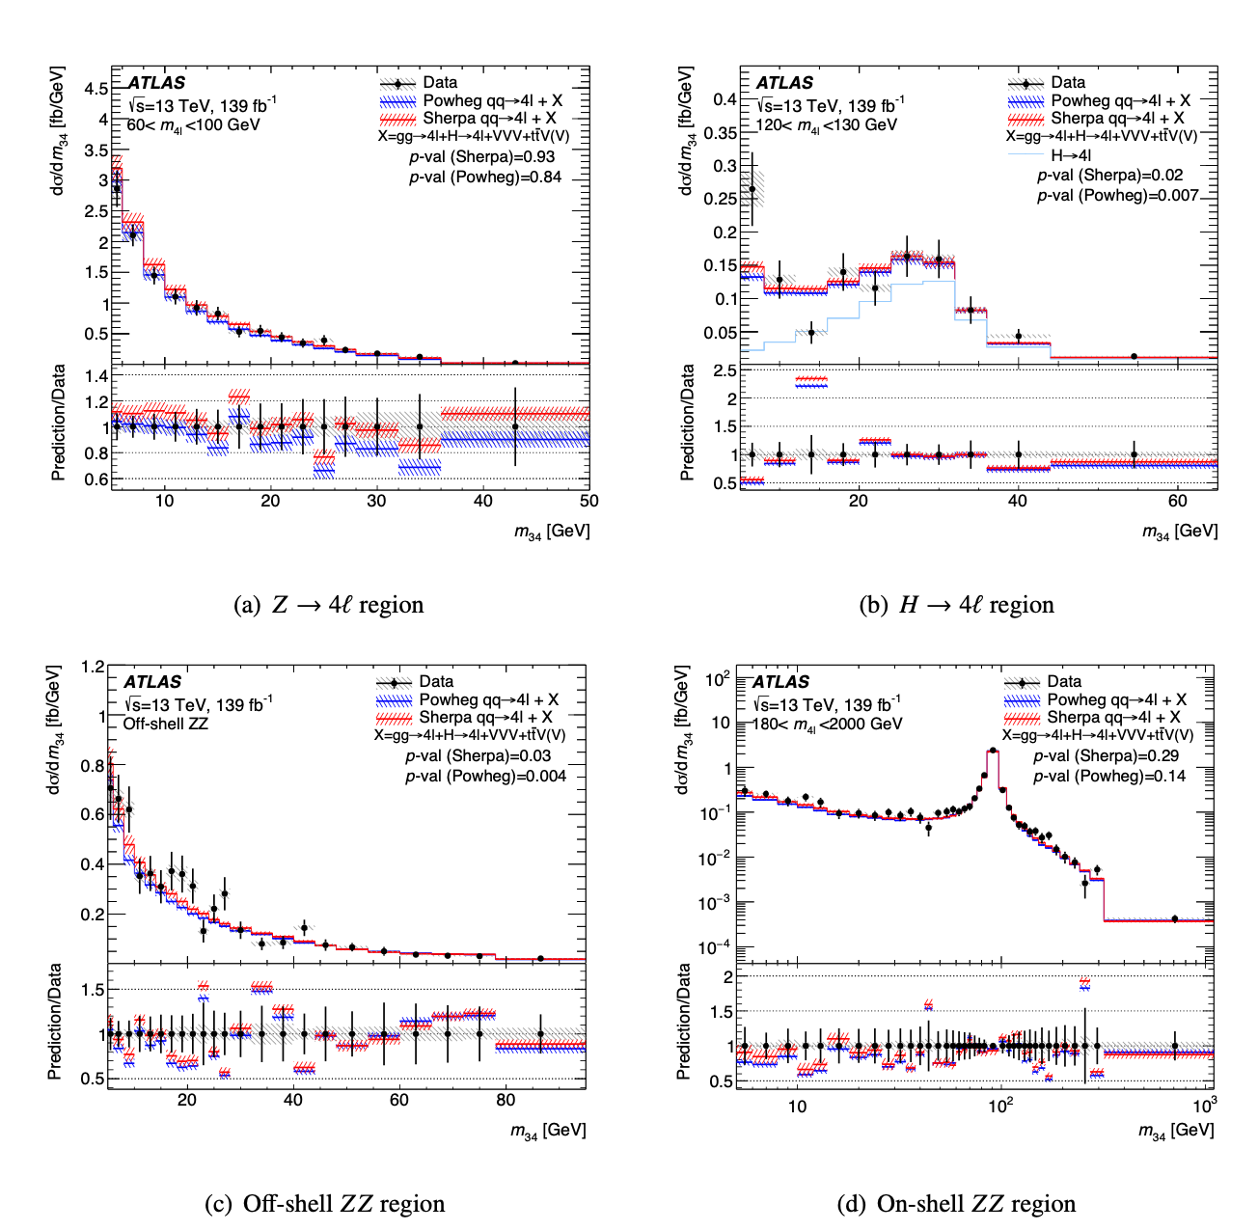
Legacy: Cross sections in fiducial regions

Slide 33
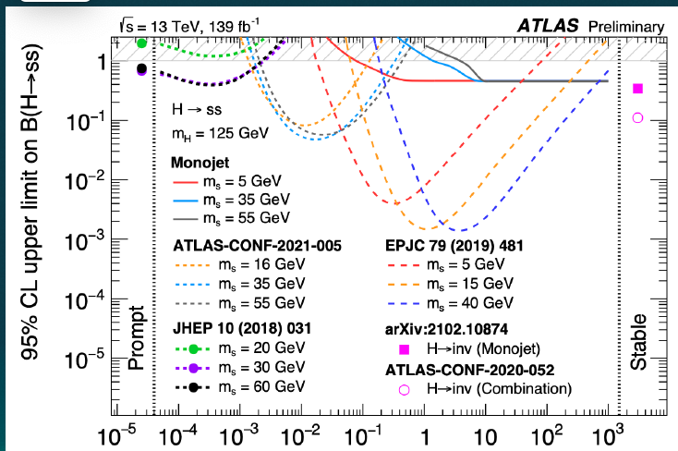
Legacy: Reinterpretation
Example: reinterpret monojet measurement as dark photon limit

Slide 34
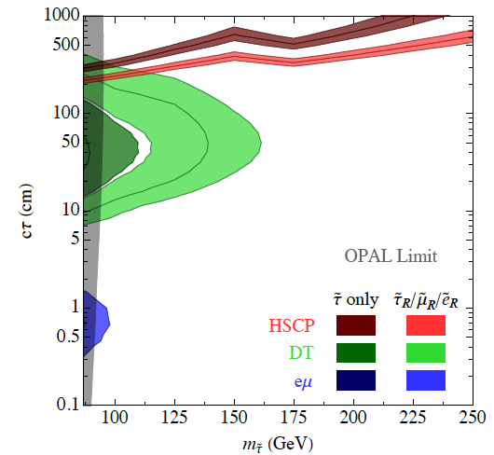
Alternative Axis: Lifetime
Single LLP production
O₁
LLP = Long Lived Particle
LLP
O₂
p
p
Not part of original design goals
Enabled by novel triggers
Example of how we can change the program over time
Inputs to that are always welcomed
Lifetime, cτ (cm)
Mass(LLP) (GeV)

Slide 35
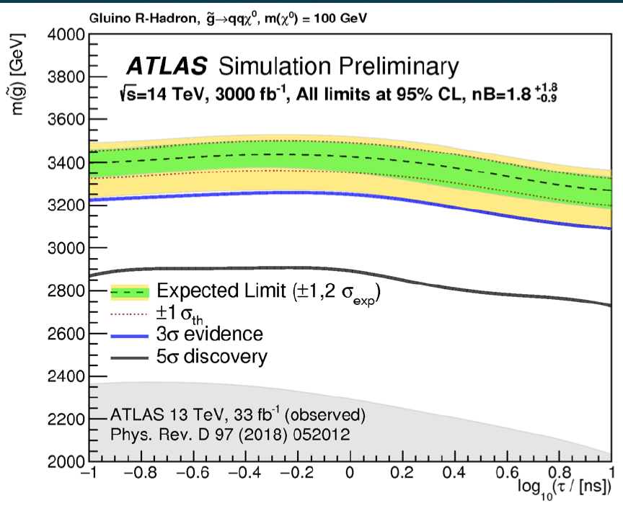
Prospects: long-lived particles
Still extending algorithmic capability
Just one example: SUSY long-lived gluino

Slide 36
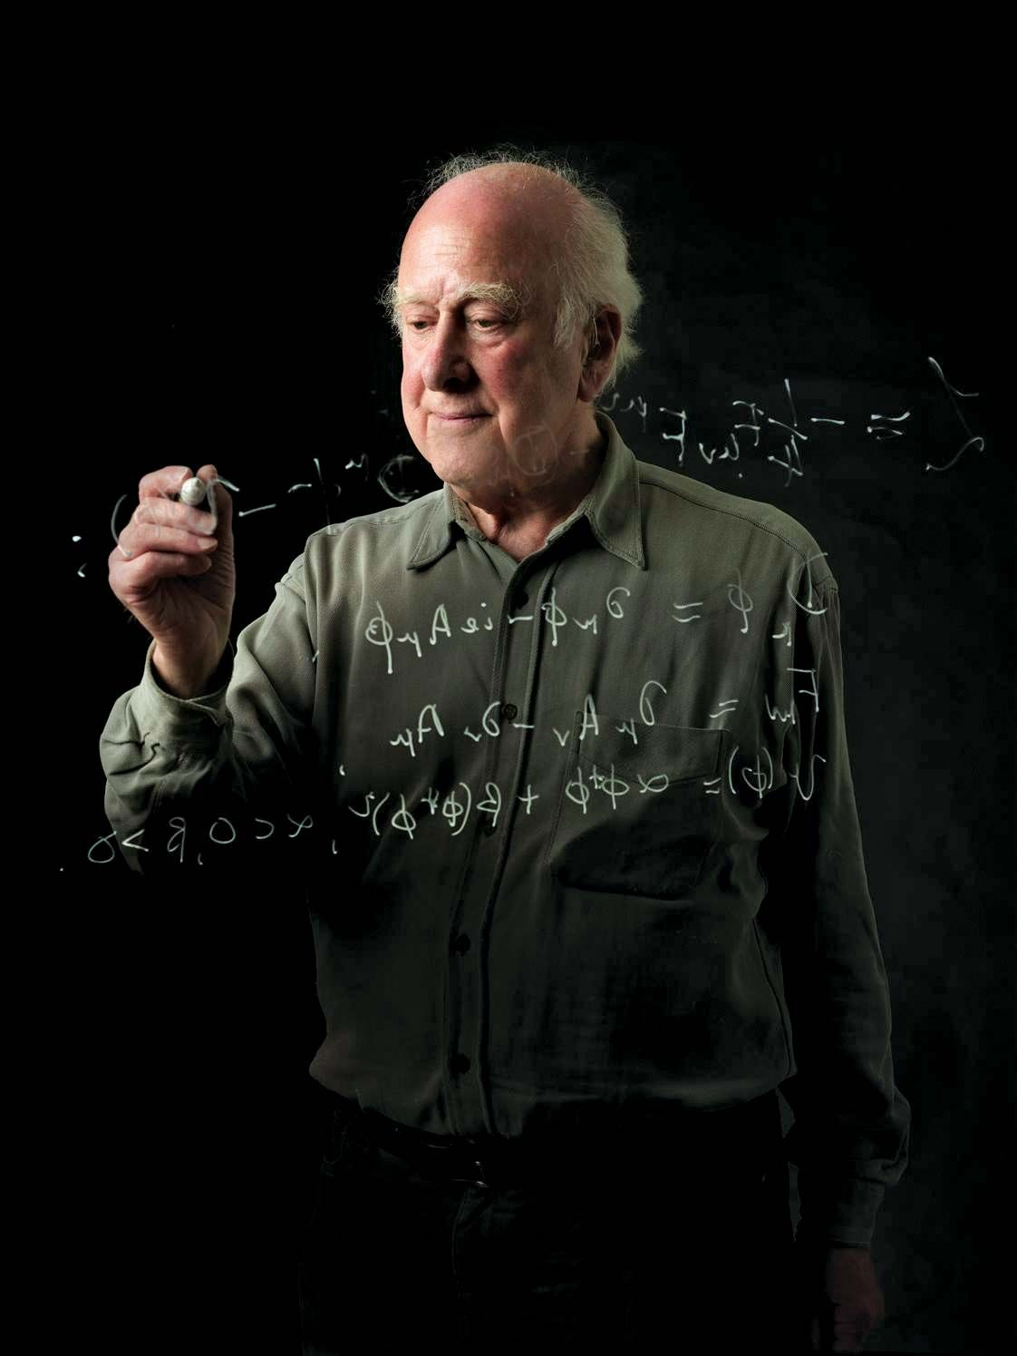
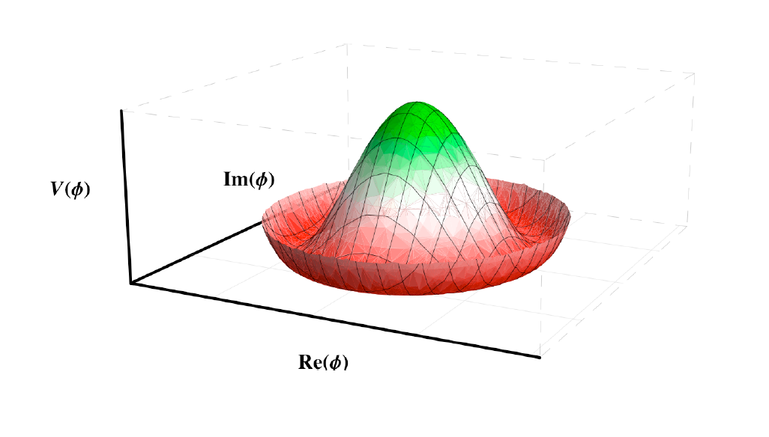
The Higgs Boson

Slide 37
SM Higgs Boson Couplings
Standard Model Higgs: h: J^{PC}=0⁺⁺
h
h
V
f

Slide 38
SM Higgs Boson Couplings
Standard Model Higgs: h: J^{PC}=0⁺⁺
2HDM (SUSY) Higgs: h⁰, H⁰: 0⁺⁺; A⁰: 0⁻⁺; H±
h
h
V
f
h,H
h,H
b
V

Slide 39
SM Higgs Boson Couplings
Standard Model Higgs: h: J^{PC}=0⁺⁺
h
h
V
f
κ_{V}
κ_{f}

Slide 40
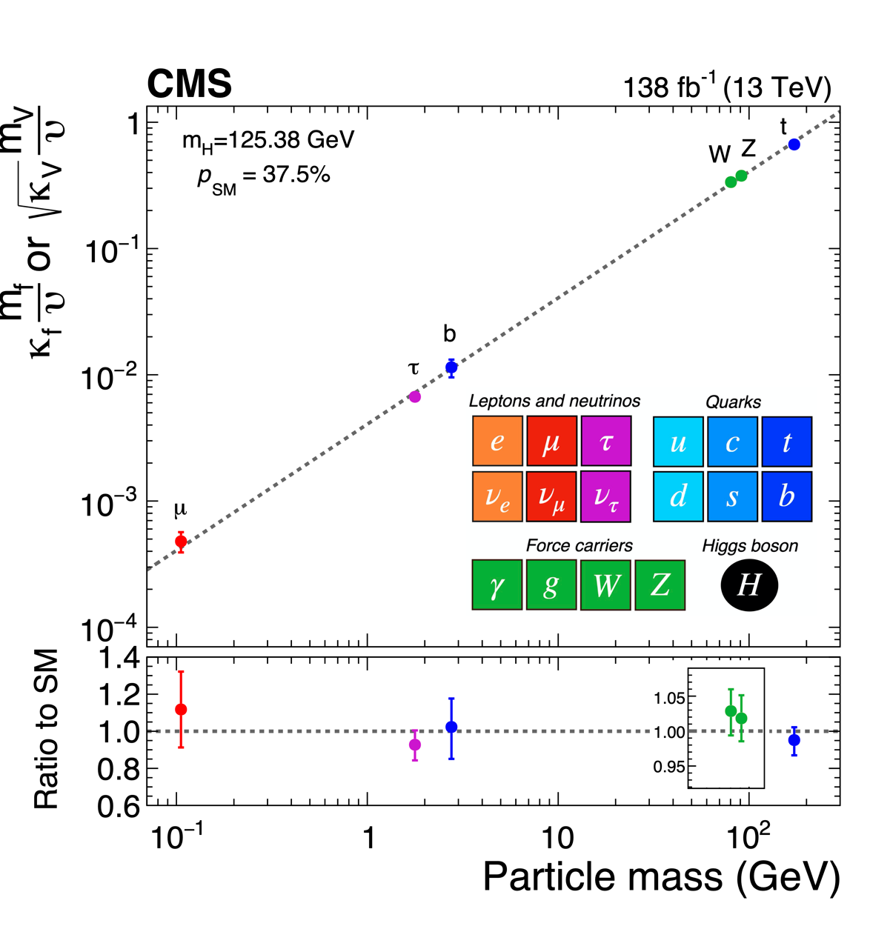
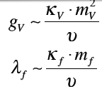
Standard Model Agreement with Data
Within uncertainties the data agree with
the Standard Model

Slide 41
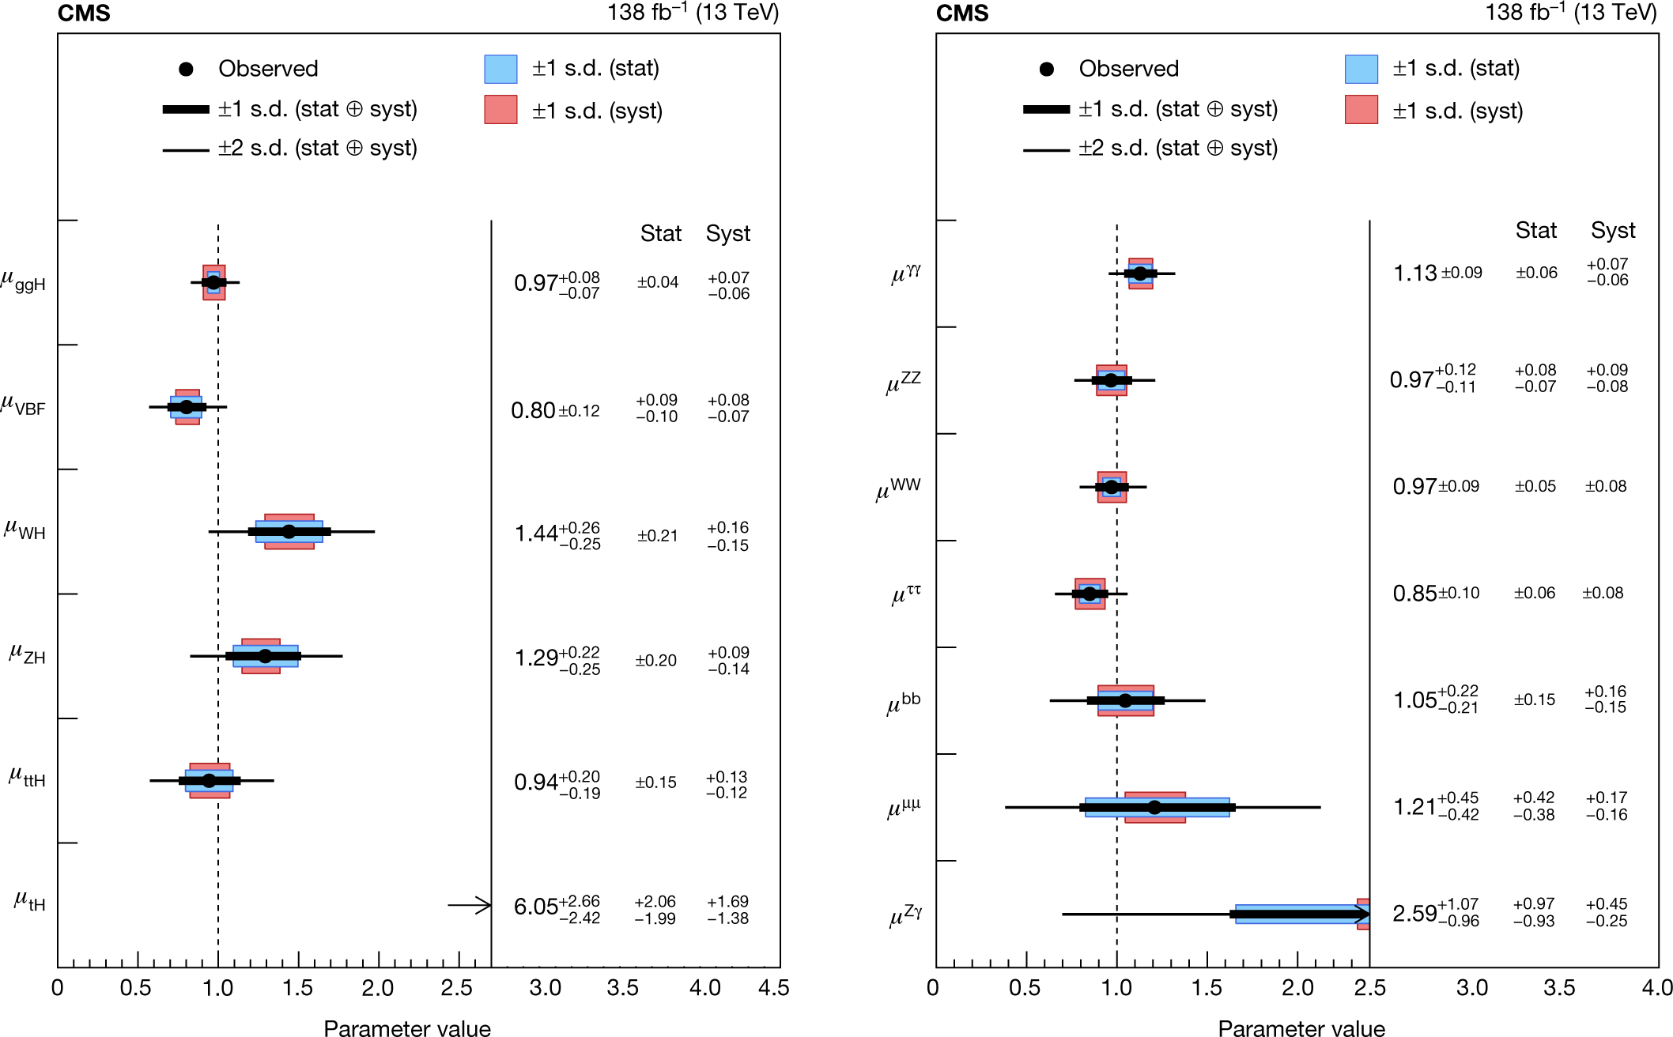
What did we discover?
Compatible with Standard Model!

Slide 42
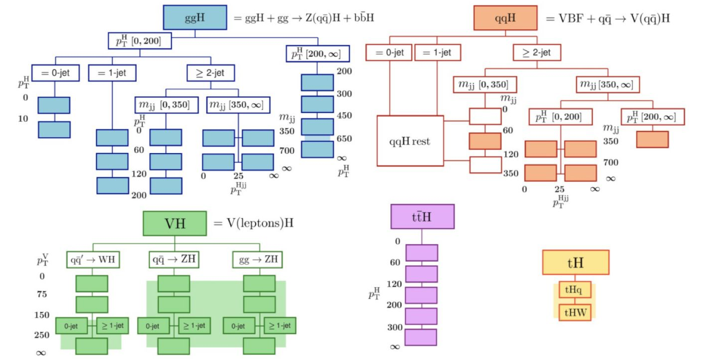
Legacy: Cross Section in exclusive regions

Slide 43
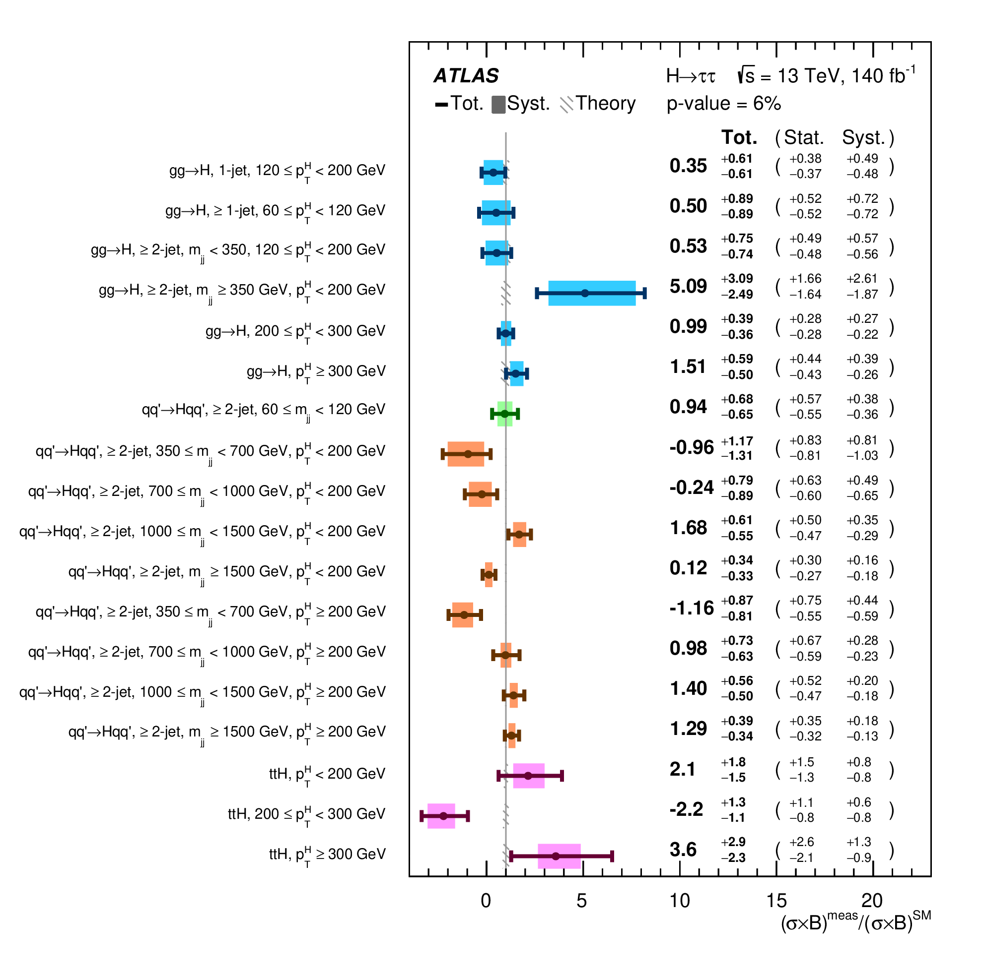
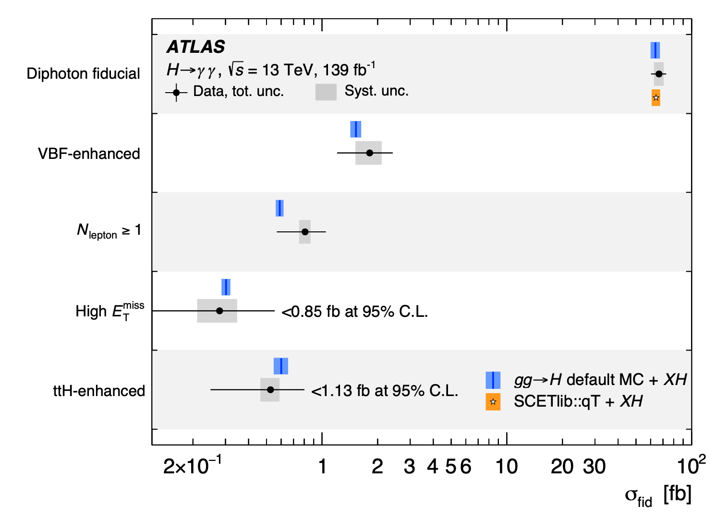
H→ττ in regions
Agreement across
three orders of magnitude

Slide 44
HL-LHC Prospects: Higgs

Slide 45
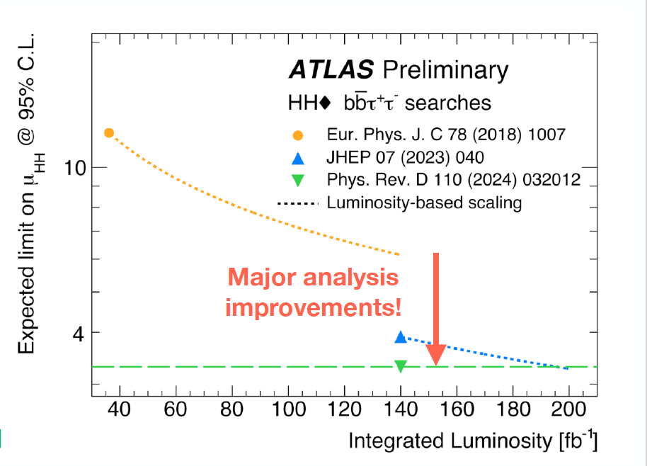
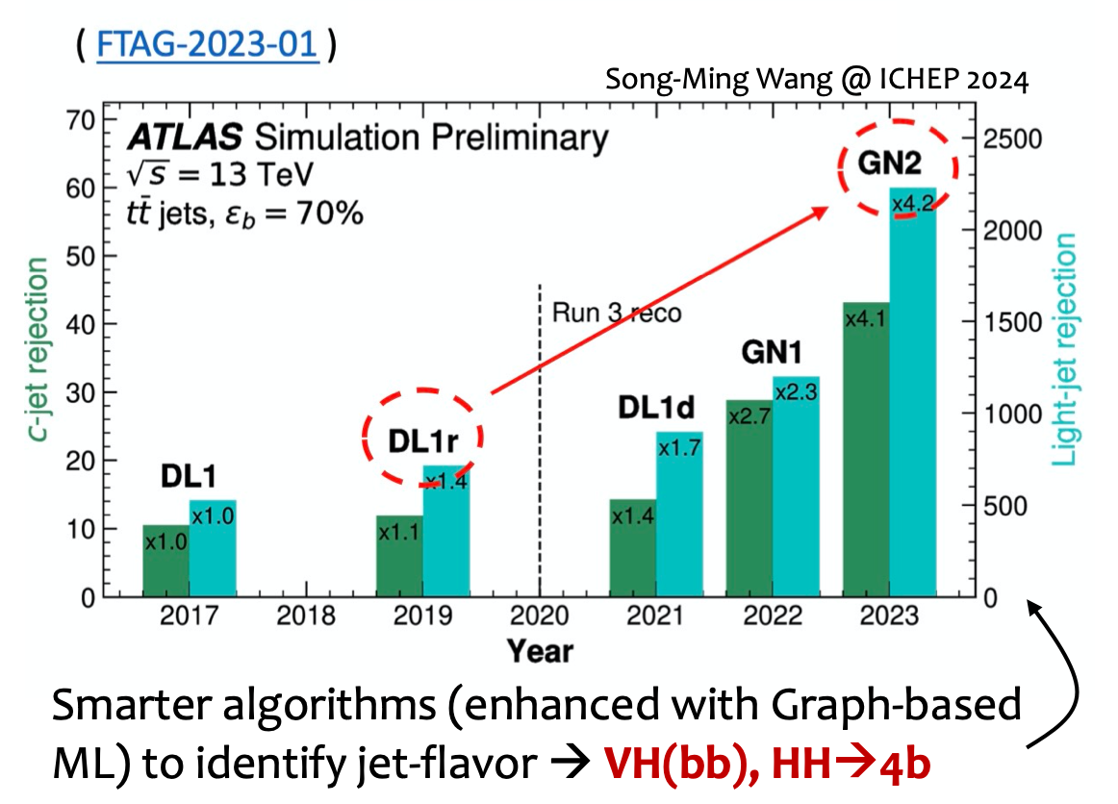
Object reconstruction: gets better

Slide 46
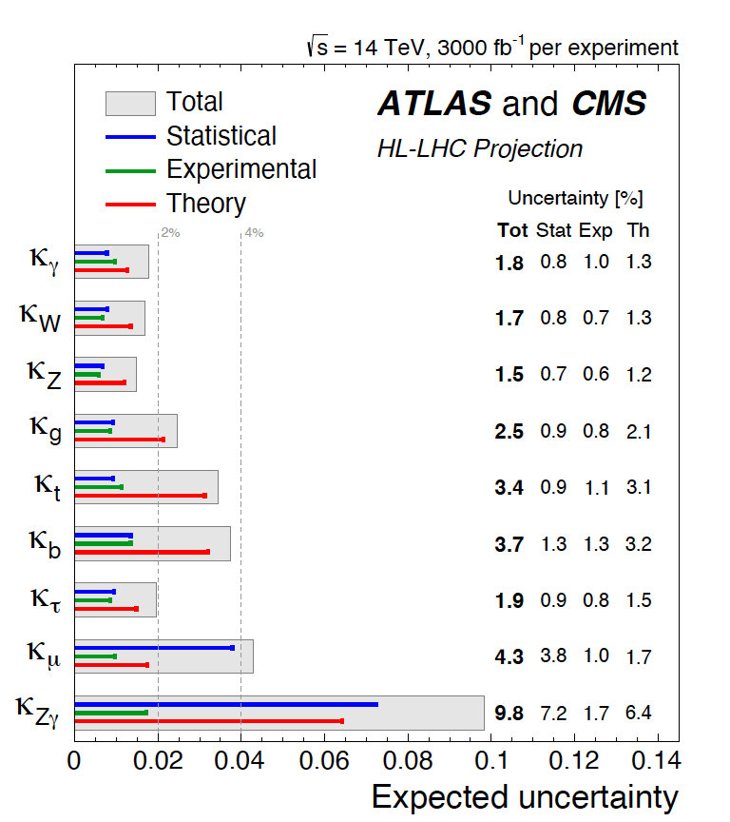
Prospects: Single Higgs Couplings
% level
What about light quarks?
Constraints through W⁺⁻H
asymmetry
Constraints from H γγ
interference
arXiv:1609.06592

Slide 47
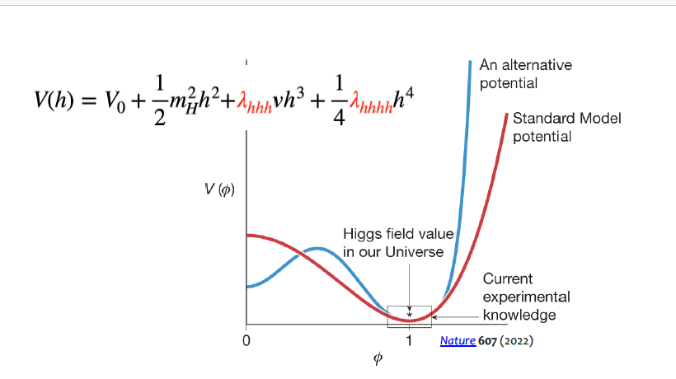
Di-Higgs
Total production cross section is very small ~30fb
Currently set limits on HH production (inclusive of both diagrams)

Slide 48
Di-Higgs
Nature 607 (2022) 60-68
Getting close to SM: both experiments set limits on cross-section at ~2.5 x SM cross-section
Theory systematics: parton shower up to 13%; PDF up to 12%; scale variations up to 8%; top quark mass scheme 25-40%!!!
Notes:
Scale variations 2-8% systematic
PDF 1-12%
Parton shower 6-13%

Slide 49
Di-Higgs
Nature 607 (2022) 60-68
Getting close to SM: both experiments set limits on cross-section at ~2.5 x SM cross-section
Theory systematics: parton shower up to 13%; PDF up to 12%; scale variations up to 8%; top quark mass scheme 25-40% in bb!!!
Notes:
Scale variations 2-8% systematic
PDF 1-12%
Parton shower 6-13%

Slide 50
Higgs to Invisible

Slide 51
Extended LHC

Slide 52
Extended LHC: e.g. ANUBIS
Extended LHC

Slide 53
Extended LHC: Forward Physics Facility
Run in LHC alongside existing program
does not use input from ATLAS detector signatures

Slide 54
Extended LHC: ep collider?

Slide 55
What might we know in 2040?
Higgs self-coupling to 20% (if SM value…)
Higgs single couplings to % level (2nd generation to a few %; light quarks? Get smart on that too?)
Top mass to 0.1%?
W mass to a few MeV
pdf constraints improved by several factors
Constraints on event rates for a huge signature phase space
(know which models not to consider…)
All this -> EFT fits – hints?
Or something direct and anomalous?

Slide 56
Some Lessons?
Smart ideas make a big difference
Trigger (big gains for di-Higgs and will be existential in HL-LHC)
Object identification (AI: big gains in b-tagging)
Smart analysis tool (e.g. separate ggF and VBF in di-Higgs)
Legacy results should include reinterpretable ones
Hadron colliders can do precision (W mass, weak mixing angle)
And low pt (whole host of QCD spectroscopy)
Leaps in sensitivity do happen
Trigger
Turn the “picoscope” to a completely new area of phase space
Colliders are complementary to other facilities

Slide 57
End

Slide 58
CMS upgrades
P. McBride

Slide 59
ATLAS upgrades
K. Tariq

Slide 60
Kinematic Distributions
N. Wardle

Slide 61
Some questions?
In projections we easily assume theory uncertainty improves by factor 2 – how do we get there and is this realistic?
What accuracy of κ_{λ} will tell us the fate of the universe?
How would you organize to have a comprehensive set of legacy measurements in ~2040?

Slide 62
Standard Model Shortcomings
Remarkable self-consistency and predictive power… but…
Couplings of different scales – partial unification through Electroweak theory, but not unified with QCD
Nothing to say about gravity
(Too?) many free parameters
Hierarchy problem (difference in scales of fundamental forces)
Naturalness problem (Higgs mass fine—tuned)
No dark matter candidate
… and so we are driven to look Beyond the Standard Model

Slide 63
What precision is necessary?
SM couplings can be modified by new physics
Modifications can be small depending on the BSM scenario (Snowmass report)
For new physics at the 1TeV mass scale:
Higher scales imply smaller effects
arXiv:1310.8361

Slide 64
Dark Matter

