Slide 1
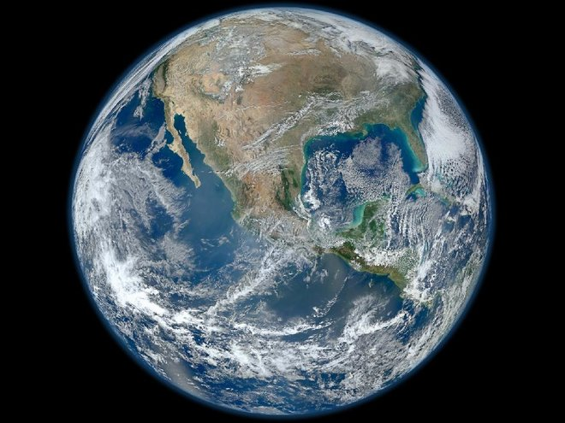
Sustainable Future for HEP - Challenges in Physics and Environmental Impact
Véronique Boisvert (b. 329.7 CO2 ppm) @VBoisvertRHULPP
26th November 2024 (424.0 CO2)
Sustainability and Carbon Emissions of Future Accelerators, hep-ex 2411.03473 with Ken Bloom

Slide 2

Outline
See my IOP 2024 talk
The climate emergency
CO2e emissions & solutions from (current and future):
  Accelerators (construction/operation)
  Detectors
  Computing
  Rest (travel, conferences, buildings, etc.)
Disclaimer:
  I’m not a climate/energy scientist!
  My research is on ATLAS, so energy frontier bias!

Slide 3
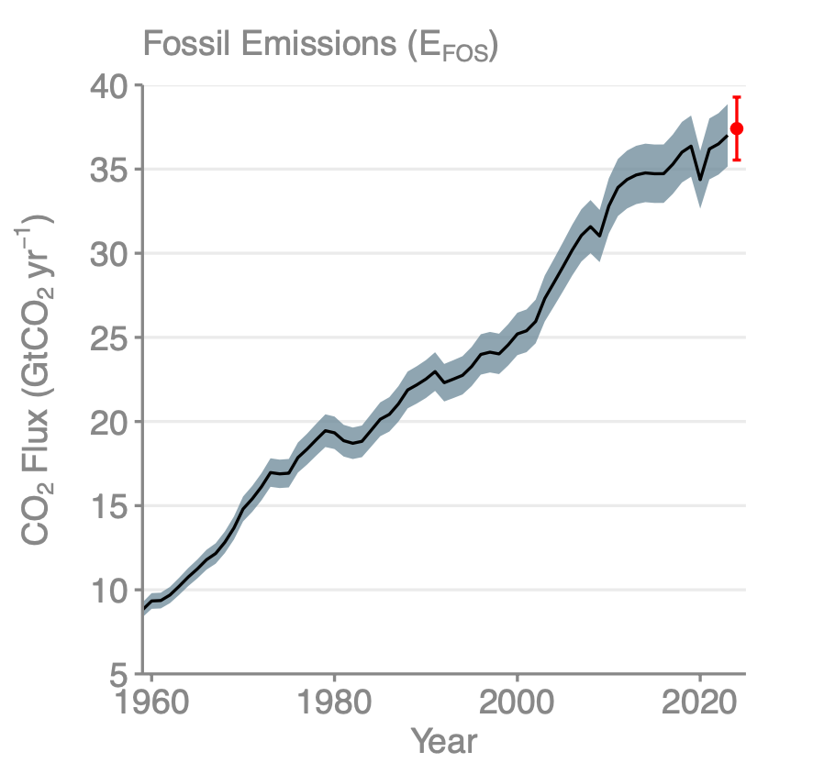
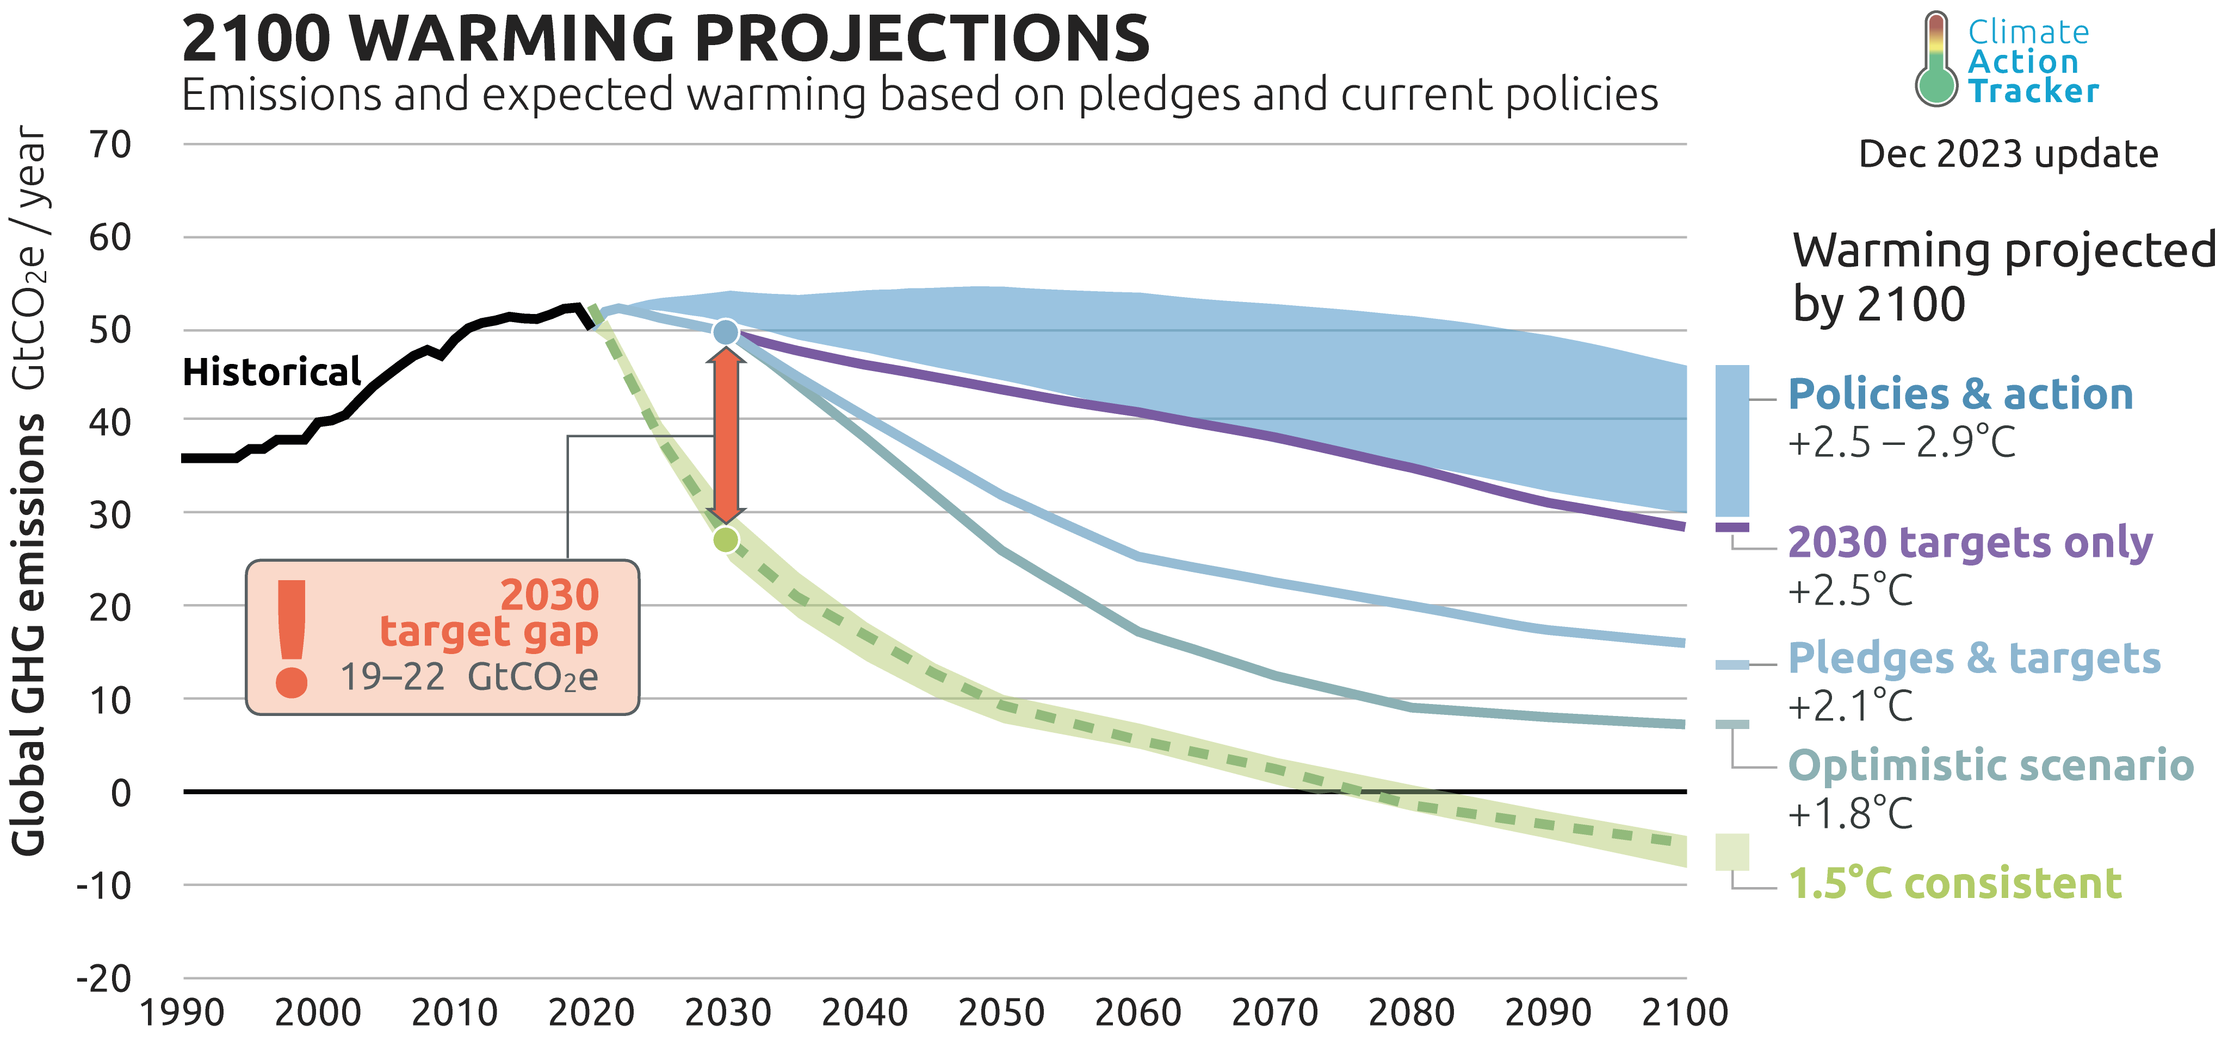
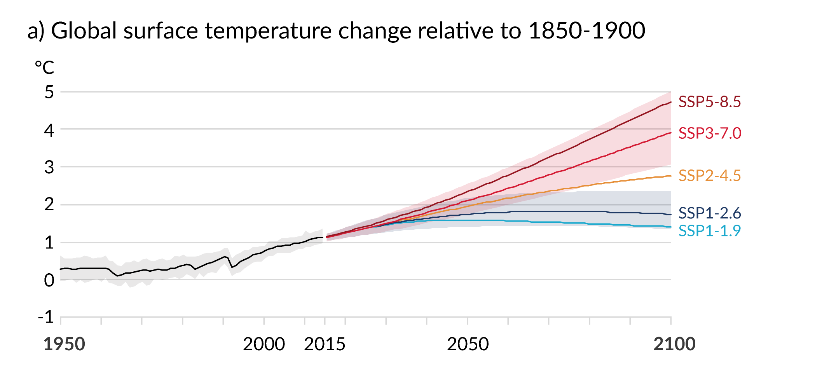
Climate Change: an emergency
UK parliament first to approve a motion to declare an “environment and climate emergency” on 1st May 2019
IPCC 2015 Paris agreement: aim to stay “below 2℃” so focus on 1.5 ℃
  NDC: Countries make pledges for how to achieve this (and then increase those pledges over time)
  Climate Action Tracker: “With all target pledges, including those made in Glasgow, global greenhouse gas emissions in 2030 will still be around twice as high as necessary for the 1.5 ℃ limit”
Global Carbon Project
2023
Covid-19 pandemic (-5.4%)
Global Financial Crisis (-1.2%)
Dissolution of Soviet Union (-3.1%)
Second Oil Crisis
First Oil Crisis
IPCC AR6
Ice ages: ~ -5℃
+4℃: civilization breakdown…
Notes:
cel

Slide 4
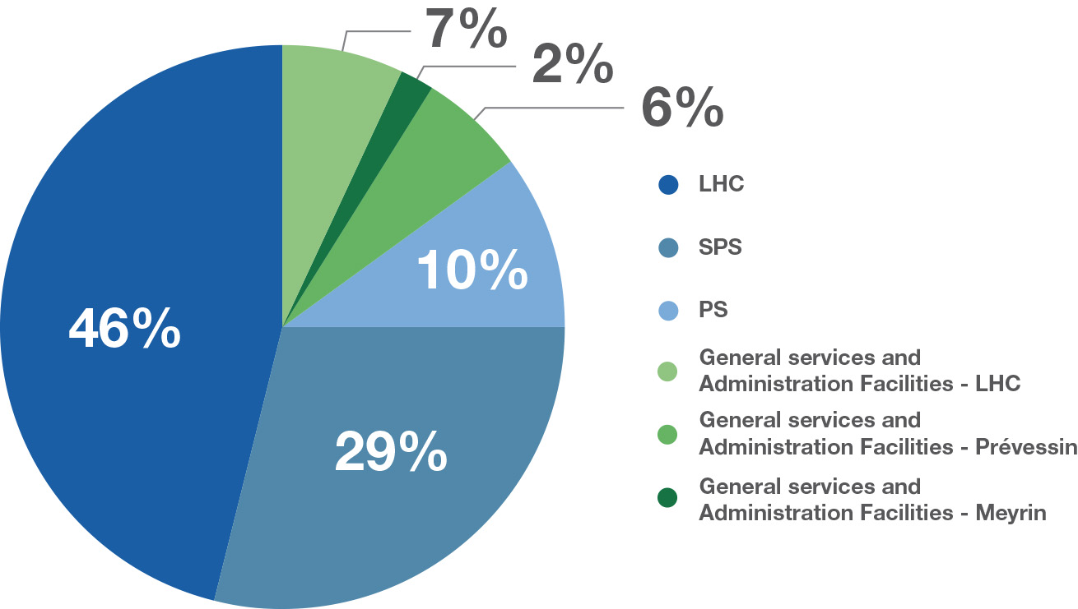
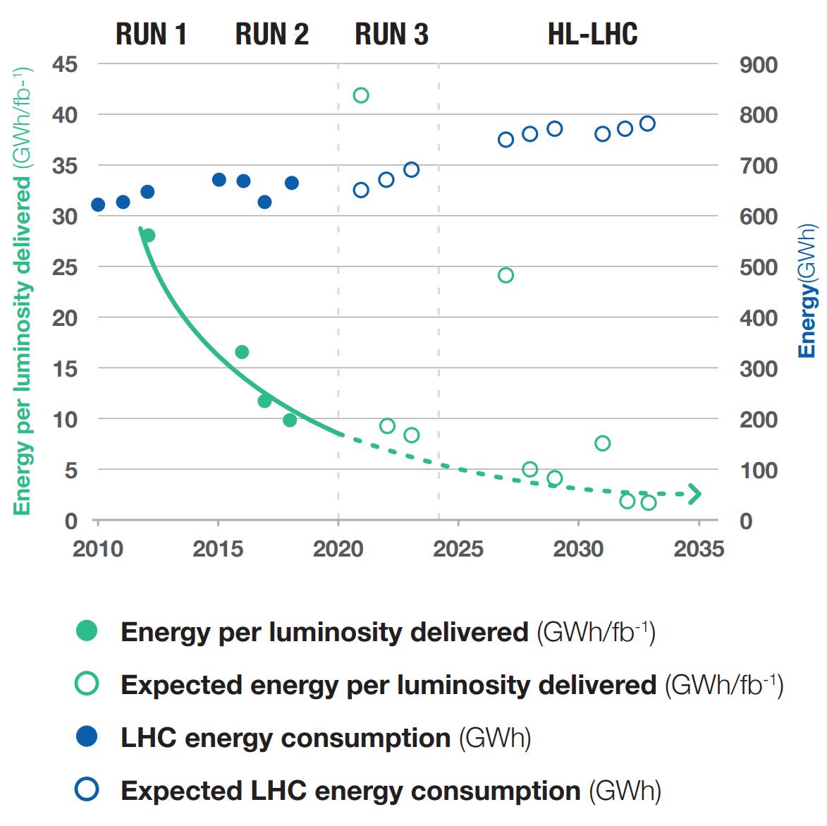
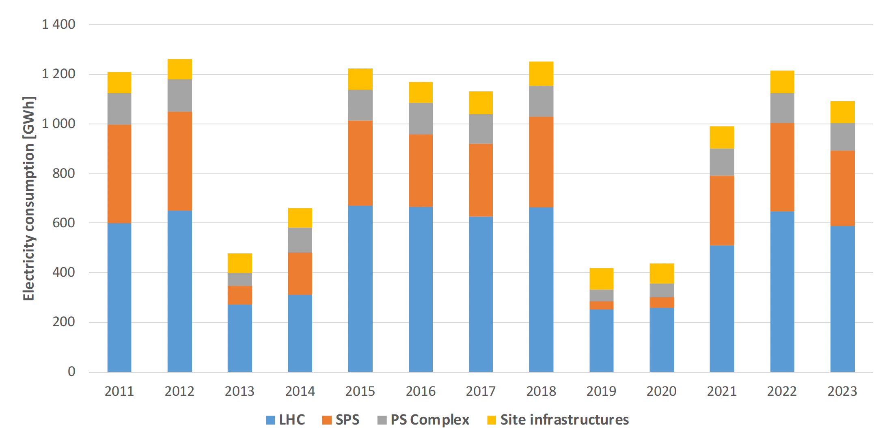
Emissions from current accelerators operations
See talk from R Losito
CERN now releases Environment reports (1st: 2017-18, 2nd: 2019-20, 3rd: 2021-22)
CERN peak power: ~180 MW (~ 1/3 of Geneva)
Per year: ~ 1.2 TWh (~ 2% of Switzerland, 0.03% of Europe)
LHC: ~55% of CERN’s E consumption
Electricity mainly comes from France: 90% carbon free (2022)
Electrical power distribution 2018
From CERN Environment Townhall 2024
Notes:
Powering CERN’s unique array of accelerators, detectors and infrastructure primarily requires electricity, which represents about 95% of CERN’s energy use

Slide 5
Emissions from FNAL
In the US, DOE requirements to report yearly on environmental impacts including emissions
REC: Renewable Energy Certificates
2019 FNAL Environment Report
2019:
CERN used 4 times more electrical E than FNAL
and yet had 4 times less Scope 2 emissions

Slide 6
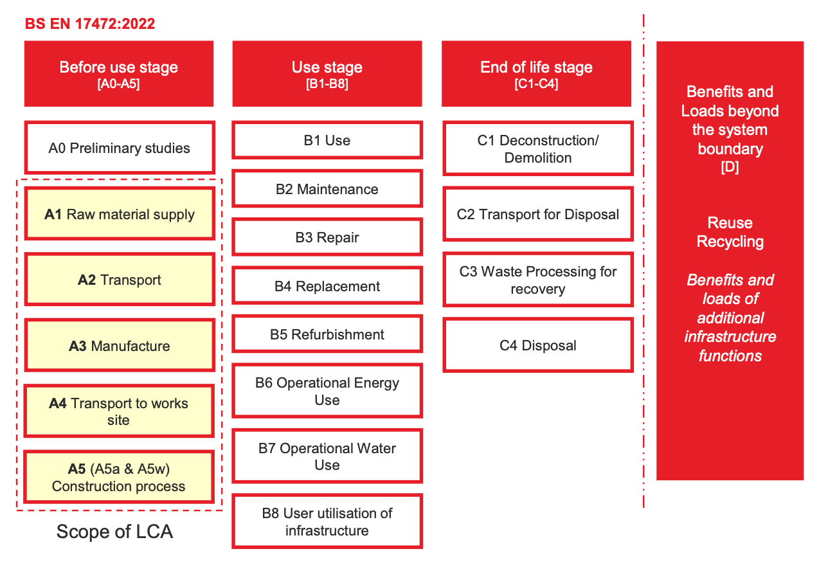
Emissions from Future Energy Frontier Colliders
Several contenders to post HL-LHC: lepton collider (e and μ) and hadron colliders
ARUP engineering company did comprehensive civil engineering LCA for ILC (TDR design (33km) not Snowmass one) and CLIC (Klystron & Drive Beam) construction
Considered A1-A5
FCC has now started this process (WSP)
ARUP final report

Slide 7
Emissions from accelerators
See talk from J Clarke
LEP3
HE-LHC
ARUP:
  emissions per total length:
    CLIC: 6.38 ktCO2e/km
    ILC: 7.34 ktCO2e/km
  Caverns & buildings: 30% of main tunnel emissions
  A4-A5: 25% of tunnels+aux.

Slide 8
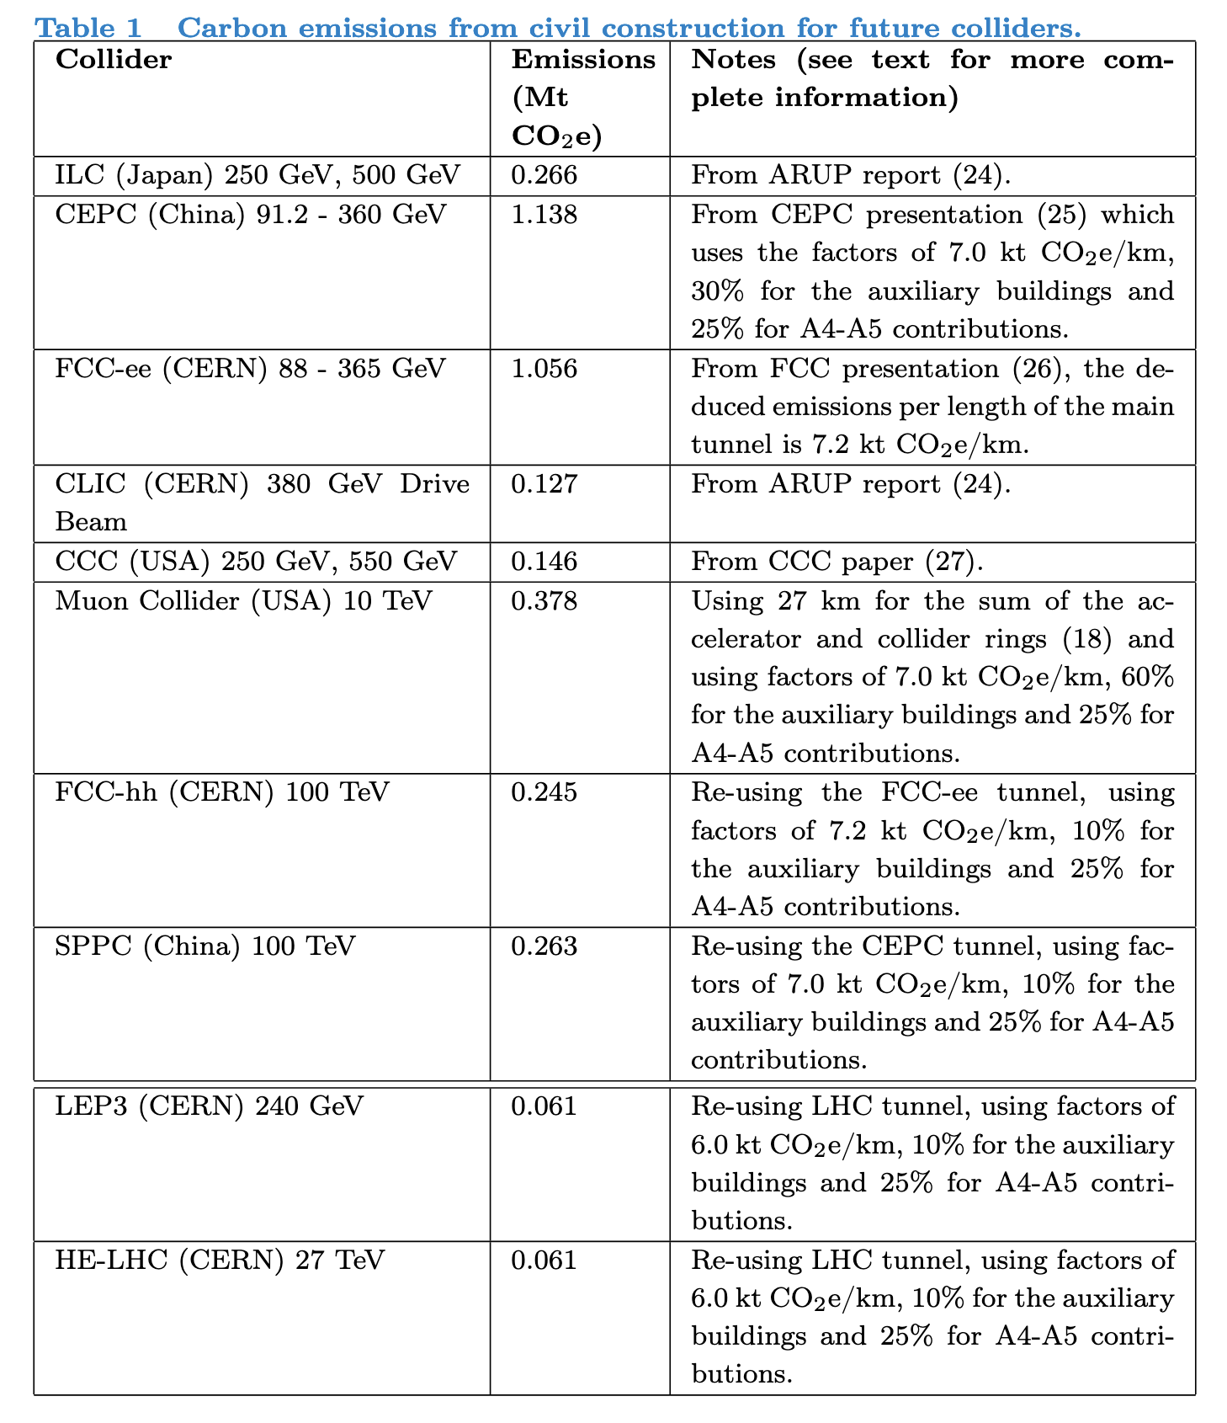
Emissions from accelerators
2411.03473 with Ken Bloom
Draft!
CEPC
FCC
CCC
60%: large detector cavern
10%: some re-use of caverns
See talks from S Renner & K Lohwasser

Slide 9
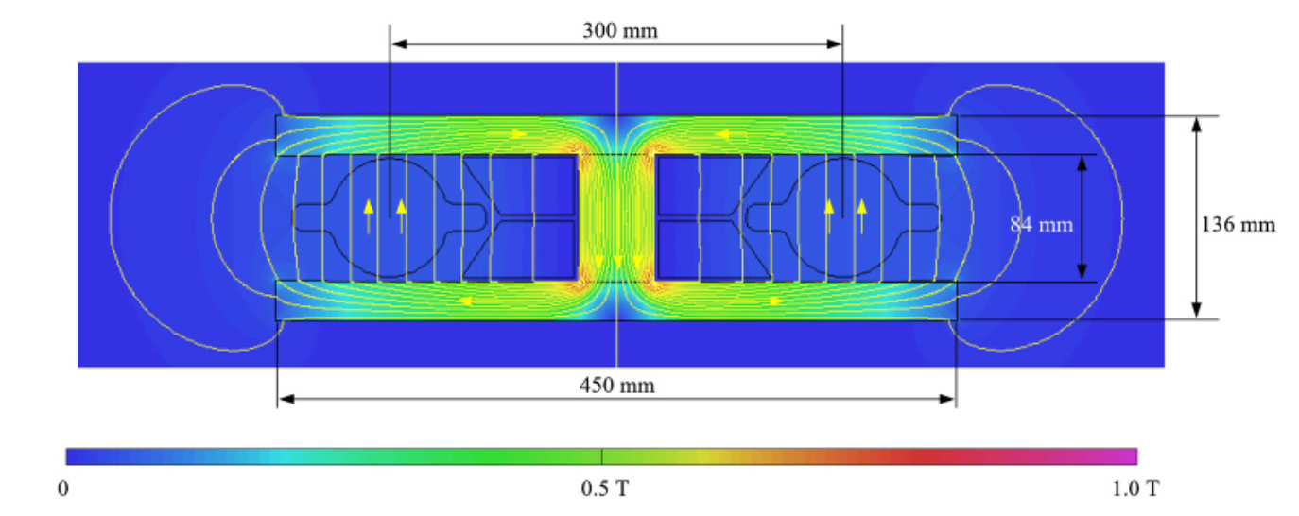
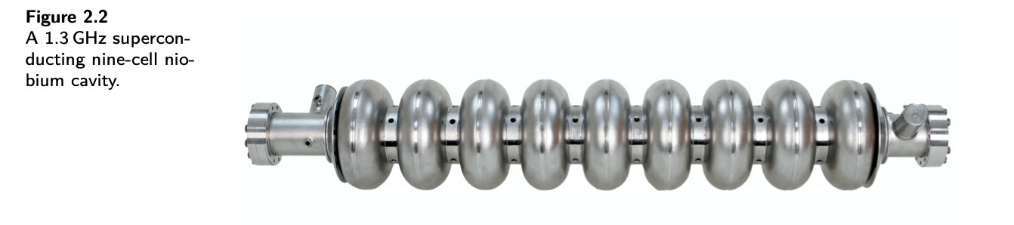
Emissions from accelerator components
2411.03473
Embedded emissions into material currently being considered by ARUP-type analysis so far
Quick order of magnitude estimate:
  Linear Colliders:
    SRF: Niobium cavities, eg. ILC: each cavity = 39.6 kg Niobium, carbon intensity ~75 kgCO2e/kg, ~3 tCO2e/cavity, about 8000 cavities → total of 26 ktCO2e = 27% of civil construction
  Circular Colliders:
    Dipole magnets: FCC-ee: 2900 dipoles, 219 kg/m Fe (Carbon intensity =2.0 kgCO2e/kg), 19.9 kg/m Al (6.8 kgCO2e/kg), magnetic length: 24m, ~14 tCO2e/dipole → Total of 40 ktCO2e (7%)
ILC TDR Vol. 3.ii
FCC-ee CDR

Slide 10
Emissions from operations
Scope 1: direct emissions from organization/vehicles etc.
Scope 2: indirect emissions from electricity generation, heating, etc. (does NOT include the emissions from building the national electricity providers)
Scope 3: all other indirect emissions, upstream and downstream (procurement, business travel, personnel commutes, catering, etc.)
In 2040+: Advanced economies will have zero carbon grids!
  If they don’t, there is NO POINT discussing particle physics research!
  It is our collective and individual responsibility as citizens and scientists to HELP governments deliver this!

Slide 11
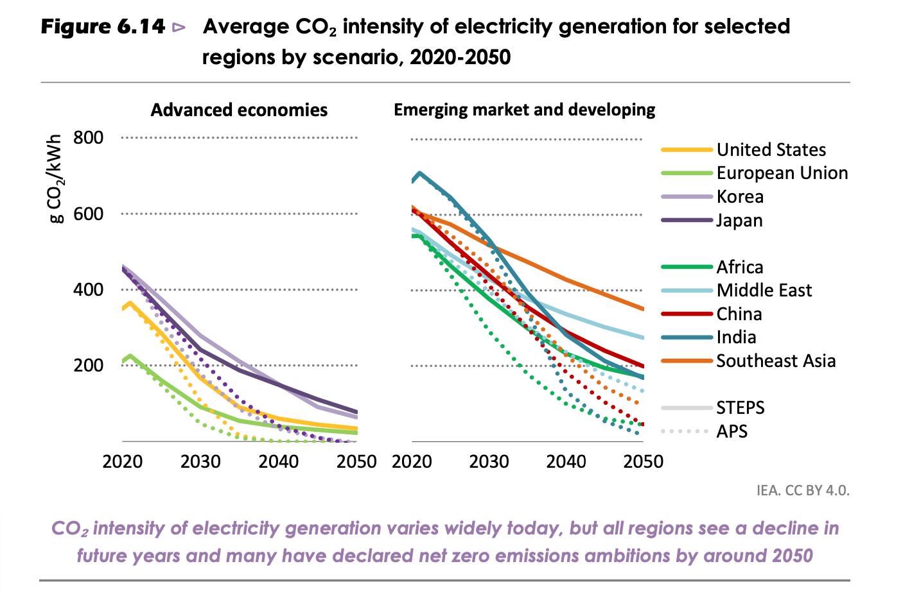
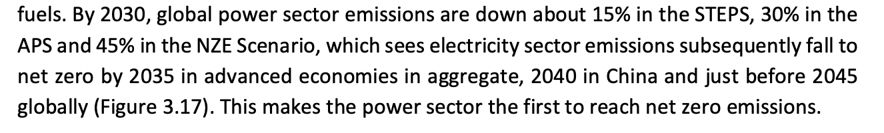
Emissions from operations
2022 IEA report
2023 IEA report

Slide 12
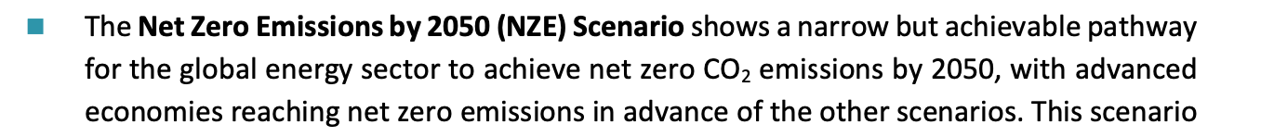
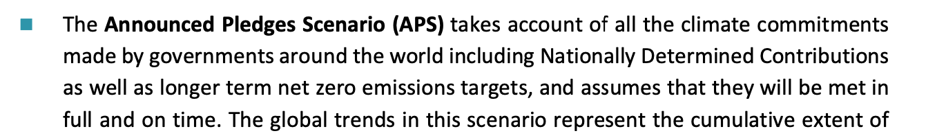
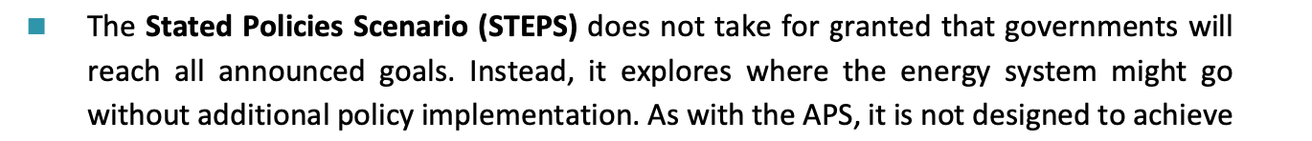
Emissions from operations

Slide 13
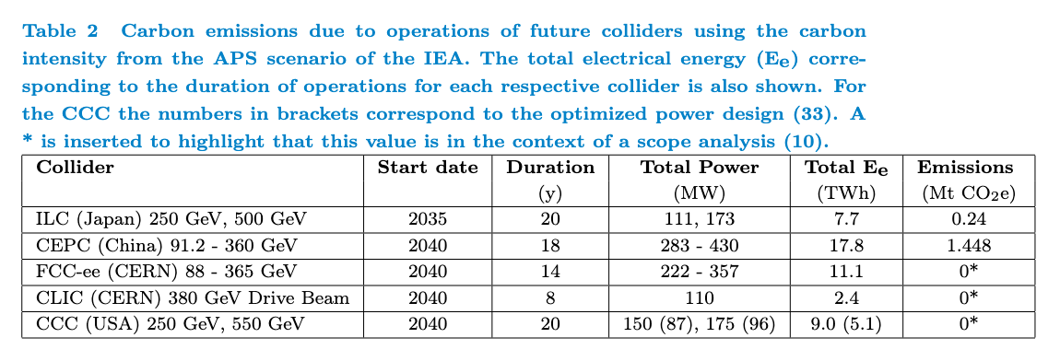
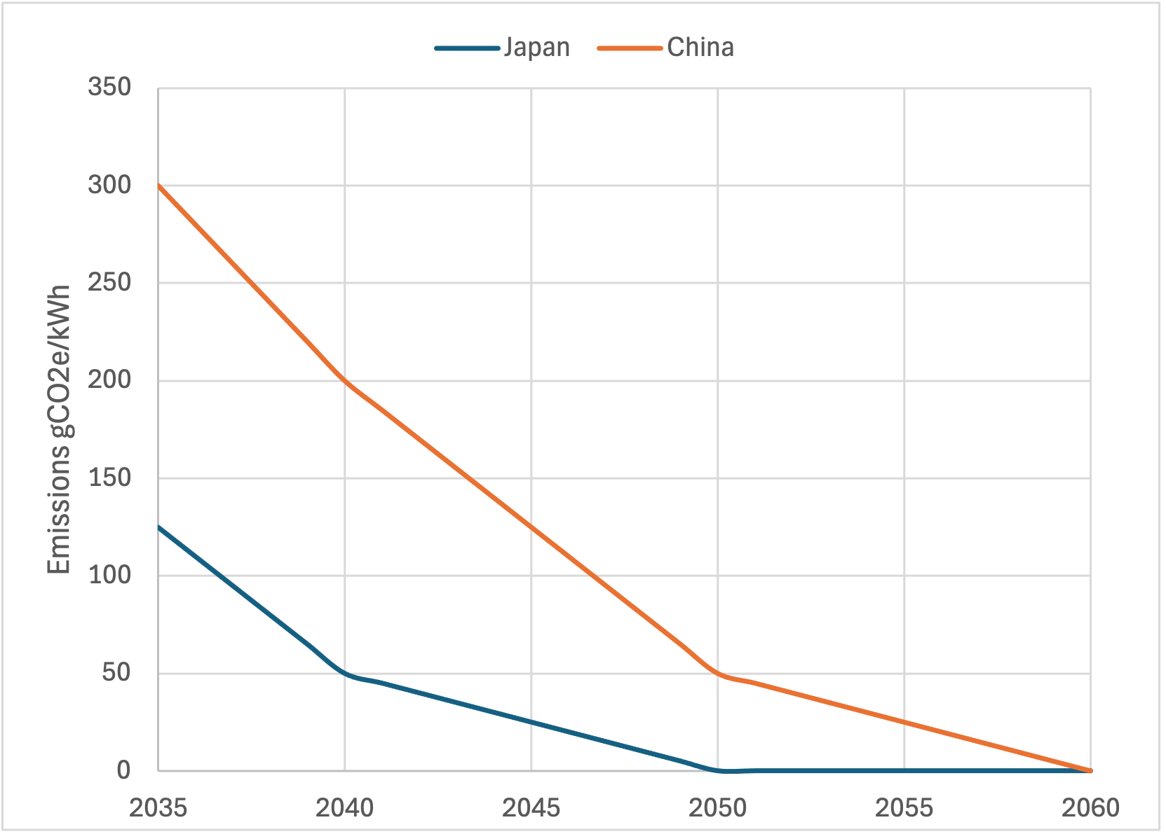
Emissions from operations
2411.03473
Draft!
Assume 10⁷s operations per year
Still a priority to minimize average and peak power:
  power demand will massively increase
  power will be expensive

Slide 14
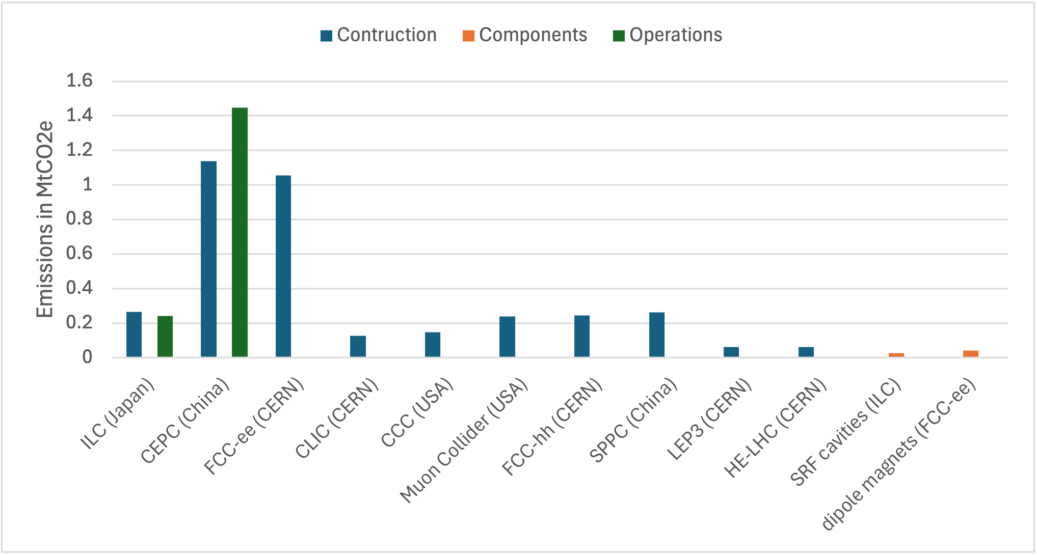
Emissions from construction+operations
2411.03473
Draft!
1 Mt CO₂ / 10,000 scientists = 100 t CO₂ per scientist when should be 1-2 t CO₂ pp/y (and now ~10 t CO₂ pp/y in UK)
Divide by population? Ok, but then need to get comparative numbers (health, defense, arts, etc.)

Slide 15
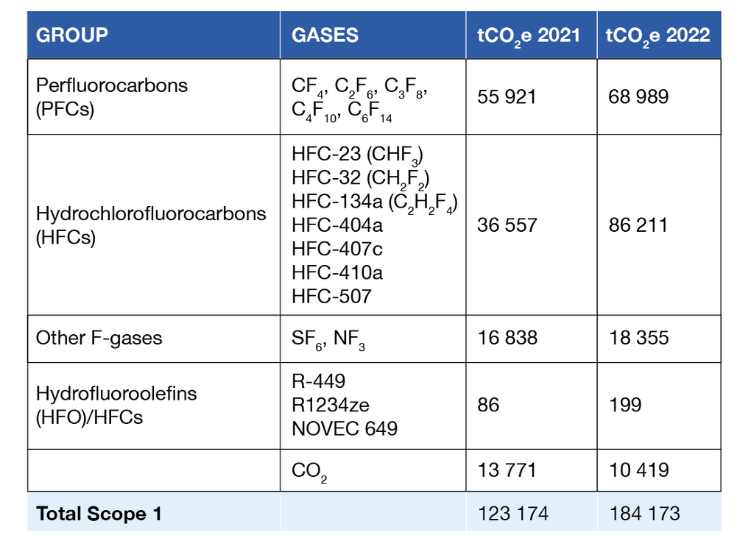
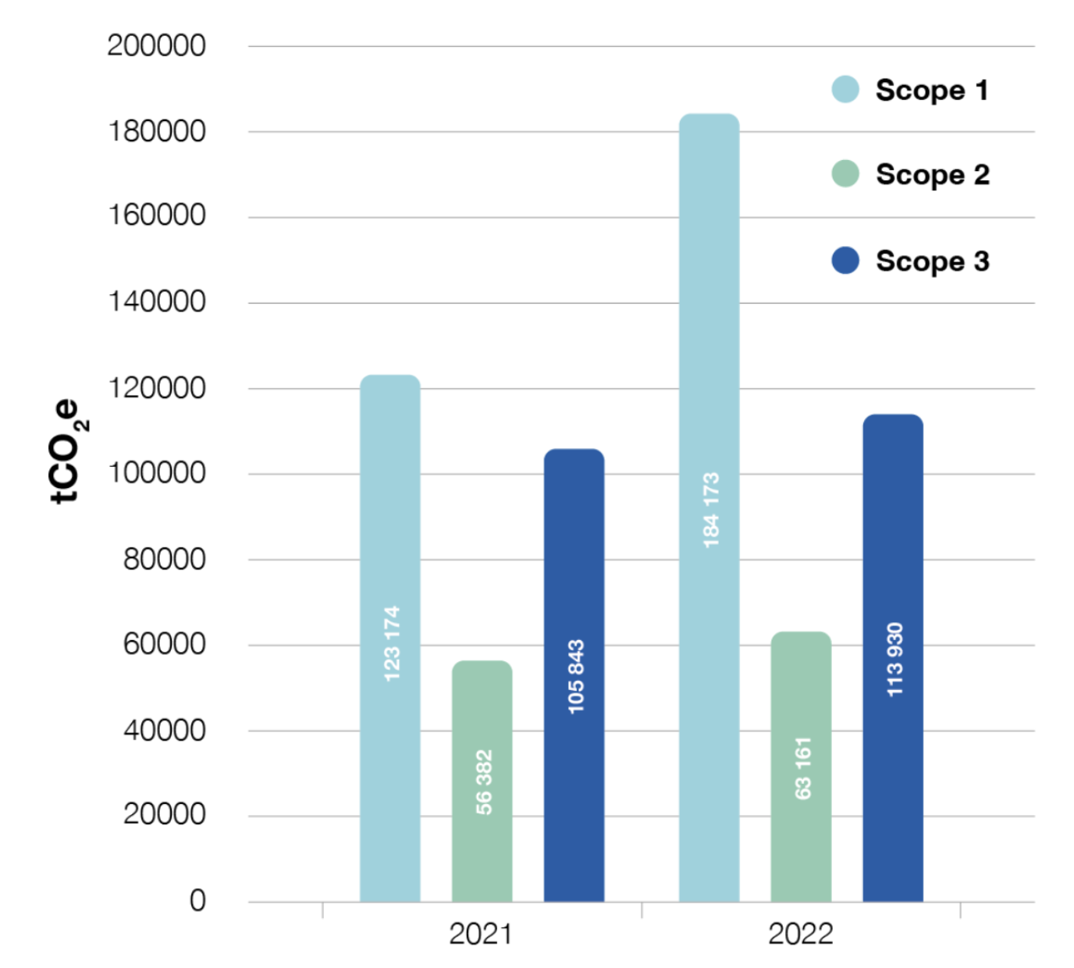
Emissions from detectors
CERN environmental report 2021-22
Dominant CO2e emissions from CERN: gases used in experiments!
bad
good

Slide 16
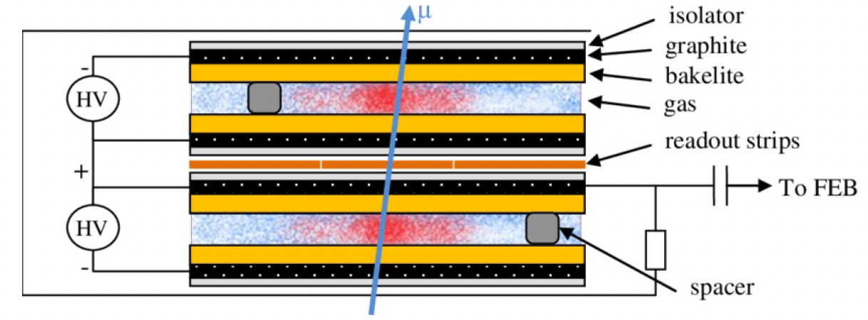
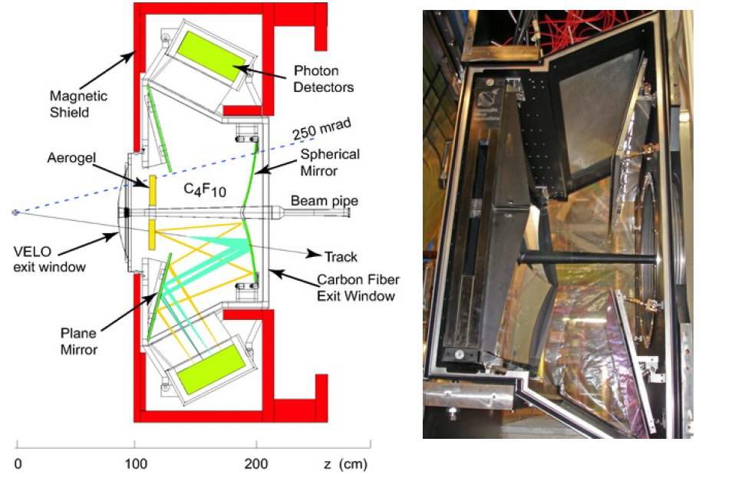
Emissions from detectors
GHG in detectors
  Tracking (eg RPCs) or TOF (eg RICH)
  Methods for minimizing releases to the atmosphere:
    Gas recirculation
    Gas recuperation
GHG for cooling
Replacement of GHG with ECO-gases

Slide 17
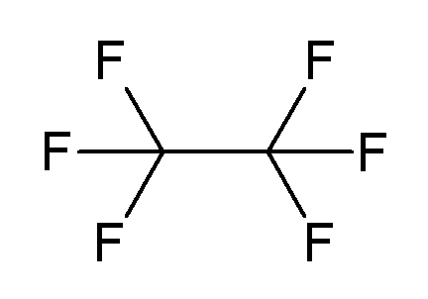
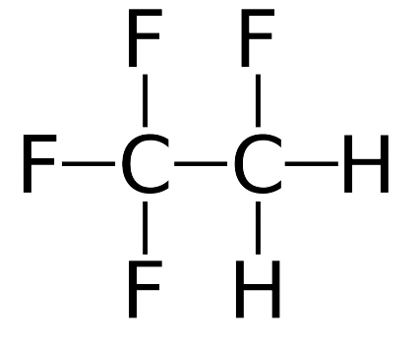
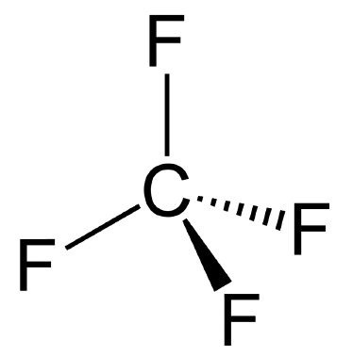
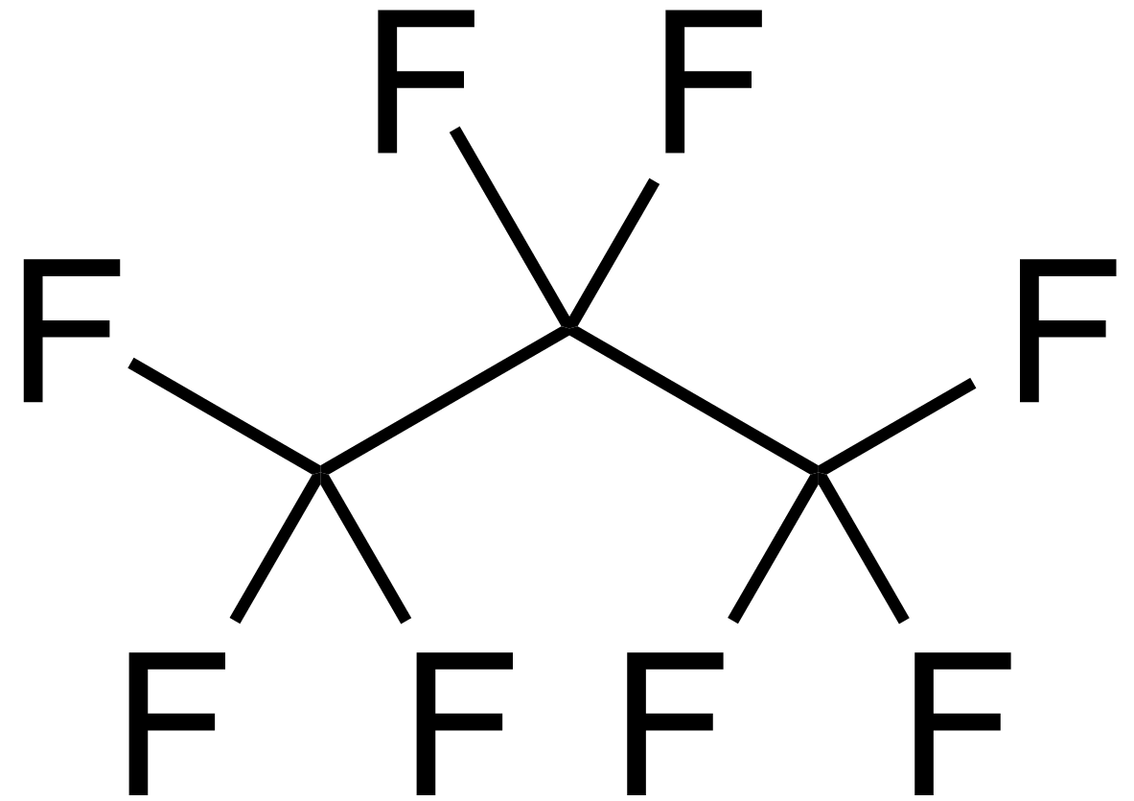
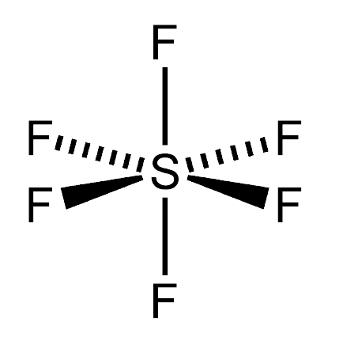
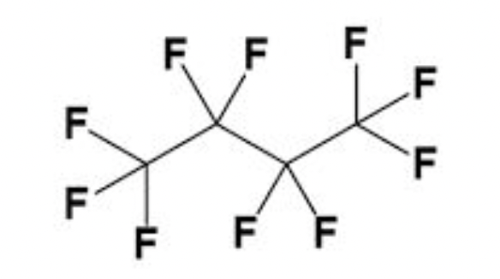
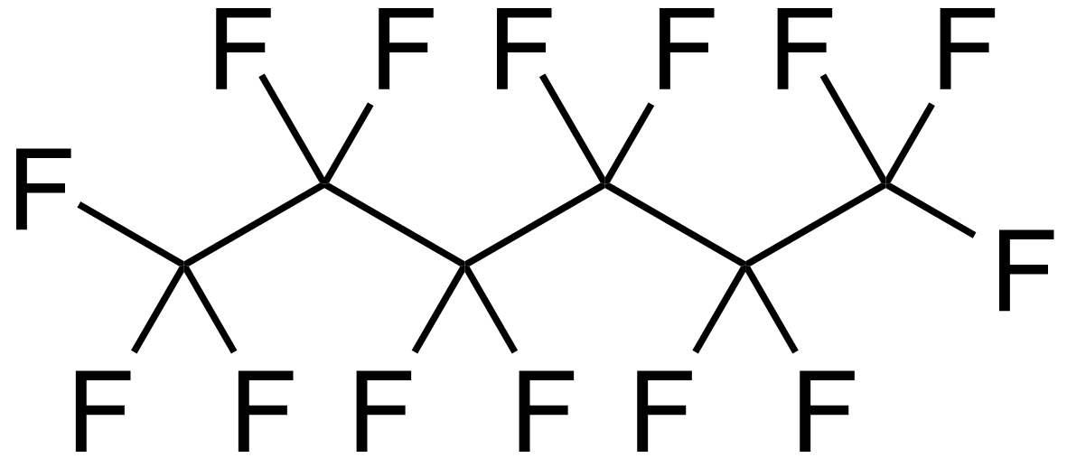
Emissions from detectors
GWP₁₀₀ from AR5
cooling
Main GHG in play:
C₂F₆ (11,100)
RICH radiator and Si coolant
C₂H₂F₄/R-134a (1300)
RPC: primary ionization, charge multiplication
Eg ATLAS/CMS: ~15 m³
CF₄ (6630)
RICH: optical properties, wire chambers: anti-polymerization, MPGD: time resolution
Eg RICH2: 100 m³
C₃F₈ (8900)
Used for evaporative cooling of TOTEM and ATLAS Si
C₄F₁₀ (9200)
RICH: optical properties
Eg RICH1: 4 m^{3,} Compass: 100 m³
SF₆(23,500)
RPC: electron quenchers
C₆F₁₄ (7910)
Liquid coolant in all LHC exp.
Notes:
MPGD: Micro Patterns Gas Detectors

Slide 18

Emissions from detectors
See talk from C Parkes
In 2040+: no more F-gases, eco-gases only solution
LHC exp. moving to CO₂ cooling
  But because of high triple point, can’t cool to low enough temperatures
Potential replacement for C₆F₁₄ :
  NOVEC 649 (C₆F₁₂O): similar thermophysical properties
  Radiation hardness promising, but reacts with water
  Now used for cooling SiPM in LHCb SciFi to -50C
Potential replacement for C₂F₆ (C₃F₈ ):
  NOVEC-like C₂F₄O (C₃F₆O)?? Toxicity issue
3M is stopping the Novec line! Future of HFO/PFK uncertain
R&D driven by electronics industry!
G. D. Hallewell, EPJ Plus (2023)
G. D. Hallewell, ICHEP 2024
Notes:
They are all PFAS (for ever chemicals): so persistent in soil and water but yet low GWP because reacts in atmosphere and doesn’t absorb IR

Slide 19

Emissions from Computing
See talks from S Krippendorf, A Portelli & D Britton
Power: see previous discussion (and also think of Jevons paradox)
  Also: operate in frequency modulation regime to adapt to national grid demands (see ICHEP 2024 talk from ATLAS)
  Ee to train a single large language model like OpenAI ChatGPT: 10 GWh (~3 days of LHC operations…, 1000 US houses for a year)
Embodied carbon will be source of emissions:
  Eg Dell server in data center: 1300 kg CO2e
Good practice:
  Choose vendors with smaller embodied carbons
  Extend life of computing parts
  Good recycling practices

Slide 20
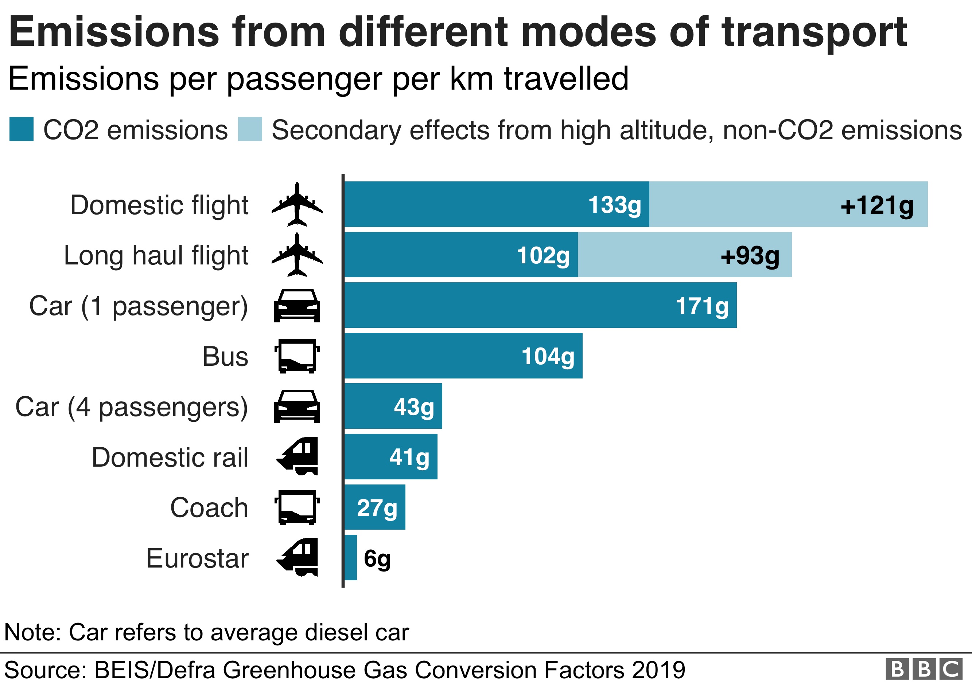
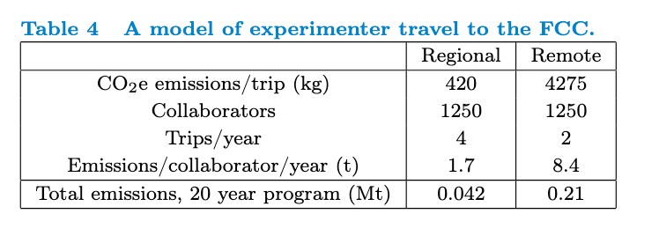
Emissions from Travel
2411.03473
Simple Model: travel to FCC for 5k researchers:
  ½ live near CERN
  ¼ regional (London), ¼ remote (Chicago) (use atmosfair)
Draft!
Low emissions flights way off, trains can be more expensive than flying
Have to reduce travel (also from travel budgets)
  Regional centers (like FNAL LPC)
  VR/AR headsets

Slide 21
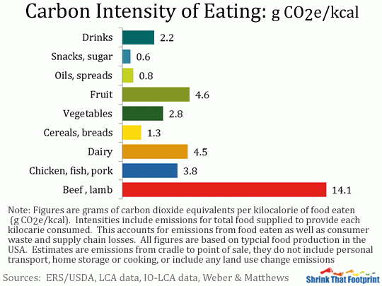
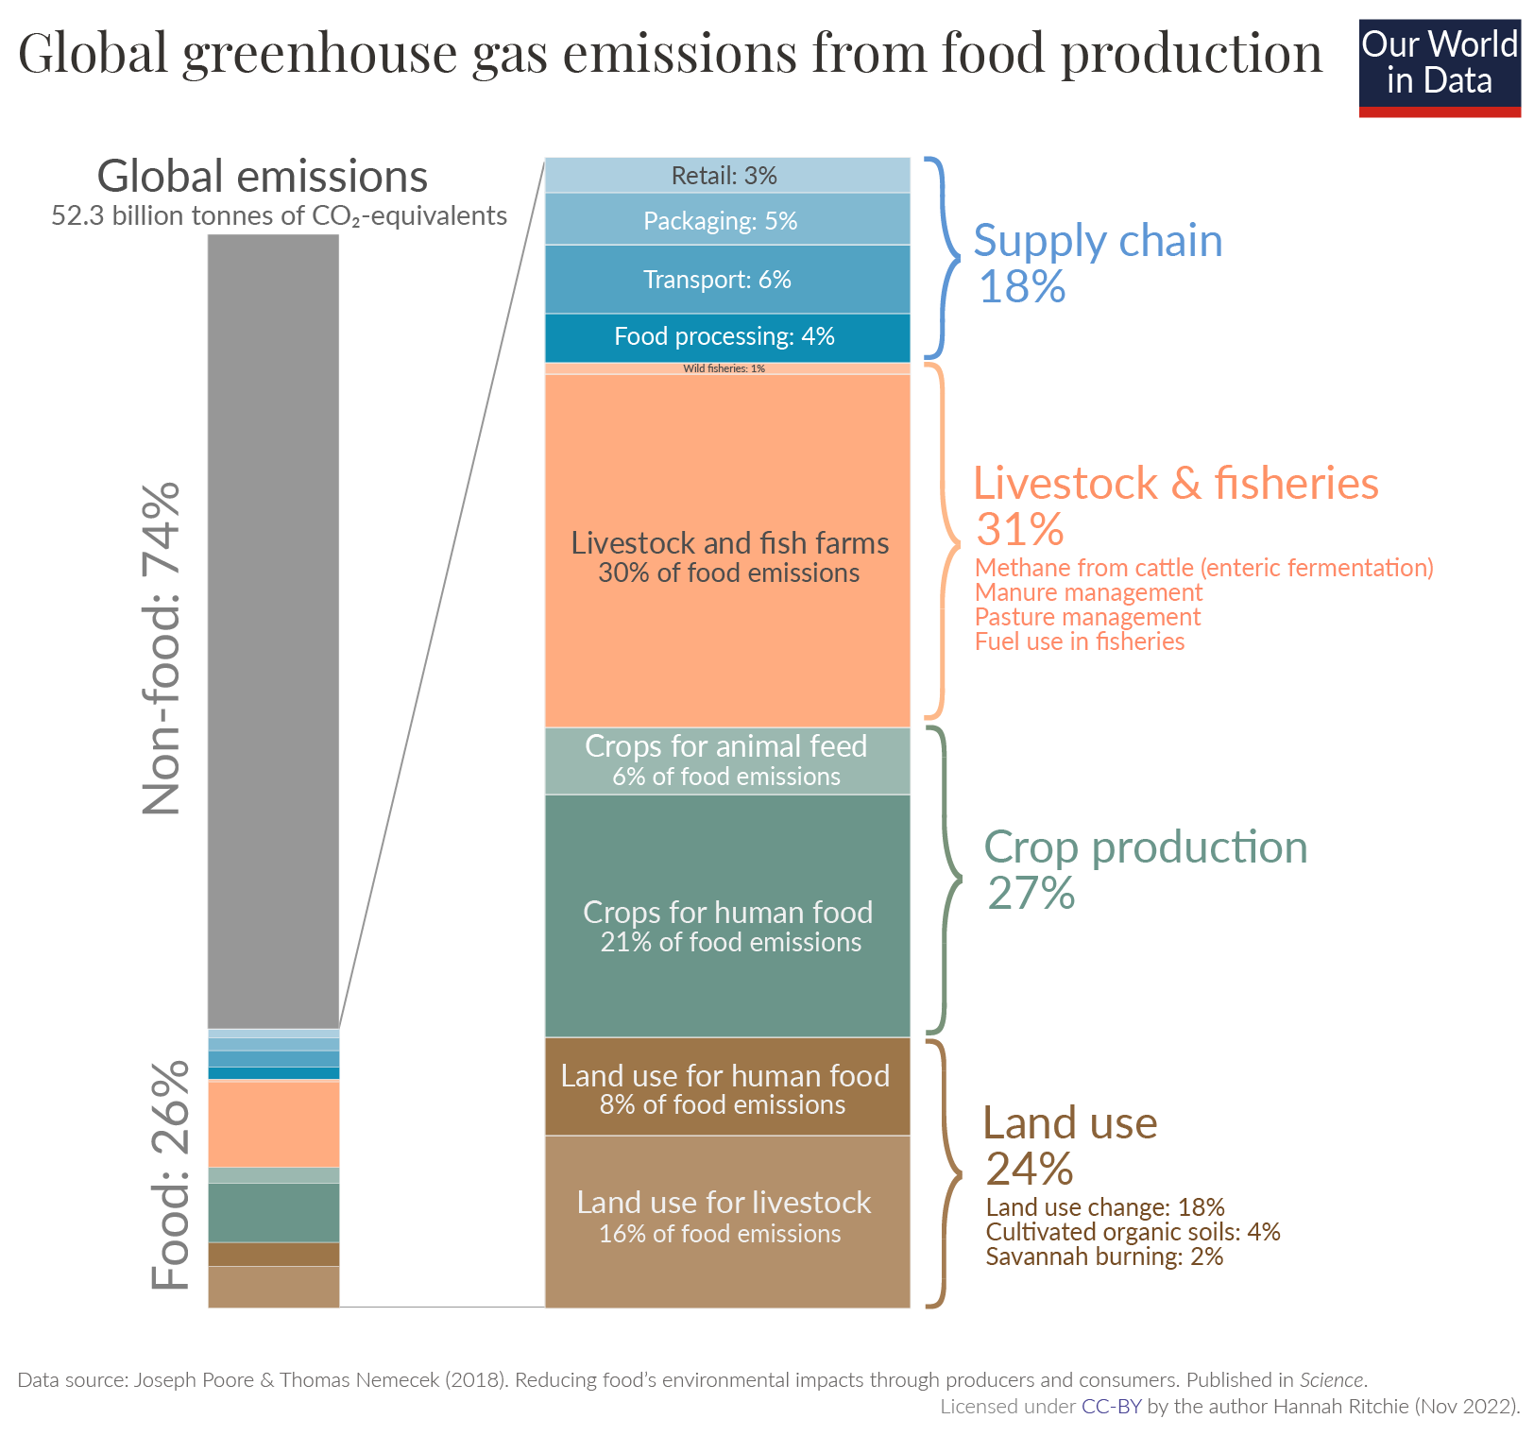
Emissions from food & Total
  IPCC report in August 2019 on Land Usage
  Food Production is 1/4 of world’s GHG Emissions!
    60% of those are for meat production
  How about migrating our PP catering (meetings, conf, workshops) in a more sustainable direction?

Slide 22
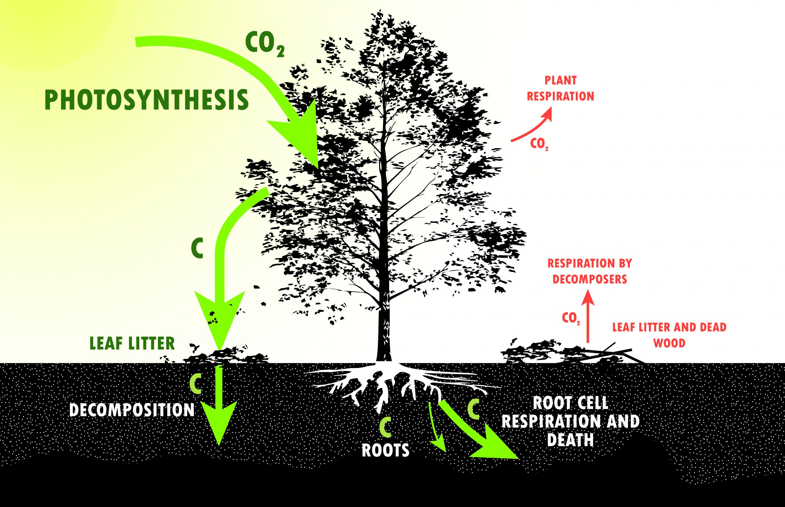
Negative Emissions
STFC has goal of being Net-Zero by 2040: see talk by J Colwell
What are going to be the negative emissions methods? Imo:
  Forget about power (zero by 2030 (2035))
  Forget about “efficiency”
  Spend money on dubious offset schemes?
What about future energy frontier collider facilities?
Plant trees?
  To absorb 1Mt CO2 over 10 y: need ~10 M NEW trees = 4,000-10,000 ha of land = 4x – 11x area of Richmond Park
  After those 10y you need to cut the trees and use them (eg build houses)
  If burn them: need to capture the CO₂ and store it (BECCS)

Slide 23
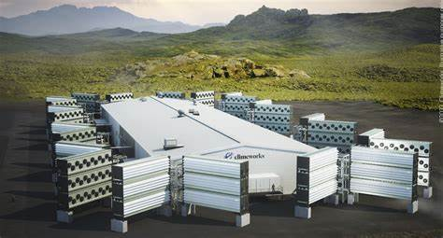
Negative emissions
Direct Air Capture (DAC)?
  Biggest plant is Climeworks in Iceland, operate Orca (4 kt CO2/year, 11 t/day, 1 t/2-3h), needs 8k-18k kWh/tonne
  Building Mammoth: 600 M USD
    36 ktCO2/y
    Uses geothermal plant from Hellisheiði: 2.65 TWh/year
      Hinckley Point C will be about 25 TWh/y
    1 Mt CO₂ = 28 years of using Mammoth

Slide 24
What to do?
Discuss climate change and sustainability with your colleagues/students
Get involved in your institution’s sustainability efforts (or start them)
Lobby your experiment about reducing its emissions, work on the solutions
If involved in a future project: minimize its emissions, look into its sustainability
Look into your travel and your overall carbon footprint
Lobby the meetings you attend to make catering more vegetarian, allow remote participating

Slide 25
What to do? (UK)
Exchange info on funding calls/activities etc.
  Do we want a UK mailing list?
  Discuss in this meeting on collaborative avenues!
Get involved in PPESU2024-2026:
  Sustainability input: ESUPP-sustainability-2024-26@cern.ch, Mattermost team called “ESUPP-sustainability”
  UK input
Infrastructure Fund SoI 2024:
  “… strong engagement with ASTeC and National Labs as essential for a revised case.”
Get involved in Knowledge Transfer toward UK Net Zero agenda
Adaptation: is our HEP infrastructure future proof?

Slide 26
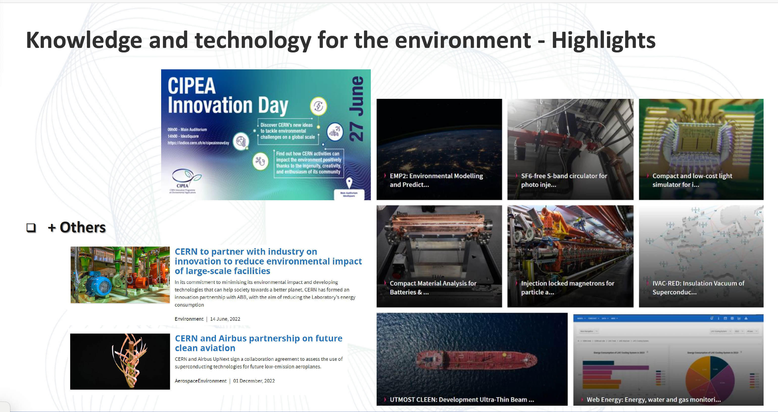
Knowledge Transfer
CERN Innovation Programme on Environmental Applications

Slide 27
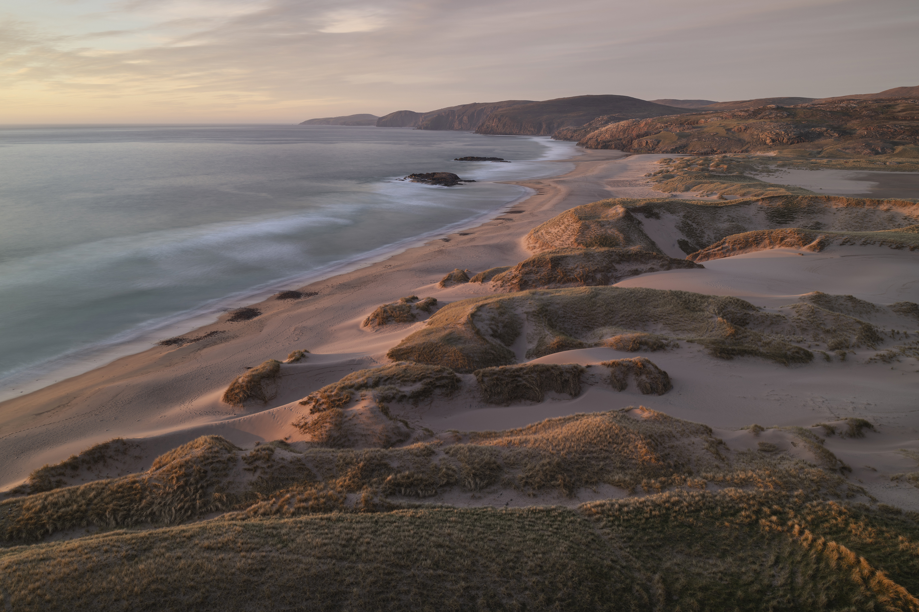
Discussion/Questions
The Climate Emergency: can Particle Physics ever be sustainable?

Slide 28
Back up

Slide 29
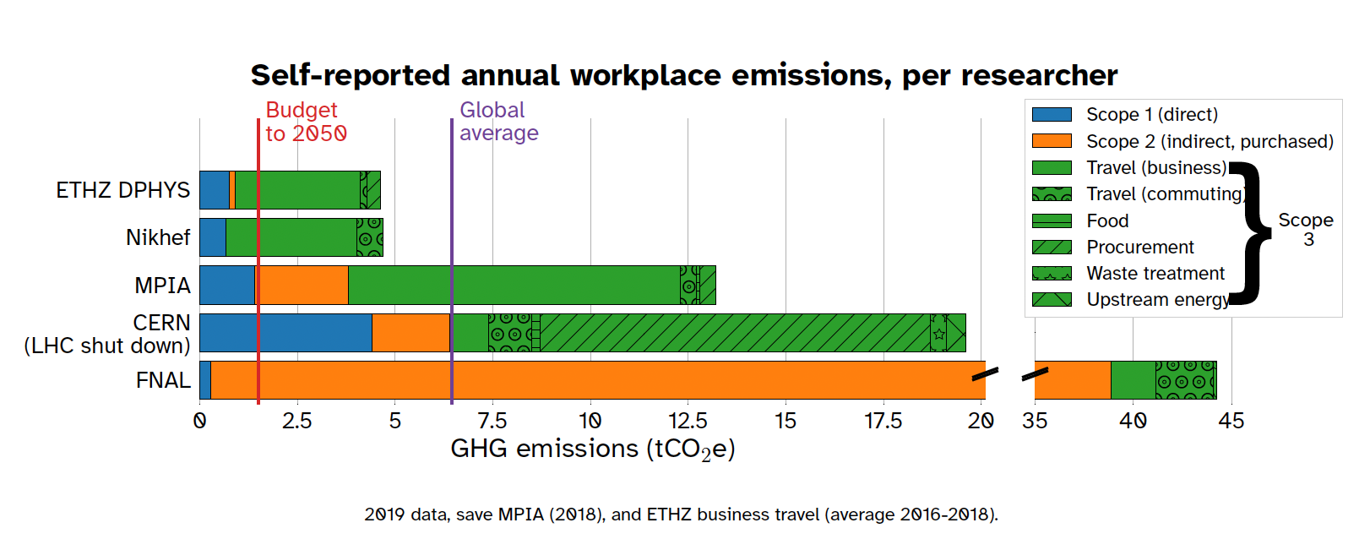
Mike Berners-Lee: average UK: 13 tonnes of CO2e
Remaining carbon budget:
(50% chance of staying < 1.5℃) 460 GtCO2
Per year per person: 2.2t

Slide 30
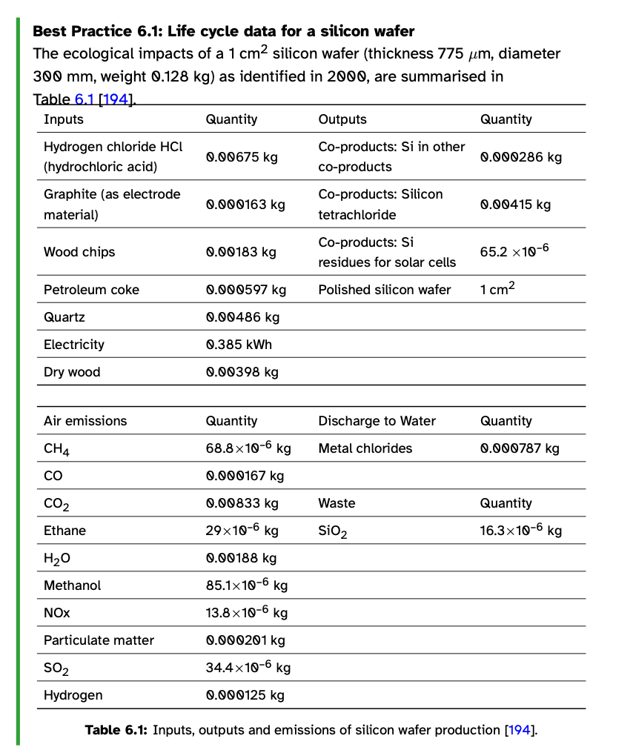
Embedded emissions from accelerators & detectors
HECAP+ 2023
Future projects need to compute the full life cycle analysis of emissions of all accelerator and detector components

Slide 31
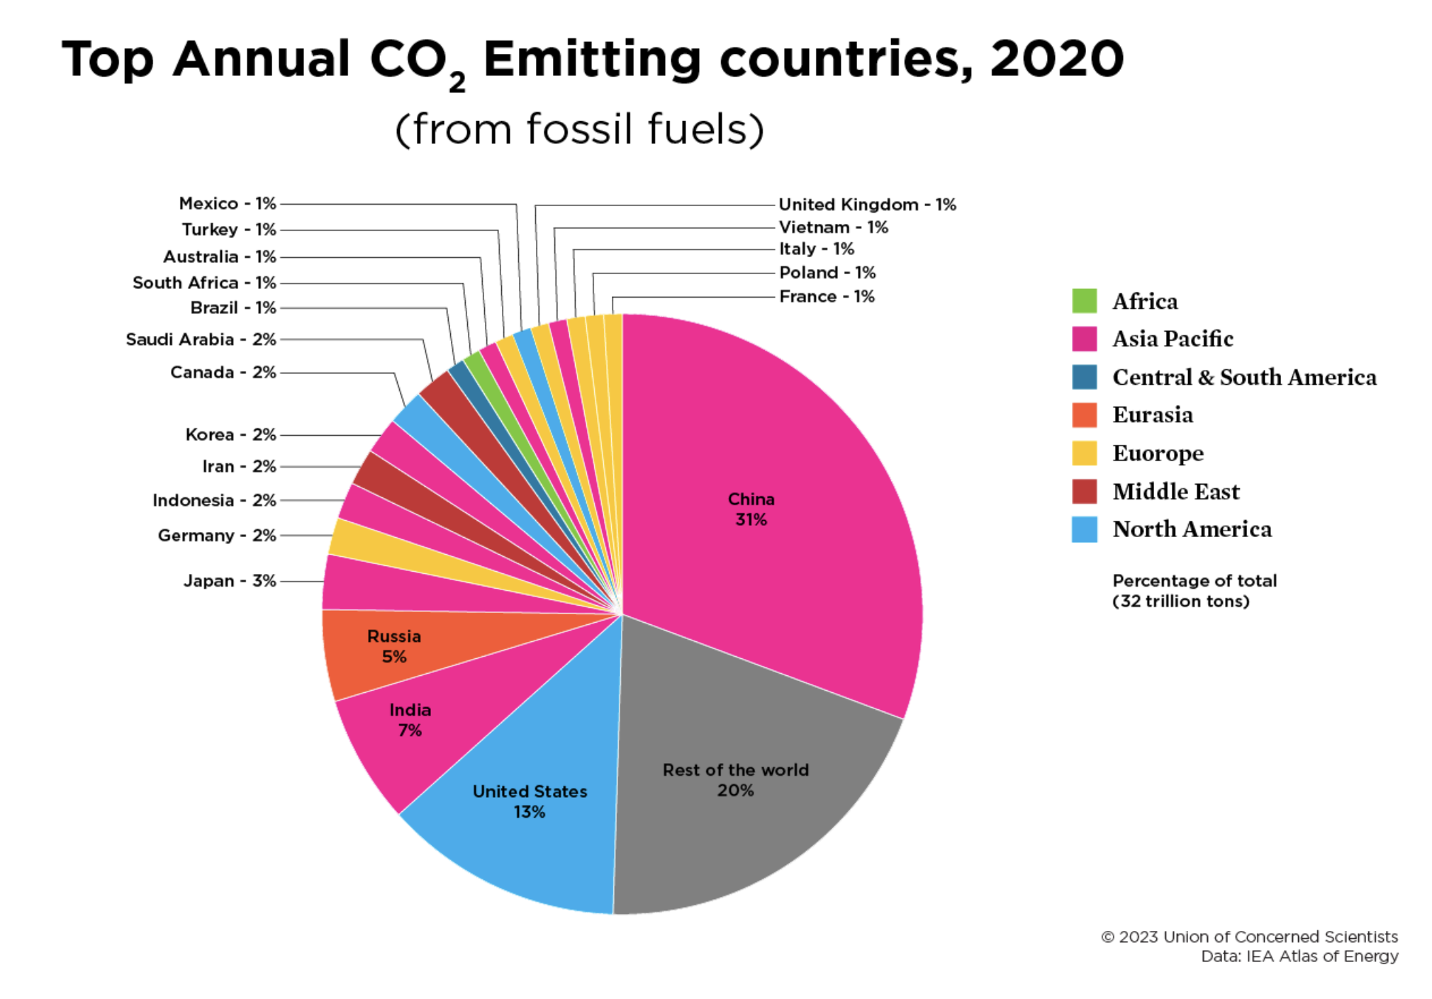
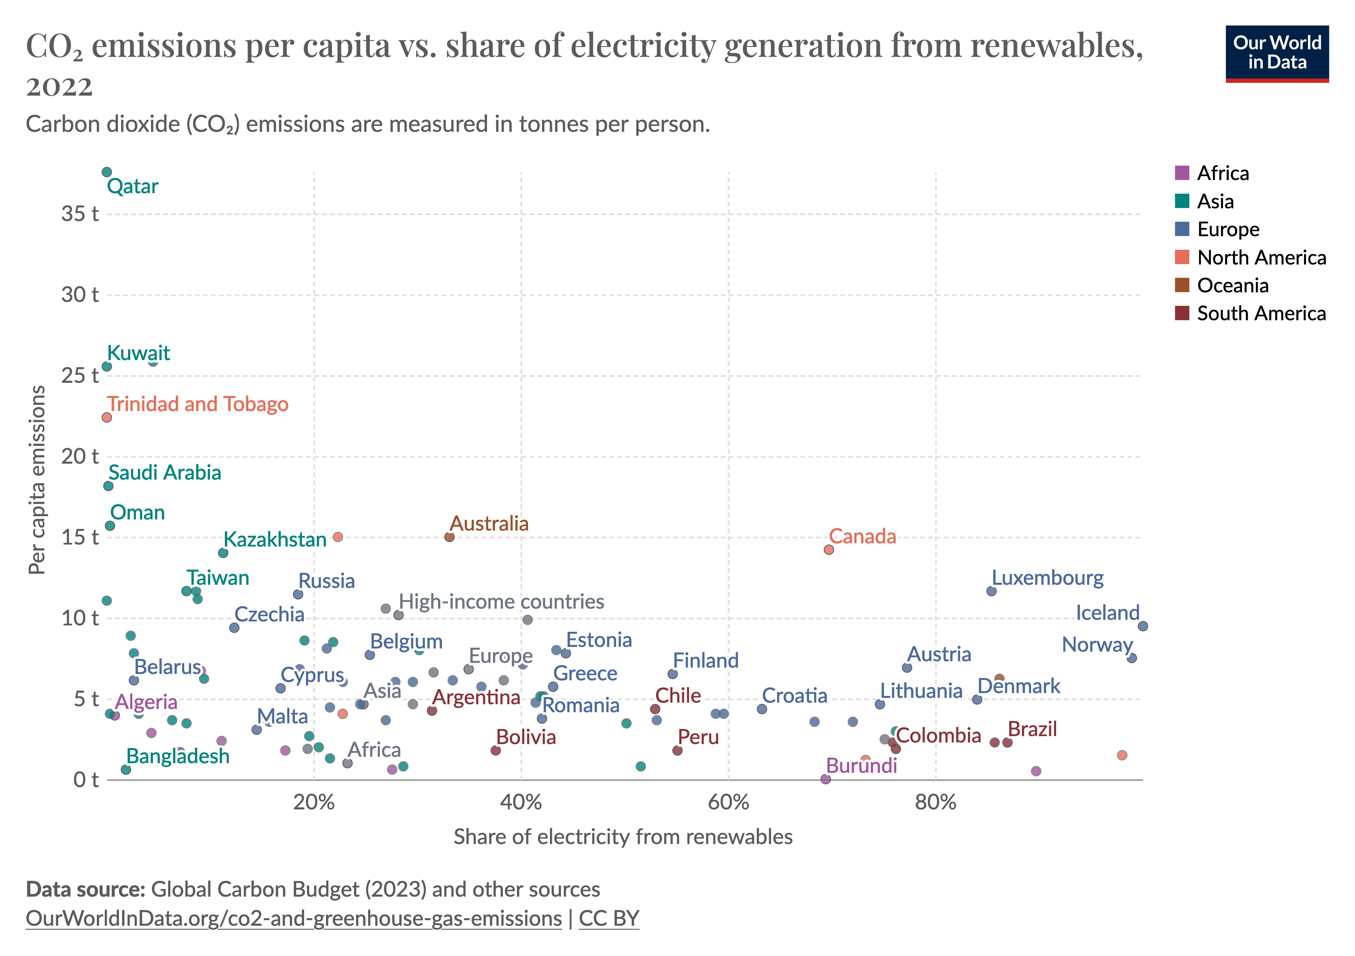

Slide 32
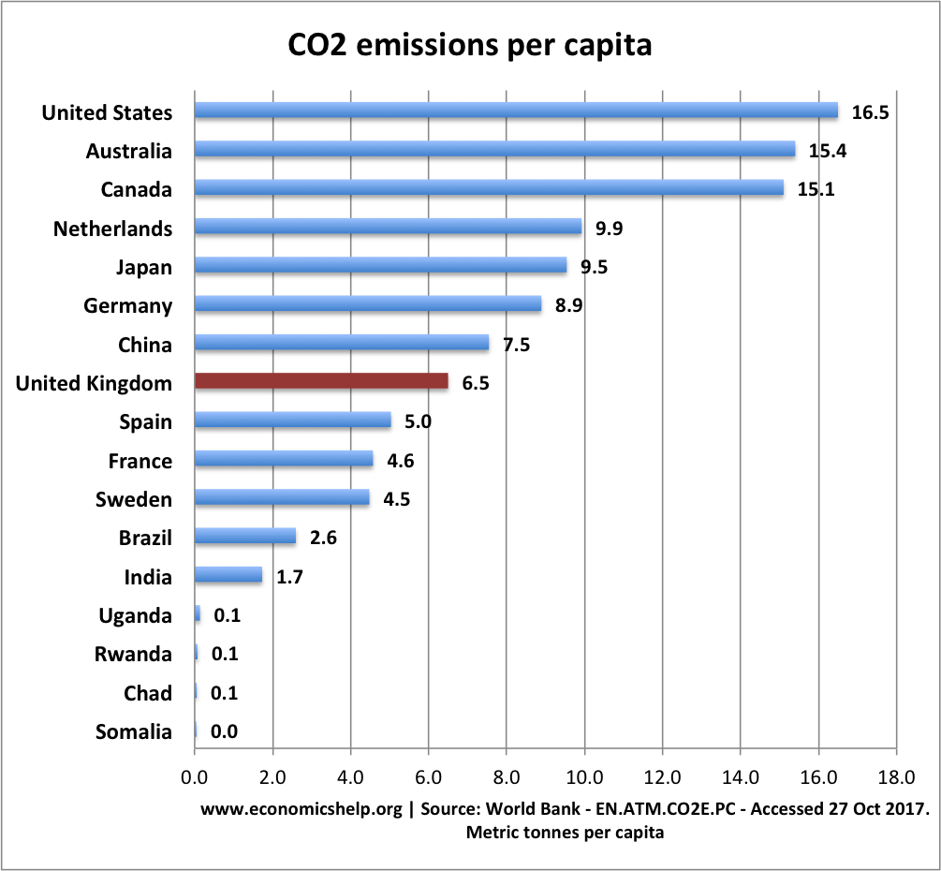
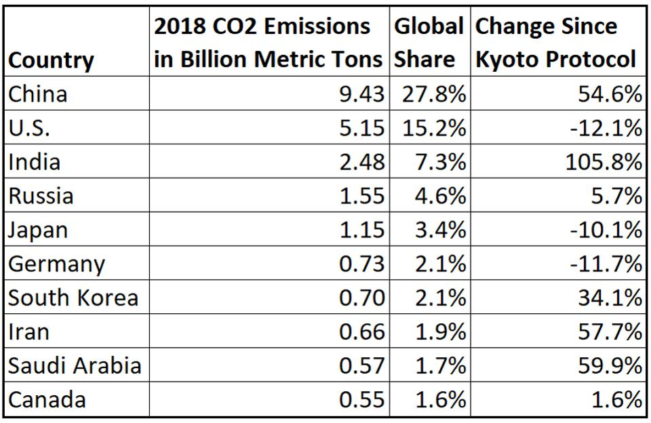
List of top CO₂ emitters
Economicshelp.org
Forbes

Slide 33
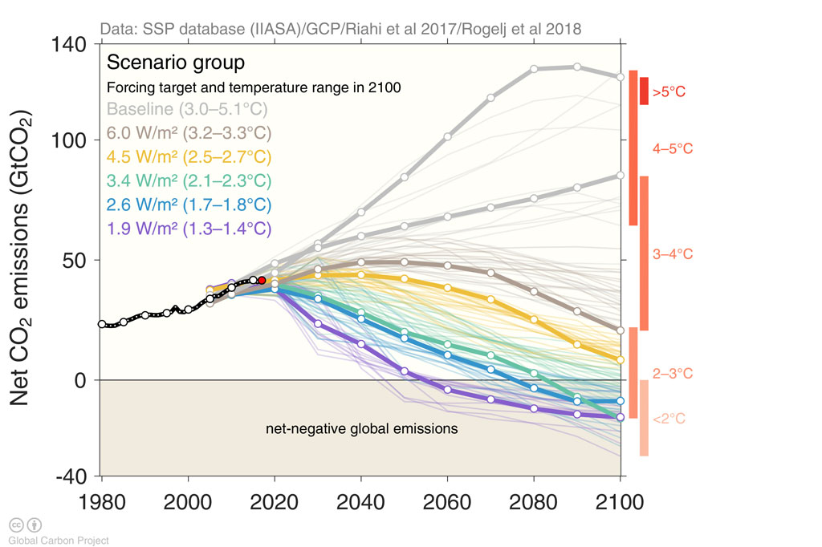
Emissions pathway

Slide 34
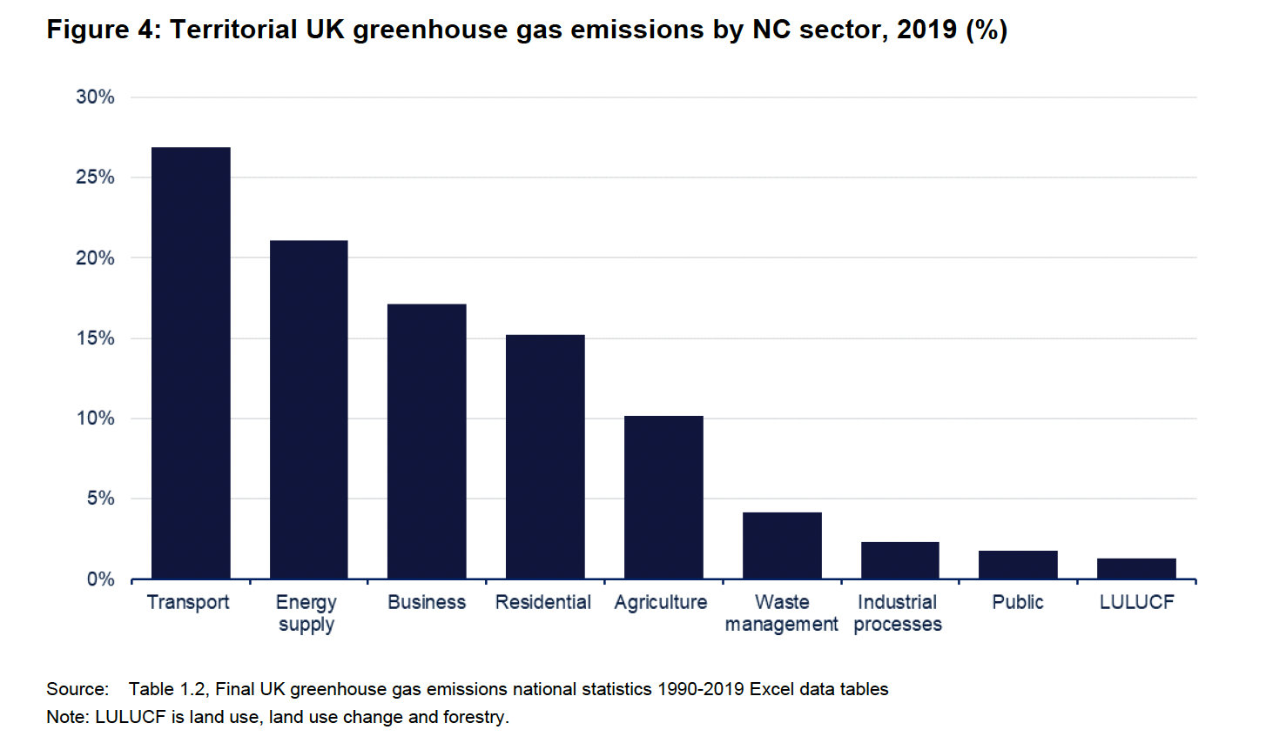
World Emissions Clock

Slide 35
Green electricity grids by 2035
Germany's target updated in 2022
  The US, Canada and UK have already committed to a similar goal [100% renewable electricity grid by 2035]. Denmark is already aiming for more than 100% renewable power by 2027, Austria 100% by 2030 and Portugal and the Netherlands are well on track with recent plans to expand renewable capacities till 2030.”
US pledge
UK CCC plan:

