Slide 1
Environmental Sustainability Overview Jo Colwell Programme Director Environmental Sustainability 26th November 2024
Sustainability at STFC
Notes:
Hello from me!
What is environmental sustainability
Opportunities/Challenges
Policy Context

Slide 2
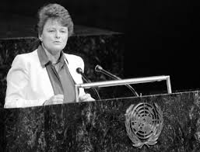
What is Environmental Sustainability
Sustainable Development:
“meeting the needs of the present without compromising the ability of future generations to meet their own needs.”
- UN Bruntland Commission, 1987 -
Defining environmental sustainability:
“Ensuring our interactions with the environment avoid depletion or degradation of natural resources, reduce, or eradicate our greenhouse gas emissions and allow for long term environmental quality; ensuring that the needs of today’s population are met without compromising future generations’ ability to meet their needs.”
- Wellcome Concordat, 2024 -
Notes:
Georgia
What is and isn’t the strategy, what do we mean by strategy and what do we mean by es that underpins the document we’re about to share.

Slide 3
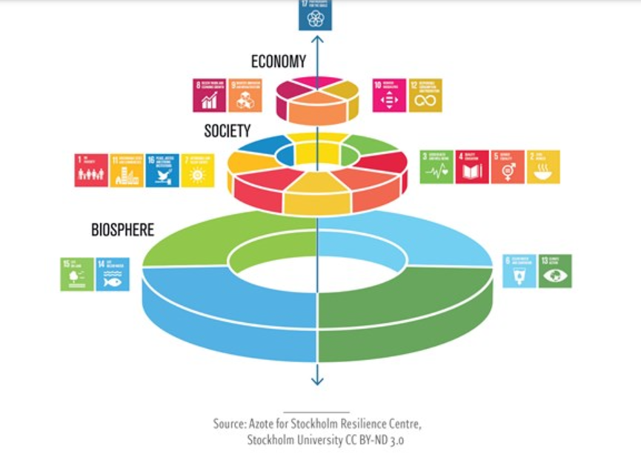

Slide 4
The opportunities for STFC are extensive
Energy Source
✓Renewable PPAs
✓Waste heat reuse
Resource Efficiency
✓Procurement of new materials
✓Energy efficiency gains through building
upgrades
✓Vehicle fleet electrification
✓Low carbon delivery of ISIS-II and
Scientific Computing
Physical
✓Manage increased capital costs for
damages to buildings, infrastructure, and
people
✓Manage increasing insurance premiums
Policy & Legal
✓Manage regulatory compliance
✓Manage changing planning requirements
Technology
✓Prepare for potential inadequate grid
capacity
✓Prepare for limited availability of
renewable energy
Products / services
✓Net zero research resources
✓Net zero research initiatives
Financial
✓Increased opportunities for research
funding on net zero
✓Opportunities with new stakeholders, e.g.
private investors, suppliers etc.
✓Research into avoided emissions to attract
funding
Resilience
✓Robust governance mechanisms
✓Limit infrastructure dependency on utility
networks
✓Employee upskilling
✓Collaboration on new initiatives
Reputation
✓Manage public perception
✓Manage workplace appeal to employees
✓Manage community relations
Market
✓Prepare for changing research priorities
and potential resulting reduced funding
g
y
S
o
u
r
c
e
r
o
d
u
c
t
s
&
E
n
e
r
s
e
r
v
i
c
e
s
r
c
e
c
y
F
u
n
i
o
e
n
a
s
i
n
e
c
i
c
R
f
f
i
e
a
l
What are the
benefits of
environmental
sustainability?
P
R
h
e
s
y
i
l
s
i
i
e
c
n
a
c
l
e
P
n
o
o
l
i
i
t
c
a
y
t
&
e
p
u
L
e
g
R
a
l
T
e
c
h
n
a
r
k
e
t
o
l
o
g
y
M

Slide 5
The challenges…
g
y
S
o
u
r
c
e
r
o
d
u
c
t
s
&
E
n
e
r
s
e
r
v
i
c
e
s
r
c
e
c
y
F
u
n
i
o
e
n
a
s
i
n
e
c
i
c
R
f
f
i
e
a
l
P
R
h
e
s
i
l
i
i
e
c
n
a
c
l
e
P
n
o
o
l
i
i
t
c
a
y
&
t
L
e
R
e
g
a
l
o
r
e
t
l
g
Notes:
Stating the obvious, the cost of utilities is rising. Huge additional cost for STFC.
My world start with reduce use, use efficiently, replace with other sources etc.
Harwell is constrained for grid electricity. Not the same in Daresbury
Growth predictions for expansion of RAL
Any new supply of grid electricity likely to take up to 7 years and with the current backdrop of Electricity Market Reform
We have the combined challenge of supply and cost of power as we continue to develop science and facilities, decarbonise heat, EV charging, cooling of facilities as UK temperatures rise
Onsite solar has been exploited well and has reduced carbon footprint and costs. Now looking at offsite solar in the form of Power Purchase Agreement – 25 years, direct wire
Demonstrators already happen eg. Ammonia cracking – at small scale they should be considered. My primary concern is for there to be secure, resiliant power to our sites that enables our scientific facilities to function to the best of their ability.

Slide 6
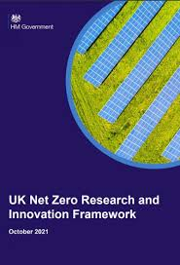
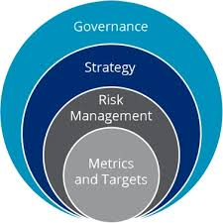
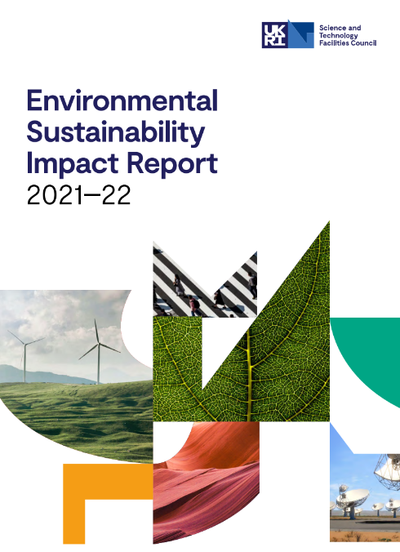
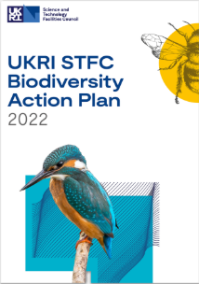
UK Policy context
HMG
Greening Government Commitments
Climate Change Act 2008
Carbon Budgets
STFC Environmental Sustainability Strategy

Slide 7
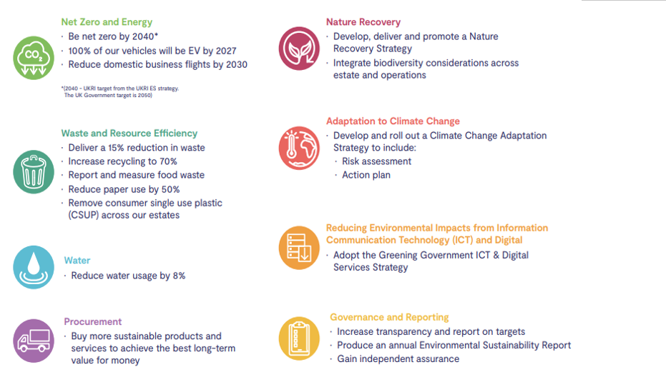
Notes:
Seven of these are government targets – set by Government and we report on these
Eighth is governance and reporting for STFC needs to be addressed and strengthened to align with the importance of this issue.
- Updating our Env Sust action plan now to incorporate this
- Two summer placement students with us for work on water and paper data…

Slide 8
Overview - Where We Are Today
Key Achievements
Key Challenges
The transition to net zero has been -
Included in STFC’s organisational strategic map and three year delivery plan; Objective 5: World-class impacts and Objective 6: A world-class organisation.
Added as separate enabler in the strategic map.
The Greening Government Commitments (GGC), set out by the UK Government, are incorporated into STFC’s ES Action Plan. These set out actions and targets that we need to take to reduce our impact on the environment.
Programme of staff & leadership engagement has been offered across all areas of STFC.
ES Impact Report launched showcasing success and priorities.
Carbon Fund directed towards Estate.
Governance approach means that there is no clear accountability or prioritisation for ES and it does not feature within the Management and Governance of STFC document.
No oversight of ES projects and research being delivered.
Developing relationship between parts of UKRI, MRC, NERC and STFC on ES.
Limited resource within ES Team outstrips perceived expectation on a range of policy areas.
Prioritisation and understanding of the risk amongst STFC Leadership Team.
Departmentally led organisation
Limited public face with stakeholders (via UKRI)

Slide 9
Decarbonisation Opportunities

Slide 10
Decarbonisation Opportunities
Resourcing

Slide 11
STFC’s Environmental Sustainability Strategy
Primary focus - getting ‘our house in order’
Delivery of science
Influencing beyond STFC/across UKRI
How we deliver research and innovation including how we operate our own facilities
What research and innovation we prioritise
Procurement & supply chain
Investments
& Funding
Using STFC’s purchasing power to partner, collaborate and engage responsibly across industry
Influence the practices of others we fund and collaborate with. This requires alignment internally and
externally
Control
Influence

Slide 12
Evidence-base to inform the Strategy – What we did
On-site
Engagement
Policy Review
Interviews
Survey
Reviewed key policy and documentation, including:
UK Greening Government Commitments
UKRI: Environmental Sustainability Strategy, Responsible Procurement Charter
STFC: ES Policy, Estates decarbonisation plan, Biodiversity Action Plan
Wellcome Concordat, International examples
Objective: Provide a long-list of ES topics, be clear on compliance, and identify key drivers that are important for STFC.
16 interviews with Directors and Leaders across a range of directorates & departments
We have 4 interviews left, insights from which will be integrated into the strategy
Objective: Explore the enablers and blockers embedding ES in different parts of the organisation, gain departmental perspective to strategy requirements and the associated organisational impacts and potential change
A full day workshop bringing together 16 senior representatives directorates & departments
Harwell Campus Site visit as part of ‘Cost of Decarbonisation’ project
Objective: Develop the case for ES at STFC, identify ES opportunities and prioritise the most significant impact areas across project, departments and directorates
All-staff survey
356 responses (approximately 11% of STFC)
Objective: Explore the motivations and opportunities for environmental sustainability across all areas of STFC, including key topics that we can and want to have the most impact on
Notes:
High level summary of where we have gathered insights from and the headline themes from each

Slide 13
Evidence-base to inform the Strategy – What we heard
On-site
Engagement
Policy Review
Interviews
Survey
Defined target for Net Zero, and other environmental topics (GGC), which cascade to STFC.
Increasing recognition to embedded non-technical factors to deliver ES e.g. organisational culture
Opportunity for increased alignment between STFC-related ES policy & plans
Decarbonisation as the principal ES theme, with growing recognition of resources and waste
We should be bold, but not at the expense of big science
We can apply our expertise to ‘solve the challenge’
To do it well we need to be better integrated
We need to decide how to best work within our constraints (e.g. annual funding timelines)
Three main areas of impact were:
Decarbonisation/ net zero
Efficient use of resources
Adaptation for climate resilience
Ratified the ambition level previously agreed by this group (exemplar-enabler)
Refined the vision
ES is everyone’s responsibility
Leadership and measurement are critical enablers
Integration is critical and whole lifecycle needs to be accounted for
Embedding ES needs to have budget and resource
Impact requires a step-change for STFC; opportunity to view sustainability through H&S model
Top driver for ES: ‘being the right thing to do for society’
Three main areas of impact were:
Optimising material use & reducing waste (56%)
Reducing carbon emissions (53%)
Transitioning to renewable energy (47%)
Notes:
Kathryn
High level summary of where we have gathered insights from and the headline themes from each

Slide 14
An overview of our Environmental Sustainability Strategy
Our overarching ambition, vision and goals are up to 2040.
Our Ambition:
We will lead by example, demonstrating to the scientific community how to excel beyond compliance and conducting big science responsibly.
Our Vision:
We will use our world-leading expertise to responsibly deliver innovative science, research and technology and embed environmental sustainability in everything we do to have a positive, lasting impact on our planet.
Our Goals:
Achieve Net Zero by 2040
Maximise resource efficiency and minimise waste
Increase the resilience of our infrastructure and research to mitigate the effects of climate change
What we set out to achieve in the next 5 years (2025-2030)
Organisational Foundations
How we will think, make decisions and act:
Our Impact Areas
The environmental sustainability improvements we will target:
We will integrate environmental sustainability into our governance and decision-making
Adopt a whole lifecycle approach to assess environmental sustainability impacts, used to inform decisions
Embed cross-organisational decision-making
Provide the capabilities, time and tools to ensure sustainability is embedded into roles across STFC
OPERATIONS
How STFC deliver science & research
Energy
Facilities and operations will embed the energy and carbon hierarchies into its design, procurement and operational processes and working practices
An actionable STFC-wide decarbonisation pathway and priority actions underway
EMBED WITHIN GOVERNANCE & DECISION MAKING
A resilient, biodiverse and efficient estate
Refurbishment and construction delivered in alignment with the best available techniques
Protect and enhance the natural environment by limiting negative impacts and, where possible, by having positive direct and indirect impacts on biodiversity
Actions will be informed by evidence and data
Establish and formally adopt intermediate STFC carbon mitigation targets in 5-year increments
Act on the environmental sustainability impacts of our operations and long-term scientific outcomes
MEASUREMENT & MONITORING
Resource efficiency and waste
Understanding our use of resources and acting to link this with our lifecycle assessment and procurement processes
We will champion the change we want to see, focussing first on getting ‘our own house in order’
Publicly state our intent to be a leader in environmentally sustainable big science
Proactively share our insights and lead working groups nationally and internationally to drive external impacts
Travel
We will adhere to the UKRI travel policy and require lower carbon options to be considered first
LEAD BY EXAMPLE
Procurement
Engage with suppliers to design sustainable solutions
Embed lifecycle assessments in procurement and manage contacts to enhance sustainability in line with UKRI’s charter
We must change our approach, our mindsets and our behaviours in line with our Vision
Collaborate effectively across STFC to optimise and accelerate our delivery of sustainable science
Build our sustainability capabilities so all can contribute
Creatively pursue long-term environmental benefits whilst working within our funding timeframes
RESEARCH & INNOVATION
The science STFC deliver and enable
Conduct research to solve environmental sustainability challenges
Leverage the capabilities of our National Laboratories to deliver solutions to (national) sustainability missions
CULTURE & BEHAVIOURAL CHANGE
Investments & Funding encourage environmental sustainability
Work with UKRI, external decision-makers and communities to enhance the environmental sustainability of what we fund
▲ A summary of headline environmental sustainability commitments, a comprehensive set can be found in our environmental sustainability strategy.

Slide 15
Focus for 2025/26
Spending Review input
Working with our new EC Prof. Michele Dougherty
Carbon budget built up from departmental operations
Actions driven departmentally around carbon budgets
Developing our data sets and publishing all that we can
Engaging with the community and partners (HECAP etc.)
Engaging with those developing the URKI ES Strategy
Understanding the implications of the Concordat on ES in Science and Innovation
Making the case on spend to save for sustainability

Slide 16
Questions?
Sustainability at STFC
Notes:
Kathryn

